Slide 1
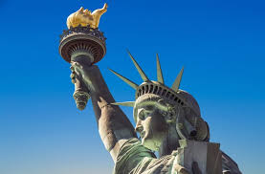
The Economics of Immigration
OLLI – Santa Clara University
January, 2022
Jennifer Alix-Garcia, PhD
Notes:
It is a pleasure to be here with you all today. I’m Jennifer Alix-Garcia and I work at Oregon State University. I’m here to talk with you about the economics of immigration. I hope to shed some light on the history of immigration in the United States, and also on how economists think about immigration.

Slide 2
National Economic Education Delegation
Vision
One day, the public discussion of policy issues will be grounded in an accurate perception of the underlying economic principles and data.
Mission
NEED unites the skills and knowledge of a vast network of professional economists to promote understanding of the economics of policy issues in the United States.
NEED Presentations
Are nonpartisan and intended to reflect the consensus of the economics profession.
Notes:
NEED a non profit organization that intends to close the gap between what professional economists generally think and the economic arguments that are made in policy debates.

Slide 3
Course Outline
Contemporary Economic Policy
Week 1 (1/5): US Economy & Coronavirus Economics
Week 2 (1/12): Climate Change Economics (Bevin Ashenmiller, Occidental College)
Week 3 (1/19): Health Economics (Jon Haveman, NEED)
Week 4 (1/26): Economics of Immigration (Jennifer Alix-Garcia, Oregon St.)
Week 5 (2/2): Infrastructure Economics (Mallika Pung, Univ. of New Mexico)
Week 6 (2/9): The U.S. Safety Net (Marianne Bitler, UC Davis)

Slide 4
Submitting Questions
Please submit questions in the chat.
I will try to handle them as they come up, but may take them in a bunch as time permits.
I will catch up on the questions in the chat before starting up again after the break.
We will do a verbal Q&A once the material has been presented.
And the questions in the chat have been addressed.
Notes:
Please feel free to submit questions in the chat. I may handle some of them as they come up, but more likely I will use the break to catch up on that. I will also try to leave some time at the end to answer more questions. Unfortunately, I am not able to stay after class to answer more questions, as I have another commitment right after this class.

Slide 5
Who Are We?
Honorary Board: 52 members
2 Fed chairs: Janet Yellen, Ben Bernanke
6 chairs of the Council of Economic Advisers
Furman (D), Rosen (R), Bernanke (R), Yellen (D), Tyson (D), Goolsbee (D)
3 Nobel prize winners
Akerlof, Smith, Maskin
Delegates: 520+ members
At all levels of academia and some in government service
All have a PhD in economics
Crowdsource slide decks
Give presentations
Global Partners: 45 PhD Economists
Aid in slide deck development
Notes:
NEED has a board of over 48 members, including two former fed chairs, 3 Nobel Prize winners and 6 former chairs of the Council of Economic advisors. It is comprised of PhD economists working in different sectors all over the country. We donate our time to give these kind of talks and hopefully elevate the conversation. The slide decks that we use are made collaboratively and then reviewed by experts in the field.

Slide 6
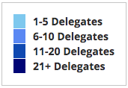
Where Are We?
Notes:
Our delegates are spread all over the country.

Slide 7
Credits and Disclaimer
This slide deck was authored by:
Anna Maria Mayda, Georgetown University
Robert Gitter, Ohio Wesleyan University
Roger White, Whittier College
This slide deck was reviewed by:
Kirk Doran, Notre Dame
Ethan Lewis, Dartmouth College
Disclaimer
NEED presentations are designed to be nonpartisan.
It is, however, inevitable that presenters will be asked for and will provide their own views.
Such views are those of the presenter and not necessarily those of the National Economic Education Delegation (NEED).
Notes:
It’s worth reiterating that NEED presentations are carefully designed to represent the professional economic consensus on a topic. They are authored by groups of experts in a given field, and then reviewed by others. I have removed some slides from this deck for time, but I will follow this consensus opinion elaborated by my colleagues.

Slide 8
Outline
What is immigration?
Why do people migrate?
History of immigration to the US
Economics of immigration
Notes:
The first three topics on this list provide critical background. You may already know some of the things that I talk about, but you may also find that some of the facts that I’m going to present are surprising.

Slide 9
What Is Immigration?
Immigration
The action of coming to live in another country.
Emigration
The act of leaving one’s own country and going to live in another country.
Notes:
Immigration is the act of moving to a country from another country for the purpose of residing there for an indefinite period of time. Emigration is the act of leaving a country for another country, again, with the intention of residing in that second country.

Slide 10
Why Do People Migrate?
Push factors:
Economic dislocation, violence, population pressures, religious persecution, or denial of political rights.
Pull factors:
Potential for higher wages, job opportunities, and political or religious liberty.
Uneven development:
Disparities in income, standards of living, and the availability of jobs within and across societies.
Source: Gilder Lehrman Institute of American History.
Notes:
People migrate from one country to another for a variety of reasons, which broadly fall into three different categories:
Push Factors: push factors are those that cause the country of a person’s current residence to become an undesirable place to live.
These factors can be political, economic, or related to safety, as well as others.
Pull Factors: pull factors, however, are those that make the destination country particularly attractive as a place of residence.
Economic factors are strongest, but political or religious factors can also play a role.
Uneven Development: an impetus to migrate may well exist if the differences between two countries are significant.
This gap is usually related to the economic well-being of the individuals/families contemplating migration.
https://www.gilderlehrman.org/content/historical-context-why-do-people-migrate

Slide 11
Why Do People Migrate?
Levels of Decision-Making
Individual level:
Economic opportunity, escape social turmoil.
Family level:
Desire of the family to improve its security or level of economic well-being.
“Remittances”
Structural or Institutional:
War, better information about opportunities, easier transportation, income differentials between countries.
Changes in immigration policies.
Source: Gilder Lehrman Institute of American History.
Notes:
The motivation for migration should be considered at several different levels. The first is the individual level; whether economic, political, or safety concerns are the motivation, the intention is to improve the well-being of the individual.
The motivation for migration should also be considered at the family level. That is, one or more people—a subset of the family—might migrate in order to improve the overall well-being of the entire household. This motivation is primarily economic, with the intention for the individual to send earnings back—remittances—to the family and to return to the country of origin at some point.
There are also structural or institutional reasons for migration, including such factors as war, changes in immigration policies, or changes in wage differentials across countries.

Slide 12
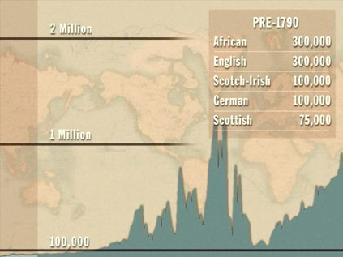
History of US Immigration
Source Countries | Pre-1790
African countries* | 300,000
England | 300,000
Scotland-Ireland | 100,000
Germany | 100,000
Scotland | 75,000
Source Countries | 1790-1820
African countries* | 85,000
Scotland-Ireland | 50,000
England | 45,000
France | 40,000
Germany | 25,000
* Slave trade and clearly not voluntary or reflective of standard motivations for immigration.
Source: https://www.libertyellisfoundation.org/immigration-timeline/.
Notes:
Most scientists believe that people first came to North America by crossing the Bering Strait about 20,000 years ago. These migrants were the ancestors of the many Native American groups, which populated the territory for thousands of years. Around the year 1000, a small number of Vikings arrived. Five hundred years later, the great European migration began.
During this period, crossing the Atlantic meant two to three months of seasickness, overcrowding, limited food rations, and disease. But the lure of available land and the hope of political and religious freedom was like a magnet to Europeans.
In some places, the interaction of Europeans and Native Americans was peaceful. In others, the two cultures clashed, leading to violence. The Europeans brought with them diseases to which the Native Americans had no previous exposure and thereby no immunity. Many tribes were decimated by these newly introduced diseases, such as smallpox, measles, and bubonic plague.
By the end of the sixteenth century, the Spanish had become established in St. Augustine in present-day Florida, and in the early seventeenth century, thriving communities dotted the landscape: the British in New England and Virginia, the Dutch in New York and New Jersey, and the Swedish in Delaware.
But the Europeans weren't the only new arrivals in these areas. As early as 1619, people taken from Africa began to be brought forcibly to the New World, whether the Caribbean or the North American mainland.
The early British settlers included indentured servants willing to trade four to seven years of unpaid labor for a one-way ticket to the colonies and the promise of land. By the mid-eighteenth century, the British colonies had become the most prosperous in North America. In fact, the exodus of skilled laborers from the Old World to the New was so concerning to the British Parliament that called for a total ban on immigration to the colonies. But history was moving in the other direction.
1790–1820
After the United States won the War of Independence with Britain the US became a destination for asylum-seekers from every part of Europe. In 1790 the first Census was conducted, and of the 3.9 million people counted, the English were the largest ethnic group. Nearly 20% were of African heritage. German, Scottish, and Irish residents were also well represented. Census takers didn't count Native Americans.
The early Congresses could do little to affect immigration, as the Constitution gave that power to the states. Although Congress was given the authority to ban the slave trade after 1808, which it did, the slave trade continued, albeit at a lower level. Further, Congress took the authority to establish rules for naturalization.
In 1790, it passed the first Naturalization Act. In the early years of the republic, immigration was light: 6,000 people a year on average. In 1806 immigration flows slowed due hostilities between England and Napoleonic France and then was even further decreased during the War of 1812 between the United States and Britain.
Peace was re-established in 1814, enabling immigration from Great Britain, Ireland, and Western Europe to resume at a record pace. The major port cities in this era—New York, Boston, Philadelphia, and Charleston—were overwhelmed with newcomers, many of them sick or dying from the long journey. Congress responded with the Steerage Act of 1819, requiring ship captains to keep detailed passenger records and provide more humane conditions for those on board.

Slide 13
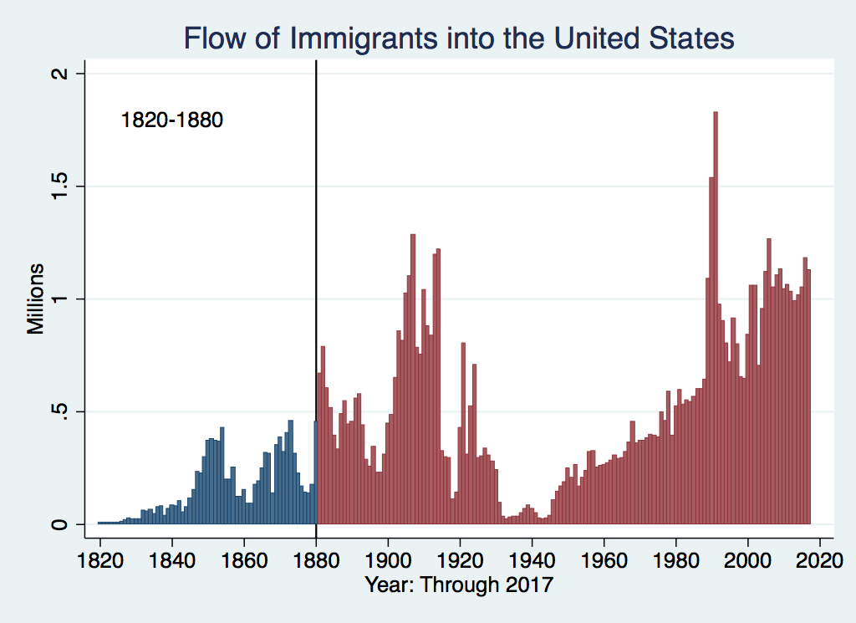
History of US Immigration
Source Countries | 1820-1880
Germany | 3,000,000
Ireland | 2,800,000
Britain | 2,000,000
Austro-Hungarian empire | 1,000,000
Canada | 750,000
China | 230,000
African countries | 50,000
https://www.libertyellisfoundation.org/immigration-timeline
Notes:
Moving forward we have a bit more disaggregated data. For the period 1820-1880, the Industrial Revolution had begun, the slave trade was nearing its end, and America was pushing westward. Thousands of immigrants found work helping to construct the transcontinental railroad, settling in towns along the way. This was also the California Gold Rush period, which drew immigrants from both Asia and Europe.
Although many new immigrants came in pursuit of a dream, nearly all the Irish immigrants in the 1840s and 1850s came to escape a devastating potato famine. The Irish weren't the only newcomers. Rapid population growth, changes in land distribution, and industrialization had stripped many European peasants and artisans of their livelihoods. Departing from Liverpool and Hamburg, they entered through the major East Coast ports and New Orleans. Chinese immigrants began to arrive in the 1850s through San Francisco.
As has always tended to be the case, the immigrants in this period were welcomed more when the economy was strong. During the Civil War, both the Union and Confederate armies relied on their strength. But in hard times, the immigrants were cast out and accused of stealing jobs from American workers. But the pro-immigrant voices of this era were very influential. The Republican platform of 1864 stated, "Foreign immigration which in the past has added so much to the wealth, resources, and increase of power to the nation … should be fostered and encouraged."

Slide 14
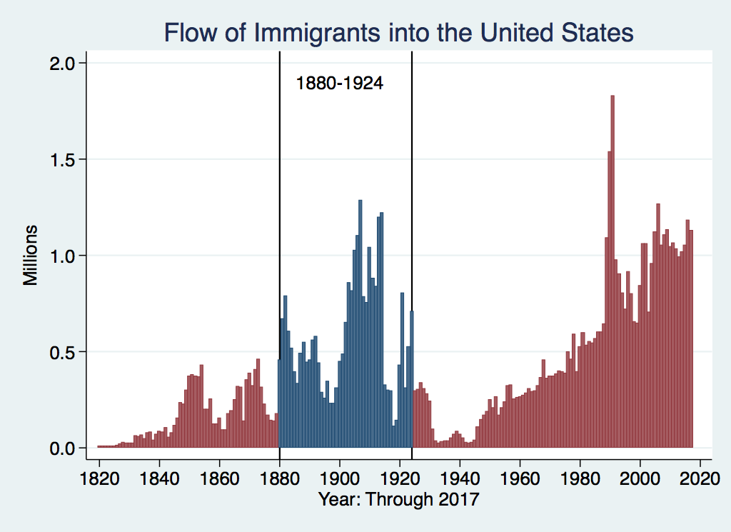
History of US Immigration
Source Country | 1880-1930
Italy | 4,600,000
Austro-Hungarian empire | 4,000,000
Russian empire | 3,300,000
German empire | 2,800,000
Britain | 2,300,000
Canada | 2,300,000
Ireland | 1,700,000
Notes:
By the 1880s, steam power had made the overseas journey to America much easier. The door was wide open for Europeans. In the 1880s alone, 9% of the population of Norway emigrated to America. After 1892, nearly all immigrants came in through the newly opened Ellis Island. Families often immigrated together during this era, although young men frequently came first to find work. Some of them then sent for their wives, children, and siblings; others returned to their families in Europe with their saved wages.
The experience for Asian immigrants in this period was quite different. In 1882, Congress passed the Chinese Exclusion Act, which severely restricted immigration from China and making Chinese immigrants ineligible for naturalization as citizens. A 1907 "Gentlemen's Agreement" with Japan extended the government's hostility toward Asian workers and families. For Mexicans victimized by the revolution, Jews fleeing pogroms in Eastern Europe and Russia, and Armenians escaping massacres in Turkey, America provided refuge.

Slide 15
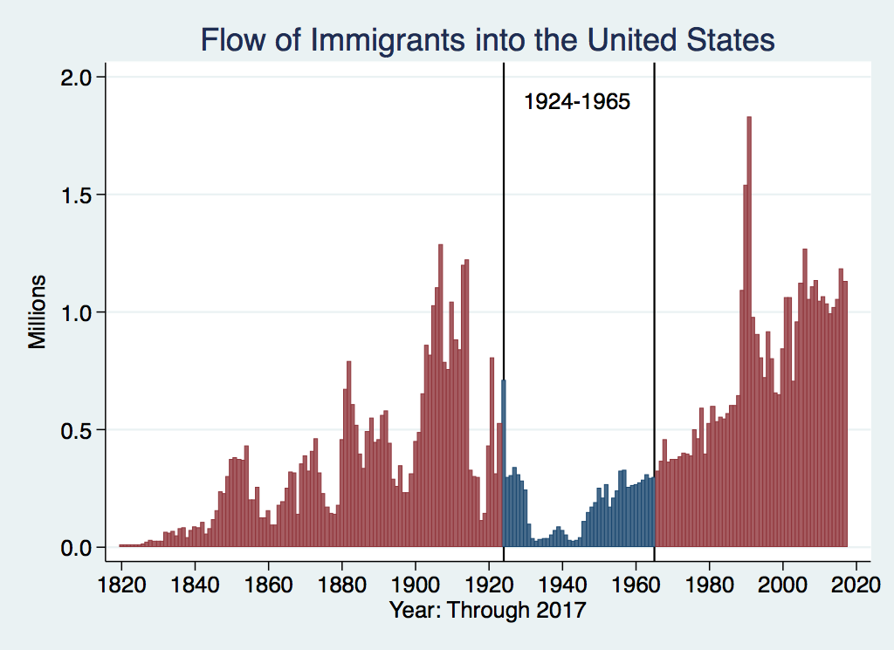
History of US Immigration
Source Countries | 1930-1965
Germany | 940,000
Canada | 900,000
Mexico | 610,000
Britain | 480,000
Italy | 390,000
Caribbean/ West Indies | 310,000
Source: https://www.libertyellisfoundation.org/immigration-timeline/.
Notes:
Between 1880 and 1924, over 26 million people entered the United States, but after the outbreak of World War I in 1914, American attitudes toward immigration began to shift. Nationalism and suspicion of foreigners were on the rise, and immigrants' loyalties were often called into question.
In the early 1920s, a series of laws was passed to limit the flow of immigrants. The two key acts were in 1921 and 1924. The Immigration Act of 1921 capped the number of immigrants admitted and set quotas on the number of immigrants based on their country of origin and strongly favored particular European countries. The Act was amended by the Immigration Act of 1924, which capped immigration at 165,000, compared with 800,000 admitted in 1920 and even larger annual numbers in the period 1890–1910.

Slide 16
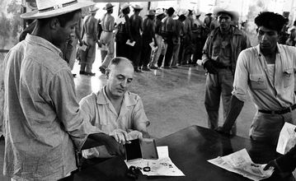
Signing up for Bracero Program
Notes:
This slide shows Mexicans signing up for the Bracero Program. The program was created in response to the domestic labor shortages during World War II. The Bracero program was started in 1942. The Spanish term bracero comes from brazos (arm). The program allowed Mexicans to come and work in the United States temporarily and then to return to Mexico.
After the war, the refugee crisis continued. Congress answered with the Displaced Persons Act of 1948, offering hundreds of thousands entry into the United States, although millions more were left to seek refuge elsewhere.
Between 1956 and 1957, the US admitted 38,000 Hungarians, refugees from a failed uprising against the Soviet-backed government. They were among the first of the cold war refugees. In this era, for the first time in US history, more women than men entered the country. They came to reunite with their families, join their GI husbands, and take part in the postwar economic boom.
By the early 1960s, calls for immigration reform had grown louder. In 1965, President Lyndon B. Johnson signed the Hart-Cellar Immigration and Naturalization Act into law that, beginning July 1, 1968, changed the immigration quota system from one that favored arrivals from Western Europe to one enabling immigrants to come from all continents.

Slide 17
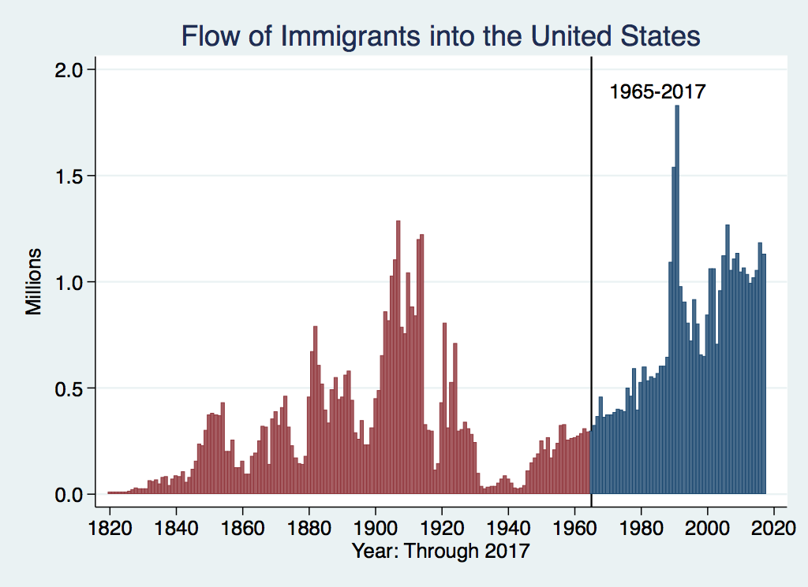
History of US Immigration: 1965-Today
Source Country | 1965-2017
Mexico | 4,300,000
Philippines | 1,400,000
South Korea | 760,000
Dominican Republic | 750,000
India | 740,000
Cuba | 700,000
Vietnam | 700,000
Canada | 650,000
Source: https://www.libertyellisfoundation.org/immigration-timeline/.
Notes:
The effects of the Immigration and Naturalization Act of 1965 were significant, dramatically increasing the number of immigrants allowed in and changing the criteria for entry. The number of immigrants rose to between 800,000 and over one million annually.
Family reunification became the most important criterion for entry, serving as the basis for immigration for over two-thirds of immigrants today. Employment and education preferences are a distant second as the reason for less than 15% of immigrants.
The Immigration Reform and Control Act of 1986 did a few things to discourage illegal immigration. For instance, it made it illegal to knowingly hire illegal immigrants. The Act also legalized most illegal immigrants who arrived in the country prior to January 1, 1982. This is the source of the several years of dramatic increase in immigration: millions of those already here were given legal status.

Slide 18
Recent Trends in Authorized Immigration
Notes:
The scale of authorized immigration gradually increased after the 1980s. Between 1980 and 2017, the annual volume roughly doubled, from about 500,000 to over 1.1 million, but with some significant deviations from this trend. For instance, authorized immigration surged between 1989 and 1991, but fell back to the trend afterward. The surge was likely the result of two legislative changes. First, as I mentioned in the previous slide, following passage of the 1986 Immigration Reform and Control Act, a significant number of unauthorized immigrants, who had arrived in the US prior to 1982, were naturalized and counted as new arrivals. The application deadline for amnesty filings under the provisions of the 1986 IRCA was Nov. 1986-Apr. 1988. Given processing time, this led to a seeming increase in the number of arrivals in subsequent years. Almost three million people were granted amnesty by the IRCA, about 2.3 million of whom came from Mexico.
Additionally, the Immigration Act of 1990 modified the Immigration Act of 1965 and the Refugee Act of 1980 such that the annual entry cap was temporarily increased to 700,000 in fiscal years 1992-1994 and then lowered to 675,000 thereafter. Prior to the increase to 700,000, the annual (non-refugee/asylum seeker) cap was 270,000. It is interesting to note that the cap on asylum seekers for 2021 was 62,500.

Slide 19
Authorized Immigration by Region
Notes:
This graph indicates geographical patterns in authorized immigration into the US between 2000 and 2017. The flow of immigrants from Asia is by far the largest, nearly twice that from Central America. Central Americans are the second-largest category, with Caribbean countries the third-largest source of authorized immigrants. Europe, Africa, and South America each sent 2 million or fewer of the roughly 19 million authorized immigrants during this period.
This pattern is not peculiar to the 2000-2017 period; rather, it began with the implementation of the Immigration Act of 1965 in July 1968. Not only was there a significant increase in annual inflows, but the source countries/regions changed considerably.
During the period 1968-2015, immigrants from Asia (31.19%), Central America (24.46%), and the Caribbean (12.7%) combined to account for 68.35% of the total authorized immigrant inflow. By comparison, because of restrictions before 1968, between 1921 and 1967, these regions accounted for a total of around 20% of total authorized inflow (4.87%, 11.25%, and 4.68%.
Immigration from Europe during the period 1921-1967 accounted for 53.79% of the total authorized inflow. Between 1968 and 2015, only 11.9% of the authorized inflow was from European countries.
********
Stop here
Because the quotas implemented with the passage of the Immigration Act of 1924 did not apply to Western Hemisphere countries, the elimination of the quota system cannot be the cause of increased inflows from Central America and the Caribbean. Thus, the explanation for the inflow shares observed since 2000 is likely changes in push and pull factors (i.e., source country- and US-specific conditions or characteristics) and changes in immigration policy (i.e., the 1965 Act)—specifically, the new entry categories broadly defined as family reunification, filling labor market vacancies, and refugees/asylum seekers. The diversity lottery also reinforced the shift in source countries, although it was likely due only marginally to the relatively low diversity lottery caps.
The diversity lottery, instituted in 1990 allowed entry by 50,000 randomly assigned individuals and families who applied for a visa. These immigrants were from countries that did not generally send a lot of people to the United States.
https://www.boundless.com/immigration-resources/diversity-visa-lottery/

Slide 20
Authorized Immigration from Asia
Notes:
Among authorized immigrants from Asia, the two largest sources are India and China. But the Philippines is in third place, with 1 million immigrants to the United States between 2000 and 2017. Immigrants from the Philippines now comprise the fourth-largest origin group in the US, after Mexico, India, and China. Over the past several decades, the Philippines has had among the highest emigration rates in the world, and the Philippine-US migration channel is well developed due to historic ties (e.g., political, military, and educational connections), including US colonization from 1901 until 1946.

Slide 21
Authorized Immigration from the Americas
Notes:
Mexico is by far the largest source country for authorized immigration to the United States over the past 18 years (2000-2017). Other countries that contribute significantly are the Dominican Republic and Cuba, from which about 700,000 have come to the US, and a variety of other countries sent less than 400,000 each.

Slide 22
Immigrant Population in 2017
Categories of the total number
of immigrants in the United States.
https://www.pewresearch.org/fact-tank/2019/07/12/how-pew-research-center-counts-unauthorized-immigrants-in-us/
Notes:
Up until now, we have been talking about authorized immigration, which is represented by the orangish components of this pie. In the current immigrant population, the vast majority, 77%, are authorized, while just 23% are unauthorized. Nearly half (45%) are naturalized, and more than a quarter (27%) are lawful permanent residents. A small share are authorized temporary residents.
The current population of immigrants is roughly 45.6 million or 14% of the total population of the United States in 2017 (325.7 million). Just 10.5 million of them are unauthorized.

Slide 23
U.S. Unauthorized Immigration Totals
Pew Research Center, 5 facts about illegal immigration in the U.S., June 12, 2019
Notes:
An unauthorized immigrant is someone is a foreign-born noncitizen who is not a legal resident. The person may have entered the US without the proper documents or entered properly but overstayed a visa—for example, a student or tourist who did not leave after the visa expired.
(Source: https://www.pewresearch.org/fact-tank/2019/06/12/us-unauthorized-immigrant-population-2017/ )
It has been estimated that the current number of unauthorized immigrants in the United States was 10.5 million in 2017. This reflects a decline in such immigrants since 2007, when it peaked at 12.2 million.
This decline may have been precipitated by the onset of the Great Recession because it was quite deep and reduced economic activity in many sectors of the economy—in particular, construction, a major employer of unauthorized immigrants.
The decline is due to the return to Mexico of many of them, and they were not replaced. The flow of illegal immigrants from other countries has slowed, but has still increased.

Slide 24
U.S. Unauthorized Immigration: Labor Force
Pew Research Center, 5 facts about illegal immigration in the U.S., June 12, 2019
Notes:
Not only has the overall number of unauthorized immigrants in the United States declined but so has their contribution to the labor force.
Even at the peak in 2007, only two-thirds of unauthorized immigrants participated in the labor force at a moment when there were 8.2 million unauthorized workers, about 5.4% of the workforce.
Since the Great Recession ended, the number of unauthorized workers declined by some 600,000 through 2017. Their contribution to the labor force also declined to 4.6% in 2017, from 5.4 in 2007.

Slide 25
Unauthorized Immigration: Education
Pew Research Center, U.S. unauthorized immigrants are more proficient in English, more educated than a decade ago, May 23, 2019
Notes:
Though their share of the labor force is relatively small, unauthorized immigrants are concentrated in a few segments of it increases their importance. Because 44% of unauthorized immigrants have less than a high school diploma, it is not surprising that they are concentrated in the construction, hospitality, and agriculture. And 17% have a bachelor’s degree or higher, which is a lower share than native-born or authorized immigrants.
Among those with a bachelor’s degree or higher, a disproportionate share come from Asia and are unlikely to come from Mexico, the Northern Triangle (El Salvador, Guatemala, and Honduras), or elsewhere in Latin America.
Keep in mind these statistics on education and what immigrants bring relative to native born Americans. I’m going to refer back to them, and use the economic terminology that says that people with higher levels of education are “high skilled.” This is an unfortunate terminology, because we all know that people with lower levels of education possess important skills that keep our economy going.

Slide 26
Unauthorized Population: Source Countries
Notes:
Mexico remains the largest source of unauthorized immigrants in the United States, nearly 5 million as of 2017, but it has declined considerably over ten years. In 2007 it was nearly 7 million.
The number coming from Europe and Canada has also declined (-150,000).
However, the number from Central America (+400,000) and Asia (+130,000) has risen. The number of unauthorized immigrants from other regions has remained relatively constant.

Slide 27
Unauthorized Immigration: Where They Live
Notes:
Unauthorized immigrants live in most states throughout the country, though they are heavily concentrated in the larger border states, California and Texas. Although Arizona and New Mexico also have a southern land border, the population of unauthorized immigrants in these states is relatively small: Arizona—228,000, New Mexico—58,000.
In general, unauthorized immigrants find their way to states with the largest populations. Each of the states listed in this chart is among the 11 largest US states by population. Ohio (107k), Pennsylvania (141k), and Michigan (129k) are the other three in the top ten. Each has less than 150,000 unauthorized immigrants (#s in paren).
Larger populations, in particular, large urban populations, offer better opportunities for unauthorized immigrants—through both greater work opportunities and larger established communities of immigrants from their country of origin and thus social support groups.
https://www.migrationpolicy.org/programs/us-immigration-policy-program-data-hub/unauthorized-immigrant-population-profiles?gclid=EAIaIQobChMIq7PipLDE5QIVkv_jBx3M_Q_CEAAYASAAEgJ1x_D_BwE

Slide 28
Why Do We Care? Economic Implications
GDP
Labor markets
Government revenue and spending
Prices
Exports and FDI
Notes:
All of this brings us to the central question of this presentation. What are the economic implications of immigration, whether authorized or unauthorized?
A wide variety of economic categories are influenced by immigrants, including overall growth of the economy, labor markets in particular, government revenues, prices, and trade and foreign investment. I’m going to talk about each of these separately.

Slide 29
Two Sets of Implications
Aggregate effects: The size of the pie
Income distribution: The size of slices of the pie
Notes:
From a theoretical point of view, economists focus on two sets of predictions regarding the impact through economic channels. These two sets of predictions relate to, respectively, aggregate effects (“the size of the pie”) and income-distribution effects (“the slices of the pie”).

Slide 30
GDP: How Does This Work?
What determines the size of an economy?
Technology/productivity
Physical capital
The number of workers
Immigration adds to the number of workers.
Number of immigrants in the labor force is high
28.2 million foreign-born persons ages 16+ in the labor force in 2018.
17.4% of the total US workforce.
Evidence
Immigrants added 11% to GDP ($2 trillion) in 2016.
Notes:
Let’s first have a look at the aggregate effects, or the size of the pie. This is measured as GDP, or the gross domestic product.
Broadly speaking, three factors cause the economy’s productive capacity to grow or to shrink. They are quite separate from the forces that cause a recession or spur growth, perhaps one or more of these factors. Those forces stem largely from aggregate demand—or how much stuff people, businesses, or governments want to buy. But that’s another story.
The three factors that determine how much an economy is capable of producing are: technology or labor productivity, the capital stock, and the number of workers.
Immigration primarily affects the size of the economy by increasing the number of workers. In 2018, 28.2 million foreign-born people age 16+ were in the labor force. This is 17.4% of the total US workforce.
By some estimates, the foreign-born population added 11% to GDP in 2016, or about $2 trillion. It is noteworthy that they added less than their share to GDP, primarily because foreign-born workers tend to be less educated than their native-born counterparts (slide 26).
The fact that immigrants help expand the economy isn’t well understood or recognized. As we will see later in the presentation, this aspect of immigration is important for some government programs, in particular, Social Security. Immigration expands the economy as well as the number of people paying into the system. Without immigrants, it would be more difficult to service all the Social Security obligations.
https://www.bls.gov/news.release/pdf/forbrn.pdf
Borjas (2014a)?

Slide 31
Immigration and Labor Markets
Notes:
More widely recognized but still not well understood is the effect of immigration on labor markets. There is a simple, intuitive understanding of how immigration affects labor markets, but, as we will see, there is much more to it.

Slide 32
Labor Market Implications: Complicated
Depends on the type of immigrant: Skills/education
Similar to native-born population?
Low-skilled?
Highly skilled?
Brings capital market implications
Low-skilled – capital supplementing
Highly skilled – capital complementing
Source: Hong & McLaren (2015).
Notes:
The public conversation about the labor market implications of immigration is fairly elementary compared to the reality. Very often the argument is: low-skilled immigrants are coming into the country, which lowers the wages of and takes jobs away from native low-skilled workers.
The reality is different for a couple of reasons. First, in recent years, there has been a significant flow of skilled workers into the United States, but the preponderance remains low skilled. This means that the skill distribution of immigrants differs from the skill distribution of native-born workers, so it has implications for relative wages.
If they came to the United States and replicated the distribution of skills among native-born workers, the results would simply be an expansion of the economy, driven by more workers and facilitated by an expansion of the capital stock. As the existing capital stock has more workers, the return to investing in additional capital goes up, which encourages additional investment in productive capacity in the economy.
The second difference between the common conversation and reality has to do with capital investment in response to immigration. By the same token, when the supply of low-skilled workers increases through immigration, there are higher returns to investing in capital that supplements this additional labor, which offsets the implications for similar native-born low-skilled workers.
Similarly, at the high-skill end, companies invest in capital that complements the skills of the workers. This expands production using these workers and to some extent offsets the implications for native-born high-skilled workers.
As we will discuss, for other reasons, the effects of immigration are even more complicated.

Slide 33
Immigration Is Similar to Trade
Trade
Allows production to be brought to where the low-wage workers are.
Immigration
Allows workers to move to where high-wage jobs are.
Both:
Equalize wages geographically
Lower prices
Increase overall economic activity
Notes:
Another way of thinking about immigration is that it is a kind of parallel to international trade.
In fact, they are two different ways in which wages are equalized across geographies/countries, goods and services are produced at lowest cost, and economic growth is facilitated.
International trade serves these functions by allowing goods to be produced where they cost the least to be produced. Think US exports of soybeans to China and imports of TVs from China.
Immigration serves a similar function by facilitating the production of services at the lowest cost. Restaurants, hotels, construction—These are all activities that have to occur where they are consumed. They cannot be produced elsewhere and shipped to the consumer. Instead of shipping the services, the labor moves from one country to another, from one location, where the labor is relatively poorly compensated for services provided to another, where labor is well compensated.
Moving goods across borders equalizes wages, lowers prices, and expands economic activity and overall well-being in societies.
Immigration does much the same thing by facilitating the production of services where they are expensive and reducing their production where they are inexpensive.

Slide 34
Labor Market Implications
Provides net benefits to the receiving economy
Larger labor supply.
Changes in labor prices increase production of goods and services that use the type of labor offered by immigrants.
Short run: there are winners and losers
Changes in wage structure and returns to capital affect native-born workers differently.
Long run: could be no winners, but also no losers
The economy might adjust to pre-immigration wage structure and returns to capital. No change for native-born individuals.
Notes:
It is important to keep in mind that immigration provides overall net benefits to society. A larger supply of workers helps to expand the economy, as we have just discussed.
At the same time, it is also important to recognize that there will be winners and losers in the short run:
Losers: native-born workers who compete directly with the immigrants for jobs
Winners:
owners of capital.
As the wages of workers are lowered, the rate of return to the existing capital stock increases.
Other native-born workers
Again, as the wages of some labor falls, prices paid by consumers will also fall. This benefits workers who do not compete with immigrants. It also benefits workers who DO compete with immigrants but does not offset their lost wages.
In the long run, the capital stock can adjust to the new higher return to investment. The net effect of this expansion of capital stock on the winners and losers is unclear, but it is possible that the economy could adjust to the pre-immigration wage structure and returns to capital, leaving nobody harmed and nobody in particular benefiting.
Note that, in this long run, the only thing that is certain is that the size of the economy will increase. It is not clear that living standards will increase, though they likely will.
Let’s talk in a little bit more detail about how these changes come to pass.

Slide 35
Labor Market Implications: Basic Case
Suppose the immigrants have the same skills as the native-born population in a city
Short run: workers lose and owners of capital win
Higher ratio of labor to capital.
Wages decline, and returns to capital rise.
Long run: there are no losers or winners
Capital flows into the city
Because the returns are now higher here than elsewhere
The original ratio of labor to capital is restored.
Notes:
To fully understand the implications of immigration, it is important to piece it together one step at a time.
As mentioned earlier, if the pool of immigrants looks just like the pool of native-born workers, in terms of their skill level, the economy simply expands in the long run, and there are no winners or losers.
In the short term, however, all workers experience lower wages until the capital stock expands to meet the larger supply of labor. So, in the short run, workers are losers, and the owners of capital—because of temporarily high returns to their capital—are the winners.
In the long run, the original ratio of labor to capital is restored, wages return to their previous level, and nothing has changed, except for the size of the economy.

Slide 36
Labor Market Implications: Low-Skill Immigrants
Suppose the immigrants are less skilled than the native-born population in a city
Short run: low-skilled workers are losers
Supply of low-skilled workers goes up, so their wages go down.
Long run: there need not be any losers, but there may still be
Prices adjust
Purchasing power of low-skilled workers need not be lower.
Subtlety: Opportunities for low-skilled native-born workers expand as the economy expands.
Greater demand for English-proficient workers.
Note: Repeated short run shocks can make the medium and long run look like the short run.
Notes:
Suppose that immigrants are primarily low-skilled workers. Here, the short-run implications are similar to the common narrative. Low-skilled workers expand the supply of low-skilled labor and lower the wages of low-skilled labor.
In the long run, things are more complicated. An important effect in the long run is that prices adjust. Because workers’ wages are lower, the costs of producing with low-skilled labor is lower, and competition in the marketplace causes prices to fall.
So, although their wages are lower, the purchasing power, or the standard of living of low-skilled workers need not be lower—though it likely will be. Inevitably, they consume some goods produced using high-skilled labor, the prices of which may not fall.
A subtle nuance in this argument is that an increasing supply of low-skilled foreign workers, who perhaps do not speak English very well, can lead to new opportunities for low-skilled English-speaking native-born workers.
It is inevitable that some companies have jobs that require a certain language facility. As the production of goods increases—because of the larger labor supply and lower wages—the number of jobs requiring a mastery of the English language may well also increase. Those jobs tend to pay better than the jobs that don’t.
This, in the end, increases the demand for English-proficient workers, which increases their wages above what they would have been otherwise.
This is another factor that suggests that the common narrative about immigration isn’t necessarily correct.
Again, in the long run, there may be, but need not be, losers from immigration.

Slide 37
Labor Market Implications: General Principles
Short run
Harm likely to native-born workers who are similar to immigrants.
Benefit likely for other workers and owners of capital.
Long run
Lower prices will restore some of the purchasing power of those harmed.
Expanded opportunities may restore wages of harmed native-born workers.
Inflows of other types of labor and capital may return the economy to its pre-immigration wage structure and production patterns.
Notes:
General principles for thinking about the effects of immigration are differentiated between the short and long run:
Short run:
Harm to native-born workers who are similar to immigrants
Benefit to other workers and to owners of capital
Long run:
Lower prices help to offset lost wages
Expanded opportunities may restore or even increase wages of native-born workers
Inflows of other types of labor and capital may well return the economy to its pre-immigration wage structure and production patterns.
Expanded opportunities may make native-born workers in fact better off.

Slide 38
Summary of Labor Market Effects
Immigration CAN lead to negative wage effects for competing native-born workers
Particularly high school dropouts and those in vulnerable communities.
Other workers will likely benefit
Through increased wages.
Through increased opportunity.
Owners of capital will benefit
Existing capital will earn greater returns.
More if immigrant labor complements existing capital.
Source: Hong & McLaren (2015).
Notes:
By way of summary, it is true that native-born workers who compete directly with immigrants might experience negative wage effects. But either because of skills or simply English-language proficiency, most native-born workers do not compete directly with immigrant workers.
Those that do not compete directly will likely experience benefits. Owners of capital certainly experience benefits from immigration.

Slide 39
Potential Benefits for Low-Skilled Native Workers
Immigration can increase native-born worker wages:
More demand for jobs where English is necessary
Increased demand for goods and services – increases wages in those industries.
Each immigrant creates 1.2 local jobs – mostly for native-born workers.
Source: Hong & McLaren (2015).
Notes:
Evidence is mounting that not all of the implications for low-skilled native workers are bad.
A push from supply of even less skilled – primarily because of a lack of English skills – immigrants can create opportunities to move up the jobs ladder more quickly than they otherwise would have. Low wage workers expand the industry, creating more opportunities in supervisorial or managerial positions, which might well be available to native born workers.
This was covered previously, but is worth reiterating. A growing population begets economic growth. It has been found that through the money spent locally, each immigrant creates 1.2 local jobs, many of which will be filled by native workers who might otherwise not have a job.
Immigration is enormously complicated and the simple story that is told is just that, a simple story. Although certainly not always, quite often simple intuitive stories neglect enormous complexity and nuance and get the answer wrong.
BREAK HERE.

Slide 40
Pattern of Immigration
Educational Attainment of Recent Immigrants – Last 5 Years
Source: Blau & Mackie (2017), p. 88.
Notes:
A lot has been made of the differential effects of immigration with different levels of skills. Here, we take a look at the skill level of immigrants over time. The graph shows—for five different years—the educational attainment of immigrants who arrived in the five years before the year indicated at the bottom of each bar.
For instance, the distribution in 1970 indicates that 51% of immigrants who arrived between 1966 and 1969 had less than a high school education. At the top, 12% had some form of education beyond a bachelor’s degree.
The trend between 1970 and 2012 is toward a significantly higher level of education among immigrants. In 2012, just 26% of immigrants had less than a high school education—as opposed to 50% in 1970. Similarly, the share of immigrants with a bachelor’s degree or more increased from 20% in 1970 to nearly 40% in 2012. This trend has continued.

Slide 41
Recent Immigrants Are Less and More Educated
Notes:
If we compare immigrants between 2012 and 2017 to the native-born population, we see that in 2017 a higher proportion of immigrants are both less well educated, with less than a high school education, and more well educated. The proportion of recent immigrants with a bachelor’s degree or more is 46.8%, compared with just 32.2% among the native-born population.
Immigration affects the supply of labor in the US by increasing it at the bottom and at the top relative to the middle. The implication is that, given the bell-shaped skill distribution of the domestic labor supply, immigrants are more likely to be competitive with only a small share of the domestic labor force (i.e., domestic workers at the top and bottom extremes of the skill distribution).
The preponderance of skilled immigrants has significant implications for the economy beyond those discussed earlier. In particular, highly skilled immigrants tend to be more innovative than other immigrants or perhaps even the native-born highly skilled population!

Slide 42
Skilled Immigrants and Innovation
1% increase in the share of the immigrant college graduate population
9-18% increase in patenting per capita
Increased immigration increases patenting by native-born population
Nonetheless, the effect is positive
In the 1990s
Increased skilled immigration can account for one-third of increased patenting in that decade.
This translates into a 1.4-2.5% increase in GDP per capita by the end of the decade.
Notes:
Innovation is an important driver of the US economy. Over the past 200 years, America’s entrepreneurs and innovators have played a vital role in making the US economy one of the largest and most dynamic in the world. There is little question that immigrants play a role in this achievement.
Contemporary evidence reinforces this notion. The evidence across the states suggests that increasing the immigrant’s share of college graduates by just 1% leads to an increase in patenting of 9-18%. This is primarily due to the fact that educated immigrants are more likely to hold degrees in science and engineering.
Note that the immigrants are responsible for the increased patenting, but their presence in the relevant industries and fields appears to help contribute to patenting among native-born scientists and entrepreneurs.
More concretely, the analysis suggests that, during the 1990s, immigrants had an enormous influence on patenting. Their presence is estimated to be responsible for about one-third of the increased patenting in that decade. Translating that into a broader effect on GDP, immigrants contributed an additional 1.4-2.5% to the US economy.
This is an additional source of “immigrant surplus.” In addition to helping the economy function more efficiently, as discussed previously, it adds products and expands the economy in more concrete ways.
Hunt and Gauthier-Loiselle (2011).
Shai Bernstein, Rebecca Diamond, Timothy McQuade, Beatriz Pousada, July 11, 2019, Working Paper, The Contribution of High-Skilled Immigrants to Innovation in the United States

Slide 43
Immigrants and Entrepreneurship
Self-Employment Rates by Nativity
Source: Magnus Lofstrom from Current Population Survey Data.
Notes:
This entrepreneurial spirit is not restricted to higher-income immigrants. Taken as a whole, immigrants are more likely to be self-employed than native-born individuals are. In 2012, the difference was significant. In that year, less than 8% of native-born individuals were self-employed, compared with about 10% of foreign-born individuals. That’s an increase in the self-employment rate of more than a 25%.
Blau and Mackie (2017).

Slide 44
Notes:
Some might be skeptical about whether this higher level of self-employment drives the economy. After all, if most immigrants are operating restaurants, convenience stores, and other small businesses, how does that drives the overall economy forward?
Well, the evidence shows that this is merely a stereotype of the businesses in which self-employed immigrants are involved. Here are some very high-profile Fortune 500 firms founded by either first- or second-generation immigrants.

Slide 45
Fortune 500: First- and Second-Generation Founders
Notes:
It turns out that immigrants are the founders of a grossly disproportionate share of Fortune 500 firms: 43%, nearly half. This suggests that there is something about immigrants and the spirit that led them to leave their home country that translates into a highly productive entrepreneurial spirit—one that might be fostered better in the US than in their native country.

Slide 46
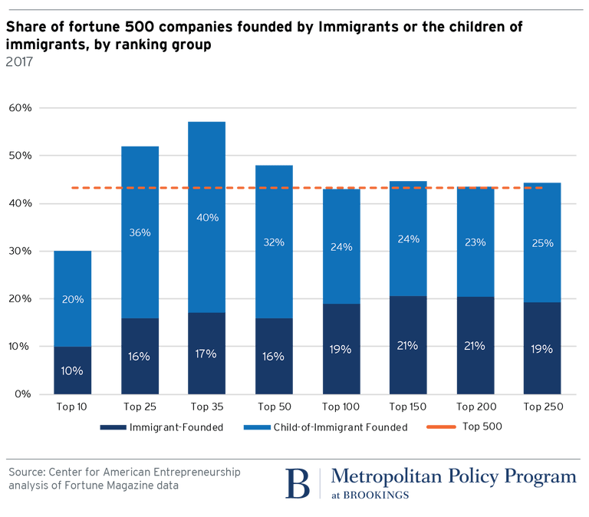
Notes:
Not only do they make up a significant share of the Fortune 500 firms but they comprise nearly 60% of the top 25.
Immigrant entrepreneurs contribute significantly to innovation and growth in the United States.

Slide 47
Immigration and Inequality
Source: Ping Xu, James C. Garand, and Ling Zhu, “How immigration makes income inequality worse in the U.S.” (October 2015), Figure 1.
Notes:
Immigration has received a lot of attention, and many believe that immigrant workers contribute to an increase in income inequality. The notion is relatively intuitive. A large share of immigrants, arguably those receiving most of the attention, are the less-educated, low-income workers. As more of these workers come into the economy, they drive down the wages of other low-wage earners, decreasing the income of those at the bottom of the income distribution. To the extent that more-educated immigrants create complementary jobs for other, more-educated workers, this increases the income of higher-income, more highly educated workers, also adding to income inequality.
This slide shows a measure of inequality called the Gini coefficient, which varies between 0 and 1 and is higher for higher levels of inequality. The figure shows that inequality without immigrants is slightly lower than inequality with immigrants, but not by very much. It is important to see in the graph that the trends of the two lines are very similar. Immigration may well add to inequality, but when we consider the number of immigrants and the pattern of immigration, there is little evidence that it is adding significantly to the trend in income inequality. Notice that the y-axis ranges only from .44 to .47. These are small differences indeed.

Slide 48
Immigration and Inequality: Summary
Beginning in about 1970, the immigrant share of the US population increased dramatically.
5% in 1970 and 14% in 2016
Compared to the native born, immigrants:
Comprise a larger share of less-educated workers (less than HS diploma)
Comprise a larger share of highly educated workers (advanced degree)
Immigration has likely increased income inequality.
Its effect has likely been small.
~5% between 1980 and 2000
No reason to think it has been bigger since then
Notes:
To recap, if we just look at the numbers, it seems as though immigration, both authorized and unauthorized, should have a large effect on income inequality. Between 1970 and 2016, the share of the US population made up of immigrants increased significantly. In 1970, it was just 5%, but in 2016, it was 14%. The percentage in 2016 is roughly consistent with the share over much of US history. Between 1860 and 1920, immigrants made up between 13% and 15% of the population, but the share declined through 1970.
Although there is likely an impact, efforts to measure the size of the effect find that it is quite small. One estimate found that, between 1980 and 2000, only 5% of the increase in income inequality in the US can be attributed to immigration.
Immigration does increase income inequality, but it is generally agreed that it is not a significant source of growing income inequality in the country.
See https://www.migrationpolicy.org/programs/data-hub/us-immigration-trends#history.
David Card, “Immigration and Inequality,” NBER Working Paper 14684, January 2009, http://www.nber.org/papers/w14683.pdf.

Slide 49
Immigration and Prices
How do immigrants lower prices?
Demand side
A higher proportion of immigrants tends to make markets more price sensitive.
Accordingly, stores are reluctant to raise prices.
Supply side
By providing labor services at lower cost.
Input prices are lowered, so final goods prices are also likely to be lower.
Primarily in nontraded sectors
Household services, construction, hospitality, agriculture.
Notes:
Immigration may lower prices. There are two avenues for this effect. On the demand side, a higher proportion of immigrants may make markets more price sensitive, so store owners may hesitate to raise prices. On the production side, immigrants lower the cost of labor, so the final goods prices may be lower. We especially see this effect in the sectors for household services, construction, hospitality, and agriculture.

Slide 50
Prices: Distributional Consequences
A 10% increase in the share of low-skilled immigrants in a city:
Lowers prices of immigrant-intensive sectors by 2%.
E.g., housekeeping, gardening, babysitting, dry cleaning
Immigration between 1980 and 2000 immigration affected the cost of living:
-0.32% for highly skilled workers
… but not for everybody:
+1% for native high school dropouts
+4.2% for low-skilled native-born Hispanics
Conclusion:
Positive net benefits for the country as a whole.
But not all benefit.
Cortes (2008)
Notes:
The largest price implications are seen in immigrant-intensive sectors, such as child care, housekeeping, and dry cleaning. In particular, it has been shown that a 10% increase in the share of low-skilled immigrants in a city can reduce prices in these sectors by 2%.
This has the effect of lowering the cost of living for those who consume these services—high-skilled workers—but raises the cost of living (by lowering wages) for other groups. In particular, low-skilled native-born Hispanics experience a 4.2% increase in cost of living with a 10% increase in immigrants’ share of low-skilled workers in a city.
So, the price effects are good in general, but not everyone experiences all the benefit from them.
The price effects have benefits for the country as a whole, but not for everybody.
Cortes (2008).

Slide 51
Prices and Economic Expansion
Economic Expansion
Increases the labor supply.
Lowers the prices of immigration-intensive products.
Frees up highly skilled labor to provide more market services.
Primarily through provision of household services.
Evidence of an expansion of labor provided by highly skilled women.
Particularly where long hours are required: law, medicine, and women with PhDs
Source: Cortes & Tesada (2011).
Notes:
These price effects, in which price fall for immigrant-intensive services, can increase the labor force among native-born workers. Evidence shows that relatively highly skilled women increase their labor supply when these services are cheaper.
As with most things in economics, when things get cheaper, people buy more of them. As household services become cheaper to contract out, more people, highly skilled women in particular, buy more of them and work more hours outside the home.
This is particularly true of women in law and medicine and who hold PhDs.

Slide 52
Government Revenues and Expenditures
Notes:
People often make statements about how immigrants burden or do not burden host countries. An important part of this question is understanding how they affect government revenues (through taxes) and expenditures (through government programs).
***********************************
Welfare-state channel (considering the dimensions of the welfare state that redistribute income from the rich to the poor)
Aggregate effects:
An inflow of low-skilled immigrants is more likely to represent a cost to the destination country’s welfare state, hence, reducing the size of the pie.
An inflow of highly skilled immigrants is more likely to make a contribution to the destination country’s welfare state, hence, increasing the size of the pie.
Welfare-state channel (considering the dimensions of the welfare state that redistribute income from the rich to the poor)
Income-distribution effects (assuming a redistributive fiscal system)
[I don’t think a specific paper has worked out these income-distribution effects. But I wanted to include this page in the presentation because I want to give a balanced view of immigration through the welfare-state channel. In many destination countries, immigrants tend to be low-skilled but also young (relative to the native population). Therefore, although their skill level makes them more likely to be a net cost for the destination country’s welfare state, their age structure makes them more likely to represent a positive net contribution)]
The welfare state of the host country can respond to an inflow of immigrants through two alternative adjustment mechanisms (note that adjustment is required to balance the government’s budget, which might go into deficit or surplus):
Tax adjustment mechanism: after immigration, tax rates adjust but per-capita benefits (either their number or their quality) do not change:
When immigrants are low skilled, everybody is likely to be affected negatively because tax rates increase. However, high-income individuals are affected more negatively than low-income individuals.
When immigrants are highly skilled, everybody is likely to be affected positively because tax rates decrease. However, high-income individuals are affected more positively than low-income individuals.
In general, in the tax adjustment model, immigration has a larger impact on individuals at the top of the income distribution, because they are affected more by changes in tax rates.
Benefit adjustment mechanism: after immigration, per-capita benefits (either their number or their quality adjust) but tax rates do not change:
When immigrants are low skilled, everybody is likely to be affected negatively because per-capita benefits decrease. However, low-income individuals are affected more negatively than high-income individuals.
When immigrants are highly skilled, everybody is likely to be affected positively because per-capita benefits increase. However, low-income individuals are affected more positively than high-income individuals.
In general, in the tax adjustment model, immigration has a larger impact on people at the bottom of the income distribution, because they are affected more by changes in per-capita benefits.
In general: in practice, the adjustment mechanism is likely to be a combination of the two adjustment mechanisms above. However, the one that dominates will determine the direction of the income-distribution effects.

Slide 53
Why Is This Important?
Important factor for understanding whether immigrants will be net contributors to the economy.
Two additional reasons:
Taxpayer inequity geographically
Necessary to understand the full consequences of admitting additional immigrants into the country
Notes:
Whether or not immigrants are net contributors in terms of government budgets is important in how people think about immigration. There are also more concrete reasons to be concerned about the possibility that they receive more from the government than they contribute.
In particular, if immigrants are a net drain on local government finances or concentrated in particular places, then geographic inequity is created. Some local governments spend more than others to support the immigrants.
It is also necessary to understand this issue in order to fully understand the consequences of expanded or reduced immigration levels.

Slide 54
Topics?
Basic Question:
Taxes (income, sales, and other) immigrants pay vs. government expenditures on public benefits and services they receive.
More complicated:
Immigrants also affect the fiscal equation for many native-born residents.
Indirectly through labor and capital markets.
Changes in wages and the return to capital.
Notes:
It is also important to recognize that the issue is more complicated than the one generally talked about. The basic or common issue is the taxes that immigrants pay vs. the benefits that they receive. There is a wide variety of benefits—from education to health care and Social Security. And we have to include taxes at all levels of government—federal, state, local—and all sources: sales taxes, Social Security, unemployment, etc.
At the same time, the more complicated version is that immigrants also affect the taxes paid and benefits received by native-born workers and the owners of capital.
Higher wages for some means higher taxes paid—as we just discussed, by making immigrant-intensive services cheaper, some highly skilled workers … work more and hence pay more in taxes.
The issue is complicated but likely works out in favor of government coffers, with immigration leading to more taxes paid than expended.
Of course, this is not always the case for every individual.

Slide 55
Age-Specific Taxes and Benefits
By Immigrant Generation, United States, 2012
Source: Blau & Mackie (2017), p. 325.
Notes:
This graph shows an estimate of the taxes paid and the value of the benefits received by first-, second-, and third-generation immigrants at various ages. The blue lines reflect the value of benefits, and the red lines reflect the amount of taxes paid in.
Immigrants between the ages of roughly 25 and 65 on average pay more into the system than they receive in benefits. The children of immigrants are relatively expensive because they go to school. Older immigrants are also expensive, because they might receive Medicare and Social Security benefits.
In terms of lifetime benefits, it depends on the age at which they arrive and whether they stay. Many immigrants are in the country only temporarily and are of prime working age. These people clearly contribute more to government revenue than they receive.
For others, it isn’t so clear.
<Note: All public spending is included in benefits except pure public goods (defense, interest on the debt, subsidies). Data are per-capita age schedules based on Current Population Survey data, smoothed and adjusted to National Product and Income Accounts annual totals.
Source: Panel analysis of Current Population Survey data. >

Slide 56
What Do We Know?
Immigrants who arrive while of working age:
Are, on average, net contributors.
21-year-old with a high school diploma: +$126,000 over a lifetime
Though this value gradually declines with age at arrival.
Turns negative for arrivals of age 35+
Net contribution crucially depends on characteristics
Age distribution, family composition, health status, fertility patterns
Temporary or permanent relocation
Employment in the legal labor market
Authorized or unauthorized
Notes:
What we know for sure is that immigrants who arrive at age 21 with a high school diploma contribute $126,000 over the course of the rest of their life.
We know that this value declines gradually with age at arrival and that it turns negative at age 35 and is negative for all subsequent ages.
Many other characteristics of the immigrant and their family can also affect their net contributions.

Slide 57
Bottom Line/Consensus of Estimates
Federal level: fiscal impact is generally positive.
State and local level: typically negative fiscal impact.
Notes:
At this point, the bottom-line estimates are that, at the federal level, the impact on net revenue is generally positive. Immigrants contribute more than they receive in benefits over the duration of their stay in the United States.
At the state and local level, which involves education, immigrants typically have a negative impact on net revenue.

Slide 58
Implications for Major Federal Programs
Documented immigrants are less likely to use Social Security and Medicare.
Unauthorized immigrants are ineligible.
They will pay into the system but cannot receive benefits.
Medicaid: not available to legal residents for the first five years.
Provide a source of revenue for an aging population.
Notes:
Social Security and Medicare are two major federal programs that account for nearly 40% of the federal budget. Immigration has some significant implications for these programs.
First, authorized immigrants are less likely than native-born workers to apply for and receive benefits under either of these programs. They contribute at the same rate as native-born workers but are less likely to receive benefits from them. This increases the solvency of both programs.
Moreover, unauthorized immigrants are ineligible to receive benefits from either program. If they have formal employment, they make contributions—which many of them do—but they will not be able to apply for benefits—which also helps to keep both programs solvent a little bit longer.
Medicaid, health insurance available to low-income individuals, is also not available to legal residents for their first five years that they are in the country. Again, unauthorized immigrants are ineligible to apply for the program.
Medicare and Social Security are both programs that rely on payments from current workers to fund current program expenditures. The more people who are age 65+ compared with the population of working age, the more difficult it is to fund the programs.

Slide 59
The Aging US Population
Source: Blau & Mackie (2017), p. 63.
Notes:
Baby boomers (born between 1946 and 1964) first started turning 65 in 2012. Because this group is disproportionately large compared with other age groups, the retirement of baby boomers will make the share of the nonworking/retired population (age 65+) exceed the size of the working-age population (25-64).
The working-age population has declined as a share of the total population since 2010 and is projected to continue to decline until at least 2030. This is a challenge for programs that depend upon current workers paying in to support retired workers.

Slide 60
Implications for Social Security
Population Age 65+ per 100 of Working Age (25-64)
Source: Blau & Mackie (2017).
Notes:
Here we look directly at the ratio of the retired population to the working-age population. As mentioned earlier, the ratio changed significantly in about 2010.
Before that year, there were about 20-25 retirees per 100 people in the workforce, but this ratio was projected to exceed 30:100 in 2020 and is estimated to reach 47:100 in 2060. Note that a ratio of 50 retirees to 100 workers means that two current workers support each retiree. A ratio of 28 to 100 is required for solvency of the system on a pay as you go basis.
The relevance here is the impact of immigration on the ratio. If immigration had been banned after 2015, the ratio in 2060 would have been over 55:100—significantly higher than with the current immigration level.
Because the natural birth rate in the United States has declined—in 2018, it was just 1.8 per woman, which is below the replacement rate of 2.1—immigration plays a significant role in helping to fund these programs.
https://www.ssa.gov/policy/docs/ssb/v66n4/v66n4p37.html

Slide 61
Other Implications of Immigration
Notes:
There are many other implications of immigration beyond those that are commonly referenced in the political arena. These include implications for international trade, the assimilation of immigrants as well as the oft discussed crimes committed by immigrants.

Slide 62
Exports and FDI
Flows of goods, services, and investments internationally rely heavily:
Information
Contacts abroad
Immigrants bring both information and networks.
A variety of studies show that increased immigration from a particular country leads to
Increased exports to that country.
Increased flows of investment to that country.
Migrant networks do indeed complement both trade and FDI.
Notes:
In addition to the economic effects that we have already discussed, immigrants have a measurable effect on trade between countries and flows of investment—foreign direct investment, or FDI.
These international transactions rely heavily on information about foreign countries and connections abroad, and immigrants often have both.
Higher levels of immigration have accordingly been shown to result in both increased exports to their country of origin and increased investment flows from the United States to their country of origin.
This facilitation of economic activity benefits both countries. A lack of information about other markets is often an impediment to productive exchange. Immigration facilitates productive exchanges that would have not taken place otherwise.

Slide 63
Non-Economic Implications
Patterns of Integration
Education
Employment and Earnings
Occupations
Poverty
Residential Integration
Language
Health
Family Patterns
The Big Misconception: Crime
Source: The Integration of Immigrants into American Society (2015).
Notes:
This all raises the question of why we care so much about immigration. One major fear is the extent to which immigration will change the country. People have many concerns about immigrants who come to the US but do not integrate well into American culture. A wide variety of metrics are referenced when these concerns are expressed.
This slide lists eight, but leaves out the biggest of all: <click> Crime. According to most measures, by the third generation, immigrants look a lot like native-born citizens. With respect to crime, however, the story is different.

Slide 64
Immigrants and Crime Rates
Conventional wisdom:
Immigrants commit crimes more frequently than do native-born residents.
Rising immigration leads to rising crime.
What do the data say?
Rates of incarceration are lower for foreign-born than U.S.-born.
Neighborhoods with more immigrants have lower crime rates.
Let’s Have a Look!
Notes:
Both of the hypotheses in this slide seem reasonable. Immigrants tend to have demographic characteristics related to higher rates of crime among the native-born population: they tend to be male and young. They also tend to have lower education levels and wages than the rest of the population. All these characteristics tend to be correlated with higher rates of criminal activity.
Butcher and Piehl (1998a, 1998b).
Harris and Shaw (2000).

Slide 65
Crime: Incarceration Rates in California
Source: Butcher & Piehl (2008).
Notes:
The data available for California, a state with a high number of immigrants, both authorized and unauthorized, show that their incarceration rates are extremely low compared with those of native-born residents.
Among those age 30-39, the highest rate of incarceration for US-born men and the incarceration rates for both men and women are about one-third of the rates for native-born men and women.
The same holds for aggregate incarceration rates, in which native-born Americans have an incarceration rate of about 1.6-1.7% and foreign-born residents have an incarceration rate of just 0.5.
It appears that the conventional wisdom has it backward. The vast majority of immigrants come to the United States to improve their situation. Committing crimes and the resulting incarceration and or deportation are inconsistent with that goal.

Slide 66
MSAs: Growing Immigration and Crime
No Relationship
Source: Butcher & Piehl (1998b).
Notes:
Researchers looking more broadly at metropolitan statistical areas (sets of several contiguous and economically related counties) found no relationship whatsoever between higher levels of immigration and crime. This graph shows one analysis, with the change in immigration on the x axis and the change in the crime rate on the y axis. The line fitted through this data, intended to illuminate any correlation between these two variables, is flat, meaning that changes in immigration have no effect on changes in crime rates.

Slide 67
Immigrants and Crime Rates
Conventional wisdom:
Immigrants commit crimes more frequently than do native born residents.
Rising immigration leads to rising crime.
What do the data say?
Rates of incarceration are lower for the foreign born than US born.
Neighborhoods with more immigrants have lower crime rates.
There is no evidence that deporting noncitizen immigrants affects crime rates.
Notes:
To summarize, the conventional wisdom is that having more immigrants means higher levels of crime where they reside.
The reality is quite different, and immigrants are, instead, much less likely to commit crimes and therefore to be incarcerated.
What’s more, there is evidence that suggests that deporting noncitizen immigrants is completely ineffective as a crime reduction strategy.
Miles and Cox (2014).

Slide 68
Summary
Immigration should be thought of as increasing the population of the United States.
This brings economic growth and opportunity, just as does increasing the native-born population.
Including unauthorized immigrants, the supply of low-skilled workers is increased
This lowers the wages of low-skilled workers.
But also increases labor force participation among highly skilled workers.
Notes:
The main way of thinking about immigration is that it increases the population of the United States, facilitating growth and opportunity.
The primary concern is the implication of low-skilled unauthorized immigration and its impact on domestic labor markets and native-born workers. While it is possible that it will lower the wages of low-skilled native-born workers, it is by no means assured.
However, their presence does increase opportunities for other native-born workers, particularly skilled women.

Slide 69
At the Same Time….
Immigrants are often a select group:
Willing to incur an enormous personal or familial cost to better their lives.
As a result:
Immigrants tend to commit crimes at low rates.
Immigrants tend to be entrepreneurial and to add significantly to economic growth.
Although there are distributional issues:
Immigration is an important contributor to economic growth.
Immigration helps to sustain vital government programs.
Notes:
Regardless of their legal status, the evidence indicates that immigrants are not a randomly selected from their home countries. Rather, they are people with the courage to move to another country, one where they are not necessarily welcome.
Consequently, they are less likely to commit crimes and are likely to be entrepreneurial, adding significantly to opportunities and economic growth in the United States.
They are also less likely to apply for important government programs such as Social Security and Medicare or Medicaid, so they play an important role in maintaining the solvency of these programs.

Slide 70
About Conventional Wisdom
Native-born unskilled workers
There is some negative impact on their wages.
But who wins and loses depend on the skill mix of immigrants;
when this skill mix changes, so do its effects.
Crime
Immigrants, both authorized and unauthorized, commit crimes at much lower rates than do native-born residents.
Government programs
Federal: immigrants are a source of revenue and stability for some important programs.
State and local: because education is funded at the local level, this can be a drain on local government coffers.

Slide 71
Infrastructure – See you next week!
With
Mallika Pung, University of New Mexico
Source: https://www.infrastructurereportcard.org/

Slide 72
Thank you!
Any Questions?
www.NEEDelegation.org
<presenter name>
<presenter email>
Contact NEED: info@needelegation.org
Submit a testimonial: www.NEEDelegation.org/testimonials.php
Become a Friend of NEED: www.NEEDelegation.org/friend.php

Slide 73
Available NEED Topics Include:
US Economy
Economic Inequality
Climate Change
US Social Policy
Trade and Globalization
Economic Mobility
Trade Wars
Housing Policy
Federal Budgets
Federal Debt
2017 Tax Law
Autonomous Vehicles

