Slide 1
Policy Hits and Misses of 2021
Rotary Club of Marin Sunrise
January 5, 2022
Geoffrey Woglom
Amherst College
Professor of Economics (emeritus)

Slide 2
National Economic Education Delegation
Vision
  One day, the public discussion of policy issues will be grounded in an accurate perception of the underlying economic principles and data.
Mission
  NEED unites the skills and knowledge of a vast network of professional economists to promote understanding of the economics of policy issues in the United States.
NEED Presentations
  Are nonpartisan and intended to reflect the consensus of the economics profession.

Slide 3
Who Are We?
Honorary Board: 54 members
  2 Fed Chairs: Janet Yellen, Ben Bernanke
  6 Chairs Council of Economic Advisers
    Furman (D), Rosen (R), Bernanke (R), Yellen (D), Tyson (D), Goolsbee (D)
  3 Nobel Prize Winners
    Akerlof, Smith, Maskin
Delegates: 600+ members
  At all levels of academia and some in government service
  All have a Ph.D. in economics
  Crowdsource slide decks
  Give presentations
Global Partners: 45 Ph.D. Economists
  Aid in slide deck development

Slide 4
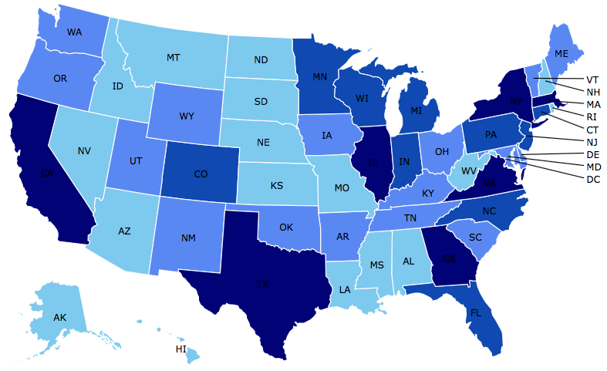

Where Are We?

Slide 5
Available NEED Topics Include:
Coronavirus Economics
US Economy
Climate Change
Economic Inequality
Economic Mobility
Trade and Globalization
Minimum Wages
Immigration Economics
Housing Policy
Federal Budgets
CryptoCurrencies
Black-White Wealth Gap
Autonomous Vehicles
US Monetary Policy

Slide 6
Credits and Disclaimer
This slide deck was authored by:
  Geoffrey Woglom, Amherst College, emeritus
Disclaimer
  NEED presentations are designed to be nonpartisan.
  It is, however, inevitable that the presenter will be asked for and will provide their own views.
  Such views are those of the presenter and not necessarily those of the National Economic Education Delegation (NEED).

Slide 7
Hits and Misses in 2021
Hits: Direct more resources to the mostly poor, young
  Early Child Care & Universal preK in BBB
  Expanded Child Tax Credit in ARP and proposed for 1 more year in BBB.
Misses: The Fed and the Resurgence of Inflation

Slide 8
Investing in the Young: House Bill
CBO estimates:
  Early Child Care: $273 billion
  Universal preK: $109 billion
The funding for both Programs start phasing out in 2028
Notes:
This is a bunt single becuaseit remains to be seen if the Senate will include it or pass any of BBB

Slide 9
James Heckman, Nobelist, in 12/2012”
“The highest rate of return in early childhood development comes from investing as early as possible, from birth through age five, in disadvantaged families. Starting at age three or four is too little too late, as it fails to recognize that skills beget skills in a complementary and dynamic way. Efforts should focus on the first years for the greatest efficiency and effectiveness.”
Caveat: Heckman is not in favor of universal provisions of BBB.
Notes:
Deficit reduction strategy. Perry experiment

Slide 10
ARP and the Expanded Child Tax Credit
Eligibility expanded from children aged 16 to 17.
Increased the maximum benefit from $2000 per child to $3600 per child 0-5 years and to $3000 for other children.
Made the credit fully refundable and payable monthly.
Notes:
BBB and the compromise to get it just for one year.

Slide 11
One Estimate of the Child Tax Credit & Poverty
Notes:
Talk about Generational Transfer Issues

Slide 12
Economic & Political Problems
Notes:
Pink slope implies an increase in next tax rate by 5% added to 24% positive tax rate. TCJA eliminated personal exemption. TCJA for personal will phase out in 2026

Slide 13
Inflation: Fed’s Policy Miss

Slide 14
What’s at Stake: Inflationary Expectations
Monetary Policy is much easier if the people believe that the Fed will achieve its inflation target.
Ben Bernanke (2007):
”…if inflation expectations respond less than previously to variations in economic activity, then inflation itself will become relatively more insensitive to the level of activity…”
Paul Volcker put the world into a costly an deep recession in 1982 to bring down inflation and to “anchor” inflationary expectations

Slide 15
“Anchoring” Inflation Expectations
Forecasts: Philadelphia Fed, “Survey of Professional Forecasters”
Notes:
Livingston Survey. 75-78. Unemployment 7% and 6% inflation. Look at the stability in the post 2001 period.

Slide 16
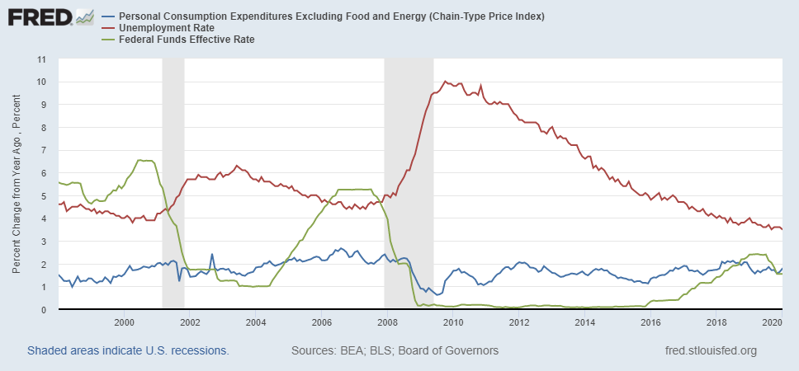
Why Did Jay Powell Do It?
Notes:
On average inflation is less than 2% And Fred raises rates before inflation exceeds 2.%. But, very credible. Latest tightening was begun before Powell became Chair

Slide 17
Policy Changes under Powell
In the Fed’s dual mandate put more emphasis on the employment goal relative to the inflation goal.
Inflation goal switched from targeting forecasted future inflation to trying to achieve average realized inflation of 2.5%
Notes:
Description of Policy goals reversed the order of the inflation and employment objectivesw

Slide 18
Fed’s December 15th Policy Statement
The Committee seeks to achieve maximum employment and inflation at the rate of 2 percent over the longer run. In support of these goals, the Committee decided to keep [short-term interest rates the same]. With inflation having exceeded 2 percent for some time, the Committee expects it will be appropriate to maintain this [level of interest rates] until labor market conditions have reached levels consistent with the Committee’s assessments of maximum employment.

Slide 19
So Far Inflationary Expectations Look Stable
Professional forecasters, financial markets and the Fed itself think that inflation in 2022 will be slightly above 2.5%
But, if that changes the Fed will have a difficult choice:
  Raise interest rates a lot (in an election year) stalling the recovery and disrupting financial markets.
  Hold tight as the inflationary expectations Genie gets out of the bottle

Slide 20
Thank you!
Any Questions?
www.NEEDelegation.org
<Geoffrey Woglom>
<grwoglom@amherst.edu>
Contact NEED: Info@NEEDelegation.org
Submit a testimonial: www.NEEDelegation.org/testimonials.php
Support NEED: www.NEEDelegation.org/donate.php

