Slide 1
Health(care) Economics
OLLI
West Virginia University
February 17, 2022
Veronika Dolar, Ph.D.
State University of New York

Slide 2
National Economic Education Delegation
Vision
One day, the public discussion of policy issues will be grounded in an accurate perception of the underlying economic principles and data.
Mission
NEED unites the skills and knowledge of a vast network of professional economists to promote understanding of the economics of policy issues in the United States.
NEED Presentations
Are nonpartisan and intended to reflect the consensus of the economics profession.

Slide 3
Who Are We?
Honorary Board: 54 members
2 Fed Chairs: Janet Yellen, Ben Bernanke
6 Chairs Council of Economic Advisers
Furman (D), Rosen (R), Bernanke (R), Yellen (D), Tyson (D), Goolsbee (D)
3 Nobel Prize Winners
Akerlof, Smith, Maskin
Delegates: 600+ members
At all levels of academia and some in government service
All have a Ph.D. in economics
Crowdsource slide decks
Give presentations
Global Partners: 44 Ph.D. Economists
Aid in slide deck development

Slide 4
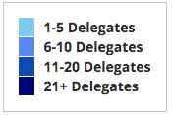
Where Are We?

Slide 5
Credits and Disclaimer
This slide deck was authored by:
Veronika Dolar, SUNY Old Westbury
Jon Haveman, NEED
Disclaimer
NEED presentations are designed to be nonpartisan.
It is, however, inevitable that the presenter will be asked for and will provide their own views.
Such views are those of the presenter and not necessarily those of the National Economic Education Delegation (NEED).

Slide 6
Outline
What is Health(care) Economics?
Taking the Pulse of the Health Economy
Health Care Systems and Institutions
Health Insurance and Reform
Pharmaceuticals – Big Pharma

Slide 7
What is Health(care) Economics?
Health Economics is a field of MICROeconomics that focuses on the health care industry.
Examples of other subfields of microeconomics include:
labor economics, industrial organization, economics of education, public economics, and urban economics.
Notes:
Microeconomics (from Greek prefix micro- meaning "small" + "economics") is a branch of economics that studies the behavior of how the individual modern household and firms make decisions to allocate limited resources.
Macroeconomics (from Greek prefix macro- meaning “large" + "economics") is the study of economy-wide phenomena, including inflation, unemployment, and economic growth.
These two branches of economics are closely intertwined, yet distinct—they address different questions.
Microeconomics studies individual markets or sectors or industries (hence health care industry is classified under microeconomics) while macroeconomics studies national economies and country/state-wide, general equilibrium questions.
Many times people think that since micro means small and macro large, that microeconomics is somehow inferior or studies smaller issues than what is studied in macroeconomics. But it should be noted, that many firms today have revenues that are substantially larger than most national incomes on nations. Obviously, this is comparing apples to oranges – but at least it gives a general idea of the size of some of these firms and markets.
https://medium.com/@denislesak/companies-with-revenues-greater-than-gdp-of-countries-58c46af4a1a9
https://oxfamblogs.org/fp2p/of-the-worlds-top-100-economic-entities-29-are-states-71-are-corporates/
See the next slide to compare US health care.

Slide 8
Health Economics is part of Microeconomics
Although health economics is part of “micro-” economics, it is actually very big:
In 2019, U.S. national health expenditure were 17.7% of GDP, which is equivalent to around $3.8 billion.
For comparison, GDP in each country in 2019:
Germany: $3,845 billion (4th largest economy)
UK: $2,827 billion (6th largest economy)
France : $2,715 billion (7th largest economy)
Notes:
Hopefully the comparison of the US health care industry to the entire economy of Germany, UK, and France will make students also appreciate how difficult any type of a reform is – when the sector being reformed is of this size and complexity.
The list of top 10 largest economies based on the total size of GDP: 1) US, 2) China, 3) Japan, 4) Germany, 5) India, 6) UK, 7) France, 8) Italy, 9) Brazil, 10) Canada

Slide 9
What is Health Economics?
Health economics studies health care resource markets and health insurance.
Healthcare is the biggest industry and the largest employer in the US.
Notes:
Here the big emphasis is on the distinction between other health care markets and health insurance – this difference it typically hard to grasp for most people.

Slide 10
What is a Market?
A market is a group of buyers and sellers of a particular product in the area or region under consideration. The area may be the earth, or countries, regions, states, or cities.
The concept of a market is any structure that allows buyers and sellers to exchange any type of goods, services, and information.
Markets can be physical and non-physical.
There are many different types of markets and depending on the type, different rules should be set up for achieve the best results for society.

Slide 11
Markets Studied in Health Economics
Markets for:
Physicians
Nurses
Hospital facilities
Nursing homes
Pharmaceuticals
Medical supplies (such as diagnostic and therapeutic equipment)
Health Insurance
Notes:
Many times people confuse Health Economics with Health Insurance. The topics discuss in health economics included health insurance, but also a number of other markets related to health care resources.
This is an important distinction – because it also relates to the Health Care reform. Health care reform in the US is mostly dealing with the reform of the Health Insurance, rather than other health care markets.
The debate about many of these issues has to do with the market structure – and the issue of when does a market work well – without a lot of government intervention (free markets) and when is it necessary for a government to play a much larger role.

Slide 12
Markets Matter for Costs, Access, and Quality

Slide 13
Market Economies
In market economies, prices adjust to balance supply and demand.
These equilibrium prices are the signals that guide economic decisions and thereby allocate scarce resources.
The invisible hand works through the price system:
The interaction of buyers and sellers determines prices.
Each price reflects the good’s value to buyers and the cost of producing the good.
Prices guide self-interested households and firms to make decisions that, in many cases, maximize society’s economic well-being.

Slide 14
When does “free market does it better” hold?
Two very important assumptions in order for this to hold are:
Perfectly Competitive Market
No Market Failure
What is a Perfectly Competitive Market?
Many (numerous) buyers – price takers
Many (numerous) sellers – price takers
Identical (homogeneous) product
Free entry and exit
Both buyers and sellers have perfect information about the price, utility, quality, and production methods of products.
What is Market Failure?
Market Failure is a situation in which the allocation of goods and services by a free market is not efficient, often it leads to a net social welfare loss.
Examples of Market Failure:
Externalities
Public Goods
Asymmetric Information

Slide 15
What types of markets are there?
More Competition
Less Competition
Perfect Competition
Monopolistic Competition
Monopoly
Oligopoly
Duopoly
Monopsony
Less Concentration
More Concentration

Slide 16
Health Care Markets are Different
Sponsor
Premiums
Insurer or
third-party payers
Premiums (individual policies)
Money (fixed or variable payments)
Taxes or Lower Wages
Claims
Insurance Coverage
Services
Consumers
Producers
Price
Health Care Providers (hospitals, physicians)
Patients
Out-of-pocket fees

Slide 17
Are Health Care Markets Special?
Market Structure
Type of products and services
Principal-Agent Problem
Asymmetric Information
Moral Hazard
Self Interest

Slide 18
Pulse of the Health Economy

Slide 19
Pulse of the Health Economy
Health economy involves activities related to population health:
Production and consumption of goods and services.
Distribution of those goods to consumers.
Performance indicators of medical care:
Cost
Access
Quality

Slide 20
Costs

Slide 21
National Health Expenditure as Percent of GDP
Total Expenditures in 2019: $3.8 Billion
17.9
17.7, 2019
13.4
5.0
Healthcare spending: increased 60x between 1929 and 2019.
US Economy: increased just 12x
Notes:
https://www.cms.gov/

Slide 22
Health Care Spending as % of GDP, 1980–2018
Everybody Else
Source: Roosa Tikkanen and Melinda K. Abrams, U.S. Health Care from a Global Perspective, 2019: Higher Spending, Worse Outcomes (Commonwealth Fund, Jan. 2020).

Slide 23
National Healthcare Expenditure Per Capita
11,172
1,239
Notes:
https://www.cms.gov/

Slide 24
GDP per Capita and Health Spending per Capita, 2017

Slide 25
International Per Capita Healthcare Spending
Source: Roosa Tikkanen and Melinda K. Abrams, U.S. Health Care from a Global Perspective, 2019: Higher Spending, Worse Outcomes (Commonwealth Fund, Jan. 2020).
Notes:
Some good resources:
https://www.commonwealthfund.org/publications/issue-briefs/2020/jan/us-health-care-global-perspective-2019
A bit older report: https://www.commonwealthfund.org/publications/issue-briefs/2015/oct/us-health-care-global-perspective
https://www.healthsystemtracker.org/chart-collection/quality-u-s-healthcare-system-compare-countries/#item-overall-age-specific-potential-years-of-life-lost-per-100000-population-1990-2017
https://axenehp.com/international-healthcare-systems-us-versus-world/

Slide 26
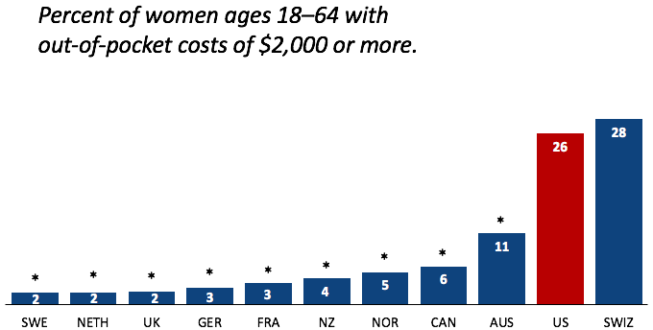
Out-of-Pocket Costs
Source: Munira Z. Gunja et al., What Is the Status of Women’s Health and Health Care in the U.S. Compared to Ten Other Countries? (Commonwealth Fund, Dec. 2018).

Slide 27
Medical Bill Problems
Percent of women ages 18–64 with at least one medical bill problem.
*
*
*
*
*
*
*
*
*
*
Source: Munira Z. Gunja et al., What Is the Status of Women’s Health and Health Care in the U.S. Compared to Ten Other Countries? (Commonwealth Fund, Dec. 2018).
Notes:
Notes: ^ Medical bill problems include any of the following in the past year: 1) serious problems paying or were unable to pay medical bills; 2) spent a lot of time on paperwork or disputes related to medical bills; or 3) insurance denied payment or paid less than expected. * Statistically significant difference compared to the United States (p<.05).
Data: The Commonwealth Fund International Health Policy Survey, 2016.
Source: Munira Z. Gunja et al., What Is the Status of Women’s Health and Health Care in the U.S. Compared to Ten Other Countries? (Commonwealth Fund, Dec. 2018). https://doi.org/10.26099/wy8a-7w13

Slide 28
Skipped Care Because of Cost
Percent of women ages 18–64 with at least one cost-related access problem
*
*
*
*
*
*
*
*
*
*
Source: Munira Z. Gunja et al., What Is the Status of Women’s Health and Health Care in the U.S. Compared to Ten Other Countries? (Commonwealth Fund, Dec. 2018).

Slide 29
Health vs Social Care Spending
Source: E. H. Bradley and L. A. Taylor, The American Health Care Paradox: Why Spending More Is Getting Us Less, Public Affairs, 2013.

Slide 30
Health vs Social Care Spending
A 2013 study by Bradley and Taylor found that the U.S. spent the least on social services—such as retirement and disability benefits, employment programs, and supportive housing—among the countries studied in this report, at just 9 percent of GDP.
From 2000 to 2011, for every dollar the US spent on health care, the country spent another $1.00 on social services, whereas across the OECD, for every dollar spent on health care, countries spend an additional $2.50 on social services
Notes:
Redo this! See the source: the book and NYT article
The U.S. invests the smallest share of its economy on social services.
A 2013 study by Bradley and Taylor found that the U.S. spent the least on social services—such as retirement and disability benefits, employment programs, and supportive housing—among the countries studied in this report, at just 9 percent of GDP.¹² Canada, Australia and New Zealand had similarly low rates of spending, while France, Sweden, Switzerland, and Germany devoted roughly twice as large a share of their economy to social services as did the U.S.
The U.S. was also the only country studied where health care spending accounted for a greater share of GDP than social services spending. In aggregate, U.S. health and social services spending rank near the middle of the pack.

Slide 31
Why is Healthcare Spending Increasing?
Costs in the United States, and elsewhere are increasing rapidly.
The share of economic spending on health care has been steadily increasing for all countries because:
Health spending growth has outpaced economic growth.
Richer countries demand more services, like attention to health.
Also because of
Advances in medical technologies.
Increased demand for services.
Rising prices in the health sector – why?

Slide 32
Tradeoffs
Tradeoffs take place among the three legs:
Increasing quality in health care may lead to higher health care costs.
This means a compromise in access (affordability).
I.e., with increasing quality, access may suffer.
By increasing access, quality may suffer.
By decreasing costs, quality may suffer.
In healthcare in the United States, there are potential opportunities to improve all three simultaneously.
E.g., it is possible that increasing quality can reduce costs.

Slide 33
Quality

Slide 34
A Bit About Quality
The U.S. has the highest chronic disease burden and an obesity rate that is two times higher than the OECD average.
Americans had fewer physician visits than peers in most countries, which may be related to a low supply of physicians in the U.S.
Compared to peer nations, the U.S. has among the highest number of hospitalizations from preventable causes and the highest rate of avoidable deaths.
Americans use some expensive technologies, such as MRIs, and specialized procedures, such as hip replacements, more often than our peers.
The U.S. outperforms its peers in terms of preventive measures — it has one of the highest rates of breast cancer screening among women ages 50 to 69 and the second-highest rate (after the U.K.) of flu vaccinations among people age 65 and older.

Slide 35
Life Expectancy: How Does the US Compare?
Everybody else
United States
Germany – US = 2.5 years
Source: Roosa Tikkanen and Melinda K. Abrams, U.S. Health Care from a Global Perspective, 2019: Higher Spending, Worse Outcomes (Commonwealth Fund, Jan. 2020).

Slide 36
Life Expectancy & Per Capita GDP

Slide 37
Life Expectancy at Birth by Race, 2017
Race/Ethnicity | Life Expectancy (Years)
All Races | 78.6
White | 78.8
Black | 75.3
Hispanic | 81.8
Notes:
CDC

Slide 38
Infant Mortality International Comparison
Deaths per 1,000 live births
Source: NEED from OECD Data

Slide 39
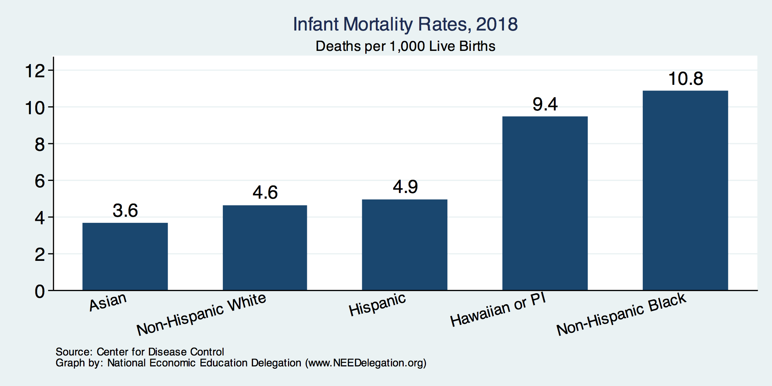
Infant Mortality by Race/Ethnicity

Slide 40
Maternal Mortality Rate
Source: Roosa Tikkanen et al., Maternal Mortality and Maternity Care in the United States Compared to 10 Other Developed Countries (Commonwealth Fund, Nov. 2020). https://doi.org/10.26099/411v-9255

Slide 41
Maternal Mortality Rate by Race

Slide 42
Percent of adults who have experienced medical, medication, or lab errors or delays
Source: 2016 Commonwealth Fund International Health Policy Survey.

Slide 43
Prevention and Screening
The U.S. excels in some prevention measures, including flu vaccinations and breast cancer screenings.
The U.S. has the highest average five-year survival rate for breast cancer, but the Lowest for Cervical Cancer.

Slide 44
Flu Immunization
Source: Roosa Tikkanen and Melinda K. Abrams, U.S. Health Care from a Global Perspective, 2019: Higher Spending, Worse Outcomes (Commonwealth Fund, Jan. 2020).

Slide 45
Breast Cancer Screening
Percent of females ages 50–69 screened (%).
Source: Roosa Tikkanen and Melinda K. Abrams, U.S. Health Care from a Global Perspective, 2019: Higher Spending, Worse Outcomes (Commonwealth Fund, Jan. 2020).

Slide 46
Suicides, 2016
Deaths per 100,000 population
OECD average: 11.5
Source: Roosa Tikkanen and Melinda K. Abrams, U.S. Health Care from a Global Perspective, 2019: Higher Spending, Worse Outcomes (Commonwealth Fund, Jan. 2020).

Slide 47
Obesity Rate, 2017
Percent (%)
Source: Roosa Tikkanen and Melinda K. Abrams, U.S. Health Care from a Global Perspective, 2019: Higher Spending, Worse Outcomes (Commonwealth Fund, Jan. 2020).

Slide 48
Adults with Multiple Chronic Conditions, 2016
Source: Roosa Tikkanen and Melinda K. Abrams, U.S. Health Care from a Global Perspective, 2019: Higher Spending, Worse Outcomes (Commonwealth Fund, Jan. 2020).

Slide 49
The World Health Report 2000, Health Systems: Improving Performance
 | Overall Ranking
30. | Canada
31. | Finland
32. | Australia
33. | Chile
34. | Denmark
35. | Dominica
36. | Costa Rica
37. | United States
38. | Slovenia
39. | Cuba
 | Overall Ranking
1. | France
2. | Italy
3. | San Marino
4. | Andorra
5. | Malta
6. | Singapore
7. | Spain
8. | Oman
9. | Austria
10. | Japan

Slide 50
Perception of Quality of Medical Care
Source: Munira Z. Gunja et al., What Is the Status of Women’s Health and Health Care in the U.S. Compared to Ten Other Countries? (Commonwealth Fund, Dec. 2018).

Slide 51
Quality of Care Notes
Metrics of quality in the U.S. are not very good.
Quality of care is not considered very good in the U.S.
The system has challenges: obesity/lifestyle.
The system has bright spots!

Slide 52
Access

Slide 53
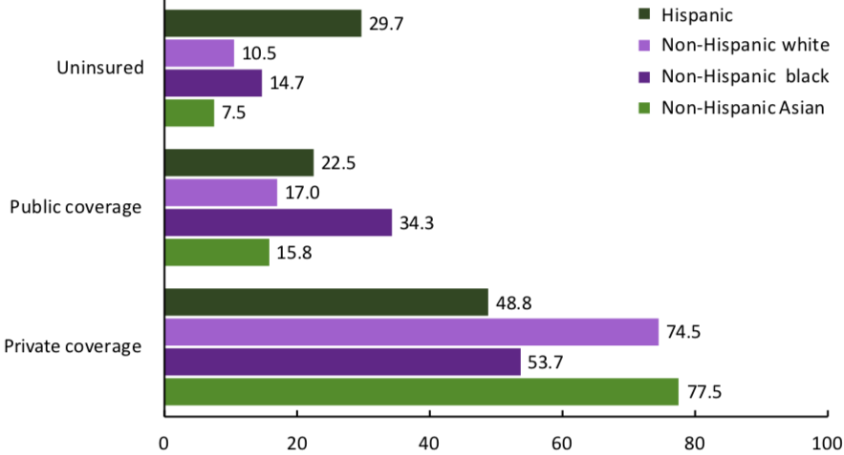
Health Insurance Coverage by Race, 2019
Percent of Persons
Source: National Center for Health Statistics

Slide 54
Physician Visits and Physician Supply
Source: Roosa Tikkanen and Melinda K. Abrams, U.S. Health Care from a Global Perspective, 2019: Higher Spending, Worse Outcomes (Commonwealth Fund, Jan. 2020).

Slide 55
Avoidable Deaths
Deaths per 100,000 population.
Heart disease, stroke, hypertension…
Source: Roosa Tikkanen and Melinda K. Abrams, U.S. Health Care from a Global Perspective, 2019: Higher Spending, Worse Outcomes (Commonwealth Fund, Jan. 2020).

Slide 56
Waited Less Than a Month to See A Specialist
But how much time did they spend
with the specialist?
How often was it necessary to see a specialist?
Percent of Women Ages 18-64
Source: 2011 Commonwealth Fund International Health Policy Survey of Sicker Adults in Eleven Countries.

Slide 57
Hospital Acute Care Average Length of Stay
Average length of stay for acute care (days)

Slide 58
Acute Care Hospital Beds per 1,000 Population
Source: OECD Health Data 2015.

Slide 59
Percent of Women Ages 18–64 Who Reported Having A Regular Doctor/Regular Place of Care
Source: Munira Z. Gunja et al., What Is the Status of Women’s Health and Health Care in the U.S. Compared to Ten Other Countries? (Commonwealth Fund, Dec. 2018).

Slide 60
Percent of Women Ages 18–64 Who Reported Going to the Emergency Room in the Past Two Years
Source: Munira Z. Gunja et al., What Is the Status of Women’s Health and Health Care in the U.S. Compared to Ten Other Countries? (Commonwealth Fund, Dec. 2018).

Slide 61
Access Notes
U.S. has the highest level of spending.
Insurance coverage in the U.S. is not universal.
Supply of medical personnel and equipment may be lower than elsewhere.
Avoidable (amenable) deaths are higher, perhaps indicating less access to care.
Emergency room use is higher in the U.S. than elsewhere.
Specialized medicine is more accessible.

Slide 62
Policy Matters for Costs, Access, and Quality

Slide 63
How Does Policy Matter?
Government spending
Has implications for prices for private parties.
Competition policy
Concentration of various parts of the healthcare industry may be impediments to success in all three areas.

Slide 64
Concentration and Hospitals

Slide 65
Hospital Monopolization
Market consolidation among and between health systems, hospitals, medical groups, and health insurers has surged over the last decade.
Over an 18-month period between July 2016 and January 2018:
hospitals acquired 8,000 more medical practices
14,000 more physicians left independent practice to become hospital employees.
The evidence suggests that with more government oversight and restraining influence over mergers, health care costs would have been lower.

Slide 66
Potential Benefits of Consolidation
Consolidation could lead to potential benefits (“Triple Aim”)
Coordination of care
Investment in care coordination, quality.
Reduction of costly, unnecessary duplication.
Achievement of scale.
Costs
Risk contracts
Volume-outcome.
But, …
Consolidation isn’t integration.
Evidence doesn’t support the claims.
Consolidation has not led to lower costs, better quality, or coordinated care.
If anything, just the opposite has happened.
We have 30 years of experience with consolidation to draw on.
Hospital mergers, integrated deliver systems, physician practice mergers, hospital acquisitions of physician practices…
Source: Martin Gaynor, NIHCM.org, Supersized: The Rise of Hospital Giants

Slide 67
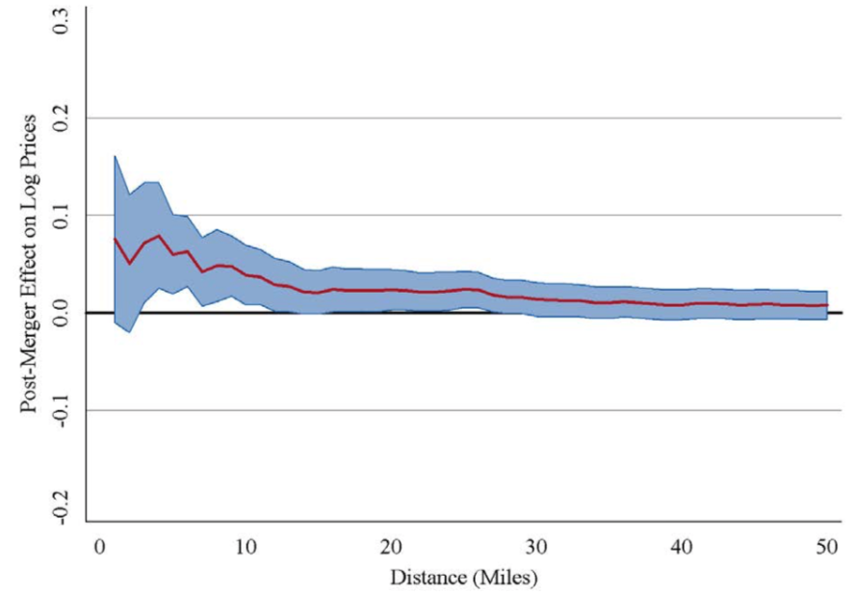
Evidence on Consolidation
Price Increase Following a Hospital Merger
Increase of
About 6%
Very small increase
The price effect of a merger declines with
the distance between the hospitals.

Slide 68
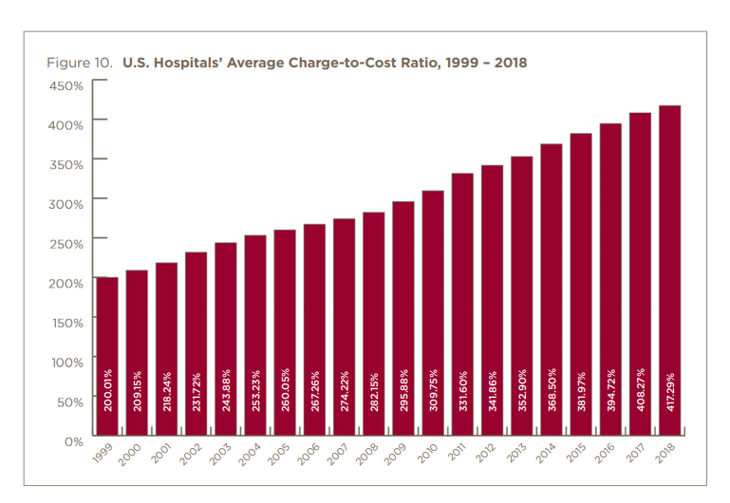

Slide 69
Hospital Monopolization Across the Nation
Hospitals Charge Patients More Than Four Times the Cost of Care
The most expensive hospitals cost of care range from 1,129% at the low end to 1,808% at the high end.
Most of the top 100 most expensive hospitals are located in states in the south and west.
Florida had the highest number, with 40 hospitals.
Other top states included Texas with 14 hospitals, Alabama with eight, Nevada with seven, and California with six.

Slide 70
Hospital Monopolization: California
A large Northern California hospital system used its size and influence to achieve a "domination of the market”.
Sutter Health grew into a behemoth hospital system and then, like a classic monopoly, used its dominance in Northern California to raise hospital prices.
Sutter used its windfall from excessive pricing to acquire more entities and grew into a conglomerate of 24 hospitals, 12,000 doctors and several cancer, cardiac and other specialty centers.
In some counties, Sutter was the sole hospital for a thousand square miles.

Slide 71
Hospital Monopolization: Florida
South Florida hospitals recorded combined profits of nearly $1.3 billion in 2018 and have posted combined profits above $1 billion for four of the past five years.
HCA hospitals were the most profitable, with a net income of $363.6 million, according to the report.
Baptist Health, a nonprofit and the largest system in the Miami area, had net income of $142.8 million and Memorial Healthcare System in Broward County, a nonprofit hospital network, had net income of $158.6 million.

Slide 72
Concentration and Pharma

Slide 73
Drug Price Comparisons
Drug Prices for 30 Most Commonly Prescribed Brand-Name and Generic Drugs, 2006–07 US is set at 1.00
 | AUS | CAN | FR | GER | NETH | NZ | SWITZ | UK | US
Brand-name drugs | 0.40 | 0.64 | 0.32 | 0.43 | 0.39 | 0.33 | 0.51 | 0.46 | 1.00
Generic drugs | 2.57 | 1.78 | 2.85 | 3.99 | 1.96 | 0.90 | 3.11 | 1.75 | 1.00
Source: IMS Health; analysis by Gerard Anderson, Johns Hopkins University.

Slide 74
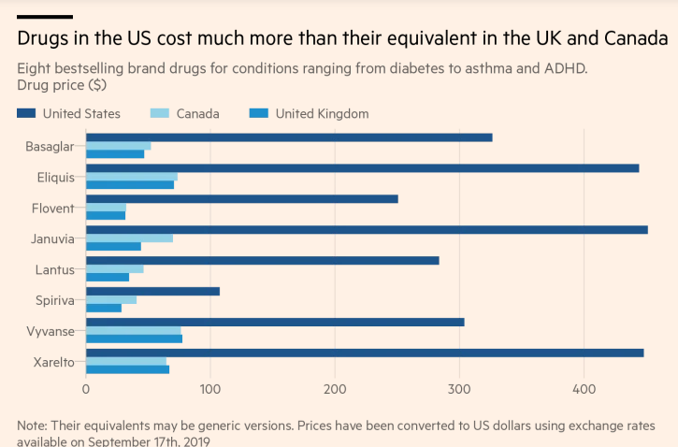
Source: https://www.ft.com/content/e92dbf94-d9a2-11e9-8f9b-77216ebe1f17

Slide 75
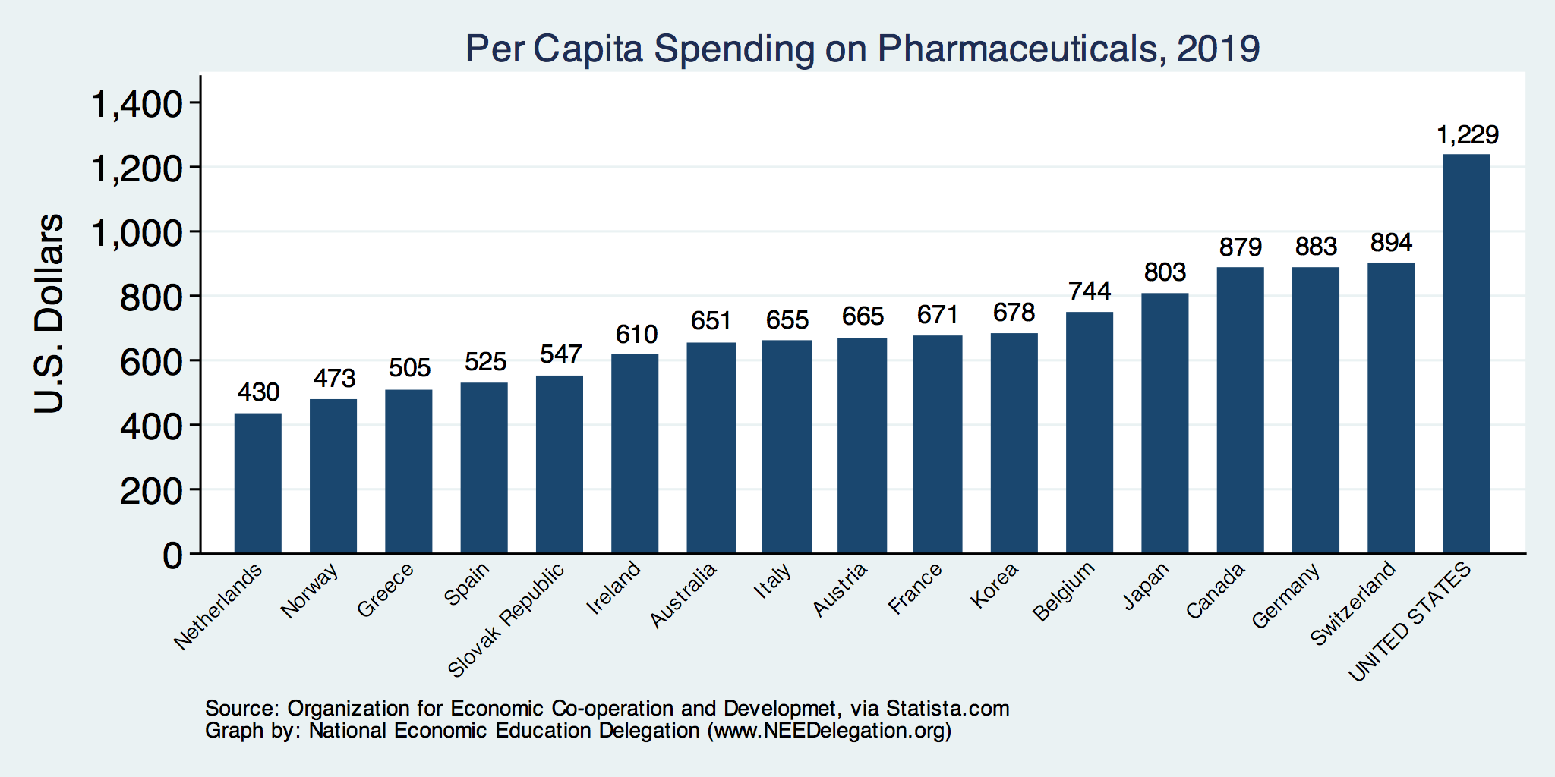
Spending on Pharmaceuticals
Notes:
https://www.bloomberg.com/quicktake/drug-prices
https://en.wikipedia.org/wiki/Prescription_drug_prices_in_the_United_States
https://www.ft.com/content/e92dbf94-d9a2-11e9-8f9b-77216ebe1f17

Slide 76
Drug Prices: Trends Over Time

Slide 77
Price Hikes
Turing Pharmaceuticals’ 5,555% price increase of Daraprim® in 2015 and Mylan’s 500% increase of EpiPen®…
More than 3,400 drugs boosted their prices in the first six months of 2019, an increase of 17% in the number of drug hikes from a year earlier.
The average price hike is 10.5%, or 5 times the rate of inflation.
About 41 drugs boosted their prices by more than 100% in 2019.
Over the course of a decade, the net cost of prescription drugs in the United States rose more than three times faster than the rate of inflation.

Slide 78
Reasons for Higher Drug Prices
The Medicare Prescription Drug, Improvement, and Modernization Act, also called the Medicare Modernization Act or MMA, is a federal law of the United States, enacted in 2003.
Concentration of pharmaceutical companies.

Slide 79
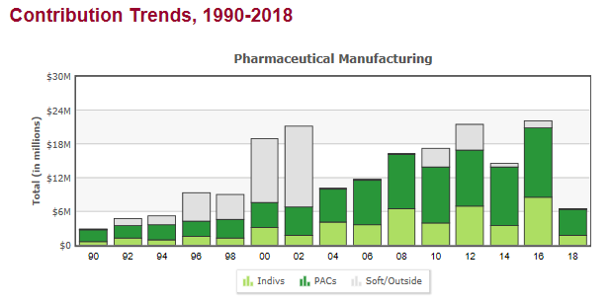
Lobbying
Medicare Prescription Drug Costs

Slide 80
Medicare Modernization Act
Prescription Drug Component
Medicare Part D, by law, cannot negotiate drug prices like other governments do.
In 2017, Medicare spent nearly $8 billion on insulin.
The researchers said that if Medicare were allowed to negotiate drug prices like the U.S. Department of Veterans Affairs (VA) can, Medicare could save about $4.4 billion just on insulin.

Slide 81
How Much is Negotiation Worth?
The CBO estimates that drug pricing negotiation would reduce federal spending by $456 billion and increase revenues by $45 billion over 10 years. This would include:
direct savings to the Medicare Part D program ($448B)
a reduction in spending related to the Affordable Care Act’s subsidies for commercial health plans
a reduction in spending for the Federal Employees Health Benefits Program
an increase in government revenue from employers using savings from reduced premiums to fund taxable wage increases for their workers.
Source: Congressional Budget Office, https://www.cbo.gov/system/files/2019-12/hr3_complete.pdf

Slide 83
Concentration in Pharmaceutical Companies
The number of mergers and acquisitions involving one of the top 25 firms more than doubled:
29 in 2006 to 61 in 2015
Between 1995 and 2015, 60 drug companies merged into 10.

Slide 84
According to the GAO:
Between 2006 and 2015:
Pharma and Biotech revenues increased from $534 billion to $775 billion (2015 $)
67% of drug companies saw an increase in profit margins.
Top 25: profit margins were between 15 and 20%.
Across non-drug companies, profit margins are 4-9%.
Mergers
# held constant, but deal values increased.
Largest 10 companies had about 38% market share – higher in narrower markets.
Between 2008 and 2014:
179 to 263 drug approvals occurred annually
13% of approvals were for novel drugs.
Research indicates that fewer competitors are associated with higher prices.
Especially in the market for generics.
Mergers have a varied impact on innovation: R&D spending, patent approvals, and drug approvals.
Certain merger retrospective studies have found a negative effect.
https://www.gao.gov/assets/gao-18-40-highlights.pdf

Slide 85
Concentration of Insurance

Slide 86
Monopolization of Health Insurance Market
As of 2011, there were close to 100 insurers in Switzerland competing for consumer health care dollars, forcing firms to compete by setting prices to just cover costs.
In the United States, markets are state specific and consumers may choose from plans available in the state in which they reside.
In 2014, of the 50 states and the District of Columbia:
11 had only 1 or 2 insurers
21 had 3 or 4, and
only 19 states had 5 or more.
As of July 2019, the number of states with only 1 or 2 insurers had increased from 11 to 20.
Notes:
6 Roy, Avik. “Why Switzerland Has the World’s Best Health Care System.” Forbes, April 29, 2011; https://www.forbes.com/sites/theapothecary/2011/04/29/why-switzerland-has-the-worlds-best-health-care-system/#2416d9a67d74.
7 Henry J. Kaiser Family Foundation. “Number of Issuers Participating in the Individual Health Insurance Marketplaces.” State Health Facts; https://www.kff.org/other/state-indicator/number-of-issuers-participating-in-the-individual-health-insurance-marketplace, accessed July 2019.

Slide 87
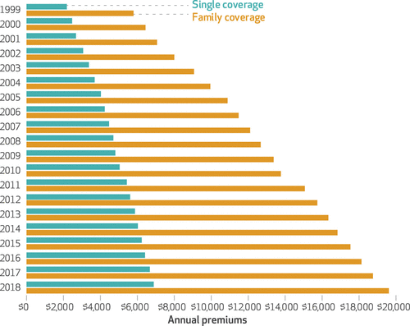
Average Annual Insurance Premiums, 1999-2018
Employer provided, Not Adjusted for Inflation
 | Average Annual Rate of Change
Inflation | 2.19
Health Care CPI | 3.68
Single coverage | 6.51
Family coverage | 6.52
Source: The Commonwealth Fund

Slide 88
Spending on Deductibles

Slide 89
Reason for Higher Health Insurance Rates
Rising prices in the health sector
Advances in medical technologies
Increased demand for services
Concentration of insurance companies!

Slide 90
Health Care Systems and Institutions

Slide 91
Health System Classification
Developed countries of the world have each taken a different approach for their health care delivery systems
5 basic models:
National health insurance (Canada)
Bismarck (France, Germany, Japan, Switzerland)
Beveridge – socialized medicine (United Kingdom, Spain, New Zealand)
Out of pocket model – you pay yourself
Mixed (United States)

Slide 92
US Health Care System
Medicare – National Health Insurance
Military Veteran Care – Beveridge model (socialized medicine)
Employer-sponsored insurance – Bismarck model
Individual market health plans - Bismarck model
Uninsured - Out of pocket model

Slide 93
Health Insurance and Reform

Slide 94
Definition: Universal Coverage
Universal coverage refers to health care systems in which all individuals have insurance coverage.
Generally, this coverage includes:
Access to all needed services and benefits.
Protects individuals from excessive financial hardships.
Canada has universal coverage, the United States does not.

Slide 95
Definition: Single-Payer
Single-payer refers to financing a health care system by making one entity solely and exclusively responsible for paying for medical goods and services.
It is only the financing component that is socialized.
The money for the payment can be either collected by
Taxes collected by the government
Premiums collected by National or Public Health Insurance
Single-payer systems: 17 countries
Norway, Japan, United Kingdom, Kuwait, Sweden, Bahrain, Brunei, Canada, United Arab Emirates, Denmark, Finland, Slovenia, Italy, Portugal, Cyprus, Spain, and Iceland.

Slide 96
Definition: Socialized Medicine
Socialized medicine: this model actually takes the single-payer system one step further.
Government not only pays for health care but operates the hospitals and employs the medical staff.
This is NOT part of the current debate in the US.

Slide 97
Definition: Third-Party Payer
A third-party payer is an entity that pays medical claims on behalf of the insured. Examples of third-party payers include government agencies, insurance companies, health maintenance organizations (HMOs), and employers.
Employer-sponsored health plans
Individual market health plans
National health insurance

Slide 98
Summary
US HealthCare system is not preforming well (very expensive with low quality and access).
One of the main reasons for very high costs is the monopolization of healthcare markets.
Hospitals, health insurance, big pharma, physicians, etc.
In addition, the Medicare Modernization Act of 2003 by law prevents government to negotiate drug prices.
A few simple solutions could drastically reduce costs:
Enforcement of antitrust laws in this sector.
Introduction of a public option in the health insurance market.
Ability for the US government to negotiate drug prices like most every other nation.
Universal health insurance would increase access and perhaps also reduce costs.
But there are always tradeoffs: you can pick two, but the third may suffer.

Slide 99
Thank you!
Any Questions?
www.NEEDelegation.org
<presenter name>
<presenter email>
Contact NEED: info@needelegation.org
Submit a testimonial: www.NEEDelegation.org/testimonials.php
Become a Friend of NEED: www.NEEDelegation.org/friend.php

Slide 100
Available NEED Topics Include:
Coronavirus Economics
US Economy
Climate Change
Economic Inequality
Economic Mobility
Trade and Globalization
Minimum Wages
Immigration Economics
Housing Policy
Federal Budgets
Federal Debt
Black-White Wealth Gap
Autonomous Vehicles
US Social Policy

Slide 101
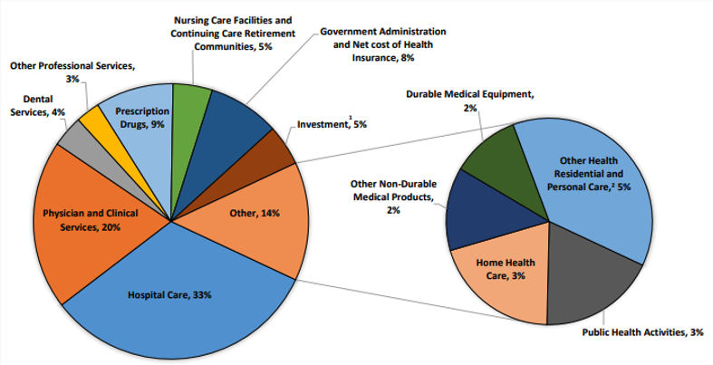
Where the money goes?
Source: Centers for Medicare & Medicaid Services, Office of the Actuary, National Health Statistics Group.

