Slide 1
Health(care) Economics
Rotary Club of The Villages
May 6th, 2021
Veronika Dolar
State University of New York
SUNY Old Westbury

Slide 2
National Economic Education Delegation
Vision
One day, the public discussion of policy issues will be grounded in an accurate perception of the underlying economic principles and data.
Mission
NEED unites the skills and knowledge of a vast network of professional economists to promote understanding of the economics of policy issues in the United States.
NEED Presentations
Are nonpartisan and intended to reflect the consensus of the economics profession.

Slide 3
Who Are We?
Honorary Board: 49 members
2 Fed Chairs: Janet Yellen, Ben Bernanke
6 Chairs Council of Economic Advisers
Furman (D), Rosen (R), Bernanke (R), Yellen (D), Tyson (D), Goolsbee (D)
3 Nobel Prize Winners
Akerlof, Smith, Maskin
Delegates: 500+ members
At all levels of academia and some in government service
All have a Ph.D. in economics
Crowdsource slide decks
Give presentations
Global Partners: 45 Ph.D. Economists
Aid in slide deck development

Slide 4
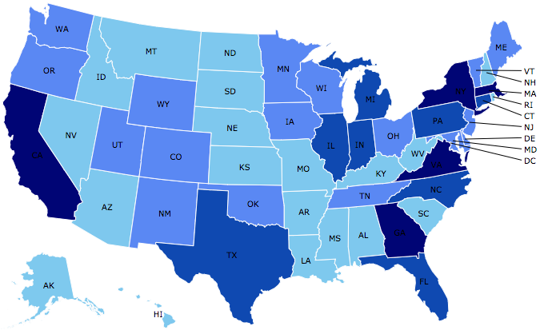
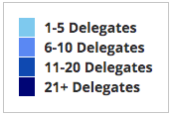
Where Are We?

Slide 5
Credits and Disclaimer
This slide deck was authored by:
Veronika Dolar, SUNY Old Westbury
Disclaimer
NEED presentations are designed to be nonpartisan.
It is, however, inevitable that the presenter will be asked for and will provide their own views.
Such views are those of the presenter and not necessarily those of the National Economic Education Delegation (NEED).

Slide 6
Outline
What is Health(care) Economics?
Taking the Pulse of the Health Economy
Health Care Systems and Institutions
Health Insurance and Reform
Pharmaceuticals – Big Pharma

Slide 7
Health Economics is part of Microeconomics
Although health economics is part of “micro-” economics, it is actually very big:
In 2019, U.S. national health expenditure was 17.8% of GDP, which is equivalent to around $3,427 billions.
For comparison, the entire GDP of Germany in 2019 was $3,845 billions (4th largest economy), GDP of UK was $2,827 billions (6th largest economy), and $2,715 billions in France (7th largest economy).
Notes:
Hopefully the comparison of the US health care industry to the entire economy of Germany, UK, and France will make students also appreciate how difficult any type of a reform is – when the sector being reformed is of this size and complexity.
The list of top 10 largest economies based on the total size of GDP: 1) US, 2) China, 3) Japan, 4) Germany, 5) India, 6) UK, 7) France, 8) Italy, 9) Brazil, 10) Canada

Slide 8
What is Health Economics?
Health economics studies health care resources markets and health insurance.
Healthcare is the biggest industry and the largest employer in the US.
Notes:
Here the big emphasis is on the distinction between other health care markets and health insurance – this difference it typically hard to grasp for most people.

Slide 9
Markets studied in health economics
Markets for:
Physicians
Nurses
Hospital facilities
Nursing homes
Pharmaceuticals
Medical supplies (such as diagnostic and therapeutic equipment)
Health Insurance
Notes:
Many times people confuse Health Economics with Health Insurance. The topics discuss in health economics included health insurance, but also a number of other markets related to health care resources.
This is an important distinction – because it also relates to the Health Care reform. Health care reform in the US is mostly dealing with the reform of the Health Insurance, rather than other health care markets.
The debate about many of these issues has to do with the market structure – and the issue of when does a market work well – without a lot of government intervention (free markets) and when is it necessary for a government to play a much larger role.

Slide 10
Market Economies
In market economies, prices adjust to balance supply and demand.
These equilibrium prices are the signals that guide economic decisions and thereby allocate scarce resources.
The invisible hand works through the price system:
The interaction of buyers and sellers determines prices.
Each price reflects the good’s value to buyers and the cost of producing the good.
Prices guide self-interested households and firms to make decisions that, in many cases, maximize society’s economic well-being.

Slide 11
What types of markets are there?
More Competition
Less Competition
Perfect Competition
Monopolistic Competition
Monopoly
Oligopoly
Duopoly
Monopsony
Less Concentration
More Concentration

Slide 12
Hospital Monopolization
Market consolidation among and between health systems, hospitals, medical groups, and health insurers has surged over the last decade.
Over an 18-month period between July 2016 and January 2018, hospitals acquired 8,000 more medical practices, and 14,000 more physicians left independent practice to become hospital employees, according to an analysis.

Slide 13
Hospital Monopolization: Florida
South Florida hospitals recorded combined profits of nearly $1.3 billion in 2018 and have posted combined profits above $1 billion for four of the past five years.
HCA hospitals were the most profitable, with a net income of $363.6 million.
Baptist Health, a nonprofit and the largest system in the Miami area, had a net income of $142.8 million and Memorial Healthcare System in Broward County, a nonprofit hospital network, had a net income of $158.6 million.

Slide 14
Health Care Markets are Different
Sponsor
Premiums
Insurer or
third-party payers
Premiums (individual policies)
Money (fixed or variable payments)
Taxes or Lower Wages
Claims
Insurance Coverage
Services
Consumers
Producers
Price
Health Care Providers (hospitals, physicians)
Patients
Out-of-pocket fees

Slide 15
Is there something special about Health Care Markets?
Market Structure
Type of products and services
Principal-Agent Problem
Asymmetric Information
Moral Hazard

Slide 16
Pulse of the Health Economy
Health economy involves activities related to population health:
Production and consumption of goods and services
Distribution of those goods to consumers
Performance indicators of medical care
Costs
Quality
Access

Slide 17
Tradeoffs
Tradeoffs take place among the three legs:
By increasing quality health care this leads to higher health care costs, which means that some individuals might not be able to afford it and the access may be more limited.
By increasing access, the costs and/or quality may suffer.
By decreasing costs, access and/or quality may suffer.

Slide 18
Costs

Slide 19
National Health Expenditure as Percent of GDP
Notes:
https://www.cms.gov/

Slide 20
National Healthcare Expenditure Per Capita
Notes:
https://www.cms.gov/

Slide 21
Health Care Spending as % of GDP, 1980–2018
Source: Roosa Tikkanen and Melinda K. Abrams, U.S. Health Care from a Global Perspective, 2019: Higher Spending, Worse Outcomes (Commonwealth Fund, Jan. 2020).

Slide 22
Monopolization of Health Insurance Market
As of 2011, there were close to 100 insurers in Switzerland competing for consumer health care dollars, forcing firms to compete by setting prices to just cover costs.
In the United States, markets are state specific and consumers may choose from plans available in the state in which they reside.
In 2014, of the 50 states and the District of Columbia, 11 had only 1 or 2 insurers, 21 had 3 or 4, and only 19 states had 5 or more.
As of July 2019, the number of states with only 1 or 2 insurers had increased from 11 to 20, indicating a growing divide between ACA exchanges and competitive markets.
Notes:
6 Roy, Avik. “Why Switzerland Has the World’s Best Health Care System.” Forbes, April 29, 2011; https://www.forbes.com/sites/theapothecary/2011/04/29/why-switzerland-has-the-worlds-best-health-care-system/#2416d9a67d74.
7 Henry J. Kaiser Family Foundation. “Number of Issuers Participating in the Individual Health Insurance Marketplaces.” State Health Facts; https://www.kff.org/other/state-indicator/number-of-issuers-participating-in-the-individual-health-insurance-marketplace, accessed July 2019.

Slide 23
Thank you!
Any Questions?
www.NEEDelegation.org
Veronika Dolar
dolarv@oldwestbury.edu
Contact NEED: info@needelegation.org
Submit a testimonial: www.NEEDelegation.org/testimonials.php
Become a Friend of NEED: www.NEEDelegation.org/friend.php

Slide 24
Available NEED Topics Include:
Coronavirus Economics
US Economy
Climate Change
Economic Inequality
Economic Mobility
Trade and Globalization
Trade Wars
Immigration Economics
Housing Policy
Federal Budgets
Federal Debt
Black-White Wealth Gap
Autonomous Vehicles
US Social Policy

