Slide 1
Health(care) Economics
Sausalito Rotary Club
November 3, 2022
Jon Haveman, Ph.D.
NEED

Slide 2
Credits and Disclaimer
This slide deck was authored by:
Veronika Dolar, SUNY Old Westbury
Jon Haveman, NEED
Disclaimer
NEED presentations are designed to be nonpartisan.
It is, however, inevitable that the presenter will be asked for and will provide their own views.
Such views are those of the presenter and not necessarily those of the National Economic Education Delegation (NEED).

Slide 3
Outline
What is Health(care) Economics?
Health Insurance and Outcomes
Health Care Systems and Institutions
Health Insurance and Reform

Slide 4
What is Health(care) Economics?
Health Economics is a field of MICROeconomics that focuses on the health care industry.
Examples of other subfields of microeconomics include:
labor economics, industrial organization, economics of education, public economics, and urban economics.
Notes:
Microeconomics (from Greek prefix micro- meaning "small" + "economics") is a branch of economics that studies the behavior of how the individual modern household and firms make decisions to allocate limited resources.
Macroeconomics (from Greek prefix macro- meaning “large" + "economics") is the study of economy-wide phenomena, including inflation, unemployment, and economic growth.
These two branches of economics are closely intertwined, yet distinct—they address different questions.
Microeconomics studies individual markets or sectors or industries (hence health care industry is classified under microeconomics) while macroeconomics studies national economies and country/state-wide, general equilibrium questions.
Many times people think that since micro means small and macro large, that microeconomics is somehow inferior or studies smaller issues than what is studied in macroeconomics. But it should be noted, that many firms today have revenues that are substantially larger than most national incomes on nations. Obviously, this is comparing apples to oranges – but at least it gives a general idea of the size of some of these firms and markets.
https://medium.com/@denislesak/companies-with-revenues-greater-than-gdp-of-countries-58c46af4a1a9
https://oxfamblogs.org/fp2p/of-the-worlds-top-100-economic-entities-29-are-states-71-are-corporates/
See the next slide to compare US health care.

Slide 5
Health Economics is part of Microeconomics
Although health economics is part of “micro-” economics, it is actually very big:
In 2019, U.S. national health expenditures were 17.7% of GDP, which is equivalent to around $3.8 trillion.
For comparison, GDP in each country in 2019:
Germany: $3,845 trillion (4th largest economy)
UK: $2,827 trillion (6th largest economy)
France : $2,715 trillion (7th largest economy)
Notes:
Hopefully the comparison of the US health care industry to the entire economy of Germany, UK, and France will make students also appreciate how difficult any type of a reform is – when the sector being reformed is of this size and complexity.
The list of top 10 largest economies based on the total size of GDP: 1) US, 2) China, 3) Japan, 4) Germany, 5) India, 6) UK, 7) France, 8) Italy, 9) Brazil, 10) Canada

Slide 6
The Three Legs of the Healthcare Stool
The market for Health Insurance is where they all come together.
Access
Quality
Cost
We will discuss metrics of performance for each.

Slide 7
Access

Slide 8
Health Insurance Coverage, 2019 - 92%
Percent of Persons
Source: National Center for Health Statistics

Slide 9
Physician Visits and Physician Supply
Source: Roosa Tikkanen and Melinda K. Abrams, U.S. Health Care from a Global Perspective, 2019: Higher Spending, Worse Outcomes (Commonwealth Fund, Jan. 2020).

Slide 10
Access Notes
Insurance coverage in the U.S. is not universal.
Supply of medical personnel and equipment may be lower than elsewhere.
Avoidable (amenable) deaths are higher, perhaps indicating less access to care.
Emergency room use is higher in the U.S. than elsewhere.
Specialized medicine is more accessible.

Slide 11
Quality

Slide 12
Life Expectancy: How Does the US Compare?
Everybody else
United States
Germany – US = 2.5 years
Swiss – US = 5 years
Source: Roosa Tikkanen and Melinda K. Abrams, U.S. Health Care from a Global Perspective, 2019: Higher Spending, Worse Outcomes (Commonwealth Fund, Jan. 2020).

Slide 13
Infant Mortality International Comparison
Deaths per 1,000 live births
Source: NEED from OECD Data

Slide 14
Prevention and Screening
The U.S. excels in some prevention measures, including flu vaccinations and breast cancer screenings.
The U.S. has the highest average five-year survival rate for breast cancer, but the Lowest for cervical cancer.

Slide 15
The World Health Report 2000, Health Systems: Improving Performance
 | Overall Ranking
1. | France
2. | Italy
3. | San Marino
4. | Andorra
5. | Malta
6. | Singapore
7. | Spain
8. | Oman
9. | Austria
10. | Japan
 | Overall Ranking
30. | Canada
31. | Finland
32. | Australia
33. | Chile
34. | Denmark
35. | Dominica
36. | Costa Rica
37. | United States
38. | Slovenia
39. | Cuba

Slide 16
Quality of Care Notes
Metrics of quality in the U.S. are not very good.
Quality of care is not considered very good in the U.S.
The system has challenges: obesity/lifestyle.
The system has bright spots!

Slide 17
Costs

Slide 18
National Health Expenditure as Percent of GDP
Total Expenditures in 2019: $3.8 Trillion
17.9
17.7, 2019
13.4
5.0
Healthcare spending: increased 60x between 1929 and 2019.
US Economy: increased just 12x
Notes:
https://www.cms.gov/

Slide 19
Health Care Spending as % of GDP, 1980–2018
United States
Everybody else
Source: Roosa Tikkanen and Melinda K. Abrams, U.S. Health Care from a Global Perspective, 2019: Higher Spending, Worse Outcomes (Commonwealth Fund, Jan. 2020).

Slide 20
Why is Healthcare Spending Increasing?
Costs in the United States, and elsewhere are increasing rapidly.
The share of economic spending on health care has been steadily increasing for all countries because:
Health spending growth has outpaced economic growth.
Richer countries demand more services, like attention to health.
Also because of
Advances in medical technologies.
Increased demand for services.
Rising prices in the health sector – why?

Slide 21
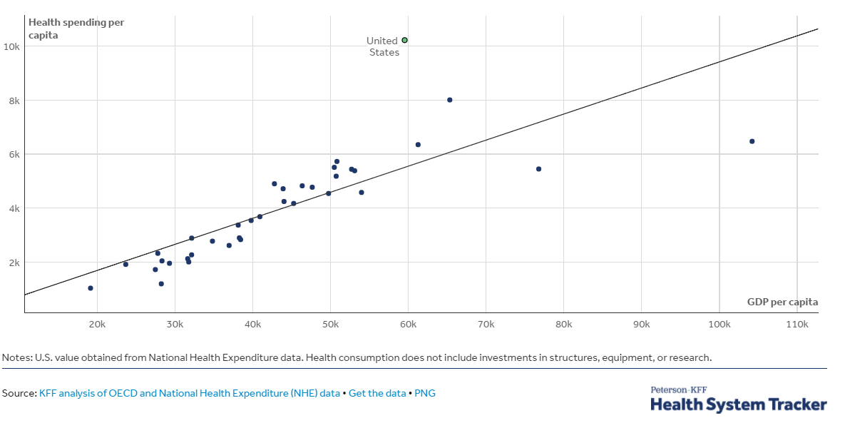
GDP per Capita and Health Spending per Capita, 2017

Slide 22
National Healthcare Expenditure Per Capita
11,172
1,239
Notes:
https://www.cms.gov/

Slide 23
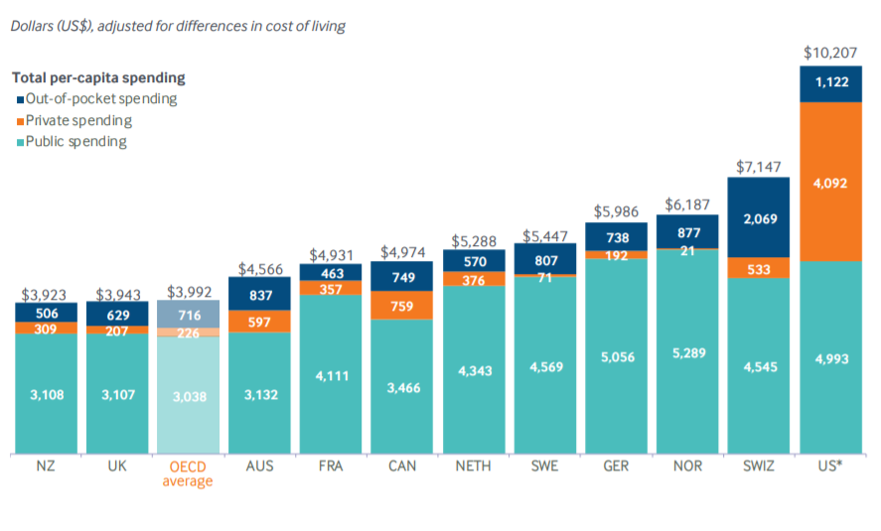
International Per Capita Healthcare Spending
Source: Roosa Tikkanen and Melinda K. Abrams, U.S. Health Care from a Global Perspective, 2019: Higher Spending, Worse Outcomes (Commonwealth Fund, Jan. 2020).
Notes:
Some good resources:
https://www.commonwealthfund.org/publications/issue-briefs/2020/jan/us-health-care-global-perspective-2019
A bit older report: https://www.commonwealthfund.org/publications/issue-briefs/2015/oct/us-health-care-global-perspective
https://www.healthsystemtracker.org/chart-collection/quality-u-s-healthcare-system-compare-countries/#item-overall-age-specific-potential-years-of-life-lost-per-100000-population-1990-2017
https://axenehp.com/international-healthcare-systems-us-versus-world/

Slide 24
Why Are Costs so High in the US?
One Reason:
The United States is the only
profit-motivated healthcare system in the world.

Slide 25
Markets Matter for Costs

Slide 26
Are Health Care Markets Special?
Market Structure
Type of products and services
Principal-Agent Problem
Asymmetric Information
Moral Hazard
Moral Imperative (?)

Slide 27
Health Care Markets are Different
Sponsor
Premiums
Insurer or
third-party payers
Premiums (individual policies)
Money (fixed or variable payments)
Taxes or Lower Wages
Claims
Insurance Coverage
Services
Consumers
Producers
Price
Health Care Providers (hospitals, physicians)
Patients
Out-of-pocket fees

Slide 28
Policy Matters for Costs

Slide 29
Hospital Monopolization
Market consolidation among and between health systems, hospitals, medical groups, and health insurers has surged over the last decade.
Over an 18-month period between July 2016 and January 2018:
Hospitals acquired 8,000 more medical practices.
14,000 more physicians left independent practice to become hospital employees.

Slide 30
Drug Price Comparisons
Drug Prices for 30 Most Commonly Prescribed Brand-Name and Generic Drugs, 2006–07 US is set at 1.00
 | AUS | CAN | FR | GER | NETH | NZ | SWITZ | UK | US
Brand-name drugs | 0.40 | 0.64 | 0.32 | 0.43 | 0.39 | 0.33 | 0.51 | 0.46 | 1.00
Generic drugs | 2.57 | 1.78 | 2.85 | 3.99 | 1.96 | 0.90 | 3.11 | 1.75 | 1.00
US Higher
US Lower
Source: IMS Health; analysis by Gerard Anderson, Johns Hopkins University.

Slide 31
Medicare Modernization Act
Prescription Drug Component
Medicare Part D, by law, cannot negotiate drug prices like other governments do.
In 2017, Medicare spent nearly $8 billion on insulin.
The researchers said that if Medicare were allowed to negotiate drug prices like the U.S. Department of Veterans Affairs (VA) can, Medicare could save about $4.4 billion just on insulin.

Slide 32
Concentration in Pharmaceutical Companies
The number of mergers and acquisitions involving one of the top 25 firms more than doubled:
29 in 2006 to 61 in 2015
Between 1995 and 2015, 60 drug companies merged into 10.

Slide 33
Monopolization of Health Insurance Market
As of 2011, there were close to 100 insurers in Switzerland competing for consumer health care dollars, forcing firms to compete by setting prices to just cover costs.
In the United States, markets are state specific and consumers may choose from plans available in the state in which they reside.
In 2014, of the 50 states and the District of Columbia:
11 had only 1 or 2 insurers
21 had 3 or 4, and
only 19 states had 5 or more. (CA has 11)
As of July 2019, the number of states with only 1 or 2 insurers had increased from 11 to 20.
Notes:
6 Roy, Avik. “Why Switzerland Has the World’s Best Health Care System.” Forbes, April 29, 2011; https://www.forbes.com/sites/theapothecary/2011/04/29/why-switzerland-has-the-worlds-best-health-care-system/#2416d9a67d74.
7 Henry J. Kaiser Family Foundation. “Number of Issuers Participating in the Individual Health Insurance Marketplaces.” State Health Facts; https://www.kff.org/other/state-indicator/number-of-issuers-participating-in-the-individual-health-insurance-marketplace, accessed July 2019.

Slide 34
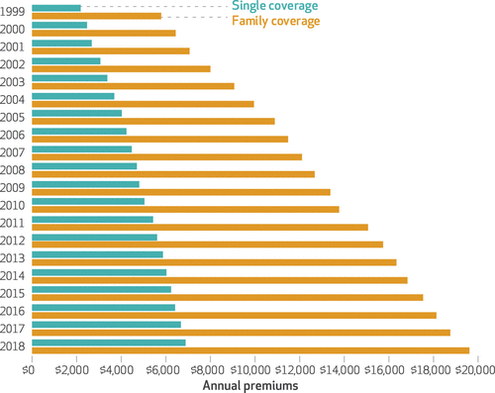
Average Annual Insurance Premiums, 1999-2018
Employer provided, Not Adjusted for Inflation
Single: ~$2,000 to ~$7,000
Family: ~$5,900 to ~$19,500
 | Average Annual Rate of Change
Inflation | 2.19
Health Care CPI | 3.68
Single coverage | 6.51
Family coverage | 6.52
Source: The Commonwealth Fund

Slide 35
Reason for Higher Health Insurance Rates
Rising prices in the health sector
Advances in medical technologies
Increased demand for services
Concentration of insurance companies!

Slide 36
Summary
US HealthCare system is not preforming well.
Very expensive with low quality and access.
One of the main reasons for very high costs is the monopolization of healthcare markets.
Hospitals, health insurance, big pharma, physicians, etc.
A few simple solutions could drastically reduce costs:
Enforcement of antitrust laws in this sector.
Introduction of a public option in the health insurance market.
Ability for the US government to negotiate drug prices like most every other nation.
Universal health insurance would increase access and perhaps also reduce costs.
But there are always tradeoffs: you can pick two, but the third may suffer.

Slide 37
Download the PDF of these slides….
Another 30 slides with information about healthcare markets.

Slide 38
Thank you!
Any Questions?
www.NEEDelegation.org
Jon D. Haveman, Ph.D.
Jon@NEEDelegation.org
Contact NEED: info@needelegation.org
Submit a testimonial: www.NEEDelegation.org/testimonials.php
Become a Friend of NEED: www.NEEDelegation.org/friend.php

