Slide 1
Health(care) Economics
Kiwanis Club of San Jose
September 13, 2021
Veronika Dolar
State University of New York
SUNY Old Westbury

Slide 2
National Economic Education Delegation
Vision
One day, the public discussion of policy issues will be grounded in an accurate perception of the underlying economic principles and data.
Mission
NEED unites the skills and knowledge of a vast network of professional economists to promote understanding of the economics of policy issues in the United States.
NEED Presentations
Are nonpartisan and intended to reflect the consensus of the economics profession.

Slide 3
Who Are We?
Honorary Board: 49 members
2 Fed Chairs: Janet Yellen, Ben Bernanke
6 Chairs Council of Economic Advisers
Furman (D), Rosen (R), Bernanke (R), Yellen (D), Tyson (D), Goolsbee (D)
3 Nobel Prize Winners
Akerlof, Smith, Maskin
Delegates: 500+ members
At all levels of academia and some in government service
All have a Ph.D. in economics
Crowdsource slide decks
Give presentations
Global Partners: 45 Ph.D. Economists
Aid in slide deck development

Slide 4
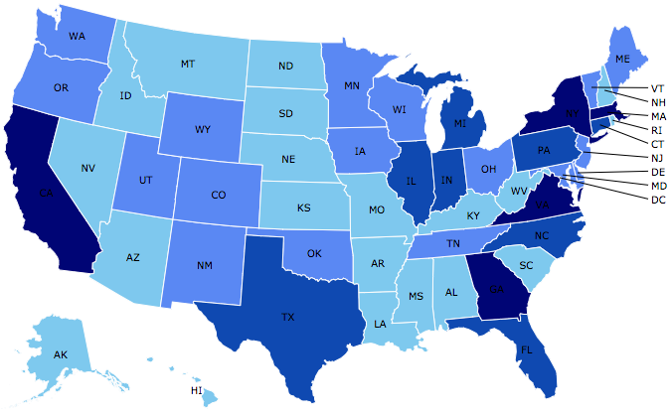
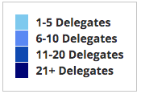
Where Are We?

Slide 5
Credits and Disclaimer
This slide deck was authored by:
Veronika Dolar, SUNY Old Westbury
Disclaimer
NEED presentations are designed to be nonpartisan.
It is, however, inevitable that the presenter will be asked for and will provide their own views.
Such views are those of the presenter and not necessarily those of the National Economic Education Delegation (NEED).

Slide 6
Outline
What is Health(care) Economics?
Taking the Pulse of the Health Economy
Health Care Systems and Institutions
Health Insurance and Reform
Pharmaceuticals – Big Pharma

Slide 7
What is Health(care) Economics?
Health Economics is a special field of (applied) microeconomics that focuses on the health care industry.
Examples of other subfields of microeconomics are labor economics, industrial organization, economics of education, public economics, and urban economics.
Notes:
Microeconomics (from Greek prefix micro- meaning "small" + "economics") is a branch of economics that studies the behavior of how the individual modern household and firms make decisions to allocate limited resources.
Macroeconomics (from Greek prefix macro- meaning “large" + "economics") is the study of economy-wide phenomena, including inflation, unemployment, and economic growth.
These two branches of economics are closely intertwined, yet distinct—they address different questions.
Microeconomics studies individual markets or sectors or industries (hence health care industry is classified under microeconomics) while macroeconomics studies national economies and country/state-wide, general equilibrium questions.
Many times people think that since micro means small and macro large, that microeconomics is somehow inferior or studies smaller issues than what is studied in macroeconomics. But it should be noted, that many firms today have revenues that are substantially larger than most national incomes on nations. Obviously, this is comparing apples to oranges – but at least it gives a general idea of the size of some of these firms and markets.
https://medium.com/@denislesak/companies-with-revenues-greater-than-gdp-of-countries-58c46af4a1a9
https://oxfamblogs.org/fp2p/of-the-worlds-top-100-economic-entities-29-are-states-71-are-corporates/
See the next slide to compare US health care.

Slide 8
Health Economics is part of Microeconomics
Although health economics is part of “micro-” economics, it is actually very big:
In 2019, U.S. national health expenditure was 17.8% of GDP, which is equivalent to around $3,427 billions.
For comparison, the entire GDP of Germany in 2019 was $3,845 billions (4th largest economy), GDP of UK was $2,827 billions (6th largest economy), and $2,715 billions in France (7th largest economy).
Notes:
Hopefully the comparison of the US health care industry to the entire economy of Germany, UK, and France will make students also appreciate how difficult any type of a reform is – when the sector being reformed is of this size and complexity.
The list of top 10 largest economies based on the total size of GDP: 1) US, 2) China, 3) Japan, 4) Germany, 5) India, 6) UK, 7) France, 8) Italy, 9) Brazil, 10) Canada

Slide 9
What is Health Economics?
Health economics studies health care resources markets and health insurance.
Healthcare is the biggest industry and the largest employer in the US.
Notes:
Here the big emphasis is on the distinction between other health care markets and health insurance – this difference it typically hard to grasp for most people.

Slide 10
What is a Market?
A market is a group of buyers and sellers of a particular product in the area or region under consideration. The area may be the earth, or countries, regions, states, or cities.
The concept of a market is any structure that allows buyers and sellers to exchange any type of goods, services and information.
Markets can be physical and non-physical.
There are many different types of markets and depending on the type a different rules should be set up for eliciting the best results for the society.

Slide 11
Markets studied in health economics
Markets for:
Physicians
Nurses
Hospital facilities
Nursing homes
Pharmaceuticals
Medical supplies (such as diagnostic and therapeutic equipment)
Health Insurance
Notes:
Many times people confuse Health Economics with Health Insurance. The topics discuss in health economics included health insurance, but also a number of other markets related to health care resources.
This is an important distinction – because it also relates to the Health Care reform. Health care reform in the US is mostly dealing with the reform of the Health Insurance, rather than other health care markets.
The debate about many of these issues has to do with the market structure – and the issue of when does a market work well – without a lot of government intervention (free markets) and when is it necessary for a government to play a much larger role.

Slide 12
Market Economies
In market economies, prices adjust to balance supply and demand.
These equilibrium prices are the signals that guide economic decisions and thereby allocate scarce resources.
The invisible hand works through the price system:
The interaction of buyers and sellers determines prices.
Each price reflects the good’s value to buyers and the cost of producing the good.
Prices guide self-interested households and firms to make decisions that, in many cases, maximize society’s economic well-being.

Slide 13
When does “free market does it better” hold?
Two very important assumptions need for this to hold are:
Perfectly Competitive Market
No Market Failure
What is a Perfectly Competitive Market?
Many (numerous) buyers – price takers
Many (numerous) sellers – price takers
Identical (homogeneous) product
Free entry and exit
Both buyers and sellers have perfect information about the price, utility, quality, and production methods of products.
What is Market Failure?
Market Failure is a situation in which the allocation of goods and services by a free market is not efficient, often it leads to a net social welfare loss.
Examples of Market Failure:
Externalities
Public Goods
Asymmetric Information

Slide 14
What types of markets are there?
More Competition
Less Competition
Perfect Competition
Monopolistic Competition
Monopoly
Oligopoly
Duopoly
Monopsony
Less Concentration
More Concentration

Slide 15
Hospital Monopolization
Market consolidation among and between health systems, hospitals, medical groups, and health insurers has surged over the last decade.
Over an 18-month period between July 2016 and January 2018, hospitals acquired 8,000 more medical practices, and 14,000 more physicians left independent practice to become hospital employees.

Slide 16
Hospital Monopolization: California
A large Northern California hospital system used its size and influence to achieve a "domination of the market”.
Sutter Health grew into a behemoth hospital system and then, like a classic monopoly, used its dominance in Northern California to raise hospital prices.
Sutter used its windfall from excessive pricing to acquire more entities and grew into a conglomerate of 24 hospitals, 12,000 doctors and several cancer, cardiac and other specialty centers.
In some counties, Sutter was the sole hospital for a thousand square miles.

Slide 17
Hospital Monopolization: Florida
Consolidation among health insurance companies drove a 12% rise in profits for health maintenance organization insurance plans, or HMOs, and South Florida hospitals reported 8% average profit margins, their highest in recent years, according to the Florida Health Market Review. (January 2020)
Hospital systems grew through new construction and acquisitions.
The Tennessee-based Hospital Corporation of America, or HCA, one of the nation’s largest for-profit systems, and AdventHealth, a nonprofit healthcare system, led the charge in Florida, acquiring hospitals from Community Health Systems, which was once the seventh-largest system in the state.

Slide 18
Hospital Monopolization: Florida
South Florida hospitals recorded combined profits of nearly $1.3 billion in 2018 and have posted combined profits above $1 billion for four of the past five years.
HCA hospitals were the most profitable, with a net income of $363.6 million.
Baptist Health, a nonprofit and the largest system in the Miami area, had a net income of $142.8 million and Memorial Healthcare System in Broward County, a nonprofit hospital network, had a net income of $158.6 million.

Slide 19
Hospital Monopolization
On average hospitals charge patients more than four times the cost of care.
The top 100 most expensive hospitals this ranges from 1,808 percent at the high end to 1,129 percent at the low end
Most of the top 100 hospitals are located in states in the west and south. Florida had the highest number, with 40 hospitals. Other top states included Texas with 14 hospitals, Alabama with eight, Nevada with seven, and California with six.

Slide 20
Health Care Markets are Different
Sponsor
Premiums
Insurer or
third-party payers
Premiums (individual policies)
Money (fixed or variable payments)
Taxes or Lower Wages
Claims
Insurance Coverage
Services
Consumers
Producers
Price
Health Care Providers (hospitals, physicians)
Patients
Out-of-pocket fees

Slide 21
Is there something special about Health Care Markets?
Market Structure
Type of products and services
Principal-Agent Problem
Asymmetric Information
Moral Hazard

Slide 22
Pulse of the Health Economy
Health economy involves activities related to population health:
Production and consumption of goods and services
Distribution of those goods to consumers
Performance indicators of medical care
Costs
Quality
Access

Slide 23
Tradeoffs
Tradeoffs take place among the three legs:
By increasing quality health care this leads to higher health care costs, which means that some individuals might not be able to afford it and the access may be more limited.
By increasing access, the costs and/or quality may suffer.
By decreasing costs, access and/or quality may suffer.

Slide 24
Costs

Slide 25
National Health Expenditure as Percent of GDP
Notes:
https://www.cms.gov/

Slide 26
National Healthcare Expenditure Per Capita
Notes:
https://www.cms.gov/

Slide 27
Amount of Medical Care Spending
Costs of health care are high and continually rising
U. S. spent 17.7% of GDP or $11,172 per person in 2018
Compared to 5.0% of GDP and $1,239 per person in 1960
Trade-offs may be involved
High health care costs implies lower amounts of other goods produced and consumed.

Slide 28
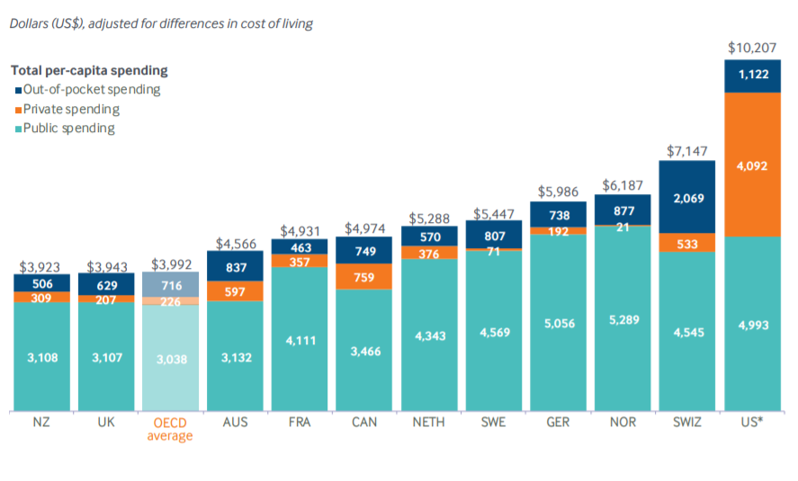
International Per Capita Healthcare Spending
Source: Roosa Tikkanen and Melinda K. Abrams, U.S. Health Care from a Global Perspective, 2019: Higher Spending, Worse Outcomes (Commonwealth Fund, Jan. 2020).
Notes:
Some good resources:
https://www.commonwealthfund.org/publications/issue-briefs/2020/jan/us-health-care-global-perspective-2019
A bit older report: https://www.commonwealthfund.org/publications/issue-briefs/2015/oct/us-health-care-global-perspective
https://www.healthsystemtracker.org/chart-collection/quality-u-s-healthcare-system-compare-countries/#item-overall-age-specific-potential-years-of-life-lost-per-100000-population-1990-2017
https://axenehp.com/international-healthcare-systems-us-versus-world/

Slide 29
International Comparison
Per capita health spending in the U.S. exceeded $10,000, more than two times higher than in Australia, France, Canada, New Zealand, and the U.K.
At $4,092 per capita, U.S. private spending is more than five times higher than Canada, the second highest spender.
In Sweden and Norway, private spending made up less than $100 per capita. As a share of total spending, private spending is much larger in the U.S. (40%) than in any other country (0.3%–15%).
Notes:
Note: in all those other OECD countries pretty much everyone is insured. In other words, in the US we pay twice as much as elsewhere, but there are still millions that are not insured.
Public spending on health care amounted to $4,197 per capita in the U.S. in 2013, more than in any other country except Norway ($4,981) and the Netherlands ($4,495), despite the fact that the U.S. was the only country studied that did not have a universal health care system.

Slide 30
Health Care Spending as % of GDP, 1980–2018
Source: Roosa Tikkanen and Melinda K. Abrams, U.S. Health Care from a Global Perspective, 2019: Higher Spending, Worse Outcomes (Commonwealth Fund, Jan. 2020).

Slide 31
International Comparison
In 1960, the U.S. was spending a higher percent of GDP on health care compared to other OECD countries, but was still part of the pack.
In 2018, the U.S. spent 16.9 percent of gross domestic product (GDP) on health care, nearly twice as much as the average OECD country.
The second-highest ranking country, Switzerland, spent 12.2 percent.
At the other end of the spectrum, New Zealand and Australia devote only 9.3 percent, approximately half as much as the U.S. does.
Notes:
The share of the economy spent on health care has been steadily increasing since the 1980s for all countries because health spending growth has outpaced economic growth, in part because of advances in medical technologies, rising prices in the health sector, and increased demand for services.

Slide 32
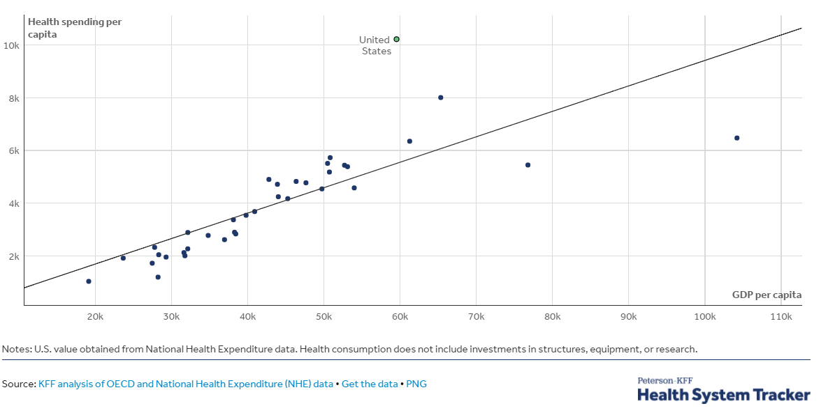
GDP per capita and health consumption spending per capita, 2017

Slide 33
Monopolization of Health Insurance Market
As of 2011, there were close to 100 insurers in Switzerland competing for consumer health care dollars, forcing firms to compete by setting prices to just cover costs.
In the United States, markets are state specific and consumers may choose from plans available in the state in which they reside.
In 2014, of the 50 states and the District of Columbia, 11 had only 1 or 2 insurers, 21 had 3 or 4, and only 19 states had 5 or more.
As of July 2019, the number of states with only 1 or 2 insurers had increased from 11 to 20, indicating a growing divide between ACA exchanges and competitive markets.
Notes:
6 Roy, Avik. “Why Switzerland Has the World’s Best Health Care System.” Forbes, April 29, 2011; https://www.forbes.com/sites/theapothecary/2011/04/29/why-switzerland-has-the-worlds-best-health-care-system/#2416d9a67d74.
7 Henry J. Kaiser Family Foundation. “Number of Issuers Participating in the Individual Health Insurance Marketplaces.” State Health Facts; https://www.kff.org/other/state-indicator/number-of-issuers-participating-in-the-individual-health-insurance-marketplace, accessed July 2019.

Slide 34
Thank you!
Any Questions?
www.NEEDelegation.org
Veronika Dolar
dolarv@oldwestbury.edu
Contact NEED: info@needelegation.org
Submit a testimonial: www.NEEDelegation.org/testimonials.php
Become a Friend of NEED: www.NEEDelegation.org/friend.php

Slide 35
Available NEED Topics Include:
Coronavirus Economics
US Economy
Climate Change
Economic Inequality
Economic Mobility
Trade and Globalization
Trade Wars
Immigration Economics
Housing Policy
Federal Budgets
Federal Debt
Black-White Wealth Gap
Autonomous Vehicles
US Social Policy

