Slide 1
Osher Lifelong Learning Institute, Winter 2023
Contemporary Economic Policy
University of Massachusetts, Boston
March-April, 2023
Host: Jon Haveman, Ph.D.
National Economic Education Delegation

Slide 2
Course Outline
Contemporary Economic Policy
Week 1 (3/13): US Economic Update (Geoffrey Woglom, Amherst College)
Week 2 (3/20): Monetary Economics (Geoffrey Woglom)
Week 3 (3/27): Trade and Globalization (Alan Deardorff, Univ. Michigan)
Week 4 (4/3): Trade Deficits and Exchange Rates (Alan Deardorff)
Week 5 (4/10): Healthcare Economics (Jon Haveman, NEED)
Week 6 (4/17): Climate Change Economics (Sarah Jacobson, Williams College)

Slide 3
Health(care) Economics
OLLI – University of Massachussets, Boston
April 10, 2023
Jon Haveman, Ph.D.
NEED

Slide 4
Credits and Disclaimer
This slide deck was authored by:
Veronika Dolar, SUNY Old Westbury
Jon Haveman, NEED
This slide deck was reviewed by:
Jonathan Gruber, MIT
Robert Hansen, Dartmouth College
Disclaimer
NEED presentations are designed to be nonpartisan.
It is, however, inevitable that the presenter will be asked for and will provide their own views.
Such views are those of the presenter and not necessarily those of the National Economic Education Delegation (NEED).

Slide 5
Outline
What is Health(care) Economics?
Health Insurance and Outcomes
Health Care Systems and Institutions

Slide 6
What is Health(care) Economics?
Economics has 2 primary fields: Micro and Macro
Health Economics is a field of MICROeconomics that focuses on the health care industry.
Examples of other subfields of microeconomics include:
labor economics, industrial organization, economics of education, public economics, and urban economics.
Notes:
Microeconomics (from Greek prefix micro- meaning "small" + "economics") is a branch of economics that studies the behavior of how the individual modern household and firms make decisions to allocate limited resources.
Macroeconomics (from Greek prefix macro- meaning “large" + "economics") is the study of economy-wide phenomena, including inflation, unemployment, and economic growth.
These two branches of economics are closely intertwined, yet distinct—they address different questions.
Microeconomics studies individual markets or sectors or industries (hence health care industry is classified under microeconomics) while macroeconomics studies national economies and country/state-wide, general equilibrium questions.
Many times people think that since micro means small and macro large, that microeconomics is somehow inferior or studies smaller issues than what is studied in macroeconomics. But it should be noted, that many firms today have revenues that are substantially larger than most national incomes on nations. Obviously, this is comparing apples to oranges – but at least it gives a general idea of the size of some of these firms and markets.
https://medium.com/@denislesak/companies-with-revenues-greater-than-gdp-of-countries-58c46af4a1a9
https://oxfamblogs.org/fp2p/of-the-worlds-top-100-economic-entities-29-are-states-71-are-corporates/
See the next slide to compare US health care.

Slide 7
Health Economics is part of Microeconomics
Although health economics is part of “micro-” economics, it is actually very big:
In 2019, U.S. national health expenditures were 17.7% of GDP, which is equivalent to around $3.8 trillion.
U.S. Healthcare is the 5th largest economy in the world.
For comparison, GDP in each country in 2019:
Germany: $3,845 trillion (4th largest economy)
UK: $2,827 trillion (6th largest economy)
France : $2,715 trillion (7th largest economy)
Notes:
Hopefully the comparison of the US health care industry to the entire economy of Germany, UK, and France will make students also appreciate how difficult any type of a reform is – when the sector being reformed is of this size and complexity.
The list of top 10 largest economies based on the total size of GDP: 1) US, 2) China, 3) Japan, 4) Germany, 5) India, 6) UK, 7) France, 8) Italy, 9) Brazil, 10) Canada

Slide 8
Markets Studied in Health Economics
Markets for:
Physicians
Nurses
Hospital facilities
Nursing homes
Pharmaceuticals
Medical supplies (such as diagnostic and therapeutic equipment)
Health Insurance
Notes:
Many times people confuse Health Economics with Health Insurance. The topics discuss in health economics included health insurance, but also a number of other markets related to health care resources.
This is an important distinction – because it also relates to the Health Care reform. Health care reform in the US is mostly dealing with the reform of the Health Insurance, rather than other health care markets.
The debate about many of these issues has to do with the market structure – and the issue of when does a market work well – without a lot of government intervention (free markets) and when is it necessary for a government to play a much larger role.

Slide 9
Why Are We Talking About the Market for Health Insurance?

Slide 10
The Three Legs of the Healthcare Stool
The market for Health Insurance is where they all come together.
Access
Quality
Cost
We will discuss metrics of performance for each leg.

Slide 11
Access

Slide 12
Health Insurance Coverage, 2019 - 92%
Percent of Persons
Source: National Center for Health Statistics

Slide 13
Physician Visits and Physician Supply
Source: Roosa Tikkanen and Melinda K. Abrams, U.S. Health Care from a Global Perspective, 2019: Higher Spending, Worse Outcomes (Commonwealth Fund, Jan. 2020).

Slide 14
Waited Less Than a Month to See A Specialist
But how much time did they spend
with the specialist?
How often was it necessary to see a specialist?
Source: 2011 Commonwealth Fund International Health Policy Survey of Sicker Adults in Eleven Countries.

Slide 15
Avoidable Deaths
Deaths per 100,000 population.
Heart disease, stroke, hypertension…
Source: Roosa Tikkanen and Melinda K. Abrams, U.S. Health Care from a Global Perspective, 2019: Higher Spending, Worse Outcomes (Commonwealth Fund, Jan. 2020).

Slide 16
Percent of Women Ages 18–64 Who Reported Having A Regular Doctor/Regular Place of Care
Source: Munira Z. Gunja et al., What Is the Status of Women’s Health and Health Care in the U.S. Compared to Ten Other Countries? (Commonwealth Fund, Dec. 2018).

Slide 17
Percent of Women Ages 18–64 Who Reported Going to the Emergency Room in the Past Two Years
Source: Munira Z. Gunja et al., What Is the Status of Women’s Health and Health Care in the U.S. Compared to Ten Other Countries? (Commonwealth Fund, Dec. 2018).

Slide 18
Access Notes
Insurance coverage in the U.S. is not universal.
Supply of medical personnel and equipment may be lower than elsewhere.
Avoidable (amenable) deaths are higher, perhaps indicating less access to care.
Emergency room use is higher in the U.S. than elsewhere.
Specialized medicine is more accessible.

Slide 19
Quality

Slide 20
Life Expectancy: How Does the US Compare?
Everybody else
United States
Germany – US = 2.5 years
Source: Roosa Tikkanen and Melinda K. Abrams, U.S. Health Care from a Global Perspective, 2019: Higher Spending, Worse Outcomes (Commonwealth Fund, Jan. 2020).

Slide 21
Life Expectancy at Birth by Race, 2017
Race/Ethnicity | Life Expectancy (Years)
All Races | 78.6
White | 78.8
Black | 75.3
Hispanic | 81.8
Notes:
CDC

Slide 22
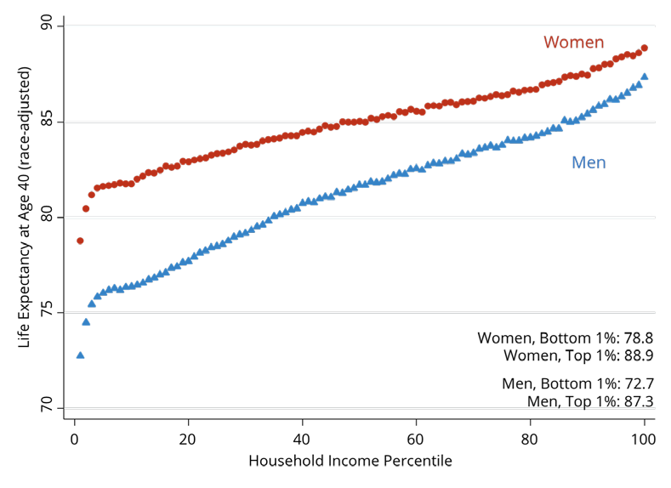
Income Also Matters – Reflecting Access?
Men:
15-year difference
Top to bottom
Source: https://healthinequality.org/documents/paper/healthineq_summary.pdf

Slide 23
Infant Mortality International Comparison
Deaths per 1,000 live births
Source: NEED from OECD Data

Slide 24
Infant Mortality by Race/Ethnicity
2016
Black
Deaths per 1,000 live births
White
Source: NEED from CDC.gov

Slide 25
Maternal Mortality Rate
Maternal deaths per 100,000 live births.
Source: Munira Z. Gunja et al., What Is the Status of Women’s Health and Health Care in the U.S. Compared to Ten Other Countries? (Commonwealth Fund, Dec. 2018).

Slide 26
Maternal Mortality Rate by Race
American Indian/Alaska Native and Black women are 2 to 3 times as likely to die from a pregnancy-related cause than white women.

Slide 27
Percent of adults who have experienced medical, medication, or lab errors or delays
Source: 2016 Commonwealth Fund International Health Policy Survey.

Slide 28
Prevention and Screening
The U.S. excels in some prevention measures:
including flu vaccinations and breast cancer screenings.
The U.S. has:
The highest average five-year survival rate for breast cancer,
but the Lowest for cervical cancer.

Slide 29
Flu Immunization
Source: Roosa Tikkanen and Melinda K. Abrams, U.S. Health Care from a Global Perspective, 2019: Higher Spending, Worse Outcomes (Commonwealth Fund, Jan. 2020).

Slide 30
Breast Cancer Screening
Percent of females ages 50–69 screened (%).
Source: Roosa Tikkanen and Melinda K. Abrams, U.S. Health Care from a Global Perspective, 2019: Higher Spending, Worse Outcomes (Commonwealth Fund, Jan. 2020).

Slide 31
Obesity Rate, 2017
Percent (%)
Source: Roosa Tikkanen and Melinda K. Abrams, U.S. Health Care from a Global Perspective, 2019: Higher Spending, Worse Outcomes (Commonwealth Fund, Jan. 2020).

Slide 32
Adults with Multiple Chronic Conditions, 2016
Source: Roosa Tikkanen and Melinda K. Abrams, U.S. Health Care from a Global Perspective, 2019: Higher Spending, Worse Outcomes (Commonwealth Fund, Jan. 2020).

Slide 33
The World Health Report 2000, Health Systems: Improving Performance
 | Overall Ranking
1. | France
2. | Italy
3. | San Marino
4. | Andorra
5. | Malta
6. | Singapore
7. | Spain
8. | Oman
9. | Austria
10. | Japan
 | Overall Ranking
30. | Canada
31. | Finland
32. | Australia
33. | Chile
34. | Denmark
35. | Dominica
36. | Costa Rica
37. | United States
38. | Slovenia
39. | Cuba

Slide 34
Perception of Quality of Medical Care
Source: Munira Z. Gunja et al., What Is the Status of Women’s Health and Health Care in the U.S. Compared to Ten Other Countries? (Commonwealth Fund, Dec. 2018).

Slide 35
Quality of Care Notes
Metrics of quality in the U.S. are not very good.
Quality of care is not considered very good in the U.S.
The system has challenges: obesity/lifestyle.
The system has bright spots!

Slide 36
A Bit About Quality
The U.S. has the highest chronic disease burden.
and an obesity rate that is two times higher than the OECD average.
Americans had fewer physician visits than peers in most countries.
which may be related to a low supply of physicians in the U.S.
The U.S. has among the highest # of hospitalizations from preventable causes.
and the highest rate of avoidable deaths.
Americans use some expensive technologies more often than our peers.
MRIs, and specialized procedures, such as hip replacements.
The U.S. outperforms its peers in terms of preventive measures.
One of the highest rates of breast cancer screening among women ages 50 to 69.
Second-highest rate (after the U.K.) of flu vaccinations among people age 65 and older.

Slide 37
Costs

Slide 38
National Health Expenditure as Percent of GDP
Total Expenditures in 2019: $3.8 Trillion
17.9
17.7, 2019
13.4
5.0
Healthcare spending: increased 60x between 1929 and 2019.
US Economy: increased just 12x
Notes:
https://www.cms.gov/

Slide 39
Health Care Spending as % of GDP, 1980–2018
United States
Everybody else
Source: Roosa Tikkanen and Melinda K. Abrams, U.S. Health Care from a Global Perspective, 2019: Higher Spending, Worse Outcomes (Commonwealth Fund, Jan. 2020).

Slide 40
Why is Healthcare Spending Increasing?
Costs in the United States, and elsewhere are increasing rapidly.
The share of economic spending on health care has been steadily increasing for all countries because:
Health spending growth has outpaced economic growth.
Richer countries demand more services, like attention to health.
Also because of
Advances in medical technologies.
Increased demand for services.
Rising prices in the health sector – why?

Slide 41
GDP per Capita and Health Spending per Capita, 2017

Slide 42
National Healthcare Expenditure Per Capita
11,172
1,239
Notes:
https://www.cms.gov/

Slide 43
International Per Capita Healthcare Spending
Source: Roosa Tikkanen and Melinda K. Abrams, U.S. Health Care from a Global Perspective, 2019: Higher Spending, Worse Outcomes (Commonwealth Fund, Jan. 2020).
Notes:
Some good resources:
https://www.commonwealthfund.org/publications/issue-briefs/2020/jan/us-health-care-global-perspective-2019
A bit older report: https://www.commonwealthfund.org/publications/issue-briefs/2015/oct/us-health-care-global-perspective
https://www.healthsystemtracker.org/chart-collection/quality-u-s-healthcare-system-compare-countries/#item-overall-age-specific-potential-years-of-life-lost-per-100000-population-1990-2017
https://axenehp.com/international-healthcare-systems-us-versus-world/

Slide 44
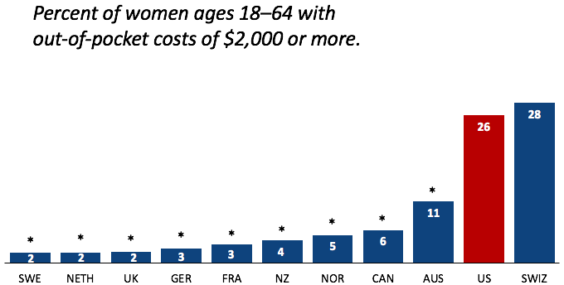
Out-of-Pocket Costs
Source: Munira Z. Gunja et al., What Is the Status of Women’s Health and Health Care in the U.S. Compared to Ten Other Countries? (Commonwealth Fund, Dec. 2018).

Slide 45
Why Are Costs so High in the US?
One Reason:
The United States is the only
profit-motivated healthcare system in the world.

Slide 46
Markets Matter for Costs

Slide 47
Are Health Care Markets Special?
Market Structure
Types of products and services
Principal-Agent Problem
Asymmetric Information
Moral Hazard
Moral Imperative (?)

Slide 48
Health Care Markets are Different
Sponsor
Premiums
Insurer or
third-party payers
Premiums (individual policies)
Money (fixed or variable payments)
Taxes or Lower Wages
Claims
Insurance Coverage
Services
Consumers
Producers
Price
Health Care Providers (hospitals, physicians)
Patients
Out-of-pocket fees

Slide 49
Policy Matters for Costs

Slide 50
Hospital Monopolization
Market consolidation among and between health systems, hospitals, medical groups, and health insurers has surged over the last decade.
Over an 18-month period between July 2016 and January 2018:
Hospitals acquired 8,000 more medical practices.
14,000 more physicians left independent practice to become hospital employees.

Slide 51
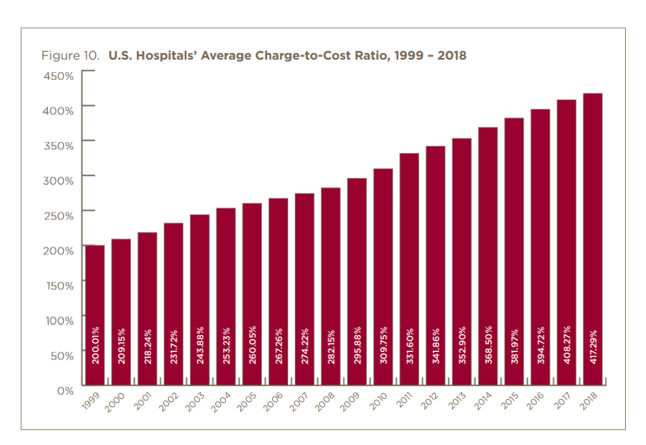

Slide 52
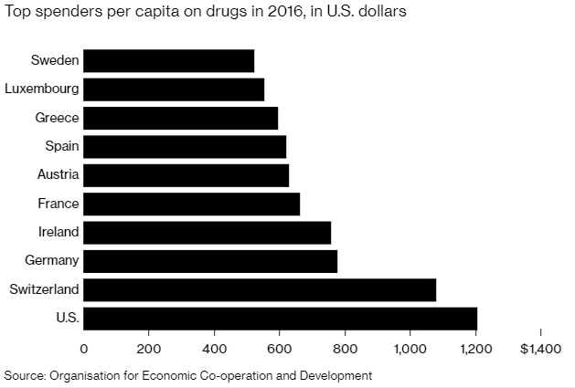
Spending on Pharmaceuticals
Notes:
https://www.bloomberg.com/quicktake/drug-prices
https://en.wikipedia.org/wiki/Prescription_drug_prices_in_the_United_States
https://www.ft.com/content/e92dbf94-d9a2-11e9-8f9b-77216ebe1f17

Slide 53
Drug Prices: Trends Over Time

Slide 54
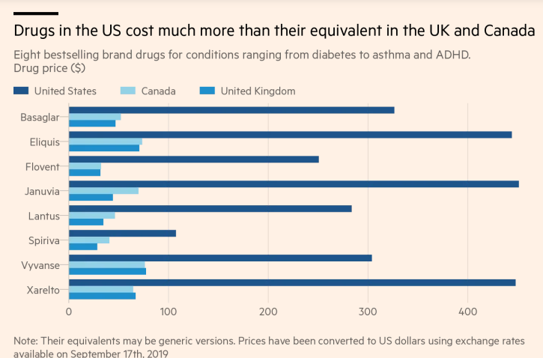

Slide 55
Drug Price Comparisons
Drug Prices for 30 Most Commonly Prescribed Brand-Name and Generic Drugs, 2006–07 US is set at 1.00
 | AUS | CAN | FR | GER | NETH | NZ | SWITZ | UK | US
Brand-name drugs | 0.40 | 0.64 | 0.32 | 0.43 | 0.39 | 0.33 | 0.51 | 0.46 | 1.00
Generic drugs | 2.57 | 1.78 | 2.85 | 3.99 | 1.96 | 0.90 | 3.11 | 1.75 | 1.00
US Higher
US Lower
Source: IMS Health; analysis by Gerard Anderson, Johns Hopkins University.

Slide 56
Medicare Modernization Act
Prescription Drug Component
Medicare Part D, by law, cannot negotiate drug prices like other governments do.
In 2017, Medicare spent nearly $8 billion on insulin.
The researchers said that if Medicare were allowed to negotiate drug prices like the U.S. Department of Veterans Affairs (VA) can, Medicare could save about $4.4 billion just on insulin.

Slide 57
Concentration in Pharmaceutical Companies
The number of mergers and acquisitions involving one of the top 25 firms more than doubled:
29 in 2006 to 61 in 2015
Between 1995 and 2015, 60 drug companies merged into 10.

Slide 58
Monopolization of Health Insurance Markets
As of 2011, there were close to 100 insurers in Switzerland competing for consumer health care dollars, forcing firms to compete by setting prices to just cover costs.
In the United States, markets are state specific and consumers may choose from plans available in the state in which they reside.
In 2014, of the 50 states and the District of Columbia:
11 had only 1 or 2 insurers
21 had 3 or 4, and
only 19 states had 5 or more. (CA had 11)
As of July 2019, the number of states with only 1 or 2 insurers had increased from 11 to 20.
Notes:
6 Roy, Avik. “Why Switzerland Has the World’s Best Health Care System.” Forbes, April 29, 2011; https://www.forbes.com/sites/theapothecary/2011/04/29/why-switzerland-has-the-worlds-best-health-care-system/#2416d9a67d74.
7 Henry J. Kaiser Family Foundation. “Number of Issuers Participating in the Individual Health Insurance Marketplaces.” State Health Facts; https://www.kff.org/other/state-indicator/number-of-issuers-participating-in-the-individual-health-insurance-marketplace, accessed July 2019.

Slide 59
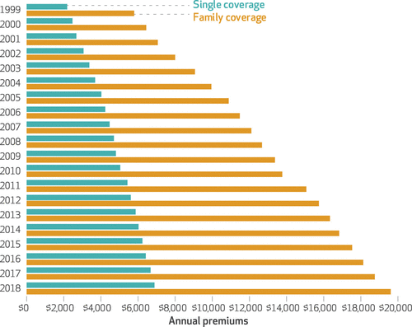
Average Annual Insurance Premiums, 1999-2018
Employer provided, Not Adjusted for Inflation
Single: ~$2,000 to ~$7,000
Family: ~$5,900 to ~$19,500
 | Average Annual Rate of Change
Inflation | 2.19
Health Care CPI | 3.68
Single coverage | 6.51
Family coverage | 6.52
Source: The Commonwealth Fund

Slide 60
Reason for Higher Health Insurance Rates
Rising prices in the health sector
Advances in medical technologies
Increased demand for services
Concentration of insurance companies

Slide 61
Health Care Systems and Institutions

Slide 62
Definition: Universal Coverage
Universal coverage – refers to health care systems in which all individuals have insurance coverage.
Generally, this coverage includes:
Access to all needed services and benefits.
Protects individuals from excessive financial hardships.
Medical indebtedness is the #1 cause of bankruptcies in the United States.
Canada has universal coverage, the United States does not.
Notes:
https://ajph.aphapublications.org/doi/abs/10.2105/AJPH.2018.304901?journalCode=ajph

Slide 63
Definition: Single-Payer
Single-payer - refers to financing a health care system by making one entity solely and exclusively responsible for paying for medical goods and services.
Not necessarily the government.
It is only the financing component that is socialized.
The money for the payment can be either collected by:
Taxes collected by the government.
Premiums collected by National or Public Health Insurance.
Single-payer systems: 17 countries
Norway, Japan, United Kingdom, Kuwait, Sweden, Bahrain, Brunei, Canada, United Arab Emirates, Denmark, Finland, Slovenia, Italy, Portugal, Cyprus, Spain, and Iceland.

Slide 64
Definition: Socialized Medicine
Socialized medicine – this model takes the single-payer system one step further.
Government not only pays for health care but operates the hospitals and employs the medical staff.
This has NEVER been a part of the debate in the United States.

Slide 65
Definition: Third-Party Payer
A third-party payer is an entity that pays medical claims on behalf of the insured. Examples of third-party payers include government agencies, insurance companies, health maintenance organizations (HMOs), and employers.
Employer-sponsored health plans
Individual market health plans
National health insurance

Slide 66
Health System Classification
Developed countries of the world have each taken a different approach for their health care delivery systems.
5 basic models:
Bismarck (France, Germany, Japan, Switzerland)
Beveridge – socialized medicine (United Kingdom, Spain, New Zealand)
National health insurance (Canada)
Out of pocket model – self insurance
Mixed (United States)

Slide 67
Model 1: Bismarck
In this model, health insurance is paid for through PREMIUMS.
Everybody must have insurance, only poor don’t have to pay premiums.
Premiums are paid into the “gov’t sickness fund” or directly to private insurers.
All insurers are private, but can’t make money off the sickness fund.
Pros:
Everybody is covered and can avoid expensive healthcare bills.
Administrative costs are much lower than in the U.S.
Little waiting time to receive basic services.
Cons:
Focus on low costs can mean fewer services are available in rural areas.
Mandatory premiums are high.
Longer waiting times for elective services.
https://www.ahaap.org/bismarck-model

Slide 68
Model 2: Beveridge
In this model, health insurance is paid for through TAXATION.
Everybody has insurance, universal coverage. Everybody receives care at no cost.
All insurers are public.
Supplemental insurance is available in the private market.
Pros:
Universal coverage.
Government controls quality of care, so cost of care may be low.
No medical bills or co-pays.
Cons:
Taxes are high, regardless of use of healthcare.
Government controls quality of care, so service availability might be low.
Longer waiting times for non-emergency care.
Potential for excessive use of the system.
https://www.ahaap.org/beveridge-model

Slide 69
Model 3: National Health Insurance
This model has elements of both Beveridge and Bismarck.
Like Beveridge: government is the single payer and paid for through taxes.
Like Bismarck: All health-care insurers are in the private sector.
Pros:
Lowers the cost of healthcare for the economy – bargaining power.
Low administrative costs for care.
No incentive to deny claims.
Healthier workforce.
Cons:
Everybody pays regardless of health care received.
May stop people from being careful about their health.
Limits payouts to doctors.
May affect technology adoption.
https://www.ahaap.org/national-health-insurance-model

Slide 70
US Health Care System
Medicare – National Health Insurance
Military Veteran Care – Beveridge model (socialized medicine)
Employer-sponsored insurance – Bismarck model
Individual market health plans – Bismarck model
Uninsured – Out of pocket model

Slide 71
Tradeoffs
Tradeoffs take place among the three legs:
Increasing quality in health care may lead to higher health care costs.
This means a compromise in access (affordability).
I.e., with increasing quality, access may suffer.
By increasing access, quality may suffer.
By decreasing costs, quality may suffer.

Slide 72
Summary
US HealthCare system is not preforming well.
Very expensive with low quality and access.
One of the main reasons for very high costs is the monopolization of healthcare markets.
Hospitals, health insurance, big pharma, physicians, etc.
A few simple solutions could drastically reduce costs:
Enforcement of antitrust laws in this sector.
Introduction of a public option in the health insurance market.
Ability for the US government to negotiate drug prices like most every other nation.
Universal health insurance would increase access and perhaps also reduce costs.
But there are always tradeoffs: you can pick two, but the third may suffer.

Slide 73
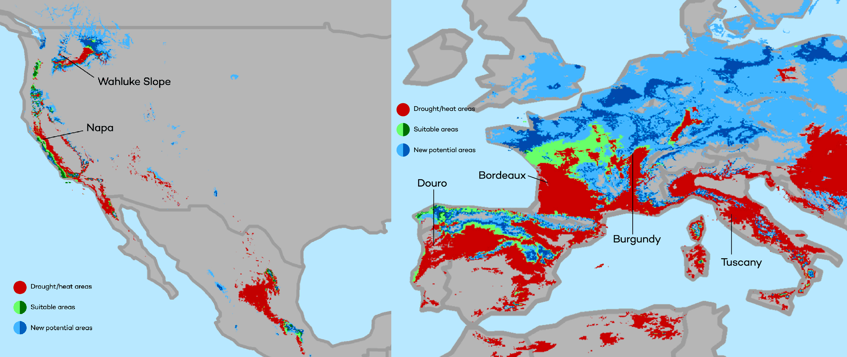
Climate Change: Sarah Jacobson
The changing map of the world’s wine-growing regions.

Slide 74
Thank you!
Any Questions?
www.NEEDelegation.org
Jon D. Haveman, Ph.D.
Jon@NEEDelegation.org
Contact NEED: info@needelegation.org
Submit a testimonial: www.NEEDelegation.org/testimonials.php
Become a Friend of NEED: www.NEEDelegation.org/friend.php

Slide 75
What is Health Economics?
Health economics studies health care resource markets and health insurance.
Healthcare is the biggest industry and the largest employer in the US.
Notes:
Here the big emphasis is on the distinction between other health care markets and health insurance – this difference it typically hard to grasp for most people.

Slide 76
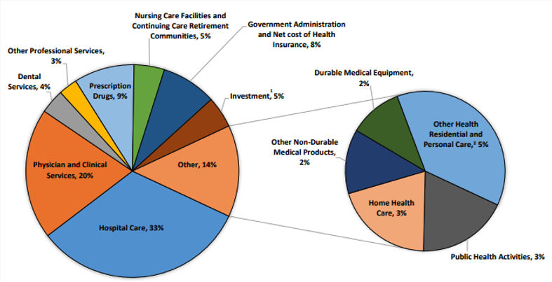
Where the money goes?
Source: Centers for Medicare & Medicaid Services, Office of the Actuary, National Health Statistics Group.

Slide 77
What is a Market?
A market is a group of buyers and sellers of a particular product in the area or region under consideration. The area may be the earth, or countries, regions, states, or cities.
The concept of a market is any structure that allows buyers and sellers to exchange any type of goods, services, and information.
Markets can be physical and non-physical.
There are many different types of markets and depending on the type, different rules should be set up to achieve the best results for society.

Slide 78
Acute Care Hospital Beds per 1,000 Population
Source: OECD Health Data 2015.

Slide 79
Income Also Matters – Reflecting Access?
Source: https://healthinequality.org/documents/paper/healthineq_summary.pdf

Slide 80
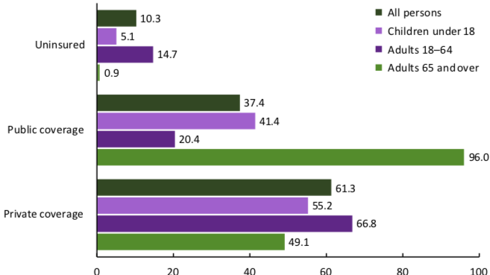
Health Insurance Coverage, 2019
Percent of Persons
Source: National Center for Health Statistics

Slide 81
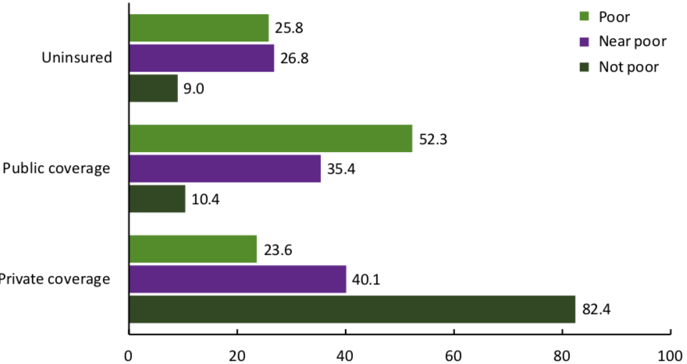
Health Insurance Coverage, 2019
Percent of Persons
Source: National Center for Health Statistics

Slide 82
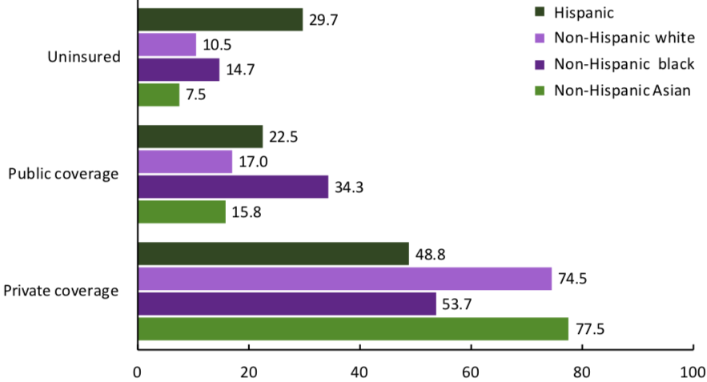
Health Insurance Coverage, 2019
Percent of Persons
Source: National Center for Health Statistics

Slide 83
Hospital Acute Care Average Length of Stay
Average length of stay for acute care (days)

Slide 84
Suicides, 2016
Deaths per 100,000 population
OECD average: 11.5
Source: Roosa Tikkanen and Melinda K. Abrams, U.S. Health Care from a Global Perspective, 2019: Higher Spending, Worse Outcomes (Commonwealth Fund, Jan. 2020).

Slide 85
What types of markets are there?
More Competition
Less Competition
Perfect Competition
Monopolistic Competition
Monopoly
Oligopoly
Duopoly
Monopsony
Less Concentration
More Concentration

Slide 86
Spending on Deductibles

Slide 87
Hospital Monopolization Across the Nation
Most of the top 100 most expensive hospitals are located in states in the west and south.
Florida had the highest number, with 40 hospitals.
Other top states included Texas with 14 hospitals, Alabama with eight, Nevada with seven, and California with six.
Hospitals Charge Patients More Than Four Times the Cost of Care
The most expensive hospitals cost of care range from 1,808 % at the high end to 1,129 % at the low end.

Slide 88
Big Pharma

Slide 89
Price Hikes
Turing Pharmaceuticals’ 5,555% price increase of Daraprim in 2015 and Mylan’s 500% increase of EpiPen prices…
More than 3,400 drugs boosted their prices in the first six months of 2019, an increase of 17% in the number of drug hikes from a year earlier.
The average price hike is 10.5%, or 5 times the rate of inflation.
About 41 drugs boosted their prices by more than 100% in 2019.
Over 10 years, the net cost of prescription drugs in the United States rose more than THREE TIMES FASTER than the rate of inflation.

Slide 90
Reasons for higher drug prices
The Medicare Prescription Drug, Improvement, and Modernization Act, also called the Medicare Modernization Act or MMA, is a federal law of the United States, enacted in 2003.
Prohibits government negotiation of lower prices.
Growing concentration of pharmaceutical companies.

Slide 91
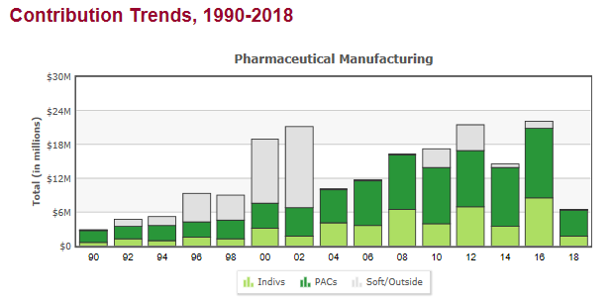
Lobbying
Medicare Prescription Drug Costs

Slide 93
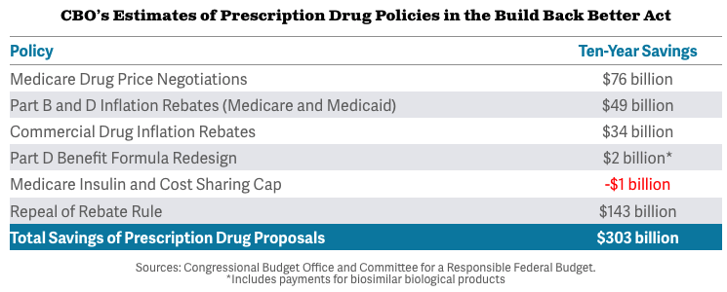
Prescription Drug Savings in Build Back Better

