Slide 1
Osher Lifelong Learning Institute, Spring 2025
Contemporary Economic Policy
University of Pittsburgh
Host: Jon Haveman, Ph.D.
Executive Director, National Economic Education Delegation

Slide 2
Available NEED Topics Include:
US Economy
Healthcare Economics
Climate Change
Economic Inequality
Economic Mobility
Trade and Globalization
Minimum Wages
Immigration Economics
Housing Policy
Federal Budgets
Federal Debt
Black-White Wealth Gap
Autonomous Vehicles
US Social Policy

Slide 3
Course Outline
Contemporary Economic Policy
  Week 1 (5/15): Economic Update (Geoffrey Woglom, Amherst College)
  Week 2 (5/22): Economics of Immigration (Jon Haveman, Exec Director, NEED)
  Week 3 (5/29): Health Economics (Jon Haveman)
  Week 4 (6/5): Federal Debt and Deficits (Brian Peterson, Lagrange College)
  Week 5 (6/12): Trade and Tariffs (Tibor Besedes, Georgia Institute of Technology)

Slide 4
Submitting Questions
Please submit questions in the chat.
  I will try to handle them as they come up.
We will do a verbal Q&A once the material has been presented.
Slides will be available from the NEED website after the talk. (https://www.needecon.org/delivered_presentations.php).

Slide 5


The Economics of Healthcare
Jon Haveman, Ph.D.
NEED

Slide 6
Credits and Disclaimer
This slide deck was authored by:
  Veronika Dolar, SUNY Old Westbury
  Jon Haveman, NEED
This slide deck was reviewed by:
  Jonathan Gruber, MIT
  Robert Hansen, Dartmouth College
Disclaimer
  NEED presentations are designed to be nonpartisan.
  It is, however, inevitable that presenters will be asked for and will provide their own views.
  Such views are those of the presenters and not necessarily those of the National Economic Education Delegation (NEED).

Slide 7
Outline
What is Health(care) Economics?
Health Insurance and Outcomes
Health Care Systems and Institutions

Slide 8
Health Economics is Big Business
The United States spends A LOT on healthcare:
  In 2023, U.S. national health expenditures were 17.6% of GDP, which is equivalent to around $4.9 trillion.
  U.S. Healthcare is the 3rd largest economy in the world.
For comparison, GDP in each country in 2023:
  China: $17.5 trillion (2nd largest economy)
  US Healthcare $4.9 trillion
  Germany: $4.5 trillion (3rd largest economy)
  Japan: $4.2 trillion (4th largest economy)
Notes:
Hopefully the comparison of the US health care industry to the entire economy of Germany, UK, and France will make students also appreciate how difficult any type of a reform is – when the sector being reformed is of this size and complexity.
https://databankfiles.worldbank.org/public/ddpext_download/GDP.pdf

Slide 9
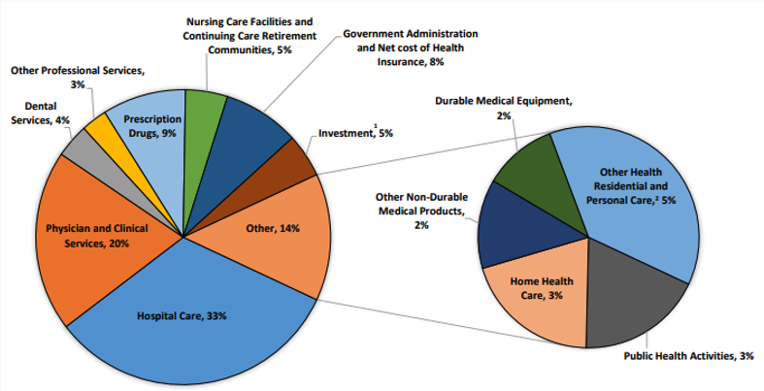
Where Does the Money Go?
Source: Centers for Medicare & Medicaid Services, Office of the Actuary, National Health Statistics Group.

Slide 10
Markets Studied in Health Economics
Markets for:
  Physicians
  Nurses
  Hospital facilities
  Nursing homes
  Pharmaceuticals
  Medical supplies
    such as diagnostic and therapeutic equipment
  Health Insurance
Notes:
Many times people confuse Health Economics with Health Insurance. The topics discuss in health economics included health insurance, but also a number of other markets related to health care resources.
This is an important distinction – because it also relates to the Health Care reform. Health care reform in the US is mostly dealing with the reform of the Health Insurance, rather than other health care markets.
The debate about many of these issues has to do with the market structure – and the issue of when does a market work well – without a lot of government intervention (free markets) and when is it necessary for a government to play a much larger role.

Slide 11

The Three Legs of the Healthcare Stool
QUALITY
ACCESS
COSTS

Slide 12
Access

Slide 13
Health Insurance Coverage, 2022 – 92.1%
Countries with Less Than Universal Coverage
Countries with Universal Coverage
Country | % of Persons
Slovakia | 94.5
Chile | 94.3
UNITED STATES | 92.1
Poland | 91.5
Mexico | 90.2
Algeria | 90.9
Jordan | 55.0
Countries | % of Persons
Australia | 100
Canada | 100
Czech Republic | 100
Slovenia | 100
United Kingdom | 100
Greece | 100
Hungary | 100
And 21 more | 99+
Source: Organization for Economic Cooperation and Development

Slide 14
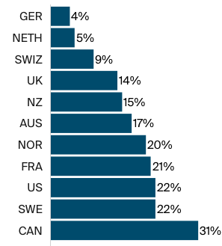
But What About Wait Times?
Percentage of adults aged 65+
Who waited more than 6 days
For an appointment when sick.
Source: Commonwealth Fund, Comparing Nations on Timeliness and Coordination of Health Care, 2021

Slide 15
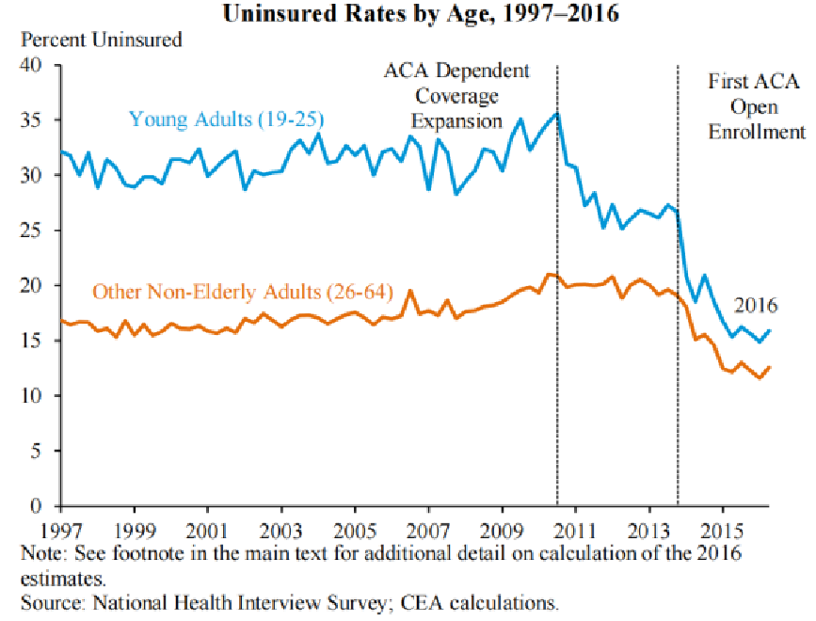
Uninsured Rate dropped dramatically with the ACA; Drop was more significant for young adults
Notes:
Source: National Health Interview Survey; CEA calculations

Slide 16
Physician Visits and Physician Supply
Source: Roosa Tikkanen and Melinda K. Abrams, U.S. Health Care from a Global Perspective, 2019: Higher Spending, Worse Outcomes (Commonwealth Fund, Jan. 2020).

Slide 17
Percent of Women Ages 18–64 Who Reported
Having A Regular Doctor/Regular Place of Care
Source: Munira Z. Gunja et al., What Is the Status of Women’s Health and Health Care in the U.S. Compared to Ten Other Countries? (Commonwealth Fund, Dec. 2018).

Slide 18
Waited Less Than a Month to See A Specialist
But how much time did they spend
with the specialist?
How often was it necessary to see a specialist?
Percent of Women Ages 18-64
Source: 2011 Commonwealth Fund International Health Policy Survey of Sicker Adults in Eleven Countries.

Slide 19
Percent of Women Ages 18–64 Who Reported Going to the Emergency Room in the Past Two Years
Source: Munira Z. Gunja et al., What Is the Status of Women’s Health and Health Care in the U.S. Compared to Ten Other Countries? (Commonwealth Fund, Dec. 2018).

Slide 20
Avoidable Deaths
Deaths per 100,000 population.
Heart disease, stroke, hypertension…
Source: Roosa Tikkanen and Melinda K. Abrams, U.S. Health Care from a Global Perspective, 2019: Higher Spending, Worse Outcomes (Commonwealth Fund, Jan. 2020).

Slide 21
Access Notes
Insurance coverage in the U.S. is not universal.
  It is universal in every other developed country.
Wait times are not necessarily lower in the U.S.
Supply of medical personnel and equipment may be lower than elsewhere.
Avoidable (amenable) deaths are higher, perhaps indicating less access to care.
Emergency room use is higher in the U.S. than elsewhere.
Specialized medicine is more accessible – but also more often used.

Slide 22
Quality

Slide 23
Life Expectancy: How Does the US Compare?
Everybody else
United States
Switzerland – US = 5 years
Source: Roosa Tikkanen and Melinda K. Abrams, U.S. Health Care from a Global Perspective, 2019: Higher Spending, Worse Outcomes (Commonwealth Fund, Jan. 2020).

Slide 24
Life Expectancy & Per Capita GDP

Slide 25
Life Expectancy at Birth by Race/Ethnicity, 2019
Race/Ethnicity | Life Expectancy (Years)
All Races | 78.8
White | 78.8
Black | 74.8
Hispanic | 81.9
Asian | 85.6
Source: KFF, Key Data on Health and Health Care by Race and Ethnicity
Notes:
CDC

Slide 26
Income Also Matters – Reflecting Access?
Sex | Income Category | Life Expectancy (Years) | Difference High vs Low
Women | Highest Incomes (top 1%) | 88.9 | 10.1 years
 | Lowest Incomes (bottom 1%) | 78.8
Men | Highest Incomes (top 1%) | 87.3 | 14.6 years
 | Lowest Incomes (bottom 1%) | 72.7
Sex | Income Category | Life Expectancy (Years) | Difference High vs Low
Women | Highest Incomes (top 1%) | 88.9 | 10.1 years
 | Lowest Incomes (bottom 1%) | 78.8
Men | Highest Incomes (top 1%) | 87.3 | 14.6 years
 | Lowest Incomes (bottom 1%) | 72.7
Source: https://healthinequality.org/documents/paper/healthineq_summary.pdf

Slide 27
Infant Mortality International Comparison
Deaths per 1,000 live births
Source: NEED from OECD Data

Slide 28
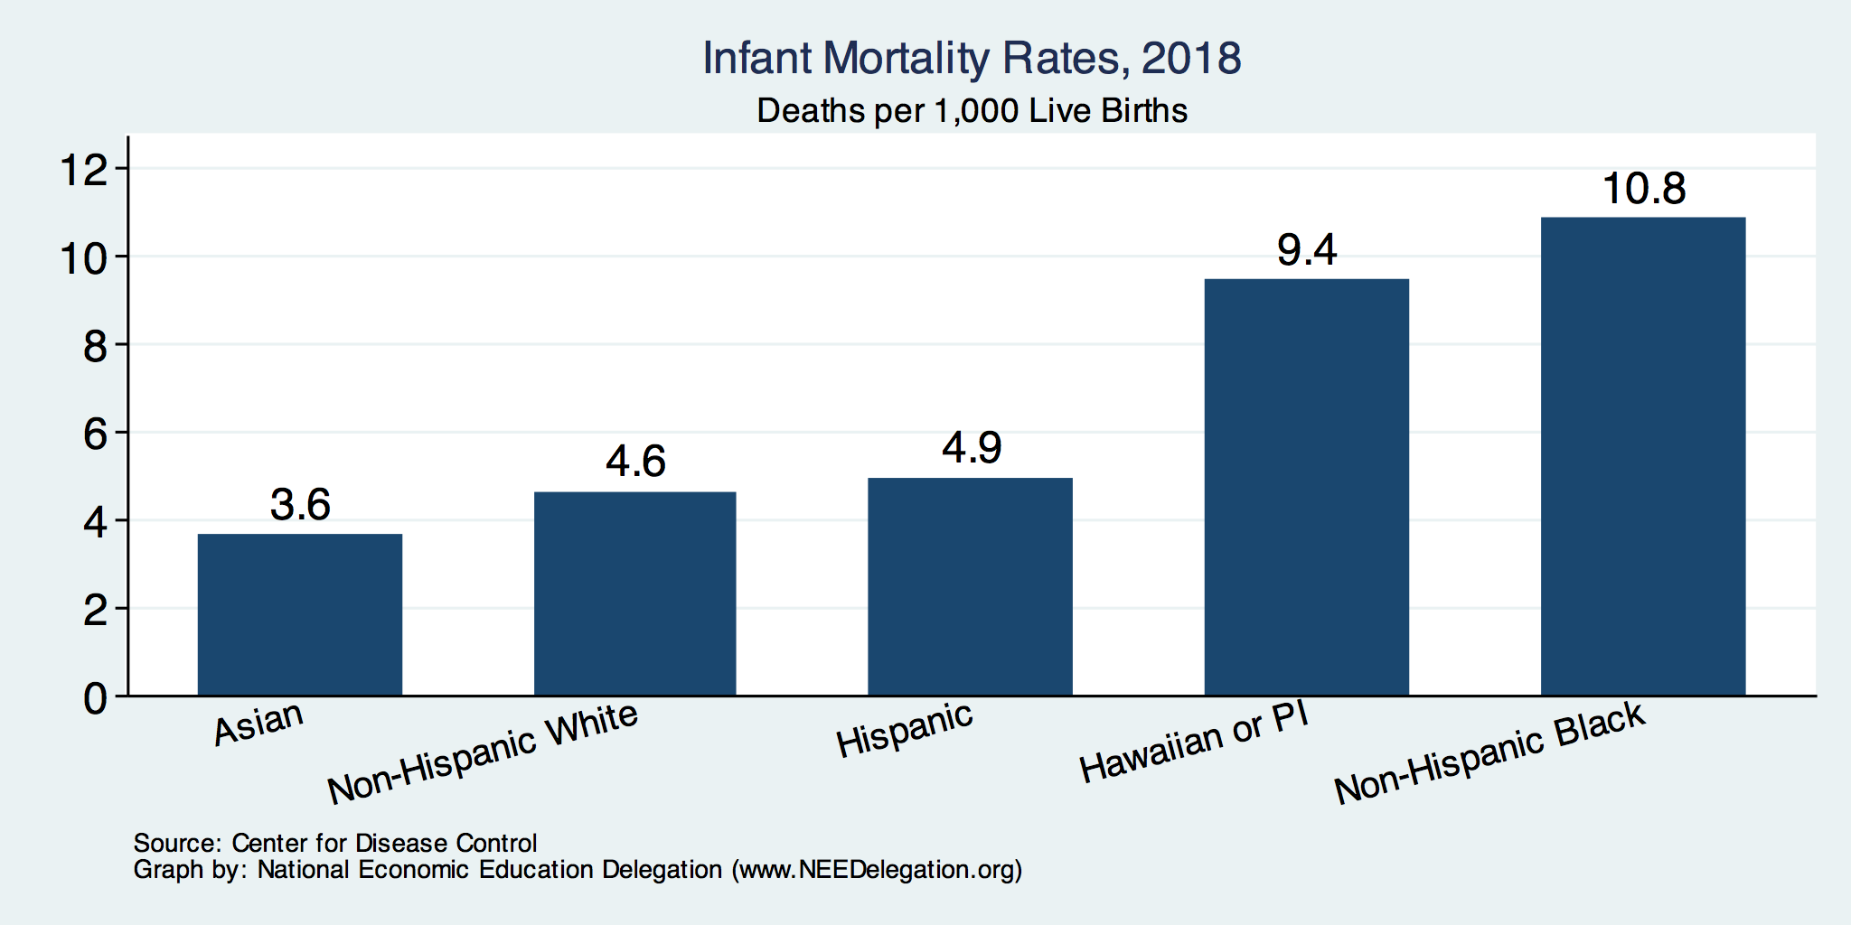
Infant Mortality by Race/Ethnicity

Slide 29
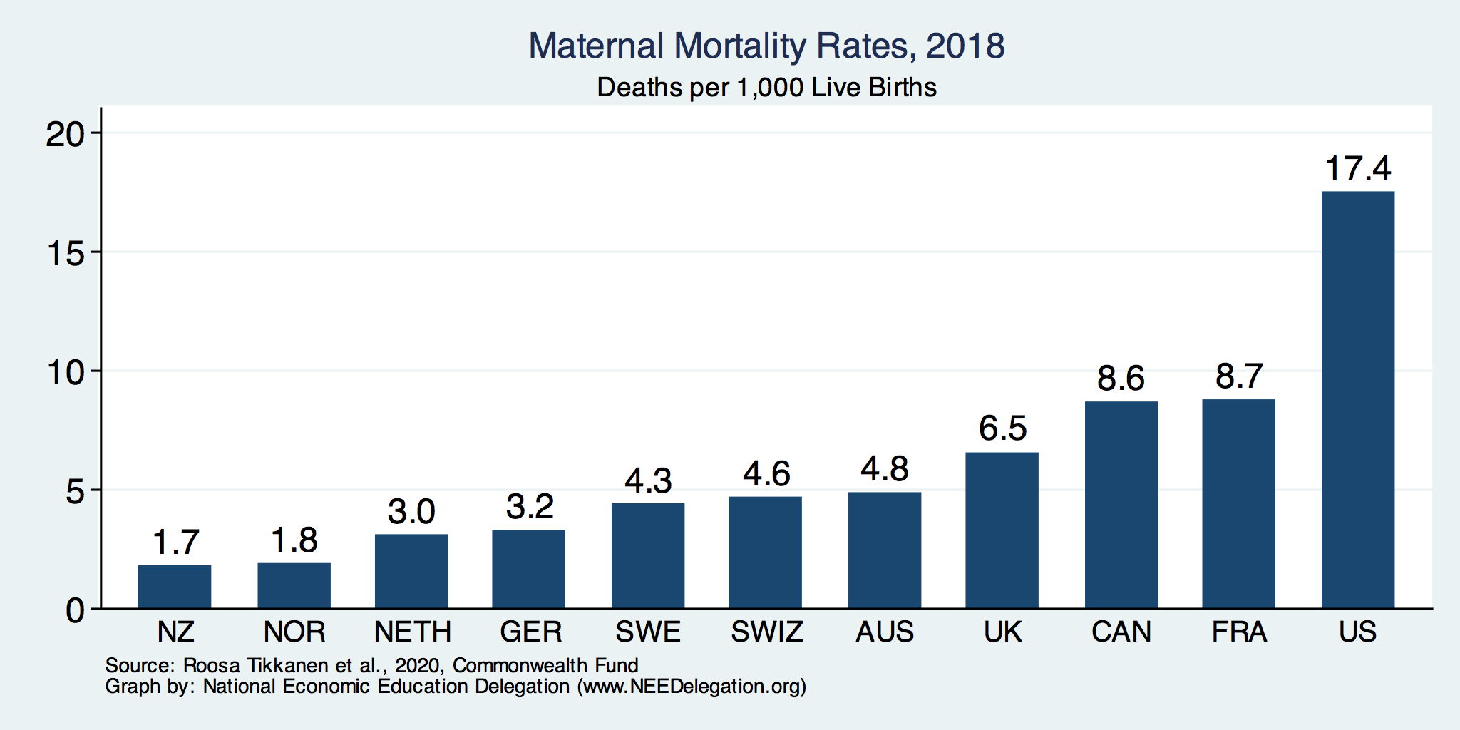
Maternal Mortality Rate
Source: Roosa Tikkanen et al., Maternal Mortality and Maternity Care in the United States Compared to 10 Other Developed Countries (Commonwealth Fund, Nov. 2020). https://doi.org/10.26099/411v-9255

Slide 30
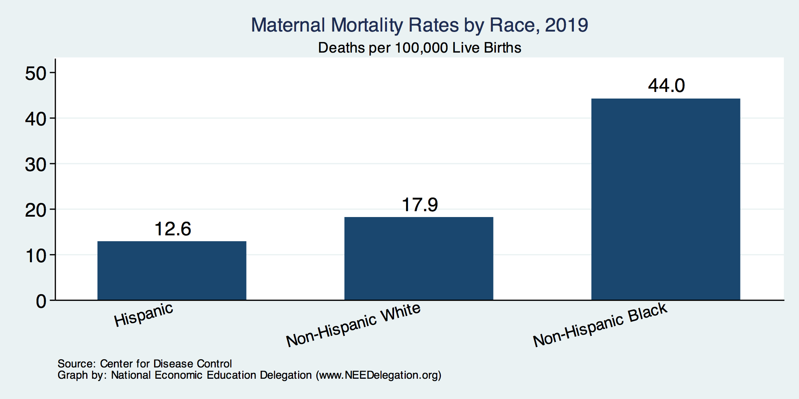
Maternal Mortality Rate by Race

Slide 31
Percent of adults who have experienced medical, medication, or lab errors or delays
Source: 2016 Commonwealth Fund International Health Policy Survey.

Slide 32
Prevention and Screening
The U.S. excels in some prevention measures (high ranking):
  including flu vaccinations and breast cancer screenings.
The U.S. has:
  The highest average five-year survival rate for breast cancer,
  but the Lowest for cervical cancer.

Slide 33
Flu Immunization
Source: Roosa Tikkanen and Melinda K. Abrams, U.S. Health Care from a Global Perspective, 2019: Higher Spending, Worse Outcomes (Commonwealth Fund, Jan. 2020).

Slide 34
Breast Cancer Screening
Percentage of females ages 50–69 screened (%).
Source: Roosa Tikkanen and Melinda K. Abrams, U.S. Health Care from a Global Perspective, 2019: Higher Spending, Worse Outcomes (Commonwealth Fund, Jan. 2020).

Slide 35
Perception of Quality of Medical Care
Source: Munira Z. Gunja et al., What Is the Status of Women’s Health and Health Care in the U.S. Compared to Ten Other Countries? (Commonwealth Fund, Dec. 2018).

Slide 36
Quality of Care Notes
Metrics of quality in the U.S. are not very good.
Quality of care is not considered very good in the U.S.
The system has bright spots!
But isn’t very well thought of…

Slide 37
Costs

Slide 38
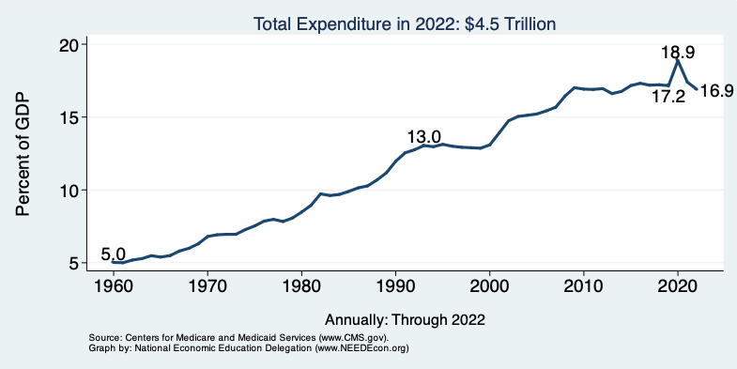
National Health Expenditure as Percent of GDP
Notes:
https://www.cms.gov/

Slide 39
Health Care Spending as % of GDP, 1980–2018
United States
Everybody else
Source: Roosa Tikkanen and Melinda K. Abrams, U.S. Health Care from a Global Perspective, 2019: Higher Spending, Worse Outcomes (Commonwealth Fund, Jan. 2020).

Slide 40
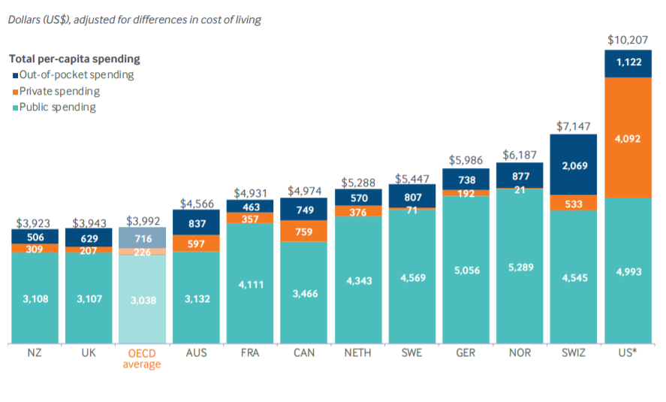
International Per Capita Healthcare Spending
Source: Roosa Tikkanen and Melinda K. Abrams, U.S. Health Care from a Global Perspective, 2019: Higher Spending, Worse Outcomes (Commonwealth Fund, Jan. 2020).
Notes:
Some good resources:
https://www.commonwealthfund.org/publications/issue-briefs/2020/jan/us-health-care-global-perspective-2019
A bit older report: https://www.commonwealthfund.org/publications/issue-briefs/2015/oct/us-health-care-global-perspective
https://www.healthsystemtracker.org/chart-collection/quality-u-s-healthcare-system-compare-countries/#item-overall-age-specific-potential-years-of-life-lost-per-100000-population-1990-2017
https://axenehp.com/international-healthcare-systems-us-versus-world/

Slide 41
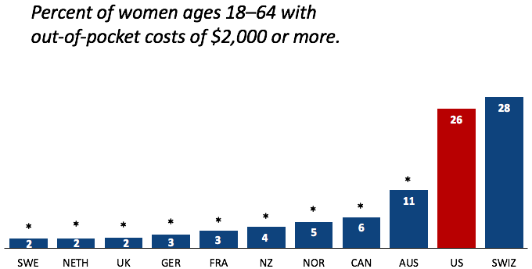
Out-of-Pocket Costs
Source: Munira Z. Gunja et al., What Is the Status of Women’s Health and Health Care in the U.S. Compared to Ten Other Countries? (Commonwealth Fund, Dec. 2018).

Slide 42
Skipped Care Because of Cost
Percent of women ages 18–64 with at least one
cost-related access problem
*
*
*
*
*
*
*
*
*
*
Source: Munira Z. Gunja et al., What Is the Status of Women’s Health and Health Care in the U.S. Compared to Ten Other Countries? (Commonwealth Fund, Dec. 2018).

Slide 43
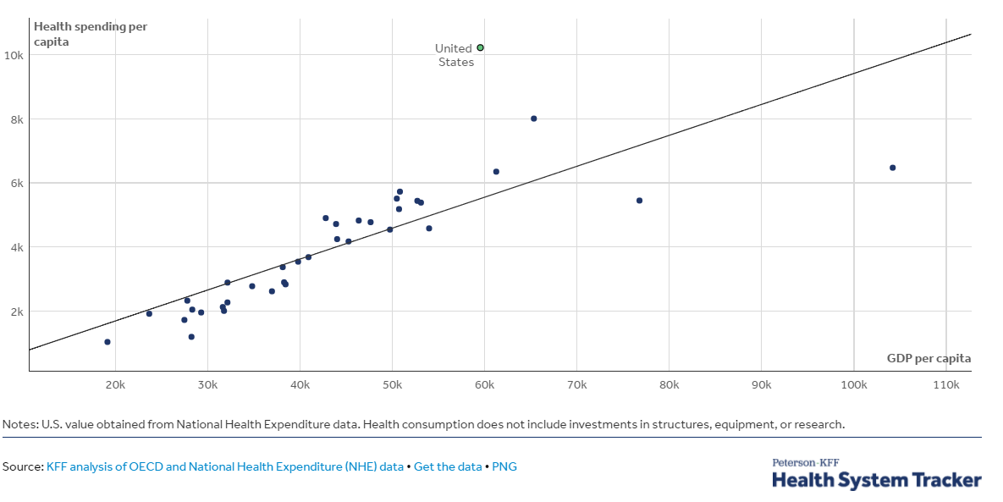
GDP per Capita and Health Spending per Capita, 2017

Slide 44
National Healthcare Expenditure Per Capita
11,172
1,239
Notes:
https://www.cms.gov/

Slide 45
Why is Healthcare Spending Increasing?
Costs in the United States, and elsewhere are increasing rapidly.
The share of economic spending on health care has been steadily increasing for all countries because:
  Health spending growth has outpaced economic growth.
  Richer countries demand more services, like attention to health.
Also because of:
  Advances in medical technologies.
  Rising prices in the health sector – why?

Slide 46
Why Are Costs so High in the US?
One Reason:
The United States is the only
profit-motivated healthcare system in the world.

Slide 47
Why Are Costs so High in the US?
Another Reason:
Our public health system isn’t very good.
(We have a health RESTORATION system, NOT a health CARE system.)

Slide 48
Adults with Multiple Chronic Conditions, 2016
Source: Roosa Tikkanen and Melinda K. Abrams, U.S. Health Care from a Global Perspective, 2019: Higher Spending, Worse Outcomes (Commonwealth Fund, Jan. 2020).

Slide 49
Obesity Rates, 2017
Percent (%)
Source: Roosa Tikkanen and Melinda K. Abrams, U.S. Health Care from a Global Perspective, 2019: Higher Spending, Worse Outcomes (Commonwealth Fund, Jan. 2020).

Slide 50
Markets Matter for Costs

Slide 51
Health Care Markets are Different
Sponsor
(Gov’t or Employer)
Premiums
Insurer or
third-party payers
Premiums (individual policies)
Money (fixed or variable payments)
Taxes or Lower Wages
Claims
Insurance Coverage
Services
Consumers
Producers
Price
Health Care Providers (hospitals, physicians)
Patients
Out-of-pocket fees

Slide 52
How Much Did Your Flu Shot Cost?
Who knows? It’s generally offered for free.
Providers of the shot do pay for it.
  Some reported prices:
    Sacrament, CA $85
    Long Beach, CA $42
    Washington, DC $15
Who really pays for the flu shot?
  YOU DO! Higher premiums.
Prices are negotiated with the
Vaccine producer.
Differences are a reflection of
More or less bargaining power.
Source: https://kffhealthnews.org/news/the-startlingly-high-cost-of-the-free-flu-shot/

Slide 53
Policy Matters for Costs

Slide 54
Hospital Monopolization
Less competition in health systems, hospitals, medical groups, and health insurers has surged in recent years.
Over an 18-month period between July 2016 and January 2018:
  Hospitals acquired 8,000 more medical practices.
  14,000 more physicians left independent practice to become hospital employees.
Between 1999 and 2018, hospital profit margins soared!
  From 100% in 1999 to 317% in 2018.

Slide 55
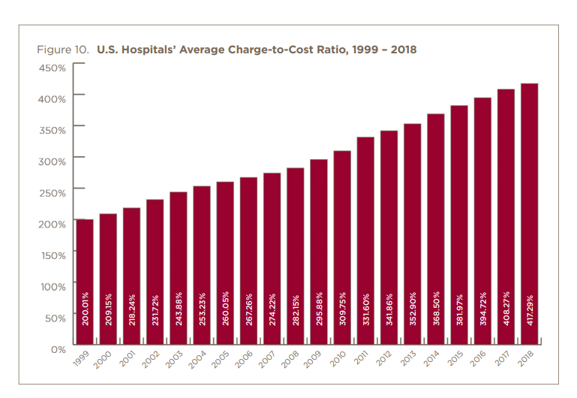

Slide 56
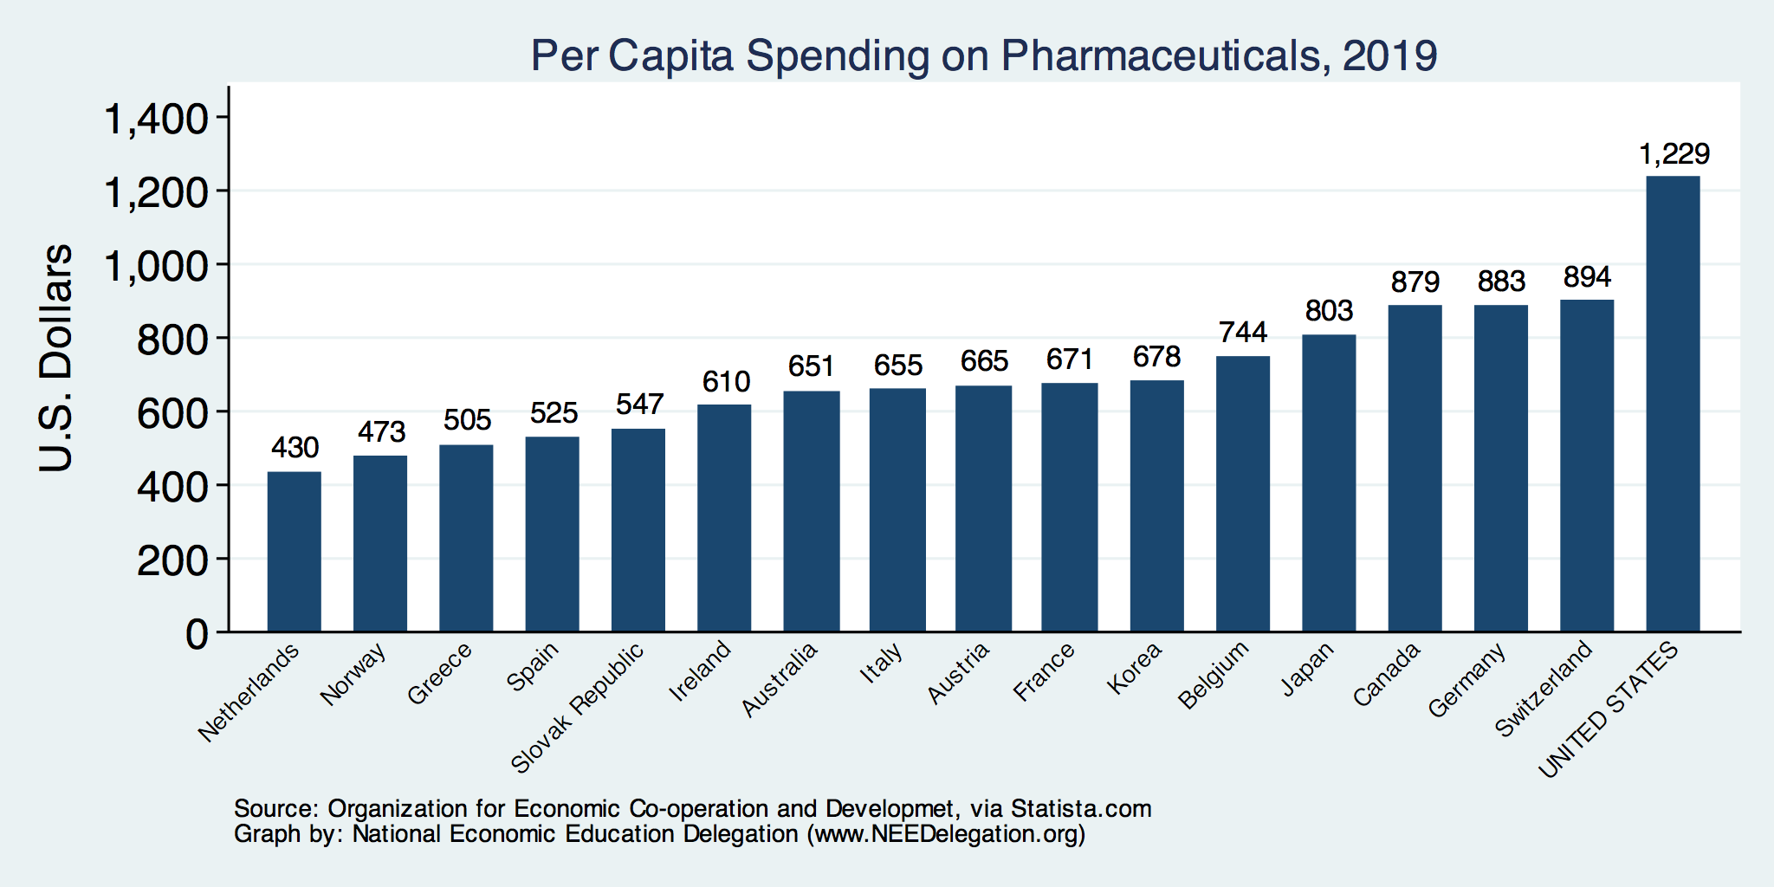
Spending on Pharmaceuticals
Notes:
https://www.bloomberg.com/quicktake/drug-prices
https://en.wikipedia.org/wiki/Prescription_drug_prices_in_the_United_States
https://www.ft.com/content/e92dbf94-d9a2-11e9-8f9b-77216ebe1f17

Slide 57
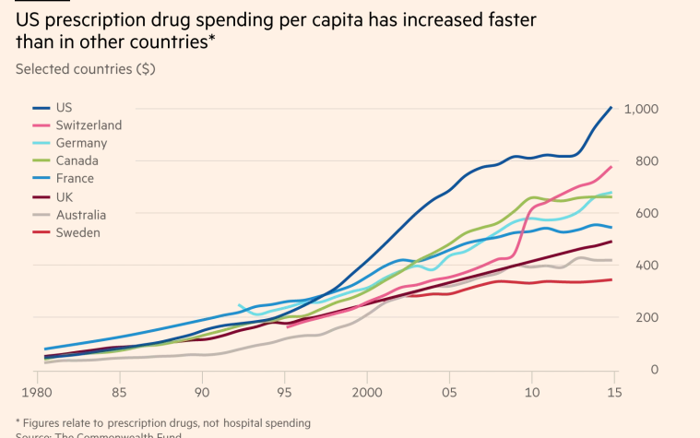
Drug Prices: Trends Over Time

Slide 58
Medicare Modernization Act
Prescription Drug Component
Medicare Part D, by law, cannot negotiate drug prices like other governments do.
In 2017, Medicare spent nearly $8 billion on insulin.
  Had Medicare been allowed to negotiate drug prices (as the U.S. Department of Veterans Affairs (VA) did),
    Medicare might have saved about $4.4 billion just on insulin.

Slide 59
Drug Price Comparisons
Drug Prices for 30 Most Commonly Prescribed
Brand-Name and Generic Drugs, 2006–07
US is set at 1.00
 | AUS | CAN | FR | GER | NETH | NZ | SWITZ | UK | US
Brand-name drugs | 0.40 | 0.64 | 0.32 | 0.43 | 0.39 | 0.33 | 0.51 | 0.46 | 1.00
Generic drugs | 2.57 | 1.78 | 2.85 | 3.99 | 1.96 | 0.90 | 3.11 | 1.75 | 1.00
Source: IMS Health; analysis by Gerard Anderson, Johns Hopkins University.

Slide 60
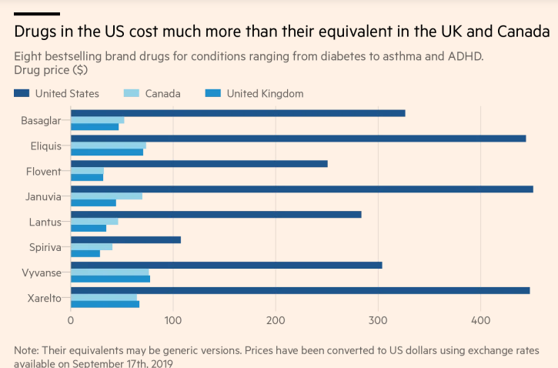
Insulin
Blood
Thinner
Diabetes
Blood
Thinner

Slide 61
Monopolization of Health Insurance Markets
As of 2011, there were close to 100 insurers in Switzerland competing for consumer health care dollars, forcing firms to compete by setting prices to just cover costs.
In 2024, of the 50 states and the District of Columbia:
  9 have only 2 insurers
  11 have 3 or 4, and
  30 states have 5 or more. (TX has 15 - high)
Pennsylvania: 6 in 2019, but 8 in 2024.
Source: KRR, Number of Issuers Participating in the Individual Health Insurance Marketplaces
Notes:
https://www.kff.org/other/state-indicator/number-of-issuers-participating-in-the-individual-health-insurance-marketplace/?currentTimeframe=0&sortModel=%7B%22colId%22:%22Number%20of%20Issuers%20in%202019%22,%22sort%22:%22desc%22%7D
6 Roy, Avik. “Why Switzerland Has the World’s Best Health Care System.” Forbes, April 29, 2011; https://www.forbes.com/sites/theapothecary/2011/04/29/why-switzerland-has-the-worlds-best-health-care-system/#2416d9a67d74.
7 Henry J. Kaiser Family Foundation. “Number of Issuers Participating in the Individual Health Insurance Marketplaces.” State Health Facts; https://www.kff.org/other/state-indicator/number-of-issuers-participating-in-the-individual-health-insurance-marketplace, accessed July 2019.

Slide 62
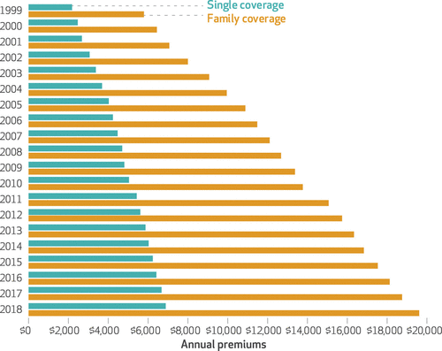
Average Annual Insurance Premiums, 1999-2018
Employer provided, Not Adjusted for Inflation
Single: ~$2,000 to ~$7,000
Family: ~$5,900 to ~$19,500
 | Average Annual Rate of Change (%)
Inflation | 2.19
Health Care CPI | 3.68
Single coverage | 6.51
Family coverage | 6.52
 | Average Annual Rate of Change
Inflation | 2.19
Health Care CPI | 3.68
Single coverage | 6.51
Family coverage | 6.52
Source: The Commonwealth Fund

Slide 63
Reason for Higher Health Insurance Rates
Rising prices in the health sector
Advances in medical technologies
Increased demand for services
Lack of competition in health insurance markets

Slide 64
Health Care Systems and Institutions

Slide 65
Definition: Universal Coverage
Universal coverage – refers to health care systems in which all individuals have insurance coverage.
Generally, this coverage includes:
  Access to all needed services and benefits.
  Protects individuals from excessive financial hardships.
    Medical indebtedness is the #1 cause of bankruptcies in the United States.
Canada has universal coverage, the United States does not.
Notes:
https://ajph.aphapublications.org/doi/abs/10.2105/AJPH.2018.304901?journalCode=ajph

Slide 66
Definition: Single-Payer
Single-payer - refers to financing a health care system by making one entity solely and exclusively responsible for paying for medical goods and services.
  Not necessarily the government.
It is only the financing component that is socialized.
  The money for the payment can be either collected by:
    Taxes collected by the government.
    Premiums collected by National or Public Health Insurance.
Single-payer systems: 17 countries
  Norway, Japan, United Kingdom, Kuwait, Sweden, Bahrain, Brunei, Canada, United Arab Emirates, Denmark, Finland, Slovenia, Italy, Portugal, Cyprus, Spain, and Iceland.

Slide 67
Definition: Socialized Medicine
Socialized medicine – this model takes the single-payer system one step further.
  Government not only pays for health care but operates the hospitals and employs the medical staff.
This has NEVER been a part of the debate in the United States.

Slide 68
Definition: Third-Party Payer
A third-party payer is an entity that pays medical claims on behalf of the insured. Examples of third-party payers include government agencies, insurance companies, health maintenance organizations (HMOs), and employers.
  Employer-sponsored health plans
  Individual market health plans
  National health insurance

Slide 69
Health System Classification
Developed countries of the world have each taken a different approach for their health care delivery systems.
5 basic models:
  Beveridge – socialized medicine (United Kingdom, Spain, New Zealand)
  Bismarck (France, Germany, Japan, Switzerland)
  National health insurance (Canada)
  Out of pocket model – self insurance
  Mixed (United States)

Slide 70
Model 1: Beveridge
In this model, health insurance is paid for through TAXATION.
  Everybody has insurance, universal coverage. Everybody receives care at no cost.
  All insurers are public.
  Supplemental insurance is available in the private market.
  Providers are Public. Similar to public libraries and police forces.
Pros:
  Universal coverage.
  Government controls quality of care, so cost of care may be low.
  No medical bills or co-pays.
Cons:
  Taxes are high, regardless of use of healthcare.
  Government controls quality of care, so service availability might be low.
  Longer waiting times for non-emergency care.
  Potential for excessive use of the system.
https://www.ahaap.org/beveridge-model

Slide 71
Model 2: Bismarck
In this model, health insurance is paid for through PREMIUMS.
  Everybody must have insurance, only poor don’t have to pay premiums.
  Premiums are paid into the “gov’t sickness fund” or directly to private insurers.
  All insurers are private, but can’t make money off the sickness fund.
  Providers are private.
Pros:
  Everybody is covered and can avoid expensive healthcare bills.
  Administrative costs are much lower than in the U.S.
  Little waiting time to receive basic services.
Cons:
  Focus on low costs can mean fewer services are available in rural areas.
  Mandatory premiums are high.
  Longer waiting times for elective services.
https://www.ahaap.org/bismarck-model

Slide 72
Model 3: National Health Insurance
This model has elements of both Beveridge and Bismarck.
  Like Beveridge: government is the single payer and paid for through taxes.
  Like Bismarck: All health-care providers are in the private sector.
Pros:
  Lowers the cost of healthcare for the economy – bargaining power.
  Low administrative costs for care.
    No incentive to deny claims.
  Healthier workforce.
Cons:
  Everybody pays regardless of health care received.
  May stop people from being careful about their health.
  Limits payouts to doctors.
  May affect technology adoption.
https://www.ahaap.org/national-health-insurance-model

Slide 73
US Health Care System
Medicare – National Health Insurance
Military Veteran Care – Beveridge model (socialized medicine)
Employer-sponsored insurance – Bismarck model (kind of)
Individual market health plans – Bismarck model (kind of)
Uninsured – Out of pocket model

Slide 74
Tradeoffs
Tradeoffs take place among the three legs:
Increasing quality in health care may lead to higher health care costs.
  This means a compromise in access (affordability).
I.e., with increasing quality, access may suffer.
By increasing access, quality may suffer.
By decreasing costs, quality may suffer.

Slide 75
Summary
US HealthCare system is not preforming well.
  Very expensive with low quality and access.
One of the main reasons for very high costs is the monopolization of healthcare markets.
Universal health insurance would increase access and perhaps also reduce costs.
Changing the focus from maximizing profits to maximizing care would help.

Slide 76
A Few Simple Solutions Could Reduce Costs
Encourage competition in healthcare markets.
Introduction of a public option in the health insurance market.
Allow the US government to negotiate drug prices
  like most every other nation.

Slide 77
Final Note: “One Big Beautiful Bill”
Changes to Medicaid:
  Cuts to funding - $80 billion/year (out of $584 billion in total).
  Work requirements
  Stricter eligibility rules
Implications:
  10 million people will lose health insurance (CBO)
  These are likely to be the most vulnerable.
    E.g., those who aren’t able to work.

Slide 78
Thank you!
Any Questions?
www.NEEDEcon.org
Jon D. Haveman, Ph.D.
Jon@NEEDEcon.org
Contact NEED: info@NEEDEcon.org
Submit a testimonial: www.NEEDEcon.org/testimonials.php
Become a Friend of NEED: www.NEEDEcon.org/friend.php

