Slide 1
Health(care) Economics: Costs
OLLI Brandeis University
December 16, 2022
Jon Haveman, Ph.D.
NEED

Slide 2
National Economic Education Delegation
Vision
One day, the public discussion of policy issues will be grounded in an accurate perception of the underlying economic principles and data.
Mission
NEED unites the skills and knowledge of a vast network of professional economists to promote understanding of the economics of policy issues in the United States.
NEED Presentations
Are nonpartisan and intended to reflect the consensus of the economics profession.

Slide 3
Who Are We?
Honorary Board: 54 members
2 Fed Chairs: Janet Yellen, Ben Bernanke
6 Chairs Council of Economic Advisers
Furman (D), Rosen (R), Bernanke (R), Yellen (D), Tyson (D), Goolsbee (D)
3 Nobel Prize Winners
Akerlof, Smith, Maskin
Delegates: 652+ members
At all levels of academia and some in government service
All have a Ph.D. in economics
Crowdsource slide decks
Give presentations
Global Partners: 49 Ph.D. Economists
Aid in slide deck development

Slide 4
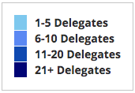
Where Are We?

Slide 5
Available NEED Topics Include:
US Economy
Healthcare Economics
Climate Change
Economic Inequality
Economic Mobility
Trade and Globalization
Minimum Wages
Immigration Economics
Housing Policy
Federal Budgets
Federal Debt
Black-White Wealth Gap
Autonomous Vehicles
US Social Policy

Slide 6
Credits and Disclaimer
This slide deck was authored by:
Veronika Dolar, SUNY Old Westbury
Jon Haveman, NEED
Disclaimer
NEED presentations are designed to be nonpartisan.
It is, however, inevitable that the presenter will be asked for and will provide their own views.
Such views are those of the presenter and not necessarily those of the National Economic Education Delegation (NEED).

Slide 7
Outline
What is Health(care) Economics?
Healthcare costs

Slide 8
What is Health(care) Economics?
Health Economics is a field of MICROeconomics that focuses on the health care industry.
Examples of other subfields of microeconomics include:
labor economics, industrial organization, economics of education, public economics, and urban economics.
Notes:
Microeconomics (from Greek prefix micro- meaning "small" + "economics") is a branch of economics that studies the behavior of how the individual modern household and firms make decisions to allocate limited resources.
Macroeconomics (from Greek prefix macro- meaning “large" + "economics") is the study of economy-wide phenomena, including inflation, unemployment, and economic growth.
These two branches of economics are closely intertwined, yet distinct—they address different questions.
Microeconomics studies individual markets or sectors or industries (hence health care industry is classified under microeconomics) while macroeconomics studies national economies and country/state-wide, general equilibrium questions.
Many times people think that since micro means small and macro large, that microeconomics is somehow inferior or studies smaller issues than what is studied in macroeconomics. But it should be noted, that many firms today have revenues that are substantially larger than most national incomes on nations. Obviously, this is comparing apples to oranges – but at least it gives a general idea of the size of some of these firms and markets.
https://medium.com/@denislesak/companies-with-revenues-greater-than-gdp-of-countries-58c46af4a1a9
https://oxfamblogs.org/fp2p/of-the-worlds-top-100-economic-entities-29-are-states-71-are-corporates/
See the next slide to compare US health care.

Slide 9
Health Economics is part of Microeconomics
Although health economics is part of “micro-” economics, it is actually very big:
In 2019, U.S. national health expenditures were 17.7% of GDP, which is equivalent to around $3.8 trillion.
For comparison, GDP in each country in 2019:
Germany: $3,845 trillion (4th largest economy)
UK: $2,827 trillion (6th largest economy)
France : $2,715 trillion (7th largest economy)
Notes:
Hopefully the comparison of the US health care industry to the entire economy of Germany, UK, and France will make students also appreciate how difficult any type of a reform is – when the sector being reformed is of this size and complexity.
The list of top 10 largest economies based on the total size of GDP: 1) US, 2) China, 3) Japan, 4) Germany, 5) India, 6) UK, 7) France, 8) Italy, 9) Brazil, 10) Canada

Slide 10
What Is Health Economics?
Health economics studies healthcare resource markets and health insurance.
Healthcare is the biggest industry and the largest employer in the United States.
Notes:
Here the big emphasis is on the distinction between other healthcare markets and health insurance – this difference it typically hard to grasp for most people.

Slide 11
Markets Studied in Health Economics
Markets for:
Physicians
Nurses
Hospital facilities
Nursing homes
Pharmaceuticals
Medical supplies (such as diagnostic and therapeutic equipment)
Health Insurance
Notes:
Many times people confuse Health Economics with Health Insurance. The topics discuss in health economics included health insurance, but also a number of other markets related to healthcare resources.
This is an important distinction – because it also relates to the Health Care reform. Health care reform in the US is mostly dealing with the reform of the Health Insurance, rather than other healthcare markets.
The debate about many of these issues has to do with the market structure – and the issue of when does a market work well – without a lot of government intervention (free markets) and when is it necessary for a government to play a much larger role.

Slide 12
The Three Legs of the Healthcare Stool
The market for Health Insurance is where they all come together.
Access
Quality
Cost
We will be focusing primarily on cost.

Slide 13
Costs

Slide 14
National Health Expenditure as Percent of GDP
Total Expenditures in 2019: $3.8 Trillion
17.9
17.7, 2019
13.4
5.0
Healthcare spending: increased 60x between 1929 and 2019.
US Economy: increased just 12x
Notes:
https://www.cms.gov/

Slide 15
Health Care Spending as % of GDP, 1980–2018
United States
Everybody else
Source: Roosa Tikkanen and Melinda K. Abrams, U.S. Health Care from a Global Perspective, 2019: Higher Spending, Worse Outcomes (Commonwealth Fund, Jan. 2020).

Slide 16
Why is Healthcare Spending Increasing?
The share of economic spending on health care has been steadily increasing for all countries because:
Health spending growth has outpaced economic growth.
Richer countries demand more services, like attention to health.
Also:
Advances in medical technologies.
Rising prices in the health sector – why?

Slide 17
GDP per Capita and Health Spending per Capita, 2017

Slide 18
National Healthcare Expenditure Per Capita
11,172
1,239
Notes:
https://www.cms.gov/

Slide 19
International Per Capita Healthcare Spending
Source: Roosa Tikkanen and Melinda K. Abrams, U.S. Health Care from a Global Perspective, 2019: Higher Spending, Worse Outcomes (Commonwealth Fund, Jan. 2020).
Notes:
Some good resources:
https://www.commonwealthfund.org/publications/issue-briefs/2020/jan/us-health-care-global-perspective-2019
A bit older report: https://www.commonwealthfund.org/publications/issue-briefs/2015/oct/us-health-care-global-perspective
https://www.healthsystemtracker.org/chart-collection/quality-u-s-healthcare-system-compare-countries/#item-overall-age-specific-potential-years-of-life-lost-per-100000-population-1990-2017
https://axenehp.com/international-healthcare-systems-us-versus-world/

Slide 20
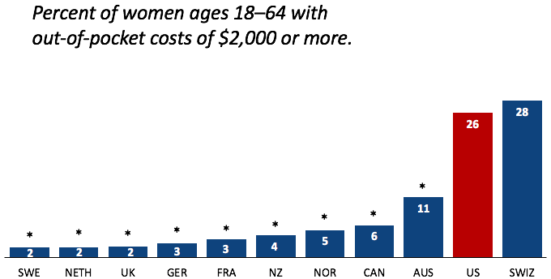
Out-of-Pocket Costs
Source: Munira Z. Gunja et al., What Is the Status of Women’s Health and Health Care in the U.S. Compared to Ten Other Countries? (Commonwealth Fund, Dec. 2018).

Slide 21
Why Are Costs so High in the US?
One Reason:
The United States is the only
profit-motivated healthcare system in the world.

Slide 22
Three Potential Reasons for Higher Costs
Quantity of care
Administrative costs
Costs of service

Slide 23
Markets Matter for Costs

Slide 24
Are Health Care Markets Special?
Market Structure
Type of products and services
Principal-Agent Problem
Asymmetric Information
Moral Hazard
Moral Imperative (?)

Slide 25
Health Care Markets are Different
Sponsor
Premiums
Insurer or
third-party payers
Premiums (individual policies)
Money (fixed or variable payments)
Taxes or Lower Wages
Claims
Insurance Coverage
Services
Consumers
Producers
Price
Health Care Providers (hospitals, physicians)
Patients
Out-of-pocket fees

Slide 26
Policy Matters for Costs
Competition Policy in Particular

Slide 27
Hospital Monopolization
Market consolidation among and between health systems, hospitals, medical groups, and health insurers has surged over the last decade.
Over an 18-month period between July 2016 and January 2018:
Hospitals acquired 8,000 more medical practices.
14,000 more physicians left independent practice to become hospital employees.

Slide 28
Concentration in Pharmaceutical Companies
The number of mergers and acquisitions involving one of the top 25 firms more than doubled:
29 in 2006 to 61 in 2015
Between 1995 and 2015, 60 drug companies merged into 10.

Slide 29
Drug Price Comparisons
Drug Prices for 30 Most Commonly Prescribed Brand-Name and Generic Drugs, 2006–07 US is set at 1.00
 | AUS | CAN | FR | GER | NETH | NZ | SWITZ | UK | US
Brand-name drugs | 0.40 | 0.64 | 0.32 | 0.43 | 0.39 | 0.33 | 0.51 | 0.46 | 1.00
Generic drugs | 2.57 | 1.78 | 2.85 | 3.99 | 1.96 | 0.90 | 3.11 | 1.75 | 1.00
US Higher
US Lower
Source: IMS Health; analysis by Gerard Anderson, Johns Hopkins University.

Slide 30
Medicare Modernization Act
Prescription Drug Component
Medicare Part D, by law, cannot negotiate drug prices like other governments do.
In 2017, Medicare spent nearly $8 billion on insulin.
The researchers said that if Medicare were allowed to negotiate drug prices like the U.S. Department of Veterans Affairs (VA) can, Medicare could save about $4.4 billion just on insulin.

Slide 31
Monopolization of Health Insurance Market
As of 2011, there were close to 100 insurers in Switzerland competing for consumer health care dollars, forcing firms to compete by setting prices to just cover costs.
In the United States, markets are state specific and consumers may choose from plans available in the state in which they reside.
In 2014, of the 50 states and the District of Columbia:
11 had only 1 or 2 insurers
21 had 3 or 4, and
only 19 states had 5 or more. (CA has 11)
As of July 2019, the number of states with only 1 or 2 insurers had increased from 11 to 20.
Notes:
6 Roy, Avik. “Why Switzerland Has the World’s Best Health Care System.” Forbes, April 29, 2011; https://www.forbes.com/sites/theapothecary/2011/04/29/why-switzerland-has-the-worlds-best-health-care-system/#2416d9a67d74.
7 Henry J. Kaiser Family Foundation. “Number of Issuers Participating in the Individual Health Insurance Marketplaces.” State Health Facts; https://www.kff.org/other/state-indicator/number-of-issuers-participating-in-the-individual-health-insurance-marketplace, accessed July 2019.

Slide 32
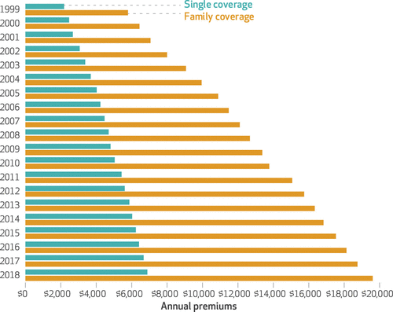
Average Annual Insurance Premiums, 1999-2018
Employer provided, Not Adjusted for Inflation
Single: ~$2,000 to ~$7,000
Family: ~$5,900 to ~$19,500
 | Average Annual Rate of Change
Inflation | 2.19
Health Care CPI | 3.68
Single coverage | 6.51
Family coverage | 6.52
Source: The Commonwealth Fund

Slide 33
Spending on Copays and Deductibles

Slide 34
Reason for Higher Health Insurance Rates
Rising prices in the health sector
Advances in medical technologies
Increased demand for services
Concentration of insurance companies!

Slide 35
What do we get for these higher costs?

Slide 36
Life Expectancy: How Does the US Compare?
Everybody else
United States
Germany – US = 2.5 years
Source: Roosa Tikkanen and Melinda K. Abrams, U.S. Health Care from a Global Perspective, 2019: Higher Spending, Worse Outcomes (Commonwealth Fund, Jan. 2020).

Slide 37
Avoidable Deaths
Deaths per 100,000 population.
Heart disease, stroke, hypertension…
Source: Roosa Tikkanen and Melinda K. Abrams, U.S. Health Care from a Global Perspective, 2019: Higher Spending, Worse Outcomes (Commonwealth Fund, Jan. 2020).

Slide 38
Maternal Mortality Rate
Source: Roosa Tikkanen et al., Maternal Mortality and Maternity Care in the United States Compared to 10 Other Developed Countries (Commonwealth Fund, Nov. 2020). https://doi.org/10.26099/411v-9255
Notes:
Delete title in graphic to avoid duplication

Slide 39
Maternal Mortality Rate by Race
Notes:
Delete title in the graphic to avoid duplication

Slide 40
Infant Mortality International Comparison
Deaths per 1,000 live births
Source: NEED from OECD data.

Slide 41
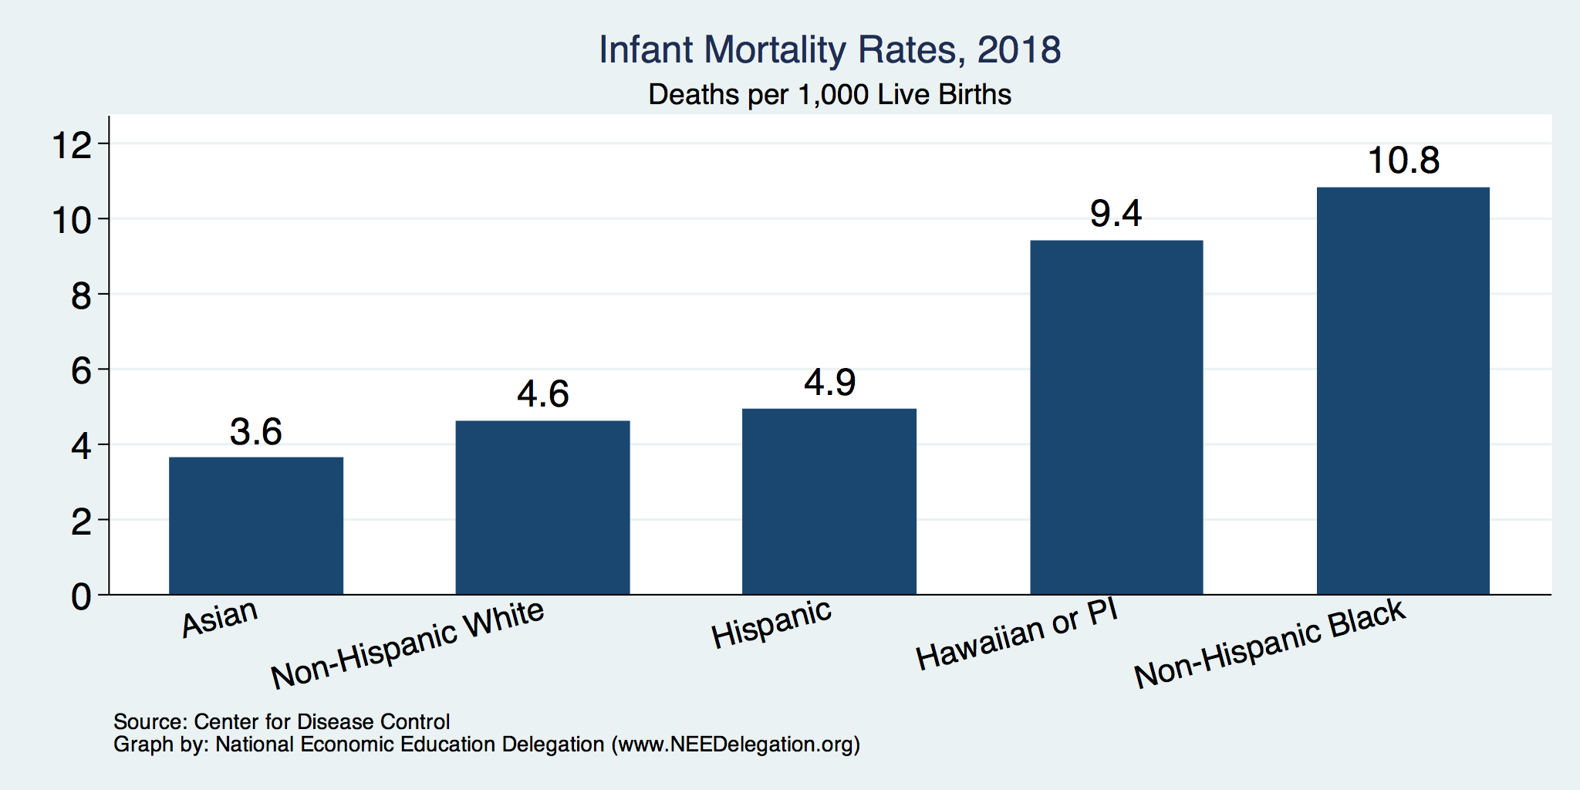
Infant Mortality by Race/Ethnicity
Notes:
Delete title in graphic to avoid duplication

Slide 42
Adults with Multiple Chronic Conditions, 2016
Source: Roosa Tikkanen and Melinda K. Abrams, U.S. Health Care from a Global Perspective, 2019: Higher Spending, Worse Outcomes (Commonwealth Fund, Jan. 2020).

Slide 43
Summary
US HealthCare system is not preforming well.
Very expensive with low quality and access.
One of the main reasons for very high costs is the monopolization of healthcare markets.
Hospitals, health insurance, big pharma, physicians, etc.
A few simple solutions could drastically reduce costs:
Enforcement of antitrust laws in this sector.
Introduction of a public option in the health insurance market.
Ability for the US government to negotiate drug prices like most every other nation.
Universal health insurance would increase access and perhaps also reduce costs.

Slide 44
Thank you!
Any Questions?
www.NEEDelegation.org
Jon D. Haveman, Ph.D.
Jon@NEEDelegation.org
Contact NEED: info@needelegation.org
Submit a testimonial: www.NEEDelegation.org/testimonials.php
Become a Friend of NEED: www.NEEDelegation.org/friend.php

