Slide 1


Osher Lifelong Learning Institute, Spring 2025
Contemporary Economic Policy
University of Hawaii, Manoa
June 23, 2025
Robert Rebelein, Ph.D.
Associate Professor of Economics
Vassar College

Slide 2
Available NEED Topics Include:
US Economy
Healthcare Economics
Climate Change
Economic Inequality
Economic Mobility
Trade and Globalization
Minimum Wages
Immigration Economics
Housing Policy
Federal Budgets
Federal Debt
Black-White Wealth Gap
Autonomous Vehicles
US Social Policy

Slide 3
Course Outline
Contemporary Economic Policy
  Week 1 (6/2): Economic Update (Geoffrey Woglom, Amherst College)
  Week 2 (6/09): Climate Change Economics (Sarah Jacobson, Williams College)
  Week 3 (6/16): Economic Mobility (Jon Haveman, Exec Director, NEED)
  Week 4 (6/23): Health Economics (Robert Rebelein, Vassar College)
  Week 5 (6/30): Cryptocurrencies (Joan Nix Queens College (CUNY)

Slide 4
Submitting Questions
Please submit questions in the chat.
  I will try to handle them as they come up but may take them in a bunch as time permits.
We will do a verbal Q&A after the material has been presented.
  And the questions in the chat have been addressed.
OLLI allowing, we can stay beyond the end of class to have further discussion.
Slides will be available on the NEED website tomorrow (https://needelegation.org/delivered_presentations.php)

Slide 5
Major Problems in the US
Expenditure growth is unsustainable
ACCESS to healthcare is not always great
QUALITY of healthcare is not always great
Increasing dependence on government payments
Lack of competition in key markets
Our healthcare system is very complex

Slide 6
Outline
U.S. Healthcare spending
Assessing the current system
  Access
  Quality
The economics of Healthcare
  Includes reasons for rising expenditures
Concentration in specific markets
  Pharmaceuticals
  Hospitals
  Insurance
Alternative Healthcare systems

Slide 7
Before we start…
Much of the data presented today comes from research done by the Kaiser Family Foundation. You can learn much more about the economics of healthcare issues at www.kff.org
Expenditure = Price times Quantity

Slide 8
Healthcare expenditure in the U.S.

Slide 9
Health Economics is Big Business
Healthcare is the biggest industry and the largest employer in the U.S.
We spend A LOT on healthcare:
  In 2023, U.S. national health expenditures were about $4.9 trillion ($14,570 per person) which is approximately 17.6% of GDP
  Expenditures grew 7.5% from 2022 to 2023
U.S. Healthcare industry would be the 3rd largest economy in the world
Notes:
Expenditures grew about 7.5% from 2022 to 2023.
Hopefully the comparison of the US health care industry to the entire economy of Germany, UK, and France will make students also appreciate how difficult any type of a reform is – when the sector being reformed is of this size and complexity.
https://databankfiles.worldbank.org/public/ddpext_download/GDP.pdf

Slide 10
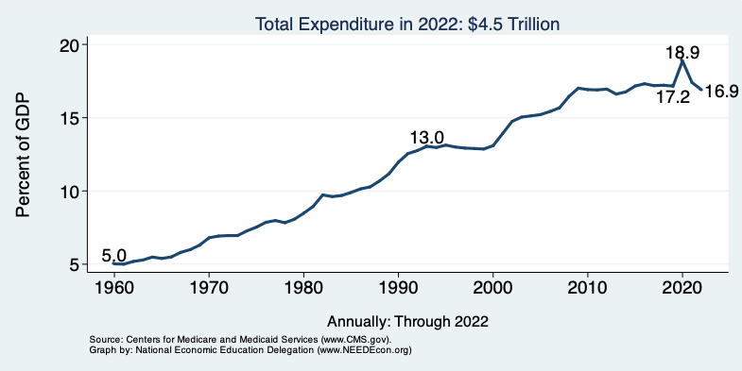
National Health Expenditure as Percent of GDP
Notes:
https://www.cms.gov/

Slide 11
Health Care Spending as % of GDP, 1980–2018
Everybody Else
Source: Roosa Tikkanen and Melinda K. Abrams, U.S. Health Care from a Global Perspective, 2019: Higher Spending, Worse Outcomes (Commonwealth Fund, Jan. 2020).

Slide 12
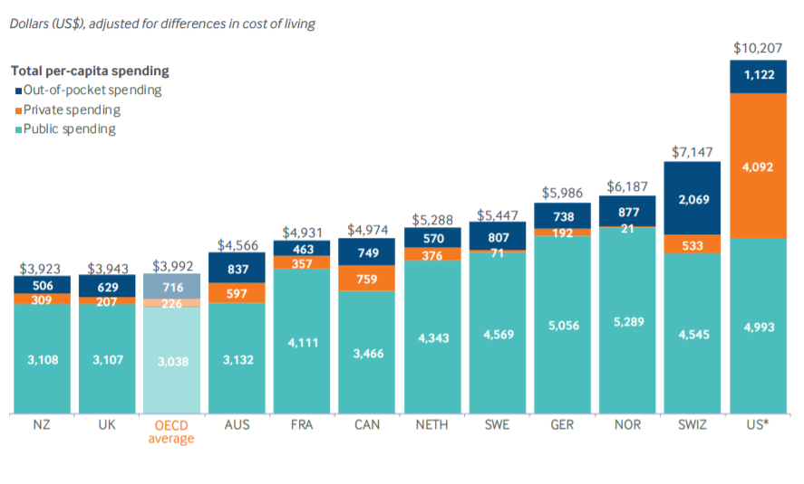
International Per Capita Healthcare Spending
US spends more than twice the OECD average
Source: Roosa Tikkanen and Melinda K. Abrams, U.S. Health Care from a Global Perspective, 2019: Higher Spending, Worse Outcomes (Commonwealth Fund, Jan. 2020).
Notes:
Some good resources:
https://www.commonwealthfund.org/publications/issue-briefs/2020/jan/us-health-care-global-perspective-2019
A bit older report: https://www.commonwealthfund.org/publications/issue-briefs/2015/oct/us-health-care-global-perspective
https://www.healthsystemtracker.org/chart-collection/quality-u-s-healthcare-system-compare-countries/#item-overall-age-specific-potential-years-of-life-lost-per-100000-population-1990-2017
https://axenehp.com/international-healthcare-systems-us-versus-world/

Slide 13
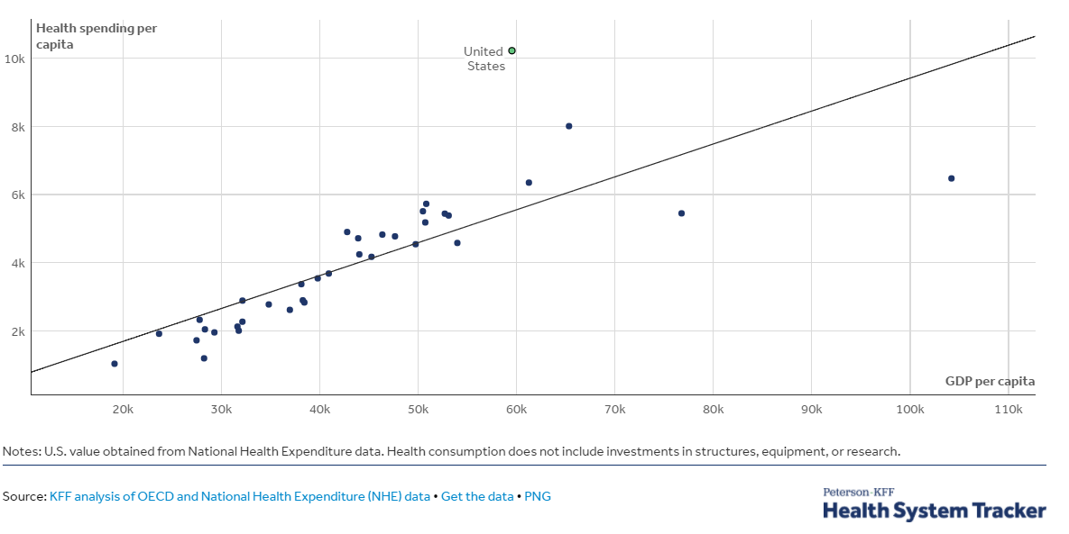
GDP per Capita and Health Spending per Capita, 2017

Slide 14
Health Care vs Social Services Spending
Source: E. H. Bradley and L. A. Taylor, The American Health Care Paradox: Why Spending More Is Getting Us Less, Public Affairs, 2013.
Notes:
From 2000 to 2011, for every dollar the US spent on health care, the country spent another $1.00 on social services, whereas across the OECD, for every dollar spent on health care, countries spend an additional $2.50 on social services

Slide 15
Health Care vs Social Care Spending
A 2013 study by Bradley and Taylor found that the U.S. spent the least on social services—such as retirement and disability benefits, employment programs, and supportive housing—among the countries studied in this report, at just 9 percent of GDP.
From 2000 to 2011, for every dollar the US spent on health care, the country spent another $1.00 on social services, whereas across the OECD, for every dollar spent on health care, countries spend an additional $2.50 on social services
Notes:
The U.S. invests the smallest share of its economy on social services.
A 2013 study by Bradley and Taylor found that the U.S. spent the least on social services—such as retirement and disability benefits, employment programs, and supportive housing—among the countries studied in this report, at just 9 percent of GDP.¹² Canada, Australia and New Zealand had similarly low rates of spending, while France, Sweden, Switzerland, and Germany devoted roughly twice as large a share of their economy to social services as did the U.S.
The U.S. was also the only country studied where health care spending accounted for a greater share of GDP than social services spending. In aggregate, U.S. health and social services spending rank near the middle of the pack.

Slide 16
Selected Statistics

Slide 17
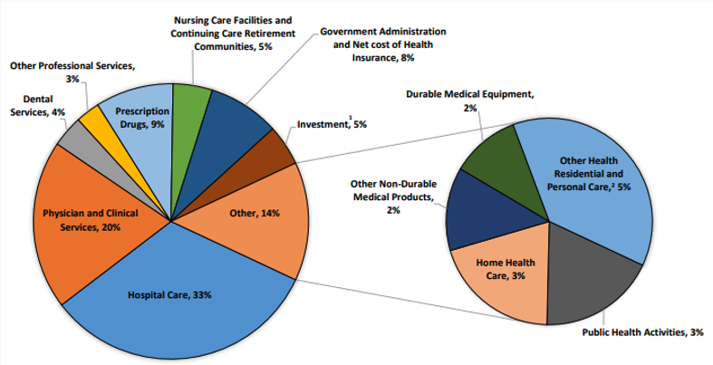
Where the money goes:
Source: Centers for Medicare & Medicaid Services, Office of the Actuary, National Health Statistics Group.

Slide 18
U.S. Healthcare Expenditure Sources
 | Total ($bill) | Out-of-Pocket | Medicare | Medicaid | Private & other Health Ins. | Other Third-Party Payers | GDP ($bill) | Total Expends as a share of GDP | Medicare & Medicaid share of Federal Budget
1960 | $27 | 48% | 0% | 0% | 27% | 25% | $543 | 5% | 0%
1980 | $255 | 23% | 15% | 10% | 31% | 22% | $2,863 | 9% | 8%
2000 | $1,369 | 15% | 16% | 15% | 36% | 19% | $10,285 | 13% | 19%
2018 | $3,649 | 10% | 21% | 16% | 37% | 16% | $20,580 | 17.7% | 27%
Notes:
In 2024, 28% of federal noninterest spending went for healthcare
CBO projects that, in 2054, healthcare will consume 39% of federal noninterest spending

Slide 19
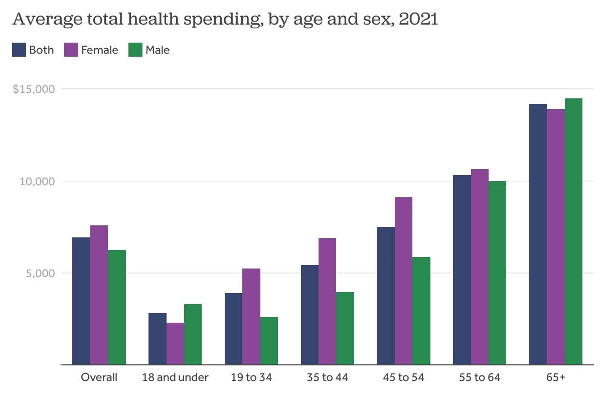

Slide 20
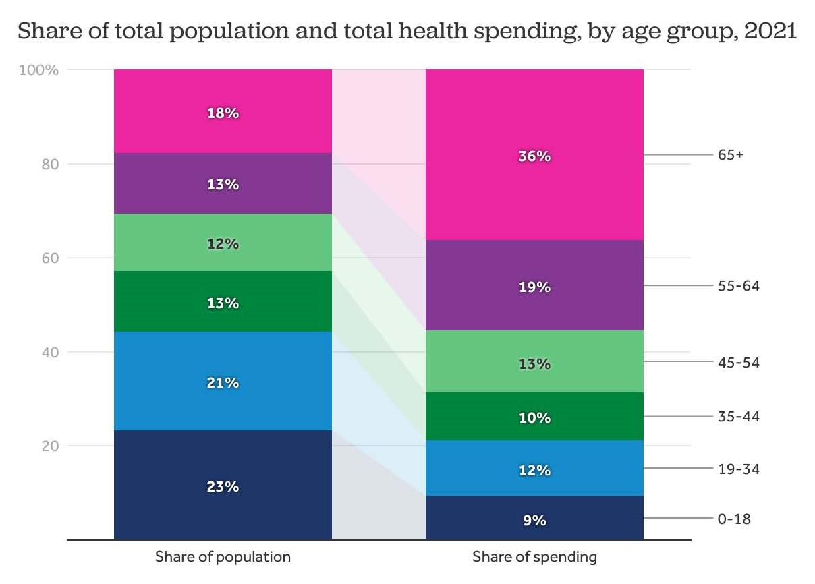

Slide 21
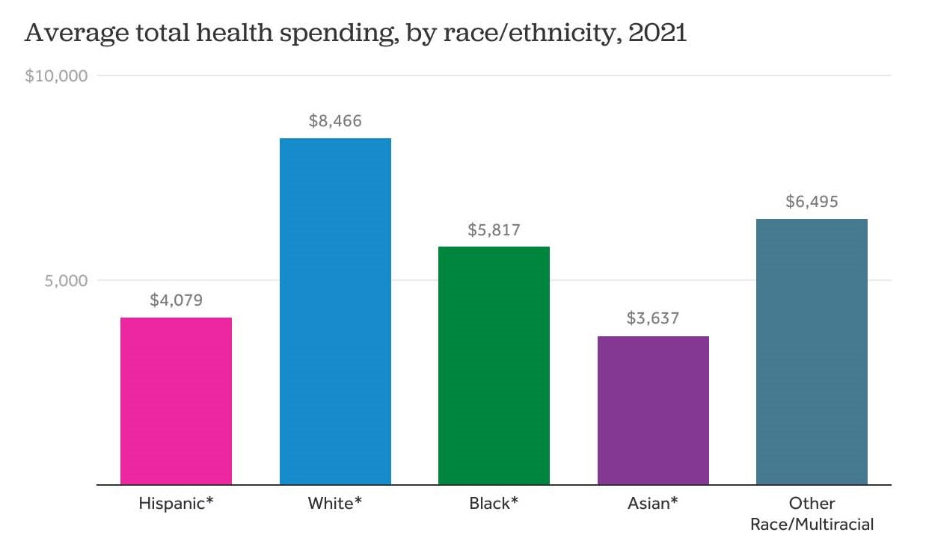

Slide 22
Inflation – CPI for all goods
Consumer Price Index

Slide 23
Inflation – CPI for Medical Care
Consumer Price Index for Medical Care
Consumer Price Index

Slide 24
Assessing the U.S. Healthcare System:
Access to Healthcare Services

Slide 25
Health Insurance Coverage, 2022 – 92.1%
Countries with Less Than Universal Coverage
Countries with Universal Coverage
Country | % of Persons
Slovakia | 94.5
Chile | 94.3
UNITED STATES | 92.1
Poland | 91.5
Mexico | 90.2
Algeria | 90.9
Jordan | 55.0
Countries | % of Persons
Australia | 100
Canada | 100
Czech Republic | 100
France | 100
United Kingdom | 100
Greece | 100
Hungary | 100
And 21 more | 99+
Source: Organization for Economic Cooperation and Development
Notes:
7.9% of 340 million people is 27 million without health insurance

Slide 26
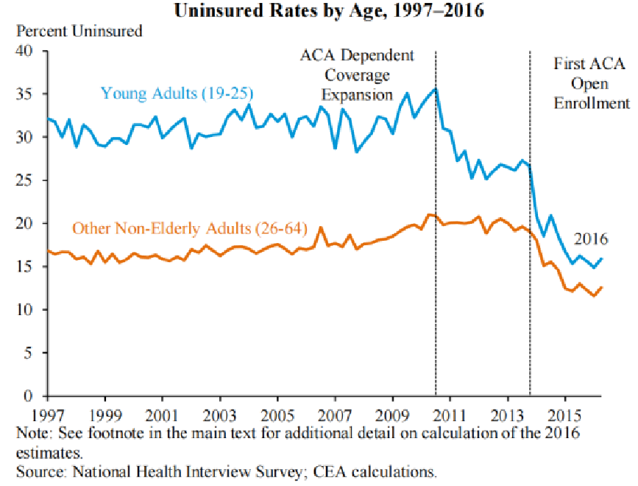
Uninsured Rate dropped dramatically with the ACA; Drop was more significant for young adults
Notes:
Source: National Health Interview Survey; CEA calculations

Slide 27
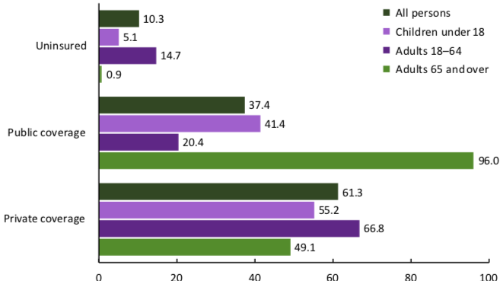
Health Insurance Coverage By Age, 2019
Percent of Persons
Source: National Center for Health Statistics
Notes:
Percentages may add to more than 100% because some people are covered by multiple programs

Slide 28
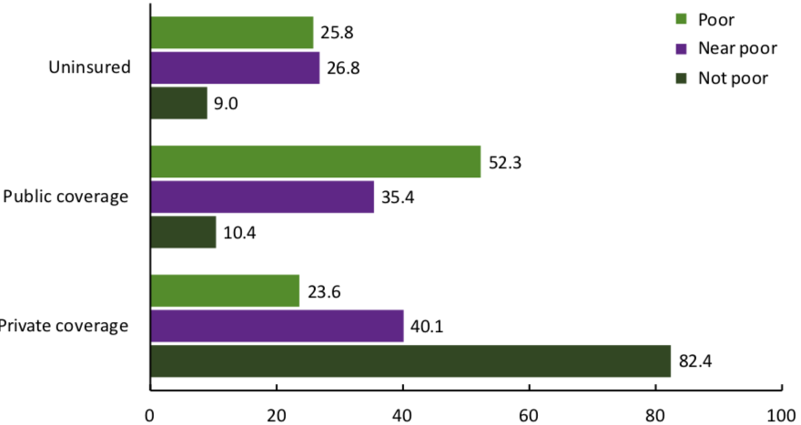
Health Insurance Coverage by Income, 2019
Percent of Persons
Source: National Center for Health Statistics

Slide 29
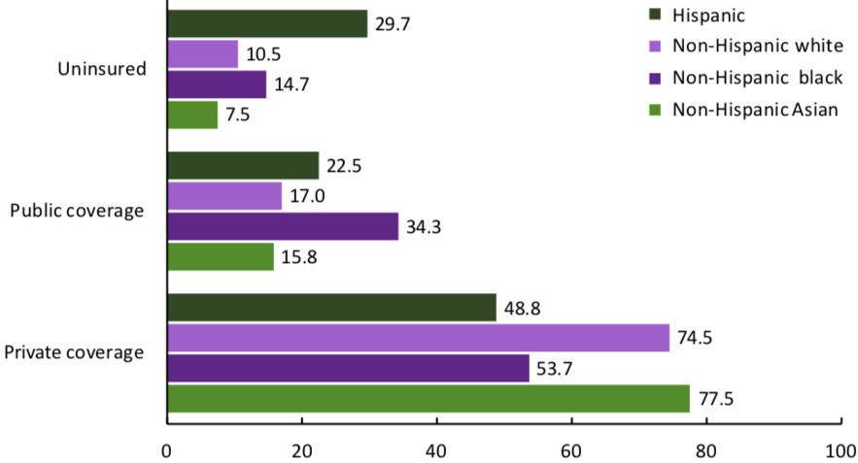
Health Insurance Coverage by Race, 2019
Percent of Persons
Source: National Center for Health Statistics

Slide 30
Physician Visits and Physician Supply
Source: Roosa Tikkanen and Melinda K. Abrams, U.S. Health Care from a Global Perspective, 2019: Higher Spending, Worse Outcomes (Commonwealth Fund, Jan. 2020).

Slide 31
Percent of Women Ages 18–64 Who Reported
Having A Regular Doctor/Regular Place of Care
Source: Munira Z. Gunja et al., What Is the Status of Women’s Health and Health Care in the U.S. Compared to Ten Other Countries? (Commonwealth Fund, Dec. 2018).

Slide 32
Percent of Women Ages 18–64 Who Reported Going to the Emergency Room in the Past Two Years
Source: Munira Z. Gunja et al., What Is the Status of Women’s Health and Health Care in the U.S. Compared to Ten Other Countries? (Commonwealth Fund, Dec. 2018).

Slide 33
Hospital Acute Care Average Length of Stay
Average length of stay for acute care (days)

Slide 34
Acute Care Hospital Beds per 1,000 Population
Source: OECD Health Data 2015.

Slide 35
Waited Less Than a Month to See A Specialist
But how much time did they spend
with the specialist?
How often was it necessary to see a specialist?
Percent of Women Ages 18-64
Source: 2011 Commonwealth Fund International Health Policy Survey of Sicker Adults in Eleven Countries.

Slide 36
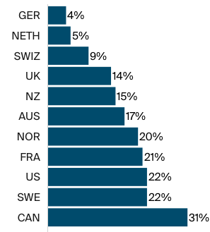
More About Wait Times
Percentage of adults aged 65+
who waited more than 6 days
for an appointment when sick.
U.S.
Source: Commonwealth Fund, Comparing Nations on Timeliness and Coordination of Health Care, 2021

Slide 37
Avoidable Deaths
Deaths per 100,000 population.
Heart disease, stroke, diabetes…
Source: Roosa Tikkanen and Melinda K. Abrams, U.S. Health Care from a Global Perspective, 2019: Higher Spending, Worse Outcomes (Commonwealth Fund, Jan. 2020).

Slide 38
Skipped Care Because of Cost
Percent of women ages 18–64 with at least one
cost-related access problem
*
*
*
*
*
*
*
*
*
*
Source: Munira Z. Gunja et al., What Is the Status of Women’s Health and Health Care in the U.S. Compared to Ten Other Countries? (Commonwealth Fund, Dec. 2018).

Slide 39
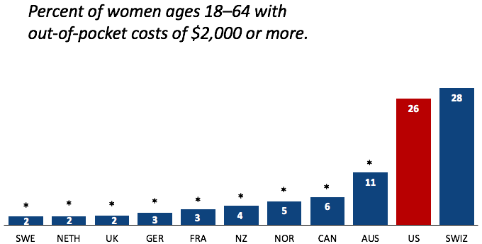
Out-of-Pocket Costs
Source: Munira Z. Gunja et al., What Is the Status of Women’s Health and Health Care in the U.S. Compared to Ten Other Countries? (Commonwealth Fund, Dec. 2018).

Slide 40
Medical Bill Problems
Percent of women ages 18–64 with at least one medical bill problem.
*
*
*
*
*
*
*
*
*
*
Source: Munira Z. Gunja et al., What Is the Status of Women’s Health and Health Care in the U.S. Compared to Ten Other Countries? (Commonwealth Fund, Dec. 2018).
Notes:
Notes: ^ Medical bill problems include any of the following in the past year: 1) serious problems paying or were unable to pay medical bills; 2) spent a lot of time on paperwork or disputes related to medical bills; or 3) insurance denied payment or paid less than expected. * Statistically significant difference compared to the United States (p<.05).
Data: The Commonwealth Fund International Health Policy Survey, 2016.
Source: Munira Z. Gunja et al., What Is the Status of Women’s Health and Health Care in the U.S. Compared to Ten Other Countries? (Commonwealth Fund, Dec. 2018). https://doi.org/10.26099/wy8a-7w13

Slide 41
Notes about Healthcare Access
Insurance coverage in the U.S. is not universal.
  Is universal in most other developed countries.
Wait times are not necessarily lower in the U.S.
Supply of medical personnel and equipment is lower than some other countries
Emergency room use is higher in the U.S. than elsewhere.
Specialized medicine more accessible in the U.S.
Avoidable deaths are higher in U.S., perhaps indicating less access to care

Slide 42
Assessing the U.S. Healthcare System:
Quality of Healthcare Services

Slide 43
Life Expectancy: How Does the US Compare?
Everybody else
United States
Germany – US = 2.5 years
Switzerland – US = 5 years
Source: Roosa Tikkanen and Melinda K. Abrams, U.S. Health Care from a Global Perspective, 2019: Higher Spending, Worse Outcomes (Commonwealth Fund, Jan. 2020).
Notes:
Among the 34 countries in the OECD, the US in 2010 was 27th in life expectancy at birth

Slide 44
Life Expectancy & Per Capita GDP

Slide 45
Life Expectancy at Birth by Race/Ethnicity, 2019
Race/Ethnicity | Life Expectancy (Years)
All Races | 78.8
White | 78.8
Black | 74.8
Hispanic | 81.9
Asian | 85.6
Source: KFF, Key Data on Health and Health Care by Race and Ethnicity
Notes:
CDC

Slide 46
Income Also Matters – Reflecting Access?
Sex | Income Category | Life Expectancy (Years) | Difference High vs Low
Women | Highest Incomes (top 1%) | 88.9 | 10.1 years
 | Lowest Incomes (bottom 1%) | 78.8
Men | Highest Incomes (top 1%) | 87.3 | 14.6 years
 | Lowest Incomes (bottom 1%) | 72.7
Sex | Income Category | Life Expectancy Years | Difference High to Low
Women | Highest Incomes (top 1%) | 88.9 | 10.1 years
 | Lowest Incomes (bottom 1%) | 78.8
Men | Highest Incomes (top 1%) | 87.3 | 14.6 years
 | Lowest Incomes (bottom 1%) | 72.7
Source: https://healthinequality.org/documents/paper/healthineq_summary.pdf

Slide 47
Infant Mortality Comparison
Deaths per 1,000 live births
Source: NEED from OECD Data

Slide 48
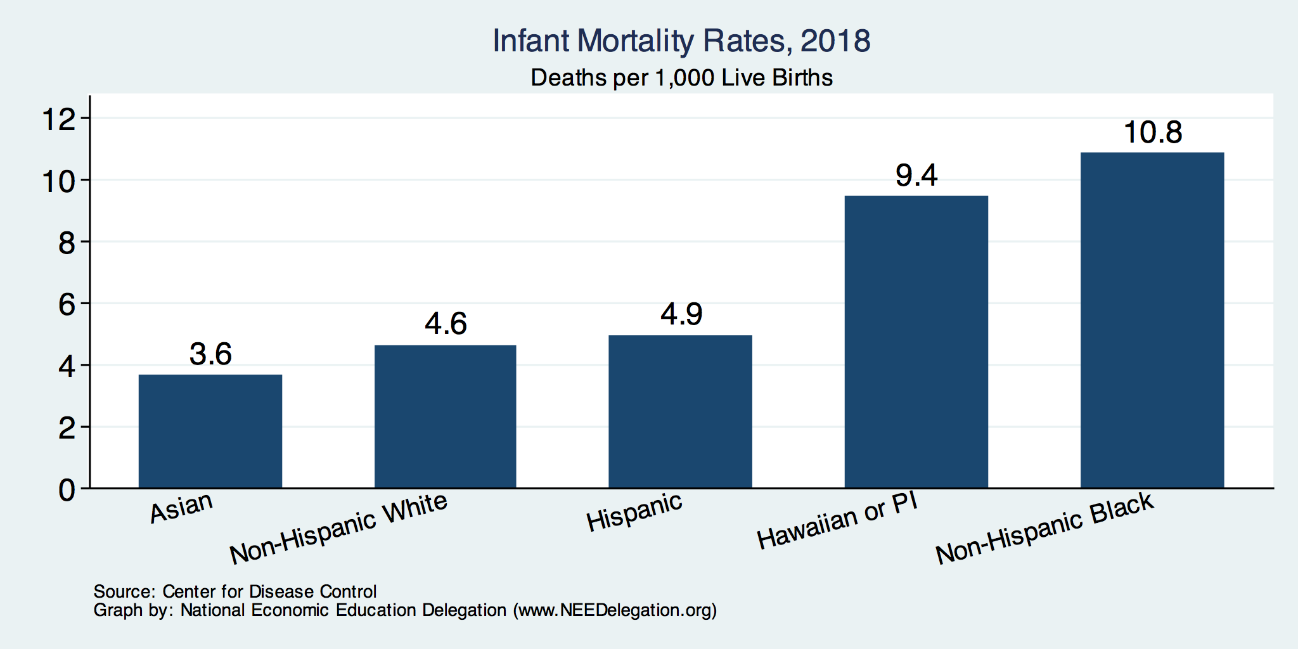
Infant Mortality by Race/Ethnicity

Slide 49
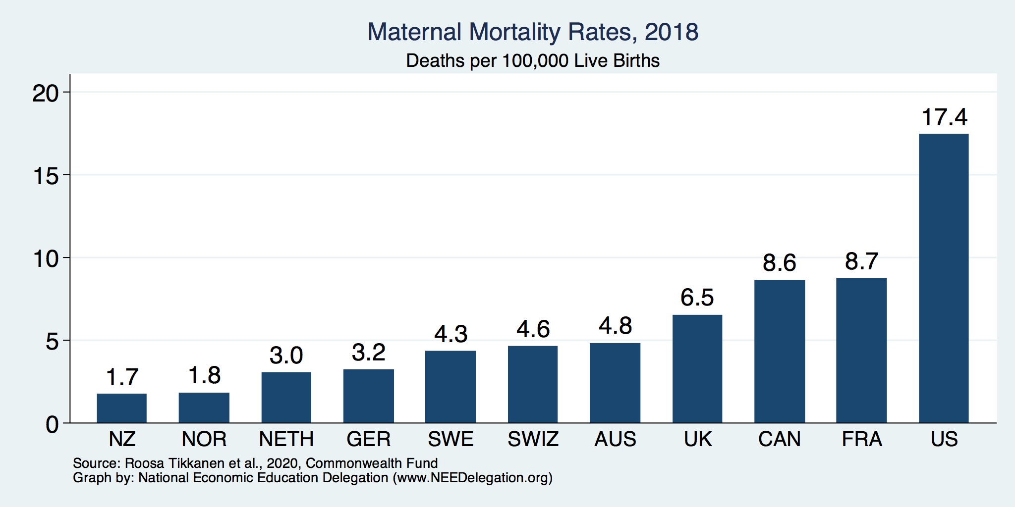
Maternal Mortality Rates
Source: Roosa Tikkanen et al., Maternal Mortality and Maternity Care in the United States Compared to 10 Other Developed Countries (Commonwealth Fund, Nov. 2020). https://doi.org/10.26099/411v-9255

Slide 50
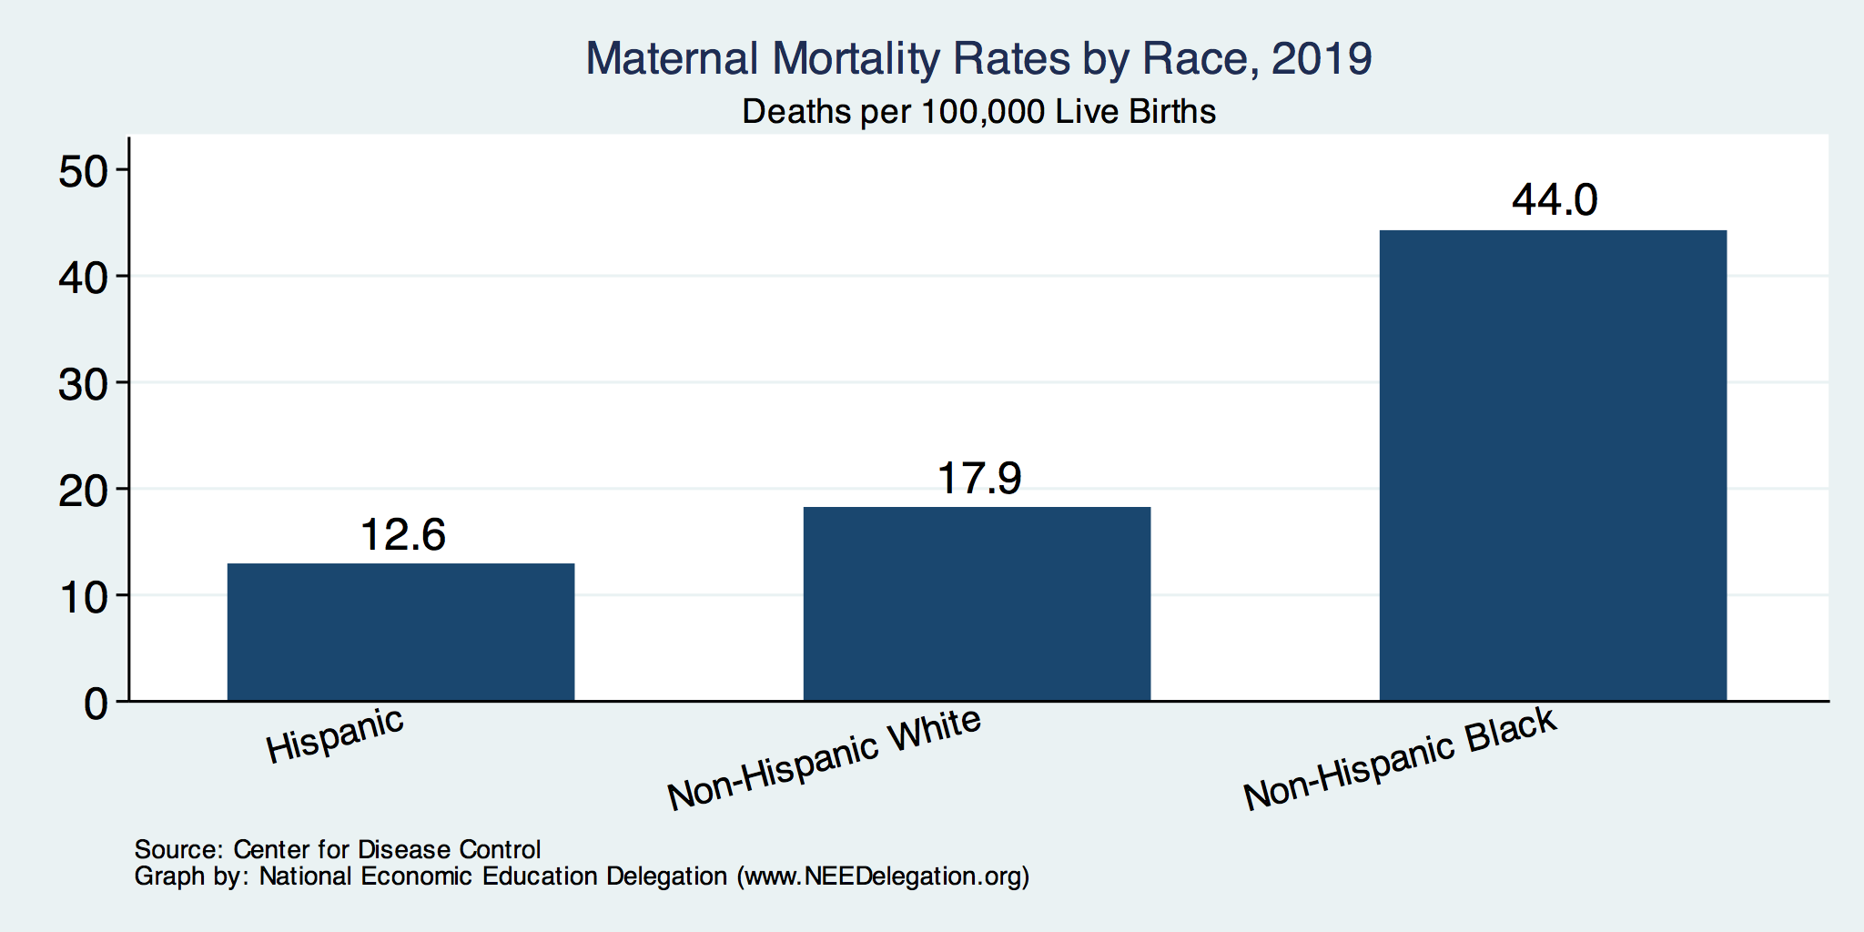
Maternal Mortality Rates by Race

Slide 51
Flu Immunization
Source: Roosa Tikkanen and Melinda K. Abrams, U.S. Health Care from a Global Perspective, 2019: Higher Spending, Worse Outcomes (Commonwealth Fund, Jan. 2020).

Slide 52
Breast Cancer Screening
Percent of females ages 50–69 screened (%).
Source: Roosa Tikkanen and Melinda K. Abrams, U.S. Health Care from a Global Perspective, 2019: Higher Spending, Worse Outcomes (Commonwealth Fund, Jan. 2020).

Slide 53
Prevention and Screening
The U.S. excels in some prevention measures (high ranking:
  including flu vaccinations and breast cancer screenings.
The U.S. has:
  The highest average five-year survival rate for breast cancer,
  but the Lowest for cervical cancer.

Slide 54
Percent of adults who have experienced medical, medication, or lab errors or delays
Source: 2016 Commonwealth Fund International Health Policy Survey.

Slide 55
Obesity Rate, 2017
Percent (%)
Source: Roosa Tikkanen and Melinda K. Abrams, U.S. Health Care from a Global Perspective, 2019: Higher Spending, Worse Outcomes (Commonwealth Fund, Jan. 2020).

Slide 56
Suicides, 2016
Deaths per 100,000 population
OECD average: 11.5
Source: Roosa Tikkanen and Melinda K. Abrams, U.S. Health Care from a Global Perspective, 2019: Higher Spending, Worse Outcomes (Commonwealth Fund, Jan. 2020).

Slide 57
Adults with Multiple Chronic Conditions, 2016
Source: Roosa Tikkanen and Melinda K. Abrams, U.S. Health Care from a Global Perspective, 2019: Higher Spending, Worse Outcomes (Commonwealth Fund, Jan. 2020).

Slide 58
Notes About U.S. Healthcare Quality
The U.S. has the highest chronic disease burden
  and an obesity rate that is two times higher than the OECD average.
The U.S. has fewer physicians and fewer physician visits than most peer countries
The U.S. has the highest rate of avoidable deaths.
Americans use more expensive technologies and specialists
  MRIs, and specialized procedures, such as hip replacements, more often than our peers.
The U.S. outperforms its peers in terms of many preventive measures

Slide 59
Notes About U.S. Healthcare Quality
The U.S. has the highest chronic disease burden
  and an obesity rate that is two times higher than the OECD average.
Americans had fewer physician visits than peers in most countries
  which may be related to a low supply of physicians in the U.S.
The U.S. has among the highest # of hospitalizations from preventable causes
  and the highest rate of avoidable deaths.
Americans use some expensive technologies
  MRIs, and specialized procedures, such as hip replacements, more often than our peers.
The U.S. outperforms its peers in terms of preventive measures
  One of the highest rates of breast cancer screening among women ages 50 to 69.
  Second-highest rate (after the U.K.) of flu vaccinations among people age 65 and older.

Slide 60
Quality of Care Notes
Metrics of quality in the U.S. don’t compare well to other countries.
The system has challenges: obesity, lifestyle, etc.
The system has bright spots: immunization and screening rates

Slide 61
The Economics of Healthcare

Slide 62
An Economic View
The Healthcare system consists of many markets:
  Medical services
  Physicians
  Nurses
  Other care providers
  Hospital facilities
  Pharmaceuticals
  Health Insurance
  Medical supplies (e.g., diagnostic and therapeutic equipment)
  Nursing homes
  Rehab facilities
  Other?
Notes:
Many participants, some with competing objectives

Slide 63
Medical Services Unlike Other Products
For most products, the price reflects the good’s value to buyers and the cost to sellers for producing the good; prices adjust to balance supply and demand.
  Market prices guide economic decisions and help to allocate society’s scarce resources.
Third-party payment system separates buyers from the true cost of the products/services they are consuming
Many healthcare products/services are heterogeneous across consumers
Buyers are poorly informed and ask suppliers what they need

Slide 64
Health Care Markets are Different
Sponsor
(Gov’t or Employer)
Premiums
Insurer or
third-party payers
Premiums
Claims
Taxes or Lower Wages
Insurance Coverage
Payment
Services
Consumers
Producers
Price
Health Care Providers (hospitals, physicians)
Patients
Out-of-pocket fees

Slide 65
How much does an office visit cost to produce?
Any ideas? Includes cost of facility and supplies, wages for doctors and nurses and other staff, their utilities and insurance, etc. (Do the doctors know???)
We pay a small co-pay
One result is that we consume more healthcare than we would if we had to pay its full cost

Slide 66
Rising HC Expenditures: Demand factors
Why the Rapid Rise in Costs?
Rising incomes
  health care is a “normal” good
Aging population
Unhealthy lifestyles
Over-indulgence in specialized care
  2 in 5 adults in the U.S. get general care from specialists
LO4
21-66
Notes:
Healthcare is a normal good with an income elasticity coefficient that is about 1 and a price elasticity of demand coefficient that is as low as .2. As the population ages, the demand for healthcare is likely to increase.

Slide 67
Rising HC Expenditures: Demand factors (cont.)
Why the Rapid Rise in Costs?
Role of providers:
  Supplier induced demand (?)
  Defensive medicine (?)
Third-party payer system separates consumers from the cost of services
  ➔Prices can’t properly signal surpluses or shortages, etc.
LO4
21-67
Notes:
Healthcare is a normal good with an income elasticity coefficient that is about 1 and a price elasticity of demand coefficient that is as low as .2. As the population ages, the demand for healthcare is likely to increase.

Slide 68
Rising HC Expenditures: Supply Factors
Limited supply of physicians
Changes in medical technology
  improved quality of tests, procedures, drugs, etc.
Slow productivity growth
Complex payment systems
High administrative costs & lack of price control
  Health care payers and providers spend $496 billion per year on billing/insurance costs
LO4
21-68
Notes:
The supply of physicians in the US has increased over the years; however, this supply has not kept up with the increase in the demand for physicians’ services. Health care is a service, and it is generally more difficult to increase productivity for a service than for goods. Some technological advances in the way we deliver healthcare have lowered costs; however, more often those medical technologies have been more expensive.

Slide 69
Two Comments
The United States has the only profit-motivated healthcare system in the world.
We have a health RESTORATION system, not a health CARE system.

Slide 70
Another Difference: “Right” or Moral Imperative
Health care as a product is often viewed as a “right” or moral imperative.
  This view argues for greater government interaction in the market, primarily to promote access.
    ➔Subsidies for insurance and care.
    ➔Market regulations to reduce inequities.
Unfettered free markets are unlikely to achieve social goals with respect to health care.

Slide 71
Consequences of Rising Expenditures
Reduced access to care
  Waiting for treatment increases costs
Slower wage growth
Personal bankruptcies
Impact on government budgets
LO2
21-71
Notes:
Rising health care costs cause employers to reduce, or eliminate, offering health insurance. The wages grow at a slower pace because health care costs make up a larger percentage of pay. Employers save money on health care if workers are part-time or temporary. Spending through Medicare and Medicaid is the fastest growing segment of the federal budget, and states can’t cover their share.

Slide 72
Tradeoffs
Tradeoffs take place among access, quality, and cost:
Increasing quality in health care may lead to higher health care costs.
  This could mean a compromise in access (affordability).
I.e., with increasing quality, access may suffer.
By increasing access, quality and cost may suffer.
By decreasing costs, quality may suffer.
In healthcare in the United States, there are potential opportunities to improve all three simultaneously.
E.g., it is possible that increasing quality can reduce costs.

Slide 73
Concentration in specific markets:
1) Pharmaceuticals

Slide 74
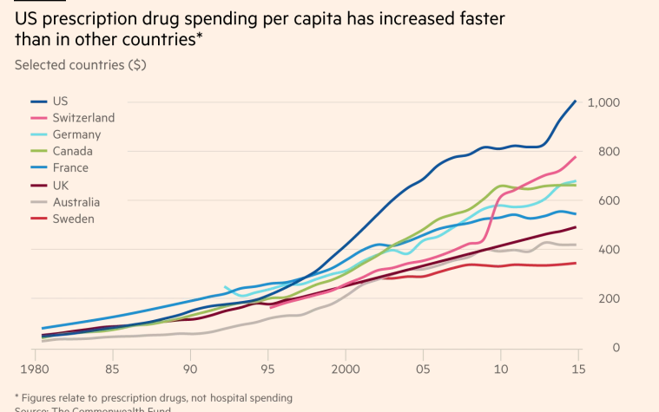
Spending on Pharma: Trends Over Time

Slide 75
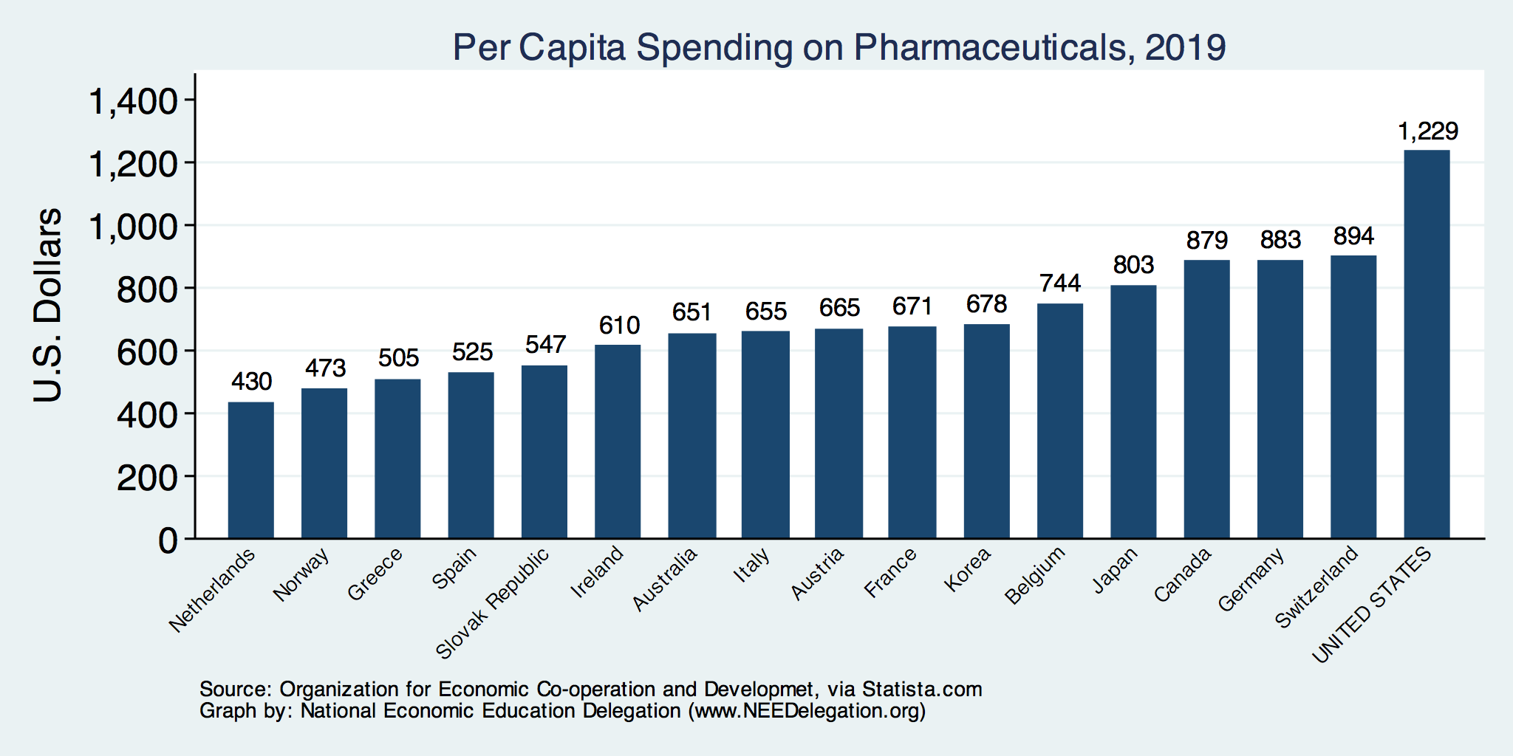
Spending on Pharmaceuticals
Notes:
https://www.bloomberg.com/quicktake/drug-prices
https://en.wikipedia.org/wiki/Prescription_drug_prices_in_the_United_States
https://www.ft.com/content/e92dbf94-d9a2-11e9-8f9b-77216ebe1f17

Slide 76
International Drug Price Comparisons
Drug Prices for 30 Most Commonly Prescribed
Brand-Name and Generic Drugs, 2006–07
US is set at 1.00
 | AUS | CAN | FR | GER | NETH | NZ | SWITZ | UK | US
Brand-name drugs | 0.40 | 0.64 | 0.32 | 0.43 | 0.39 | 0.33 | 0.51 | 0.46 | 1.00
Generic drugs | 2.57 | 1.78 | 2.85 | 3.99 | 1.96 | 0.90 | 3.11 | 1.75 | 1.00
Source: IMS Health; analysis by Gerard Anderson, Johns Hopkins University.

Slide 77
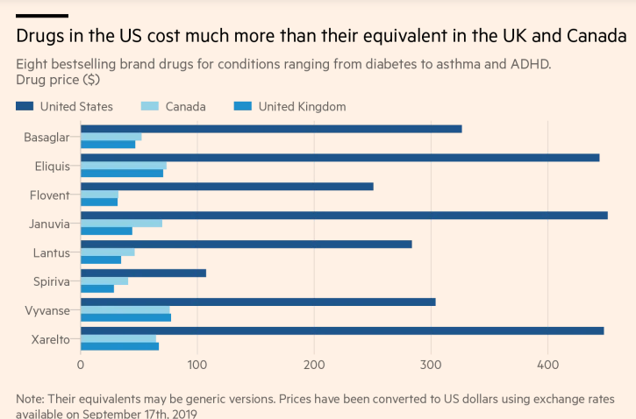
Insulin
Blood
Thinner
Diabetes
Blood
Thinner

Slide 78
Reasons for higher drug prices
By law, Medicare (Part D) cannot negotiate drug prices like other insurance programs do.
  Beginning 01/01/2026, Medicare will be allowed to negotiate prices for 10 drugs (Part of the Inflation Reduction Act of 2022)
In 2017, Medicare spent nearly $8 billion on insulin.
  The researchers said that if Medicare were allowed to negotiate drug prices like the U.S. Department of Veterans Affairs (VA) can, Medicare could save about $4.4 billion just on insulin.
Growing concentration of pharmaceutical companies.

Slide 79
How Much is Negotiation Worth?
The CBO estimates that drug pricing negotiation would reduce federal spending by $456 billion and increase revenues by $45 billion over 10 years. This would include:
  direct savings for Medicare Part D ($448B)
  lower spending for the Affordable Care Act’s subsidies for commercial health plans
  lower spending for the Federal Employees Health Benefits Program
  more government tax revenue because employers using savings from reduced premiums to fund wage increases for their workers.
Source: Congressional Budget Office, https://www.cbo.gov/system/files/2019-12/hr3_complete.pdf

Slide 80
Concentration in Pharmaceutical Companies
The number of mergers and acquisitions involving one of the top 25 firms more than doubled:
  29 in 2006 to 61 in 2015
Between 1995 and 2015, 60 drug companies merged into 10.

Slide 81
According to the GAO:
Between 2006 and 2015:
  Pharma and Biotech revenues increased from $534 billion to $775 billion (2015 $)
  67% of drug companies saw an increase in profit margins.
  Top 25: profit margins were between 15 and 20%.
    Across non-drug companies, profit margins are 4-9%.
Mergers
  # held constant, but deal values increased.
  Largest 10 companies had about 38% market share – higher in narrower markets.
Between 2008 and 2014:
  179 to 263 drug approvals occurred annually
    13% of approvals were for novel drugs.
Research indicates that fewer competitors are associated with higher prices.
  Especially in the market for generics.
Mergers have a varied impact on innovation: R&D spending, patent approvals, and drug approvals.
  Certain merger retrospective studies have found a negative effect.
https://www.gao.gov/assets/gao-18-40-highlights.pdf

Slide 82
Concentration in specific markets: 2) Hospital Consolidations

Slide 83
Hospital Monopolization
Less competition in health systems, hospitals, medical groups, and health insurers has surged in recent years.
Between July 2016 and January 2018:
  Hospitals acquired 8,000 more medical practices.
  14,000 more physicians left independent practice to become hospital employees.
Between 1999 and 2018, hospital profit margins soared!
  From 100% in 1999 to 317% in 2018.
Evidence suggests that with more government oversight and restraining mergers, health care costs would have been lower.

Slide 84
Potential Benefits of Consolidation
Consolidation could lead to potential benefits (“Triple Aim”)
  Coordination of care
  Investment in care coordination, quality.
  Reduction of costly, unnecessary duplication.
  Achievement of scale.
    Costs
      Risk contracts
      Volume-outcome.
But, …
  Consolidation isn’t integration.
  Evidence doesn’t support the claims.
    Consolidation has not led to lower costs, better quality, or coordinated care.
    If anything, just the opposite has happened.
    We have 30 years of experience with consolidation to draw on.
      Hospital mergers, integrated deliver systems, physician practice mergers, hospital acquisitions of physician practices…
Source: Martin Gaynor, NIHCM.org, Supersized: The Rise of Hospital Giants

Slide 85
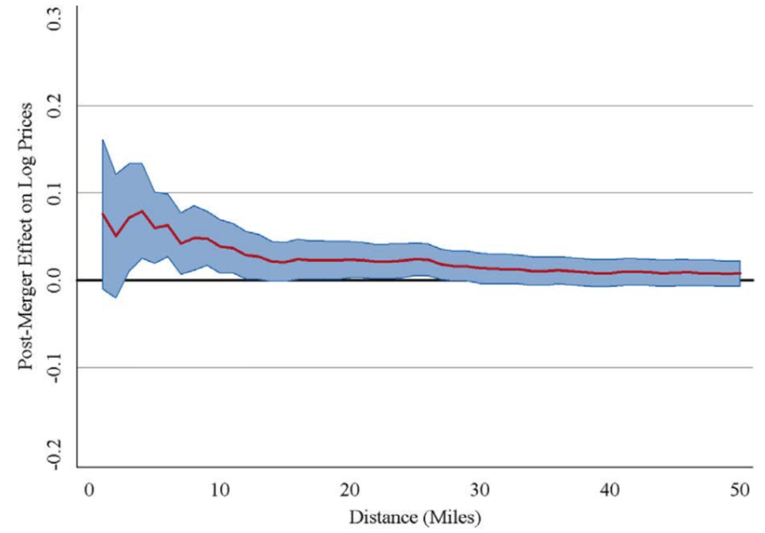
Evidence on Consolidation
Price Increase Following a Hospital Merger
Increase of
About 6%
Very small increase
The price effect of a merger declines with
the distance between the hospitals.

Slide 86
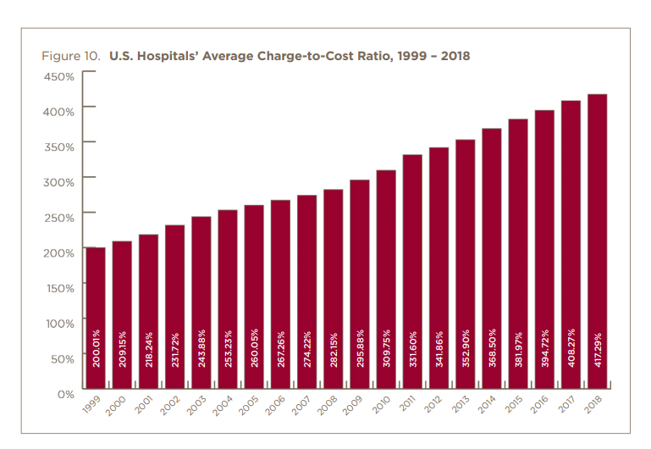

Slide 87
Hospital Monopolization Across the Nation
Hospitals Charge Patients More Than Four Times the Cost of Care
The most expensive hospitals cost of care range from 1,129% at the low end to 1,808% at the high end.
Most of the top 100 most expensive hospitals are located in states in the south and west.
  Florida had the highest number, with 40 hospitals.
  Other top states included Texas with 14 hospitals, Alabama with eight, Nevada with seven, and California with six.

Slide 88
Concentration in specific markets:
3) Health Insurance

Slide 89
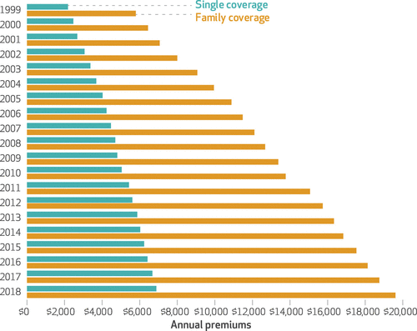
Average Annual Insurance Premiums, 1999-2018
Employer provided, Not Adjusted for Inflation
Single: ~$2,000 to ~$7,000
Family: ~$5,900 to ~$19,500
 | Average Annual Rate of Change
Inflation | 2.19
Health Care CPI | 3.68
Single coverage | 6.51
Family coverage | 6.52
Source: The Commonwealth Fund

Slide 90
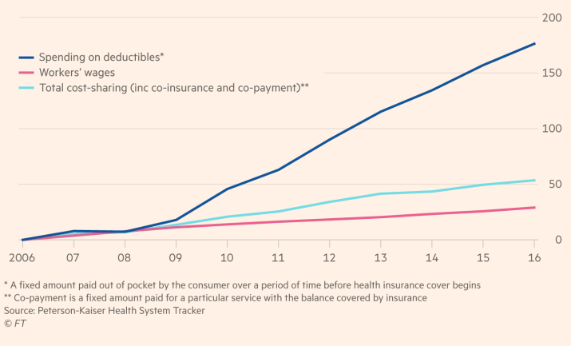
Spending on Deductibles

Slide 91
Reason for Higher Health Insurance Rates
Rising prices in the health sector
Advances in medical technologies
Increased demand for services
Decreasing competition in health insurance markets

Slide 92
Monopolization of Health Insurance Markets
As of 2011, there were close to 100 insurers in Switzerland competing for consumer health care dollars, forcing firms to compete by setting prices to just cover costs.
In the United States, markets are state specific; consumers can choose only from plans available in the state in which they reside.
In 2019, of the 50 states and the District of Columbia:
  21 had only 1 or 2 insurers (up from 11 in 2014)
  14 had 3 or 4, and
  16 states had 5 or more. (CA had 11)
Source: KRR, Number of Issuers Participating in the Individual Health Insurance Marketplaces
Notes:
https://www.kff.org/other/state-indicator/number-of-issuers-participating-in-the-individual-health-insurance-marketplace/?currentTimeframe=0&sortModel=%7B%22colId%22:%22Number%20of%20Issuers%20in%202019%22,%22sort%22:%22desc%22%7D
6 Roy, Avik. “Why Switzerland Has the World’s Best Health Care System.” Forbes, April 29, 2011; https://www.forbes.com/sites/theapothecary/2011/04/29/why-switzerland-has-the-worlds-best-health-care-system/#2416d9a67d74.
7 Henry J. Kaiser Family Foundation. “Number of Issuers Participating in the Individual Health Insurance Marketplaces.” State Health Facts; https://www.kff.org/other/state-indicator/number-of-issuers-participating-in-the-individual-health-insurance-marketplace, accessed July 2019.

Slide 93
Alternative Health Care Systems

Slide 94
Definition: Universal Coverage
Universal coverage – refers to a healthcare system in which all individuals have the same insurance coverage.
Generally, this coverage includes:
  Access to all needed services and benefits.
  Protects individuals from excessive financial hardships.
    Medical indebtedness is the #1 cause of bankruptcies in the United States.
Notes:
https://ajph.aphapublications.org/doi/abs/10.2105/AJPH.2018.304901?journalCode=ajph

Slide 95
Definition: Single-Payer
Single-payer - refers to financing a healthcare system by making one entity solely and exclusively responsible for paying for medical goods and services. (Not necessarily the government.)
Only the financing component is nationalized.
  The money for the payment can be either collected by:
    Taxes collected by the government
    Premiums collected by National or Public Health Insurance
Single-payer systems: 17 countries
  Norway, Japan, United Kingdom, Kuwait, Sweden, Bahrain, Brunei, Canada, United Arab Emirates, Denmark, Finland, Slovenia, Italy, Portugal, Cyprus, Spain, and Iceland.

Slide 96
Definition: Socialized Medicine
Socialized medicine – this model takes the single-payer system one step further.
  Government not only pays for health care but operates the hospitals and employs the medical staff.
This is NOT, and has NEVER been, part of the debate in the United States.

Slide 97
Definition: Third-Party Payer
A third-party payer is an entity that pays medical claims on behalf of the insured. Examples of third-party payers include government agencies, insurance companies, health maintenance organizations (HMOs), and employers.
  Employer-sponsored health plans
  Individual market health plans
  National health insurance

Slide 98
Potential pros and cons of national insurance
Potential Pros
  Universal coverage
  Government controls quality of care
  No medical bills or co-pays (or debt!)
  Consolidated medical records (lower administrative costs; fewer errors)
  Higher wages/wage growth
Potential Cons
  Higher taxes
  Long wait times for elective services
  Government determines service eligibility
  May reduce incentives for innovation

Slide 99
Key ACA components
Expand health insurance coverage (i.e., increase access)
  Individual mandate
  Corporate mandate
  Insurance Exchanges
  Medicaid expansion
Electronic medical records
Cost effectiveness studies

Slide 100
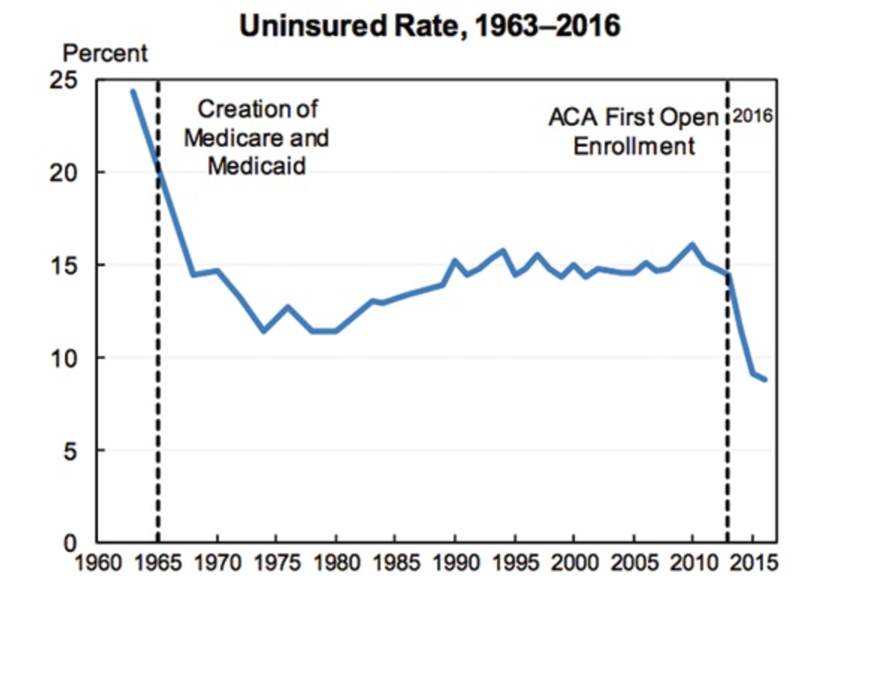
Uninsured rate dropped dramatically after first ACA open enrollment in 2016
Source: The Century Foundation
Notes:
Sarah The Affordable Care Act, formally called the Patient Protection and Affordable Care Act, was signed in 2010 by President Obama, but the major provisions weren’t put into place til 2014 and the first open enrollment period wasn’t until 2016. The enrollment period is basically a window of time where you can sign up for a plan/benefits, and if you miss the window you could lose your benefits or have to pay a fine, and you usually can’t enroll until the next period.
I know overall the ACA was talked about a fair amount in the readings on Moodle so we specifically want to focus just on the healthcare exchanges it introduced and the impacts on enrollment. In the graph here, you can see how after the creation of Medicare and Medicaid, the uninsured rate dropped substantially, but after the ACA’s first open enrollment, it dropped by the same amount if not more and this is important because it shows the extent of the impact of the ACA.

Slide 101
Summary
Healthcare is a very complex issue
US HealthCare system is not performing well.
  Very expensive with mixed quality and access.
One reason for rising expenditures is the monopolization of healthcare markets.
Universal health insurance would increase access and perhaps also reduce costs.

Slide 102
Closing Thoughts…
Is health care a right or a privilege?
Must have someone decide how to ration healthcare services. Currently, health insurance companies do this
Changing the focus from maximizing profits to maximizing health would help.

Slide 103

Next Week: Bitcoin mine

Slide 104
Thank you!
Any Questions?
www.NEEDEcon.org
Robert Rebelein, Ph.D.
Vassar@vassar.edu
Contact NEED: info@NEEDEcon.org
Submit a testimonial: www.NEEDEcon.org/testimonials.php
Become a Friend of NEED: www.NEEDEcon.org/friend.php

