Slide 1
Osher Lifelong Learning Institute, Winter 2022
Contemporary Economic Policy
S. Maine University
January-February, 2022
Jon Haveman, Ph.D.
National Economic Education Delegation

Slide 2
Available NEED Topics Include:
Coronavirus Economics
US Economy
Climate Change
Economic Inequality
Economic Mobility
Trade and Globalization
Minimum Wages
Immigration Economics
Housing Policy
Federal Budgets
Federal Debt
Black-White Wealth Gap
Autonomous Vehicles
US Social Policy

Slide 3
Course Outline
Contemporary Economic Policy
Week 1 (1/11): US Economy & Coronavirus Economics
Week 2 (1/18): Federal Debt (Ryan Herzog, Gonzaga University)
Week 3 (1/25): Economics of Immigration (Jennifer Alix-Garcia, Oregon St.)
Week 4 (2/1): Health Economics (Me)
Week 5 (2/8): Minimum Wage (Me)
Week 6 (2/15): Cryptocurrencies (Geoffrey Woglom, Amherst College)

Slide 4
Health(care) Economics
OLLI – University of Southern Maine
February 1, 2022
Jon Haveman, Ph.D.
NEED

Slide 5
Credits and Disclaimer
This slide deck was authored by:
Veronika Dolar, SUNY Old Westbury
Jon Haveman, NEED
Disclaimer
NEED presentations are designed to be nonpartisan.
It is, however, inevitable that the presenter will be asked for and will provide their own views.
Such views are those of the presenter and not necessarily those of the National Economic Education Delegation (NEED).

Slide 6
Outline
What is Health(care) Economics?
Health Insurance and Outcomes
Health Care Systems and Institutions
Health Insurance and Reform
Time permitting: Big Pharma

Slide 7
What is Health(care) Economics?
Health Economics is a field of MICROeconomics that focuses on the health care industry.
Examples of other subfields of microeconomics include:
labor economics, industrial organization, economics of education, public economics, and urban economics.
Notes:
Microeconomics (from Greek prefix micro- meaning "small" + "economics") is a branch of economics that studies the behavior of how the individual modern household and firms make decisions to allocate limited resources.
Macroeconomics (from Greek prefix macro- meaning “large" + "economics") is the study of economy-wide phenomena, including inflation, unemployment, and economic growth.
These two branches of economics are closely intertwined, yet distinct—they address different questions.
Microeconomics studies individual markets or sectors or industries (hence health care industry is classified under microeconomics) while macroeconomics studies national economies and country/state-wide, general equilibrium questions.
Many times people think that since micro means small and macro large, that microeconomics is somehow inferior or studies smaller issues than what is studied in macroeconomics. But it should be noted, that many firms today have revenues that are substantially larger than most national incomes on nations. Obviously, this is comparing apples to oranges – but at least it gives a general idea of the size of some of these firms and markets.
https://medium.com/@denislesak/companies-with-revenues-greater-than-gdp-of-countries-58c46af4a1a9
https://oxfamblogs.org/fp2p/of-the-worlds-top-100-economic-entities-29-are-states-71-are-corporates/
See the next slide to compare US health care.

Slide 8
Health Economics is part of Microeconomics
Although health economics is part of “micro-” economics, it is actually very big:
In 2019, U.S. national health expenditures were 17.7% of GDP, which is equivalent to around $3.8 trillion.
U.S. Healthcare is the 5th largest economy in the world.
For comparison, GDP in each country in 2019:
Germany: $3,845 trillion (4th largest economy)
UK: $2,827 trillion (6th largest economy)
France : $2,715 trillion (7th largest economy)
Notes:
Hopefully the comparison of the US health care industry to the entire economy of Germany, UK, and France will make students also appreciate how difficult any type of a reform is – when the sector being reformed is of this size and complexity.
The list of top 10 largest economies based on the total size of GDP: 1) US, 2) China, 3) Japan, 4) Germany, 5) India, 6) UK, 7) France, 8) Italy, 9) Brazil, 10) Canada

Slide 9
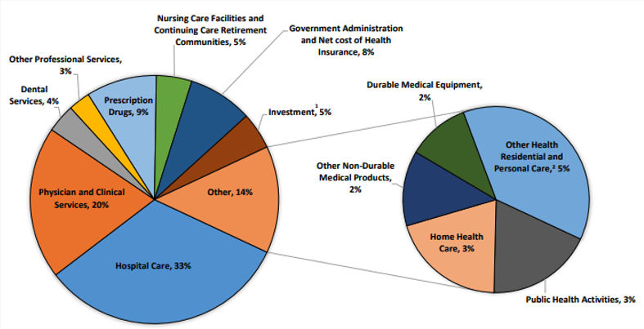
Where the money goes?
Source: Centers for Medicare & Medicaid Services, Office of the Actuary, National Health Statistics Group.

Slide 10
What is Health Economics?
Health economics studies health care resource markets and health insurance.
Healthcare is the biggest industry and the largest employer in the US.
Notes:
Here the big emphasis is on the distinction between other health care markets and health insurance – this difference it typically hard to grasp for most people.

Slide 11
What is a Market?
A market is a group of buyers and sellers of a particular product in the area or region under consideration. The area may be the earth, or countries, regions, states, or cities.
The concept of a market is any structure that allows buyers and sellers to exchange any type of goods, services, and information.
Markets can be physical and non-physical.
There are many different types of markets and depending on the type, different rules should be set up to achieve the best results for society.

Slide 12
Markets Studied in Health Economics
Markets for:
Physicians
Nurses
Hospital facilities
Nursing homes
Pharmaceuticals
Medical supplies (such as diagnostic and therapeutic equipment)
Health Insurance
Notes:
Many times people confuse Health Economics with Health Insurance. The topics discuss in health economics included health insurance, but also a number of other markets related to health care resources.
This is an important distinction – because it also relates to the Health Care reform. Health care reform in the US is mostly dealing with the reform of the Health Insurance, rather than other health care markets.
The debate about many of these issues has to do with the market structure – and the issue of when does a market work well – without a lot of government intervention (free markets) and when is it necessary for a government to play a much larger role.

Slide 13
Why Are We Talking About the Market for Health Insurance?

Slide 14
The Three Legs of the Healthcare Stool
The market for Health Insurance is where they all come together.
Access
Quality
Cost
We will discuss metrics of performance for each.

Slide 15
Access

Slide 16
Health Insurance Coverage, 2019
Percent of Persons
Source: National Center for Health Statistics

Slide 17
Physician Visits and Physician Supply
Source: Roosa Tikkanen and Melinda K. Abrams, U.S. Health Care from a Global Perspective, 2019: Higher Spending, Worse Outcomes (Commonwealth Fund, Jan. 2020).

Slide 18
Avoidable Deaths
Deaths per 100,000 population.
Heart disease, stroke, hypertension…
Source: Roosa Tikkanen and Melinda K. Abrams, U.S. Health Care from a Global Perspective, 2019: Higher Spending, Worse Outcomes (Commonwealth Fund, Jan. 2020).

Slide 19
Waited Less Than a Month to See A Specialist
But how much time did they spend
with the specialist?
How often was it necessary to see a specialist?
Source: 2011 Commonwealth Fund International Health Policy Survey of Sicker Adults in Eleven Countries.

Slide 20
Acute Care Hospital Beds per 1,000 Population
Source: OECD Health Data 2015.

Slide 21
Percent of Women Ages 18–64 Who Reported Having A Regular Doctor/Regular Place of Care
Source: Munira Z. Gunja et al., What Is the Status of Women’s Health and Health Care in the U.S. Compared to Ten Other Countries? (Commonwealth Fund, Dec. 2018).

Slide 22
Percent of Women Ages 18–64 Who Reported Going to the Emergency Room in the Past Two Years
Source: Munira Z. Gunja et al., What Is the Status of Women’s Health and Health Care in the U.S. Compared to Ten Other Countries? (Commonwealth Fund, Dec. 2018).

Slide 23
Access Notes
Insurance coverage in the U.S. is not universal.
Supply of medical personnel and equipment may be lower than elsewhere.
Avoidable (amenable) deaths are higher, perhaps indicating less access to care.
Emergency room use is higher in the U.S. than elsewhere.
Specialized medicine is more accessible.

Slide 24
Quality

Slide 25
Life Expectancy: How Does the US Compare?
Everybody else
United States
Germany – US = 2.5 years
Source: Roosa Tikkanen and Melinda K. Abrams, U.S. Health Care from a Global Perspective, 2019: Higher Spending, Worse Outcomes (Commonwealth Fund, Jan. 2020).

Slide 26
Life Expectancy at Birth by Race, 2017
Race/Ethnicity | Life Expectancy (Years)
All Races | 78.6
White | 78.8
Black | 75.3
Hispanic | 81.8
Notes:
CDC

Slide 27
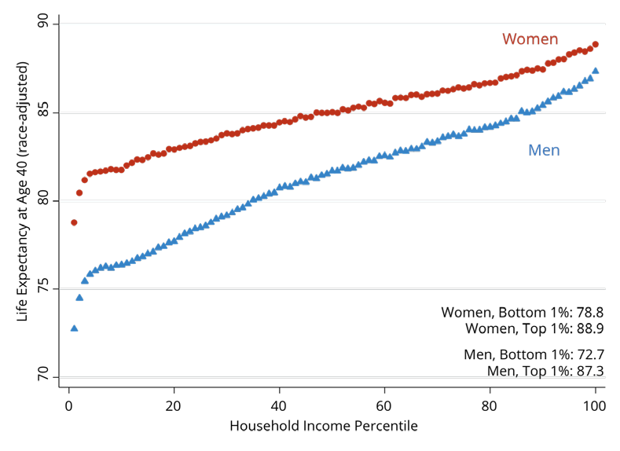
Income Also Matters – Reflecting Access?
Source: https://healthinequality.org/documents/paper/healthineq_summary.pdf

Slide 28
Infant Mortality International Comparison
Deaths per 1,000 live births
Source: NEED from OECD Data

Slide 29
Infant Mortality by Race/Ethnicity
2016
Black
Deaths per 1,000 live births
White
Source: NEED from CDC.gov

Slide 30
Maternal Mortality Rate
Maternal deaths per 100,000 live births.
Source: Munira Z. Gunja et al., What Is the Status of Women’s Health and Health Care in the U.S. Compared to Ten Other Countries? (Commonwealth Fund, Dec. 2018).

Slide 31
Maternal Mortality Rate by Race
American Indian/Alaska Native and Black women are 2 to 3 times as likely to die from a pregnancy-related cause than white women.

Slide 32
Percent of adults who have experienced medical, medication, or lab errors or delays
Source: 2016 Commonwealth Fund International Health Policy Survey.

Slide 33
Prevention and Screening
The U.S. excels in some prevention measures, including flu vaccinations and breast cancer screenings.
The U.S. has the highest average five-year survival rate for breast cancer, but the Lowest for cervical cancer.

Slide 34
Flu Immunization
Source: Roosa Tikkanen and Melinda K. Abrams, U.S. Health Care from a Global Perspective, 2019: Higher Spending, Worse Outcomes (Commonwealth Fund, Jan. 2020).

Slide 35
Breast Cancer Screening
Percent of females ages 50–69 screened (%).
Source: Roosa Tikkanen and Melinda K. Abrams, U.S. Health Care from a Global Perspective, 2019: Higher Spending, Worse Outcomes (Commonwealth Fund, Jan. 2020).

Slide 36
Obesity Rate, 2017
Percent (%)
Source: Roosa Tikkanen and Melinda K. Abrams, U.S. Health Care from a Global Perspective, 2019: Higher Spending, Worse Outcomes (Commonwealth Fund, Jan. 2020).

Slide 37
Adults with Multiple Chronic Conditions, 2016
Source: Roosa Tikkanen and Melinda K. Abrams, U.S. Health Care from a Global Perspective, 2019: Higher Spending, Worse Outcomes (Commonwealth Fund, Jan. 2020).

Slide 38
The World Health Report 2000, Health Systems: Improving Performance
 | Overall Ranking
1. | France
2. | Italy
3. | San Marino
4. | Andorra
5. | Malta
6. | Singapore
7. | Spain
8. | Oman
9. | Austria
10. | Japan
 | Overall Ranking
30. | Canada
31. | Finland
32. | Australia
33. | Chile
34. | Denmark
35. | Dominica
36. | Costa Rica
37. | United States
38. | Slovenia
39. | Cuba

Slide 39
Perception of Quality of Medical Care
Source: Munira Z. Gunja et al., What Is the Status of Women’s Health and Health Care in the U.S. Compared to Ten Other Countries? (Commonwealth Fund, Dec. 2018).

Slide 40
Quality of Care Notes
Metrics of quality in the U.S. are not very good.
Quality of care is not considered very good in the U.S.
The system has challenges: obesity/lifestyle.
The system has bright spots!

Slide 41
A Bit About Quality
The U.S. has the highest chronic disease burden.
and an obesity rate that is two times higher than the OECD average.
Americans had fewer physician visits than peers in most countries.
which may be related to a low supply of physicians in the U.S.
The U.S. has among the highest # of hospitalizations from preventable causes.
and the highest rate of avoidable deaths.
Americans use some expensive technologies more often than our peers.
MRIs, and specialized procedures, such as hip replacements.
The U.S. outperforms its peers in terms of preventive measures.
One of the highest rates of breast cancer screening among women ages 50 to 69.
Second-highest rate (after the U.K.) of flu vaccinations among people age 65 and older.

Slide 42
Costs

Slide 43
National Health Expenditure as Percent of GDP
Total Expenditures in 2019: $3.8 Trillion
17.9
17.7, 2019
13.4
5.0
Healthcare spending: increased 60x between 1929 and 2019.
US Economy: increased just 12x
Notes:
https://www.cms.gov/

Slide 44
Health Care Spending as % of GDP, 1980–2018
United States
Everybody else
Source: Roosa Tikkanen and Melinda K. Abrams, U.S. Health Care from a Global Perspective, 2019: Higher Spending, Worse Outcomes (Commonwealth Fund, Jan. 2020).

Slide 45
Why is Healthcare Spending Increasing?
Costs in the United States, and elsewhere are increasing rapidly.
The share of economic spending on health care has been steadily increasing for all countries because:
Health spending growth has outpaced economic growth.
Richer countries demand more services, like attention to health.
Also because of
Advances in medical technologies.
Increased demand for services.
Rising prices in the health sector – why?

Slide 46
GDP per Capita and Health Spending per Capita, 2017

Slide 47
National Healthcare Expenditure Per Capita
11,172
1,239
Notes:
https://www.cms.gov/

Slide 48
International Per Capita Healthcare Spending
Source: Roosa Tikkanen and Melinda K. Abrams, U.S. Health Care from a Global Perspective, 2019: Higher Spending, Worse Outcomes (Commonwealth Fund, Jan. 2020).
Notes:
Some good resources:
https://www.commonwealthfund.org/publications/issue-briefs/2020/jan/us-health-care-global-perspective-2019
A bit older report: https://www.commonwealthfund.org/publications/issue-briefs/2015/oct/us-health-care-global-perspective
https://www.healthsystemtracker.org/chart-collection/quality-u-s-healthcare-system-compare-countries/#item-overall-age-specific-potential-years-of-life-lost-per-100000-population-1990-2017
https://axenehp.com/international-healthcare-systems-us-versus-world/

Slide 49
Why Are Costs so High in the US?
One Reason:
The United States is the only
profit-motivated healthcare system in the world.

Slide 50
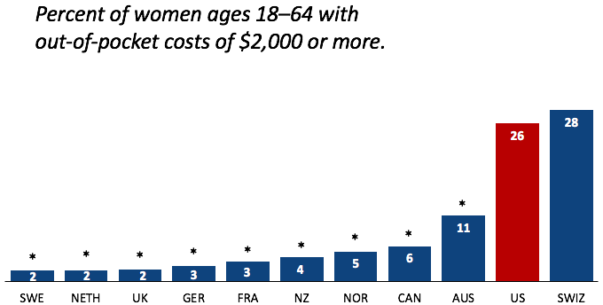
Out-of-Pocket Costs
Source: Munira Z. Gunja et al., What Is the Status of Women’s Health and Health Care in the U.S. Compared to Ten Other Countries? (Commonwealth Fund, Dec. 2018).

Slide 51
Markets Matter for Costs

Slide 52
What types of markets are there?
More Competition
Less Competition
Perfect Competition
Monopolistic Competition
Monopoly
Oligopoly
Duopoly
Monopsony
Less Concentration
More Concentration

Slide 53
Are Health Care Markets Special?
Market Structure
Type of products and services
Principal-Agent Problem
Asymmetric Information
Moral Hazard
Moral Imperative (?)

Slide 54
Health Care Markets are Different
Sponsor
Premiums
Insurer or
third-party payers
Premiums (individual policies)
Money (fixed or variable payments)
Taxes or Lower Wages
Claims
Insurance Coverage
Services
Consumers
Producers
Price
Health Care Providers (hospitals, physicians)
Patients
Out-of-pocket fees

Slide 55
Policy Matters for Costs

Slide 56
Hospital Monopolization Across the Nation
Most of the top 100 most expensive hospitals are located in states in the west and south.
Florida had the highest number, with 40 hospitals.
Other top states included Texas with 14 hospitals, Alabama with eight, Nevada with seven, and California with six.
Hospitals Charge Patients More Than Four Times the Cost of Care
The most expensive hospitals cost of care range from 1,808 % at the high end to 1,129 % at the low end.

Slide 57
Hospital Monopolization
Market consolidation among and between health systems, hospitals, medical groups, and health insurers has surged over the last decade.
Over an 18-month period between July 2016 and January 2018:
Hospitals acquired 8,000 more medical practices.
14,000 more physicians left independent practice to become hospital employees.

Slide 58
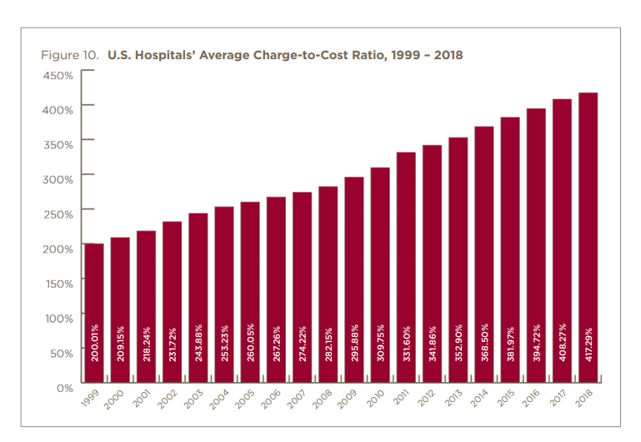

Slide 59
Drug Price Comparisons
Drug Prices for 30 Most Commonly Prescribed Brand-Name and Generic Drugs, 2006–07 US is set at 1.00
 | AUS | CAN | FR | GER | NETH | NZ | SWITZ | UK | US
Brand-name drugs | 0.40 | 0.64 | 0.32 | 0.43 | 0.39 | 0.33 | 0.51 | 0.46 | 1.00
Generic drugs | 2.57 | 1.78 | 2.85 | 3.99 | 1.96 | 0.90 | 3.11 | 1.75 | 1.00
Source: IMS Health; analysis by Gerard Anderson, Johns Hopkins University.

Slide 60
Medicare Modernization Act
Prescription Drug Component
Medicare Part D, by law, cannot negotiate drug prices like other governments do.
In 2017, Medicare spent nearly $8 billion on insulin.
The researchers said that if Medicare were allowed to negotiate drug prices like the U.S. Department of Veterans Affairs (VA) can, Medicare could save about $4.4 billion just on insulin.

Slide 61
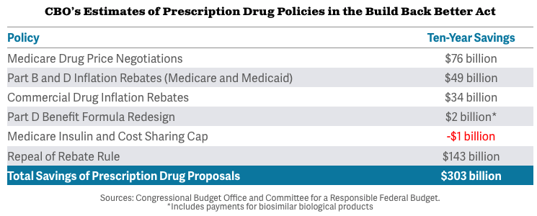
Prescription Drug Savings in Build Back Better

Slide 62
Concentration in Pharmaceutical Companies
The number of mergers and acquisitions involving one of the top 25 firms more than doubled:
29 in 2006 to 61 in 2015
Between 1995 and 2015, 60 drug companies merged into 10.

Slide 63
Monopolization of Health Insurance Market
As of 2011, there were close to 100 insurers in Switzerland competing for consumer health care dollars, forcing firms to compete by setting prices to just cover costs.
In the United States, markets are state specific and consumers may choose from plans available in the state in which they reside.
In 2014, of the 50 states and the District of Columbia:
11 had only 1 or 2 insurers
21 had 3 or 4, and
only 19 states had 5 or more. (CA has 11)
As of July 2019, the number of states with only 1 or 2 insurers had increased from 11 to 20.
Notes:
6 Roy, Avik. “Why Switzerland Has the World’s Best Health Care System.” Forbes, April 29, 2011; https://www.forbes.com/sites/theapothecary/2011/04/29/why-switzerland-has-the-worlds-best-health-care-system/#2416d9a67d74.
7 Henry J. Kaiser Family Foundation. “Number of Issuers Participating in the Individual Health Insurance Marketplaces.” State Health Facts; https://www.kff.org/other/state-indicator/number-of-issuers-participating-in-the-individual-health-insurance-marketplace, accessed July 2019.

Slide 64
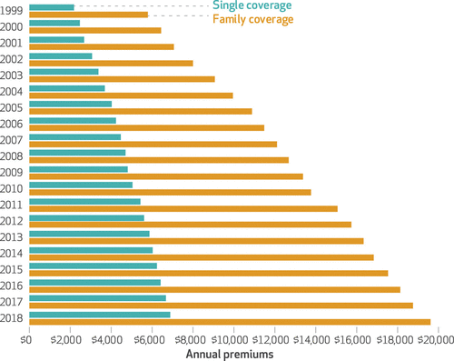
Average Annual Insurance Premiums, 1999-2018
Employer provided, Not Adjusted for Inflation
Single: ~$2,000 to ~$7,000
Family: ~$5,900 to ~$19,500
 | Average Annual Rate of Change
Inflation | 2.19
Health Care CPI | 3.68
Single coverage | 6.51
Family coverage | 6.52
Source: The Commonwealth Fund

Slide 65
Spending on Deductibles

Slide 66
Reason for Higher Health Insurance Rates
Rising prices in the health sector
Advances in medical technologies
Increased demand for services
Concentration of insurance companies!

Slide 67
Health Care Systems and Institutions

Slide 68
Health System Classification
Developed countries of the world have each taken a different approach for their health care delivery systems.
5 basic models:
National health insurance (Canada)
Bismarck (France, Germany, Japan, Switzerland)
Beveridge – socialized medicine (United Kingdom, Spain, New Zealand)
Out of pocket model – self insurance
Mixed (United States)

Slide 69
US Health Care System
Medicare – National Health Insurance
Military Veteran Care – Beveridge model (socialized medicine)
Employer-sponsored insurance – Bismarck model
Individual market health plans - Bismarck model
Uninsured - Out of pocket model

Slide 70
Health Care Spending as % of GDP, 1980–2018
Everybody Else
Source: Roosa Tikkanen and Melinda K. Abrams, U.S. Health Care from a Global Perspective, 2019: Higher Spending, Worse Outcomes (Commonwealth Fund, Jan. 2020).

Slide 71
Life Expectancy: How Does the US Compare?
Everybody else
United States
Germany – US = 2.5 years
Source: Roosa Tikkanen and Melinda K. Abrams, U.S. Health Care from a Global Perspective, 2019: Higher Spending, Worse Outcomes (Commonwealth Fund, Jan. 2020).

Slide 72
Health Insurance and Reform

Slide 73
Definition: Universal Coverage
Universal coverage – refers to health care systems in which all individuals have insurance coverage.
Generally, this coverage includes:
Access to all needed services and benefits.
Protects individuals from excessive financial hardships.
Medical indebtedness is the #1 cause of bankruptcies in the United States.
Canada has universal coverage, the United States does not.

Slide 74
Definition: Single-Payer
Single-payer - refers to financing a health care system by making one entity solely and exclusively responsible for paying for medical goods and services.
It is only the financing component that is socialized.
The money for the payment can be either collected by:
Taxes collected by the government
Premiums collected by National or Public Health Insurance
Single-payer systems: 17 countries
Norway, Japan, United Kingdom, Kuwait, Sweden, Bahrain, Brunei, Canada, United Arab Emirates, Denmark, Finland, Slovenia, Italy, Portugal, Cyprus, Spain, and Iceland.

Slide 75
Definition: Socialized Medicine
Socialized medicine – this model actually takes the single-payer system one step further.
Government not only pays for heath care but operates the hospitals and employs the medical staff.
This is NOT part of the current debate in the United States.

Slide 76
Definition: Third-Party Payer
A third-party payer is an entity that pays medical claims on behalf of the insured. Examples of third-party payers include government agencies, insurance companies, health maintenance organizations (HMOs), and employers.
Employer-sponsored health plans
Individual market health plans
National health insurance

Slide 77
Tradeoffs
Tradeoffs take place among the three legs:
Increasing quality in health care may lead to higher health care costs.
This means a compromise in access (affordability).
I.e., with increasing quality, access may suffer.
By increasing access, quality may suffer.
By decreasing costs, quality may suffer.

Slide 78
Summary
US HealthCare system is not preforming well.
Very expensive with low quality and access.
One of the main reasons for very high costs is the monopolization of healthcare markets.
Hospitals, health insurance, big pharma, physicians, etc.
A few simple solutions could drastically reduce costs:
Enforcement of antitrust laws in this sector.
Introduction of a public option in the health insurance market.
Ability for the US government to negotiate drug prices like most every other nation.
Universal health insurance would increase access and perhaps also reduce costs.
But there are always tradeoffs: you can pick two, but the third may suffer.

Slide 79
Big Pharma

Slide 80
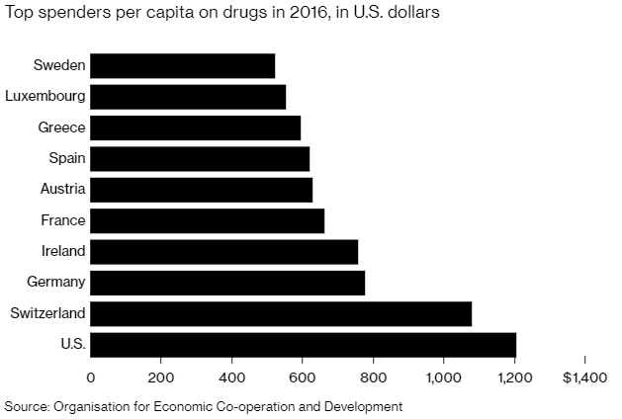
Spending on Pharmaceuticals
Notes:
https://www.bloomberg.com/quicktake/drug-prices
https://en.wikipedia.org/wiki/Prescription_drug_prices_in_the_United_States
https://www.ft.com/content/e92dbf94-d9a2-11e9-8f9b-77216ebe1f17

Slide 81
Drug Prices: Trends Over Time

Slide 82
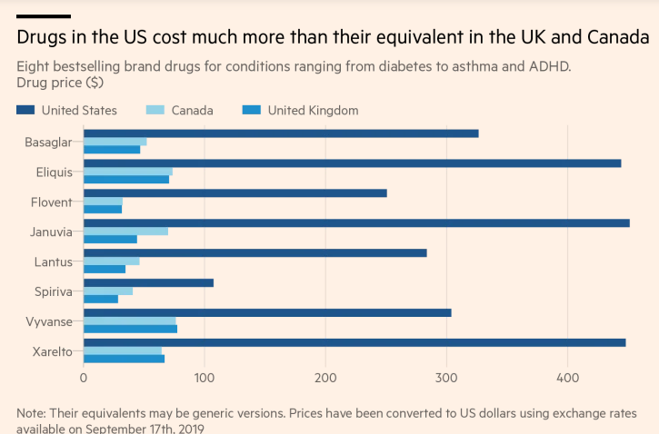

Slide 83
Price Hikes
Turing Pharmaceuticals’ 5,555% price increase of Daraprim in 2015 and Mylan’s 500% increase of EpiPen prices…
More than 3,400 drugs boosted their prices in the first six months of 2019, an increase of 17% in the number of drug hikes from a year earlier.
The average price hike is 10.5%, or 5 times the rate of inflation.
About 41 drugs boosted their prices by more than 100% in 2019.
Over 10 years, the net cost of prescription drugs in the United States rose more than THREE TIMES FASTER than the rate of inflation.

Slide 84
Reasons for higher drug prices
The Medicare Prescription Drug, Improvement, and Modernization Act, also called the Medicare Modernization Act or MMA, is a federal law of the United States, enacted in 2003.
Prohibits government negotiation of lower prices.
Growing concentration of pharmaceutical companies.

Slide 85
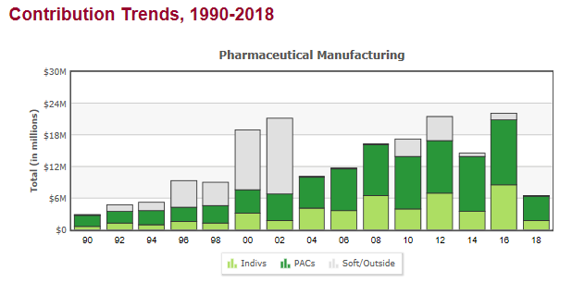
Lobbying
Medicare Prescription Drug Costs

Slide 87
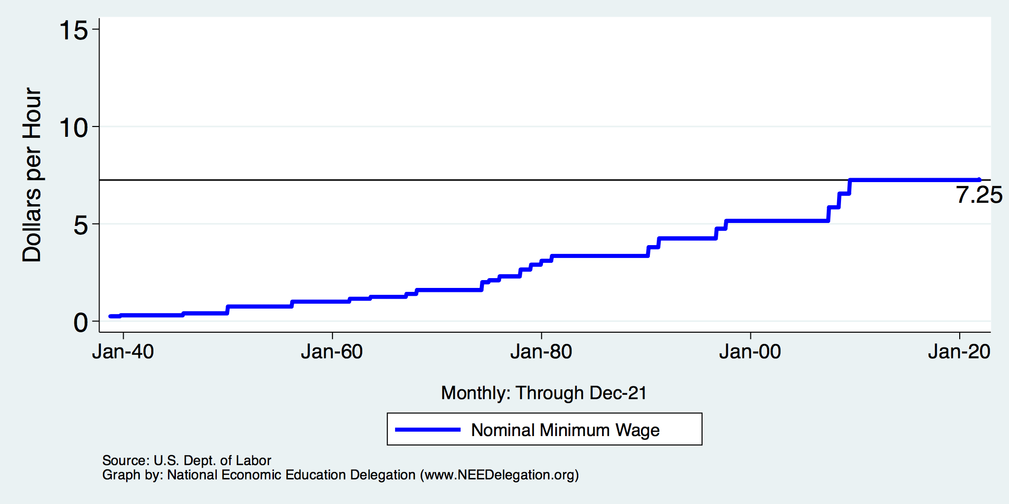
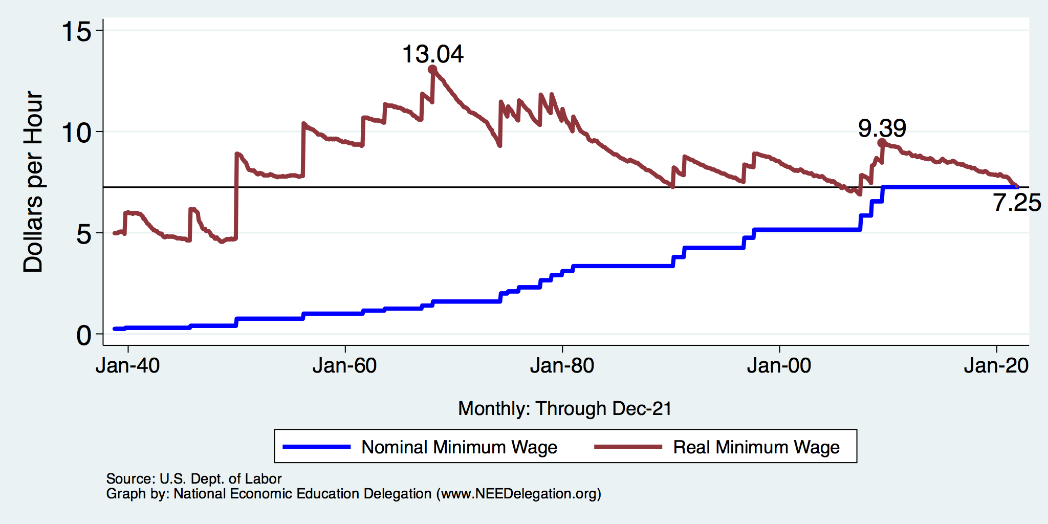
Next Week: Minimum Wages

Slide 88
Thank you!
Any Questions?
www.NEEDelegation.org
Jon D. Haveman, Ph.D.
Jon@NEEDelegation.org
Contact NEED: info@needelegation.org
Submit a testimonial: www.NEEDelegation.org/testimonials.php
Become a Friend of NEED: www.NEEDelegation.org/friend.php

Slide 89
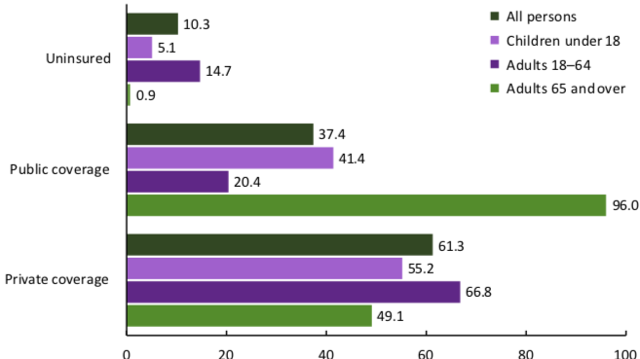
Health Insurance Coverage, 2019
Percent of Persons
Source: National Center for Health Statistics

Slide 90
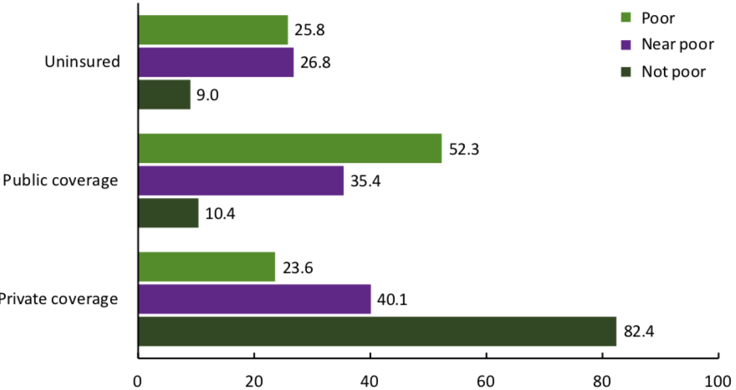
Health Insurance Coverage, 2019
Percent of Persons
Source: National Center for Health Statistics

Slide 91
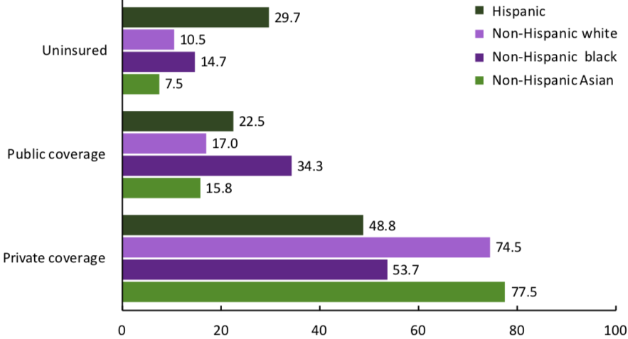
Health Insurance Coverage, 2019
Percent of Persons
Source: National Center for Health Statistics

Slide 92
Hospital Acute Care Average Length of Stay
Average length of stay for acute care (days)

Slide 93
Suicides, 2016
Deaths per 100,000 population
OECD average: 11.5
Source: Roosa Tikkanen and Melinda K. Abrams, U.S. Health Care from a Global Perspective, 2019: Higher Spending, Worse Outcomes (Commonwealth Fund, Jan. 2020).

