Slide 1


The Economics of Healthcare
Marin Academy
October 29, 2026
Jon Haveman, Ph.D.
NEED & Marin Academy

Slide 2
Healthcare is Big Business
Healthcare is the biggest industry and the largest employer in the U.S.
We spend A LOT on healthcare:
  In 2024, U.S. national health expenditures were about $5.3 trillion -- approximately 18.0% of GDP ($15,000 per person)
  Expenditures grew 7.2% from 2023 to 2024
Notes:
Expenditures grew about 7.5% from 2022 to 2023.
Hopefully the comparison of the US health care industry to the entire economy of Germany, UK, and France will make students also appreciate how difficult any type of a reform is – when the sector being reformed is of this size and complexity.
https://databankfiles.worldbank.org/public/ddpext_download/GDP.pdf

Slide 3
Markets Studied in Health Economics
Markets for:
  Physicians
  Nurses
  Hospital facilities
  Nursing homes
  Pharmaceuticals
  Medical supplies
    such as diagnostic and therapeutic equipment
  Health Insurance
Notes:
Many times people confuse Health Economics with Health Insurance. The topics discuss in health economics included health insurance, but also a number of other markets related to health care resources.
This is an important distinction – because it also relates to the Health Care reform. Health care reform in the US is mostly dealing with the reform of the Health Insurance, rather than other health care markets.
The debate about many of these issues has to do with the market structure – and the issue of when does a market work well – without a lot of government intervention (free markets) and when is it necessary for a government to play a much larger role.

Slide 4

The Three Legs of the Healthcare Stool
QUALITY
ACCESS
COSTS

Slide 5
Access

Slide 6
Health Insurance Coverage, 2022 – 92.1%
Countries with Less Than Universal Coverage
Countries with Universal Coverage
Country | % of Persons
Slovakia | 94.5
Chile | 94.3
UNITED STATES | 92.1
Poland | 91.5
Mexico | 90.2
Algeria | 90.9
Jordan | 55.0
Countries | % of Persons
Australia | 100
Canada | 100
Czech Republic | 100
Slovenia | 100
United Kingdom | 100
Greece | 100
Hungary | 100
And 21 more | 99+
Source: Organization for Economic Cooperation and Development

Slide 7
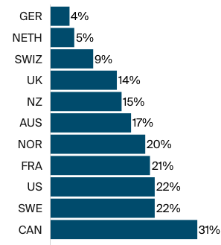
But What About Wait Times?
Percentage of adults aged 65+
Who waited more than 6 days
For an appointment when sick.
Source: Commonwealth Fund, Comparing Nations on Timeliness and Coordination of Health Care, 2021

Slide 8
Physician Visits and Physician Supply
Source: Roosa Tikkanen and Melinda K. Abrams, U.S. Health Care from a Global Perspective, 2019: Higher Spending, Worse Outcomes (Commonwealth Fund, Jan. 2020).

Slide 9
Percent of Women Ages 18–64 Who Reported Going to the Emergency Room in the Past Two Years
Source: Munira Z. Gunja et al., What Is the Status of Women’s Health and Health Care in the U.S. Compared to Ten Other Countries? (Commonwealth Fund, Dec. 2018).

Slide 10
Access Notes
Insurance coverage in the U.S. is not universal.
  It is universal in every other developed country.
Wait times are not necessarily lower in the U.S.
Supply of medical personnel and equipment may be lower than elsewhere.
Emergency room use is higher in the U.S. than elsewhere.

Slide 11
Quality

Slide 12
Life Expectancy: How Does the US Compare?
United States
Source: KFF data collection. https://www.healthsystemtracker.org/chart-collection/quality-u-s-healthcare-system-compare-countries/
Notes:
Among the 34 countries in the OECD, the US in 2010 was 27th in life expectancy at birth

Slide 13
Infant Mortality Comparison (2023)
Deaths per 1,000 live births
Source: Health at a Glance, 2025 OECD; graph by NEED

Slide 14
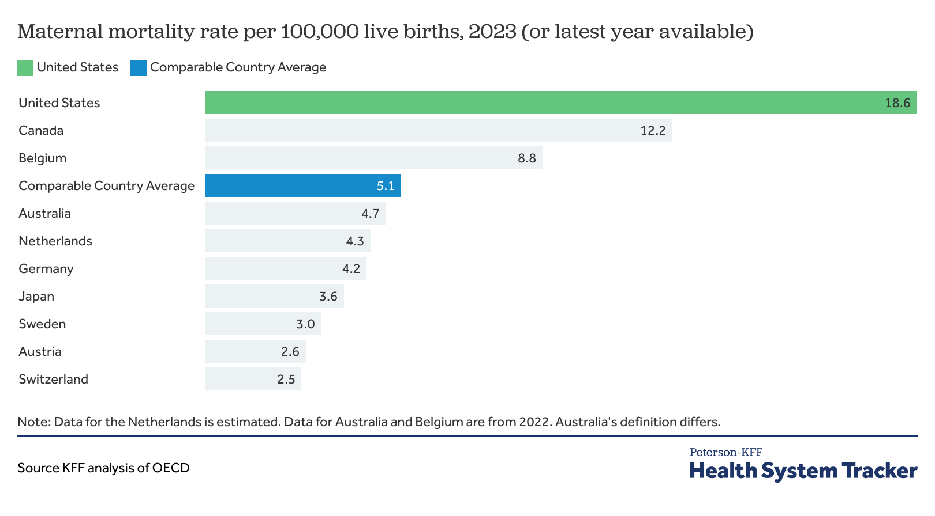
Maternal Mortality Rates per 100,000 live births (2023)
Source: KFF analysis of OECD data

Slide 15
Prevention and Screening
The U.S. excels in some prevention measures (high ranking):
  including flu vaccinations and breast cancer screenings.
The U.S. has:
  The highest average five-year survival rate for breast cancer.
  But the Lowest for cervical cancer.

Slide 16
Perception of Quality of Medical Care
Source: Munira Z. Gunja et al., What Is the Status of Women’s Health and Health Care in the U.S. Compared to Ten Other Countries? (Commonwealth Fund, Dec. 2018).

Slide 17
Quality of Care Notes
Metrics of quality in the U.S. are not very good.
The system has bright spots!
Quality of care is not considered very good in the U.S.

Slide 18
Costs

Slide 19
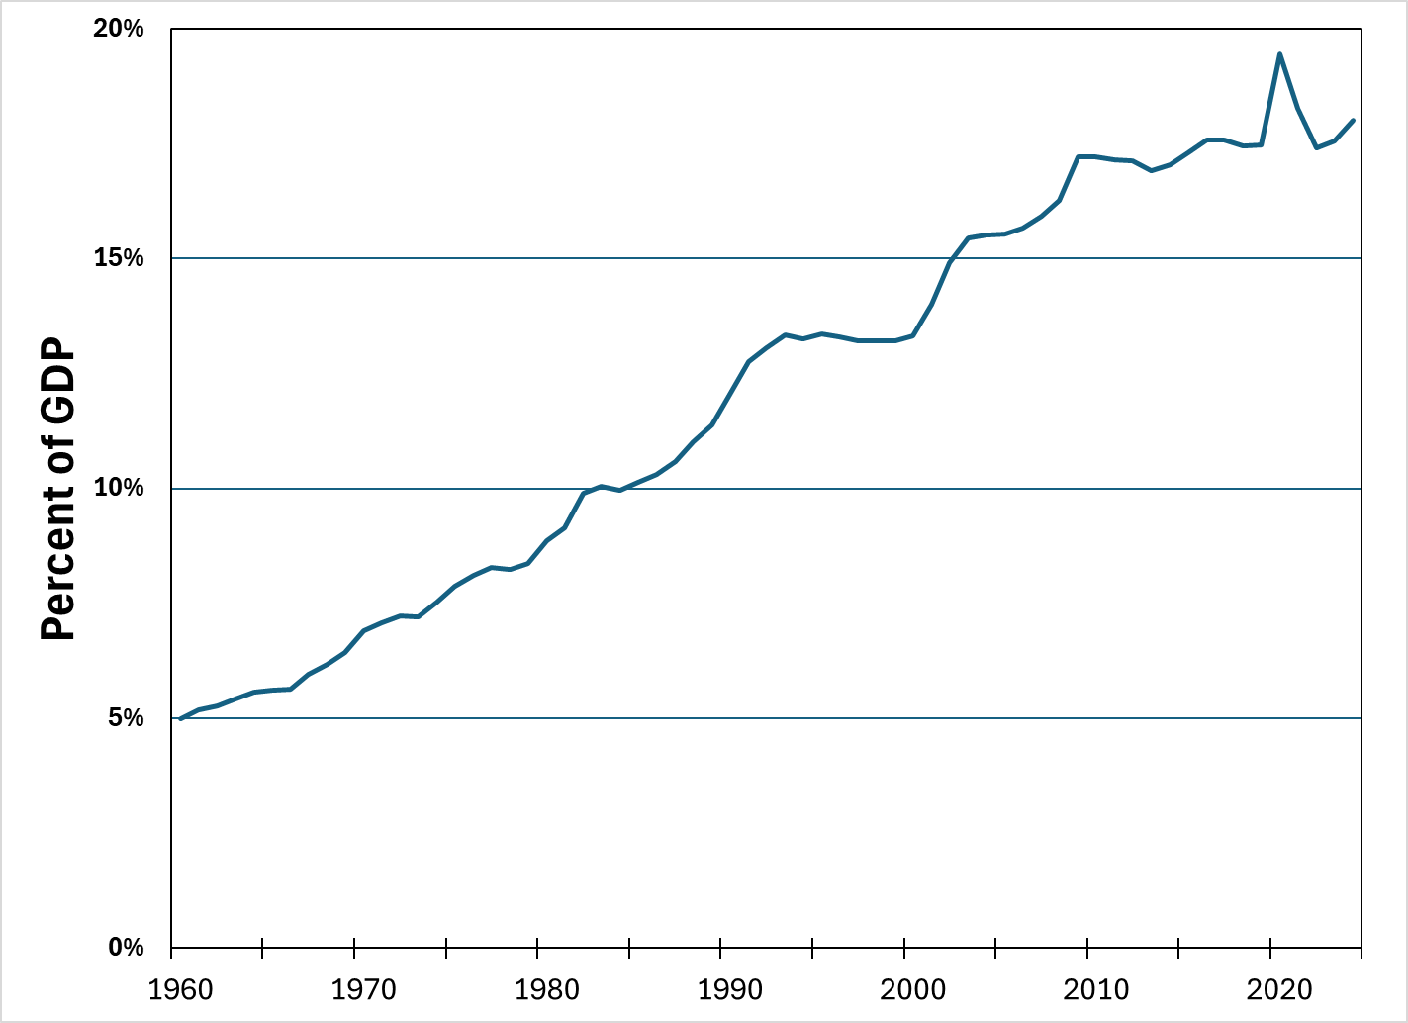
National Health Expenditure as Percent of GDP
19.5%
13%
9%
5%
Source: Centers for Medicare and Medicaid Services (graph by NEED)

Slide 20
Health Care Spending as % of GDP, 1980–2018
United States
Everybody else
Source: Roosa Tikkanen and Melinda K. Abrams, U.S. Health Care from a Global Perspective, 2019: Higher Spending, Worse Outcomes (Commonwealth Fund, Jan. 2020).

Slide 21
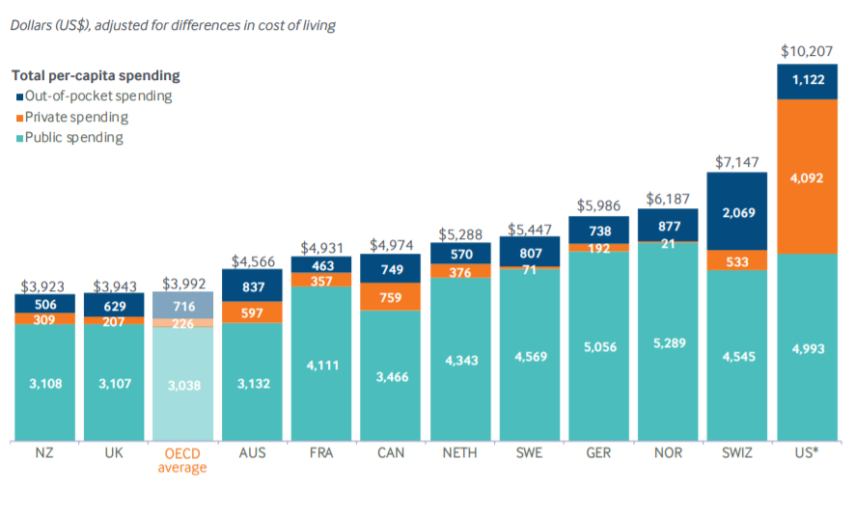
International Per Capita Healthcare Spending
Source: Roosa Tikkanen and Melinda K. Abrams, U.S. Health Care from a Global Perspective, 2019: Higher Spending, Worse Outcomes (Commonwealth Fund, Jan. 2020).
Notes:
Some good resources:
https://www.commonwealthfund.org/publications/issue-briefs/2020/jan/us-health-care-global-perspective-2019
A bit older report: https://www.commonwealthfund.org/publications/issue-briefs/2015/oct/us-health-care-global-perspective
https://www.healthsystemtracker.org/chart-collection/quality-u-s-healthcare-system-compare-countries/#item-overall-age-specific-potential-years-of-life-lost-per-100000-population-1990-2017
https://axenehp.com/international-healthcare-systems-us-versus-world/

Slide 22
Why is Healthcare Spending Increasing?
Costs in the United States, and elsewhere are increasing rapidly.
The share of economic spending on health care has been steadily increasing for all countries because:
  Health spending growth has outpaced economic growth.
  Richer countries demand more services, like attention to health.
Also because of:
  Advances in medical technologies.
  Rising prices in the health sector – why?

Slide 23
Why Are Costs so High in the US?
One Reason:
The United States is the only
profit-motivated healthcare system in the world.

Slide 24
Why Are Costs so High in the US?
Another Reason:
Our public health system isn’t very good.
(We have a health RESTORATION system, NOT a health CARE system.)

Slide 25
Obesity Rates, 2017
Obese individuals are more likely to have multiple morbidities:
Cardiovascular Diseases
Liver & Digestive Diseases
Kidney Conditions
Cancer
Respiratory Issues
Mental Health
More….
Percent (%)
Source: Roosa Tikkanen and Melinda K. Abrams, U.S. Health Care from a Global Perspective, 2019: Higher Spending, Worse Outcomes (Commonwealth Fund, Jan. 2020).

Slide 26
Markets Matter for Costs

Slide 27
Health Care Markets are Different
Sponsor
(Gov’t or Employer)
Premiums
Insurer or
third-party payers
Premiums (individual policies)
Money (fixed or variable payments)
Taxes or Lower Wages
Claims
Insurance Coverage
Services
Consumers
Producers
Price
Health Care Providers (hospitals, physicians)
Patients
Out-of-pocket fees

Slide 28
Policy Matters for Costs

Slide 29
Hospital Monopolization
Less competition in health systems, hospitals, medical groups, and health insurers has surged in recent years.
Over an 18-month period between July 2016 and January 2018:
  Hospitals acquired 8,000 more medical practices.
  14,000 more physicians left independent practice to become hospital employees.
Between 1999 and 2018, hospital profit margins soared!
  From 100% in 1999 to 317% in 2018.

Slide 30
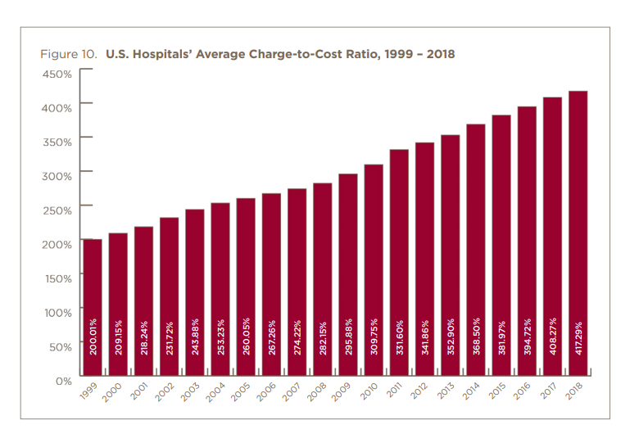

Slide 31
Concentration in Pharmaceutical Companies
Between 1995 and 2015, 60 drug companies merged into 10.
The number of mergers and acquisitions involving one of the top 25 firms more than doubled, from 29 in 2006 to 61 in 2015
Concentration:
  Raises prices.
  Lowers R&D on new drugs.

Slide 32
Spending on Pharmaceuticals (2023)
Source: Health at a Glance, 2025 OECD; graph by NEED
Notes:
https://en.wikipedia.org/wiki/Prescription_drug_prices_in_the_United_States
https://www.ft.com/content/e92dbf94-d9a2-11e9-8f9b-77216ebe1f17

Slide 33
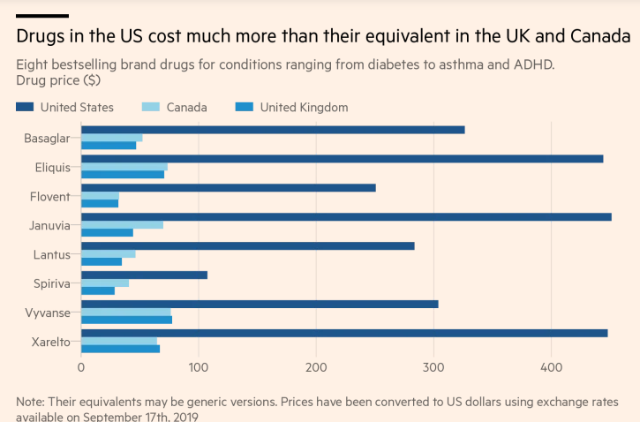
Insulin
Blood
Thinner
Diabetes
Blood
Thinner

Slide 34
Medicare Modernization Act (2003)
Prescription Drug Component
  AKA – gift to pharmaceutical companies.
Medicare Part D, by law, cannot negotiate drug prices like other governments do.
In 2017, Medicare spent nearly $8 billion on insulin.
  The researchers said that if Medicare were allowed to negotiate drug prices like the U.S. Department of Veterans Affairs (VA) can, Medicare could save about $4.4 billion just on insulin.

Slide 35
Concentration of Health Insurance Markets
As of 2011, there were close to 100 insurers in Switzerland competing for consumer health care dollars, forcing firms to compete by setting prices to just cover costs.
In 2019, of the 50 states and the District of Columbia:
  21 had only 1 or 2 insurers
  14 had 3 or 4, and
  16 states had 5 or more. (CA had 11)
Source: KRR, Number of Issuers Participating in the Individual Health Insurance Marketplaces
Notes:
https://www.kff.org/other/state-indicator/number-of-issuers-participating-in-the-individual-health-insurance-marketplace/?currentTimeframe=0&sortModel=%7B%22colId%22:%22Number%20of%20Issuers%20in%202019%22,%22sort%22:%22desc%22%7D
6 Roy, Avik. “Why Switzerland Has the World’s Best Health Care System.” Forbes, April 29, 2011; https://www.forbes.com/sites/theapothecary/2011/04/29/why-switzerland-has-the-worlds-best-health-care-system/#2416d9a67d74.
7 Henry J. Kaiser Family Foundation. “Number of Issuers Participating in the Individual Health Insurance Marketplaces.” State Health Facts; https://www.kff.org/other/state-indicator/number-of-issuers-participating-in-the-individual-health-insurance-marketplace, accessed July 2019.

Slide 36
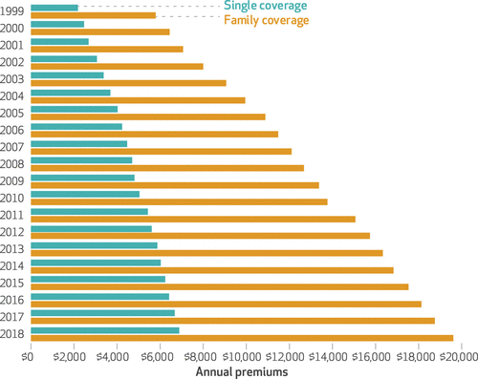
Average Annual Insurance Premiums, 1999-2018
Employer provided, Not Adjusted for Inflation
Single: ~$2,000 to ~$7,000
Family: ~$5,900 to ~$19,500
 | Average Annual Rate of Change (%)
Inflation | 2.19
Health Care CPI | 3.68
Single coverage | 6.51
Family coverage | 6.52
 | Average Annual Rate of Change
Inflation | 2.19
Health Care CPI | 3.68
Single coverage | 6.51
Family coverage | 6.52
Source: The Commonwealth Fund

Slide 37
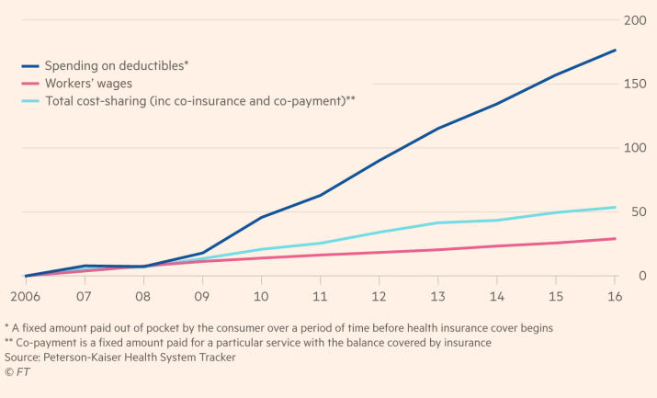
Spending on Deductibles

Slide 38
Reason for Higher Health Insurance Rates
Rising prices in the health sector
Advances in medical technologies
Increased demand for services
Decreasing competition in health insurance markets

Slide 39
Summary
US HealthCare system is not preforming well.
  Very expensive with low quality and access.
One of the main reasons for very high costs is the monopolization of healthcare markets.
Universal health insurance would increase access and perhaps also reduce costs.
Changing the focus from maximizing profits to maximizing care would help.

Slide 40
A Few Simple Solutions Could Reduce Costs
Pursue competition in healthcare markets.
  Hospitals, pharmaceuticals, insurance.
Introduction of a public option in the health insurance market.
Allow the US government to negotiate drug prices
  Like most every other nation.
  Biden administration has started down this path.
  One Big Beautiful Bill is backpedaling.

Slide 41
Thank you!
Any Questions?
www.NEEDEcon.org
Jon D. Haveman, Ph.D.
Jon@NEEDEcon.org
Contact NEED: info@needecon.org
Submit a testimonial: www.NEEDEcon.org/testimonials.php
Become a Friend of NEED: www.NEEDEcon.org/friend.php

Slide 42
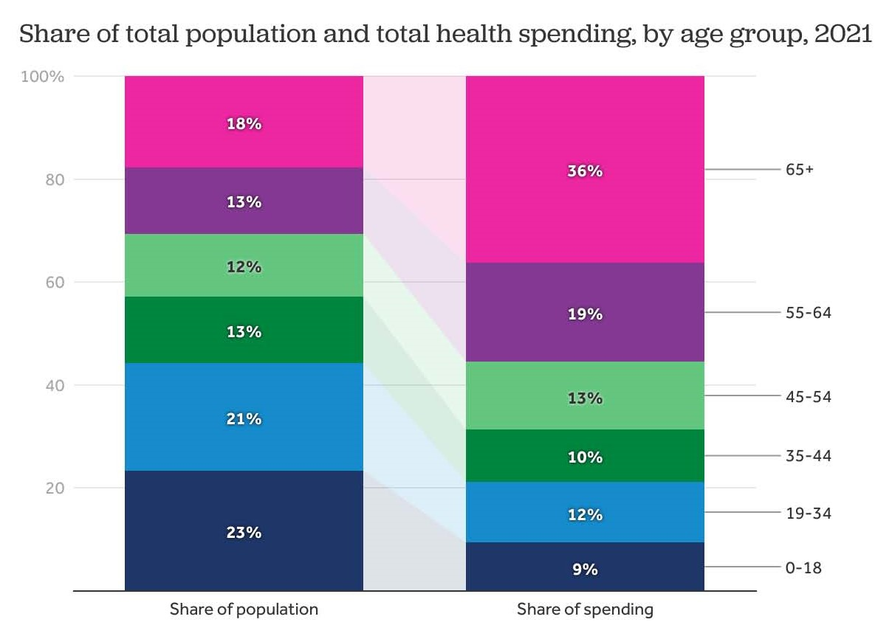

Slide 43
Life Expectancy at Birth by Race/Ethnicity, 2019
Race/Ethnicity | Life Expectancy (Years)
All Races | 78.8
White | 78.8
Black | 74.8
Hispanic | 81.9
Asian | 85.6
Source: KFF, Key Data on Health and Health Care by Race and Ethnicity
Notes:
CDC

Slide 44
Income Also Matters – Reflecting Access?
Sex | Income Category | Life Expectancy (Years) | Difference High vs Low
Women | Highest Incomes (top 1%) | 88.9 | 10.1 years
 | Lowest Incomes (bottom 1%) | 78.8
Men | Highest Incomes (top 1%) | 87.3 | 14.6 years
 | Lowest Incomes (bottom 1%) | 72.7
Sex | Income Category | Life Expectancy Years | Difference High to Low
Women | Highest Incomes (top 1%) | 88.9 | 10.1 years
 | Lowest Incomes (bottom 1%) | 78.8
Men | Highest Incomes (top 1%) | 87.3 | 14.6 years
 | Lowest Incomes (bottom 1%) | 72.7
Source: https://healthinequality.org/documents/paper/healthineq_summary.pdf

Slide 45
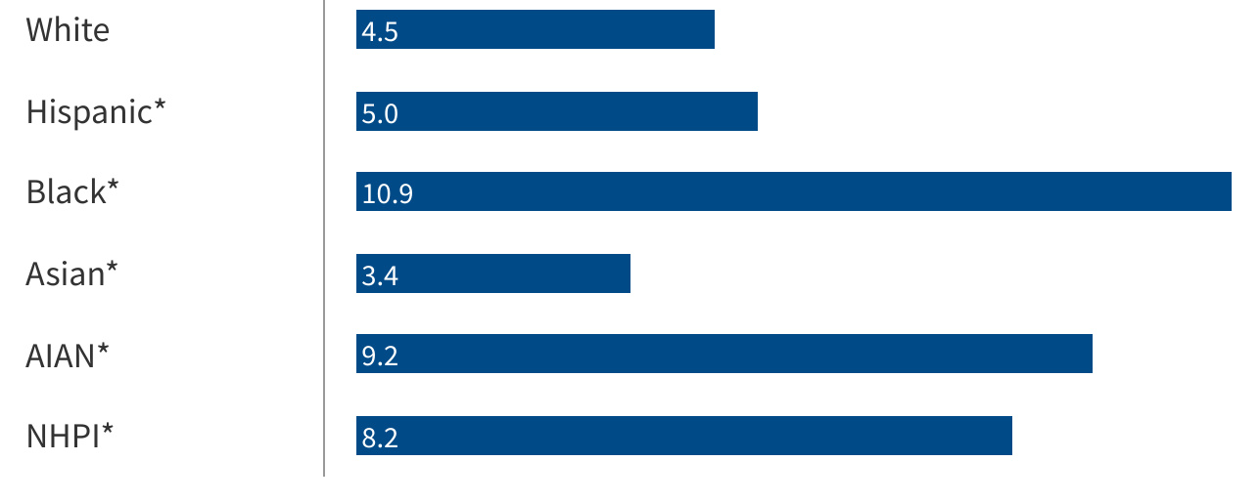
Infant Mortality by Race/Ethnicity (2023)
Deaths per 1,000 live births
Source: Ely, DM, Driscoll, AK. Infant mortality in the United States, 2023, CDC
Notes:
Source: Ely, DM, Driscoll, AK. Infant mortality in the United States, 2023: Data From the Period Linked Birth/Infant Death File. National Vital Statistics Report Vol. 74 No. 7, National Center for Health Statistics, Centers for Disease Control and Prevention, 2025.Get the dataDownload PNG
* Indicates the difference in values from those for Whites is statistically significant

Slide 46
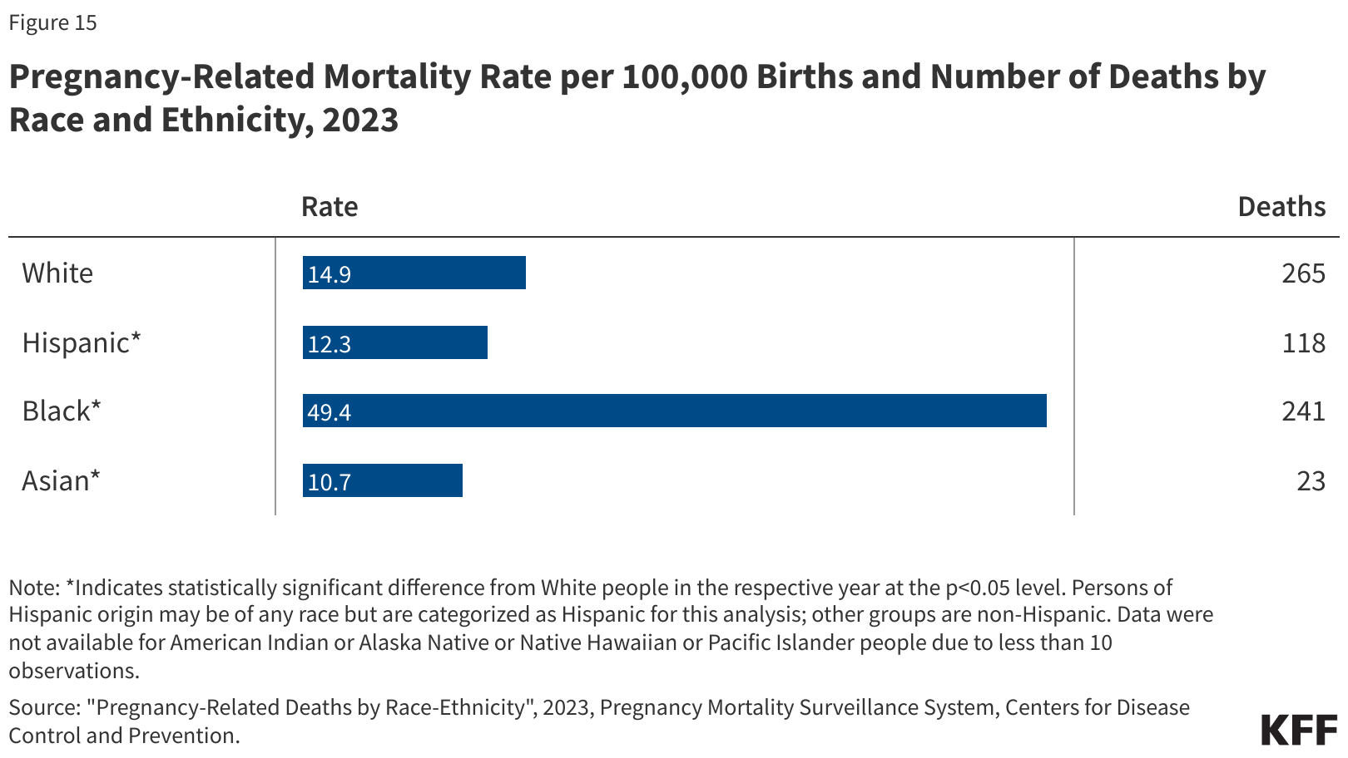
Maternal Mortality Rates by Race
Source: Pregnancy-Related Deaths by Race-Ethnicity, 2023, CDC

