Slide 1
Health(care) Economics: Part 2
Sausalito Rotary Club
January 12, 2022
Jon Haveman, Ph.D.
NEED

Slide 2
Credits and Disclaimer
This slide deck was authored by:
Veronika Dolar, SUNY Old Westbury
Jon Haveman, NEED
Disclaimer
NEED presentations are designed to be nonpartisan.
It is, however, inevitable that presenters will be asked for and will provide their own views.
Such views are those of the presenters and not necessarily those of the National Economic Education Delegation (NEED).

Slide 3
Outline
Brief review of US Healthcare System performance
Healthcare Systems and Institutions
Health Insurance and Reform

Slide 4
The Three Legs of the Healthcare Stool
The market for Health Insurance is where they all come together.
Access
Quality
Cost
We will discuss metrics of performance for each.

Slide 5
National Healthcare Expenditure per Capita
11,172
1,239
Notes:
https://www.cms.gov/

Slide 6
Life Expectancy: How Does the US Compare?
Everybody else
United States
Germany – US = 2.5 years
Swiss – US = 5 years
Source: Roosa Tikkanen and Melinda K. Abrams, U.S. Health Care from a Global Perspective, 2019: Higher Spending, Worse Outcomes (Commonwealth Fund, Jan. 2020).

Slide 7
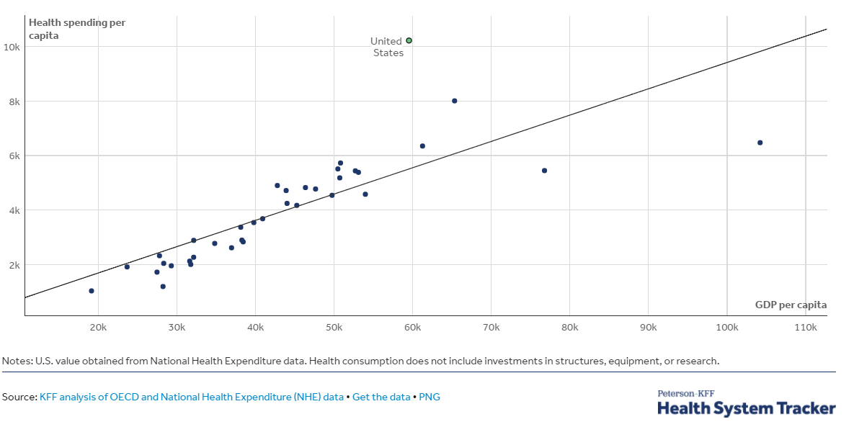
GDP per Capita and Health Spending per Capita, 2017

Slide 8
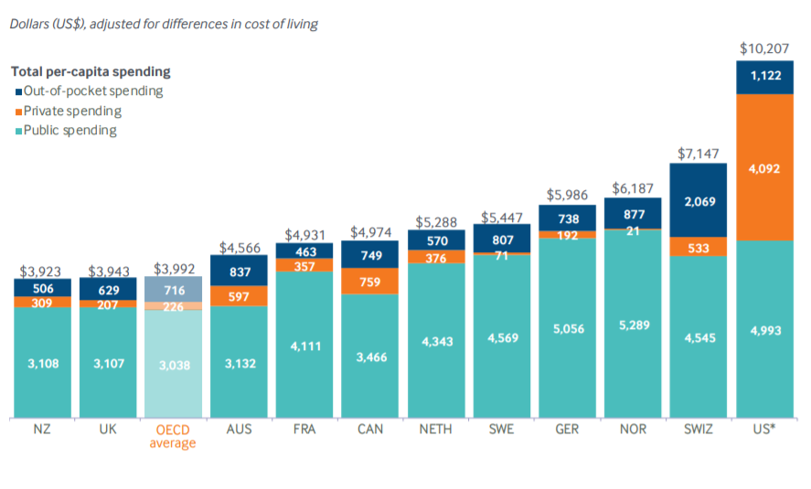
International per Capita Healthcare Spending
Source: Roosa Tikkanen and Melinda K. Abrams, U.S. Health Care from a Global Perspective, 2019: Higher Spending, Worse Outcomes (Commonwealth Fund, Jan. 2020).
Notes:
Some good resources:
https://www.commonwealthfund.org/publications/issue-briefs/2020/jan/us-health-care-global-perspective-2019
A bit older report: https://www.commonwealthfund.org/publications/issue-briefs/2015/oct/us-health-care-global-perspective
https://www.healthsystemtracker.org/chart-collection/quality-u-s-healthcare-system-compare-countries/#item-overall-age-specific-potential-years-of-life-lost-per-100000-population-1990-2017
https://axenehp.com/international-healthcare-systems-us-versus-world/

Slide 9
Health vs. Social Care Spending
Source: E. H. Bradley and L. A. Taylor, The American Health Care Paradox: Why Spending More Is Getting Us Less, Public Affairs, 2013.

Slide 10
Healthcare Systems and Institutions

Slide 11
Health System Classification
Developed countries in the world have each taken a different approach in their healthcare delivery systems.
5 basic models:
National health insurance (Canada)
Bismarck (France, Germany, Japan, Switzerland)
Beveridge – socialized medicine (United Kingdom, Spain, New Zealand)
Out-of-pocket model – self insurance
Mixed (United States)

Slide 12
US Healthcare System
Medicare – National Health Insurance
Military Veteran Care – Beveridge model (socialized medicine)
Employer-sponsored insurance – Bismarck model
Individual market health plans - Bismarck model
Uninsured – Out-of-pocket model

Slide 13
Health Insurance and Reform

Slide 14
Definition: Universal Coverage
Universal coverage refers to healthcare systems in which all individuals have insurance coverage.
Generally, this coverage includes:
Access to all needed services and benefits.
Protects individuals from excessive financial hardships.
Canada has universal coverage, but the United States does not.

Slide 15
Definition: Single Payer
Single payer: refers to financing a healthcare system by making one entity solely and exclusively responsible for paying for medical goods and services.
It is only the financing component that is socialized.
The money for payment can be collected by either:
Taxes collected by the government
Premiums collected by National or Public Health Insurance
Single-payer systems: 17 countries
Norway, Japan, United Kingdom, Kuwait, Sweden, Bahrain, Brunei, Canada, United Arab Emirates, Denmark, Finland, Slovenia, Italy, Portugal, Cyprus, Spain, and Iceland.

Slide 16
Definition: Socialized Medicine
Socialized medicine: this model takes the single-payer system one step further.
Government not only pays for healthcare but operates the hospitals and employs the medical staff.
This is NOT part of the current debate in the United States.

Slide 17
Definition: Third-Party Payer
A third-party payer is an entity that pays medical claims on behalf of the insured. Examples of third-party payers include government agencies, insurance companies, health maintenance organizations (HMOs), and employers.
Employer-sponsored health plans
Individual market health plans
National health insurance

Slide 18
Affordable Care Act
Insurance reform
Can not deny based on preexisting conditions.
Rates may not differ based on health.
Mandated that all residents be covered
Sort of, teeth removed
Expansion of Medicaid
Cost reduction measures
Private insurance exchange
Cap on tax exclusion for employer provided insurance

Slide 19
Missed Opportunities in Reform
Single payer
Public option
Universal coverage
Government negotiation

Slide 20
Summary
US healthcare system does not perform well.
very expensive, with low quality and access.
One of the main reasons for very high costs is the monopolization of healthcare markets.
Hospitals, health insurance, big pharma, physicians, etc.
A few simple solutions could drastically reduce costs:
Enforcement of antitrust laws in this sector.
Introduction of a public option in the health insurance market.
Enable the US government to negotiate drug prices, as most other nations do.
Universal health insurance would increase access and perhaps also reduce costs.
But there are always tradeoffs: you can pick two, but the third might suffer.

Slide 21
Thank you!
Any Questions?
www.NEEDelegation.org
Jon D. Haveman, Ph.D.
Jon@NEEDelegation.org
Contact NEED: info@needelegation.org
Submit a testimonial: www.NEEDelegation.org/testimonials.php
Become a Friend of NEED: www.NEEDelegation.org/friend.php

Slide 22
Available NEED Topics Include:
Coronavirus Economics
US Economy
Climate Change
Economic Inequality
Economic Mobility
Trade and Globalization
Minimum Wages
Immigration Economics
Housing Policy
Federal Budgets
Federal Debt
Black-White Wealth Gap
Autonomous Vehicles
US Social Policy

