Slide 1


Gender Wage Gap
Inequality: Week 3
Mallika Pung, Ph.D.
University of New Mexico
February 6, 2024

Slide 2
Outline
What is gender wage gap?
Gender wage gap in numbers.
What are the potential causes for this gender wage gap?
What can we do?

Slide 3
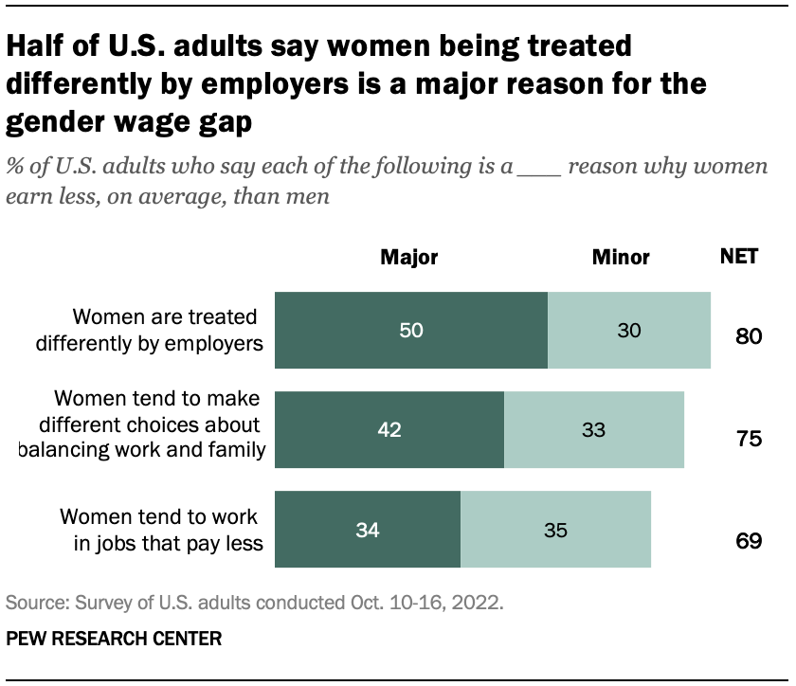
The Issue of Gender Wage Gap
“We have to pass pay equity for women workers. It is not acceptable that women are making 78 cents an hour compared to men.”
-- Sen. Bernie Sanders, 2015

Slide 4
Popular Theories
Biased managers and co-workers
Occupational segregation
Inferior bargaining skills
Lack of competitiveness
And more
  We will delve deeper into what is meant by gender wage gap and how economists think about the issue.

Slide 5
Significant strides have been made
Progress made in combating gender inequality and discrimination against women in workplace since the 1970s
  The Fair Labor Standards Act of 1938,
  The Equal Pay Act of 1963,
  Title VII of the Civil Rights Act of 1964, and
  The Pregnancy Discrimination Act of 1973 in conjunction with
  Providing Urgent Maternal Protections (PUMP) for Nursing Mothers Act
  Pregnant Workers Fairness Act
“Gender Revolution”

Slide 6
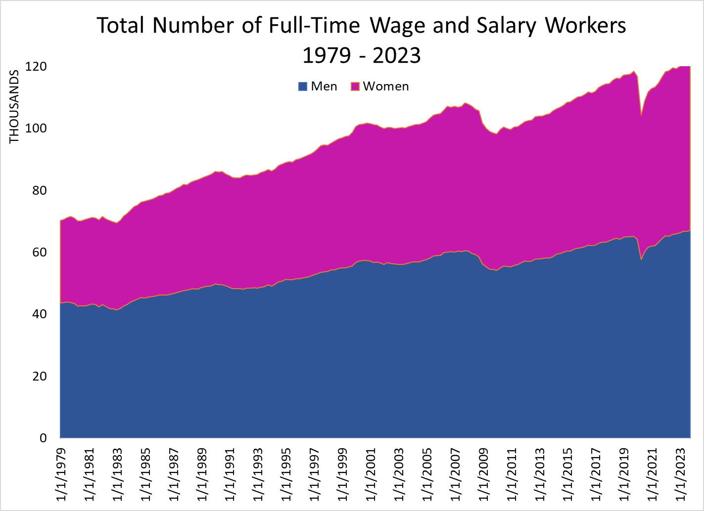
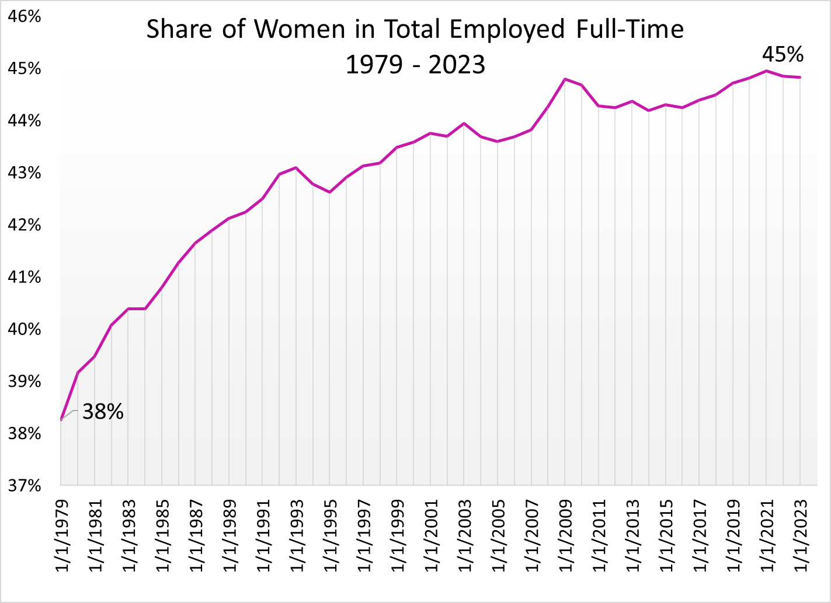
Composition of the Full-Time Workforce
Growth:
Total: 71%
Men: 52%
Women: 100%

Slide 7
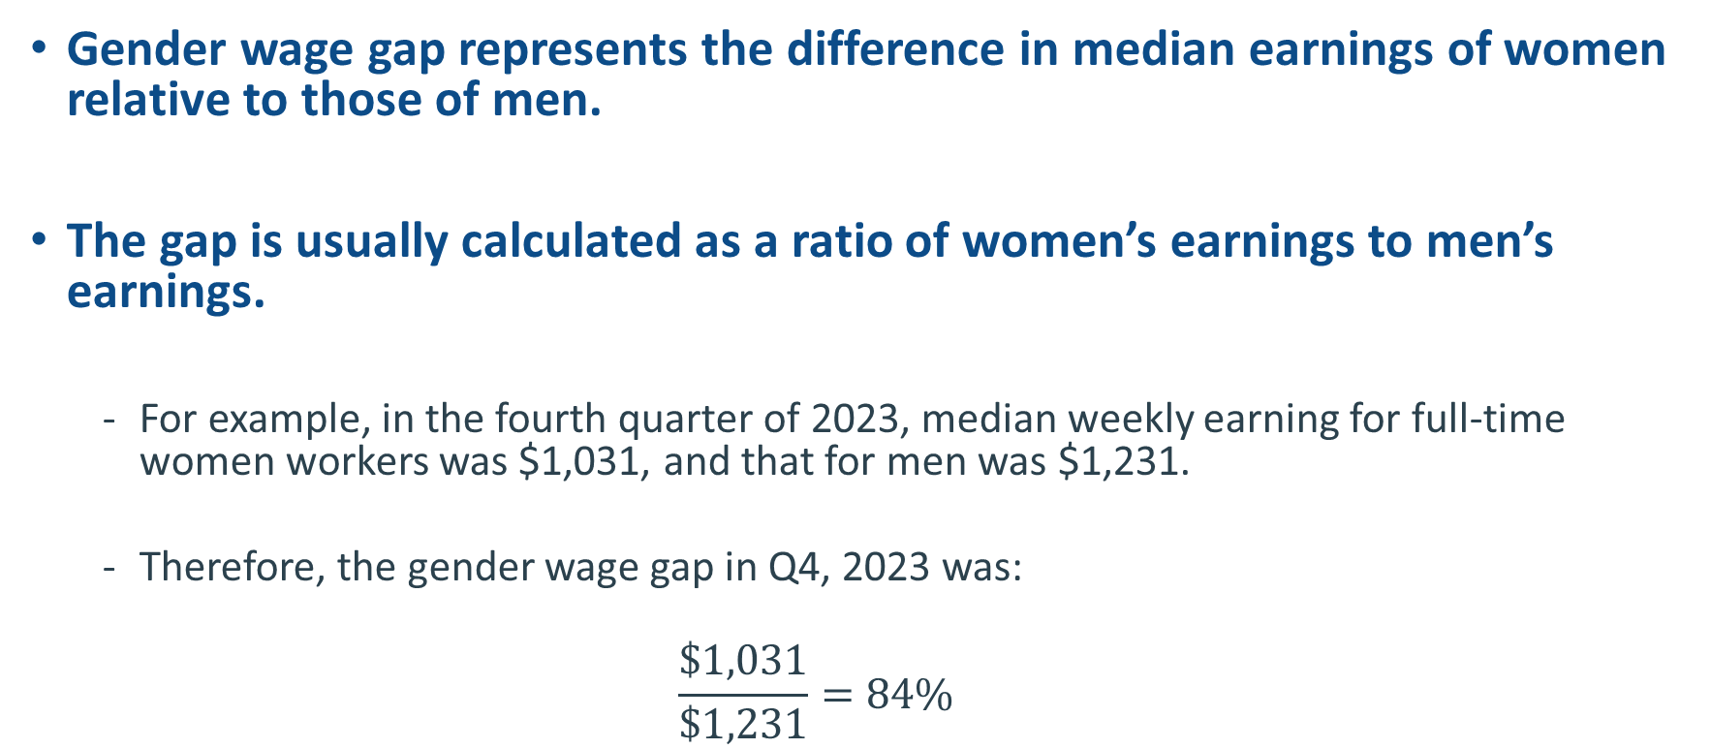
What is Gender Wage Gap?
Gender wage gap represents the difference in median earnings of women relative to those of men.
The gap is usually calculated as a ratio of women’s earnings to men’s earnings.
  For example, in the fourth quarter of 2023, median weekly earning for full-time women workers was $1,031, and that for men was $1,231.
  Therefore, the gender wage gap in Q4, 2023 was:
  $$\frac{\$1,031}{\$1,231}=84\%$$

Slide 8
Relative Wage Gap Over Time
2023 Q4 Women’s Wages: $1,031
2023 Q4 Men’s Wages: $1,231
Gap between men and women’s median earnings
has narrowed considerably since the late 1970s.

Slide 9
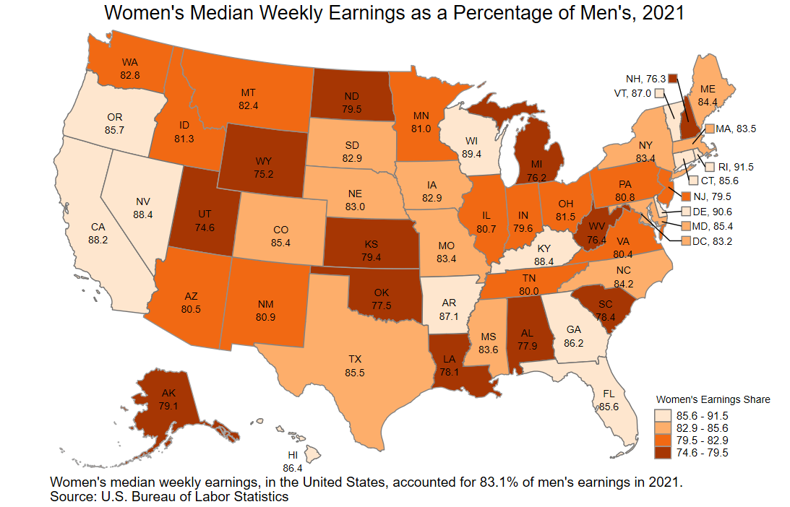
Wage Gap by State

Slide 10
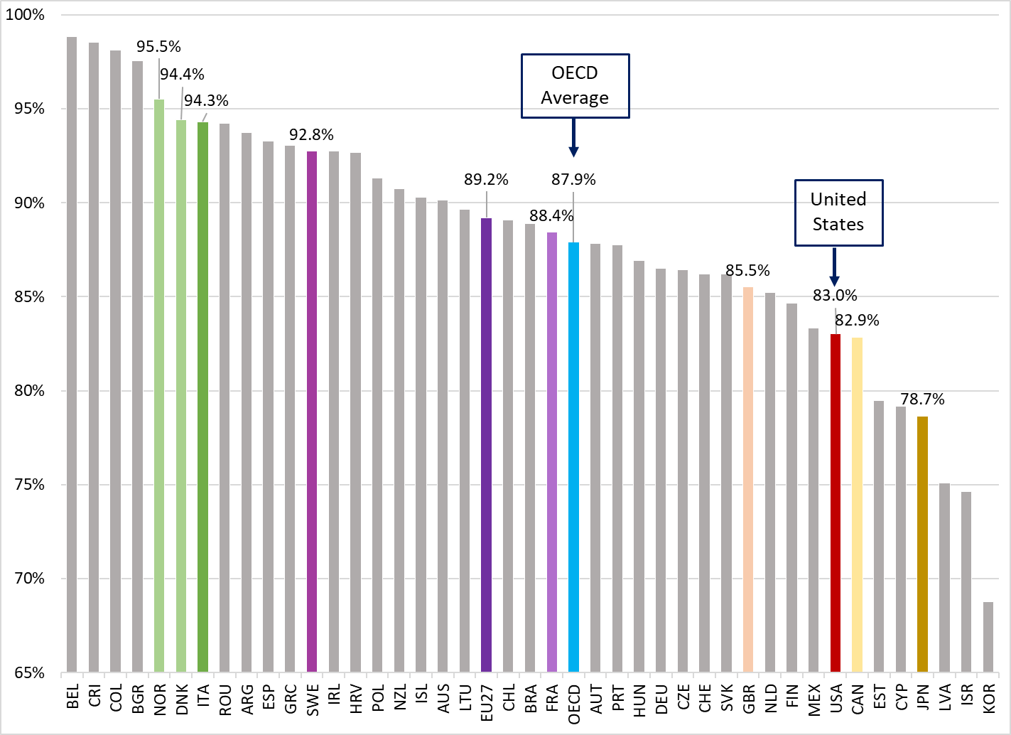
Wage Gap Across the Globe

Slide 11
What is NOT included in these calculations?
These are unconditional or uncontrolled or raw wage gap.
The difference doesn’t account for differences in:
  Age and Experience
  Occupation
  Educational attainment
  Job skills and responsibilities
  Specialization

Slide 12
The Wage Gap
Gender wage gap is not a single statistic; it’s dynamic.
Average wage comparison based on a limited sample. Men and women:
  Working full time
  Working year round
Wage gap is not: Apples to Apples
  Does not compare wages of men and women in the same occupation or industry.

Slide 13
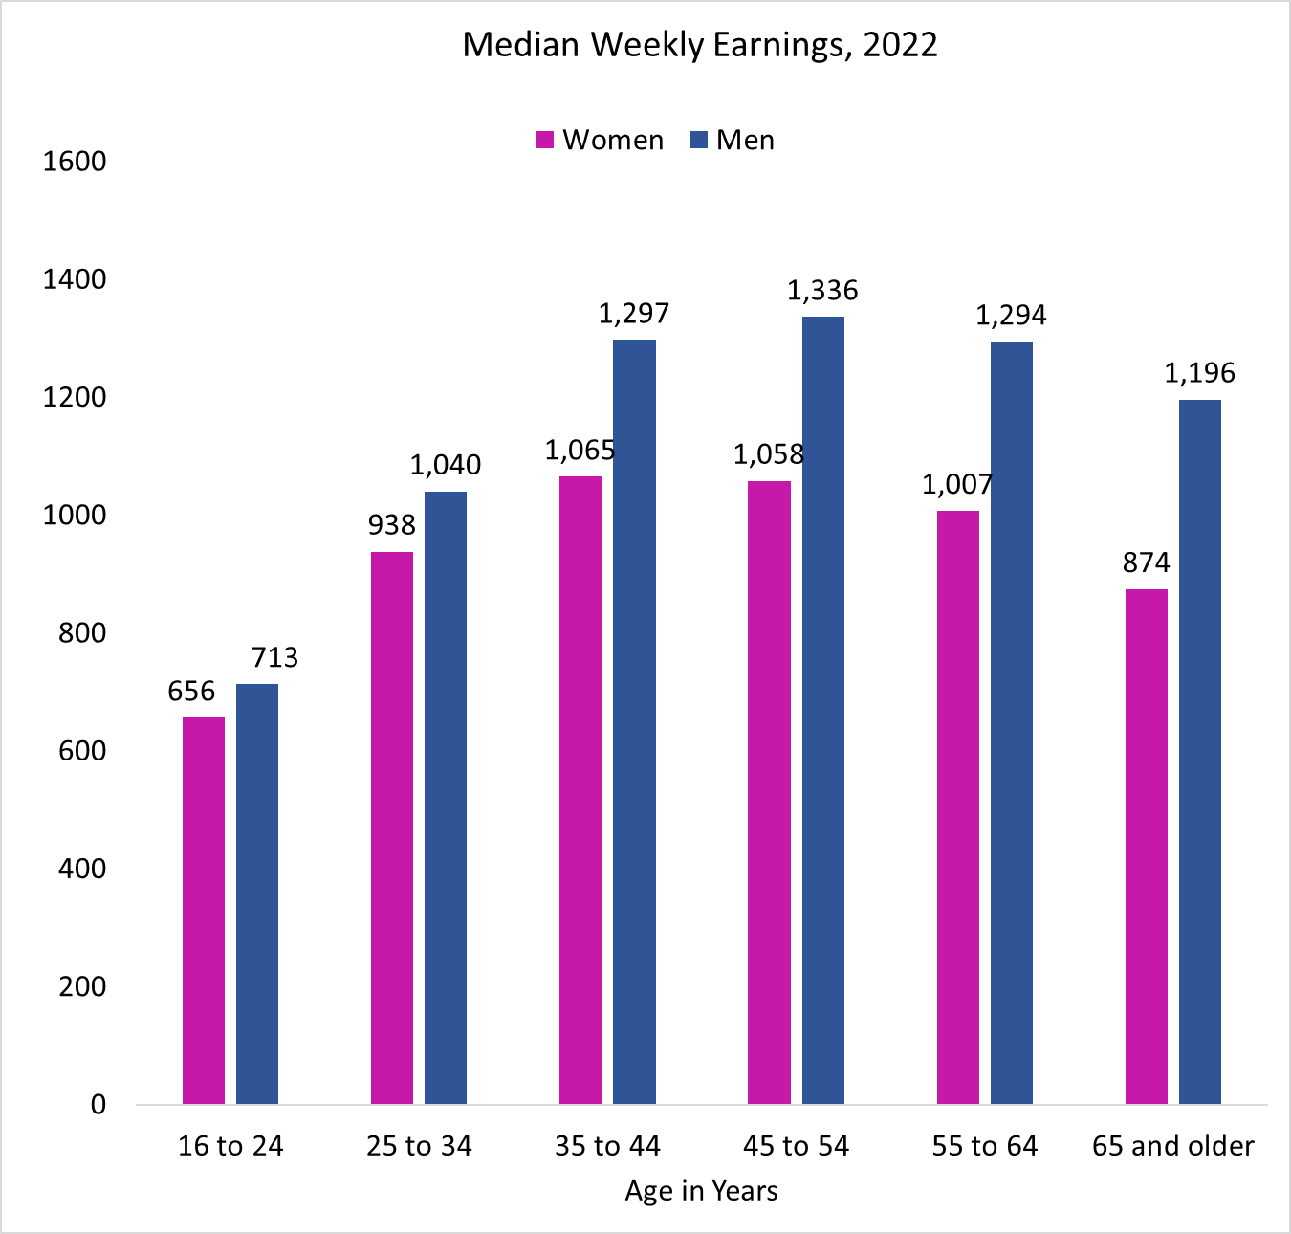
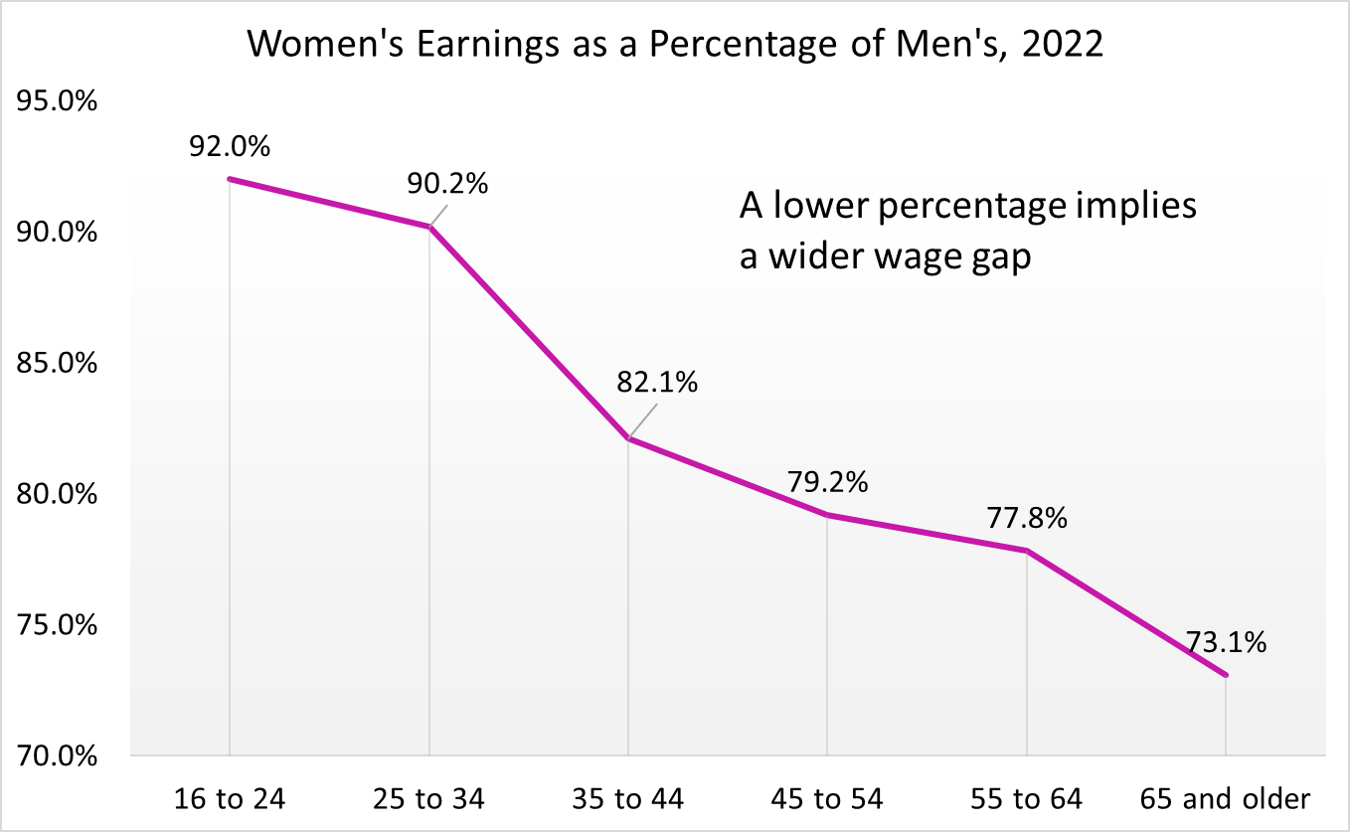
Wage Gap by Age
In 2022, median weekly earnings for 16 years or older:
Women - $958
Men - $1,154
Wage Gap – 83%
The gap between men and women’s median earnings was the largest among those aged 45 years or older.

Slide 14
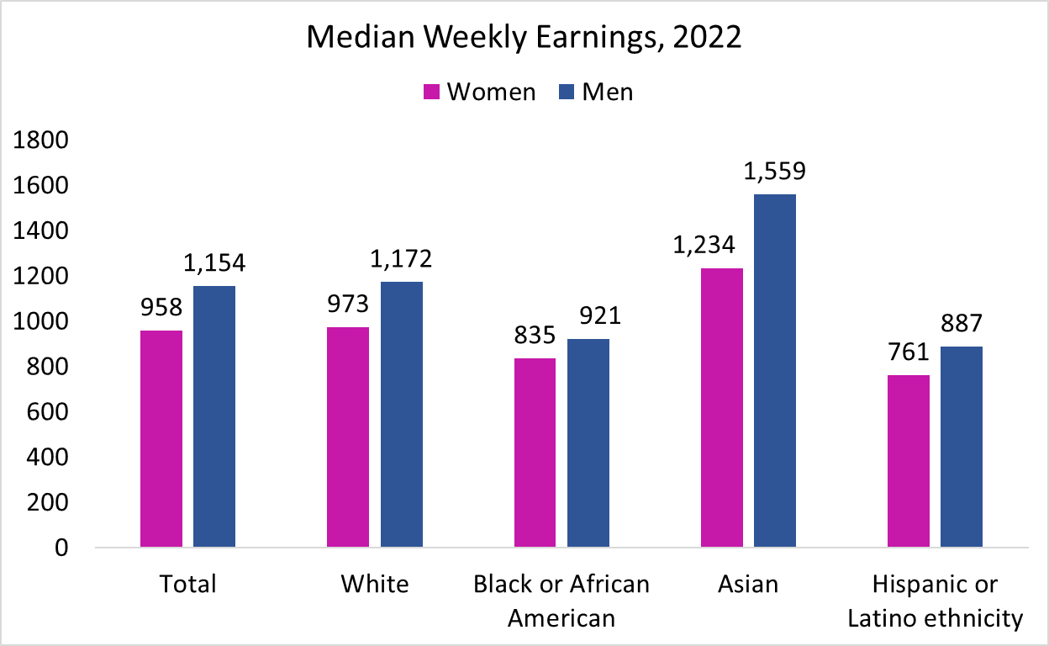
Wage Gap by Race/Ethnicity
83.0
83.0
90.7
79.2
85.8

Slide 15
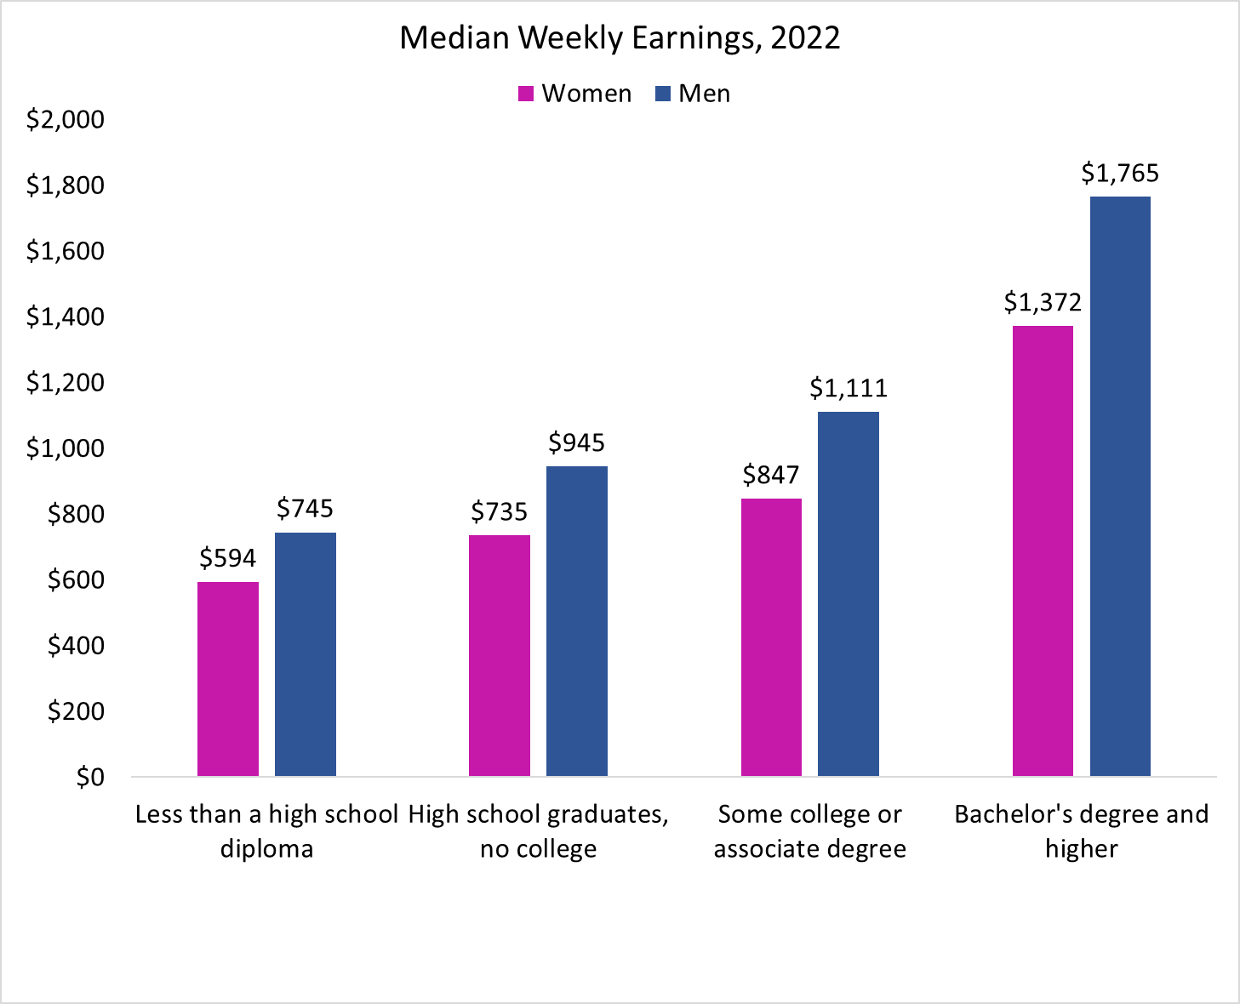
Wage Gap by Level of Education
In 2022, median weekly earnings for 25 years or older:
Women - $1,002
Men - $1,219
Wage Gap – 82.2%
College pays – among all workers, median earnings of those with at most a HS degree were 55% of those with at least a bachelor’s degree.
The gap between men and women’s median earnings was larger than the national average among college graduates, with women’s median earnings at only 77.7% of men’s.
79.7
77.8
76.2
77.7

Slide 16
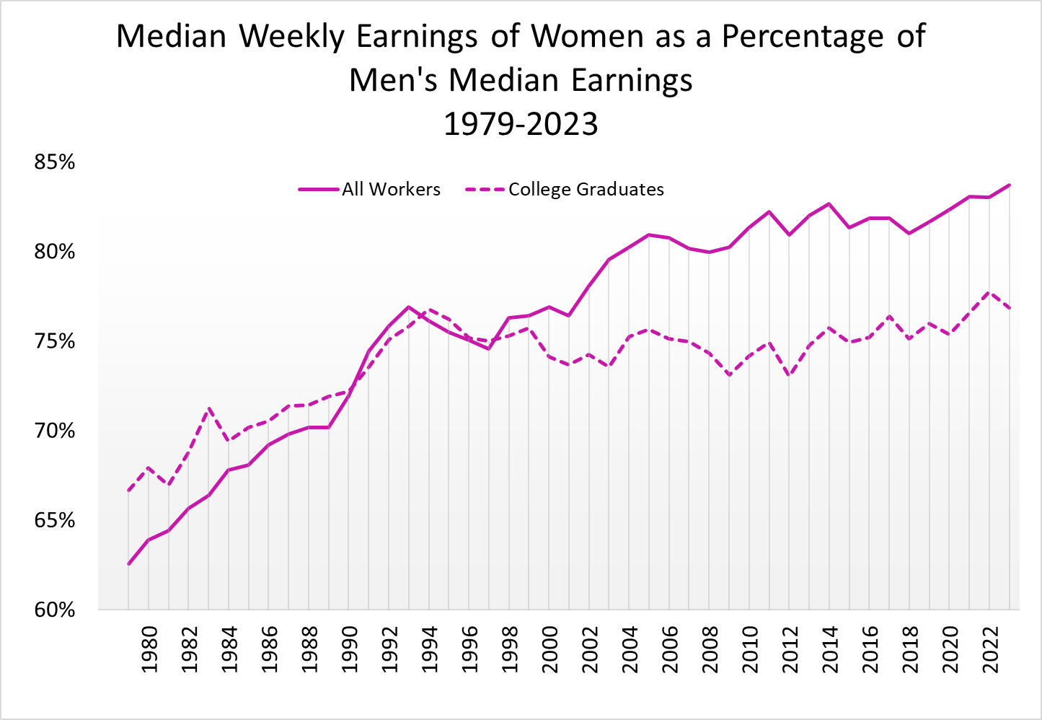
Gender Wage Gap Over the Years – College Graduates

Slide 17
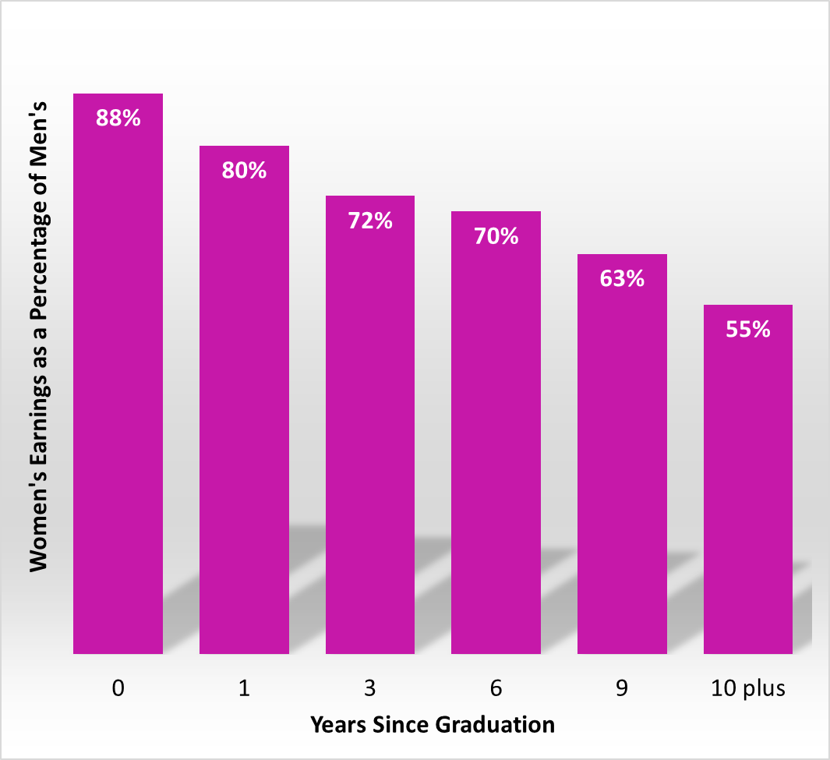
Wage Gap Widens with Age and with Years
After Leaving School
From Bertrand, Goldin, Katz (2010)
Directly following MBA receipt, average earnings are comparable among men and women, but they soon diverge.
In the first 9 years after graduation, women’s average earnings increase by 117%, while those of men increase by 208%.

Slide 18
Wage Gap Among MBA Graduates Not Random
The sample controls for ability, training and education
Almost all the gap can be explained by:
  Career interruptions
  Differences in average weekly work hours
    49 hrs vs 57 hrs for men
    More part-time, self-employed workers
The gap grows largely with the arrival of children
  Well-intentioned paternalism by supervisors
  Husband’s position on the earnings distribution
Several studies, even those from Nordic countries, support these results

Slide 19
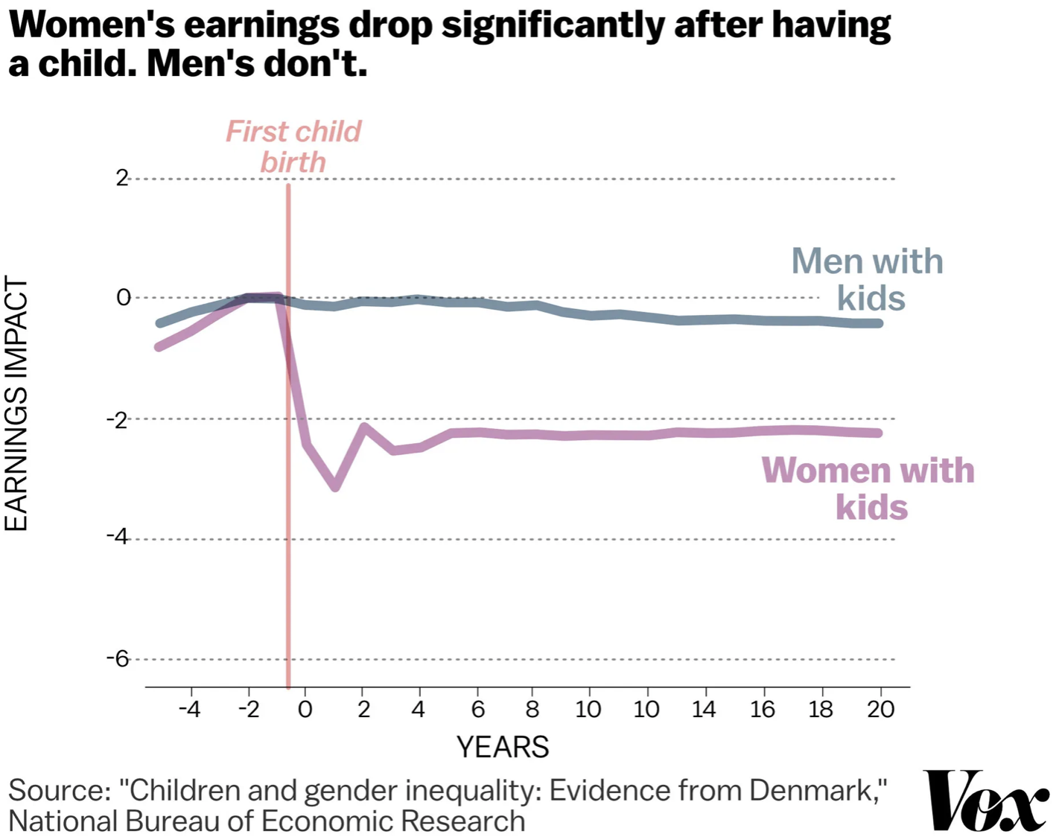
The Kid Effect

Slide 20
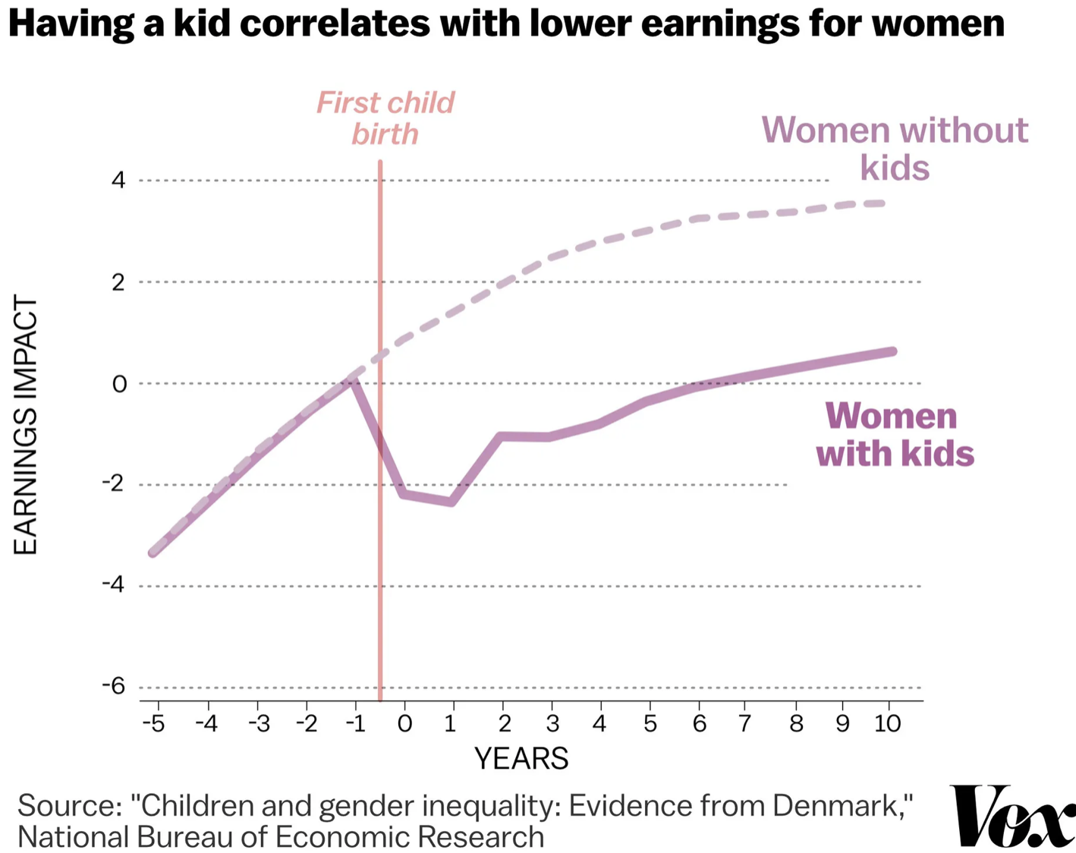
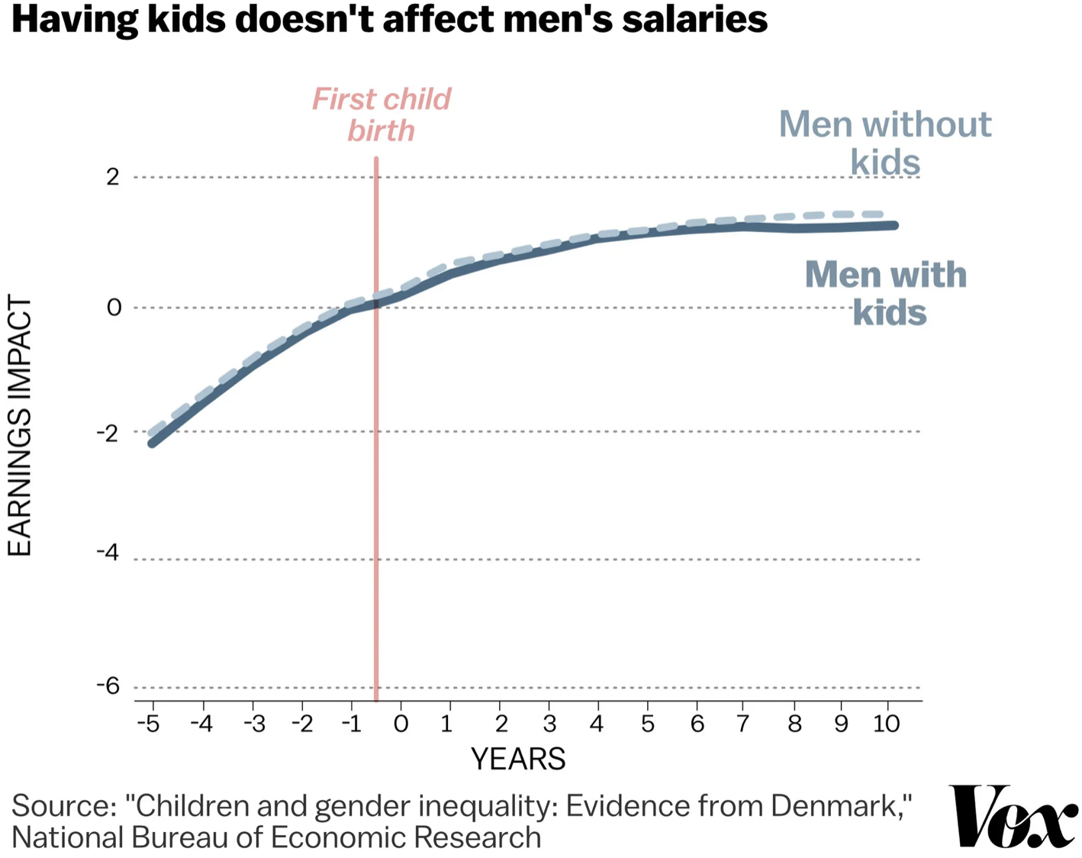
The Kid Effect

Slide 21
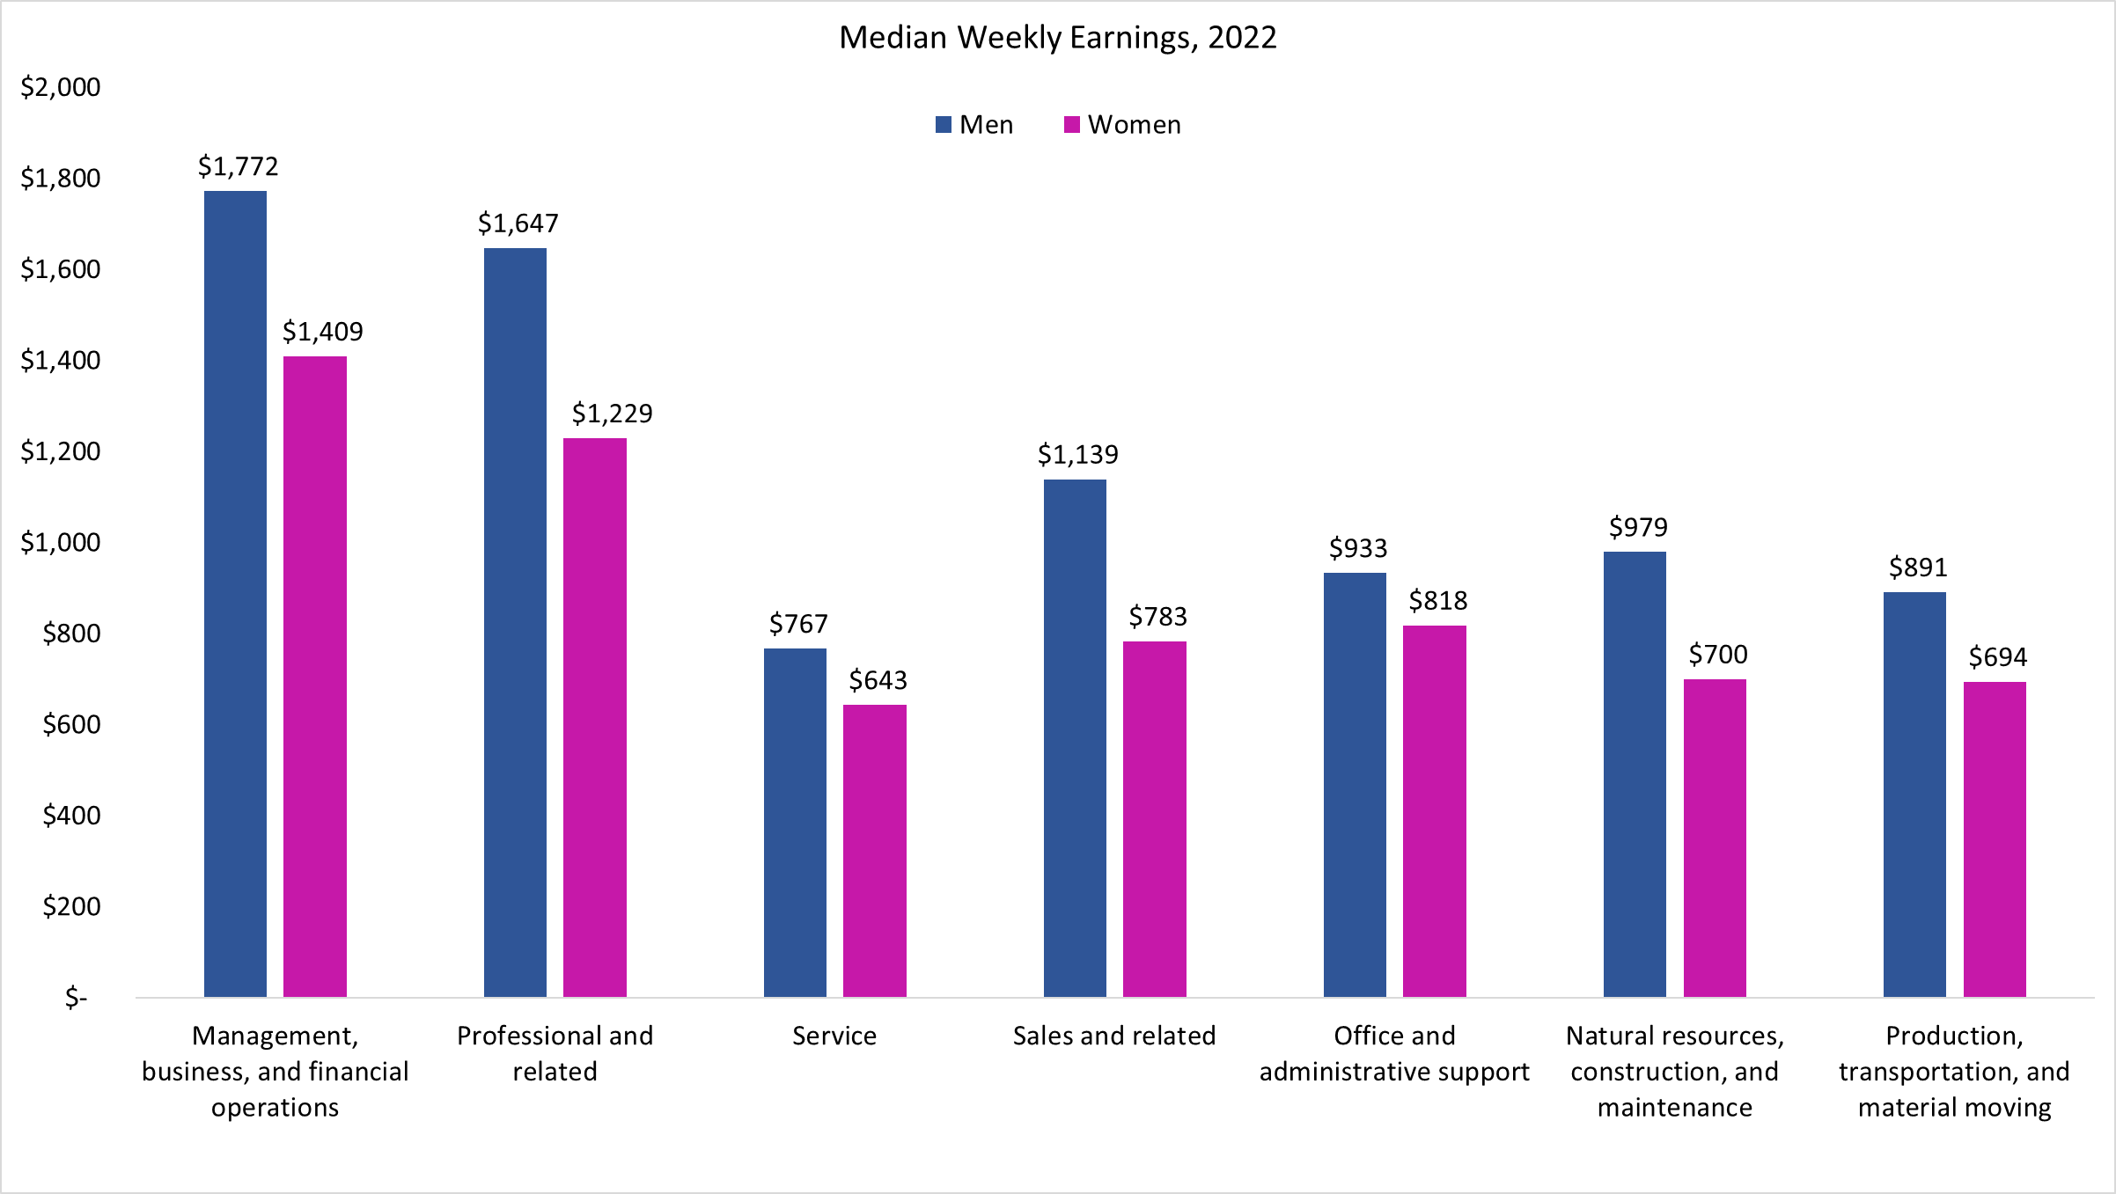
Weekly Earnings by Occupation
79.5
74.6
83.8
68.7
87.7
71.5
77.9
83.0
= National Average Ratio

Slide 22
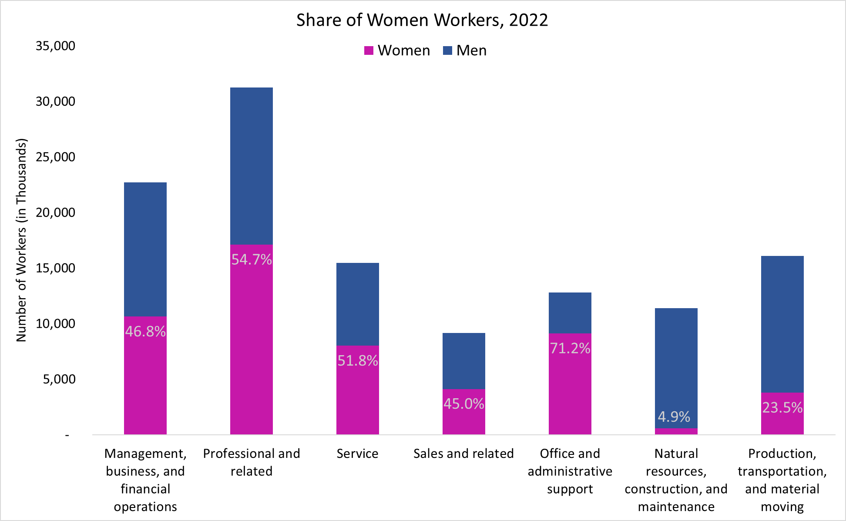
Gender Distribution of Occupations
79.5
74.6
83.8
68.7
87.7
71.5
77.9
83.0
= National Average Ratio

Slide 23
Occupations with the Lowest Wage Gap, 2022

Slide 24
Occupations with the Highest Wage Gap, 2022

Slide 25
These are still unadjusted wage gap numbers
Controlled for one or two factors at a time
May still not fully explain earnings differences
For example, when comparing median earnings differences by occupation, we still would like to know if these differences can be further explained by differences in other key factors such as
  age,
  job responsibilities,
  work experience, and
  other individual life choices such as marital status or to have children and to take time off to raise them.

Slide 26
Adjusting the Wage Gap
Men and women make different choices. It is possible to account for some of those choices to explain the wage gap.
Two possible adjustments:
Adjustment 1 accounts for human capital:
  Education
  Experience
  Geographic region
  Race
Adjustment 2 also accounts for:
  Unionization
  Industry
  Occupation

Slide 27
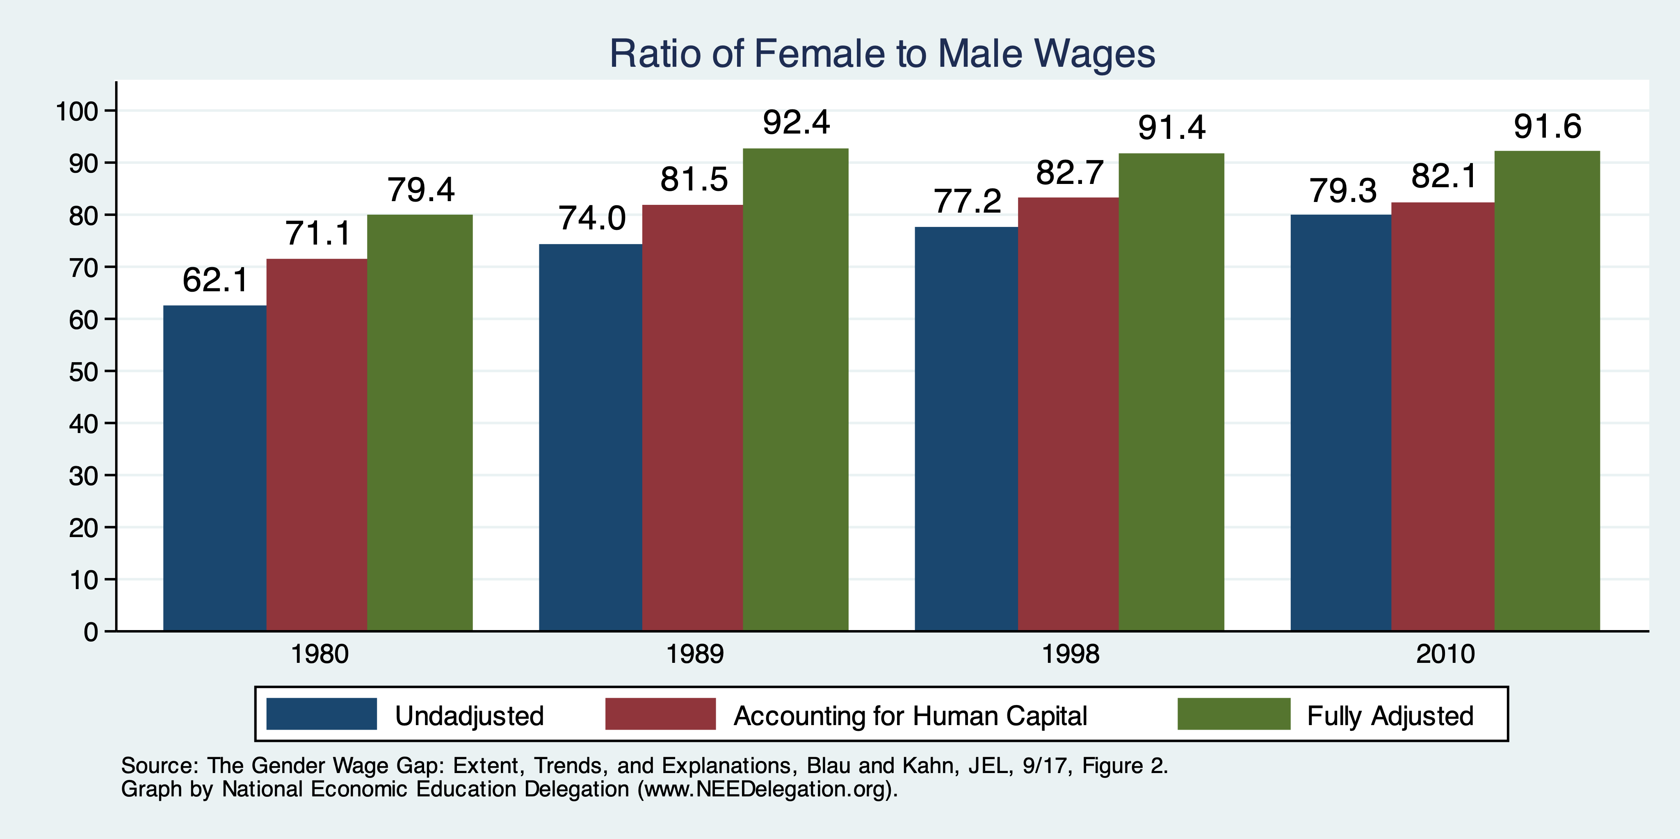
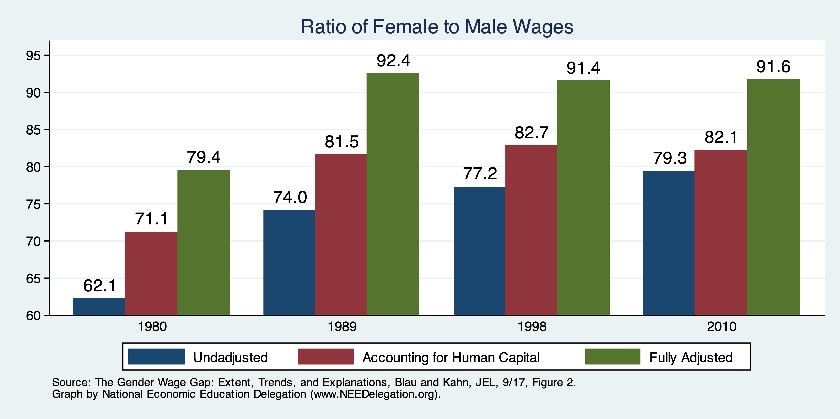
Wage Gap With Adjustments

Slide 28
What do the Adjustments Tell Us?
Human capital decisions, as well as region and race, matter for the wage gap.
Ultimate job matters:
  Is it unionized?
  Is it an industry with a large gap?
  Is it an occupation with a large gap?
Still 10% unaccounted for.
  Is this discrimination?
    Perhaps, but not all of it.
    Labor market decisions are influenced by discrimination or perceptions of women’s vs men’s majors, occupations, or industries.

Slide 29
Gap Occurs Primarily WITHIN Occupations
Occupational differences and wage gap
Source: Reassessing the Gender Wage Gap: Sharing Jobs, Equalizing Pay, Right Now, the Expanding Harvard Universe.

Slide 30
Non-Linearities in Pay and the Wage Gap
Pay increases with the number of hours worked each week.
  Why?
    In some occupations, workers are not good substitutes for each other.
    To ensure continuity, employers value individual workers working more hours.
  Implications:
    Men and women in traditional households divide the work.
Source: Reassessing the Gender Wage Gap: Sharing Jobs, Equalizing Pay, Right Now, the Expanding Harvard Universe.

Slide 31
Explaining Gender Wage Gap by Occupation
Women, traditionally, the “on-call” parent – Goldin [2021]
Prefer occupations with
  shorter hours,
  fewer “on-call” hours,
  predictable schedules
  standardized products/services
    greater substitutability of workers within teams
Men, traditionally, opt for jobs with greater time demands but pay more
Appear to care less about time flexibility
  Ready to work evening/weekend hours to meet clients

Slide 32
Gap Occurs Primarily WITHIN Occupations
Not all occupations have the same pay gap.
  Depends on how substitutable workers are.
Source: Reassessing the Gender Wage Gap: Sharing Jobs, Equalizing Pay, Right Now, the Expanding Harvard Universe.

Slide 33
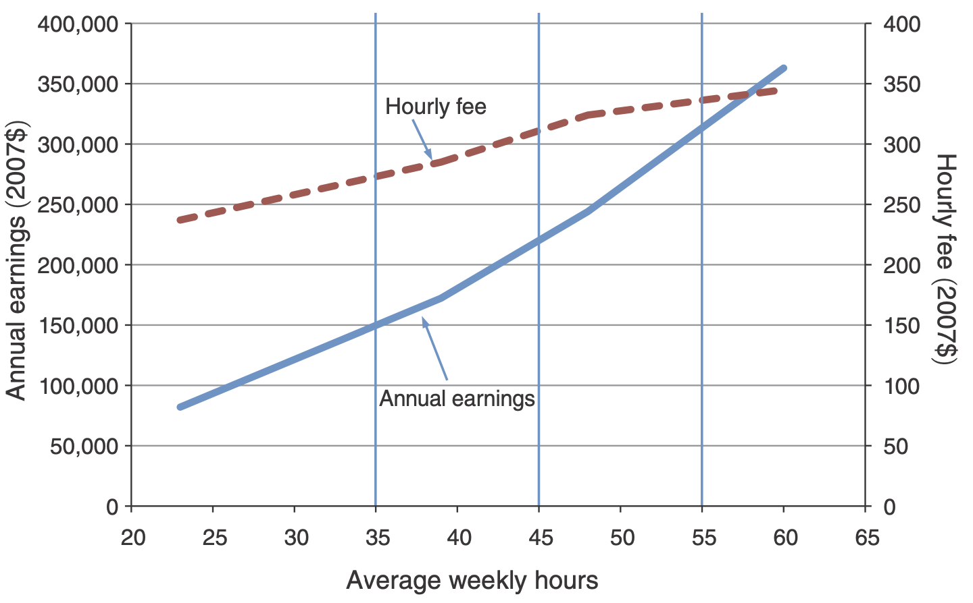
Evidence on Non-Linearities from Law Firms
Lawyers:
Hours go up
So does hourly pay
Source: A Grand Gender Convergence: Its Last Chapter, Goldin, AER, 2014.

Slide 34
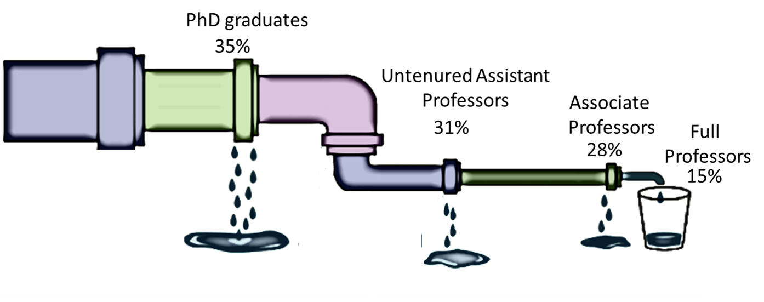
The Leaky Pipelines Phenomenon
In many professional occupations
  There’s a more equitable gender distribution at entry level,
  But at the higher ranks, number of female workers plummets.
Time demands – likely explanation?
The Leaky Pipelines In Economics
Share of Women in Economics, 2020

Slide 35
The Broken Rung and the Great Breakup
Women are significantly underrepresented in leadership.
A broken rung at the first step up to manager is holding women back.
For every 100 men who are promoted from entry-level roles to manager positions, only 87 women are promoted
The Great Breakup
  New Pipeline Problem
  More women leaders are leaving their companies
Source: Women in the Workplace 2022, LeanIn.Org and McKensey, 2022

Slide 36
Sorting
Sorting happens:
  With the decision to go to college.
  With the election of a major.
  With the choice of an occupation.
Women tend to:
  Go to college more than men.
  Select majors with lower expected wages.
    Though convergence WAS happening.
  Within a major, select occupations with lower wages.
    Though convergence IS happening.

Slide 37
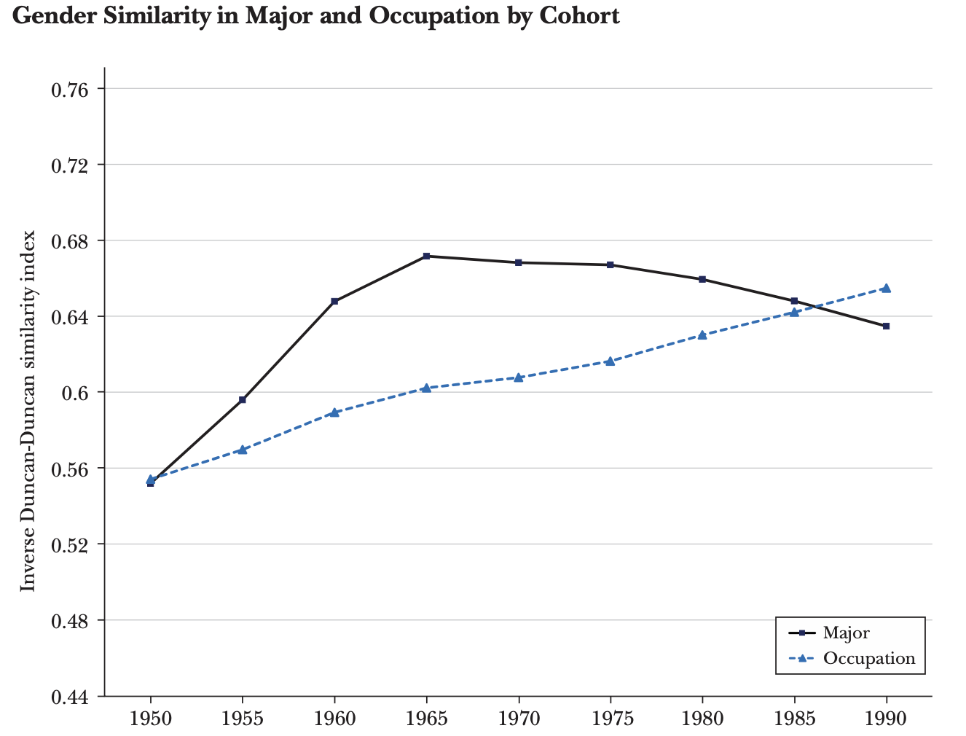
Occupation Convergence, Less So Majors
Values close to 1 imply parity.
Less than 1
- women’s choices correspond
to lower wages
Greater than 1
- women’s choices correspond
to higher wages
Women are increasingly choosing majors
that pay less than the majors chosen by men.
(B) Women are increasingly choosing occupations
that pay as well as the occupations chosen by men.
Major
(A)
(B)
Occupation
Source: College Majors, Occupations, and the Gender Wage Gap, Sloane, Hurst, and Black, JEP, Fall 2021.

Slide 38
Solutions to the gender wage gap issue
Debiasing the labor market
  Diversity training for supervisor and manager
  Changing the organizational culture
  Gender blind hiring/evaluation procedures
Training women to be more competitive and removing unconscious bias
Legislative actions by federal and state governments

Slide 39
The system not individual bias is the culprit
The “system” is characterized by:
  Decisions made by ordinary couples in terms of being on-call at work or at home
  Cost of time flexibility at work
The higher the cost of temporal flexibility, the higher is the likelihood of a couple to forego equity in favor of higher family income.
Substitution among workers needs to be encouraged in occupations with high gender pay gaps

Slide 40
Private Sector is Responding... Slowly
With more women entering the profession
More men wanting equitable relationships with their life partners
Costly job training
Valuable client-employee relationships formed by the women in early years
Firms have more incentive to retain the female employees now than ever.

Slide 41
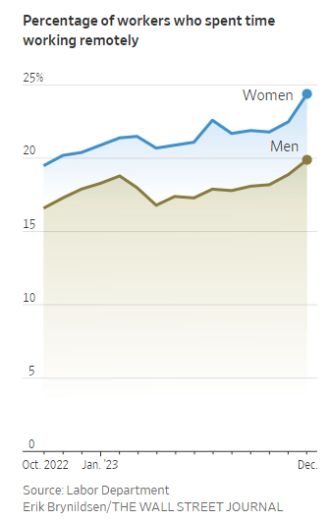
Time Demand Tradeoffs and COVID-19
COVID-19 accelerated trends towards more workplace flexibility.
Remote work may have lasting beneficial impact on all workers, including women.
But there may also be losses.
  WFH = Working from Home or Working from Hell?
  Promotions
Women’s attachment to labor market at risk due to:
  Difficulty in obtaining affordable, dependable childcare

Slide 42
What Have We Learned?
The gap is significant and seemingly stubborn.
  Some, but not very much progress in the last 20 years.
Discrimination clearly plays a role, but we can’t identify how much.
  In wage setting, in people’s choices, as a result of market structures.
Gender roles in child rearing play an enormous role.
Government policy can help, by:
  Implementing policies that reduce the child-bearing penalty for women.
    Access to childcare, for instance.
  Influencing the structure of labor markets, the workplace, hiring practices, and job flexibility.
  Generally, address the hours/compensation relationship.

Slide 43
Thank you!
Any Questions?
www.NEEDEcon.org
Mallika Pung, Ph.D.
MallikaPung@gmail.com
Contact NEED: info@NEEDEcon.org
Submit a testimonial: www.NEEDEcon.org/testimonials.php
Become a Friend of NEED: www.NEEDEcon.org/friend.php

