Slide 1
Osher Lifelong Learning Institute, Summer 2022
Contemporary Economic Policy
University of Hawaii, Manoa
July-Aug, 2022
Jon Haveman, Ph.D.
National Economic Education Delegation

Slide 2
Available NEED Topics Include:
Coronavirus Economics
US Economy
Climate Change
Economic Inequality
Economic Mobility
Trade and Globalization
Minimum Wages
Immigration Economics
Housing Policy
Federal Budgets
Federal Debt
Black-White Wealth Gap
Autonomous Vehicles
US Social Policy

Slide 3
Course Outline
Contemporary Economic Policy
Week 1 (7/8): Economic Update (Geoffrey Woglom, Amherst College)
Week 2 (7/15): The Black-White Wealth Gap (Jon Haveman, NEED)
Week 3 (7/22): Cryptocurrencies (Geoffrey Woglom, Amherst College)
Week 4 (7/29): Autonomous Vehicles (Jon Haveman, NEED)
Week 5 (8/5): Federal Debt (Joseph Carolan, Oakland University)
Week 6 (8/12): Gender Pay Gap (Jon Haveman, NEED)

Slide 4
Submitting Questions
Please submit questions in the chat.
I will try to handle them as they come up, but may take them in a bunch as time permits.
We will do a verbal Q&A once the material has been presented.
And the questions in the chat have been addressed.
OLLI allowing, we can stay beyond the end of class to have further discussion.

Slide 5
The Gender Pay Gap
OLLI – Hawaii, Manoa
August 12, 2022
Jon Haveman, Ph.D.

Slide 6
Credits and Disclaimer
This slide deck was authored by:
Mallika Pung, University of New Mexico
Jon Haveman, NEED
This slide deck was reviewed by:
Donna Ginther, University of Kansas
<name>, <affiliation>
Disclaimer
NEED presentations are designed to be nonpartisan.
It is, however, inevitable that the presenter will be asked for and will provide their own views.
Such views are those of the presenter and not necessarily those of the National Economic Education Delegation (NEED).

Slide 7
Outline
What is gender wage gap?
Gender wage gap in numbers.
What are the potential causes for this gender wage gap?
What can we do?

Slide 8
The Issue of Gender Wage Gap
“We have to pass pay equity for women workers. It is not acceptable that women are making 78 cents an hour compared to men.”
-- Sen. Bernie Sanders (I-Vt.), speech to the National Press Club, March 9, 2015
“..42% [women] in the United States say they have faced discrimination on the job because of their gender… One of the biggest gender gaps is in the area of income: …25% [women] say they have earned less than a man who was doing the same job..”
-- 2017 Pew Research Center survey

Slide 9
Popular Theories
Occupational segregation
Biased managers and co-workers
Inferior bargaining skills
Lack of competitiveness
Labor market incentives
And more
We will delve deeper into what is meant by the gender wage gap and how economists think about the issue.

Slide 10
Significant strides have been made
Progress made in combating gender inequality and discrimination against women in workplace since the 1970s
The Fair Labor Standards Act of 1938,
The Equal Pay Act of 1963,
Title VII of the Civil Rights Act of 1964, and
The Pregnancy Discrimination Act of 1973 in conjunction with
Affirmative Action and other movements aimed at diversity
“Gender Revolution”

Slide 11
Composition of the Full-Time Workforce
Growth:
Total: 56%
Men: 39%
Women: 82%

Slide 12
What is Gender Wage Gap?
Gender wage gap represents the difference in average earnings of women relative to those of men.
The gap is usually calculated as a ratio of women’s earnings to men’s earnings.
For example, in Q1, 2022, median weekly earning for full-time women workers was $955.5, and that for men was $1,141.3.
Therefore, the gender wage gap in January 2021 was:
$$\frac{\$955.5}{\$1,141.3}=83.7\%$$

Slide 13
Relative Wage Gap Over Time
Gap between men and women’s median earnings
has narrowed considerably since the late 1970s.

Slide 14
Sources of Reduction
Relatively more women in jobs with collective bargaining.
Falling for both since 1981, but more for men than women.
Women are getting more education than men.
Women’s devotion to the labor market is growing.

Slide 15
The Wage Gap
Average wage comparison based on a limited sample. Men and women:
Working full time
Working year round
Wage gap is not: Apples to Apples
Does not compare wages of men and women in the same occupation or industry.

Slide 16
What Does the Wage Gap Capture?
It reflects gender differences in:
jobs,
hours worked,
years of experience,
educational attainment,
or personal choices that people make about their careers,
and discrimination.
Which begs the question of why the non-discrimination aspects differ by gender?
Discrimination?
The structure of our economic system?

Slide 17
Wage Gap by State
Leaders:
Conn: 97.0
CA: 87.8
Laggard:
Utah: 72.7
Hawaii: 79.4

Slide 18
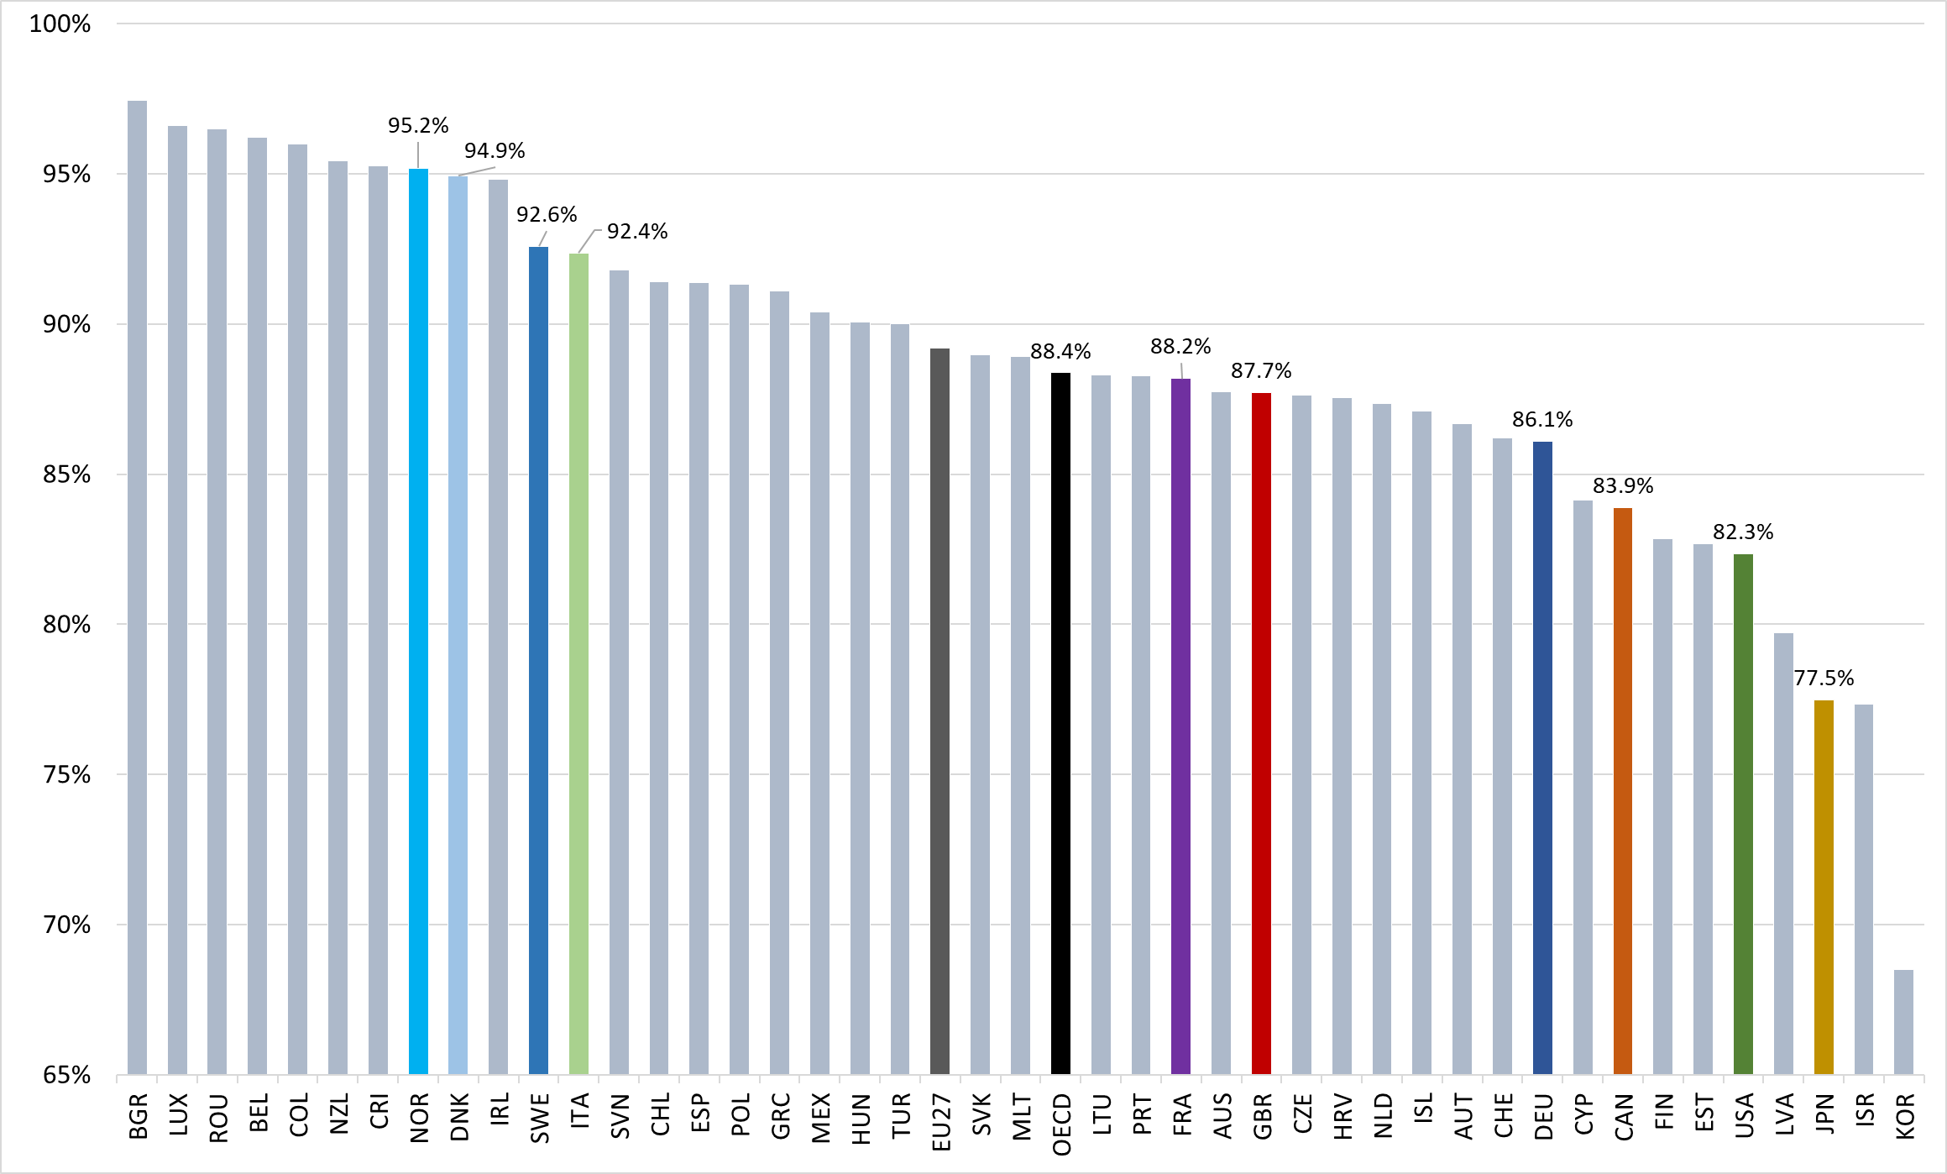
Wage Gap Across the Globe

Slide 19
What is NOT included in these calculations?
These are unconditional or uncontrolled or raw wage gap.
The difference doesn’t take into account important determinants of earnings such as:
Age
Occupation
Educational attainment
Job skills and responsibilities
Work experience
Specialization
Gender wage gap is not a single statistic; it is dynamic.

Slide 20
Wage Gap by Age
The gap between men and women’s median earnings was the largest among those aged 45 years or older.

Slide 21
The Kid Effect

Slide 22
The Kid Effect

Slide 23
Wage Gap by Race/Ethnicity
Earnings differences between women and men were largest among Asians and among Whites.
Asian women earned 79% as much as Asian men, and White women earned 82%as much as White men.
Black women had median earnings that were 92% of Black men’s, and Hispanic women’s earnings were 89% of Hispanic men.

Slide 24
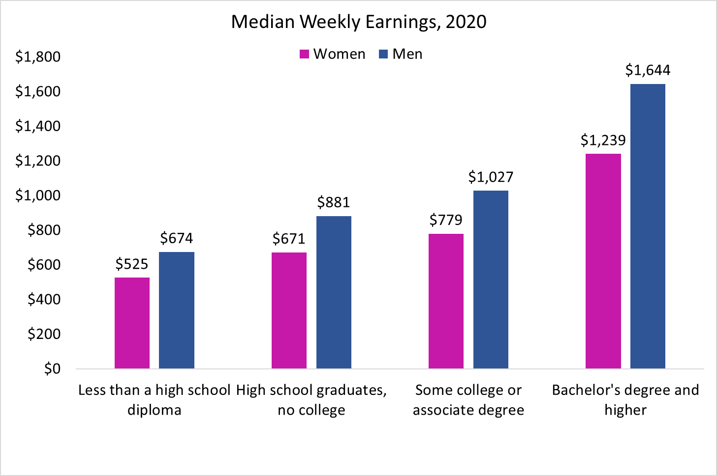
Wage Gap by Level of Education
College pays – among all workers, median earnings of those with at most a HS degree were 55% of those with at least a bachelor’s degree.
The gap between men and women’s median earnings was the largest among college graduates, with women’s median earning at only 75% of men’s.
77.9
76.2
75.9
75.4

Slide 25
Wage Change by Level of Education
Long-term trend in inflation-adjusted earnings has been more favorable for women than for men.

Slide 26
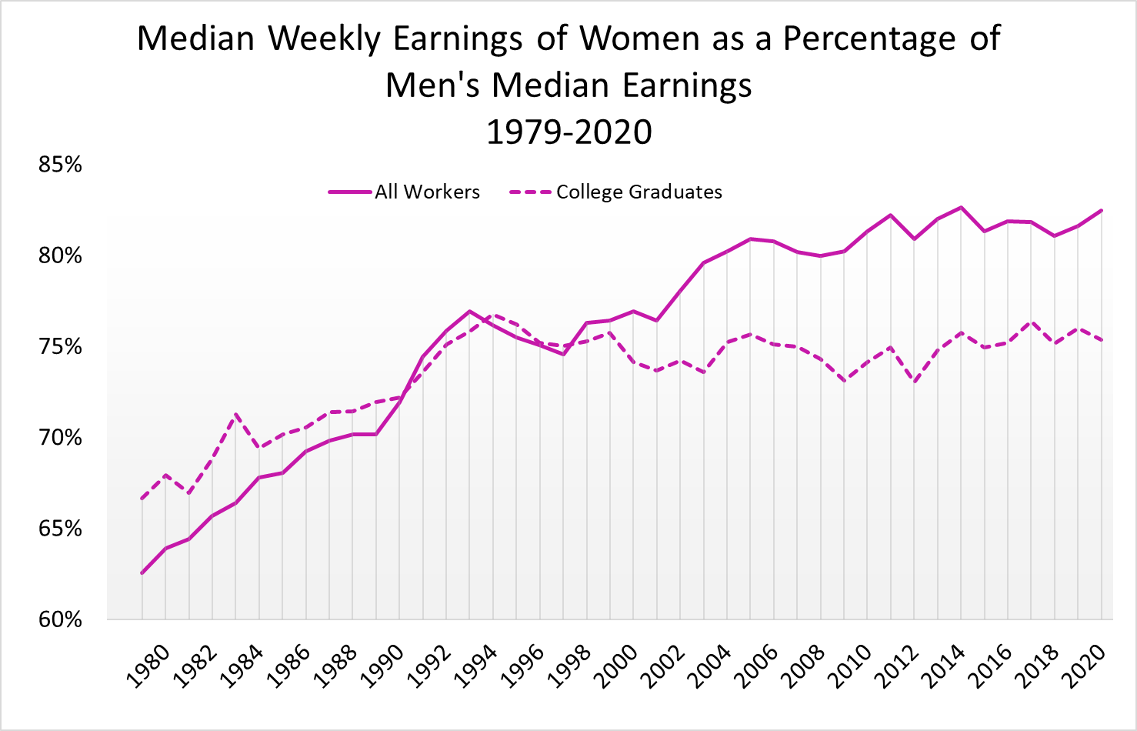
Gender Wage Gap Over the Years – College Graduates

Slide 27
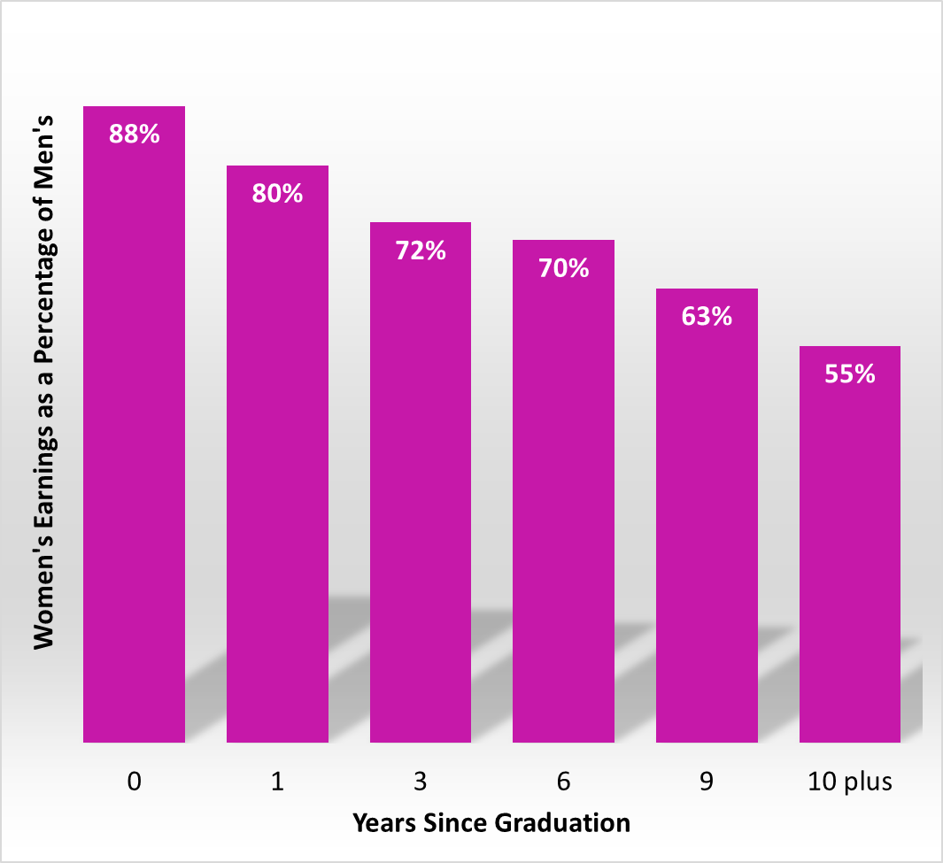
Wage Gap Widens with Age and with Years After Leaving School
From Bertrand, Goldin, Katz (2010)
Directly following MBA receipt, average earnings are comparable among men and women, but they soon diverge.
In the first 9 years after graduation, women’s average earnings increase by 117%, while those of men increase by 208%.

Slide 28
Wage Gap Among MBA Graduates Not Random
The sample controls for ability, training and education.
Almost all the gap can be explained by:
Career interruptions.
Differences in average weekly work hours.
49 hrs vs 57 hrs for men.
More part-time, self-employed workers.
The gap grows largely with the arrival of children.
Well-intentioned paternalism by supervisors.
Husband’s position on the earnings distribution and its interaction with children also a factor.
Several studies, even those from Nordic countries, support these results.

Slide 29
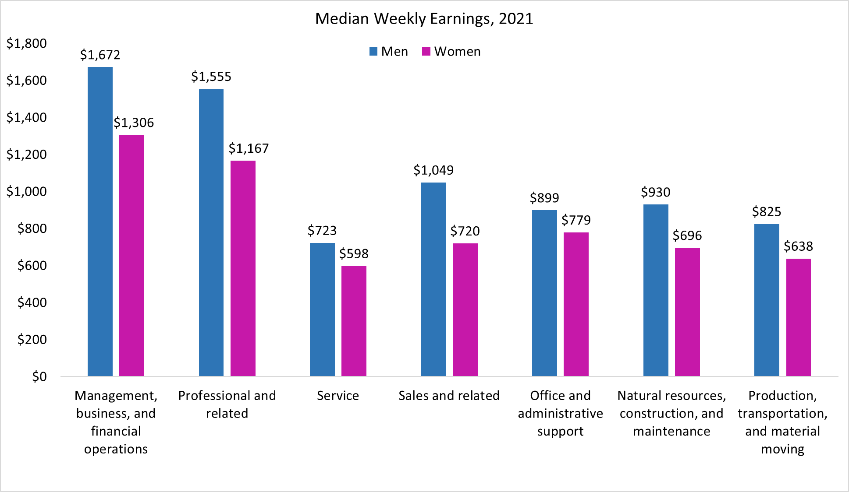
Weekly Earnings by Occupation
78.1
75.0
82.7
68.6
86.7
96.3
77.3
82.3
= National Average Ratio

Slide 30
Gender Distribution of Occupations
78.1
75.0
82.7
68.6
86.7
96.3
77.3
82.3
= National Average Ratio

Slide 31
Occupations with the Smallest Wage Gap, 2021

Slide 32
Occupations with the Biggest Wage Gap, 2021

Slide 33
These are Still Unadjusted Wage Gap Numbers
In the previous slides we controlled for one factor at a time that might affect earnings of workers.
However, controlling for just one of the factors may not fully explain earnings differences.
For example, when comparing median earnings differences by occupation, we still would like to know if these differences can be further explained by differences in other key factors such as
age,
job responsibilities,
work experience, and
other individual life choices such as marital status or to have children and to take time off to raise them.

Slide 34
Adjusting the Wage Gap
Men and women make different choices. It is possible to account for some of those choices to explain the wage gap.
Two possible adjustments:
Adjustment 1 accounts for human capital:
Education
Experience
Geographic region
Race
Adjustment 2 also accounts for:
Unionization
Industry
Occupation

Slide 35
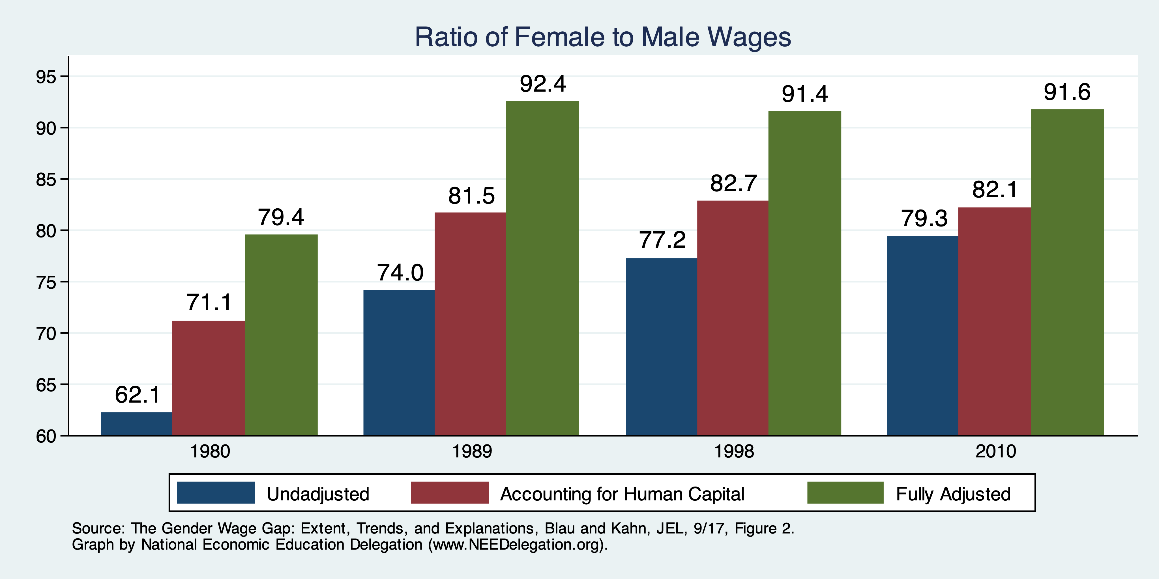
Wage Gap With Adjustments

Slide 36
What do the Adjustments Tell Us?
Human capital decisions, as well as region and race, matter for the wage gap.
Ultimate job matters:
Is it unionized?
Is it an industry with a large gap?
Is it an occupation with a large gap?
Still 10% unaccounted for.
Is this discrimination?
Perhaps, but not all of it.
Labor market decisions are influenced by discrimination or perceptions of women’s vs men’s majors, occupations, or industries.

Slide 37
Changes Over Time
Not much changed between 1990 and 2010.

Slide 38
Explaining Gender Wage Gap by Occupation
Women, traditionally, the “on-call” parent
Prefer occupations with
shorter hours,
fewer “on-call” hours,
predictable schedules
standardized products/services
greater substitutability of workers within teams
Men, traditionally, opt for jobs with greater time demands but pay more
Men appear to care less about time flexibility
Ready to work evening/weekend hours to meet clients

Slide 39
Explaining Gender Wage Gap by Occupation
High time demand occupations:
Contact with others
Frequency of decision making
Time pressure
Structured vs. unstructured work
Establishing and maintaining interpersonal relationships
Level of competition within an occupation
Income inequality among men within an occupation

Slide 40
Gap Occurs Primarily WITHIN Occupations
Where does the wage gap come from?
 | Between Occupations | Within Occupations
All Workers | 15% | 85%
College Graduates | 35% | 65%
Source: Reassessing the Gender Wage Gap: Sharing Jobs, Equalizing Pay, Right Now, the Expanding Harvard Universe.

Slide 41
Non-Linearities in Pay and the Wage Gap
Pay increases with the number of hours worked each week.
Why?
In some occupations, workers are not good substitutes for each other.
To ensure continuity, employers value individual workers working more hours.
Implications:
Households divide the work.
Rather than both working 40 hours, perhaps one works 80 and the other does not work.
Women are more likely to be the ones working fewer hours, receiving less pay.
Source: Reassessing the Gender Wage Gap: Sharing Jobs, Equalizing Pay, Right Now, the Expanding Harvard Universe.

Slide 42
Evidence on Non-Linearities from Law Firms
Lawyers:
Hours go up
So does hourly pay
Source: A Grand Gender Convergence: Its Last Chapter, Goldin, AER, 2014.

Slide 43
Gap Occurs Primarily WITHIN Occupations
Not all occupations have the same pay gap.
Depends on how substitutable workers are.
 | Ration W/M Wages
Science and Health Professions | .892
Business and Finance | .787
Law | .815
OVERALL | .780
Source: Reassessing the Gender Wage Gap: Sharing Jobs, Equalizing Pay, Right Now, the Expanding Harvard Universe.

Slide 44
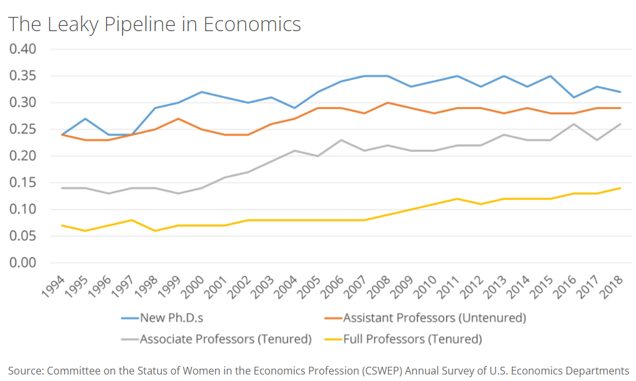
The Leaky Pipelines Phenomenon
In many professional occupations
There’s a more equitable gender distribution at entry level.
But at the higher ranks, number of female workers plummets.
Time demands – likely explanation?

Slide 45
Sorting
Sorting happens:
With the decision to go to college.
With the election of a major.
With the choice of an occupation.
Women tend to:
Go to college more than men.
Select majors with lower expected wages.
Though convergence WAS happening.
Within a major, select occupations with lower wages.
Though convergence IS happening.

Slide 46
Occupation Convergence, Less So Majors
Values close to 1 imply parity.
Less than 1
- women’s choices correspond
to lower wages
Greater than 1
- women’s choices correspond
to higher wages
Women are increasingly choosing majors
that pay less than the majors chosen by men.
(B) Women are increasingly choosing occupations
that pay as well as the occupations chosen by men.
Major
(A)
(B)
Occupation
Source: College Majors, Occupations, and the Gender Wage Gap, Sloane, Hurst, and Black, JEP, Fall 2021.

Slide 47
Earnings Penalty for Taking Time Out
Occupations with the largest wage gap tend to also be highly skilled.
Earnings penalty for taking time out for career paths with the most prestigious degrees is generally very high.
Goldin and Katz (2008), Harvard and Beyond study: Earnings penalty for taking time off, at 15 years since leaving college with a Bachelors:
Lowest for MDs
Highest for MBAs - at 1.4 times the penalty for MDs
Followed by JDs and PhDs - at 1.2 times the penalty for MDs
Women with children tend to do less well than men.

Slide 48
Solutions to the Gender Wage Gap
Debiasing the labor market
Diversity training for supervisors and managers.
Changing the organizational culture.
Gender blind hiring/evaluation procedures.
Training women to be more competitive and removing unconscious bias.
Legislative actions by federal and state governments.

Slide 49
The System - Not Individual Bias is the Culprit
The “system” is characterized by:
Decisions made by ordinary couples in terms of being on-call at work or at home.
Cost of time flexibility at work.
The higher the cost of time flexibility, the higher is the likelihood of a couple to forego equity in favor of higher family income.
Substitution among workers needs to be encouraged in occupations with high gender pay gaps.

Slide 50
Private Sector is Responding... Slowly
With more women entering the profession.
More men wanting equitable relationships with their life partners.
Costly job training.
Valuable client-employee relationships formed by the women in early years.
Firms have more incentive to retain the female employees now than ever.

Slide 51
Time Demand Tradeoffs and COVID-19
COVID-19 may have accelerated some of the trends towards more workplace flexibility.
Remote work may have lasting beneficial impact on all workers, including women.
But there may also be losses.
WFH = Working from Home or Working from Hell?
Women’s attachment to labor market at risk due to:
Difficulty in obtaining affordable, dependable childcare.
Unpredictability in school closures/re-openings.

Slide 52
What can we do?
Reduce the cost of flexibility
Increase or incentivize substitutability
Reduce the cost of caregiving – childcare as well as elderly care
Alter societal norms
“We need men to lean out at work, support their male colleagues who are on parental leave, vote for public policies that subsidize childcare, and get their firms to change their greedy ways by letting them know that their families are worth even more than their jobs. Dreams won’t come true, aspirations won’t be realized unless men are brought along for the rest of the journey.”
-- Claudia Goldin

Slide 53
Flexibility and Substitutability?
Science
Tech
Business

Slide 54
What Have We Learned?
The gap is significant and seemingly stubborn.
Some, but not very much progress in the last 20 years.
Discrimination clearly plays a role, but we can’t identify how much.
In wage setting, in people’s choices, as a result of market structures.
Gender roles in child rearing play an enormous role.
Government policy can help, by:
Implementing policies that reduce the child-bearing penalty for women.
Access to child care, for instance.
Influencing the structure of labor markets, the workplace, hiring practices, and job flexibility.
Generally, address the hours/compensation relationship.

Slide 55
Thank you!
Any Questions?
www.NEEDelegation.org
Jon D. Haveman, Ph.D.
Jon@NEEDelegation.org
Contact NEED: info@needelegation.org
Submit a testimonial: www.NEEDelegation.org/testimonials.php
Become a Friend of NEED: www.NEEDelegation.org/friend.php

