Slide 1
Osher Lifelong Learning Institute, Winter 2022
Contemporary Economic Policy
American University
March-May, 2022
Host: Jon Haveman, Ph.D.
National Economic Education Delegation

Slide 2
Available NEED Topics Include:
Coronavirus Economics
US Economy
Climate Change
Economic Inequality
Economic Mobility
Trade and Globalization
Minimum Wages
Immigration Economics
Housing Policy
Federal Budgets
Federal Debt
Black-White Wealth Gap
Autonomous Vehicles
US Social Policy

Slide 3
Course Outline
Contemporary Economic Policy
Week 1 (3/11): US Economy & Coronavirus Economics
Week 2 (3/18): Federal Debt (Brian Peterson, Central College)
Week 3 (3/25): Trade and Globalization (Alan Deardorff, Univ. of Michigan)
Week 4 (4/1): Healthcare Economics (Veronika Dolar, SUNY-Old Westbury)
Week 5 (4/8): Economics of Immigration (Jennifer Alix-Garcia, Oregon St. Univ.)
Week 6 (4/15): Economic Inequality (Kyle Montanio, Colorado University - Denver)
Week 7 (4/22): Economic Mobility (Kathryn Wilson, Kent State University)
Week 8 (4/29): Discrimination in US Policy History (Jon Haveman, NEED)
Week 9 (5/6): The Black-White Wealth Gap (Mike Shor, Univ. of Connecticut)
Week 10 (5/13): The Gender Pay Gap (Mallika Pung, Univ. of New Mexico)

Slide 4
Gender Pay Gap
Mallika Pung, Ph.D.
University of New Mexico
May 13, 2022

Slide 5
Outline
What is gender wage gap?
Gender wage gap in numbers.
What are the potential causes for this gender wage gap?
What can we do?

Slide 6
The Issue of Gender Wage Gap
“We have to pass pay equity for women workers. It is not acceptable that women are making 78 cents an hour compared to men.”
-- Sen. Bernie Sanders (I-Vt.), speech to the National Press Club, March 9, 2015
“..42% [women] in the United States say they have faced discrimination on the job because of their gender… One of the biggest gender gaps is in the area of income: …25% [women] say they have earned less than a man who was doing the same job..”
-- 2017 Pew Research Center survey

Slide 7
Popular Theories
Occupational segregation
Biased managers and co-workers
Inferior bargaining skills
Lack of competitiveness
And more
We will delve deeper into what is meant by gender wage gap and how economists think about the issue.

Slide 8
Significant strides have been made
Progress made in combating gender inequality and discrimination against women in workplace since the 1970s
The Fair Labor Standards Act of 1938,
The Equal Pay Act of 1963,
Title VII of the Civil Rights Act of 1964, and
The Pregnancy Discrimination Act of 1973 in conjunction with
Affirmative Action and other movements aimed at diversity
“Gender Revolution”

Slide 9
Composition of the Full-Time Workforce

Slide 10
What is Gender Wage Gap?
Gender wage gap represents the difference in average earnings of women relative to those of men.
The gap is usually calculated as a ratio of women’s earnings to men’s earnings.
For example, in July 2021, median weekly earning for full-time women workers was $914, and that for men was $1105.
Therefore, the gender wage gap in July 2021 was:
$$\frac{\$914}{\$1105}=82.7\%$$

Slide 11
Gender Wage Gap Over the Years
Gap between men and women’s median earnings has narrowed considerably
since the late 1970s.

Slide 12
Wage Gap by State

Slide 13
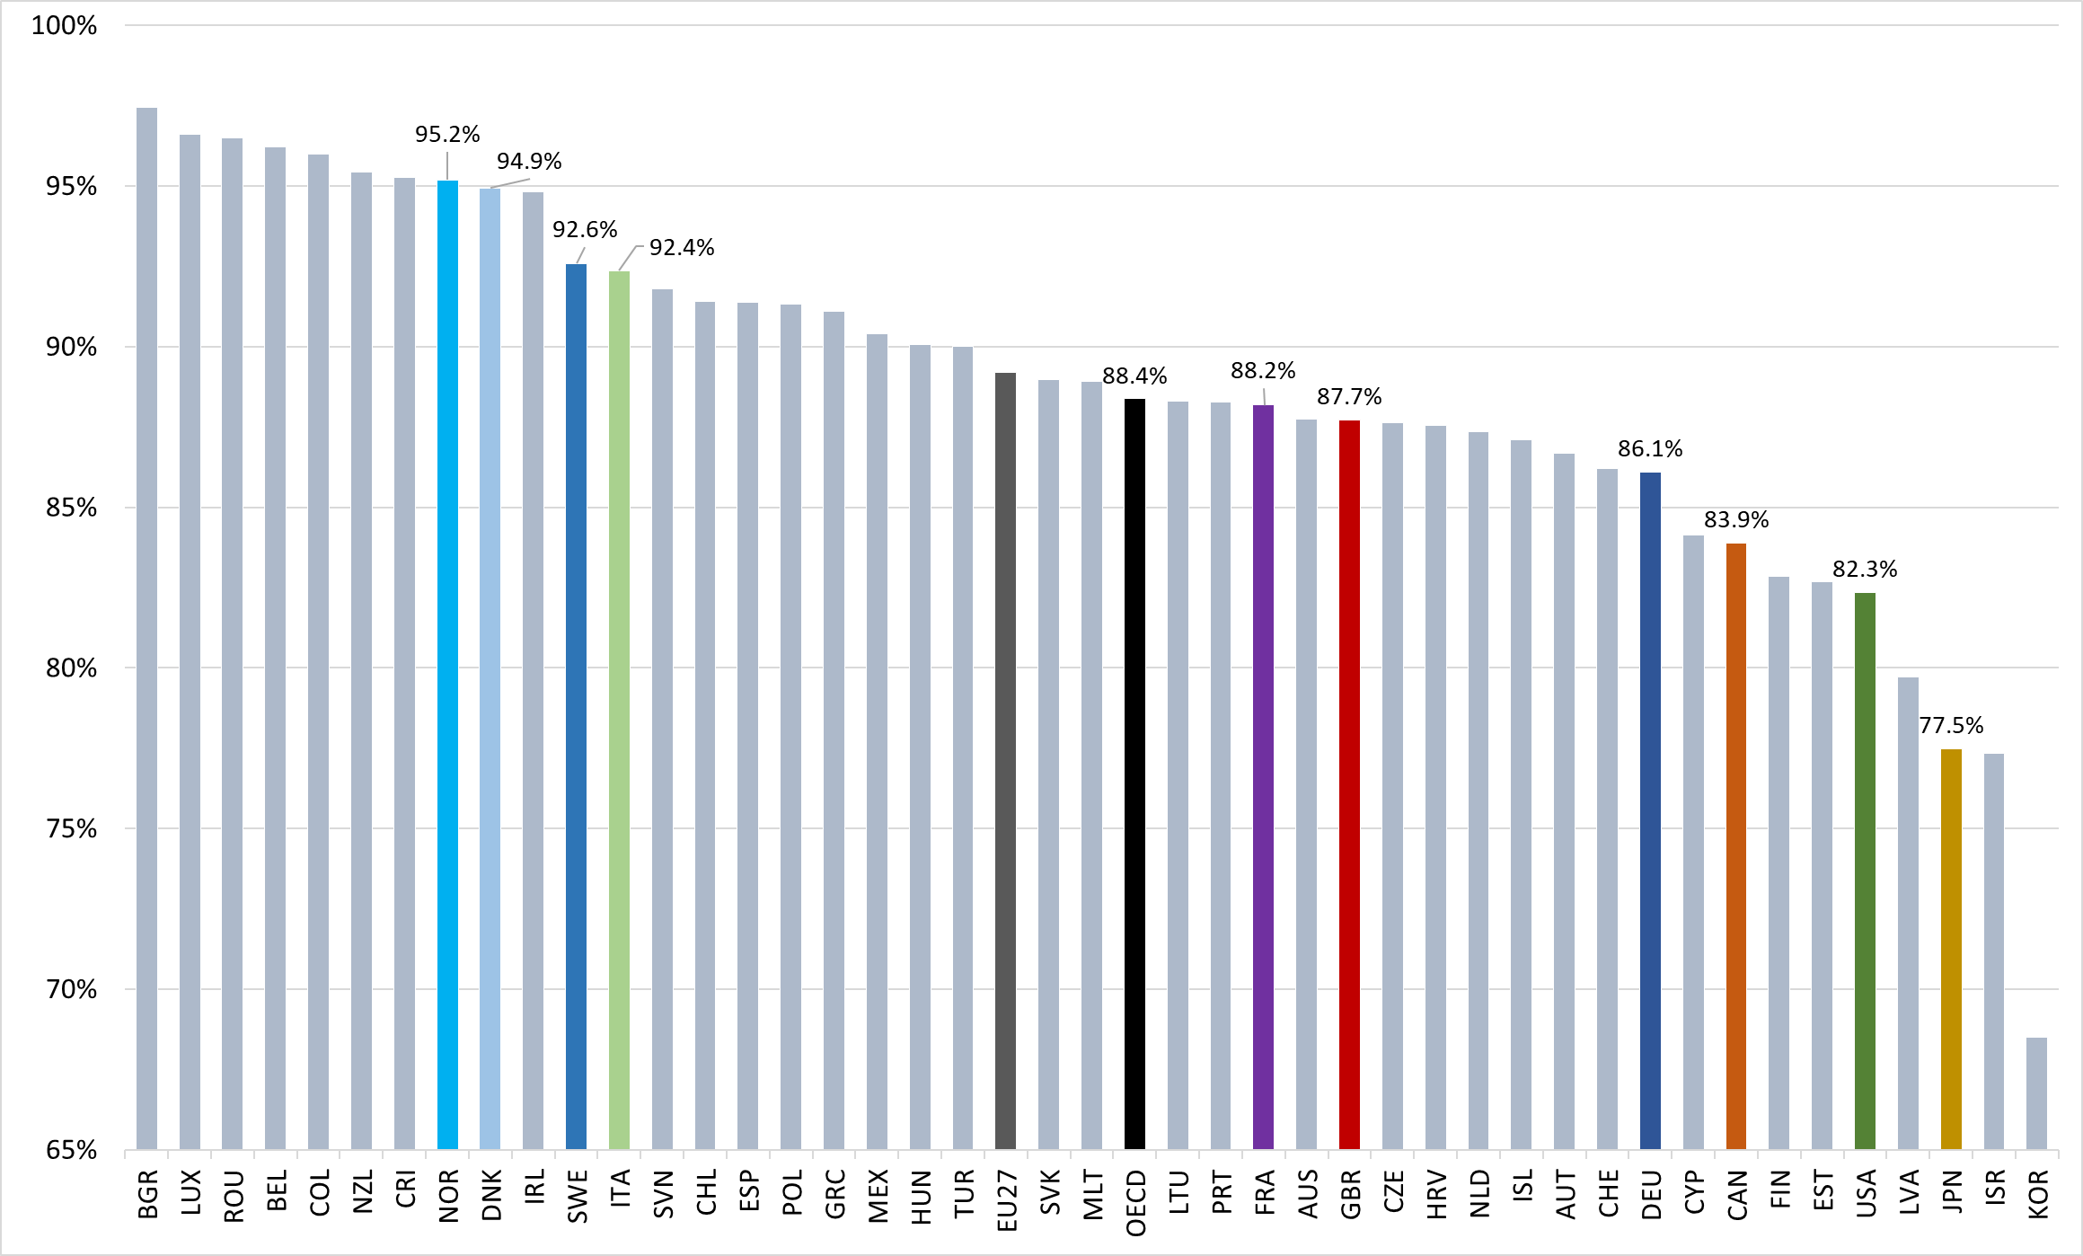
Wage Gap Across the Globe
Average
OECD
United
States

Slide 14
What is NOT included in these calculations?
These are unconditional or uncontrolled or raw wage gap.
The difference doesn’t take into account important determinants of earnings such as:
Age
Occupation
Educational attainment
Job skills and responsibilities
Work experience
Specialization
Gender wage gap is not a single statistic; it’s dynamic.

Slide 15
Wage Gap by Age
The gap between men and women’s median earnings was the largest among those aged 45 years or older.

Slide 16
Wage Gap by Race/Ethnicity
Earnings differences between women and men were largest among Asians and among Whites.
Asian women earned 79% as much as Asian men, and White women earned 82%as much as White men.
Black women had median earnings that were 92% of Black men’s, and Hispanic women’s earnings were 89% of Hispanic men.

Slide 17
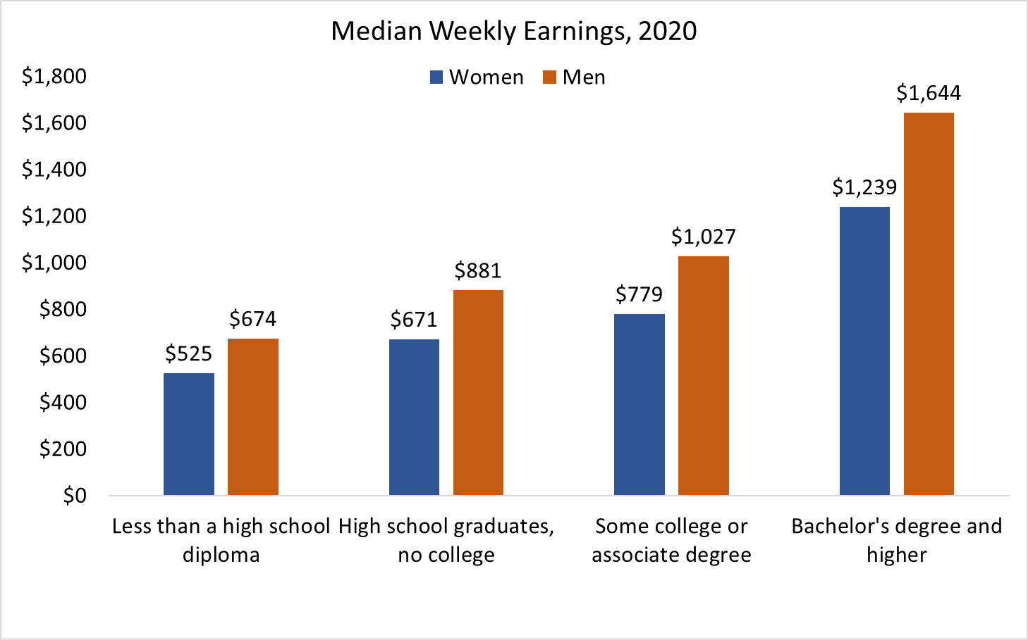
Wage Gap by Level of Education
College pays – among all workers, median earnings of those with at most a HS degree were 55% of those with at least a bachelor’s degree.
The gap between men and women’s median earnings was the largest among college graduates, with women’s median earning at only 75% of men’s.

Slide 18
Wage Change by Level of Education
Long-term trend in inflation-adjusted earnings has been more favorable for women than for men.

Slide 19
Gender Wage Gap Over the Years – College Graduates

Slide 20
Wage Gap Widens with Age and with Years Since Leaving School
From Bertrand, Goldin, Katz (2010)
Directly following MBA receipt, average earnings are comparable among men and women, but they soon diverge.
In the first 9 years after graduation, women’s average earnings increase by 117%, while those of men increase by 208%.

Slide 21
Wage Gap Among MBA Graduates Not Random
The sample controls for ability, training and education
Almost all the gap can be explained by:
Career interruptions
Differences in average weekly work hours
49 hrs vs 57 hrs for men
More part-time, self-employed workers
The gap grows largely with the arrival of children
Well-intentioned paternalism by supervisors
Husband’s position on the earnings distribution and its interaction with children also a factor
Several studies, even those from Nordic countries, support these results

Slide 22
Weekly Earnings by Occupation

Slide 23
Gender Distribution of Occupations

Slide 24
Occupations with the Lowest Wage Gap, 2021

Slide 25
Occupations with the Highest Wage Gap, 2021

Slide 26
These are still unadjusted wage gap numbers
In the previous slides we controlled for one factor at a time that might affect earnings of workers.
However, controlling for just one of the factors may not fully explain earnings differences.
For example, when comparing median earnings differences by occupation, we still would like to know if these differences can be further explained by differences in other key factors such as
age,
job responsibilities,
work experience, and
other individual life choices such as marital status or to have children and to take time off to raise them.

Slide 27
Explaining Gender Wage Gap by Occupation
Women, traditionally, the “on-call” parent – Goldin [2021]
Prefer occupations with
shorter hours,
fewer “on-call” hours,
predictable schedules
standardized products/services
greater substitutability of workers within teams
Men, traditionally, opt for jobs with greater time demands but pay more
Appear to care less about time flexibility
Ready to work evening/weekend hours to meet clients

Slide 28
Explaining Gender Wage Gap by Occupation
High time demand occupations:
Contact with others
Frequency of decision making
Time pressure
Structured vs. unstructured work
Establishing and maintaining interpersonal relationships
Level of competition within an occupation
Income inequality among men within an occupation

Slide 29
Earnings Penalty for Taking Time Out
Occupations with the most wage gap tend to also be the highly skilled
Earnings penalty for women (as well as men) for taking time out for career paths with the most prestigious degrees such as JD, MD, MBA or PhDs – lawyers, physicians, managers or academicians – is generally very high.
Goldin and Katz (2008), Harvard and Beyond study: Earnings penalty for taking time off, at 15 years since leaving college with a Bachelors:
Lowest for MDs
Highest for MBAs at 1.4 times the penalty for MDs
Followed by JDs and PhDs at 1.2 times the penalty for MDs
Women with children tend to do less well than men.

Slide 30
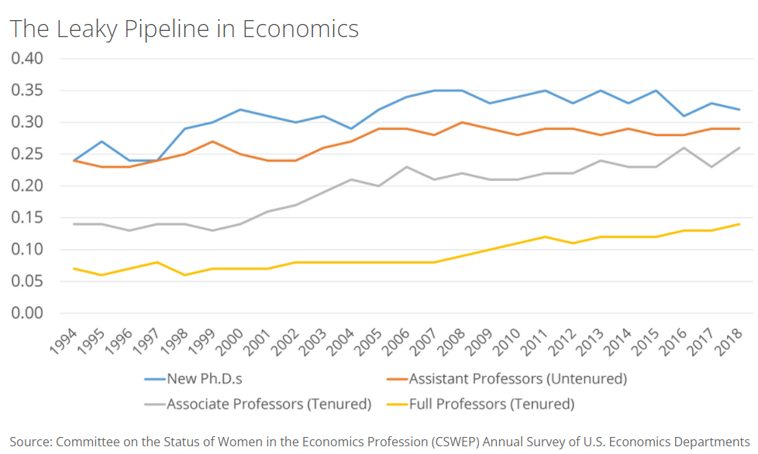
The Leaky Pipelines Phenomenon
In many professional occupations
There’s a more equitable gender distribution at entry level,
But at the higher ranks, number of female workers plummets.
Time demands – likely explanation?

Slide 31
Solutions to the gender wage gap issue
Debiasing the labor market
Diversity training for supervisor and manager
Changing the organizational culture
Gender blind hiring/evaluation procedures
Training women to be more competitive and removing unconscious bias
Legislative actions by federal and state governments

Slide 32
The system not individual bias is the culprit
The “system” is characterized by:
Decisions made by ordinary couples in terms of being on-call at work or at home
Cost of time flexibility at work
The higher the cost of temporal flexibility, the higher is the likelihood of a couple to forego equity in favor of higher family income.
Substitution among workers needs to be encouraged in occupations with high gender pay gaps

Slide 33
Private Sector is Responding... Slowly
With more women entering the profession
More men wanting equitable relationships with their life partners
Costly job training
Valuable client-employee relationships formed by the women in early years
Firms have more incentive to retain the female employees now than ever.

Slide 34
Time Demand Tradeoffs and COVID-19
COVID-19 may have accelerated some of the trends towards more workplace flexibility.
Remote work may have lasting beneficial impact on all workers, including women.
But there may also be losses.
WFH = Working from Home or Working from Hell?
Women’s attachment to labor market at risk due to:
Difficulty in obtaining affordable, dependable childcare
Unpredictability in school closures/re-openings

Slide 35
What can we do?
Reduce the cost of flexibility
Increase or incentivize substitutability
Reduce the cost of caregiving – childcare as well as elderly care
Alter societal norms
“We need men to lean out at work, support their male colleagues who are on parental leave, vote for public policies that subsidize childcare, and get their firms to change their greedy ways by letting them know that their families are worth even more than their jobs. Dreams won’t come true aspirations won’t be realized unless men are brought along for the rest of the journey”
-- Claudia Goldin

Slide 36
Thank you!
Any Questions?
www.NEEDelegation.org
Mallika Pung, Ph.D.
MallikaPung@gmail.com
Contact NEED: info@NEEDelegation.org
Submit a testimonial: www.NEEDelegation.org/testimonials.php
Become a Friend of NEED: www.NEEDelegation.org/friend.php

