Slide 1


The Gender Pay Gap
American Association of University Women
February 7, 2024
Jon Haveman, Ph.D.

Slide 2
National Economic Education Delegation
Vision
  One day, the public discussion of policy issues will be grounded in an accurate perception of the underlying economic principles and data.
Mission
  NEED unites the skills and knowledge of a vast network of professional economists to promote understanding of the economics of policy issues in the United States.
NEED Presentations
  Are nonpartisan and intended to reflect the consensus of the economics profession.

Slide 3
Who Are We?
Honorary Board: 54 members
  2 Fed Chairs: Janet Yellen, Ben Bernanke
  6 Chairs Council of Economic Advisers
    Furman (D), Rosen (R), Bernanke (R), Yellen (D), Tyson (D), Goolsbee (D)
  4 Nobel Prize Winners
    Akerlof, Smith, Maskin, Bernanke
Delegates: 652+ members
  At all levels of academia and some in government service
  All have a Ph.D. in economics
  Crowdsource slide decks
  Give presentations
Global Partners: 49 Ph.D. Economists
  Aid in slide deck development

Slide 4


Where Are We?

Slide 5
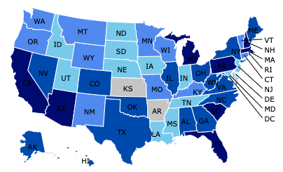
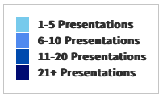
Where Have We Presented? (1,114 Talks)

Slide 6
Available NEED Topics Include:
Coronavirus Economics
US Economy
Climate Change
Economic Inequality
Economic Mobility
Trade and Globalization
Minimum Wages
Immigration Economics
Housing Policy
Federal Budgets
Federal Debt
Black-White Wealth Gap
Autonomous Vehicles
Gender Wage Gap

Slide 7
Credits and Disclaimer
This slide deck was authored by:
  Mallika Pung, University of New Mexico
  Jon Haveman, NEED
This slide deck was reviewed by:
  Donna Ginther, University of Kansas
Disclaimer
  NEED presentations are designed to be nonpartisan.
  It is, however, inevitable that the presenter will be asked for and will provide their own views.
  Such views are those of the presenter and not necessarily those of the National Economic Education Delegation (NEED).

Slide 8
Outline
What is the gender wage gap?
The gender wage gap in numbers.
What are the potential causes for this gender wage gap?
What can we do?

Slide 9
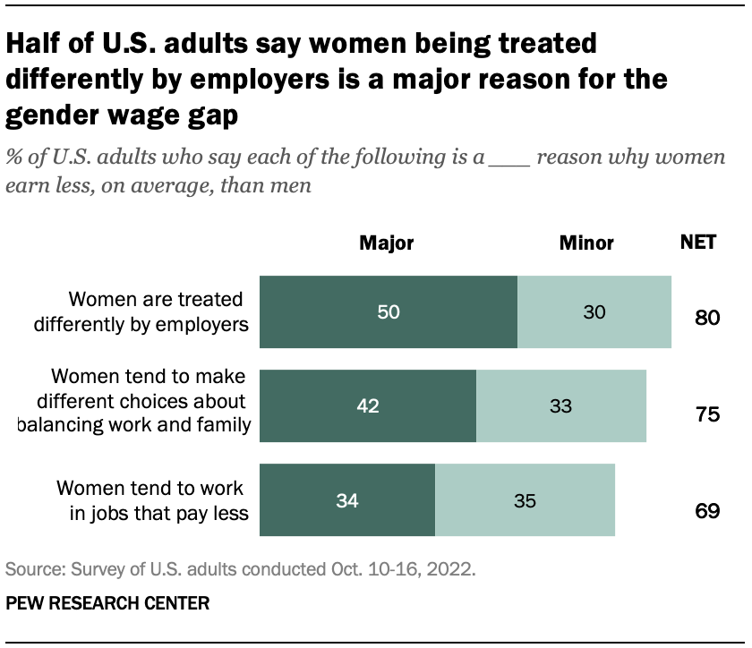
The Issue of Gender Wage Gap
“We have to pass pay equity for women workers. It is not acceptable that women are making 78 cents an hour compared to men.”
-- Sen. Bernie Sanders, 2015

Slide 10
Popular Theories
Biased managers and co-workers
Occupational segregation
Inferior bargaining skills
Lack of competitiveness
Labor market incentives
And more
  We will delve deeper into what is meant by the gender wage gap and how economists think about the issue.

Slide 11
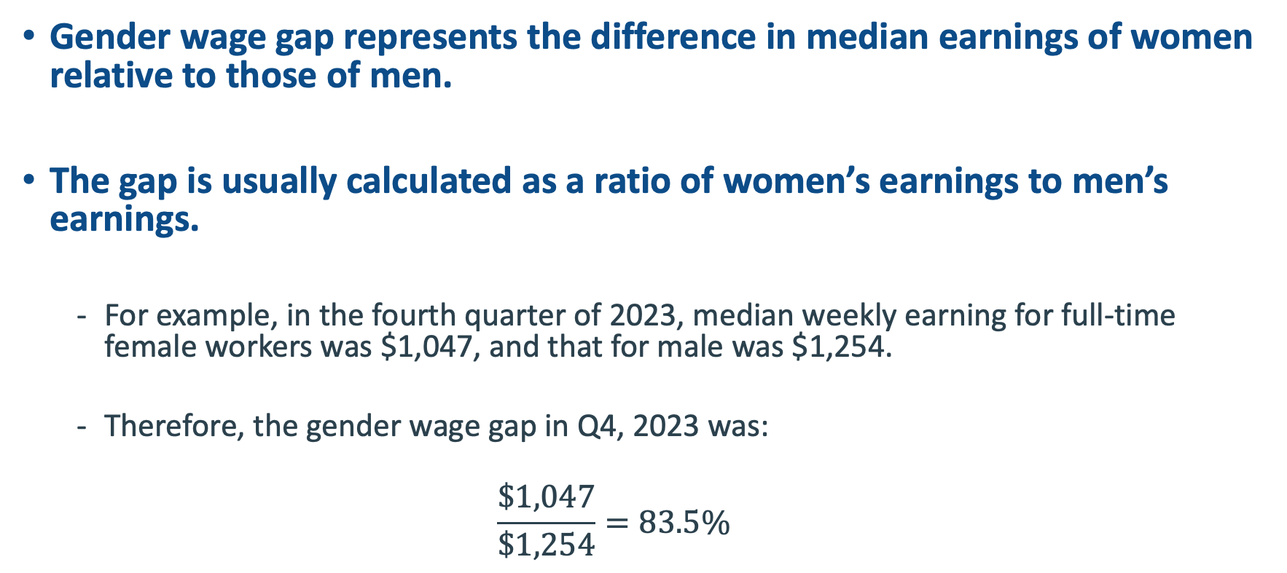
What is Gender Wage Gap?
Gender wage gap represents the difference in median earnings of women relative to those of men.
The gap is usually calculated as a ratio of women’s earnings to men’s earnings.
  For example, in the fourth quarter of 2023, median weekly earning for full-time female workers was $1,047, and that for male was $1,254.
  Therefore, the gender wage gap in Q4, 2023 was:
  $$\frac{\$1,047}{\$1,254}=83.5\%$$

Slide 12
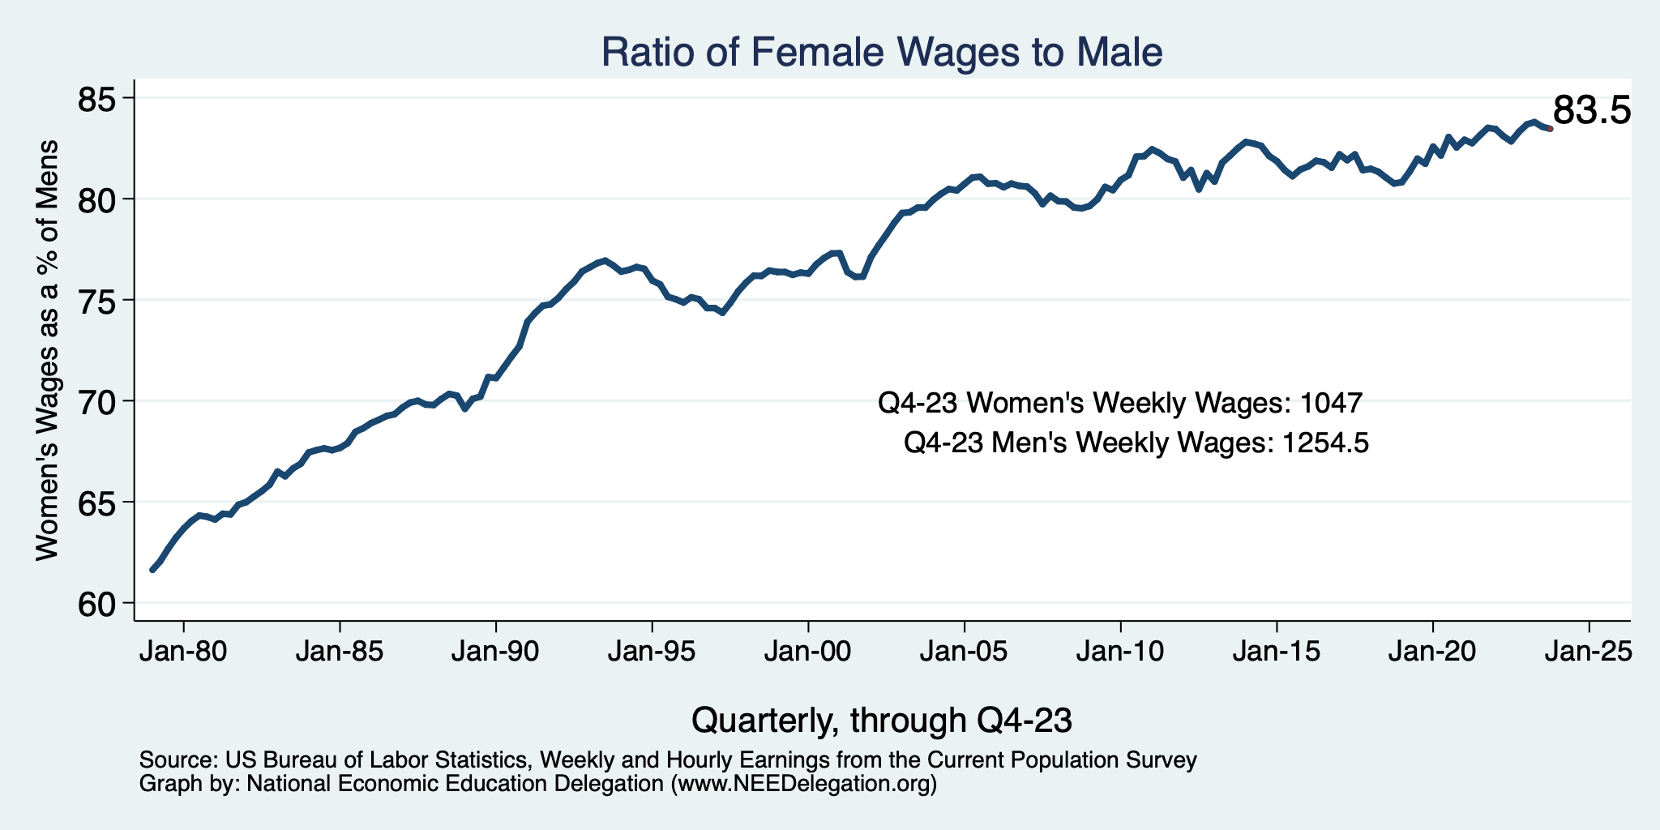
Relative Wage Gap Over Time
63
Gap between men and women’s median earnings
has narrowed considerably since the late 1970s.

Slide 13
Sources of Reduction
Relatively more women in jobs with collective bargaining.
  Falling for both since 1981, but more for men than women.
Women are getting more education than men.
Women’s devotion to the labor market is growing.

Slide 14
Significant strides have been made
Progress made in combating gender inequality and discrimination against women in workplace since the 1970s
  The Fair Labor Standards Act of 1938,
  The Equal Pay Act of 1963,
  Title VII of the Civil Rights Act of 1964, and
  The Pregnancy Discrimination Act of 1973
  Tax Cuts and Jobs Act 2017 – disclosure of sexual harassment settlements
  Providing Urgent Maternal Protections (PUMP) for Nursing Mothers Act
  Pregnant Workers Fairness Act

Slide 15
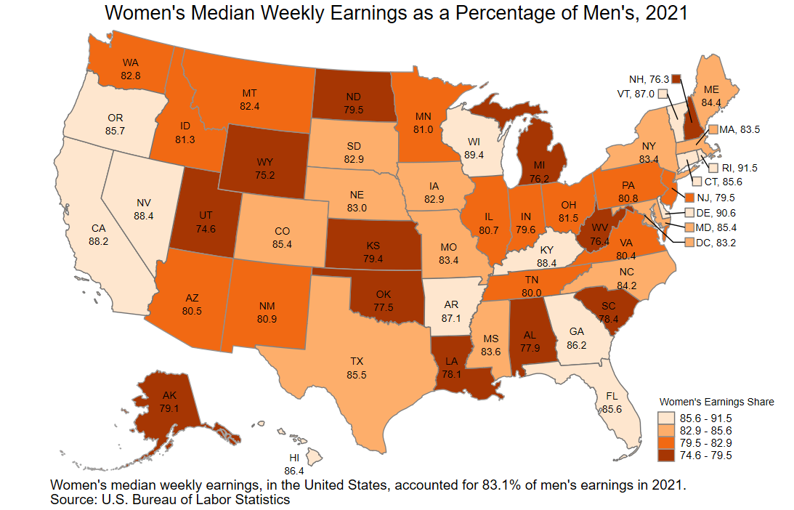
Wage Gap by State
Leaders:
Rhode Island: 91.5
Delaware: 90.6
Wisconsin: 89.4
Laggard:
Utah: 74.6

Slide 16
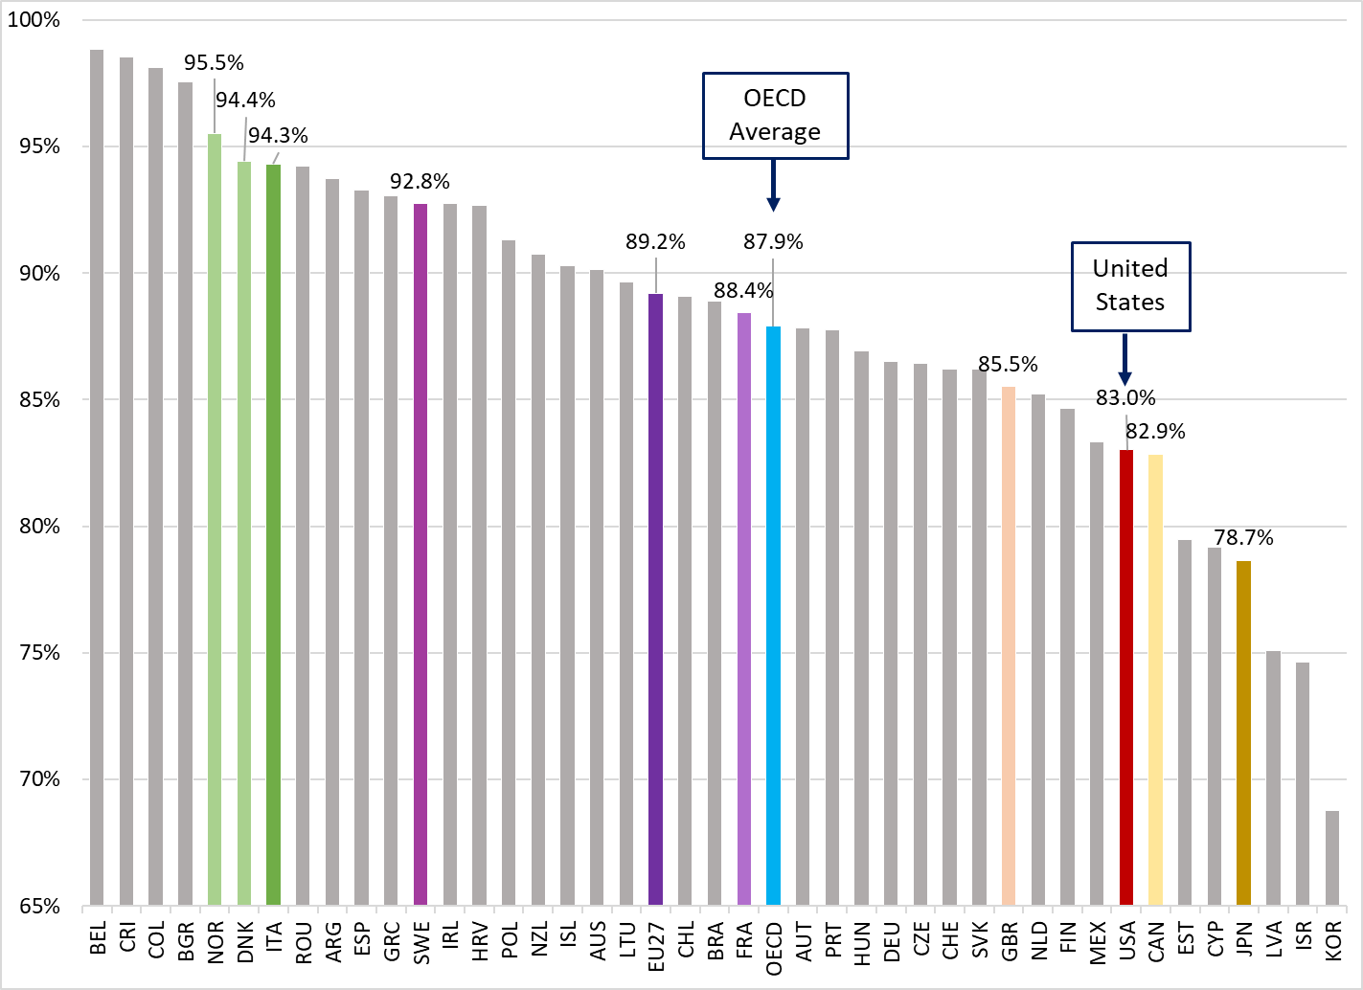
Wage Gap Across the Globe, 2022

Slide 17
The Wage Gap
The gender wage gap is a summary statistic.
  Hides lots of variation.
Wage comparison based on a limited sample. Men and women:
  Working full time
  Working year round
Wage gap is not: Apples to Apples
  Does not compare wages of men and women in the same occupation or industry.

Slide 18
What Does the Wage Gap Capture?
It reflects gender differences in:
  jobs,
  hours worked,
  years of experience,
  educational attainment,
  personal choices that people make about their careers,
  and discrimination.
Which begs the question of why the non-discrimination aspects differ by gender?
  Discrimination?
  The structure of our economic system?

Slide 19
What is NOT included in these calculations?
These are unconditional or uncontrolled or raw wage gap.
The difference doesn’t take into account important determinants of earnings such as:
  Age
  Occupation
  Educational attainment
  Job skills and responsibilities
  Work experience
  Specialization

Slide 20
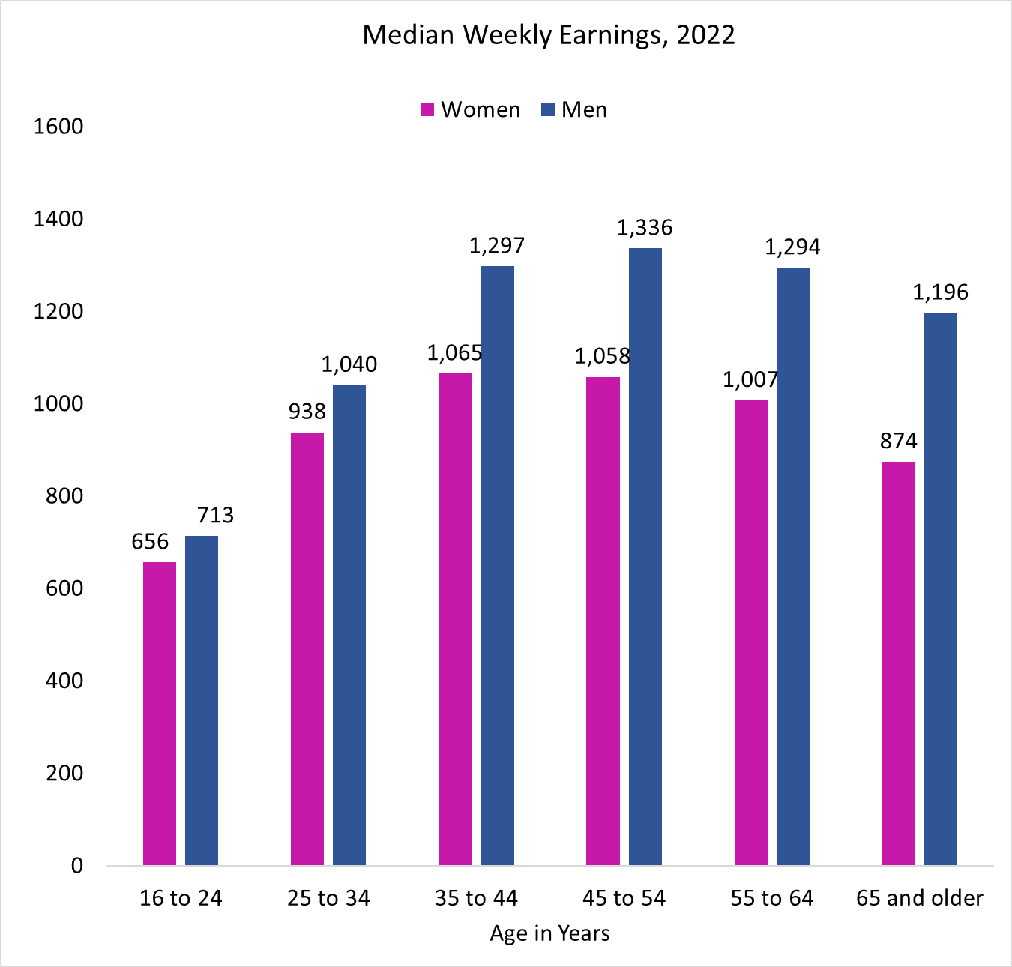
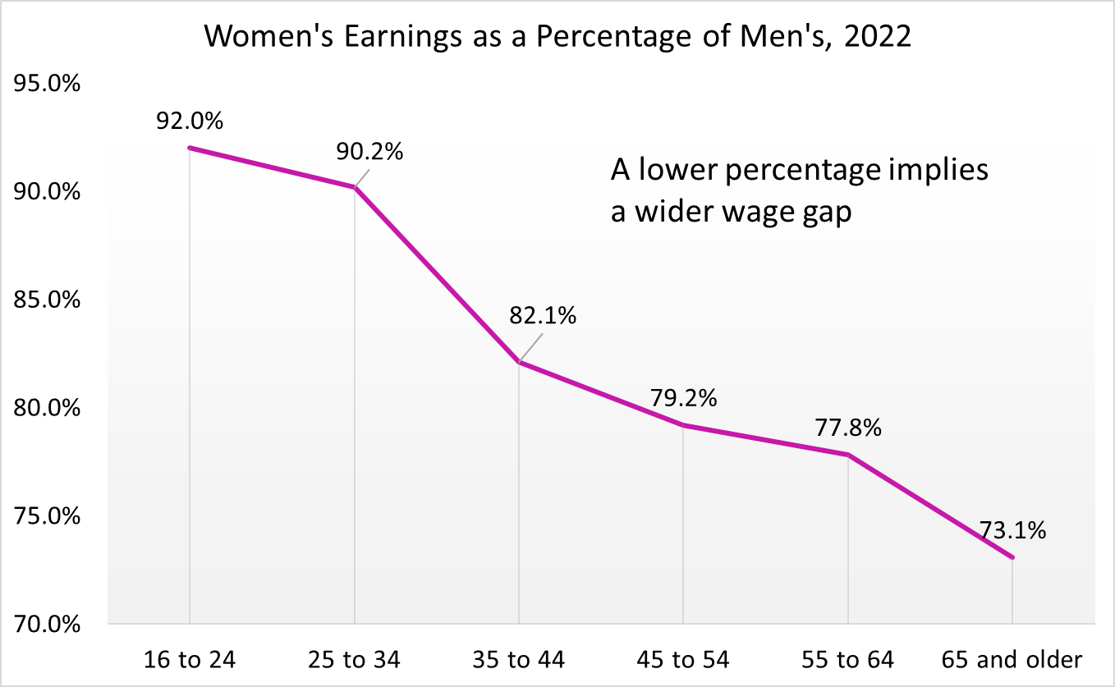
Wage Gap by Age
The gap between men and women’s median earnings was the largest among those aged 45 years or older.

Slide 21
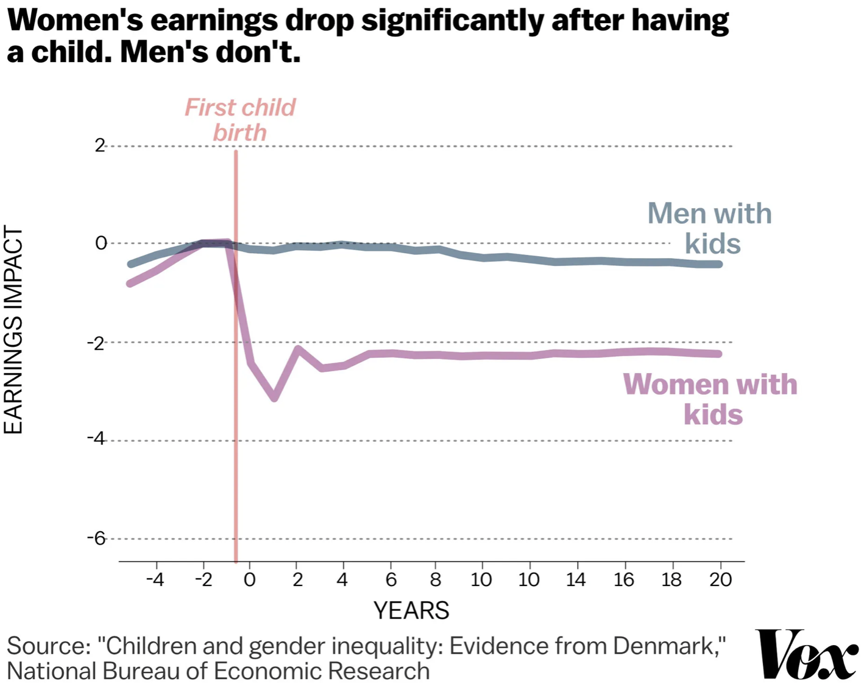
The Kid Effect

Slide 22
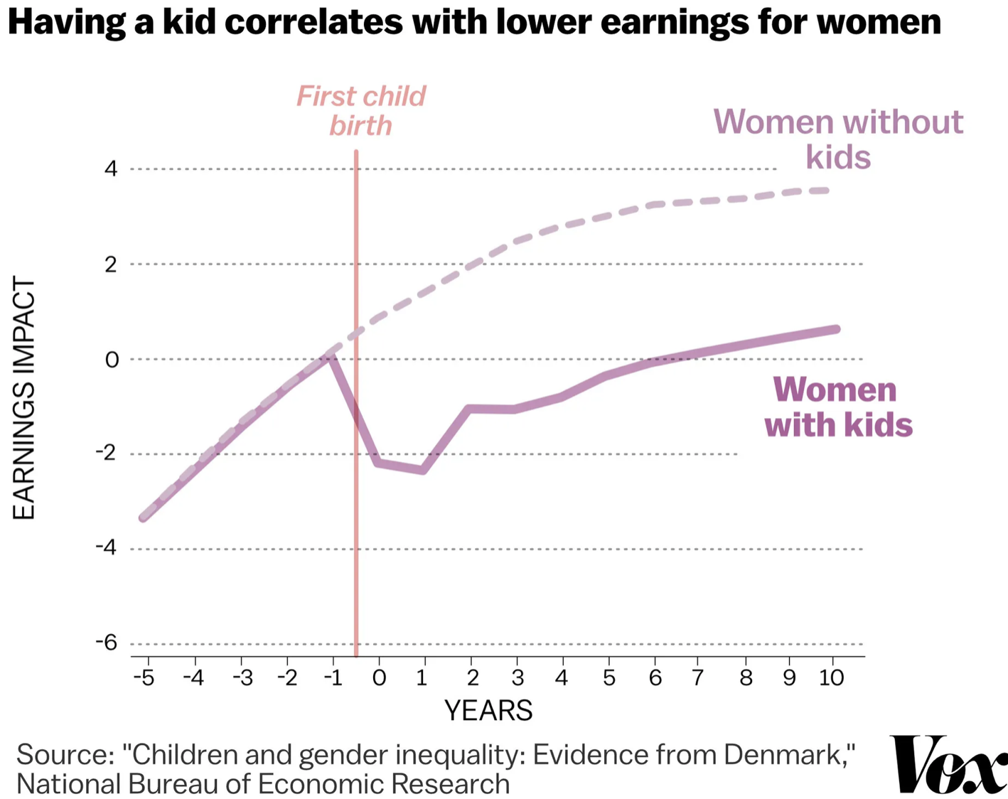
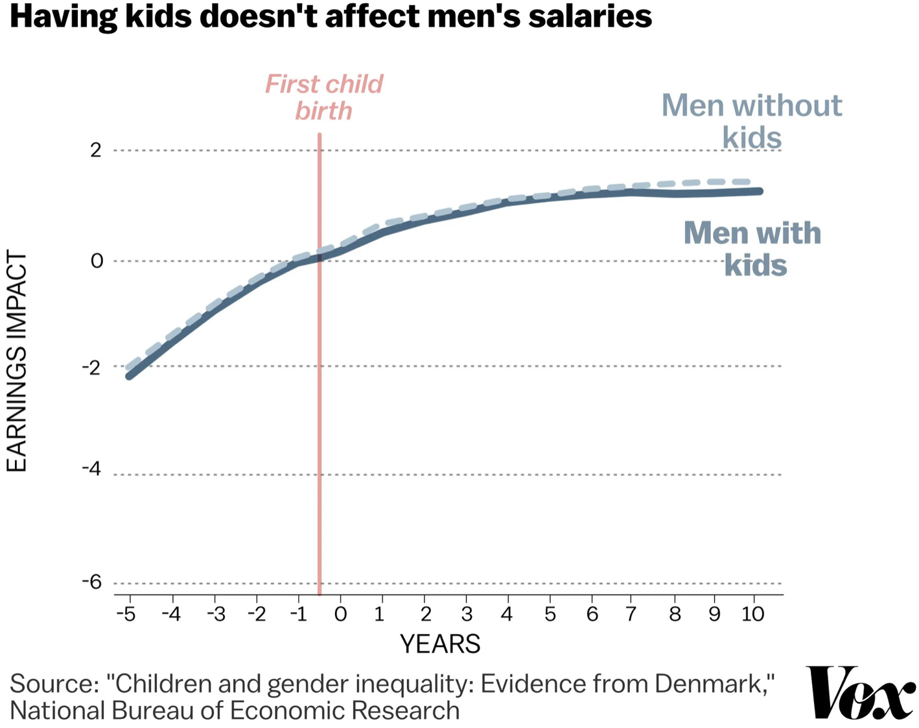
The Kid Effect

Slide 23
Earnings Penalty for Taking Time Out
Occupations with the largest wage gap tend to also be highly skilled.
Earnings penalty for taking time out for career paths with the most prestigious degrees is generally very high.
Earnings penalty for taking time off, at 15 years since leaving college with a Bachelors:
  Lowest for MDs
  Highest for MBAs - at 1.4 times the penalty for MDs
  Followed by JDs and PhDs - at 1.2 times the penalty for MDs
Women with children tend to do less well than men with children.

Slide 24
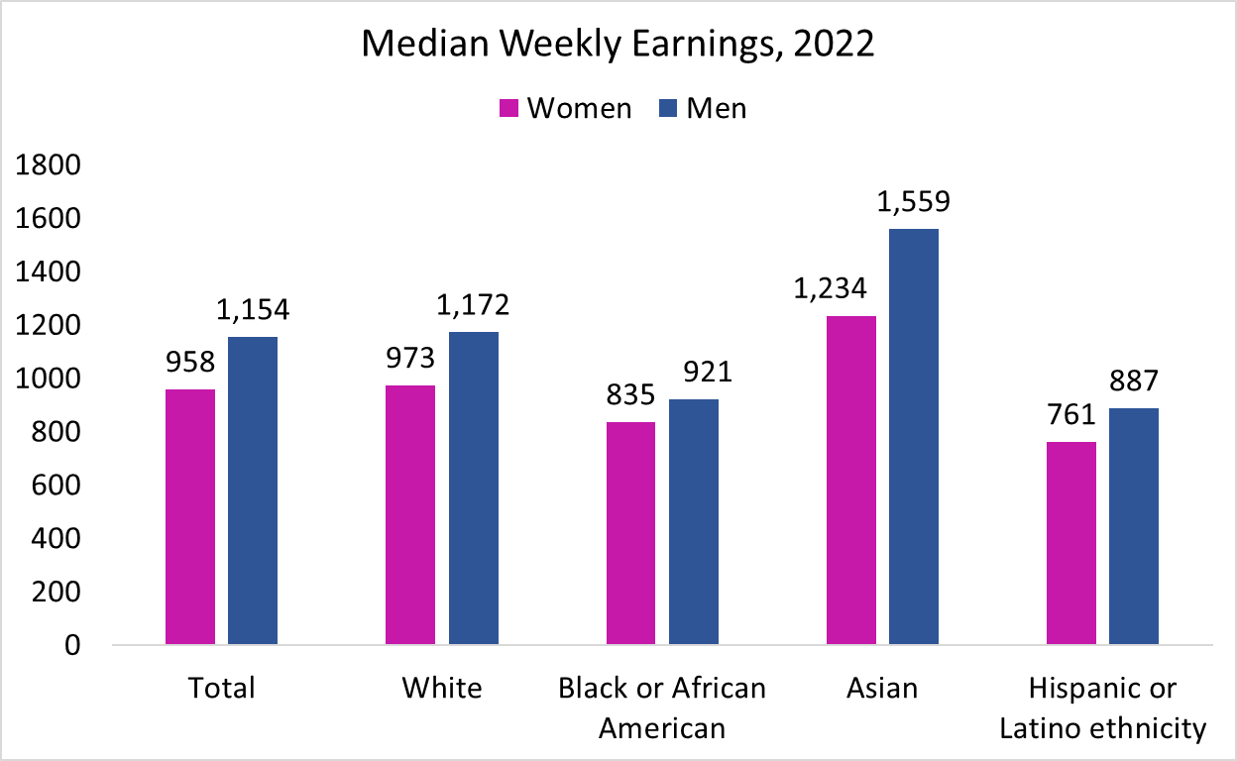
Wage Gap by Race/Ethnicity
83.0
83.0
90.7
79.2
85.8

Slide 25
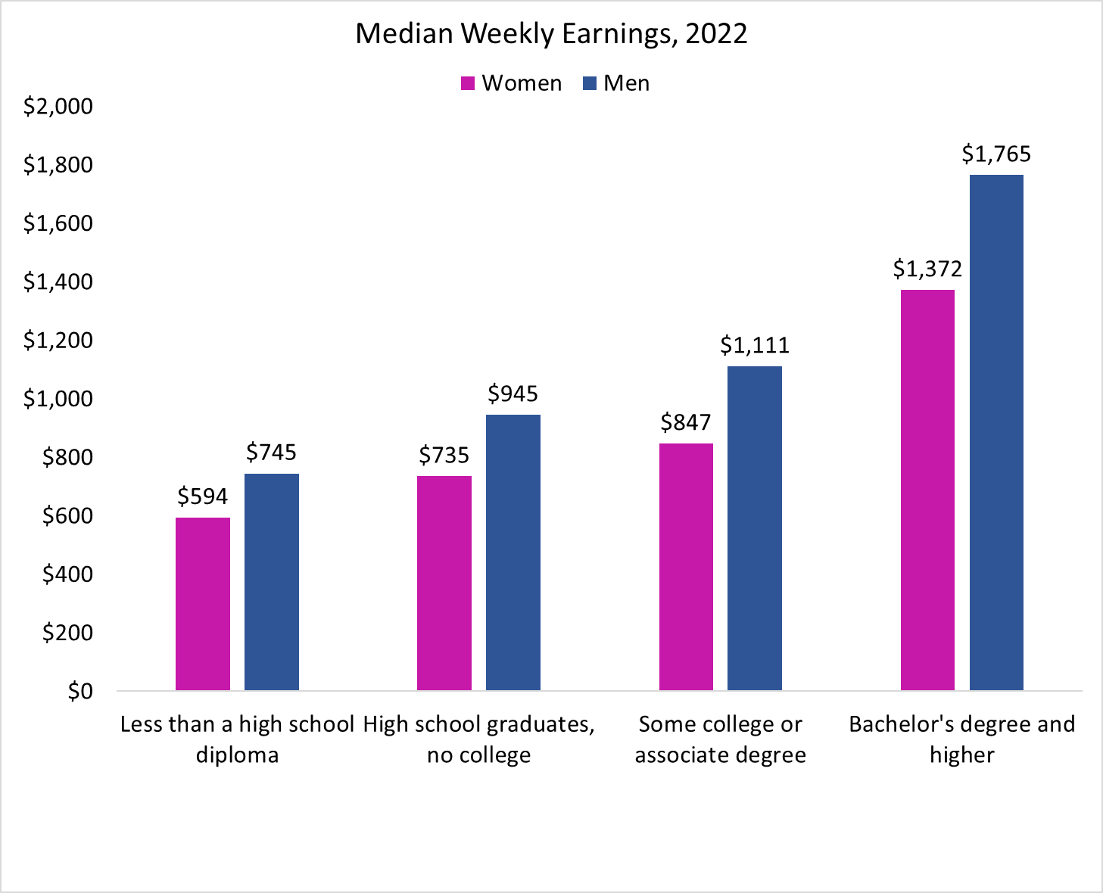
Wage Gap by Level of Education
In 2022, median weekly earnings for 25 years or older:
Women - $1,002
Men - $1,219
Wage Gap – 82.2%
The gap between men and women’s median earnings was larger than the national average among college graduates, with women’s median earnings at only 77.7% of men’s.
79.7
77.8
76.2
77.7

Slide 26
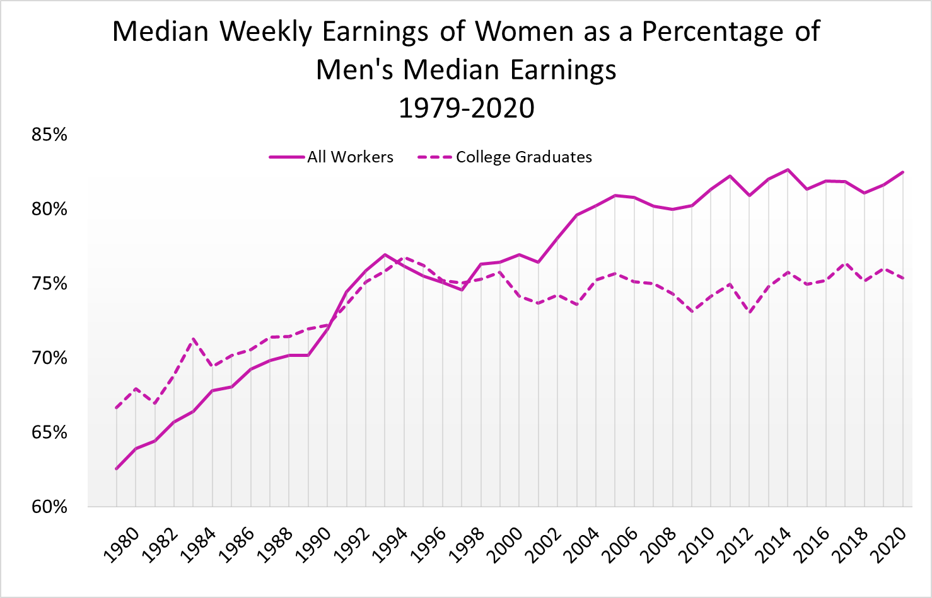
Gender Wage Gap Over the Years – College Graduates

Slide 27
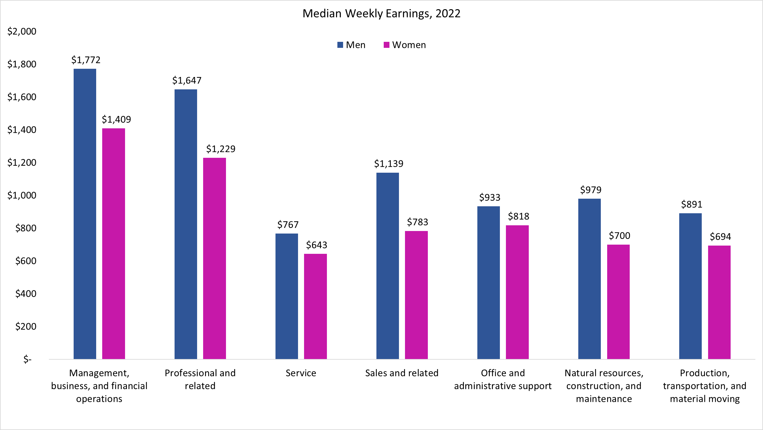
Weekly Earnings by Occupation
79.5
74.6
83.8
68.7
87.7
71.5
77.9
83.0
= National Average Ratio

Slide 28
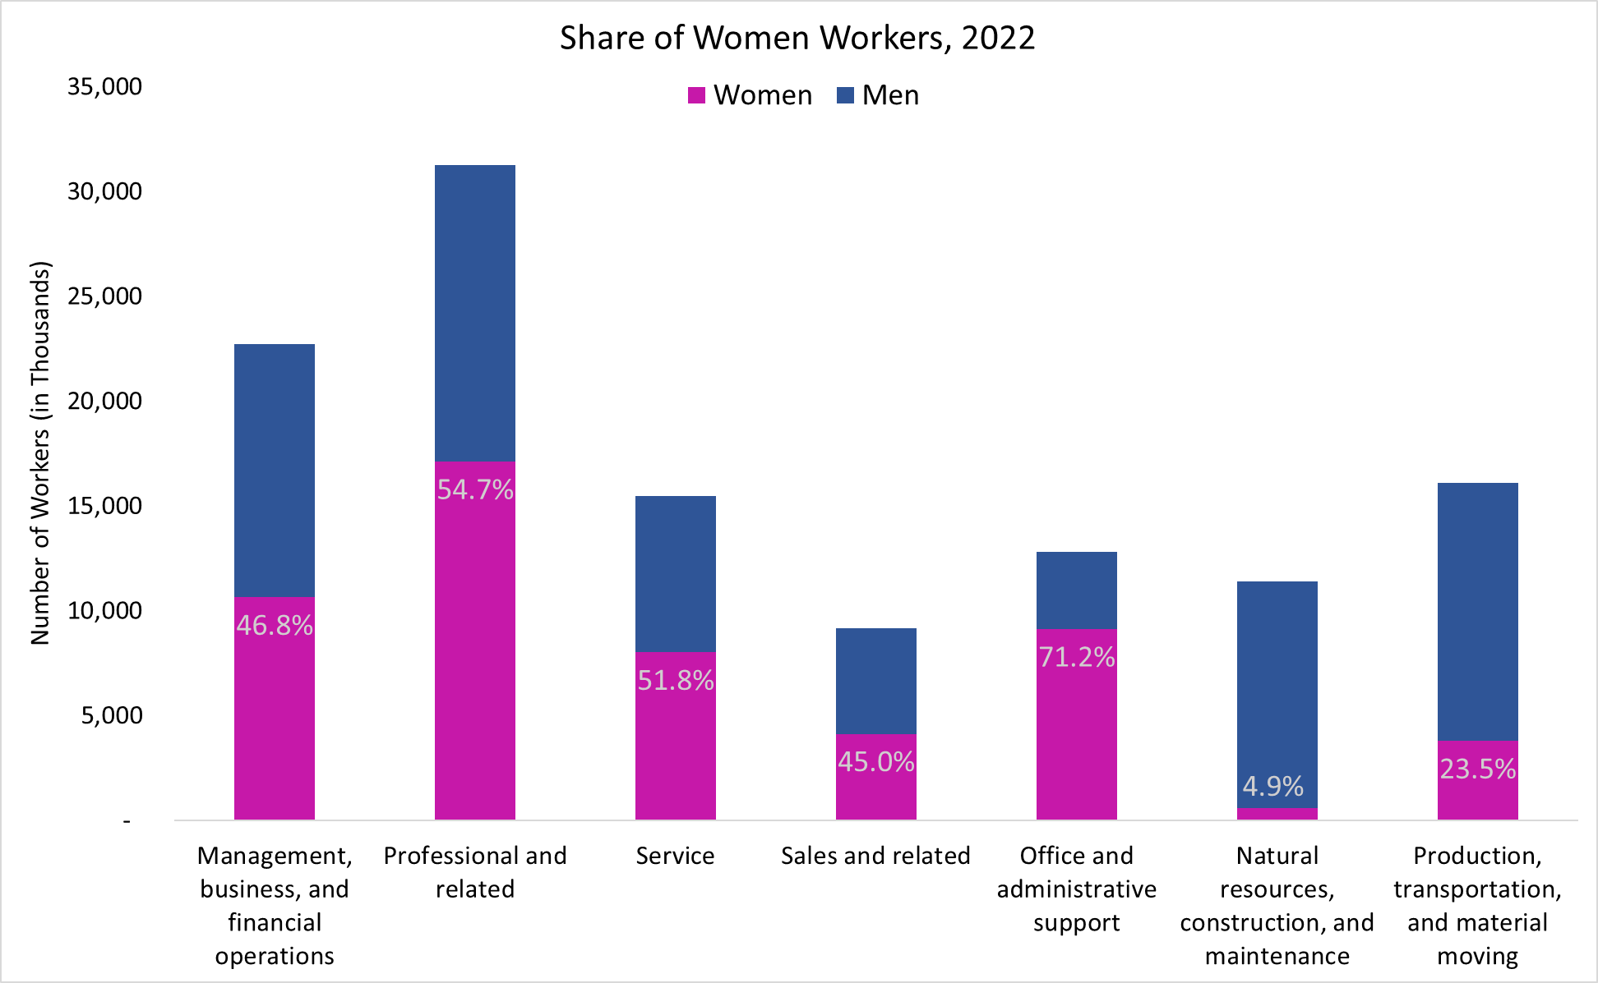
Gender Distribution of Occupations
79.5
74.6
83.8
68.7
87.7
71.5
77.9
83.0
= National Average Ratio

Slide 29
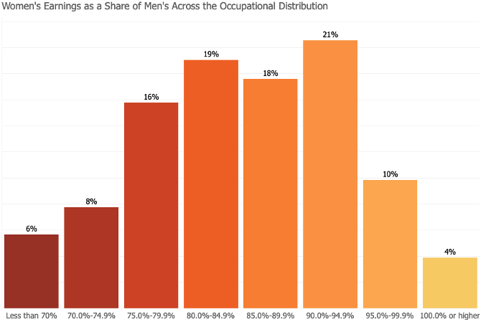
Wage Gap by Occupation: 2021
Source: https://www.dol.gov/agencies/wb/data/earnings

Slide 30
Occupations with the Lowest Wage Gap, 2022

Slide 31
Occupations with the Highest Wage Gap, 2022

Slide 32
Explaining Gender Wage Gap by Occupation
Women, traditionally, the “on-call” parent.
Prefer occupations with:
  shorter hours,
  fewer “on-call” hours,
  predictable schedules,
  standardized products/services, and,
    greater substitutability of workers within teams.
Men, traditionally, opt for jobs with greater time demands but pay more.
Men appear to care less about time flexibility.
  Ready to work evening/weekend hours to meet clients.
  Affects occupation selection.

Slide 33
Explaining Gender Wage Gap by Occupation
High time demand occupations:
  Contact with others
  Frequency of decision making
  Time pressure
  Structured vs. unstructured work
  Establishing and maintaining interpersonal relationships
Level of competition within an occupation
Income inequality among men within an occupation

Slide 34
Gap Occurs Primarily WITHIN Occupations
Where does the wage gap come from?
 | Between Occupations | Within Occupations
All Workers | 15% | 85%
College Graduates | 35% | 65%
Source: Reassessing the Gender Wage Gap: Sharing Jobs, Equalizing Pay, Right Now, the Expanding Harvard Universe.

Slide 35
Non-Linearities in Pay and the Wage Gap
Pay increases with the number of hours worked each week.
  Why?
    In some occupations, workers are not good substitutes for each other.
    To ensure continuity, employers value individual workers working more hours.
  Implications:
    Households divide the work.
      Rather than both working 40 hours, perhaps one works 80 and the other does not work.
        Women are more likely to be the ones working fewer hours, receiving less pay.
Source: Reassessing the Gender Wage Gap: Sharing Jobs, Equalizing Pay, Right Now, the Expanding Harvard Universe.

Slide 36
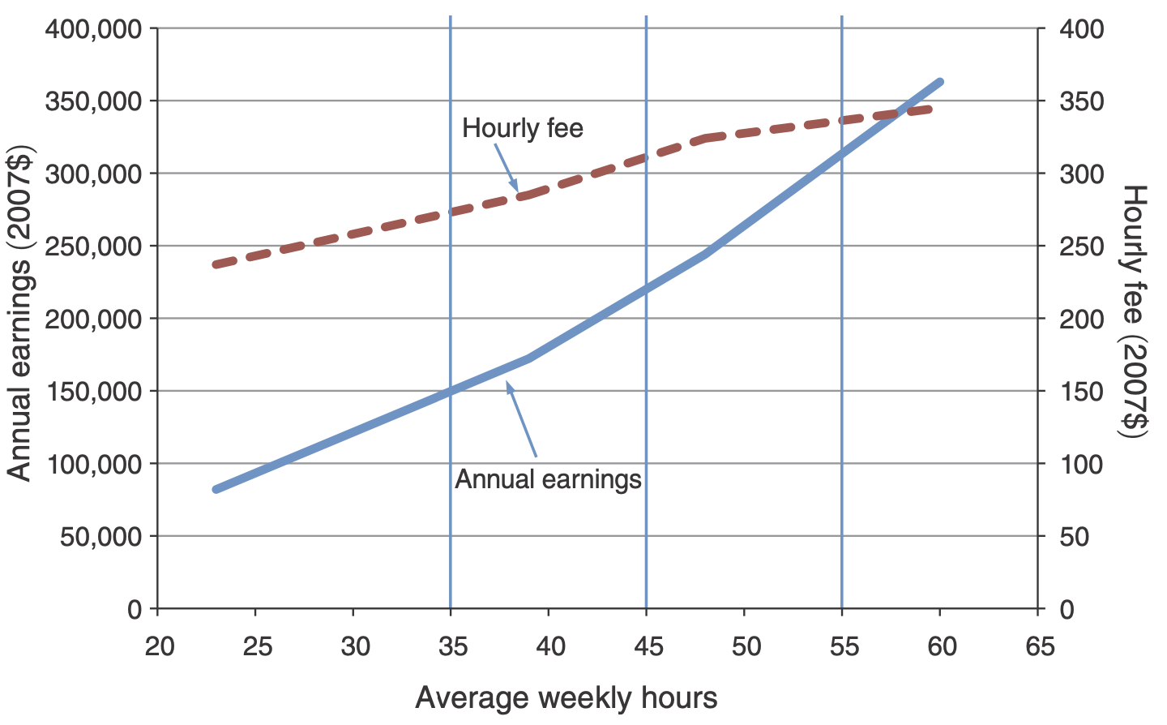
Evidence on Non-Linearities from Law Firms
Lawyers:
Hours go up
So does hourly pay
Source: A Grand Gender Convergence: Its Last Chapter, Goldin, AER, 2014.

Slide 37
These are Still Unadjusted Wage Gap Numbers
In the previous slides we controlled for one factor at a time that might affect earnings of workers.
  Controlling for just one of the factors may not fully explain earnings differences.
For example, when comparing median earnings differences by occupation, we still would like to know if these differences can be further explained by differences in other key factors such as:
  age,
  job responsibilities,
  work experience, and
  other individual life choices such as marital status or to have children and to take time off to raise them.

Slide 38
Adjusting the Wage Gap
Men and women make different choices. It is possible to account for some of those choices to explain the wage gap.
Two possible adjustments:
Adjustment 1 accounts for human capital:
  Education
  Experience
  Geographic region
  Race
Adjustment 2 also accounts for:
  Unionization
  Industry
  Occupation

Slide 39
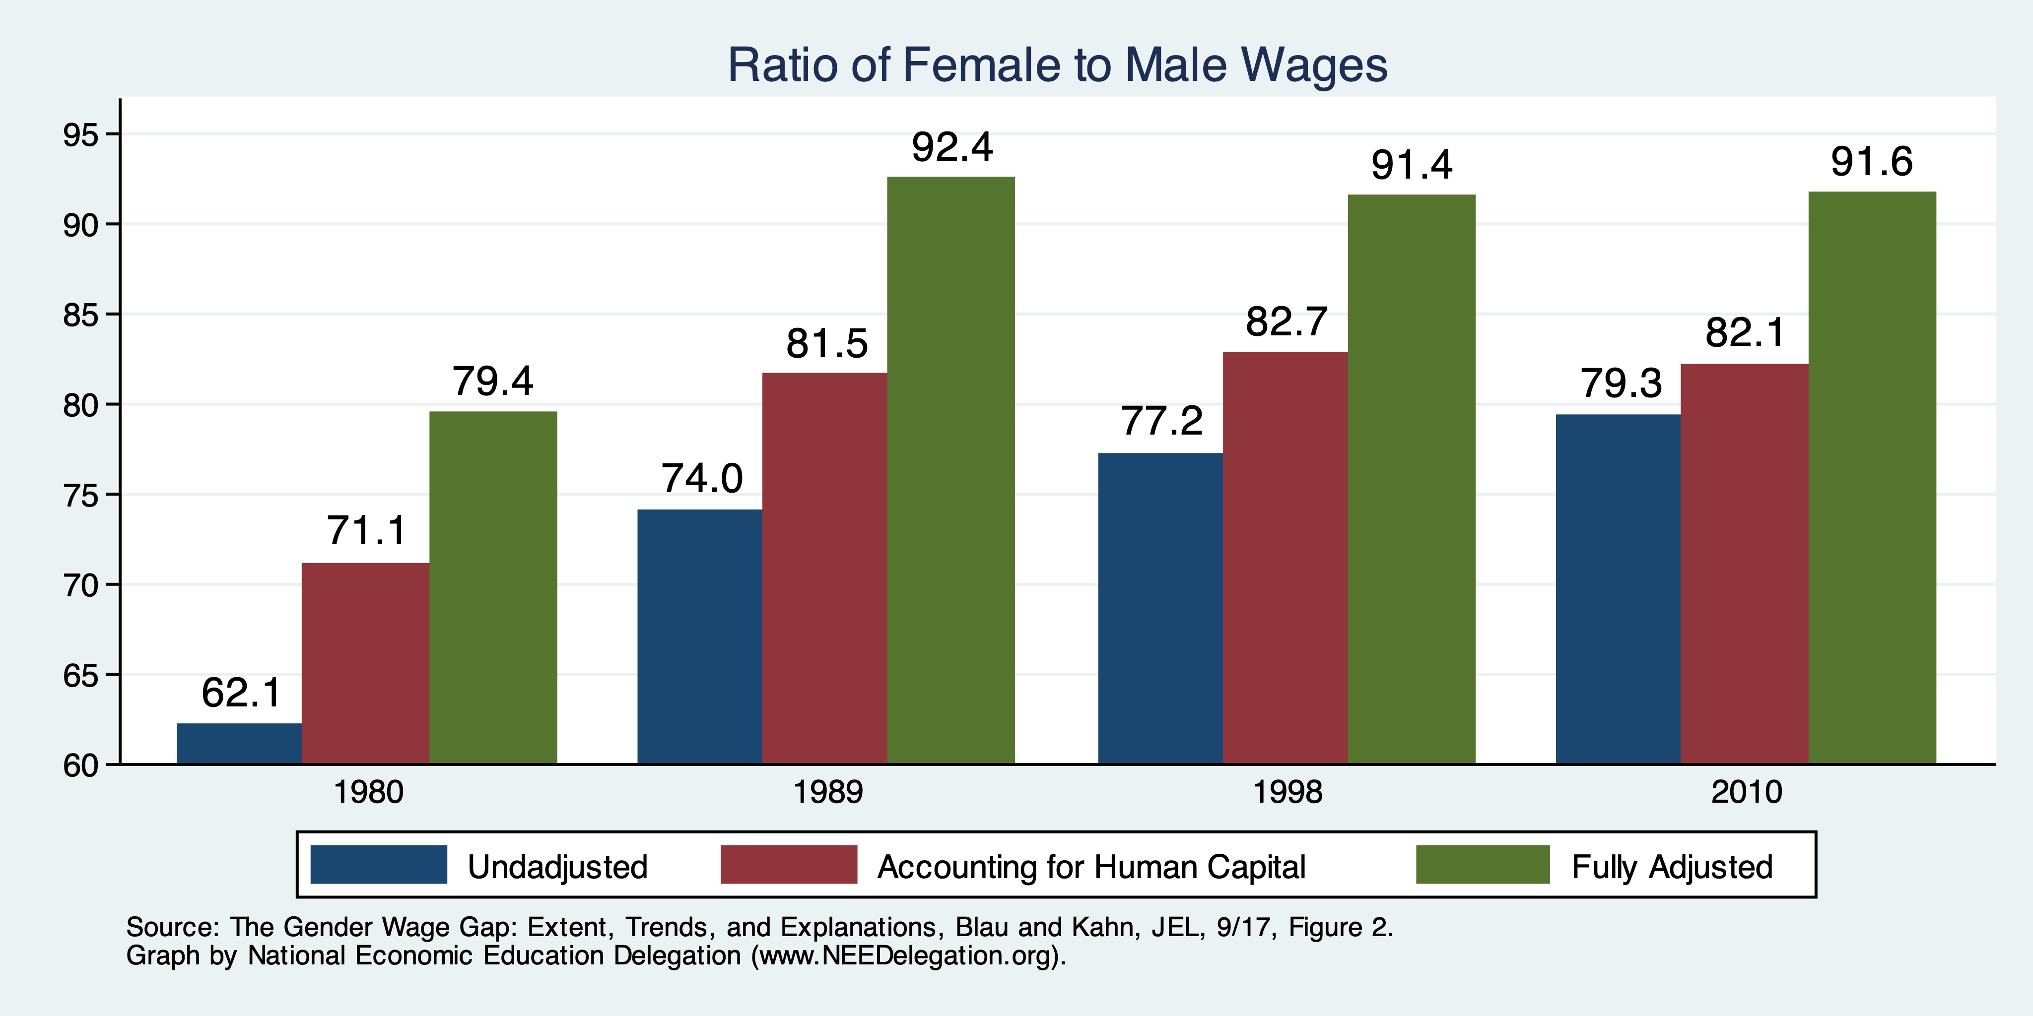
Wage Gap With Adjustments

Slide 40
What do the Adjustments Tell Us?
Human capital decisions, as well as region and race, matter for the wage gap.
Ultimate job matters:
  Is it unionized?
  Is it an industry with a large gap?
  Is it an occupation with a large gap?
Still 10% unaccounted for.
  Is this discrimination?
    Perhaps, but not all of it.
    Labor market decisions are influenced by discrimination or perceptions of women’s vs men’s majors, occupations, or industries.

Slide 41
Sorting: The Decisions Men and Women Make
Sorting happens:
  With the decision to go to college.
  With the election of a major.
  With the choice of an occupation.
Women tend to:
  Go to college more than men.
  Select majors with lower expected wages.
    Though convergence WAS happening.
  Within a major, select occupations with lower wages.
    Though convergence IS happening.

Slide 42
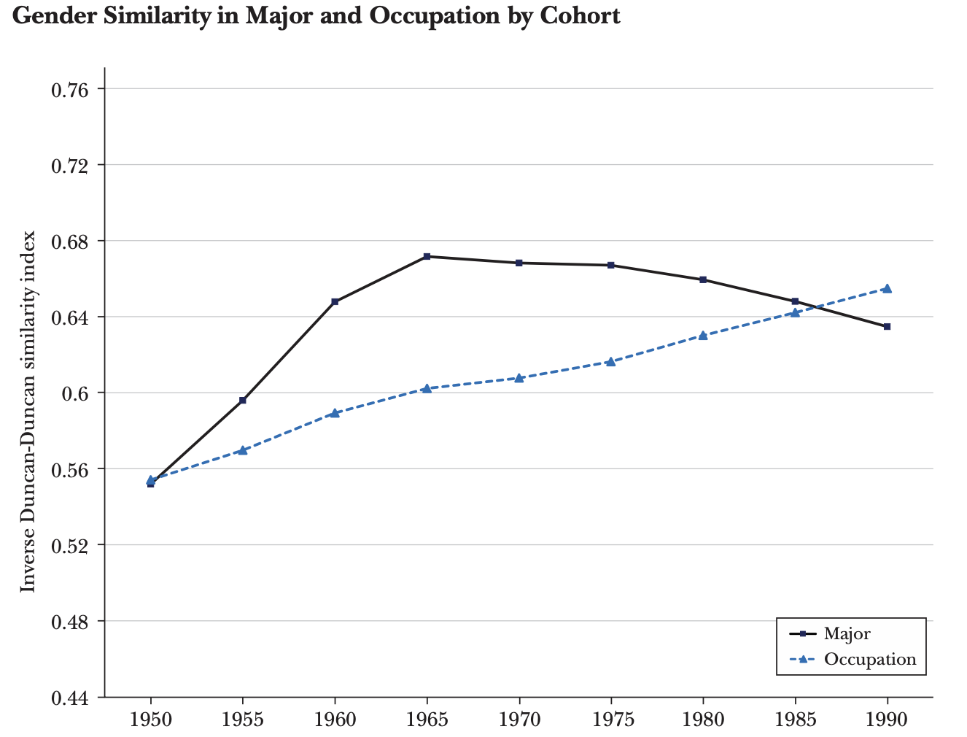
Occupation Convergence, Less So Majors
Values close to 1 imply parity.
Less than 1
- women’s choices correspond
to lower wages
Greater than 1
- women’s choices correspond
to higher wages
Women are increasingly choosing majors
that pay less than the majors chosen by men.
(B) Women are increasingly choosing occupations
that pay as well as the occupations chosen by men.
Major
(A)
(B)
Occupation
Source: College Majors, Occupations, and the Gender Wage Gap, Sloane, Hurst, and Black, JEP, Fall 2021.

Slide 43
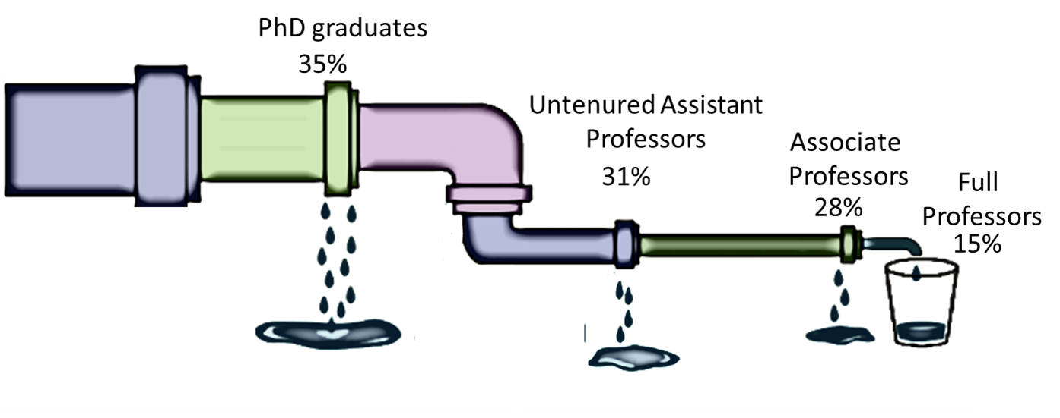
The Leaky Pipelines Phenomenon
In many professional occupations
  There’s a more equitable gender distribution at entry level,
  But at the higher ranks, number of female workers plummets.
Time demands – likely explanation?
The Leaky Pipelines In Economics
Share of Women in Economics, 2020

Slide 44
The Broken Rung and the Great Breakup
Women are significantly underrepresented in leadership.
A broken rung at the first step up to manager is holding women back.
  For every 100 men who are promoted from entry-level roles to manager positions, only 87 women are promoted.
The Great Breakup
  New Pipeline Problem
  More women leaders are leaving their companies.
Source: Women in the Workplace 2022, LeanIn.Org and McKensey, 2022

Slide 45
Solutions to the Gender Wage Gap
Debiasing the labor market
  Diversity training for supervisors and managers.
  Changing the organizational culture.
  Gender blind hiring/evaluation procedures.
Training women to be more competitive and removing unconscious bias.
Legislative actions by federal and state governments.

Slide 46
The System - Not Individual Bias is the Culprit
The “system” is characterized by:
  Decisions made by ordinary couples in terms of being on-call at work or at home.
  Cost of time flexibility at work.
The higher the cost of time flexibility, the higher is the likelihood of a couple to forego equity in favor of higher family income.
Substitution among workers needs to be encouraged in occupations with high gender pay gaps.

Slide 47
Private Sector is Responding... Slowly
Firms have more incentive to retain the female employees now than ever.
  With more women entering the profession.
  More men wanting equitable relationships with their life partners.
  Costly job training.
  Valuable client-employee relationships formed by the women in early years.

Slide 48
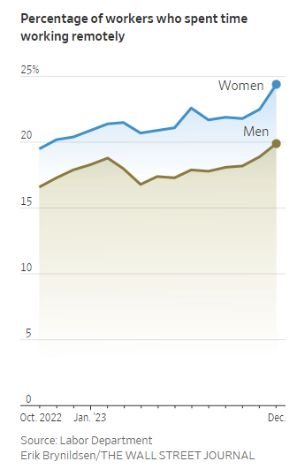
Time Demand Tradeoffs and COVID-19
COVID-19 accelerated trends towards more workplace flexibility.
Remote work may have lasting beneficial impact on all workers, including women.
But there may also be losses.
  Promotions?
Women’s attachment to labor market at risk due to:
  Difficulty in obtaining affordable, dependable childcare.

Slide 49
What can we do?
Reduce the cost of flexibility
Increase or incentivize substitutability
Reduce the cost of caregiving – childcare as well as elderly care
Alter societal norms
“We need men to lean out at work, support their male colleagues who are on parental leave, vote for public policies that subsidize childcare, and get their firms to change their greedy ways by letting them know that their families are worth even more than their jobs. Dreams won’t come true, aspirations won’t be realized unless men are brought along for the rest of the journey.”
-- Claudia Goldin

Slide 50
What Have We Learned?
The gap is significant and seemingly stubborn.
  Some, but not very much progress in the last 20 years.
Discrimination clearly plays a role, but we can’t identify how much.
  In wage setting, in people’s choices, as a result of market structures.
Gender roles in child rearing play an enormous role.
Government policy can help, by:
  Implementing policies that reduce the child-bearing penalty for women.
    Access to childcare, for instance.
  Influencing the structure of labor markets, the workplace, hiring practices, and job flexibility.
  Generally, address the hours/compensation relationship.

Slide 51
Thank you!
Any Questions?
www.NEEDEcon.org
Jon Haveman, Ph.D.
Jon@NEEDEcon.org
Contact NEED: info@NEEDEcon.org
Submit a testimonial: www.NEEDEcon.org/testimonials.php
Become a Friend of NEED: www.NEEDEcon.org/friend.php

