Slide 1
Finance: The Good the Bad and the Ugly
Geoffrey Woglom,
Professor of Economics
Amherst College, emeritus
April 27, 2023

Slide 2
National Economic Education Delegation
Vision
One day, the public discussion of policy issues will be grounded in an accurate perception of the underlying economic principles and data.
Mission
NEED unites the skills and knowledge of a vast network of professional economists to promote understanding of the economics of policy issues in the United States.
NEED Presentations
Are nonpartisan and intended to reflect the consensus of the economics profession.

Slide 3
Who Are We?
Honorary Board: 54 members
2 Fed Chairs: Janet Yellen, Ben Bernanke
6 Chairs Council of Economic Advisers
Furman (D), Rosen (R), Bernanke (R), Yellen (D), Tyson (D), Goolsbee (D)
3 Nobel Prize Winners
Akerlof, Smith, Maskin
Delegates: 652+ members
At all levels of academia and some in government service
All have a Ph.D. in economics
Crowdsource slide decks
Give presentations
Global Partners: 48 Ph.D. Economists
Aid in slide deck development

Slide 4
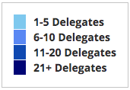
Where Are We?

Slide 5
Available NEED Topics Include:
Healthcare Economics
US Economy
Climate Change
Economic Inequality
Economic Mobility
Trade and Globalization
Minimum Wages
Immigration Economics
Housing Policy
Federal Budgets
Federal Debt
Black-White Wealth Gap
Autonomous Vehicles
US Social Policy

Slide 6
The Economic Role of Finance
The four major roles of finance are facilitating exchange, the efficient allocation of saving and investment, the management of risk.
Manage payments securely and at low cost.
Saving: households need to decide how best to spread consumption over a lifetime.
Investment: Firms need to decide on how much and which investment projects will maximize firm value for shareholders.
Risk: Everyone needs to plan on how best to avoid risk and to pay to insure against risk that can’t be avoided.
Side Benefit: asset prices provide valuable information
These roles are met, imperfectly, by financial assets, markets, and firms

Slide 7
Financial Assets:
Financial Assets are promises to pay money in the future (IOUs).
Households, firms and governments hold checking deposits to facilitate transactions.
Households save by buying stocks, bonds and savings accounts in the hope of earning a future return.
Firms finance investment by selling new shares and bonds.
Insurance Contracts allow households to pay a premium to avoid risk.
Derivative contracts, such as options and futures, allow parties to trade risk.
All financial assets are someone else’s liabilities

Slide 8
Financial Markets
New York Stock Exchange, Chicago Mercantile Exchange
The trading of financial assets puts a price on the promises of the issuer:
The price of future goods: “the time value of money”
The riskiness of the promised payments.
The trading of existing financial assets on “secondary markets” makes these assets more liquid.

Slide 9
Financial Institutions
Brokers and Dealers economize on transactions costs.
Investment banks help firms to raise funds for new investment projects
Insurance companies arrange contracts where the policy holder pays the average loss on all policies rather than the face his or her individual risk of loss.
Mutual Funds: allow small investors to hold diversified portfolios and save for retirement.
And, commercial banks…

Slide 10
Banks
Traditional Role of Banks:
Manage the payments system through checking accounts, credit cards, wire transfers.
Generate information about the creditworthiness of small firms and households in order to meet their legitimate needs to borrow.

Slide 11
Problematic Aspects of Finance
Liquidity.
Leverage.
Speculation.
The volume of trading.
Financial engineering.
For all 5 of these problematic aspects, there are some offsetting benefits.
Financial Crises or Systemic Risk: The Last will be first!

Slide 12
6.Financial Crises in the 19th Century
Financial Panics (and recessions) in the 19th century: 1819, 1837, 1857, 1873, 1893.
Financial Panics are caused by a shortage of liquidity.
Illiquidity: the value of liquid assets (cash, short-term Treasuries) are less than the value of liquid liabilities (short-term debt, bank deposits)
Insolvency: the value of assets is less than liabilities, so unless conditions change, liabilities will not be fully paid off.

Slide 13
Illiquidity Can Lead to Insolvency
Most banks are technically illiquid, which is not a problem in normal times because money is being deposited to offset the money that is being withdrawn.
But during a panic solvency is no guarantee of survival (As George Bailey learned in It’s a Wonderful Life)
To meet pressing demands for cash, the bank may have to sell assets in a “fire sale,” leading to insolvency and a bank failure.
One bank failure can cause “contagion,” leading to widespread failures, e.g., called systemic risk.

Slide 14
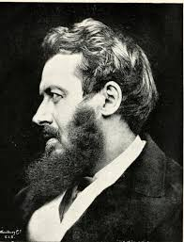
Walter Bagehot’s and his Famous Dictum
Walter Bagehot (1826-77): Lombard Street, 1873
Save the solvent institutions while allowing the insolvent ones to fail.
His “Dictum” during a panic the Central Bank should:
Lend freely,
At a high interest rate,
To solvent institutions,
On good collateral.

Slide 15
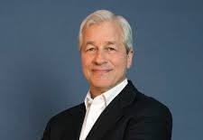
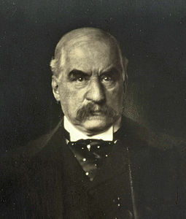
JP Morgan, “Lender of Last Resort?” (LOL)
October 1907, JP Morgan cuts short his vacation to deal with a financial panic
Market falls by 50%
Runs on banks threaten a complete collapse of financial markets.
Morgan calls a number of bankers to his offices to pledge money to provide liquidity to markets.

Slide 16
The Aftermath: Federal Reserve Act of 1913
Original Roles of the Fed
Oversee Currency & Regulate Banks; 2. Lender of Last Resort.
Great Depression and the Banking Panics of the 30s
Fed fails miserably.
RFC lent more money to the banks than did the Fed
Footnote on later LOL Roles:
2008: Bernanke saves the world, but Congress is not happy.
2020: Powell goes even bigger, but the verdict is still out.

Slide 17
1. Liquidity, more generally
The ability to transform an asset into money quickly with little loss of value.
Increasing Liquidity: House, Share of Stock, Treasury Bill, Savings Account, Currency.
Secondary markets, such as the NYSE greatly enhance liquidity.

Slide 18
1. Liquidity: the good
Liquidity makes saving more attractive because it provides flexibility about when to enjoy future consumption.
More attractive savings lowers borrowing costs to firms.

Slide 19
1. Liquidity and Information
Trading on secondary markets provides an incentive to gather information.
Trading on better information can be very profitable.
Information advantage of proximity to exchanges. Michael Lewis, Flash Boys
The security precautions for the release of the BLS reports on employment and CPI.
All economists agree that information is quickly reflected in asset prices.

Slide 20
Is the Bond Market Informationally Efficient?
Notes:
BlS Report at 8:30 that CPI for the 12 months ending in august was 8.3%

Slide 21
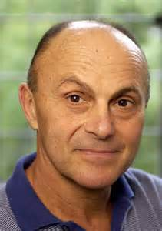
Information about What?
Optimists: Eugene Fama, Nobel laureate, 2013.
Asset prices fully reflect all available information about promised future payments and the riskiness of these payments. Asset prices reflect “fundamental values.”
Stock prices provide informationally efficient signals about the value of firm’s investment projects: Announce a project and see if the stock price rises or falls.
Firms that undertake risky strategies will pay a penalty in terms of increasing borrowing costs.
Fed can learn a lot about the state of the economy from financial asset prices: a) the reaction of long-term interest rates; 2) inflationary expectations.

Slide 22
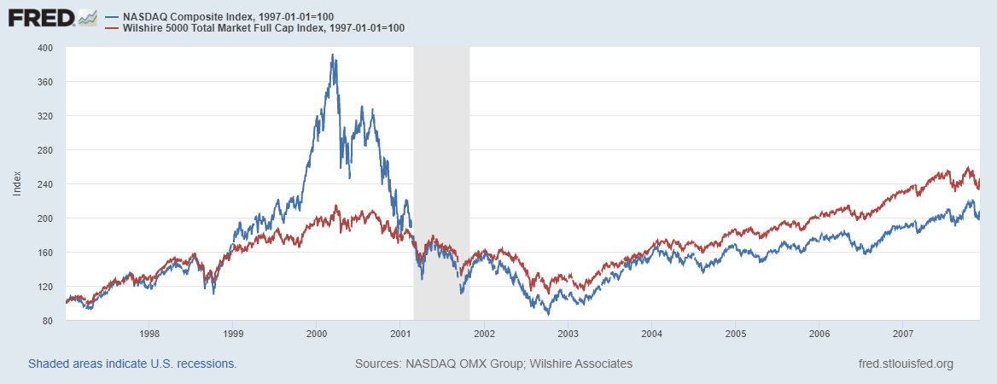
Really? (personal comment)
Notes:
Define Bubble

Slide 23
Fama’s Response
I don’t even know what a bubble means. These words have become popular. I don’t think they have any meaning….
Now after the fact you always find people who said before the fact that prices are too high. People are always saying that prices are too high. When they turn out to be right, we anoint them. When they turn out to be wrong, we ignore them. They are typically right and wrong about half the time.
New Yorker, 1/13/2010

Slide 24
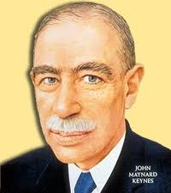
Information about What?
Pessimist: John Maynard Keynes
Asset prices reflect investor psychology and bear little relation to fundamental value
Beauty Contest: Pick the girl that other people think is the prettiest
“Animal Spirits” cause irrational and inefficient swings in investment and cause macroeconomic instability

Slide 25
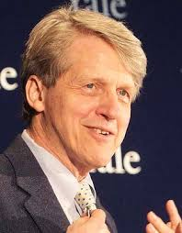
Information about What?
Middle of the Roader (?): Robert Shiller, also Nobel laureate, 2013.
Asset prices fluctuate unpredictably around fundamental values.
Financial market bubbles can lead to inefficient investment. e.g., Internet bubble.
Originated the phrase “irrational exuberance.”

Slide 26
Informational Efficiency: 2 Kinds
“No free lunch:” It is impossible to use publicly available information to earn consistently above average returns
“Prices are Right” Asset prices fully reflect all available information about fundamental values.
Fama and Shiller both believe in 1. Fama believes that 1. implies 2., and Shiller does not.

Slide 27
2. Borrowing and Leverage: the Good
Good Borrowing:
Reasonable anticipation of higher income in the future: senior with a job borrows to buy a suit
Temporary need: borrow to repair damaged roof.
Firms: Borrow to finance profitable, but large investment project.

Slide 28
Borrowing to Increase Leverage and Returns
Borrowing to buy risky assets:
In good states, gains are magnified because returns exceed borrowing costs.
In bad states, losses are magnified because interest on borrowing must be paid no matter what.
Borrowing increases average return, but also increases risk
Modigliani-Miller 1958: Borrowing by itself does not create social value.

Slide 29
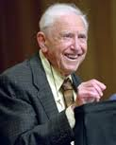
Then Why do Firms Borrow?
Average debt/equity ratio for the S&P500 is about 1.5.
Original M&M answer: Maybe borrowing allows the firm to pass on costs to others
Corporate borrowing is tax deductible and by borrowing to finance investment, some of the costs of borrowing are paid by Uncle Sam.
N.B. Borrowing may be privately beneficial without being socially beneficial

Slide 30
Then Why do Firms Borrow (cont.)?
The Attraction of Limited Liability
Pass on Costs of Bad States of Nature to others
Heads I win big; Tails I don’t lose as much
Zombie firms: S&L crisis and junk bonds
Problem: if lenders see risk, they should increase borrowing costs or stop lending.
Something to think about: what about insured depositors and other lenders to institutions that are perceived to be “Too Big To Fail.”

Slide 31
Another Example of Good Borrowing?
Large public firms can enjoy economies of scale that requires the separation of ownership from management.
Offsetting this advantage are agency costs because the interests of owners and managers differ.
Jensen and Meckling (1976) pioneered an approach of studying how firms minimize agency costs by their choice of financing and organizational form (e.g., partnership, public company, private company)

Slide 32
Agency Costs an Example
Manager gets salary no matter the size of firms profits: incentive to shirk
Owners may not see that profits are lower than they could be.
One solution: give the manager a stake in the firm.
Leverage allows the firm to magnify the managers incentives without requiring the manager to hold a larger stake in the firm.
More generally, the choice of organizational form of the firm and its financing is a way of minimizing agency costs.

Slide 33
Given M&M Why do Banks Borrow?
Commercial banks and investment bank increased their leverage prior to the financial crisis,
Largest Investment Banks had debt to equity ratios on the order of 30 to 1, pre-crisis. Much of the borrowing was interconnected. E.g., money market mutual funds bought Lehman Brothers financial assets
Regulators allowed this leverage as a result of 2004 legislation pushed by none other than Hank Paulson, pre-Treasury days
“Too big to fail:” makes bank borrowing a particular problem because the perception (and reality) was (is?) that the government would not impose losses on bank lenders.
Therefore lenders did not “discipline” risky bank behavior by raising borrowing costs or withholding new loans.

Slide 34
But It Is Worse
Large banks are, in fact, too big to fail.
They pursue similar strategies and lend to one another.
Therefore, large bank lending creates “systemic”risk.
The failure of an S&L is a tragedy for shareholders and community
The failure of Lehman precipitated a world-wide recession
Notes:
Roubini and Mihm book

Slide 35
3. The Good: Hedging with Derivatives
Derivative markets have an important role in eliminating and managing risk.
Futures example of hedging: Farmer sells wheat futures and baker buys wheat futures to lock in the price, eliminating the risk of price fluctuations for both parties.
Options work similarly, except they provide insurance against either a fall in the price of an asset you own (put option) or a rise in price of an asset you may want to buy in the future (call option).

Slide 36
Problems: Speculation (?)
But what is the virtue of a derivative if only one side is hedging.
Suppose in our futures example the farmer sells the futures contract to a hedge fund
Hedge fund may be better able to bear the risk of price fluctuations than can the farmer, and earns a kind of insurance premium on the contract, or
Hedge fund believes that the price of wheat is going to rise and will earn a capital gain on the contract.
Number 1 OK, number 2 more problematic
What is the role of trades when neither side is hedging?

Slide 37
Speculation with Derivatives
Derivatives provide a kind of leverage: the small price of an option or futures gives control over large possible gains.
Hidden and compound leverage: suppose I borrow money to buy a derivative contract.
Derivative contracts can be complicated and poorly understood.
What can justify the large volume of derivatives, mostly private contracts (OTC)?
In 2002, Warren Buffet called derivatives, “financial weapons of mass destruction, carrying dangers, while now latent, are potentially lethal.”

Slide 38
4. Trading Volumes
Good:
Trading provides liquidity that enhances saving investment.
Trading allows prices to react quickly to new information.
In terms of orders of magnitude, how much trading is needed to fulfill economic roles of saving investment and insuring against risk?
Stock trading volume has fallen in the last few years, but it is usually about 100 percent of GDP and don’t forget bond and derivative trading.
Trading and other financial activities takes resources.

Slide 39
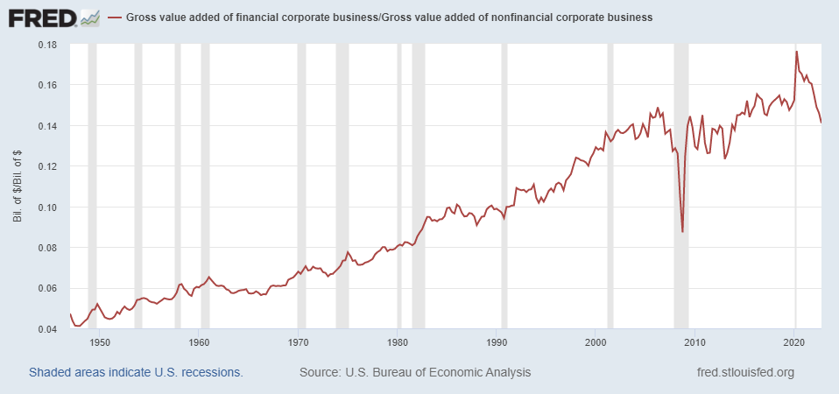
We are devoting increasing resources to finance:

Slide 40
New Harvard MBAs by Job Function

Slide 41
Trading Volumes?
What is all this trading accomplishing?
Speculation?
The creation of systemic risk?
Fama maybe, more information reflected in prices?

Slide 42
5. Financial Engineering: Its Not All Bad!
Savings Banks dual role: help unsophisticated savers find a good return.
Specialize in information on creditworthiness of local mortgage borrowers.
Manage the collection of mortgage payments
Does it make sense to pair 1. with 2. and 3. in “Originate and Hold” model?

Slide 43
The Good Side of Securitization
Originate and distribute model:
Thrifts should make as many good mortgage loans as they can find.
sell a bundle of loans to investment banks, so more mortgages can be made.
Investment bank bundle the mortgages and sells shares of the pool as Mortgage Backed Securities, MBS.
Savings bank manages the mortgage and passes payments to the Investment Bank, who pays owners of MBS.
Essentially, allows households to tap capital markets for mortgage financing at lower borrowing costs.
MBSs designed with different credit “tranches,” to match individual investor preferences for risk and return. Provides (some) diversification or risk.

Slide 44
What went wrong?
If the thrift (or mortgage lender) is not going to hold the mortgage, what incentive do they have to make only credit worthy loans.
How can investors evaluate the credit worthiness of the mortgages in the pool.
Credit ratings agencies had bad incentives to underestimate the riskiness of the securities.
But it got much worse: Slicing and dicing.

Slide 45
CDOs²
MBS is a “collateralized debt obligation,” or CDO.
Somebody had the brilliant idea of issuing a security that held tranches of many different mortgage backed securities.
So, an investor could buy a security that held the lowest tranche of a whole bunch of regular MBS securities. Diversfication(?)
Really just complexity and opacity (fraud?).

Slide 46
Does Mortgage Securitization Prove that Financial Engineering is Bad?
Absolutely not.
It shows that poorly, designed and complicated financial engineering can lead to a lot of harm.
It also shows that the market on its own will not eliminate “bad” products or bad behavior.

Slide 47
Therefore:
Given the systemic risk created by finance, there is a role for regulation
But what is that role?
We don’t want to throw the baby out with the bath water.
How do we limit the excesses of finance, while still enjoying the considerable benefits provided by finance and financial innovations?
That topic takes on particular relevance in our last session on cryptocurrencies.

