Slide 1
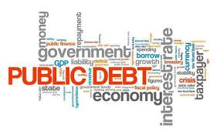
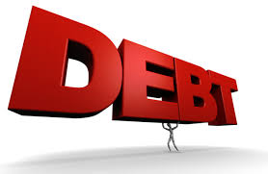
The US Federal Debt
SIRs #128 – Investment Group
June 26, 2024
Jon Haveman, Ph.D.
NEED

Slide 2
Available NEED Topics Include:
US Economy
Healthcare Economics
Climate Change
Economic Inequality
Economic Mobility
Trade and Globalization
Minimum Wages
Immigration Economics
Housing Policy
Federal Budgets
Federal Debt
Black-White Wealth Gap
Autonomous Vehicles
Healthcare Economics

Slide 3
Credits and Disclaimer
This slide deck was created by:
Jon Haveman, Executive Director, NEED
Geoffrey Woglom, Amherst College, Emeritus
Disclaimer
NEED presentations are designed to be nonpartisan.
It is, however, inevitable that presenters will be asked for and offer their own views.
Such views are those of the presenters and not necessarily those of the National Economic Education Delegation (NEED).

Slide 4
What Does the US Govt. Budget Look Like?
2023 Budget Summary (in Billions)
Revenue |  |  | Outlays
Income Taxes | $2,632 |  | Mandatory | $4,134
Payroll Taxes | $1,484 |  | Discretionary | $1,661
Corporate Taxes | $425 |  | Interest | $475
Other | $356
Total | $4,897 |  | Total | $6,270
Revenue |  |  | Outlays
Income Taxes | $2,176 |  | Mandatory | $3,753
Payroll Taxes | $1,614 |  | Discretionary | $1,722
Corporate Taxes | $420 |  | Interest | $659
Other | $228
Total | $4,439 |  | Total | $6,134
Budget Deficit: $1,695 Billion
Source: https://www.cbo.gov/publication/60053
Notes:
https://www.cbo.gov/publication/53627
https://www.cbo.gov/publication/53624

Slide 6
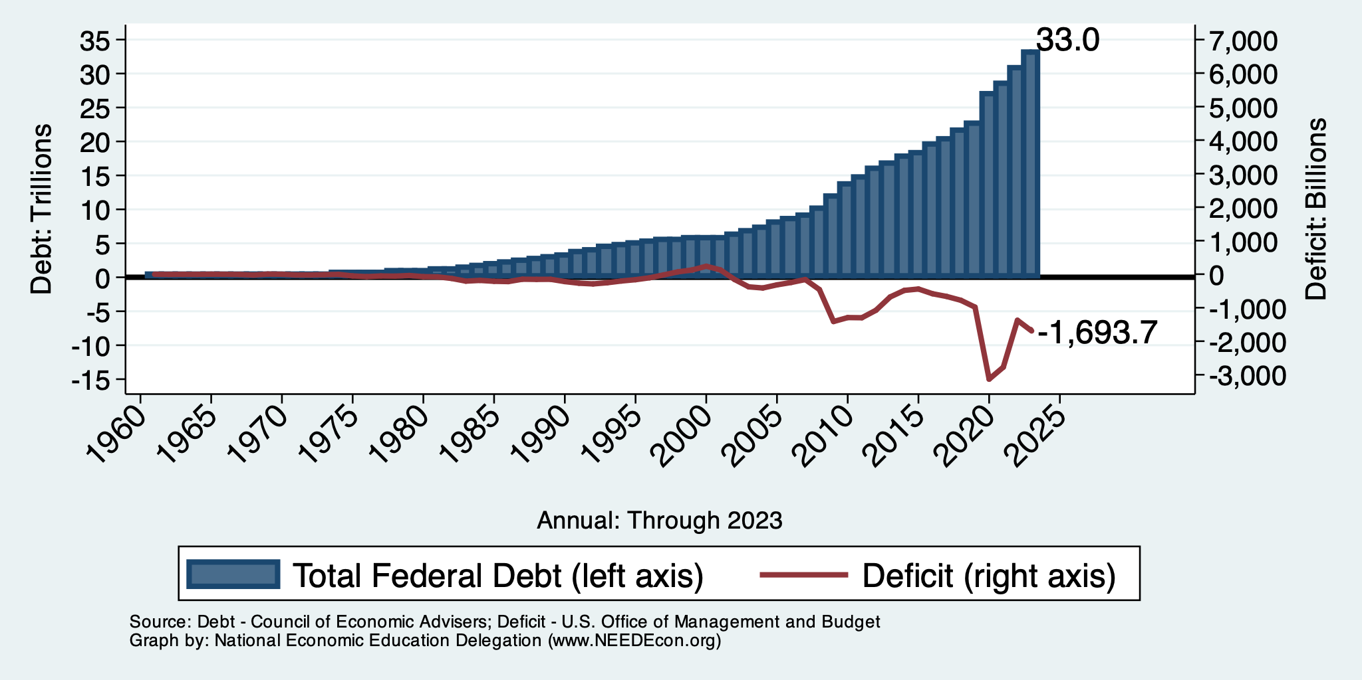
Debt vs. Deficit
Debt = The Sum of All Past Deficits Less Surpluses
Notes:
Debt2deficit.png

Slide 7
How Does the US Government Borrow?
It issues debt.
Treasury marketable securities:
Treasury bills, notes, and bonds
TIPS: Treasury inflation-protected securities
Savings bonds
Who buys the debt?
Other federal agencies
Individuals and businesses
State and local governments
Federal Reserve
Foreign governments and individuals

Slide 8
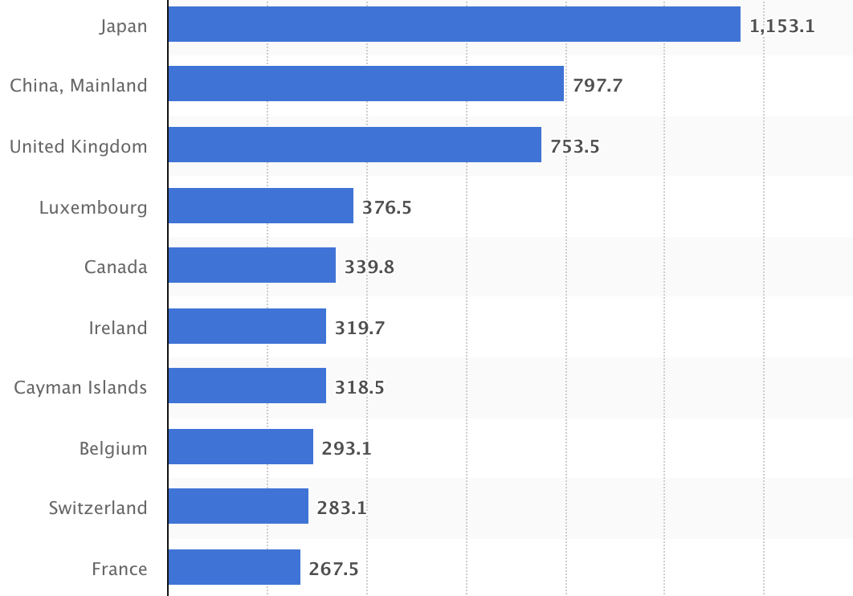
Who Holds Debt to Foreigners, Jan. 2024
Foreign ownership is relatively recent
– in 1990 foreign ownership was less than 20%
– peaked at 40+%
– now is 28.9%
Billions of U.S. Dollars
Source: https://www.statista.com/statistics/246420/major-foreign-holders-of-us-treasury-debt/

Slide 9
Important Points:
Not all debt is created equal.
What is the right measure of the debt?

Slide 10
Not All Debt Is Created Equal
Some debt can reduce the availability of investment funds to other borrowers.
Often referred to as “crowding out” private investment.
Intragovernmental debt is (important) bookkeeping.
This debt DOES NOT crowd out private investment.
Debt held by the public.
This debt MIGHT crowd out private investment.
Most analyses of debt focus on federal debt held by the public.

Slide 11
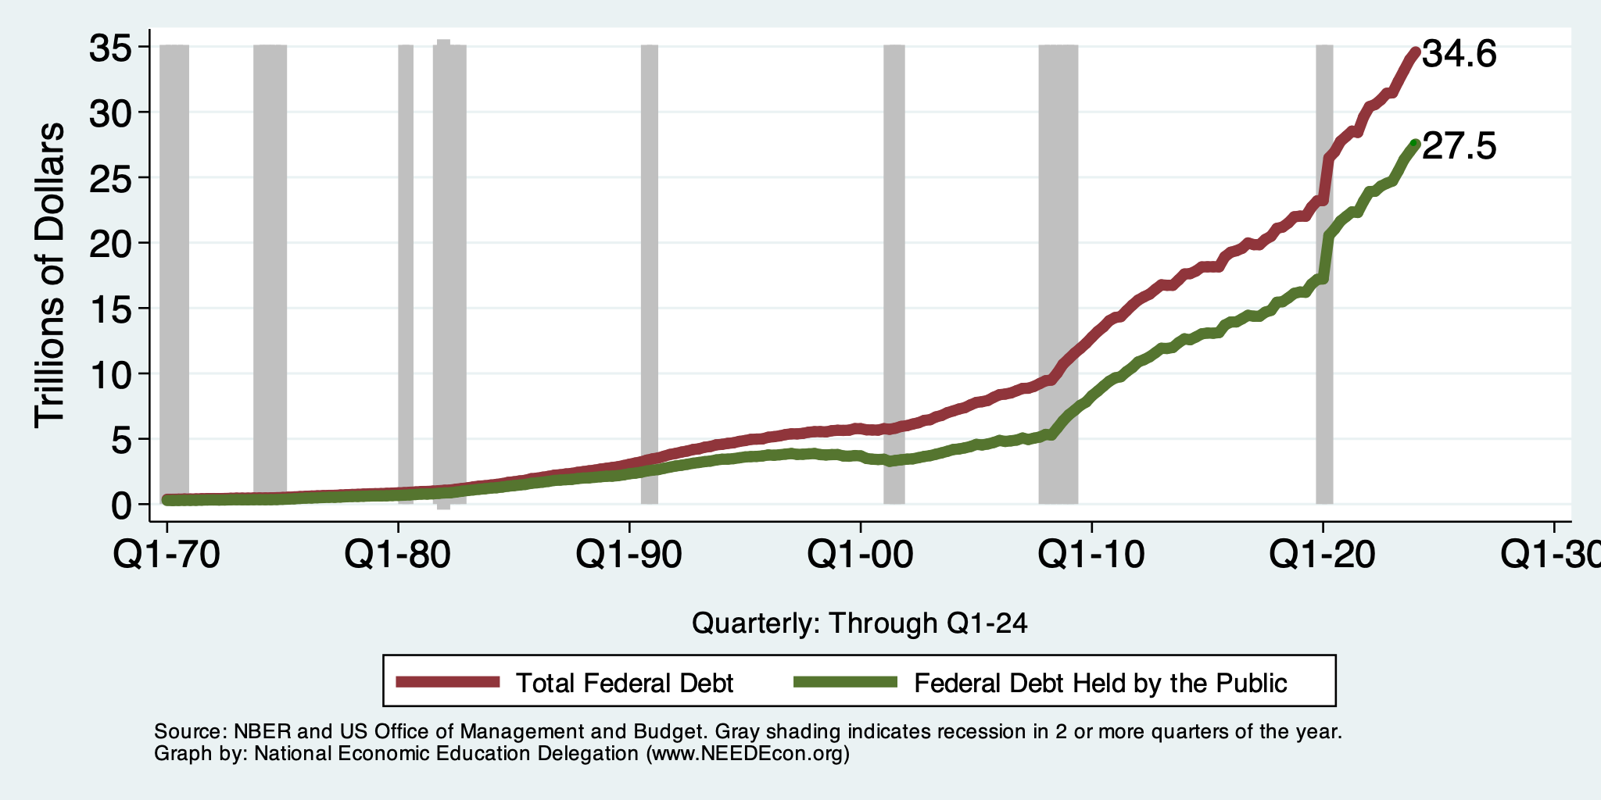
Two Measures of the Debt

Slide 12
The All-Important Relative Debt
CBO analyzes the debt relative to GDP because:
To the extent that debt and deficits have burdens, these burdens depend on the size of the debt relative to the size of the economy.
 | Total Public Debt | Relative Debt Debt/GDP
United States | $27.5 Trillion | 97.4%
Greece | $0.215 Trillion | 170%

Slide 13
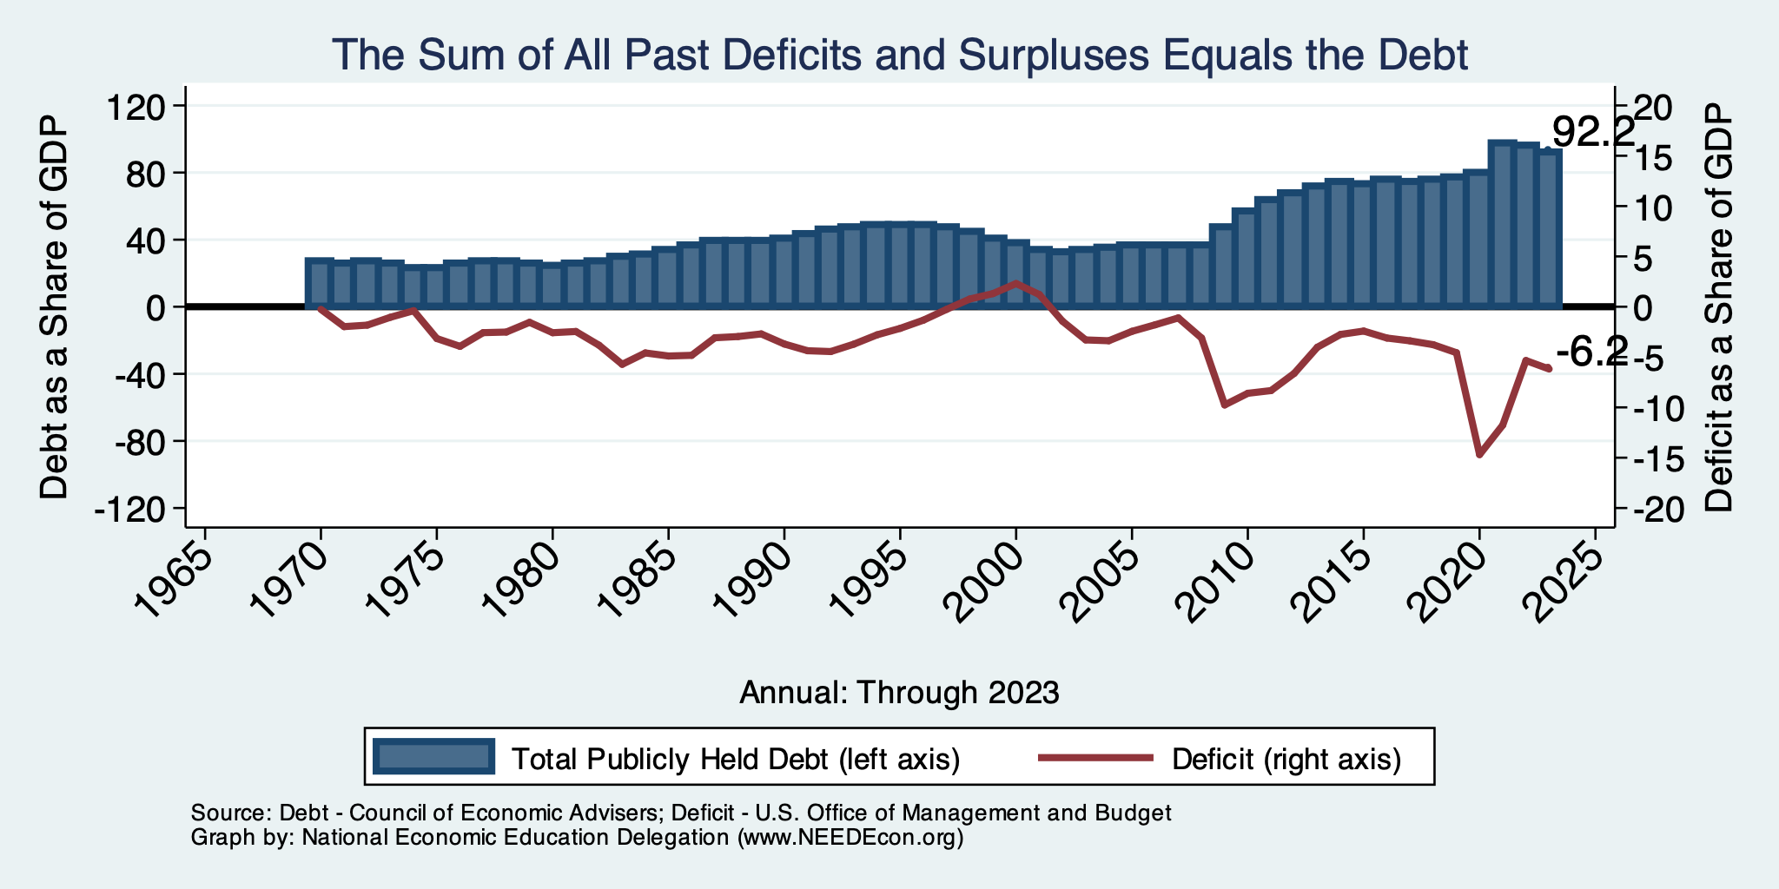
Relative Debt and Deficit
Notes:
Debt2deficit.png

Slide 14
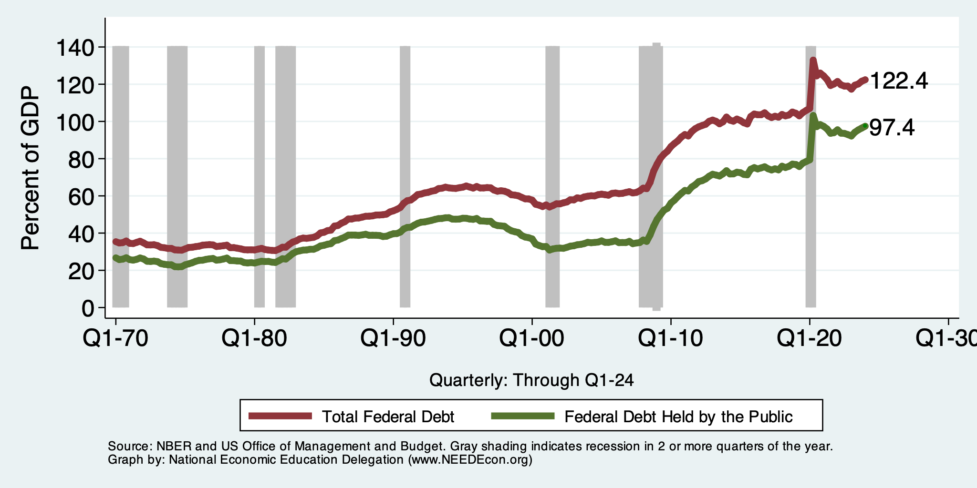
Two Measures of RELATIVE Debt

Slide 15
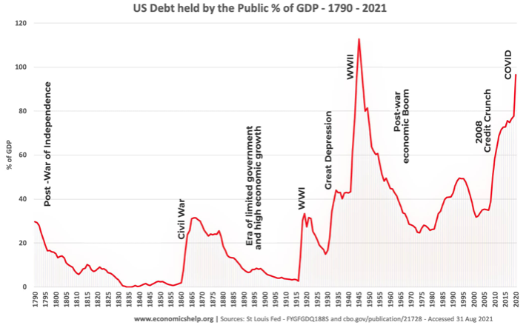
But Let’s Think About Today

Slide 16
Why Has the Federal Debt Risen So Much?
Expenditures UP:
Social Security
Health-care costs
Economic stimulus
In particular, during the Great Recession & COVID.
Military engagements overseas
Revenues DOWN:
Declining income tax revenues
Stagnant wages
Tax cuts
Social security
Declining revenues

Slide 17
Tax Cuts Have Driven The Debt Increases
Trump Tax Cuts: 6% of GDP
Bush Tax Cuts: 32% of GDP
Great Recession & COVID: 26% of GDP
The rest: 34% of GDP
Up from 31% in 2001

Slide 18
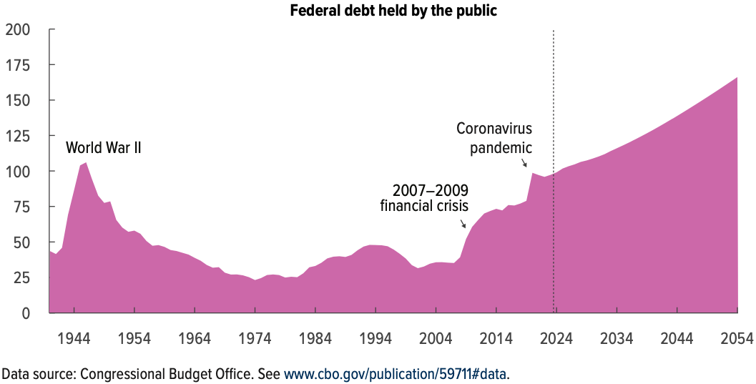
Now Let’s Think About Today and the Future
166% of GDP
Percent of GDP

Slide 19
Interest Will Grow as a Share of the Deficit
Primary
Interest
2024 2054
Source: CBO 2023 Long Term Budget Outlook

Slide 20
What Are the Primary Drivers Going Forward?
Social Security
And Medicare
Source: CBO 2024 Long Term Budget Outlook

Slide 21
Mostly Healthcare

Slide 22
How to Think About the Debt

Slide 23
Is The Debt a Problem Today?
Federal government borrows each month with little difficulty.
Very little evidence of ”crowding out.”
Interest rates were low, but have risen – this is becoming a concern.
So, no, other than the debt ceiling, it’s not a problem today.

Slide 24
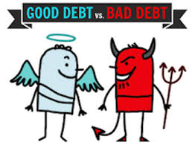
Not All Borrowing Is Bad!
Two good reasons to borrow:
During a temporary crisis
Recession
War
Pandemic
Productive public investment
Infrastructure
Education
These deficits did not and do not permanently increase relative debt.
Great Depression, WWII, Great Recession, COVID
Public investment expands GDP and tax revenue

Slide 25
What About a Fiscal Crisis?
Increased perception of risk in government debt.
Potential manifestations:
Sudden significant increase in interest rates
Plunging exchange rates
Why?
Increased expectation of default
Potential results:
Dramatic budget reforms may be quickly necessary to stave off actual default.
Recession from declines in:
Investment (interest rates)
Consumption (interest rates)
Government spending
Higher interest bill on existing debt

Slide 26
Summary

Slide 27
Bottom Line: We Need to Worry about the Debt
Interest rates are high.
A fiscal crisis should be avoided at all costs.
Stabilizing relative debt would substantially reduce the possibility of a crisis.
The good news is we might be able to stabilize relative debt without a primary surplus.
But we must substantially reduce primary deficits.
We MUST MUST MUST continue raising the debt ceiling.

Slide 28
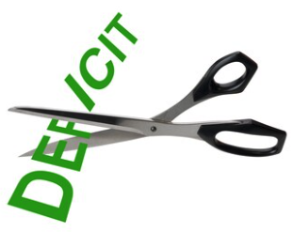
Bottom Bottom Line
Question is not WHETHER the US will have to act…
but WHEN.
Some combination of the following WILL be necessary:
Raising taxes
Cutting spending
Reining in health-care costs
The longer we wait, the harder it will be!

Slide 29
Thank you!
Any Questions?
www.NEEDEcon.org
Jon Haveman, Ph.D.
Contact NEED: Jon@NEEDEcon.org
Submit a testimonial: www.NEEDEcon.org/testimonials.php
Support NEED: www.NEEDEcon.org/donate.php

