Slide 1


The US Federal Debt
Geoffrey Woglom,
Professor of Economics
Amherst College, emeritus
April 20, 2023

Slide 2
National Economic Education Delegation
Vision
  One day, the public discussion of policy issues will be grounded in an accurate perception of the underlying economic principles and data.
Mission
  NEED unites the skills and knowledge of a vast network of professional economists to promote understanding of the economics of policy issues in the United States.
NEED Presentations
  Are nonpartisan and intended to reflect the consensus of the economics profession.

Slide 3
Who Are We?
Honorary Board: 54 members
  2 Fed Chairs: Janet Yellen, Ben Bernanke
  6 Chairs Council of Economic Advisers
    Furman (D), Rosen (R), Bernanke (R), Yellen (D), Tyson (D), Goolsbee (D)
  3 Nobel Prize Winners
    Akerlof, Smith, Maskin
Delegates: 652+ members
  At all levels of academia and some in government service
  All have a Ph.D. in economics
  Crowdsource slide decks
  Give presentations
Global Partners: 48 Ph.D. Economists
  Aid in slide deck development

Slide 4


Where Are We?

Slide 5
Available NEED Topics Include:
Healthcare Economics
US Economy
Climate Change
Economic Inequality
Economic Mobility
Trade and Globalization
Minimum Wages
Immigration Economics
Housing Policy
Federal Budgets
Federal Debt
Black-White Wealth Gap
Autonomous Vehicles
US Social Policy

Slide 6
Credits and Disclaimer
This slide deck was created by:
  Jon Haveman, Executive Director, NEED
  Geoffrey Woglom, Amherst College, Emeritus
This slide deck was reviewed by:
  Olivier Blanchard, Peterson Institute for International Economics
  John H. Cochrne, Stanford University
Disclaimer
  NEED presentations are designed to be nonpartisan.
  It is, however, inevitable that presenters will be asked for and offer their own views.
  Such views are those of the presenters and not necessarily those of the National Economic Education Delegation (NEED).

Slide 7
Outline
Definitions and Basic Data and Historical Data.
What needs to be done to “stabilize” the debt?
Traditional Economic Analysis of the Costs of the Debt
New Ideas about the Costs of the Debt and the importance of foreign holders of the debt.
“Debt? What me Worry?” Modern Monetary Theory.
Recent Congressional Budget Office (CBO) analysis of the Cost of the Debt.
Citizens Guide to Debt Issue

Slide 8
Basic Definitions
Fiscal year Deficit = Total Outlays Less Revenues between Oct to September.
The deficit paid for by government borrowing: (net) issue of new government bonds.
The accumulated value of past borrowing is the total government debt.

Slide 9
The Federal Budget in FY2022
Mandatory: $4.1tr 64% Discretion.: $1.7tr, 27%
Net Interest, $0.5tr 8%
Inc Tax, 54%
SS Tax, 30%
Corp Tax, 8.7%
Deficit: 22% of Spending
5.5% of GDP
Programmatic Outlays = Mandatory + Discretionary
Source: Monthly Treasury Report, 9/2022 & CBO, Feb, 2023
Notes:
Over 2/3rds of total income reported to the IRS for 2019 returns was earned income.

Slide 10
Past and Future of Deficits
Useful Deficit Decompositions:
Total Deficit= (Programmatic Outlays +
Interest Expense)-Revenue
=(Programmatic Outlays – Revenue)+Interest Expense
=Primary Deficit + Net Interest
E.g, 2007: 1.1 = (17.4+1.7) - 18.0 = 19.1-18.0 = 1.1
1.1 = (17.4-18.0) + 1.7 = -0.6 + 1.7 = 1.1
Source: CBO, “The Budget and Economic Outlook,” 2/2023
Notes:
Christina Romer: 3 packages war production of 1943.

Slide 11
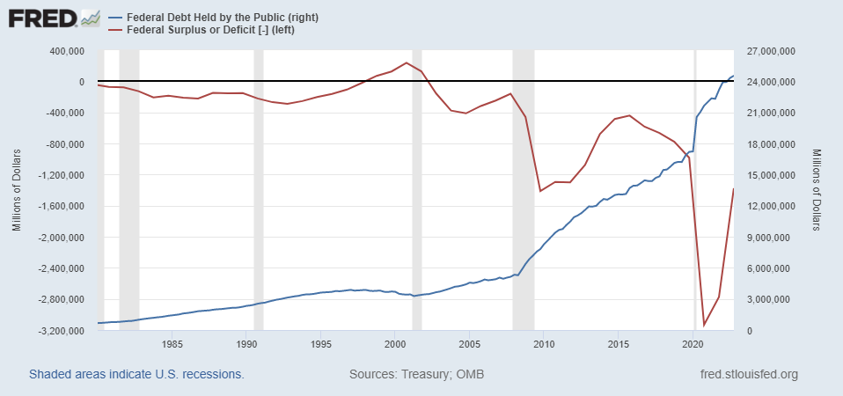
Debt vs. Deficit
The Sum of All Past Deficits Less Surpluses Equals the Debt
Blue Line Debt; Red Line Deficit
Shaded areas are recessions
Notes:
Yestere

Slide 12
A Breakdown of the Total Federal Debt
Sources: US Treasury, Federal Reserve Board
Notes:
China holding od US Treasuries peaked aat 1.3tr in 2013. and more recently has been falling. Japan not so much. 10/6 31.1and 24.3

Slide 13
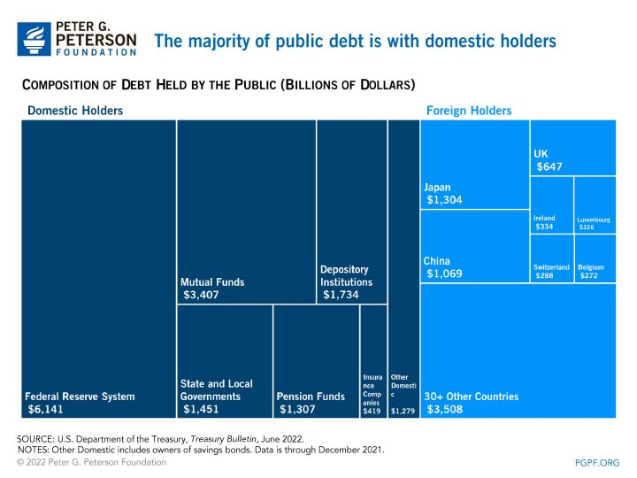
More Detail on Ownership of the Debt (12/21)

Slide 14
Not All Debt Is Created Equal
Intra-governmental debt is important bookkeeping.
  This debt DOES NOT require funding on credit markets
Debt held by the public
  This debt is funded by borrowing on credit markets and competes with private funding.
Most analyses focus on the publicly held debt relative to GDP because:
  To the extent that debt and deficits have burdens these burdens depend on the size of the debt relative to the size of the economy.

Slide 15
CBO: Budget Analysts in Chief
The Congressional Budget Office was founded in 1974 to provide Congress with information about the budgetary implications of legislation.
Two kinds of Reports
  Cost Estimates or “Scoring”
    H.R. 486 Ukraine Religious Freedom Support Act
    Build Back Better Scoring.
  Projections of Debt and Deficits – The Budget and Economic Outlook: 2022 to 2032
Notes:
Lindsey Graham an alternate scoring

Slide 16
Key Points About the U.S. Relative Debt
1946-1974
Relative debt peaked during WWII (106%) - followed by a steady decline until the 1980s.
Prior to 1983, relative debt rose purposefully (wars, recessions, public investment) and then fell.
What can we learn from the 46-74 period, where the relative debt fell continuously?

Slide 17
Debt Dynamics
The relative debt fell in spite of deficits in 21 of the 29 years, with the debt increasing by 42%. How?
1946-1974, deficits caused the debt to grow, but not as fast as the economy was growing.
While the debt grew by 42%, GDP (nominal) grew by 550%
You don’t need a surplus to reduce the relative debt:
You just need GDP to grow faster than the debt

Slide 18
Relative Debt Dynamics
Two Parts to the growth rate of the debt:
  The interest rate on the debt.
  A portion that reflects a primary deficit (+) or primary surplus (-)
Numerical Example: GDP grows at 4%, interest rate is 5%
  Interest expense will cause the debt to grow at 5%. Unless there is a primary surplus: Growth in debt is greater than or equal to 5%, greater than GDP growth of 4%, and the relative debt rises.
  To stabilize the debt, there must be a primary surplus
  Primary surplus has to be bigger, the higher the relative debt.
Notes:
Interest on the debt is about 2 % . If the primary budget had been in surplus the debt still would have grown by 2% Because there was still a very large primarty deficit.he debt actually grew by 6,5%

Slide 19
Pop Quiz!
https://drive.google.com/file/d/1BsjSkT1-PFkDRPD9TKEgS-SH1uVl7F1e/view

Slide 20
Good and Bad Borrowing
Good
  Reasonable expectation of higher income in the future.
  Temporary Need.
  Profitable Investment Opportunity.
Criteria are the same for households, firms, and governments.
If you are not borrowing for one of these reasons it is bad, no matter what it does to the debt.

Slide 21
Traditional Views of the Cost of the Debt
First a non-issue: There is no analogy between household and government debt.
  The government does not have to pay back the debt.
  Maturing government bonds are paid by issuing new bonds.
Economist View of the Debt circa 1980, very little cost because relative debt was falling. That changes in 1983.

Slide 22
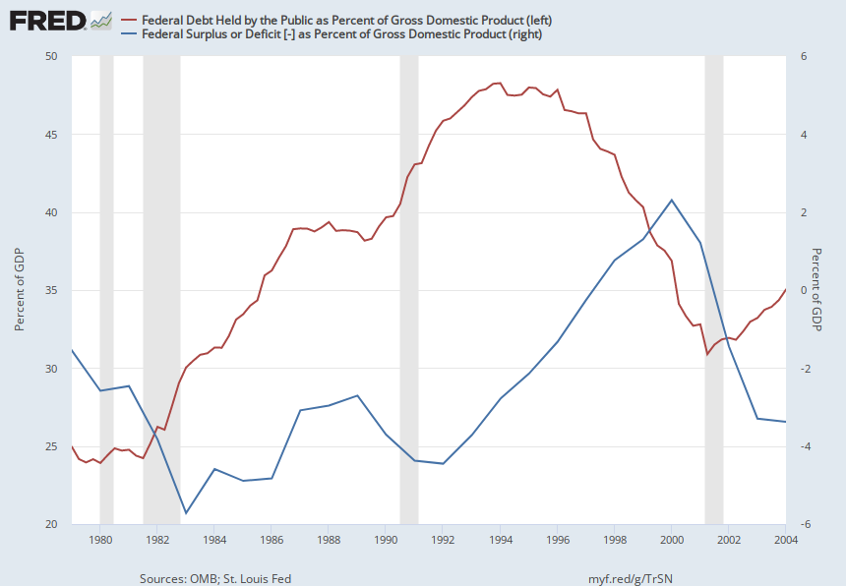
Tax Cuts Don’t “Pay for Themselves”
Although, some would disagree: Clinton economy
Notes:
Why 1983?

Slide 23
Traditional View: Debt and Deficits Raise Interest Rates
Crowding Out via higher interest rates:
  Private: less investment and over time to a smaller capital stock and reduced future output.
  Government: primary surplus needed to stabilize the debt is larger; i.e., less programmatic outlays or higher taxes
Foreign Borrowing: Higher interest rates lead to foreign capital inflows or foreign borrowing. With foreign borrowing, some of our GDP is paid to foreigners as interest.

Slide 24
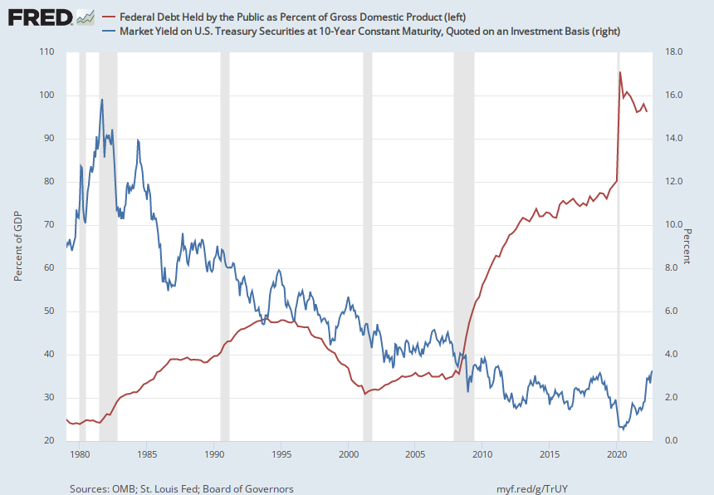
The Dog that Didn’t Bark; Rising Interest Rates?
Blue Line Rate on 10-Yr Treasury Bonds; Red Line Relative Debt

Slide 25
Olivier Blanchard’s Presidential Address to the AEA 1/2019
“If the future is like the past [with low interest rates],…the issuance of debt without a later increase in taxes may well be feasible. Put bluntly, public debt may have no fiscal cost.”
But,
“My purpose…is not to argue for more public debt, especially in the current political environment. It is to have a richer discussion of the costs of debt…than is currently the case.”

Slide 26
What the Traditional View Got Wrong
Assumed that the interest rate was greater than the growth in GDP
  In order to stabilize the debt, government must run a primary surplus.
  The bigger the debt, the larger the required primary surplus.
More debt today means a higher primary surplus is needed in the future, i.e., higher taxes and/or less programmatic outlays.
Notes:
Numerical example: interest rate a 4%; GDP growth at 3%. there must be a primary surplus to offset the interest rate

Slide 27
New View: Almost a Free Lunch
If the interest rate is less than the growth rate of GDP, then Debt to GDP can be stabilized with a (small) primary deficit: programmatic outlays can be less than revenues!
Remember our example with GDP growth of 4%. Now assume the interest rate is 3%. Relative debt will fall with a primary balance of zero!
Blanchard does believe that the relative debt must be stabilized
  At some point current deficits must be reduced.
  But it may not be crucial at what level of debt we stabilize.
Notes:
Olivier Blanchard

Slide 28
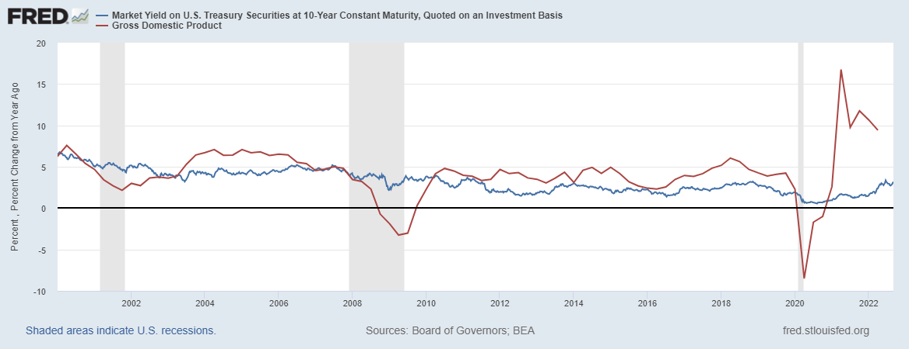
Blanchard’s Evidence
Blue Line Rate on 10-Yr Treasury Bonds; Red Line GDP growth
Notes:
Except for recessions. Blanchard does not explain why interest rates have been so low!

Slide 29
But Why Must the Relative Debt Be Stabilized?
Stephanie Kelton provided a prominent and recent exposition of Modern Monetary Theory in her June 6th 2020, NYTimes op-ed, “Learn to Love Trillion-Dollar Deficits.”
  US Treasury borrows in dollars and therefore cannot default (as opposed to Greece).
  Example: How did we “find the money” in FY 2020 to increase in the deficit by about $1.9 trillion?
  Answer: Fed open market purchases of $1.7 trillion provided 89% of the financing.
  More generally, she argues that we can always find the money to increase federal spending

Slide 30
MMT’s Free Lunch
The only limit on deficit spending is if it leads to too much spending thereby increasing current inflation.
Recognizing this fact, “…could free policymakers not only to act boldly amid crises but also to invest boldly in times of more stability.”
Too bad the second part isn’t true.
We rely on foreigners to hold a substantial portion of our debt and they can loose if the exchange value of the dollar falls

Slide 31
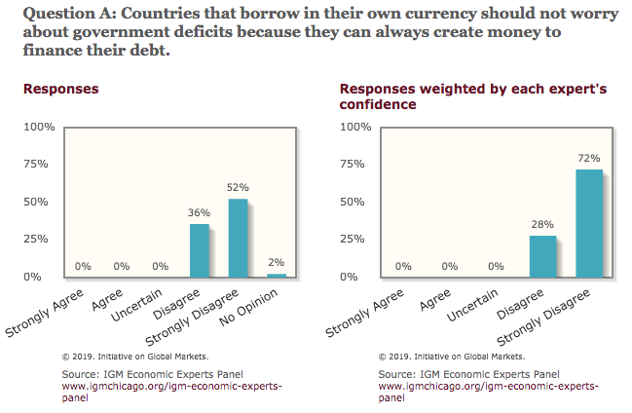
Don’t Just Take My Word for It
Notes:
Recent Increase in inflation does not discredit MMT

Slide 32
Why do Foreigners Buy US Treasuries?
Market for Treasuries is the deepest, most liquid and safest capital market in the world.
US economy has a history of political and economic stability.
We enjoy “An exorbitant privilege” (Valery Giscard d’Estaing): The dollar is the largest international reserve currency.
  Most trade transactions are quoted in dollars, e.g., oil.
  With some exceptions, foreigners borrow in dollars. E.g., Yankee bonds

Slide 33
Demand for Dollars by Central Banks
Source IMF Currency Composition of Official Exchange Reserves
Notes:
Talk about the fall of the Euro Brexit etc. What will the war in Ukraine do to these numbers.

Slide 34
CBO on the Costs of “High and Rising Debt”
The interest expense portion of the deficit will rise, including payments to foreigners.
Crowding out of private investment.
“The likelihood of a fiscal crisis in the United States would increase.”
Slow erosion of confidence in the U.S. dollar as an international reserve currency leading to higher interest rates.
Policymaker constraint in using deficit-financed fiscal policy to respond to unforeseen events.
CBO, “Budget and Economic Outlook: 2022-2032,” May 2022, pp15-16.
Notes:
1 & 2 are part of my traditional costs. 3-5 are new and related

Slide 35
What would a Fiscal Crisis Look Like?
Foreigners lose confidence in the dollar and sell Treasuries in exchange for assets denominated in their own currency,
  Sale of Treasuries raises interest rates, worsening our fiscal outlook.
  Trading of Foreign for US assets lowers US exchange rate.
    Raising the price of imports thereby increasing inflation.
    Lowering the foreign currency returns on all US assets, exacerbating 1.
Could the Fed Bail us Out?
  It could buy Treasuries and prevent the rise in interest rates.
  Insufficient foreign assets to prevent the fall in the exchange rate,

Slide 36
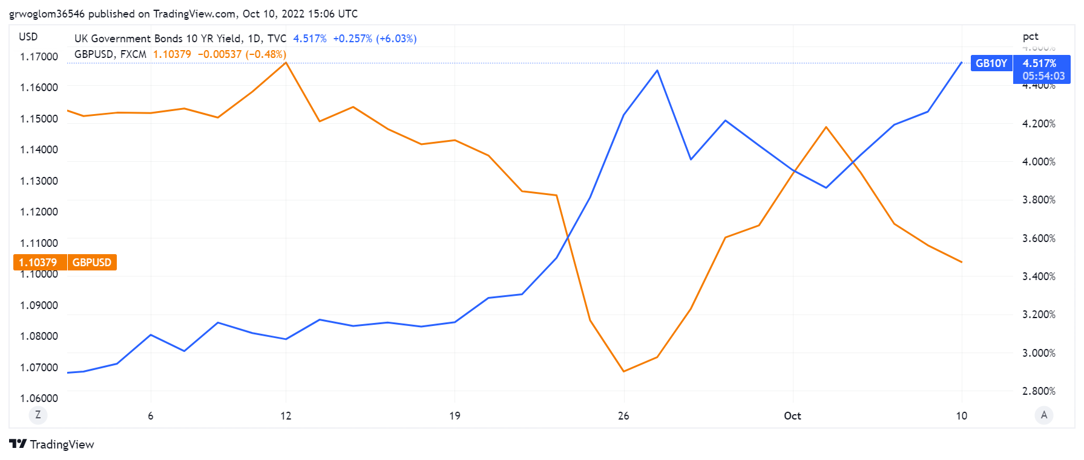
Fiscal Crisis Preview: UK & Liz Truss

Slide 37
Bottom Line: We Need to Worry about the Debt
Interest rates may not stay this low forever. In fact, economist don’t really know why they have fallen to such low levels over the past 20 years
A fiscal crisis should be avoided at all costs.
The good news is we may be able to stabilize the relative debt without a running a surplus.

Slide 38
But is this Problem Impossible?
CBO, “The Budget and Economic Outlook,” Feb 2023

Slide 39
CBO Baseline Projection
CBO, “Budget and Economic Outlook: 2022-2032,” May 2022
Notes:
10 yr Treasury rate rising slowly from 2.4 to 3.7 and then stabilizing

Slide 40
The Blueprint for a Crisis?
But, these are “projections,” not forecasts!
CBO, “Budget and Economic Outlook: 2023-2033,” Feb 2023

Slide 41
Citizen’s Guide to “Budget Reconciliation.”
Procedure successfully used 22 times since 1974 to avoid a Senate filibuster.
Reconciliation can be used for changing taxes and spending (not Social Security) subject to the Byrd Rule.
Byrd rule:
  No extraneous provisions.
  No increase in the deficit after 10 year window.
Reconciliation games played by both parties:
  BBB.
  Trump Tax Cut

Slide 42
Reconciliation and CBO Projections
For the CBO to be effective it must be perceived to be (and must be) nonpartisan.
Therefore, CBO “baseline” projections and legislative scoring must not try to predict changes in legislation.
Instead, CBO must analyze the data based on the current law as written.
CBO is allowed to provide analyses of policy options.
Notes:
One exception: assumes SS will be paid

Slide 43
Example: Trump Tax Cut
Why do Income Taxes go up in 2025?

Slide 44
Outlays based on Current Law
CBO, “Budget and Economic Outlook: 2022-2033,” May 2022

Slide 45
Unfortunately, The Required Changes are Big!
To Stabilize the relative debt at the current level of 100% of GDP:
  Deficit in 2025 needs to go from projected 4.7 % of GDP to 2.9% and be maintained at the 2.9% level.
  This amounts to over $500 billion per year.
CBO, “2020 Long-Term Budget Outlook, “ Sep 2022

Slide 46
Any of these Options Sound Good?
Pick 10!

Slide 47
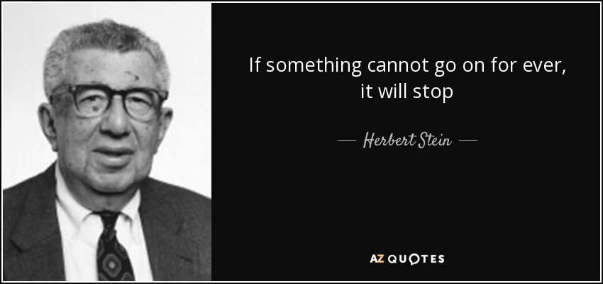
The Wit and Wisdom of Herb Stein
Notes:
Ben Stein’s father and Chair Council under Nixon

Slide 48
Your Turn
https://needecon.org/
grwoglom@amherst.edu
Contact NEED: Info@NEEDelegation.org
Submit a testimonial: www.NEEDelegation.org/testimonials.php
Support NEED: www.NEEDelegation.org/donate.php

