Slide 1
Osher Lifelong Learning Institute, Fall 2023
Contemporary Economic Policy
American University
Fall, 2023
Jon Haveman, Ph.D.
National Economic Education Delegation

Slide 2
National Economic Education Delegation
Vision
  One day, the public discussion of policy issues will be grounded in an accurate perception of the underlying economic principles and data.
Mission
  NEED unites the skills and knowledge of a vast network of professional economists to promote understanding of the economics of policy issues in the United States.
NEED Presentations
  Are nonpartisan and intended to reflect the consensus of the economics profession.

Slide 3
Who Are We?
Honorary Board: 54 members
  2 Fed Chairs: Janet Yellen, Ben Bernanke
  6 Chairs Council of Economic Advisers
    Furman (D), Rosen (R), Bernanke (R), Yellen (D), Tyson (D), Goolsbee (D)
  3 Nobel Prize Winners
    Akerlof, Smith, Maskin
Delegates: 652+ members
  At all levels of academia and some in government service
  All have a Ph.D. in economics
  Crowdsource slide decks
  Give presentations
Global Partners: 48 Ph.D. Economists
  Aid in slide deck development

Slide 4


Where Are We?

Slide 5
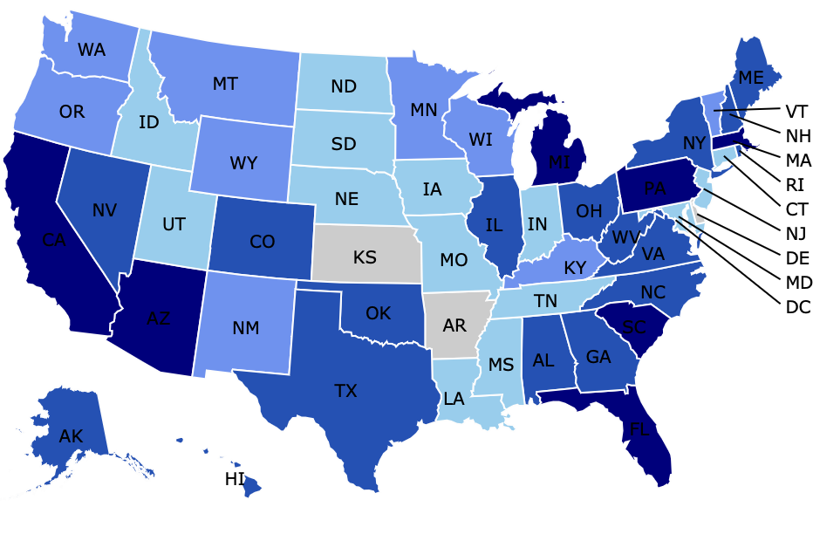
Where Have we Given Talks?

Slide 6
Available NEED Topics Include:
US Economy
Healthcare Economics
Climate Change
Economic Inequality
Economic Mobility
Trade and Globalization
Minimum Wages
Immigration Economics
Housing Policy
Federal Budgets
Federal Debt
Black-White Wealth Gap
Autonomous Vehicles
US Social Policy

Slide 7
Course Outline
Contemporary Economic Policy
  Week 1 (9/28): US Federal Budget (Jon Haveman, NEED)
  Week 2 (10/5): Trade and Globalization (Arkadiusz Mironko, Indiana Univ. East)
  Week 3 (10/12): International Institutions (Alan Deardorff, U of Michigan)
  Week 4 (10/19): Economic Update (Geoffrey Woglom, Amherst College)
  Week 5 (10/26): Monetary Policy (Geoffrey Woglom)
  Week 6 (11/02): Intro to Financial Economics (Geoffrey Woglom)

Slide 8

Trade: Bicycle Supply Chain
Source: World Development Report 2020

Slide 9
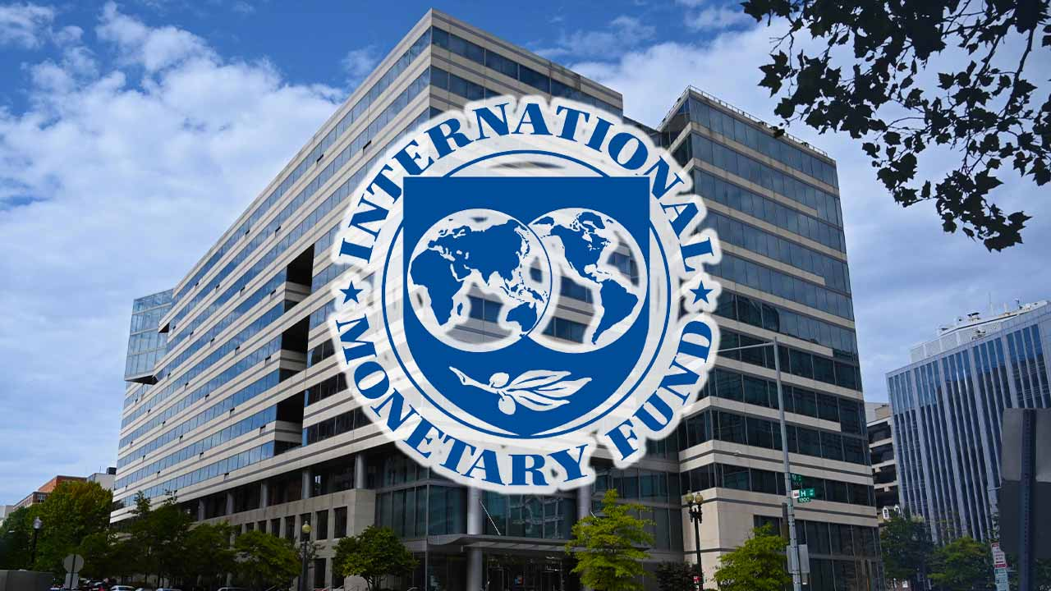
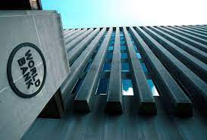
International Institutions: Alan Deardorff
October 12, 2023

Slide 10
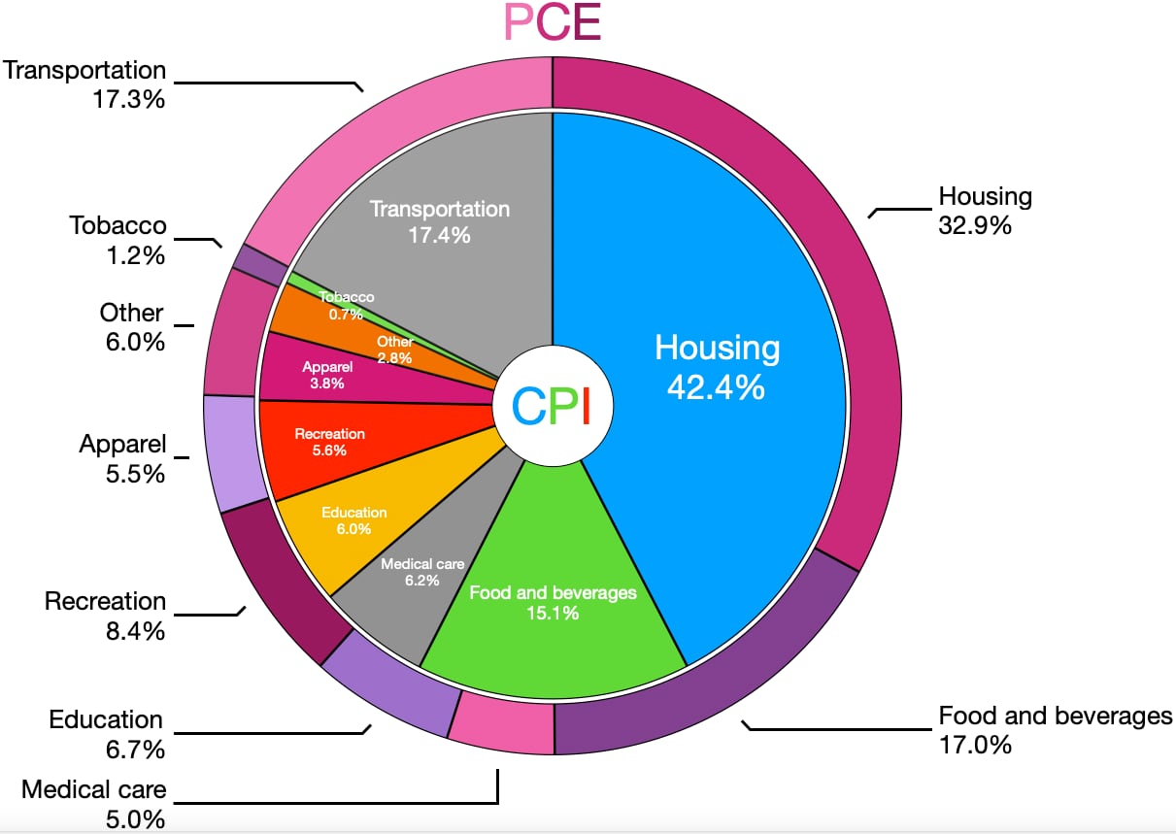
CPI vs. PCE: Differences
CPI tends to be higher (Mar):
CPI, 4.9%
Core CPI, 5.6%
PCE, 4.2%
Core PCE, 4.6%.
Typically more like 0.5 % pts.
https://en.wikipedia.org/wiki/Personal_consumption_expenditures_price_index#

Slide 11
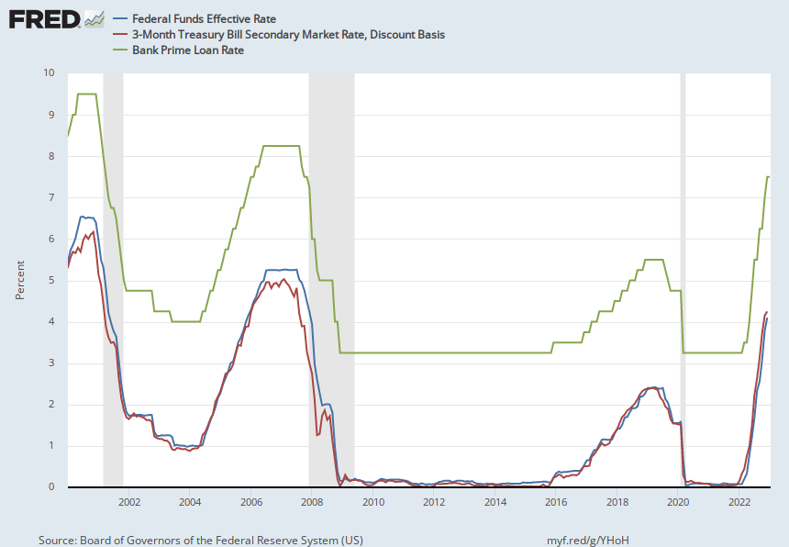
The Fed and Short-term Interest Rates
Blue is the fed funds rate.
Red is the rate on 3 month Treasuries.
Green is the prime bank lending rate
Notes:
Take note over the redline peeking above the others

Slide 12
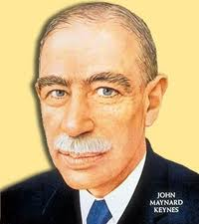
Financial Economics
Pessimist: John Maynard Keynes
Asset prices reflect investor psychology and bear little relation to fundamental value
Beauty Contest: Pick the girl that other people think is the prettiest
“Animal Spirits” cause irrational and inefficient swings in investment and cause macroeconomic instability

Slide 13
Submitting Questions
Please submit questions of clarification in the chat.
  I will try to handle them as they come up.
We will do a verbal Q&A once the material has been presented.
Slides will be available from the NEED website shortly after the talk (https://NEEDEcon.org/delivered_presentations.php)

Slide 14
The US Federal Budget
OLLI – American University
September 28, 2023
Jon Haveman, Ph.D.
NEED

Slide 15
Credits and Disclaimer
This slide deck was authored by:
  Jon Haveman, NEED
  Geoffrey Woglom
Disclaimer
  NEED presentations are designed to be nonpartisan.
  It is, however, inevitable that the presenter will be asked for and will provide their own views.
  Such views are those of the presenter and not necessarily those of the National Economic Education Delegation (NEED).

Slide 16
Outline
Budget Overview
Government Spending
Tax Expenditures
Government Revenues
Government Shutdown

Slide 17
Budget Overview

Slide 18
What Does the U.S. Gov’t Budget Look Like?
Fiscal Year 2022 Budget Summary
Revenue | Billions |  | Expenditures | Billions
Income Taxes | $2,632 |  | Mandatory | $4,010*
Payroll Taxes | $1,484 |  | Discretionary | $1,787*
Corporate Taxes | $425 |  | Interest | $475
Other | $356
Total | $4,896 |  | Total | $6,272
19.8%
25.4%
Budget Deficit: $1,375 Billion
5.5%
Source: Monthly Treasury Statement. 9/22 . *Estimates based on OMB Forecasted Breakdown
Notes:
https://www.cbo.gov/publication/53627
https://www.cbo.gov/publication/53624

Slide 19
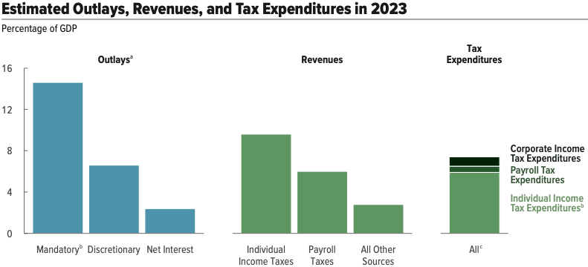
Budget Components

Slide 20
The Budget Details
Source: Monthly Treasury Statement. 9/22

Slide 21
U.S. Government Spending

Slide 22
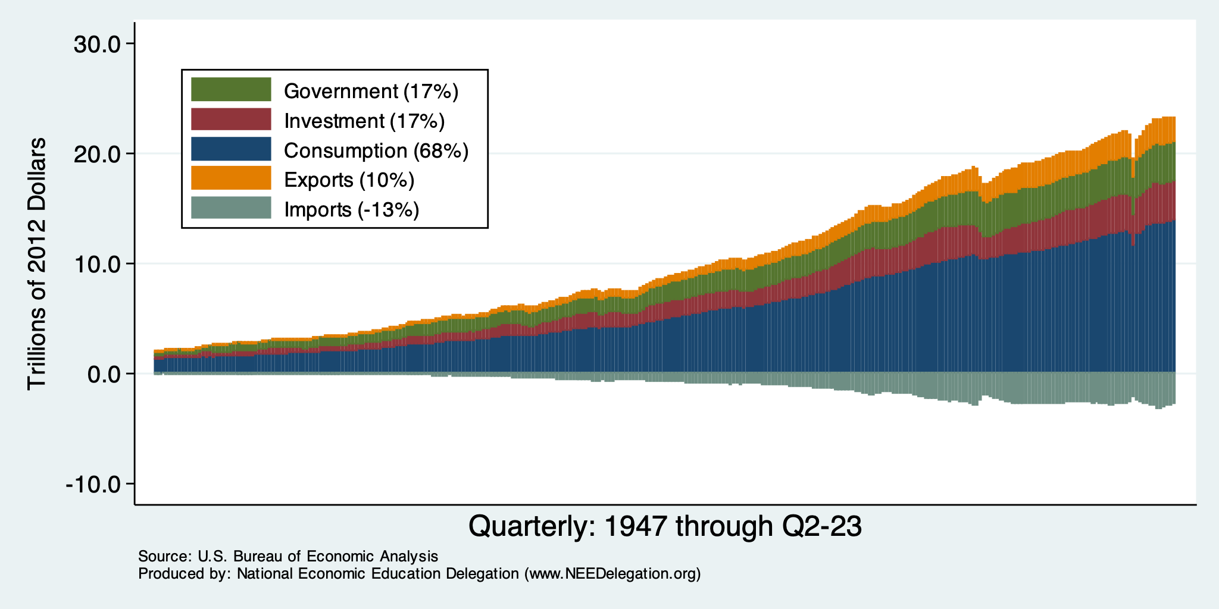
Gov’t Expenditures and the US Economy

Slide 23
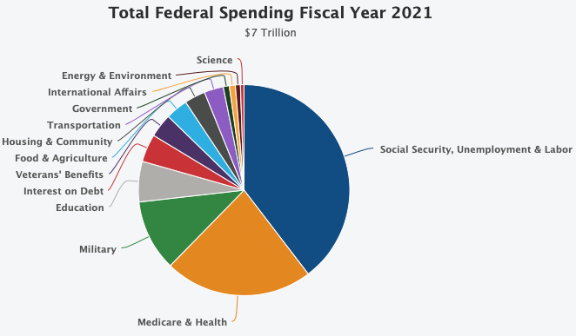

Slide 24
An Important Distinction:
Mandatory vs. Discretionary Spending:
  Discretionary Spending requires annual appropriations, e.g., most of Defense.
  Mandatory Spending is ongoing authorization to spend mostly on “entitlements:” such as Social Security and Medicare.
Budget for 2022:
  Mandatory + Net Interest was 74%;
  Discretionary 26%.
Source: Hutchins Center

Slide 25
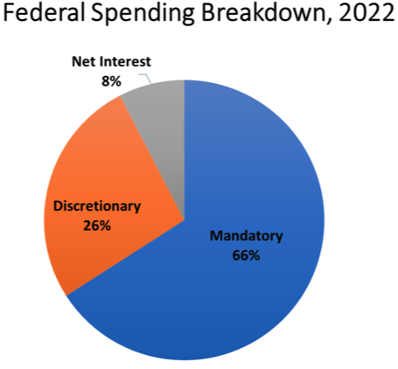
On What is the Money Spent? Complicated
Source: Hutchins Center, Brookings Institution

Slide 26
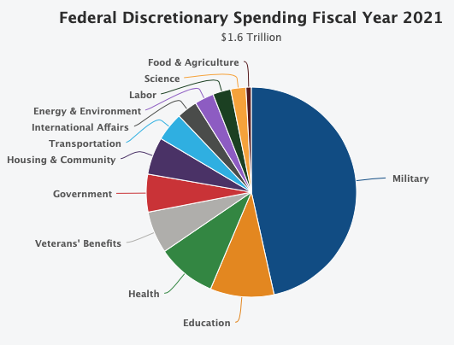

Slide 27
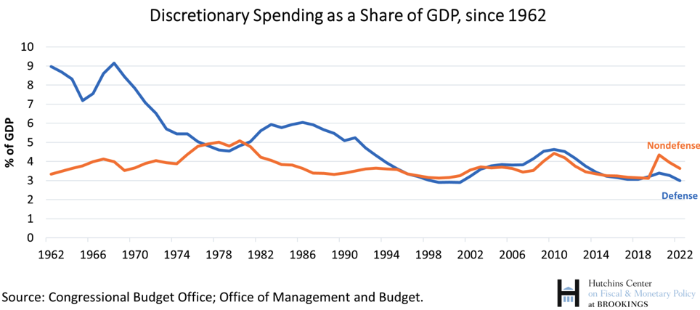

Slide 28
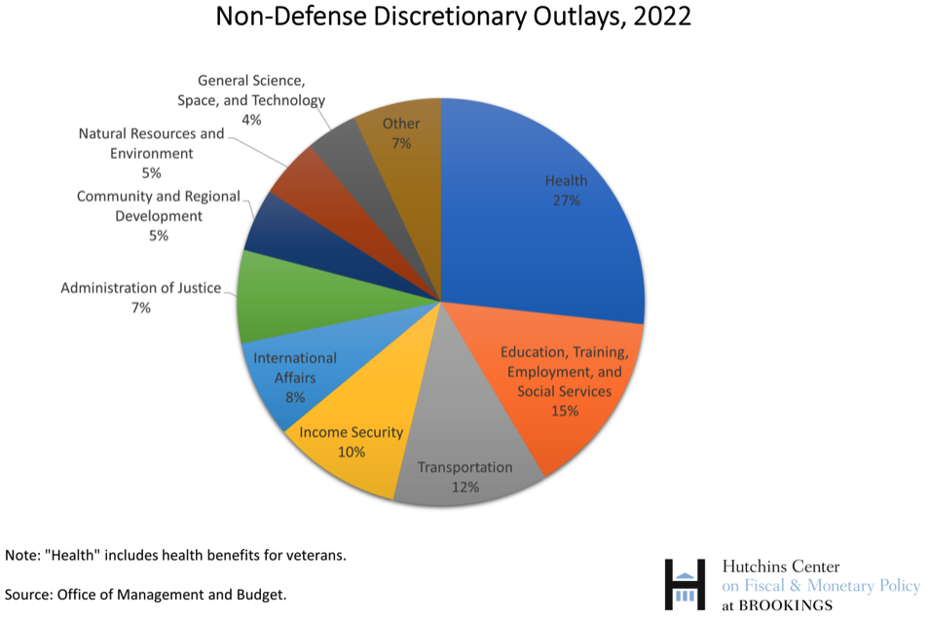

Slide 29
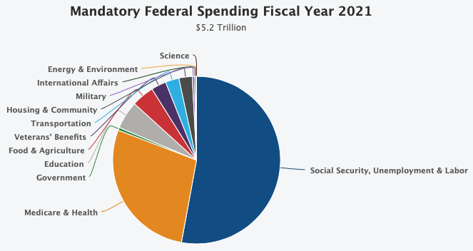

Slide 30
Mandatory Spending: Social Security (24%)
Retirement
  Covers 96% of US workers.
  Retirement age is increasing from 65-67.
Survivors
  A worker's spouse and dependents may be eligible for survivors' benefits if the worker dies.
Disability
  A medical condition expected to last at least one year or to be fatal.

Slide 31
Where Do Social Security Funds Come From?
Payroll taxes
  Tax rates:
    Employee: 6.2%
    Employer: 6.2%
    Self Employed: 12.4%
  Cap in 2023: $160,200
Taxes on OASDI benefits
  Not all benefits are taxed.
Interest earnings
Key Question:
Who pays?

Slide 32
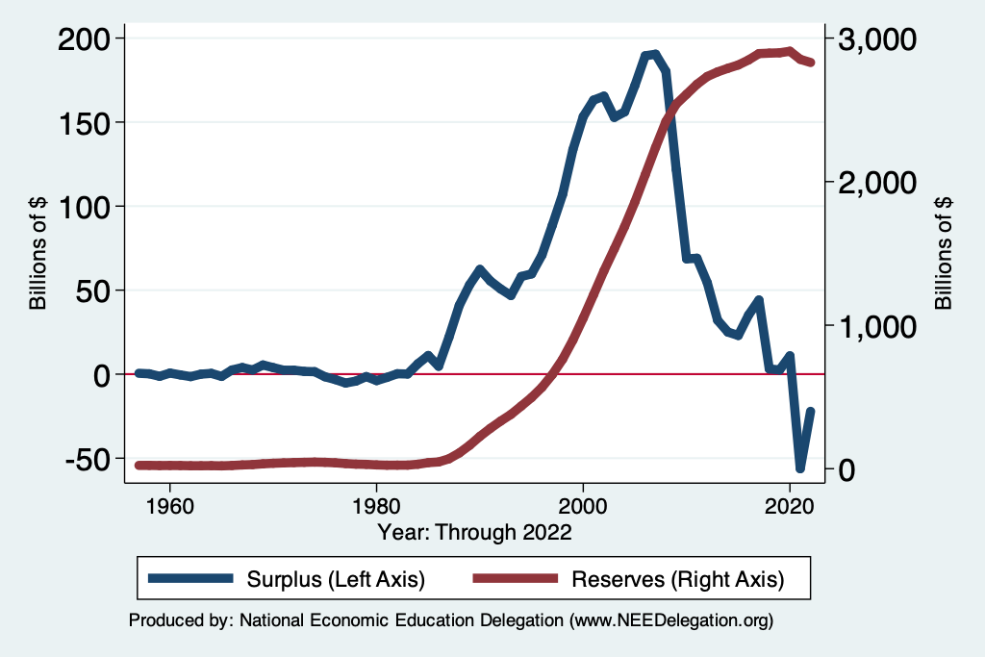
Social Security Trust Fund
Spending in 2022
  OASI: $1,097 billion
  DI: $147 billion
Income in 2022
  OASI: $1,057
  DI: $165
Surplus in 2022
  OASI: $-41
  DI: $19
Total Deficit: $22 Billion
Source: https://www.ssa.gov/OACT/TRSUM/index.html

Slide 33
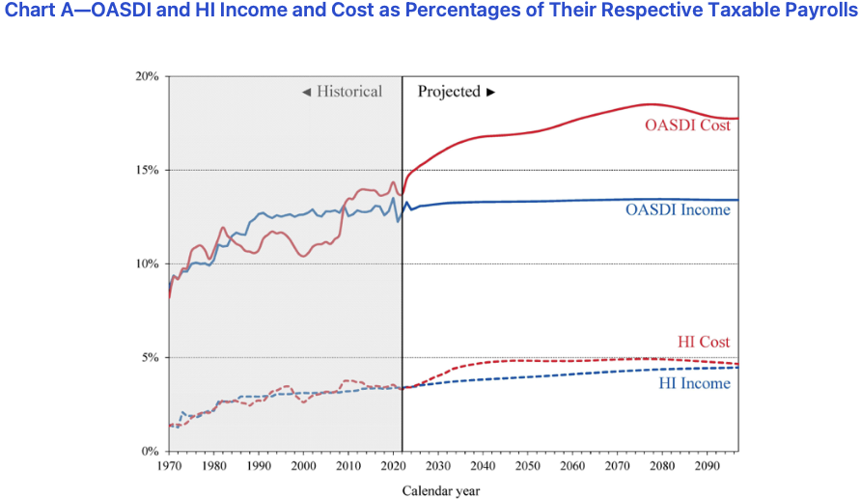
Deficits As Far As the Eye Can See
Trust Fund Solvency
  Annual deficits after 2019
  Fund insolvent after 2036
SOURCE: 2019 Annual Report of the Board of Trustees of the Federal Old-Age and Survivors Insurance and Disability Insurance Trust Funds, Table IV.B1

Slide 34
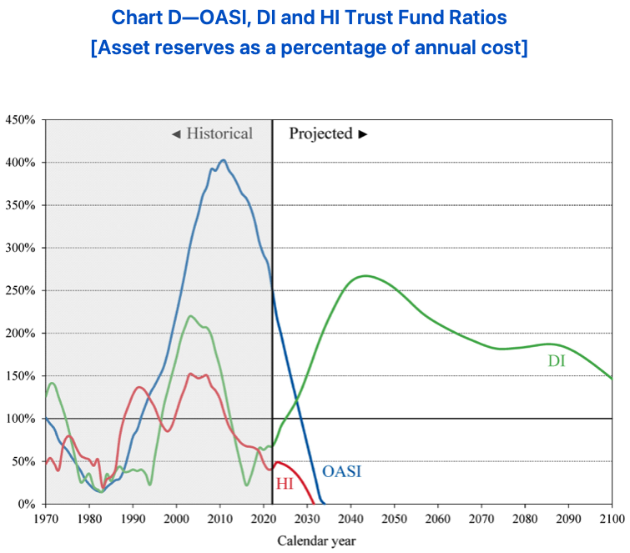

Slide 35
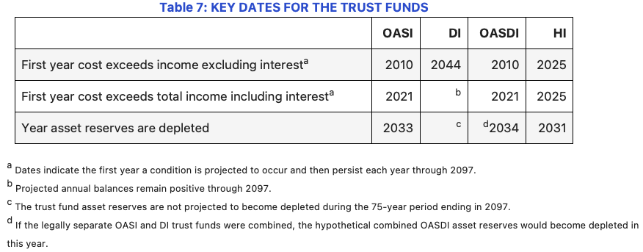

Slide 36
Options for Eliminating the Soc Sec Deficits
Problem is 1-1.5% of GDP
Raise the retirement age.
Increase the tax rate.
  4 percentage pt. increase raises 0.6% of GDP.
Raise the amount of income subject to tax.
  Tax all wages raises 1.1% of GDP.
Reduce benefits.
  21% cut in benefits by 2034 would be necessary.

Slide 37
Mandatory Spending: Medicare (13%)
Part A: Hospital Insurance
Part B: Physician, outpatient, home health, and other services.
Part D: Subsidized access to pharmaceuticals.
Part C: Medicare Advantage Plans – offered by private companies approved by Medicare.
  Medicare Advantage Plans may offer extra coverage, such as vision, hearing, dental, and/or health and wellness programs. But, you must receive referrals within network.

Slide 38
Medicare Finances in 2021
Part A:
  Income in 2021: $342 billion
  Expenses in 2021: $402 billion
  Deficit: $60 billion
Part B and Part D:
  Income in 2021: $558 billion
  Expenses in 2021: $524 billion
  Surplus: $24 billion
Long term sustainability:
  Deficits began in 2016
  Part A Trust Fund depleted by 2026.
SOURCE: 2021 Annual Report of the Board of Trustees of the Federal Hospital Insurance and Supplementary Medical Insurance
Trust Funds

Slide 39
Where Do Medicare Funds Come From?
Payroll taxes
  Tax rates:
    Employee: 1.45%
    Employer: 1.45%
    Self Employed: 2.9%
  No Income Cap
Interest earnings
General revenues
Beneficiary premiums: Parts B & D

Slide 40
Mandatory Spending: Medicaid (10%)
Medicaid provides medical insurance for those whose income and resources are insufficient to pay for health care.
It is a program with costs shared with the states.
Amount spent in FY 2022: $838 Billion
  Federal: 70% or $589 Billion
  States: 30% $249 Billion
People served in 2022: 83 million (24% of Americans)
Sources: CBO, Budget Projections, NASBO, State Expenditure Survey, and Medicaid.gov

Slide 41
Mandatory Spending: Income Security (10%)
EITC
SNAP
SSI
TANF
Housing
WIC
School Lunches
Head Start

Slide 42
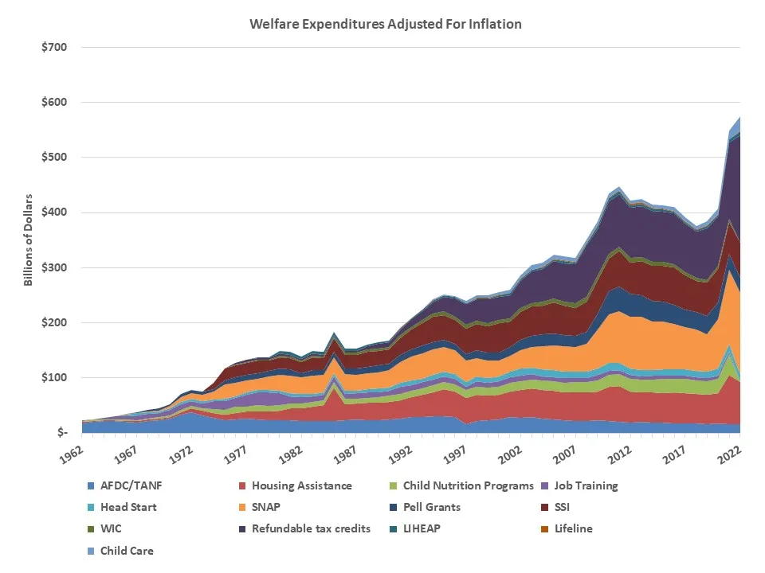
Safety Net Expenditures
Adjusted for Inflation

Slide 43
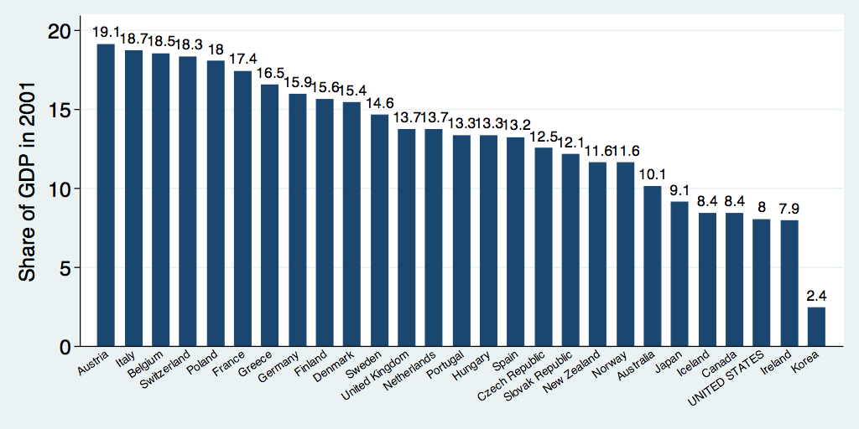
Safety Net Spending Across the OECD
U.S.: 8%
Source: World Bank Social Safety Nets Primer Notes
Notes:
http://siteresources.worldbank.org/SAFETYNETSANDTRANSFERS/Resources/281945-1124119303499/SSNPrimerNote25.pdf

Slide 44
Mandatory Spending: Interest
Interest costs in 2022: $399 Billion
  1.6% of GDP, or 7% of the Federal Budget
Forecast to increase to $1,323 Billion in 2052
  7.2% of GDP, or 24% of the Federal Budget
Source: CBO, July 2022 Long-term Budget Projections

Slide 45
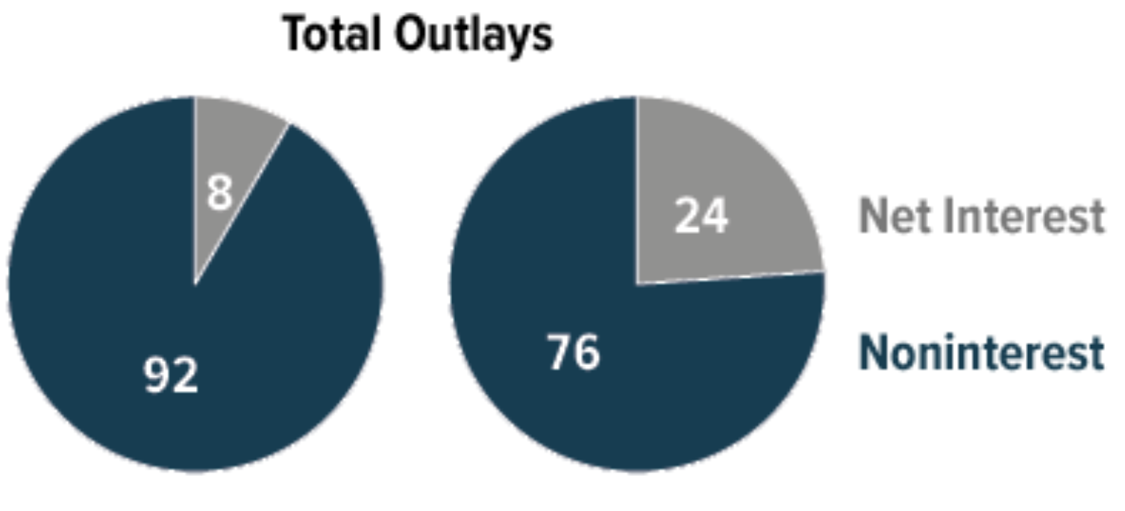

Interest Will Grow as a Share of the Deficit
Primary
Interest
Source: CBO 2022 Long Term Budget Outlook

Slide 46
Mandatory Spending: Other (13%)
Food and agriculture
Veterans’ Benefits
Transportation
Other

Slide 47
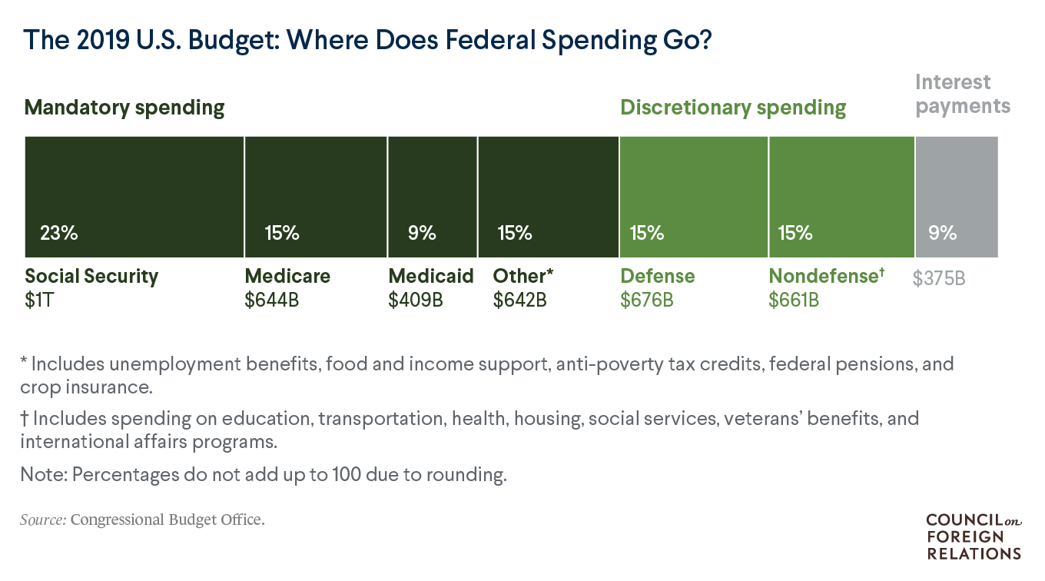
https://www.cfr.org/backgrounder/national-debt-dilemma

Slide 48
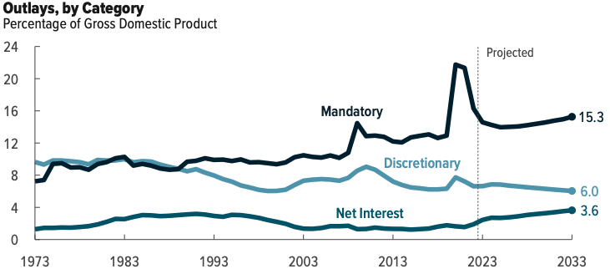
Mandatory Spending Dominates Projections
Source: Congressional Budget Office, The Budget and Economic Outlook: 2023 to 2033

Slide 49
Aging and Health Care Costs
Source: Congressional Budget Office, The Budget and Economic Outlook: 2022 to 2032

Slide 50
Another Category of Spending: Tax Expenditures
Description
  Social policies that are implemented and paid for through the tax code.
List of the largest tax breaks:
  Mortgage interest deduction - Low tax rates for Capital Gains
  Retirement contributions - Child related tax credits
  State and local taxes - Charitable gifts
  Health insurance - Lifetime Learning
Evidence of who they benefit
  Regressive

Slide 51
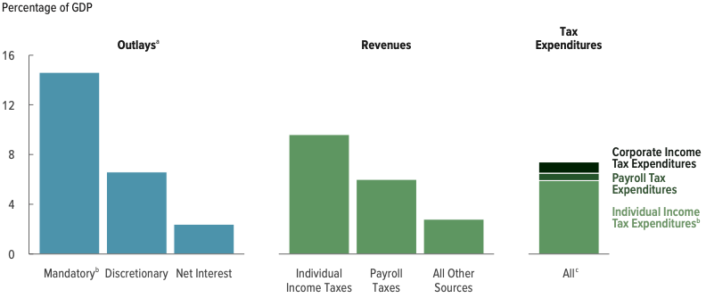
Tax Expenditures are Significant
Over $2 Trillion 200 different categories
7.4% of GDP and more than Discretionary Spending
Source: Congressional Budget Office, The Budget and Economic Outlook: 2022 to 2032

Slide 52
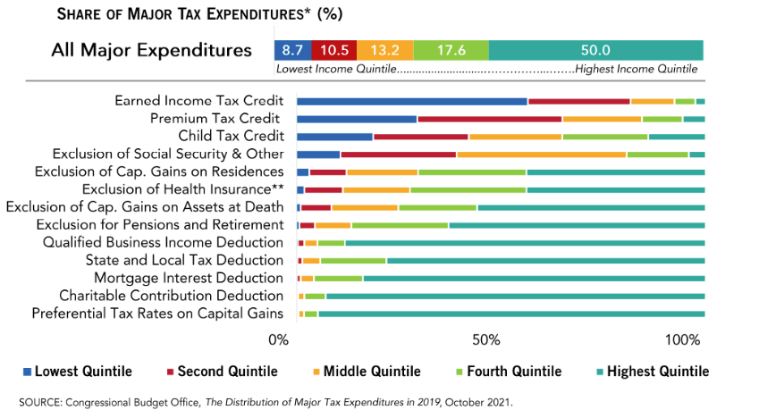
What Are Tax Expenditures?
Total: About $1.2 TRILLION in 2019
Source: https://www.pgpf.org/Chart-Archive/0199_distribution_tax_expenditures

Slide 53
Distributional Effects of Tax Expenditures

Slide 54
Distributional Effects of Tax Expenditures

Slide 55
US Government Revenues

Slide 56
Where Do Federal Revenues Come From?
Most Federal revenues are raised on earned income.
Notes:
Most income taxes are on income.

Slide 57
Individual Income Taxes
Marginal tax rates
Not all income is subject to the same tax rates
  capital gains
Deductions
  Talked about as Tax Expenditures

Slide 58
Marginal Tax Rates: Married Filing Jointly (2022)
Income Above | Tax Rate
0 | 10%
20,550 | 12%
83,550 | 22%
178,150 | 24%
340,100 | 32%
431,900 | 35%
647,850 | 37%
Income is taxed differently at different levels.
Individuals are taxed the same way, regardless of overall taxable income:
  First dollar is taxed at 10%
  20,551st dollar is taxed at 12%

Slide 59

Tax Rates Over Time

Slide 60

The Top Tax Rate and Income Cutoff
Massive tax cut for those with
More than $4 million in income.
And for those with more than
About $200,000 in income.

Slide 61
Progressive Tax System
Tax Systems are:
  Progressive: increasing average tax with income
  Neutral or flat: same share of income at all income levels
  Regressive: decreasing average tax with income (sales tax)
Ability to pay rises with income.
Income Inequality.

Slide 62
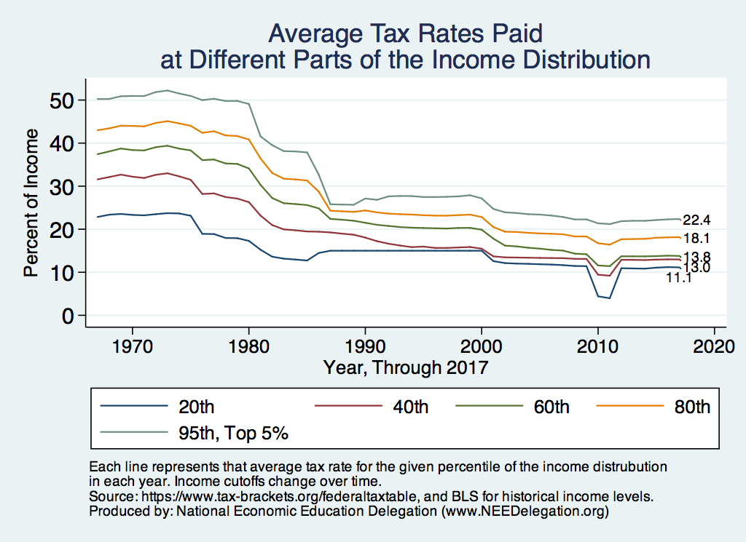
Average: Coming Down – Mostly at the Top

Slide 63

Dramatically Less Progressivity in the Tax Code
1961 to 2011
Source: New York Times, from Thomas Piketty, Emmanuel Saez and Gabriel Zucman, “
Distributional National Accounts: Methods and Estimates for the United States”

Slide 64
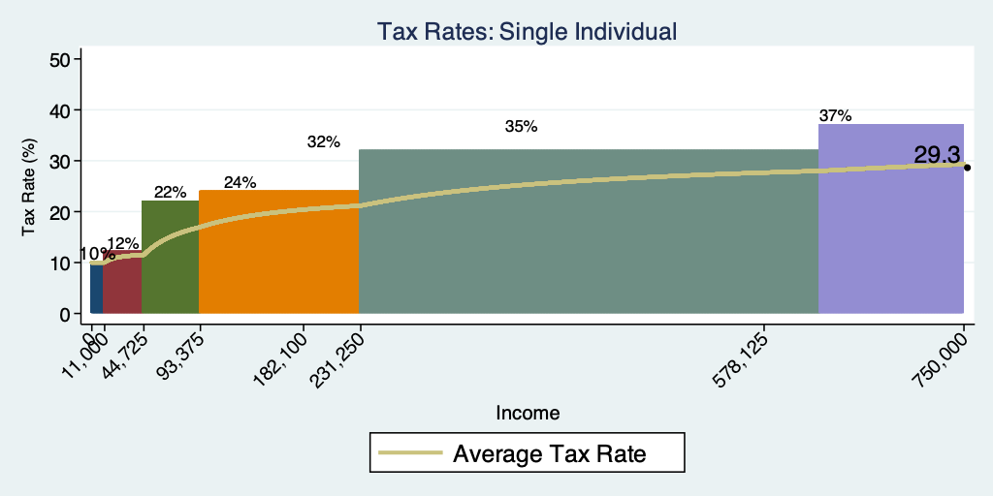
Current Tax Rates Across Incomes (2023)

Slide 65
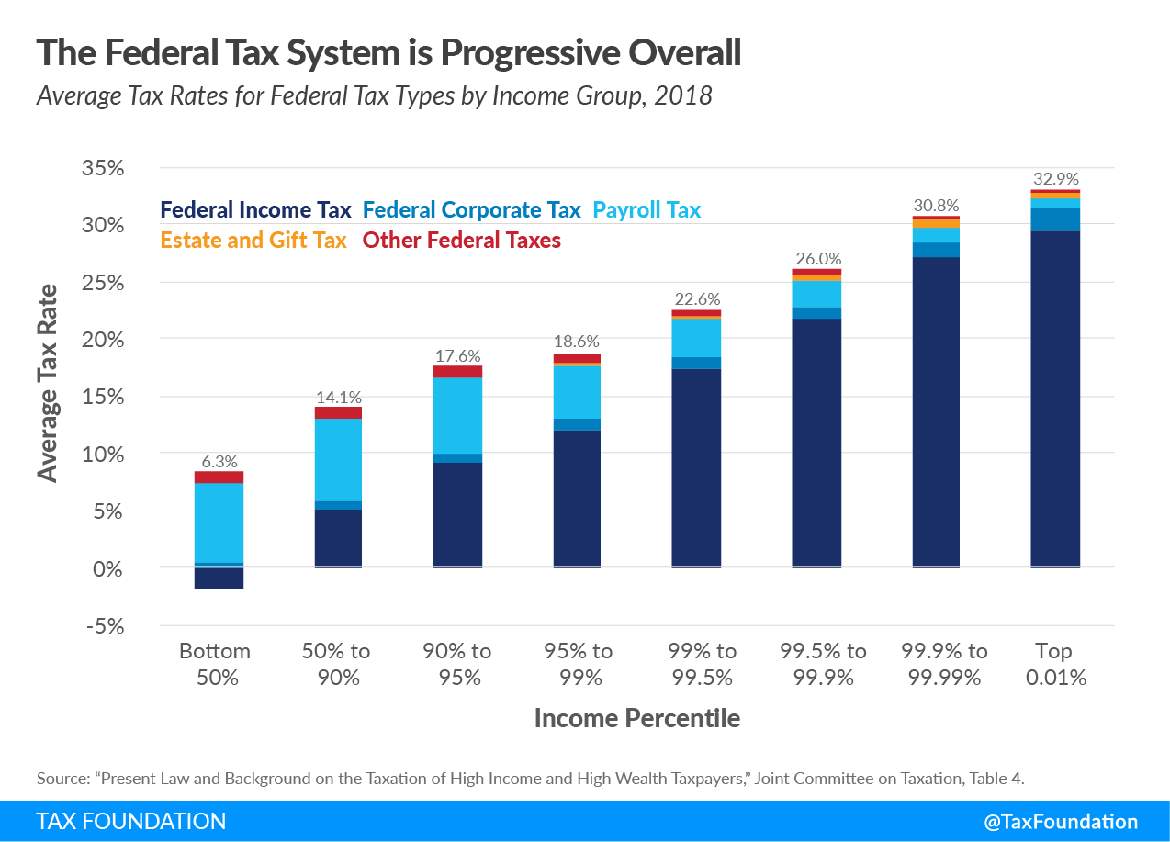
All Federal Taxes

Slide 66
All Taxes

Slide 67
Average Tax is a Bit More Complicated
Is ability to pay better measured by taxable income, or before tax income?
Remember tax expenditures.
But not all tax expenditures are bad: medical expense deductibility.
In judging inequality you have to look at the effect of transfers as well as all taxes.
No perfect answers

Slide 68
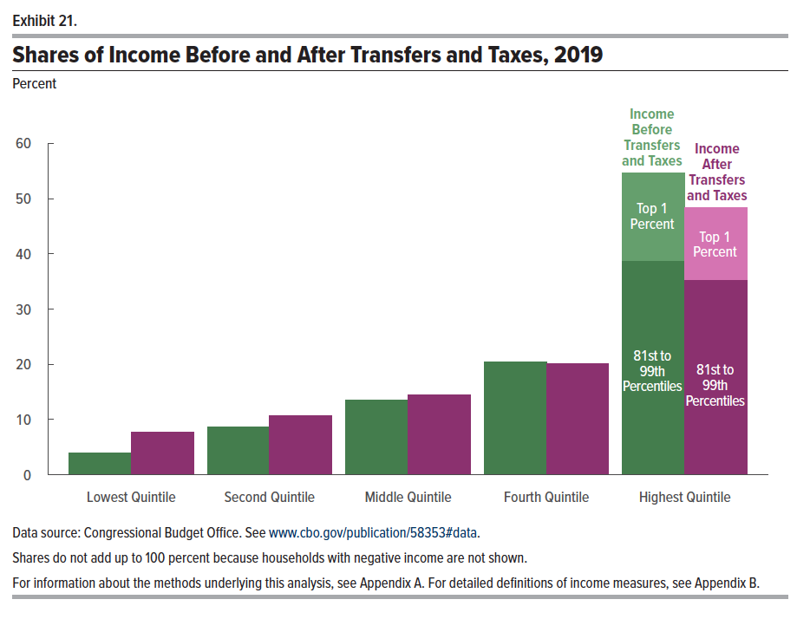
Federal Taxes and Transfers

Slide 69
The Bottom 40% Don’t Pay Income Taxes?
There is a common narrative that the bottom 40% don’t pay income taxes.
But they pay other taxes and they also pay state and local taxes
  Payroll
  State and local taxes
  Excise taxes – see the slide 4 slides ago.
But, previous slide shows that the bottom 60% are net beneficiaries of Federal tax and transfer system.
Is that bad?

Slide 70
Income Quintiles in 2019
Average Income within the quintile:
$17,200
$39,600
$67,500
$108,700
$318,900
At the top:
  81-90, $166,600;
  91-95, $236,700;
  96-99, $403,600;
  top 1%, $1,983,700

Slide 71
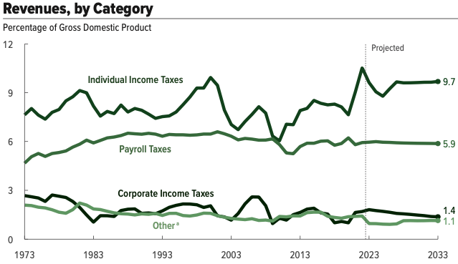
Revenue Sources: Share of GDP over Time
Source: Congressional Budget Office, The Budget and Economic Outlook: 2023 to 2033

Slide 72
International
Comparison
OECD Avg. 33.5%

Slide 73
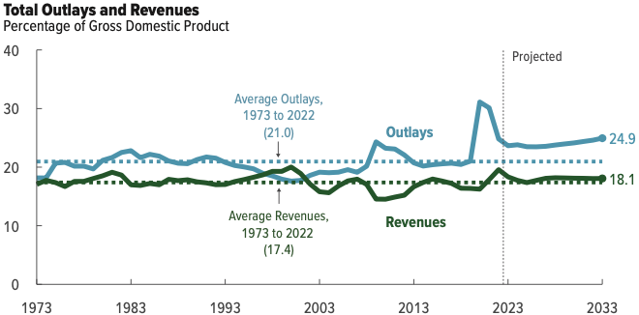
Summary: Past and Future Budgets
Source: Congressional Budget Office, The Budget and Economic Outlook: 2022 to 2032

Slide 74
Summary: Slide 1
Total Federal Spending: $4.9 Trillion in FY 2022
There is remarkably little discretion in each budget:
  Mandatory: 74%
  Discretionary 26%
Fastest growing parts of the budget: Health Care and Interest
By 2052:
  Debt is forecast to grow to 185% of GDP, from 98% now
  Interest payments are forecast to grow from 7% to 24% of budget

Slide 75
Summary Slide1a: Tax Expenditures
…Are policy enacted through the tax code.
…Are not explicitly on the books.
…Add > 25% to budget deficit.
…Reduce the progressive nature of the tax code.
…Are larger than all of “Discretionary Spending”.

Slide 76
Summary: Slide 2
Most Federal Revenues come from taxes on earned income.
Tax and Transfer System is modestly progressive, particularly at the lowest quintile.
Both these statement are true:
  Top 20% of earners pay 2/3rds of total taxes.
  But, this is only slightly more than their share of pre-tax income, 62%

Slide 77
Citizen’s Guide To Government Shutdown
Federal fiscal year: Oct 1– Sep 30
  Ends Saturday night.
Action needs to be taken to fund key government services before the end of the fiscal year.
So far, not looking good.
  Senate – bipartisan agreement (Temporary)
  House – disarray….

Slide 78
Implications (1)
Families Will Get Cut Off from Food Assistance Programs: Vital nutrition assistance is at risk for nearly 7 million women and children who rely on the Special Supplemental Nutrition Program for Women, Infants, and Children (WIC)—a program that serves nearly half of babies born in this country.
Kids May Lose Access to Head Start: Thousands of children across the country may lose access to Head Start, as the Department of Health and Human Services wouldn’t be able to award Head Start Grants during a shutdown.
Critical Services like Disaster Preparedness and Response Will Be Interrupted: A shutdown would create an increased risk that FEMA’s Disaster Relief Fund is depleted and would complicate new emergency response efforts if additional catastrophic disasters occur. Funding for long-term recovery projects would also remain halted, worsening ongoing delays as FEMA awaits new appropriations.

Slide 79
Implications (2)
Servicemembers and Law Enforcement Officers Will Work Without Pay: All active-duty military personnel and many law enforcement officers would remain at work but receive no pay until funds are available.
Access to our National Parks May Be Shut Off: Maintenance of parks will also be suspended — including restroom cleaning, visitor services, and trash collection.
Small Businesses Will Not Get New Loans from the SBA: The Small Business Administration will not accept, review, or approve any new business loans in the event of a shut down.
Travelers May Face Significant Delays: Air traffic controllers and TSA Officers are expected to work without pay—potentially leading to significant delays and longer wait times for travelers at airports across the country like there were during previous shutdowns.

Slide 80
Solutions?
Usually ”continuing resolutions”.
  Keep spending as we were this year.
  Extends last year’s budget into next year.
Others?
  Your guess is as good as mine.

Slide 81
Economic Implications?
Short closure? None (well, vanishingly small)
Long term?
  Could grow to be significant.
  Essentially, a cut in government spending.
    Drag on economic growth.
    Fuel the potential for a recession, along with:
      high interest rates
      UAW strike
Other: Ukraine War Funding

Slide 82
Trade: Bicycle Supply Chain
Arkadiusz Mironko
Source: World Development Report 2020

Slide 83
Thank you!
Any Questions?
www.NEEDEcon.org
Jon Haveman, Ph.D.
Jon@NEEDEcon.org
Contact NEED: info@NEEDEcon.org
Submit a testimonial: www.NEEDEcon.org/testimonials.php
Become a Friend of NEED: www.NEEDEcon.org/friend.php

Slide 84
Another Important Spending Distinction
Government Expenditures in GDP include Federal, State, and Local.
In 2021 (latest data), of the $4,487b of government expenditures in GDP
  $1,657b, or 37% are from the Federal Government.
  $2,380b, or 63% are from State and Local governments,
From here on, we will only be concerned with the Federal Budget.

Slide 85
