Slide 1
Osher Lifelong Learning Institute, Winter 2026
Critical Economic Topics for 2026
Bradley University
Host: Jon Haveman, Executive Director
National Economic Education Delegation

Slide 2
Available NEED Topics Include:
US Economy
Healthcare Economics
Climate Change
Economic Inequality
Economic Mobility
Trade and Globalization
Minimum Wages
Immigration Economics
Housing Policy
Federal Budget
Federal Debt
Black-White Wealth Gap
Autonomous Vehicles
Saving Social Security

Slide 3
Course Schedule
Critical Economic Topics for 2026
  Week 1 (2/04): Economic Update, Geoffrey Woglom, Amherst College
  Week 2 (2/11): Monetary Policy, Geoffrey Woglom, Amherst College
  Week 3 (2/18): U.S. Federal Budget, Jon Haveman, Executive Director NEED
  Week 4 (2/25): International Institutions, Alan Deardorff, University of Michigan

Slide 4
Submitting Questions
Please submit questions of clarification in the chat.
  I will try to handle them as they come up.
We can have a verbal Q&A once the material has been presented.
Slides will be available from the NEED website later today. (https://NEEDEcon.org/delivered_presentations.php)

Slide 5
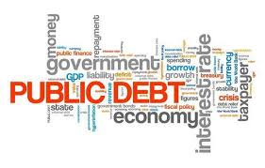

The U.S. Federal Budget
Jon Haveman, Ph.D.
Executive Director, NEED

Slide 6
Outline
Budget Overview
Government Revenues
Government Spending
Tax Expenditures
Summary

Slide 7
What Does the US Govt. Budget Look Like?
2025 Budget Summary (in Trillions, % of GDP)
Revenue |  |  | Outlays
Income Taxes | $2.7 |  | Mandatory | $4.2
Payroll Taxes | $1.7 |  | Discretionary | $1.9
Corporate Taxes | $0.5 |  | Interest | $1.0
Other | $0.4
Total | $5.2 (17.3%) |  | Total | $7.0 (23.1%)
Budget Deficit: $1.8 Trillion (5.8%)
Source: https://www.cbo.gov/publication/60053
Notes:
https://www.cbo.gov/publication/53627
https://www.cbo.gov/publication/53624

Slide 8
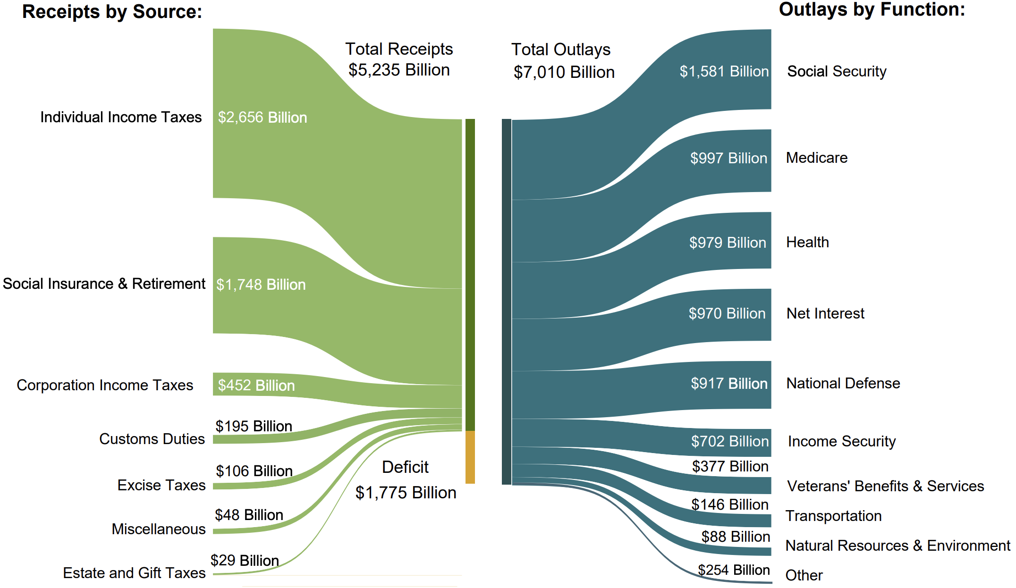
The Budget Details, 2025FY
Customs Duties
2024: $7 Billion
2025: $195 Billion
Source: Monthly Treasury Statement. 9/25

Slide 9
US Government Revenues

Slide 10
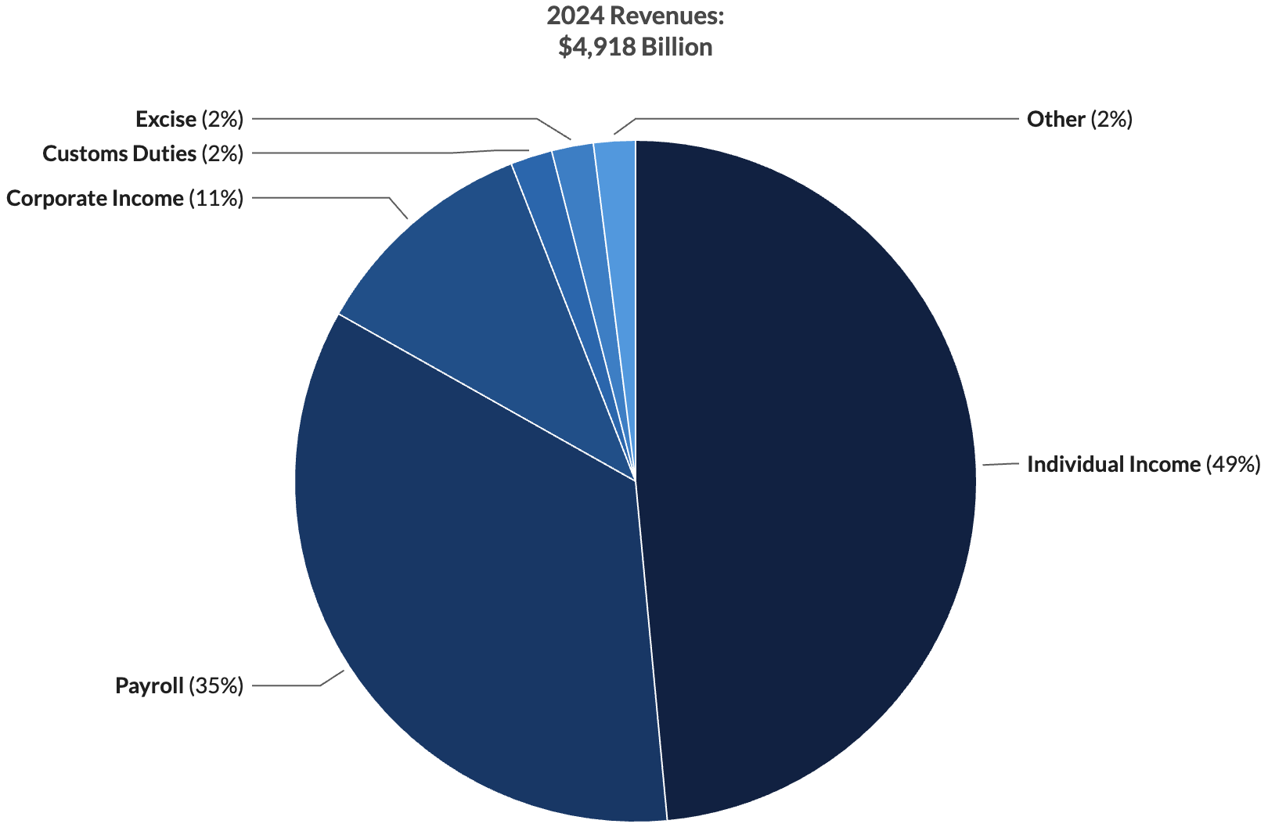
Where Do Federal Revenues Come From?
Most Federal revenues
(49%+35%) are raised on earned income.
Notes:
Most income taxes are on income.

Slide 11
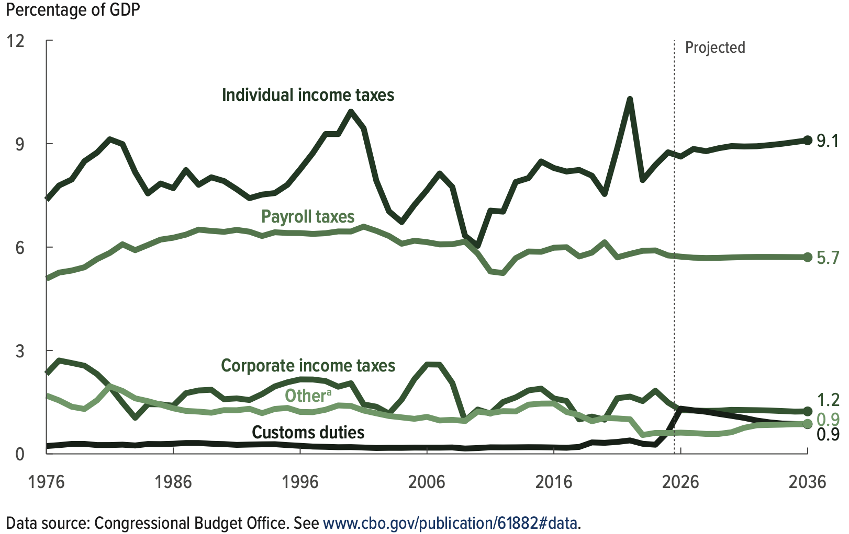
Revenue Sources: Share of GDP over Time
Outlays, by Category
Source: Congressional Budget Office, The Budget and Economic Outlook: 2026 to 2036

Slide 12
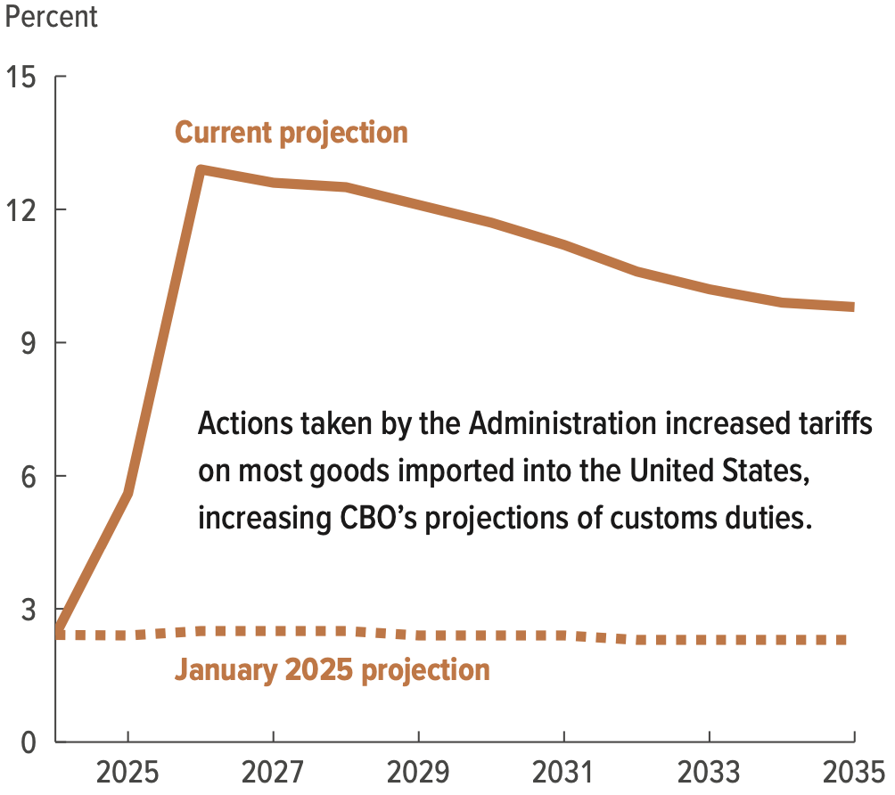
How Much Have Tariffs Increased?

Slide 13
Individual Income Taxes
Marginal tax rates
Not all income is taxed
  Only adjusted gross income.
Deductions
  Will talk about as tax expenditures.

Slide 14
Marginal Tax Rates: Married Filing Jointly (2026)
Income Above | Tax Rate
0-24,800 | 10%
24,801-100,800 | 12%
100,801-211,400 | 22%
211,401–403,550 | 24%
403,551-512,450 | 32%
512,451-768,700 | 35%
Above 768,701 | 37%
Income is taxed differently at different levels.
Individuals are taxed the same way, regardless of overall taxable income:
  First dollar is taxed at 10%
  24,801st dollar is taxed at 12%

Slide 15
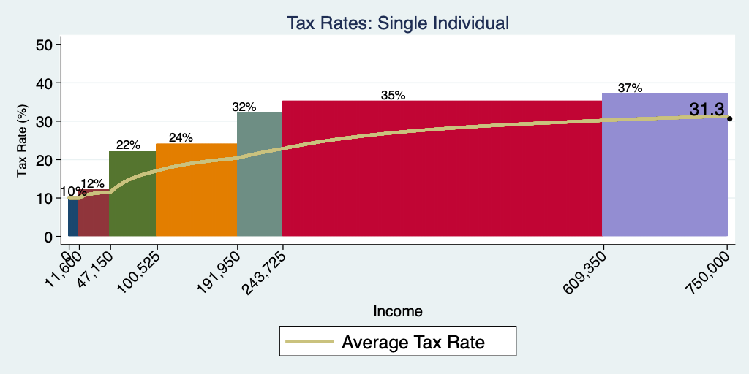
Current Tax Rates Across Incomes (2024)

Slide 16
Progressive Tax System
Tax Systems are:
  Progressive: increasing average tax with income
  Neutral or flat: same share of income at all income levels
  Regressive: decreasing average tax with income (sales tax)
Ability to pay rises with income.
Income Inequality.

Slide 17
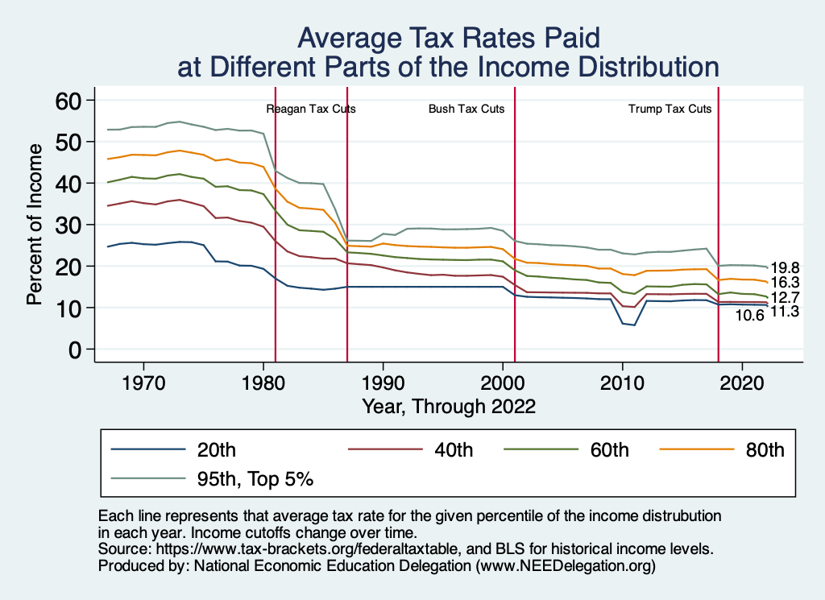
Average: Coming Down – Mostly at the Top

Slide 18
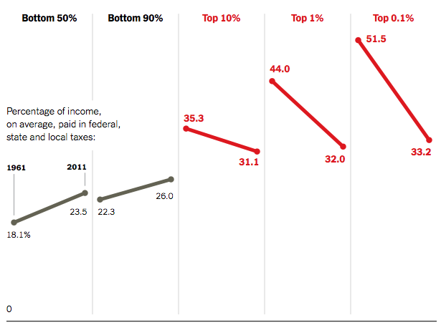
Dramatically Less Progressivity in the Tax Code
1961 to 2011
Source: New York Times, from Thomas Piketty, Emmanuel Saez and Gabriel Zucman, “
Distributional National Accounts: Methods and Estimates for the United States”

Slide 19
All Taxes

Slide 20
The Bottom 40% Don’t Pay Income Taxes?
There is a common narrative that the bottom 40% don’t pay income taxes.
But they pay other taxes and they also pay state and local taxes
  Payroll
  State and local taxes
  Excise taxes – see the slide 4 slides ago.
But, this portion of the income distribution are net beneficiaries of Federal tax and transfer system.
Is that bad?

Slide 21
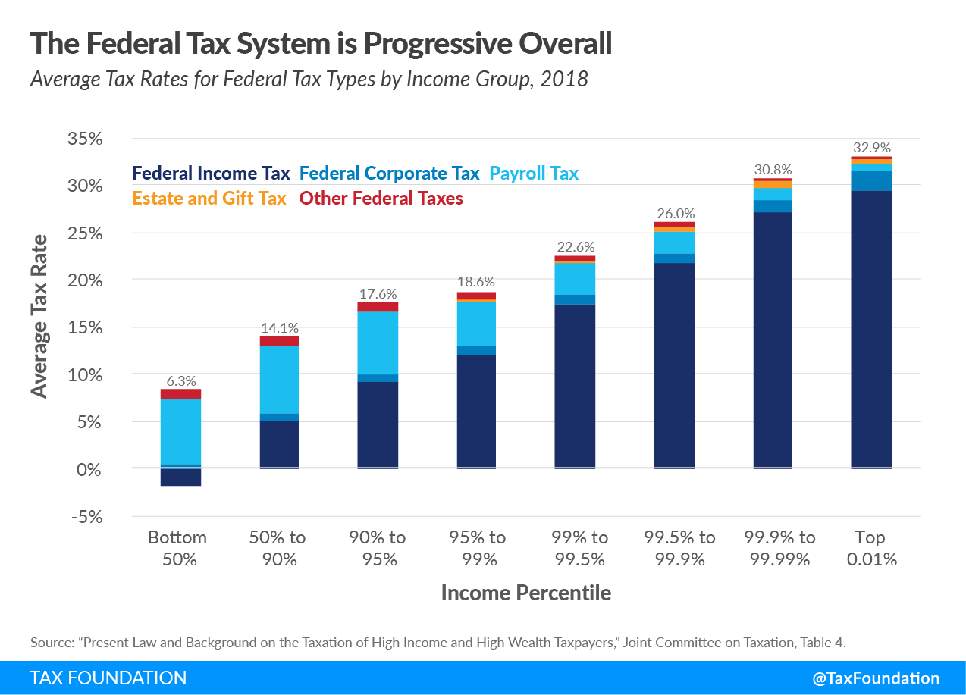
All Federal Taxes

Slide 22
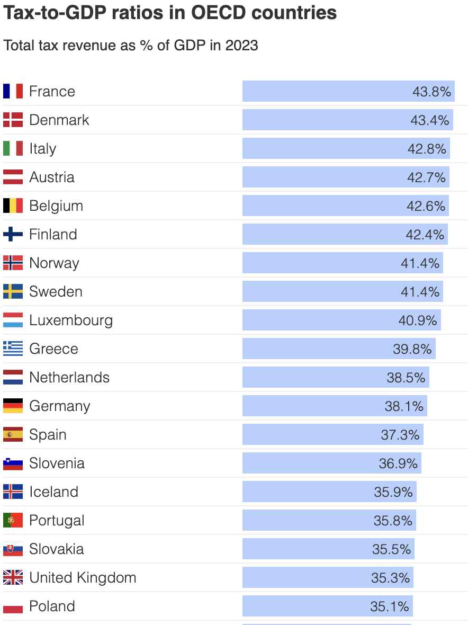
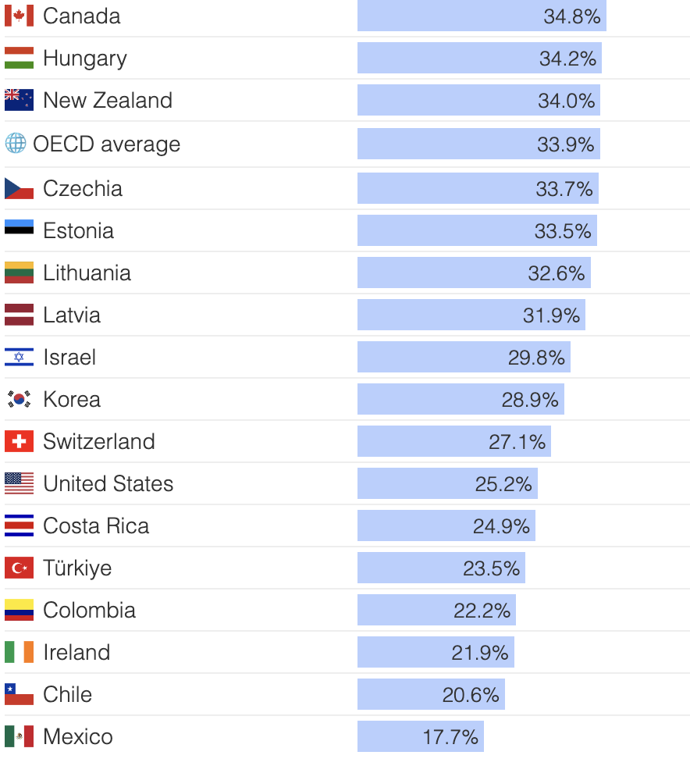
International Comparison

Slide 23
Summary: Revenues
Most Federal Revenues come from taxes on earned income.
Tax and Transfer System is modestly progressive, particularly at the lowest quintile
Top 20% of earners pay 2/3 of total taxes, but this is only slightly more than their share of pre-tax income, 62%

Slide 24
U.S. Government Spending

Slide 25
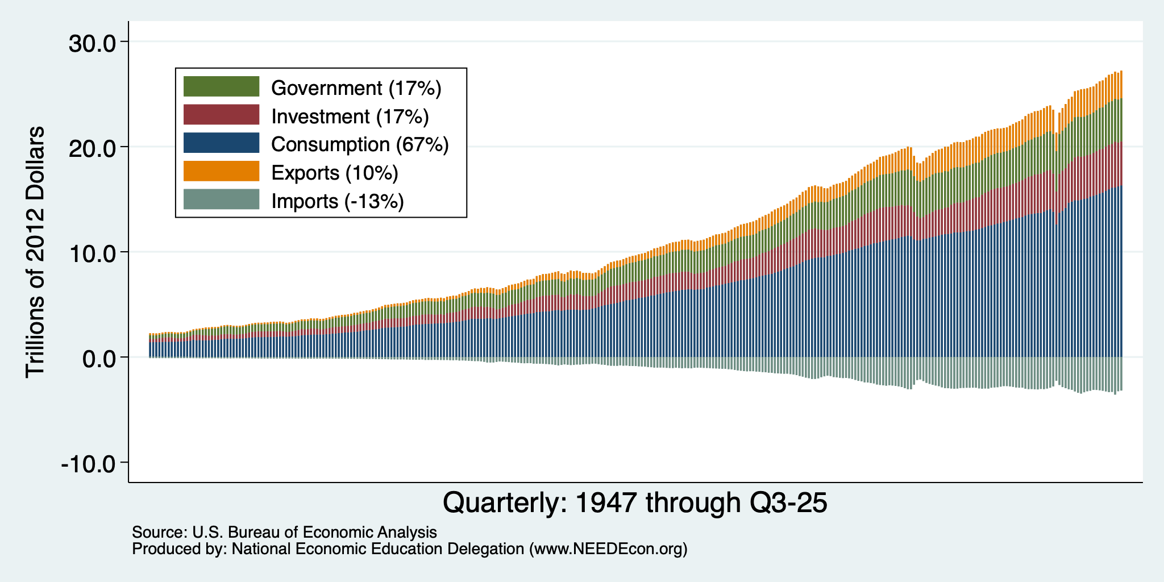
Gov’t Expenditures and the US Economy

Slide 26
An Important Distinction:
Mandatory vs. Discretionary Spending:
  Discretionary Spending requires annual appropriations, e.g., most of Defense.
  Mandatory Spending is ongoing authorization to spend mostly on “entitlements:” such as Social Security and Medicare.
Budget for 2025:
  Mandatory + Net Interest was 73%;
  Discretionary 27%.
Source: Hutchins Center

Slide 27
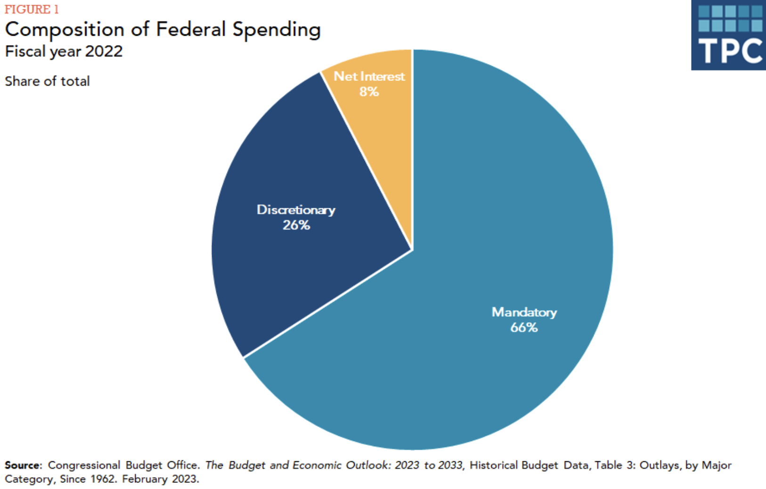

Slide 28
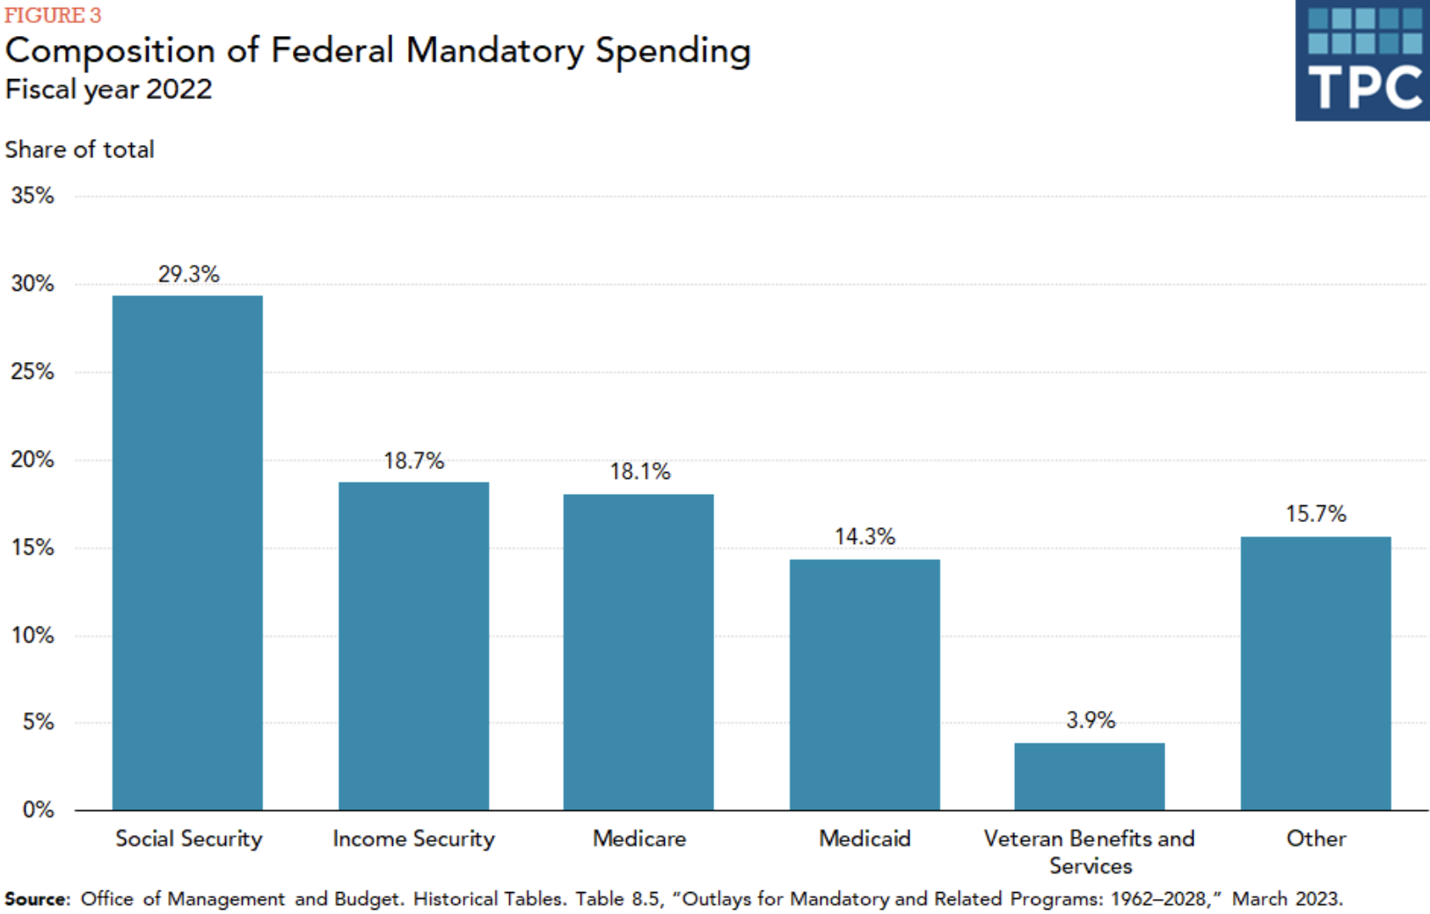
E.g., TANF,
Unemp Ins
and SNAP

Slide 29
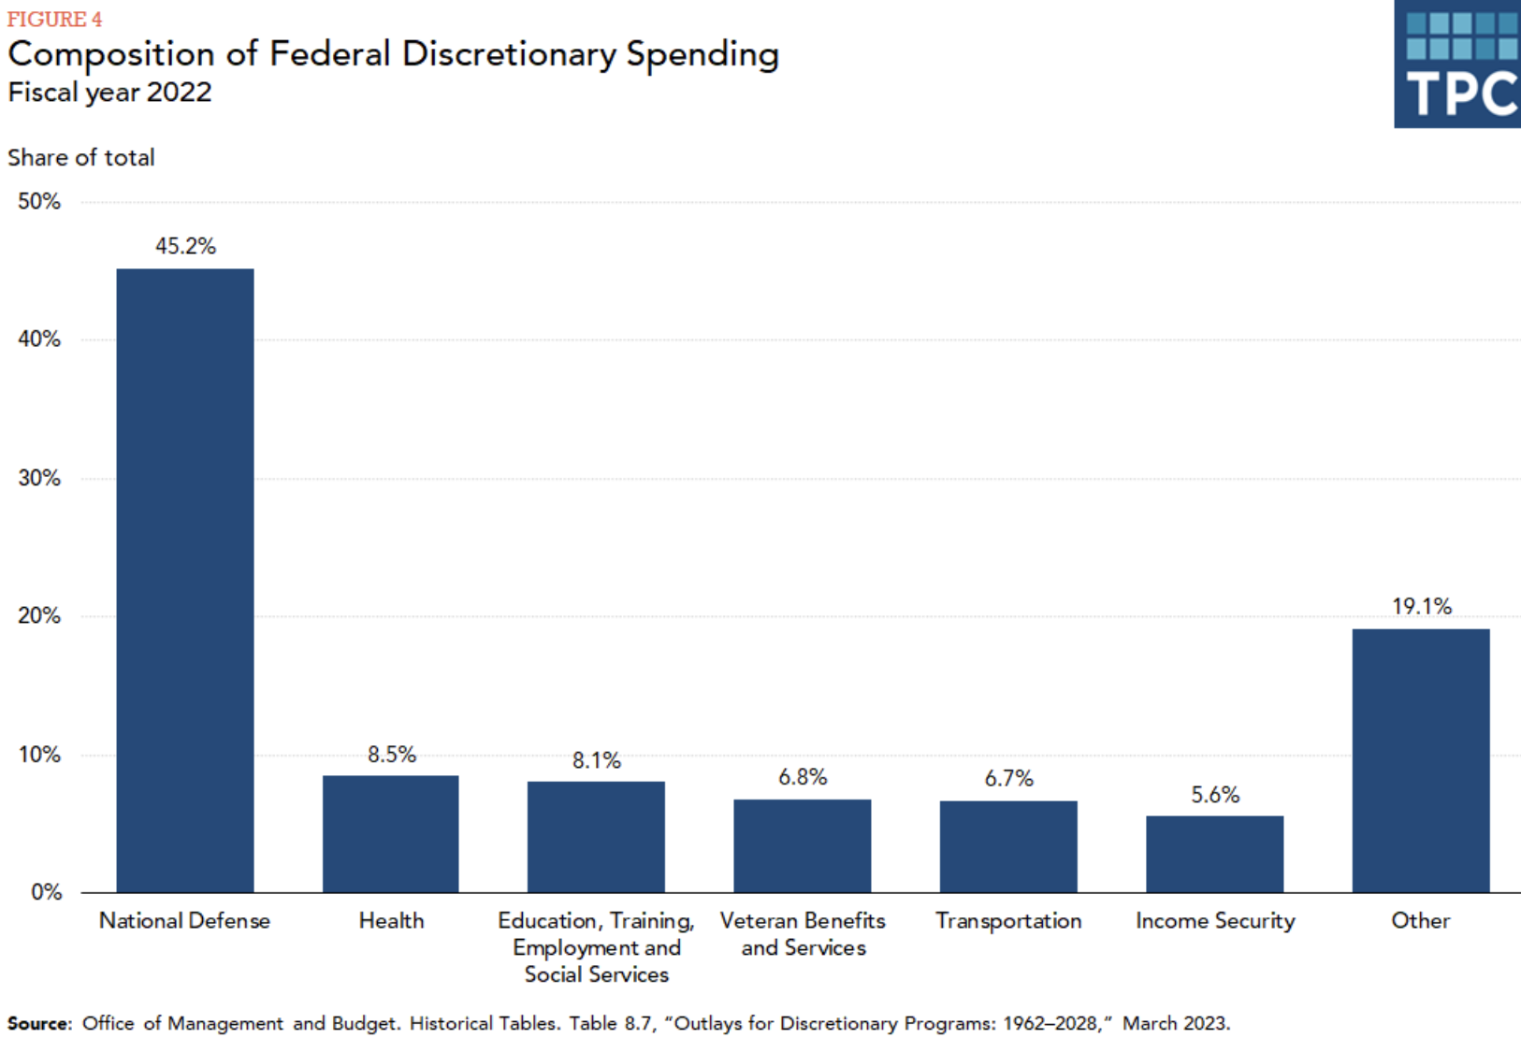

Slide 30
Mandatory Spending: Social Security
Retirement (OA)
  Covers 96% of US workers.
Survivors (S)
  A worker's spouse and dependents may be eligible for survivors' benefits if the worker dies.
Disability (DI)
  A medical condition expected to last at least one year or to be fatal.

Slide 31
Mandatory Spending: Medicare
Part A: Hospital Insurance
Part B: Physician, outpatient, home health, and other services.
Part D: Subsidized access to pharmaceuticals.
Part C: Medicare Advantage Plans – offered by private companies approved by Medicare.
  Medicare Advantage Plans may offer extra coverage, such as vision, hearing, dental, and/or health and wellness programs. But, you must receive referrals within network.

Slide 32
Where Do Medicare Funds Come From?
Payroll taxes
  Tax rates:
    Employee: 1.45%
    Employer: 1.45%
    Self Employed: 2.9%
  No Income Cap
Interest earnings
General revenues
Beneficiary premiums: Parts B & D

Slide 33
Mandatory Spending: Medicaid
Medicaid provides medical insurance for those whose income and resources are insufficient to pay for health care.
It is a program with costs shared with the states.
Amount spent in FY 2022: $838 Billion
  Federal: 70% or $589 Billion
  States: 30% $249 Billion
People served in 2022: 83 million (24% of Americans)
Sources: CBO, Budget Projections, NASBO, State Expenditure Survey, and Medicaid.gov

Slide 34
Mandatory Spending: Income Security
Earned Income Tax Credit (EITC)
Supplemental Nutrition Assistance Program (SNAP)
Supplemental Security Income (SSI)
Unemployment Compensation
Temporary Assistance for Needy Families (TANF)
Housing
Women, Infants, and Children (WIC)
School Lunches
Head Start

Slide 35
Mandatory Spending: Interest
Interest costs in FY2025: $970 Billion
  3.2% of GDP, or 14% of the Federal Budget
Forecast to increase to $4,800 Billion in 2055
  5.4% of GDP, or 20% of the Federal Budget
Source: CBO, July 2022 Long-term Budget Projections

Slide 36
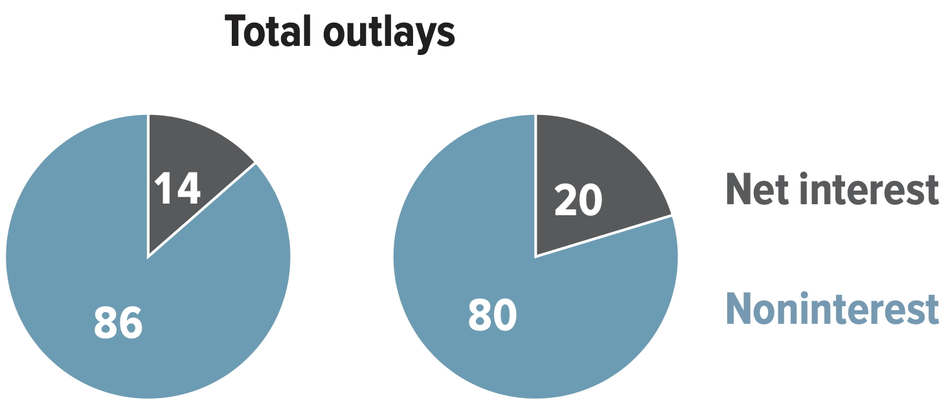
Interest Will Grow as a Share of the Deficit
Primary
Interest
2025 2055
Source: CBO 2025 Long Term Budget Outlook

Slide 37
Mandatory Spending: Other (13%)
Food and agriculture
Veterans’ Benefits
Transportation
Other

Slide 38
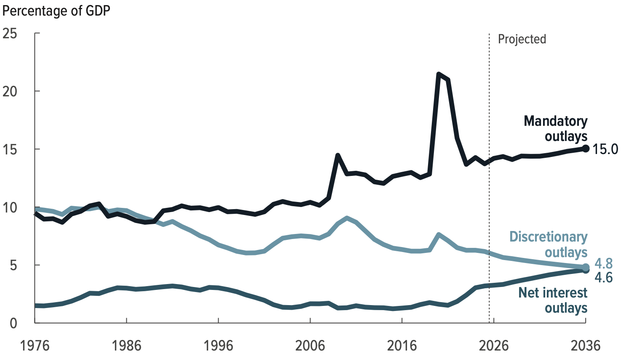
Mandatory Spending Dominates Projections
Outlays, by Category
Source: Congressional Budget Office, The Budget and Economic Outlook: 2026 to 2036

Slide 39
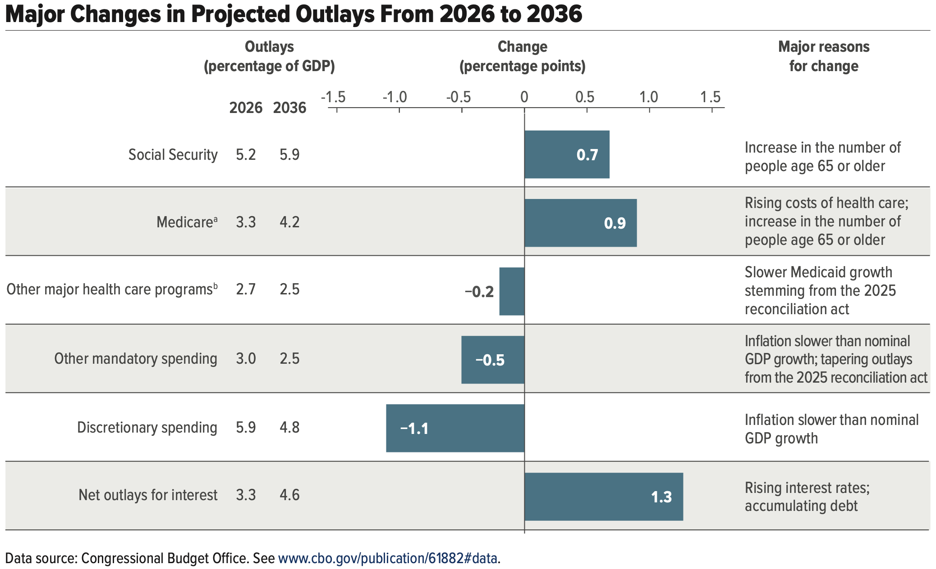
Aging and Health Care Costs

Slide 40
Summary: Spending
Total Federal Spending: $7.0 Trillion in FY 2025 (+Tax Expenditures)
There is remarkably little discretion in each budget:
  Mandatory: 74%
  Discretionary 26%
Fastest growing parts of the budget: Health Care and Interest
By 2056:
  Debt is forecast to grow to 175% of GDP, from more than 100% now
  Interest payments are forecast to grow from 14% to 20% of budget

Slide 41
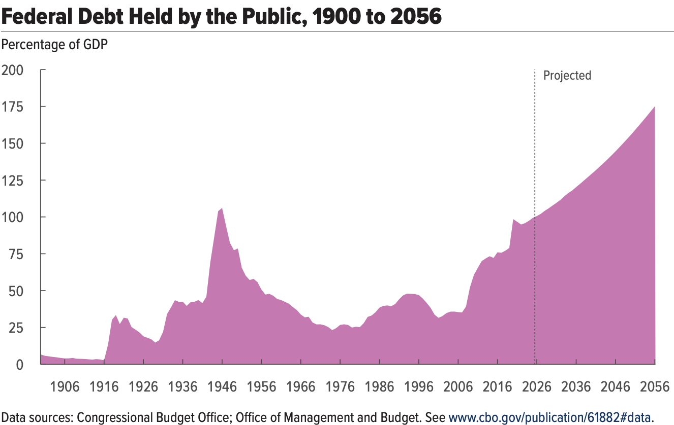
Projections Aren’t Good
175%
100%
Source: Congressional Budget Office, The Budget and Economic Outlook: 2026 to 2036

Slide 42
Tax Expenditures (Deductions)

Slide 43
Another Category of Spending: Tax Expenditures
Description
  Social policies that are implemented and paid for through the tax code.
List of the largest tax breaks:
  Mortgage interest deduction - Low tax rates for Capital Gains
  Retirement contributions - Child related tax credits
  State and local taxes - Charitable gifts
  Health insurance - Lifetime Learning
Evidence of who they benefit
  Regressive

Slide 44
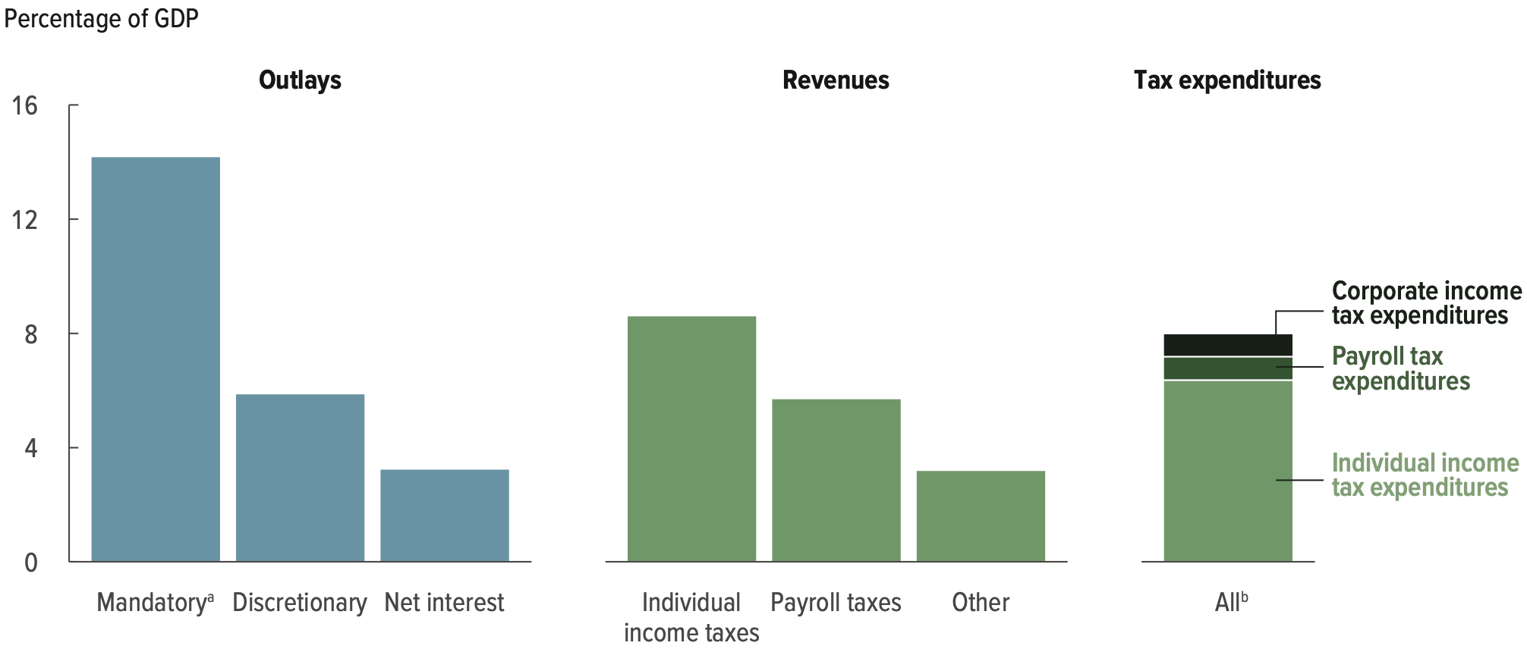
Tax Expenditures are Significant (2025)
$2.2 Trillion 200 different categories
7.3% of GDP and more than Discretionary Spending
Source: Congressional Budget Office, The Budget and Economic Outlook: 2026 to 2036

Slide 45
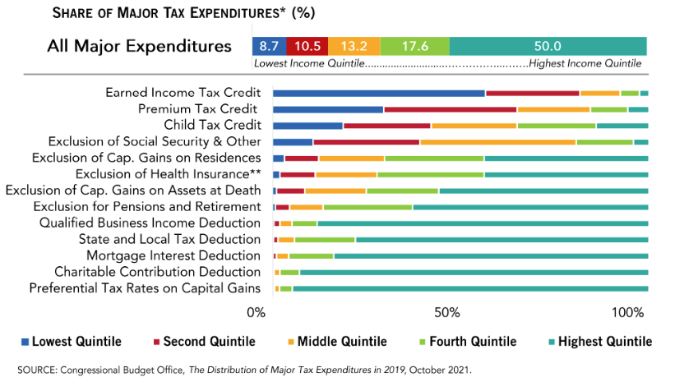
What Are Tax Expenditures?
Total: About $2.2 TRILLION in 2025
Source: https://www.pgpf.org/Chart-Archive/0199_distribution_tax_expenditures

Slide 46
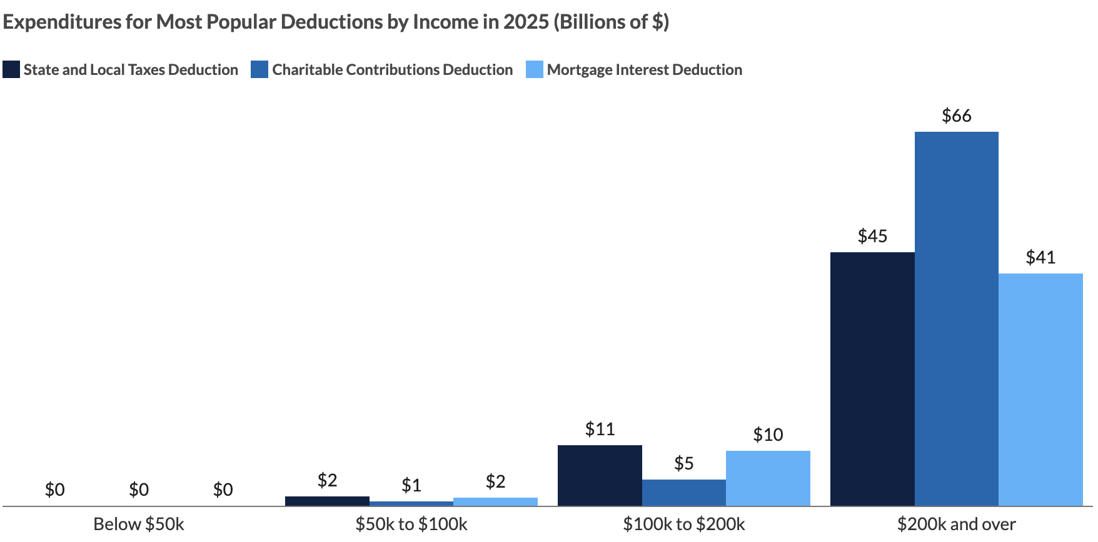
Distributional Effects of Tax Expenditures
Source: Peter G. Peterson Foundation. Pgpf.org

Slide 47
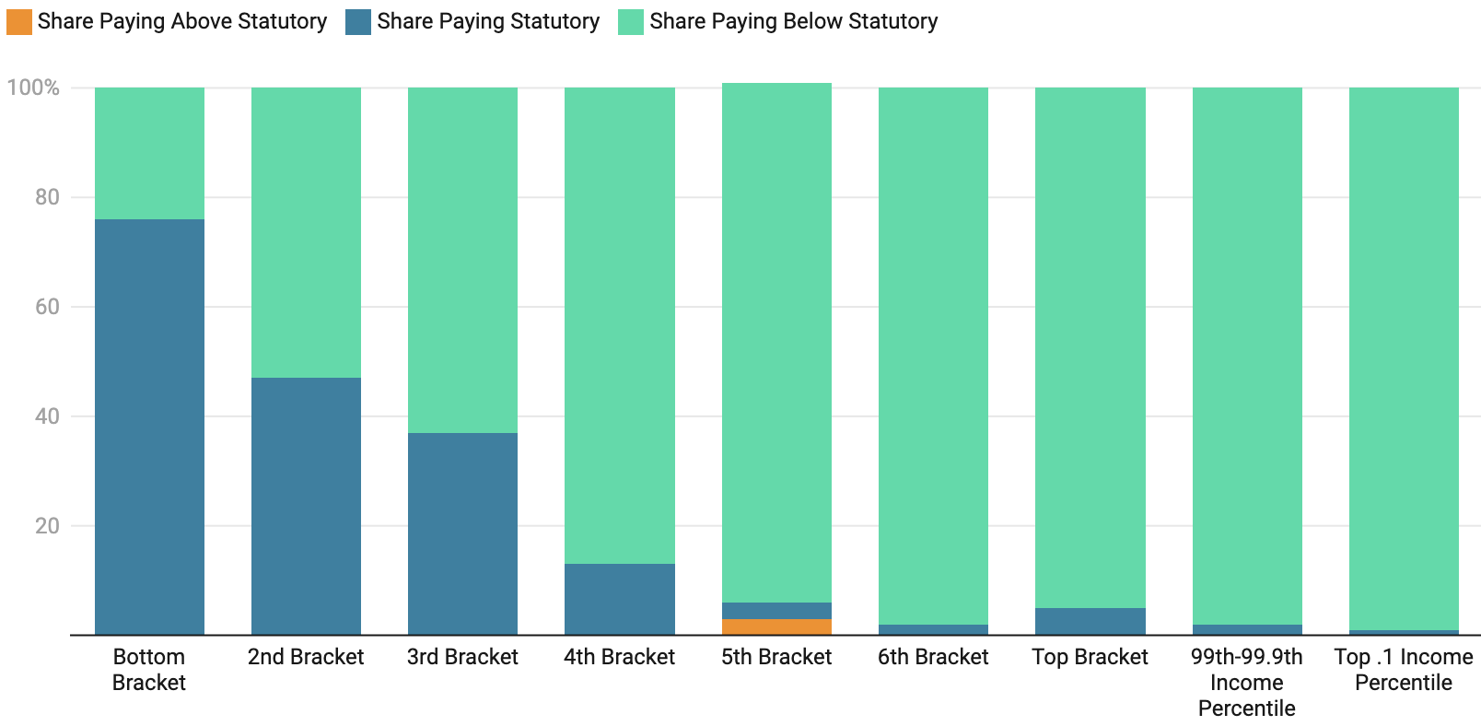
Harder to Exploit with Little Income
https://budgetlab.yale.edu/research/who-paying-their-fair-share-taxes-new-analysis-and-interactive-tool

Slide 48
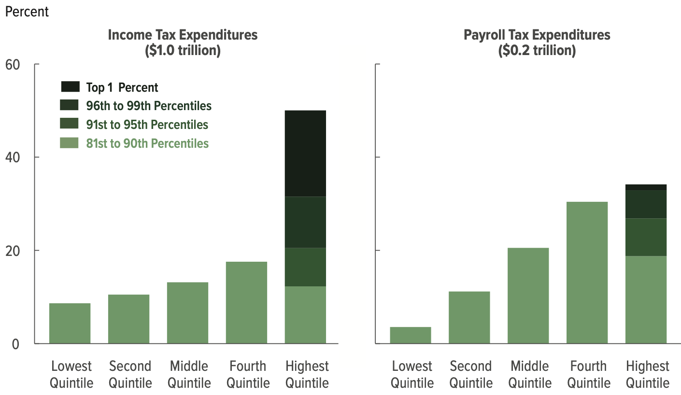
Distributional Effects of Tax Expenditures
Shares of Combined Major Tax Expenditures

Slide 49
Distributional Effects of Tax Expenditures

Slide 50
Summary: Tax Expenditures
…Are policy enacted through the tax code.
  But are no different from spending programs.
…Are not explicitly on the books.
…Add > 25% to budget deficit.
…Reduce the progressive nature of the tax code.
…Are larger than all of “Discretionary Spending”.

Slide 51
Summary: Overall
Expenditures significantly exceed revenues.
  Ongoing deficit/debt problem.
Tax revenues, both income and corporate, have been significantly eroded in recent years.
Balancing the budget must include attention to tax expenditures.
Tariff revenue has very little capacity to:
  Solve deficit problem.
  Replace the income tax.

Slide 52

Main Economic Institutions: Alan Deardorff
Notes:
https://sbhshgovapmacro.wordpress.com/2011/06/02/international-institutions/

Slide 53
Thank you!
Any Questions?
www.NEEDEcon.org
Jon Haveman, Ph.D.
Jon@NEEDEcon.org
Contact NEED: info@NEEDEcon.org
Submit a testimonial: www.NEEDEcon.org/testimonials.php
Become a Friend of NEED: www.NEEDEcon.org/friend.php

Slide 54
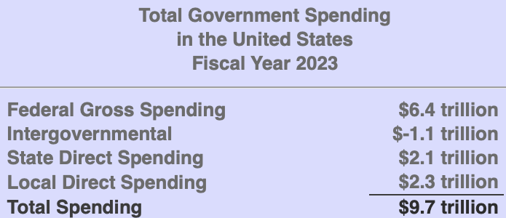

Slide 55
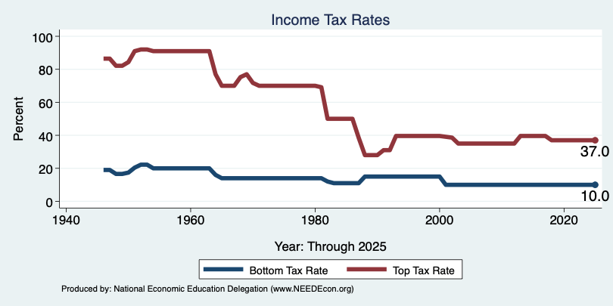
Tax Rates Over Time

Slide 56
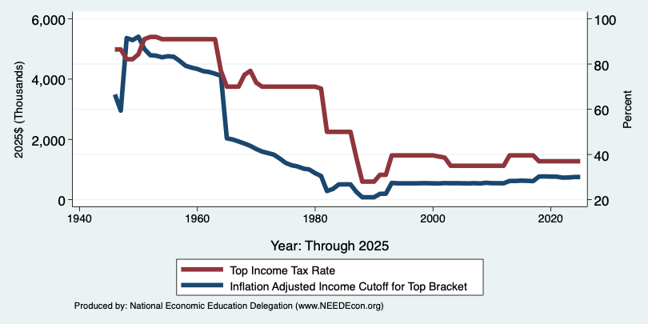
The Top Tax Rate and Income Cutoff
Massive tax cut for those with
More than $4 million in income.
And for those with more than
About $200,000 in income.

Slide 57
Average Tax is a Bit More Complicated
Is ability to pay better measured by taxable income, or before tax income?
Remember tax expenditures.
But not all tax expenditures are bad: medical expense deductibility.
In judging inequality you have to look at the effect of transfers as well as all taxes.
No perfect answers

Slide 58
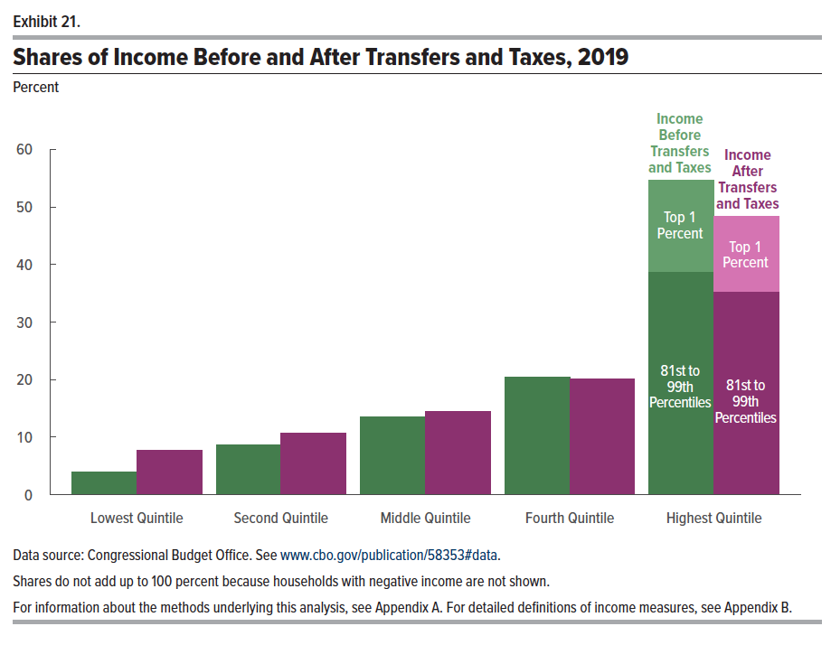
Federal Taxes and Transfers

Slide 59
Income Quintiles in 2019
Average Income within the quintile:
$17,200
$39,600
$67,500
$108,700
$318,900
At the top:
  81-90, $166,600;
  91-95, $236,700;
  96-99, $403,600;
  top 1%, $1,983,700

Slide 60
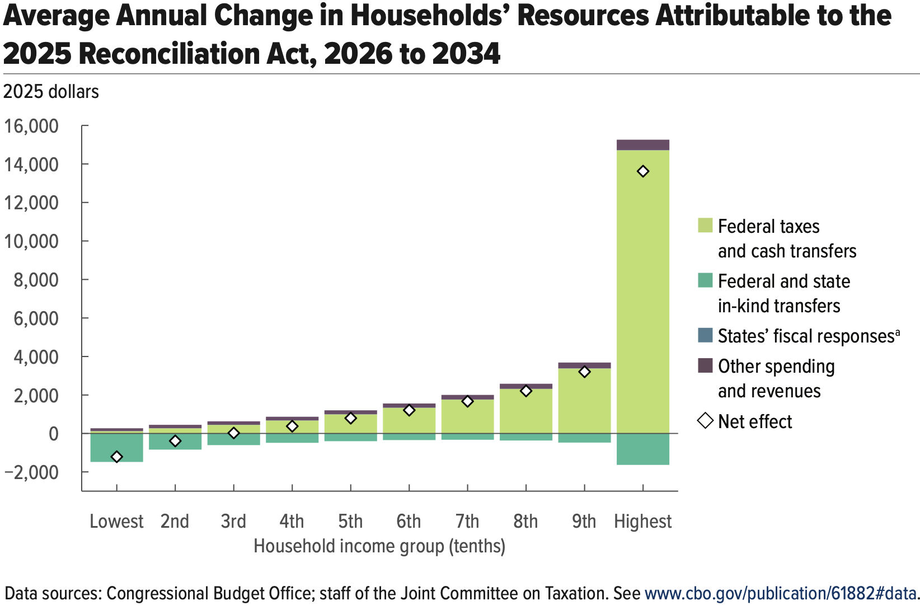

Slide 61
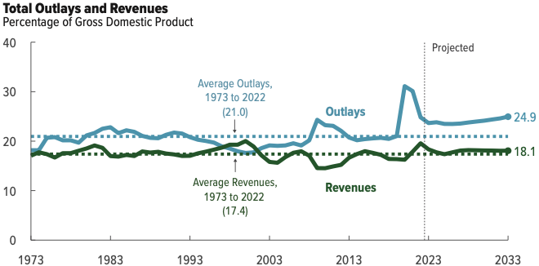
Summary: Past and Future Budgets
Source: Congressional Budget Office, The Budget and Economic Outlook: 2022 to 2032

Slide 62
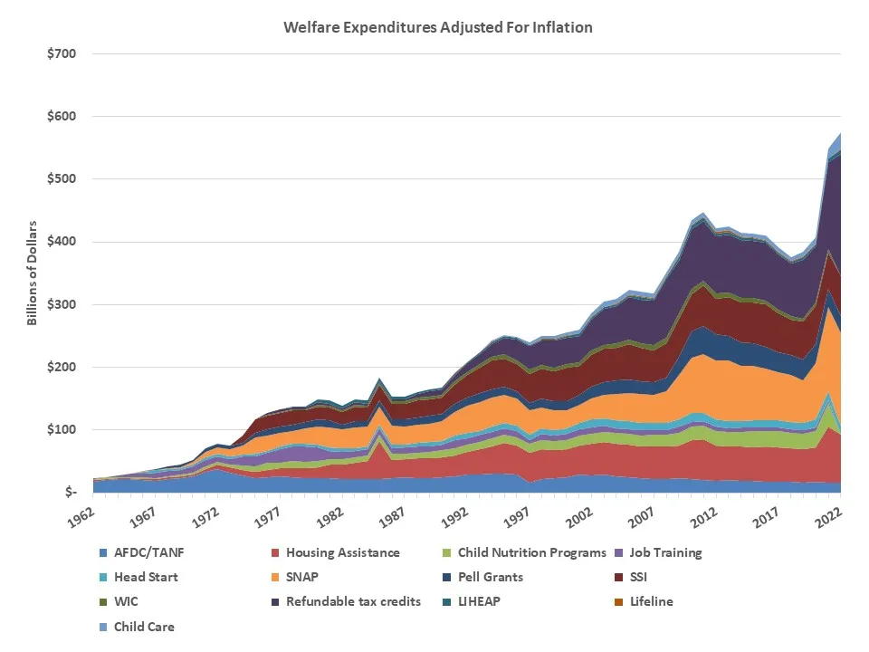
Safety Net Expenditures
Adjusted for Inflation

Slide 63
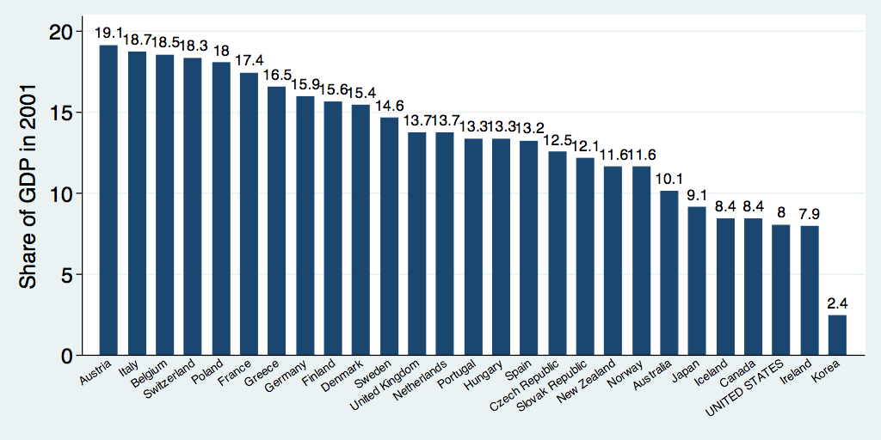
Safety Net Spending Across the OECD
U.S.: 8%
Source: World Bank Social Safety Nets Primer Notes
Notes:
http://siteresources.worldbank.org/SAFETYNETSANDTRANSFERS/Resources/281945-1124119303499/SSNPrimerNote25.pdf

Slide 64
Citizen’s Guide To Government Shutdown
Federal fiscal year: Oct 1– Sep 30
Action needs to be taken to fund key government services before the end of the fiscal year.
In fall 2023...
  Senate – bipartisan agreement (Temporary)
  House – disarray….

Slide 65
Implications (1)
Families Will Get Cut Off from Food Assistance Programs
Kids May Lose Access to Head Start
Critical Services like Disaster Preparedness and Response Will Be Interrupted

Slide 66
Implications (2)
Servicemembers and Law Enforcement Officers Will Work Without Pay
Access to our National Parks May Be Shut Off
Small Businesses Will Not Get New Loans from the SBA
Travelers May Face Significant Delays

Slide 67
Solutions?
Usually “continuing resolutions”.
  Keep spending as we were this year.
  Extends last year’s budget into next year.
Others?
  Your guess is as good as mine.

Slide 68
Economic Implications?
Short closure? None (well, vanishingly small)
Long term?
  Could grow to be significant.
  Essentially, a cut in government spending.
    Drag on economic growth.
    Fuel the potential for a recession, along with:
      high interest rates
      UAW strike
Other: Ukraine War Funding

Slide 69
Where Do Social Security Funds Come From?
Payroll taxes
  Tax rates:
    Employee: 6.2%
    Employer: 6.2%
    Self Employed: 12.4%
  Cap in 2024: $168,600
Taxes on OASDI benefits
  Not all benefits are taxed.
Interest earnings
Key Question:
Who pays?

Slide 70
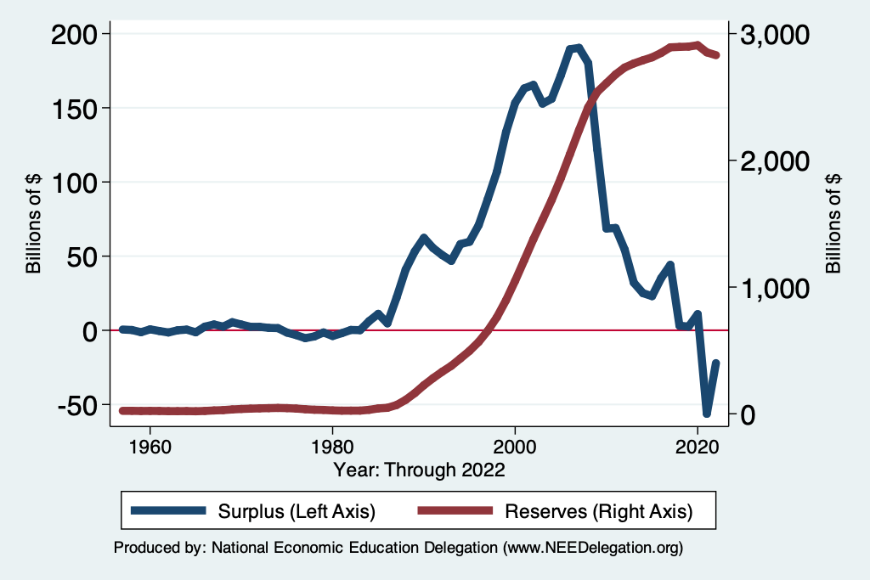
Social Security Trust Fund
Spending in 2022
  OASI: $1,097 billion
  DI: $147 billion
Income in 2022
  OASI: $1,057
  DI: $165
Surplus in 2022
  OASI: $-41
  DI: $19
Total Deficit: $22 Billion
Source: https://www.ssa.gov/OACT/TRSUM/index.html

Slide 71
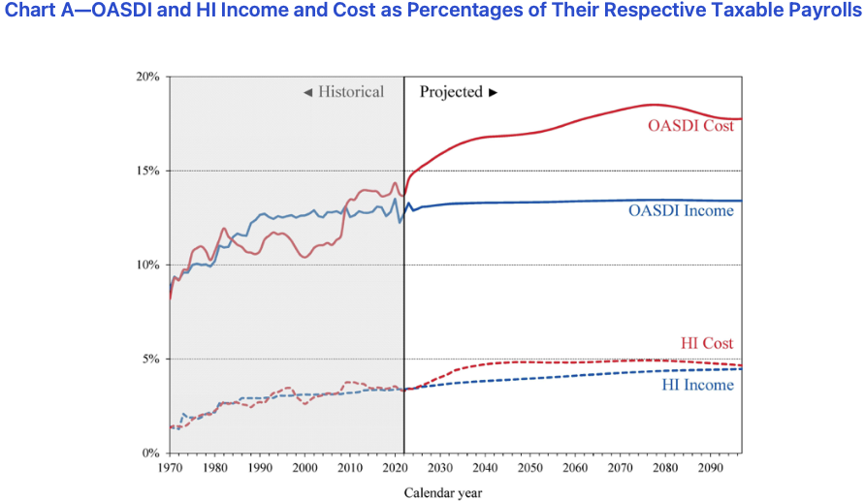
Deficits As Far As the Eye Can See
Trust Fund Solvency
  Annual deficits after 2019
  Fund insolvent after 2036
SOURCE: 2019 Annual Report of the Board of Trustees of the Federal Old-Age and Survivors Insurance and Disability Insurance Trust Funds, Table IV.B1

Slide 72
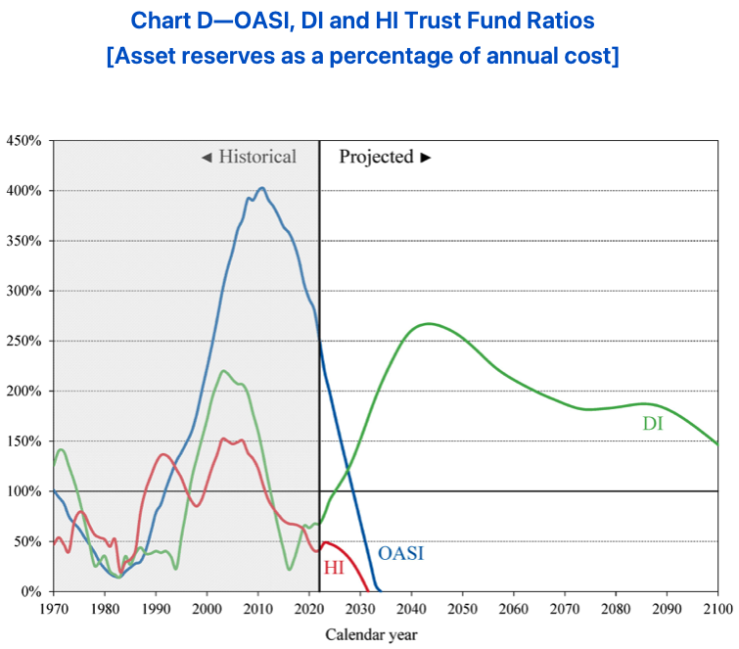

Slide 73
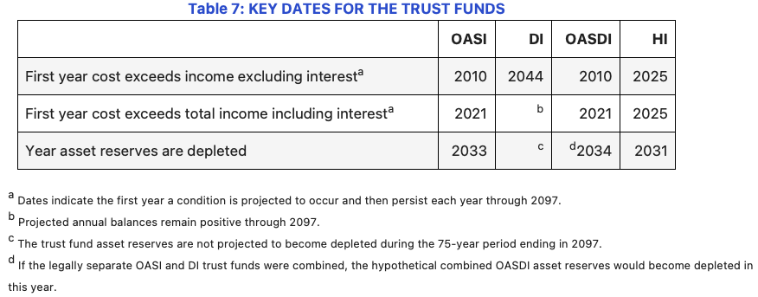

Slide 74
Options for Eliminating the Soc Sec Deficits
Problem is 1-1.5% of GDP
Raise the retirement age.
Increase the tax rate.
  4 percentage pt. increase raises 0.6% of GDP.
Raise the amount of income subject to tax.
  Tax all wages raises 1.1% of GDP.
Reduce benefits.
  21% cut in benefits by 2036 would be necessary.

Slide 75
Medicare Finances in 2021
Part A:
  Income in 2021: $342 billion
  Expenses in 2021: $402 billion
  Deficit: $60 billion
Part B and Part D:
  Income in 2021: $558 billion
  Expenses in 2021: $524 billion
  Surplus: $24 billion
Long term sustainability:
  Deficits began in 2016
  Part A Trust Fund depleted by 2026.
SOURCE: 2021 Annual Report of the Board of Trustees of the Federal Hospital Insurance and Supplementary Medical Insurance
Trust Funds

Slide 76
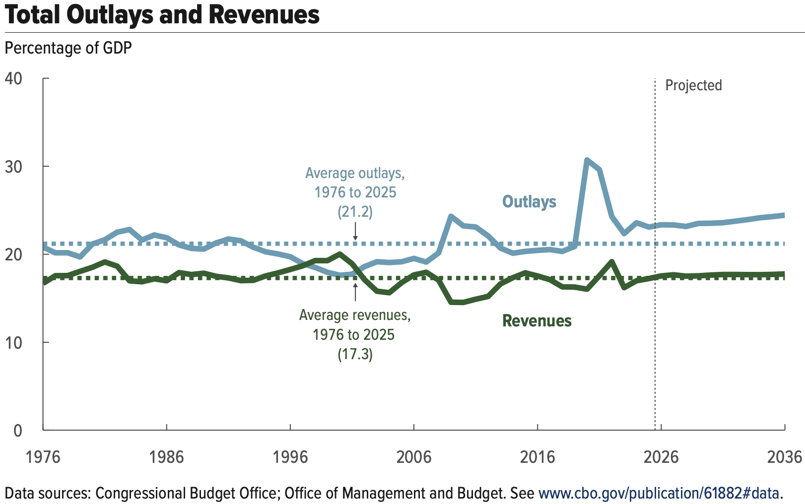
Projections Aren’t Good
Source: Congressional Budget Office, The Budget and Economic Outlook: 2026 to 2036

