Slide 1
The US Federal Budget
OLLI-Arizona State University
December 12, 2022
Geoffrey Woglom
Professor of Economics, emeritus, Amherst College

Slide 2
National Economic Education Delegation
Vision
  One day, the public discussion of policy issues will be grounded in an accurate perception of the underlying economic principles and data.
Mission
  NEED unites the skills and knowledge of a vast network of professional economists to promote understanding of the economics of policy issues in the United States.
NEED Presentations
  Are nonpartisan and intended to reflect the consensus of the economics profession.

Slide 3
Who Are We?
Honorary Board: 54 members
  2 Fed Chairs: Janet Yellen, Ben Bernanke
  6 Chairs Council of Economic Advisers
    Furman (D), Rosen (R), Bernanke (R), Yellen (D), Tyson (D), Goolsbee (D)
  3 Nobel Prize Winners
    Akerlof, Smith, Maskin
Delegates: 652+ members
  At all levels of academia and some in government service
  All have a Ph.D. in economics
  Crowdsource slide decks
  Give presentations
Global Partners: 49 Ph.D. Economists
  Aid in slide deck development

Slide 4
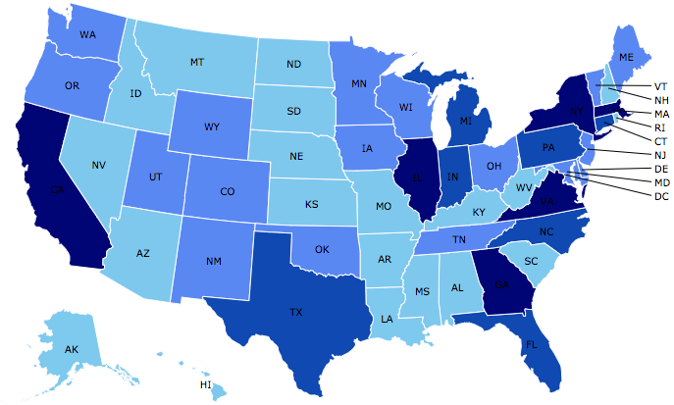
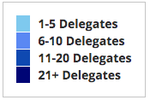
Where Are We?

Slide 5
Credits and Disclaimer
This slide deck was authored by:
  Jon Haveman, NEED
  Geoffrey Woglom
Disclaimer
  NEED presentations are designed to be nonpartisan.
  It is, however, inevitable that the presenter will be asked for and will provide their own views.
  Such views are those of the presenter and not necessarily those of the National Economic Education Delegation (NEED).

Slide 6
What Does the U.S. Gov’t Budget Look Like?
Fiscal Year 2022 Budget Summary
Revenue | Billions |  | Expenditures | Billions
Income Taxes | $2,632 |  | Mandatory | $4,010*
Payroll Taxes | $1,484 |  | Discretionary | $1,787*
Corporate Taxes | $425 |  | Interest | $475
Other | $356
Total | $4,896 |  | Total | $6,272
19.8%
25.4%
Budget Deficit: $1,375 Billion
5.5%
Source: Monthly Treasury Statement. 9/22 . *Estimates based on OMB Forecasted Breakdown
Notes:
https://www.cbo.gov/publication/53627
https://www.cbo.gov/publication/53624

Slide 7
Outline
Government Spending
Government Revenues
Citizen’s Guides
  Trump Tax Cuts
  Budget Reconciliation Games
  The Debt Ceiling
  Budget Options

Slide 8
U.S. Government Spending

Slide 9
Government Is a Large Portion of the Economy
Spending Totals are at Annual Rates, source BEA

Slide 10
Some Important Distinctions
Government Expenditures in GDP include both Federal and State and Local.
In 2021 (latest data), of the $4,487b of government expenditures in GDP
  $1,657b, or 37% are from the Federal Government.
  $2,380b, or 63% are from State and Local governments,
From here on, we will only be concerned with the Federal Budget.

Slide 11
Expenditures on GDP vs. Total Spending
Expenditures on GDP are government purchases of final goods and services, and use up national resources.
Government Spending on transfers such as Social Security payments and interest payments do not use up resources.
Total government spending (or outlays) are Government expenditures on GDP plus transfers plus net interest on the debt.

Slide 12
The Importance of Transfers
For Fiscal Year 2022, the CBO projects $1,585b federal expenditures on GDP; transfers, $3,888b and net interest of $399b.
Why it matters: During Fiscal Year 2021 National Defense was $782b, or
  Dove: 49% of Federal expenditures on GDP.
  Hawk: 13% of total Federal spending.
Source: CBO Budget projection Data

Slide 13
The Budget Details
Source: Monthly Treasury Statement. 9/22

Slide 14
One Last Distinction:
Mandatory vs. Discretionary Spending:
  Discretionary Spending requires annual appropriations, e.g., most of Defense.
  Mandatory Spending is ongoing authorization to spend mostly on “entitlements:” such as Social Security and Medicare.
CBO Projects for 2022, Mandatory + Net Interest was 71%; Discretionary 19%.
CBO Budget projection Data

Slide 15
“Mandatory” Spending + Interest
71% of Total Spending

Slide 16
Mandatory : Social Security (18% of Total Spend)
Retirement
  Covers 96% of US workers.
Survivors
  A worker's spouse and dependents may be eligible for survivors' benefits if the worker dies.
Disability
  A medical condition expected to last at least one year or to be fatal.

Slide 17
Where Do Social Security Funds Come From?
Payroll taxes
  Tax rates:
    Employee: 6.2%
    Employer: 6.2%
    Self Employed: 12.4%
  Cap in 2023: $160,200
Taxes on OASDI benefits
  Not all benefits are taxed. Up to 85% of benefits are taxable income.
Interest earnings not taxed
Key Question:
Who pays?

Slide 18
Social Security Trust Fund
Spending in 2021
  OASI: $1,002 billion
  DI: $146 billion
Income in 2021
  OASI: $943
  DI: $172
Surplus in 2021
  OASI: $-59
  DI: $3
Total Deficit: $56 Billion
Source: https://www.ssa.gov/OACT/TRSUM/index.html

Slide 19
Trust Fund Solvency?
Trust Fund Balances
  Annual projected deficits lead to the exhaustion of the Trust Fund in 2032.
  Under current law, benefits will continue to be paid equal to OASDI income.
  This amounts to about 80% of current benefits.
SOURCE: 2021 Annual Report of the Board of Trustees of the Federal Old-Age and Survivors Insurance and Disability Insurance Trust Funds, Table IV.B1

Slide 20
Mandatory Spending: Medicare (13%)
Part A: Hospital Insurance
Part B: Physician, outpatient, home health, and other services.
Part D: Subsidized access to pharmaceuticals.
Part C: Medicare Advantage Plans – offered by private companies approved by Medicare.
  Medicare Advantage Plans may offer extra coverage, such as vision, hearing, dental, and/or health and wellness programs. But, you must receive referrals within network.

Slide 21
Medicare Finances in 2021
Part A:
  Income in 2021: $342 billion
  Expenses in 2021: $402 billion
  Deficit: $60 billion
Part B and Part D:
  Income in 2021: $558 billion
  Expenses in 2021: $524 billion
  Surplus: $24 billion
Long term sustainability:
  Deficits began in 2016
  Part A Trust Fund depleted by 2026.
SOURCE: 2021 Annual Report of the Board of Trustees of the Federal Hospital Insurance and Supplementary Medical Insurance
Trust Funds

Slide 22
Where Do Medicare Funds Come From?
Payroll taxes
  Tax rates:
    Employee: 1.45%
    Employer: 1.45%
    Self Employed: 2.9%
  No Income Cap
Interest earnings
General revenues
Beneficiary premiums: Parts B & D

Slide 23
Mandatory Spending: Medicaid (10%)
Medicaid provides medical insurance for those whose income and resources are insufficient to pay for health care.
It is a program with costs shared with the states.
Amount spent in FY 2022: $838 Billion
  Federal: 70% or $589 Billion
  States: 30% $249 Billion
People served in 2022: 83 million (24% of Americans)
Sources: CBO, Budget Projections, NASBO, State Expenditure Survey, and Medicaid.gov

Slide 24
Mandatory Spending: Income Security (10%)
EITC
SNAP
SSI
TANF
Housing
WIC
School Lunches
Head Start

Slide 25
Mandatory Spending: Interest
Interest costs in 2022: $399 Billion
  1.6% of GDP, or 7% of the Federal Budget
Forecast to increase to $1,323 Billion in 2052
  7.2% of GDP, or 24% of the Federal Budget
Source: CBO, July 2022 Long-term Budget Projections

Slide 26
Mandatory Spending: Other (13%)
Food and agriculture
Veterans’ Benefits
Transportation
Other

Slide 27
Discretionary Spending
29% of Total Spending

Slide 28
Discretionary Spending: Other (25%)
Category | Amount (Millions)
Energy | 26,300
Agriculture | 17,219
Medicare | 7,788
General government | 21,101
General science, space and tech | 38,165
Veteran’s Benefits | 111,467
Housing Assistance | 57,031
Community Development | 39,179

Slide 29
Mandatory Spending Dominates Projections
Source: Congressional Budget Office, The Budget and Economic Outlook: 2022 to 2032

Slide 30
Aging and Health Care Costs
Source: Congressional Budget Office, The Budget and Economic Outlook: 2022 to 2032

Slide 31
Another Category of Spending: Tax Expenditures
Description
  Social policies that are implemented and paid for through the tax code.
List of the largest tax breaks:
  Mortgage interest deduction - Low tax rates for Capital Gains
  Retirement contributions - Child related tax credits
  State and local taxes - Charitable gifts
  Health insurance - Lifetime Learning
Evidence of who they benefit
  Regressive

Slide 32
Tax Expenditures are Significant
Over $2 Trillion 200 different categories
8.3% of GDP and more than Discretionary Spending
Source: Congressional Budget Office, The Budget and Economic Outlook: 2022 to 2032

Slide 33
Distributional Effects of Tax Expenditures

Slide 34
US Government Revenues

Slide 35
International
Comparison
OECD Avg. 33.5%

Slide 36
Where Do Federal Revenues Come From?
Most Federal revenues are raised on earned income.
Notes:
Most income taxes are on income.

Slide 37
Individual Income Taxes
Marginal tax rates
Not all income is subject to the same tax rates
  capital gains
Deductions
  Talked about as Tax Expenditures

Slide 38
Marginal Tax Rates: Married Filing Jointly (2022)
Income Above | Tax Rate
0 | 10%
20,550 | 12%
83,550 | 22%
178,150 | 24%
340,100 | 32%
431,900 | 35%
647,850 | 37%
Taxable Income is taxed differently at different levels.
Individuals are taxed the same way, regardless of overall taxable income:
  First dollar is taxed at 10%
  20,551st dollar is taxed at 12%

Slide 39
Marginal and Average Tax Rates
Example Tax on $1 million in taxable income:
Marginal Tax rate is 37%
Average Tax rate is Less:
=.1(20,550)+.22(83,550-20,551)+…+.37(1,000,0000=-647,851)= $304,548, or an average tax rate on taxable income is 30.5%
The higher taxable income the closer the average tax gets to 37%

Slide 40
History of the Top Marginal Rate
The 91% rate in 1963 applied to couple’s income of about $1.4 million in today’s $s.
Don’t forget the marginal average distinction.
I agree with Ronnie; 91% is too high.

Slide 41
Progressivity Tax System
Tax Systems are:
  Progressive: increasing average tax with income
  Neutral or flat: same share of income at all income levels
  Regressive: decreasing average tax with income (sales tax)
Ability to pay rises with income.
Income Inequality.

Slide 42
Average Tax is a Bit More Complicated
Is ability to pay better measured by taxable income, or before tax income?
Remember tax expenditures.
But not all tax expenditures are bad: medical expense deductibility.
In judging inequality you have to look at the effect of transfers as well as all taxes.
No perfect answers

Slide 43
Income Quintiles in 2019
Average Income within the quintile:
$17,200
$39,600
$67,500
$108,700
$318,900
81-90, $166,600; 91-95, $236,700; 96-99, $403,600; top 1%, $1,983,700

Slide 44
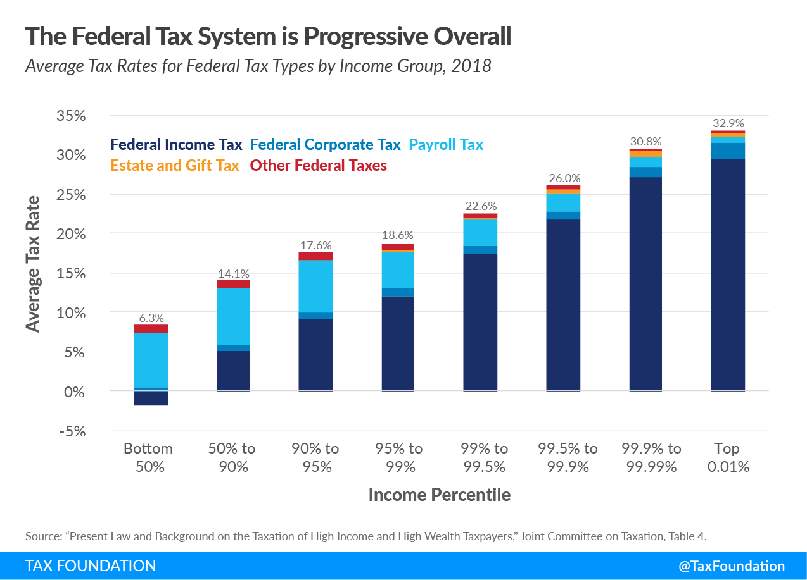
All Federal Taxes

Slide 45
All Taxes

Slide 46
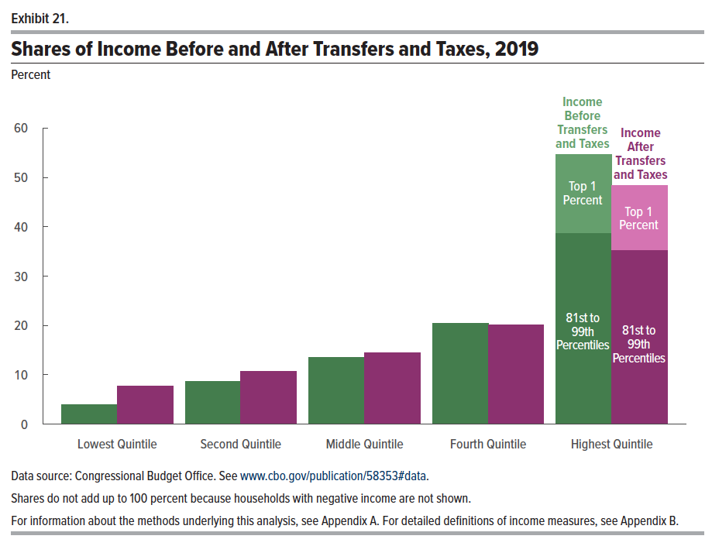
Federal Taxes and Transfers

Slide 47
The Bottom 40% Don’t Pay Income Taxes?
There is a common narrative that the bottom 40% don’t pay income taxes.
But they pay other taxes and they also pay state and local taxes
  Payroll
  State and local taxes
  Excise taxes – see the slide 4 slides ago.
But, previous slide shows that the bottom 60% are net beneficiaries of Federal tax and transfer system.
Is that bad?

Slide 48
Revenue Sources: Share of GDP over Time
Source: Congressional Budget Office, The Budget and Economic Outlook: 2022 to 2032

Slide 49
Summary: Past and Future Budgets
Source: Congressional Budget Office, The Budget and Economic Outlook: 2022 to 2032

Slide 50
Summary: Slide 1
Total Federal Spending: $4.9 Trillion in FY 2022
There is remarkably little discretion in each budget:
  Mandatory: 71%
  Discretionary 29%
Fastest growing parts of the budget: Health Care and Interest
By 2052:
  Debt is forecast to grow to 185% of GDP, from 98% now
  Interest payments are forecast to grow from 7% to 24% of budget

Slide 51
Summary Slide1a: Tax Expenditures
…Are policy enacted through the tax code.
…Are not explicitly on the books.
…Add > 25% to budget deficit.
…Reduce the progressive nature of the tax code.
…Are larger than all of “Discretionary Spending”.

Slide 52
Summary: Slide 2
Most Federal Revenues come from taxes on earned income.
Tax and Transfer System is modestly progressive, particularly at the lowest quintile.
Both these statement are true:
  Top 20% of earners pay 2/3rds of total taxes.
  But, this is only slightly more than their share of pre-tax income, 62%

Slide 53
Citizen’s Guide: Trump Tax Cuts (TCJA, 12/17)
Individual Income Taxes
  Lowered “marginal rates.”
  Eliminated personal exemptions, but raised standard deduction to $24,000 for couple. (currently, $25,900)
  Limited deductibility of State and Local taxes to $10,000.
  Most provisions “sunset” after 2025.
Corporate Income Tax (permanent)
  Lowers statutory rate from 35% to 21%
  Cuts interest deductibility; provides investment incentives for 5 years.
  Attempts to eliminate “corporate inversions.”
Estate Taxes: Doubles exemption to $22.4 million for a couple (currently, $24.1)

Slide 54
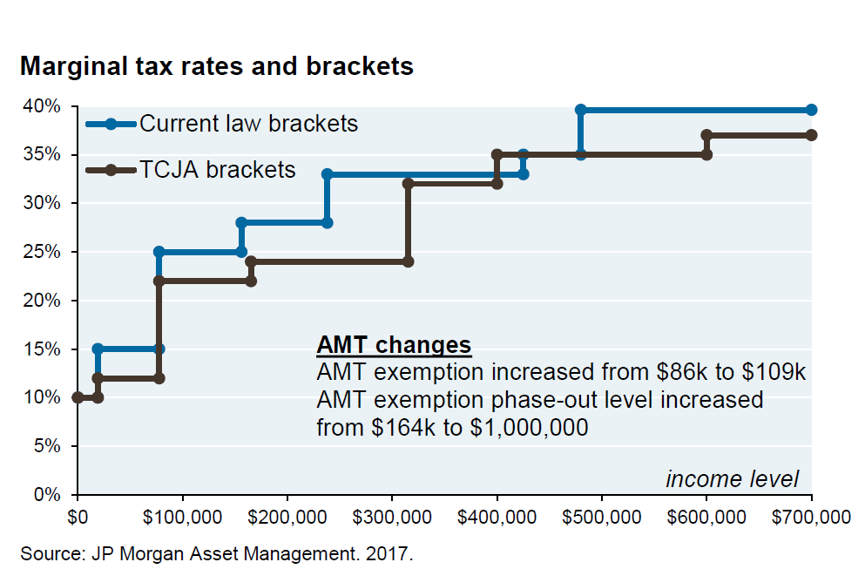
Change in 2018 Marginal Tax Rates

Slide 55
Effect on Itemized Deductions
From the Tax Foundation

Slide 56
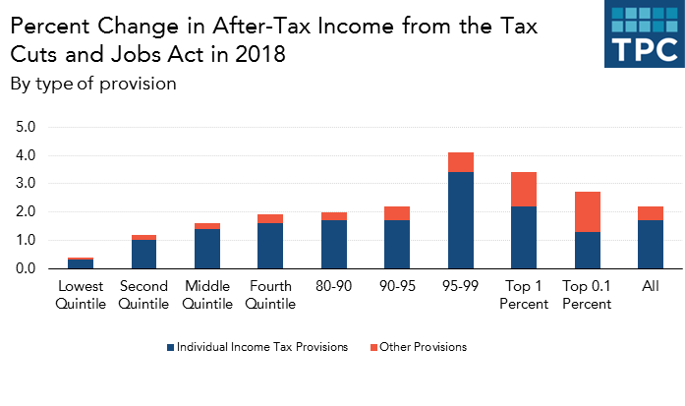
Distributional Effects of TCJA
Top 20% got almost 2/3rds of the benefit!
But, Top 20% get over 80% of all income

Slide 57
Citizen’s Guide to “Budget Reconciliation.”
Procedure successfully used 22 times since 1974 to avoid a Senate filibuster.
Reconciliation can be used for changing taxes and mandatory spending (not Social Security) subject to the Byrd Rule.
Byrd rule:
  No extraneous provisions.
  No increase in the deficit after 10 year window.
Reconciliation games played by both parties:
  Trump Tax Cut.
  Build Back Better.

Slide 58
Reconciliation and CBO Projections
For the CBO to be effective it must be perceived to be (and must be) nonpartisan.
Therefore, CBO “baseline” projections and legislative scoring must not try to predict changes in legislation.
Instead, CBO must analyze the data based on the current law as written.
CBO is allowed to provide analyses of policy options.
Notes:
One exception: assumes SS will be paid

Slide 59
Example: Trump Tax Cut
Most provisions “sunset” after 2025

Slide 60
CBO Scores Build Back Better
 | 2022-2026 | 2027-2031
Outlays | 940,933 | 695,055
Revenues | 149,315 | 1,119,549
Deficit | 791,618 | -424,494
In addition there was an unscored “revenue enhancement” of $207b from greater IRS funding.
https://www.cbo.gov/publication/57627

Slide 61
Citiizen’s Guide to the Debt Ceiling
Pre 1917:
Constitution provides Congress with the power to borrow. Congress must authorize specific borrowing.
Post 1917:
In 1917, Congress passes a law that transfers its power to borrow to the Treasury to provide flexibility to finance World War 1, but imposes a limit.
1953: Democrats threaten to use the debt ceiling to prevent Eisenhower’s Interstate Highway program.
1995: Newt Gingrich threatens to use the debt ceiling, but backs down in 1996.
2011: Debt ceiling standoff causes S&P500 to downgrade US debt from AAA to AA leading to stock market decline and increase in borrowing costs.
2023: At some point we will hit the debt ceiling

Slide 62
Debt Ceiling
Congress already has the power through the budget process to limit borrowing.
Is it Constitutional for Congress to legislate taxing and spending that leads to borrowing above the ceiling?
Republicans have offered the elimination of the debt ceiling in exchange for limits on entitlements.
Biden in October: Eliminating the debt ceiling would be “irresponsible.”
Minting $1 trillion dollar coin!

Slide 63
Budget Options to deal with the Debt
CBO “baseline” projections suggest unsustainable increases in debt and deficits.
CBO projects that to stabilize the current debt-to GDP ratio the deficit needs to be reduced by 2025 by 2.9 percentage points, or $730 billion per year.
Last week CBO published budget options (its not pretty):
Source: Congressional Budget Office, The 2020 Long-term Budget Outlook, 9/2020

Slide 64
Do Any of these Strike Your Fancy?
Remember:
We need $730 billion
per year!
https://www.cbo.gov/publication/58164

Slide 65
On That Happy Note:
Your Questions?
grwoglom@amherst,edu
Geoffrey Woglom
Contact NEED: Info@NEEDelegation.org
Slides will be available at: https://needelegation.org/delivered_presentations.php

