Slide 1
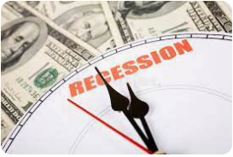
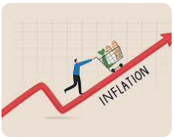
US/Marin Economic Update
San Rafael Leadership Institute
San Rafael Chamber of Commerce
Jon Haveman, Ph.D.
NEED
December 8, 2022

Slide 2
Credits and Disclaimer
This slide deck was authored by:
Jon D. Haveman, NEED
Scott Baier, Clemson University
Geoffrey Woglom, Amherst College (Emeritus)
Brian Dombeck, Lewis & Clark College
Doris Geide-Stevenson, Weber State
Disclaimer
NEED presentations are designed to be nonpartisan.
It is, however, inevitable that the presenter will be asked for and will provide their own views.
Such views are those of the presenter and not necessarily those of the National Economic Education Delegation (NEED).

Slide 3
Outline
Recession – The State of the US Economy
Inflation
Marin’s Economy – mixed in
Summary

Slide 4
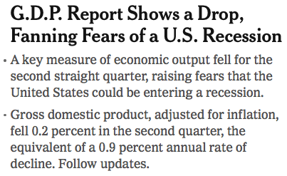
Headline:

Slide 5
GDP: Quarterly Growth
Notes:
Graph: gdp_pot_grow.png
The Point: From 1990 – 2007, average annual US GDP growth pre-crisis is 2.94%. However, post-crisis US GDP growth is 2.19% (0.75 percentage points lower). Why is has the recovery been sluggish?
Note: At the recession’s height, the gap between quarterly GDP growth and potential growth was 2.5 percentage points.

Slide 6
GDP Trajectory: Pandemic Plunge!
GDP is:
$0.3 Trillion below 2019 forecast.
$1.0 Trillion ABOVE 2019-Q4 level.

Slide 7
Marin is Rebounding, but Not Uniformly

Slide 8
Contribution to GDP Growth: Consumption
Notes:
Average GDP growth from 1990-2007 is 2.99% and from 2010+ is 2.19%
Average Consumption contribution from 1990-2007 is 2.16 percentage points and from 2010+ is 1.67 percentage points

Slide 9
Contributions to GDP: Residential Investment
Notes:
Contribution of residential investment to GDP growth has risen post-2009

Slide 10
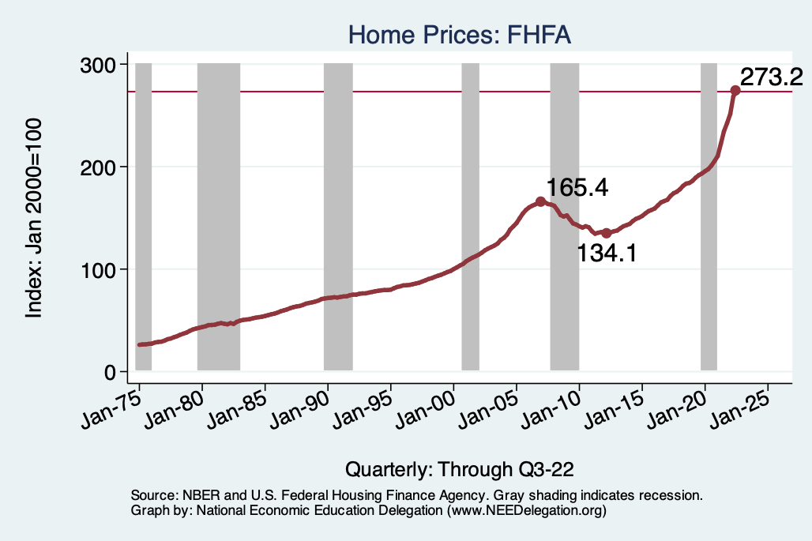
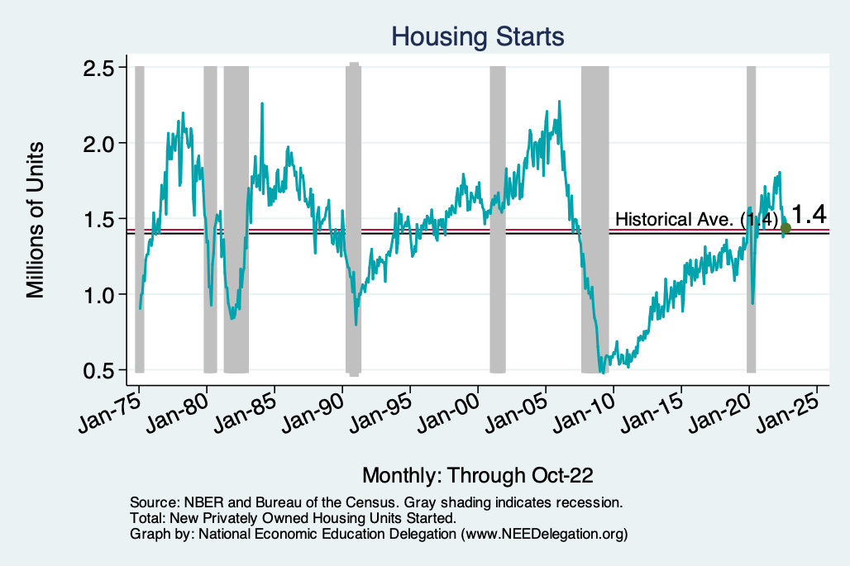
Home Prices and Housing Starts
Notes:
Charts:
homeprices_recession.png
housing.png

Slide 11
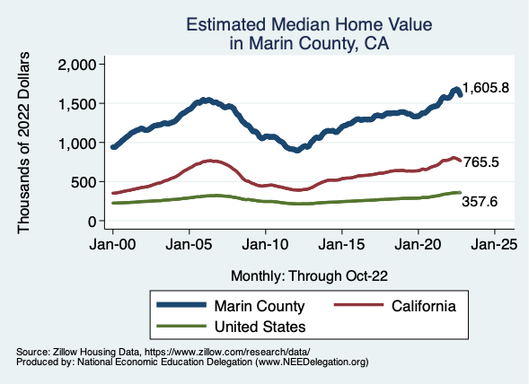
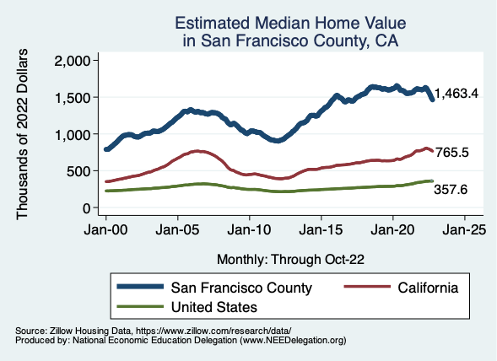
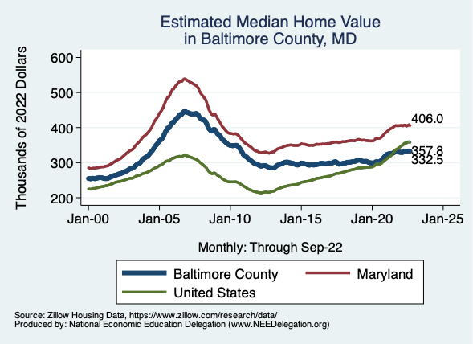
Home Prices … Depends on Where You Are
Notes:
Charts:
homeprices_recession.png
housing.png

Slide 12
Monthly Changes in Nonfarm Employment
October: 284,000
November: 263,000
Notes:
PAYEMS.png

Slide 13
Employment Gap
1.0 Million ABOVE February, 2020.
6.2 Million below where we should be (?).
Notes:
payroll_recent.png

Slide 14
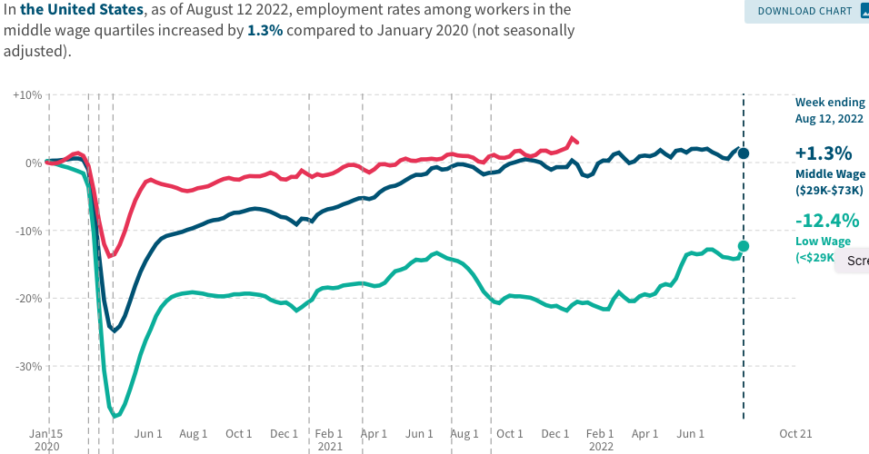
Low Wage Employment is Lagging
Source: https://tracktherecovery.org

Slide 15
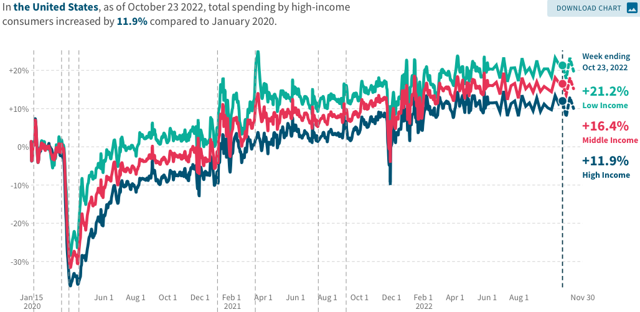
Stimulus Payments Saved Low Wage Workers

Slide 16
Where Have All the Workers Gone?
4.3 million below where we should be

Slide 17
How Are Things in Marin?

Slide 18
Marin’s Primary Employment Industries

Slide 19
How Are They Doing?

Slide 20
Working from Home?

Slide 21
Inflation

Slide 22
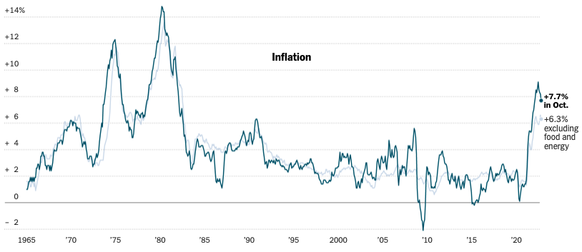
Inflation: Latest Figures
Source: NYTimes.com

Slide 23
Which Prices?
Sep-Oct: +0.4
Aug-Sep: +0.4
July-Aug: 0
June-July: 0

Slide 24
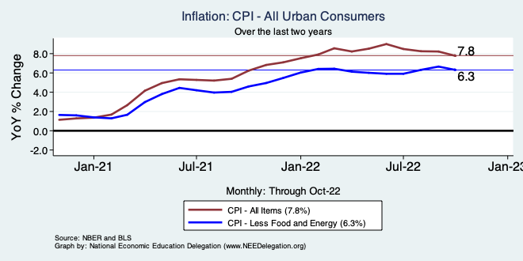
Inflation – Turning Around?
Notes:
Cpi_recent.png

Slide 25
Spending Patterns Changed - More Goods!
Goods spending up 16.7%
- And stable.
Services spending up 3.1%
- And going up.

Slide 26
Supply Chains

Slide 27
My Diagnosis for the Uptick in Inflation
Spending patterns have changed dramatically.
Yes, there were supply chain issues that affected some areas in particular (e.g., computer chips).
Corporations have used the cover of inflation to raise prices more.
But there was also too much total spending.
Fiscal stimulus led households to increase saving over 2021 by more than $2 trillion. Strong retail sales numbers suggest they are prepared to spend it.
Whose to Blame: ARP probably too big, but the Fed could have acted sooner.
International forces.

Slide 28
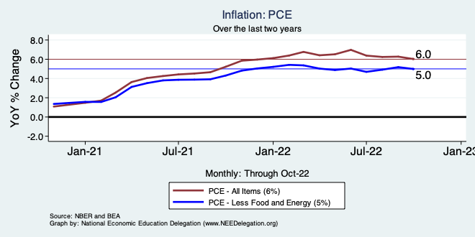
Inflation – The Fed’s Metric
Notes:
Cpi_recent.png

Slide 29
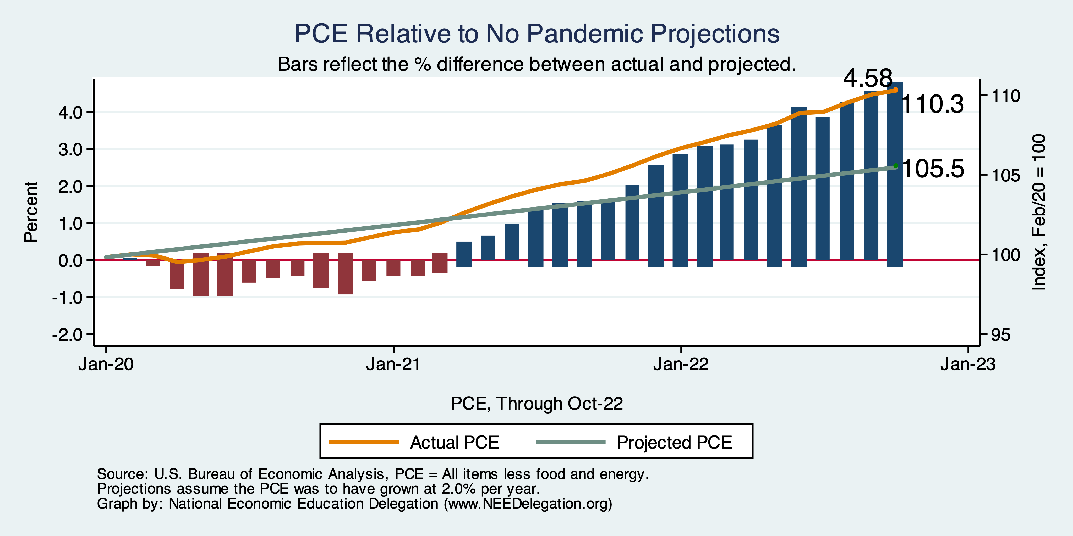
Inflation – PCE and Fed Suggest: I don’t know.
Notes:
Cpi_recent.png

Slide 30
Measure of Inflation Expectations
Breakeven Inflation Rate = Difference between
nominal and real 5-year and 10-year Treasury
constant maturity securities.
Market participants expect around 2.2%
inflation annually over the next 10 years and
2.25% over the next 5 years.
Inflation expectations are calming down.

Slide 31
What’s the Fed Doing About It?

Slide 32
Federal Funds Rate – Recent Activity
Expect 2 more increases: .5 to .75%, each.

Slide 33
Treasuries
Notes:
treas_recent.png

Slide 34
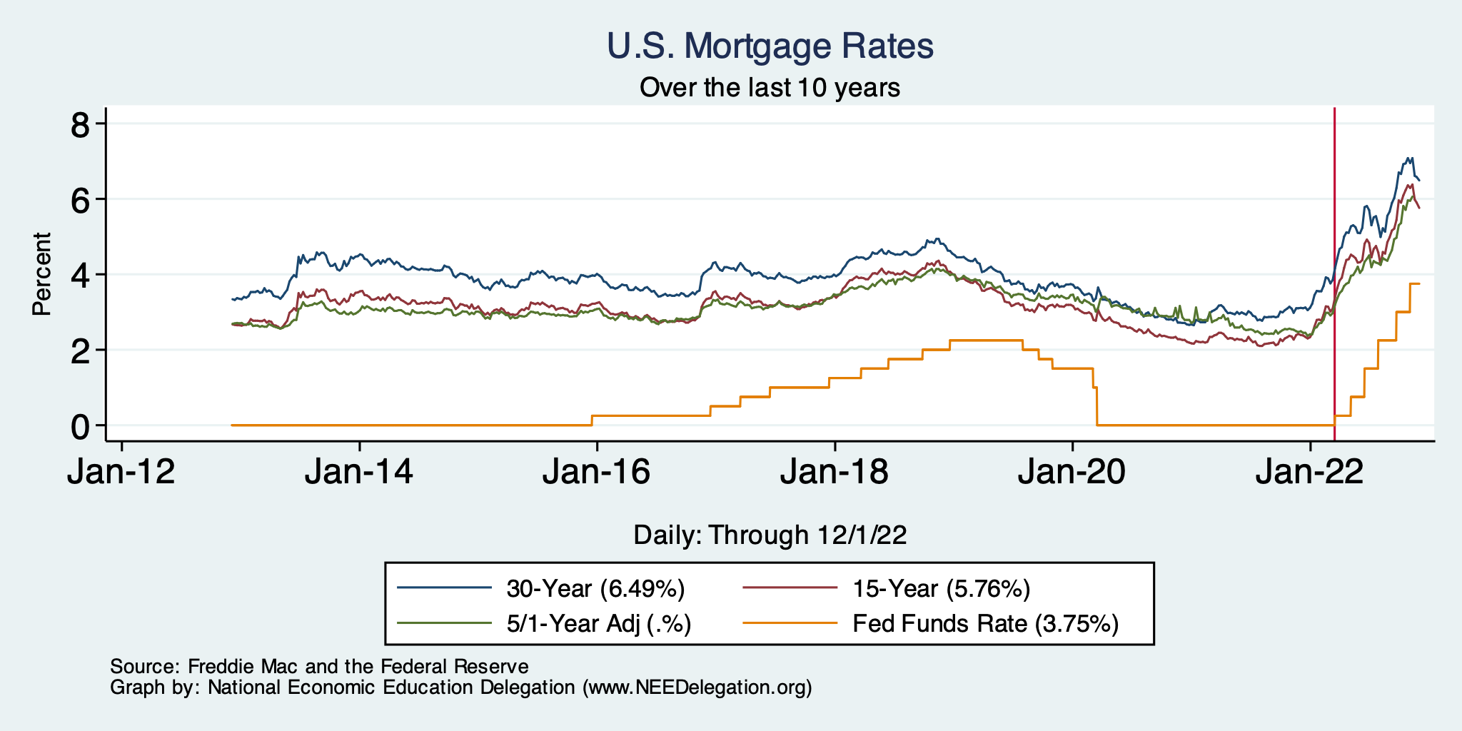
Mortgage Rates

Slide 35
Fed: Also Reducing its Asset Holdings
Reducing the Money Supply – A Little
Jun-Aug: $47.5 billion roll off its portfolio every 30 days
Sep: $85 billion.
Quantitative Tightening

Slide 36
Other Indicators

Slide 37
Industrial Production

Slide 38
Consumer Confidence: Not High
Notes:
Consumer_confidence.png

Slide 39
Producer Confidence: In Trouble

Slide 40
Capacity Utilization: Trending Down

Slide 41
Alarming Compression of Interest Rates
Notes:
Yield_curve.png

Slide 42
Takeaways
Is a recession on the horizon?
Larry Summers, Jamie Dimon, and Elon Musk are worried about a recession.
While the chances of slipping into a recession have increased, I think on many dimensions the economy is doing quite well.
Consumers have been driving the recovery, and consumers account for two-thirds of GDP.
Job creation remains robust – 263k in November.
What about GDP? Looking OK!
Other Indicators suggest slowing.
A real mixed bag. Great uncertainty. News reports aren’t helping.
Marin economy…
Shrinking employment and labor force.
Housing markets very slow.
Uncertain times.

Slide 43
Thank you!
Any Questions?
www.NEEDelegation.org
Jon D. Haveman
Jon@NEEDelegation.org
Contact NEED: info@NEEDelegation.org
Submit a testimonial: www.NEEDelegation.org/testimonials.php
Become a Friend of NEED: www.NEEDelegation.org/friend.php

Slide 44
www.NEEDelegation.org/LocalGraphs
For every state and county in the United States.
Detailed graphs on employment, housing, moves, and other statistics.

