Slide 1
US Economic Update
Vistages, Santa Rosa
December 15, 2021
Jon Haveman, Ph.D.
Executive Director, NEED

Slide 2
National Economic Education Delegation
Vision
One day, the public discussion of policy issues will be grounded in an accurate perception of the underlying economic principles and data.
Mission
NEED unites the skills and knowledge of a vast network of professional economists to promote understanding of the economics of policy issues in the United States.
NEED Presentations
Are nonpartisan and intended to reflect the consensus of the economics profession.

Slide 3
Who Are We?
Honorary Board: 54 members
2 Fed Chairs: Janet Yellen, Ben Bernanke
6 Chairs Council of Economic Advisers
Furman (D), Rosen (R), Bernanke (R), Yellen (D), Tyson (D), Goolsbee (D)
3 Nobel Prize Winners
Akerlof, Smith, Maskin
Delegates: 600+ members
At all levels of academia and some in government service
All have a Ph.D. in economics
Crowdsource slide decks
Give presentations
Global Partners: 44 Ph.D. Economists
Aid in slide deck development

Slide 4
Available NEED Topics Include:
Coronavirus Economics
US Economy
Climate Change
Economic Inequality
Economic Mobility
Trade and Globalization
Minimum Wages
Immigration Economics
Housing Policy
Federal Budgets
Federal Debt
Black-White Wealth Gap
Autonomous Vehicles
US Social Policy

Slide 5
Credits and Disclaimer
This slide deck was authored by:
Jon D. Haveman, NEED
Scott Baier, Clemson University
Geoffrey Woglom, Amherst College (Emeritus)
Brian Dombeck, Lewis & Clark College
Doris Geide-Stevenson, Weber State
Disclaimer
NEED presentations are designed to be nonpartisan.
It is, however, inevitable that the presenter will be asked for and will provide their own views.
Such views are those of the presenter and not necessarily those of the National Economic Education Delegation (NEED).

Slide 6
Outline
State of the Pandemic
Evidence of Impact
Employment Growth
Inflation

Slide 7
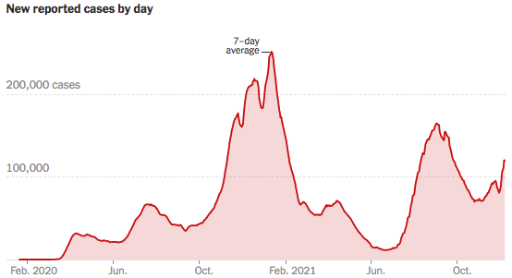
COVID Cases: Trend is Reversing Nationwide
Source: NYTimes

Slide 8
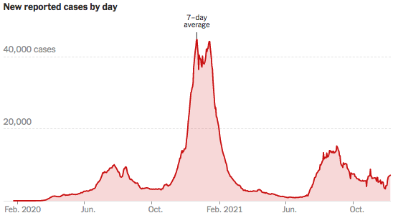
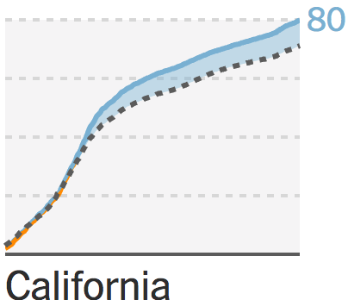
California Cases Were Falling Nicely
Vaccines:
CA Ahead of the Nation
Source: NYTimes

Slide 9
Evidence of Impact

Slide 10
GDP Trajectory: Pandemic Plunge!
GDP is:
$0.6 Trillion below 2019 forecast.
$0.2 Trillion ABOVE 2019-Q4 level.

Slide 11
GDP Growth & Forecast
Quarter | Growth (%), SAAR
2020-Q3 | 33.8
2020-Q4 | 4.5
2021-Q1 | 6.3
2021-Q2 | 6.7
2021-Q3 | 2.1
2021-Q4 | 5.1*
Growth has slowed significantly.
Coincidentally, so has government COVID spending.
* Average of Blue Chip forecasts.

Slide 12
Spending Patterns Since First US Case
Q3 - Flat
Source: https://tracktherecovery.org/

Slide 13
But Not All Industries Did

Slide 14
Employment Gap
3.9 Million below February, 2020.
8.6 Million below where we should be.
Notes:
payroll_recent.png

Slide 15
Employment Growth Has Been Disappointing

Slide 16
Why Slow Employment Growth?
It might be:
Continued fear of the virus – now Omicron.
Microchip shortages.
Geographic mismatch and an unwillingness to relocate…yet.
Childcare – lack of availability.
People wanting to do better.
Facilitated by additional UI/Child Tax Credit payments.
People dropping out of the labor force.

Slide 17
Job Openings Are Up

Slide 18
Quits Are High! The Great Resignation

Slide 19
Quits – Rising, but More in Some Industries
Reached a peak?
Accom. & Food Services
Leisure & Hospitality
Retail

Slide 20
This is Happening Despite Rising Wages
Leisure & Hospitality
Total Nonfarm

Slide 21
Labor Force Gap is Widening
Pre-Pandemic Gap of 10 million
Gap is now 15.6 million

Slide 22
Rising Wages and Declining Resources
Source: NYTimes.com

Slide 23
Employment in California

Slide 24
Concerns: Debt, Inflation & Structural Changes

Slide 25
Debt: A Problem Exacerbated….Not Created

Slide 26
Current Deficits in Perspective:
The budgetary cost of the 3 major fiscal packages during the pandemic was over $5 trillion. As a share of the economy this is almost the size of war production in 1943.
(Romer, Brookings Papers on Economic Activity, 3/25/2021.)
Since March of 2021, Fed net holdings of US Treasury bonds have increased by $2.7 trillion.

Slide 27
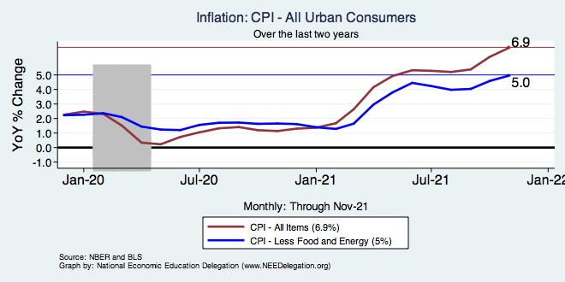
Inflation – Climbing! Should we worry?
Notes:
Cpi_recent.png

Slide 28
Inflation in Historical Perspective

Slide 29
What Index to Follow: CPI or PCE?
CPI is the headline statistic, followed by most newspapers.
Allows more granularity – ability to look at specific products.
PCE is the one followed by the Fed.
Why?
Accounts for short term fluctuations in consumer purchases.
Based on more reliable data.
Fed generally pays attention to the core inflation #s.
Excluding food and energy.

Slide 30
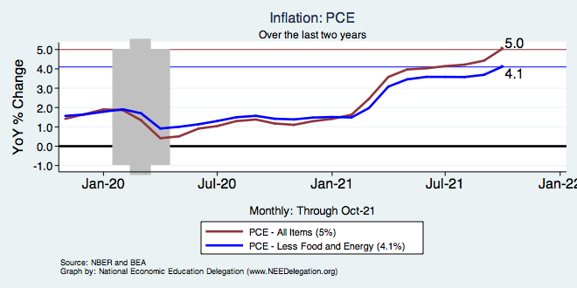
Inflation – The Fed’s Metric! Should we worry?
Notes:
Cpi_recent.png

Slide 31
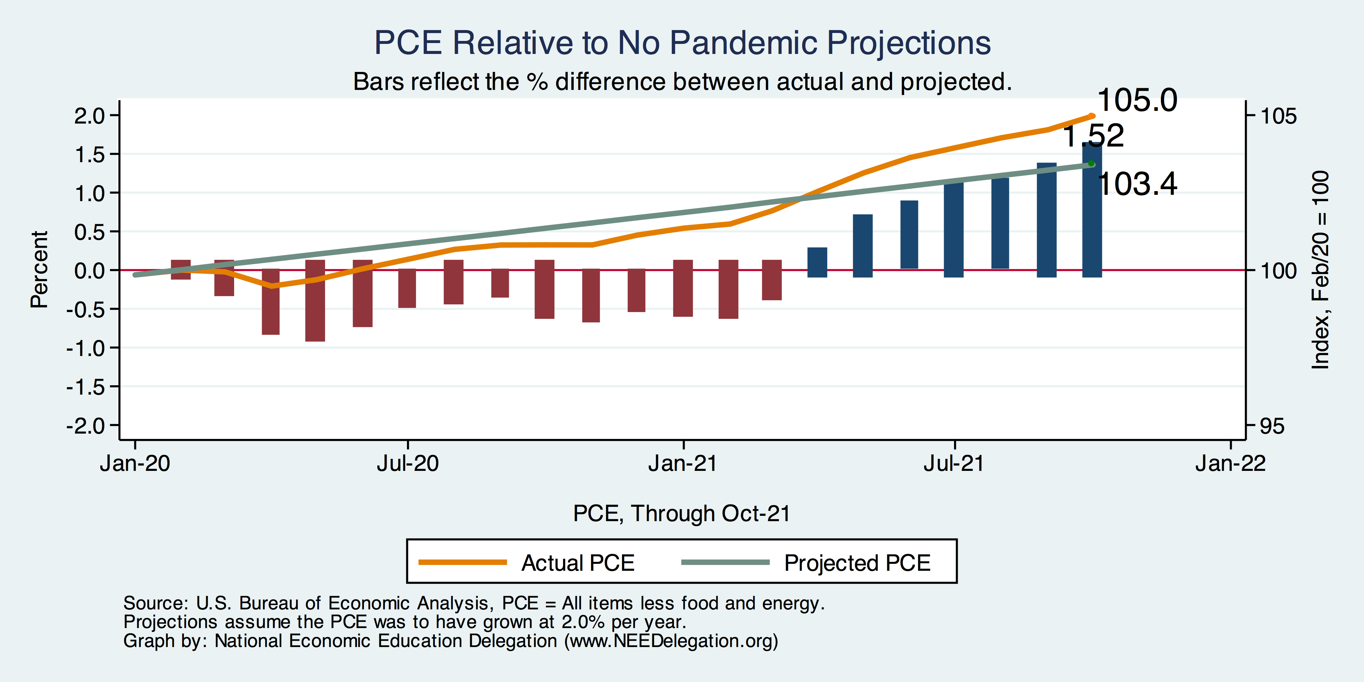
Inflation – PCE and Fed Suggest: I don’t know.
Notes:
Cpi_recent.png

Slide 32
Inflation: Concentrated

Slide 33
Puzzle: Is Inflation Permanently Higher?
Fed: Price increases may be:
1) rebound from low prices last year;
2) temporary due to supply chain disruptions; e.g., used cars, bldg supplies.
3) influenced by rising wages in the future.
On the other hand: We are close to full employment and monetary and fiscal policies are very easy.
Nobody knows, but Fed has wavered in its optimism.

Slide 34
Structural Changes Contributing?
Pandemic has been an accelerant.
Not a change agent.
Retail
Telecommuting
Telehealth
Business travel?
Wealth concentration
Industry concentration
Automation

Slide 35
Residential Real Estate
Rental markets
Eviction moratoria are over.
CA: Making payments can stay + 25%.
Self-evictions?
Not enough in the American Rescue Plan.
Reports of rents rising significantly.
Owned homes
Depends on location.
San Francisco – recovering.
Los Angeles County – continued strength.
Size matters: large homes are selling particularly well.

Slide 36
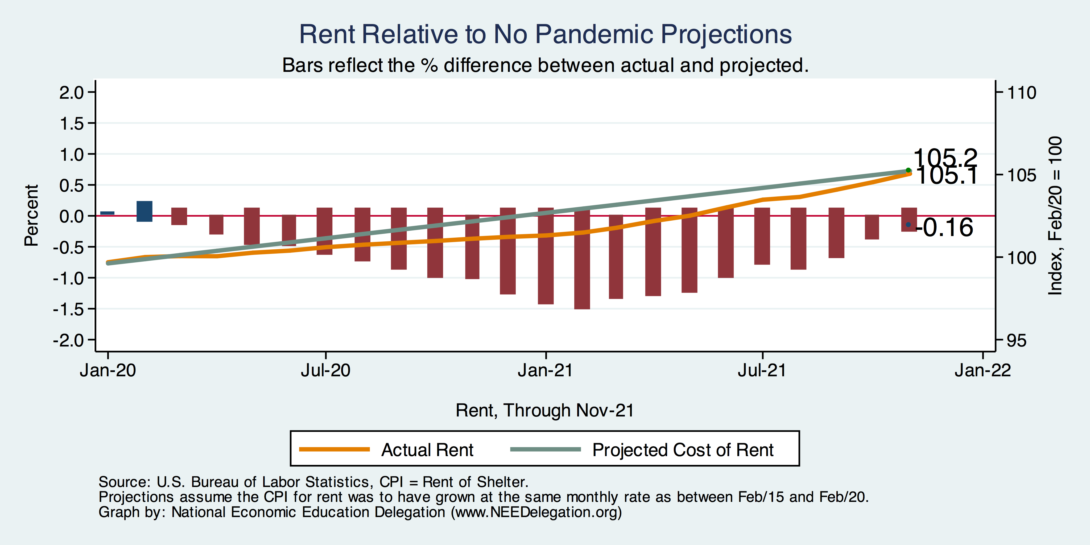
Inflation – Cost of Rent
Notes:
Cpi_recent.png

Slide 37
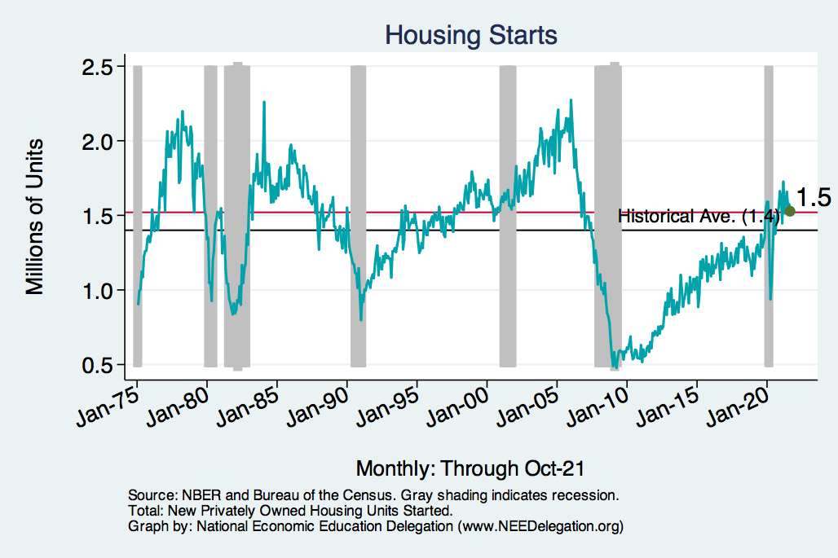
Home Prices and Housing Starts
Notes:
Charts:
homeprices_recession.png
housing.png

Slide 38
Real Estate Prices

Slide 39
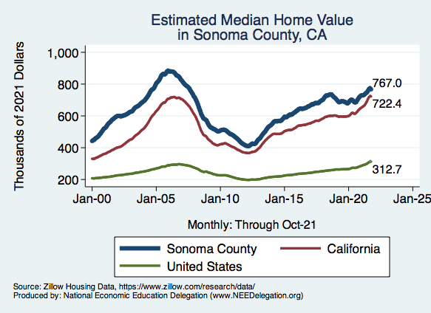
RE Experiences Differ!

Slide 40
Population Change: San Francisco & Sonoma Counties

Slide 41
Primary Topics Covered
GDP
Recovered the decline, but not where it should be.
Won’t recover previous forecast until late 2022.
Employment
Still down 8.6 million jobs relative to forecast. (3.9 million relative to Feb/20).
Labor force is 2.5 million smaller than at the beginning of the pandemic.
Rising wages are not enticing low-wage workers back to work.
Inflation
Going to be high for a while, but transitory – maybe?
Federal Debt
Has grown significantly, but economists are not worried…yet.
Real Estate
Residential, strong. Commercial, less so…for some time.

Slide 42
Conclusion
Recovery is well underway, but may be slowing.
Significant structural changes – accelerant.
GDP will likely expand 5% percent this year, 3-4% next.
Physical health determines economic health for the economy.
Well on our way to recovery, both health and economic.
Variants may well slow our progress: Omicron.
Gov’t missteps may also hinder progress.
Biggest problems:
Supply chain bottlenecks.
Labor force participation.

Slide 43
Thank you!
Any Questions?
www.NEEDelegation.org
Jon D. Haveman
Jon@NEEDelegation.org
Contact NEED: info@NEEDelegation.org
Submit a testimonial: www.NEEDelegation.org/testimonials.php
Become a Friend of NEED: www.NEEDelegation.org/friend.php

Slide 44
GDP: Quarterly Growth
Notes:
Graph: gdp_pot_grow.png
The Point: From 1990 – 2007, average annual US GDP growth pre-crisis is 2.94%. However, post-crisis US GDP growth is 2.19% (0.75 percentage points lower). Why is has the recovery been sluggish?
Note: At the recession’s height, the gap between quarterly GDP growth and potential growth was 2.5 percentage points.

Slide 45
Recovery Due to Immense Fiscal Stimulus and Control of COVID

Slide 46
Stimulus allowed Spending to Recover
But Note that Saving also went way up
Saving
Abnormally high Saving is over $2trillion

Slide 47
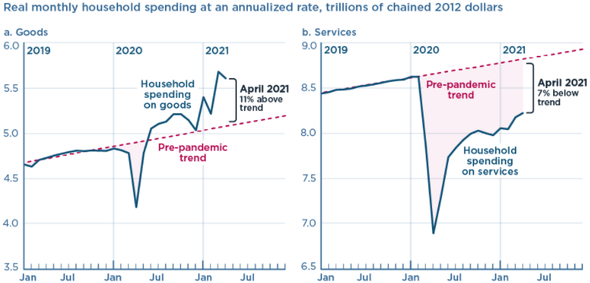
And We’re Buying Mostly … Stuff
Source: Jason Furman, PIIE

Slide 48
Labor Force is Shrinking

Slide 49
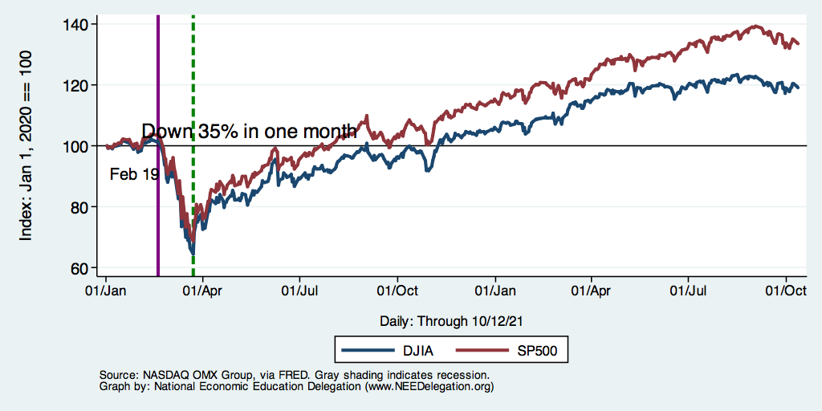
DJIA and S&P 500

Slide 50
Small Businesses: They Didn’t Get Enough PPP

Slide 51
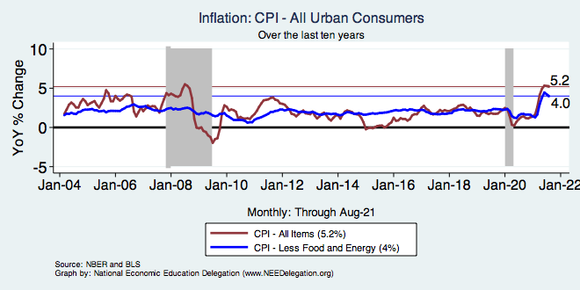
Inflation – Prepandemic Stability
Notes:
Cpi_recent.png

Slide 52
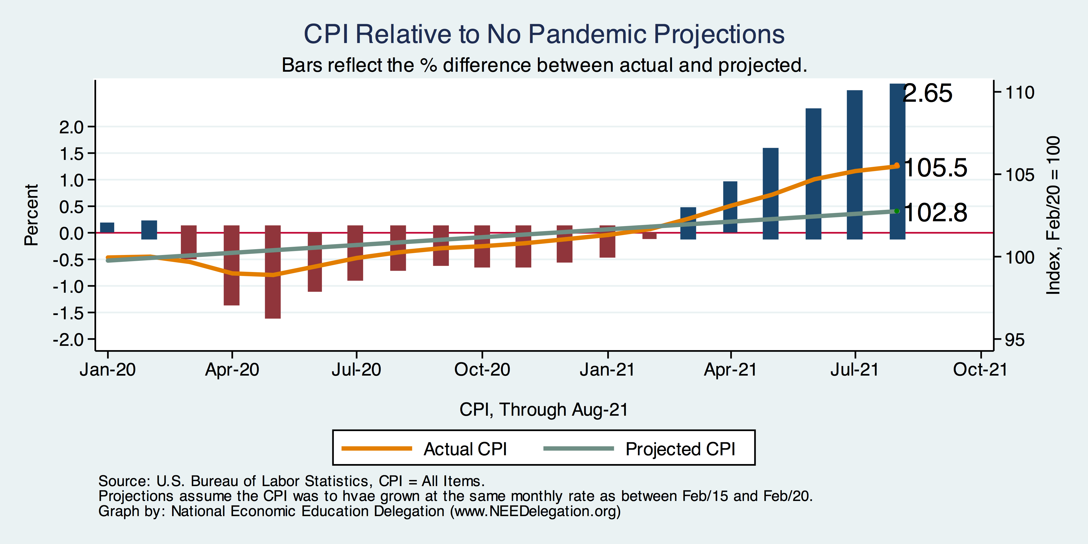
Inflation – CPI Suggests: Yes!
Notes:
Cpi_recent.png

Slide 53
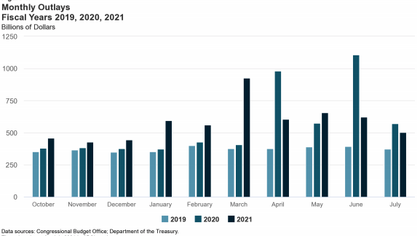
Trillions in Pandemic Spending

Slide 54
Why so Excited About Telecommunting?
Productivity at home appears to be really high during pandemic.
Nothing else to do.
Short term – corporate culture and new hires – visibility to the boss – camaraderie.
CEOs are salivating over reduced Comm RE costs.

Slide 55
Telecommuting – Will it Stick?
Working from home is ALWAYS less productive than working in the office.
But the gap has shrunk because of technology.
In the interest of workplace productivity, employers are likely to allow more working from home.
Increased in-office moral and hence productivity.
But not 100% or even 50%. How much?
Has important implications for real estate.

Slide 56
Population Change: San Francisco & Marin Counties

Slide 57
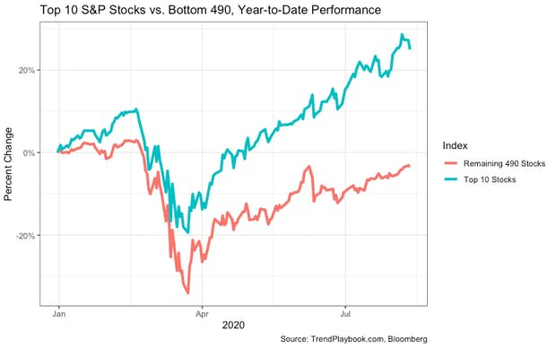
Recovery/Recession for Whom?
Top 10 S&P Stocks:
Apple
Microsoft
Amazon
Facebook
Alphabet Class A shares
Alphabet Class C shares
Berkshire Hathaway
Johnson & Johnson
Visa
Procter & Gamble

Slide 58
Inflation – Summary
Headline inflation story is troublesome.
The Fed suggests that it is not.
Powell: current high inflation is “transitory”.
That does not mean that price levels will come down.
It means that inflation is likely to return to its prior trajectory once the economy has worked out the pandemic kinks.
Fed targets 2.0%. We are currently just 1.2% above that.
Notes:
Cpi_recent.png

Slide 59
www.NEEDelegation.org/LocalGraphs
For every state and county in the United States.
Detailed graphs on employment, housing, moves, and other statistics.

