Slide 1
Osher Lifelong Learning Institute, Winter 2022
Contemporary Economic Policy
Clemson University
January-February, 2022
National Economic Education Delegation

Slide 2
National Economic Education Delegation
Vision
  One day, the public discussion of policy issues will be grounded in an accurate perception of the underlying economic principles and data.
Mission
  NEED unites the skills and knowledge of a vast network of professional economists to promote understanding of the economics of policy issues in the United States.
NEED Presentations
  Are nonpartisan and intended to reflect the consensus of the economics profession.

Slide 3
Who Are We?
Honorary Board: 54 members
  2 Fed Chairs: Janet Yellen, Ben Bernanke
  6 Chairs Council of Economic Advisers
    Furman (D), Rosen (R), Bernanke (R), Yellen (D), Tyson (D), Goolsbee (D)
  3 Nobel Prize Winners
    Akerlof, Smith, Maskin
Delegates: 649+ members
  At all levels of academia and some in government service
  All have a Ph.D. in economics
  Crowdsource slide decks
  Give presentations
Global Partners: 48 Ph.D. Economists
  Aid in slide deck development

Slide 4


Where Are We?

Slide 5
Available NEED Topics Include:
Coronavirus Economics
US Economy
Climate Change
Economic Inequality
Economic Mobility
Trade and Globalization
Minimum Wages
Immigration Economics
Housing Policy
Federal Budgets
Federal Debt
Black-White Wealth Gap
Autonomous Vehicles
US Social Policy

Slide 6
Course Outline
Contemporary Economic Policy
  Week 1 (1/31): US Economy & Coronavirus Economics
  Week 2 (2/7): Monetary Policy (Geoffrey Woglom, Amherst College)
  Week 3 (2/14): Trade (Alan Deardorff, University of Michigan)
  Week 2 (1/21): Climate Change Economics (Sarah Jacobson, Williams College)

Slide 7
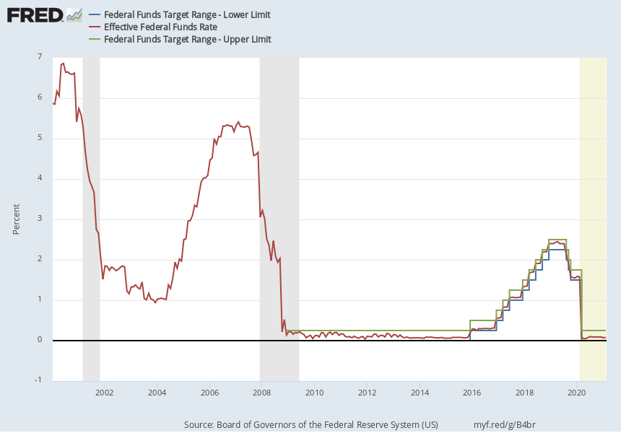
Monetary Policy Is About the Interest Rate
The FOMC does not set an exact number for the Federal funds rate. Instead, it sets an upper (green line) and lower (blue) range.
“The Committee decided to keep the target range for the federal funds rate at 0 to 1/4 percent…” (4/28/2021)
Grey bars are recessions

Slide 8

Trade: Bicycle Supply Chain
Source: World Development Report 2020

Slide 9
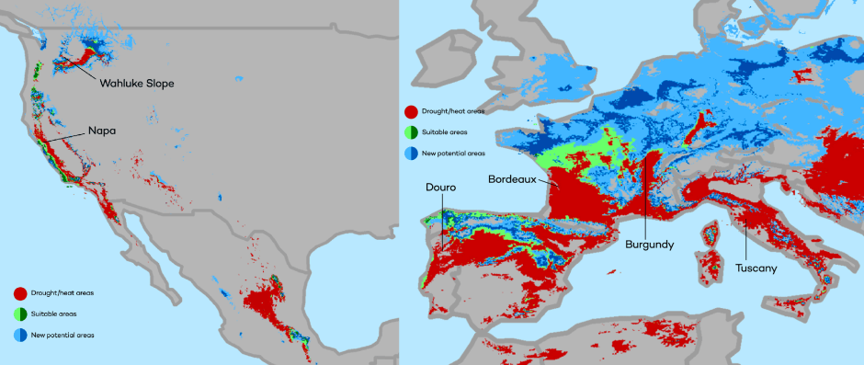
Climate Change Economics
The changing map of the world’s wine-growing regions.

Slide 10
Submitting Questions
Please submit questions in the chat.
  I will try to handle them as they come up, but may take them in a bunch as time permits.
We will do a verbal Q&A once the material has been presented.
  And the questions in the chat have been addressed.
OLLI allowing, we can stay beyond the end of class to have further discussion.

Slide 11
US Economy and Coronavirus Economics
Scott Baier, Ph.D.
Clemson University
National Economic Education Delegation

Slide 12
Credits and Disclaimer
This slide deck was authored by:
  Jon D. Haveman, NEED
  Scott Baier, Clemson University
  Geoffrey Woglom, Amherst College (Emeritus)
  Brian Dombeck, Lewis & Clark College
  Doris Geide-Stevenson, Weber State
Disclaimer
  NEED presentations are designed to be nonpartisan.
  It is, however, inevitable that the presenter will be asked for and will provide their own views.
  Such views are those of the presenter and not necessarily those of the National Economic Education Delegation (NEED).

Slide 13
Outline
State of the pandemic
The U.S. Economy
Hot Topics
  Government policy
  Debt
  Inflation
  Great resignation

Slide 14
State of the Pandemic

Slide 15
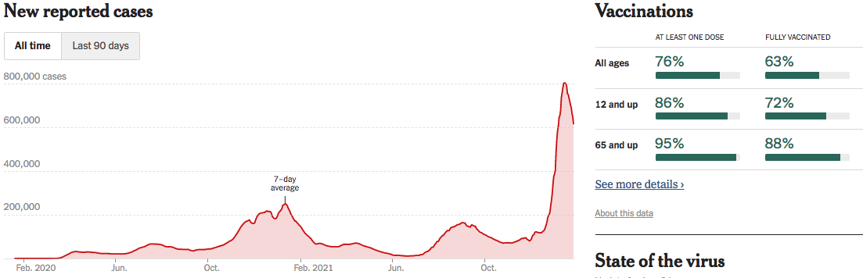
Making Real Progress…Until Omicron
Nationally
Source: NYTimes

Slide 16
Omicron is Making Things Difficult
Covid-related absences:
  Are creating headaches for businesses that were struggling to hire workers even before Omicron.
  Restaurants and retail stores have cut back hours.
  Broadway shows called off performances.
  Airlines canceled thousands of flights over the holidays because so many crew members called in sick;
  on one day last month, nearly a third of United Airlines Workers at Newark Liberty International Airport, a major hub, called in sick.
Source: NYTimes.com

Slide 17
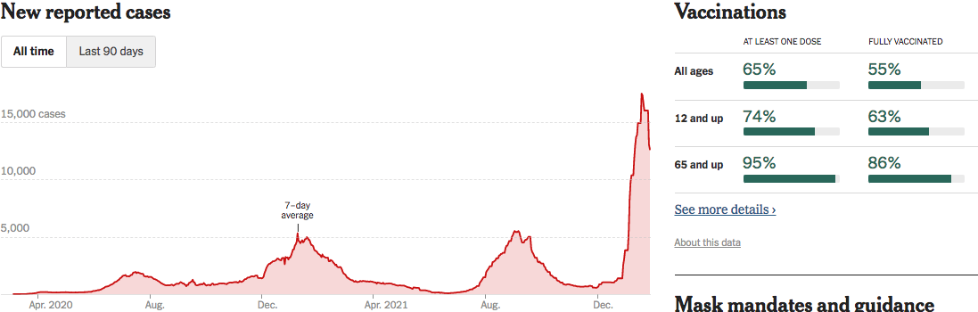
South Carolina Cases Are Falling Nicely
S. Carolina
Source: NYTimes

Slide 18
The U.S. Economy

Slide 19
Some Basic Statistics
Statistic: | Value
Population | 331.9 Million
Labor Force | 162.3 Million
Employment | 149.0 Million
Gross Domestic Product (GDP) | $23.9 Trillion
Income per Capita | $63,002
Ave. Hourly Earnings | $31.31

Slide 20
Composition of the U.S. Economy: GDP
Share of Total GDP
Source: U.S. Bureau of Economic Analysis

Slide 21
Anderson County GSP: Manufacturing!
Share of GDP
Source: U.S. Bureau of Economic Analysis

Slide 22
Anderson County Employment
Share of Total Employment
Source: U.S. Bureau of Economic Analysis

Slide 23
Evidence of Impact

Slide 24
GDP Trajectory: Pandemic Plunge!

Slide 25
GDP Trajectory: Great Recession Slowdown!
11% Gap
Income per person
would be about
$5,000 higher.

Slide 26
GDP: Quarterly Growth: 1990. - 2019
Notes:
Graph: gdp_pot_grow.png
The Point: From 1990 – 2007, average annual US GDP growth pre-crisis is 2.94%. However, post-crisis US GDP growth is 2.19% (0.75 percentage points lower). Why is has the recovery been sluggish?
Note: At the recession’s height, the gap between quarterly GDP growth and potential growth was 2.5 percentage points.

Slide 27
GDP: Quarterly Growth: 1990 - 2019
Notes:
Graph: gdp_pot_grow.png
The Point: From 1990 – 2007, average annual US GDP growth pre-crisis is 2.94%. However, post-crisis US GDP growth is 2.19% (0.75 percentage points lower). Why is has the recovery been sluggish?
Note: At the recession’s height, the gap between quarterly GDP growth and potential growth was 2.5 percentage points.

Slide 28
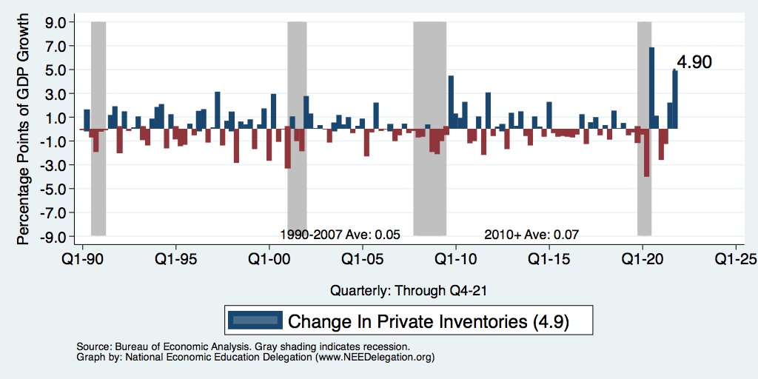
GDP Growth: Mostly Inventories
Notes:
Graph: gdp_pot_grow.png
The Point: From 1990 – 2007, average annual US GDP growth pre-crisis is 2.94%. However, post-crisis US GDP growth is 2.19% (0.75 percentage points lower). Why is has the recovery been sluggish?
Note: At the recession’s height, the gap between quarterly GDP growth and potential growth was 2.5 percentage points.

Slide 29
Spending Patterns Since First US Case
24.7%
Q3 - Flat
Source: https://tracktherecovery.org/

Slide 30
Spending Patterns: Income Groups
Source: https://tracktherecovery.org/

Slide 31
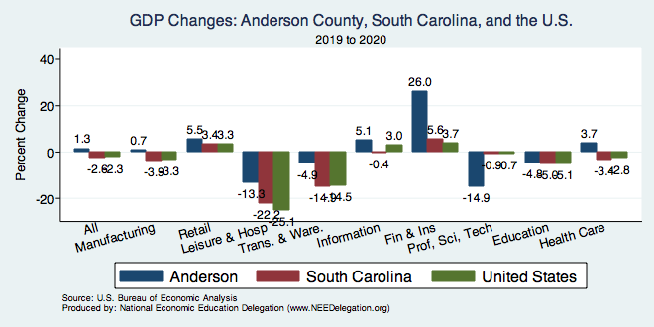
But Not All Industries Were Equally Harmed

Slide 32
Spending Patterns – Hardest Hit Sectors
Health
Food & Accom
Arts & Entertain
Source: https://tracktherecovery.org/

Slide 33
Monthly Changes in Nonfarm Employment
From 1990 -2007, average gain in employment each month averaged about 131,000
Notes:
PAYEMS.png

Slide 34
Monthly Employment: Hires and Separations
Hires
Separations
Notes:
PAYEMS.png

Slide 35
Monthly Changes in Nonfarm Employment
Notes:
PAYEMS.png

Slide 36
Monthly Employment: Hires and Separations
Notes:
PAYEMS.png

Slide 37
Monthly Changes in Nonfarm Employment
In March and April of 2020, the US economy lost more than 22 million jobs.
Since that time, the economy has recovered about 18.8 million jobs.
Still roughly 3.5 million jobs below where we were in 2/2020
If you consider the normal addition of 131 k jobs per month, we about 6.5 million below where we should be.
Notes:
PAYEMS.png

Slide 38
Monthly Changes in Nonfarm Employment
Notes:
PAYEMS.png

Slide 39
Monthly Changes in Nonfarm Employment
Notes:
PAYEMS.png

Slide 40
Unemployment Rate
Notes:
Unemployment rises during recessions and falls during economic expansions.
Unemployment peaked at the end of the 2009 recession.
The Fed worked to reduce the effects of the recession. Near the end of 2008, the FOMC reduced the federal funds rate to nearly zero and worked to reduce longer-term interest rates via large-scale asset purchase programs (late 2008 – 10/2014).
Unemployment is currently below the natural rate of unemployment. This is traditionally accompanied by economic growth and rising price levels. It’s also a major reason for FOMC’s decision to increase the federal funds rate.

Slide 41
Trends in Labor Force Participation
Notes:
CLF16OV.png

Slide 42
Labor Force is Shrinking – Drives Down UR
7%

Slide 43
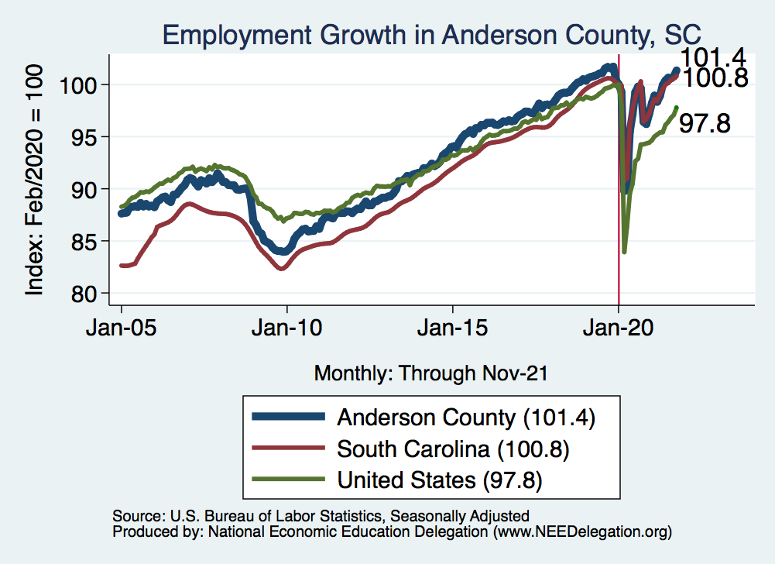
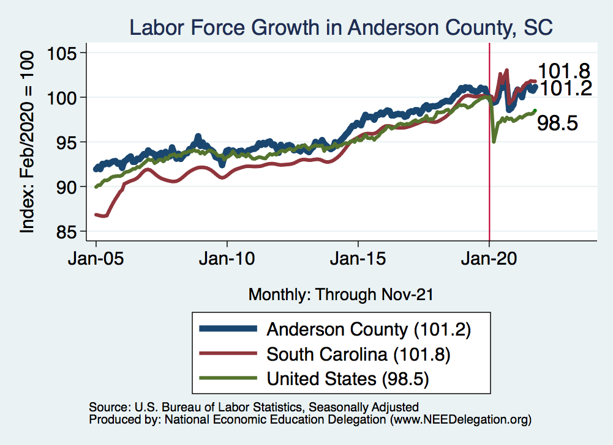
Employment in Anderson County

Slide 44
Hot Topics
Economic Recovery and Government policy
Inflation
Great resignation
Government Deficit and Debt

Slide 45
Personal Consumption Expenditures
Trend from2010-2019

Slide 46
What Have Been Policy Effects?
MONETARY POLICY (Fed) acted quickly and effectively to prevent a financial market meltdown and to keep credit flowing. But the Fed lends and does not spend.
FISCAL POLICY (Congress) acted quickly, but inevitably made some mistakes.
  Stimulus Checks, A ($268b)
  Expanded Unemployment, B ($268b)
  Paycheck Protection Program, C- ($525b)

Slide 47
Personal Disposable Income

Slide 48
Personal Savings as a Fraction of Disposable Income

Slide 49
Retail Sales: Retail Trade and Food Services
Retail Sales is about 11% above trend
This represents a shift to more goods consumption and less service consumption

Slide 50
Spending Patterns: Income Groups
Source: https://tracktherecovery.org/

Slide 51
South Carolina Spending
31.4
Opportunity Insights

Slide 52
Durable Goods and Service Consumption
Consumption of durable goods is about 35% higher than its pre-pandemic levels
Consumption of services is almost back to pre-pandemic levels.
Note: PC Expenditures Services are nearly 6.5 times greater than PC expenditures on Durables

Slide 53
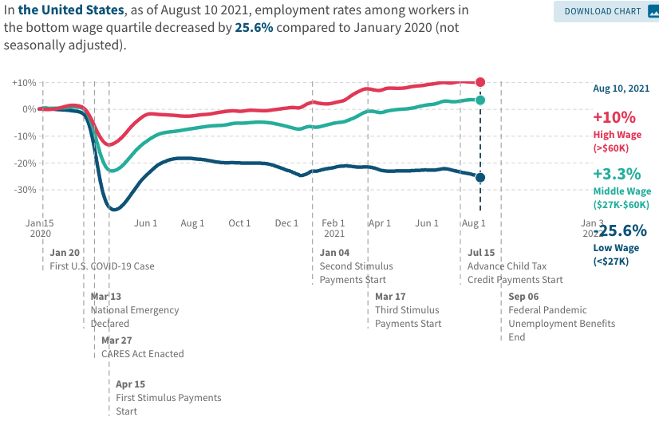
Low Wage Employment is Lagging

Slide 54
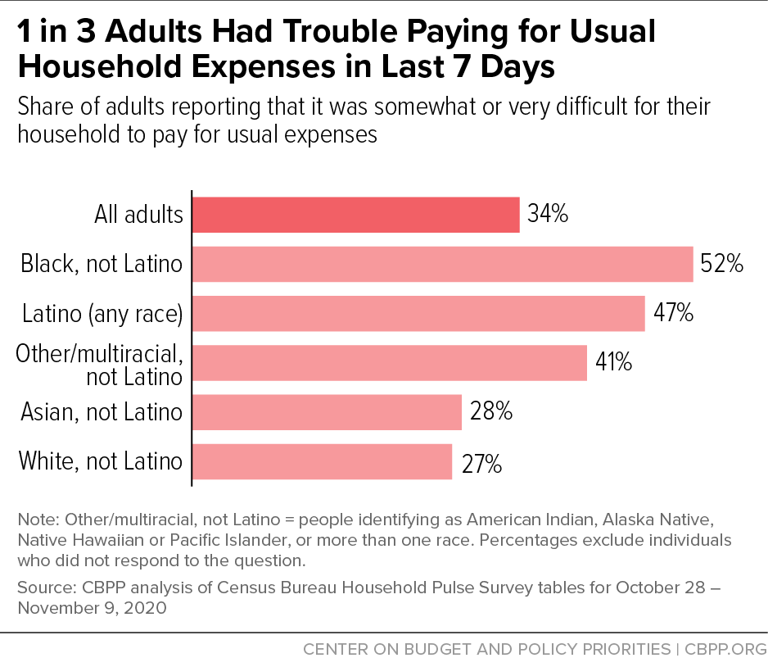
Low Income Troubles

Slide 55
Take Away: Consumption and the Recovery
Consumption has rebounded rapidly coming out of the recession.
The rebound in consumption was supported by the stimulus packages that were passed by the Trump and Biden Administration.
Compared to before the pandemic consumption has shifted more toward the consumption of goods and away from services.
  This a demand effect that is causing some of the supply chain disruptions

Slide 56
Inflation

Slide 57
Inflation

Slide 58
What is Driving Inflation?
Profiteering / Greed: President Biden and Senator Elizabeth Warren.
Supply Chains Disruptions:
  the pandemic has impacted the ability to get parts and supplies.
  Labor shortages and rising wages have raised costs and help push up prices.
Increased Demand:
  During the pandemic there has been an increase in demand for goods. For many of these goods, it is not easy to ramp up production.
  The fiscal and monetary authorities have provided lots of stimulus.

Slide 59
Profits: Profit Margins
After-Tax Profit Margins
After-Tax and Before Tax Profit Margins

Slide 60
Supply Chain Delays: ISM Delivery Days

Slide 61
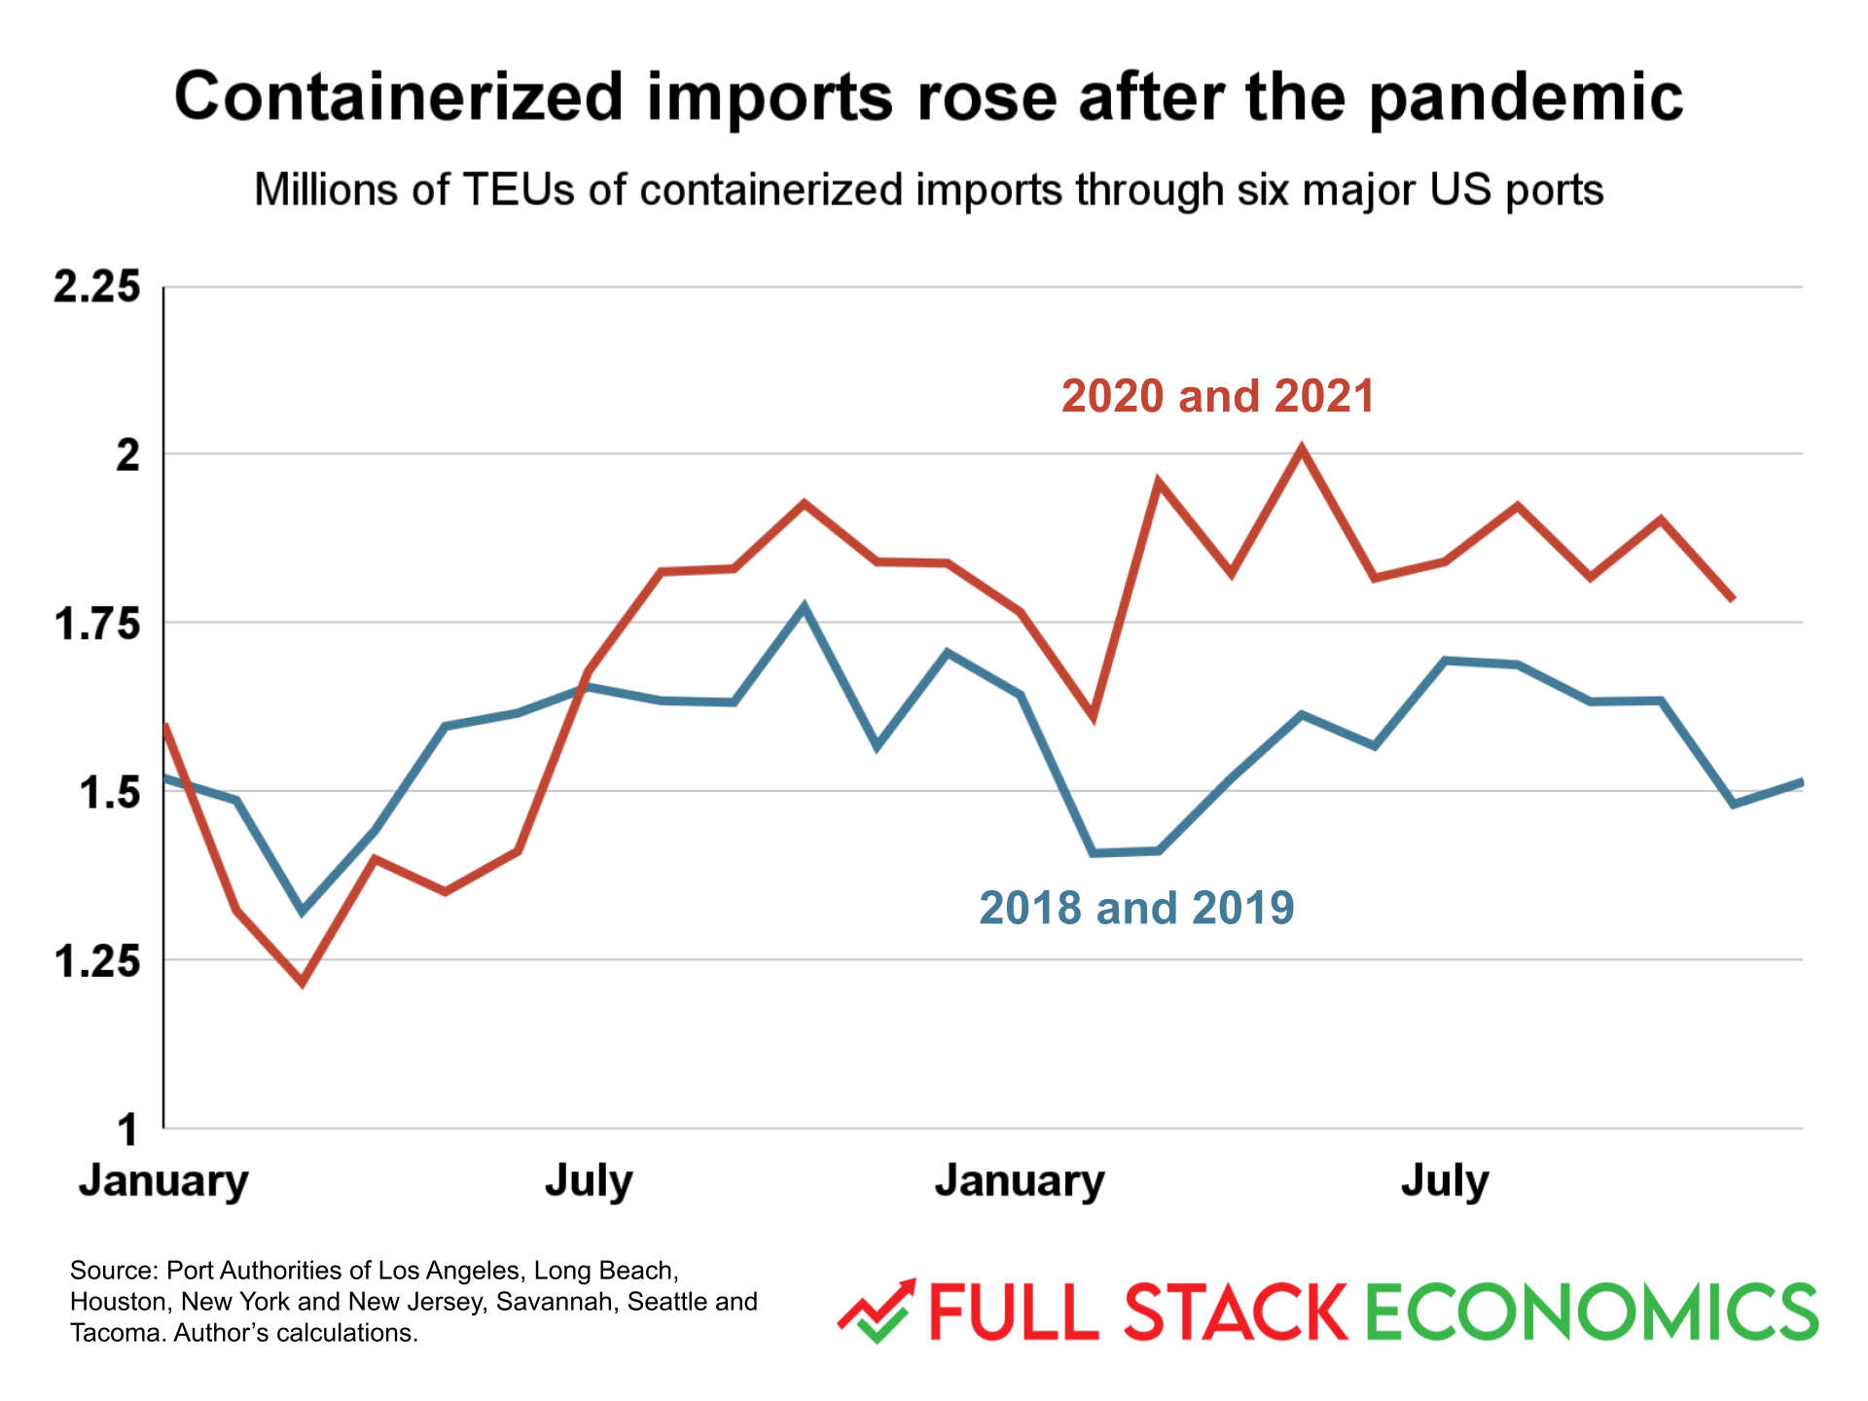
Supply Chain Delays: It is Not All Supply Shortages

Slide 62
Money Growth: M2 (Transactions Money)
6.1%

Slide 63
Annualized Money Growth
Growth Rate of Money Stock (percent per year) | Beginning of Period | End of Period
6.1 | January 2000 | March 2020
46.3 | April 2020 | June 2020
12.3 | July 2020 | November 2021

Slide 64
Real Personal Disposable Income
2.5%
2.8%

Slide 65
Personal Savings as a Fraction of Disposable Income

Slide 66
Durable Goods and Service Consumption
Consumption of durable goods is about 35% higher than its pre-pandemic levels
Consumption of services is almost back to pre-pandemic levels.

Slide 67
PCE: Inflation Goods and Services

Slide 68
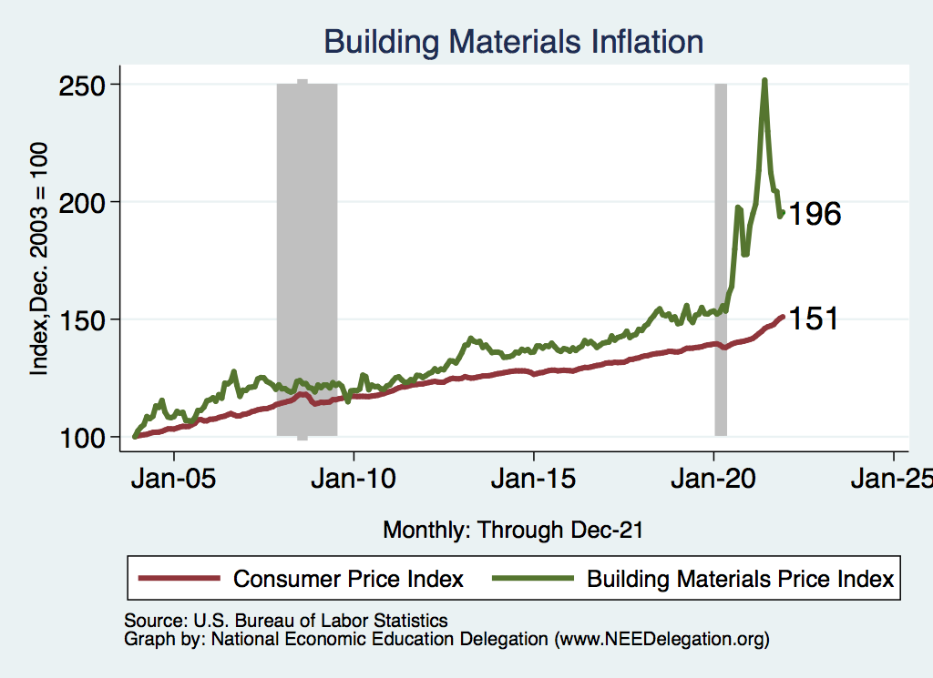
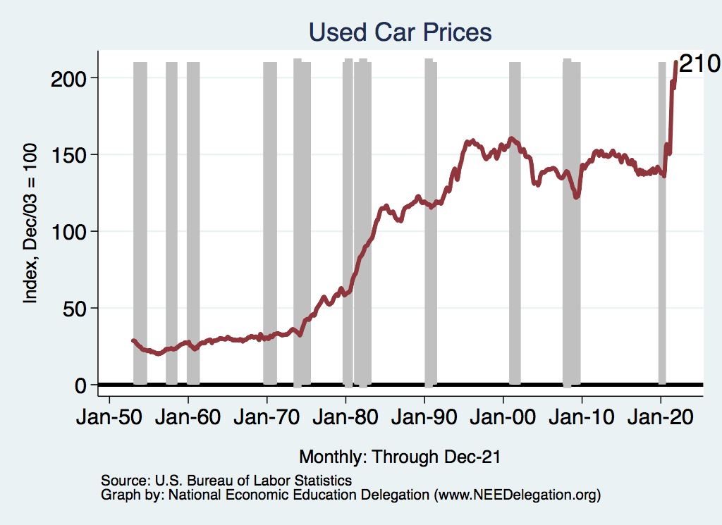
Inflation: Concentrated
Cost-Push

Slide 69
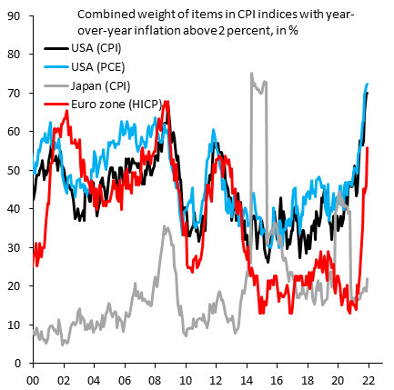
Inflation: Or is it Broad Based?

Slide 70
Is Inflation Permanently Higher?
Fed: Price increases may be:
  1) rebound from low prices last year;
  2) temporary due to supply chain disruptions; e.g., used cars, bldg supplies.
  3) influenced by rising wages in the future.
Omicron:
  Lessen inflation in the short term.
  Increase it in the long term by increasing supply chain issues.
Nobody knows, but Fed has wavered in its optimism.
  Uncertainty hurts both workers and businesses – hard to plan.

Slide 71
The Great Resignation

Slide 72
Monthly Employment: Hires and Separations
Hires
Separations
Notes:
PAYEMS.png

Slide 73
Employment Dynamics: Separations and Hires

Slide 74
Employment Dynamics: Quits and Layoffs
QUITS

Slide 75
Employment Dynamics
Job Openings
Job Hires

Slide 76
Pre-COVID Quit Rates by Industry

Slide 77
Pre & Post COVID Quit Rates by Industry

Slide 78
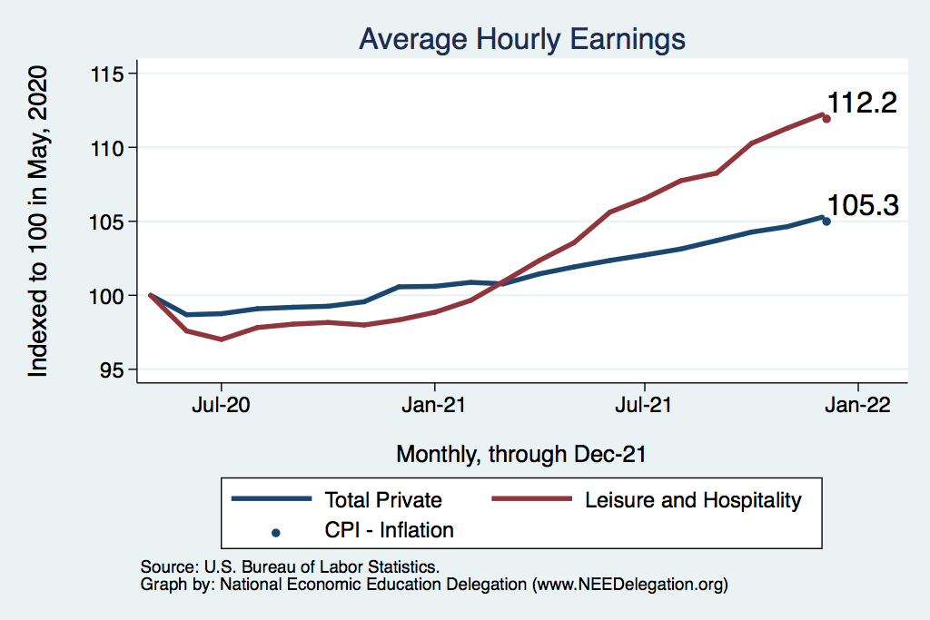
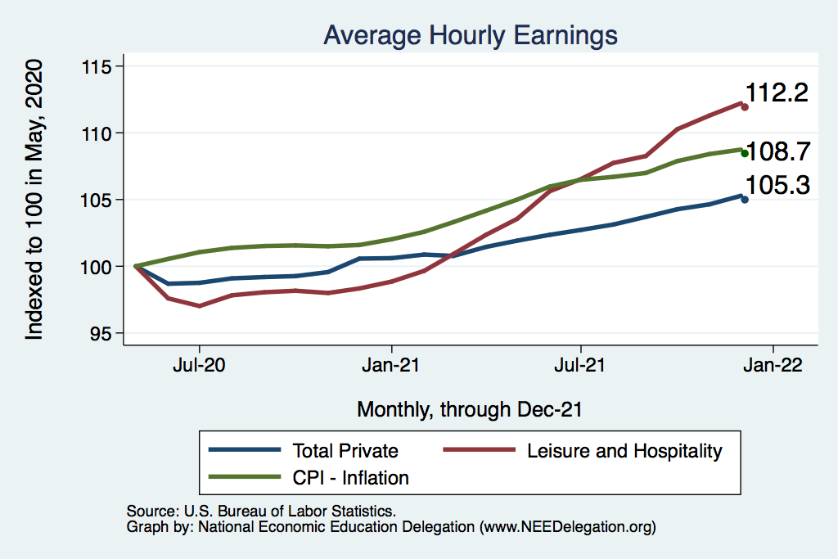
This is Happening Despite Rising Wages
Leisure & Hospitality
Total Nonfarm

Slide 79
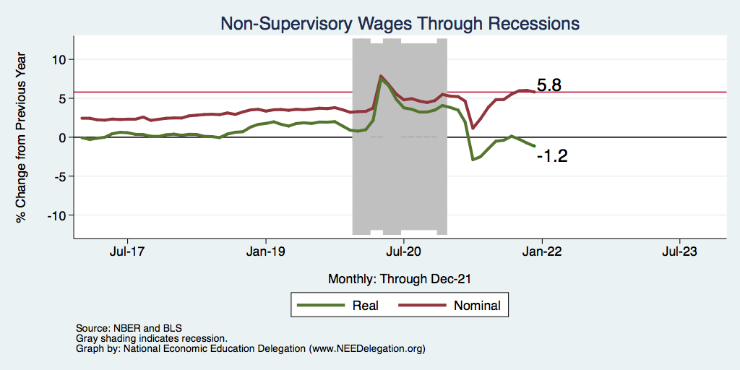
Inflation Adjusted Wages Are Falling

Slide 80
Great Resignation: Employment Situation
Employment is still on the rebound rebound
The real challenge has been for employers to fill vacancies.
What gives?
  Extended (or expected continuation) unemployment benefits and other stimulus payments
  Parents with young children at home.
  Workers reluctant to work in certain industries and occupations
  Workers looking for different career opportunities.
  Workers looking for better employment opportunities withing their industry/occupation – non-pecuniary benefits
    Increased desire to have the option to work from home.
    Better working conditions
    Recognition of accomplishments

Slide 81
Debt and Deficit

Slide 82
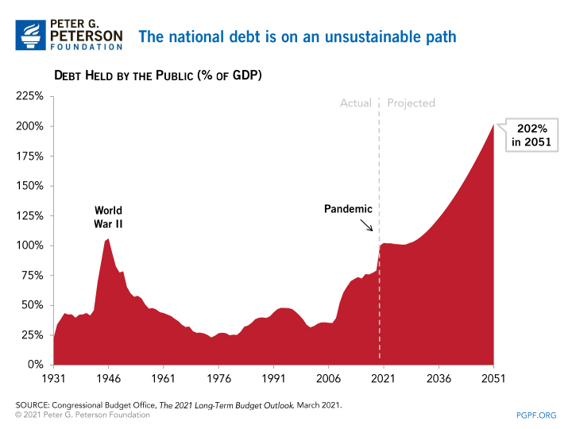
A Problem Exacerbated….Not Created

Slide 83
Current Deficits in Perspective:
The budgetary cost of the 3 major fiscal packages during the pandemic was over $5 trillion. As a share of the economy this is almost the size of war production in 1943.
  (Romer, Brookings Papers on Economic Activity, 3/25/2021.)
Since March of 2021, Fed net holdings of US Treasury bonds have increased by $2.7 trillion.

Slide 84
The End

Slide 85
Conclusion
Recovery is well underway, but may be slowing.
GDP expanded 5.7% percent in 2021, likely 3-4% in 2022.
2021 was an odd year.
  Workers attained the upper hand.
  Supply chains broke.
  Inflation surged.
  The economy rebuilt itself.
Biggest problems:
  Supply chain bottlenecks.
  Labor force participation.

Slide 86
Best Measures of Progress
INFLATION – getting it under control.
REAL WAGES– need to see progress.
WORKFORCE PARTICIPATION – need growth here to get GDP growth.
Pay no attention to the unemployment rate.

Slide 87
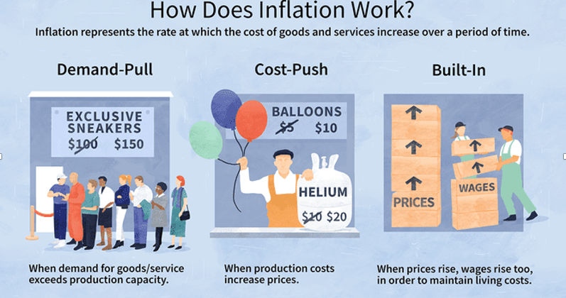
Source: Investopedia

Slide 88
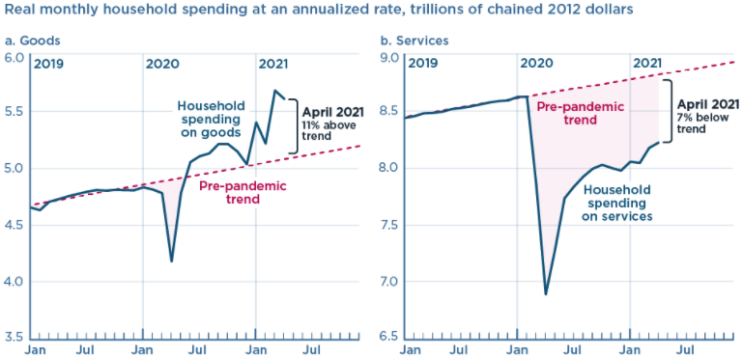
We’re Buying Mostly … Stuff
Demand-Pull
Source: Jason Furman, PIIE

Slide 89
Inflation: Concentrated
Cost-Push

Slide 90
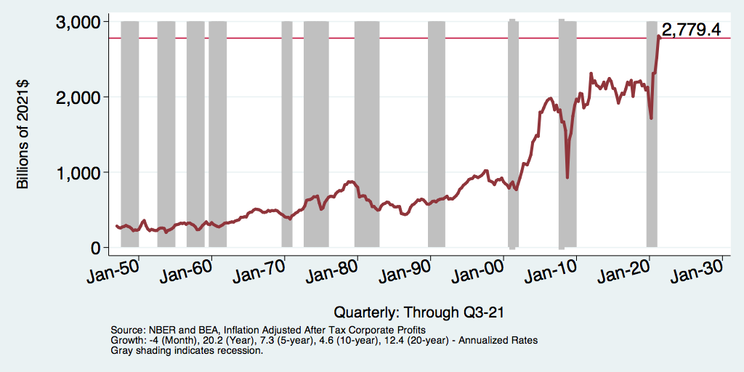
Corporate Profits…Adding to Inflation?

Slide 91
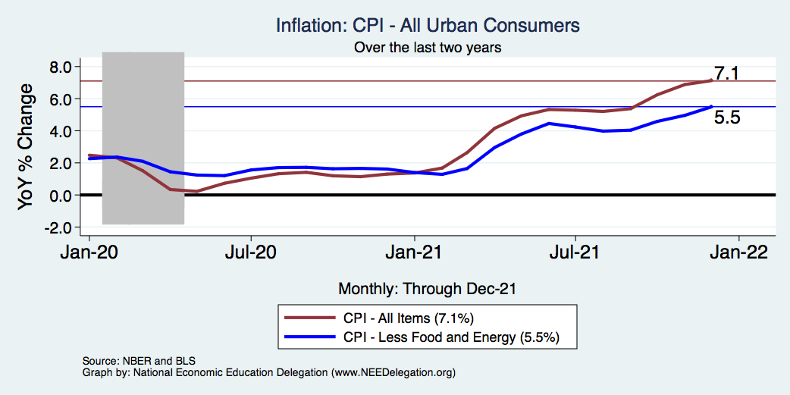
Inflation – Climbing! Should we worry?
Notes:
Cpi_recent.png

Slide 92
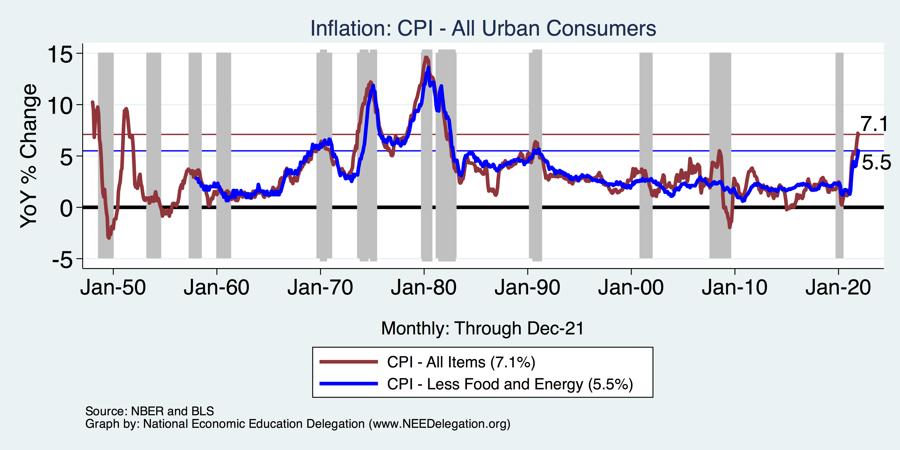
Inflation in Historical Perspective

Slide 93
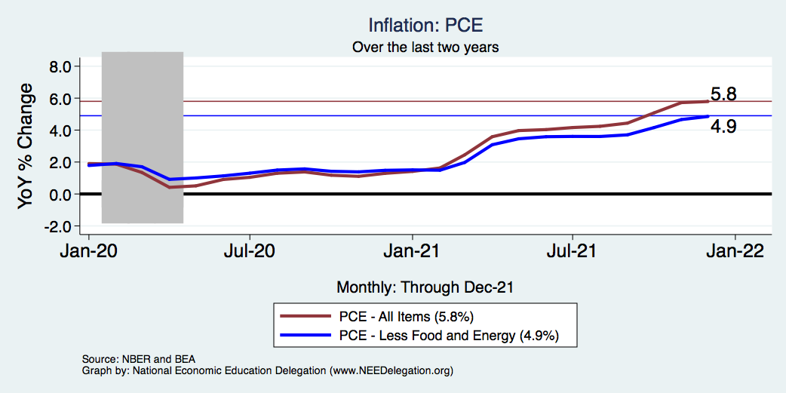
Inflation – The Fed’s Metric! Should we worry?
Notes:
Cpi_recent.png

Slide 94
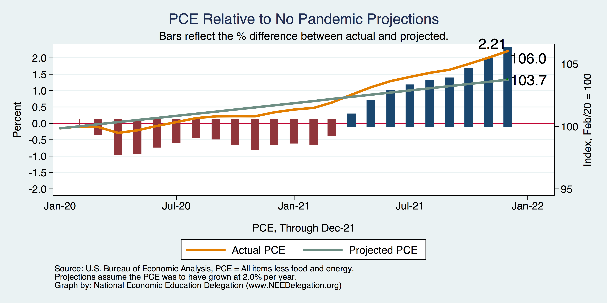
Inflation – PCE and Fed Suggest: I don’t know.
Notes:
Cpi_recent.png

Slide 95
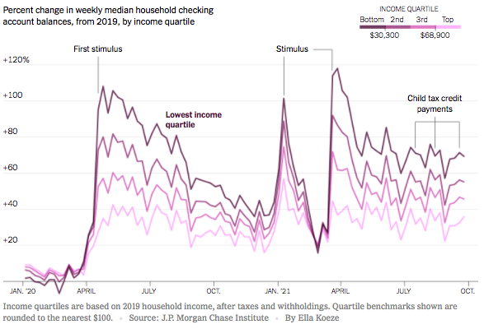
Declining Resources May Change Things
Source: NYTimes.com

Slide 96
Monetary Policy – Geoffrey Woglom
The FOMC does not set an exact number for the Federal funds rate. Instead, it sets an upper (green line) and lower (blue) range.
“The Committee decided to keep the target range for the federal funds rate at 0 to 1/4 percent…” (4/28/2021)
Grey bars are recessions

Slide 97
Thank you!
Any Questions?
www.NEEDelegation.org
Scott Baier, Ph.D.
sbaier@g.clemson.edu
Contact NEED: info@NEEDelegation.org
Submit a testimonial: www.NEEDelegation.org/testimonials.php
Become a Friend of NEED: www.NEEDelegation.org/friend.php

Slide 98
Structural Changes?
Pandemic has been an accelerant.
  Not a change agent.
Retail
Telecommuting
Telehealth
Business travel?
Wealth concentration
Industry concentration
Automation

Slide 99
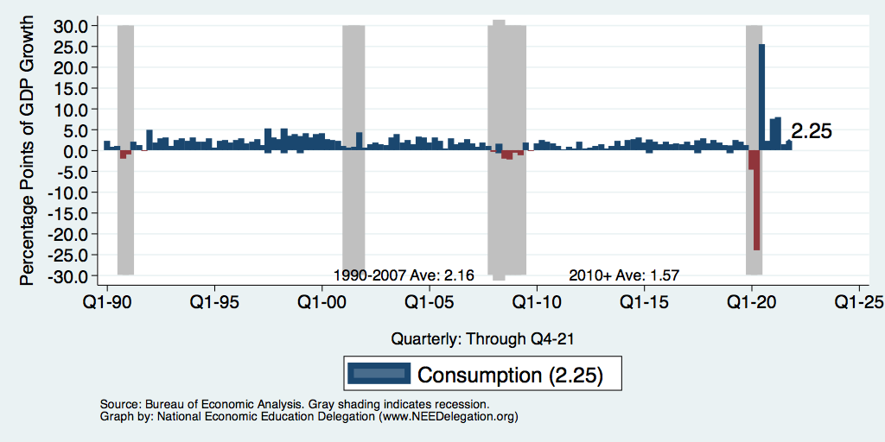
Consumption: Quarterly Growth
Notes:
Graph: gdp_pot_grow.png
The Point: From 1990 – 2007, average annual US GDP growth pre-crisis is 2.94%. However, post-crisis US GDP growth is 2.19% (0.75 percentage points lower). Why is has the recovery been sluggish?
Note: At the recession’s height, the gap between quarterly GDP growth and potential growth was 2.5 percentage points.

Slide 100
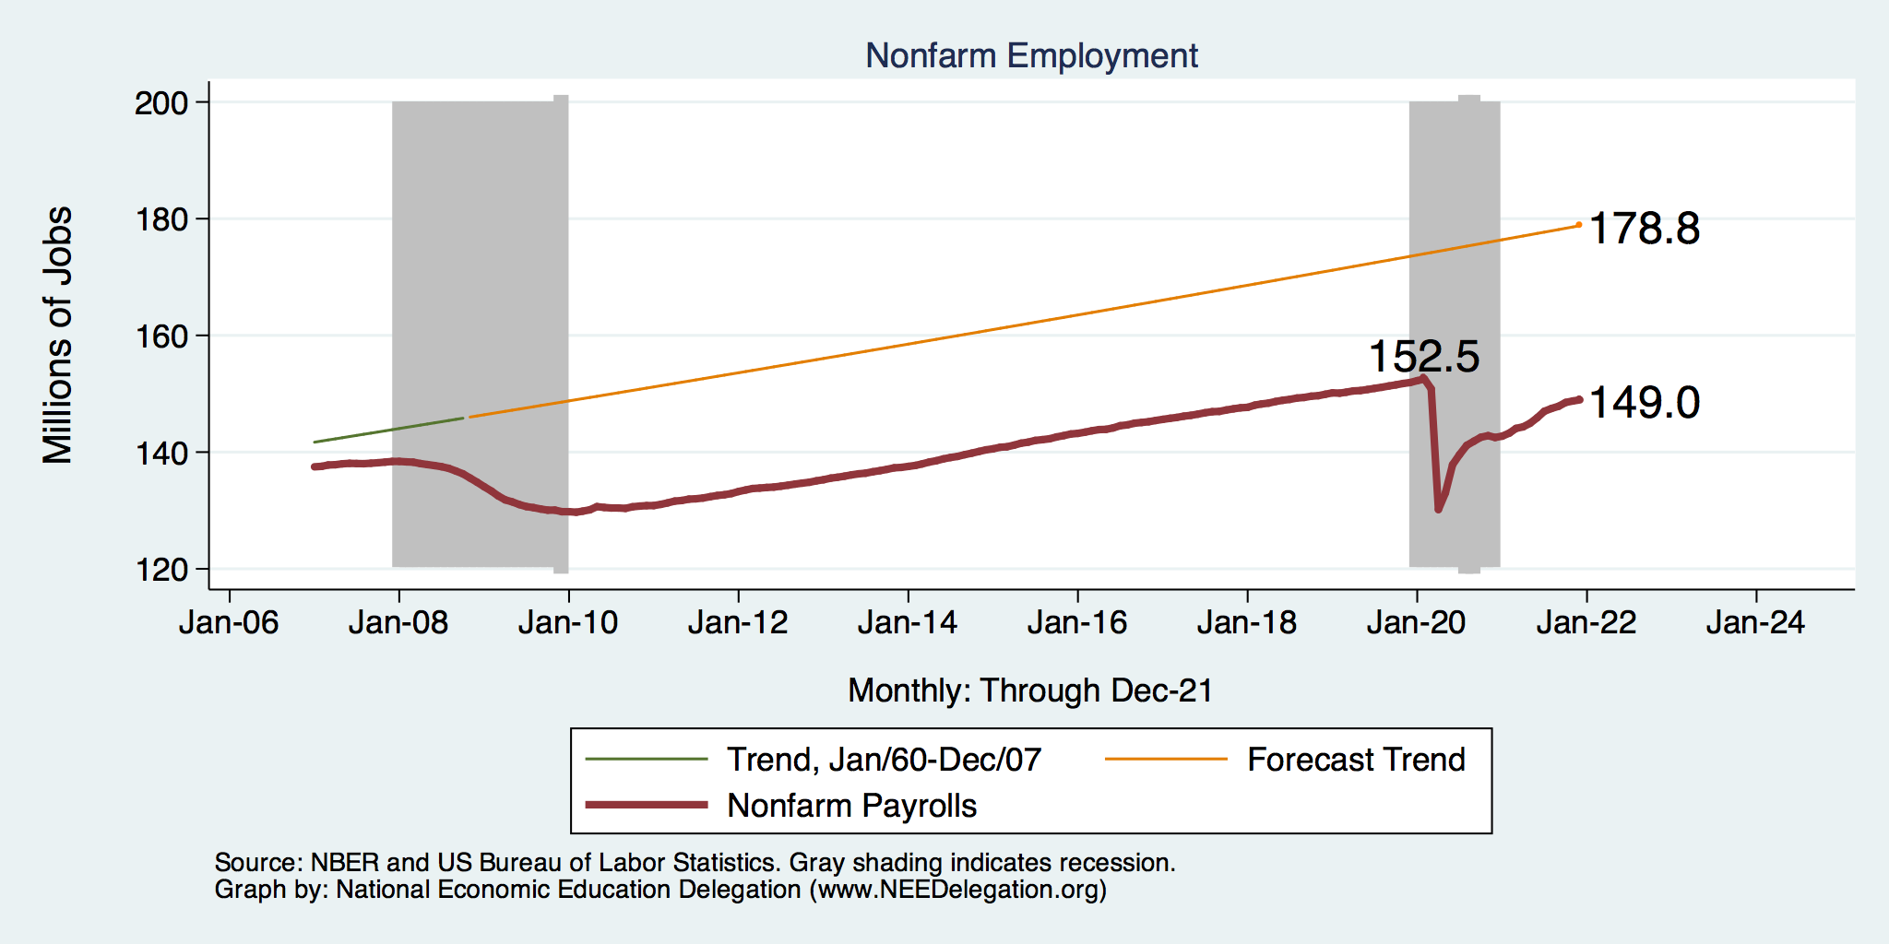
Employment Gap
Notes:
payroll_recent.png

Slide 101
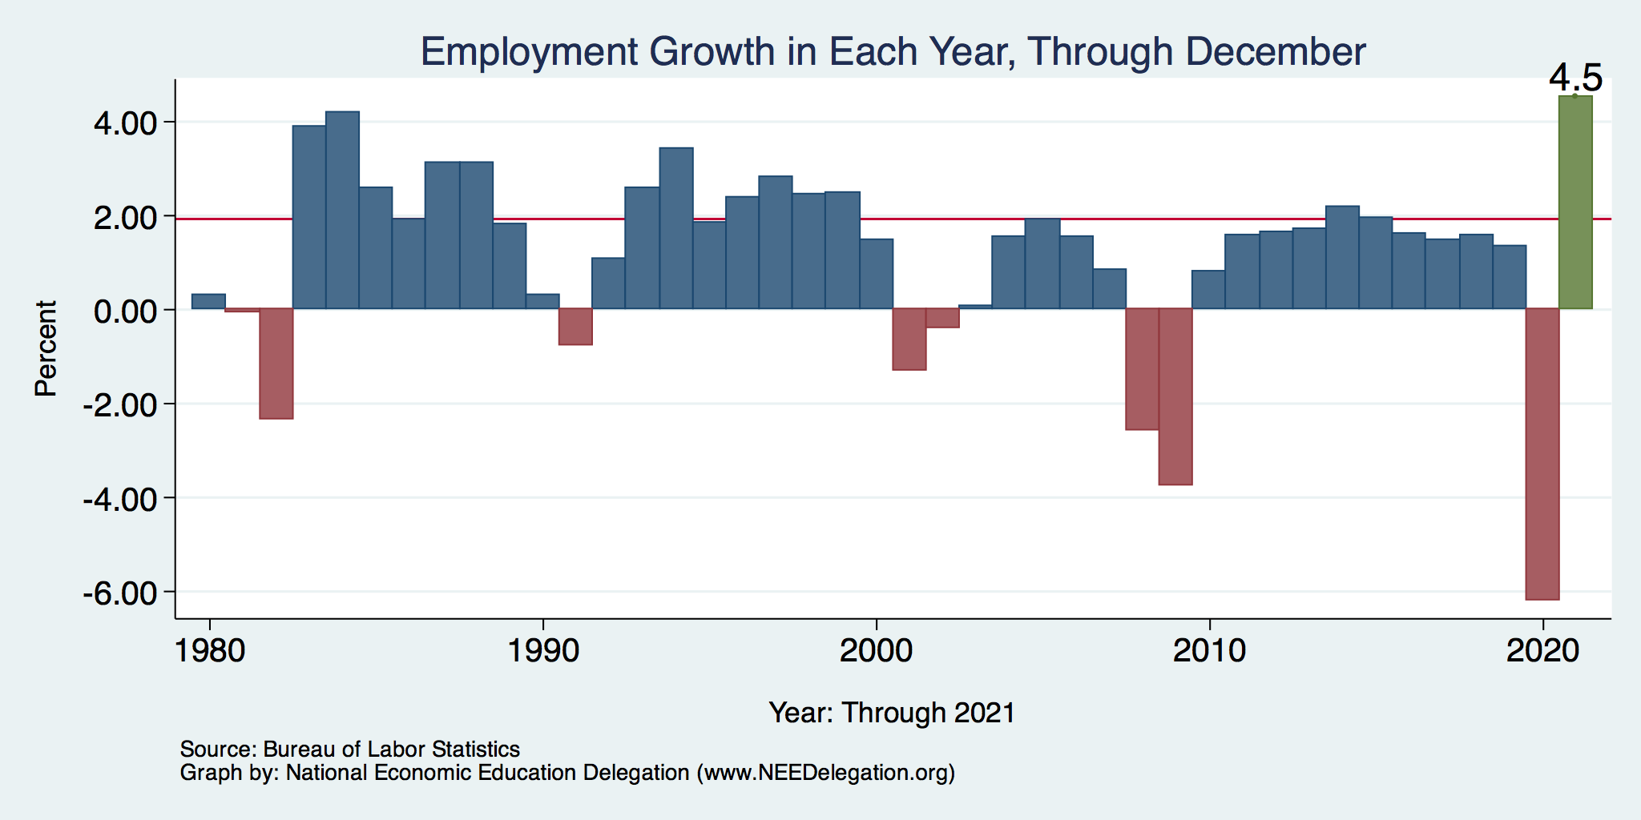
Annual Changes in Nonfarm Employment

Slide 102
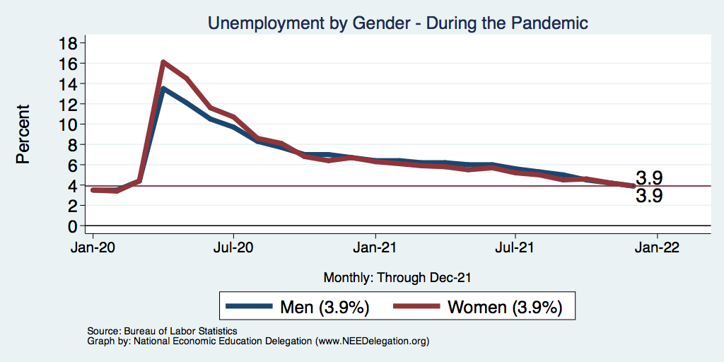
Affected Women More Than Men?

Slide 103
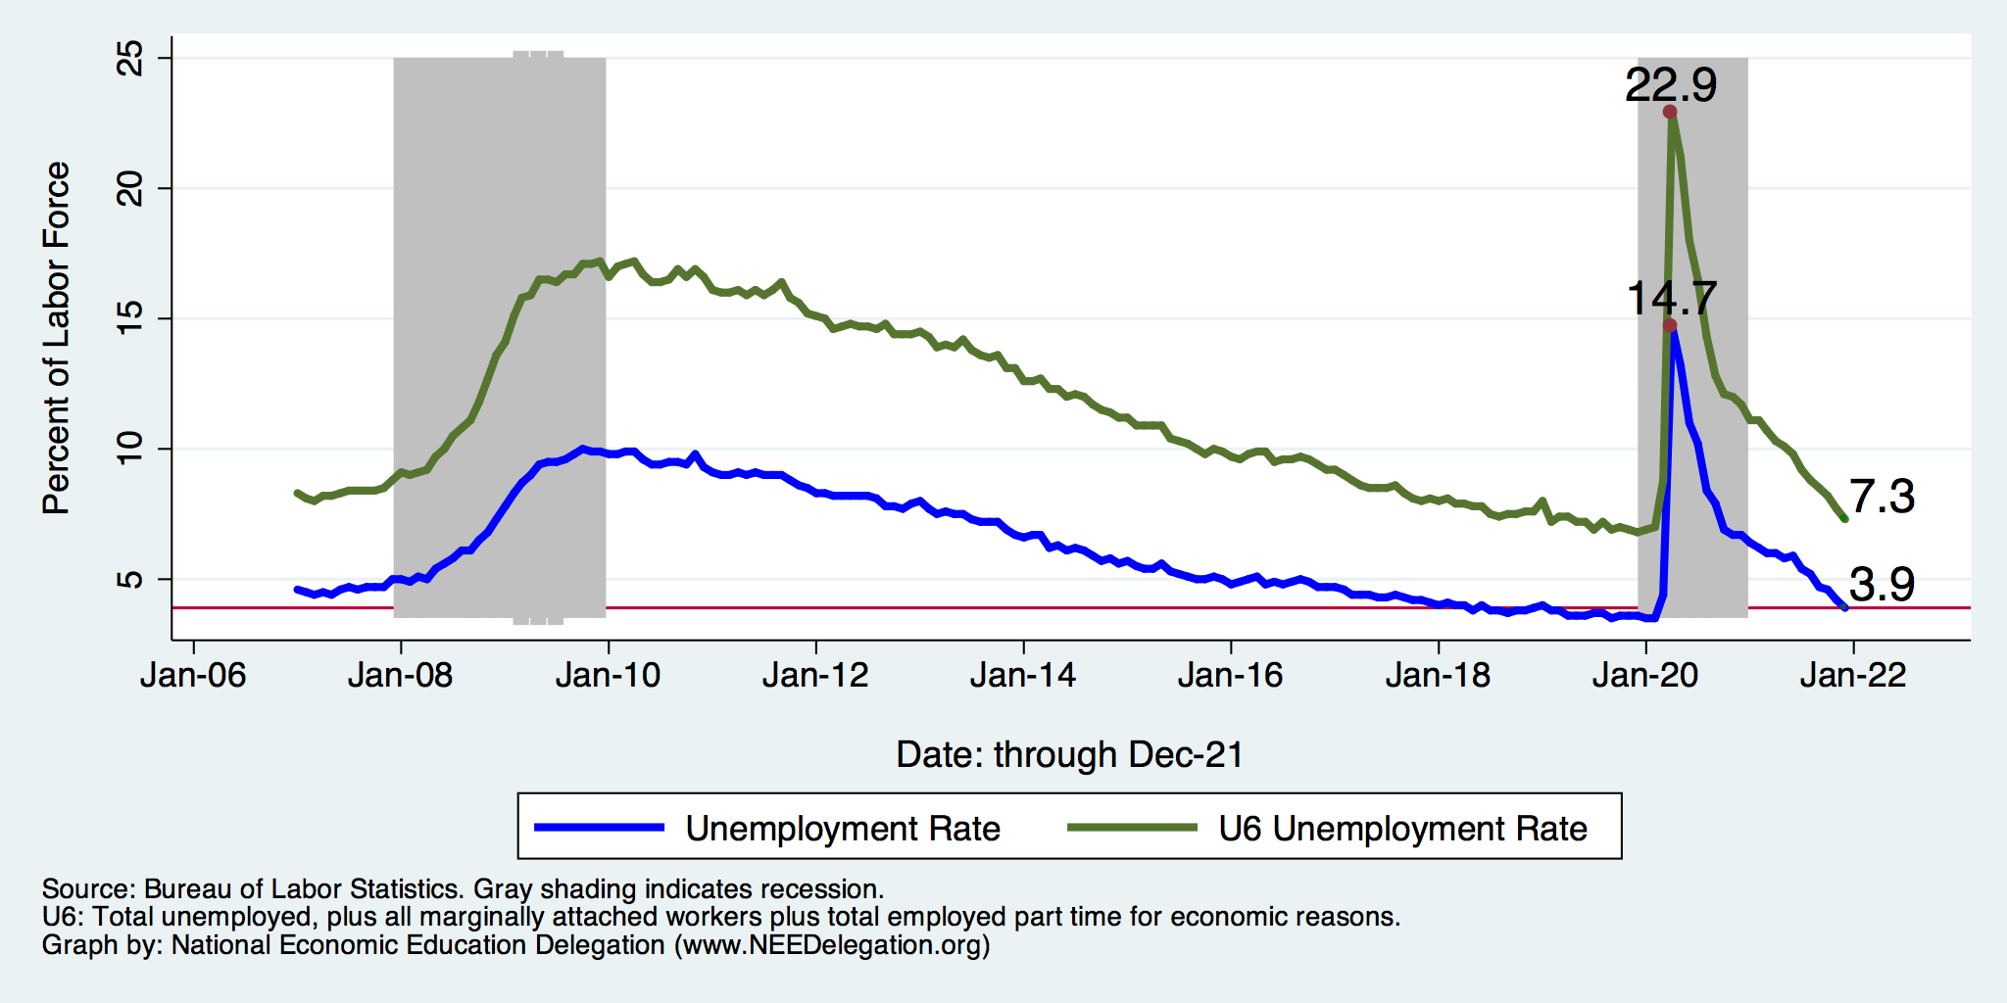
Another Measure: Unemployment
Peak: 22.9%
(April, 2019)

Slide 104
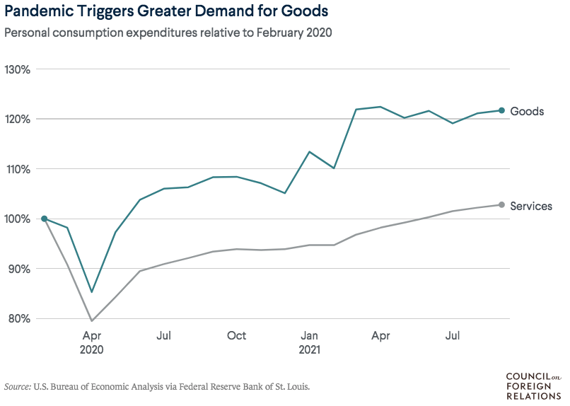
Supply Chains Are at the Core

Slide 105
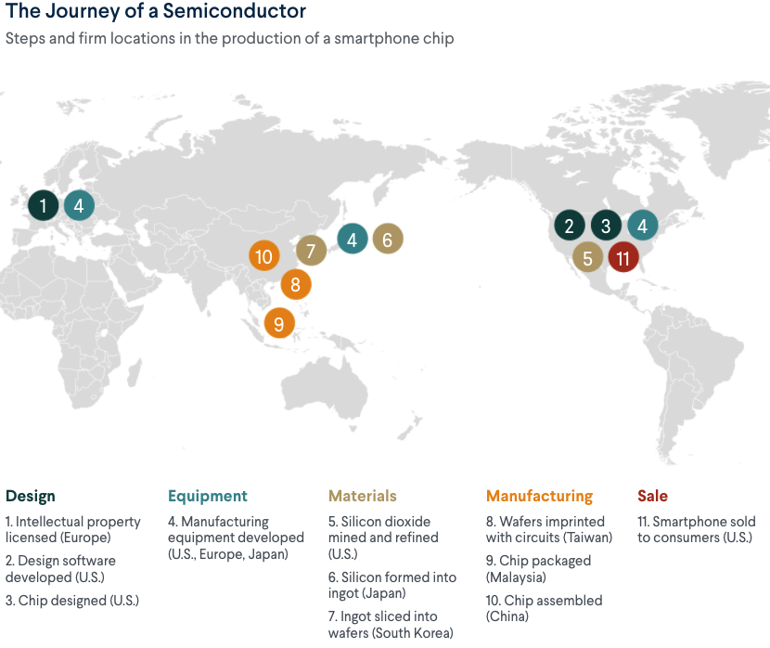
What Are Supply Chains?
https://www.cfr.org/article/what-happened-supply-chains-2021

Slide 106
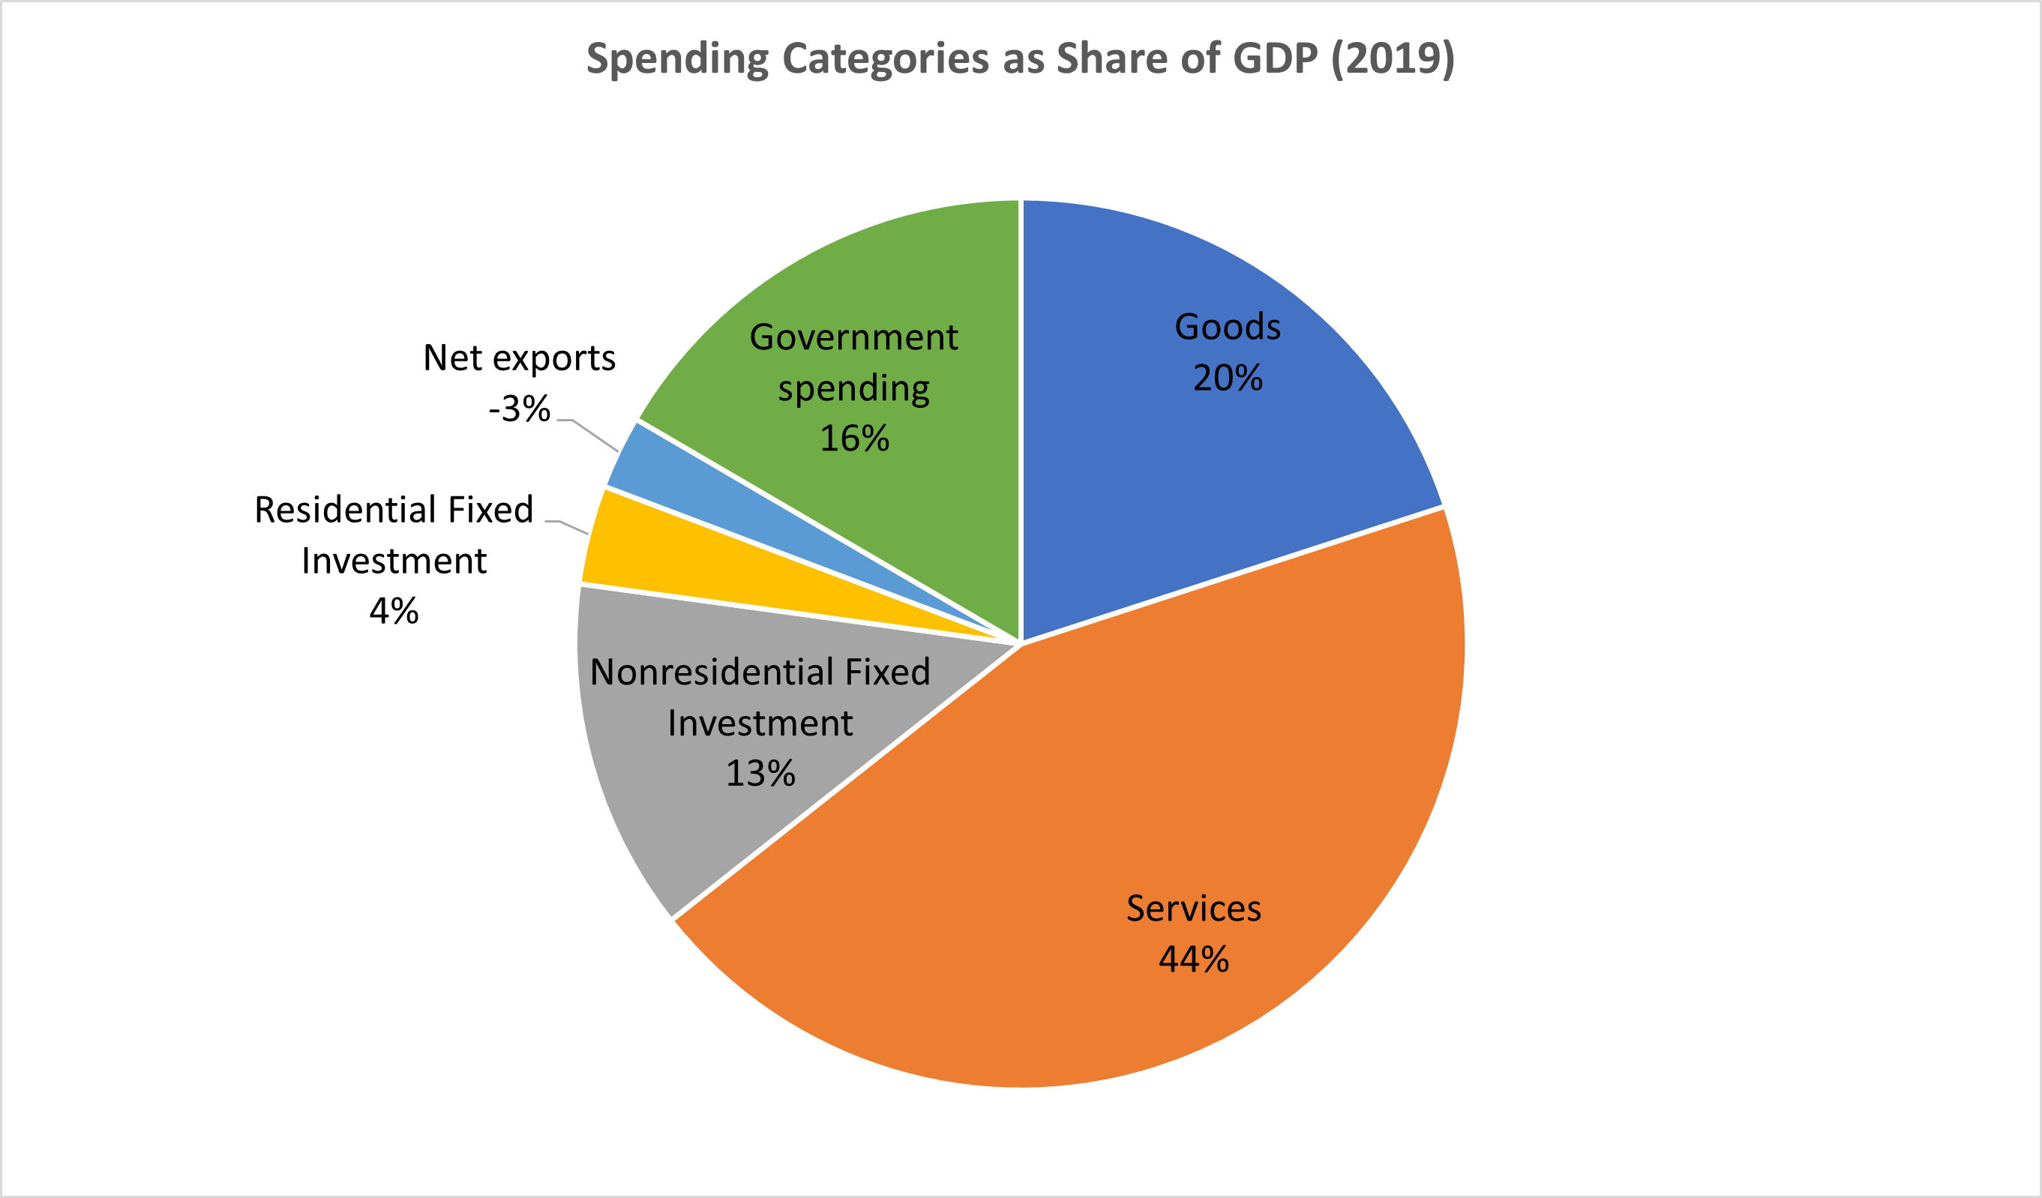
Why does spending matter?
Spending:
Goods 20%
Services 44%
Total 64%
Notes:
Components sum to GDP
Average % of GDP for each component from 1960-Present: C = 64%, I=15%, G=24%, NX = 2% (X = 7%, M=9%)
Net Exports as a % of GDP has increased over the sample period, but it’s contribution to GDP is relatively small

Slide 107
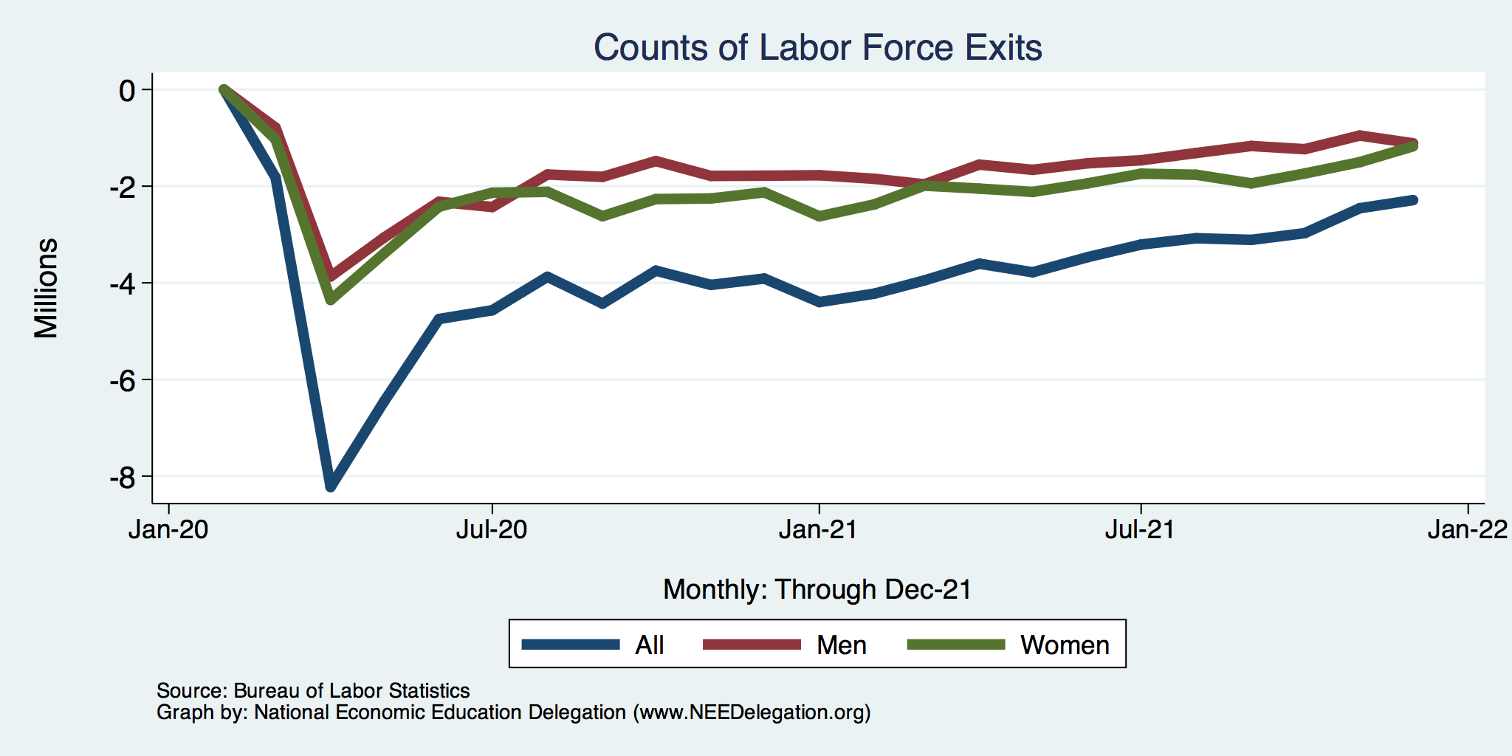
Affected Women More Than Men
Men
Women
Long term implications for women?

Slide 108
Why Women More Than Men?
Women are disproportionately represented in low-wage and face-to-face jobs.
Our childcare and school systems don’t meet the needs of working mothers.
COVID-19 has upended the labor market, with disastrous consequences for working women and their families.
  Many women continued working in high risk jobs.
The difference in impact is waning.

Slide 109
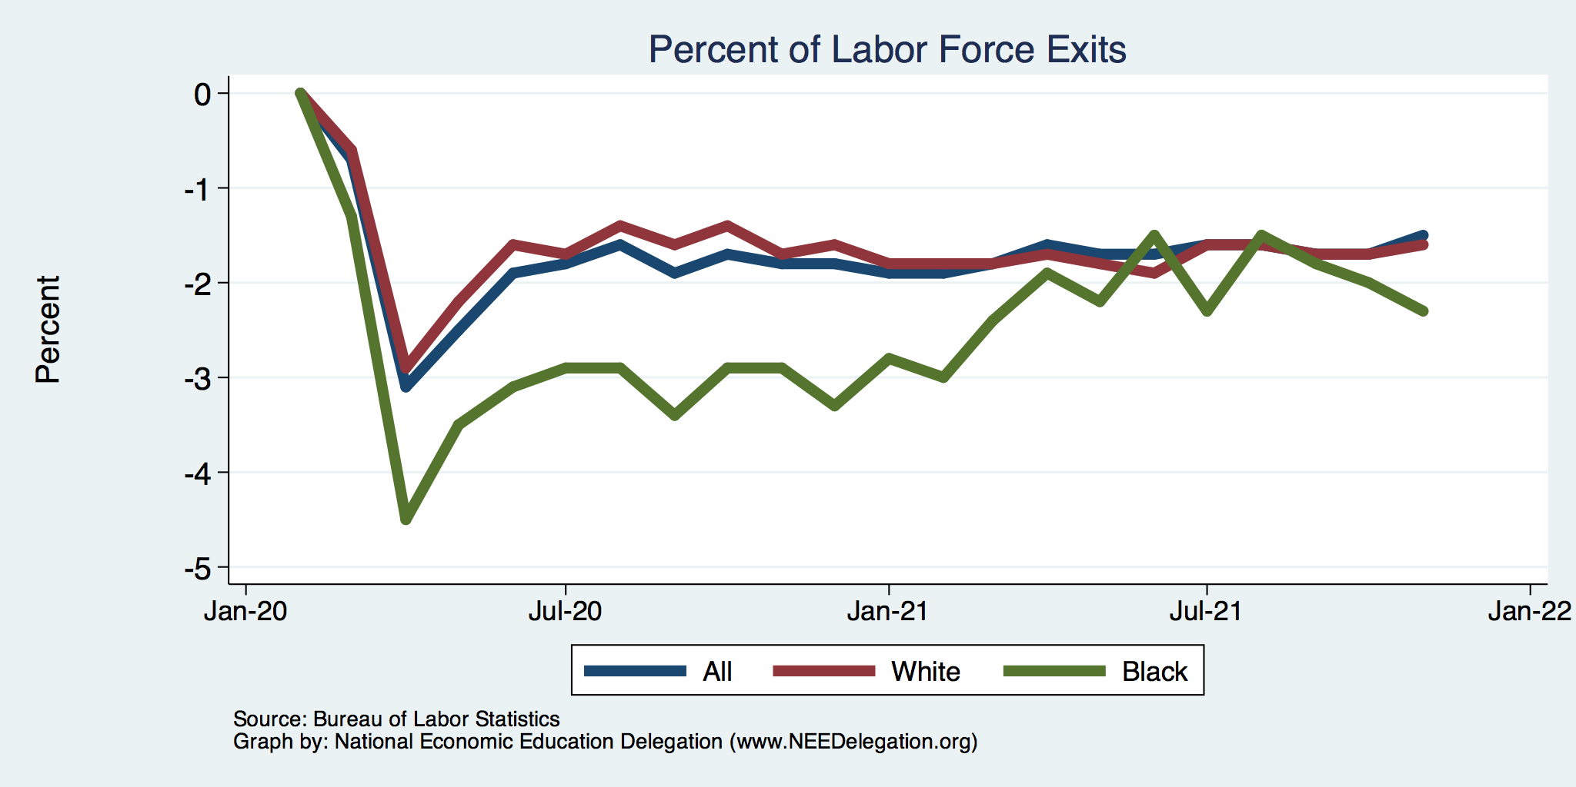
Affecting Black Workers More than White
White
Black

Slide 110
What Index to Follow: CPI or PCE?
CPI is the headline statistic, followed by most newspapers.
  Allows more granularity – ability to look at specific products.
PCE is the one followed by the Fed.
  Why?
    Accounts for short term fluctuations in consumer purchases.
    Based on more reliable data.
Fed generally pays attention to the core inflation #s.
  Excluding food and energy.

Slide 111
Inflation: Critical Issues
Inequities
  Price changes vary wildly across goods.
  How inflation hits you depends on what you buy and your level of income.
    Some evidence that lower income individuals face higher inflation.
Online inflation is much lower than the CPI
  Estimates suggest about 2% lower.
Both have implications for the policy response.
  Safety net? Antitrust action?

Slide 112
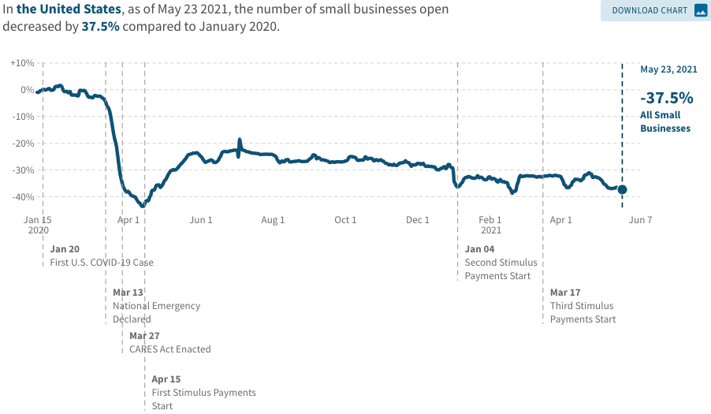
A Hard-Hit Sector: Small Business
Small Biz Closures in the United States

Slide 113
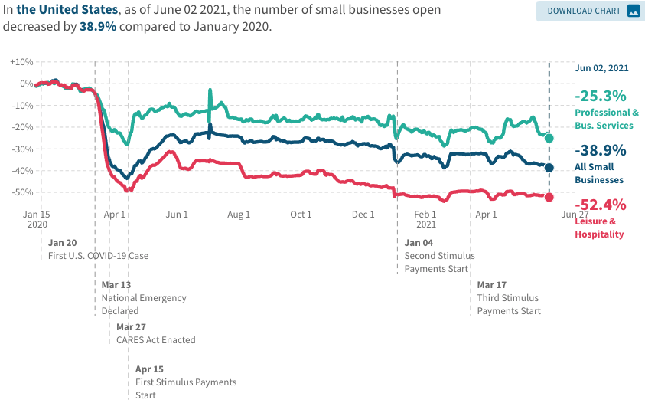
Small Businesses: They Didn’t Get Enough PPP

Slide 114
A “K-shaped” recovery?
Executive Summary
Those with financial wealth/residential real estate have seen its value grow in excess of inflation.
High income earners (>60k/yr) have largely kept their jobs;
  middle and low income earners have depressed employment rates
Women are disproportionately exiting labor force.
Food insecurity has been very high.

Slide 115
Coronavirus and Inequality
Resources to weather the storm.
Racial inequities.
Educational inequities
Telecommuting
Low wage jobs are at risk.

Slide 116
Monetary Policy: Federal Reserve
Primary goal is to keep interest rates low, to facilitate continued borrowing.
  Federal Funds Rate – rate at which banks lend to each other, usually overnight.
  Purchases of U.S. Treasury securities – keep money flowing to the government at low rates of interest.

Slide 117
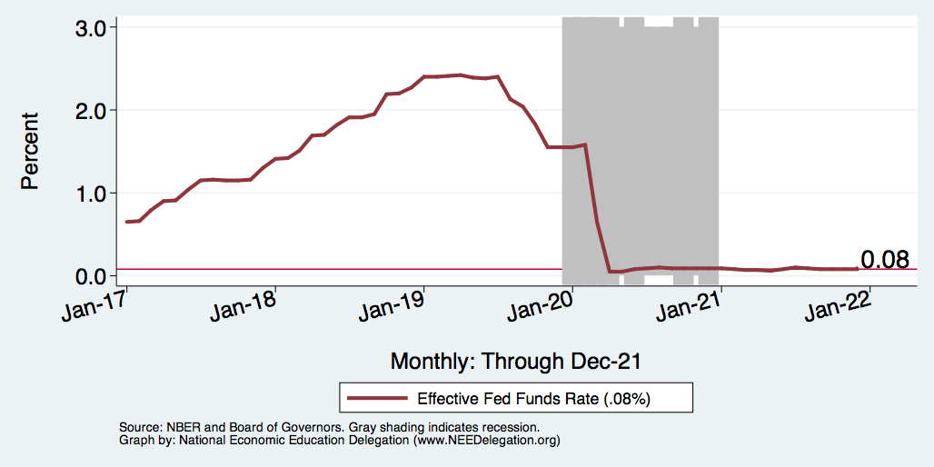
Federal Funds Rate – Last 5 Years
Notes:
The FOMC waited for labor market conditions to improve before raising the fed funds rate in late 2015.
FOMC currently working to normalize monetary policy by raising interest rates and reducing assets on its balance sheet
FedFunds_recent.png

Slide 118
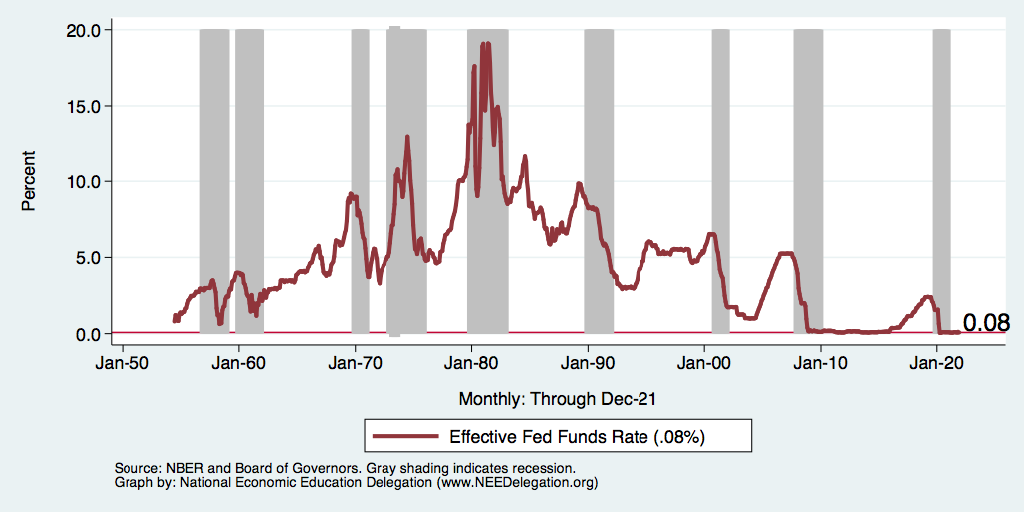
Federal Funds Rate
Notes:
The fed funds rate is the interest rate on overnight loans between banks. Think of it as the baseline interest rate on which banks base all other interest rates (e.g. mortgage rates)
FOMC lowers the fed funds rate during recessions and raises the fed funds rate during expansions
Fed funds rate peaked in the 1980s as then Chairman Paul Volcker sought to reign in “run away” inflation of the 1970s; doing so resulted in a recession in the early 1980s.
Since the 2008-09 recession, the fed funds rate has been kept near zero.
During the 2008-09 recession, Federal Reserve turned to unconventional tools to influence longer term interest rates to further stimulate the economy - QE
FedFunds.png

Slide 119
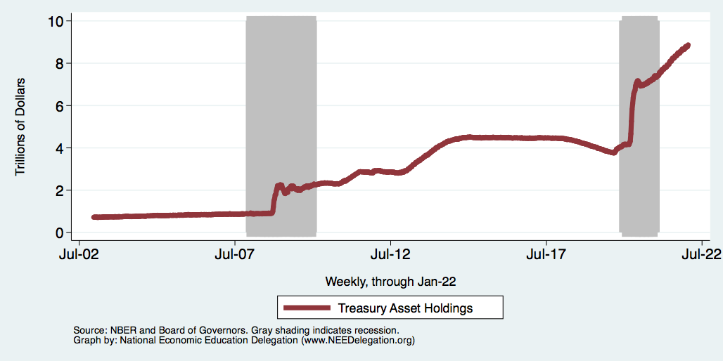
Federal Reserve Assets
8.8
Largely Treasury Securities
Pandemic
Financial Crisis
3.8
1.0
Notes:
The fed funds rate is the interest rate on overnight loans between banks. Think of it as the baseline interest rate on which banks base all other interest rates (e.g. mortgage rates)
FOMC lowers the fed funds rate during recessions and raises the fed funds rate during expansions
Fed funds rate peaked in the 1980s as then Chairman Paul Volcker sought to reign in “run away” inflation of the 1970s; doing so resulted in a recession in the early 1980s.
Since the 2008-09 recession, the fed funds rate has been kept near zero.
During the 2008-09 recession, Federal Reserve turned to unconventional tools to influence longer term interest rates to further stimulate the economy - QE
FedFunds.png

Slide 120
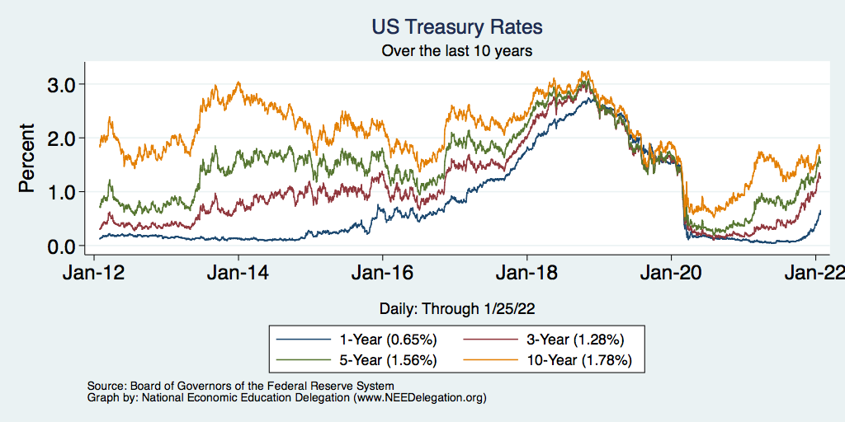
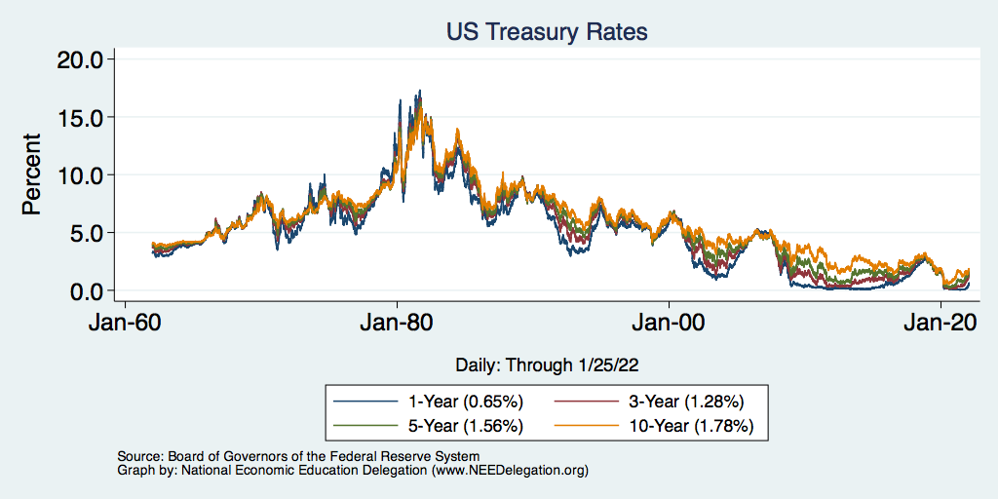
Treasuries – Low Interest Rates
Notes:
treas_recent.png

Slide 121
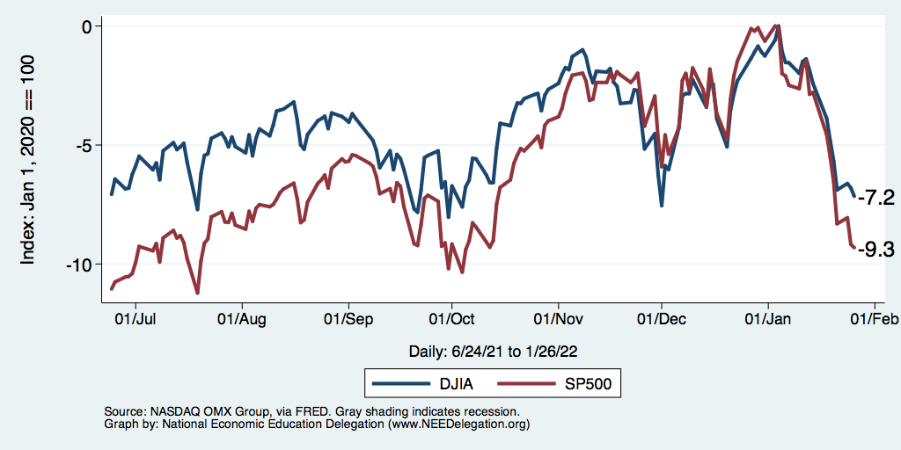
Markets Respond To Fed Policies
…and COVID and Russia and Inflation
Notes:
CV_DJSP_6mo.png

Slide 122
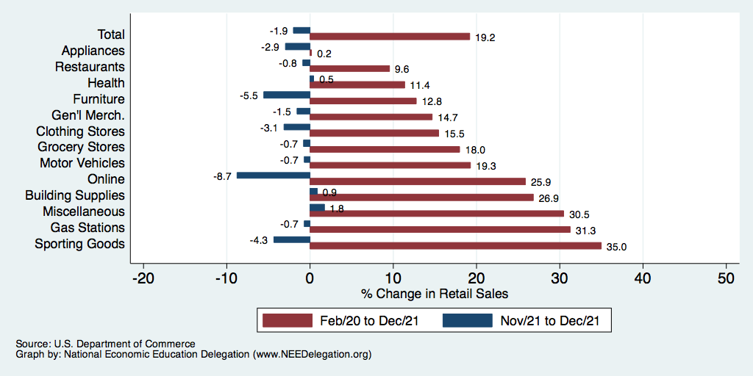
Retail Sales Are Slowing
Could be X-mas shopping
all happened in November.
(Supply chain awareness?)

Slide 123
www.NEEDelegation.org/LocalGraphs
For every state and county in the United States.
Detailed graphs on employment, housing, moves, and other statistics.

Slide 124
Osher Lifelong Learning Institute, Winter 2022
Contemporary Economic Policy
Clemson University
January-February, 2022
National Economic Education Delegation

Slide 125
National Economic Education Delegation
Vision
  One day, the public discussion of policy issues will be grounded in an accurate perception of the underlying economic principles and data.
Mission
  NEED unites the skills and knowledge of a vast network of professional economists to promote understanding of the economics of policy issues in the United States.
NEED Presentations
  Are nonpartisan and intended to reflect the consensus of the economics profession.

Slide 126
Who Are We?
Honorary Board: 54 members
  2 Fed Chairs: Janet Yellen, Ben Bernanke
  6 Chairs Council of Economic Advisers
    Furman (D), Rosen (R), Bernanke (R), Yellen (D), Tyson (D), Goolsbee (D)
  3 Nobel Prize Winners
    Akerlof, Smith, Maskin
Delegates: 649+ members
  At all levels of academia and some in government service
  All have a Ph.D. in economics
  Crowdsource slide decks
  Give presentations
Global Partners: 48 Ph.D. Economists
  Aid in slide deck development

Slide 127
Where Are We?

Slide 128
Available NEED Topics Include:
Coronavirus Economics
US Economy
Climate Change
Economic Inequality
Economic Mobility
Trade and Globalization
Minimum Wages
Immigration Economics
Housing Policy
Federal Budgets
Federal Debt
Black-White Wealth Gap
Autonomous Vehicles
US Social Policy

Slide 129
Course Outline
Contemporary Economic Policy
  Week 1 (1/31): US Economy & Coronavirus Economics
  Week 2 (2/7): Monetary Policy (Geoffrey Woglom, Amherst College)
  Week 3 (2/14): Trade (Alan Deardorff, University of Michigan)
  Week 2 (1/21): Climate Change Economics (Sarah Jacobson, Williams College)

Slide 130
Monetary Policy Is About the Interest Rate
The FOMC does not set an exact number for the Federal funds rate. Instead, it sets an upper (green line) and lower (blue) range.
“The Committee decided to keep the target range for the federal funds rate at 0 to 1/4 percent…” (4/28/2021)
Grey bars are recessions

Slide 131
Trade: Bicycle Supply Chain
Source: World Development Report 2020

Slide 132
Climate Change Economics
The changing map of the world’s wine-growing regions.

Slide 133
Submitting Questions
Please submit questions in the chat.
  I will try to handle them as they come up, but may take them in a bunch as time permits.
We will do a verbal Q&A once the material has been presented.
  And the questions in the chat have been addressed.
OLLI allowing, we can stay beyond the end of class to have further discussion.

Slide 134
US Economy and Coronavirus Economics
Scott Baier, Ph.D.
Clemson University
National Economic Education Delegation

Slide 135
Credits and Disclaimer
This slide deck was authored by:
  Jon D. Haveman, NEED
  Scott Baier, Clemson University
  Geoffrey Woglom, Amherst College (Emeritus)
  Brian Dombeck, Lewis & Clark College
  Doris Geide-Stevenson, Weber State
Disclaimer
  NEED presentations are designed to be nonpartisan.
  It is, however, inevitable that the presenter will be asked for and will provide their own views.
  Such views are those of the presenter and not necessarily those of the National Economic Education Delegation (NEED).

Slide 136
Outline
State of the pandemic
The U.S. Economy
Hot Topics
  Government policy
  Debt
  Inflation
  Great resignation

Slide 137
State of the Pandemic

Slide 138
Making Real Progress…Until Omicron
Nationally
Source: NYTimes

Slide 139
Omicron is Making Things Difficult
Covid-related absences:
  Are creating headaches for businesses that were struggling to hire workers even before Omicron.
  Restaurants and retail stores have cut back hours.
  Broadway shows called off performances.
  Airlines canceled thousands of flights over the holidays because so many crew members called in sick;
  on one day last month, nearly a third of United Airlines Workers at Newark Liberty International Airport, a major hub, called in sick.
Source: NYTimes.com

Slide 140
Arizona Cases Are Falling Nicely
S. Carolina
Source: NYTimes

Slide 141
The U.S. Economy

Slide 142
Some Basic Statistics
Statistic: | Value
Population | 331.9 Million
Labor Force | 162.3 Million
Employment | 149.0 Million
Gross Domestic Product (GDP) | $23.9 Trillion
Income per Capita | $63,002
Ave. Hourly Earnings | $31.31

Slide 143
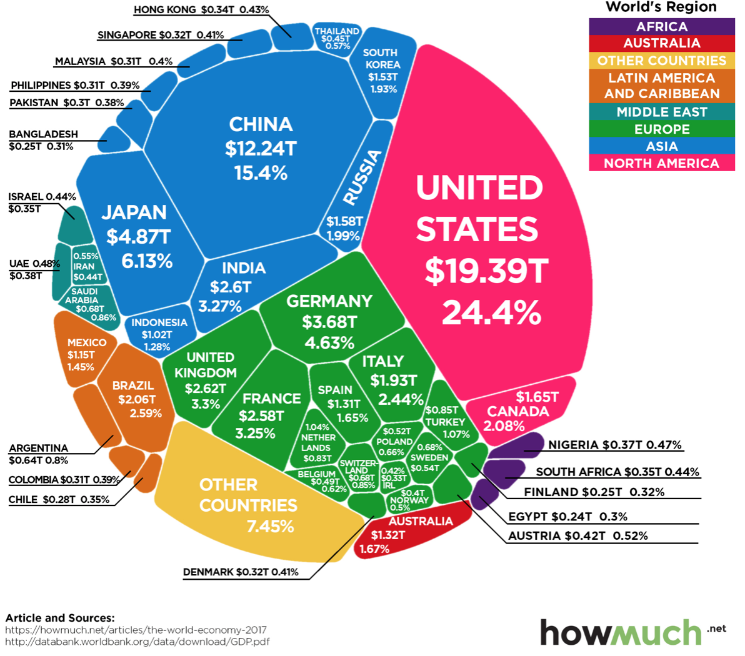
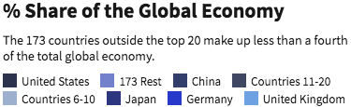
U.S. Economy in Global Perspective
U.S. Real GDP:
$19.202 trillion in 2019-Q4
$17.258 trillion in 2020-Q2
$19.806 trillion in 2021-Q4
Notes:
https://www.investopedia.com/insights/worlds-top-economies/#countries-by-gdp

Slide 144
Composition of the U.S. Economy: GDP
Share of Total GDP
Source: U.S. Bureau of Economic Analysis

Slide 145
Anderson County GSP: Manufacturing!
Share of GDP
Source: U.S. Bureau of Economic Analysis

Slide 146
Anderson County Employment
Share of Total Employment
Source: U.S. Bureau of Economic Analysis

Slide 147
Evidence of Impact

Slide 148
GDP Trajectory: Pandemic Plunge!

Slide 149
GDP Trajectory: Great Recession Slowdown!
11% Gap
Income per person
would be about
$5,000 higher.

Slide 150
GDP: Quarterly Growth: 1990. - 2019
Notes:
Graph: gdp_pot_grow.png
The Point: From 1990 – 2007, average annual US GDP growth pre-crisis is 2.94%. However, post-crisis US GDP growth is 2.19% (0.75 percentage points lower). Why is has the recovery been sluggish?
Note: At the recession’s height, the gap between quarterly GDP growth and potential growth was 2.5 percentage points.

Slide 151
GDP: Quarterly Growth: 1990 - 2019
Notes:
Graph: gdp_pot_grow.png
The Point: From 1990 – 2007, average annual US GDP growth pre-crisis is 2.94%. However, post-crisis US GDP growth is 2.19% (0.75 percentage points lower). Why is has the recovery been sluggish?
Note: At the recession’s height, the gap between quarterly GDP growth and potential growth was 2.5 percentage points.

Slide 152
GDP Growth: Mostly Inventories
Notes:
Graph: gdp_pot_grow.png
The Point: From 1990 – 2007, average annual US GDP growth pre-crisis is 2.94%. However, post-crisis US GDP growth is 2.19% (0.75 percentage points lower). Why is has the recovery been sluggish?
Note: At the recession’s height, the gap between quarterly GDP growth and potential growth was 2.5 percentage points.

Slide 153
Spending Patterns Since First US Case
24.7%
Q3 - Flat
Source: https://tracktherecovery.org/

Slide 154
Spending Patterns: Income Groups
Source: https://tracktherecovery.org/

Slide 155
But Not All Industries Were Equally Harmed

Slide 156
Spending Patterns – Hardest Hit Sectors
Health
Food & Accom
Arts & Entertain
Source: https://tracktherecovery.org/

Slide 157
Monthly Changes in Nonfarm Employment
From 1990 -2007, average gain in employment each month averaged about 131,000
Notes:
PAYEMS.png

Slide 158
Monthly Employment: Hires and Separations
Hires
Separations
Notes:
PAYEMS.png

Slide 159
Monthly Changes in Nonfarm Employment
Notes:
PAYEMS.png

Slide 160
Monthly Employment: Hires and Separations
Notes:
PAYEMS.png

Slide 161
Monthly Changes in Nonfarm Employment
In March and April of 2020, the US economy lost more than 22 million jobs.
Since that time, the economy has recovered about 18.8 million jobs.
Still roughly 3.5 million jobs below where we were in 2/2020
If you consider the normal addition of 131 k jobs per month, we about 6.5 million below where we should be.
Notes:
PAYEMS.png

Slide 162
Monthly Changes in Nonfarm Employment
Notes:
PAYEMS.png

Slide 163
Monthly Changes in Nonfarm Employment
Notes:
PAYEMS.png

Slide 164
Unemployment Rate
Notes:
Unemployment rises during recessions and falls during economic expansions.
Unemployment peaked at the end of the 2009 recession.
The Fed worked to reduce the effects of the recession. Near the end of 2008, the FOMC reduced the federal funds rate to nearly zero and worked to reduce longer-term interest rates via large-scale asset purchase programs (late 2008 – 10/2014).
Unemployment is currently below the natural rate of unemployment. This is traditionally accompanied by economic growth and rising price levels. It’s also a major reason for FOMC’s decision to increase the federal funds rate.

Slide 165
Trends in Labor Force Participation
Notes:
CLF16OV.png

Slide 166
Labor Force is Shrinking – Drives Down UR
7%

Slide 167
Employment in Anderson County

Slide 168
Hot Topics
Economic Recovery and Government policy
Inflation
Great resignation
Housing markets
Structural changes

Slide 169
Personal Consumption Expenditures
Trend from2010-2019

Slide 170
What Have Been Policy Effects?
MONETARY POLICY (Fed) acted quickly and effectively to prevent a financial market meltdown and to keep credit flowing. But the Fed lends and does not spend.
FISCAL POLICY (Congress) acted quickly, but inevitably made some mistakes.
  Stimulus Checks, A ($268b)
  Expanded Unemployment, B ($268b)
  Paycheck Protection Program, C- ($525b)

Slide 171
Personal Disposable Income

Slide 172
Personal Savings as a Fraction of Disposable Income

Slide 173
Retail Sales: Retail Trade and Food Services
Retail Sales is about 11% above trend
This represents a shift to more goods consumption and less service consumption

Slide 174
Spending Patterns: Income Groups
Source: https://tracktherecovery.org/

Slide 175
South Carolina Spending
31.4
Opportunity Insights

Slide 176
Durable Goods and Service Consumption
Consumption of durable goods is about 35% higher than its pre-pandemic levels
Consumption of services is almost back to pre-pandemic levels.
Note: PC Expenditures Services are nearly 6.5 times greater than PC expenditures on Durables

Slide 177
Low Wage Employment is Lagging

Slide 178
Low Income Troubles

Slide 179
Take Away: Consumption and the Recovery
Consumption has rebounded rapidly coming out of the recession.
The rebound in consumption was supported by the stimulus packages that were passed by the Trump and Biden Administration.
Compared to before the pandemic consumption has shifted more toward the consumption of goods and away from services.
  This a demand effect that is causing some of the supply chain disruptions

Slide 180
Inflation

Slide 181
Inflation

Slide 182
What is Driving Inflation?
Profiteering / Greed: President Biden and Senator Elizabeth Warren.
Supply Chains Disruptions:
  the pandemic has impacted the ability to get parts and supplies.
  Labor shortages and rising wages have raised costs and help push up prices.
Increased Demand:
  During the pandemic there has been an increase in demand for goods. For many of these goods, it is not easy to ramp up production.
  The fiscal and monetary authorities have provided lots of stimulus.

Slide 183
Profits: Profit Margins
After-Tax Profit Margins
After-Tax and Before Tax Profit Margins

Slide 184
Supply Chain Delays: ISM Delivery Days

Slide 185
Supply Chain Delays: It is Not All Supply Shortages

Slide 186
Money Growth: M2 (Transactions Money)
6.1%

Slide 187
Annualized Money Growth
Growth Rate of Money Stock (percent per year) | Beginning of Period | End of Period
6.1 | January 2000 | March 2020
46.3 | April 2020 | June 2020
12.3 | July 2020 | November 2021

Slide 188
Real Personal Disposable Income
2.5%
2.8%

Slide 189
Personal Savings as a Fraction of Disposable Income

Slide 190
Durable Goods and Service Consumption
Consumption of durable goods is about 35% higher than its pre-pandemic levels
Consumption of services is almost back to pre-pandemic levels.

Slide 191
Inflation: Concentrated
Cost-Push

Slide 192
Inflation: Or is it More Broad Based

Slide 193
Is Inflation Permanently Higher?
Fed: Price increases may be:
  1) rebound from low prices last year;
  2) temporary due to supply chain disruptions; e.g., used cars, bldg supplies.
  3) influenced by rising wages in the future.
Omicron:
  Lessen inflation in the short term.
  Increase it in the long term by increasing supply chain issues.
Nobody knows, but Fed has wavered in its optimism.
  Uncertainty hurts both workers and businesses – hard to plan.

Slide 194
The Great Resignation

Slide 195
Monthly Employment: Hires and Separations
Hires
Separations
Notes:
PAYEMS.png

Slide 196
Employment Dynamics: Separations and Hires

Slide 197
Employment Dynamics: Quits and Layoffs
QUITS

Slide 198
Employment Dynamics
Job Openings
Job Hires

Slide 199
Pre-COVID Quit Rates by Industry

Slide 200
Pre & Post COVID Quit Rates by Industry

Slide 201
This is Happening Despite Rising Wages
Leisure & Hospitality
Total Nonfarm

Slide 202
Inflation Adjusted Wages Are Falling

Slide 203
Great Resignation: Employment Situation
Employment is still on the rebound rebound
The real challenge has been for employers to fill vacancies.
What gives?
  Extended (or expected continuation) unemployment benefits and other stimulus payments
  Parents with young children at home.
  Workers reluctant to work in certain industries and occupations
  Workers looking for different career opportunities.
  Workers looking for better employment opportunities withing their industry/occupation – non-pecuniary benefits
    Increased desire to have the option to work from home.
    Better working conditions
    Recognition of accomplishments

Slide 204
Debt and Deficit

Slide 205
A Problem Exacerbated….Not Created

Slide 206
Current Deficits in Perspective:
The budgetary cost of the 3 major fiscal packages during the pandemic was over $5 trillion. As a share of the economy this is almost the size of war production in 1943.
  (Romer, Brookings Papers on Economic Activity, 3/25/2021.)
Since March of 2021, Fed net holdings of US Treasury bonds have increased by $2.7 trillion.

Slide 207
The End

Slide 208
Source: Investopedia

Slide 209
We’re Buying Mostly … Stuff
Demand-Pull
Source: Jason Furman, PIIE

Slide 210
Inflation: Concentrated
Cost-Push

Slide 211
Corporate Profits…Adding to Inflation?

Slide 212
Inflation – Climbing! Should we worry?
Notes:
Cpi_recent.png

Slide 213
Inflation in Historical Perspective

Slide 214
Inflation – The Fed’s Metric! Should we worry?
Notes:
Cpi_recent.png

Slide 215
Inflation – PCE and Fed Suggest: I don’t know.
Notes:
Cpi_recent.png

Slide 216
Declining Resources May Change Things
Source: NYTimes.com

Slide 217
Real Estate

Slide 218
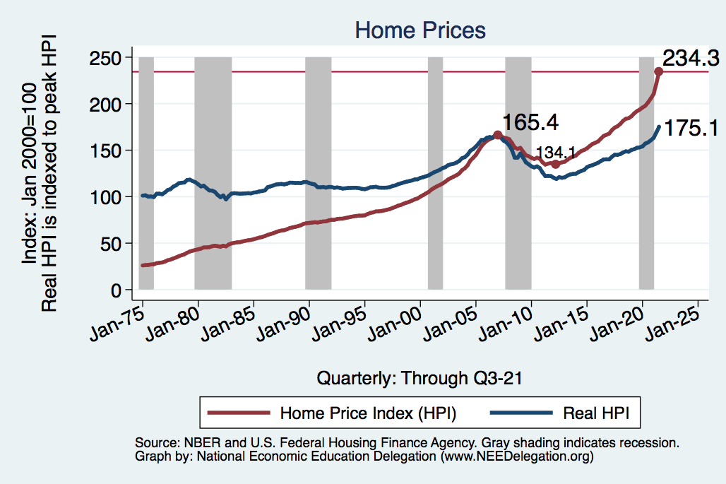
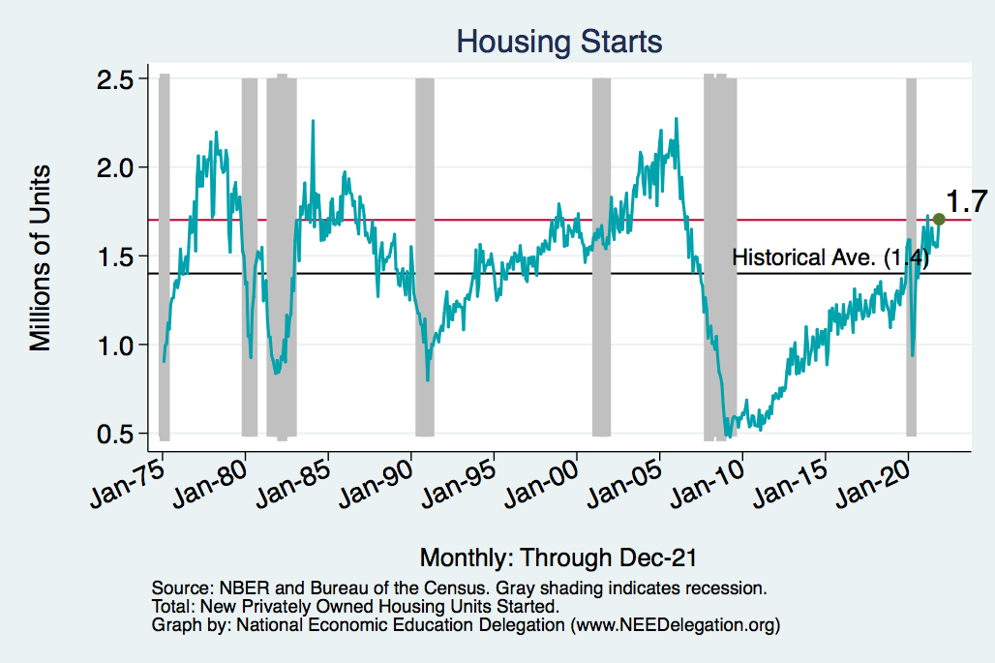
Home Prices and Housing Starts
Notes:
Charts:
homeprices_recession.png
housing.png

Slide 219
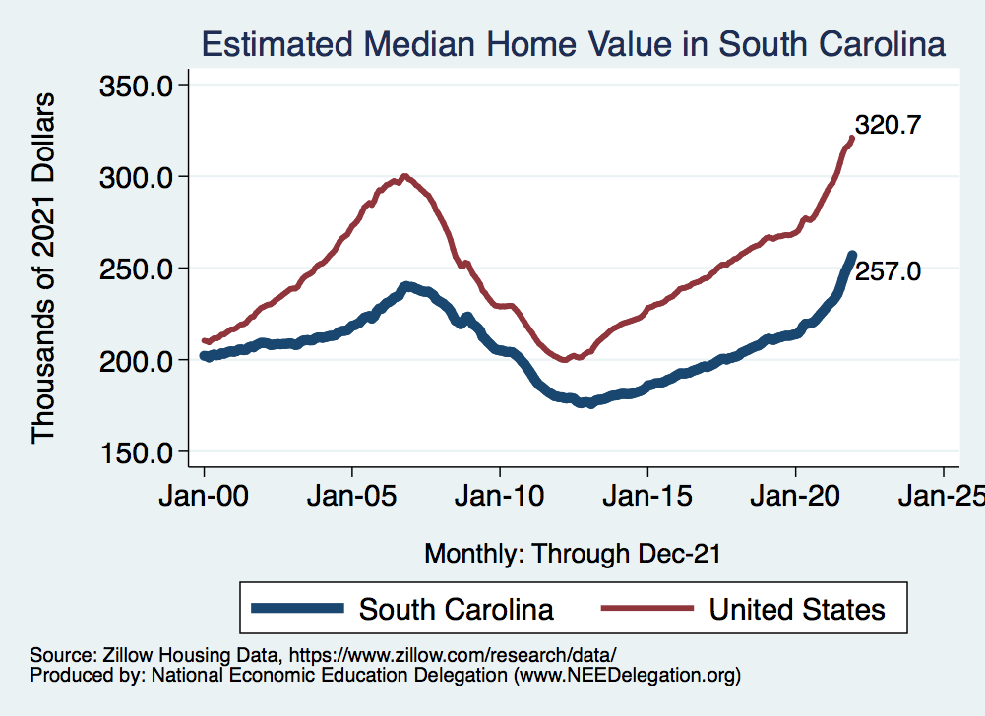
Real Estate Prices

Slide 220


RE Experiences Differ!

Slide 221
Primary Topics Covered
GDP
  Recovered the decline, but not where it should be.
  Won’t recover previous forecast until late 2022.
Employment
  Still down 8.4 million jobs relative to forecast. (3.5 million relative to Feb/20).
  Labor force is 2.5 million smaller than at the beginning of the pandemic.
  Rising wages are not enticing low-wage workers back to work.
Inflation
  Going to be high for a while, but transitory – maybe?

Slide 222
Conclusion
Recovery is well underway, but may be slowing.
GDP expanded 5.7% percent in 2021, likely 3-4% in 2022.
2021 was an odd year.
  Workers attained the upper hand.
  Supply chains broke.
  Inflation surged.
  The economy rebuilt itself.
Biggest problems:
  Supply chain bottlenecks.
  Labor force participation.

Slide 223
Best Measures of Progress
INFLATION – getting it under control.
REAL WAGES– need to see progress.
WORKFORCE PARTICIPATION – need growth here to get GDP growth.
Pay no attention to the unemployment rate.

Slide 224
Monetary Policy – Geoffrey Woglom
The FOMC does not set an exact number for the Federal funds rate. Instead, it sets an upper (green line) and lower (blue) range.
“The Committee decided to keep the target range for the federal funds rate at 0 to 1/4 percent…” (4/28/2021)
Grey bars are recessions

Slide 225
Thank you!
Any Questions?
www.NEEDelegation.org
Scott Baier, Ph.D.
sbaier@g.clemson.edu
Contact NEED: info@NEEDelegation.org
Submit a testimonial: www.NEEDelegation.org/testimonials.php
Become a Friend of NEED: www.NEEDelegation.org/friend.php

Slide 226
Structural Changes?
Pandemic has been an accelerant.
  Not a change agent.
Retail
Telecommuting
Telehealth
Business travel?
Wealth concentration
Industry concentration
Automation

Slide 227
Consumption: Quarterly Growth
Notes:
Graph: gdp_pot_grow.png
The Point: From 1990 – 2007, average annual US GDP growth pre-crisis is 2.94%. However, post-crisis US GDP growth is 2.19% (0.75 percentage points lower). Why is has the recovery been sluggish?
Note: At the recession’s height, the gap between quarterly GDP growth and potential growth was 2.5 percentage points.

Slide 228
Employment Gap
Notes:
payroll_recent.png

Slide 229
Annual Changes in Nonfarm Employment

Slide 230
Affected Women More Than Men?

Slide 231
Another Measure: Unemployment
Peak: 22.9%
(April, 2019)

Slide 232
Supply Chains Are at the Core

Slide 233
What Are Supply Chains?
https://www.cfr.org/article/what-happened-supply-chains-2021

Slide 234
Why does spending matter?
Spending:
Goods 20%
Services 44%
Total 64%
Notes:
Components sum to GDP
Average % of GDP for each component from 1960-Present: C = 64%, I=15%, G=24%, NX = 2% (X = 7%, M=9%)
Net Exports as a % of GDP has increased over the sample period, but it’s contribution to GDP is relatively small

Slide 235
Affected Women More Than Men
Men
Women
Long term implications for women?

Slide 236
Why Women More Than Men?
Women are disproportionately represented in low-wage and face-to-face jobs.
Our childcare and school systems don’t meet the needs of working mothers.
COVID-19 has upended the labor market, with disastrous consequences for working women and their families.
  Many women continued working in high risk jobs.
The difference in impact is waning.

Slide 237
Affecting Black Workers More than White
White
Black

Slide 238
What Index to Follow: CPI or PCE?
CPI is the headline statistic, followed by most newspapers.
  Allows more granularity – ability to look at specific products.
PCE is the one followed by the Fed.
  Why?
    Accounts for short term fluctuations in consumer purchases.
    Based on more reliable data.
Fed generally pays attention to the core inflation #s.
  Excluding food and energy.

Slide 239
Inflation: Critical Issues
Inequities
  Price changes vary wildly across goods.
  How inflation hits you depends on what you buy and your level of income.
    Some evidence that lower income individuals face higher inflation.
Online inflation is much lower than the CPI
  Estimates suggest about 2% lower.
Both have implications for the policy response.
  Safety net? Antitrust action?

Slide 240
A Hard-Hit Sector: Small Business
Small Biz Closures in the United States

Slide 241
Small Businesses: They Didn’t Get Enough PPP

Slide 242
A “K-shaped” recovery?
Executive Summary
Those with financial wealth/residential real estate have seen its value grow in excess of inflation.
High income earners (>60k/yr) have largely kept their jobs;
  middle and low income earners have depressed employment rates
Women are disproportionately exiting labor force.
Food insecurity has been very high.

Slide 243
Coronavirus and Inequality
Resources to weather the storm.
Racial inequities.
Educational inequities
Telecommuting
Low wage jobs are at risk.

Slide 244
Monetary Policy: Federal Reserve
Primary goal is to keep interest rates low, to facilitate continued borrowing.
  Federal Funds Rate – rate at which banks lend to each other, usually overnight.
  Purchases of U.S. Treasury securities – keep money flowing to the government at low rates of interest.

Slide 245
Federal Funds Rate – Last 5 Years
Notes:
The FOMC waited for labor market conditions to improve before raising the fed funds rate in late 2015.
FOMC currently working to normalize monetary policy by raising interest rates and reducing assets on its balance sheet
FedFunds_recent.png

Slide 246
Federal Funds Rate
Notes:
The fed funds rate is the interest rate on overnight loans between banks. Think of it as the baseline interest rate on which banks base all other interest rates (e.g. mortgage rates)
FOMC lowers the fed funds rate during recessions and raises the fed funds rate during expansions
Fed funds rate peaked in the 1980s as then Chairman Paul Volcker sought to reign in “run away” inflation of the 1970s; doing so resulted in a recession in the early 1980s.
Since the 2008-09 recession, the fed funds rate has been kept near zero.
During the 2008-09 recession, Federal Reserve turned to unconventional tools to influence longer term interest rates to further stimulate the economy - QE
FedFunds.png

Slide 247
Federal Reserve Assets
8.8
Largely Treasury Securities
Pandemic
Financial Crisis
3.8
1.0
Notes:
The fed funds rate is the interest rate on overnight loans between banks. Think of it as the baseline interest rate on which banks base all other interest rates (e.g. mortgage rates)
FOMC lowers the fed funds rate during recessions and raises the fed funds rate during expansions
Fed funds rate peaked in the 1980s as then Chairman Paul Volcker sought to reign in “run away” inflation of the 1970s; doing so resulted in a recession in the early 1980s.
Since the 2008-09 recession, the fed funds rate has been kept near zero.
During the 2008-09 recession, Federal Reserve turned to unconventional tools to influence longer term interest rates to further stimulate the economy - QE
FedFunds.png

Slide 248
Treasuries – Low Interest Rates
Notes:
treas_recent.png

Slide 249
Markets Respond To Fed Policies
…and COVID and Russia and Inflation
Notes:
CV_DJSP_6mo.png

Slide 250
Retail Sales Are Slowing
Could be X-mas shopping
all happened in November.
(Supply chain awareness?)

Slide 251
www.NEEDelegation.org/LocalGraphs
For every state and county in the United States.
Detailed graphs on employment, housing, moves, and other statistics.

