Slide 1
Rotary of Campbellsville U.S. Economic Outlook
National Economic Education Delegation
Scott Baier Ph.D.
Professor and Department Chair, Clemson University
December 8, 2021

Slide 2
National Economic Education Delegation
Vision
One day, the public discussion of policy issues will be grounded in an accurate perception of the underlying economic principles and data.
Mission
NEED unites the skills and knowledge of a vast network of professional economists to promote understanding of the economics of policy issues in the United States.
NEED Presentations
Are nonpartisan and are intended to reflect the consensus of the economics profession.

Slide 3
COVID-19 Cases US

Slide 4
Brief Outline
GDP and its components --- what is supporting the economic recovery.
Labor Markets and Employment Dynamics
Inflation and Supply Chain Disruptions
Debt and Deficit
Infrastructure package
Conclusion

Slide 5
US Gross Domestic Product (GDP) Overtime

Slide 6
US GDP Level and GDP Trend
11% Gap
Income per person
would be about
$5,000 higher.

Slide 7
US GDP Growth Annual Growth: 1990-2020

Slide 8
Average Annual US GDP Growth (by decades)

Slide 9
US Gross Domestic Product (GDP) Overtime

Slide 10
Understanding Contributions to GDP Growth
GDP Growth is a combination of the growth in its components:
Consumption, Investment, Government, and Net Exports
It’s a weighted average of these components

Slide 11
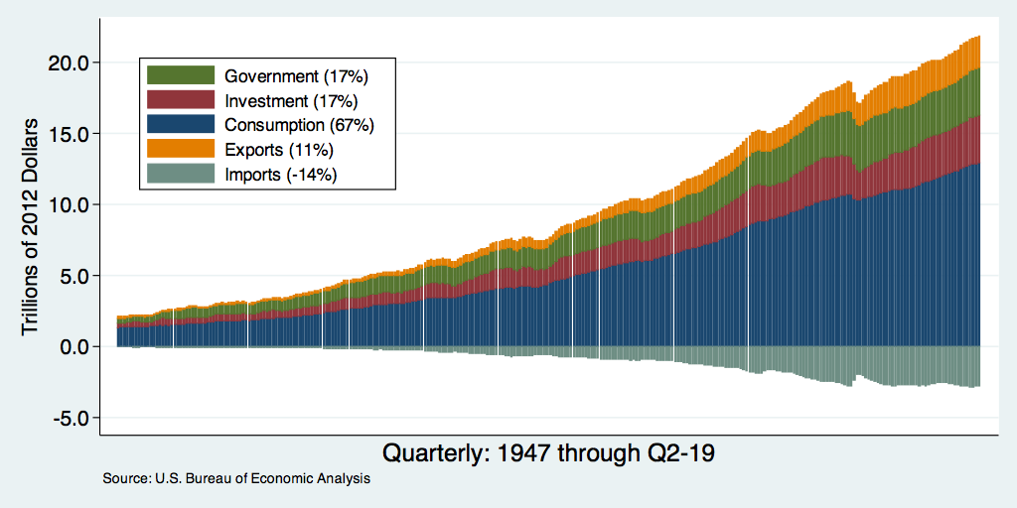
Composition of Real GDP
Notes:
Components sum to GDP
Average % of GDP for each component from 1960-Present: C = 64%, I=15%, G=24%, NX = 2% (X = 7%, M=9%)
Net Exports as a % of GDP has increased over the sample period, but it’s contribution to GDP is relatively small

Slide 12
Real Consumption
From 2000-2019 quarterly consumption
growth was about 2.2 percent per year

Slide 13
National Spending
Opportunity Insights

Slide 14
Spending by Income Groups
Lower Income
High Income
Middle Income
Opportunity Insights

Slide 15
Kentucky Spending
Opportunity Insights

Slide 16
Retail Sales: Retail Trade and Food Services
Retail Sales is about 11% above trend

Slide 17
Real Disposable Income
What did people do with these ”stimulus” checks?
Real Disposable Income: Trillions of $

Slide 18
Take Away: Consumption
consumption has rebounded rapidly coming out of the recession.
The rebound in consumption was supported by the stimulus packages that were passed by the Trump and Biden Administration.
Compared to before the pandemic consumption has shifted more toward the consumption of goods and away from services.
This a demand effect that is causing some of the supply chain disruptions

Slide 19
Investment
Uncertainty clouds investment decisions:
I would not anticipate strong growth from
Investment until there is more clarity on direction
of the pandemic.
Year-over-year growth in purchase of plants machine and equipment

Slide 20
Employment
Unemployment
Employment Growth
Employment by Sector

Slide 21
Unemployment Rate

Slide 22
Employment Changes: Nonfarm Payroll
1990-2019
From 1990 -2007, average gain in employment each month averaged about 131,000

Slide 23
Employment Changes
In March and April of 2020, the US economy lost more than 22 million jobs.
Since that time, the economy has recovered about 18.5 million jobs.
Still roughly 4 million jobs below where we were in 2/2020

Slide 24
Nonfarm Payroll: Job Losses March -April 2020
Roughly 22 million Jobs lost in March and April of 2020
Source: BLS

Slide 25
Nonfarm Payroll: Employment Gains 5/20-11/21
In most of sectors approximately 75-80 percent of employment returned compared to the losses in March and April 2020

Slide 26
Employment Dynamics
Job Openings
Job Hires

Slide 27
Employment Dynamics: Separations and Hires

Slide 28
Employment Dynamics: Quits and Layoffs
Quits

Slide 29
Employment Dynamics: Wage Growth

Slide 30
Employment: National

Slide 31
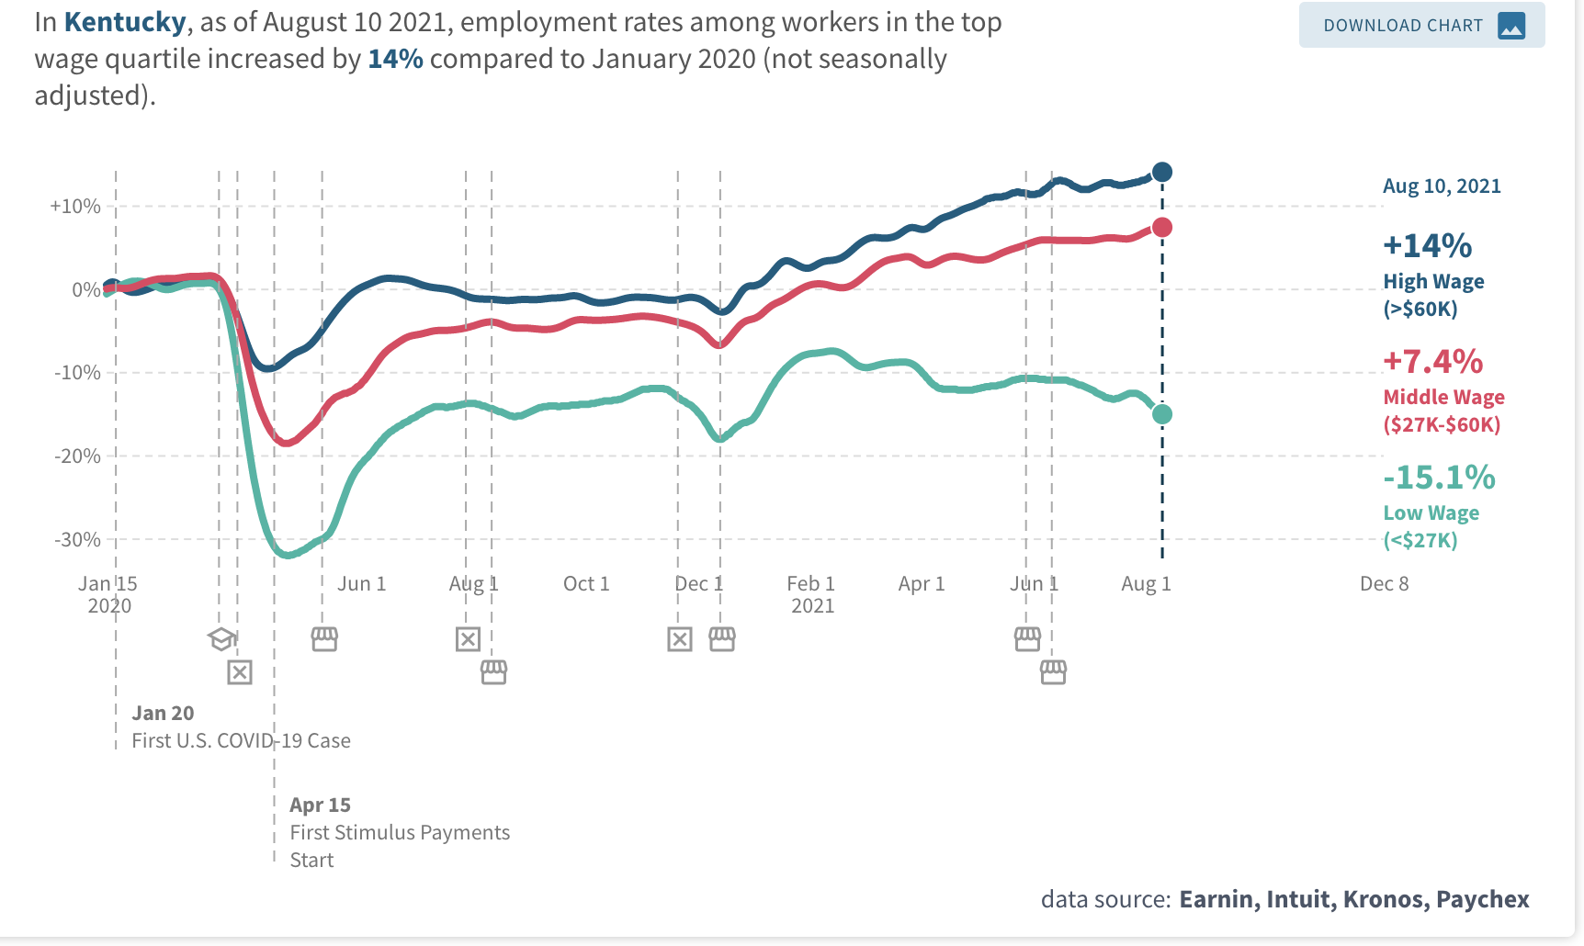
Employment: Kentucky

Slide 32
Employment Situation
Employment has been slow to rebound
More recently, The real challenge has been for employers to fill vacancies.
What gives?
Extended (or expected continuation) unemployment benefits
Parents with young children at home.
Workers reluctant to work in certain industries and occupations
Workers looking for different career opportunities.
Increased desire to have the option to work from home.

Slide 33
Inflation

Slide 34
Money Growth: M2 (Transactions Money)

Slide 35
Annualized Money Growth
Growth Rate of Money Stock (percent per year) | Beginning of Period | End of Period
6.1 | January 2000 | March 2020
48.3 | April 2020 | June 2020
11.5 | July 2020 | August 2021

Slide 36
Monetary Policy
Fed does not control M2
What generally determines the growth of M2?
Expected inflation
Recent increase is something different
Federal government transfers to checking accounts
Helicopter drop
Generally, faster growth of M2 associated with higher inflation
Here?

Slide 37
CPI Inflation So Far This Year
6.20 percent year-over-year from October
5.52 percent from the start of the year.
6.74 percent at end of December 2021 given Federal Reserve Bank of Cleveland’s Nowcasts

Slide 38
Inflation Over the Next Few Years
Reasonable to expect prices continue to rise
What will happen to expected inflation?
Stay at 2 percent per year?
Increase to quite a bit more?
What will happen to inflation given the current monetary policy framework?
Inflation will be about two percent
Inflation will increase quite a bit, say 5 to 10 percent per year

Slide 39
Thinking About Infrastructure Package
Key components are:
Efficiency: Is the government spending (infrastructure) undertaken efficiently?
Multiplier: Does the government spending raise the productivity of the private sector (human capital and physical capital)?
Think of this like a multiplier .
Depends on the nature of private capital: Complements or Substitutes
Resource Use: Does the spending pull use “idle” resources or is their crowding out.
If the infrastructure pulls workers and capital from other uses the net effect on GDP is likely to be smaller.
Funding Distortions DWL: Effect of Infrastructure depends on how the funds are raised.
If raised by taxes, what private sector activities are reduced because of the taxes.
If the infrastructure package is financed by borrowing will there be crowding out through higher interest rates.
If it is financed by printing money (MMT) will this be inflationary

Slide 40
Thinking About Infrastructure Package
Key components are:
Efficiency: Is the government spending (infrastructure) undertaken efficiently?
Multiplier: Does the government spending raise the productivity of the private sector (human capital and physical capital)?
Think of this like a multiplier .
Depends on the nature of private capital: Complements or Substitutes
Resource Use: Does the spending pull use “idle” resources or is their crowding out.
If the infrastructure pulls workers and capital from other uses the net effect on GDP is likely to be smaller.
Funding Distortions DWL: Effect of Infrastructure depends on how the funds are raised.
If raised by taxes, what private sector activities are reduced because of the taxes.
If the infrastructure package is financed by borrowing will there be crowding out through higher interest rates.
If it is financed by printing money (MMT) will this be inflationary

Slide 41
Conclusion
The economy continues to recover from the pandemic.
Until there is clarity on the health side, I would not anticipate the labor market to fully recover.
The actions that the government took helped the recovery, but may have also planted the seeds for higher inflation.
The increased deficit and debt is not expected to be permanent, but …

Slide 42
Path of the Debt
Peter G. Petersen Foundation
Source: Congressional Budget Office, Additional Information About the Budget Outlook: 2021 to 2031

Slide 43
Path of the Debt: Spending and Revenues
Peter G. Petersen Foundation
Source: Congressional Budget Office, Additional Information About the Budget Outlook: 2021 to 2031

Slide 44
Path of the Debt: Spending and Revenues
Peter G. Petersen Foundation

Slide 45
Infrastructure Package
Thinking of infrastructure broadly the US has $40 trillion in non-defense, non-residential fixed assets (infrastructure).
The private sector owns 65% of the infrastructure.
State and local governments own 30%
Federal government 5%
Administrative claims that infrastructure package has zero cost
Difference between net and gross.
Physical infrastructure: Airports and Broadband
Since the private sector own much of the infrastructure, how much will an increase in taxes reduces private investment.

Slide 46
Who Are We?
Honorary Board: 54 members
2 Fed Chairs: Janet Yellen, Ben Bernanke
6 Chairs Council of Economic Advisers
Furman (D), Rosen (R), Bernanke (R), Yellen (D), Tyson (D), Goolsbee (D)
3 Nobel Prize Winners
Akerlof, Smith, Maskin
Delegates: 600+ members
At all levels of academia and some in government service
All have a Ph.D. in economics
Crowdsource slide decks
Give presentations
Global Partners: 45 Ph.D. Economists
Aid in slide deck development

Slide 47
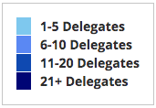
Where Are We?

Slide 48
Credits and Disclaimer
This slide deck was authored by:
Jon Haveman, Executive Director of NEED
Allison Roehling, DePauw University
This slide deck was reviewed by:
Jeffrey Frankel, Harvard University
Scott Baier, Clemson University
Rob Eyler, Sonoma State University
Disclaimer
NEED presentations are designed to be nonpartisan
It is, however, inevitable that the presenter will be asked for and will provide their own views.
Such views are those of the presenter and not necessarily those of the National Economic Education Delegation (NEED).

