Slide 1
US Economy and Coronavirus Economics
Inland Empire, Coachella, Desert Mountain Chapters of the CSMFO
Doris Geide-Stevenson, Ph.D. Weber State University, Ogden, UT

Slide 2
National Economic Education Delegation
Vision
One day, the public discussion of policy issues will be grounded in an accurate perception of the underlying economic principles and data.
Mission
NEED unites the skills and knowledge of a vast network of professional economists to promote understanding of the economics of policy issues in the United States.
NEED Presentations
Are nonpartisan and intended to reflect the consensus of the economics profession.

Slide 3
Who Are We?
Honorary Board: 54 members
2 Fed Chairs: Janet Yellen, Ben Bernanke
6 Chairs Council of Economic Advisers
Furman (D), Rosen (R), Bernanke (R), Yellen (D), Tyson (D), Goolsbee (D)
3 Nobel Prize Winners
Akerlof, Smith, Maskin
Delegates: 640+ members
At all levels of academia and some in government service
All have a Ph.D. in economics
Crowdsource slide decks
Give presentations
Global Partners: 48 Ph.D. Economists
Aid in slide deck development

Slide 4
Credits and Disclaimer
This slide deck was authored by:
Jon D. Haveman, NEED
Scott Baier, Clemson University
Geoffrey Woglom, Amherst College (Emeritus)
Brian Dombeck, Lewis & Clark College
Doris Geide-Stevenson, Weber State
Disclaimer
NEED presentations are designed to be nonpartisan.
It is, however, inevitable that the presenter will be asked for and will provide their own views.
Such views are those of the presenter and not necessarily those of the National Economic Education Delegation (NEED).

Slide 5
Outline
State of the pandemic
The U.S. Economy
Total Output
Policy Support
Labor Market
Inflation
Equity Markets
Housing Markets
Great Resignation

Slide 6
State of the Pandemic

Slide 7
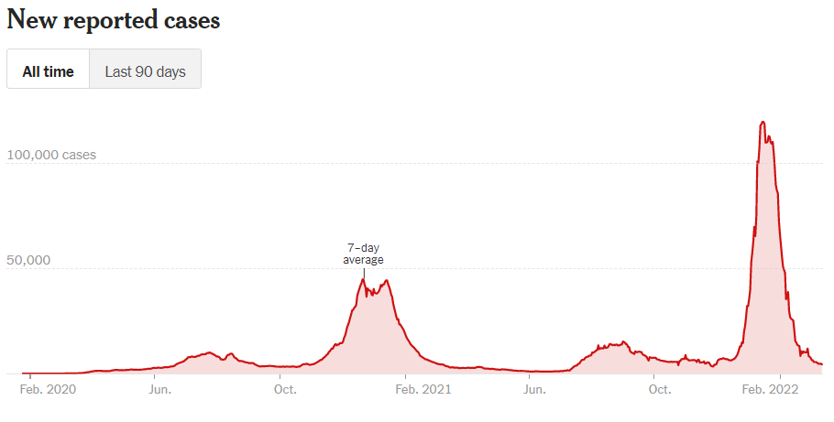
Making Progress in California…then Omicron
Source: NYTimes March 15, 22

Slide 8
Hospitalizations and Deaths – California
Total Covid deaths in the US: 964,674 (Johns Hopkins Coronavirus Resource Center, March 10, 2022)
Source: New York Times, March 10, 2022

Slide 9
Omicron BA.2 ? Europe and China
Coronavirus in Germany
Source: New York Times, March 17,22

Slide 10
and now – the Russian invasion of Ukraine

Slide 11
The U.S. Economy
The Role of the Pandemic versus Policy Adjustments? And what now?

Slide 12
GDP Trajectory: Pandemic Plunge and Recovery
GDP is:
$0.5 Trillion below 2019 forecast.
$0.2 Trillion ABOVE 2019-Q4 level.
Real GDP = Total value of production = Consumption + Investment + Government Purchases + Net Exports
Almost no Output Gap compared to the start of the pandemic, but a quick recovery.
Notes:
Above pre-pandemic levels, but not back to potential output.

Slide 13
Spending Patterns Since First US Case
Q3 - Flat
Source: https://tracktherecovery.org/

Slide 14
But Not All Industries Were Equally Harmed

Slide 15
But Not All Industries Were Equally Harmed

Slide 16
Poll Question
1. Which of the following industries saw the largest decline in output at the beginning of the pandemic?
Retail
Leisure and Hospitality
Education
Health Care

Slide 17
Unprecedented Policy Support
Source: Vanguard Economic and Market Outlook for 2022:Striking a better balance

Slide 18
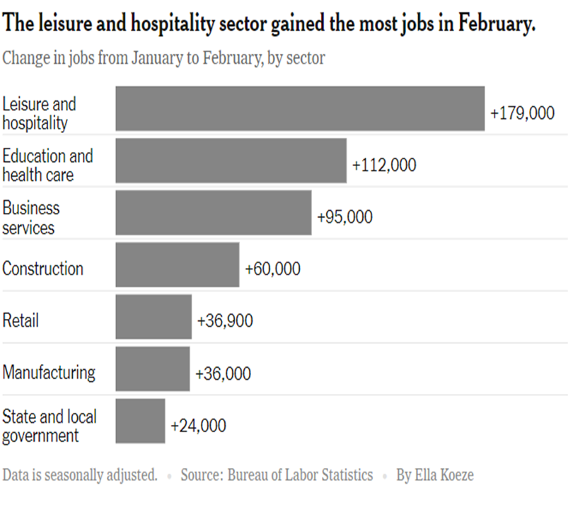
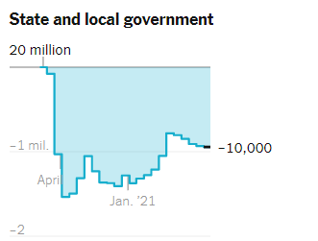
Employment Changes - US
Source: New York Times

Slide 19
Employment Gap
3.9 Million below February, 2020.
8.6 Million below where we should be.
Notes:
payroll_recent.png

Slide 20
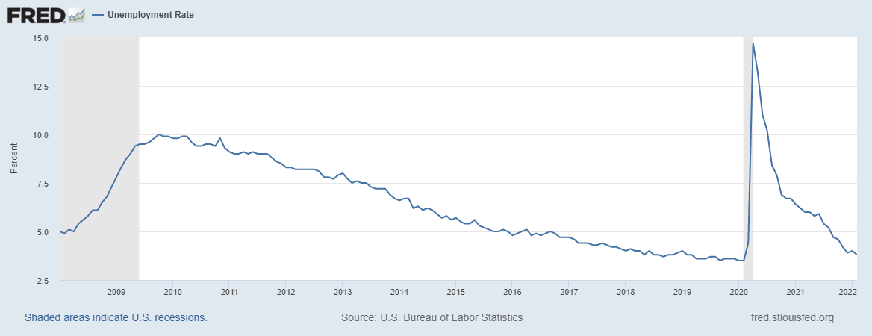
Labor Force Participation and Unemployment
Unemployment rate is still somewhat misleading.

Slide 21
Labor Force Growth in Riverside
Notes:
Same for San Bernardino Co. US unemployment rate: Feb. 22 : 3.8% CA 5.8% Jan. 22 Riverside Co. 5.1% (Dec. 21)

Slide 22
Poll Question
2. Employment in state and local governments:
fell at the start of the pandemic, but has fully recovered to pre-pandemic levels.
fell at the start of the pandemic, and is slower to recover to pre-pandemic level than employment in other sectors.
did not fall at the start of the pandemic and has increased since then.
did not fall at the start of the pandemic and has stayed constant.

Slide 23
Inflation and Asset Markets
Inflation, Equity Markets, Housing Markets

Slide 24
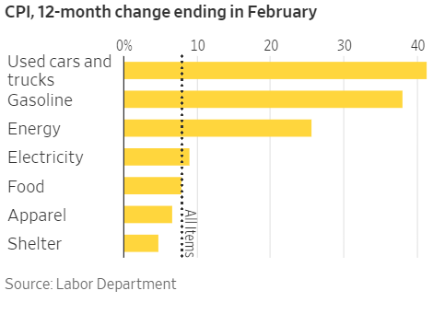
Inflation News
January 2022
All items: 7.9% - new four decade high
Source: Wall Street Journal
Notes:
Why CPI overestimates or underestimates inflation – COVID CPI should reflect a change in purchases. Covid CPI 6.54%

Slide 25
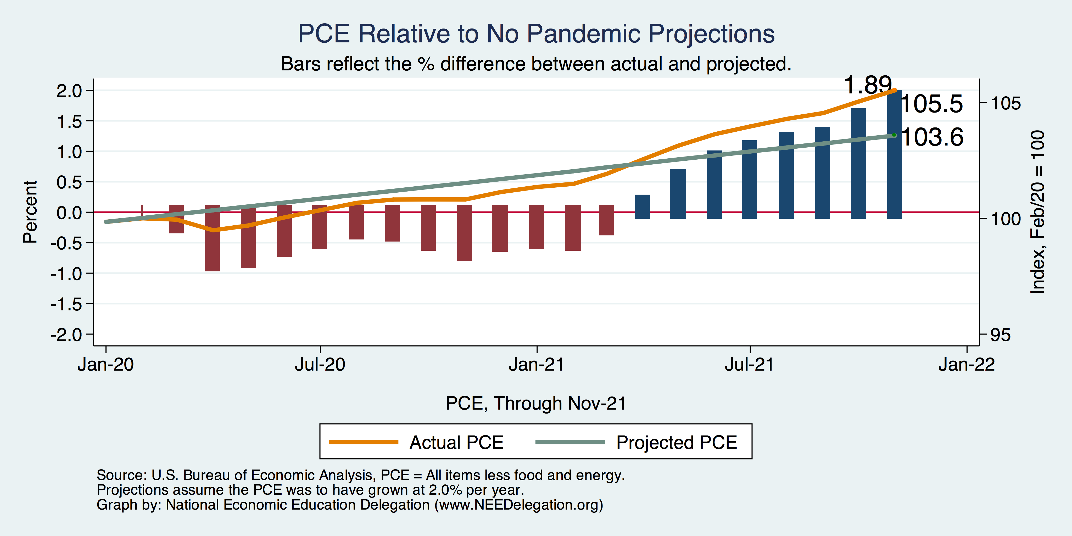
Inflation Targeting over the longer term?
Notes:
Personal Consumption Expenditures price index

Slide 26
Measure of Inflation Expectations
Breakeven Inflation Rate = Difference between
nominal and real 5-year and 10-year Treasury
constant maturity securities.
Market participants expect around 2.9%
of inflation annually over the next 10 years and
3.4% over the next 5 years.
Inflation expectations are increasing – especially after the Russian invasion.

Slide 27
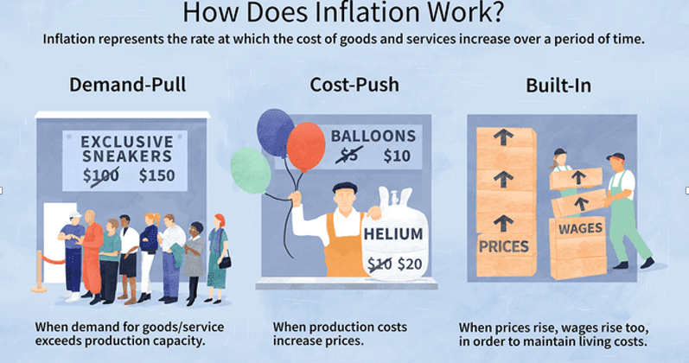
Source: Investopedia

Slide 28
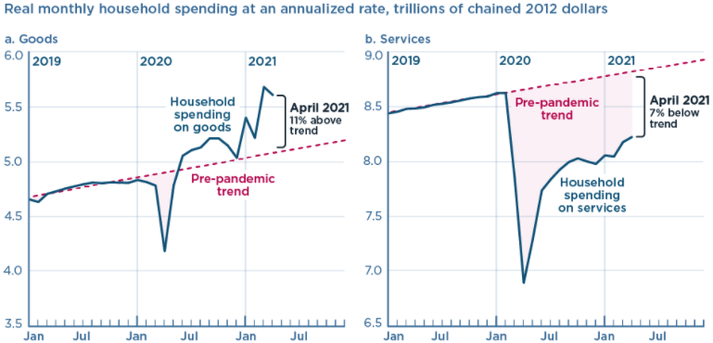
We’re Buying Mostly … Stuff
Demand-Pull
Source: Jason Furman, PIIE

Slide 29
Inflation: Concentrated
Cost-Push
Notes:
Cost push will continue through 22: China Covid measures, staffing issues US

Slide 30
More Cost-push, but with a twist
Effects of sanctions on Russi are countered by Covid-related lockdowns in China and Hongkong.
Source: Wall Street Journal, March 17, 22

Slide 31
Corporate Profits…Adding to Inflation?

Slide 32
Will Inflation continue to be elevated?
Yes, at least through 2022 and 2023.
Continued supply chain issues (China Covid strategy, US staff shortages, Russia-Ukraine conflict)
Mitigated by decrease in demand (policy support decreased), but if consumers go back to substituting toward in-home consumption more bottlenecks will develop
Sanctions on Russia will impact energy markets.

Slide 33
Poll Question
3. The current causes of inflation are best described as:
Demand-pull inflation
Cost-push inflation
Built-in inflation
All of the above

Slide 34
Projected Policy Changes - Fed
Notes:
From Dec. 15, 2021

Slide 35
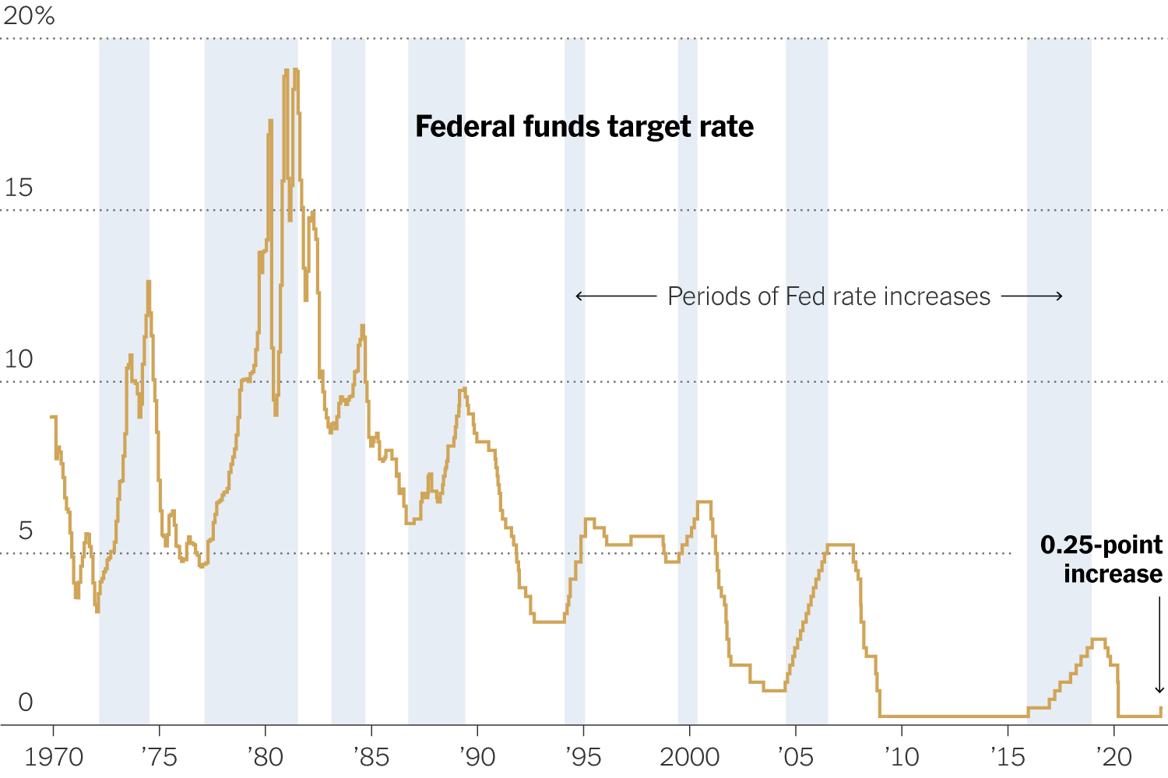
FedReaction – Wed. March 17, 2022
Fed is likely to raise interest rates faster than expected. Projects inflation at 4.3% for 2022.
Monetary policy adjustment is very unlikely to cause a recession.

Slide 36
Equity Markets – Is there still Overvaluation?
Maybe yes – based on negative real earnings yields (inflation adjusted earnings per share) which indicates
that profits are not keeping up with share price increases (even though corporate profits are increasing)
at the peak of the market.

Slide 37
Real Estate Prices – Both counties

Slide 38
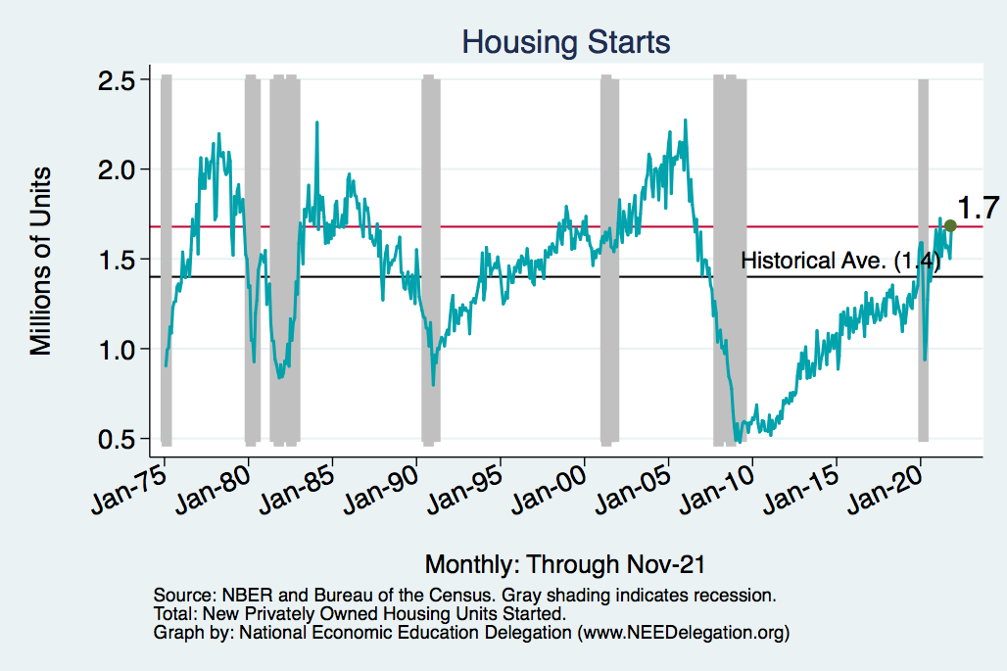
Home Prices and Housing Starts
Notes:
Charts:
homeprices_recession.png
housing.png

Slide 39
An End to California Outmigration?
Source: UCLA Anderson Review, Dec. 15, 2021

Slide 40
The Great Resignation

Slide 41
Quits Are High! The Great Resignation

Slide 42
Quits – Rising, but More in Some Industries
Accom. & Food Services
Leisure & Hospitality
Retail

Slide 43
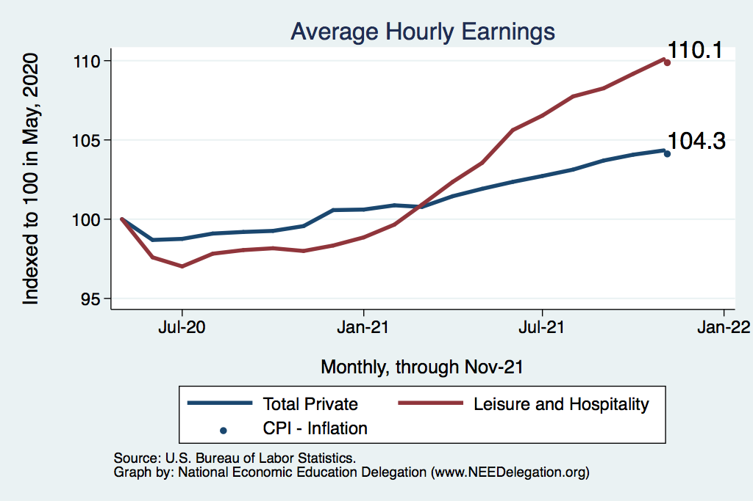
This is Happening as Nominal Wages Rise
Leisure & Hospitality
Total Nonfarm

Slide 44
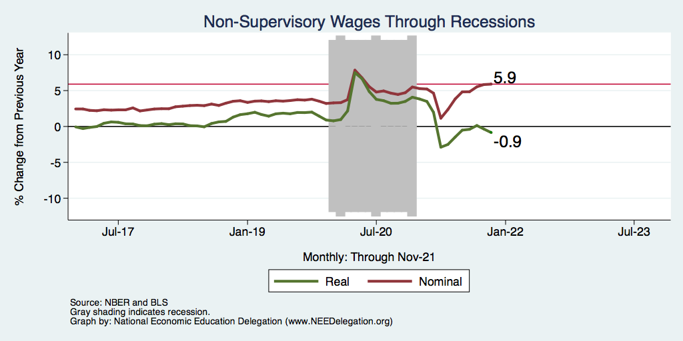
Inflation Adjusted Wages Are Falling

Slide 45
Primary Topics Covered
GDP
Recovered the decline, but not where it should be.
Won’t recover previous forecast until late 2022. Growth: 4.0%
Employment
Still down 8.6 million jobs relative to forecast. (3.9 million relative to Feb/20).
Labor force is 2.5 million smaller than at the beginning of the pandemic.
Rising wages are just now starting to entice low-wage workers back to work.
Inflation
Going to be high for a while – definitely not transitory.
Notes:
IMF: 6% Fed: 5.5%

Slide 46
Conclusion
Recovery was V-shaped!
GDP will likely have expanded 5.5% percent in 2021, about 4% in 2022.
Physical health determines economic health for the economy.
Variants may well slow our progress: Omicron.
Gov’t missteps may also hinder progress.
Biggest problems:
Supply chain bottlenecks.
Labor force participation.
Russian invasion of Ukraine.

Slide 47
Best Measures of Progress – Conclusion
Inflation – getting it under control.
Real wages – need to see progress.
No further waves of Covid – State and federal plans to address future outbreaks

Slide 48
Thank you!
Any Questions?
www.NEEDelegation.org
Jon D. Haveman
Jon@NEEDelegation.org
Contact NEED: info@NEEDelegation.org
Submit a testimonial: www.NEEDelegation.org/testimonials.php
Become a Friend of NEED: www.NEEDelegation.org/friend.php

Slide 49
www.NEEDelegation.org/LocalGraphs
For every state and county in the United States.
Detailed graphs on employment, housing, moves, and other statistics.

Slide 50
Available NEED Topics Include:
Coronavirus Economics
US Economy
Climate Change
Economic Inequality
Economic Mobility
Trade and Globalization
Minimum Wages
Immigration Economics
Housing Policy
Federal Budgets
Federal Debt
Black-White Wealth Gap
Autonomous Vehicles
US Social Policy

