Slide 1
US Economy and Coronavirus Economics
Orange County Chapter of the CSMFO,
Doris Geide-Stevenson, Ph.D. Weber State University, Ogden, UT

Slide 2
National Economic Education Delegation
Vision
One day, the public discussion of policy issues will be grounded in an accurate perception of the underlying economic principles and data.
Mission
NEED unites the skills and knowledge of a vast network of professional economists to promote understanding of the economics of policy issues in the United States.
NEED Presentations
Are nonpartisan and intended to reflect the consensus of the economics profession.

Slide 3
Who Are We?
Honorary Board: 54 members
2 Fed Chairs: Janet Yellen, Ben Bernanke
6 Chairs Council of Economic Advisers
Furman (D), Rosen (R), Bernanke (R), Yellen (D), Tyson (D), Goolsbee (D)
3 Nobel Prize Winners
Akerlof, Smith, Maskin
Delegates: 640+ members
At all levels of academia and some in government service
All have a Ph.D. in economics
Crowdsource slide decks
Give presentations
Global Partners: 48 Ph.D. Economists
Aid in slide deck development

Slide 4
Credits and Disclaimer
This slide deck was authored by:
Jon D. Haveman, NEED
Scott Baier, Clemson University
Geoffrey Woglom, Amherst College (Emeritus)
Brian Dombeck, Lewis & Clark College
Doris Geide-Stevenson, Weber State
Disclaimer
NEED presentations are designed to be nonpartisan.
It is, however, inevitable that the presenter will be asked for and will provide their own views.
Such views are those of the presenter and not necessarily those of the National Economic Education Delegation (NEED).

Slide 5
Outline
State of the pandemic
The U.S. Economy
Total Output
Policy Support
Labor Market
Inflation
Equity Markets
Housing Markets
Great Resignation

Slide 6
State of the Pandemic

Slide 7
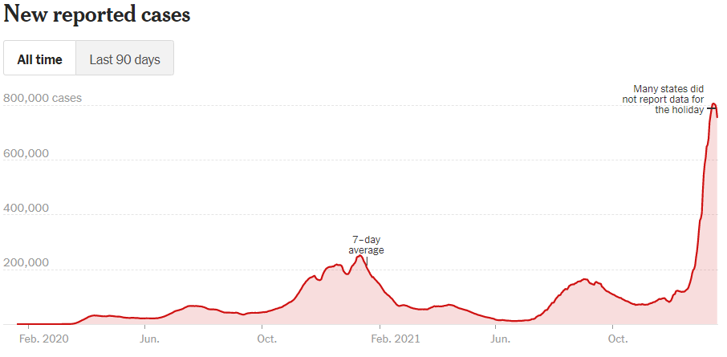
Making Real Progress…Until Omicron
Source: NYTimes

Slide 8
California Cases Were Falling Nicely
Source: NYTimes, Jan. 11, 2022

Slide 9
California – Hospitalizations and Deaths
Source: New York Times, Jan. 11, 2022

Slide 10
The U.S. Economy
The Role of the Pandemic versus Policy Adjustments?

Slide 11
GDP Trajectory: Pandemic Plunge and Recovery
GDP is:
$0.5 Trillion below 2019 forecast.
$0.2 Trillion ABOVE 2019-Q4 level.
Real GDP = Total value of production = Consumption + Investment + Government Purchases + Net Exports
Still a negative Output Gap compared to the start of the pandemic, but a quick recovery.
Notes:
Above pre-pandemic levels, but not back to potential output.

Slide 12
Spending Patterns Since First US Case
Q3 - Flat
Source: https://tracktherecovery.org/
Notes:
San Luis Obispo +18.4% , Santa Barbara +25.7%

Slide 13
But Not All Industries Were Equally Harmed

Slide 14
Unprecedented Policy Support
Source: Vanguard Economic and Market Outlook for 2022:Striking a better balance

Slide 15
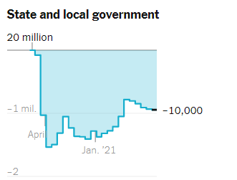
Employment Changes - US
Source: New York Times

Slide 16
Employment Gap
3.9 Million below February, 2020.
8.6 Million below where we should be.
Notes:
payroll_recent.png

Slide 17
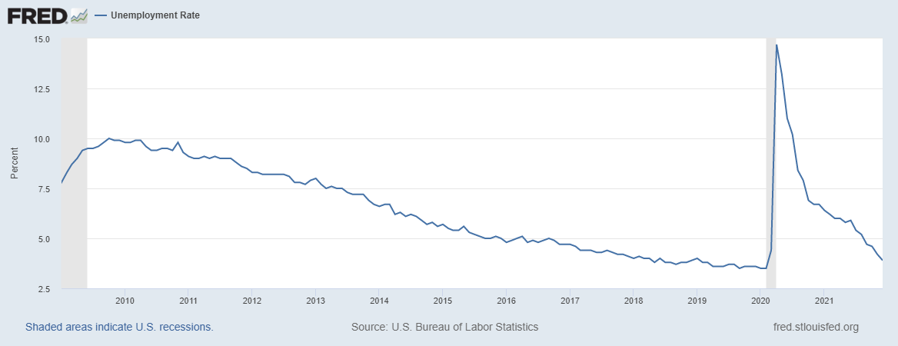
Labor Force Participation and Unemployment
Unemployment rate is somewhat misleading.

Slide 18
Labor Force Growth in Orange Co.
Notes:
US Dec. 2021 3.9% California 6.9% (Nov. 21) Orange Co. 4.4 % (Nov. 21)

Slide 19
Inflation and Asset Markets
Inflation, Equity Markets, Housing Markets

Slide 20
Inflation News – Jan. 12, 2022
Source: Wall Street Journal
Notes:
Why CPI overestimates or underestimates inflation – COVID CPI should reflect a change in purchases. Covid CPI 6.54%

Slide 21
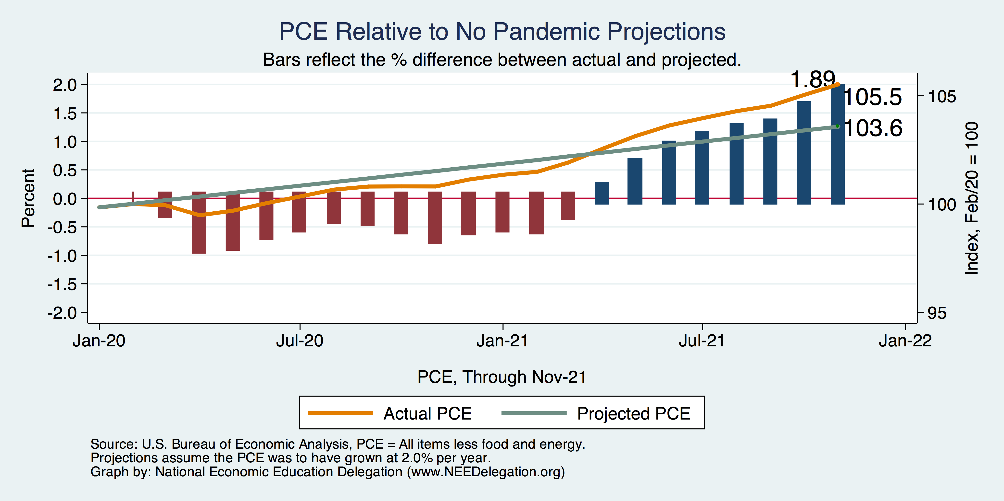
Inflation Targeting over the longer term?
Notes:
Cpi_recent.png

Slide 22
Measure of Inflation Expectations
Breakeven Inflation Rate = Difference between
nominal and real 10-year Treasury constant
Maturity securities.
Market participants still expect around 2.5%
of inflation annually over the next 10 years.
Inflation expectations are still ‘anchored’.

Slide 23
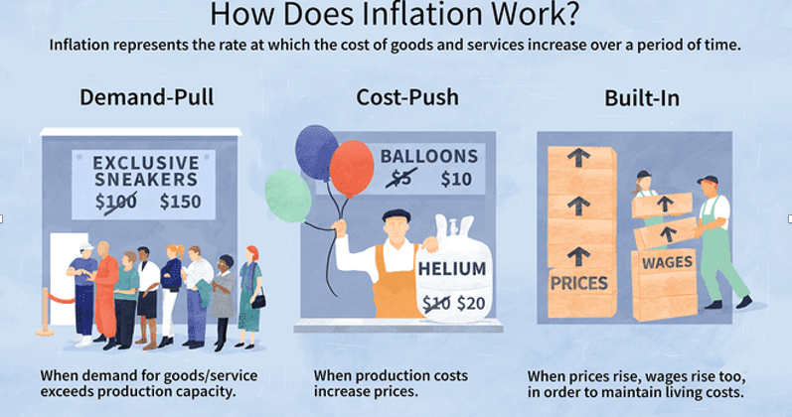
Source: Investopedia

Slide 24
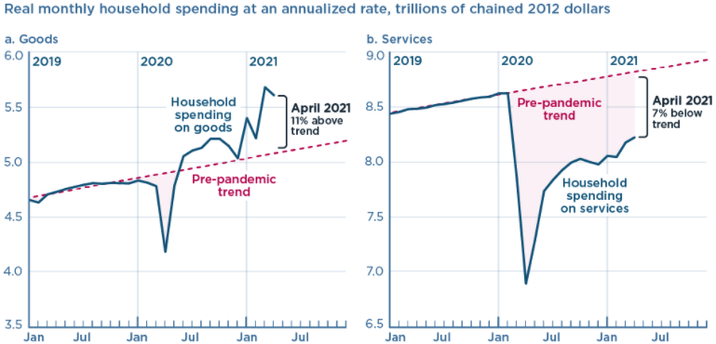
We’re Buying Mostly … Stuff
Demand-Pull
Source: Jason Furman, PIIE

Slide 25
Inflation: Concentrated
Cost-Push
Notes:
Cost push will continue through 22: China Covid measures, staffing issues US

Slide 26
Corporate Profits…Adding to Inflation?

Slide 27
Will Inflation continue to be elevated?
Likely yes, through 2022.
Continued supply chain issues (China, US staff shortages)
Mitigated by decrease in demand (policy support decreased), but consumers are back to substituting toward in-home consumption which can create bottlenecks

Slide 28
Projected Policy Changes - Fed
Notes:
From Dec. 15, 2021

Slide 29
FedReaction
Very likely to raise interest rates faster than expected – especially if the labor market keeps recovering (fewer demand/supply imbalances, continued recovery of the labor force participation rate and low unemployment rate).

Slide 30
Equity Markets – Is there Overvaluation?
Likely yes – based on negative real earnings yields (inflation adjusted earnings per share) which indicates
that profits are not keeping up with share price increases (even though corporate profits are increasing).

Slide 31
Real Estate Prices

Slide 32
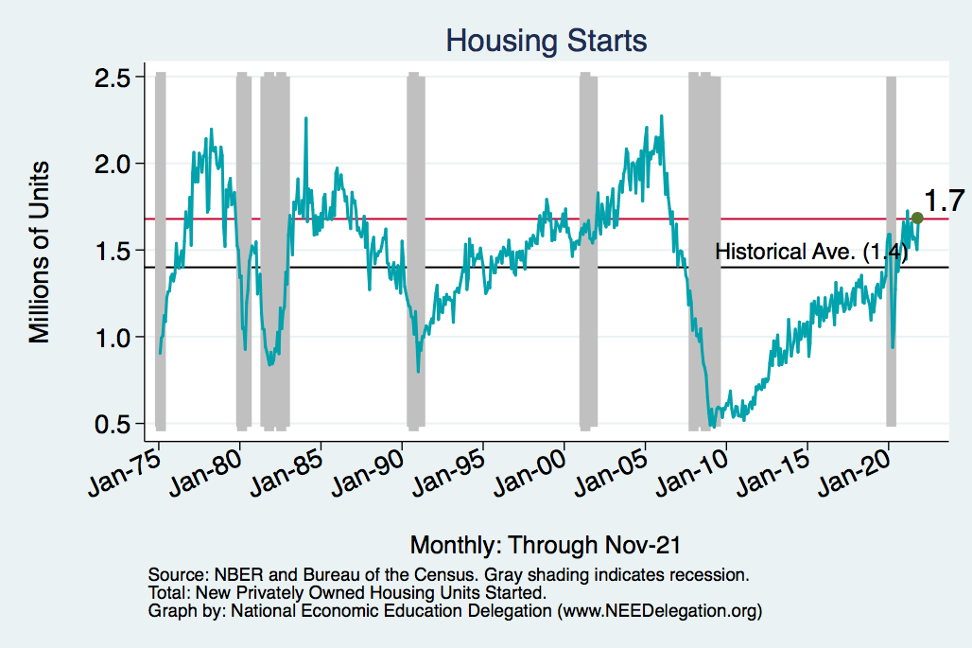
Home Prices and Housing Starts
Notes:
Charts:
homeprices_recession.png
housing.png

Slide 33
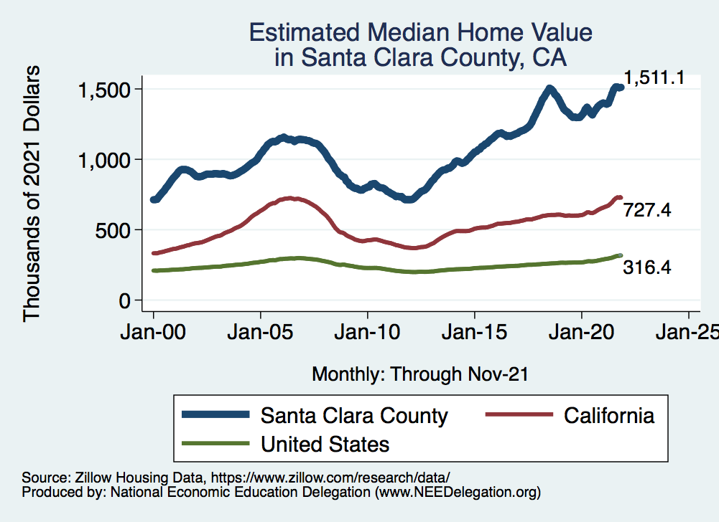
RE Experiences Differ!

Slide 34
An End to California Outmigration?
Source: UCLA Anderson Review, Dec. 15, 2021

Slide 35
The Great Resignation

Slide 36
Quits Are High! The Great Resignation

Slide 37
Quits – Rising, but More in Some Industries
Accom. & Food Services
Leisure & Hospitality
Retail

Slide 38
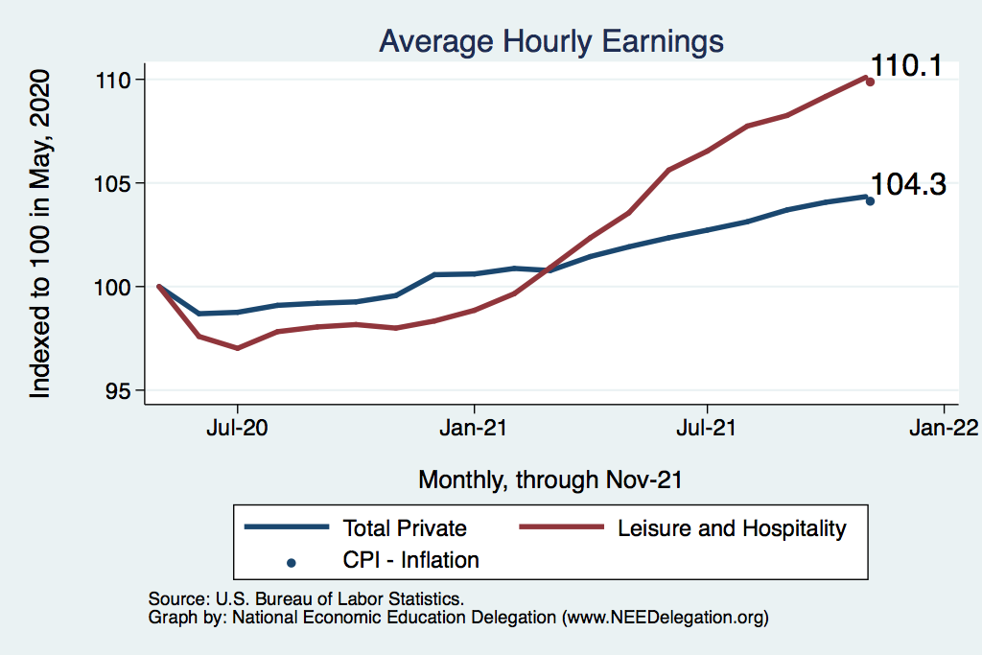
This is Happening as Nominal Wages Rise
Leisure & Hospitality
Total Nonfarm

Slide 39
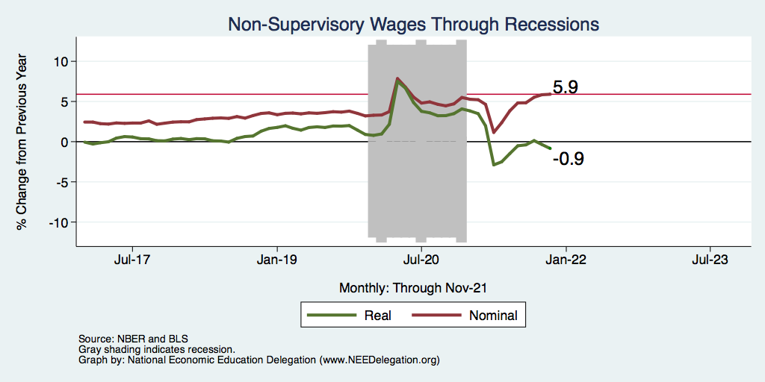
Inflation Adjusted Wages Are Falling

Slide 40
Declining Resources May Change Things
Source: NYTimes.com

Slide 41
Primary Topics Covered
GDP
Recovered the decline, but not where it should be.
Won’t recover previous forecast until late 2022. Growth: 4.0%
Employment
Still down 8.6 million jobs relative to forecast. (3.9 million relative to Feb/20).
Labor force is 2.5 million smaller than at the beginning of the pandemic.
Rising wages are not enticing low-wage workers back to work.
Inflation
Going to be high for a while, but transitory – maybe?
Notes:
IMF: 6% Fed: 5.5%

Slide 42
Conclusion
Recovery is well underway, but will be slowing.
GDP will likely have expanded 5.5% percent in 2021, about 4% in 2022.
Physical health determines economic health for the economy.
Variants may well slow our progress: Omicron.
Gov’t missteps may also hinder progress.
Biggest problems:
Supply chain bottlenecks.
Labor force participation.

Slide 43
Best Measures of Progress – Conclusion
Inflation – getting it under control.
Real wages – need to see progress.
Workforce participation – need growth here to get GDP growth.
Pay less attention to the unemployment rate.

Slide 44
Thank you!
Any Questions?
www.NEEDelegation.org
Jon D. Haveman
Jon@NEEDelegation.org
Contact NEED: info@NEEDelegation.org
Submit a testimonial: www.NEEDelegation.org/testimonials.php
Become a Friend of NEED: www.NEEDelegation.org/friend.php

Slide 45
www.NEEDelegation.org/LocalGraphs
For every state and county in the United States.
Detailed graphs on employment, housing, moves, and other statistics.

Slide 46
Available NEED Topics Include:
Coronavirus Economics
US Economy
Climate Change
Economic Inequality
Economic Mobility
Trade and Globalization
Minimum Wages
Immigration Economics
Housing Policy
Federal Budgets
Federal Debt
Black-White Wealth Gap
Autonomous Vehicles
US Social Policy

Slide 47
Trends in Labor Force Participation
Notes:
CLF16OV.png

Slide 48
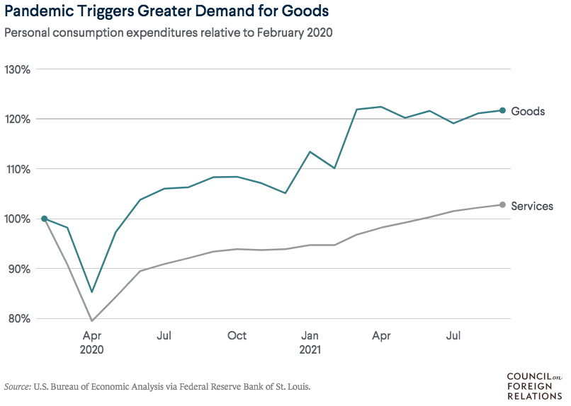
Supply Chains Are at the Core

Slide 49
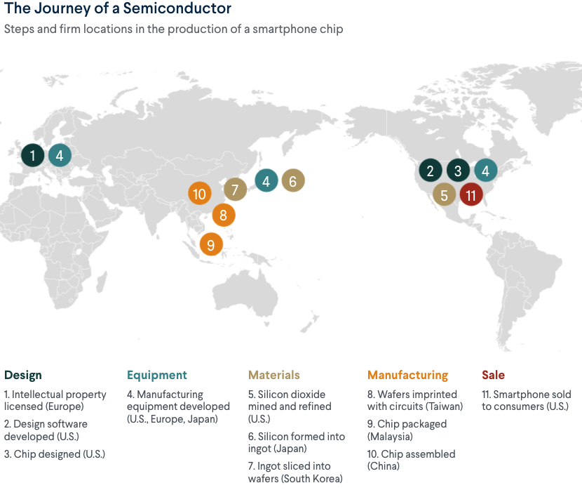
What Are Supply Chains?
https://www.cfr.org/article/what-happened-supply-chains-2021

Slide 50
Puzzle: Is Inflation Permanently Higher?
Fed: Price increases may be:
1) rebound from low prices last year;
2) temporary due to supply chain disruptions; e.g., used cars, bldg supplies.
3) influenced by rising wages in the future.
On the other hand: We are close to full employment and monetary and fiscal policies are very easy.
Nobody knows, but Fed has wavered in its optimism.

Slide 51
Telecommuting – Will it Stick?
Working from home is ALWAYS less productive than working in the office.
But the gap has shrunk because of technology.
In the interest of workplace productivity, employers are likely to allow more working from home.
Increased in-office moral and hence productivity.
But not 100% or even 50%. How much?
Has important implications for real estate.

Slide 52
Residential Real Estate
Rental markets
Eviction moratoria are over.
CA: Making payments can stay + 25%.
Self-evictions?
Not enough in the American Rescue Plan.
Reports of rents rising significantly.
Owned homes
Depends on location.
San Francisco – recovering.
Los Angeles County – continued strength.
Size matters: large homes are selling particularly well.

Slide 53
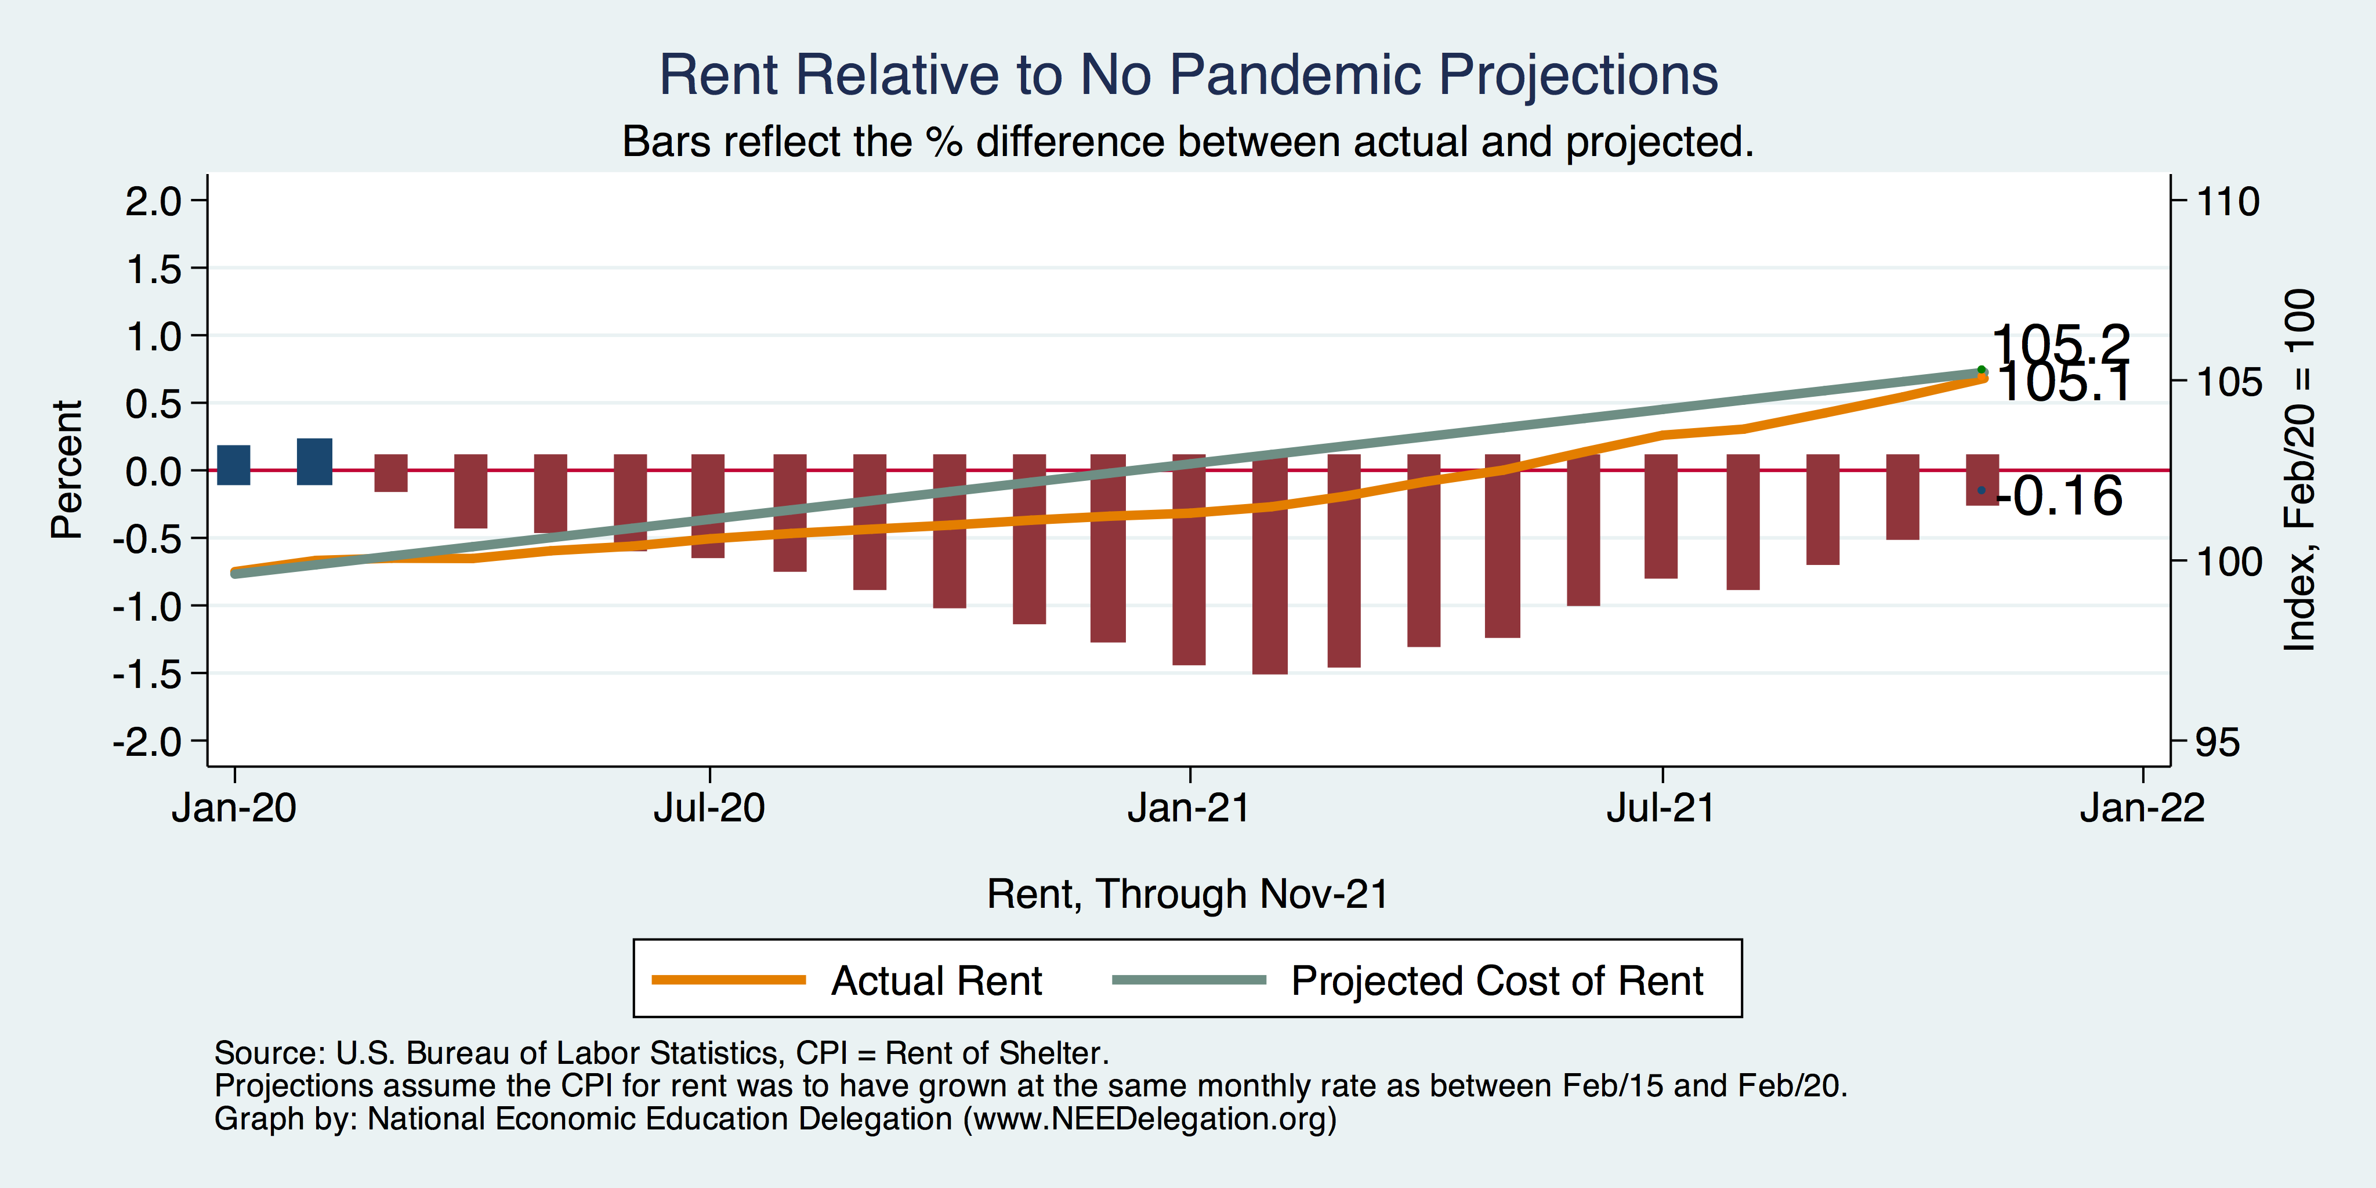
Inflation – Cost of Rent
Notes:
Cpi_recent.png

