Slide 1
US Economy and Coronavirus Economics
Sons in Retirement #8, Walnut Creek
Jon Haveman, Ph.D.
National Economic Education Delegation

Slide 2
National Economic Education Delegation
Vision
One day, the public discussion of policy issues will be grounded in an accurate perception of the underlying economic principles and data.
Mission
NEED unites the skills and knowledge of a vast network of professional economists to promote understanding of the economics of policy issues in the United States.
NEED Presentations
Are nonpartisan and intended to reflect the consensus of the economics profession.

Slide 3
Who Are We?
Honorary Board: 54 members
2 Fed Chairs: Janet Yellen, Ben Bernanke
6 Chairs Council of Economic Advisers
Furman (D), Rosen (R), Bernanke (R), Yellen (D), Tyson (D), Goolsbee (D)
3 Nobel Prize Winners
Akerlof, Smith, Maskin
Delegates: 640+ members
At all levels of academia and some in government service
All have a Ph.D. in economics
Crowdsource slide decks
Give presentations
Global Partners: 48 Ph.D. Economists
Aid in slide deck development

Slide 4
Available NEED Topics Include:
Coronavirus Economics
US Economy
Climate Change
Economic Inequality
Economic Mobility
Trade and Globalization
Minimum Wages
Immigration Economics
Housing Policy
Federal Budgets
Federal Debt
Black-White Wealth Gap
Autonomous Vehicles
US Social Policy

Slide 5
Credits and Disclaimer
This slide deck was authored by:
Jon D. Haveman, NEED
Scott Baier, Clemson University
Geoffrey Woglom, Amherst College (Emeritus)
Brian Dombeck, Lewis & Clark College
Doris Geide-Stevenson, Weber State
Disclaimer
NEED presentations are designed to be nonpartisan.
It is, however, inevitable that the presenter will be asked for and will provide their own views.
Such views are those of the presenter and not necessarily those of the National Economic Education Delegation (NEED).

Slide 6
Outline
State of the pandemic
The U.S. Economy
Hot Topics
Debt
Inflation
Great resignation
Structural changes

Slide 7
State of the Pandemic

Slide 8
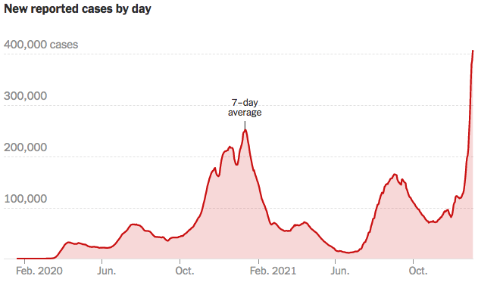
Making Real Progress…Until Omicron
Source: NYTimes

Slide 9
California Cases Were Falling Nicely
Source: NYTimes

Slide 10
The U.S. Economy

Slide 11
GDP Trajectory: Pandemic Plunge!
GDP is:
$0.5 Trillion below 2019 forecast.
$0.2 Trillion ABOVE 2019-Q4 level.

Slide 12
Spending Patterns Since First US Case
Q3 - Flat
Source: https://tracktherecovery.org/

Slide 13
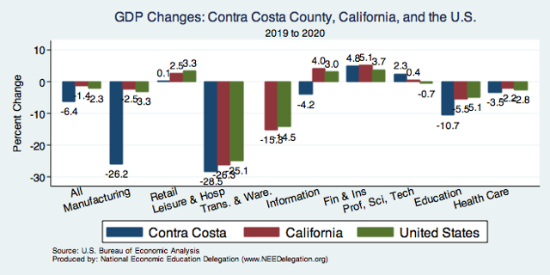
But Not All Industries Were Equally Harmed

Slide 14
Spending Patterns – Hardest Hit Sectors
+0.2%
Transportation
Source: https://tracktherecovery.org/

Slide 15
Spending Patterns Since First US Case: CA
Total Spending: +20.6%
Source: https://tracktherecovery.org/

Slide 16
Stimulus allowed Spending to Recover
But Note that Saving also went way up
Saving
Abnormally high Saving is over $2trillion

Slide 17
Monthly Changes in Nonfarm Employment
Notes:
PAYEMS.png

Slide 18
Monthly Changes in Nonfarm Employment
Recovery
Delta
Omicron
Notes:
PAYEMS.png

Slide 19
Employment Gap
3.5 Million below February, 2020.
8.4 Million below where we should be.
Notes:
payroll_recent.png

Slide 20
Labor Force is Shrinking – Drives Down UR

Slide 21
Hot Topics
Debt
Inflation
Great resignation
Structural changes

Slide 22
A Problem Exacerbated….Not Created

Slide 23
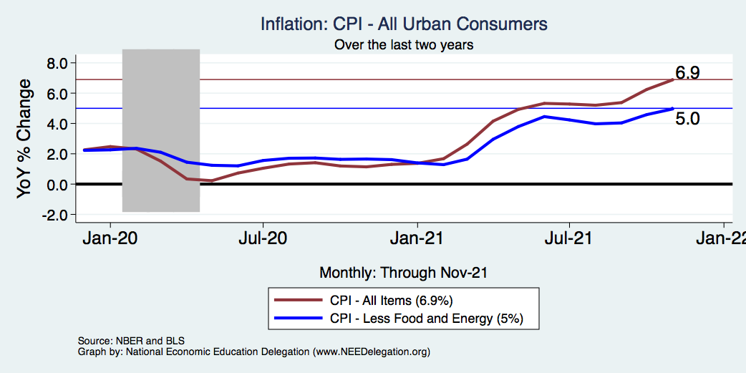
Inflation – Climbing! Should we worry?
Notes:
Cpi_recent.png

Slide 24
Inflation in Historical Perspective

Slide 25
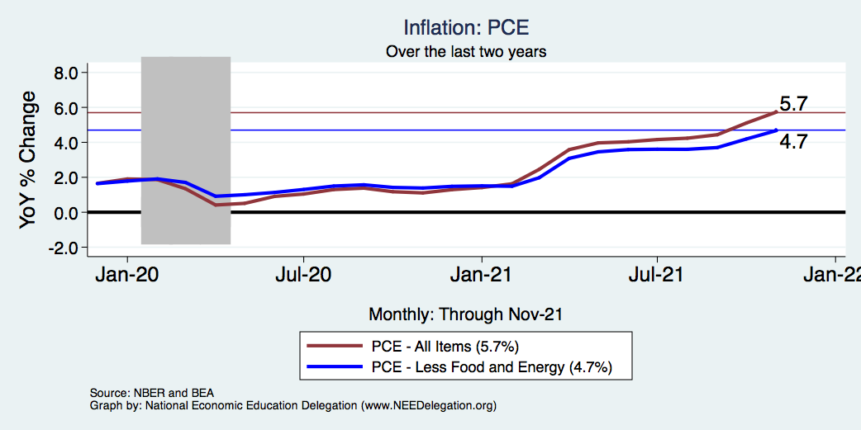
Inflation – The Fed’s Metric! Should we worry?
Notes:
Cpi_recent.png

Slide 26
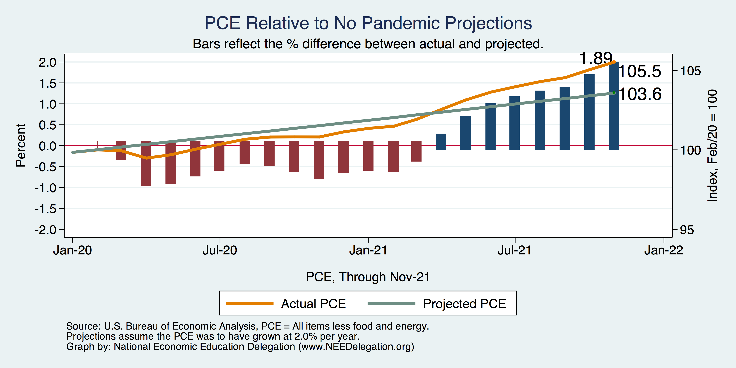
Inflation – PCE and Fed Suggest: I don’t know.
Notes:
Cpi_recent.png

Slide 27
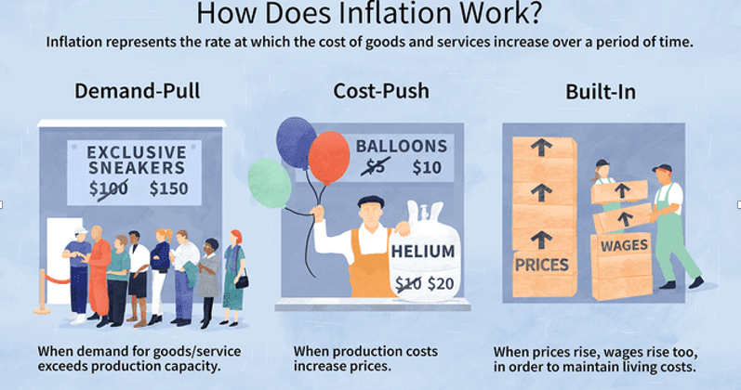
Source: Investopedia

Slide 28
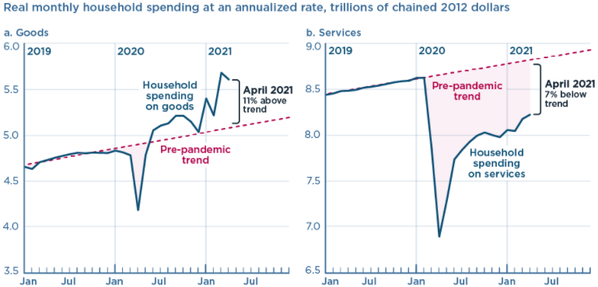
We’re Buying Mostly … Stuff
Demand-Pull
Source: Jason Furman, PIIE

Slide 29
Inflation: Concentrated
Cost-Push

Slide 30
Corporate Profits…Adding to Inflation?

Slide 31
The Great Resignation

Slide 32
Quits Are High! The Great Resignation

Slide 33
Quits – Rising, but More in Some Industries
Accom. & Food Services
Leisure & Hospitality
Retail

Slide 34
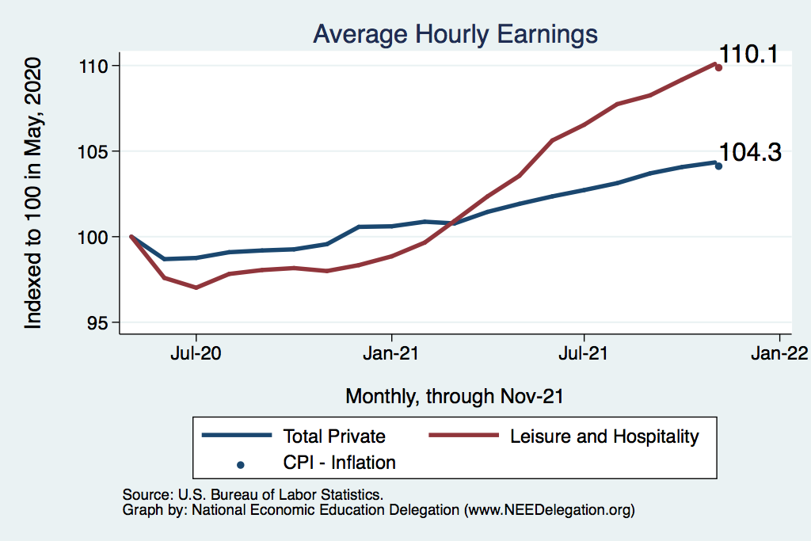
This is Happening Despite Rising Wages
Leisure & Hospitality
Total Nonfarm

Slide 35
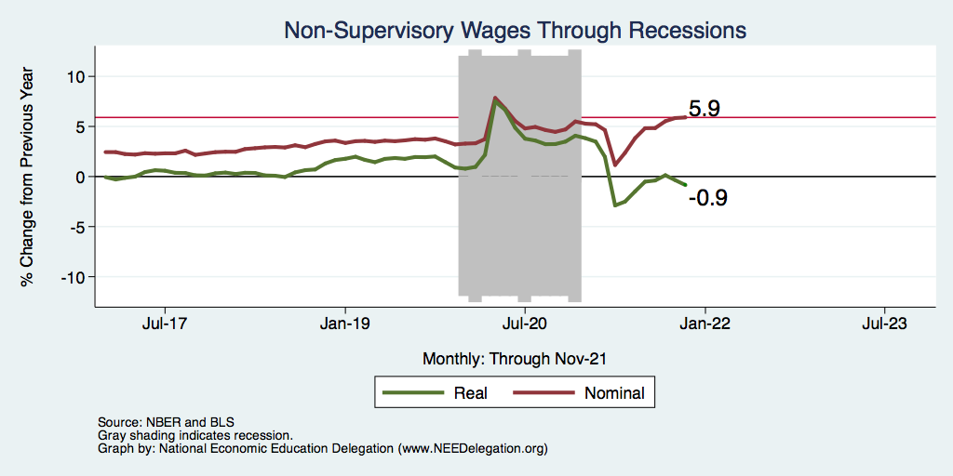
Inflation Adjusted Wages Are Falling

Slide 36
Declining Resources May Change Things
Source: NYTimes.com

Slide 37
Structural Changes?
Pandemic has been an accelerant.
Not a change agent.
Retail
Telecommuting
Telehealth
Business travel?
Wealth concentration
Industry concentration
Automation

Slide 38
Primary Topics Covered
GDP
Recovered the decline, but not where it should be.
Won’t recover previous forecast until late 2022.
Employment
Still down 8.4 million jobs relative to forecast. (3.5 million relative to Feb/20).
Labor force is 2.5 million smaller than at the beginning of the pandemic.
Rising wages are not enticing low-wage workers back to work.
Inflation
Going to be high for a while, but transitory – maybe?

Slide 39
Conclusion
Recovery is well underway, but may be slowing.
GDP will likely have expanded 5% percent in 2021, 3-4% in 2022.
2021 was an odd year.
GDP recovered significantly.
Workers attained the upper hand.
Supply chains broke.
Inflation surged.
The economy rebuilt itself.
Biggest problems:
Supply chain bottlenecks.
Labor force participation.

Slide 40
Best Measures of Progress
Inflation – getting it under control.
Real wages – need to see progress.
Workforce participation – need growth here to get GDP growth.
Pay no attention to the unemployment rate.

Slide 41
Thank you!
Any Questions?
www.NEEDelegation.org
Jon D. Haveman
Jon@NEEDelegation.org
Contact NEED: info@NEEDelegation.org
Submit a testimonial: www.NEEDelegation.org/testimonials.php
Become a Friend of NEED: www.NEEDelegation.org/friend.php

Slide 42
www.NEEDelegation.org/LocalGraphs
For every state and county in the United States.
Detailed graphs on employment, housing, moves, and other statistics.

Slide 43
Trends in Labor Force Participation
Notes:
CLF16OV.png

Slide 44
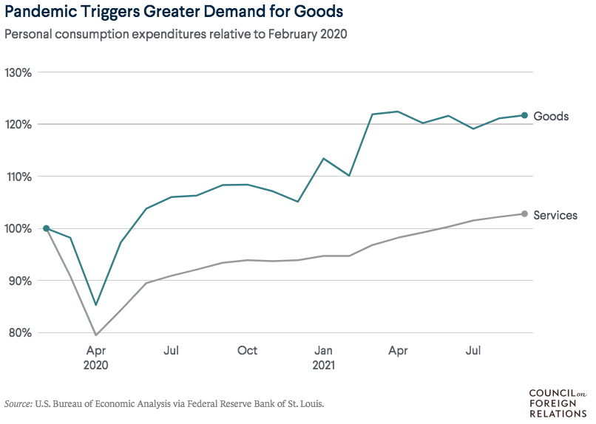
Supply Chains Are at the Core

Slide 45
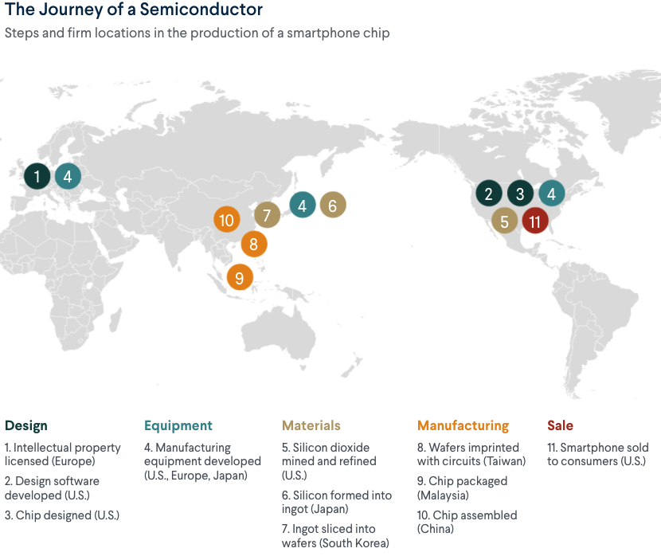
What Are Supply Chains?
https://www.cfr.org/article/what-happened-supply-chains-2021

Slide 46
Puzzle: Is Inflation Permanently Higher?
Fed: Price increases may be:
1) rebound from low prices last year;
2) temporary due to supply chain disruptions; e.g., used cars, bldg supplies.
3) influenced by rising wages in the future.
On the other hand: We are close to full employment and monetary and fiscal policies are very easy.
Nobody knows, but Fed has wavered in its optimism.

Slide 47
Why so Kean on Telecommunting?
Productivity at home appears to be really high during pandemic.
Nothing else to do.
Short term – corporate culture and new hires – visibility to the boss – camaraderie.
CEOs are salivating over reduced Comm RE costs.

