Slide 1
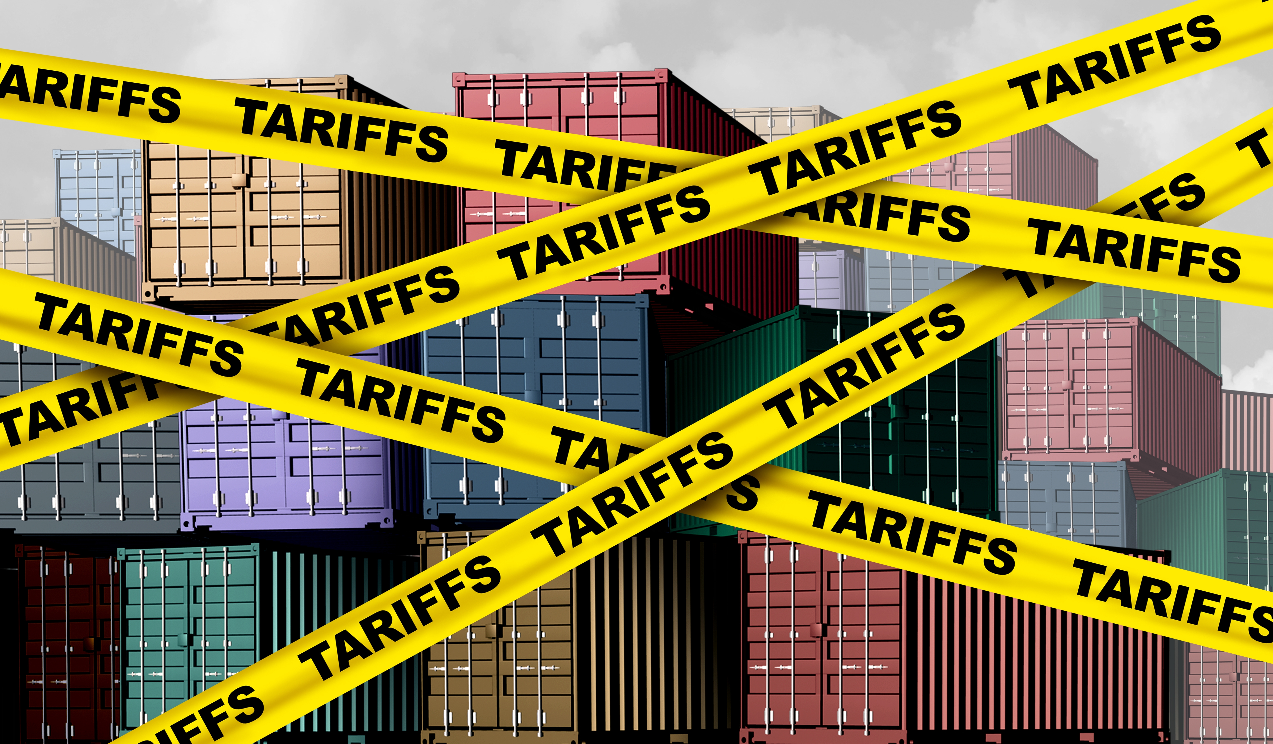

Economic Update
SIRs, Branch 19
Jon Haveman, Ph.D.
NEED
October 2, 2025

Slide 2
Outline
Economic Indicators
Big Picture: Uncertainty

Slide 3
Economic Indicators

Slide 4
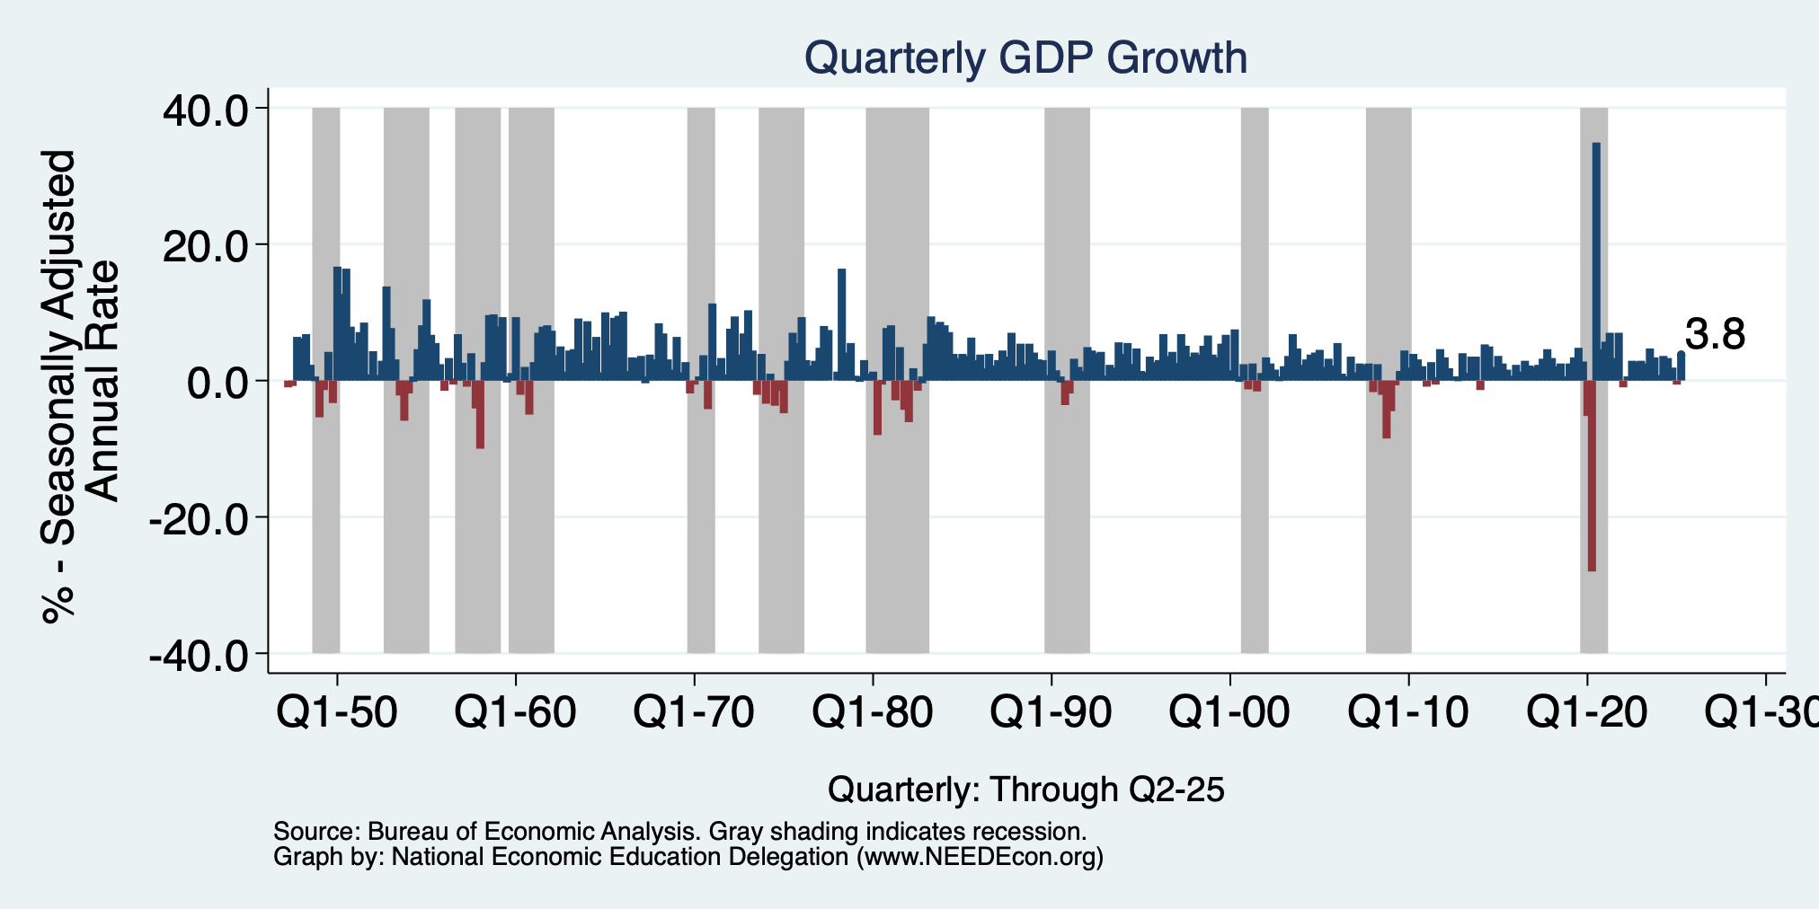
GDP: Quarterly Growth
Q3-2024: 3.1%
Q4-2024: 2.5%
Q1-2025: -0.2%
Q2-2025: 3.8%
Growth 6 Months into 2025: 1.6% Annualized Rate
Notes:
Graph: gdp_pot_grow.png
The Point: From 1990 – 2007, average annual US GDP growth pre-crisis is 2.94%. However, post-crisis US GDP growth is 2.19% (0.75 percentage points lower). Why is has the recovery been sluggish?
Note: At the recession’s height, the gap between quarterly GDP growth and potential growth was 2.5 percentage points.

Slide 5
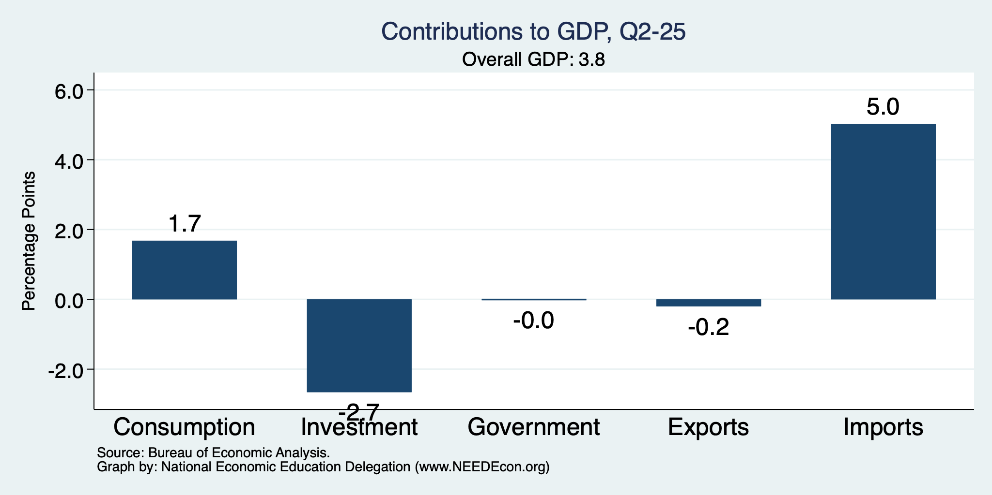
What Drove GDP to Such Growth?
Normally
2.3%

Slide 6
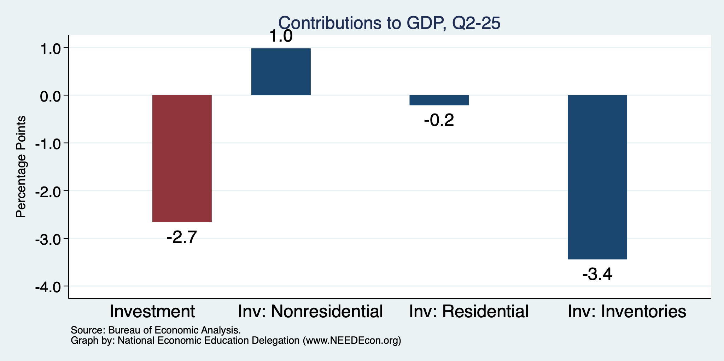
Imports Went Into Inventories
Normally
About 0%
AI Bubble?

Slide 7
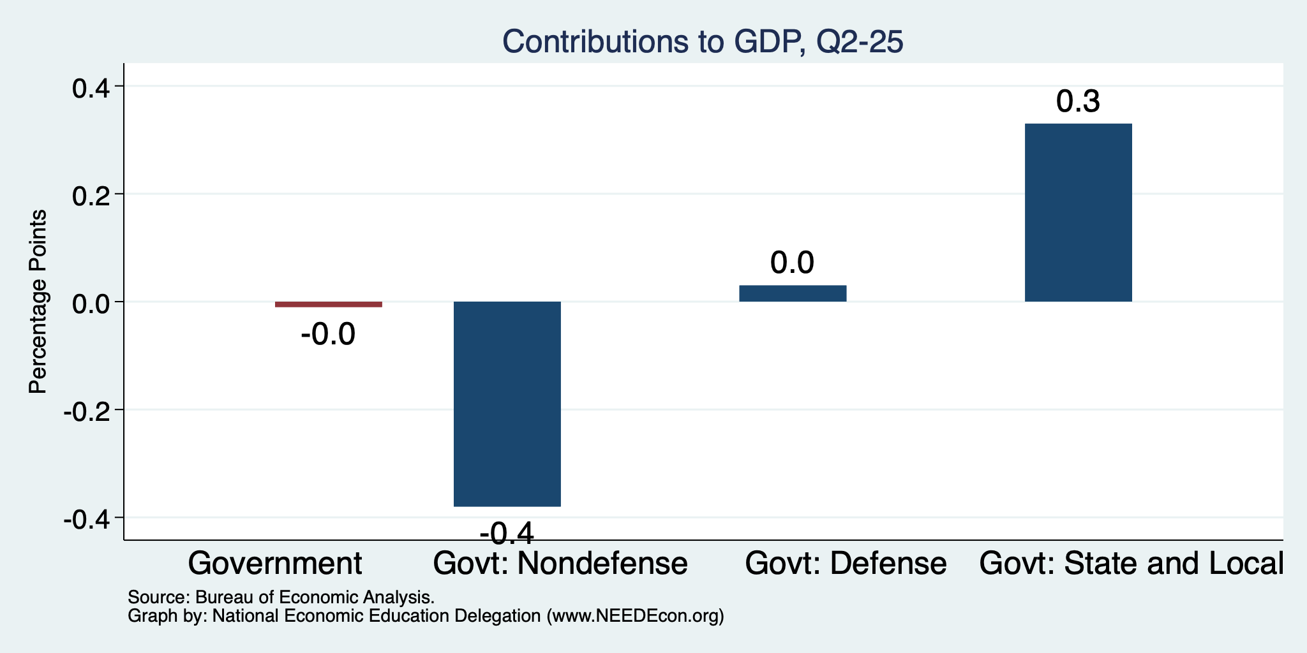
Government Spending Didn’t Help

Slide 8
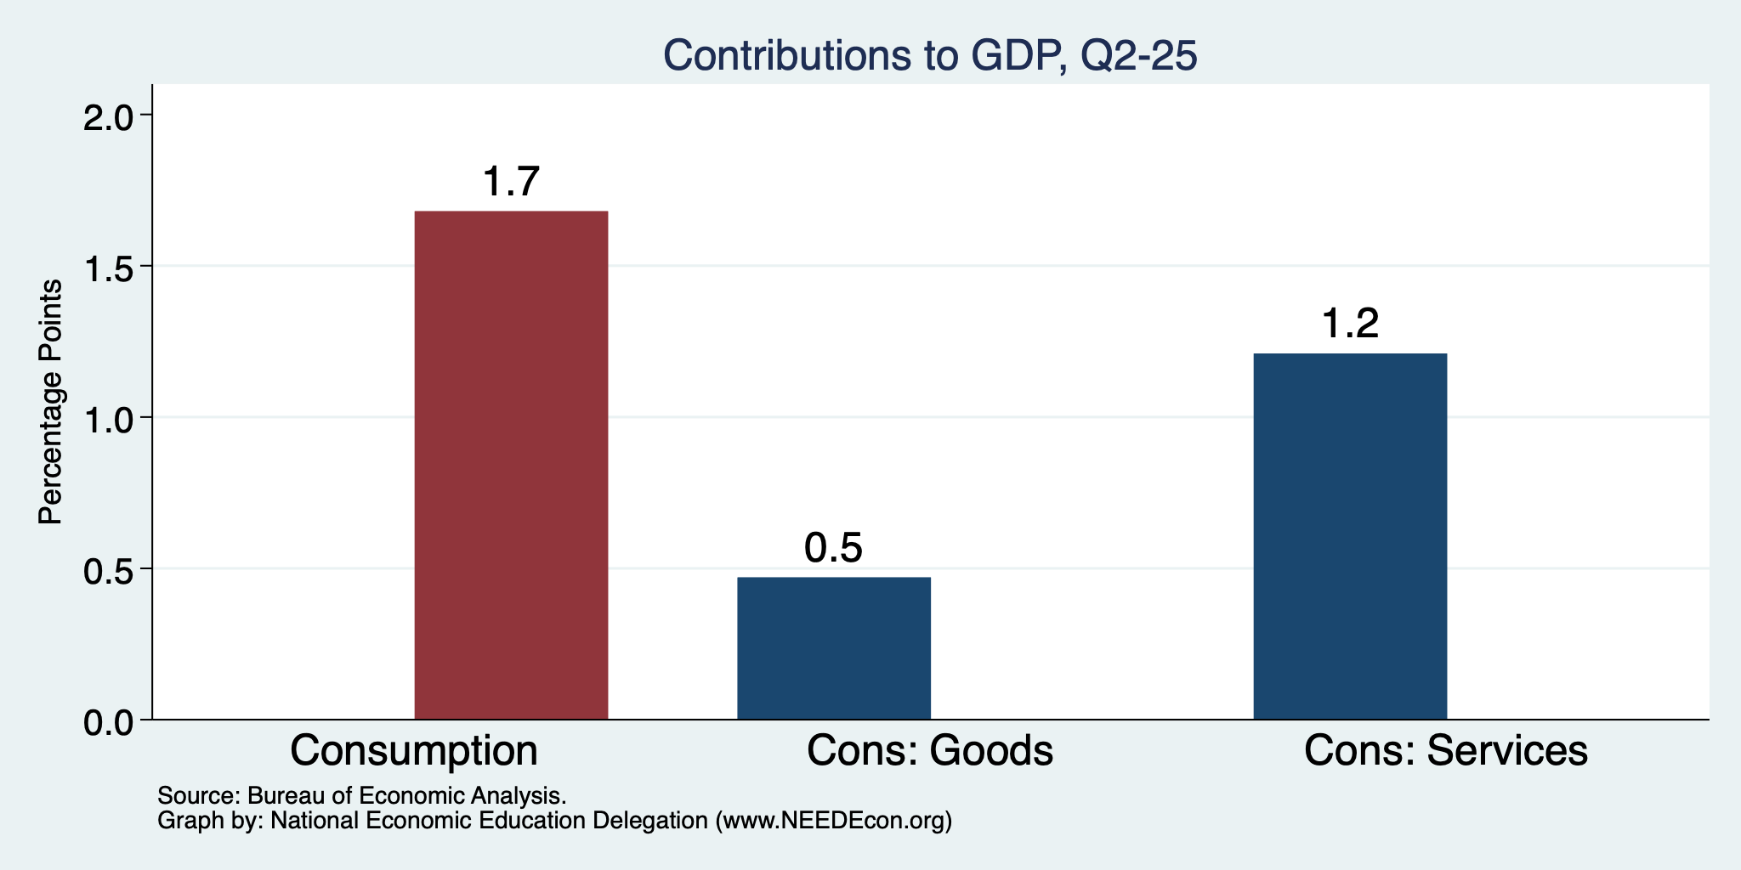
Consumers Also Tightened
Normally
0.8%

Slide 9
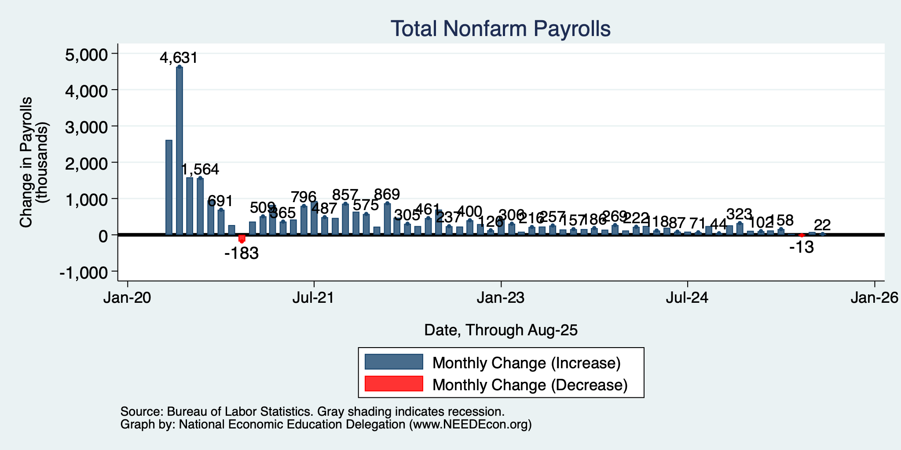
Monthly Changes in Nonfarm Employment
June: -13,000
July: 79,000
Aug: 22,000
ADP Thinks that September Job Growth was NEGATIVE.
We should, but won’t, hear from BLS tomorrow about September.
Notes:
PAYEMS.png

Slide 10
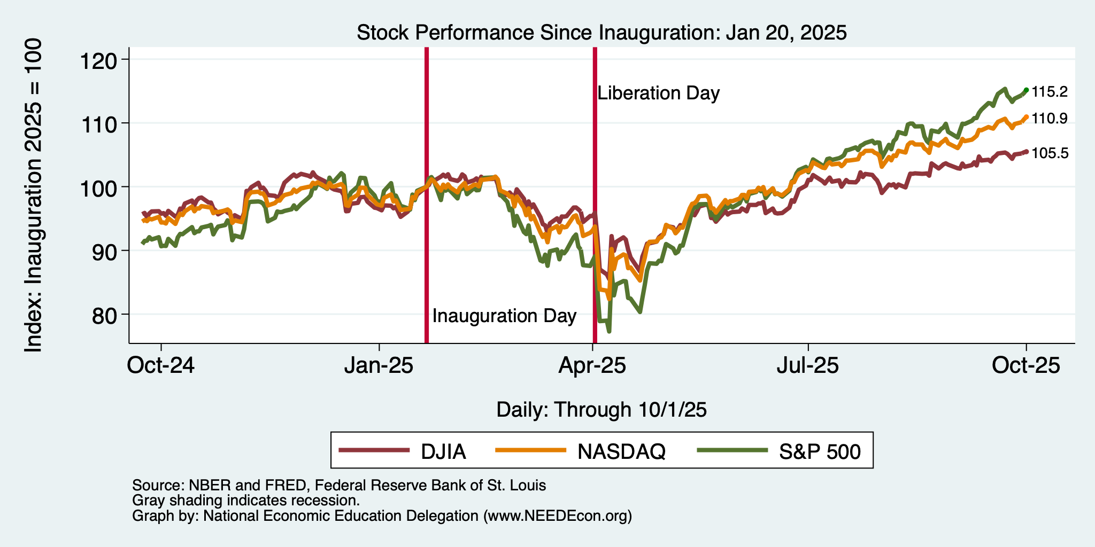
And Stocks?

Slide 11
Inflation

Slide 12
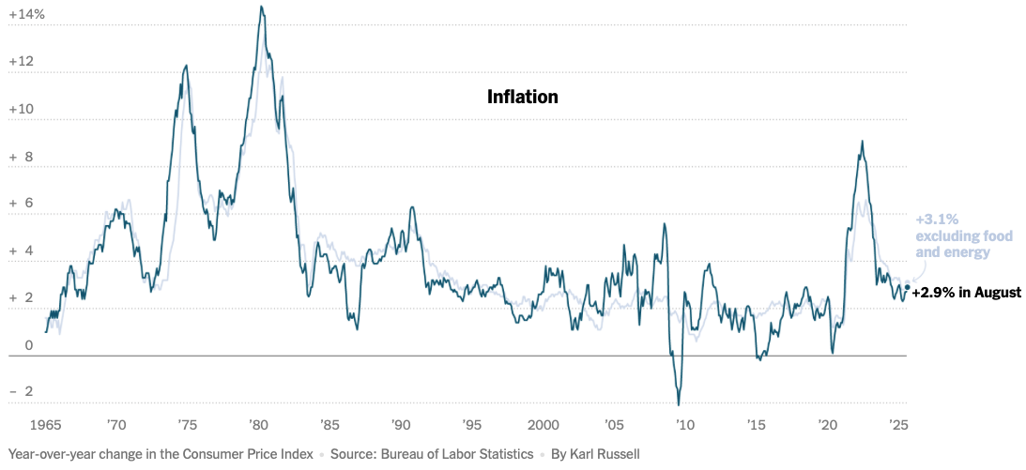
Inflation: Latest Figures
The uptick is almost certainly because of tariffs.
Source: NYTimes.com

Slide 13
The Fed: Conservative

Slide 14
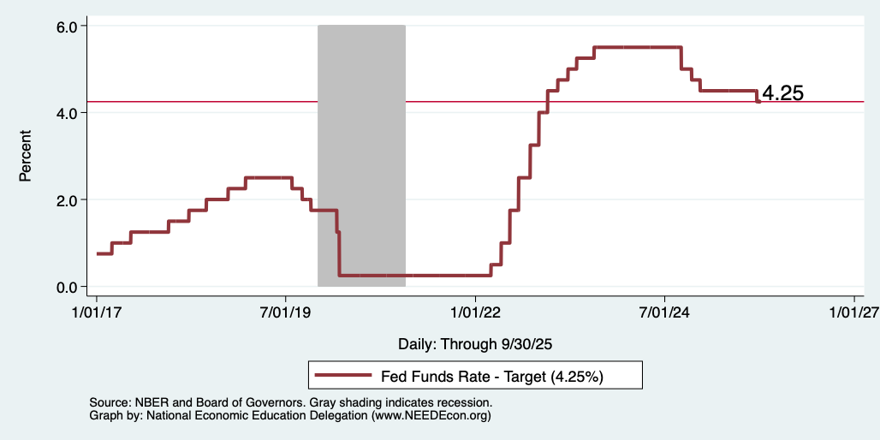
Federal Funds Rate
Notes:
The fed funds rate is the interest rate on overnight loans between banks. Think of it as the baseline interest rate on which banks base all other interest rates (e.g. mortgage rates)
FOMC lowers the fed funds rate during recessions and raises the fed funds rate during expansions
Fed funds rate peaked in the 1980s as then Chairman Paul Volcker sought to reign in “run away” inflation of the 1970s; doing so resulted in a recession in the early 1980s.
Since the 2008-09 recession, the fed funds rate has been kept near zero.
During the 2008-09 recession, Federal Reserve turned to unconventional tools to influence longer term interest rates to further stimulate the economy - QE
FedFunds.png

Slide 15
Takeaways
Is a recession on the horizon?
I wouldn’t be surprised.
Many indicators are in the black.
2024 2nd half GDP growth was pretty good – 2.8% YoY.
2025 Q1 < 0 is almost meaningless.
2025 Q2 = 3.8 is artificial.
Stagflation almost assuredly is on the horizon.
The problem?
Uncertainties abound!

Slide 16
Uncertainties
Federal Government Policies
How far will they go with immigration?
How many federal employees will be laid off?
How high will tariffs remain?
Will Fed Chair Powell be replaced prematurely?
Increased prominence:
Federal Debt
New:
Government shutdown

Slide 17
Bigger Picture

Slide 18
Since Inauguration: Policies = Anti-Growth
Deportations
Tariffs
Cuts to spending and employment
Threats to Fed Chair Powell
Federal Debt
Federal Shutdown

Slide 19
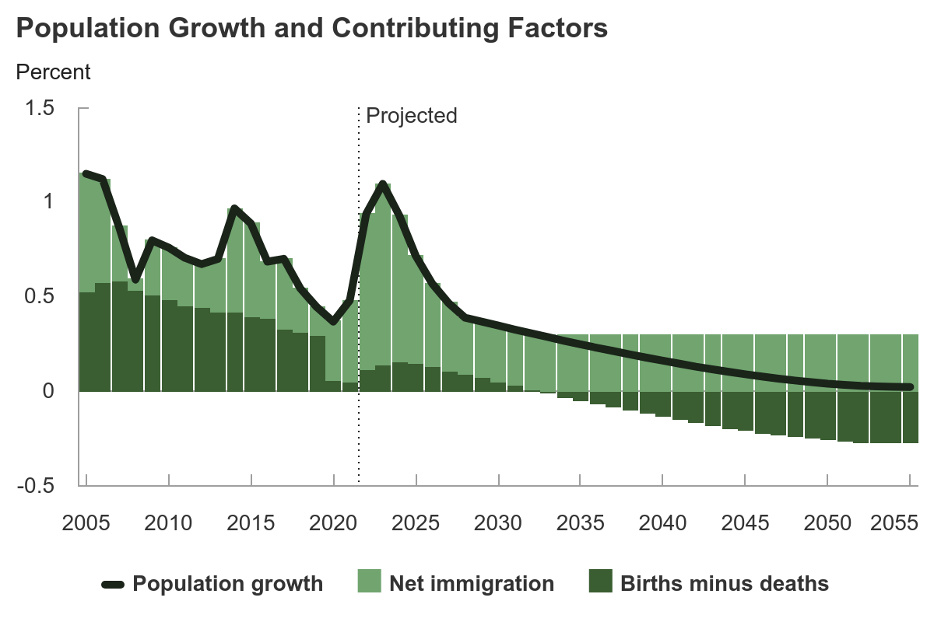
Is Immigration Saving the Day?
Source: CBO – The Demographic Outlook, 2025-2055

Slide 20
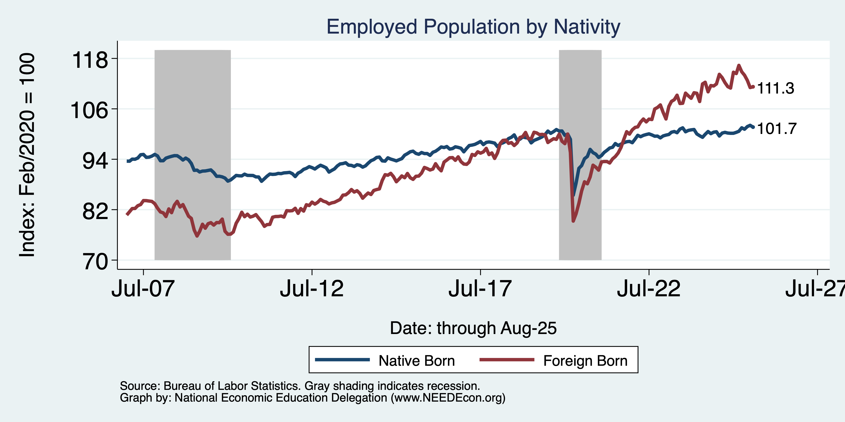
Immigrants to the Rescue?

Slide 21
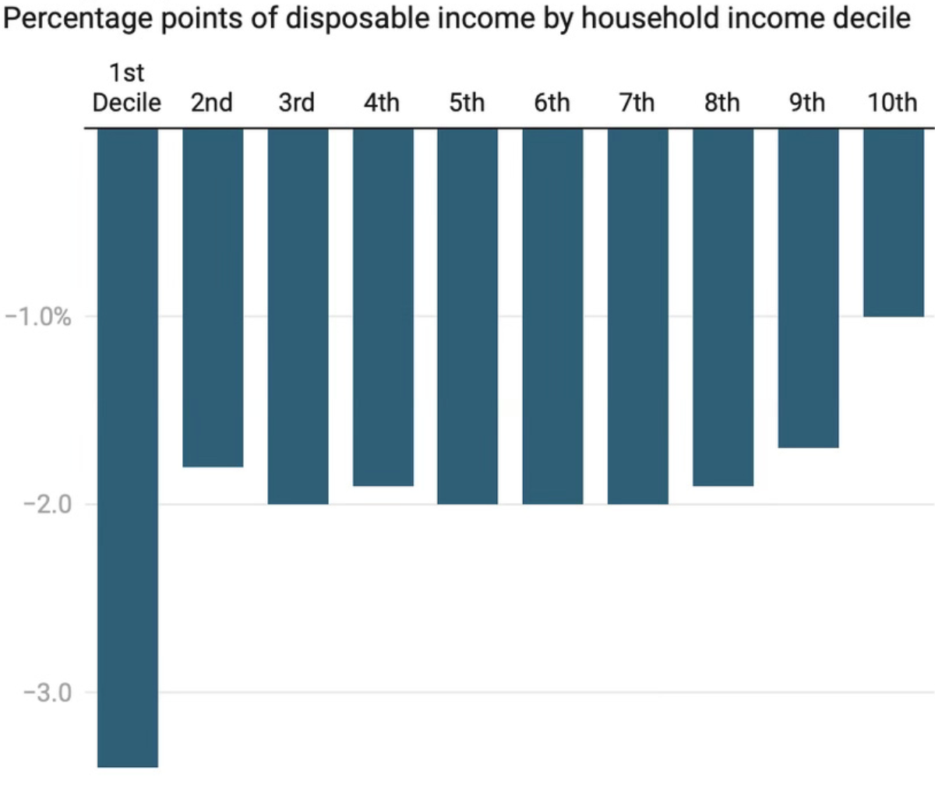
Tariffs: Inequitable Way to Raise Revenues

Slide 22
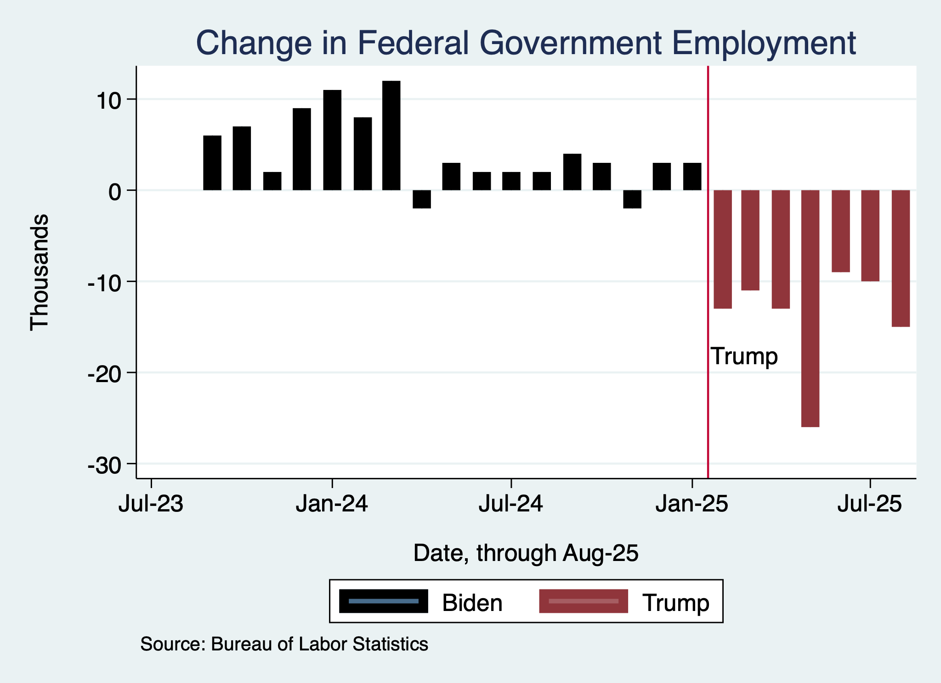
Monthly Changes in Federal Gov’t Employment
Notes:
PAYEMS.png

Slide 23
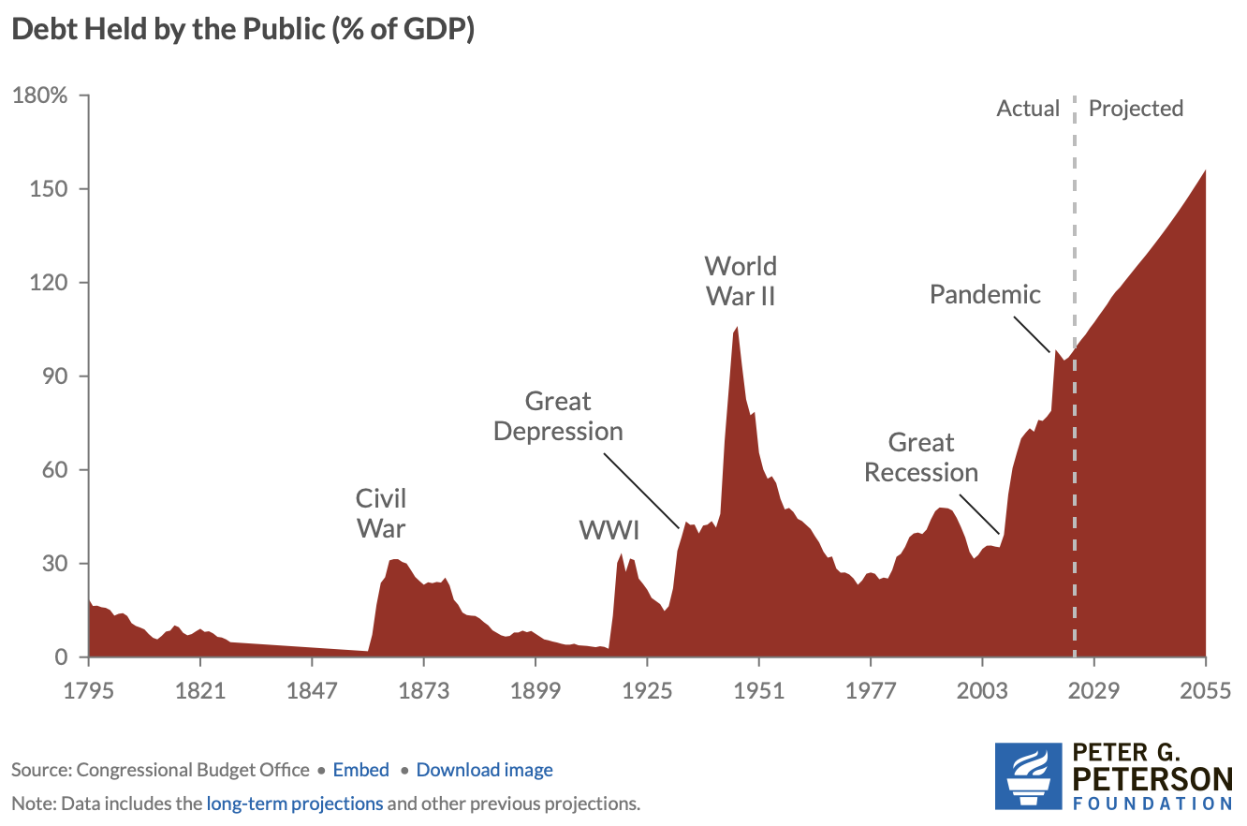
Federal Debt is on an Unsustainable Path

Slide 24
Summary
Inflation: was getting close to Fed’s 2% target.
This is now going in the wrong direction
Current immigration and trade policies will exacerbate inflation.
Immigration: deportations tax the economy and are expensive.
Many, MANY ag workers are unauthorized immigrants. (50% of Central Valley)
Tariffs: are a tax.
Taxes raise prices. Period. Full Stop.
Taxes often cost jobs. Tariffs likely will.

Slide 25
Biggest Problem: Uncertainty
Nobody knows how to plan into uncertainty.
Business investment is particularly at risk.
Hardly anybody increases spending into uncertainty.
Other countries will look elsewhere if the U.S. is volatile.
Tourists already are. 10.3% drop in March/25.
Outlook: is not good.
Inflation is inevitable.
Job losses are inevitable.

Slide 26
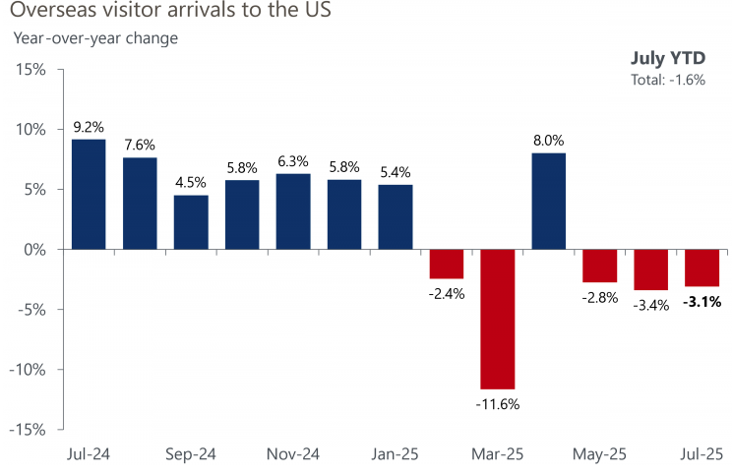
Tourism Evidence
Source: National Travel and Tourism Office

Slide 27
Are We Headed for A Recession?
Uncertain.
Our current path has many forecasters indicating that a recession is more likely than not.
IMF has cut it’s U.S. growth forecast to 1.8%, down from 2.8% in 2024.
A slowdown in economic growth seems inevitable.
A bout of stagflation is happening.
And then there is the shutdown….

Slide 28
About the Shutdown
General effects:
Horribly inconvenient for many. Many of whom are vulnerable.
Economics effects: usually business delayed, not destroyed.
Delay of important economic data.
This time might be different:
Duration: not clear both sides want it to end.
Will furloughs turn into layoffs?
Huge cuts in government contracts (not normal in a shutdown).
The data are particularly important as Fed navigates inflation/growth.

Slide 29
Thank you!
Any Questions?
www.NEEDEcon.org
Jon D. Haveman
Jon@NEEDEcon.org
Contact NEED: info@NEEDEcon.org
Submit a testimonial: www.NEEDEcon.org/testimonials.php
Become a Friend of NEED: www.NEEDEcon.org/friend.php

