Slide 1
US Economy and
Russia/Ukraine Economics
Vistage – Corte Madera
March 24, 2022
Jon Haveman, Ph.D.
National Economic Education Delegation

Slide 2
National Economic Education Delegation
Vision
One day, the public discussion of policy issues will be grounded in an accurate perception of the underlying economic principles and data.
Mission
NEED unites the skills and knowledge of a vast network of professional economists to promote understanding of the economics of policy issues in the United States.
NEED Presentations
Are nonpartisan and intended to reflect the consensus of the economics profession.

Slide 3
Who Are We?
Honorary Board: 54 members
2 Fed Chairs: Janet Yellen, Ben Bernanke
6 Chairs Council of Economic Advisers
Furman (D), Rosen (R), Bernanke (R), Yellen (D), Tyson (D), Goolsbee (D)
3 Nobel Prize Winners
Akerlof, Smith, Maskin
Delegates: 651+ members
At all levels of academia and some in government service
All have a Ph.D. in economics
Crowdsource slide decks
Give presentations
Global Partners: 49 Ph.D. Economists
Aid in slide deck development

Slide 4
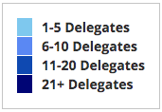
Where Are We?

Slide 5
Available NEED Topics Include:
Coronavirus Economics
US Economy
Climate Change
Economic Inequality
Economic Mobility
Trade and Globalization
Minimum Wages
Immigration Economics
Housing Policy
Federal Budgets
Federal Debt
Black-White Wealth Gap
Autonomous Vehicles
US Social Policy

Slide 6
Credits and Disclaimer
This slide deck was authored by:
Jon D. Haveman, NEED
Scott Baier, Clemson University
Geoffrey Woglom, Amherst College (Emeritus)
Brian Dombeck, Lewis & Clark College
Doris Geide-Stevenson, Weber State
Disclaimer
NEED presentations are designed to be nonpartisan.
It is, however, inevitable that the presenter will be asked for and will provide their own views.
Such views are those of the presenter and not necessarily those of the National Economic Education Delegation (NEED).

Slide 7
Outline
State of the pandemic
The U.S. Economy
Hot Topics
Russia/Ukraine
Inflation
Monetary Policy

Slide 8
Making Real Progress!
Nationally
Source: NYTimes

Slide 9
California Cases Are Falling Nicely
California
Source: NYTimes

Slide 10
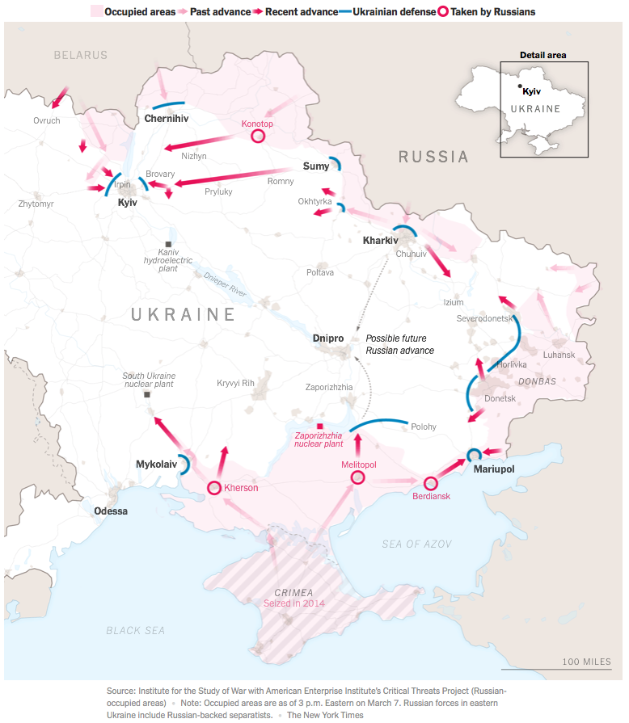
and now: Russian Invasion of Ukraine

Slide 11
The U.S. Economy

Slide 12
GDP Trajectory: Pandemic Plunge!
GDP is:
$0.3 Trillion below 2019 forecast.
$0.7 Trillion ABOVE 2019-Q4 level.

Slide 13
Monthly Changes in Nonfarm Employment
Notes:
PAYEMS.png

Slide 14
Monthly Changes in Nonfarm Employment
Recovery?
Recovery
Delta
Omicron
Notes:
PAYEMS.png

Slide 15
Employment Gap
1.1 Million below February, 2020.
7.4 Million below where we should be.
Notes:
payroll_recent.png

Slide 16
Trends in Labor Force Participation
0.6 Million below February, 2020.
3.7 Million below where we should be.
Notes:
CLF16OV.png

Slide 17
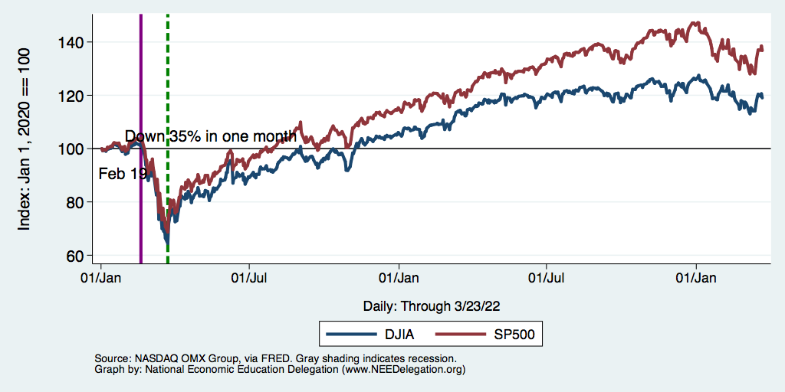
Stocks: Jittery
Interest rates, inflation, Ukraine….oh my!

Slide 18
Hot Topics
Russia/Ukraine
Oil
Wheat
Inflation
Monetary Policy

Slide 19
Russia/Ukraine(/Belarus)

Slide 20
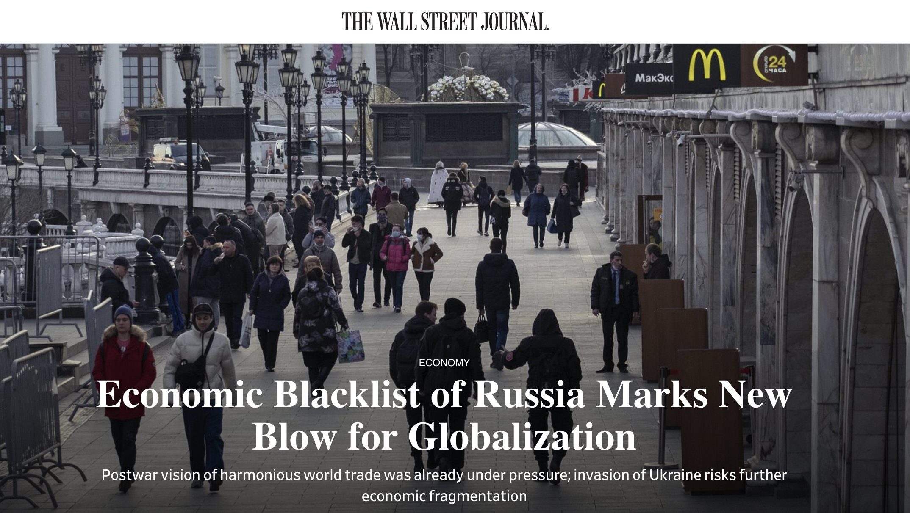
March 10, 2022
Notes:
Josh Zumbrun, “Economic Blacklist of Russia Marks New Blow for Globalization,” Wall Street Journal, March 10, 2022
https://www.wsj.com/articles/economic-blacklist-of-russia-marks-new-blow-for-globalization-11646940040?mod=itp_wsj&ru=yahoo

Slide 21
Impact of Russia-Ukraine War
How Russia-Ukraine war impacts globalization
War itself disrupts trade, especially exports of
Ukraine: wheat
Russia: wheat, oil
Economic sanctions by governments disrupt
Financial linkages
Trade
Private companies stop dealing with Russia

Slide 22
Impact of Russia-Ukraine War
Financial sanctions by US, EU, UK, and others
Frozen foreign-held assets of individuals, Putin and dozens of others
Restrictions on Russia’s Central Bank’s use of international reserves
Several Russian banks removed from the Swift international payments system
Cut off many Russian banks from transactions and operations
Long list of Russian companies banned or restricted
Possible restrictions on Russia borrowing from IMF and World Bank
Notes:
Eir Noisoe and Valentina Pop, “Russia sanctions list: What the west imposed over the Ukraine invasion,” Financial Times, March 4, 2022.
https://www.ft.com/content/6f3ce193-ab7d-4449-ac1b-751d49b1aaf8

Slide 23
Impact of Russia-Ukraine War
Trade sanctions by governments
Oil and other energy
Germany puts Nord Stream 2 gas pipeline on hold
US bans from Russia
UK to phase out Russian oil by end of 2022
EU to become independent from Russia by 2030
EU bans steel imports from Russia
US restricts exports to Russia, especially technology and military; later also to Belarus; later also luxury goods
EU and UK impose export restrictions similar to US
Ban on Russian air carriers by Canada, EU, US, UK
G-7 to revoke Russia’s most favored nation status
Permits them to raise tariffs on Russian goods
Notes:
https://bis.doc.gov/index.php/policy-guidance/country-guidance/russia-belarus

Slide 24
Impact of Russia-Ukraine War
Private Companies Stop Dealing in Russia, per NBC News Mar 11:
Automotive: Ford, GM, Toyota, …
Aviation: Airbus, Boeing, American, Delta, United, …
Energy: BP, ExxonMobil, Shell
Equipment: Caterpillar, Honeywell, Deere
Food & Bev: Burger King, Coke, McDonalds, Starbucks,…
Finance: Citigroup, Deutsche Bank, Vanguard, …
Consumer goods: Proctor & Gamble, Unilever, Mars, …
Leisure: Airbnb, Hilton, Expedia, …
Logistics: DHL, FedEx, Maersk, UPS
Media: Netflix, Roku, Disney, …
Payment services: Amex, Visa, Western Union, …
And many more: Consulting, Retail, Technology
Notes:
Haley Messenger and Noah Sheidlower, “Which companies have stopped doing business with Russia?” NBC News, updated Mar 11, 2022.
https://www.nbcnews.com/business/business-news/companies-stopped-business-russia-rcna19006

Slide 25
Consequences for the Russian Economy
Devaluation of the Ruble
High interest rates
Shortages
Massive inflation
Not to mention the Oligarchs
Sanctions on 100 specific individuals.
Fear of renewed “Iron Curtain”

Slide 26
Consequences for the Global Economy
Primarily:
Oil
Wheat
Why?
Major suppliers of each
29% of world wheat production
20-40% of Europe’s oil and gas
Russia part of OPEC+
Russian and Ukranian combined economies are small.
Don’t forget Belarus.

Slide 27
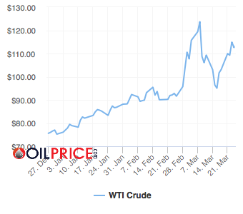
Oil - West Texas Intermediate
Russia Invades
Why did it fall?
Who knows?
Slack demand in China
Long bets sold
Notes:
https://oilprice.com/oil-price-charts/#WTI-Crude

Slide 28
Oil Prices in Historical Context

Slide 29
Oil Prices in Historical Context – Inflation Adj.

Slide 30
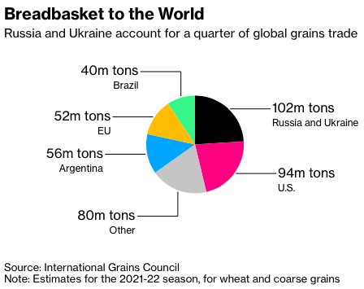
Grains
Notes:
https://www.bloomberg.com/news/articles/2022-03-02/wheat-soars-above-10-as-russia-invasion-stifles-black-sea-trade

Slide 31
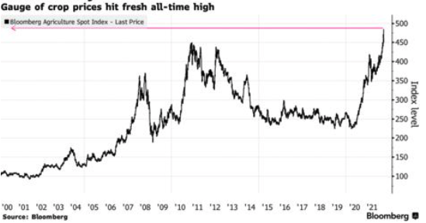
Grain Prices: All-Time High
Notes:
https://news.yahoo.com/surge-wheat-prices-expected-seed-133755571.html?fr=yhssrp_catchall

Slide 32
Oh, and…
40% of the world’s PALLADIUM comes from Russia.
Used in catalytic convertors.
70% of the world’s NEON comes from Ukraine.
Used in production of semiconductors.
Fertilizer: Russia is the world’s largest supplier.
Prices are 3-4x their 2020 levels.
Therefore: more supply chain issues, more inflation, food insecurity.

Slide 33
Inflation

Slide 34
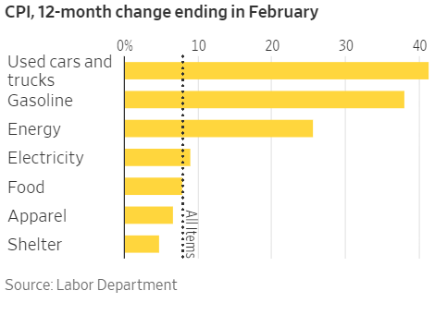
Inflation News
January 2022
All items: 7.9% - new four decade high
Source: Wall Street Journal
Notes:
Why CPI overestimates or underestimates inflation – COVID CPI should reflect a change in purchases. Covid CPI 6.54%

Slide 35
Food and Fuel are A Big Part of the Story

Slide 36
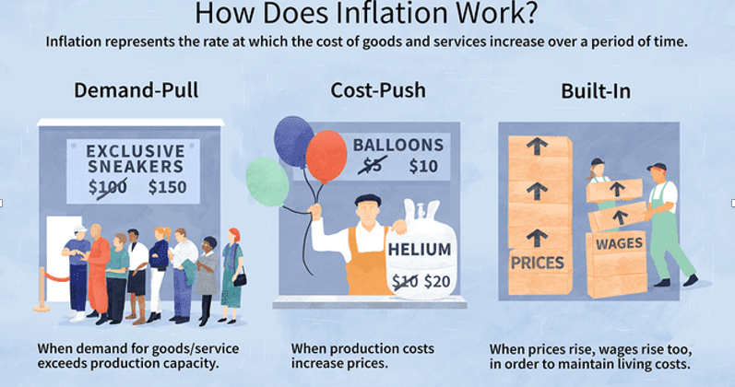
Source: Investopedia

Slide 37
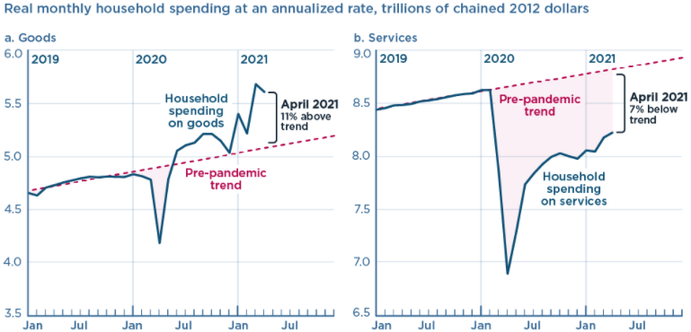
We’re Buying Mostly … Stuff
Demand-Pull
Source: Jason Furman, PIIE

Slide 38
Inflation: Concentrated
Cost-Push

Slide 39
Corporate Profits…Adding to Inflation?

Slide 40
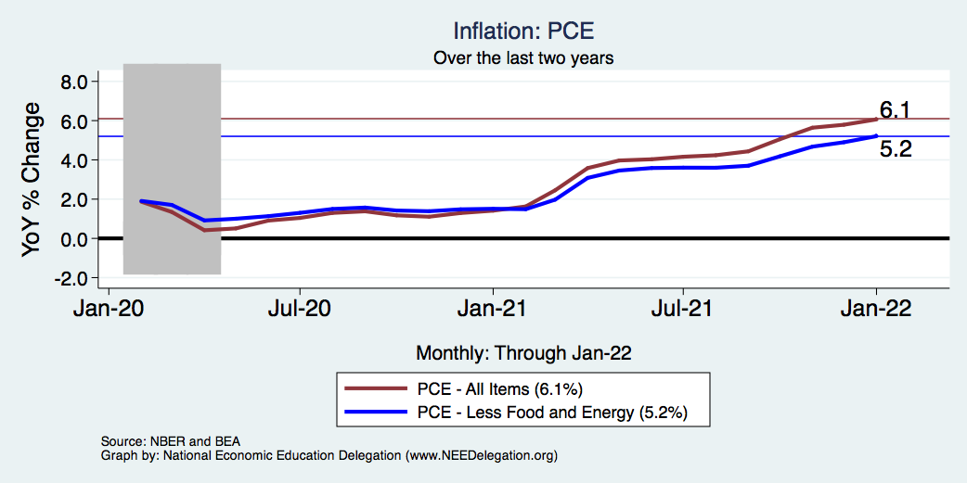
Inflation – The Fed’s Metric! Not Sooo High.
Notes:
Cpi_recent.png

Slide 41
Goods are Driving Inflation

Slide 42
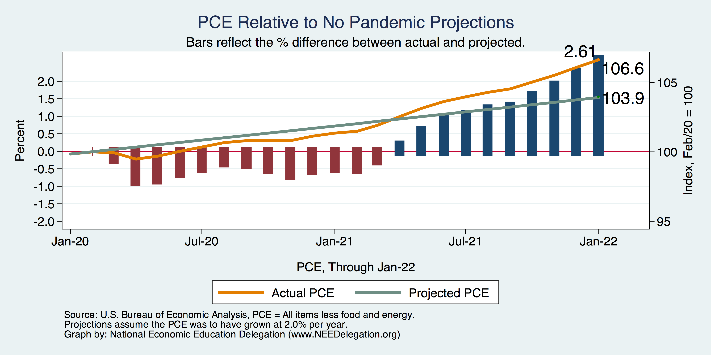
Inflation – PCE and Fed Suggest: I don’t know.
Notes:
Cpi_recent.png

Slide 43
So Far Inflationary Expectations Look Stable
Professional forecasters, financial markets and the Fed itself think that inflation in 2022 will be in the 2.5-3%, range
 | Median Fed Forecasts from 12/15/21 FOMC Meeting
 | 2022 | 2023 | 2024 | Longer run
Unemployment rate | 3.5 | 3.5 | 3.5 | 4.0
Inflation | 2.6 | 2.3 | 2.1 | 2.0
Interest rate | 0.9 | 1.6 | 2.1 | 2.5
Russia/Ukraine conflict may well raise these forecasts.

Slide 44
Measure of Inflation Expectations
Breakeven Inflation Rate = Difference between
nominal and real 5-year and 10-year Treasury
constant maturity securities.
Market participants expect around 2.9%
of inflation annually over the next 10 years and
3.5% over the next 5 years.
Inflation expectations are increasing – especially after the Russian invasion.

Slide 45
Monetary Policy
Fed has raised interest rates by 25 basis pts. (1/4%)
Is this enough or too much?
Nobody knows.
Likely not too much.
Should Fed be more aggressive?
Recessions tend to follow Fed aggression.
Inflation of 2010-11 says Fed should play it cool.

Slide 46
Federal Funds Rate

Slide 47
Conclusion
Recovery is well underway, but may be slowing.
GDP expanded by 5.7% percent in 2021, 3-4% in 2022.
2021 was an odd year.
Workers attained the upper hand.
Supply chains broke.
Inflation surged.
The economy rebuilt itself.
Biggest problems:
Supply chain bottlenecks.
Labor force participation.
Russian war in Ukraine

Slide 48
Where Are We Headed?
Economic fallout of the Russia/Ukraine conflict … will be modest?
Recession is a remote possibility, but not out of the question.
At best, back to where we were before the pandemic.
Economic growth of ~2%/year.
Low interest rates.
Inflation back in the 2% range.
How long is it going to take to get there and what will we endure?
Could be 5 years before we are back to equilibrium. NOT back to normal.
Next year: elevated inflation and interest rates.
2023: GDP growth relatively slow, but perhaps greater than recent averages.

Slide 49
Thank you!
Any Questions?
www.NEEDelegation.org
Jon D. Haveman
Jon@NEEDelegation.org
Contact NEED: info@NEEDelegation.org
Submit a testimonial: www.NEEDelegation.org/testimonials.php
Become a Friend of NEED: www.NEEDelegation.org/friend.php

Slide 50
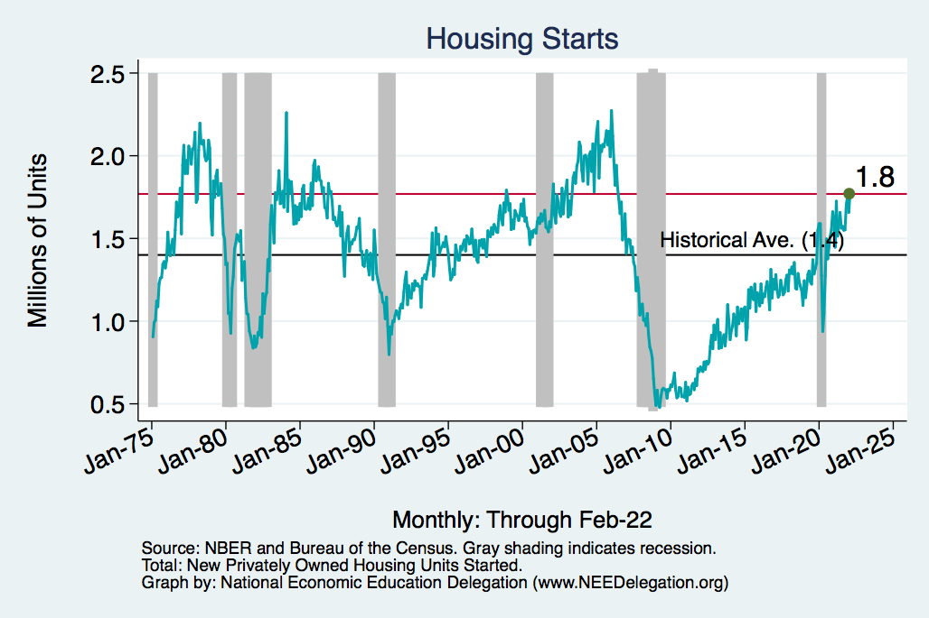
Home Prices and Housing Starts
Notes:
Charts:
homeprices_recession.png
housing.png

Slide 51
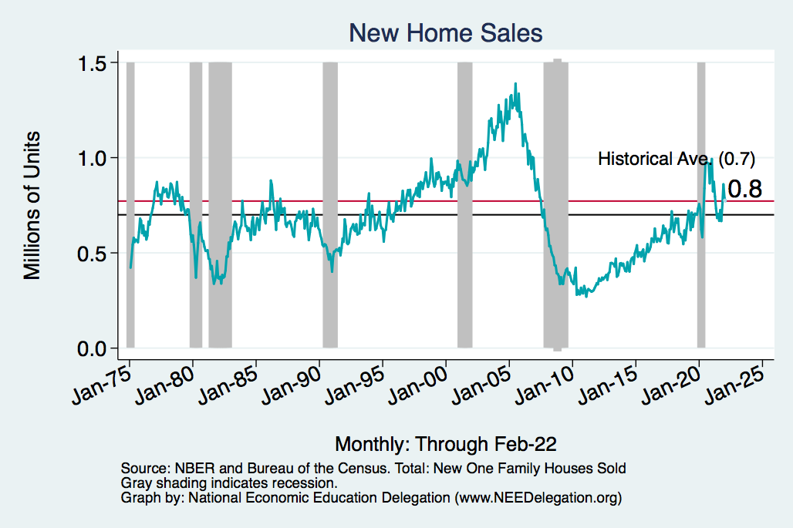
Home Prices and Home Sales
Notes:
Charts:
homeprices_recession.png
housing.png

Slide 52
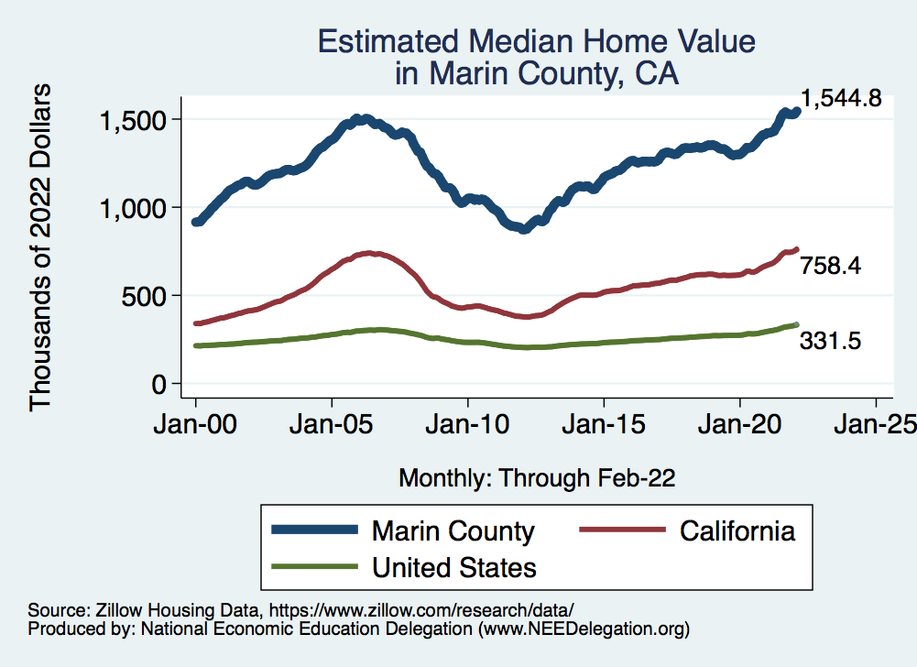
RE Experiences Differ!

Slide 53
www.NEEDelegation.org/LocalGraphs
For every state and county in the United States.
Detailed graphs on employment, housing, moves, and other statistics.

