Slide 1
Osher Lifelong Learning Institute, Winter 2022
Contemporary Economic Policy
University of Pittsburgh, PA
February-March, 2022
Jon Haveman, Ph.D.
National Economic Education Delegation

Slide 2
National Economic Education Delegation
Vision
  One day, the public discussion of policy issues will be grounded in an accurate perception of the underlying economic principles and data.
Mission
  NEED unites the skills and knowledge of a vast network of professional economists to promote understanding of the economics of policy issues in the United States.
NEED Presentations
  Are nonpartisan and intended to reflect the consensus of the economics profession.

Slide 3
Available NEED Topics Include:
Coronavirus Economics
US Economy
Climate Change
Economic Inequality
Economic Mobility
Trade and Globalization
Minimum Wages
Immigration Economics
Housing Policy
Federal Budgets
Federal Debt
Black-White Wealth Gap
Autonomous Vehicles
US Social Policy

Slide 4
Course Outline
Contemporary Economic Policy
  Week 1 (2/2): Trade and Globalization (Alan Deardorff, University of Michigan)
  Week 2 (2/9): US Economy & Coronavirus Economics (Me)
  Week 3 (2/16): The Black-White Wealth Gap (Stephanie Seguino, U-Vermont)
  Week 4 (2/23): Health Economics (Veronika Dolar, SUNY, Old Westbury)
  Week 5 (3/2): Economic Inequality (Me)

Slide 5
Submitting Questions
Please submit questions in the chat.
  I will try to handle them as they come up, but may take them in a bunch as time permits.
We will do a verbal Q&A once the material has been presented.
  And the questions in the chat have been addressed.
OLLI allowing, we can stay beyond the end of class to have further discussion.

Slide 6
US Economy and Coronavirus Economics
Jon Haveman, Ph.D.
National Economic Education Delegation

Slide 7
Credits and Disclaimer
This slide deck was authored by:
  Jon D. Haveman, NEED
  Scott Baier, Clemson University
  Geoffrey Woglom, Amherst College (Emeritus)
  Brian Dombeck, Lewis & Clark College
  Doris Geide-Stevenson, Weber State
Disclaimer
  NEED presentations are designed to be nonpartisan.
  It is, however, inevitable that the presenter will be asked for and will provide their own views.
  Such views are those of the presenter and not necessarily those of the National Economic Education Delegation (NEED).

Slide 8
Outline
State of the pandemic
The U.S. Economy
Hot Topics
  Government policy
  Debt
  Inflation
  Great resignation
  Housing markets

Slide 9
State of the Pandemic

Slide 10
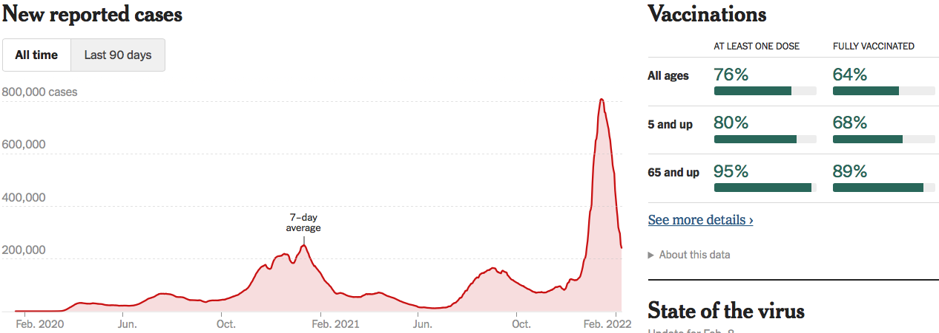
Making Real Progress…Until Omicron
Nationally
Source: NYTimes

Slide 11
Omicron is Making Things Difficult
Covid-related absences:
  Are creating headaches for businesses that were struggling to hire workers even before Omicron.
  Restaurants and retail stores have cut back hours.
  Broadway shows called off performances.
  Airlines canceled thousands of flights over the holidays because so many crew members called in sick;
  on one day last month, nearly a third of United Airlines Workers at Newark Liberty International Airport, a major hub, called in sick.
Source: NYTimes.com

Slide 12
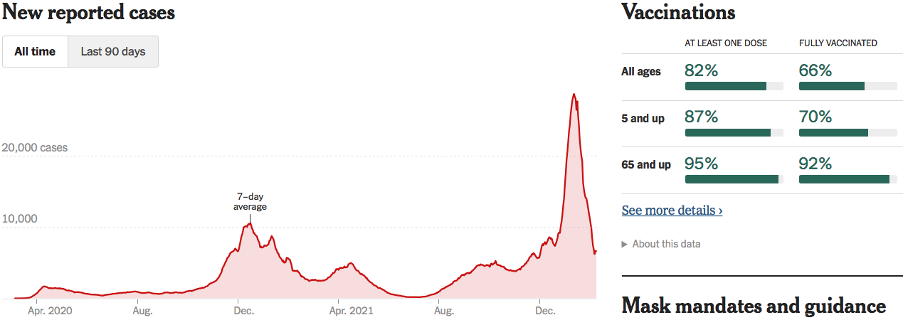
Pennsylvania Cases Are Falling Nicely
Pennsylvania
Source: NYTimes

Slide 13
The U.S. Economy

Slide 14
Some Basic Statistics
Statistic: | Value
Population | 331.9 Million
Labor Force | 163.7 Million
Employment | 149.6 Million
Gross Domestic Product (GDP) | $23.9 Trillion
Income per Capita | $63,002
Ave. Hourly Earnings | $31.31

Slide 15
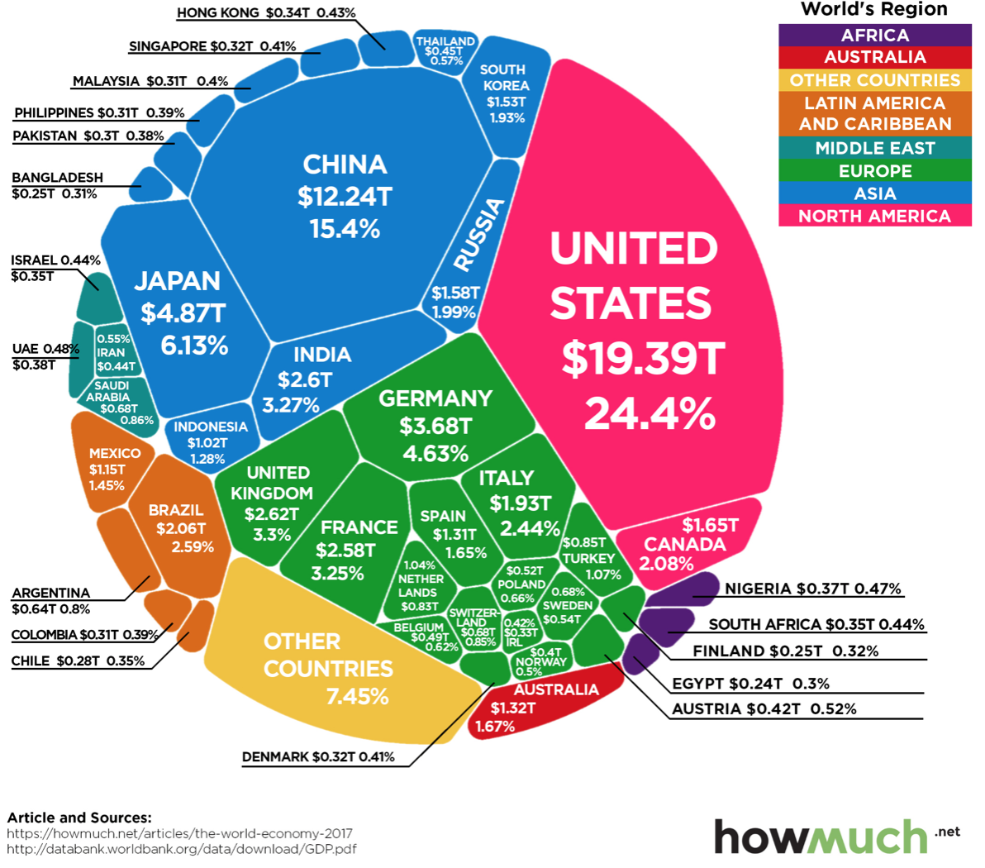
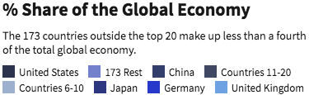
U.S. Economy in Global Perspective
U.S. Real GDP (2019$):
$21.845 trillion in 2019-Q4
$19.663 trillion in 2020-Q2
$22.531 trillion in 2021-Q4
Notes:
https://www.investopedia.com/insights/worlds-top-economies/#countries-by-gdp

Slide 16
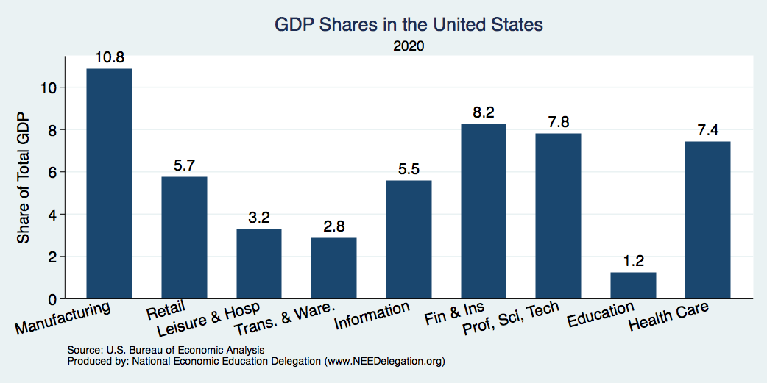
Composition of the U.S. Economy: GDP

Slide 17
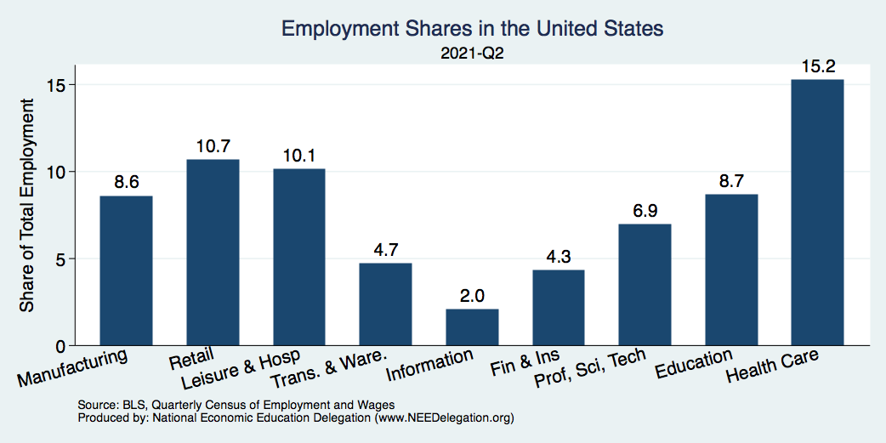
Composition of the U.S. Economy: Employment
Manufacturing
GDP Share = 10.9%
Health GDP Share = 7.4%

Slide 18
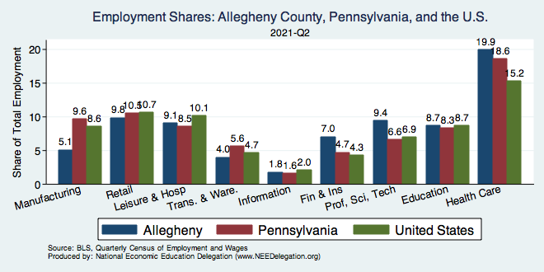
Allegheny County Employment: Health

Slide 19
Evidence of Impact

Slide 20
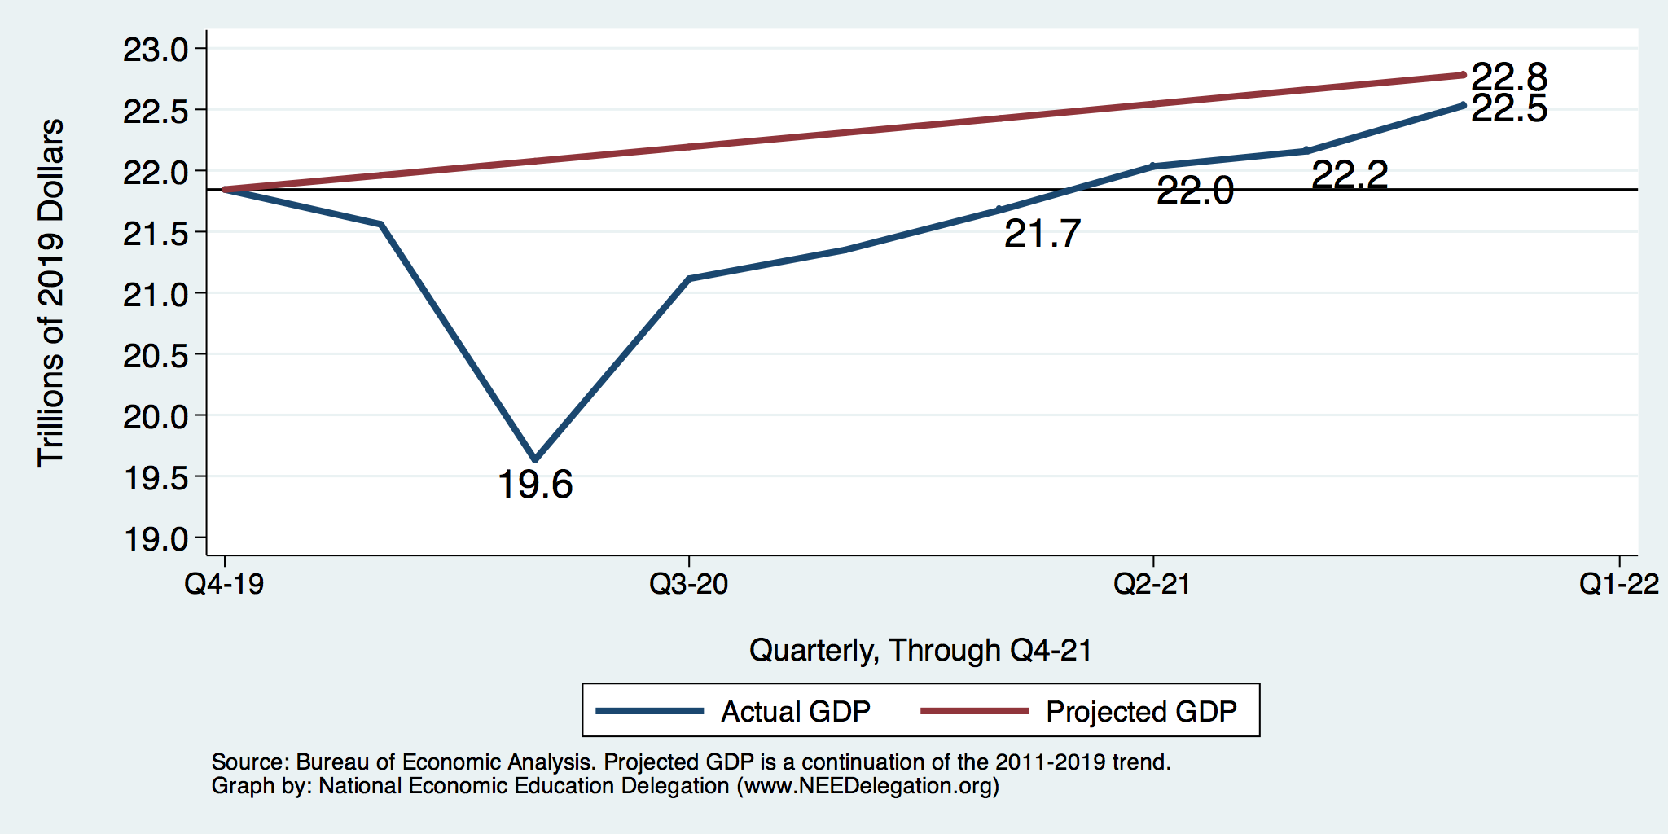
GDP Trajectory: Pandemic Plunge!
Q3 - Flat
GDP is:
$0.3 Trillion below 2019 forecast.
$0.7 Trillion ABOVE 2019-Q4 level.

Slide 21
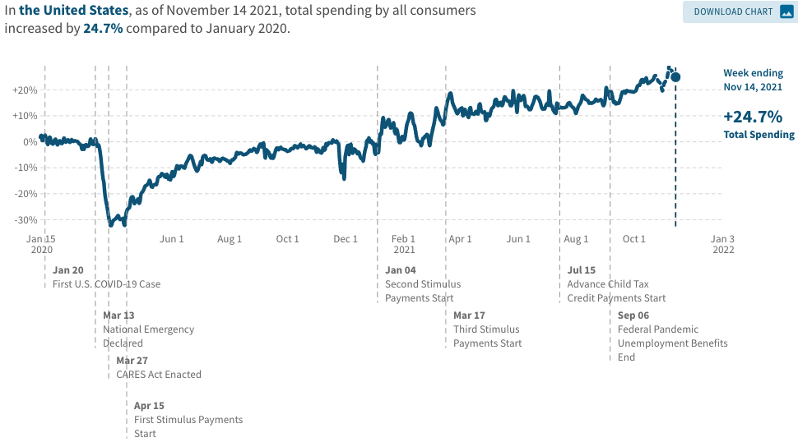
Spending Patterns Since First US Case
Q3 - Flat
Source: https://tracktherecovery.org/

Slide 22
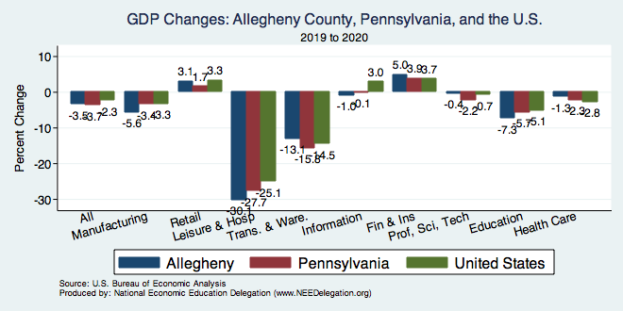
But Not All Industries Were Equally Harmed

Slide 23
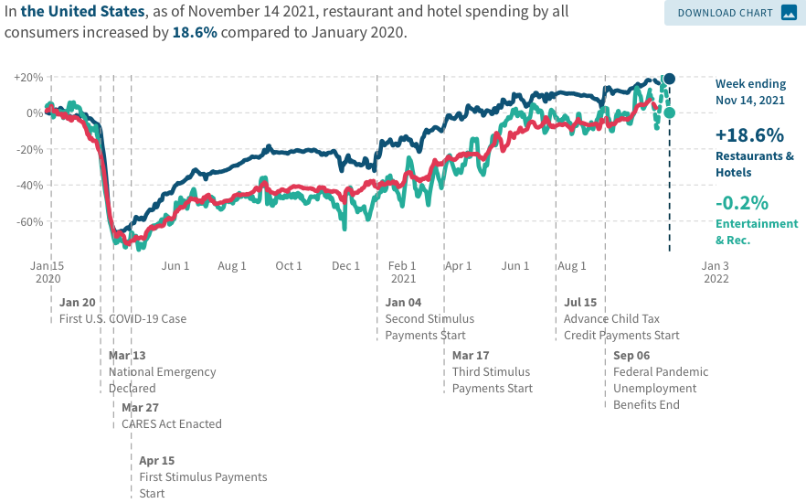
Spending Patterns – Hardest Hit Sectors
+0.2%
Transportation
Source: https://tracktherecovery.org/

Slide 24
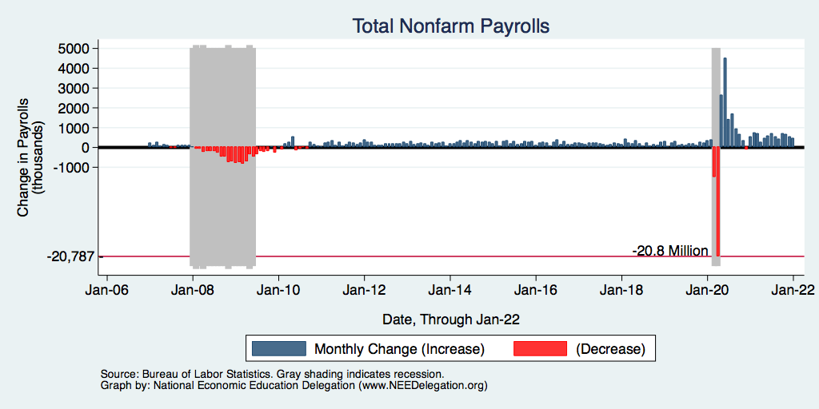
Monthly Changes in Nonfarm Employment
Notes:
PAYEMS.png

Slide 25
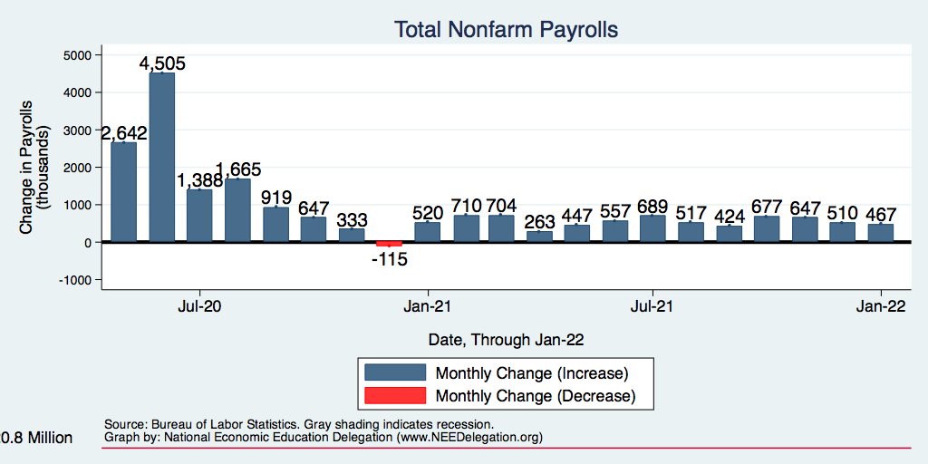
Monthly Changes in Nonfarm Employment
Delta
Recovery
Omicron
Notes:
PAYEMS.png

Slide 26
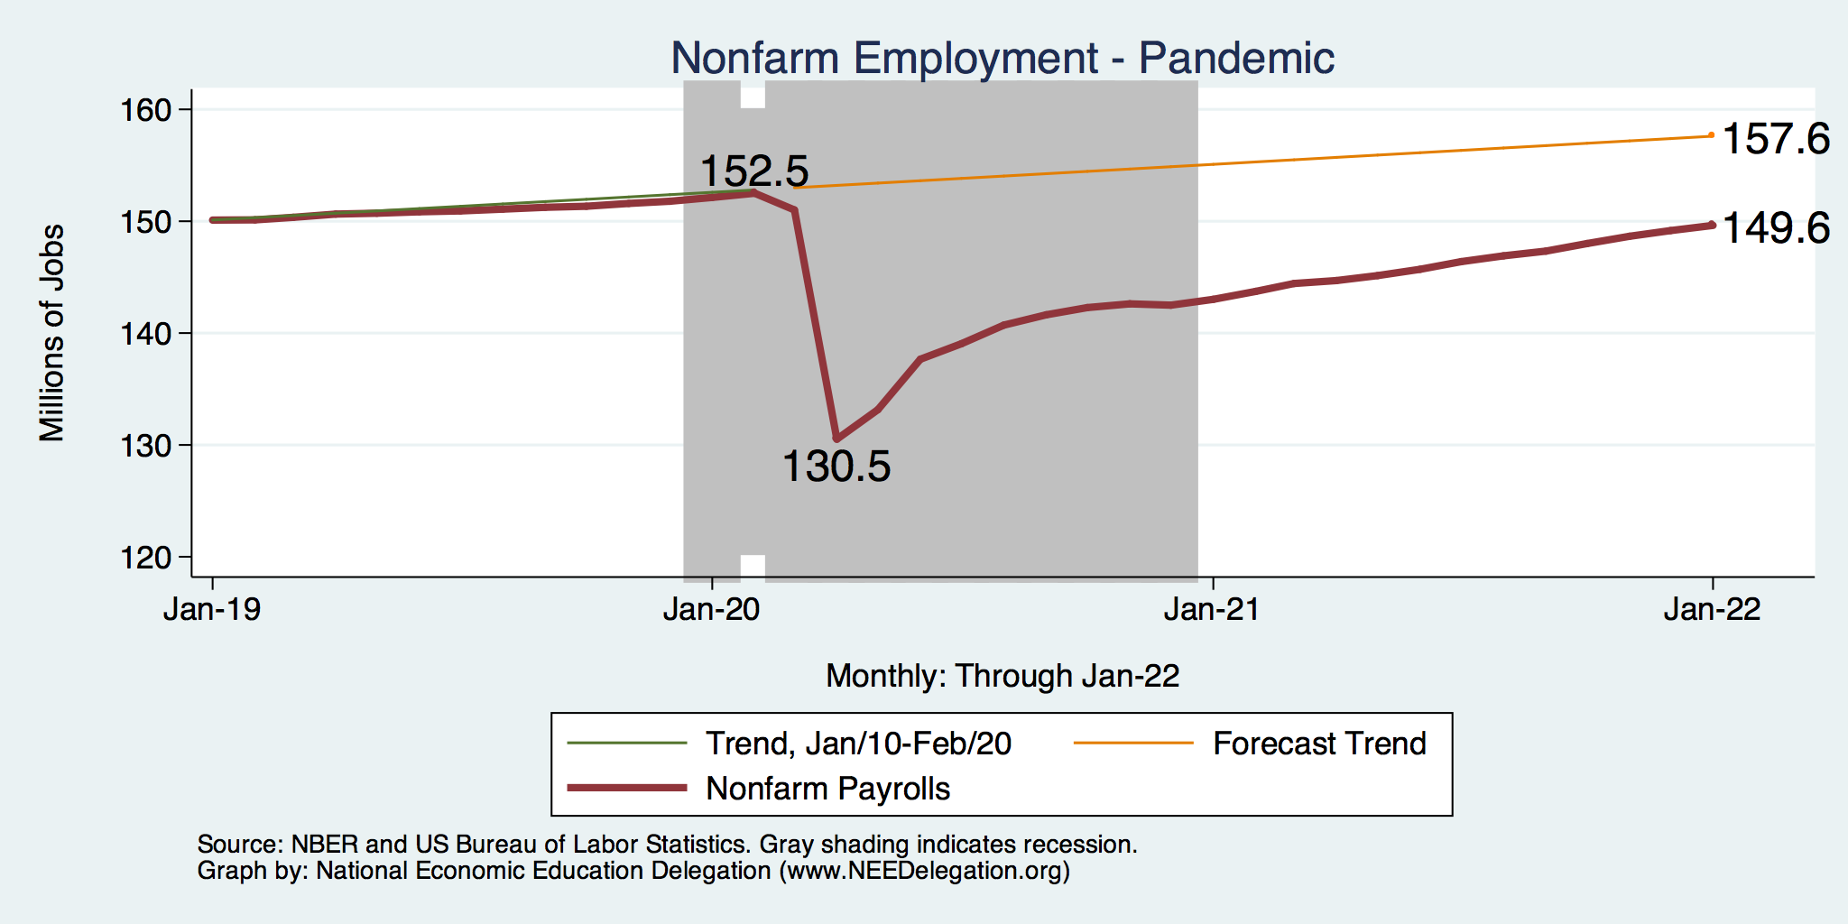
Employment Gap
2.0 Million below February, 2020.
8.0 Million below where we should be.
Notes:
payroll_recent.png

Slide 27
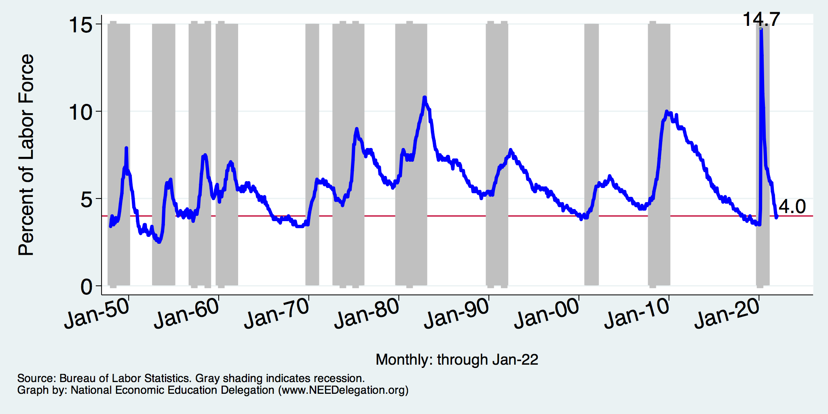
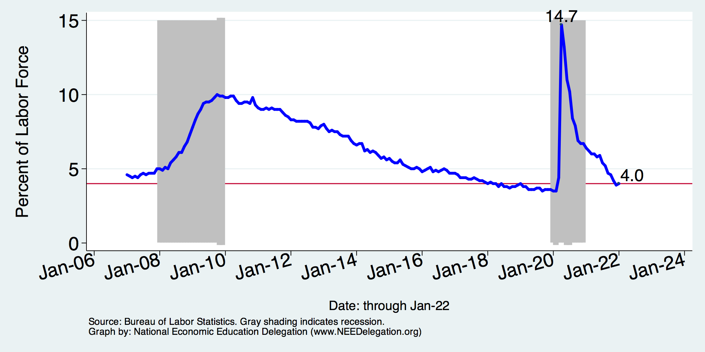
Unemployment Rate
Notes:
Unemployment rises during recessions and falls during economic expansions.
Unemployment peaked at the end of the 2009 recession.
The Fed worked to reduce the effects of the recession. Near the end of 2008, the FOMC reduced the federal funds rate to nearly zero and worked to reduce longer-term interest rates via large-scale asset purchase programs (late 2008 – 10/2014).
Unemployment is currently below the natural rate of unemployment. This is traditionally accompanied by economic growth and rising price levels. It’s also a major reason for FOMC’s decision to increase the federal funds rate.

Slide 28
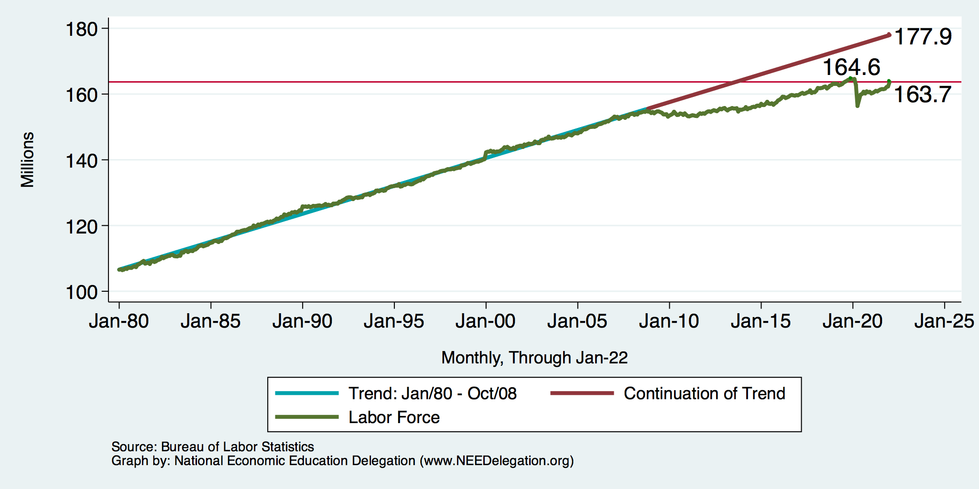
Trends in Labor Force Participation
0.9 Million below February, 2020.
14.7 Million below where we should be.
Notes:
CLF16OV.png

Slide 29
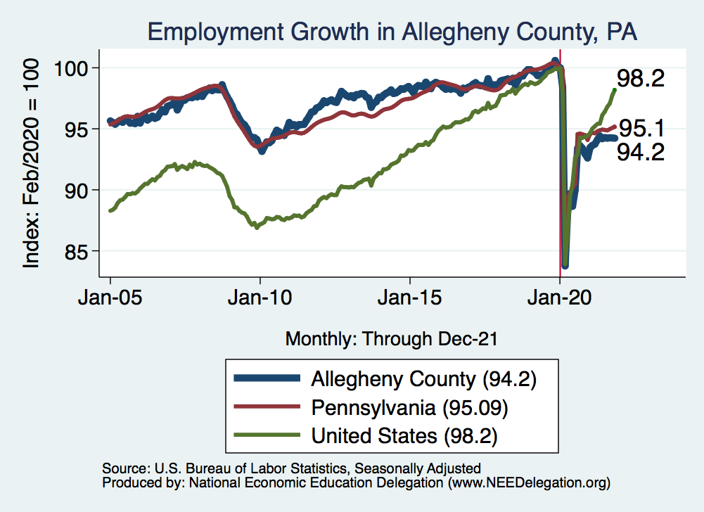
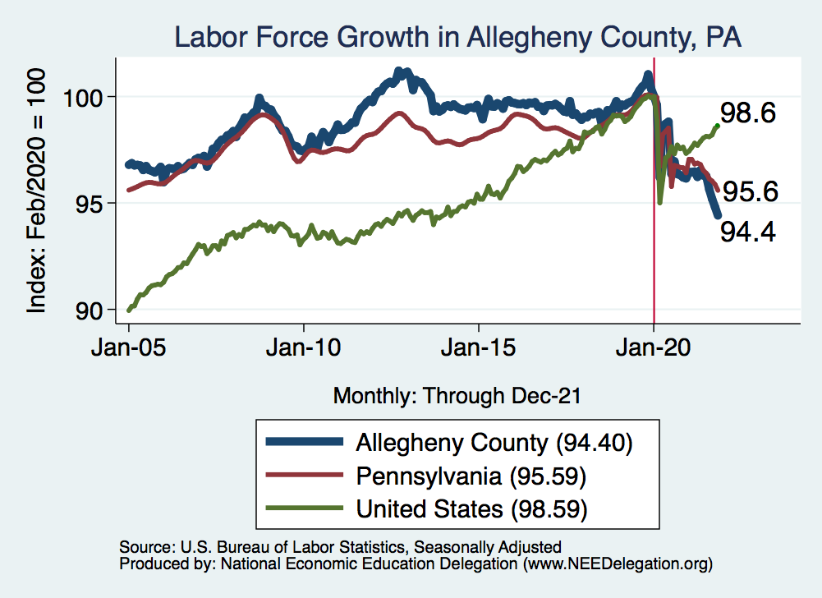
Employment in Allegheny County

Slide 30
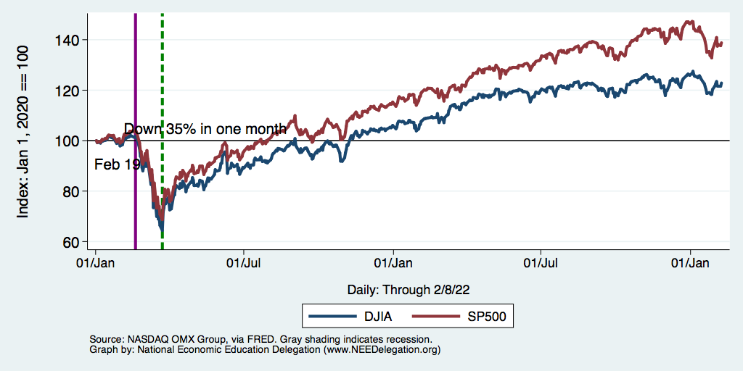
Stocks: Bounced Back Quicker This Time

Slide 31
Hot Topics
Government policy
Inflation
Great resignation
Housing markets

Slide 32
What Have Been Policy Effects?
MONETARY POLICY (Fed) acted quickly and effectively to prevent a financial market meltdown and to keep credit flowing. But the Fed lends and does not spend.
FISCAL POLICY (Congress) acted quickly, but inevitably made some mistakes.
  Stimulus Checks, A ($268b)
  Expanded Unemployment, B ($268b)
  Paycheck Protection Program, C- ($525b)

Slide 33
Recovery Due to Immense Fiscal Stimulus and Control of COVID

Slide 34
Stimulus allowed Spending to Recover
But Note that Saving also went way up
Saving
Abnormally high Saving is over $2.8 trillion

Slide 35
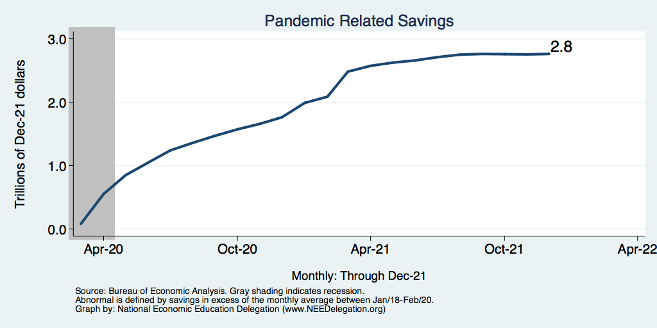
Abnormally High Savings
Biden Boost
Trump Bump
CARES

Slide 36
Monetary Policy: Federal Reserve
Primary goal is to keep interest rates low, to facilitate continued borrowing.
  Federal Funds Rate – rate at which banks lend to each other, usually overnight.
  Purchases of U.S. Treasury securities – keep money flowing to the government at low rates of interest.

Slide 37
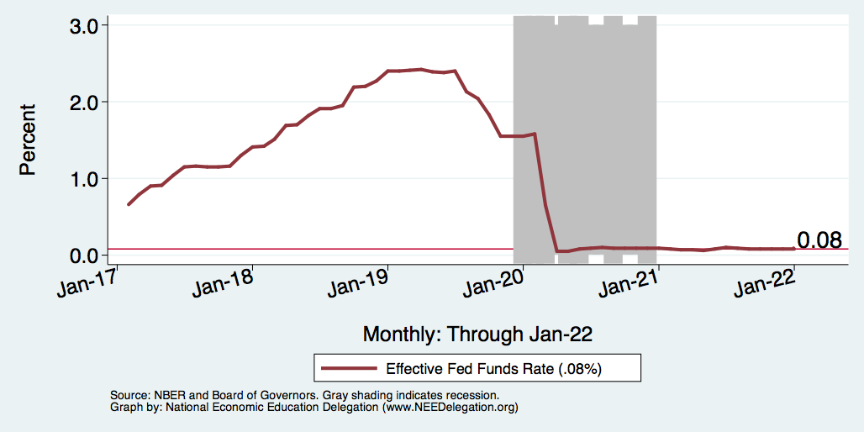
Federal Funds Rate – Last 5 Years
Notes:
The FOMC waited for labor market conditions to improve before raising the fed funds rate in late 2015.
FOMC currently working to normalize monetary policy by raising interest rates and reducing assets on its balance sheet
FedFunds_recent.png

Slide 38
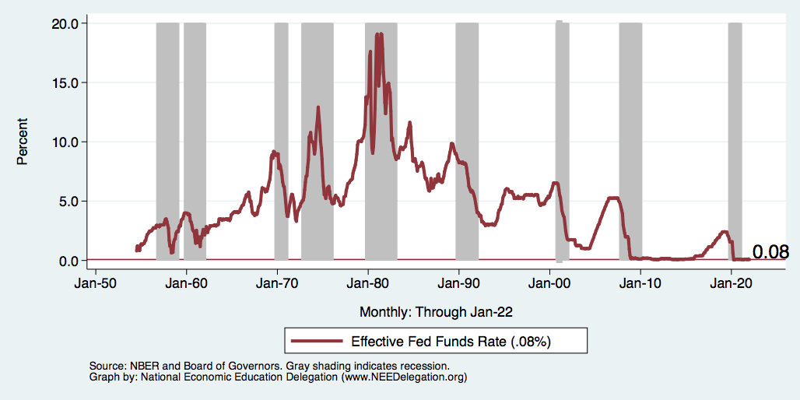
Federal Funds Rate
Notes:
The fed funds rate is the interest rate on overnight loans between banks. Think of it as the baseline interest rate on which banks base all other interest rates (e.g. mortgage rates)
FOMC lowers the fed funds rate during recessions and raises the fed funds rate during expansions
Fed funds rate peaked in the 1980s as then Chairman Paul Volcker sought to reign in “run away” inflation of the 1970s; doing so resulted in a recession in the early 1980s.
Since the 2008-09 recession, the fed funds rate has been kept near zero.
During the 2008-09 recession, Federal Reserve turned to unconventional tools to influence longer term interest rates to further stimulate the economy - QE
FedFunds.png

Slide 39
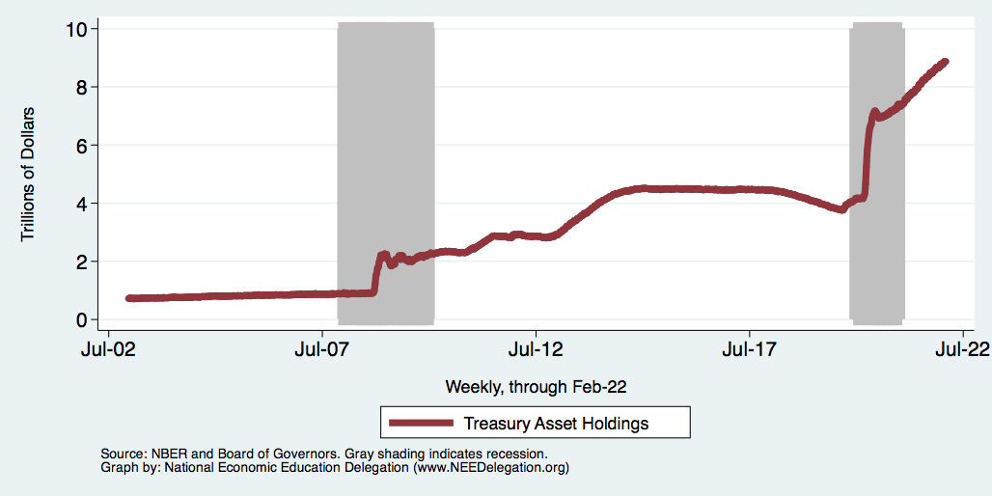
Federal Reserve Assets
8.8
Largely Treasury Securities
Pandemic
Financial Crisis
3.8
1.0
Notes:
The fed funds rate is the interest rate on overnight loans between banks. Think of it as the baseline interest rate on which banks base all other interest rates (e.g. mortgage rates)
FOMC lowers the fed funds rate during recessions and raises the fed funds rate during expansions
Fed funds rate peaked in the 1980s as then Chairman Paul Volcker sought to reign in “run away” inflation of the 1970s; doing so resulted in a recession in the early 1980s.
Since the 2008-09 recession, the fed funds rate has been kept near zero.
During the 2008-09 recession, Federal Reserve turned to unconventional tools to influence longer term interest rates to further stimulate the economy - QE
FedFunds.png

Slide 40
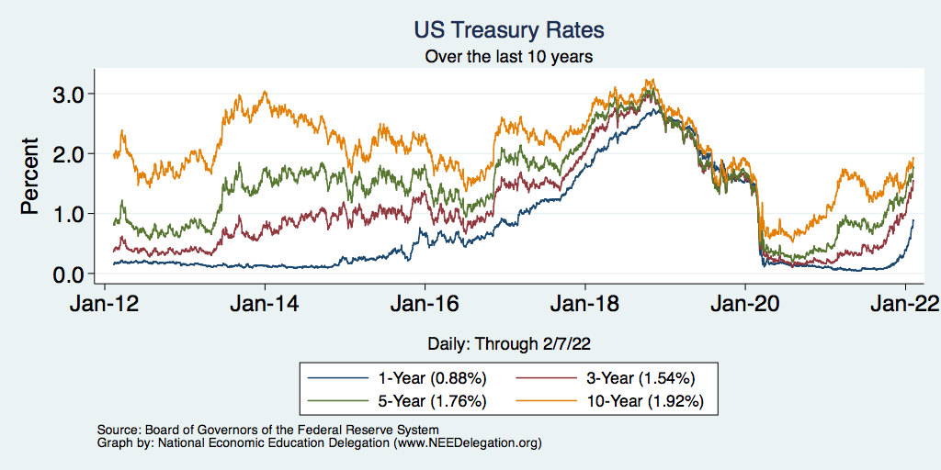
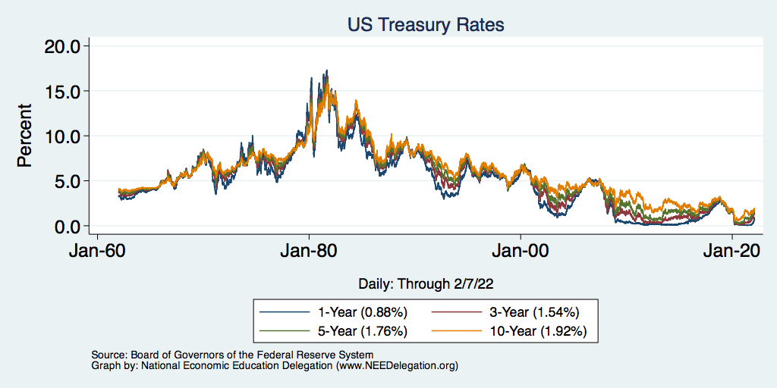
Treasuries – Low Interest Rates
Notes:
treas_recent.png

Slide 41
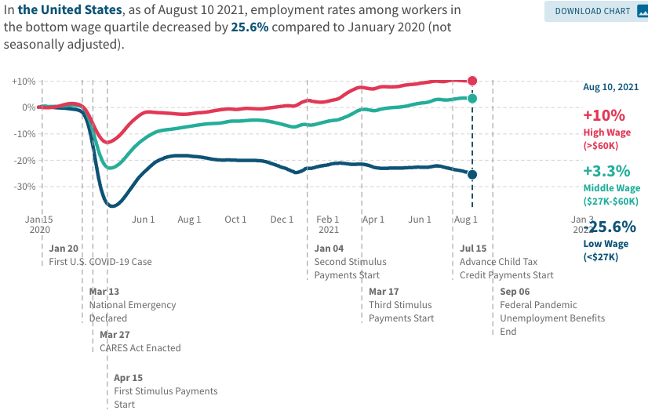
Low Wage Employment is Lagging

Slide 42
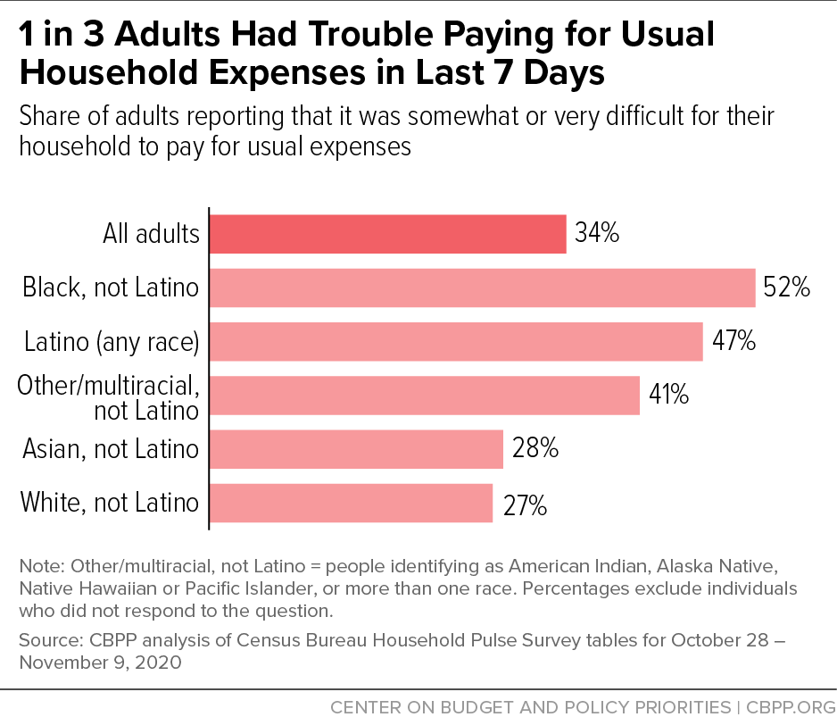
Low Income Troubles

Slide 43
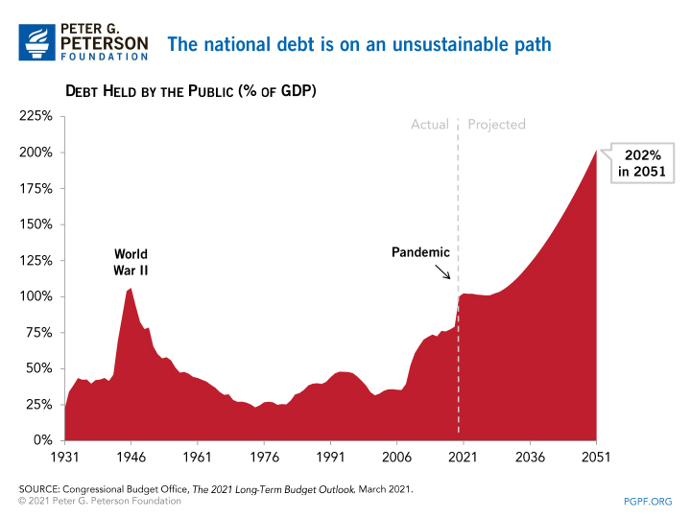
A Problem Exacerbated….Not Created

Slide 44
Current Deficits in Perspective:
The budgetary cost of the 3 major fiscal packages during the pandemic was over $5 trillion. As a share of the economy this is almost the size of war production in 1943.
  (Romer, Brookings Papers on Economic Activity, 3/25/2021.)
Since March of 2020, Fed net holdings of US Treasury bonds have increased by $5.0 trillion.

Slide 45
Inflation

Slide 46
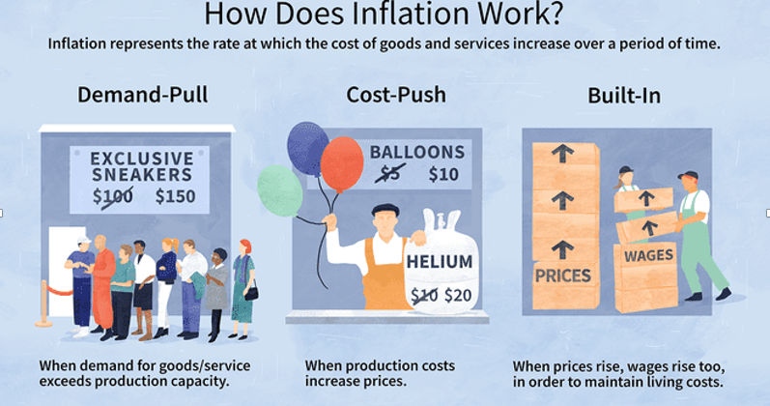
Source: Investopedia

Slide 47
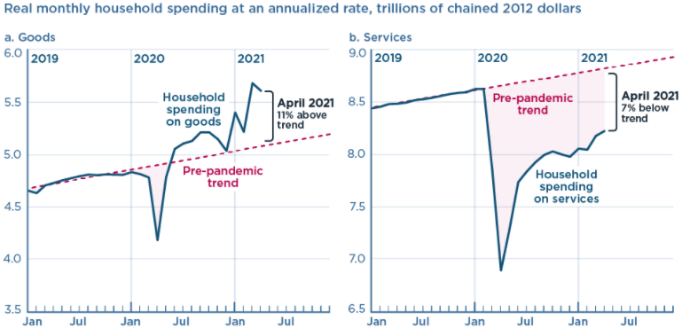
We’re Buying Mostly … Stuff
Demand-Pull
Source: Jason Furman, PIIE

Slide 48
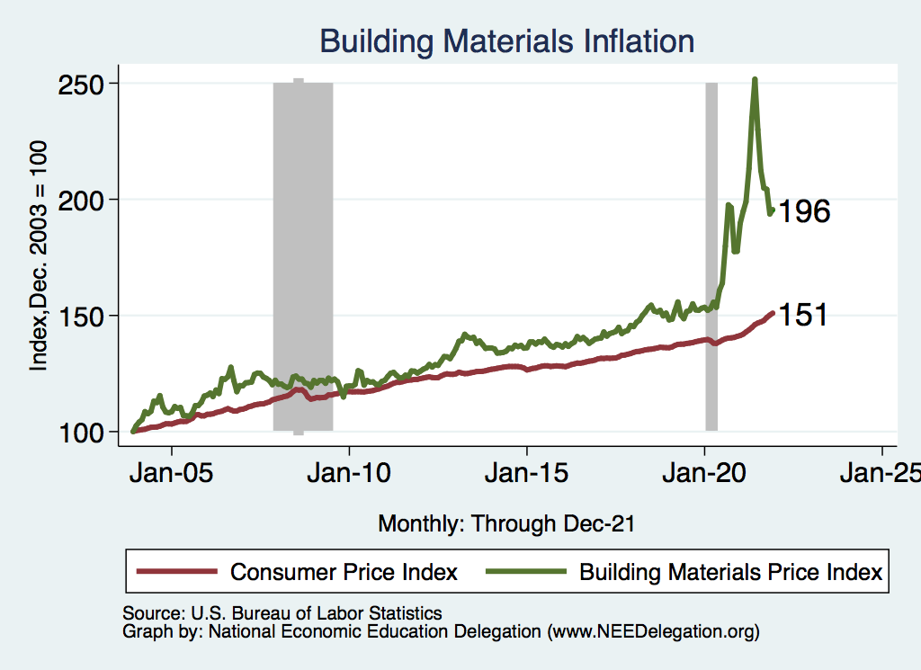
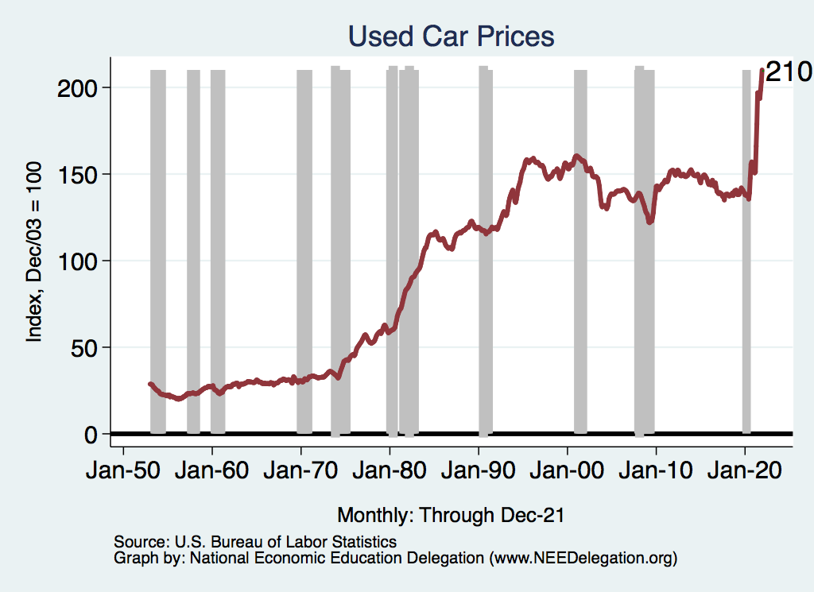
Inflation: Concentrated
Cost-Push

Slide 49
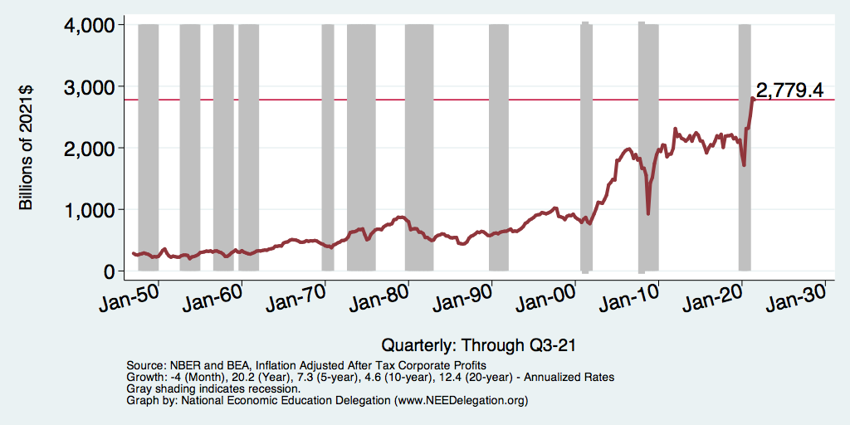
Corporate Profits…Adding to Inflation?

Slide 50
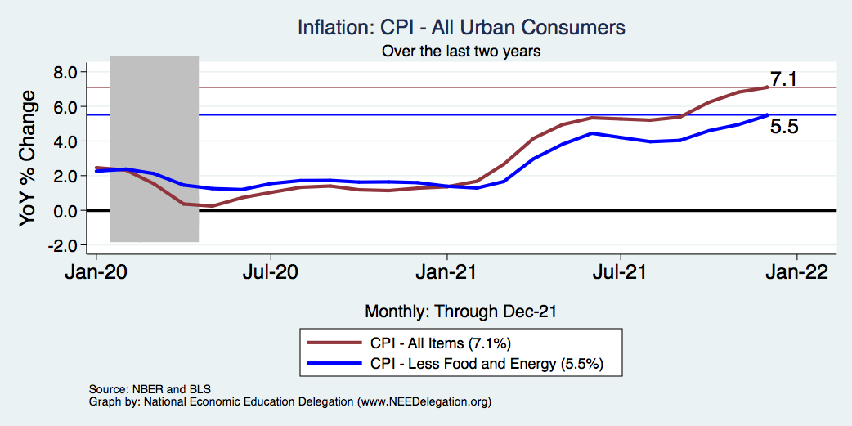
Inflation – Climbing! Should we worry?
Notes:
Cpi_recent.png

Slide 51
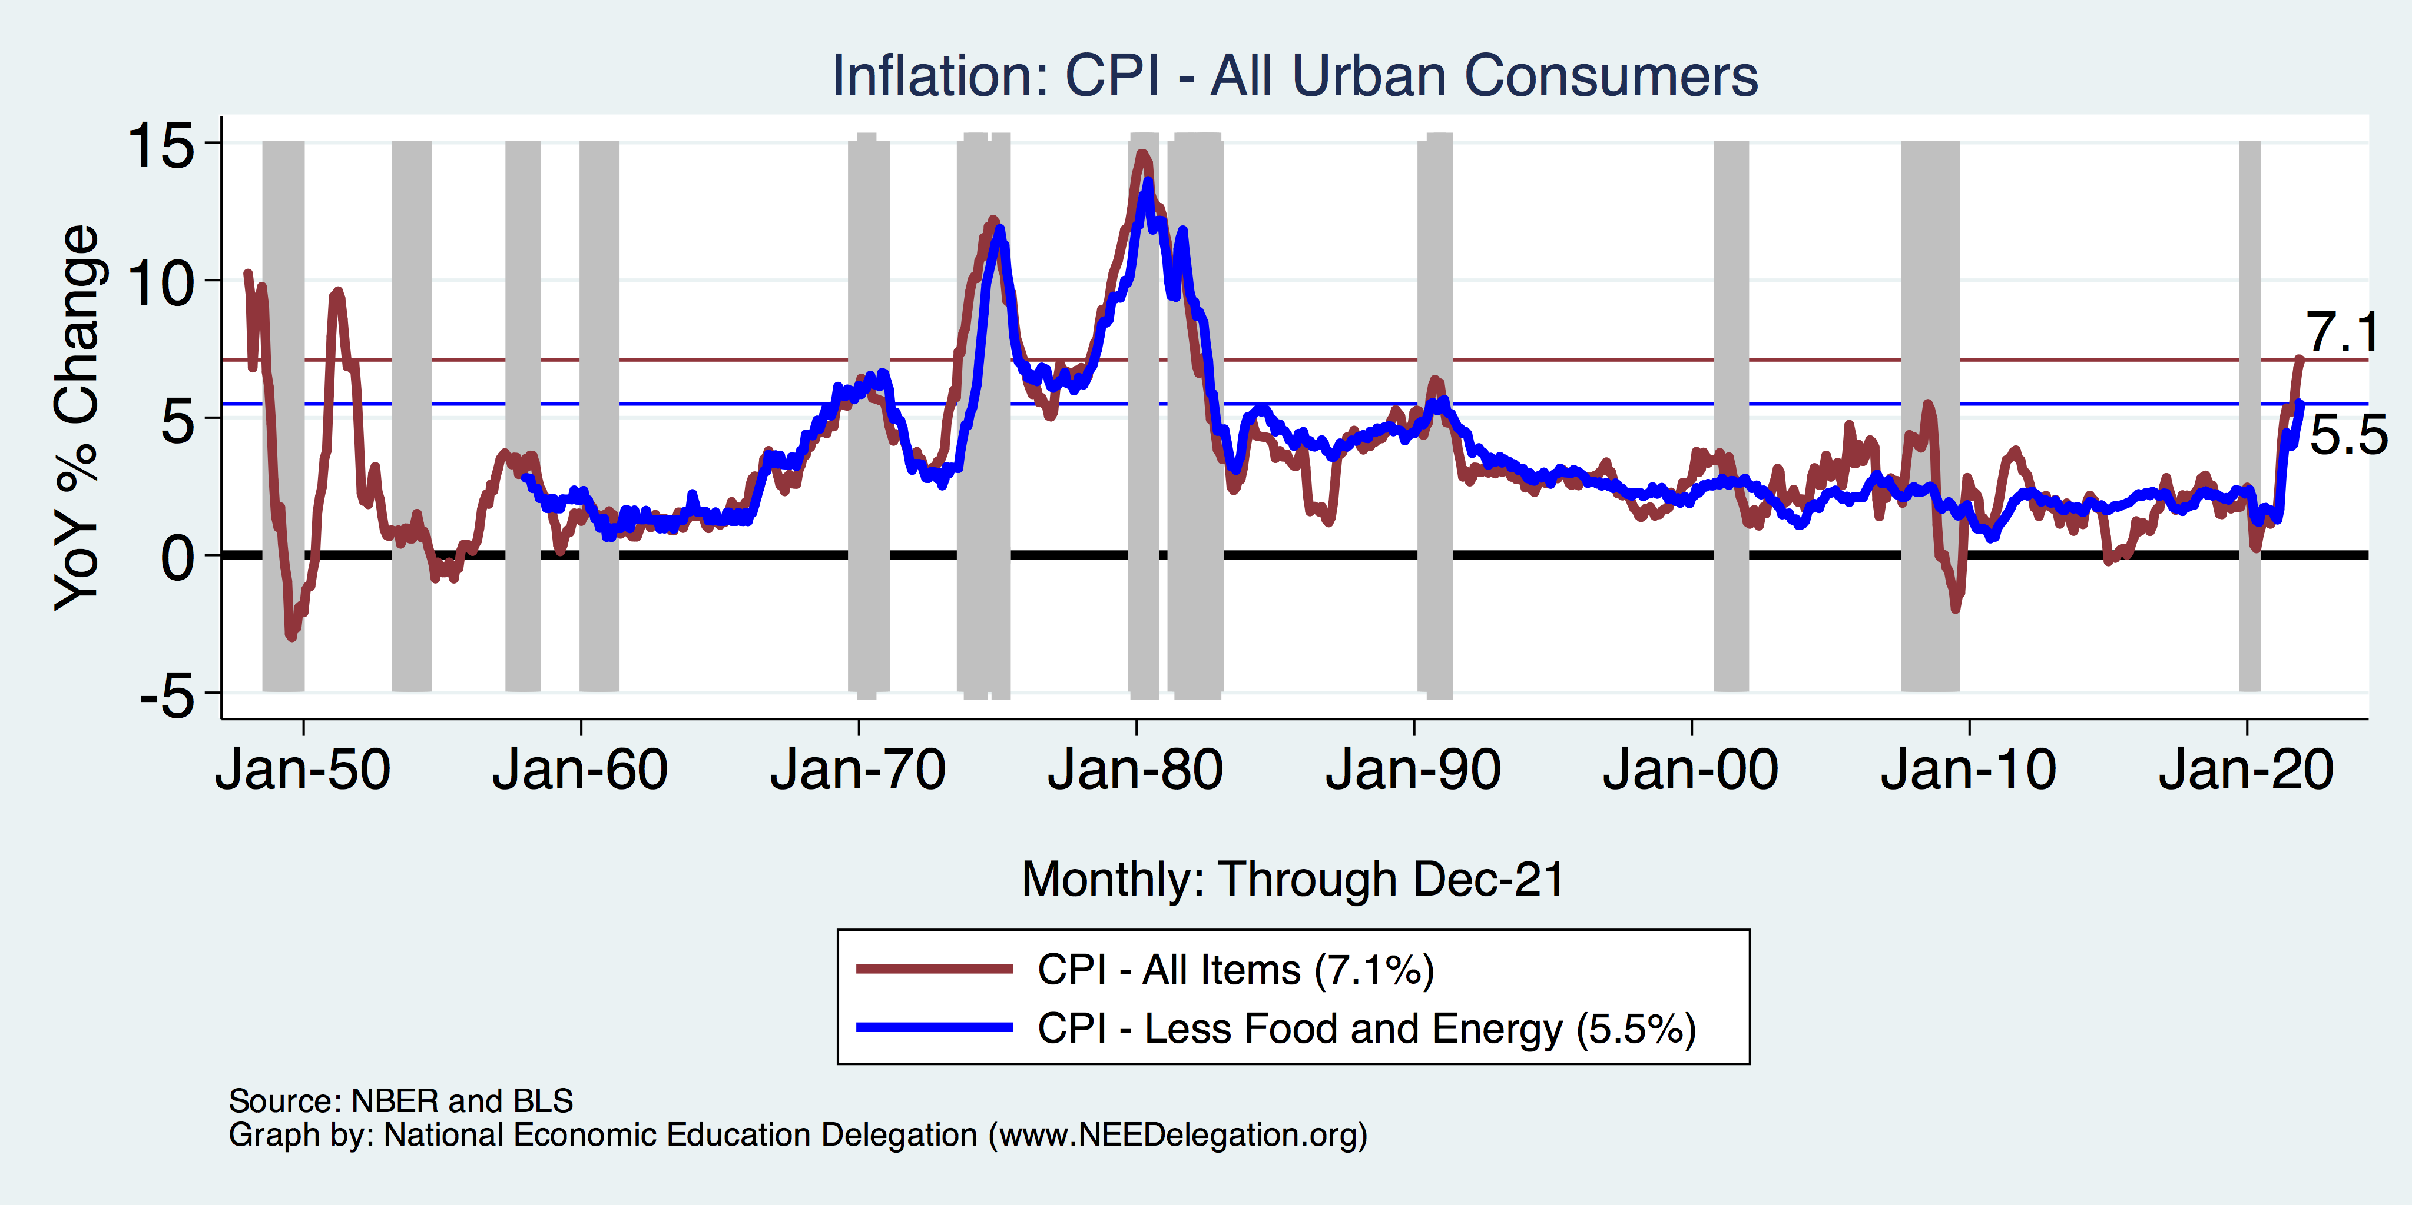
Inflation in Historical Perspective

Slide 52
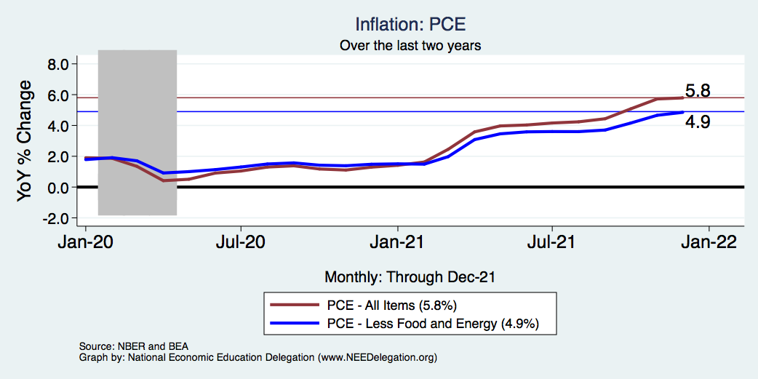
Inflation – The Fed’s Metric! Should we worry?
Notes:
Cpi_recent.png

Slide 53
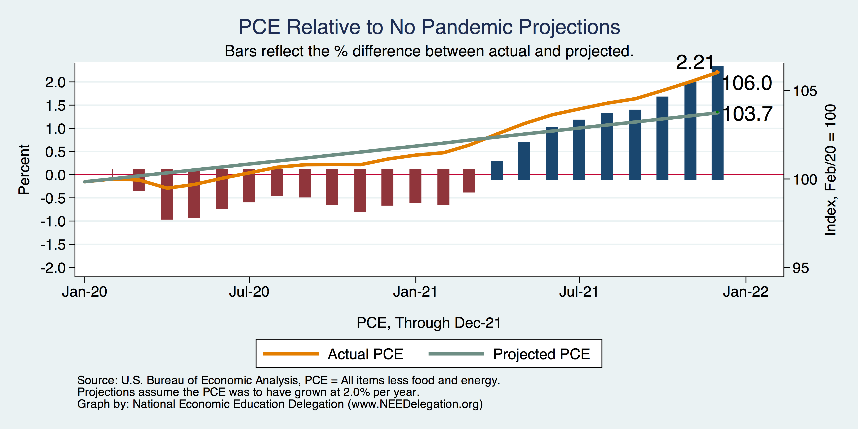
Inflation – PCE and Fed Suggest: I don’t know.
Notes:
Cpi_recent.png

Slide 54
What is Driving Inflation?
Profiteering / Greed: President Biden and Senator Elizabeth Warren.
Supply Chains Disruptions:
  The pandemic has impacted the ability to get parts and supplies.
  Labor shortages and rising wages have raised costs and help push up prices.
Increased Demand:
  During the pandemic there has been an increase in demand for goods. For many of these goods, it is not easy to ramp up production.
  The fiscal and monetary authorities have provided lots of stimulus.

Slide 55
Supply Chain Delays: ISM Delivery Days

Slide 56
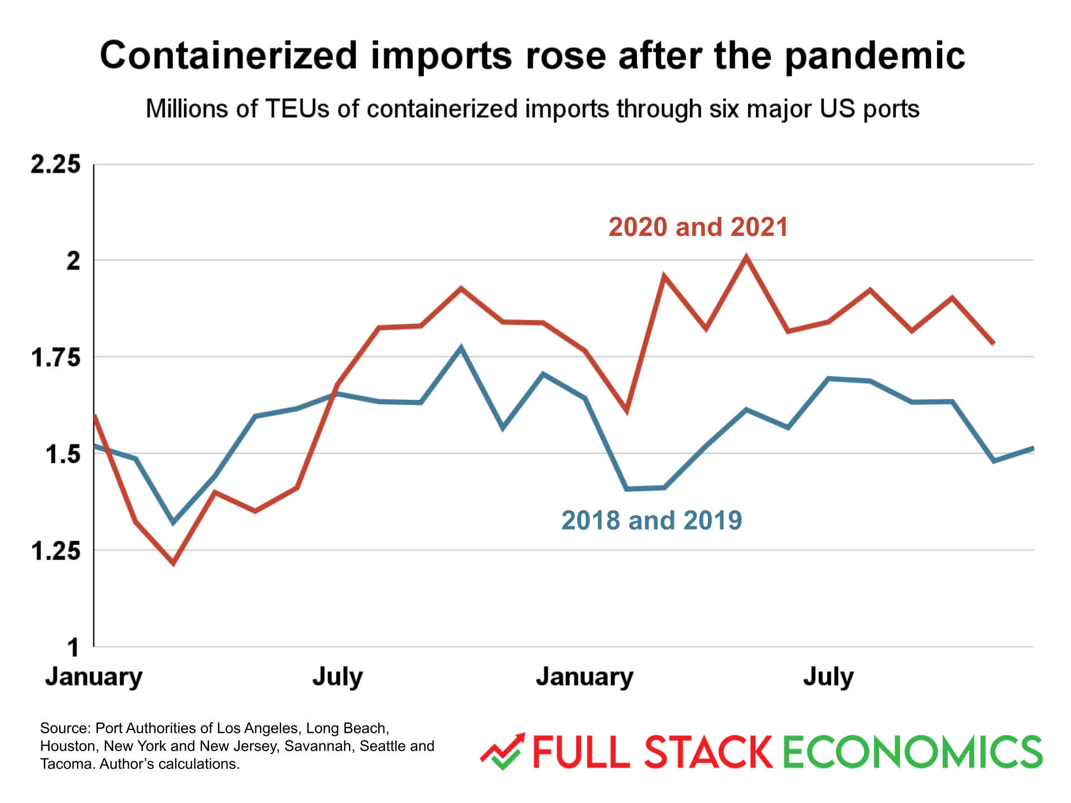
Supply Chain Delays: It’s Not All Supply Shortages

Slide 57
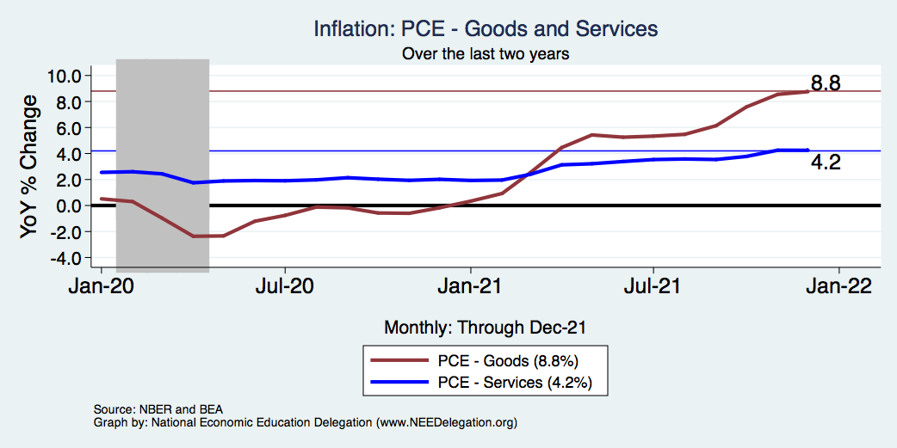
Inflation – Catching up Gets Credibility
Notes:
Cpi_recent.png

Slide 58
The Great Resignation

Slide 59
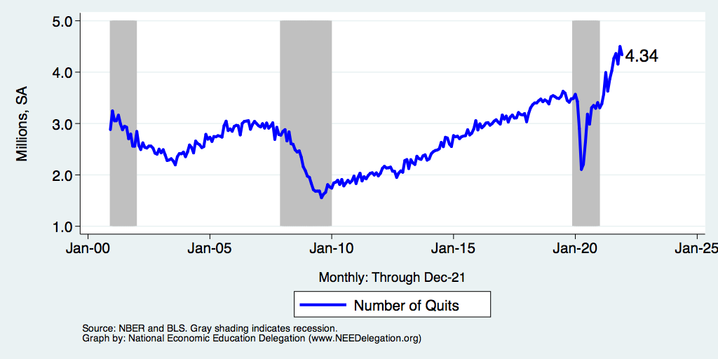
Quits Are High! The Great Resignation

Slide 60
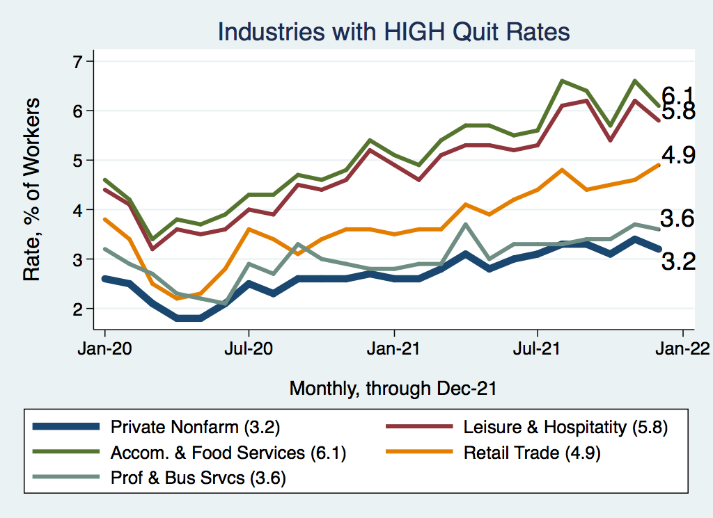
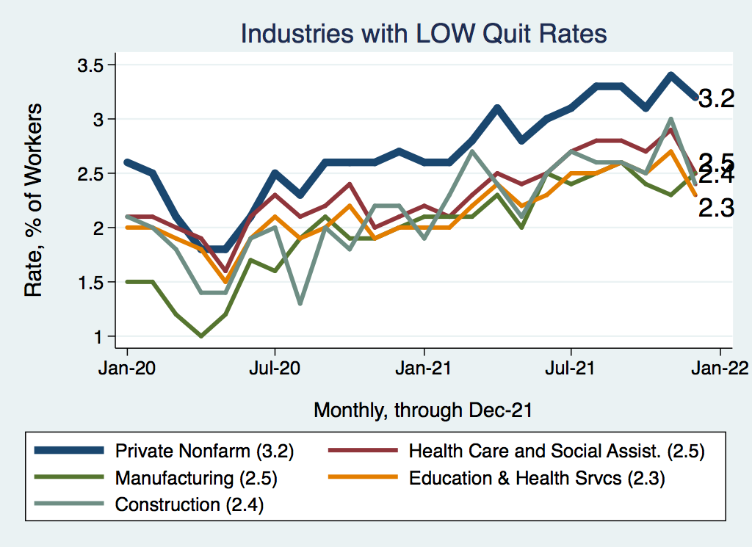
Quits – Rising, but More in Some Industries
Accom. & Food Services
Leisure & Hospitality
Retail

Slide 61
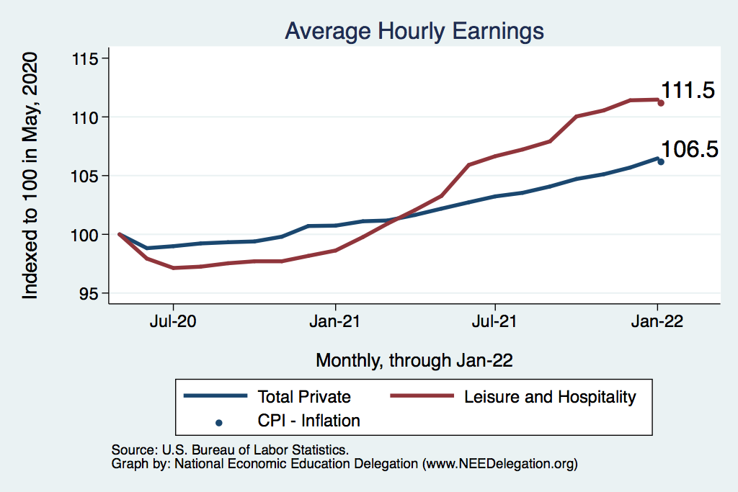
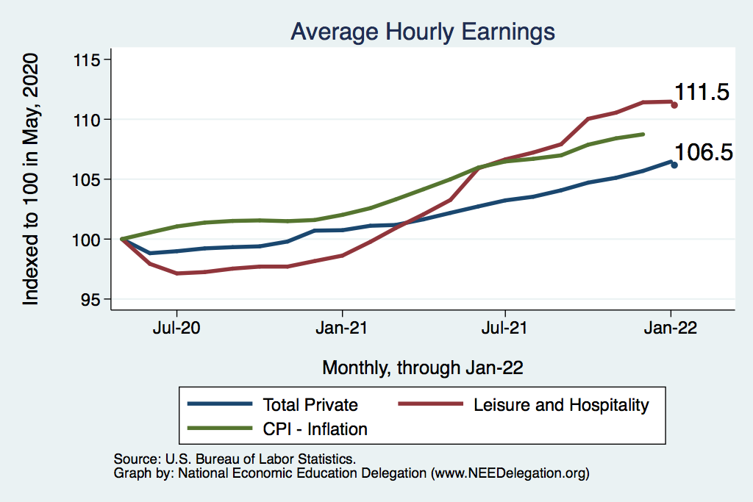
This is Happening Despite Rising Wages
Leisure & Hospitality
108.7
Total Nonfarm

Slide 62
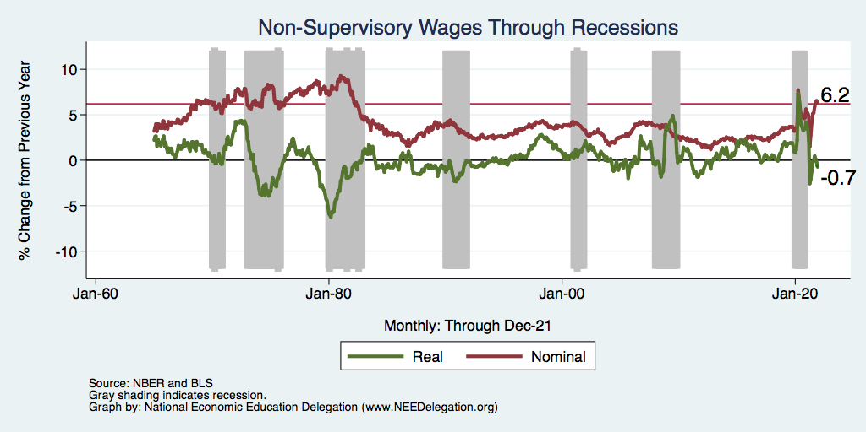
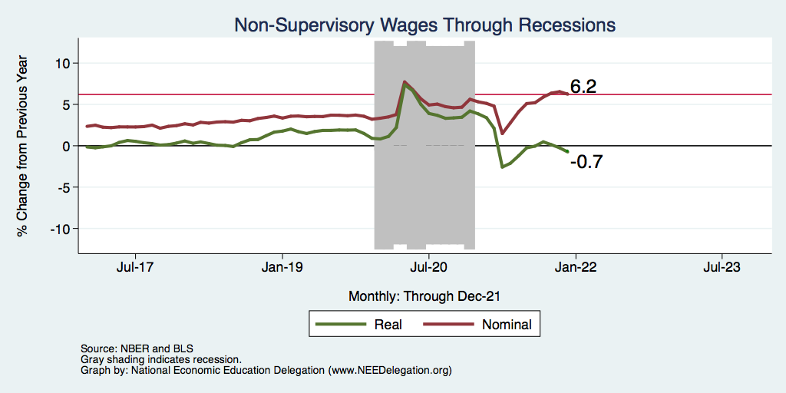
Inflation Adjusted Wages Are Falling

Slide 63
Real Estate

Slide 64
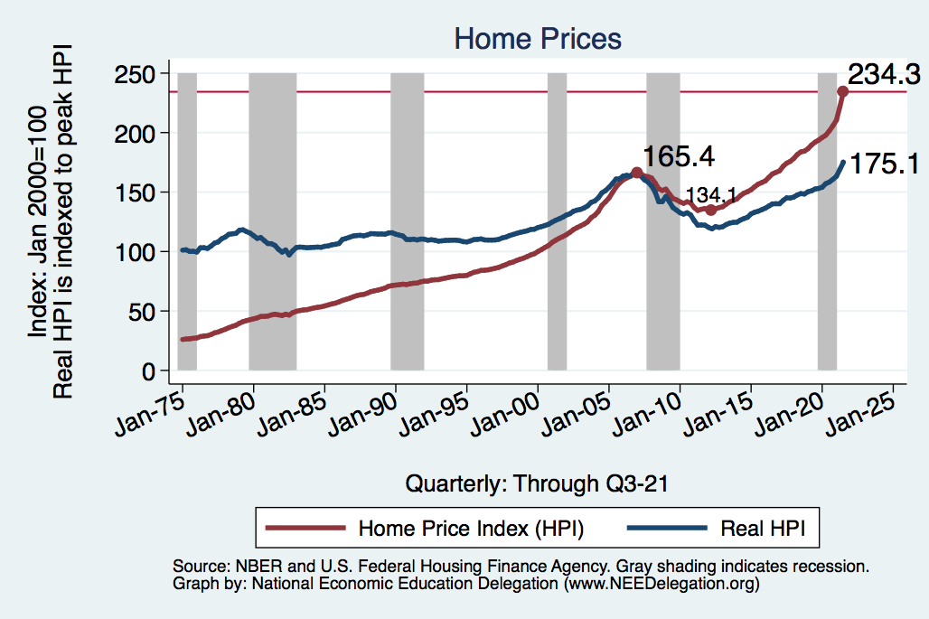
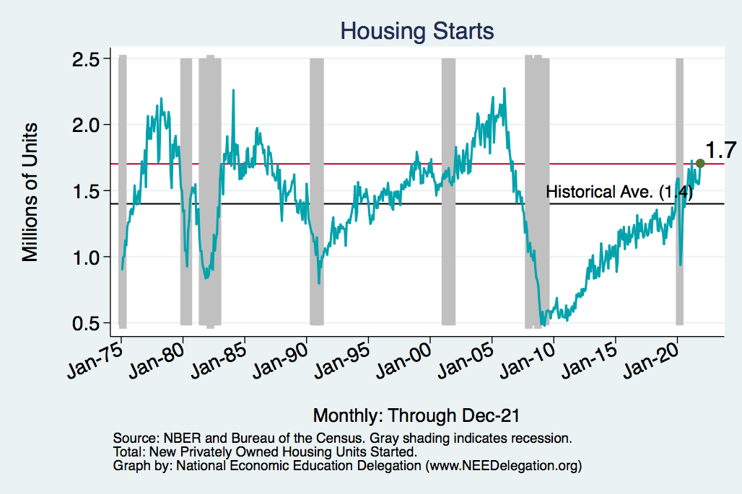
Home Prices and Housing Starts
Notes:
Charts:
homeprices_recession.png
housing.png

Slide 65
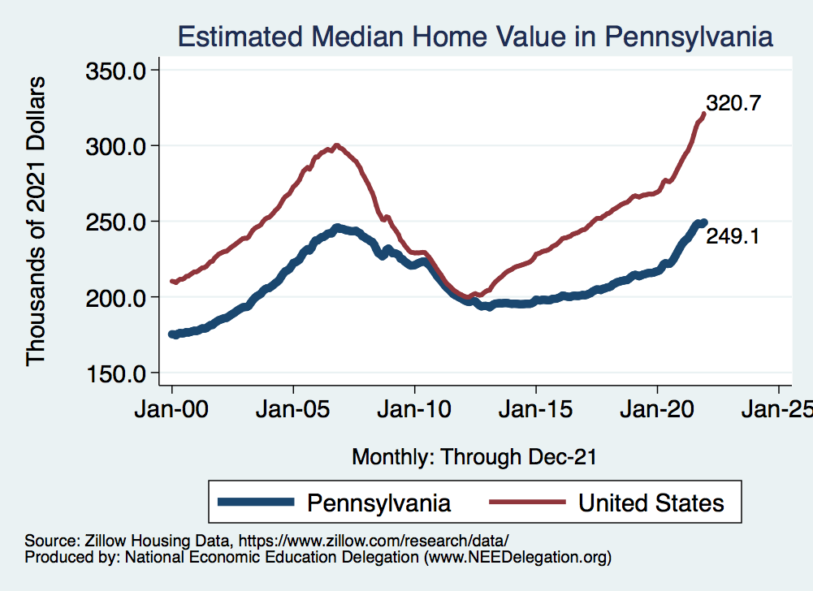
Real Estate Prices

Slide 66


RE Experiences Differ!

Slide 67
Primary Topics Covered
GDP
  Recovered the decline, but not where it should be.
  Won’t recover previous forecast until late 2022.
Employment
  Still down 8.0 million jobs relative to forecast. (2.0 million relative to Feb/20).
  Labor force is 0.9 million smaller than at the beginning of the pandemic.
  Rising wages may be enticing low-wage workers back to work.
Inflation
  Going to be high for a while, but transitory – maybe?

Slide 68
Conclusion
Recovery is well underway, but may be slowing.
GDP expanded by 5.7% percent in 2021, 3-4% in 2022.
2021 was an odd year.
  Workers attained the upper hand.
  Supply chains broke.
  Inflation surged.
  The economy rebuilt itself.
Biggest problems:
  Supply chain bottlenecks.
  Labor force participation.

Slide 69
Best Measures of Progress
INFLATION – getting it under control.
REAL WAGES– need to see progress.
WORKFORCE PARTICIPATION – need growth here to get GDP growth.
Pay no attention to the unemployment rate.

Slide 70

B-W Wealth Gap: Stephanie Seguino
Mean is
7x Greater
Median is 8x Greater

Slide 71
Thank you!
Any Questions?
www.NEEDelegation.org
Jon D. Haveman
Jon@NEEDelegation.org
Contact NEED: info@NEEDelegation.org
Submit a testimonial: www.NEEDelegation.org/testimonials.php
Become a Friend of NEED: www.NEEDelegation.org/friend.php

Slide 72

Retail Sales Are Slowing – Q4-21? Q1-22?
Could be X-mas shopping
all happened in November.
(Supply chain awareness?)

Slide 73

Consumption: Quarterly Growth
Notes:
Graph: gdp_pot_grow.png
The Point: From 1990 – 2007, average annual US GDP growth pre-crisis is 2.94%. However, post-crisis US GDP growth is 2.19% (0.75 percentage points lower). Why is has the recovery been sluggish?
Note: At the recession’s height, the gap between quarterly GDP growth and potential growth was 2.5 percentage points.

Slide 74

Employment Gap
Notes:
payroll_recent.png

Slide 75

Affected Women More Than Men?

Slide 76

Another Measure: Unemployment
Peak: 22.9%
(April, 2019)

Slide 77

Supply Chains Are at the Core

Slide 78

What Are Supply Chains?
https://www.cfr.org/article/what-happened-supply-chains-2021

Slide 79

Why does spending matter?
Spending:
Goods 20%
Services 44%
Total 64%
Notes:
Components sum to GDP
Average % of GDP for each component from 1960-Present: C = 64%, I=15%, G=24%, NX = 2% (X = 7%, M=9%)
Net Exports as a % of GDP has increased over the sample period, but it’s contribution to GDP is relatively small

Slide 80

Affected Women More Than Men
Men
Women
Long term implications for women?

Slide 81
Why Women More Than Men?
Women are disproportionately represented in low-wage and face-to-face jobs.
Our childcare and school systems don’t meet the needs of working mothers.
COVID-19 has upended the labor market, with disastrous consequences for working women and their families.
  Many women continued working in high risk jobs.
The difference in impact is waning.

Slide 82

Affecting Black Workers More than White
White
Black

Slide 83
What Index to Follow: CPI or PCE?
CPI is the headline statistic, followed by most newspapers.
  Allows more granularity – ability to look at specific products.
PCE is the one followed by the Fed.
  Why?
    Accounts for short term fluctuations in consumer purchases.
    Based on more reliable data.
Fed generally pays attention to the core inflation #s.
  Excluding food and energy.

Slide 84
Inflation: Critical Issues
Inequities
  Price changes vary wildly across goods.
  How inflation hits you depends on what you buy and your level of income.
    Some evidence that lower income individuals face higher inflation.
Online inflation is much lower than the CPI
  Estimates suggest about 2% lower.
Both have implications for the policy response.
  Safety net? Antitrust action?

Slide 85

A Hard-Hit Sector: Small Business
Small Biz Closures in the United States

Slide 86

Small Businesses: They Didn’t Get Enough PPP

Slide 87
A “K-shaped” recovery?
Executive Summary
Those with financial wealth/residential real estate have seen its value grow in excess of inflation.
High income earners (>60k/yr) have largely kept their jobs;
  middle and low income earners have depressed employment rates
Women are disproportionately exiting labor force.
Food insecurity has been very high.

Slide 88
Coronavirus and Inequality
Resources to weather the storm.
Racial inequities.
Educational inequities
Telecommuting
Low wage jobs are at risk.

Slide 89
Structural Changes?
Pandemic has been an accelerant.
  Not a change agent.
Retail
Telecommuting
Telehealth
Business travel?
Wealth concentration
Industry concentration
Automation

Slide 90

Allegheny County GSP: Trans & Warehousing

Slide 91

Employment Gap – In Historical Perspective
Notes:
payroll_recent.png

Slide 92

Annual Changes in Nonfarm Employment

Slide 93


Markets Respond To Fed Policies
…and COVID and Russia and Inflation?
Notes:
CV_DJSP_6mo.png

Slide 94
www.NEEDelegation.org/LocalGraphs
For every state and county in the United States.
Detailed graphs on employment, housing, moves, and other statistics.

