Slide 1
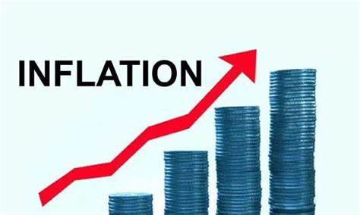
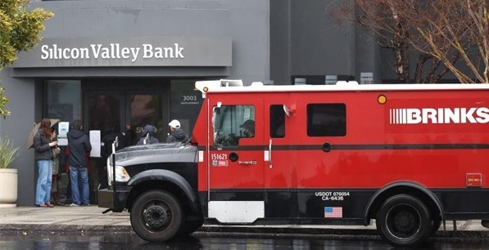
US Economic Update
Eagle Harbor Congregational Church Oatmeal Club
Jon Haveman, Ph.D.
NEED
April 27, 2023

Slide 2
Credits and Disclaimer
This slide deck was authored by:
Jon D. Haveman, NEED
Scott Baier, Clemson University
Geoffrey Woglom, Amherst College (Emeritus)
Brian Dombeck, Lewis & Clark College
Doris Geide-Stevenson, Weber State
Disclaimer
NEED presentations are designed to be nonpartisan.
It is, however, inevitable that the presenter will be asked for and will provide their own views.
Such views are those of the presenter and not necessarily those of the National Economic Education Delegation (NEED).

Slide 3
Outline
Economic Indicators
Inflation/Federal Reserve/Banks
The Debt Ceiling

Slide 4
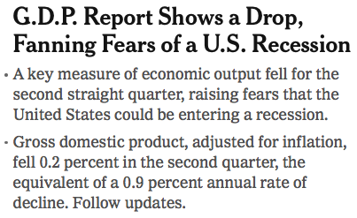
Headline:
Last July

Slide 5
GDP: Quarterly Growth
Notes:
Graph: gdp_pot_grow.png
The Point: From 1990 – 2007, average annual US GDP growth pre-crisis is 2.94%. However, post-crisis US GDP growth is 2.19% (0.75 percentage points lower). Why is has the recovery been sluggish?
Note: At the recession’s height, the gap between quarterly GDP growth and potential growth was 2.5 percentage points.

Slide 6
GDP Trajectory: Pandemic Plunge!
GDP is:
$0.3 Trillion below 2019 forecast.
$1.2 Trillion ABOVE 2019-Q4 level.

Slide 7
Monthly Changes in Nonfarm Employment
February: 326,000
March: 236,000
Notes:
PAYEMS.png

Slide 8
Employment Gap
3.1 Million ABOVE February, 2020.
5.0 Million BELOW where we should be.
Notes:
payroll_recent.png

Slide 9
Where Have All the Workers Gone?
2.6 million below where we should be

Slide 10
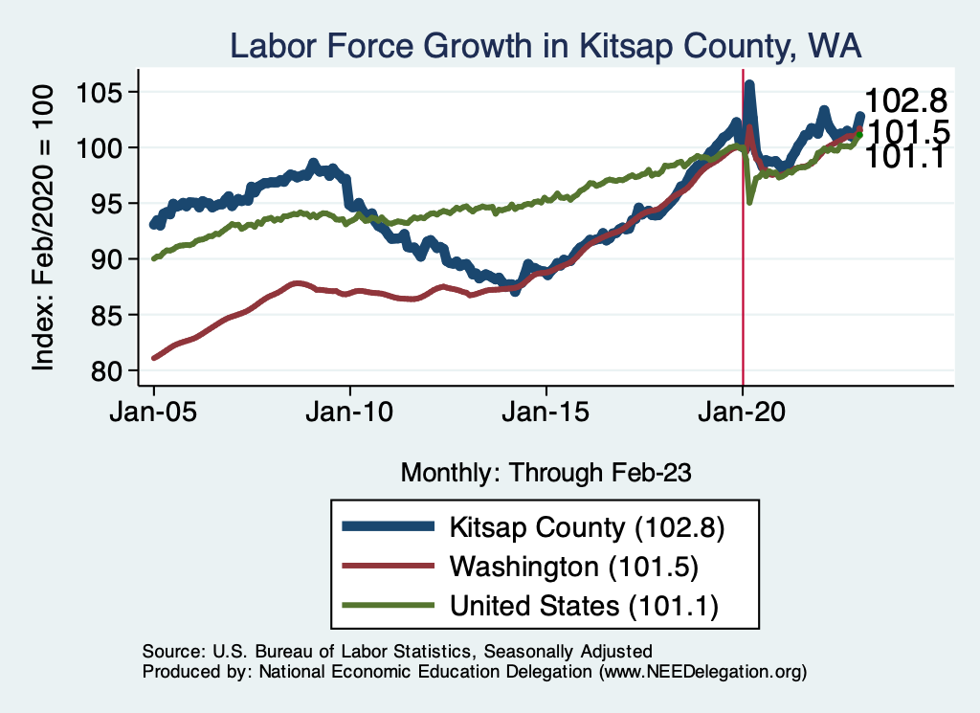
Labor Market Experience: Kitsap County

Slide 11
www.NEEDEcon.org/LocalGraphs
For every state and county in the United States.
Detailed graphs on employment, housing, moves, and other statistics.

Slide 12
Inflation

Slide 13
Inflation: Latest Figures
Source: NYTimes.com, Bureau of Labor Statistics

Slide 14
Inflation in the Last 6 Months – Less Than 4%!

Slide 15
Food Prices Are Coming Down

Slide 16
As Are Fuel Prices

Slide 17
Gas Prices…not so much

Slide 18
Inflation is Not just a U.S. Problem

Slide 19
Supply Chains

Slide 20
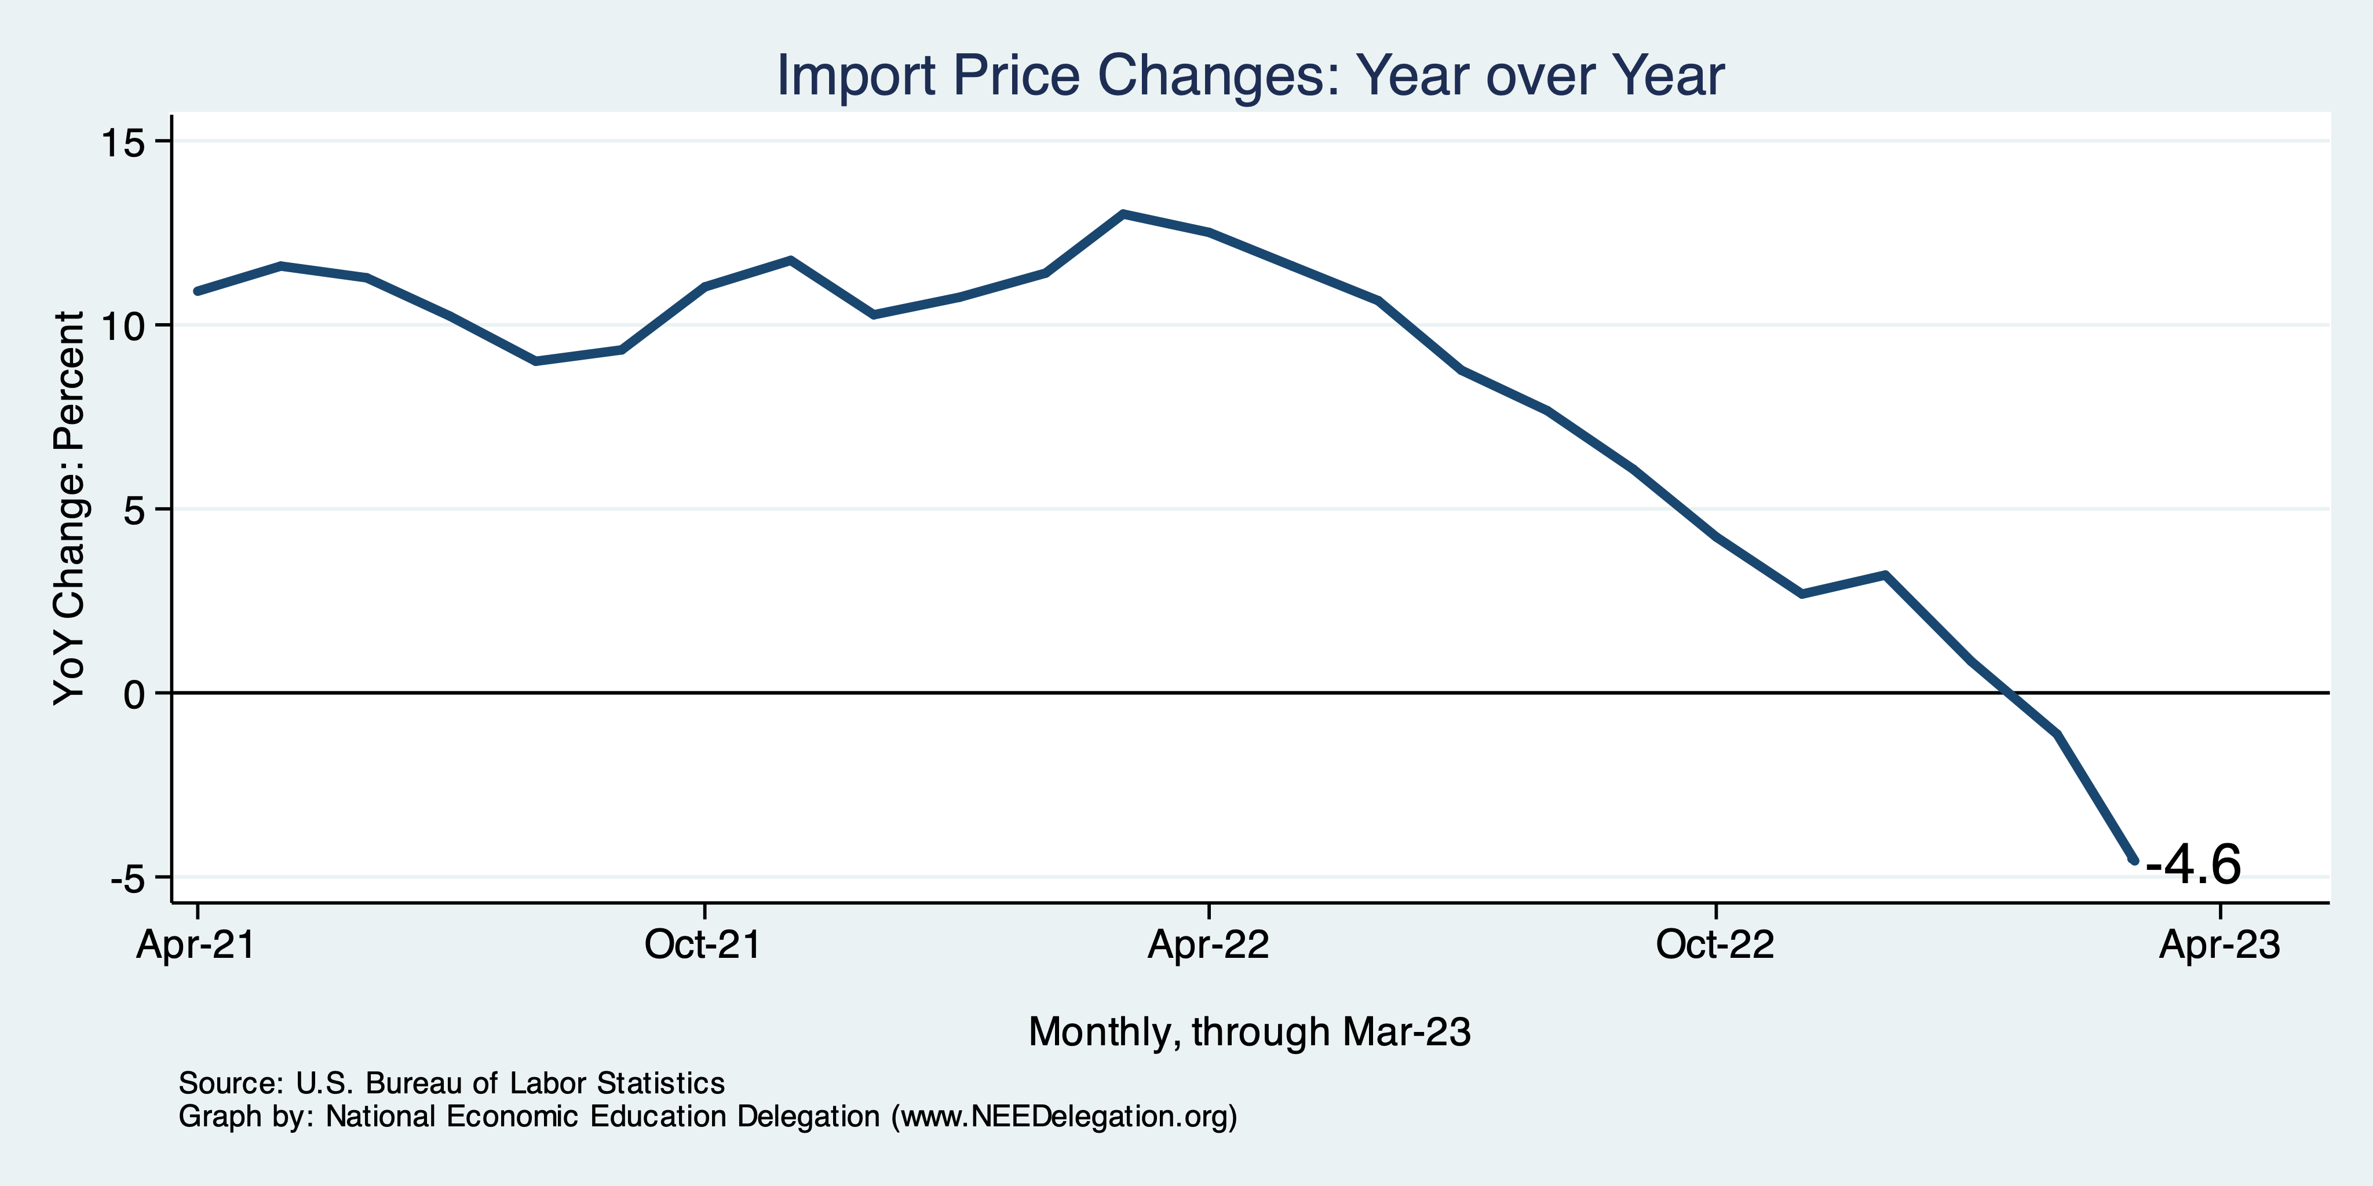
Import Price Inflation WAS Very High
Inflation – Imported Products: 9-10%
> 10% for a year!

Slide 21
Spending Patterns Changed - More Goods!
Goods spending up 17.1%
- And stable.
Services spending up 3.9%
- And going up.

Slide 22
Corporations Have Pricing Power!
Corporate Profits
Was Up 40%
Excuseflation
Premiumization

Slide 23
Spending is Still Very High!

Slide 24
How Elevated Are Prices?

Slide 25
My Thoughts on the Sources of Inflation
Supply Chain issues were significant – less so now.
Composition of spending changed significantly.
Is now bouncing back, as are prices.
Corporations have used the cover of inflation to raise prices more.
But there was too much total spending.
Fiscal stimulus led households to increase saving over 2021 by more than $2 trillion. Strong retail sales numbers suggest they are prepared to spend it.
Who is to Blame: ARP probably too big, but the Fed could have acted sooner.
Bottom line: Recovery from a dramatic economic disruption is seldom painless.

Slide 26
What’s the Fed Doing About It?

Slide 27
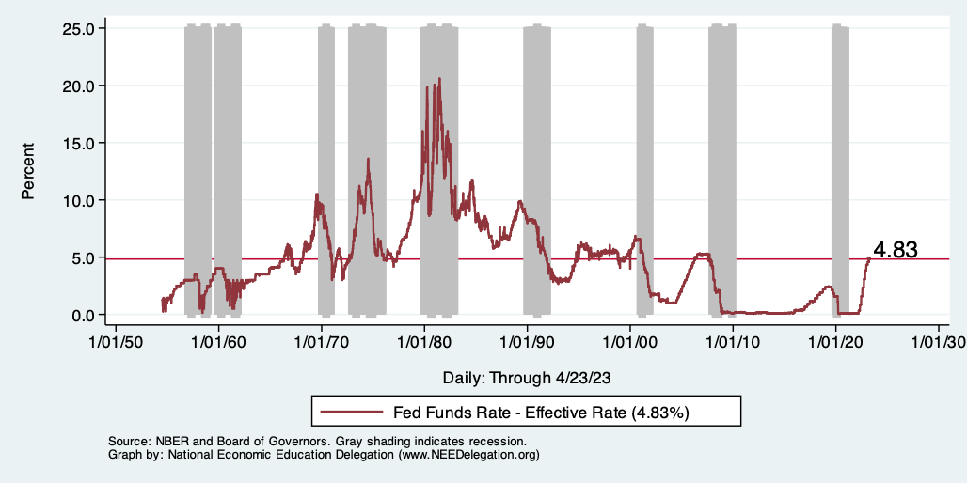
Raising the Federal Funds Rate
Notes:
The fed funds rate is the interest rate on overnight loans between banks. Think of it as the baseline interest rate on which banks base all other interest rates (e.g. mortgage rates)
FOMC lowers the fed funds rate during recessions and raises the fed funds rate during expansions
Fed funds rate peaked in the 1980s as then Chairman Paul Volcker sought to reign in “run away” inflation of the 1970s; doing so resulted in a recession in the early 1980s.
Since the 2008-09 recession, the fed funds rate has been kept near zero.
During the 2008-09 recession, Federal Reserve turned to unconventional tools to influence longer term interest rates to further stimulate the economy - QE
FedFunds.png

Slide 28
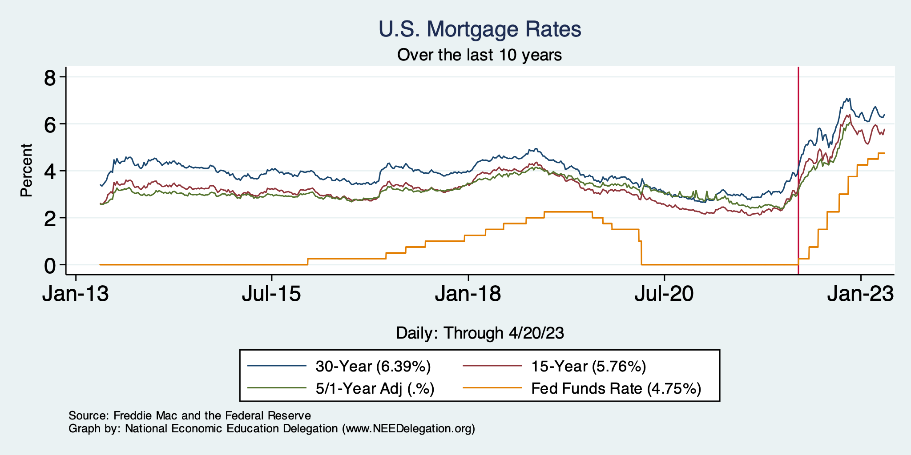
Mortgage Rates

Slide 29
Home Sales Falling…Well, They Had Been

Slide 30
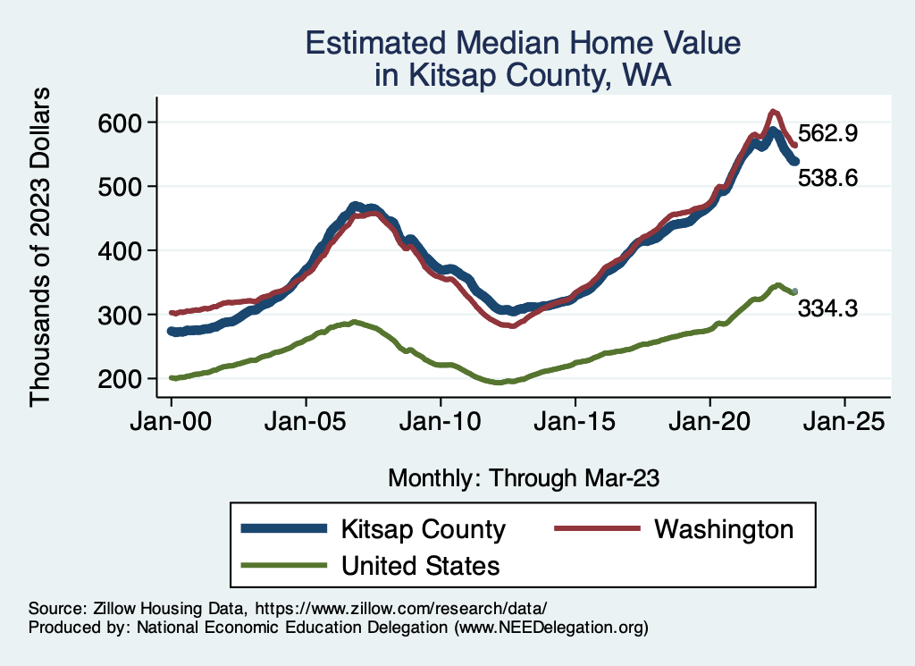
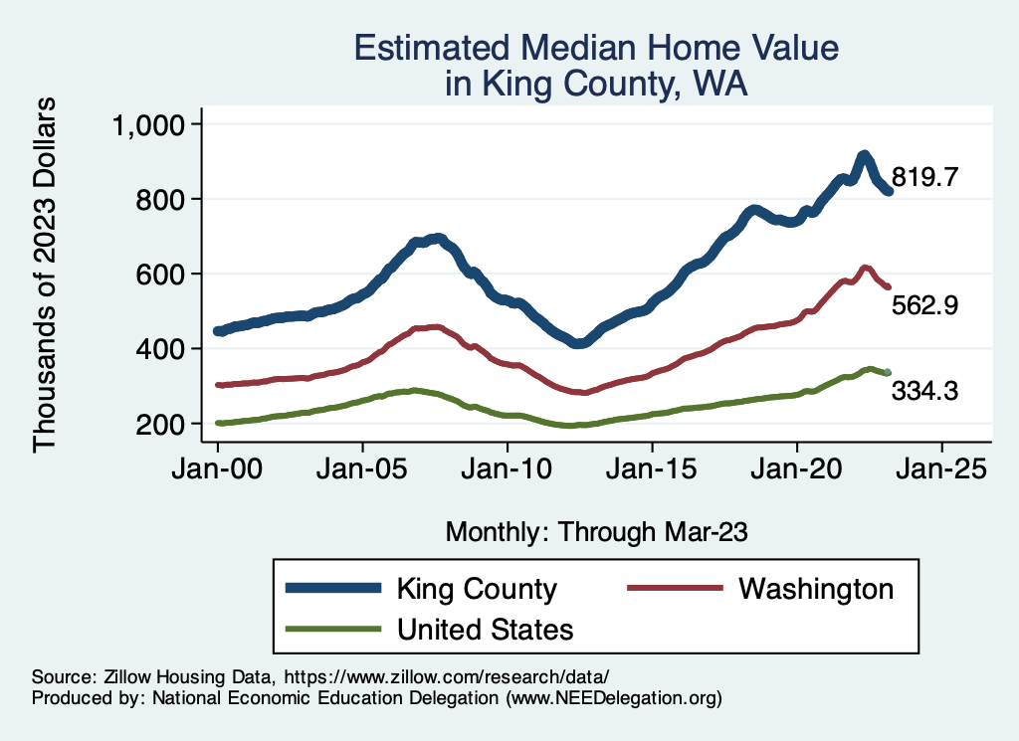
Home Prices … in Northern CA
Notes:
Charts:
homeprices_recession.png
housing.png

Slide 31
And Then Banks Started Falling…

Slide 32
Silicon Valley Bank
Regional mid-sized bank with $212b in assets; $6billion in capitalization (15th largest).
Focused on loans to venture capital and managing the deposit accounts of startups.
Very rapid growth in deposits and assets between 2021 and 2022, which led to big investments in “safe” long-term Treasury bond.
The market value of these bonds fell drastically due to the Fed’s rise in interest rates.
No problem! The bank does not incur “losses” unless it sells the bonds before maturity.
Notes:
JP morgan chase 3.7 trillion

Slide 33
Whoops!
Concentrated and sophisticated depositors see the problem and want to get their money out (FDIC insurance guarantees deposits up to $250 thousand, and 90% above this amount!).
Deposit withdrawals force SVB to sell those bonds.
Precipitating a classic bank run and leading to the FDIC seizing the bank on Friday, a month ago.

Slide 34
Response was Unique in This Case:
Janet Yellen announced that all depositors would be paid in full, and there would be complete insurance of all bank deposits for a year.
Senior Executives all fired.
Fed created a new lending program, so that banks can borrow against Treasury bonds without realizing losses.
The rationale was to prevent bank run spreading to other midsize banks.
One other bank recently closed, others were struggling.
Stock prices of a number of similar sized banks have plummeted, but are recovering.

Slide 35
Banking Crisis and Bank Credit

Slide 36
Is This a Problem?
Commercial and Industrial Lending - Rebounding

Slide 37
DC: Shall We Create Our Own Financial Crisis?

Slide 38
Existential Threat: Coming This June!

Slide 39
5 Things to Know about the Debt Ceiling
The debt limit has been raised continually for more than a century.
Raising the debt limit is not about new spending; it is about paying for previous choices policymakers legislated.
The uselessness of a debt limit is exhibited by the fact that only one other advanced country—Denmark—has a separate debt limit rule like ours.
If debt hits the ceiling, the Treasury Department uses several accounting gimmicks to postpone the day of reckoning, but these typically last only a few months.
The economic consequences of a large-scale, intentional default are unknown, but predictions range from bad to catastrophic.
Souce: https://www.brookings.edu/2023/01/19/7-things-to-know-about-the-debt-limit/

Slide 40
Lessons from 2011
Government shutdown was very costly:
Stock markets plunged (17%).
Employment growth stuttered.
Treasuries – downgraded credit ratings.
Borrowing costs rose.
The Debt Ceiling may be a very effective bargaining tool, but…
It is costly.
It is unnecessary.
Accidental partial default in 1979:
increased borrowing costs by $40 Billion!

Slide 41
A Recent Estimate of the Potential Damage:
Moody’s:
Could cost up to 6 million jobs,
Drive unemployment up to 9%, and,
Wipe out $15 trillion in household wealth.

Slide 42
Countdown to Default
Tax Day: 4/18

Slide 43
Takeaways
Is a recession on the horizon?
Perhaps, but shallow?
Many indicators are still in the black.
2022-Q4 GDP growth was pretty good!
Threats to continued growth:
If inflation starts to rise again, which seems unlikely.
Layoff contagion.
Broader banking crisis.
Borrowing and lending seem to be low and shrinking.
Debt ceiling negotiations
Significant cuts to government budgets may well result.

Slide 44
Thank you!
Any Questions?
www.NEEDEcon.org
Jon D. Haveman
Jon@NEEDelegation.org
Contact NEED: info@NEEDelegation.org
Submit a testimonial: www.NEEDEcon.org/testimonials.php
Become a Friend of NEED: www.NEEDEcon.org/friend.php

Slide 45
Some Explanations
500 Thousand: Long COVID Exits
1-2%: Long Social Distancing

Slide 46
Industrial Production (Manuf, Util, Mining)

Slide 47
Problems with the Bailout
Political:
Did political favoritism play a role in bailing out well connected, sophisticated silicon valley depositors.
Why didn’t bank regulators see this coming?
Economic: has the moral hazard of “too big to fail” been increased.
For the Fed: Will the Fed have to scale back its interest rate increases to prevent wide scale financial crisis?

Slide 48
What About This?

Slide 49
Existing Home Sales: Inventory & Supply

