Slide 1
Osher Lifelong Learning Institute, Spring 2023
Contemporary Economic Policy Issues
Olli – Washington University, St. Louis
May, 2023
Host: Jon Haveman
National Economic Education Delegation

Slide 2
National Economic Education Delegation
Vision
  One day, the public discussion of policy issues will be grounded in an accurate perception of the underlying economic principles and data.
Mission
  NEED unites the skills and knowledge of a vast network of professional economists to promote understanding of the economics of policy issues in the United States.
NEED Presentations
  Are nonpartisan and intended to reflect the consensus of the economics profession.

Slide 3
Who Are We?
Honorary Board: 54 members
  2 Fed Chairs: Janet Yellen, Ben Bernanke
  6 Chairs Council of Economic Advisers
    Furman (D), Rosen (R), Bernanke (R), Yellen (D), Tyson (D), Goolsbee (D)
  3 Nobel Prize Winners
    Akerlof, Smith, Maskin
Delegates: 652+ members
  At all levels of academia and some in government service
  All have a Ph.D. in economics
  Crowdsource slide decks
  Give presentations
Global Partners: 48 Ph.D. Economists
  Aid in slide deck development

Slide 4
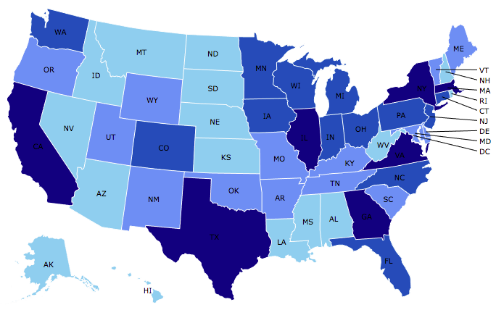

Where Are We?

Slide 5
Available NEED Topics Include:
US Economy
Healthcare Economics
Climate Change
Economic Inequality
Economic Mobility
Trade and Globalization
Minimum Wages
Immigration Economics
Housing Policy
Federal Budgets
Federal Debt
Black-White Wealth Gap
Autonomous Vehicles
Healthcare Economics

Slide 6
Course Outline
Contemporary Economic Policy
  Week 1 (5/5): US Economic Update (Geoffrey Woglom, Amherst College)
  Week 2 (5/12): Economic Inequality (Adina Ardelean)
  Week 3 (5/19): Economic Mobility (Kathryn Wilson, Kent State Univ.)
  Week 4 (5/26): The Black-White Wealth Gap (Jon Haveman, NEED)

Slide 7

Income Inequality: Share of Top 10%
Stock Market Crash
WWII
Housing Bubble
Dot-com Bubble

Slide 8
Mobility
9 out of 10 of those born in the early 1940s could expect to earn more than their parents
  1 in 2 Millennials (born after 1980) earn more than their parents.

Slide 9

Evidence of the B-W Wealth Gap
Mean is
7x Greater
Median is 8x Greater

Slide 10
Submitting Questions
Please submit questions of clarification in the chat or raise your “digital” hand.
  I will try to handle them as they come up.
We will do a verbal Q&A once the material has been presented.
Slides will be available from the at the course web site later today.
https://sites.google.com/view/macro-current-issues/home

Slide 11
Credits and Disclaimer
This slide deck was authored by:
  Jon D. Haveman, NEED
  Scott Baier, Clemson University
  Geoffrey Woglom, Amherst College (Emeritus)
  Brian Dombeck, Lewis & Clark College
  Doris Geide-Stevenson, Weber State
Disclaimer
  NEED presentations are designed to be nonpartisan.
  It is, however, inevitable that the presenter will be asked for and will provide their own views.
  Such views are those of the presenter and not necessarily those of the National Economic Education Delegation (NEED).

Slide 12
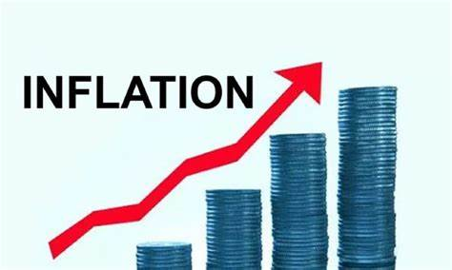
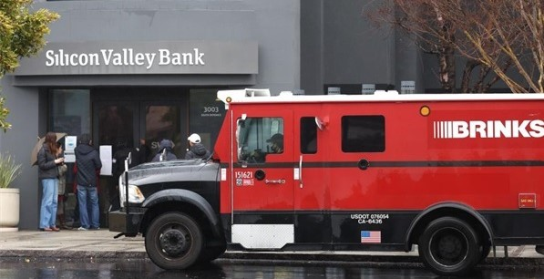
US Economy: Update
Geoffrey Woglom,
Professor of Economics
Amherst College, emeritus
May 5, 2023

Slide 13
Outline for the Talk
Summary of the state of the economy.
The Effect of M&F policies.
What lies ahead for the economy.
Wild Cards
  Bank Failures.
  Debt Ceiling Crisis.

Slide 14
Gross Domestic Product
Consumption | 68.4%
Investment | 17.2%
Exports | 11.4%
Imports | -14.5%
Government | 17.5%
GDP | 100.0%

Slide 15
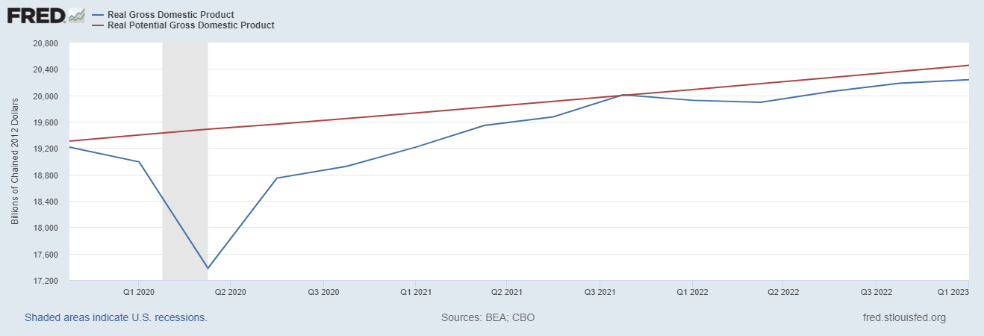
Real GDP and ‘Potential’ during the Recovery
The “output gap” is about $250b
Source: Fred, St Louis Fed

Slide 16
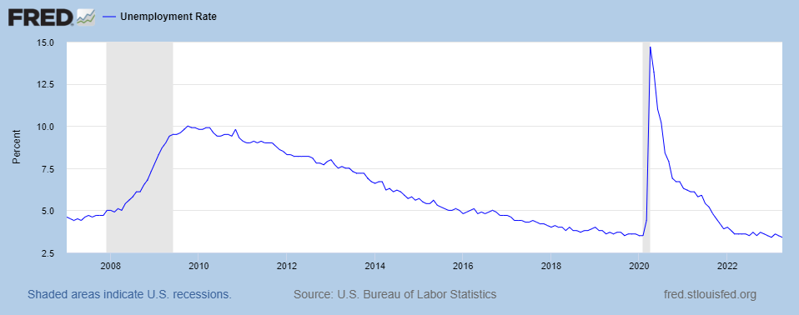
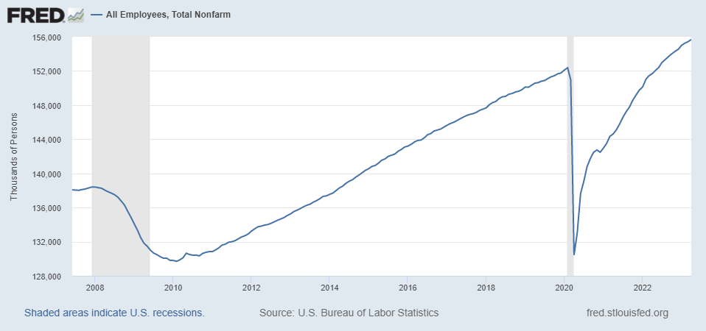
Labor Market: Fully Recovered?
Missing Workers?
Notes:
Lowest rate since 1969

Slide 17
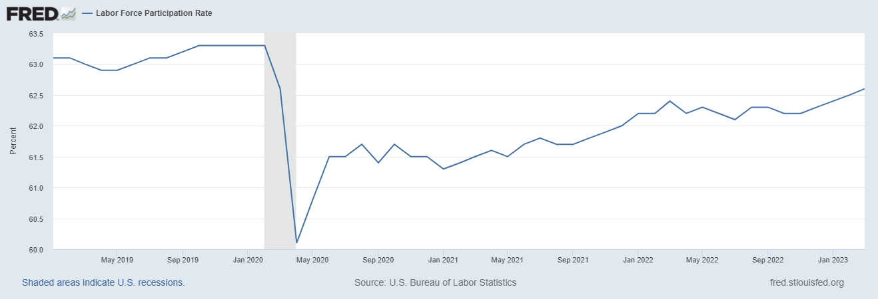
The Great Resignation?
Notes:
CBO Jan 2020 projections: LF, 62.5, vs 62.6; Total employment; 154.8 million vs actual 155.6. Civilian Labor Force; 160 vs 166.7

Slide 18
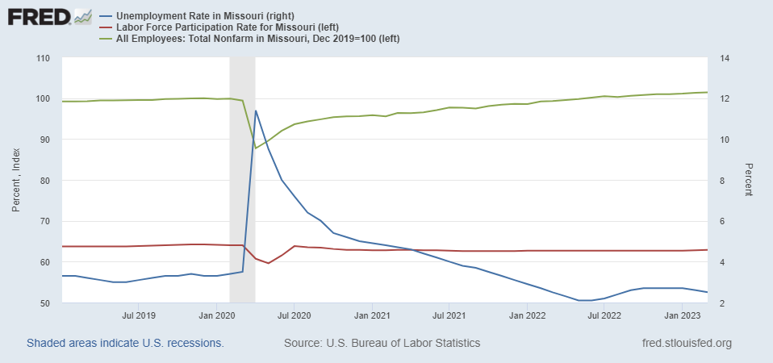
Labor Market in Missouri

Slide 19
Overall Good News on the Real Side
GDP is very close to its potential.
The labor market as measured by the unemployment rate is fully recovered.
There was no apparent Great Resignation
But there is also a nominal side: interest rates, asset prices, inflation and wages.
News isn’t so good!

Slide 20
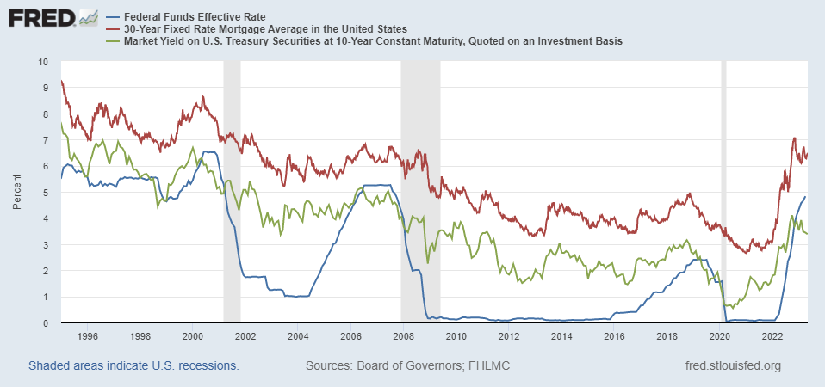
Interest Rates: Era of Falling Rates Over?
Notes:
Fed policy rate 4.5 to 4.25. Concerns with inflation

Slide 21
National Housing Market and Closer to Home
https://www.zillow.com/research/data/

Slide 22
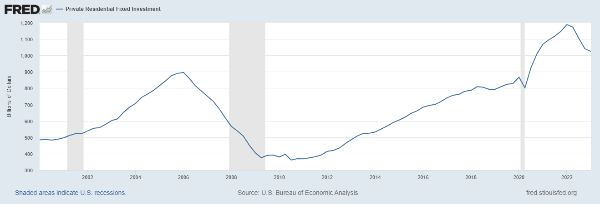
The Fall in House Prices is Having an Effect

Slide 23
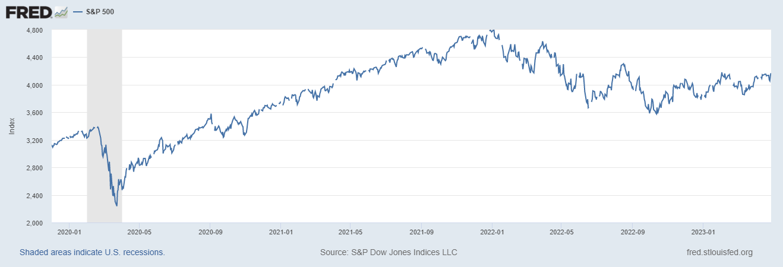
Stock Prices: Fear about Rates and Recession
Notes:
Since the end of 2021, lost almost 15%

Slide 24
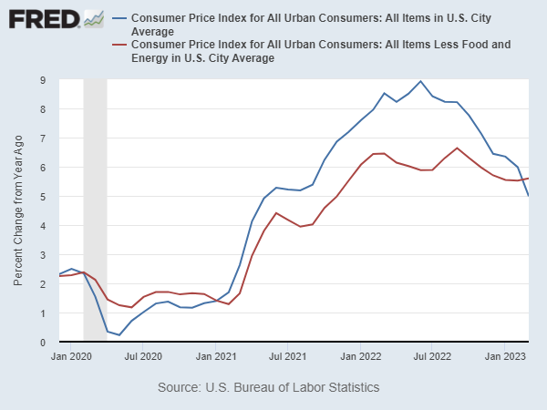
Inflation during the Recovery (CPI)
Notes:
August CPI yoy 8.3% down from 8.5 and Core 6.3 up from 6.3 in JUly

Slide 25
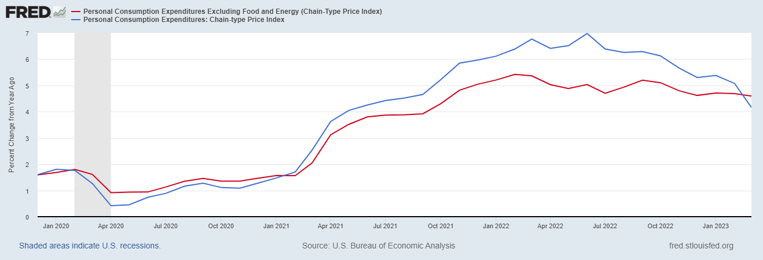
Fed’s Measure (PCE)
Looks Promising?

Slide 26
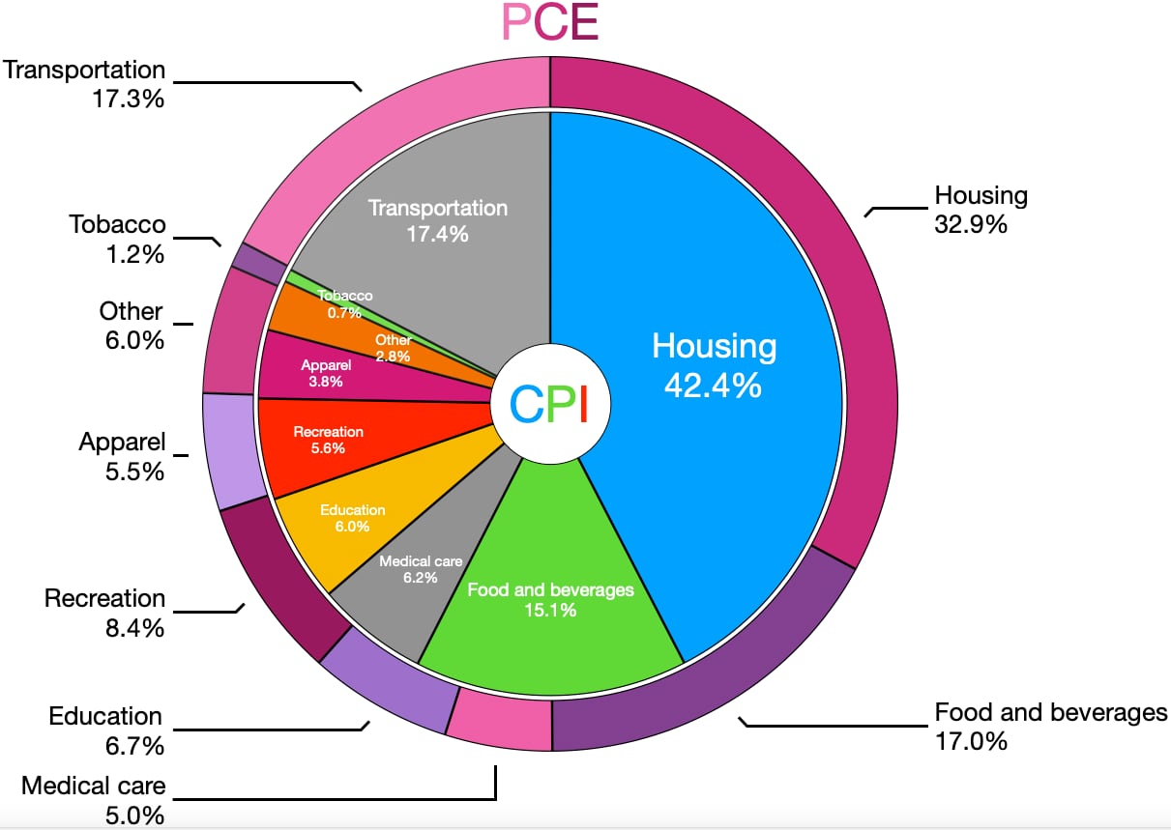
CPI vs. PCE: Differences
CPI tends to be higher (Mar):
CPI, 4.9%
Core CPI, 5.6%
PCE, 4.2%
Core PCE, 4.6%.
Typically more like 0.5 % pts.
https://en.wikipedia.org/wiki/Personal_consumption_expenditures_price_index#

Slide 27
Rents Paid versus Asking Rents

Slide 28
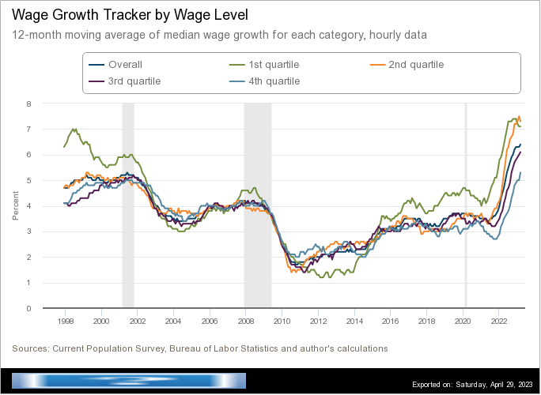
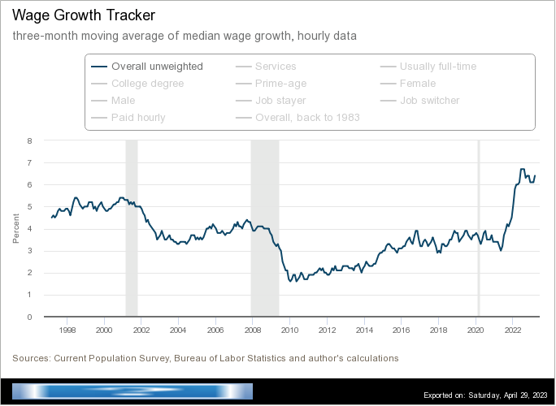
Wages Haven’t Kept Pace with Inflation
Notes:
But, note that low wage workers are doing relatively the best

Slide 29
The “Nominal” Side
Inflation: There is a lot of work still to be done.

Slide 30
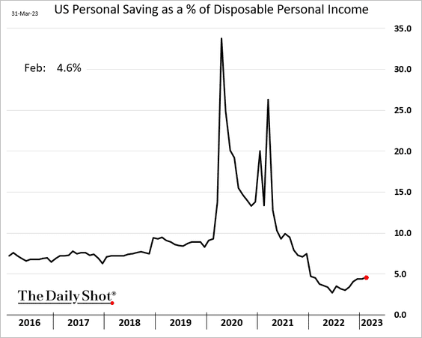
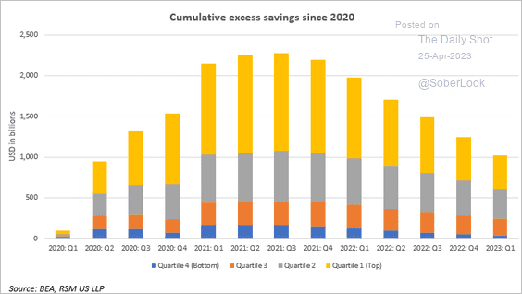
Policy Effects: Fiscal
2020-2021: massive stimulus. Cares Act, 3 rounds of stimulus checks, expanded unemployment benefits, Payroll Protection Loans.

Slide 31
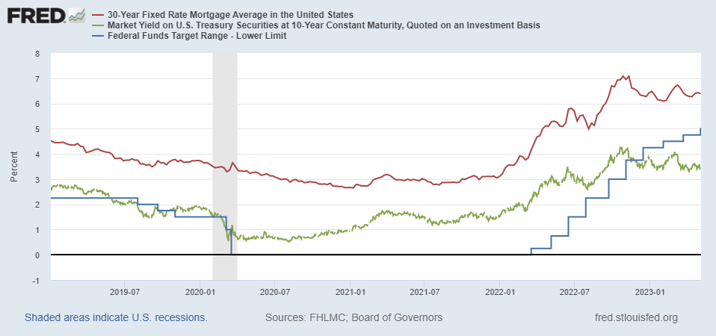
Policy Effects: Monetary
2020-2/2022: policy interest rate at zero, new round of quantitative easing.
3/2022-present: most rapid increase in interest rates since Paul Volcker

Slide 32
Where we Stand
The ARP was probably too big, but helped many poor families, and the Fed was aware of the size of the stimulus.
Monetary policy was too easy for too long, but since March of last years has been much more restrictive.
Yes, there were supply chain issues that temporarily raised inflation, but there was (is?) too much total spending.
So, where are we headed?
What will the Fed do?

Slide 33
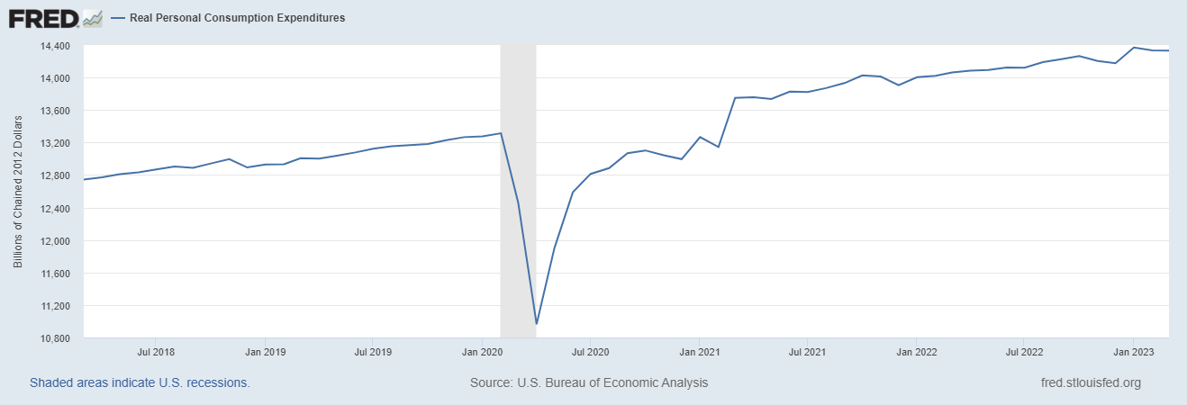
Latest Numbers on Consumption

Slide 34
Forecasters Are in fact Seeing the “R” Word

Slide 35
What is a Recession?
Defined by the National Bureau of Economic Research (NBER)
“The NBER's definition emphasizes that a recession involves a significant decline in economic activity that is spread across the economy and lasts more than a few months.”
Popular Rule of Thumb: Two or more, consecutive quarters where Real GDP falls.
Recessions are caused by decreases in total spending.

Slide 36
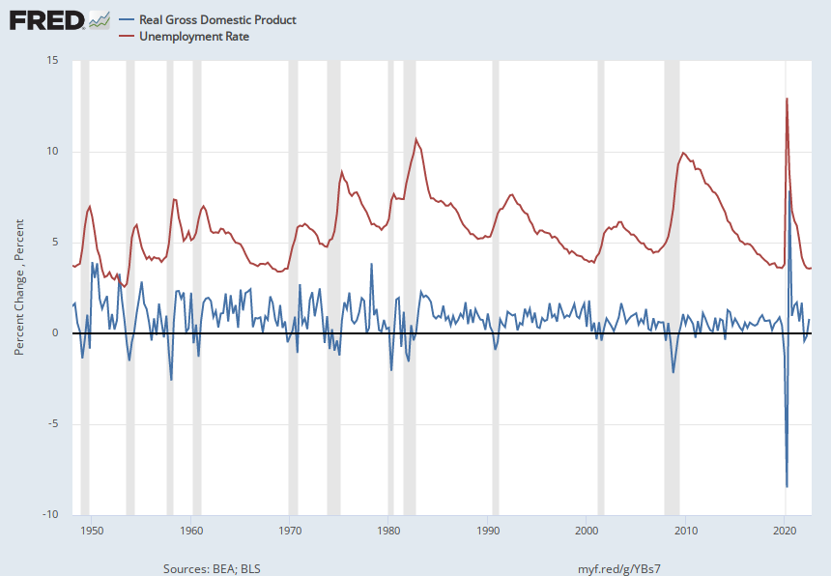
Real GDP Growth and Recessions
Notes:
Shaded Bars are recessions. 2022Q1, -1.6; Q2, -0.6 at annual rates.

Slide 37
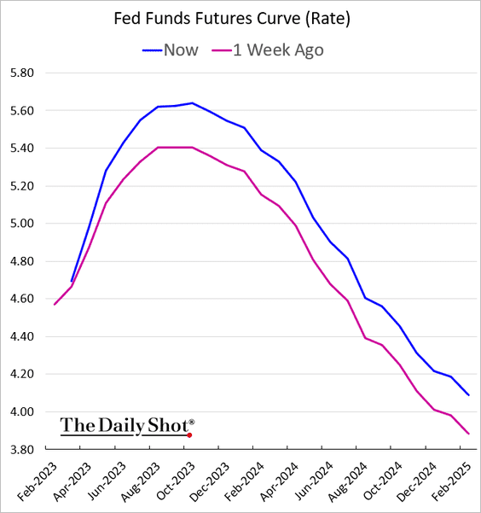
On March 7th Powell Emphasized Rate Hikes?
Red Pre March 7; Post March 7
Terminal rate

Slide 38
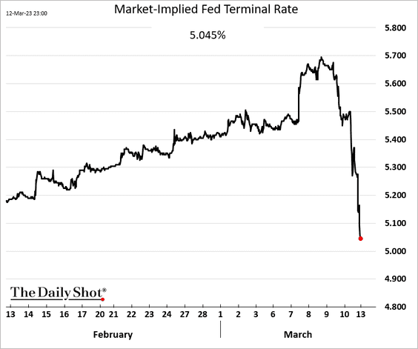
Something Happened the Next Weekend!

Slide 39
Silicon Valley Bank
Regional mid-sized bank with $212b in assets; $6billion in capitalization (15th largest).
Focused on loans to venture capital and managing the desposit accounts of startups.
Very rapid growth in deposits and assets between 2021 and 2022, which led to big investments in “safe” long term Treasury bond.
The market value of these bonds fell drastically due to the Fed’s rise in interest rates.
No problem! The bank does not incur “losses” unless it sells the bonds before maturity.
Notes:
JP morgan chase 3.7 trillion

Slide 40
Whoops!
Concentrated and sophisticated depositors see the problem and want to get their money out (FDIC insurance guarantees deposits up to $250 thousand, and 90% above this amount!).
Deposit withdrawals force SVB to sell those bonds.
Precipitating a classic bank run and leading to the FDIC seizing the bank on Friday.

Slide 41
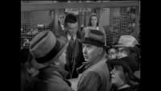
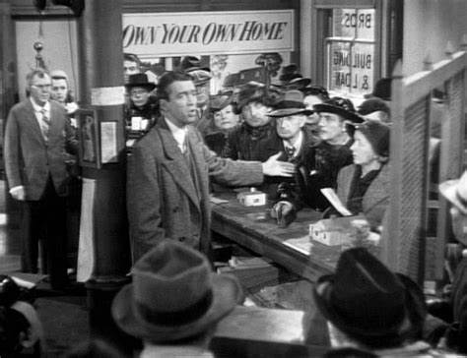
Silicon Valley’s Not So Wonderful Life

Slide 42
FDIC Bank Closures, in General
“Auction” off the failed bank; all depositors paid in full.
Payoff insured deposits and liquidate bank assets
Under Dodd-Frank, the FDIC is supposed to use the cheaper procedure.
In either case, funding comes from banks’ payments of deposit insurance premium.

Slide 43
But, in This Case:
Janet Yellen announced that all depositors would be paid in full, and there would be complete insurance of all bank deposits for a year.
Senior Executives all fired.
Fed created a new lending program, so that banks can borrow against Treasury bonds without realizing losses.
The rationale was to prevent bank run spreading to other midsize banks.
  Two other banks recently closed
  Stock prices of a number of similar sized banks have plummeted.

Slide 44
Problems with the Bailout
Political:
  Did political favoritism play a role in bailing out well connected, sophisticated silicon valley depositors.
  Why didn’t bank regulators see this coming?
Economic: has the moral hazard of “too big to fail” been increased.
For the Fed: Will the Fed have to scale back its interest rate increases to prevent wide scale financial crisis?

Slide 45
Another Shoe Drops?
Front Page of the NYTimes, May 1,2023

Slide 46
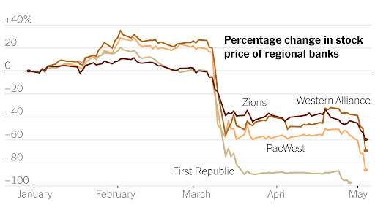
We Are Still in Danger

Slide 47
Short-term and Long-Term Problem?

Slide 48
And, Then There is the Debt Ceiling
Biden Can:
  Declare Debt Ceiling unconstitutional due to 14th amendment.
  Direct the Treasury to Mint a $5 trillion coin.
  Direct the Treasury to replace existing bonds with very high coupon payments, so that they sell for more than their face value.

Slide 49
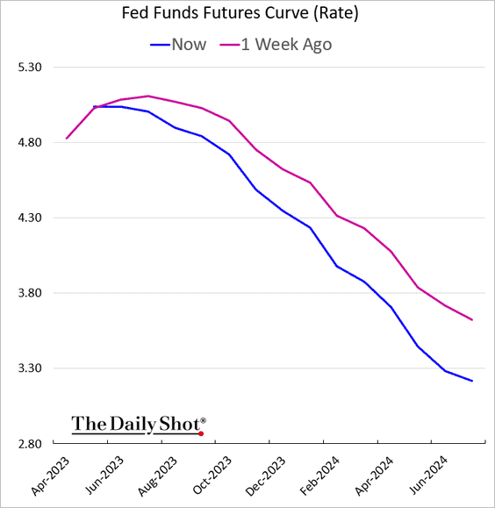
Interest Rates and the May 3rd Fed Meeting

Slide 50
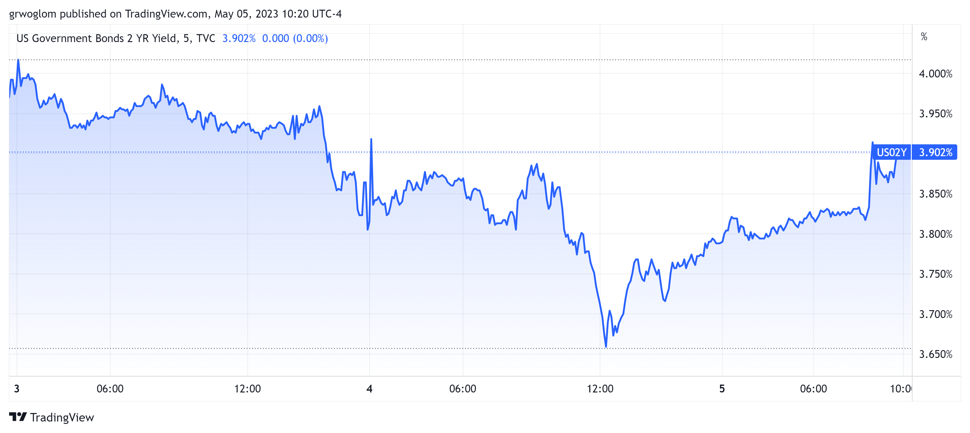
This AM’s Employment Report

Slide 51
Fed Remains Optimistic
Variable (in percent) | Medians
 | 2023 | 2024 | 2025 | Longer Run
RGDP growth | 0.4 | 1.2 | 1.9 | 1.8
Dec. | 0.5 | 1.6 | 1.8 | 1.8
Unemployment | 4.5 | 4.6 | 4.6 | 4.0
Dec. | 4.6 | 4.6 | 4.5 | 4.0
Inflation | 3.2 | 2.5 | 2.1 | 2.0
Dec. | 3.1 | 2.5 | 2.1 | 2.0
Core Inflation | 3.6 | 2.6 | 2.1
Dec. | 3.5 | 2.5 | 2.1
Federal Funds | 5.1 | 4.3 | 3.1 | 2.5
Dec. | 5.1 | 4.1 | 3.1 | 2.5

Slide 52
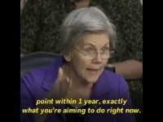
Next Week: Why is Sen Warren so Angry?

Slide 53
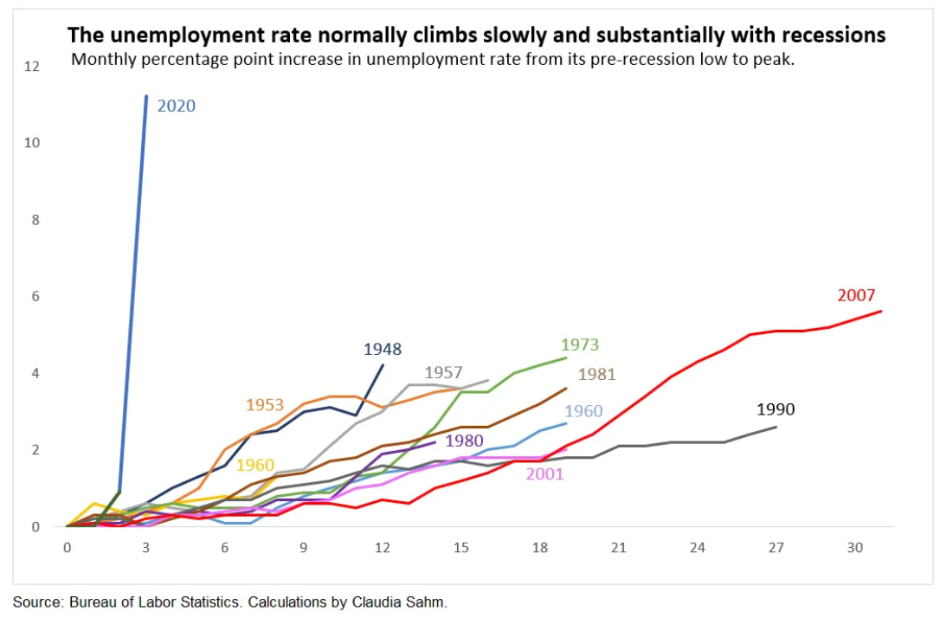
Sen Warren is Right

Slide 54
Economists’ Frustration with MP & Inflation
Olivier Blanchard 12/30 Twitter Post:
Inflation is fundamentally the outcome of the distributional conflict, between firms, workers, and taxpayers… The source of the conflict may be too hot an economy. But in the end, forcing the players to accept the outcome, and thus stabilizing inflation, is typically left to the central bank… It is a highly inefficient way to deal with distributional conflicts…

Slide 55
Things to Ponder
The Fed through monetary policy has the most influence on the short-run behavior of the (world?) economy. These governmental decisions are made “technocratically” and not democratically.
Congress has mandated the Fed to pursue:
Both the inflation goal and the unemployment goal.
The mandate does not include anything about the effects of Fed policy on other countries.
Is there a better way to conduct monetary policy, while maintaining a credible commitment to low inflation?

Slide 56
Income Inequality: Adina Ardelean
Stock Market Crash
WWII
Housing Bubble
Dot-com Bubble

Slide 57
Let’s Hear from You!
Geoffrey Woglom
grwoglom@amherst.edu
Contact NEED: Info@NEEDelegation.org
Submit a testimonial: www.NEEDelegation.org/testimonials.php
Support NEED: www.NEEDelegation.org/donate.php

