Slide 1
Osher Lifelong Learning Institute, Spring 2025
Contemporary Economic Policy Issues
Washington University in St. Louis
Host: Jon Haveman, Ph.D.
National Economic Education Delegation

Slide 2
Available NEED Topics Include:
US Economy
Healthcare Economics
Climate Change
Economic Inequality
Economic Mobility
Trade and Globalization
Minimum Wages
Immigration Economics
Housing Policy
Federal Budgets
Federal Debt
Black-White Wealth Gap
Autonomous Vehicles
US Social Policy

Slide 3
Course Outline
Contemporary Economic Policy
  Week 1 (4/29): US Economic Update & Tariffs (Geoffrey Woglom, NEED)
  Week 2 (5/6): Federal Debt (Geoffrey Woglom, NEED)
  Week 3 (5/13): Economics of Immigration (Jon Haveman)
  Week 4 (5/20): Autonomous Vehicles (Jon Haveman)

Slide 4
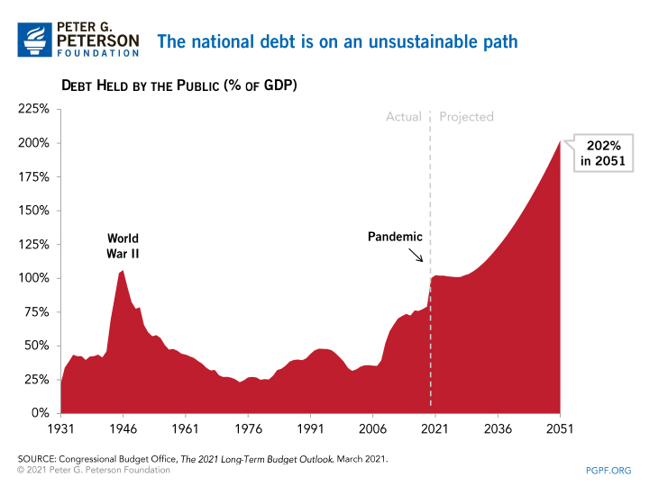
The Federal Debt is Becoming A Problem

Slide 5
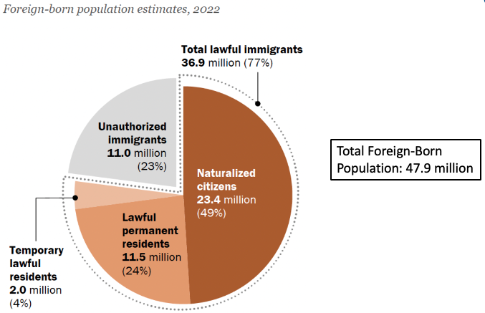
Immigrant Population in 2022
Categories and total number
of immigrants in the United States.
https://www.pewresearch.org/fact-tank/2019/07/12/how-pew-research-center-counts-unauthorized-immigrants-in-us/

Slide 6
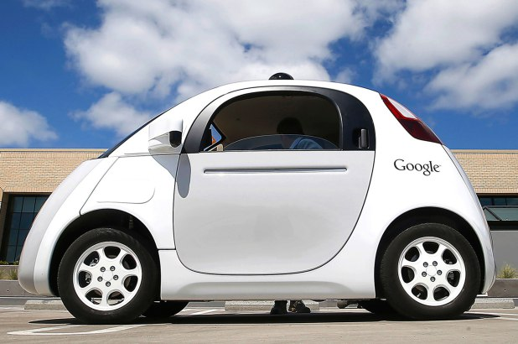
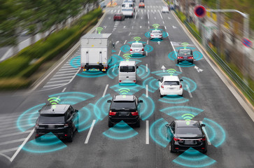
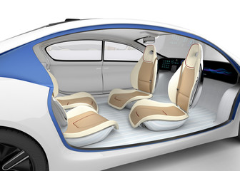

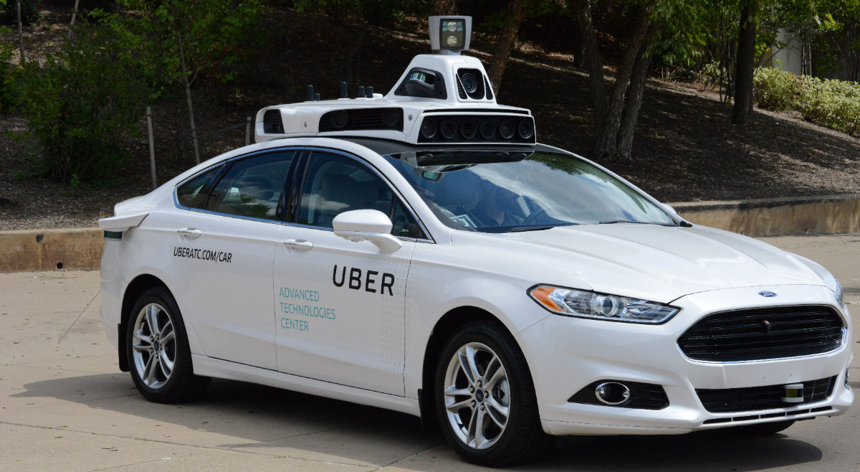
Autonomous Vehicles

Slide 7
Submitting Questions
Submit questions in the chat or raising your digital hand. I will try to address questions as they come up.
We will do a verbal Q&A once the material has been presented.
Slides will be available from the NEED website tonight (https://needelegation.org/delivered_presentations.php).
My macro site: https://sites.google.com/view/macro-current-issues/economic-update

Slide 8
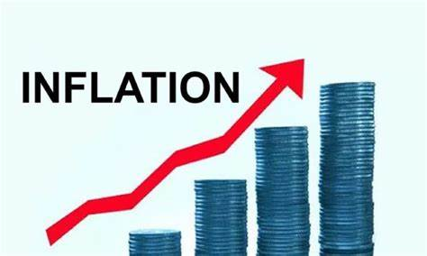

US Economy: Update
Geoffrey Woglom,
Professor of Economics
Amherst College, emeritus
April 29, 2025

Slide 9
Revised Outline
Quick Overview of State of the Economy
“Liberation Day” primer on
  Tariffs
  Trade Deficits
End with Key Takeaways.

Slide 10
Gross Domestic Product: 2024 = $29.2 tr
$30.1
Less Imports
-$4.1
Plus Exports
+$3.2
Equals GDP
$29.2

Slide 11
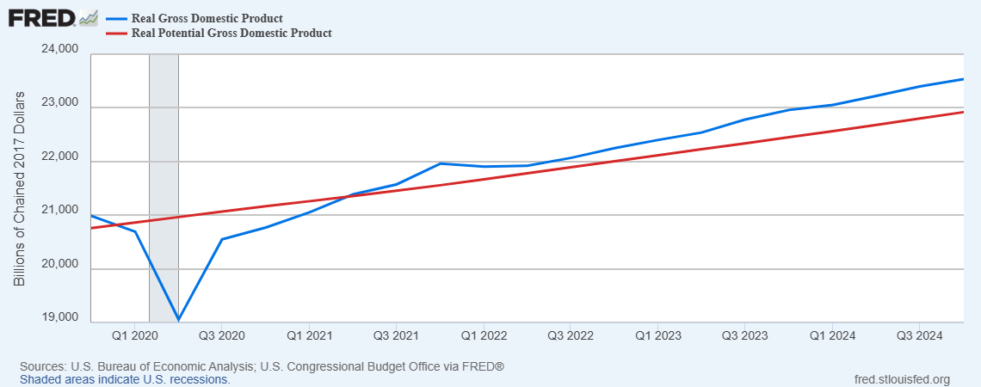
GDP and ‘Potential’ during the Recovery
Grey bar indicates recessions
Source: Fred, St Louis Fed

Slide 12
What is a Recession?
Defined by the National Bureau of Economic Research (NBER)
“The NBER's definition emphasizes that a recession involves a significant decline in economic activity that is spread across the economy and lasts more than a few months.”
Popular Rule of Thumb: Two or more, consecutive quarters where Real GDP falls. (Doesn’t always work!)
Recessions are caused by a drop in total spending (remember the consumer).

Slide 13
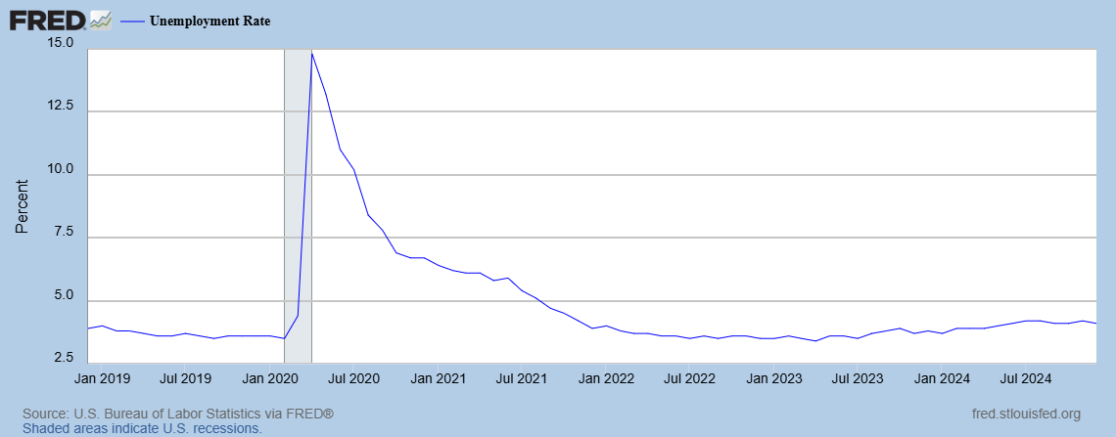
Unemployment is Near Record Lows

Slide 14
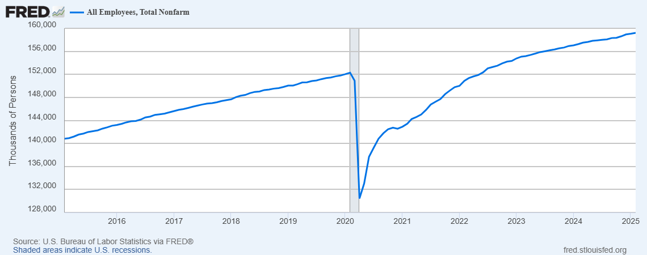
Where Have All the Workers Gone?
Source: Fred, St Louis Fed

Slide 15
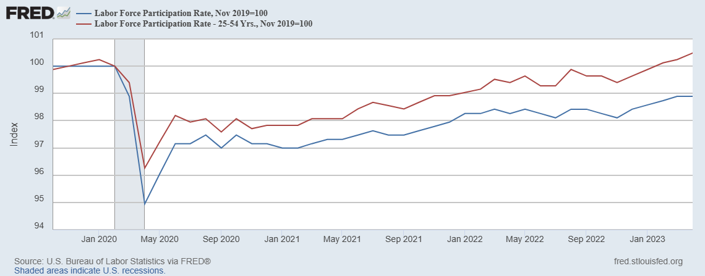
The Aging of the Labor Force
Notes:
F

Slide 16
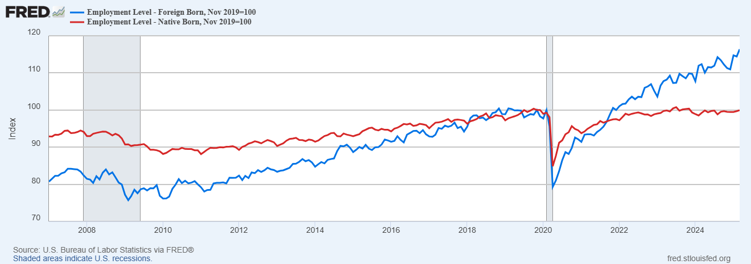
Supplemented by Foreign Workers
Between 11/19 and 3/25
NB employment fell by 66k
FB employment rose by over 4500k

Slide 17
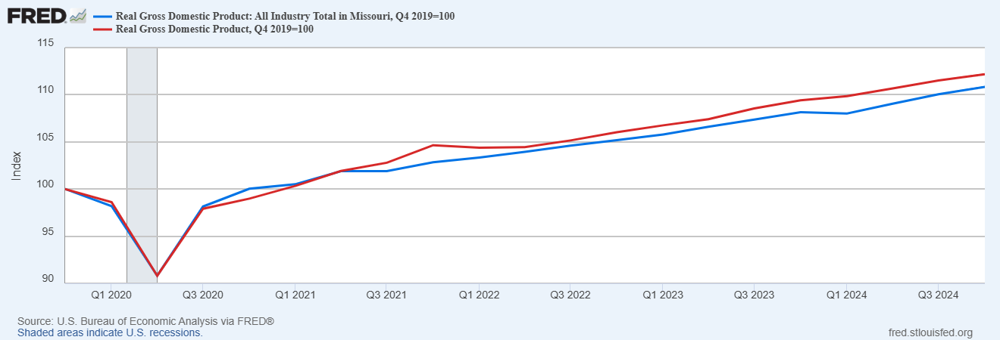
How is Missouri Doing?

Slide 18
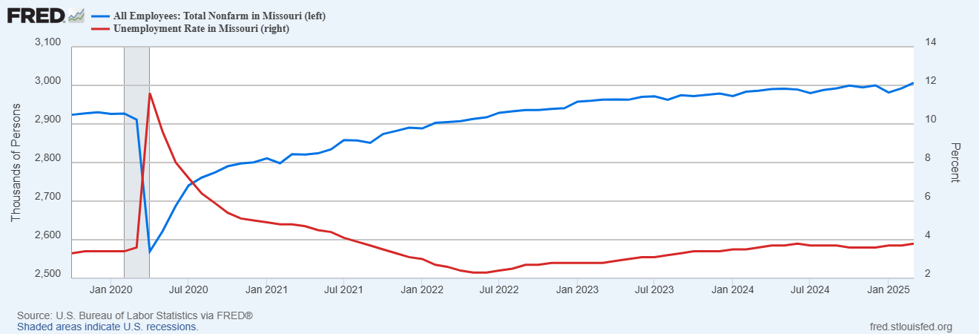
Labor Market in Missouri
Employment growth since 12/2019, 2.6%; vs. 4.7% nationally
Notes:
REI about 1% increase in employment vs. 4.3

Slide 19
Overall Good News on the Real Side
GDP is very close to its potential.
The labor market as measured by the unemployment rate is fully recovered.
But there is also a nominal side: interest rates, asset prices, inflation and wages.
News is pretty good, but progress on inflation seems to have stalled.

Slide 20
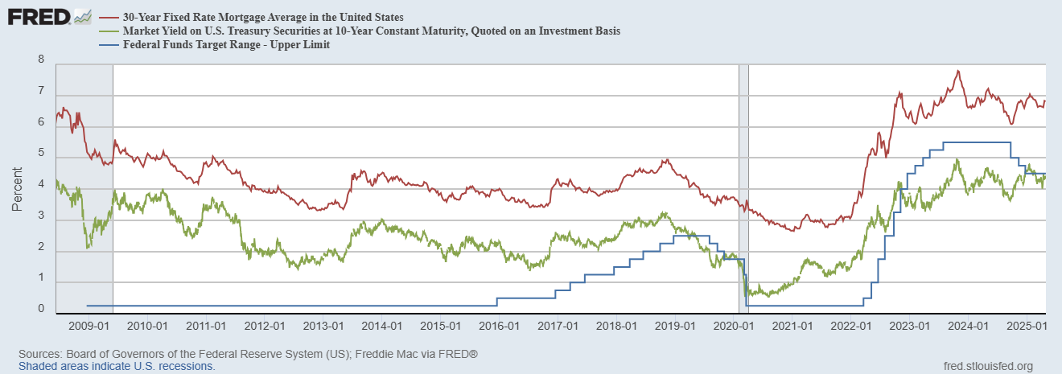
Interest Rates: Era of Falling Rates Over?
Notes:
Fed policy rate 4.5 to 4.25. Concerns with inflation

Slide 21
National Housing Market and Closer to Home
https://www.zillow.com/research/data/

Slide 22
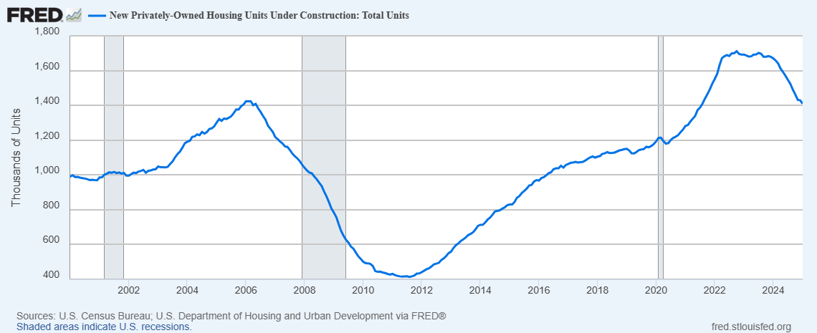
Housing Construction is Slowing?

Slide 23
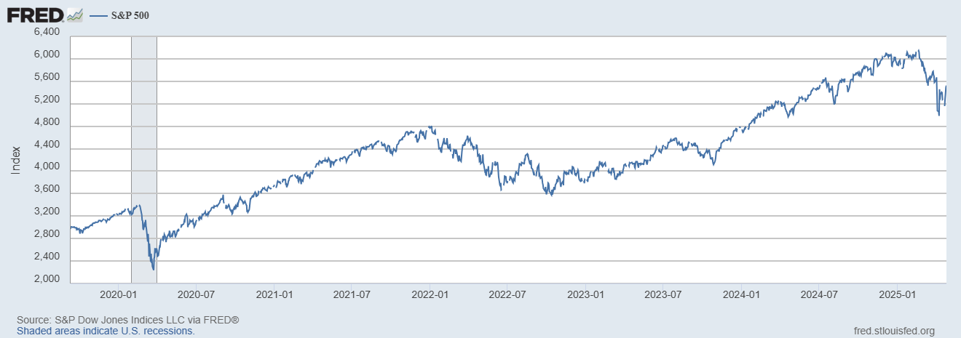
Stock Prices: Don’t Look at Your Retirement Acct!
Notes:
Since the end of 2021, lost almost 15%

Slide 24
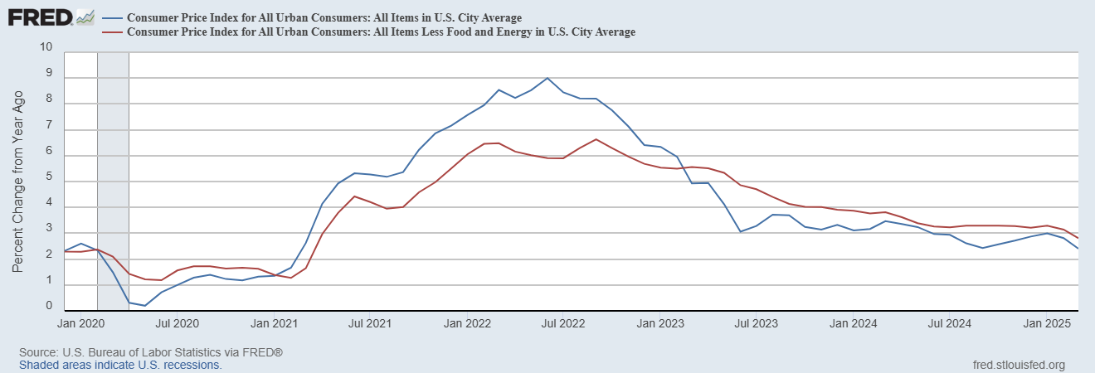
Inflation during the Recovery (CPI)
Latest Reading for Mar
2.4% & 2.8%
Notes:
August CPI yoy 8.3% down from 8.5 and Core 6.3 up from 6.3 in JUly

Slide 25
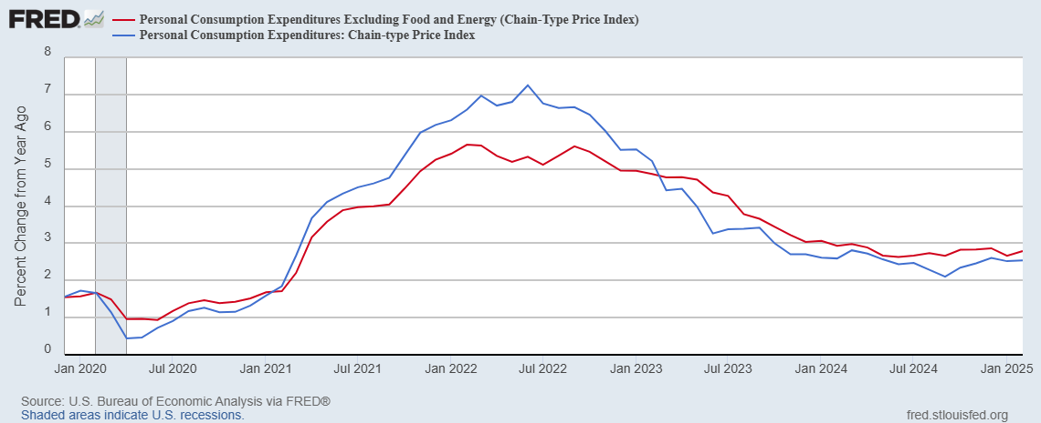
Fed’s Measure (PCE)
March PCE numbers will be released tomorrow
Inflation Accelerates 3/2021
Fed Doesn’t React until 3/2022
Progress slows Spring 2024

Slide 26
CPI vs. PCE: Differences
CPI tends typically to be 0.3 pct point higher
Feb:
CPI, 2.8%
PCE, 2.5%
Core CPI, 3.1%
Core PCE, 2.8%.
https://www.morningstar.com/markets/whats-difference-between-cpi-pce

Slide 27
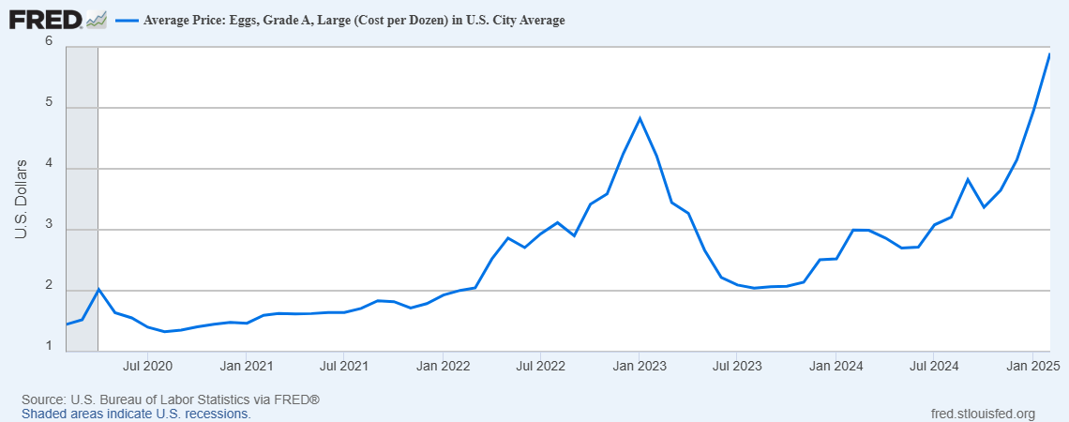
Uses of Inflation Measures
Two Reasons for Measuring Recent Inflation:
What has happened to the Cost of Living?
What is likely to happen to inflation over the next 12-18 months?

Slide 28
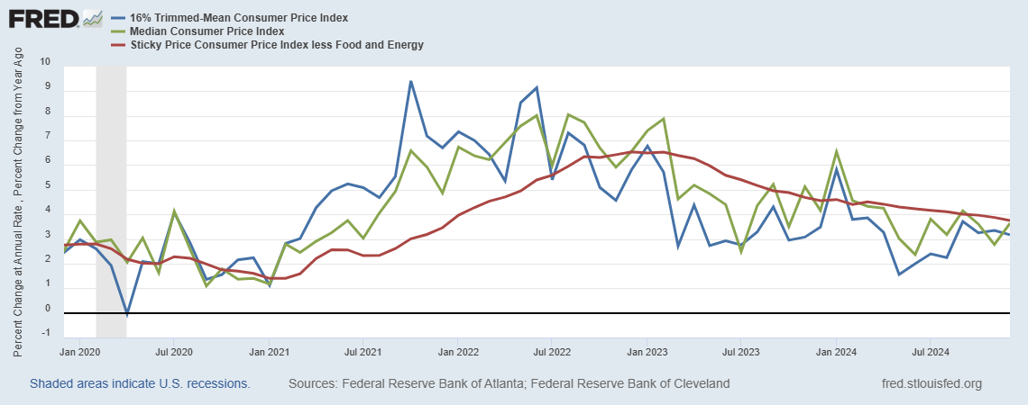
Measuring “Underlying” Inflation
Notes:
Super Core has a weight of less than 30% in the overall CPI

Slide 29
The Problem with Measuring Housing Costs
Housing over 30% in CPI and 15% in PCE
Housing costs are measured by rents, “stale” prices.
https://www.zillow.com/research/data/

Slide 30
Wages Haven’t Kept Pace with Inflation, Yet
Federal Reserve of Atlanta, “Wage Tracker” and BLS
Notes:
But, note that low wage workers are doing relatively the best

Slide 31
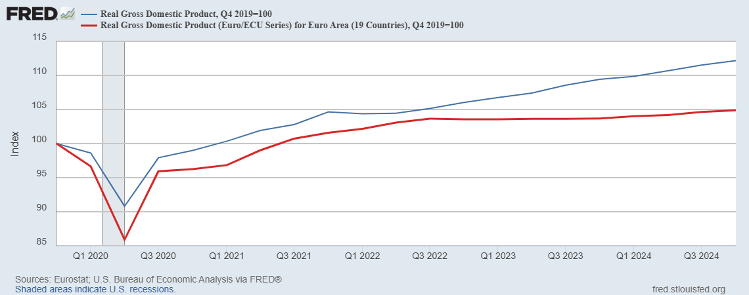
International Comparisons: Real GDP

Slide 32
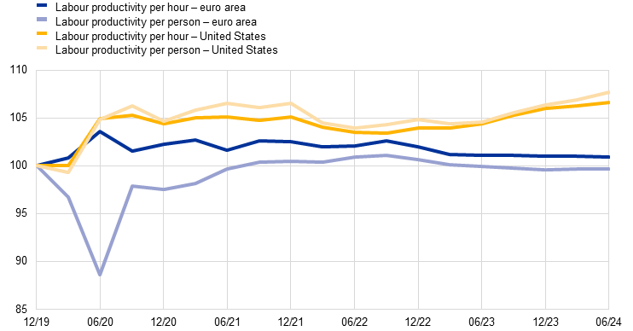
Why?
Labour productivity in the euro area and
the United States (Q4 2019 = 100)
https://www.ecb.europa.eu/press/economic-bulletin/focus/2024/html/ecb.ebbox202406_01~9c8418b554.en.html

Slide 33
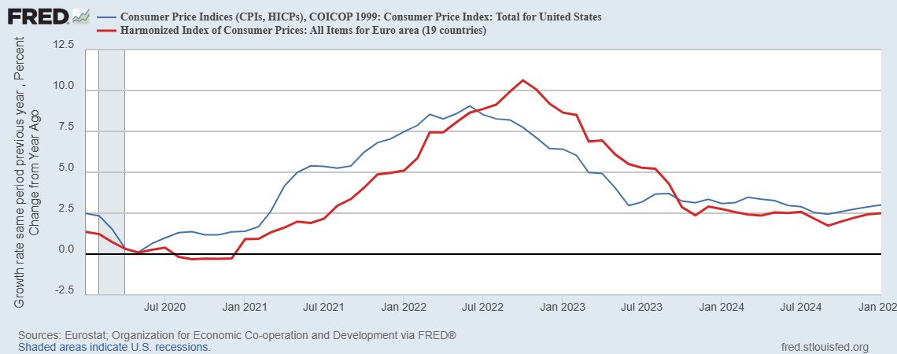
Iinternational Comparison: Inflation

Slide 34
TheSState of the Economy & Policy Effects
In terms of output and employment the economy is fully recovered
Inflation is still a bit elevated, but close to Fed target.
Policy Effects
Biden Fiscal Stimulus led to a rapid recovery, but may have been too big.
Fed reacted too little and too late and let inflation get out of control.
But since Spring 2023, Fed has been close to perfect.
But Dark Clouds Are Looming on the Horizon,

Slide 35
Consumer’s Are Not Happy (2/3rds of GDP)

Slide 36
They Are Worried about Inflation

Slide 37
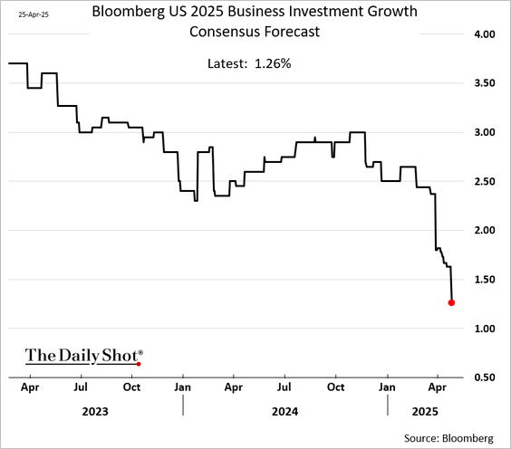
Busineses aren’t Too Happy Either

Slide 38
Professional Forecasters Are Worried

Slide 39
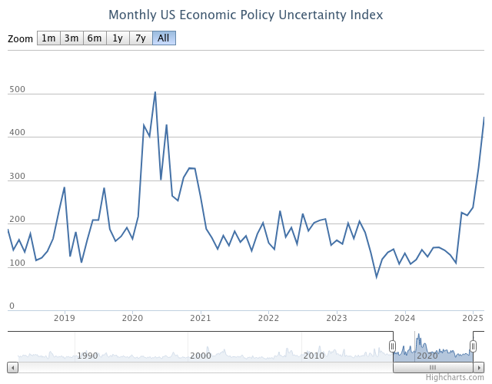
Why the Doom & Gloom
Uncertainty !

Slide 40
What Was the Source of the Uncertainty?
https://www.policyuncertainty.com/trade_uncertainty.html

Slide 41
A Brief Primer on Tariffs
Tariffs are a sales tax on imported goods, collected from importers
The burden of the tariff in general falls on buyers of imports (consumers and firms) to the extent of higher prices and on the foreign country.
Economist don’t like tariffs in general because they reduce the gains from trade
  More efficient utilization of global resources: Why doesn’t Patrick Mahomes mow his own lawn
  Economies of scale for producing for large markets.
Gains to Trade Taken to a New Level with Global supply chains

Slide 42
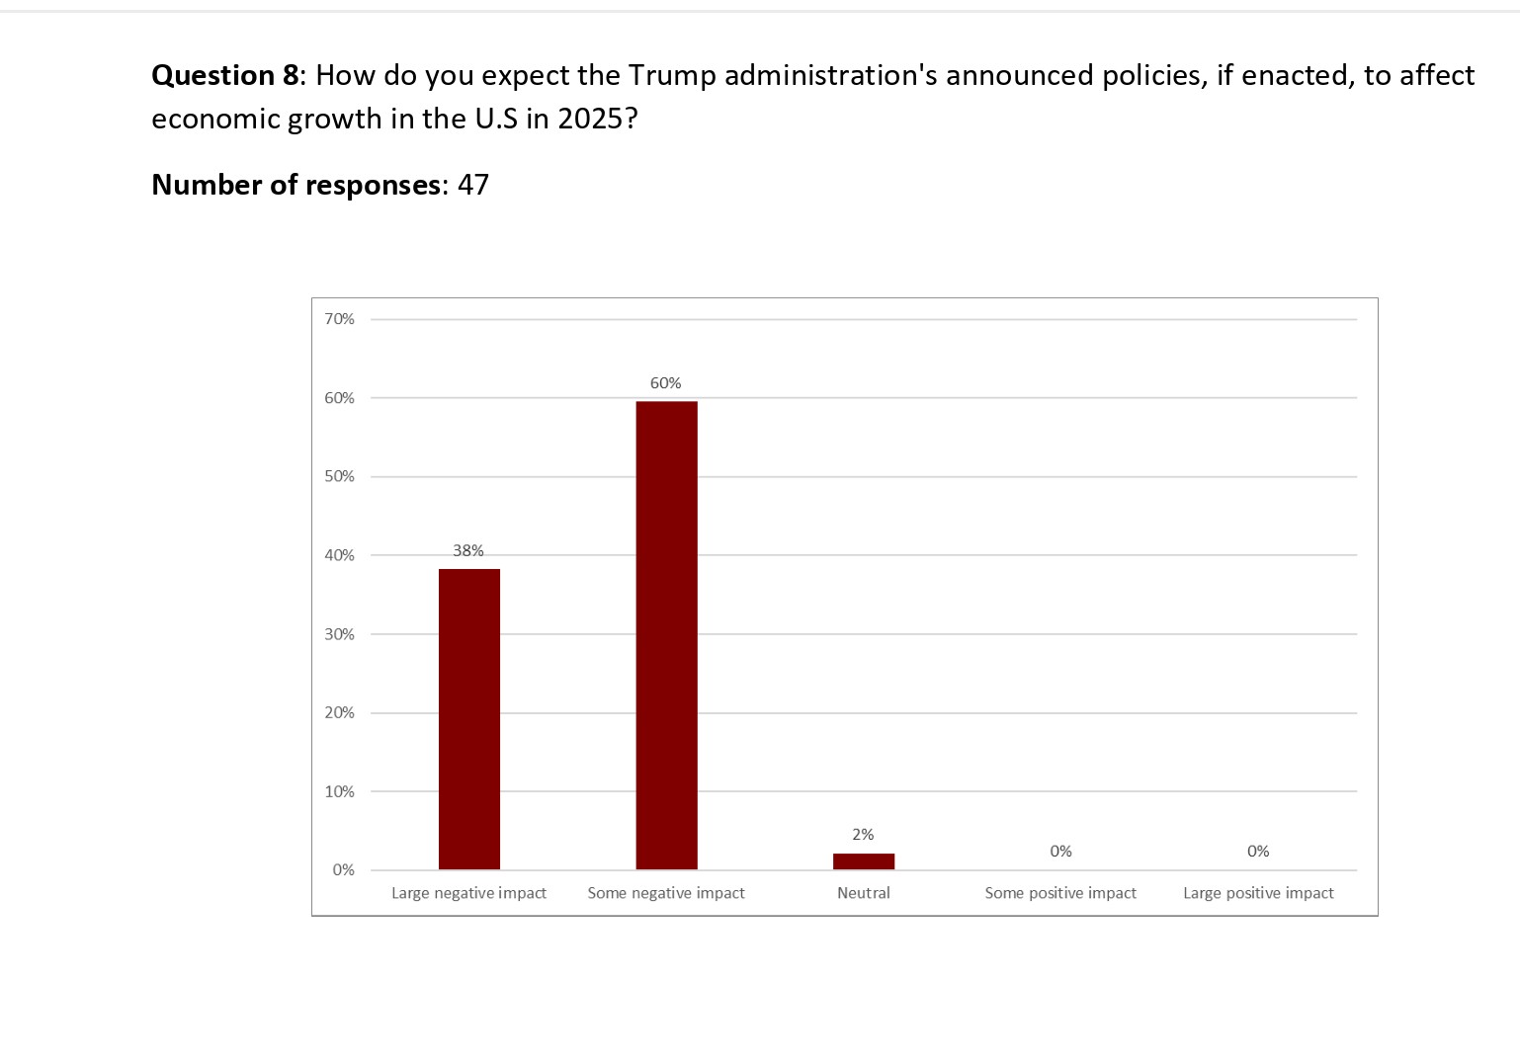
I Guess They Didn’t Ask Peter Navarro
https://www.kentclarkcenter.org/wp-content/uploads/2025/03/RESULTS-2025-03-12-Survey-16.pdf

Slide 43
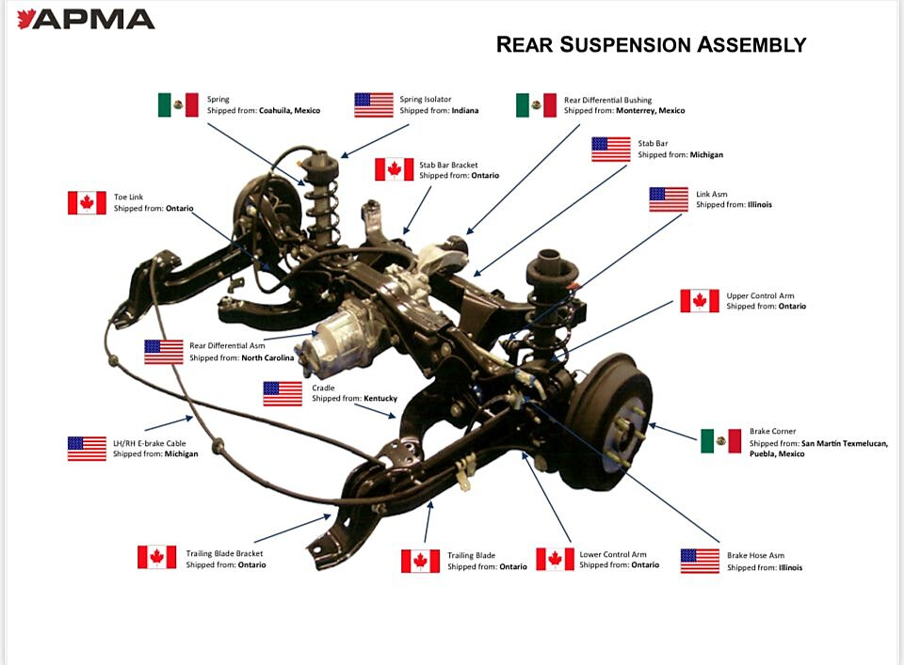
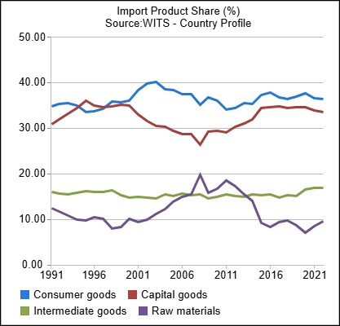
Gains to Trade with Global Supply Chains
US
https://www.cato.org/blog/trumps-automotive-tariffs-will-hurt-american-consumers-producers

Slide 44
Possible Economic Arguments for Tariffs
Possible arguments for tariffs
  National Defense – strategic resource. Do we need the capacity to make our own computer chips, just in case?
  “Infant” Industry
  Temporary strategy to reduce foreign tariffs

Slide 45
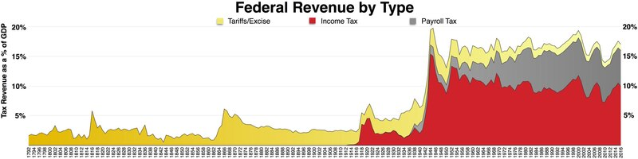
History of the Source of Federal Revenues
1913; Sixteenth Amendment. The Congress shall have the power to lay and collect taxes on incomes, from whatever source derived…
1930; Smoot Hawley Tariff.
1935; Social Security and Payroll taxes.
https://en.wikipedia.org/wiki/File:Federal_taxes_by_type.pdf

Slide 46
History of US Average Effective Tariff Rates
Inc. Tax
Smoot-Hawley
https://budgetlab.yale.edu/research/state-us-tariffs-april-15-2025

Slide 47
The Original Reciprocal Tariffs
Reciprocal Trade Agreements Act of 1934
  President has the authority to negotiate bilateral trade agreements allowing for the reciprocal tariff reductions of up to 50% of Smoot Hawley.
  32 Bilateral trade agreements signed between 1934 and 1945.
  Sets a precedent of Congress delegating tariff authority to the President.
General Agreement on Tariffs and Trade 1947
  Outgrowth of Bretton Woods – Multilateral reciprocity.
  Average tariffs fall from 22% in1947 to 5% in 1999.
https://en.wikipedia.org/wiki/Reciprocal_Tariff_Act
https://en.wikipedia.org/wiki/General_Agreement_on_Tariffs_and_Trade

Slide 48
World Trade Organization (WTO) 1995
GATT was only a set of legal agreements and had no organizational structure.
New trade issues arose, e.g., intellectual property rights, non-tariff barriers to trade.
More efficient and “binding” dispute resolution.
China joins the WTO in December of 2001.
https://www.britannica.com/topic/General-Agreement-on-Tariffs-and-Trade

Slide 49
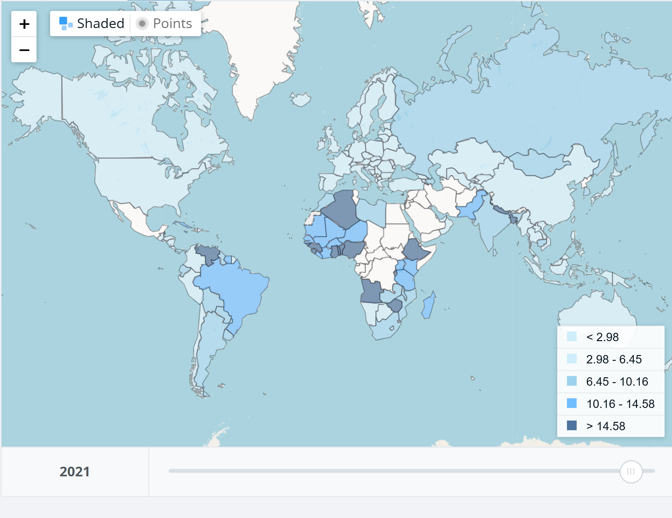
Tariffs in 2021
Key Takeaway:
Tariffs have been generally very low
1.33%
1.47%
2.31%

Slide 50
Doesn’t Congress Set Taxes, including Tariffs?
Yes, but Congress has delegated the authority to raise tariffs 3 times
  1962: If imports threaten national security following an investigation by the Secretary of Commerce
  1974: If the US International Trade Commission finds that a surge in imports is harming domestic industries
  1977: President declares a national emergency due to “an unusual and extraordinary threat” originating outside the US
President Trump has been claiming tariff authority from 1&3., but is being challenged in courts.

Slide 51
Gross Domestic Product: 2024 = $29.2 tr
$30.1
Less Imports (IM)
-$4.1
Plus Exports (EX)
+$3.2
Equals GDP (Y)
$29.2
$30.1
Less Trade Deficit
Exports (EX)- Imports (IM)
$3.2 -$4.1 =$ -0.9
Equals GDP (Y)
$29.2

Slide 52
Basic GDP Accounting
Trade Deficit is when imports (IM) exceed exports (EX)
Trade Deficits arise when we spend domestically more than we produce
Y - C - I – G = -IM + EX, $29.2-$30.1=-$0.9
Useful definition Y – C – G is “National Saving” & rearranging;
(Y – C - G )– I = National Saving less Investment = -IM + EX = Trade Deficit
We spend more than we produce when national saving isn’t sufficient to finance our investment, so we borrow from abroad.
Trade Deficit = Borrowing from foreigners = National Saving less Investment.
Key Takeaway: Trade Deficits are Associated with an imbalance of national saving and investment

Slide 53
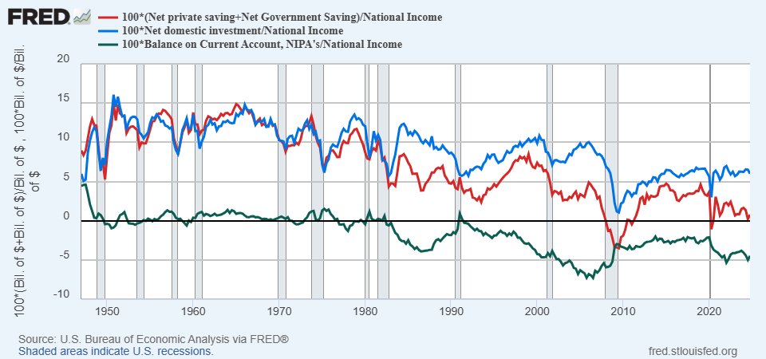
History of Saving, Investment and Trade Balance
Persistent Trade Deficits Start in the 1980s

Slide 54
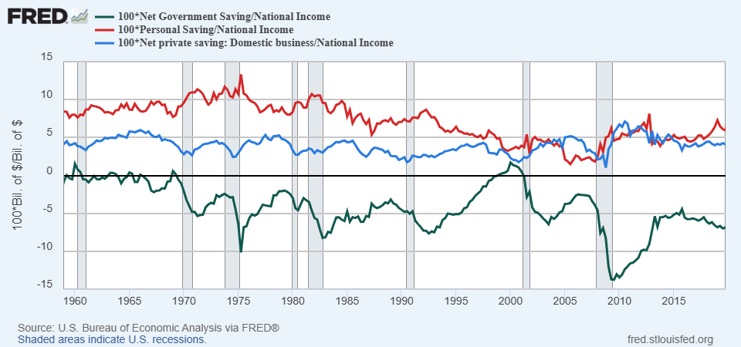
Three Components of National Saving
Movements in National Savings are Dominated by Government Deficits

Slide 55
Trade Deficits
Remember, trade deficits occur when national saving is insufficient to finance investment.
Three possible causes (not mutually exclusive):
  Low national saving due to government deficits
  Low national saving due to low private saving.
  High levels of investment.
Good Trade Deficits: South Korea from 66-76?
  GDP growth averaged around 10%
  Investment about 25% of GDP
  National Saving about 22%
  Government Deficit of about 3%
Good Trade Deficits Allocate International Saving to the most productive investments.
https://www.nber.org/system/files/chapters/c7523/c7523.pdf

Slide 56
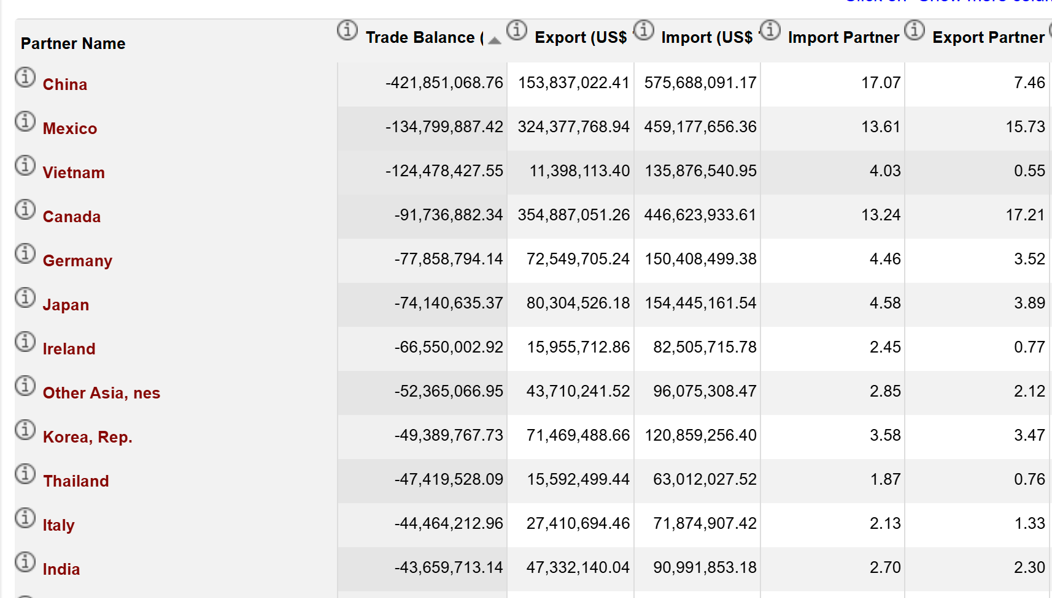
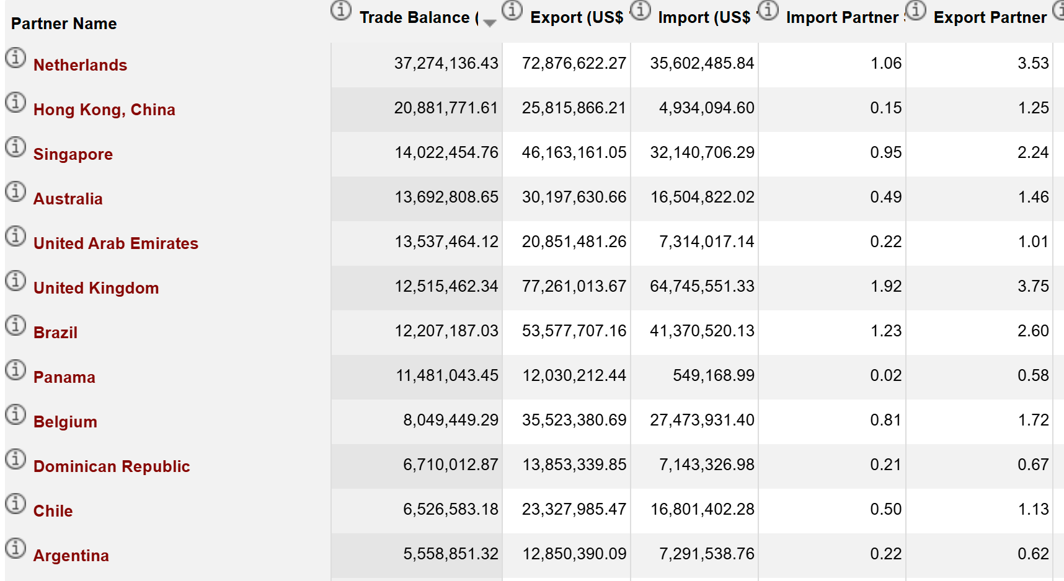
US Trade Balance 2022
US with all countries: - Total Imports (IM) +Total Exports(EX) =-$3.4 tr+$2.1 tr = $-1.2 tr
https://wits.worldbank.org/CountryProfile/en/Country/USA/Year/2022/TradeFlow/EXPIMP/Partner/by-region

Slide 57
US: Since 2000s, Good or Bad?

Slide 58
What about the China Shock?
2000 Economist View of the Effects of Increasing Trade
  Free Trade leads to more gains than losses
  Trade was not the major cause of the decline in manufacturing employment nor in the rise of inequality.
  Increasing trade would affect low skilled wages generally and not by trade-exposed workers speciifically.
  Worker mobility was high.
Given 4, increasing trade should provide gains for most.
https://www.nber.org/system/files/working_papers/w21906/w21906.pdf

Slide 59
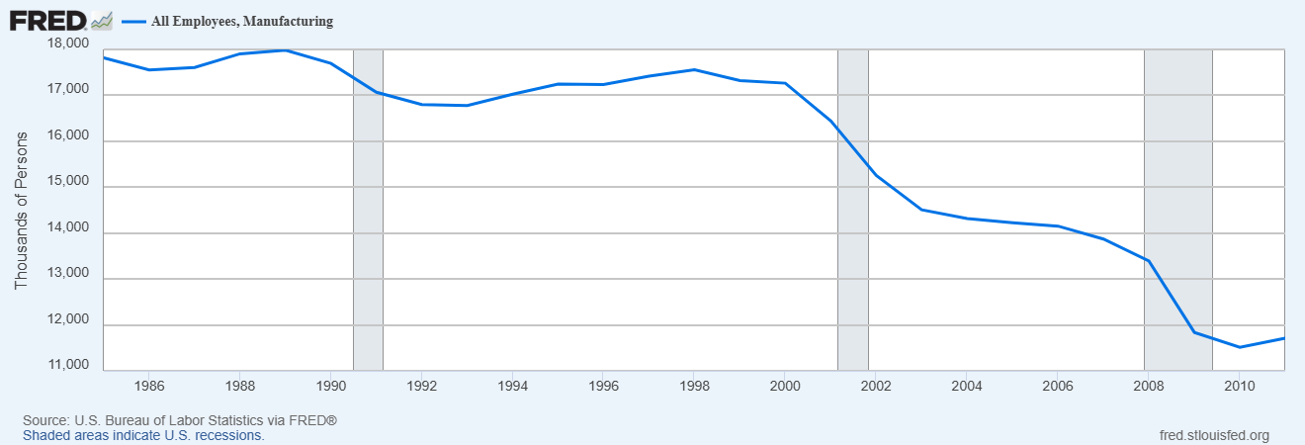
The China Shock
Reminder: China Joins WTO in December of 2001

Slide 60
Autor et. al.’s Conclusion
While these results do not at all suggest that international trade is in the aggregate harmful to nations-indeed, China's unprecedented rise from widespread poverty bears testimony to trade's transformative economic power-it makes clear that trade not only has benefits but also significant costs. These include distributional costs, which theory has long recognized, and adjustment costs, which the literature has tended to downplay.
China shock showed that a rapid influx of imports can cause harm that is geographically concentrated and long lasting to communities with import competing industries.

Slide 61
Tariffs and Trade Deficits
Remember, Trade Deficits are the mirro image of investment greater than national saving.
For the trade deficit to fall either national saving must rise and/or investment must fall (not what we want).
For national saving to rise
  Households and businesses must save more, or
  The government deficit must fall.

Slide 62
So, What Do Tariffs Do?
Tariffs do increase national saving by raising revenue, but also
Decreases the demand for the imports subject to the tariff, which
Decreases the supply of dollars on foreign exchange market.
Increases the value of the dollar, thereby
  Lowering our exports as domestic goods cost more to foreigners.
  Offsets some but not all of the effect of the tariff on total imports, as non-tariffed imports are cheaper.
Net Effect (first approximation)
  Exports fall, Total Imports fall, and the change in the trade balance is solely due to reduced government deficit.
  Composition of imports changes while the relative share of non-tariffed imports rises.
  Winners and Losers and rent seeking?

Slide 63
Trump “Reciprocal” Tariffs
Suspended for 90 days
Easy Peasey – Charge the rate country imposes on us.
Complications
  Non-tariff barriers, strict labeling requirements, state procurement policies.
  Exchange rate policy that leads to undervalued currency.
  Not, Value Added Taxes
Complicated and Controversial, but NOT what was done.
Instead, half of the bilateral trade surplus with the US divided by total exports to the US 0.5(EX-IM)/EX.

Slide 64

Example, Lesotho (2022 data)
(EX-IM)/EX=
($236m-$7m)/$236m=0.97
“Reciprocal” Tariff = 0.5(.97)= .485,
49% tariff rate (actually, 50%)
Facts about Lesotho:
GDP/Pop =$1,073;
Population 2.1 million
Overall Trade Balance -$349 million
Average eff. tariff rate against US = 10%
https://wits.worldbank.org/CountryProfile/en/USA
https://www.imf.org/en/Publications/WEO/weo-database/2024/October
Notes:
99% textiles. 2000 African Growth and Opportunity Act 0 tariffs on textiles

Slide 65
More Generally
Bilateral Trade Surplus, by itself, doesn’t have much economic significance, and certainly doesn’t have any general relationship to the level of tariff or non-tariff barriers.
Pastrick Mahomes runs a trade deficit with the teenager who mows his lawn!
Is the teenager “ripping off” Patrick Mahomes.
China may be the exception.

Slide 66
Tariffs as of April 15
Source for this and following slides: https://budgetlab.yale.edu/research/state-us-tariffs-april-15-2025

Slide 67
Estimated Macro effects
Tariff Revenue 2026-2035: between $2.4 and $1.8 trillion
2025 growth in GDP falls by 1.1 percentage points.
Change in the Price Level 3.0 points.
2 Estimates of Average Effective Tariff Rates
  No substitution effects – 25.6% (Chinese imports 14% of total)
  Substitution effects – 15.6% (Chinese imports fall to 3% of total!)

Slide 68
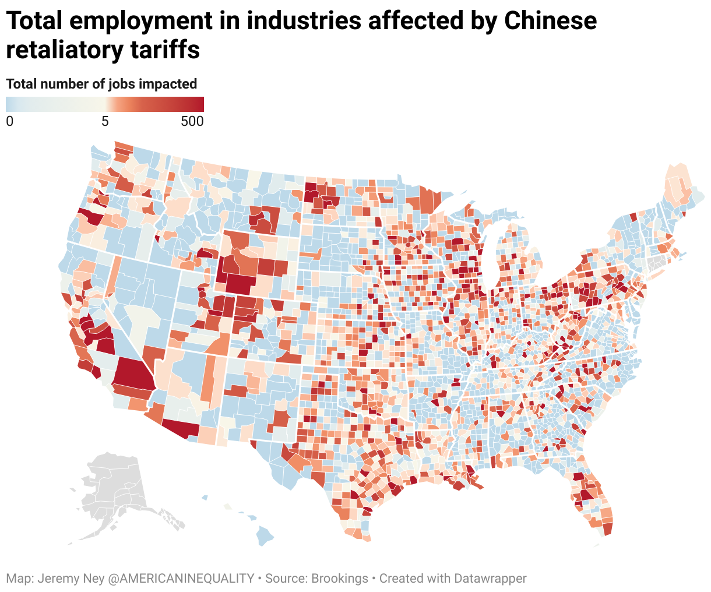
Retaliation by China
https://www.brookings.edu/articles/chinas-retaliatory-tariffs-will-hurt-trump-voting-counties-most/

Slide 69
Distributional Effects
Poor hurt relatively the most, “regressive” tax

Slide 70
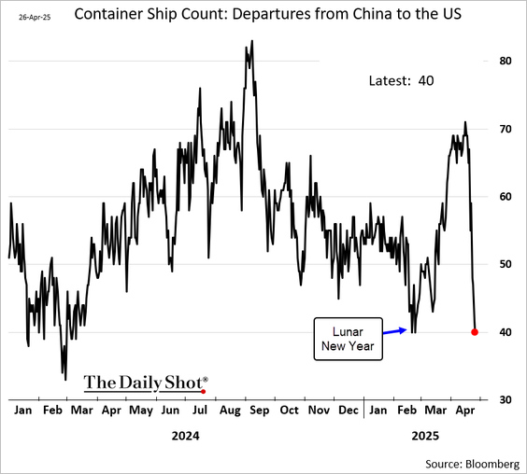
You Can’t Turn the Effects of Tariffs On & Off

Slide 71
Yes, but it Lowers the Deficit, Raising National Saving
$2.4 to $1.8 trillion over ten years in perspective.
Non-partisan Joint Committee on Taxation recently estimated that the Republican tax plans including extending 2017 tax cuts will raise deficits by $5.5 trillion over the next ten years.
Are spending cuts the size needed to prevent rising deficits likely?
https://punchbowl.news/wyden_merkley_neal_boyle_release_new_estimate_of_republican_tax_planpdf/

Slide 72
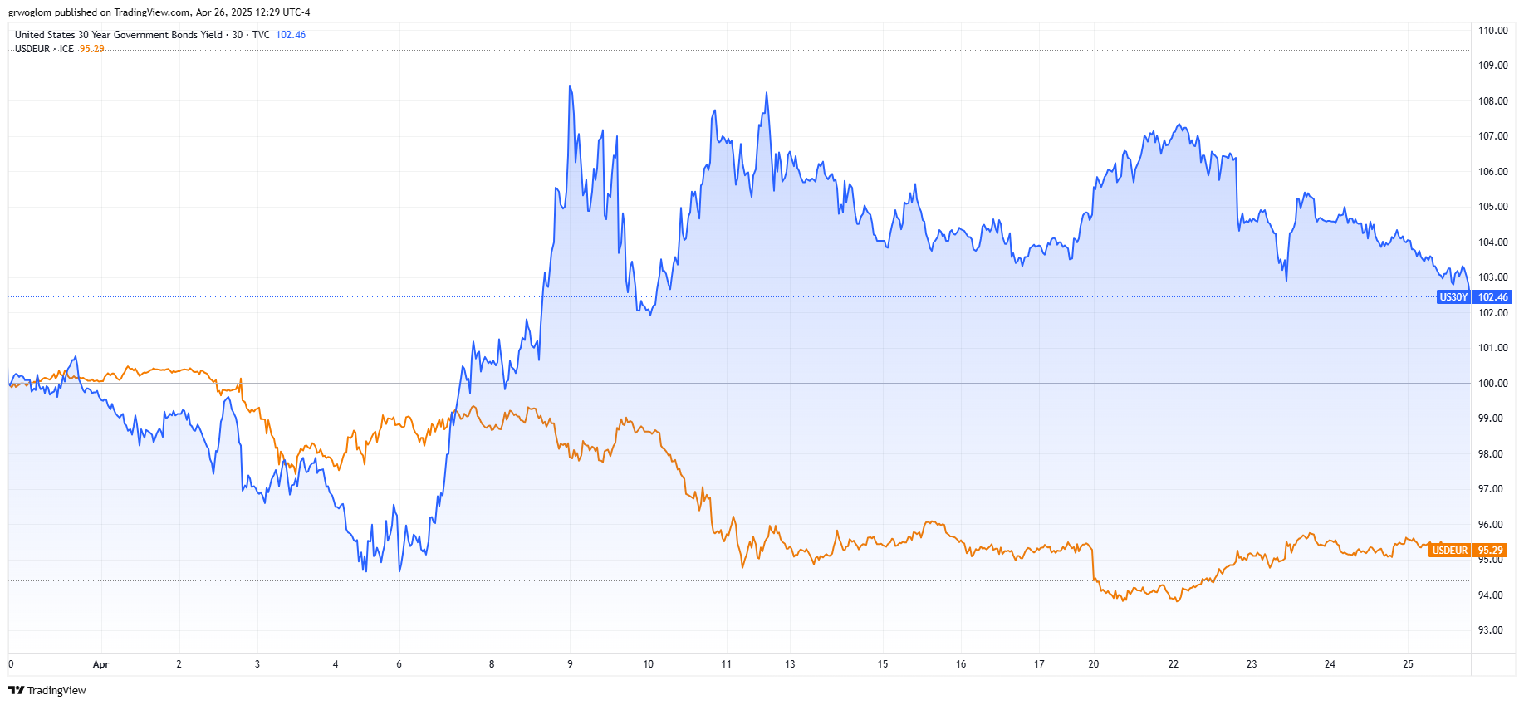
Limitations & Ominous Mystery
How do you estimate Effects of Policy Changes that haven’t been seen in nearly 100 years?
Wait a Minute. Tariffs were supposed to raise the value of the dollar
Liberation Day

Slide 73
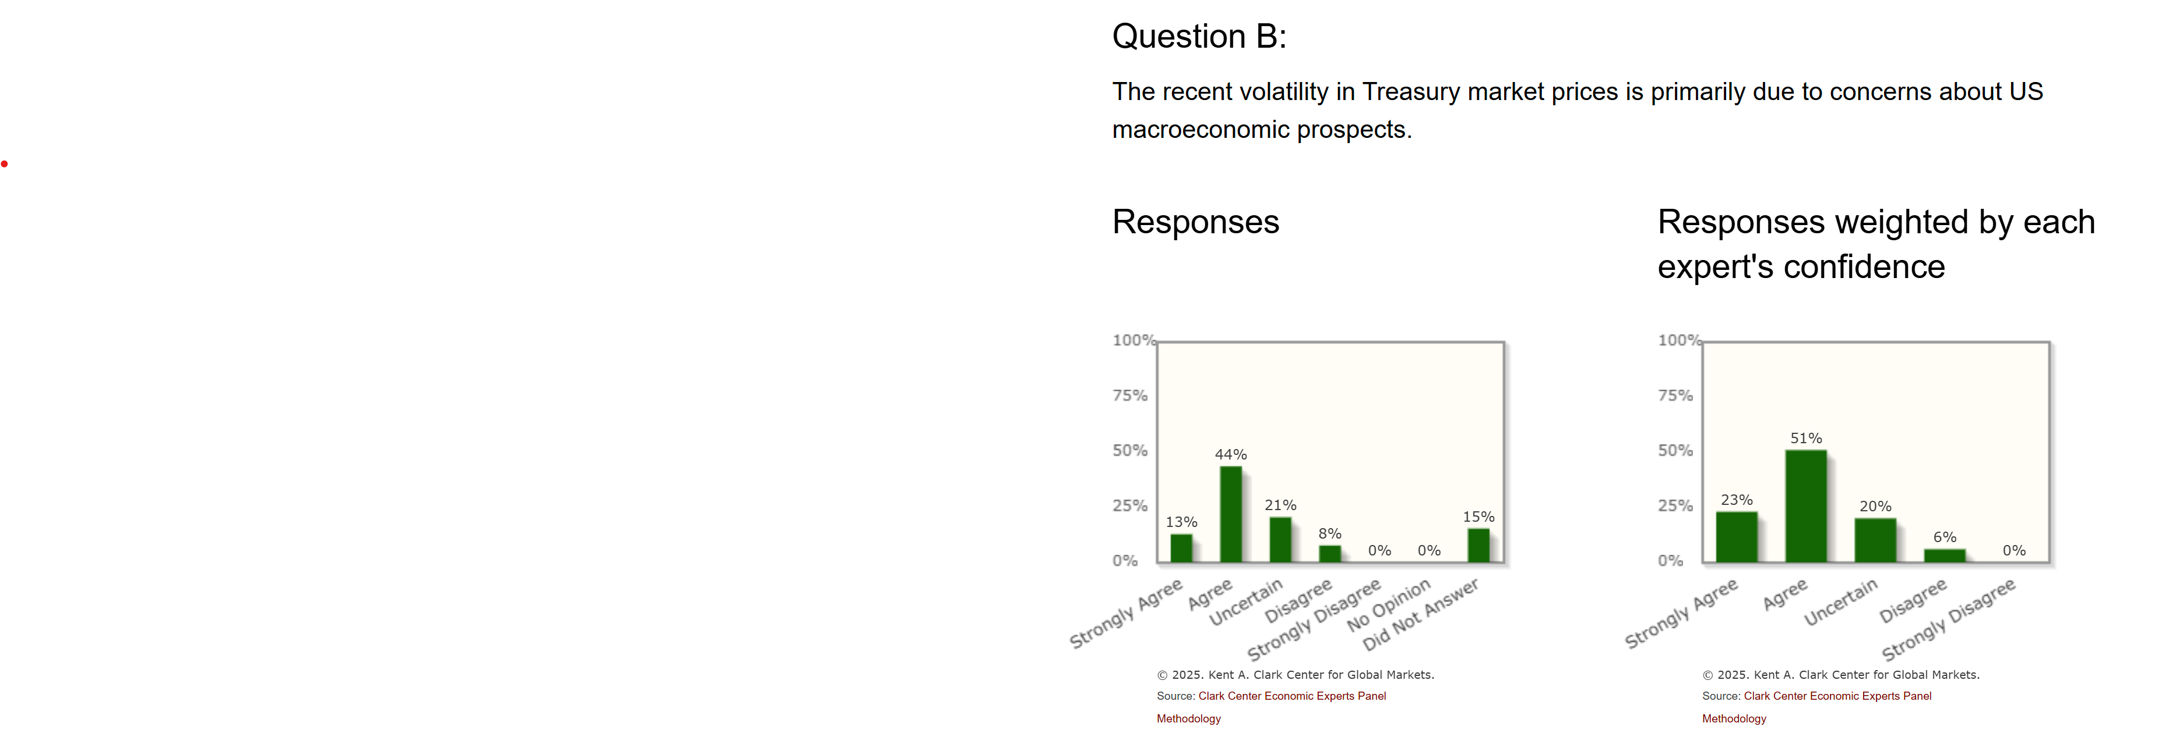
Interpreting Those Signals

Slide 74
Key Takeaways on Tariffs and Trade Deficits
Trade Deficits occur when National Saving is less than investment.
Tariffs had been falling from 1947 and were still quite low.
Trade deficits that reflect a countries productive investment opportunities are good.
China Shock (2001-2011) showed that not all expansions of trade are beneficial.
The way to reduce the trade deficit is to increase national saving.
Trump tariffs will hurt the poor relatively the most.
Financial Markets are Flashing Warning Signals.

Slide 75
My Google Site
https://sites.google.com/view/macro-current-issues/economic-update

Slide 76
Next Week: The Federal Debt is Becoming A Problem

Slide 77
Let’s Hear from You!
Geoffrey Woglom grwoglom@amherst.edu
Contact NEED: Info@NEEDEcon.org
Support NEED: www.NEEDEcon.org/donate.php

