Slide 1
Osher Lifelong Learning Institute, Summer 2022
Contemporary Economic Policy
University of Wisconsin, Milwaukee
July, 2022
Host: Jon Haveman, Ph.D.
National Economic Education Delegation

Slide 2
National Economic Education Delegation
Vision
  One day, the public discussion of policy issues will be grounded in an accurate perception of the underlying economic principles and data.
Mission
  NEED unites the skills and knowledge of a vast network of professional economists to promote understanding of the economics of policy issues in the United States.
NEED Presentations
  Are nonpartisan and intended to reflect the consensus of the economics profession.

Slide 3
Who Are We?
Honorary Board: 54 members
  2 Fed Chairs: Janet Yellen, Ben Bernanke
  6 Chairs Council of Economic Advisers
    Furman (D), Rosen (R), Bernanke (R), Yellen (D), Tyson (D), Goolsbee (D)
  3 Nobel Prize Winners
    Akerlof, Smith, Maskin
Delegates: 651+ members
  At all levels of academia and some in government service
  All have a Ph.D. in economics
  Crowdsource slide decks
  Give presentations
Global Partners: 49 Ph.D. Economists
  Aid in slide deck development

Slide 4


Where Are We?

Slide 5
Available NEED Topics Include:
Healthcare Economics
US Economy
Climate Change
Economic Inequality
Economic Mobility
Trade and Globalization
Minimum Wages
Immigration Economics
Housing Policy
Federal Budgets
Federal Debt
Black-White Wealth Gap
Autonomous Vehicles
US Social Policy

Slide 6
Course Outline
Contemporary Economic Policy
  Week 1 (7/14): Economic Update (Geoffrey Woglom, Amherst College)
  Week 2 (7/21): Trade and Globalization (Alan Deardorff, University of Michigan)
  Week 3 (7/28): Climate Change Economics (Sarah Jacobson, Williams College)

Slide 7

Trade: Bicycle Supply Chain
Source: World Development Report 2020

Slide 8
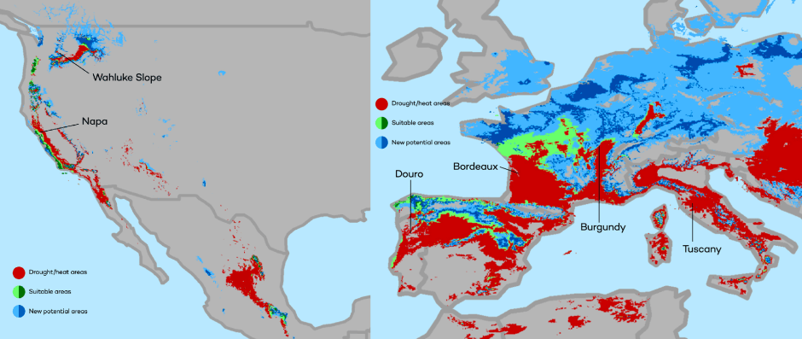
Climate Change Economics
The changing map of the world’s wine-growing regions.

Slide 9
Submitting Questions
Please submit questions of clarification in the chat.
  I will try to handle them as they come up.
We will do a verbal Q&A once the material has been presented.
OLLI allowing, we can stay beyond the end of class to have further discussion.
Slides will be available from the NEED website tomorrow (https://needelegation.org/delivered_presentations.php)

Slide 10
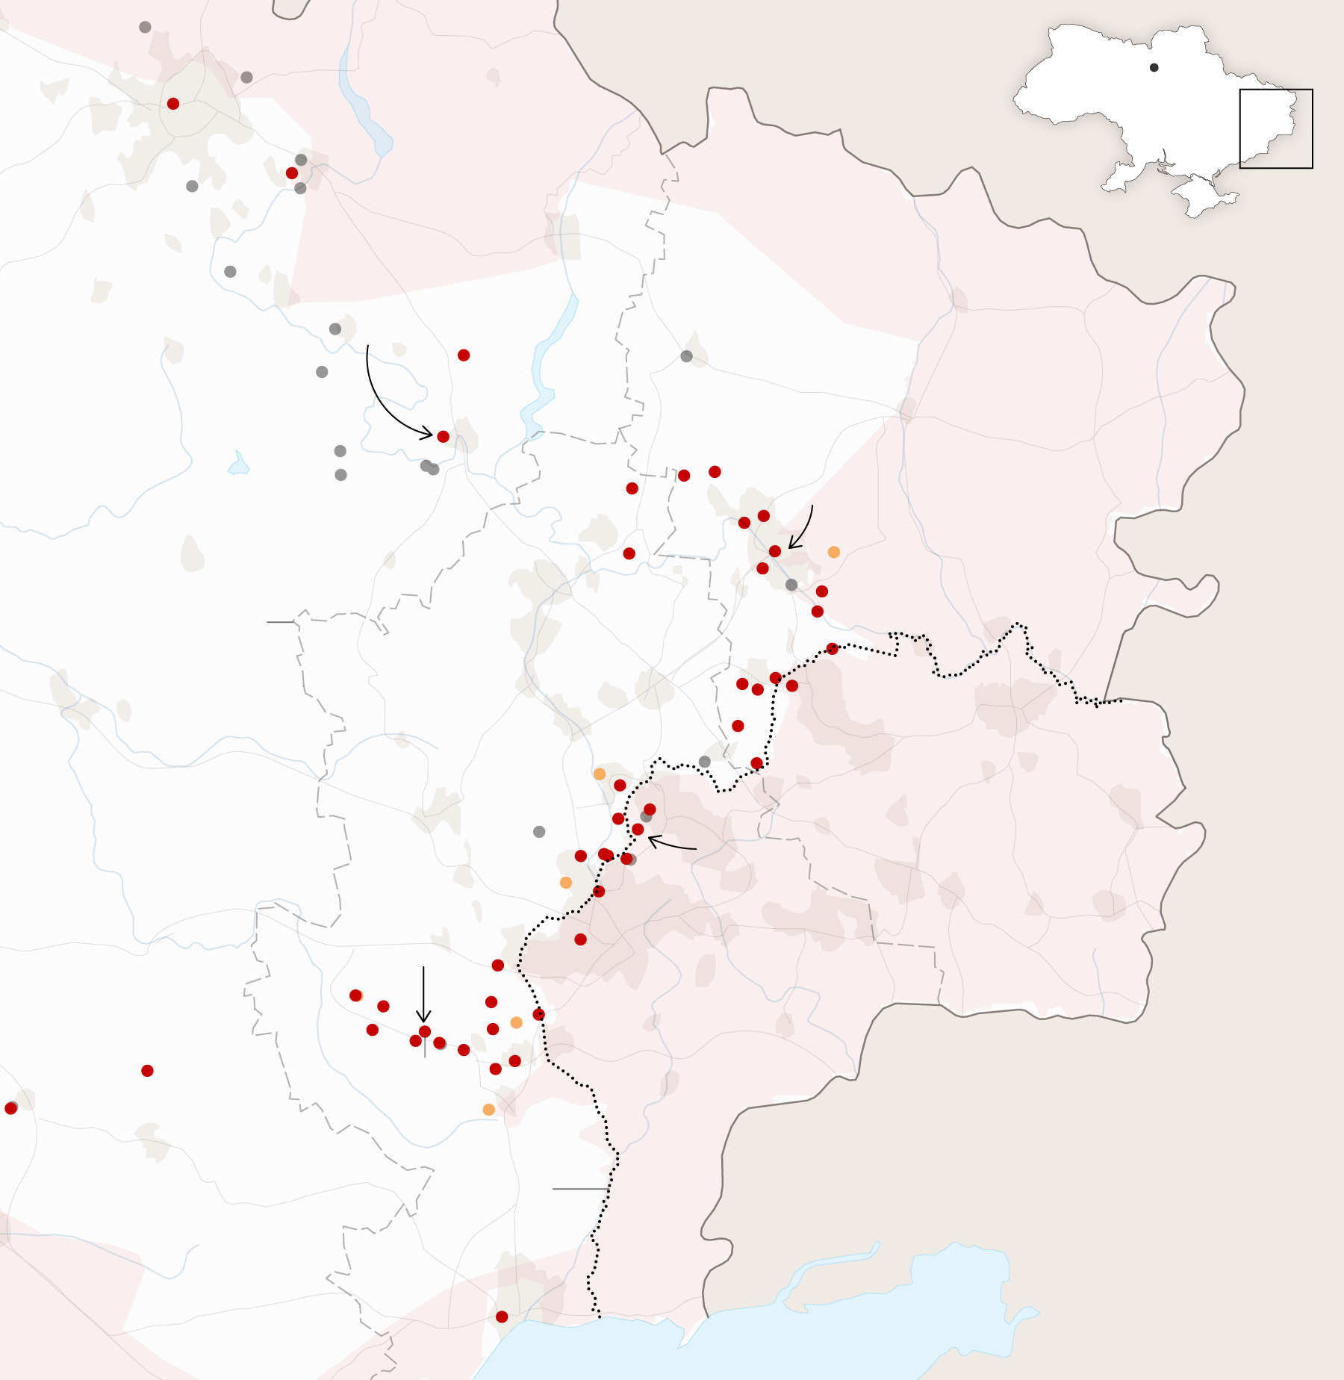
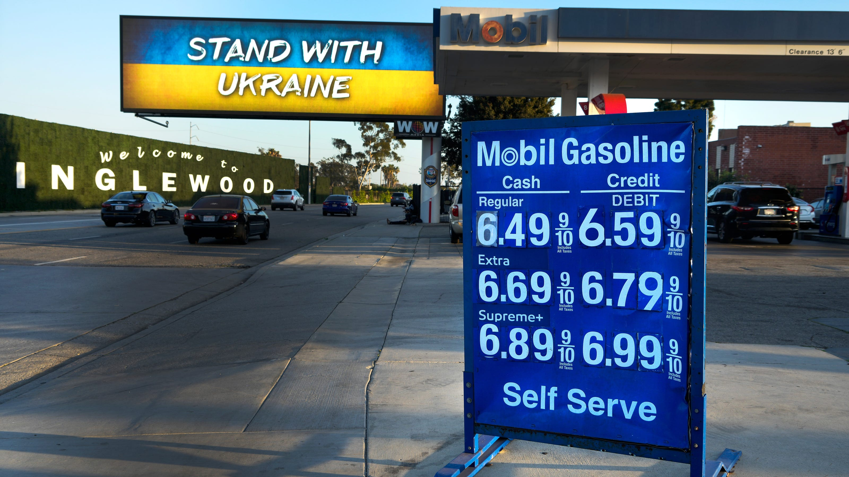
US Economy: Update
Geoffrey Woglom, Ph.D.
Amherst College, emeritus
July 8, 2022

Slide 11
Outline for the Talk
Quick summary of the state of the economy.
Closer look at inflation and whose to blame (in my opinion).
Current confusion on the state of the economy.
What’s at stake in controlling inflation.
Brief thoughts on the effects of the Ukraine crisis. (if there is time)

Slide 12
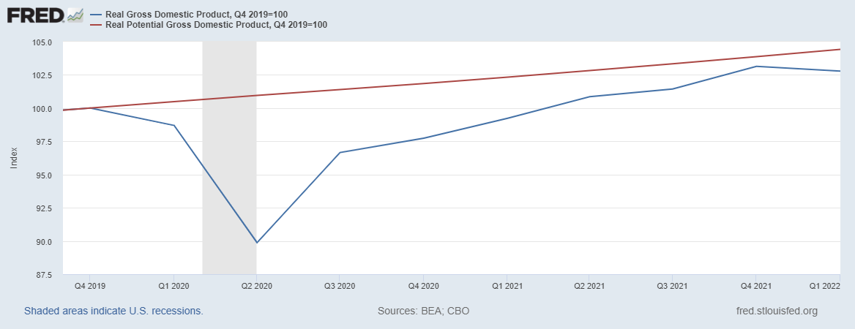
Real GDP and ‘Potential’ during the Recovery
The “output gap” is less than $300b
89.9
Source: Fred, St Louis Fed
Notes:
Point Out that the recover is slowing

Slide 13
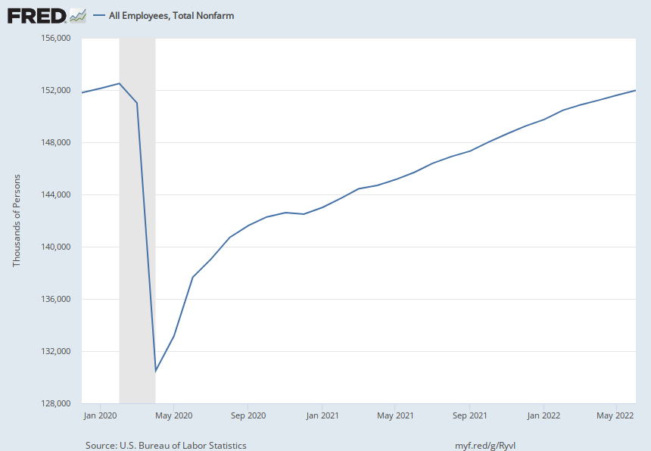
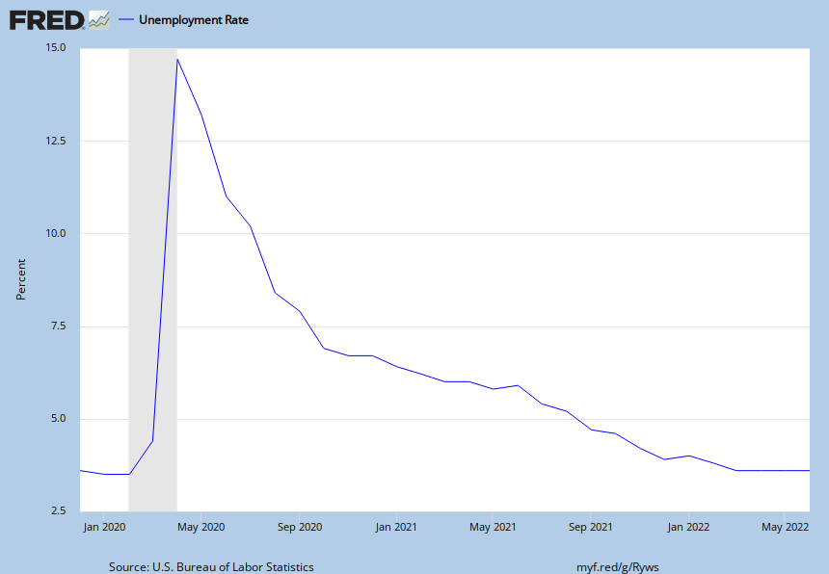
Labor Market is Almost Fully Recovered
Down 600 thousand
Up 0.1 pct points

Slide 14
Where Have all the Workers Gone?
Notes:
Women and Older Workers

Slide 15
Fiscally Driven Recovery

Slide 16
Households Lead the Way
Saving
Consumption Higher than Pre-pandemic, but Savings up, about $2.2 trillion

Slide 17

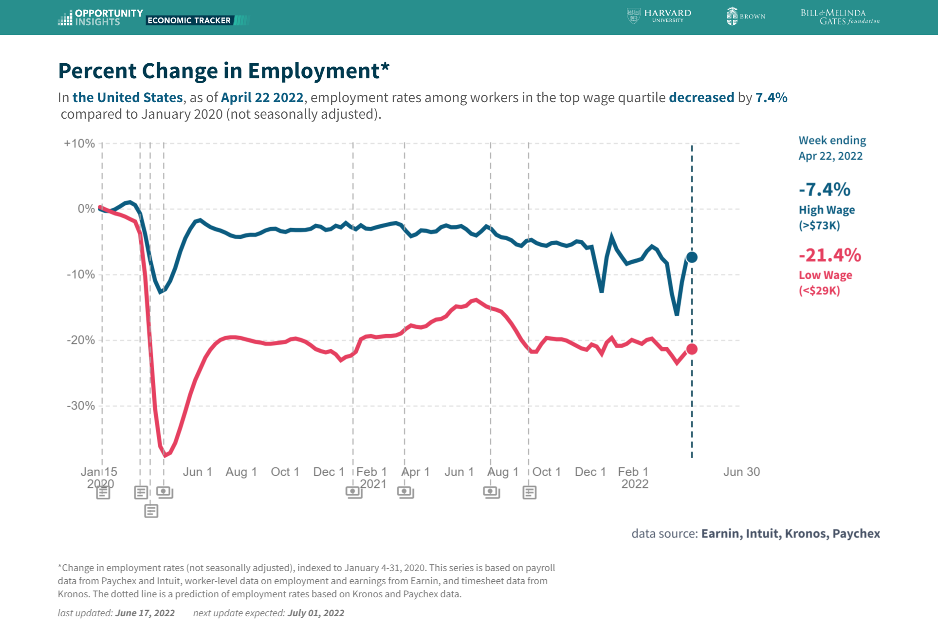

Slide 18

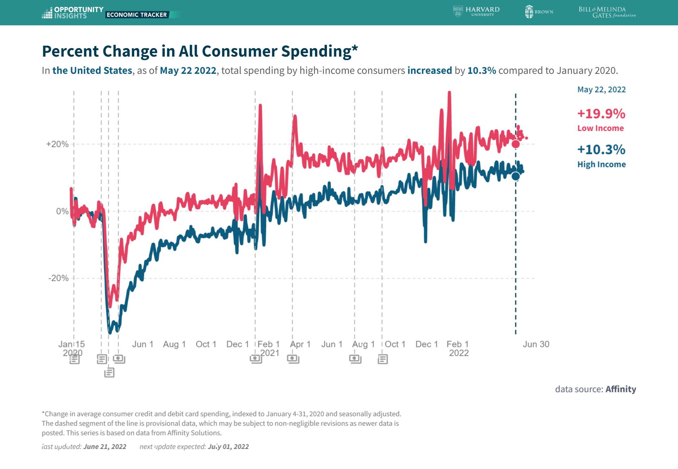
Stimulus Payments Saved Low Wage Workers

Slide 19
Inflation during the Recovery
Notes:
March 22 is 5 percent above Fed’s ideal

Slide 20
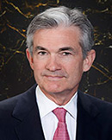
Stabilizer in Chief: the Fed
The Fed’s Dual Mandate:
  “Stable prices” which means 2% rate of inflation in the Personal Consumption Price Index (which corresponds to about 2.5% inflation in the more well-known CPI).
  “Maximum employment” which means the highest level of employment (lowest unemployment rate) consistent with mandate 1.
Fiscal Policy (taxes and spending, President and the Congress) can affect inflation and unemployment, but it is the Fed’s job to achieve the dual mandate
Jerome Powell
February 2018
Notes:
Define inflation as the rate of increase in the average level of prices not gasoline price inflation. Exceptions Deep Recesssions. ARP we will talk about later.

Slide 21
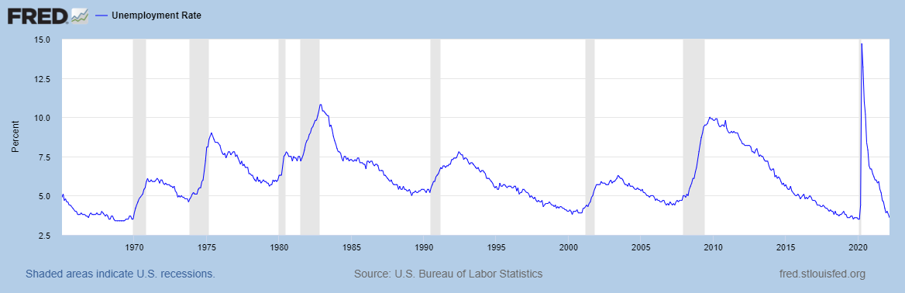
Track Record on Unemployment
Shaded Bars are Recessions
Shaded Bars are Recessions

Slide 22
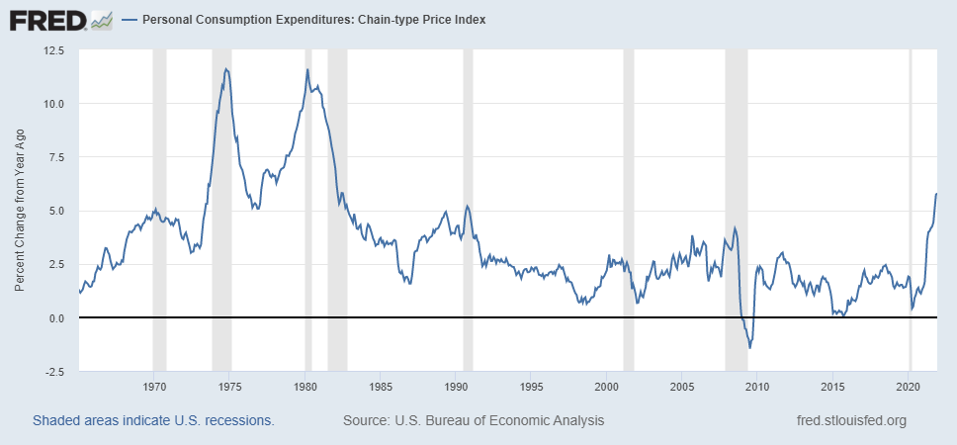
Track Record on “Price Stability”
Notes:
Shaded lines are recessions . 1970S THE Great Moderation

Slide 23
Determinants of Unemployment & Inflation
Unemployment: The higher the level of total spending, the lower the unemployment rate.
Inflation:
  Too much spending and inflation rises (Vietnam).
  Increase in production costs (e.g., “supply chain bottlenecks.”)
  Expectations of high inflation can cause inflation to be high.
Notes:
Slides 21 and 22, then back to 24

Slide 24
The Fed’s Affects the Economy via Interest Rates
Higher Interest rates discourage firms from buying new plant and equipment, households from buying new homes and tend to lower stock and house prices (!).
Reduced spending tends to lower production and employment and eventually lowers inflation.

Slide 25
Become a Central Banker in One Slide!
If you are more concerned that inflation is too high, raise interest rates.
If you are more concerned that unemployment is too high, lower interest rates.
Inflation and unemployment just right: keep rates the same.

Slide 26
One Big Complication: Lags
Milton Friedman: Monetary Policy affects GDP and Inflation with Long and Variable (Unpredictable) Lags.
Raising interest rates today does nothing to spending today nor to inflation.
But over time spending slows and eventually inflation falls.
Friedman believed that lags led to the Fed to “oversteering” the economy consistently.

Slide 27
The Great Moderation
From 1990 until 2008, the performance of the US economy was extraordinary and even Milton Friedman gave kudos to the Alan Greenspan.
We (economist) thought we knew why: Central Bankers finally listened to us on the importance of stabilizing inflationary expectations, starting with Paul Volcker.
Volcker was determined to reduce inflationary expectations.
Notes:
Back to slide 24 and then on to 30

Slide 28
“Anchoring” Inflation Expectations
Forecasts: Philadelphia Fed, “Survey of Professional Forecasters”
Notes:
Livingston Survey. 75-78. Unemployment 7% and 6% inflation. Look at the stability in the post 2001 period and the 2003-2005 period

Slide 29
But, this Inflation is Different!
12-month, percentage price increase, selected items in the CPI
Category: | Weight in CPI, 2022 | December 1981 | June 2022
All Items | 100% | 8.9 | 9.1
Services | 60.1 | 13.0 | 6.2
Commodities | 40.0 | 6.0 | 13.6
Housing | 41.9 | 10.2 | 7.3
Transportation | 18.9 | 11.0 | 19.7
Food | 14.3 | 4.3 | 13.4
Medical Care | 8.4 | 12.5 | 4.5
Energy | 8.3 | 11.9 | 41.6
New Cars | 4.0 | 6.8 | 11.4
Sources: BLS and Fred data from the St Louis Federal Reserve Bank

Slide 30
My Diagnosis for the Uptick in Inflation
Yes, there were supply chain issues that affected some areas in particular (e.g., computer chips).
But there is too much total spending and in the absence of bold Fed actions is likely to continue.
Fiscal stimulus led households to increase saving over 2021 by more than $2 trillion and today’s strong retail sales numbers suggest they are prepared to spend it.
Whose to Blame: ARP probably too big, but the Fed could have acted sooner.

Slide 31
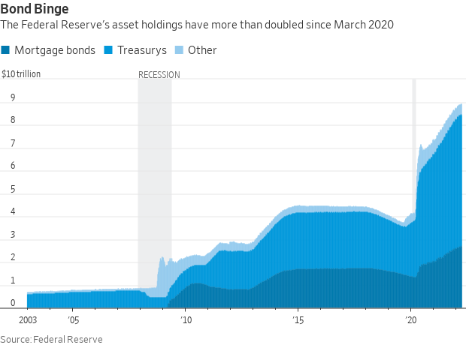
Fed Policy during the Recovery
Zero interest rates until March and a Big QE program
Notes:
25% of marketable Federal Debt; 15 percent of mortgages

Slide 32
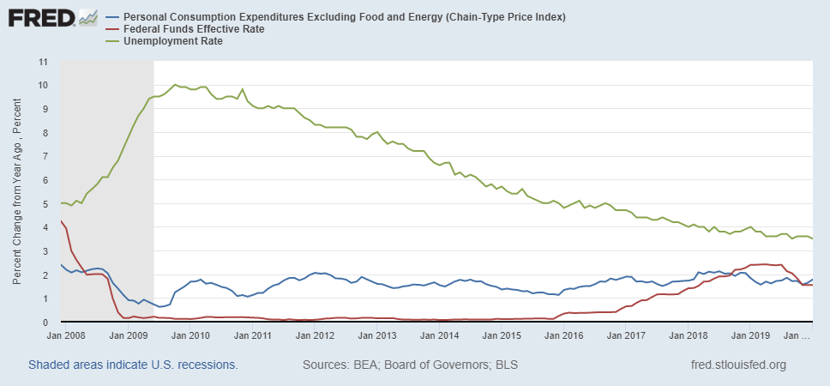
Why Did Powell Do It?
Powell Replaces
Yellen as Chair
Notes:
On average inflation is less than 2% And Fred raises rates before inflation exceeds 2.%. But, very credible. Latest tightening was begun before Powell became Chair. Tightening is very gradual 1.5 pct pts in 2 years.

Slide 33
Policy Changes under Powell
In the Fed’s dual mandate put more emphasis on the employment goal relative to the inflation goal.
Inflation goal switched from targeting forecasted future inflation to trying to achieve average realized inflation of 2%
Have they forgotten about Lags!
Notes:
Description of Policy goals reversed the order of the inflation and employment objectivesw

Slide 34
But, Boy Have Things Changed!
Powell’s Wakeup Moment
"Surveys of Consumers,” University of Michigan, ©

Slide 35
Three Increases in 3 Meetings
Notes:
25, 50 and 75 with more to come

Slide 36
Reality sets in at the FOMC, June Meeting
Good Luck with these Forecasts!

Slide 37
FOMC Minutes from June Meeting
Members judged that, with high and widespread inflation pressures and some measures of longer-term inflation expectations moving up somewhat, it would be appropriate for the postmeeting statement to note that the Committee was strongly committed to returning inflation to its 2 percent objective. As the further firming in the policy stance would likely result in some slowing in economic growth and tempering in labor market conditions, members also agreed to remove the previous statement language that had indicated an expectation that appropriate policy would result in a return of inflation to 2 percent and a strong labor market.

Slide 38
And, There is More!

Slide 39
More Reality on Wall Street Too
WSJ, Survey of Professional Forecasters, June (medians)
 | 2022 | 2023
CHANGE IN REAL GDP | 1.3 | 1.4
APRIL | 2.6 | 2.4
UNEMPLOYMENT | 3.7 | 4.2
APRIL | 3.4 | 3.6
INFLATION (CPI) | 7.0 | 3.3
APRIL | 4.8 | 2.8
FEDERAL FUNDS RATE | 3.3 | 3.5
APRIL | 2.0 | 2.7

Slide 40
Fed and Wall Street Forecasters are Similar
By 2023, inflation will come down substantially.
The federal funds rate will stay below 4 percent.
Unemployment will rise less than 0.5 percentage points.
I don’t get it. This scenario only works if most of inflation is due to supply issues and expectations of inflation are “well anchored,” so that the Fed achieves a “soft landing.”

Slide 41
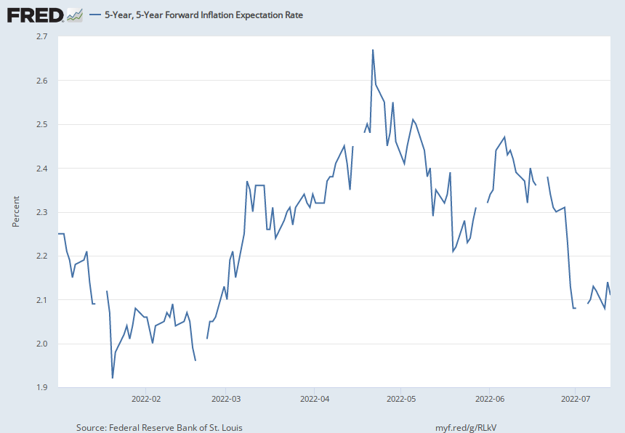
Financial Markets on the Expectations Story

Slide 42
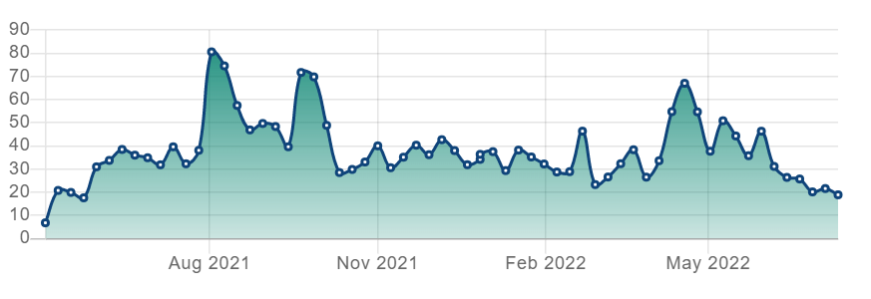
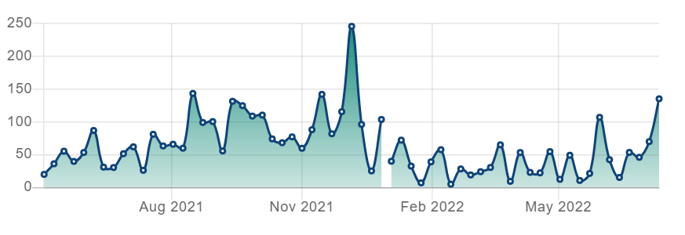
Port Delays are Getting Back to Normal
Shanghai
Long Beach
https://insights.spire.com/maritime/

Slide 43
Supply Shocks Easing
https://markets.businessinsider.com/

Slide 44
But Wall Street is also Worried about Recession

Slide 45
First, What is a Recession?
Defined by the National Bureau of Economic Research (NBER)
“The NBER's definition emphasizes that a recession involves a significant decline in economic activity that is spread across the economy and lasts more than a few months.”
Popular Rule of Thumb: Two or more, consecutive quarters where Real GDP falls.
Recessions are caused by decreases in total spending.

Slide 46
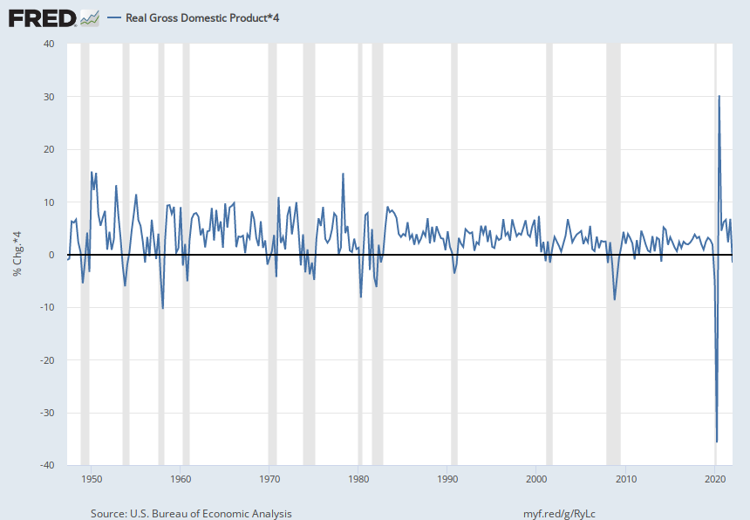
Real GDP Growth and Recessions
Atlanta Fed’s GDPNow estimate of second quarter GDP growth is -1.2%!
Notes:
Define natural 3 episodes. Great Moderation

Slide 47
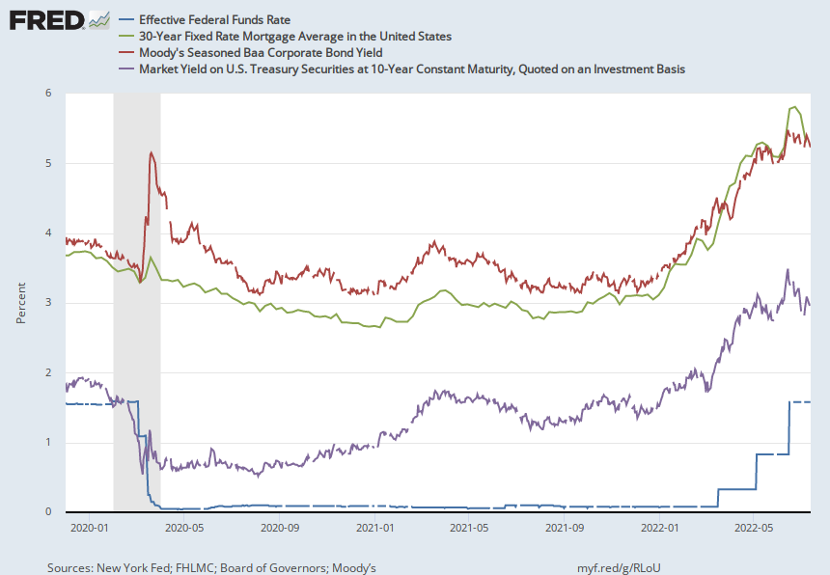
The Case for Recession: Long-term Rates?
Notes:
But the recent fall in rates implies financial markets will start to lower rates or at least not raise them as much

Slide 48
The Case for Recession: Consumers are Worried
"Surveys of Consumers,” University of Michigan ©

Slide 49
June Employment Report?
Household Survey:
  315 thousand fewer people employed.
  350 thousand people dropped out of the labor force.
Firm or Establishment Survey:
  370 thousand more jobs created in June.
  Consensus estimate was 265 thousand
Are you confused?
I am

Slide 50
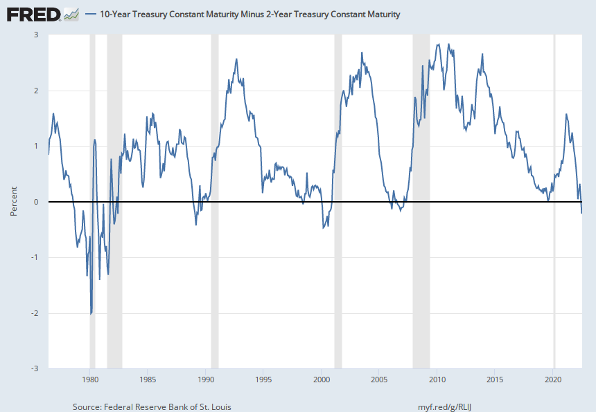
The Fed is Over Doing Rate Increases!
“Inverted Yield Curve”

Slide 51
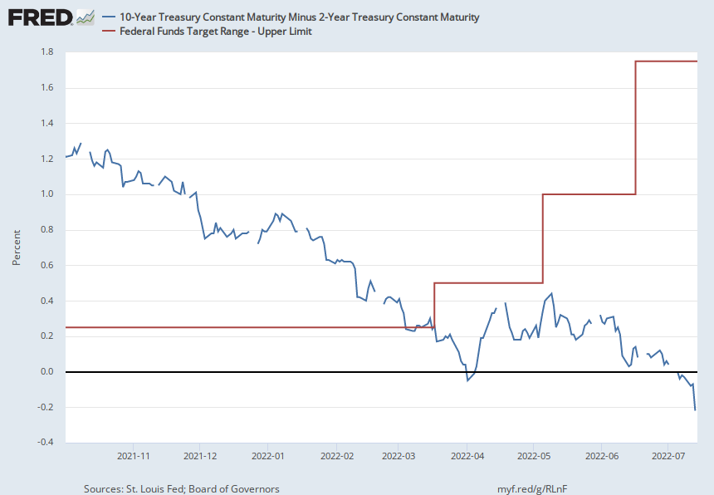
A Closer Look

Slide 52
Bloomberg Headline July 13
Fed Could Weigh Historic 100 Basis-Point Hike After Inflation Scorcher
Futures show one-in-two chance of super-sized July move
75 basis points now also in play for Fed’s September meeting

Slide 53
So, What Will it Be?
Darned if I know.
The Fed will have a very difficult choice
Keep interest rates high(in an election year) to slow inflation
  causing a recession recovery.
  disrupting financial markets.
Don’t let rates rise too much cushioning the effect on employment
  avoids a recession (maybe).
  inflationary expectations become unanchored

Slide 54
The Conflict in Ukraine and the US Economy
Short run
  Uncertainty
  Increase in Cost of Food and Fuel
Long run
  Decrease in Globalization
  The Role of the Dollar as a International Reserve Currency.

Slide 55
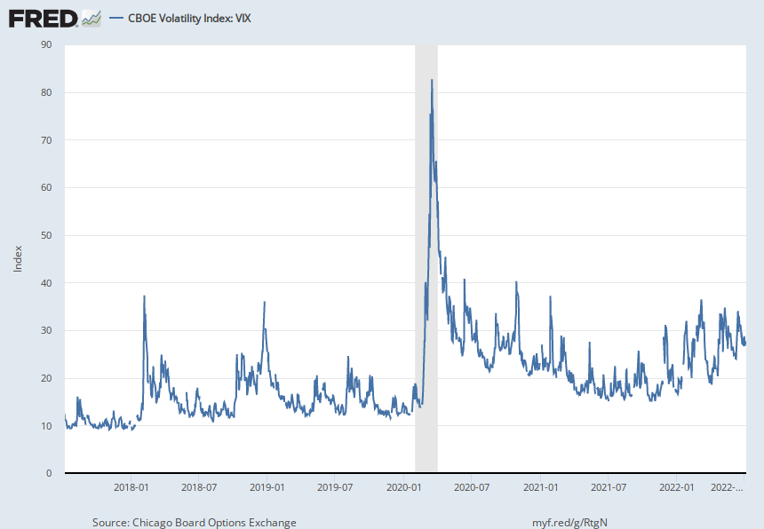
The Fear Index

Slide 56
Supply Shocks: Then and Now
Historical Oil Price
Source:'https://www.macrotrends.net/1369/crude-oil-price-history-chart'

Slide 57
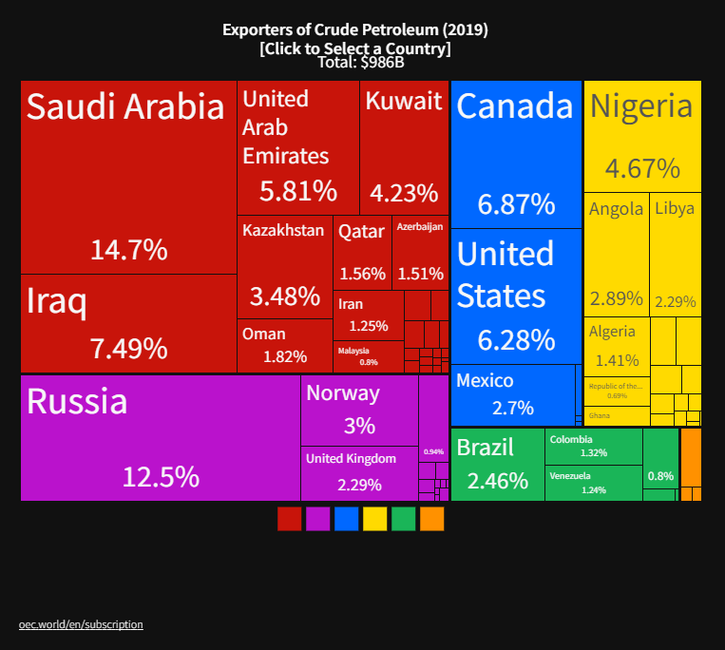
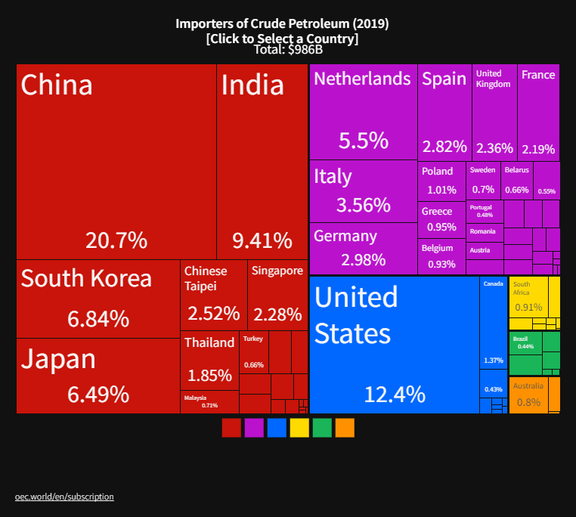
The Price of Oil is Likely to Stay High
Winners
Losers
Notes:
Since 2019 US has become a net exporter of oil

Slide 58
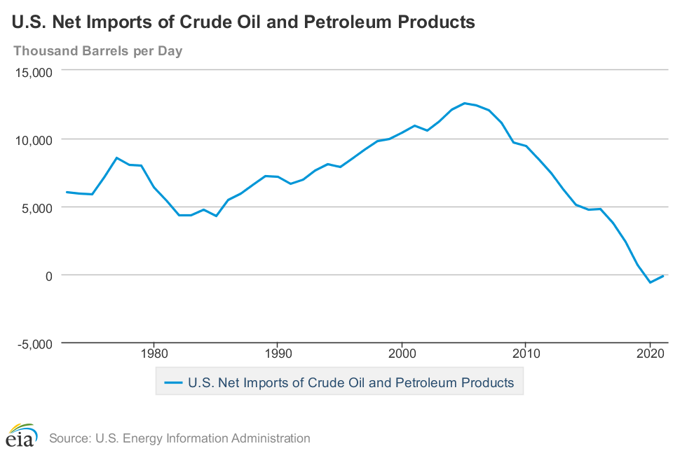
How Much Will the US be Hurt?
In the 1970s, the US as a whole was less wealthy when oil price went up.
Not now (fracking)
But, unless you own an oil well, you are likely to feel the pinch!

Slide 59
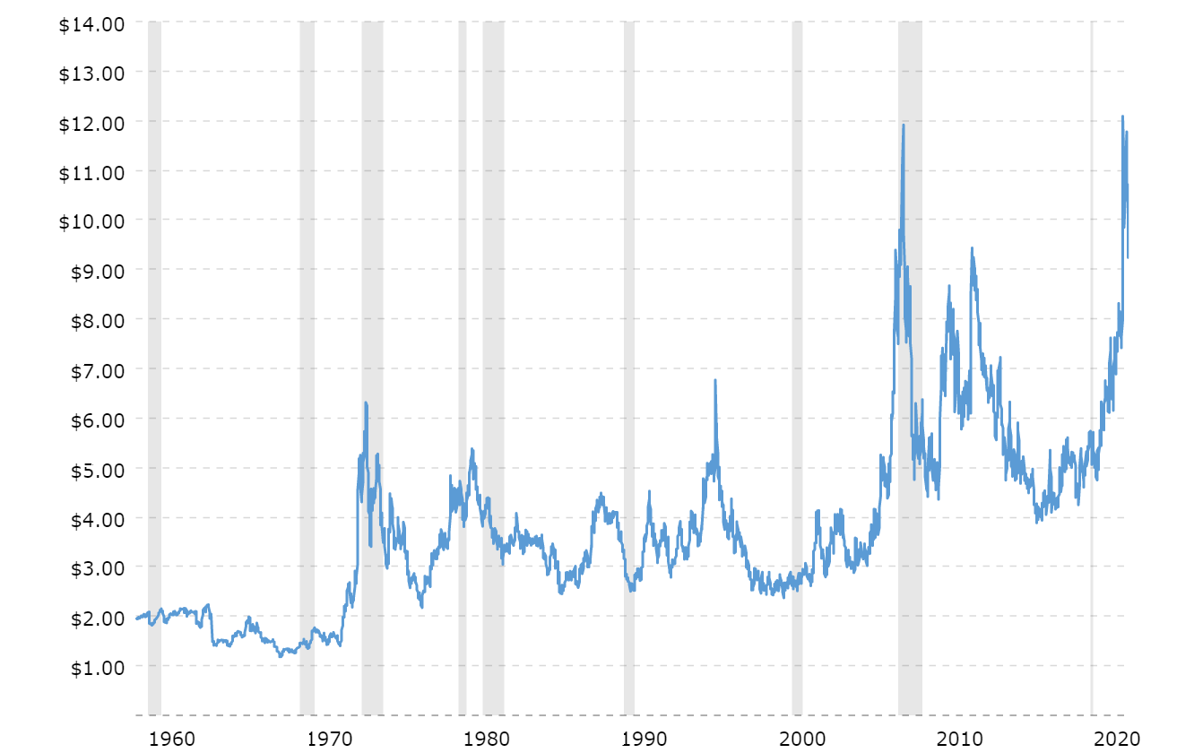
Wheat Prices Also Look Scary
Wheat Futures Prices
Source:'https://www.macrotrends.net/2534/wheat-prices-historical-chart-data'
Notes:
Recently have come down below $10

Slide 60
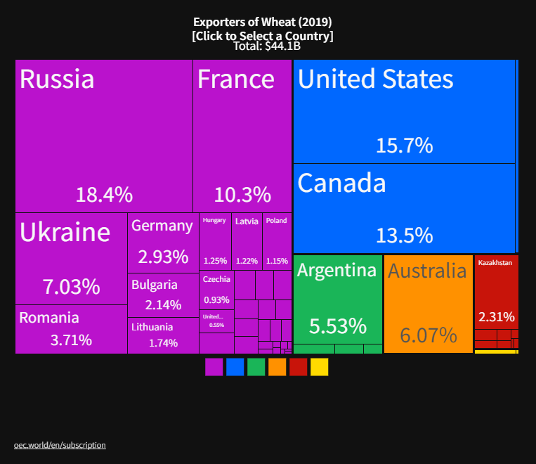
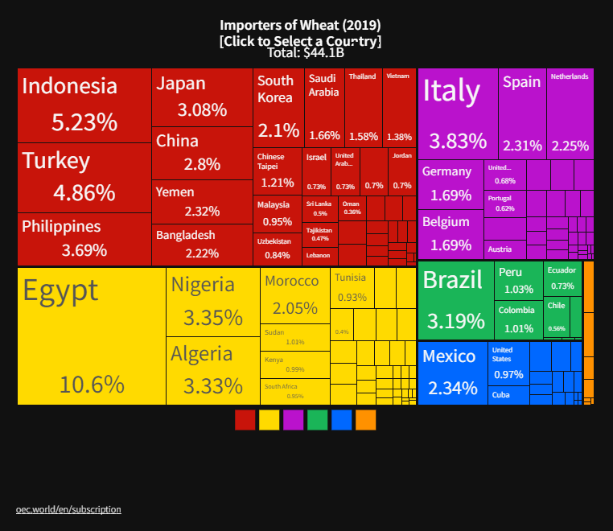
The Price of Wheat: Winners and Losers
Winners
Losers

Slide 61
Long-run Effects
Deglobalization to Protect Supply Chains.
New Developments to avoid-US imposed financial wars.
  China’s alternative to SWIFT
  Rise (or fall?) of crypto currencies
  The Dollar’s Role as a reserve Currency

Slide 62
Demand for Dollars by Central Banks
Source IMF Currency Composition of Official Exchange Reserves
Notes:
Talk about the fall of the Euro Brexit etc.

Slide 63
Trade: Alan Deardorff, University of Michigan
Source: World Development Report 2020

Slide 64
Questions?
www.NEEDelegation.org
Geoffrey Woglom
grwoglom@amherst.edu
Contact NEED: Info@NEEDelegation.org
Submit a testimonial: www.NEEDelegation.org/testimonials.php
Support NEED: www.NEEDelegation.org/donate.php

Slide 65
www.NEEDelegation.org/LocalGraphs
For every state and county in the United States.
Detailed graphs on employment, housing, moves, and other statistics.

