Slide 1
Osher Lifelong Learning Institute, Winter 2023
Contemporary Economic Policy
University of Vermont
February-March, 2023
Host: Jon Haveman, Ph.D.
National Economic Education Delegation

Slide 2
National Economic Education Delegation
Vision
One day, the public discussion of policy issues will be grounded in an accurate perception of the underlying economic principles and data.
Mission
NEED unites the skills and knowledge of a vast network of professional economists to promote understanding of the economics of policy issues in the United States.
NEED Presentations
Are nonpartisan and intended to reflect the consensus of the economics profession.

Slide 3
Who Are We?
Honorary Board: 54 members
2 Fed Chairs: Janet Yellen, Ben Bernanke
6 Chairs Council of Economic Advisers
Furman (D), Rosen (R), Bernanke (R), Yellen (D), Tyson (D), Goolsbee (D)
3 Nobel Prize Winners
Akerlof, Smith, Maskin
Delegates: 652+ members
At all levels of academia and some in government service
All have a Ph.D. in economics
Crowdsource slide decks
Give presentations
Global Partners: 48 Ph.D. Economists
Aid in slide deck development

Slide 4
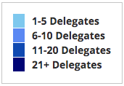
Where Are We?

Slide 5
Available NEED Topics Include:
US Economy
Healthcare Economics
Climate Change
Economic Inequality
Economic Mobility
Trade and Globalization
Minimum Wages
Immigration Economics
Housing Policy
Federal Budgets
Federal Debt
Black-White Wealth Gap
Autonomous Vehicles
Healthcare Economics

Slide 6
Course Outline
Contemporary Economic Policy
Week 1 (3/9): US Economic Update (Scott Baier, Clemson University)
Week 2 (3/16): Trade and Globalization (Alan Deardorff, Univ. Michigan)
Week 3 (3/23): Trade Deficits and Exchange Rates (Alan Deardorff)
Week 4 (3/30): Cryptocurrencies (Jon Haveman, NEED)

Slide 7
Real Gross Domestic Product: 1949 – 2007

Slide 8
Real Gross Domestic Product: 1949 – 2022

Slide 9
Real Gross Domestic Product
Source: Bureau of Economic Analysis

Slide 10
Real Gross Domestic Product
Two-quarters of negative growth
2022:Q1 and 2022:Q2
Source: Bureau of Economic Analysis

Slide 11
Real Gross Domestic Product
Source: Bureau of Economic Analysis

Slide 12
Growth by Sector: US and Vermont
Pre-pandemic

Slide 13
Real GDP Growth

Slide 14
Real GDP Growth

Slide 15
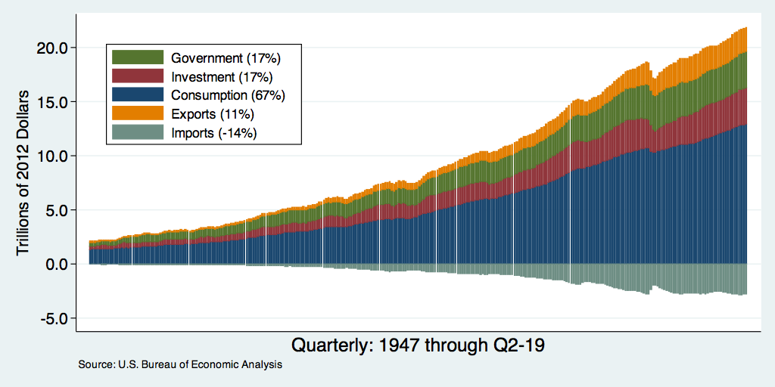
Composition and Contribution of Real GDP
Notes:
Components sum to GDP
Average % of GDP for each component from 1960-Present: C = 64%, I=15%, G=24%, NX = 2% (X = 7%, M=9%)
Net Exports as a % of GDP has increased over the sample period, but it’s contribution to GDP is relatively small

Slide 16
Understanding Contributions to GDP Growth
GDP Growth is a combination of the growth in its components:
Consumption, Investment, Government, and Net Exports
It’s a weighted average of these components
For example: Consumption
If consumption accounts for 2/3 of the economy,
If consumption grew by 3%,
It implies that consumption growth accounts for 2 percentage points of GDP growth; that is, $2\%=\left(\frac{2}{3}\right)∗3\%$.

Slide 17
Consumption Contributions to GDP Growth

Slide 18
Personal Consumption Expenditures

Slide 19
Disposable Income and Consumption
Disposable Income
Consumption

Slide 20
Real Retail Sales and Food Service Sales
Retail Sales, Adjusted for Inflation
Is 14% higher than at the start of the pandemic

Slide 21
Excess Savings
Peaked at $2 Trillion

Slide 22
Goods and Service Consumption
Service spending is up 3 percent
Compared to pre-dpandemic
Goods consumption is up 15%
compared to pre-pandemic

Slide 23
Investment Spending’s Contribution
Recessionm

Slide 24
Investment Spending:
Investment includes the:
purchase of plants machines and equipment,
changes in business Inventories,
and residential investment
The drivers of each of these components are different.

Slide 25
Real Fixed Investment

Slide 26
ISM Manufacturing Index
Recession

Slide 27
ISM Manufacturing Index and Real GDP
Real GDP Growth

Slide 28
Inventory Contribution to GDP Growth
Inventory Investment is the most volatile component.
Inventories of intermediate inputs and finished products move quickly
JIT and JIC
Source: Bureau of Economic Analysis

Slide 29
Residential Investment Contribution to GDP Growth
Re-suburbanization
Home improvements

Slide 30
Mortgage Rates
Source: Bureau of Economic Analysis
Housing Starts Source: HUD

Slide 31
Housing Starts and Housing Completions
Completions
Starts

Slide 32
Net Exports and GDP Growth
Source: Bureau of Economic Analysis

Slide 33
Takeaways from GDP and Components
GDP growth has been supported by relatively strong consumption growth.
Consumption remains “tilted” toward goods rather than services
Consumers are spending through the excess savings that accumulated during the pandemic.
Investment spending
Higher mortgage rates will likely slow residential investment.
Fixed investment remains uncertain -- PMI index seems to indicate investment will slow.
Net Exports
Exports will depend on world GDP growth– if the GDP growth slows globally, it will likely reduce exports.

Slide 34
What is the Data Telling Us Now?
Fourth Quarter GDP was 2.89 percent!
Positive contributions from consumption
What happens with fixed business investment and residential investment is key.
Net exports and government expenditures contributed a modest amount as well.
Going forward
Depends on how difficult it is for the Federal Reserve to bring inflation down.
Also depends on supply-side factors like productivity growth and innovation
In the long-run, economic growth is driven by productivity growth, but it is difficult to project where and when the productivity growth is going to come from.

Slide 35
Unemployment
Source: Bureau of Labor Statistics

Slide 36
Employment
Source: Bureau of Labor Statistics

Slide 37
Employment: US and Vermont
Source: Bureau of Labor Statistics

Slide 38
Employment Changes in US
Source: Bureau of Labor Statistics

Slide 39
Job Losses: March and April 2020
Source: Bureau of Labor Statistics

Slide 40
Job Losses and Gains May 2020 and January 2023
Source: Bureau of Labor Statistics

Slide 41
Employment Growth: Vermont and US

Slide 42
Openings and Hires
Openings
Hires
Data in 1,000s

Slide 43
Job Separations and Job Hires
Hires
Separations

Slide 44
Quits and Layoffs
Quits
Lay-offs
Data in 1,000s

Slide 45
Employment Levels (By Age)
35-44 year-olds
25-34 year-olds

Slide 46
Employment Changes by Age Group

Slide 47
Wages and Unemployment

Slide 48
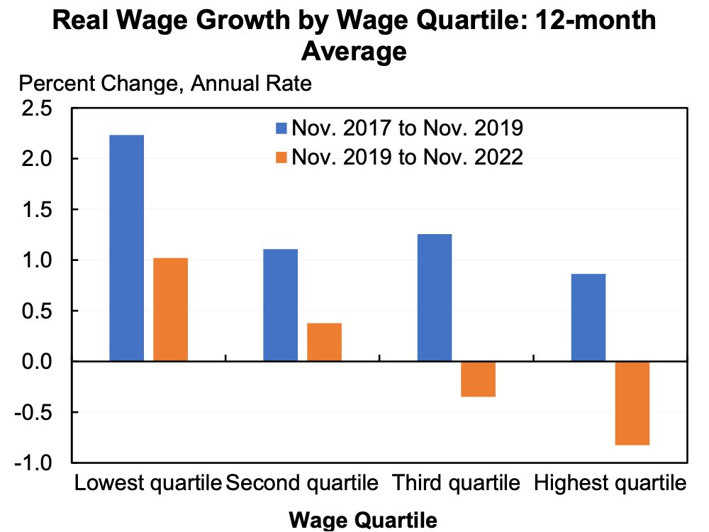
Wage Growth Adjusted for Inflation

Slide 49
Employment Situation
Employment: Economy continues to add jobs (January added 517k)
The challenge has been for employers to fill vacancies.
Why?
Extended (or expected continuation) unemployment benefits and other stimulus payments
Workers reluctant to work in certain industries and occupations
Workers looking for different career opportunities.
Workers looking for better employment opportunities withing their industry/occupation – non-pecuniary benefits
Increased desire to have the option to work from home.
Better working conditions
Recognition of accomplishments

Slide 50
Inflation
Inflation
less food and energy
Inflation
Source: Bureau of Labor Statistics

Slide 51
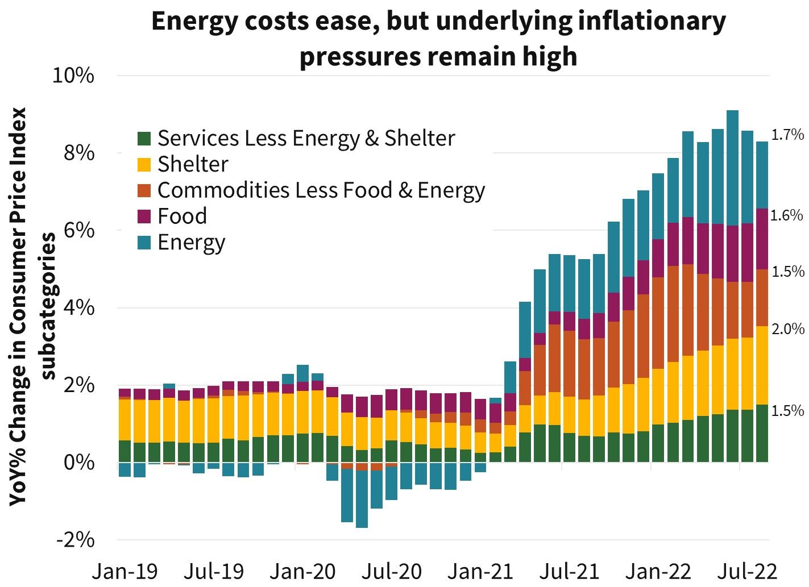
Source: BLS and Jason Furman

Slide 52
Global Supply (and Demand) Chains
Pressure seems to be easing but it is still above pre-pandemic levels
Source: New York Federal Reserve

Slide 53
Not all Supply Disruptions

Slide 54
Goods and Service Consumption

Slide 55
Percent Change in Goods and Service Prices
Goods Inflation
Service Inflation

Slide 56
Money Growth: M2 (Transactions Money)
6 percent

Slide 57
Inflation: Comparison
Inflation 1967-1977 (RHS)
Current Inflation

Slide 58
Inflation: Comparison
Inflation 1967-1983 (RHS)
Current Inflation

Slide 59
Inflation and Federal Funds Rate: 1967-1976
Inflation
Federal Funds Rate

Slide 60
Federal Funds Rate
The Federal Reserve will likely
increase the Federal Funds Target Rate
by 25 to 50 basis points next week.
In February, the Federal Reserve increased
increased the Federal Funds Target Rate
by 25 basis point.

Slide 61
Inflation Outlook
The inflation outlook is improved:
Falling commodity prices,
Supply chain improvements,
Higher interest rates cooling demand,
Reduction of the money supply.
Still issues – inflation has been very high in the last year.
Main question: How much lower does inflation have to go before the Fed takes off the breaks?

Slide 62
Is Inflation a Global Phenomenon?
Yes, but the sources may be different.
In terms of basic supply and demand …..
the price increases are supply-driven, we will see higher prices and lower quantities – negative supply shocks --> real GDP below trend.
If the price increases are demand-driven, we will see higher prices and higher quantities – positive demand shocks -> higher nominal GDP.
We can look at real GDP and Nominal GDP
If real GDP is at or above trend, demand shocks are likely to be more important.
If nominal and real GDP are above trend, it is likely the case that demand shocks are also more important.

Slide 63
Is Inflation a Global Phenomenon?
Why do we care?
If the shocks are demand-driven, it means that the government response (stimulus) to the pandemic is, at least, partially responsible for the higher inflation.
If the inflation is demand-driven, the Central Bank is better equipped to respond to higher demand than supply-side shocks.

Slide 64
Is Inflation a Global Phenomenon?
It looks like Supply shocks are more important in the EURO area
Source: BLS / FRED

Slide 65
Is Inflation a Global Phenomenon?
For the US it looks like demand shocks are more important

Slide 66
Takeaways
Economic Growth: The recovery has been a V-shaped recovery
The economic recovery should continue through 2022.
Atlanta Fed predicts US growth to be 3.8% in 2022:Q4
Tailwinds: Strong consumer demand (until excess savings are gone?)
Headwinds: Inflation, supply chain disruptions (?), rising commodity prices, labor market challenges
The labor market still faces some challenges
The unemployment rate is low.
We have just recently reached the pre-pandemic levels of employment.
In some (service) sectors, we have not reached pre-pandemic employment levels
Inflation: Can the Fed bring down inflation without sending the economy into a recession.
Political Uncertainty

Slide 67
Annualized Money Growth
Growth Rate of Money Stock (percent per year) | Beginning of Period | End of Period
6.15 | January 2000 | March 2020
37.3 | March 2020 | July 2020
12.44 | July 2020 | December 2021

