Slide 1
Osher Lifelong Learning Institute, Winter 2022
Contemporary Economic Policy
University of Southern Maine
January-February, 2023
Host: Jon Haveman, Ph.D.
National Economic Education Delegation

Slide 2
Course Outline
Contemporary Economic Policy
  Week 1 (1/10): Trade and Globalization (Alan Deardorff, Univ. Michigan)
  Week 2 (1/17): Trade Deficits and Exchange Rates (Alan Deardorff)
  Week 3 (1/24): US Economic Update (Geoffrey Woglom, Amherst College)
  Week 4 (1/31): Monetary Economics (Geoffrey Woglom)
  Week 5 (2/7): The Black-White Wealth Gap(Jon Haveman, NEED)
  Week 6 (2/14): Autonomous Vehicles (Jon Haveman)

Slide 3
Submitting Questions
Please submit questions of clarification in the chat.
  I will try to handle them as they come up.
We will do a verbal Q&A once the material has been presented.
Slides will be available from the NEED website tomorrow (https://needelegation.org/delivered_presentations.php)

Slide 4
Credits and Disclaimer
This slide deck was authored by:
  Jon D. Haveman, NEED
  Scott Baier, Clemson University
  Geoffrey Woglom, Amherst College (Emeritus)
  Brian Dombeck, Lewis & Clark College
  Doris Geide-Stevenson, Weber State
Disclaimer
  NEED presentations are designed to be nonpartisan.
  It is, however, inevitable that the presenter will be asked for and will provide their own views.
  Such views are those of the presenter and not necessarily those of the National Economic Education Delegation (NEED).

Slide 5
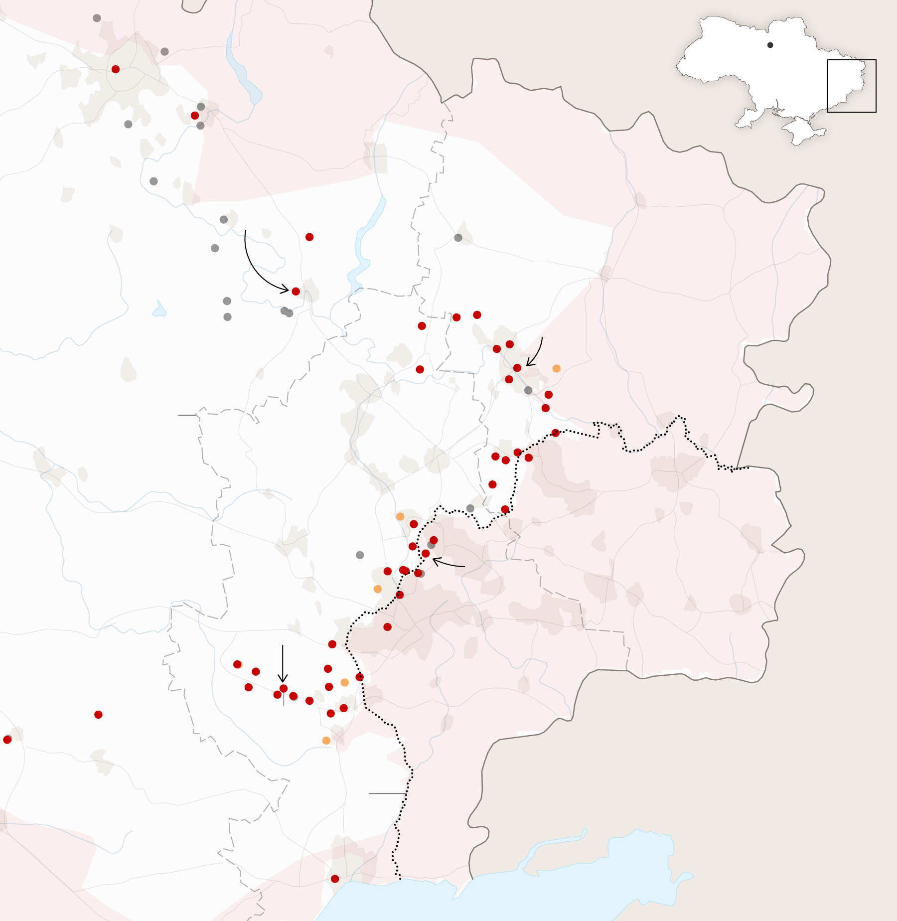
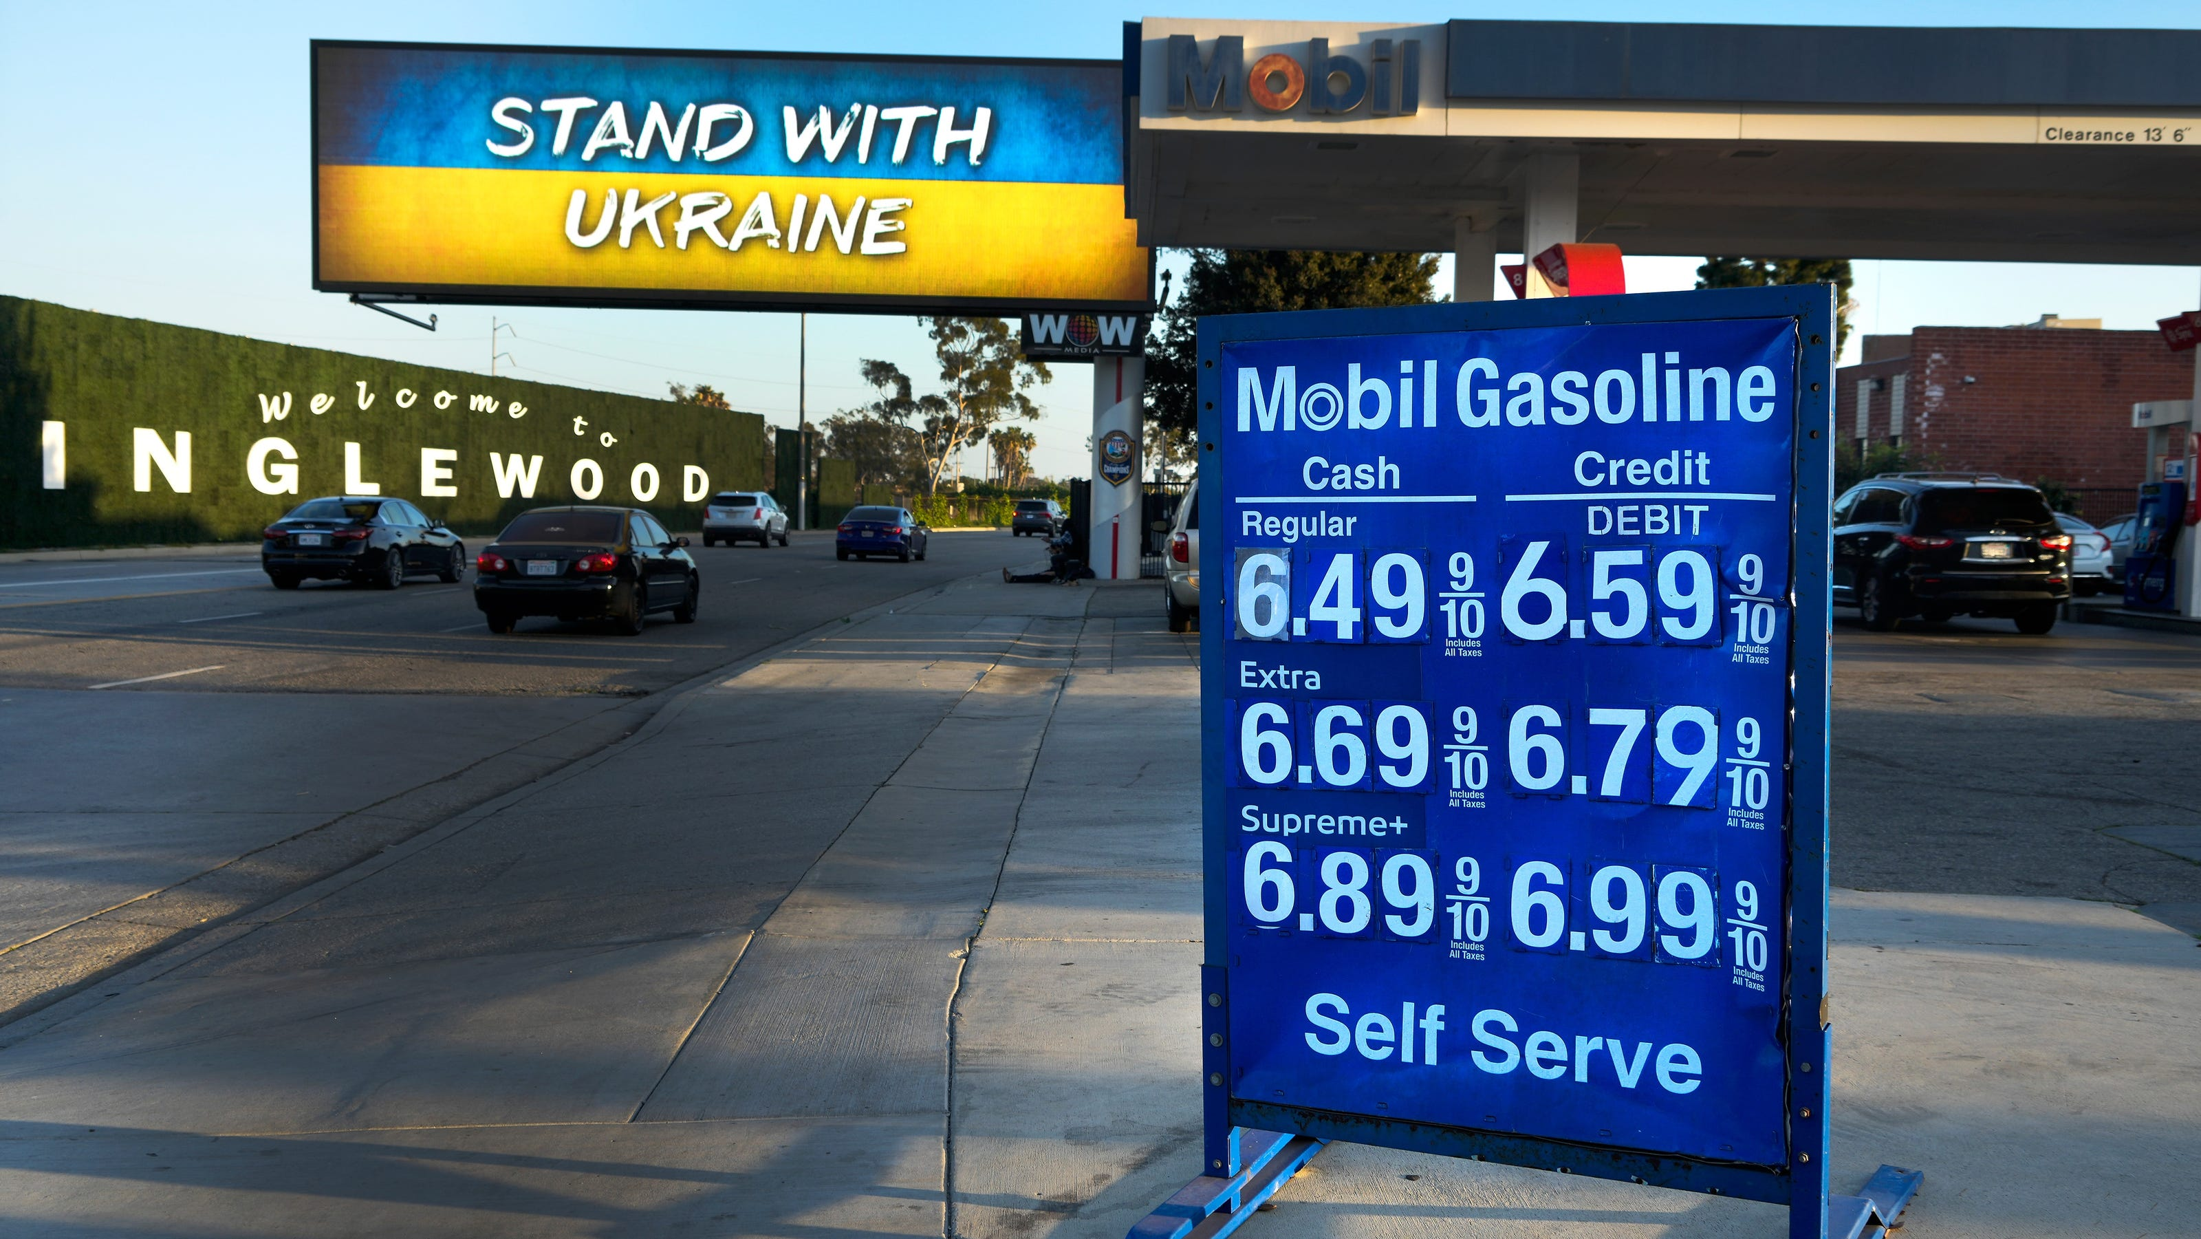
US Economy: Update
Geoffrey Woglom,
Professor of Economics
Amherst College, emeritus
January 24, 2023

Slide 6
Outline for the Talk
Quick summary of the state of the economy.
The Effect of M&F policies.
What lies ahead for the economy.
What’s at stake in controlling inflation.

Slide 7
Gross Domestic Product
Consumption | 68.2%
Investment | 17.8%
Exports | 11.9%
Imports | -15.4%
Government | 17.5%
GDP | 100.0%

Slide 8
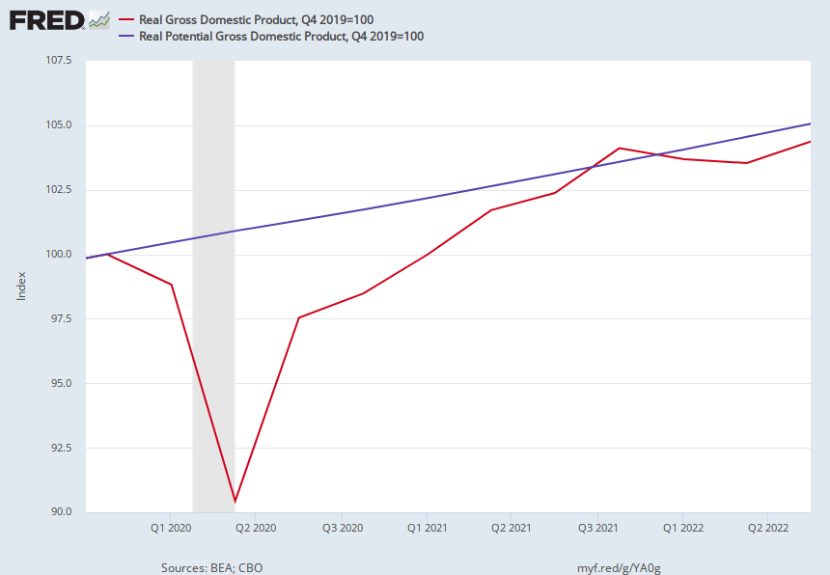
Real GDP and ‘Potential’ during the Recovery
The “output gap” is about $150b
Source: Fred, St Louis Fed
Notes:
GDP is about $27 trillion. GDPNOw 3.9 1/5 Blue Chip 1.2

Slide 9
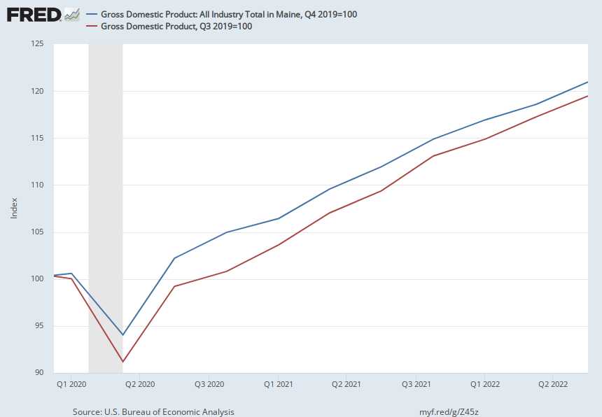
GDP in Maine

Slide 10
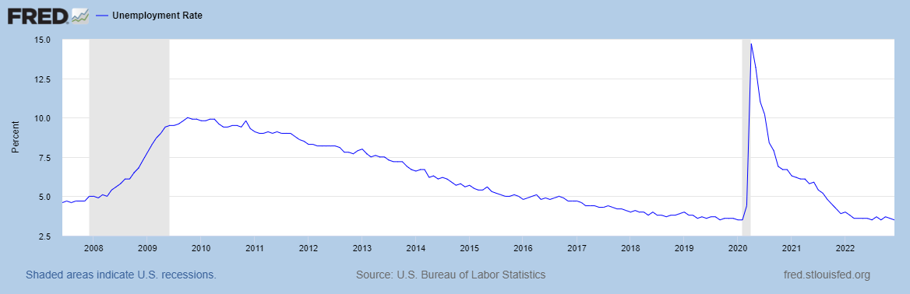
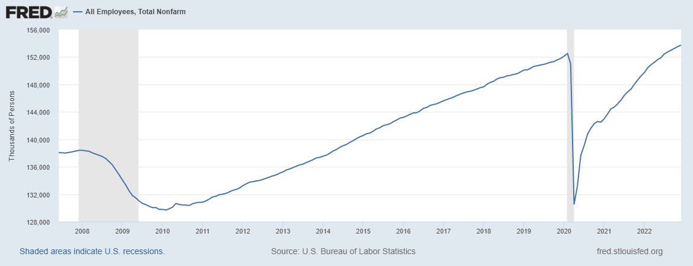
Labor Market: Fully Recovered?
Notes:
One big difference with GDP graph. Total jobs have barely recovered

Slide 11
Where Have All the Workers Gone?
Notes:
Overstates because of the slowdown in population growth. Drop in participation rate from 63.3 to 62.3 accounts for about 1.6 million lost jobs

Slide 12
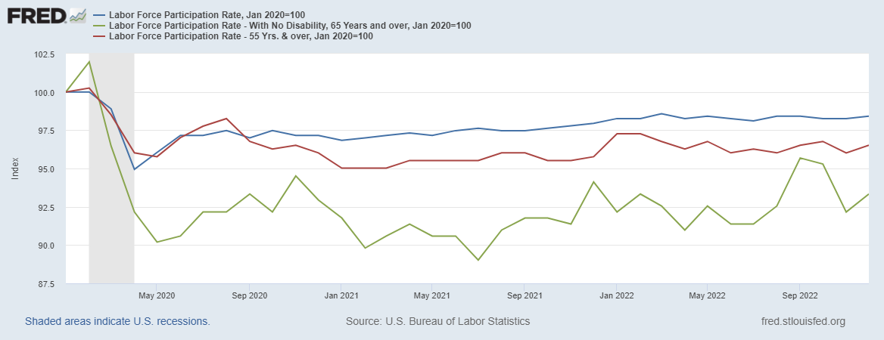
Age Seems to Matter

Slide 13
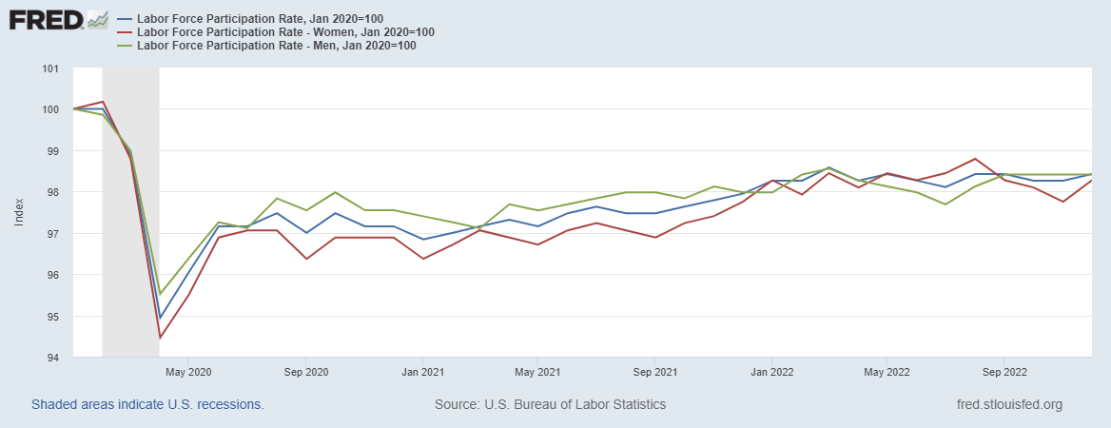
Gender Doesn’t Seem to Matter

Slide 14
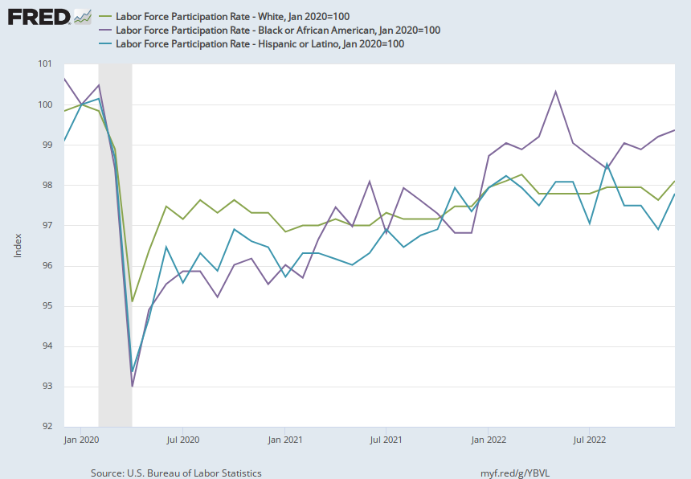
Race?

Slide 15
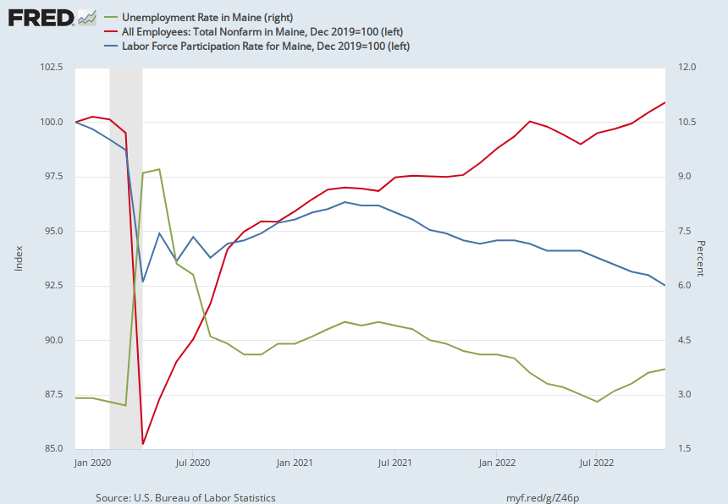
Labor Market in Maine

Slide 16
Overall Good News on the Real Side
GDP is very close to its potential.
The labor market as measured by the unemployment rate is fully recovered.
Fly in the ointment: labor force has lost over 1.5 million workers.
But there is also a nominal side: interest rates, asset prices, inflation and wages.
News isn’t so good!

Slide 17
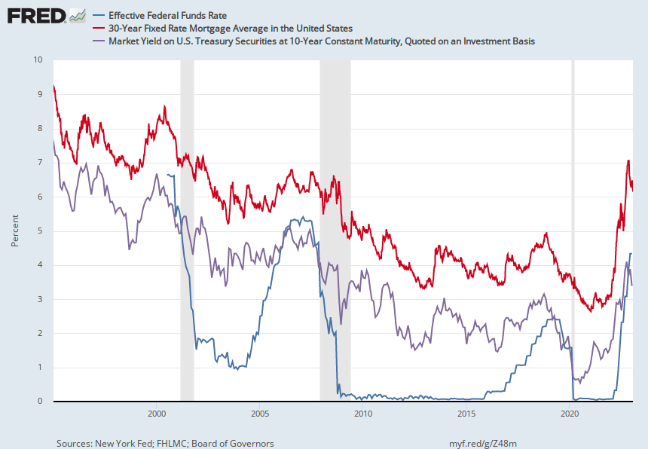
Interest Rates: Era of Falling Rates Over?
Notes:
Fed policy rate 4.5 to 4.25. Concerns with inflation

Slide 18
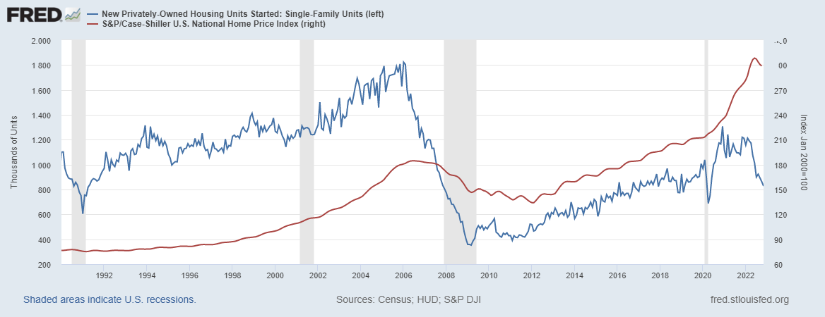
What about Housing?

Slide 19
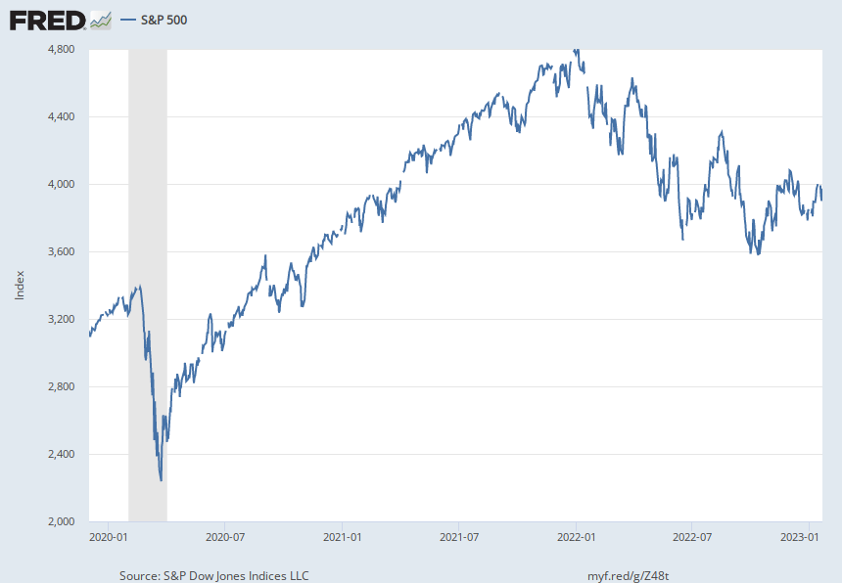
Stock Prices: Rates and Recession?

Slide 20
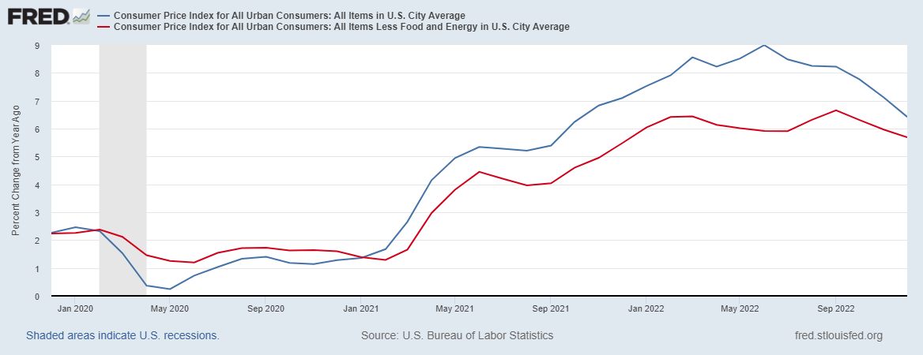
Inflation during the Recovery
Notes:
August CPI yoy 8.3% down from 8.5 and Core 6.3 up from 6.3 in JUly

Slide 21
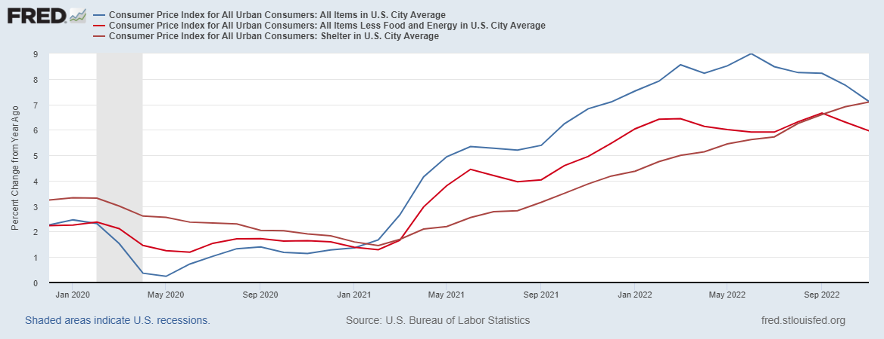
Inflation a Closer Look: Good News

Slide 22
Rents Paid and Rents Asked For

Slide 23
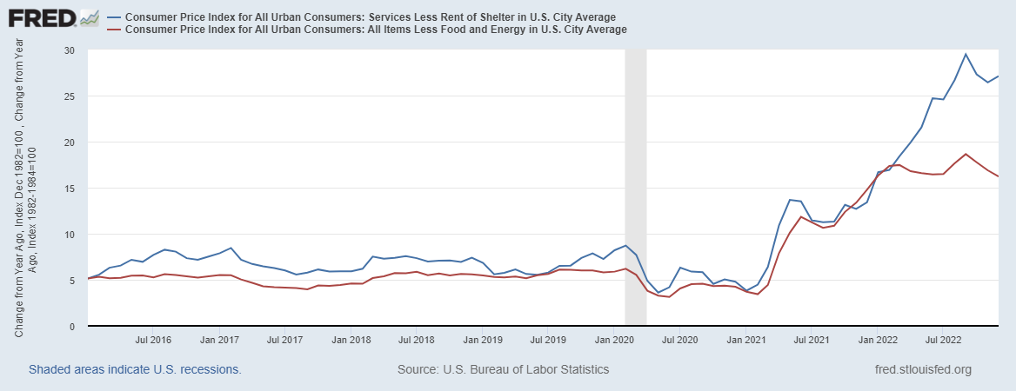
Inflation a Closer Look: Troubling News

Slide 24
Gasoline Prices
Source: US Energy Information Administration

Slide 25
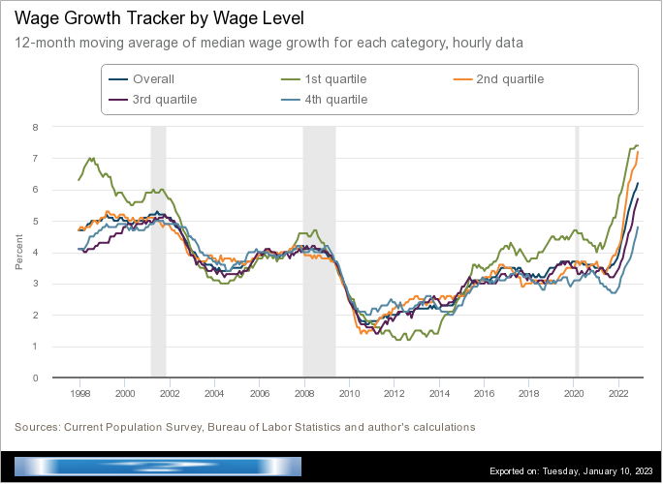
Wages Haven’t Kept Pace with Inflation
Notes:
But, note that low wage workers are doing relatively the best

Slide 26
Policy Effects
Fiscal:
2020-2021: massive stimulus. Cares Act, 3 rounds of stimulus checks, expanded unemployment benefits, Payroll Protection Loans.
Monetary:
2020-2/2022: policy interest rate at zero, new round of quantitative easing.
3/2022-present: most rapid increase in interest rates since Paul Volcker

Slide 27
Fiscally Driven Recovery
Saving

Slide 28

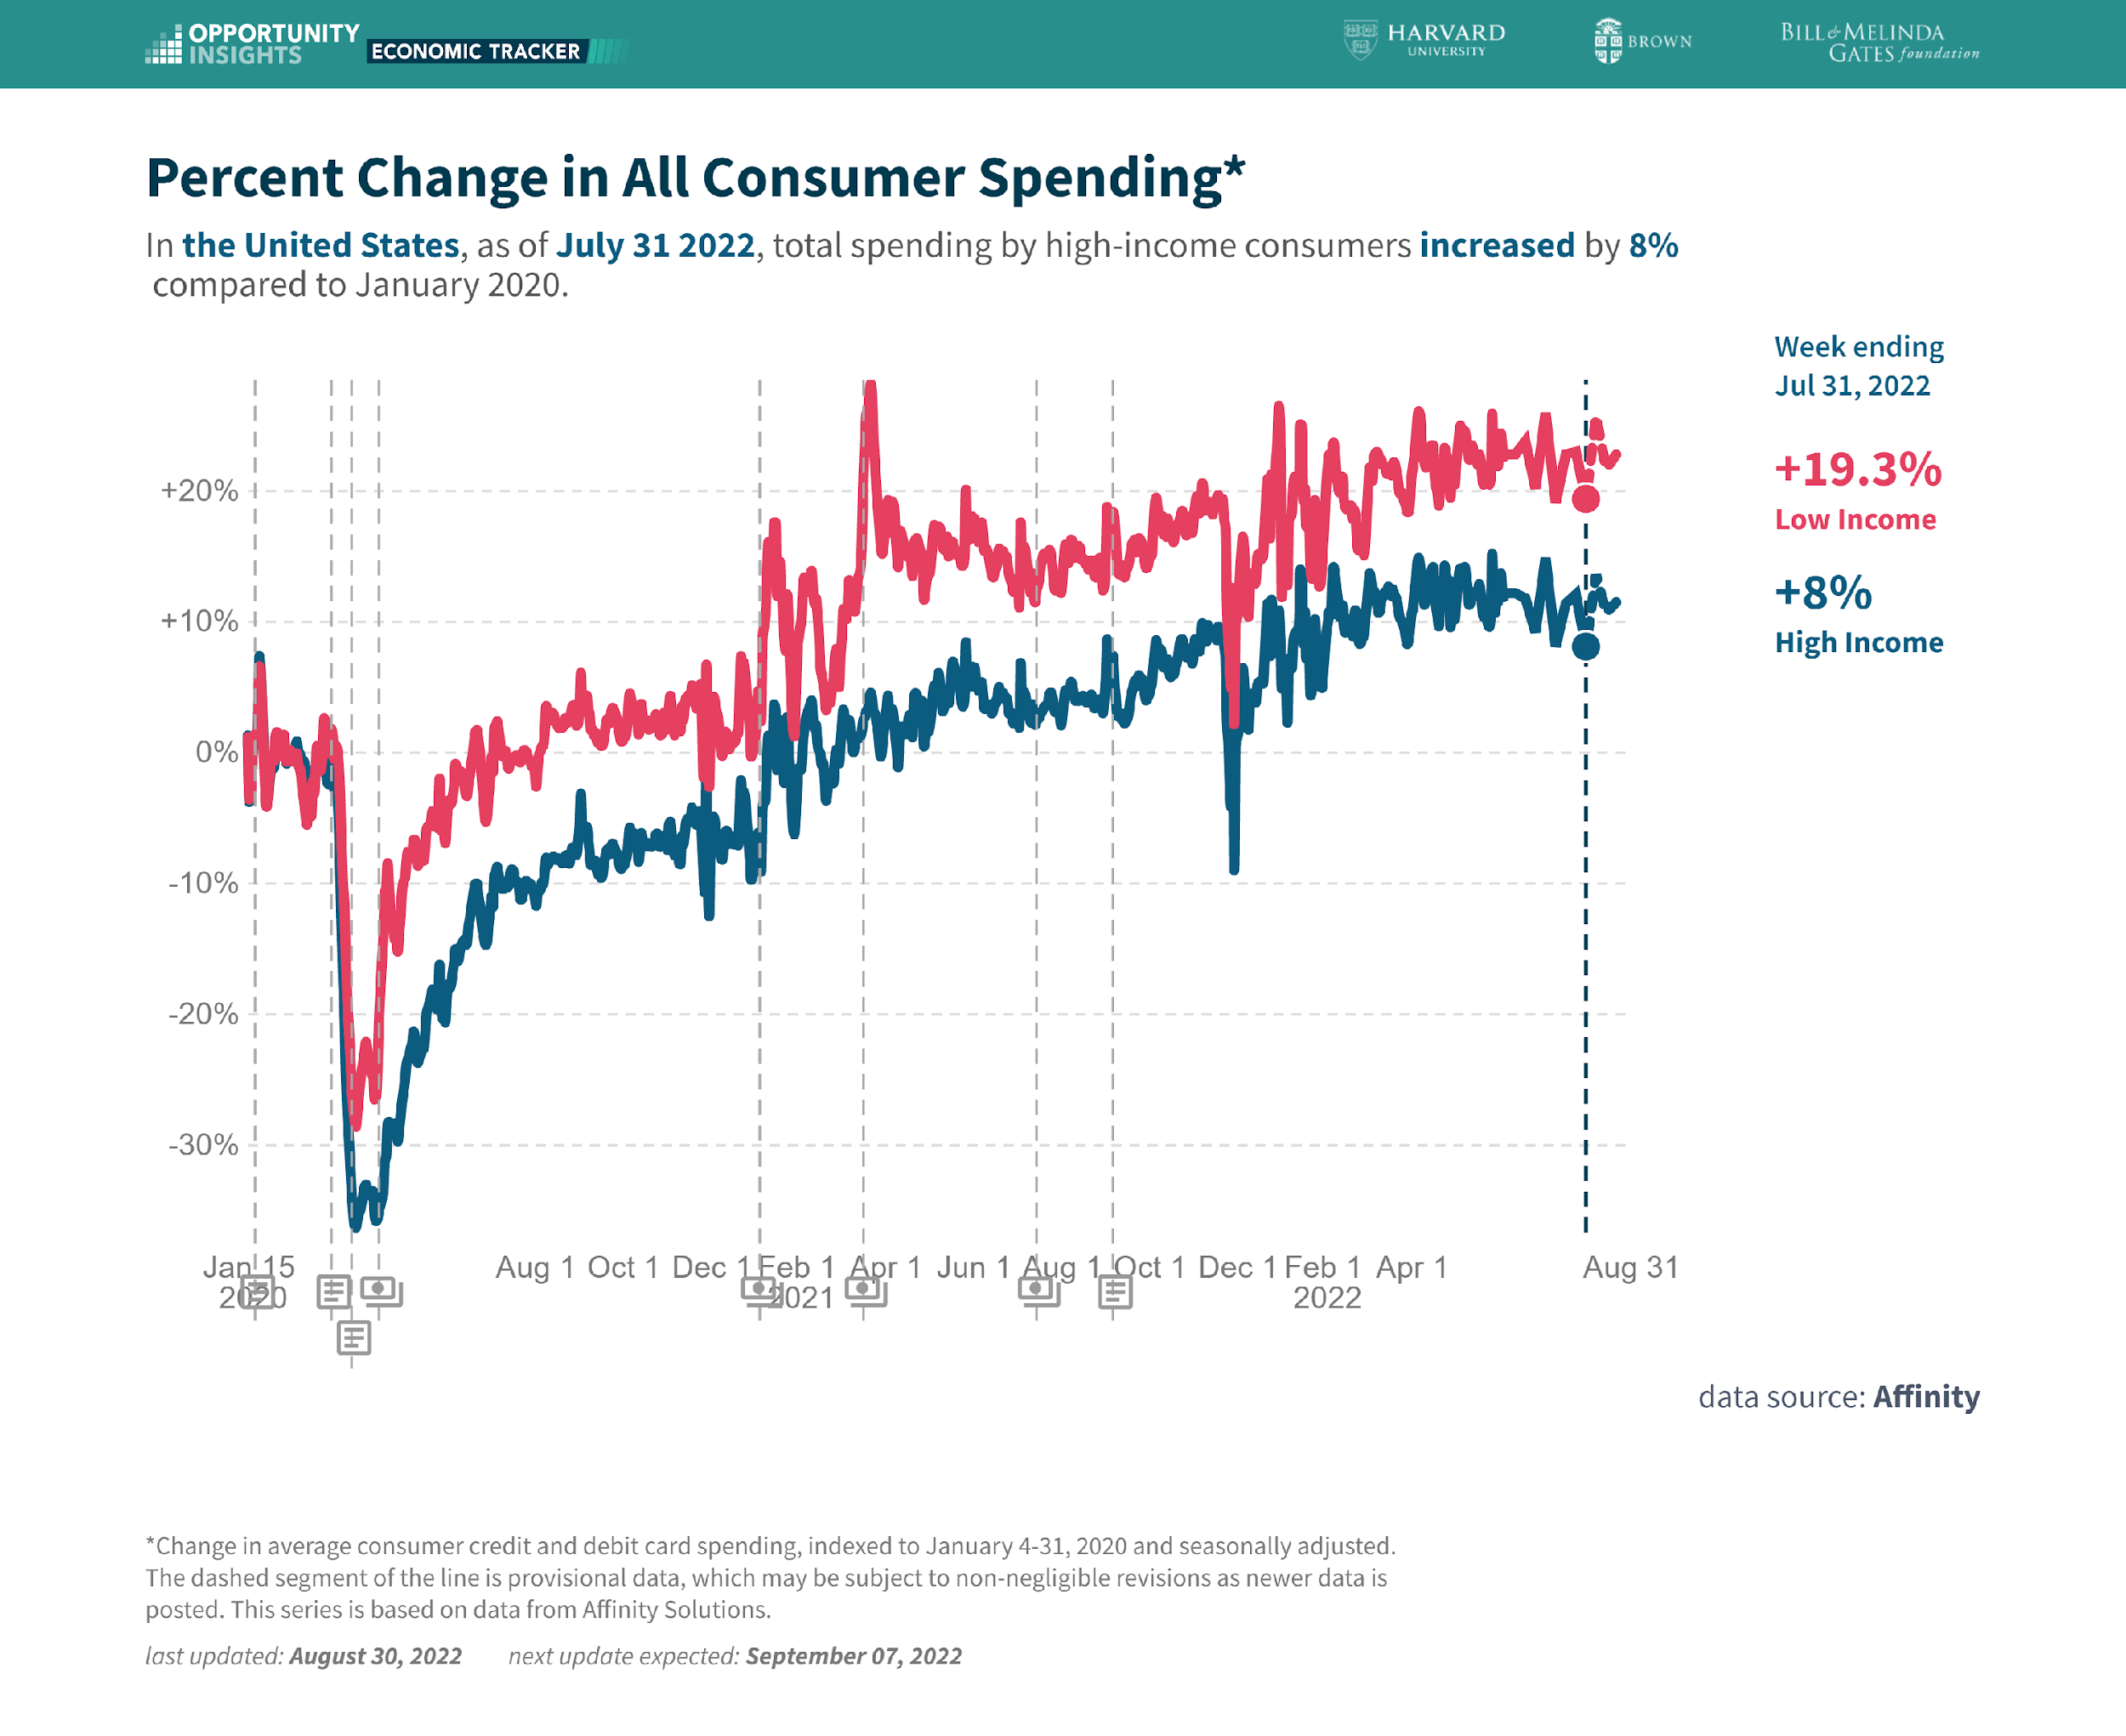
Stimulus Payments Saved Low Wage Workers

Slide 29

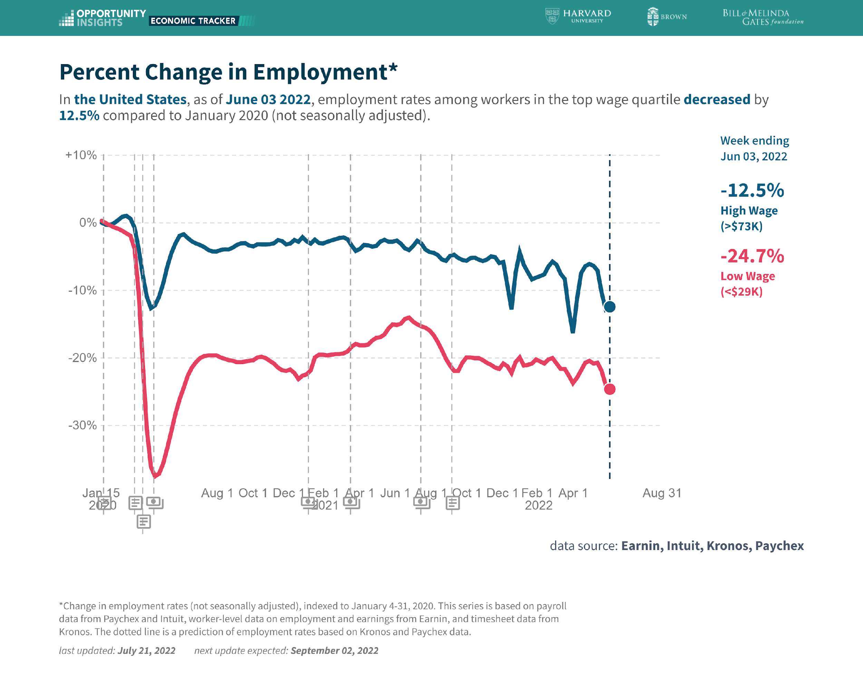

Slide 30
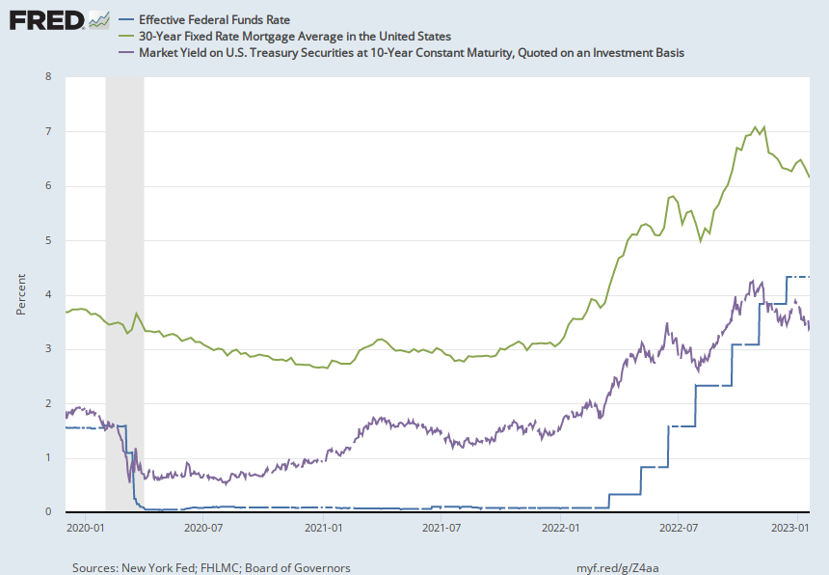
Accommodative Monetary Policy until 3/2022

Slide 31
Fed QE during the Recovery
Zero interest rates until March and a Big QE program
Notes:
25% of marketable Federal Debt; 15 percent of mortgages

Slide 32
Where we Stand
The ARP was probably too big, but helped many poor families, and the Fed was aware of the size of the stimulus.
Monetary policy was too easy for too long, but since March of last years has been much more restrictive.
Yes, there were supply chain issues that temporarily raised inflation, but there was (is?) too much total spending.
So, where are we headed?

Slide 33
What about the “R” Word?
Latest Observation, 10/2022: 63%
Source Wall Street Journal

Slide 34
What is a Recession?
Defined by the National Bureau of Economic Research (NBER)
“The NBER's definition emphasizes that a recession involves a significant decline in economic activity that is spread across the economy and lasts more than a few months.”
Popular Rule of Thumb: Two or more, consecutive quarters where Real GDP falls.
Recessions are caused by decreases in total spending.

Slide 35
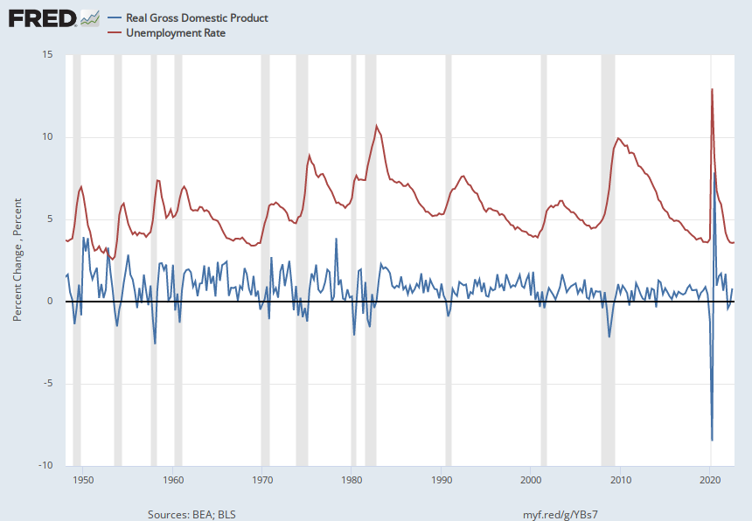
Real GDP Growth and Recessions
Notes:
Shaded Bars are recessions. 2022Q1, -1.6; Q2, -0.6 at annual rates.

Slide 36
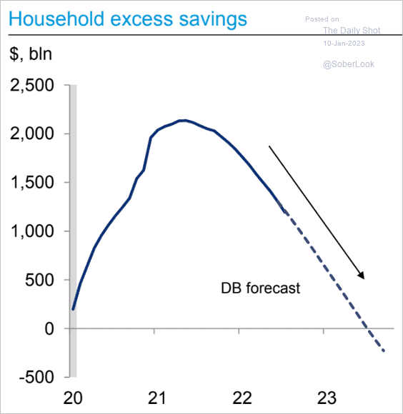
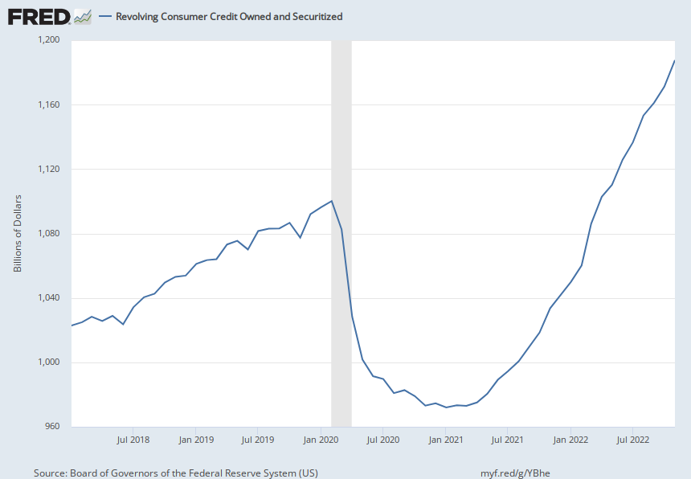
Prospects for Consumer Spending?
Credit Card Debt
Deutsche Bank Research
Notes:
Last year consumption increased by 7 %

Slide 37
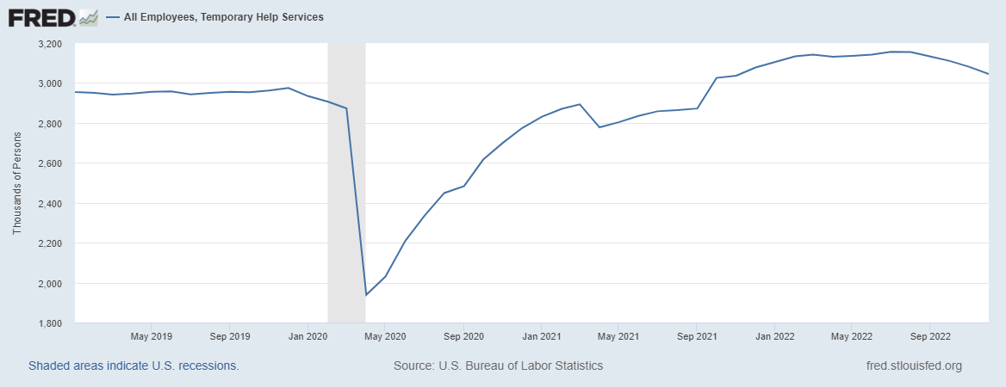
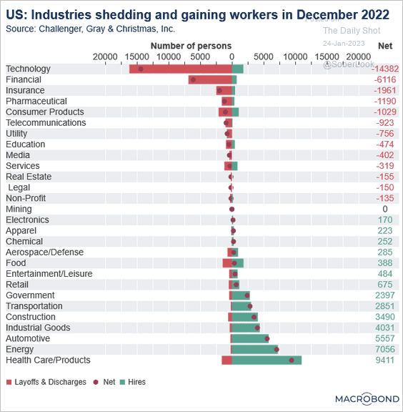
Labor Market Cooling?

Slide 38
Prospects for Inflation: Some Other Good News

Slide 39
Troubling Signs: Inflation Expectations
Source: Federal Reserve of Philadelphia

Slide 40
Summary of the Fed’s View
Economy is stronger than had been anticipated in September, but real GDP growth will remain positive.
Unemployment will have to rise by about 1 percentage point.
Short-term interest rates will have to rise some more, to above 5 percent.
Inflation will slowly return to the Fed’s target of 2 percent: sort of a “soft landing.”

Slide 41
FOMC Forecasts, December 14, 2022
Variable (in percent) | Medians
 | 2022 | 2023 | 2024 | 2025 | Longer Run
RGDP growth | 0.5 | 0.5 | 1.6 | 1.8 | 1.8
Sept. | 0.2 | 1.2 | 1.7 | 1.8 | 1.8
Unemployment | 3.7 | 4.6 | 4.6 | 4.5 | 4.0
Sept. | 3.8 | 4.4 | 4.4 | 4.3 | 4.0
Inflation | 5.6 | 3.1 | 2.5 | 2.1 | 2.0
Sept. | 5.4 | 2.8 | 2.3 | 2.0 | 2.0
Core Inflation | 4.8 | 3.5 | 2.5 | 2.1 | 2.0
Sept. | 5.4 | 2.8 | 2.3 | 2.0 | 2.0
Federal Funds | 4.4 | 5.1 | 4.1 | 3.1 | 2.5
Sept | 4.4 | 4.6 | 3.9 | 2.9 | 2.5
Notes:
GDP NOw

Slide 42
Philadelphia Fed Survey of Professional Forecasters
Variable (in percent) | Medians
 | 2022 | 2023 | 2024 | 2025
RGDP growth | 1.9 | 0.7 | 1.8 | 2.2
Aug. | 1.6 | 1.3 | 2.3 | 2.1
Unemployment | 3.7 | 4.2 | 4.3 | 4.2
Aug. | 3.7 | 3.9 | 3.9 | 3.9
Inflation | 5.9 | 2.9 | 2.3
Aug. | 5.8 | 2.8 | 2.3
Core Inflation | 4.8 | 3.0 | 2.4
Aug. | 4.5 | 2.8 | 2.2 | 2.0
3 mo. Tbill | 2.0 | 4.5 | 3.9 | 3.3
Aug. | 1.7 | 3.3 | 3.0 | 2.8

Slide 43
Market’s Expectations of Future Fed Actions

Slide 44
Summary of Where We are Headed
The growth in total spending is at least slowing.
Labor Market is still strong, but lagging indicator.
Hard or Soft Landing: the Jury is out.
Inflation is coming down, but how fast?
Known Unknowns: New Covid Variant, Ukraine War, Budget Fight, Fed Actions.
Unknown, Unknowns!

Slide 45
What’s at Stake?
If people expect inflation, that can lead to high actual inflation.
Paul Volcker in 1981 realized this point and wrung inflation out of the system with a massive recession.
Unemployment peaked at 11%.
Europe’s lost decade.
Latin America Debt Crisis.
But, (for the US) it worked!

Slide 46
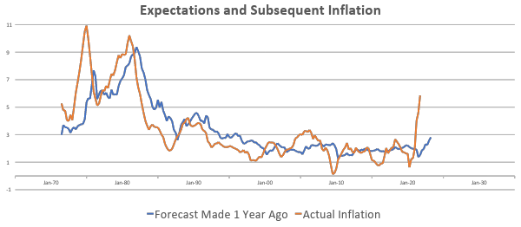
“Anchoring” Inflation Expectations
Forecasts: Philadelphia Fed, “Survey of Professional Forecasters”
Notes:
Livingston Survey. 75-78. Unemployment 7% and 6% inflation. Look at the stability in the post 2001 period and the 2003-2005 period

Slide 47
How Did We Get Here? The Fed?
September 22, 2021: inflation, 5.2%; unemployment 5.2%
Inflation is elevated, largely reflecting transitory factors. …With inflation having run persistently below this longer-run goal, the Committee will aim to achieve inflation moderately above 2 percent for some time so that inflation averages 2 percent over time and longer‑term inflation expectations remain well anchored at 2 percent.
December 14, 2022: inflation, 7.1%, unemployment 3.6%
[T]he Committee decided to raise the target range for the federal funds rate to 4-1/4 to 4-1/2 percent. The Committee anticipates that ongoing increases in the target range will be appropriate …to return inflation to 2 percent over time. .. The Committee is strongly committed to returning inflation to its 2 percent objective.

Slide 48
Stay Tuned
January 26, BEA first estimate of fourth quarter GDP.
January 27, BEA releases PCE inflation for December.
January 31, next Federal Reserve meeting.
Next week we will look in more depth at the Fed and their current policy stance.

Slide 49
Let’s Hear from You!
Geoffrey Woglom
grwoglom@amherst.edu
Contact NEED: Info@NEEDelegation.org
Submit a testimonial: www.NEEDelegation.org/testimonials.php
Support NEED: www.NEEDelegation.org/donate.php

