Slide 1
Osher Lifelong Learning Institute, Winter 2022
Contemporary Economic Policy
University of Nevada, Las Vegas
February-March, 2023
Host: Jon Haveman, Ph.D.
National Economic Education Delegation

Slide 2
National Economic Education Delegation
Vision
One day, the public discussion of policy issues will be grounded in an accurate perception of the underlying economic principles and data.
Mission
NEED unites the skills and knowledge of a vast network of professional economists to promote understanding of the economics of policy issues in the United States.
NEED Presentations
Are nonpartisan and intended to reflect the consensus of the economics profession.

Slide 3
Who Are We?
Honorary Board: 54 members
2 Fed Chairs: Janet Yellen, Ben Bernanke
6 Chairs Council of Economic Advisers
Furman (D), Rosen (R), Bernanke (R), Yellen (D), Tyson (D), Goolsbee (D)
3 Nobel Prize Winners
Akerlof, Smith, Maskin
Delegates: 652+ members
At all levels of academia and some in government service
All have a Ph.D. in economics
Crowdsource slide decks
Give presentations
Global Partners: 48 Ph.D. Economists
Aid in slide deck development

Slide 4
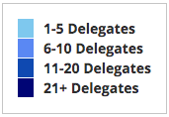
Where Are We?

Slide 5
Available NEED Topics Include:
US Economy
Healthcare Economics
Climate Change
Economic Inequality
Economic Mobility
Trade and Globalization
Minimum Wages
Immigration Economics
Housing Policy
Federal Budgets
Federal Debt
Black-White Wealth Gap
Autonomous Vehicles
Healthcare Economics

Slide 6
Course Outline
Contemporary Economic Policy
Week 1 (2/15): US Economic Update (Geoffrey Woglom, Amherst College)
Week 2 (2/22): Monetary Economics (Geoffrey Woglom)
Week 3 (3/1): Trade and Globalization (Alan Deardorff, Univ. Michigan)
Week 4 (3/8): Trade Deficits and Exchange Rates (Alan Deardorff)
Week 5 (3/22): Economic Mobility (Jon Haveman, NEED)
Week 6 (3/29): The Black-White Wealth Gap (Jon Haveman)

Slide 7
Monetary Policy
Blue is the fed funds rate.
Red is the rate on 3 month Treasuries.
Green is the prime bank lending rate
Notes:
Take note over the redline peeking above the others

Slide 8
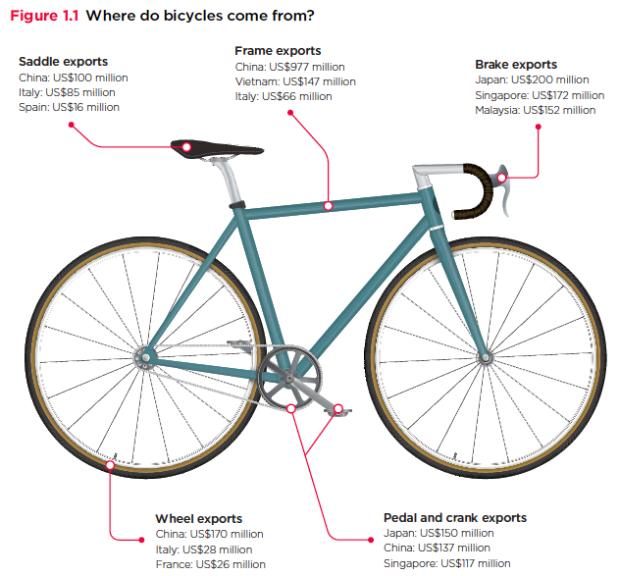
Trade: Bicycle Supply Chain
Source: World Development Report 2020

Slide 9
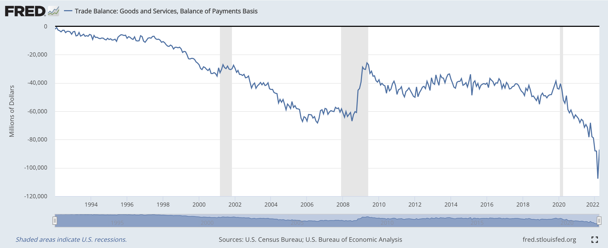
Trade Deficits and Exchange Rates

Slide 10
Mobility
9 out of 10 of those born in the early 1940s could expect to earn more than their parents
1 in 2 Millennials (born after 1980) earn more than their parents.

Slide 11
Evidence of the B-W Wealth Gap
Mean is
7x Greater
Median is 8x Greater

Slide 12
Submitting Questions
Please submit questions of clarification in the chat.
I will try to handle them as they come up.
We will do a verbal Q&A once the material has been presented.
Slides will be available from the NEED website tomorrow (https://needelegation.org/delivered_presentations.php)

Slide 13
Credits and Disclaimer
This slide deck was authored by:
Jon D. Haveman, NEED
Scott Baier, Clemson University
Geoffrey Woglom, Amherst College (Emeritus)
Brian Dombeck, Lewis & Clark College
Doris Geide-Stevenson, Weber State
Disclaimer
NEED presentations are designed to be nonpartisan.
It is, however, inevitable that the presenter will be asked for and will provide their own views.
Such views are those of the presenter and not necessarily those of the National Economic Education Delegation (NEED).

Slide 14
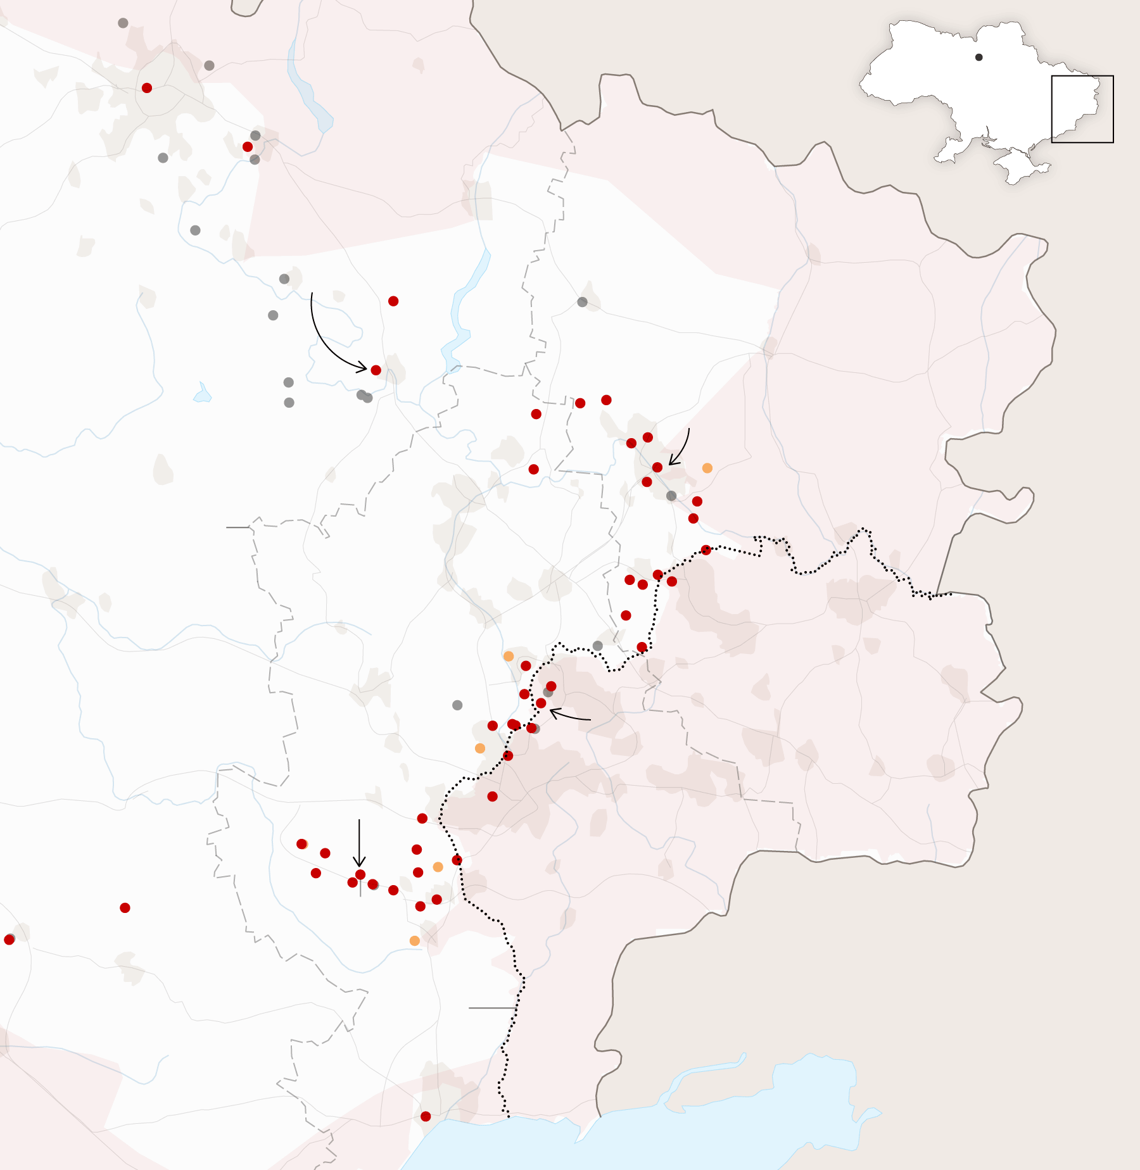
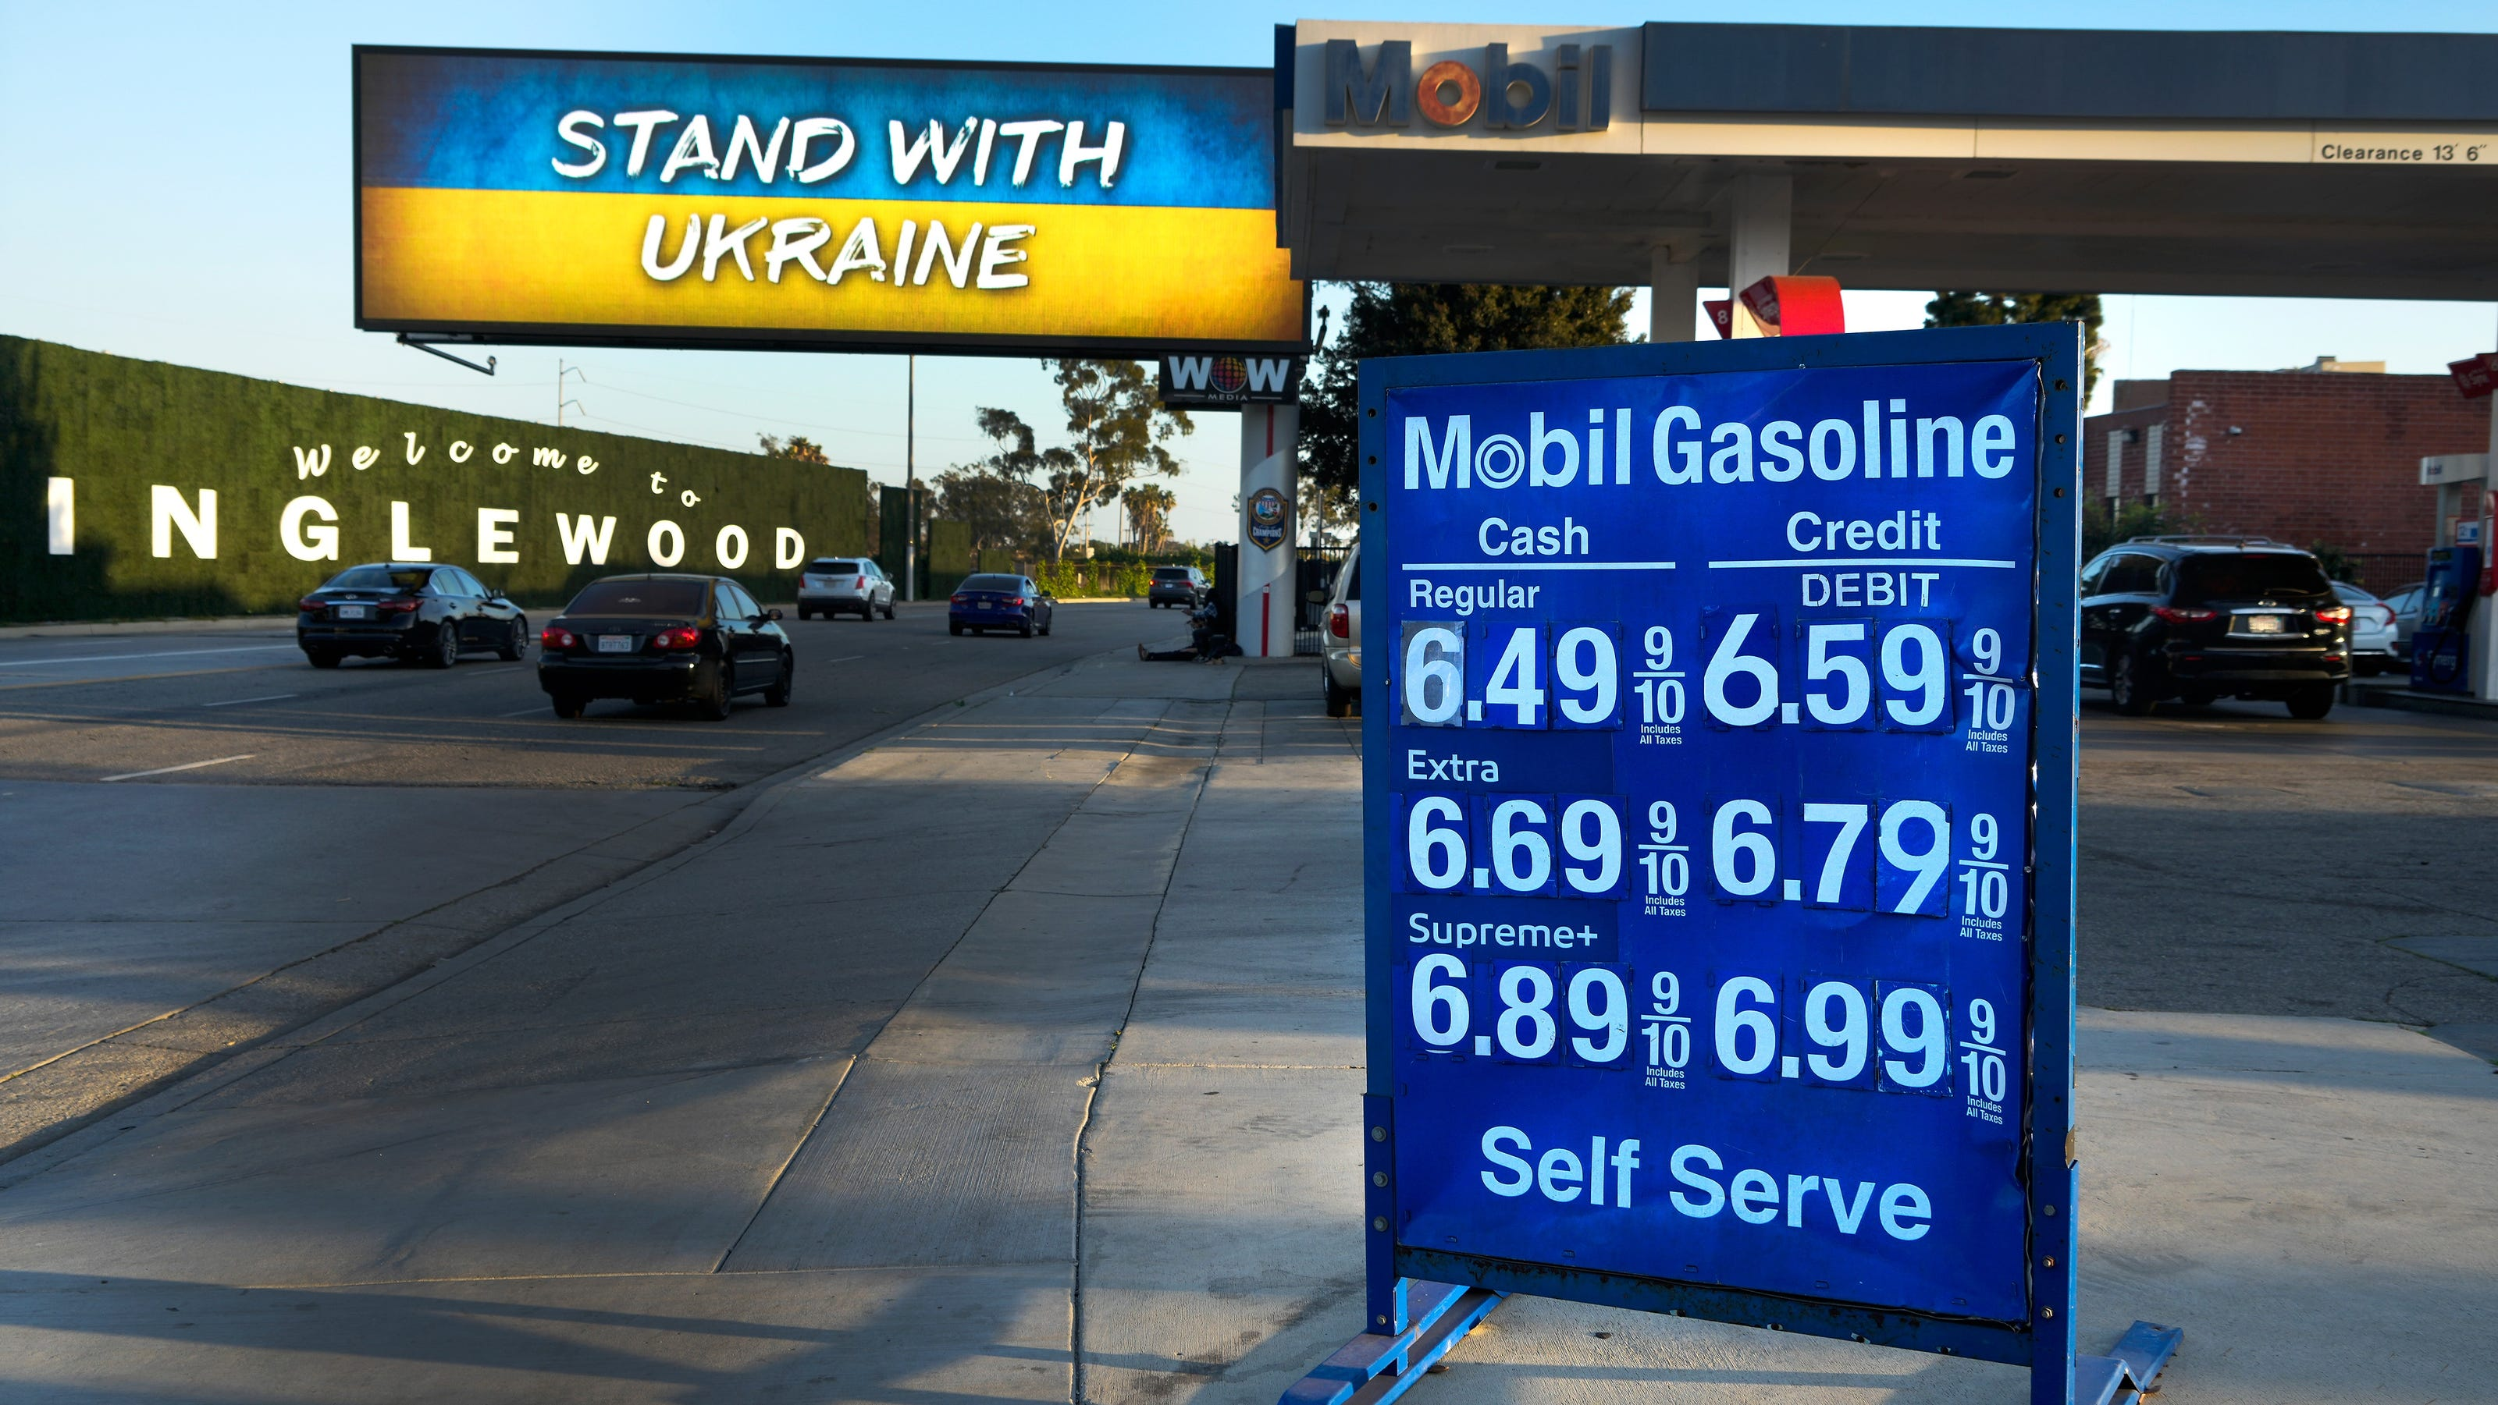
US Economy: Update
Geoffrey Woglom,
Professor of Economics
Amherst College, emeritus
February 15, 2023

Slide 15
Outline for the Talk
Summary of the state of the economy.
The Effect of M&F policies.
What lies ahead for the economy.
What’s at stake in controlling inflation.

Slide 16
Gross Domestic Product
Consumption | 68.2%
Investment | 17.8%
Exports | 11.5%
Imports | -14.7%
Government | 17.5%
GDP | 100.0%

Slide 17
Real GDP and ‘Potential’ during the Recovery
The “output gap” is about $100b
Source: Fred, St Louis Fed
Notes:
GDP is about $27 trillion. GDPNOw 3.9 1/5 Blue Chip 1.2

Slide 18
RGDP in Nevada

Slide 19
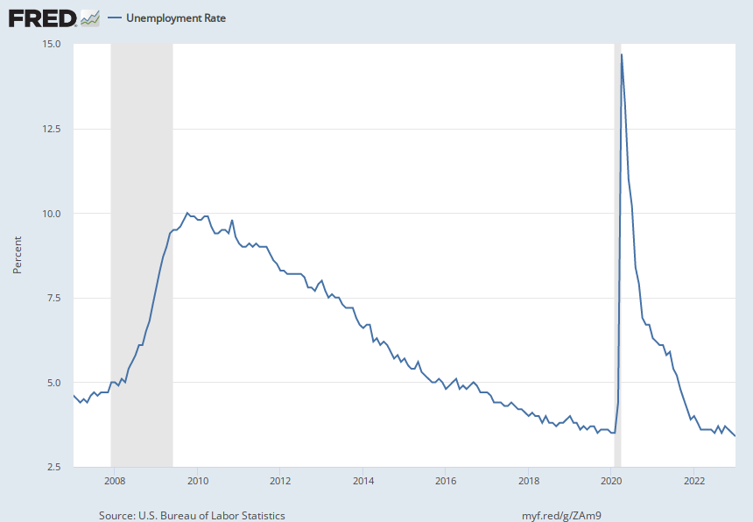
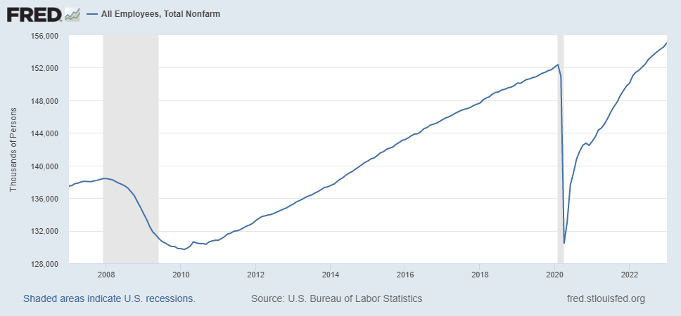
Labor Market: Fully Recovered?
1/23 rate of 3.4% is a 53-yr low
Notes:
One big difference with GDP graph. Total jobs have barely recovered, although 517 thousand jobs added in January

Slide 20
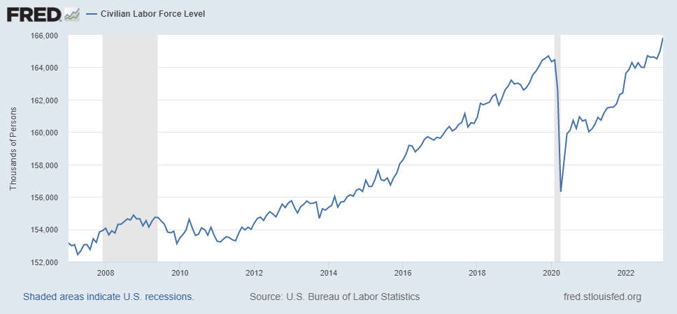
Where Have All the Workers Gone?
Notes:
Overstates because of the slowdown in population growth. Drop in participation rate from 63.3 to 62.3 accounts for about 1.6 million lost jobs

Slide 21
Early Retirements?

Slide 22
Labor Market in Nevada

Slide 23
Overall Good News on the Real Side
GDP is very close to its potential.
The labor market as measured by the unemployment rate is fully recovered.
Fly in the ointment: labor force has lost over 1.5 million workers.
But there is also a nominal side: interest rates, asset prices, inflation and wages.
News isn’t so good!

Slide 24
Interest Rates: Era of Falling Rates Over?
Notes:
Fed policy rate 4.5 to 4.25. Concerns with inflation

Slide 25
What about Housing?

Slide 26
Stock Prices: Rates and Recession?

Slide 27
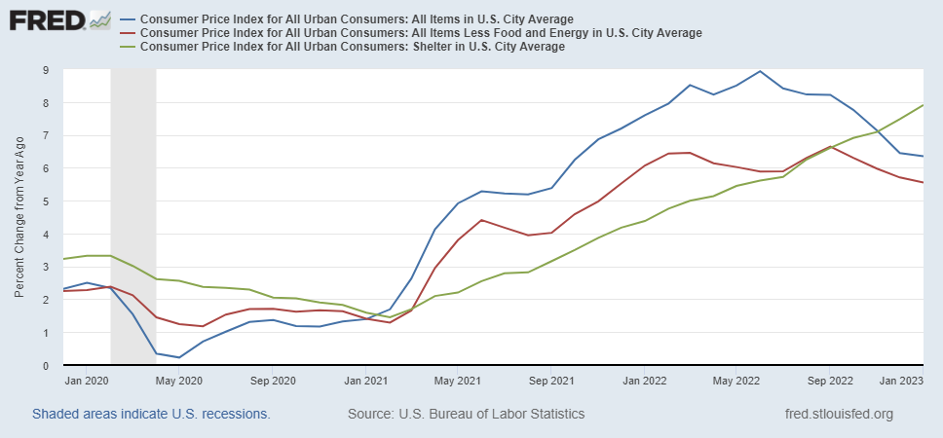
Inflation during the Recovery
Good News (?)
Notes:
August CPI yoy 8.3% down from 8.5 and Core 6.3 up from 6.3 in JUly

Slide 28
Rents Paid and Rents Asked For

Slide 29
A Different Look

Slide 30
Wages Haven’t Kept Pace with Inflation
Notes:
But, note that low wage workers are doing relatively the best

Slide 31
Policy Effects
Fiscal:
2020-2021: massive stimulus. Cares Act, 3 rounds of stimulus checks, expanded unemployment benefits, Payroll Protection Loans.
Monetary:
2020-2/2022: policy interest rate at zero, new round of quantitative easing.
3/2022-present: most rapid increase in interest rates since Paul Volcker

Slide 32
Accommodative Monetary Policy until 3/2022

Slide 33
Where we Stand
The ARP was probably too big, but helped many poor families, and the Fed was aware of the size of the stimulus.
Monetary policy was too easy for too long, but since March of last years has been much more restrictive.
Yes, there were supply chain issues that temporarily raised inflation, but there was (is?) too much total spending.
So, where are we headed?

Slide 34
What about the “R” Word?
Latest Observation, 1/2023: 61%
Source Wall Street Journal, 1/15/2023

Slide 35
What is a Recession?
Defined by the National Bureau of Economic Research (NBER)
“The NBER's definition emphasizes that a recession involves a significant decline in economic activity that is spread across the economy and lasts more than a few months.”
Popular Rule of Thumb: Two or more, consecutive quarters where Real GDP falls.
Recessions are caused by decreases in total spending.

Slide 36
Real GDP Growth and Recessions
Notes:
Shaded Bars are recessions. 2022Q1, -1.6; Q2, -0.6 at annual rates.

Slide 37
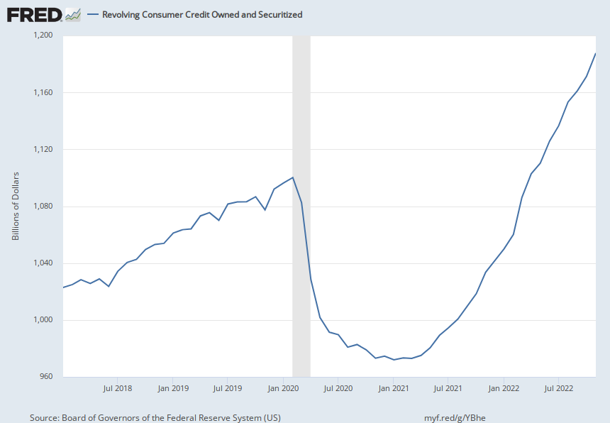
Prospects for Consumer Spending?
Credit Card Debt
Deutsche Bank Research
Notes:
Last year consumption increased by 7 %

Slide 38
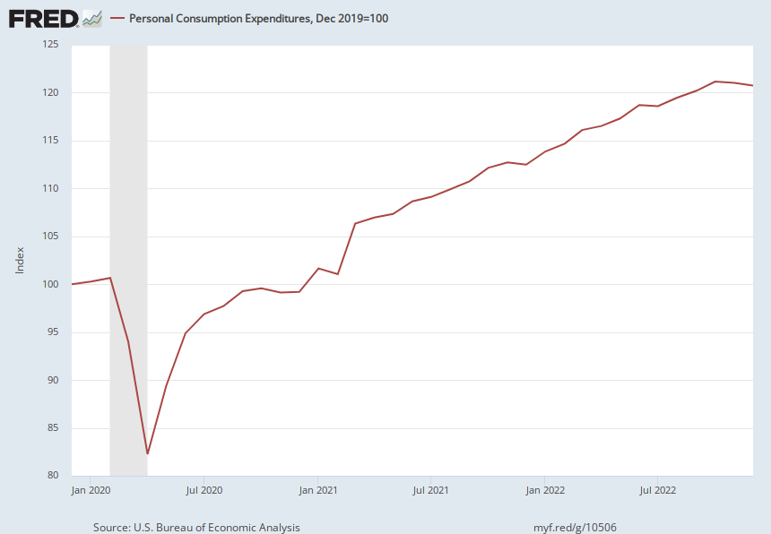
Consumer Spending Slowing?
Or, Not

Slide 39
Labor Market Cooling?
Or, Not

Slide 40
We (I) Don’t Know What’s Ahead
There are some signs that consumer spending is slowing.
Housing is certainly slowing.
But the labor market seems very strong (517K jobs added in January).
What will the Fed do?

Slide 41
What’s at Stake?
If people expect inflation, that can lead to high actual inflation.
Paul Volcker in 1981 realized this point and wrung inflation out of the system with a massive recession.
Unemployment peaked at 11%.
Europe’s lost decade.
Latin America Debt Crisis.
But, (for the US) it worked!

Slide 42
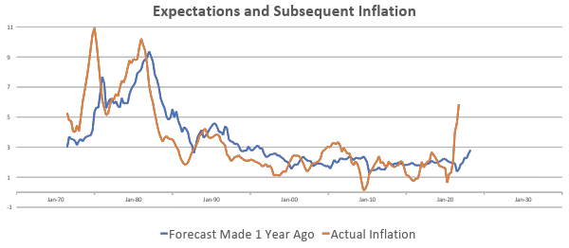
“Anchoring” Inflation Expectations
Forecasts: Philadelphia Fed, “Survey of Professional Forecasters”
Notes:
Livingston Survey. 75-78. Unemployment 7% and 6% inflation. Look at the stability in the post 2001 period and the 2003-2005 period

Slide 43
How Did We Get Here? The Fed?
Why was the Fed so late to act?
What is the Fed’s current thinking, and how will they respond to incoming economic data?
A brief description of the Fed and their policy tools and the answer to the previous two questions are the topics for next week.

Slide 44
Let’s Hear from You!
Geoffrey Woglom
grwoglom@amherst.edu
Contact NEED: Info@NEEDelegation.org
Submit a testimonial: www.NEEDelegation.org/testimonials.php
Support NEED: www.NEEDelegation.org/donate.php

