Slide 1
Osher Lifelong Learning Institute, Fall 2022
Contemporary Economic Policy Issues
University of California, Santa Cruz
Fall, 2022
Jon Haveman, Ph.D.
National Economic Education Delegation

Slide 2
National Economic Education Delegation
Vision
One day, the public discussion of policy issues will be grounded in an accurate perception of the underlying economic principles and data.
Mission
NEED unites the skills and knowledge of a vast network of professional economists to promote understanding of the economics of policy issues in the United States.
NEED Presentations
Are nonpartisan and intended to reflect the consensus of the economics profession.

Slide 3
Who Are We?
Honorary Board: 54 members
2 Fed Chairs: Janet Yellen, Ben Bernanke
6 Chairs Council of Economic Advisers
Furman (D), Rosen (R), Bernanke (R), Yellen (D), Tyson (D), Goolsbee (D)
3 Nobel Prize Winners
Akerlof, Smith, Maskin
Delegates: 652+ members
At all levels of academia and some in government service
All have a Ph.D. in economics
Crowdsource slide decks
Give presentations
Global Partners: 49 Ph.D. Economists
Aid in slide deck development

Slide 4
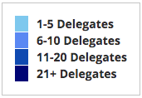
Where Are We?

Slide 5
Available NEED Topics Include:
US Economy
Healthcare Economics
Climate Change
Economic Inequality
Economic Mobility
Trade and Globalization
Minimum Wages
Immigration Economics
Housing Policy
Federal Budgets
Federal Debt
Black-White Wealth Gap
Autonomous Vehicles
Healthcare Economics

Slide 6
Course Outline
Contemporary Economic Policy
Week 1 (10/3): Economic Update (Jon Haveman, NEED)
Week 2 (10/10): Climate Change Economics (Trevor O’Grady)
Week 3 (10/17): Economics of Immigration (Roger White, Whittier College)
Week 4 (10/24): Autonomous Vehicles (Jon Haveman, NEED)

Slide 7
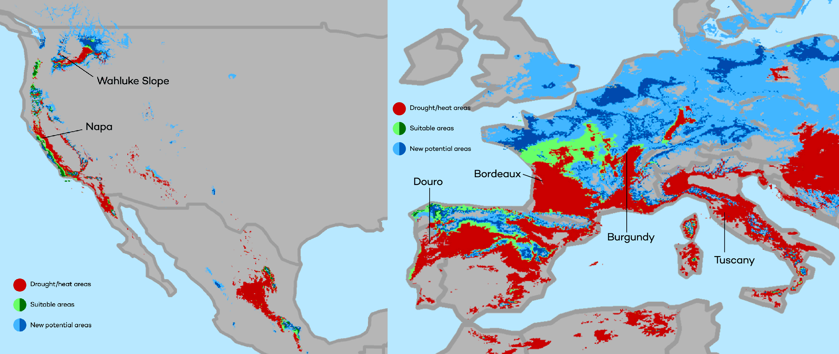
Climate Change Economics
The changing map of the world’s wine-growing regions.

Slide 8
Immigrant Population in 2017
Categories of the total number
of immigrants in the United States.
https://www.pewresearch.org/fact-tank/2019/07/12/how-pew-research-center-counts-unauthorized-immigrants-in-us/

Slide 9
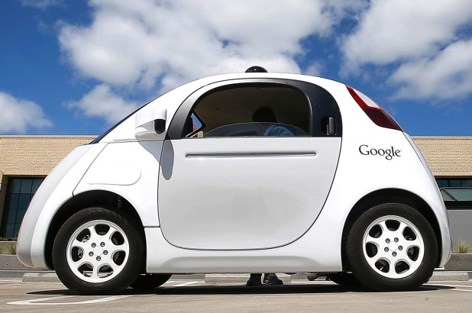
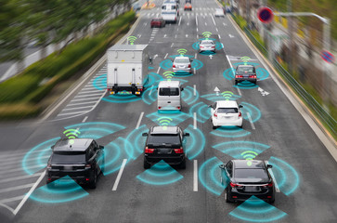
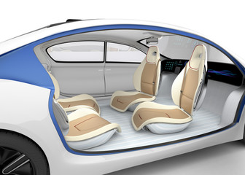
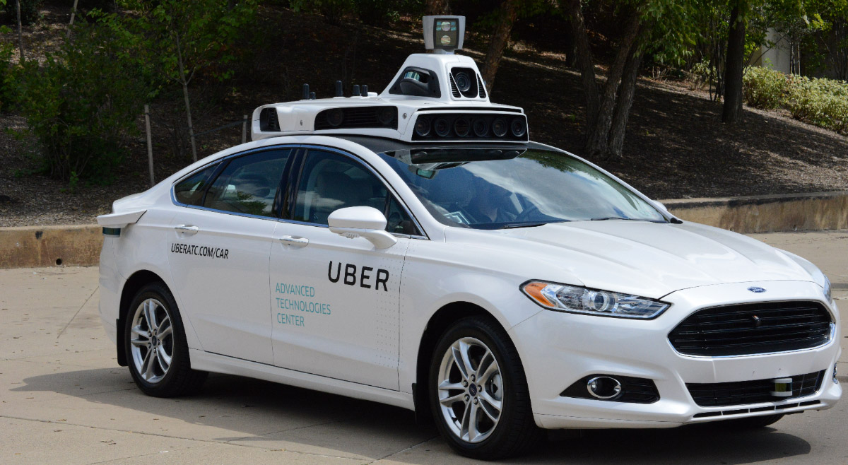
Autonomous Vehicles

Slide 10
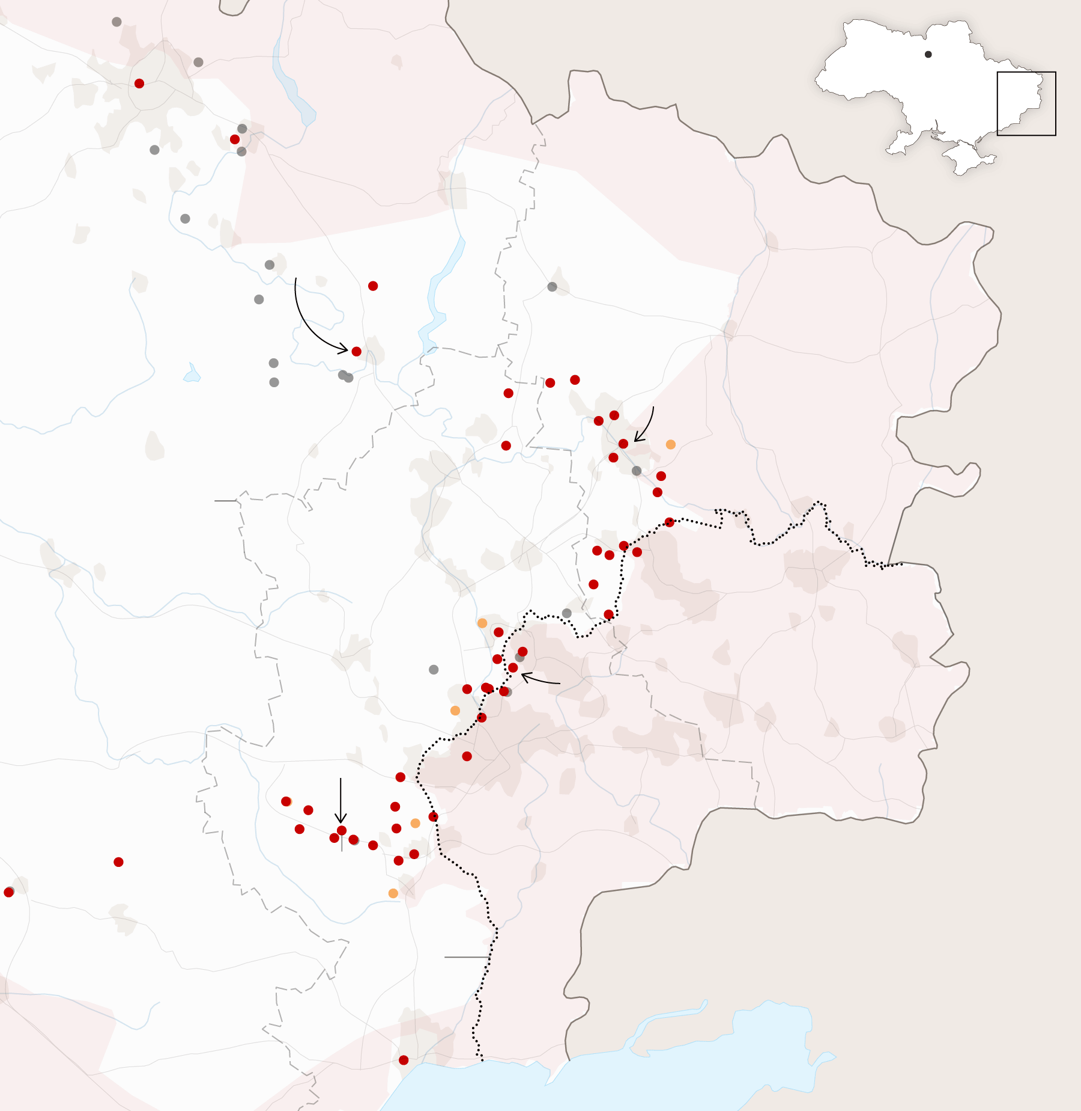
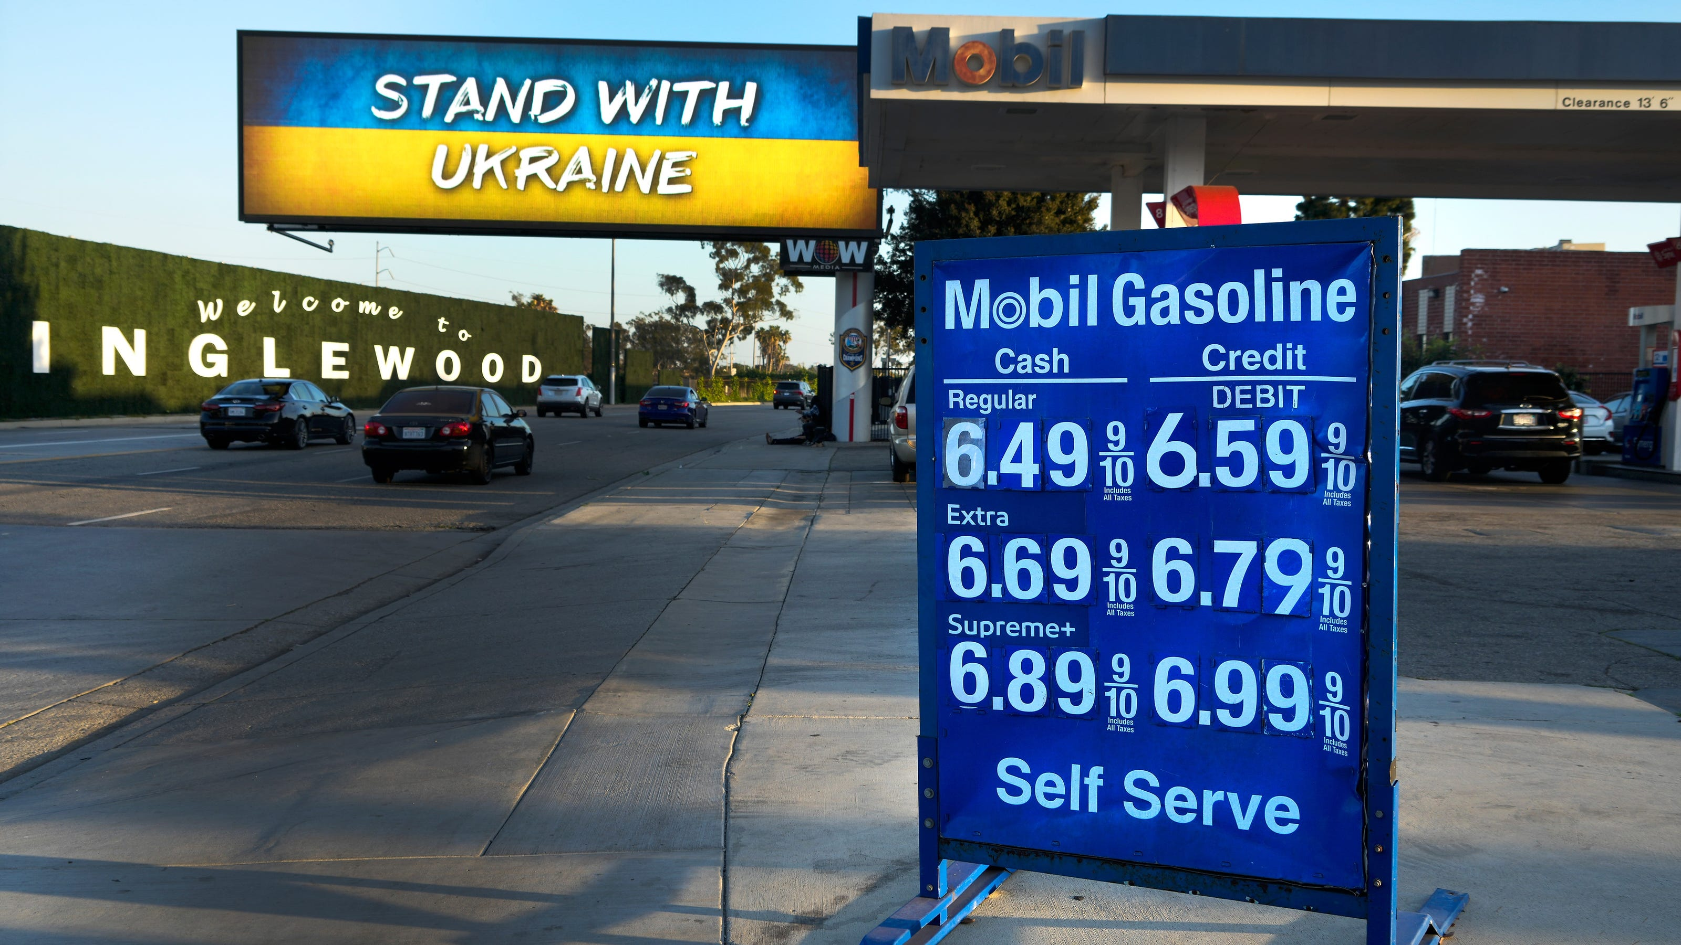
US Economy: Update
Jon Haveman, Ph.D.
NEED
October 3, 2022

Slide 11
Credits and Disclaimer
This slide deck was authored by:
Jon D. Haveman, NEED
Scott Baier, Clemson University
Geoffrey Woglom, Amherst College (Emeritus)
Brian Dombeck, Lewis & Clark College
Doris Geide-Stevenson, Weber State
Disclaimer
NEED presentations are designed to be nonpartisan.
It is, however, inevitable that the presenter will be asked for and will provide their own views.
Such views are those of the presenter and not necessarily those of the National Economic Education Delegation (NEED).

Slide 12
Outline
About the U.S. Economy
Recession – The State of the US Economy
Global Comparisons
Inflation
On the policy response:
To the pandemic
To inflation

Slide 13
Some Basic Statistics
Statistic: | Value
Population | 333.1 Million
Labor Force | 164.7 Million
Employment | 152.7 Million
Gross Domestic Product (GDP) | $24.9 Trillion
Income per Capita | $64,908
Ave. Hourly Earnings | $32.36

Slide 14
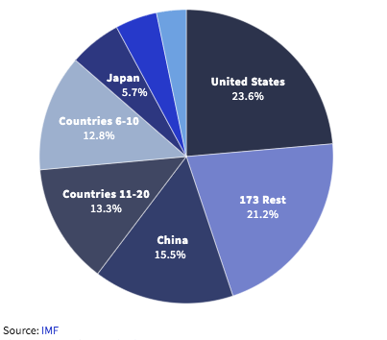
U.S. Economy in Global Perspective
U.S. Nominal GDP:
$21.747 trillion in 2019-Q4
$19.487 trillion in 2020-Q2
$24.852 trillion in 2022-Q2
Notes:
https://www.investopedia.com/insights/worlds-top-economies/#countries-by-gdp

Slide 15
Composition of the U.S. Economy: 2020

Slide 16
Composition of the U.S. Economy: Employment
Manufacturing
GDP Share = 10.9%
Health GDP Share = 7.4%
Note: Does not add to 100% because of omitted sectors.

Slide 17
Recession(?)

Slide 18
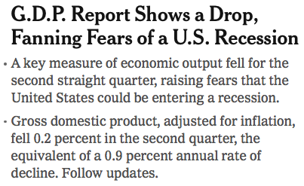
Headline:

Slide 19
GDP: Quarterly Growth
Notes:
Graph: gdp_pot_grow.png
The Point: From 1990 – 2007, average annual US GDP growth pre-crisis is 2.94%. However, post-crisis US GDP growth is 2.19% (0.75 percentage points lower). Why is has the recovery been sluggish?
Note: At the recession’s height, the gap between quarterly GDP growth and potential growth was 2.5 percentage points.

Slide 20
GDP Trajectory: Pandemic Plunge!
GDP is:
$0.6 Trillion below 2019 forecast.
$0.6 Trillion ABOVE 2019-Q4 level.

Slide 21
What Is “Accounting” for the Decline?
Expenditures drive GDP growth.
GDP is the sum of four categories of spending:
Consumption
Investment – housing/business/inventories
Government spending
Net Exports: Exports – Imports
Notes:
Recall: GDP is measures production of an economy; we often measure GDP as the sum of spending on final goods/services produced within an economy. The first three categories (C,I,G) contain spending on both domestically and foreign produced goods. To accurately measure domestic production, we subtract domestic consumption of foreign goods (imports).
The Point: Analysis of components of GDP as well as the production side of the economy should provide a comprehensive picture of the US economic landscape

Slide 22
Recession? Two Quarters….
Depends on what is driving the drop.
Inventories
Housing
Government spending
Consumer spending is still ok.
Employment growth is solid.
Other indicators are still ok.

Slide 23
Contribution to GDP Growth: Consumption
Notes:
Average GDP growth from 1990-2007 is 2.99% and from 2010+ is 2.19%
Average Consumption contribution from 1990-2007 is 2.16 percentage points and from 2010+ is 1.67 percentage points

Slide 24
Contribution to GDP Growth: Inventories
Notes:
Average GDP growth from 1990-2007 is 2.99% and from 2010+ is 2.19%
Average Consumption contribution from 1990-2007 is 2.16 percentage points and from 2010+ is 1.67 percentage points

Slide 25
Industrial Production (Manuf, Util, Mining)

Slide 26
Monthly Changes in Nonfarm Employment
Notes:
PAYEMS.png

Slide 27
Monthly Changes in Nonfarm Employment
August: 315,000
Notes:
PAYEMS.png

Slide 28
Employment Gap
240 thousand ABOVE February, 2020.
6.3 Million below where we should be.
Notes:
payroll_recent.png

Slide 29
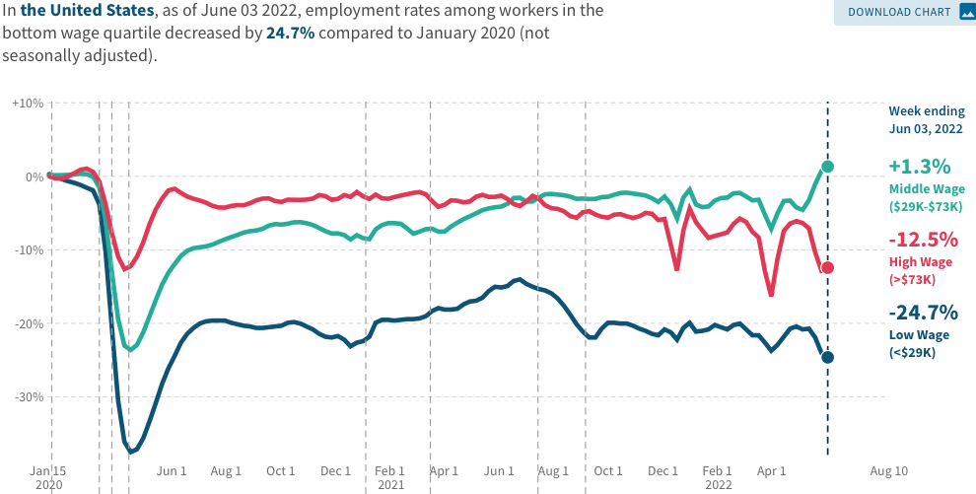
Low Wage Employment is Lagging
Source: https://tracktherecovery.org

Slide 30
Stimulus Payments Saved Low Wage Workers

Slide 31
Where Have All the Workers Gone?
3.7 million below where we should be

Slide 32
Some Explanations
500 Thousand: Long COVID Exits

Slide 33
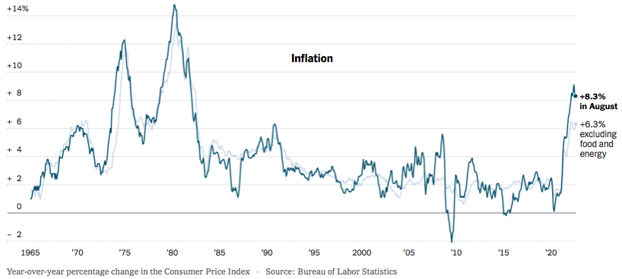
Inflation: Latest Figures
Source: NYTimes.com

Slide 34
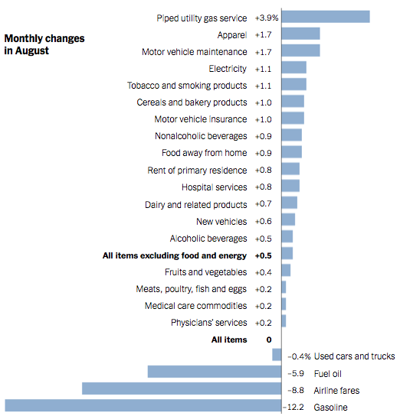
Which Prices?
Food

Slide 35
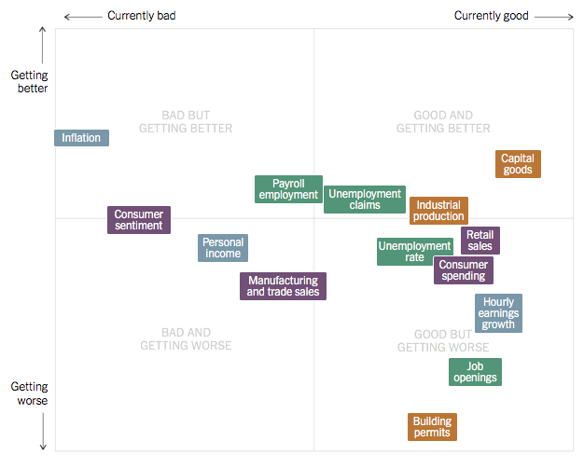
Summing Up The US Economy
Source: NYTimes.com

Slide 36
Global Evidence

Slide 37
Inflation: Not just a US Problem
United States: 8.5
Netherlands: 12.0
Spain: 10.4
United Kingdom: 10.1
Denmark: 8.9
Sweden: 8.5
Germany: 7.9
Norway: 6.5
France: 5.8
Source: TradingEconomics.com, 9/12/22

Slide 38
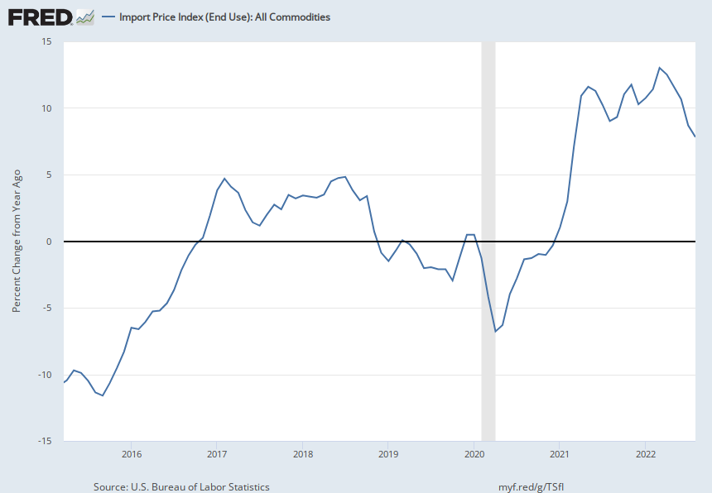
Import Prices Are Elevated
Inflation – Imported Products: 9-10%

Slide 39
GDP: U.S. Stands Out, But Not Alone
United States: -0.6
Netherlands: 2.6
Spain: 1.1
United Kingdom: -0.1
Denmark: 0.9
Sweden: 0.9
Germany: 0.1
Norway: 0.7
France: 0.5
Source: TradingEconomics.com, 9/12/22

Slide 40
Global Summary
Developed economies are uniformly down.
Not entirely a surprise. The bounce back from the early closures was rapid.
We have very little experience with this type of a global shock.
Entirely possible that interconnected economies will be on a similar cycle.
Somewhat surprising because the economic responses varied across countries. However:
Significant stimulus was a common theme.
Supply chain issues are a common theme.
Shifts from purchases of services to goods was a common theme.
And now the shift back.

Slide 41
Inflation

Slide 42
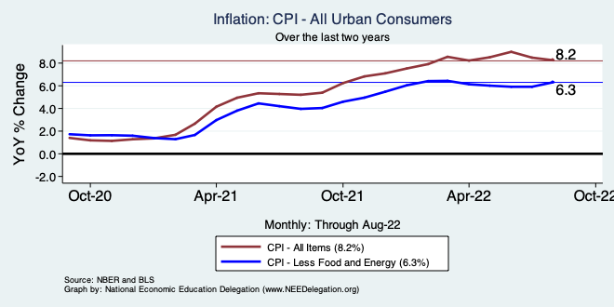
Inflation – Climbing! Or Turning Around?
Notes:
Cpi_recent.png

Slide 43
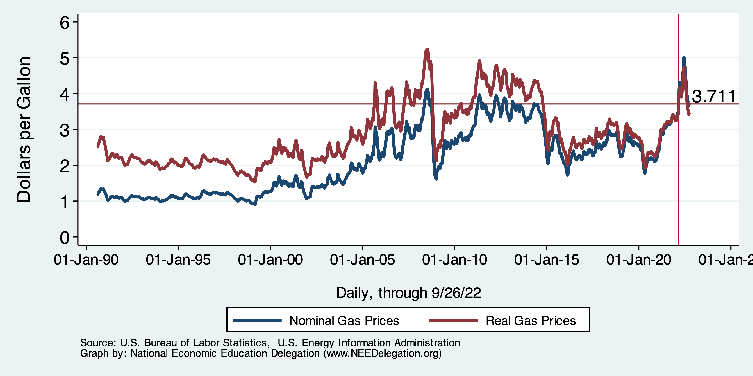
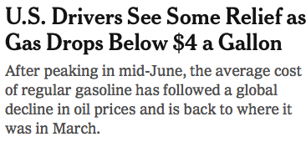
Gas Prices: National Average at the Pump

Slide 44
Fuel Costs Are Still Elevated

Slide 45
Food Costs Continue to Rise
Food at home: 13.5
Food away from home: 8.0

Slide 46
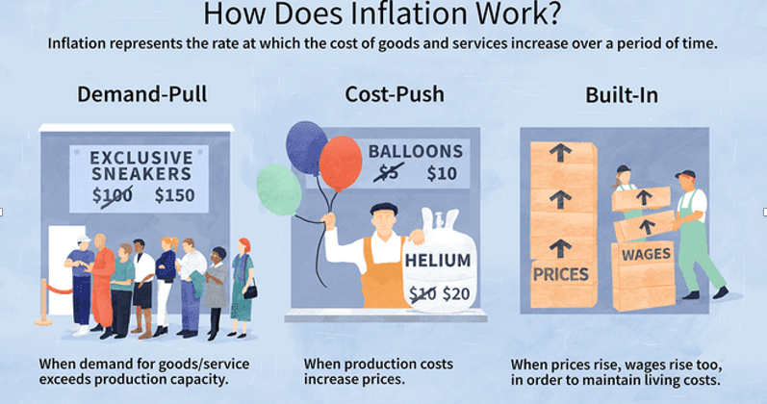
Source: Investopedia

Slide 47
Spending Patterns Changed - More Goods!
Demand-Pull
Goods spending up 14.3%
- And coming down.
Services spending up 0.7%
- And going up.

Slide 48
Inflation: Concentrated
Cost-Push

Slide 49
Supply Chains
Cost-Push

Slide 50
Fed’s Preferred Measure of Inflation

Slide 51
My Diagnosis for the Uptick in Inflation
Spending patterns have changed dramatically.
Yes, there were supply chain issues that affected some areas in particular (e.g., computer chips).
But there was also too much total spending.
Fiscal stimulus led households to increase saving over 2021 by more than $2 trillion. Strong retail sales numbers suggest they are prepared to spend it.
Whose to Blame: ARP probably too big, but the Fed could have acted sooner.

Slide 52
Measure of Inflation Expectations
Breakeven Inflation Rate = Difference between
nominal and real 5-year and 10-year Treasury
constant maturity securities.
Market participants expect around 2.4%
inflation annually over the next 10 years and
2.6% over the next 5 years.
Inflation expectations are calming down.

Slide 53
What’s the Fed Doing About It?

Slide 54
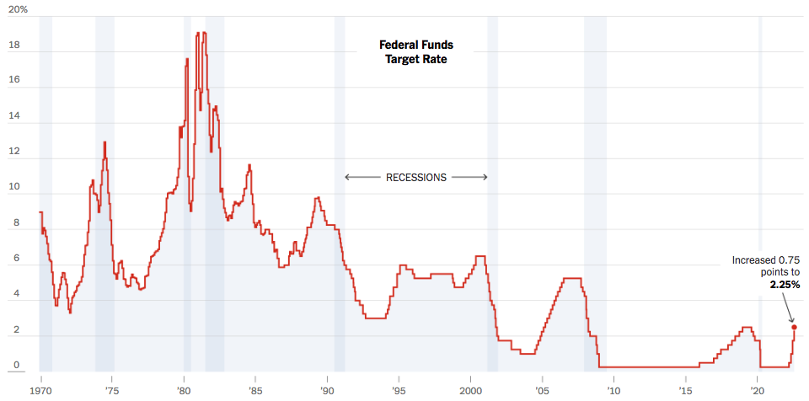
Federal Funds Rate
Just raised to: 3%
Notes:
The fed funds rate is the interest rate on overnight loans between banks. Think of it as the baseline interest rate on which banks base all other interest rates (e.g. mortgage rates)
FOMC lowers the fed funds rate during recessions and raises the fed funds rate during expansions
Fed funds rate peaked in the 1980s as then Chairman Paul Volcker sought to reign in “run away” inflation of the 1970s; doing so resulted in a recession in the early 1980s.
Since the 2008-09 recession, the fed funds rate has been kept near zero.
During the 2008-09 recession, Federal Reserve turned to unconventional tools to influence longer term interest rates to further stimulate the economy - QE
FedFunds.png

Slide 55
Implications for Demand
Investment borrowing
Home loans – tied to 10-year Treasury
Car loans
Credit cards
Savings accounts – positive
And more….

Slide 56
Treasuries
Notes:
treas_recent.png

Slide 57
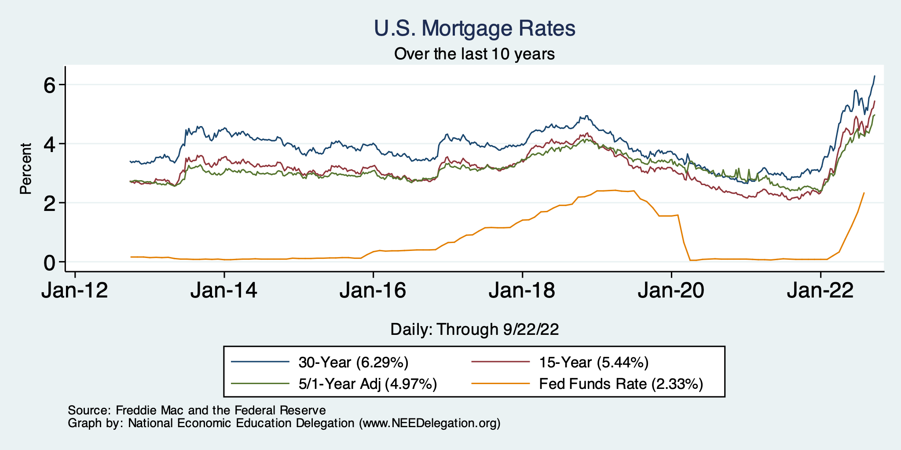
Mortgage Rates

Slide 58
Takeaways
Is a recession on the horizon?
Larry Summers, Jamie Dimon, and Elon Musk are worried about a recession.
While the chances of slipping into a recession have increased, I think on many dimensions the economy is doing quite well.
Consumer’s have been driving the recovery, and consumer’s account for two-thirds of GDP.
Job creation remains robust – 315k in August.
What about GDP?
2022:Q1 was -1.6%, 2022:Q2 was -0.6.
Much of this lower growth was driven by lower inventory.
Inventories led GDP growth in 2021:Q4, didn’t sell, so production in Q1&Q2 fell.
Housing markets – very tightly linked to interest rates – softened … A LOT.
Government spending is falling.

Slide 59
The Role of Policy
Did it get us into this mess?
Can it get us out?

Slide 60
Policy-Induced Inflation/Downturn?
The big questions is: What is responsible for the cycles related to the pandemic?
Policies
The United States spent $5 trillion in pandemic related programs.
There remains $2 trillion in excess savings.
What role did local shutdowns play?
What role did the nature of business support play?
In particular, the lack of support for small businesses.
Natural fear and self preservation?
More goods and less services.
Leaving the labor force.
Bouncing back too aggressively and optimistically (inventories)?
Natural struggles of an economy to respond to changes?

Slide 61
Did Politicians Get Us Into This Mess?
Clear that policy played a significant role.
Too much untargeted spending.
How should we think about that?
Washington sausage making comes with tradeoffs:
Quality comes from moving slowly, but perhaps misses the window of opportunity.
Haste makes waste. Pandemic spending has clearly not been as thoughtful as it might have been.
But there is lots of blame to throw around.
Economies just don’t respond very well to significant shocks.

Slide 62
Can Politicians/Policymakers Get Us Out?
Well, no.
President Biden: Really has very little control over aggregate demand or prices.
Could put price controls in place. But nobody wants that.
Congress: similarly hamstrung.
Federal Reserve: Acting aggressively, which seems to be paying off.

Slide 63
Bottom Line:
Politicians did what they felt was necessary.
They also did the best they could.
The pandemic threw spanners in the works that neither politicians nor economists had/have the answers to
Blaming anybody for actions or inactions, for economic woes (inflation) is not reasonable.
Though a case could be made that the Fed should have acted sooner.
But we don’t really know if that would have made a difference.
Really left with the Fed doing the best that it can…and being patient.

Slide 64
Climate Change Economics: Trevor O’Grady
The changing map of the world’s wine-growing regions.

Slide 65
Thank you!
Any Questions?
www.NEEDelegation.org
Jon D. Haveman
Jon@NEEDelegation.org
Contact NEED: info@NEEDelegation.org
Submit a testimonial: www.NEEDelegation.org/testimonials.php
Become a Friend of NEED: www.NEEDelegation.org/friend.php

Slide 66
www.NEEDelegation.org/LocalGraphs
For every state and county in the United States.
Detailed graphs on employment, housing, moves, and other statistics.

