Slide 1
US Economy and Coronavirus Economics
OLLI, San Francisco State University
January 12, 2022
Jon Haveman, Ph.D.
National Economic Education Delegation

Slide 2
National Economic Education Delegation
Vision
One day, the public discussion of policy issues will be grounded in an accurate perception of the underlying economic principles and data.
Mission
NEED unites the skills and knowledge of a vast network of professional economists to promote understanding of the economics of policy issues in the United States.
NEED Presentations
Are nonpartisan and intended to reflect the consensus of the economics profession.

Slide 3
Who Are We?
Honorary Board: 54 members
2 Fed Chairs: Janet Yellen, Ben Bernanke
6 Chairs Council of Economic Advisers
Furman (D), Rosen (R), Bernanke (R), Yellen (D), Tyson (D), Goolsbee (D)
3 Nobel Prize Winners
Akerlof, Smith, Maskin
Delegates: 640+ members
At all levels of academia and some in government service
All have a Ph.D. in economics
Crowdsource slide decks
Give presentations
Global Partners: 48 Ph.D. Economists
Aid in slide deck development

Slide 4
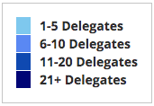
Where Are We?

Slide 5
Available NEED Topics Include:
Coronavirus Economics
US Economy
Climate Change
Economic Inequality
Economic Mobility
Trade and Globalization
Minimum Wages
Immigration Economics
Housing Policy
Federal Budgets
Federal Debt
Black-White Wealth Gap
Autonomous Vehicles
US Social Policy

Slide 6
Credits and Disclaimer
This slide deck was authored by:
Jon D. Haveman, NEED
Scott Baier, Clemson University
Geoffrey Woglom, Amherst College (Emeritus)
Brian Dombeck, Lewis & Clark College
Doris Geide-Stevenson, Weber State
Disclaimer
NEED presentations are designed to be nonpartisan.
It is, however, inevitable that the presenter will be asked for and will provide their own views.
Such views are those of the presenter and not necessarily those of the National Economic Education Delegation (NEED).

Slide 7
Outline
State of the pandemic
The U.S. Economy
Hot Topics
Government policy
Debt
Inflation
Great resignation
Housing markets

Slide 8
State of the Pandemic

Slide 9
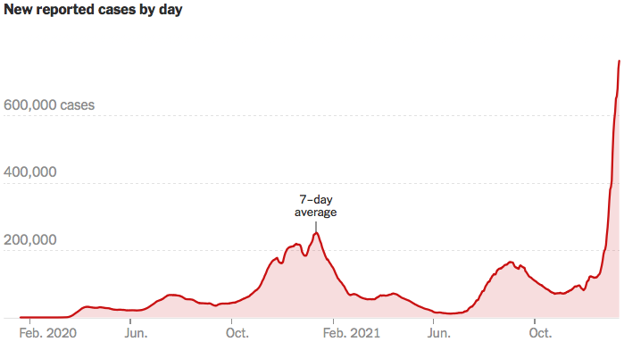
Making Real Progress…Until Omicron
Source: NYTimes

Slide 10
California Cases Were Falling Nicely
Source: NYTimes

Slide 11
What is this?
A natural disaster – with important twists:
Global
Duration is unpredictable
Economic toll is enormous and potentially durable
A health crisis that spilled over onto the economy.
A perfect storm of economic difficulty
Supply side
Demand side
Financial
Without a culprit

Slide 12
The U.S. Economy

Slide 13
Some Basic Statistics
Statistic: | Value
Population | 331.1 Million
Labor Force | 160.9 Million
Employment | 144.9 Million
Gross Domestic Product (GDP) | $22.1 Trillion
Ave. Hourly Earnings | $30.33

Slide 14
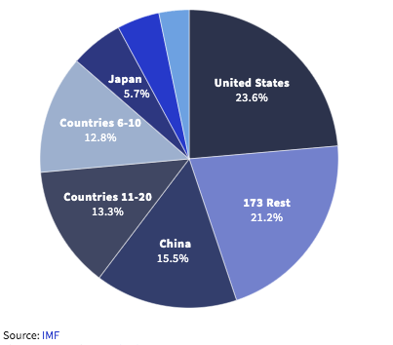
U.S. Economy in Global Perspective
U.S. Real GDP:
$19.202 trillion in 2019-Q4
$17.258 trillion in 2020-Q2
$19.479 trillion in 2021-Q3
Notes:
https://www.investopedia.com/insights/worlds-top-economies/#countries-by-gdp

Slide 15
Composition of the U.S. Economy: GDP

Slide 16
Composition of the U.S. Economy: Employment
Manufacturing
GDP Share = 10.9%
Health GDP Share = 7.4%

Slide 17
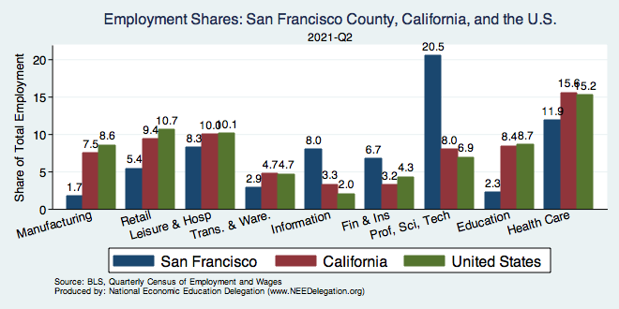
SF County: Tech and Finance Intensive

Slide 18
Evidence of Impact

Slide 19
Spending Patterns Since First US Case
Q3 - Flat
Source: https://tracktherecovery.org/

Slide 20
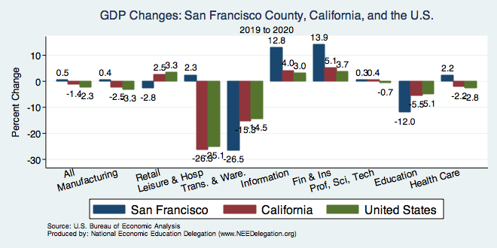
But Not All Industries Were Equally Harmed

Slide 21
Spending Patterns – Hardest Hit Sectors
+0.2%
Transportation
Source: https://tracktherecovery.org/

Slide 22
Spending Patterns – Hardest Hit Sectors
+0.2%
Transportation
Source: https://tracktherecovery.org/

Slide 23
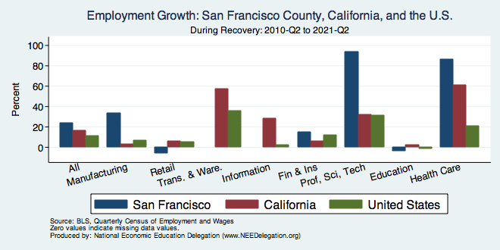
SF County Emp Growth: Tech and Health

Slide 24
Why does spending matter?
Spending:
Goods 20%
Services 44%
Total 64%
Notes:
Components sum to GDP
Average % of GDP for each component from 1960-Present: C = 64%, I=15%, G=24%, NX = 2% (X = 7%, M=9%)
Net Exports as a % of GDP has increased over the sample period, but it’s contribution to GDP is relatively small

Slide 25
GDP Trajectory: Pandemic Plunge!
Q3 - Flat
GDP is:
$0.5 Trillion below 2019 forecast.
$0.2 Trillion ABOVE 2019-Q4 level.

Slide 26
GDP: Quarterly Growth
Notes:
Graph: gdp_pot_grow.png
The Point: From 1990 – 2007, average annual US GDP growth pre-crisis is 2.94%. However, post-crisis US GDP growth is 2.19% (0.75 percentage points lower). Why is has the recovery been sluggish?
Note: At the recession’s height, the gap between quarterly GDP growth and potential growth was 2.5 percentage points.

Slide 27
Consumption: Quarterly Growth
Notes:
Graph: gdp_pot_grow.png
The Point: From 1990 – 2007, average annual US GDP growth pre-crisis is 2.94%. However, post-crisis US GDP growth is 2.19% (0.75 percentage points lower). Why is has the recovery been sluggish?
Note: At the recession’s height, the gap between quarterly GDP growth and potential growth was 2.5 percentage points.

Slide 28
Monthly Changes in Nonfarm Employment
Notes:
PAYEMS.png

Slide 29
Monthly Changes in Nonfarm Employment
Recovery
Delta
Omicron
Notes:
PAYEMS.png

Slide 30
Annual Changes in Nonfarm Employment

Slide 31
Employment Gap
3.5 Million below February, 2020.
8.4 Million below where we should be.
Notes:
payroll_recent.png

Slide 32
Employment Gap
Notes:
payroll_recent.png

Slide 33
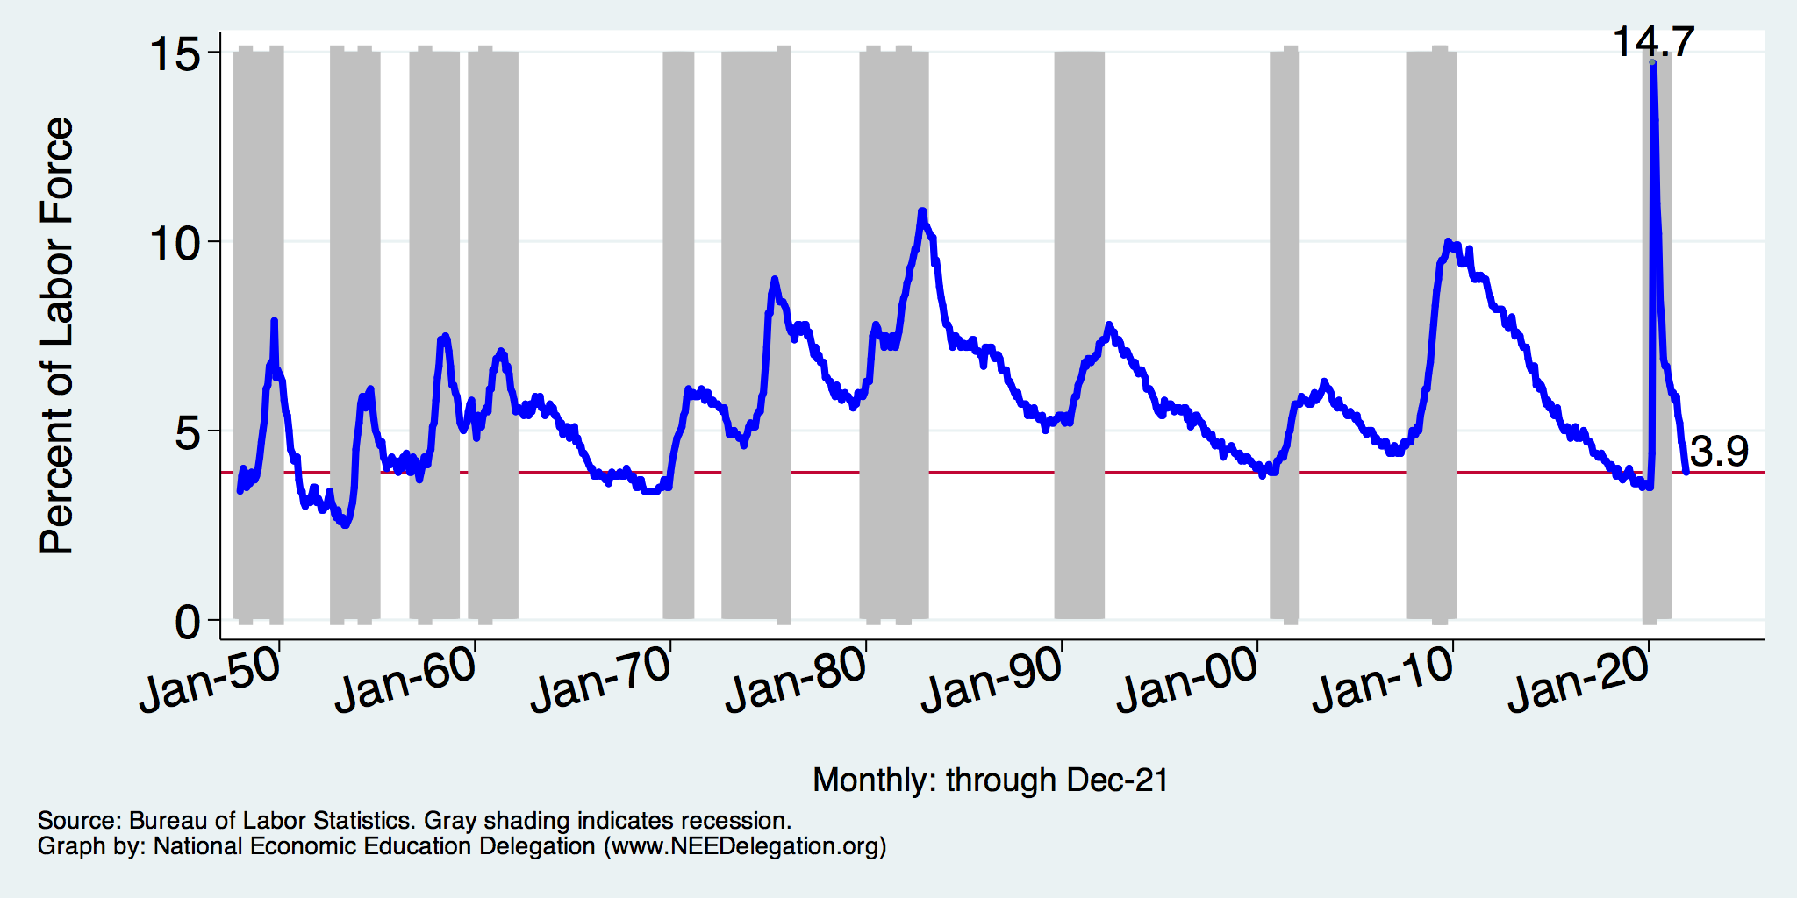
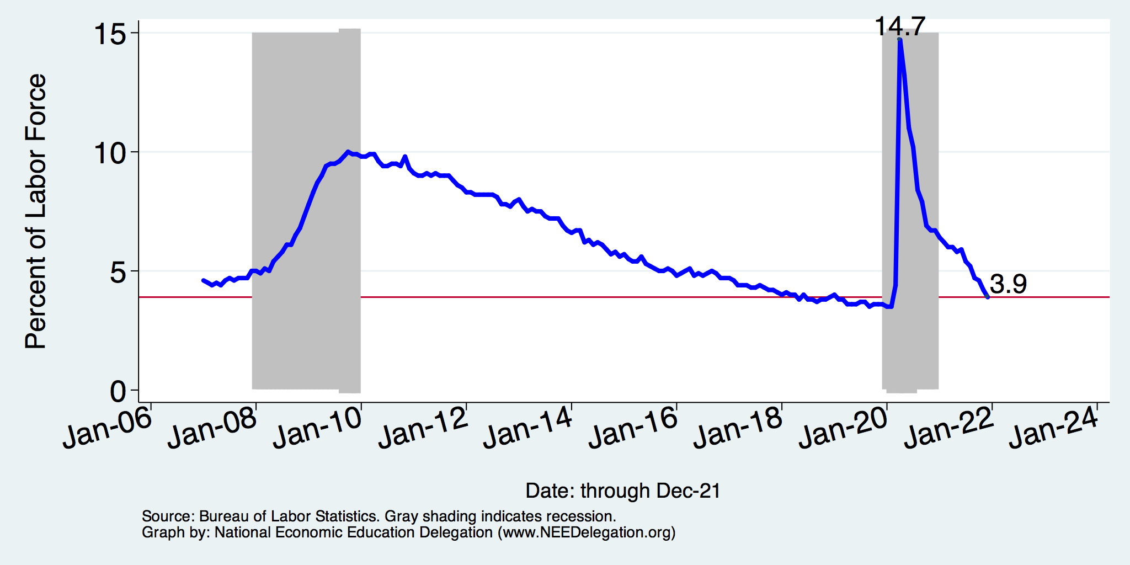
Unemployment Rate
Notes:
Unemployment rises during recessions and falls during economic expansions.
Unemployment peaked at the end of the 2009 recession.
The Fed worked to reduce the effects of the recession. Near the end of 2008, the FOMC reduced the federal funds rate to nearly zero and worked to reduce longer-term interest rates via large-scale asset purchase programs (late 2008 – 10/2014).
Unemployment is currently below the natural rate of unemployment. This is traditionally accompanied by economic growth and rising price levels. It’s also a major reason for FOMC’s decision to increase the federal funds rate.

Slide 34
Reduced Spending: Unemployment
Peak: 22.9% (April, 2019)

Slide 35
Trends in Labor Force Participation
Notes:
CLF16OV.png

Slide 36
Labor Force is Shrinking – Drives Down UR

Slide 37
Affected Women More Than Men?

Slide 38
Affected Women More Than Men
Men
Women
Long term implications for women?

Slide 39
Why Women More Than Men?
Women are disproportionately represented in low-wage and face-to-face jobs.
Our childcare and school systems don’t meet the needs of working mothers.
COVID-19 has upended the labor market, with disastrous consequences for working women and their families.
Many women continued working in high risk jobs.
The difference in impact is waning.

Slide 40
Affecting Black Workers More than White
White
Black

Slide 41
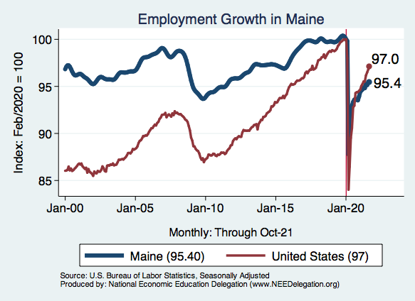
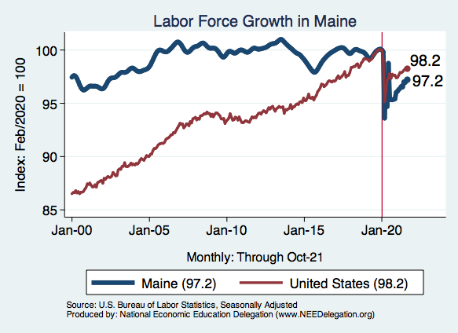
Employment in Maine

Slide 42
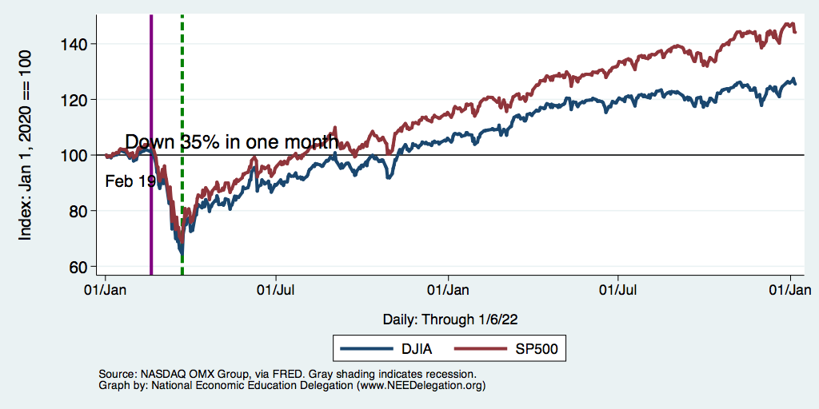
DJIA and S&P 500

Slide 43
Hot Topics
Government policy
Debt
Inflation
Great resignation
Structural changes
Housing markets
Inequality

Slide 44
What Have Been Policy Effects?
MONETARY POLICY (Fed) acted quickly and effectively to prevent a financial market meltdown and to keep credit flowing. But the Fed lends and does not spend.
FISCAL POLICY (Congress) acted quickly, but inevitably made some mistakes.
Stimulus Checks, A ($268b)
Expanded Unemployment, B ($268b)
Paycheck Protection Program, C- ($525b)
Last two packages: $2.8 Trillion

Slide 45
Recovery Due to Immense Fiscal Stimulus and Control of COVID

Slide 46
Stimulus allowed Spending to Recover
But Note that Saving also went way up
Saving
Abnormally high Saving is over $2trillion

Slide 47
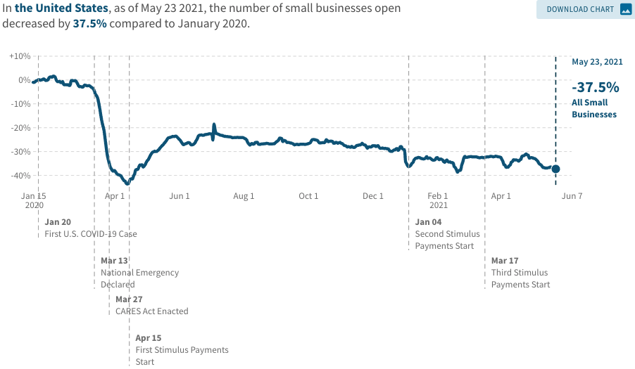
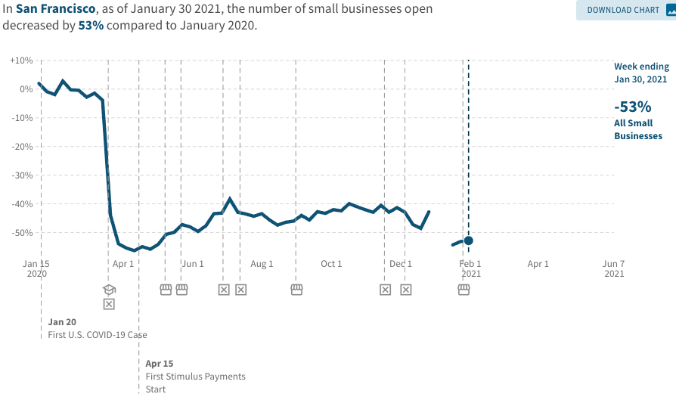
A Hard-Hit Sector: Small Business
Small Biz Closures in the United States
Small Biz Closures in San Francisco

Slide 48
Small Businesses: They Didn’t Get Enough PPP

Slide 49
Monetary Policy: Federal Reserve
Primary goal is to keep interest rates low, to facilitate continued borrowing.
Federal Funds Rate – rate at which banks lend to each other, usually overnight.
Purchases of U.S. Treasury securities – keep money flowing to the government at low rates of interest.

Slide 50
Federal Funds Rate – Last 5 Years
Notes:
The FOMC waited for labor market conditions to improve before raising the fed funds rate in late 2015.
FOMC currently working to normalize monetary policy by raising interest rates and reducing assets on its balance sheet
FedFunds_recent.png

Slide 51
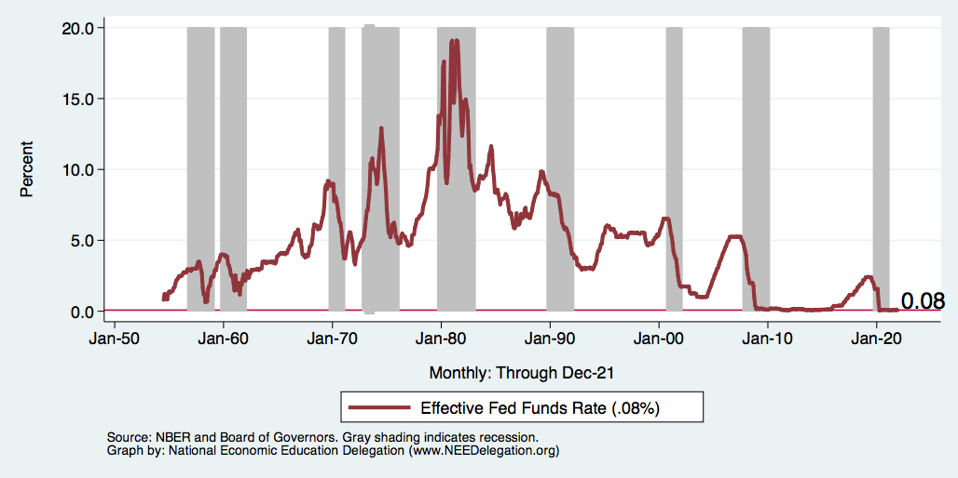
Federal Funds Rate
Notes:
The fed funds rate is the interest rate on overnight loans between banks. Think of it as the baseline interest rate on which banks base all other interest rates (e.g. mortgage rates)
FOMC lowers the fed funds rate during recessions and raises the fed funds rate during expansions
Fed funds rate peaked in the 1980s as then Chairman Paul Volcker sought to reign in “run away” inflation of the 1970s; doing so resulted in a recession in the early 1980s.
Since the 2008-09 recession, the fed funds rate has been kept near zero.
During the 2008-09 recession, Federal Reserve turned to unconventional tools to influence longer term interest rates to further stimulate the economy - QE
FedFunds.png

Slide 52
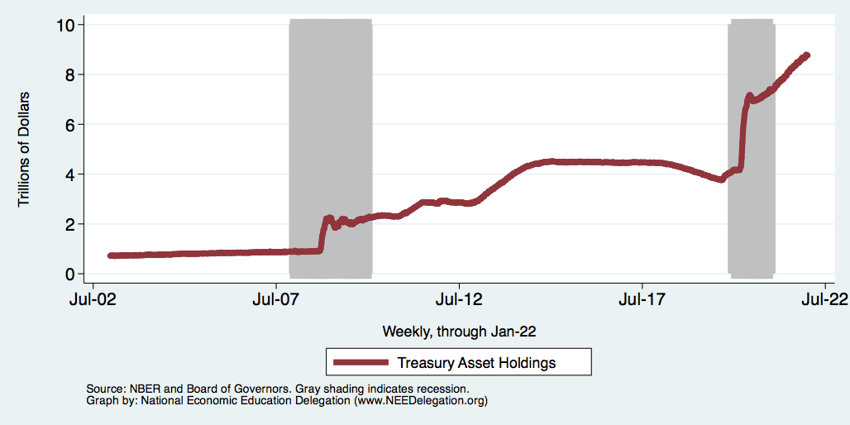
Federal Reserve Assets
8.8
Largely Treasury Securities
Pandemic
Financial Crisis
3.8
1.0
Notes:
The fed funds rate is the interest rate on overnight loans between banks. Think of it as the baseline interest rate on which banks base all other interest rates (e.g. mortgage rates)
FOMC lowers the fed funds rate during recessions and raises the fed funds rate during expansions
Fed funds rate peaked in the 1980s as then Chairman Paul Volcker sought to reign in “run away” inflation of the 1970s; doing so resulted in a recession in the early 1980s.
Since the 2008-09 recession, the fed funds rate has been kept near zero.
During the 2008-09 recession, Federal Reserve turned to unconventional tools to influence longer term interest rates to further stimulate the economy - QE
FedFunds.png

Slide 53
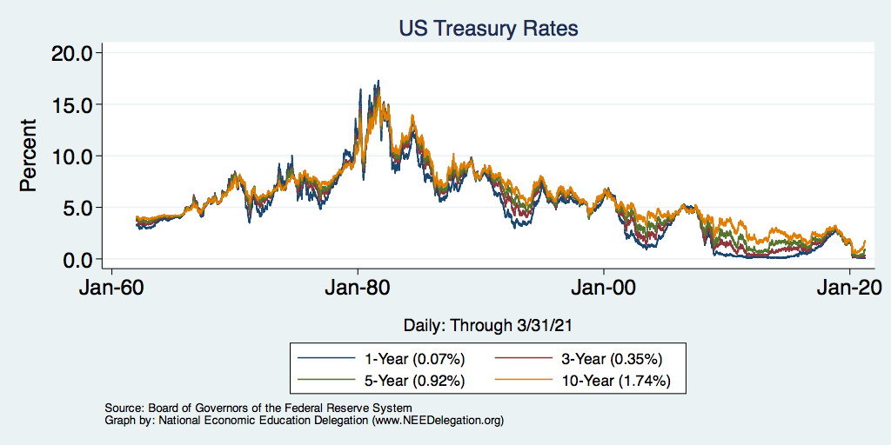
Treasuries – Low Interest Rates
Notes:
treas_recent.png

Slide 54
A “K-shaped” recovery?
Executive Summary
Those with financial wealth/residential real estate have seen its value grow in excess of inflation.
High income earners (>60k/yr) have largely kept their jobs;
middle and low income earners have depressed employment rates
Women are disproportionately exiting labor force.
Food insecurity has been very high.

Slide 55
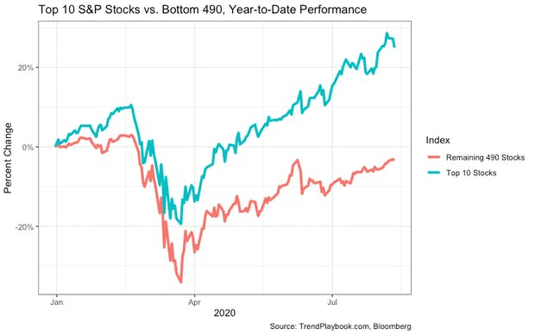
Recovery/Recession for Whom?
Top 10 S&P Stocks:
Apple
Microsoft
Amazon
Facebook
Alphabet Class A shares
Alphabet Class C shares
Berkshire Hathaway
Johnson & Johnson
Visa
Procter & Gamble

Slide 56
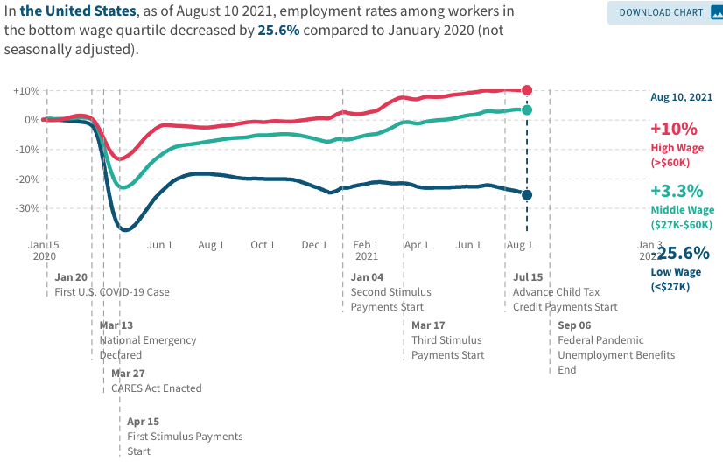
Low Wage Employment is Lagging

Slide 57
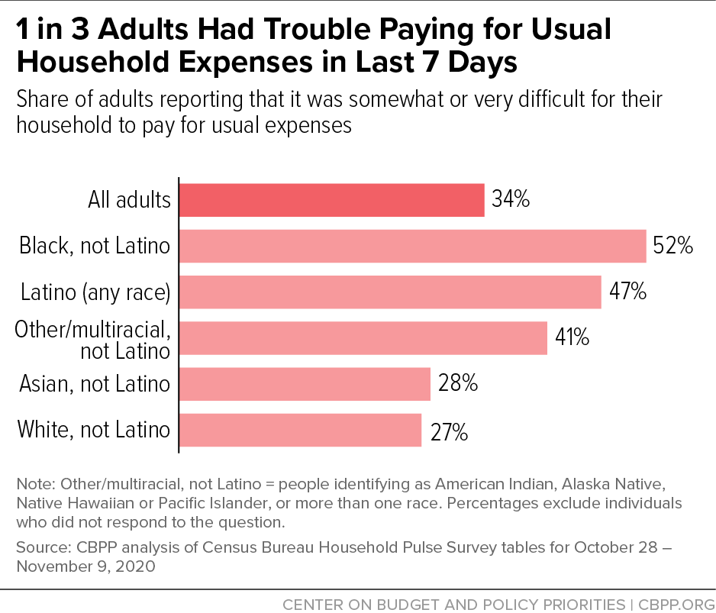
Low Income Troubles

Slide 58
Coronavirus and Inequality
Resources to weather the storm.
Racial inequities.
Educational inequities
Telecommuting
Low wage jobs are at risk.

Slide 59
A Problem Exacerbated….Not Created

Slide 60
Current Deficits in Perspective:
The budgetary cost of the 3 major fiscal packages during the pandemic was over $5 trillion. As a share of the economy this is almost the size of war production in 1943.
(Romer, Brookings Papers on Economic Activity, 3/25/2021.)
Since March of 2021, Fed net holdings of US Treasury bonds have increased by $2.7 trillion.

Slide 61
Inflation

Slide 62
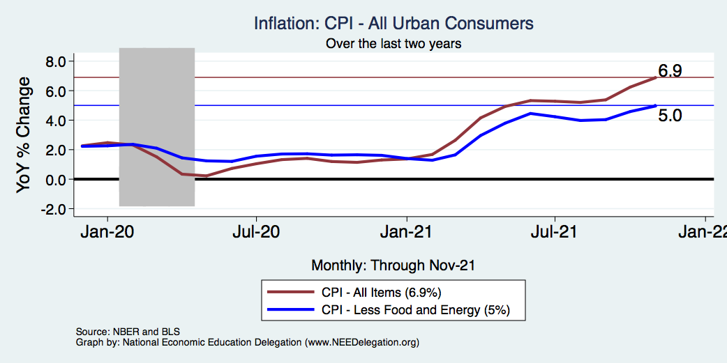
Inflation – Climbing! Should we worry?
Notes:
Cpi_recent.png

Slide 63
Inflation in Historical Perspective

Slide 64
What Index to Follow: CPI or PCE?
CPI is the headline statistic, followed by most newspapers.
Allows more granularity – ability to look at specific products.
PCE is the one followed by the Fed.
Why?
Accounts for short term fluctuations in consumer purchases.
Based on more reliable data.
Fed generally pays attention to the core inflation #s.
Excluding food and energy.

Slide 65
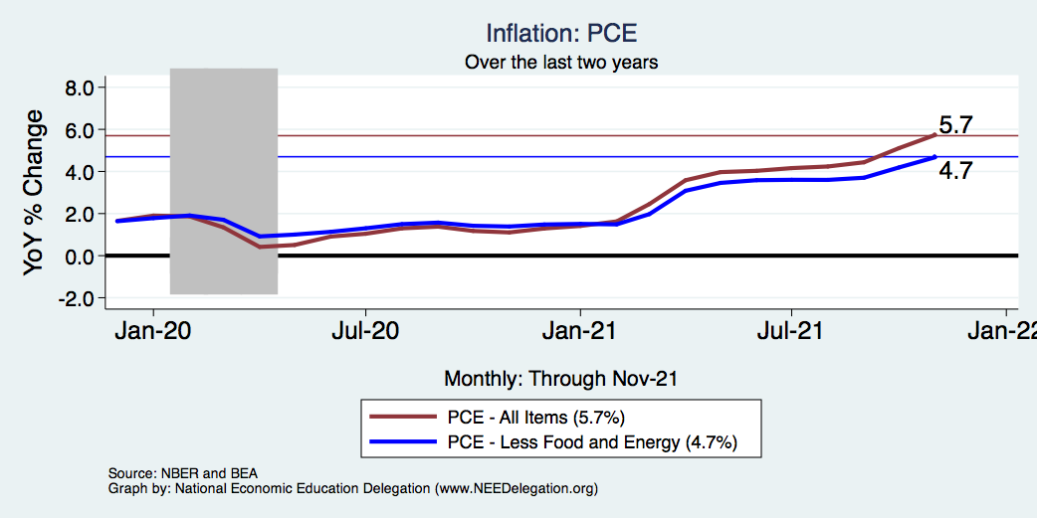
Inflation – The Fed’s Metric! Should we worry?
Notes:
Cpi_recent.png

Slide 66
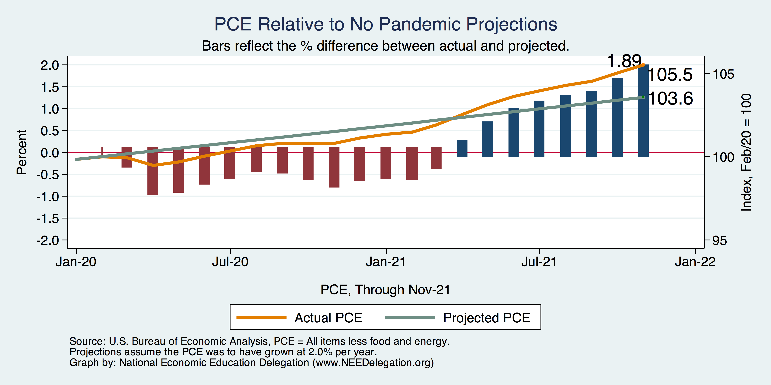
Inflation – PCE and Fed Suggest: I don’t know.
Notes:
Cpi_recent.png

Slide 67
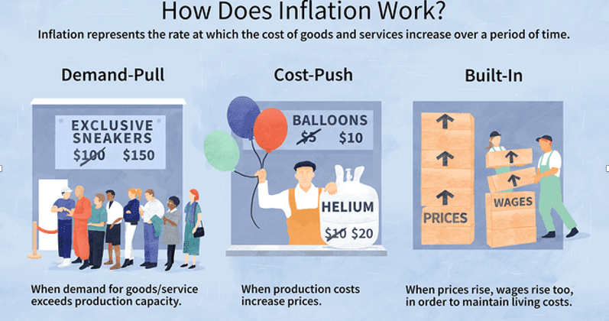
Source: Investopedia

Slide 68
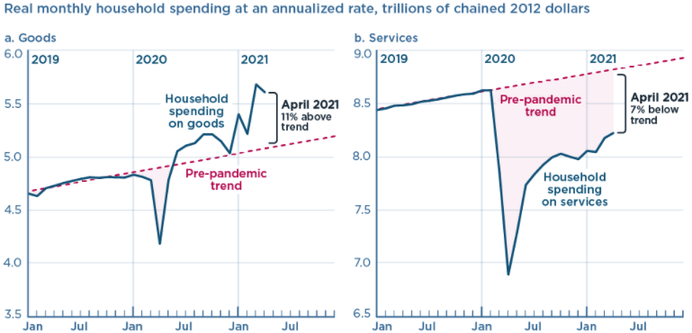
We’re Buying Mostly … Stuff
Demand-Pull
Source: Jason Furman, PIIE

Slide 69
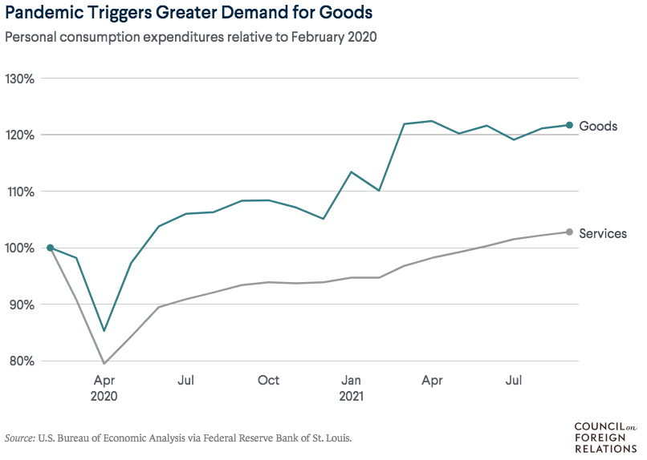
Supply Chains Are at the Core

Slide 70
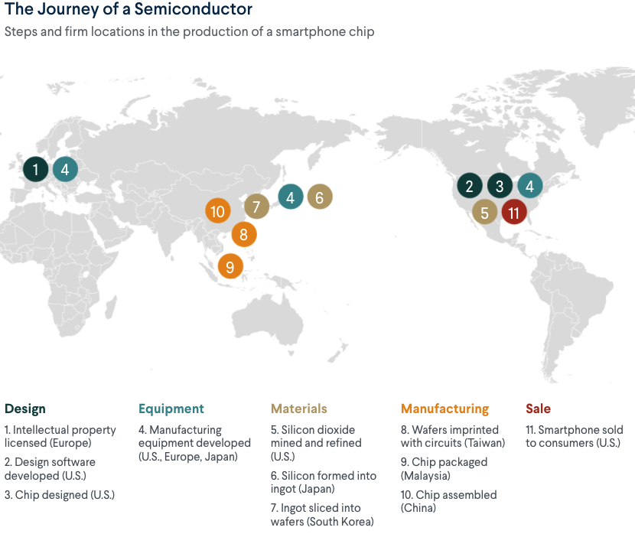
What Are Supply Chains?
https://www.cfr.org/article/what-happened-supply-chains-2021

Slide 71
Inflation: Concentrated
Cost-Push

Slide 72
Corporate Profits…Adding to Inflation?

Slide 73
Puzzle: Is Inflation Permanently Higher?
Fed: Price increases may be:
1) rebound from low prices last year;
2) temporary due to supply chain disruptions; e.g., used cars, bldg supplies.
3) influenced by rising wages in the future.
On the other hand: We are close to full employment and monetary and fiscal policies are very easy.
Nobody knows, but Fed has wavered in its optimism.

Slide 74
Inflation: Critical Issues
Inequities
Price changes vary wildly across goods.
How inflation hits you depends on what you buy and your level of income.
Some evidence that lower income individuals face higher inflation.
Online inflation is much lower than the CPI
Estimates suggest about 2% lower.
Both have implications for the policy response.
Safety net? Antitrust action?

Slide 75
The Great Resignation

Slide 76
Quits Are High! The Great Resignation

Slide 77
Quits – Rising, but More in Some Industries
Accom. & Food Services
Leisure & Hospitality
Retail

Slide 78
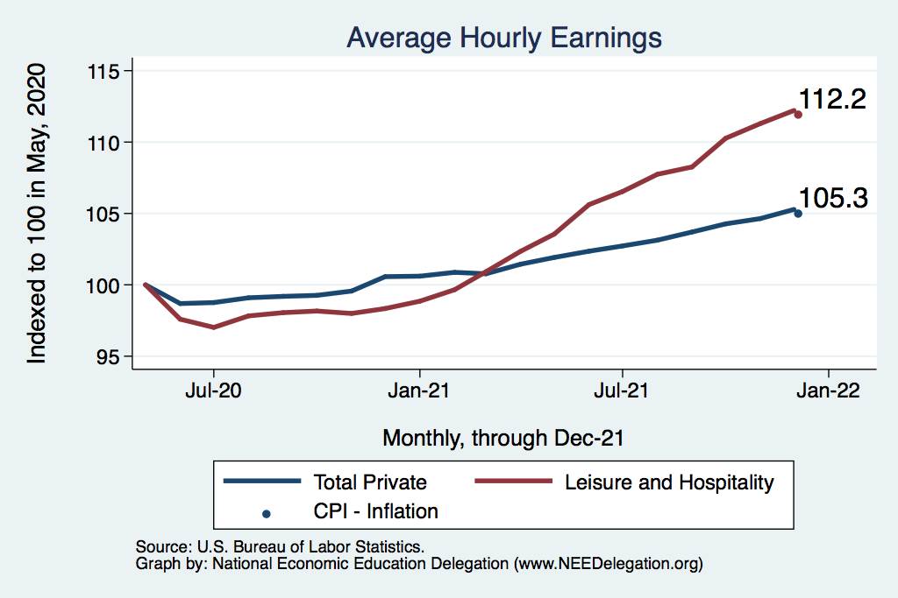
This is Happening Despite Rising Wages
Leisure & Hospitality
Total Nonfarm

Slide 79
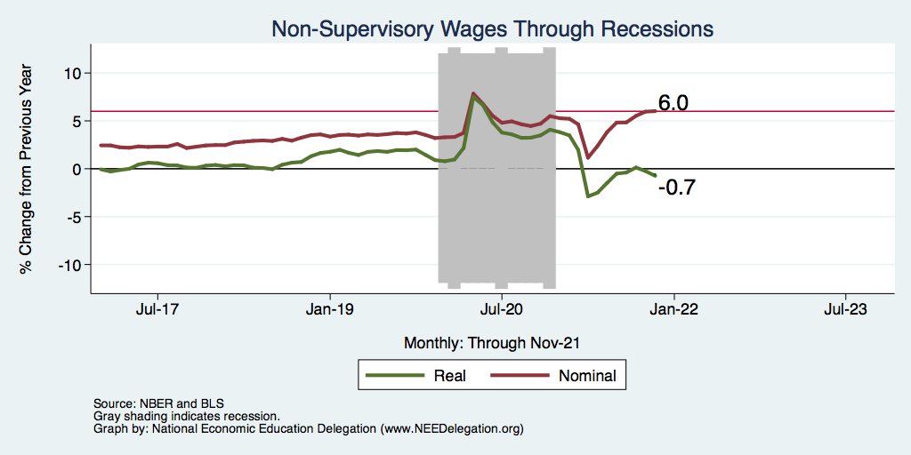
Inflation Adjusted Wages Are Falling

Slide 80
Declining Resources May Change Things
Source: NYTimes.com

Slide 81
Structural Changes?
Pandemic has been an accelerant.
Not a change agent.
Retail
Telecommuting
Telehealth
Business travel?
Wealth concentration
Industry concentration
Automation

Slide 82
Why so Excited About Telecommuting?
Productivity at home appears to be really high during pandemic.
Nothing else to do.
Short term – corporate culture and new hires – visibility to the boss – camaraderie.
CEOs are salivating over reduced Comm RE costs.

Slide 83
Telecommuting – Will it Stick?
Working from home is ALWAYS less productive than working in the office.
But the gap has shrunk because of technology.
In the interest of workplace productivity, employers are likely to allow more working from home.
Increased in-office moral and hence productivity.
But not 100% or even 50%. How much?
Has important implications for real estate.

Slide 84
Residential Real Estate
Rental markets
Eviction moratoria are over.
Not enough in the American Rescue Plan.
Reports of rents rising significantly.
Owned homes
Depends on location.
San Francisco – recovering.
Maine – continued strength.
Size matters: large homes are selling particularly well.

Slide 85
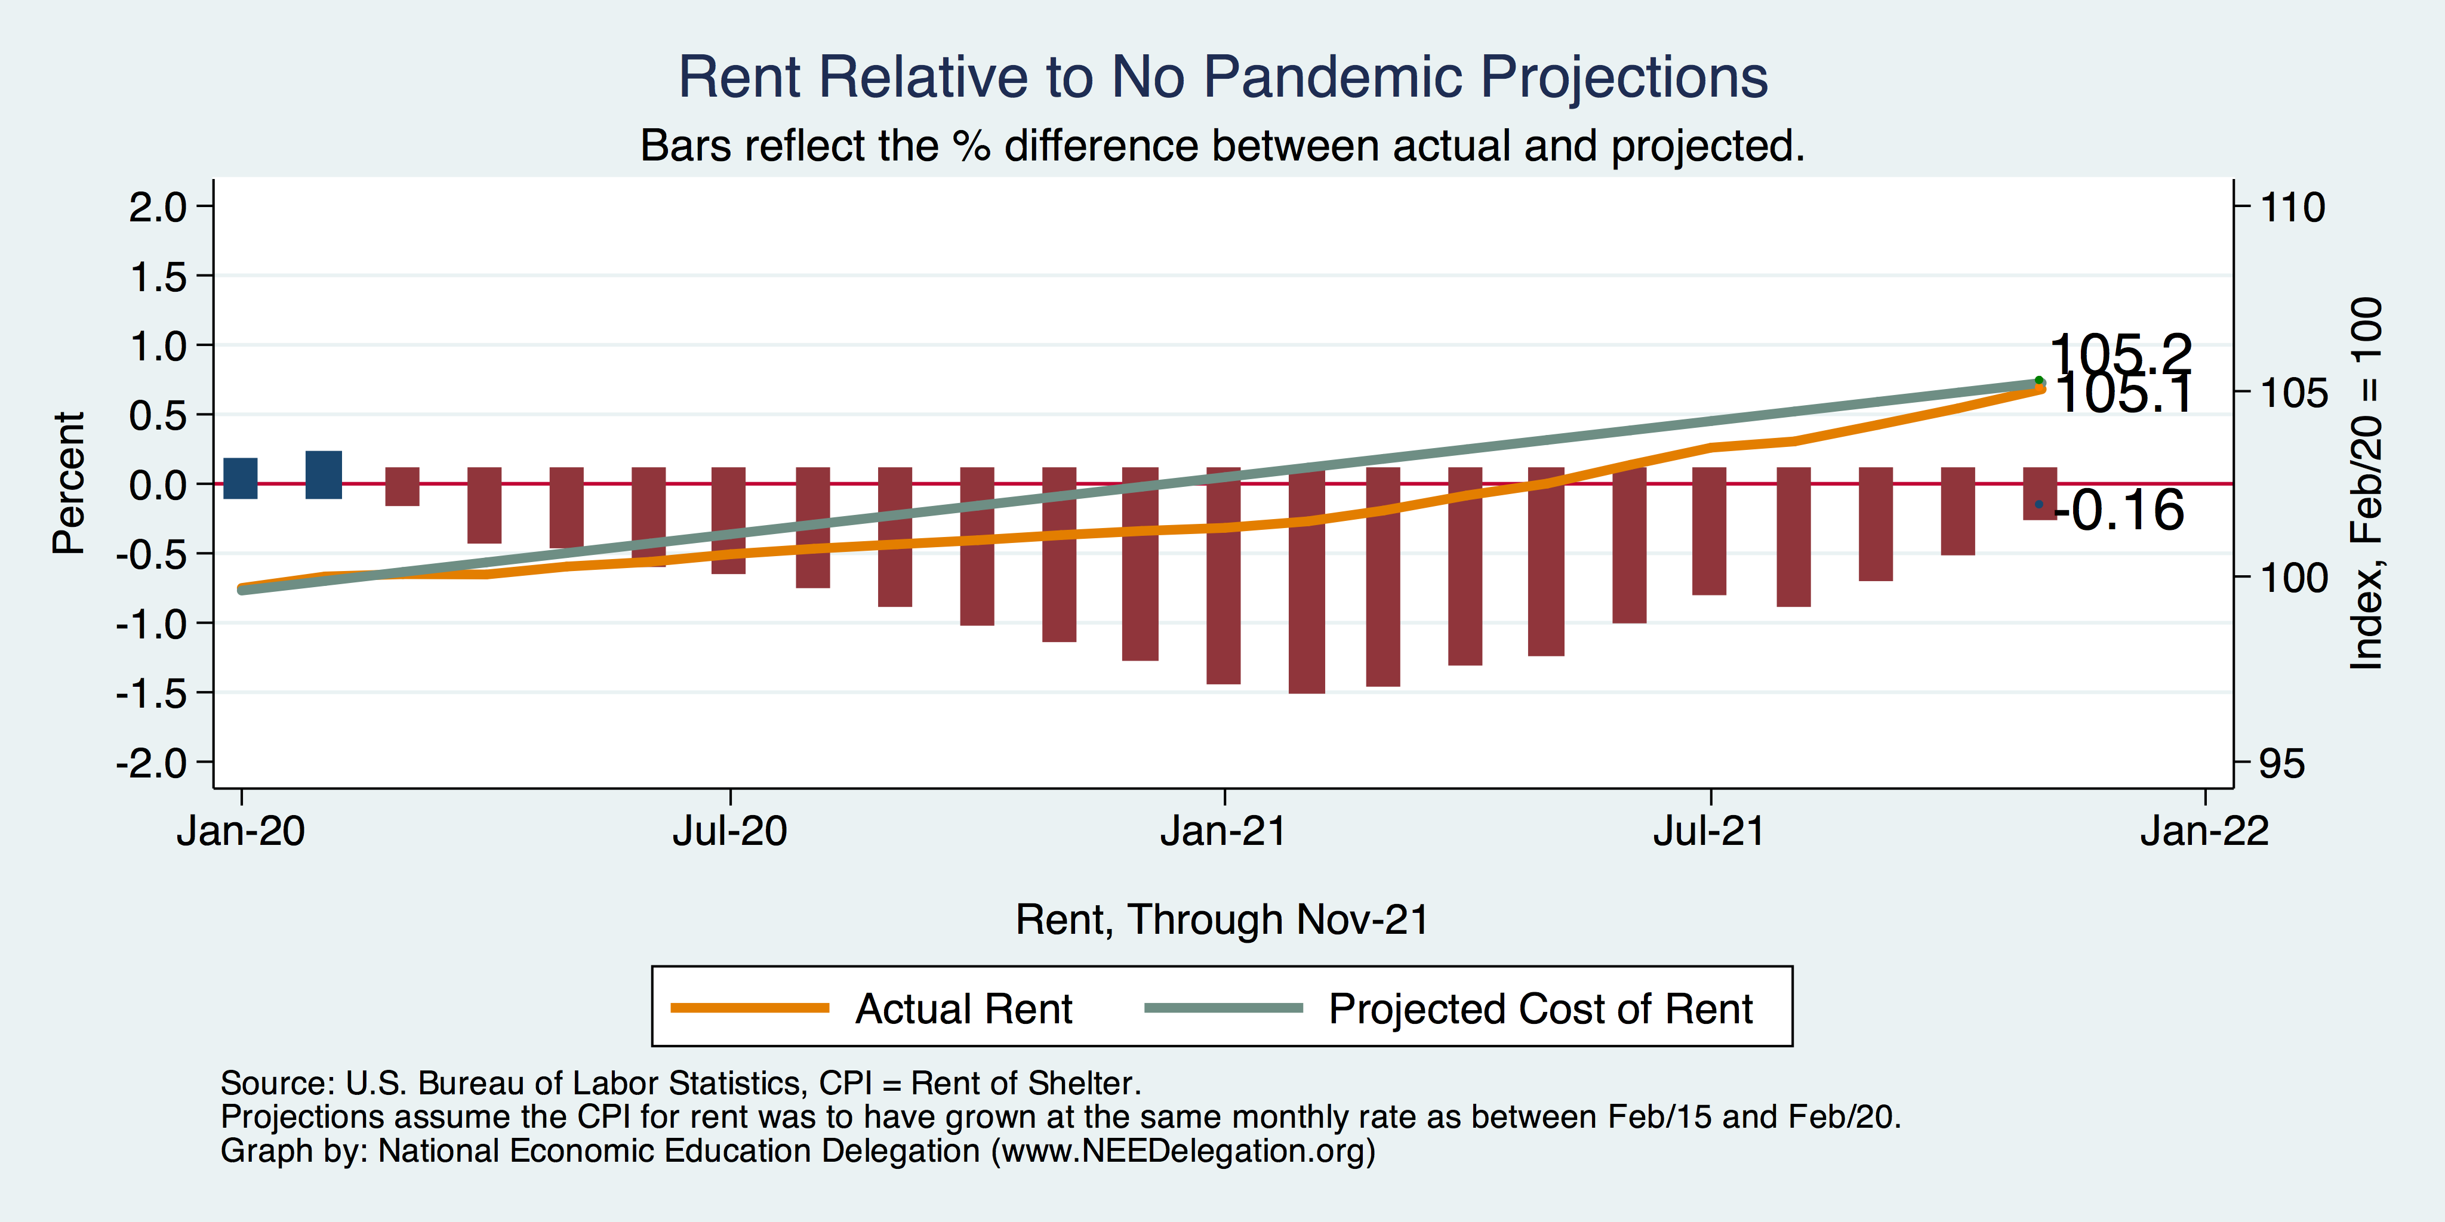
Inflation – Cost of Rent
Notes:
Cpi_recent.png

Slide 86
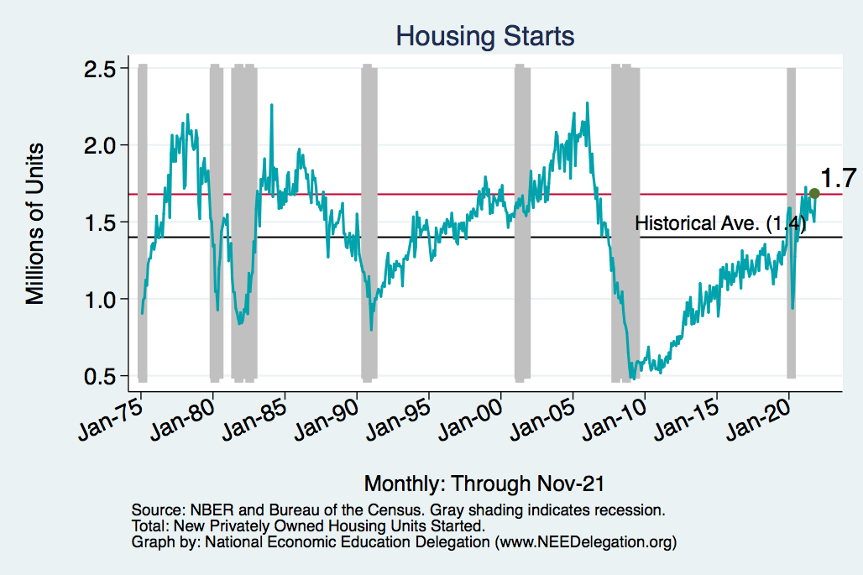
Home Prices and Housing Starts
Notes:
Charts:
homeprices_recession.png
housing.png

Slide 87
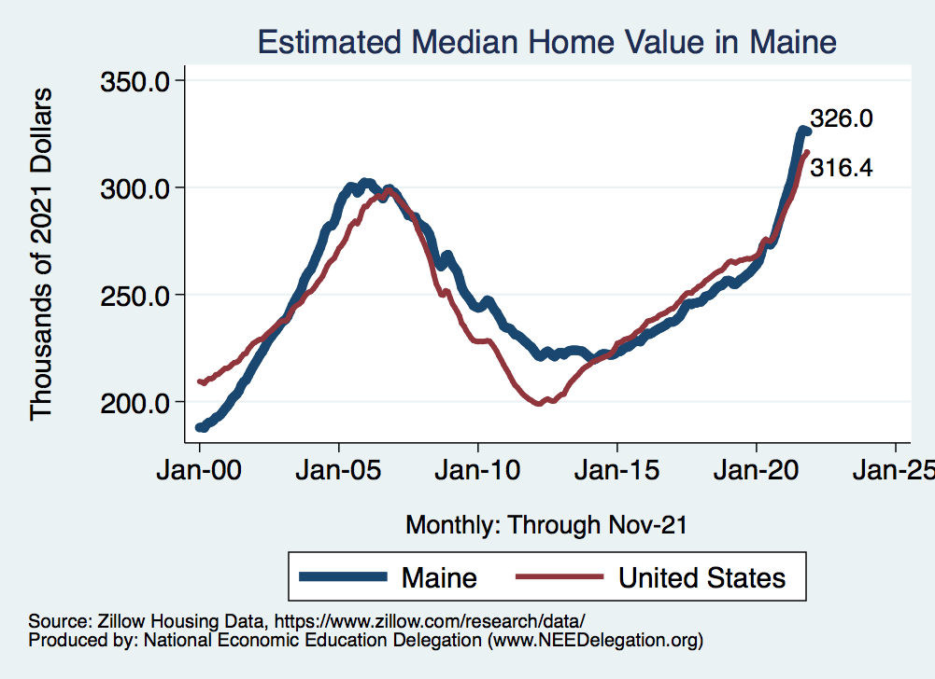
Real Estate Prices

Slide 88
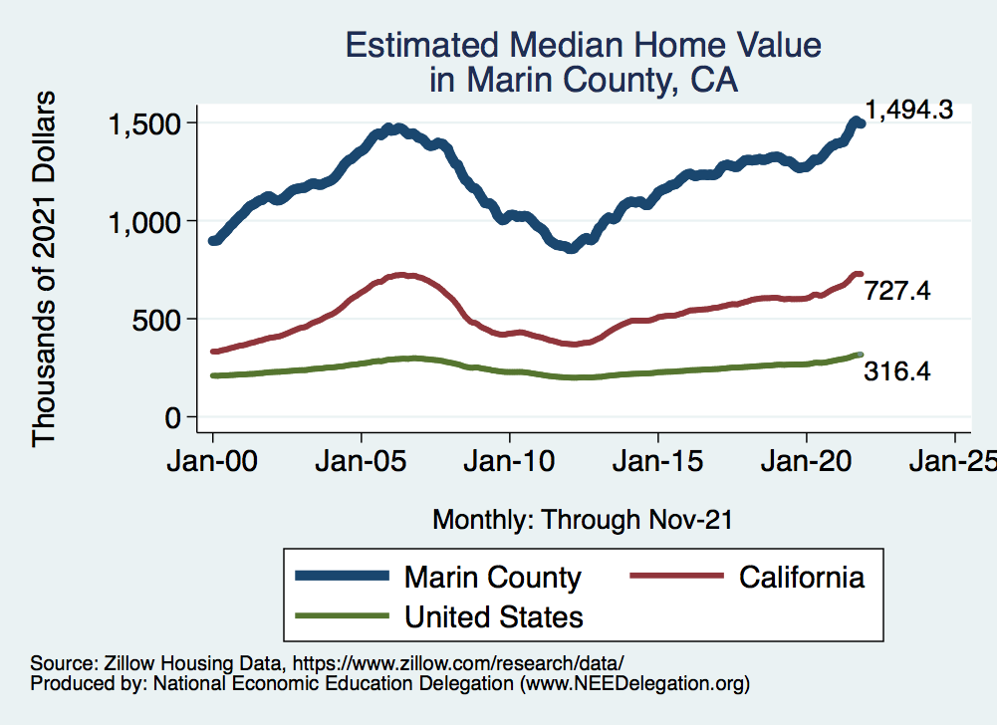
RE Experiences Differ!

Slide 89
Primary Topics Covered
GDP
Recovered the decline, but not where it should be.
Won’t recover previous forecast until late 2022.
Employment
Still down 8.4 million jobs relative to forecast. (3.5 million relative to Feb/20).
Labor force is 2.5 million smaller than at the beginning of the pandemic.
Rising wages are not enticing low-wage workers back to work.
Inflation
Going to be high for a while, but transitory – maybe?

Slide 90
Conclusion
Recovery is well underway, but may be slowing.
GDP will likely have expanded 5% percent in 2021, 3-4% in 2022.
2021 was an odd year.
GDP recovered significantly.
Workers attained the upper hand.
Supply chains broke.
Inflation surged.
The economy rebuilt itself.
Biggest problems:
Supply chain bottlenecks.
Labor force participation.

Slide 91
Best Measures of Progress
INFLATION – getting it under control.
REAL WAGES– need to see progress.
WORKFORCE PARTICIPATION – need growth here to get GDP growth.
Pay no attention to the unemployment rate.

Slide 92
Thank you!
Any Questions?
www.NEEDelegation.org
Jon D. Haveman
Jon@NEEDelegation.org
Contact NEED: info@NEEDelegation.org
Submit a testimonial: www.NEEDelegation.org/testimonials.php
Become a Friend of NEED: www.NEEDelegation.org/friend.php

Slide 93
www.NEEDelegation.org/LocalGraphs
For every state and county in the United States.
Detailed graphs on employment, housing, moves, and other statistics.

