Slide 1
Osher Lifelong Learning Institute, Summer 2022
Contemporary Economic Policy
Rochester Institute of Technology
July-Aug, 2022
Jon Haveman, Ph.D.
National Economic Education Delegation

Slide 2
National Economic Education Delegation
Vision
One day, the public discussion of policy issues will be grounded in an accurate perception of the underlying economic principles and data.
Mission
NEED unites the skills and knowledge of a vast network of professional economists to promote understanding of the economics of policy issues in the United States.
NEED Presentations
Are nonpartisan and intended to reflect the consensus of the economics profession.

Slide 3
Who Are We?
Honorary Board: 54 members
2 Fed Chairs: Janet Yellen, Ben Bernanke
6 Chairs Council of Economic Advisers
Furman (D), Rosen (R), Bernanke (R), Yellen (D), Tyson (D), Goolsbee (D)
3 Nobel Prize Winners
Akerlof, Smith, Maskin
Delegates: 651+ members
At all levels of academia and some in government service
All have a Ph.D. in economics
Crowdsource slide decks
Give presentations
Global Partners: 49 Ph.D. Economists
Aid in slide deck development

Slide 4
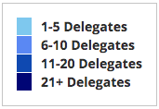
Where Are We?

Slide 5
Available NEED Topics Include:
Coronavirus Economics
US Economy
Climate Change
Economic Inequality
Economic Mobility
Trade and Globalization
Minimum Wages
Immigration Economics
Housing Policy
Federal Budgets
Federal Debt
Black-White Wealth Gap
Autonomous Vehicles
Healthcare Economics

Slide 6
Course Outline
Contemporary Economic Policy
Week 1 (7/11): Economic Update (Jon Haveman, NEED)
Week 2 (7/18): Economic Inequality (Christopher Herrington VCU)
Week 3 (7/25): Trade and Globalization (Alan Deardorff, University of Michigan)
Week 4 (8/1): Economic Mobility (Jon Haveman, NEED)
Week 5 (8/8): The Black-White Wealth Gap (Jon Haveman, NEED)
Week 6 (8/15): Climate Change Economics (Jon Haveman, NEED)
Week 7 (8/22): Autonomous Vehicles (Jon Haveman, NEED)

Slide 7
Income Inequality: Share of Top 10%
Stock Market Crash
WWII
Housing Bubble
Dot-com Bubble

Slide 8
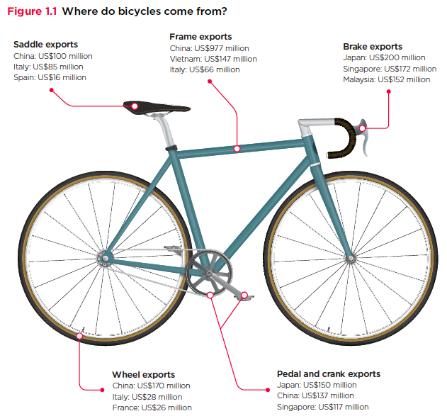
Trade: Bicycle Supply Chain
Source: World Development Report 2020

Slide 9
Mobility
9 out of 10 of those born in the early 1940s could expect to earn more than their parents
1 in 2 Millennials (born after 1980) earn more than their parents.

Slide 10
Evidence of the B-W Wealth Gap
Mean is
7x Greater
Median is 8x Greater

Slide 11
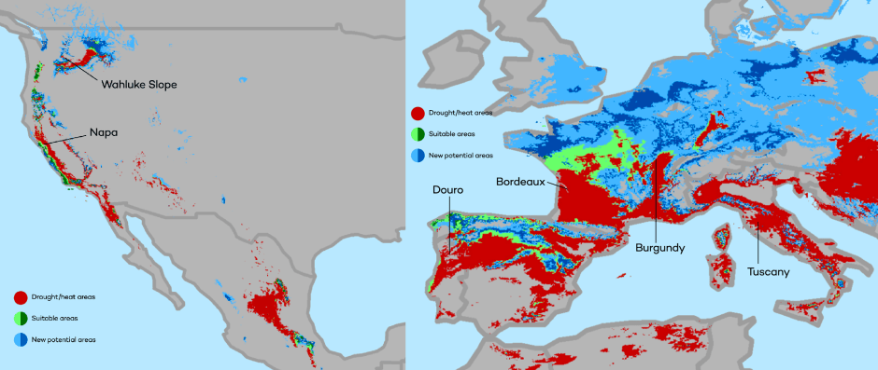
Climate Change Economics
The changing map of the world’s wine-growing regions.

Slide 12
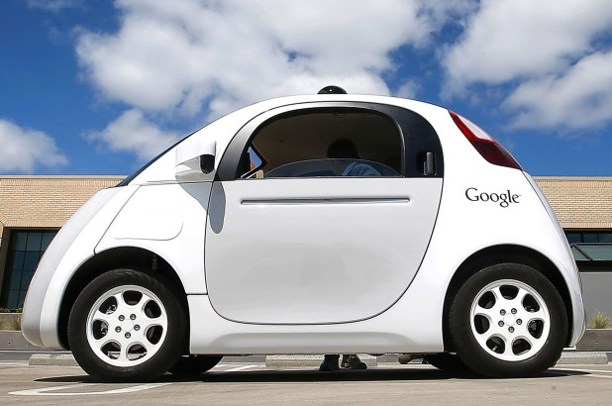
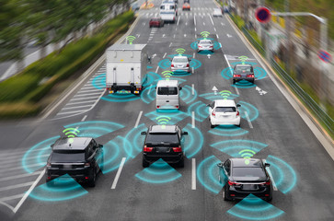
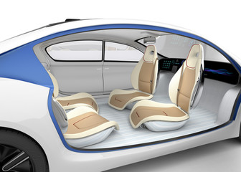
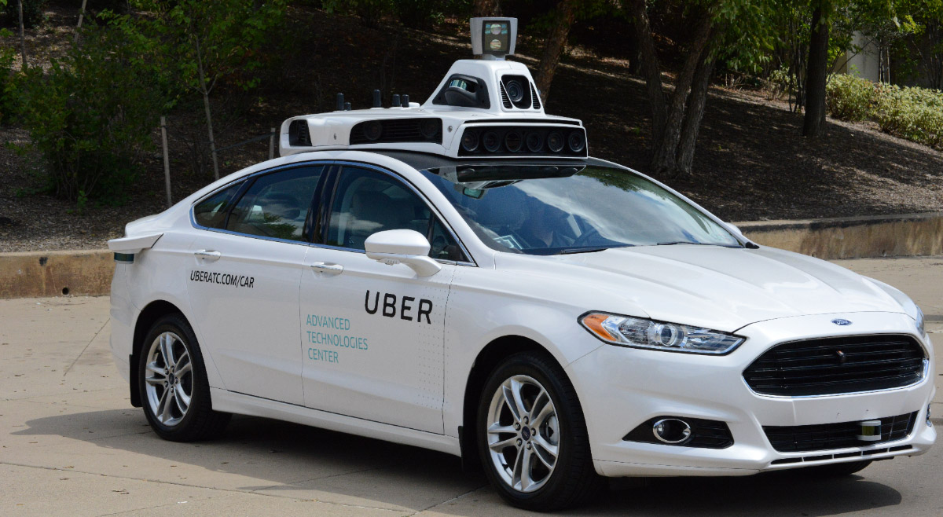
Autonomous Vehicles

Slide 13
Submitting Questions
Please submit questions of clarification in the chat.
I will try to handle them as they come up.
We will do a verbal Q&A once the material has been presented.
OLLI allowing, we can stay beyond the end of class to have further discussion.
Slides will be available from the NEED website tomorrow (https://needelegation.org/delivered_presentations.php)

Slide 14
US Economic Update

Slide 15
Credits and Disclaimer
This slide deck was authored by:
Jon D. Haveman, NEED
Scott Baier, Clemson University
Geoffrey Woglom, Amherst College (Emeritus)
Brian Dombeck, Lewis & Clark College
Doris Geide-Stevenson, Weber State
Disclaimer
NEED presentations are designed to be nonpartisan.
It is, however, inevitable that the presenter will be asked for and will provide their own views.
Such views are those of the presenter and not necessarily those of the National Economic Education Delegation (NEED).

Slide 16
Outline
State of the pandemic
The U.S. Economy
Hot Topics
Government policy
Inflation

Slide 17
State of the Pandemic

Slide 18
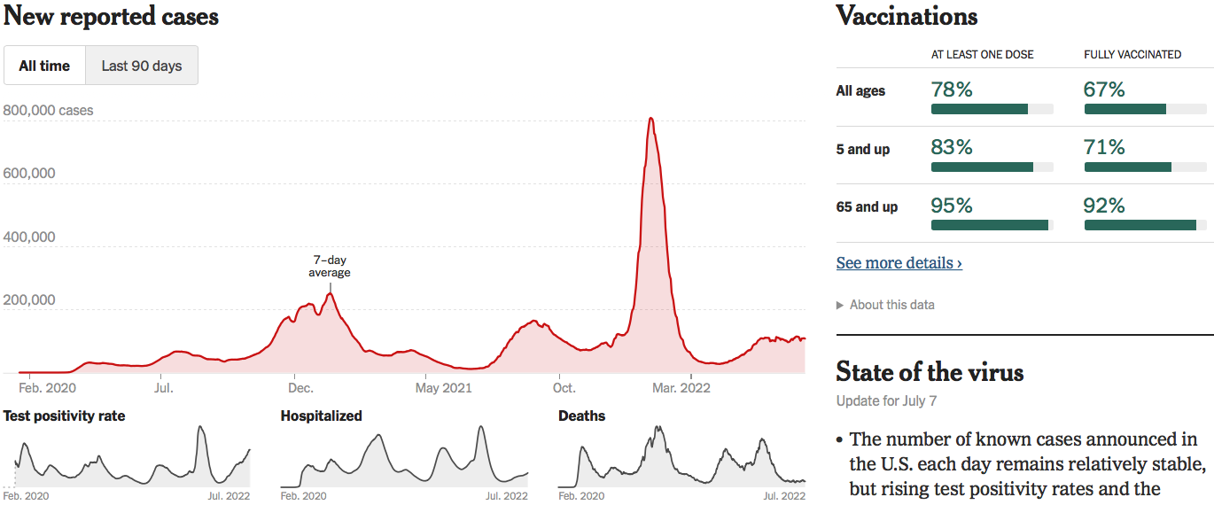
Making Real Progress…Until Omicron
Nationally
Source: NYTimes

Slide 19
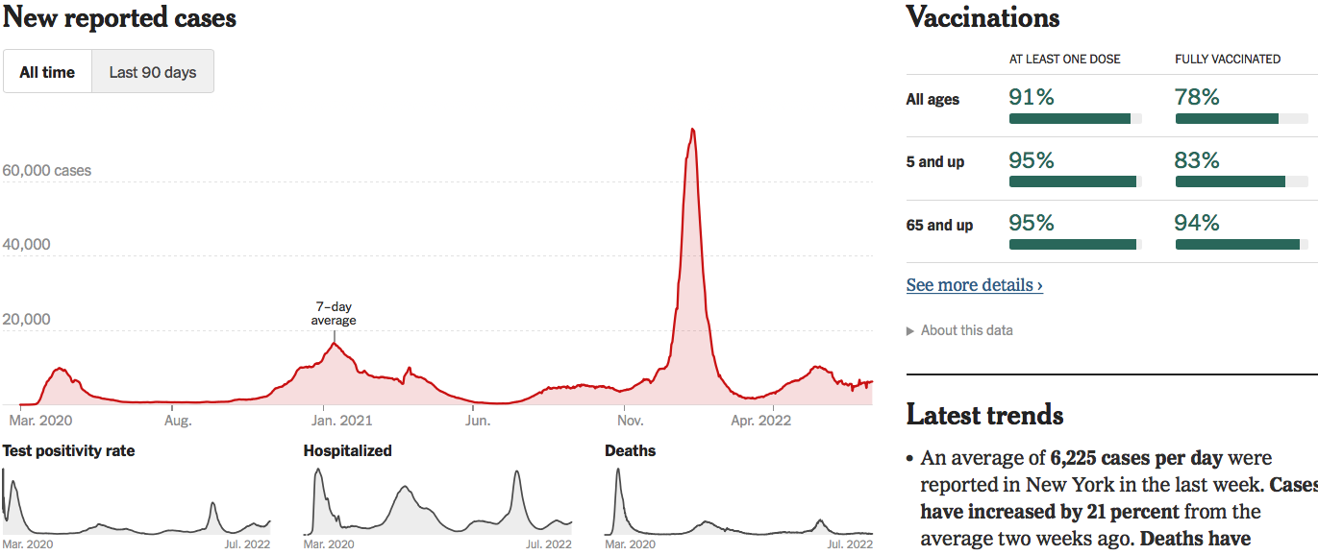
Making Real Progress…Until Omicron
New York
Source: NYTimes

Slide 20
The U.S. Economy

Slide 21
Some Basic Statistics
Statistic: | Value
Population | 332.9 Million
Labor Force (age 16+) | 164.4 Million
Employment (Nonfarm) | 151.7 Million
Gross Domestic Product (GDP) | $24.4 Trillion
Income per Capita | $63,884
Ave. Hourly Earnings | $31.95

Slide 22
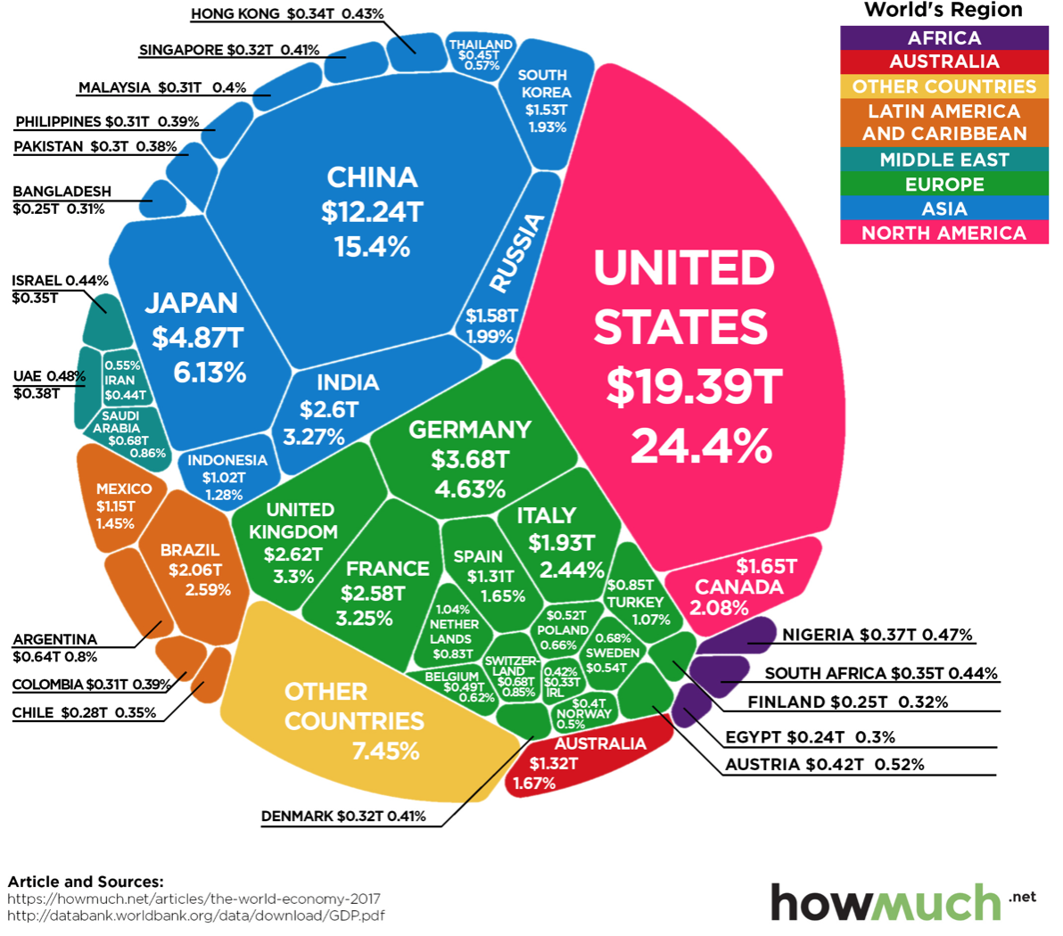
U.S. Economy in Global Perspective
U.S. Nominal GDP:
$21.747 trillion in 2019-Q4
$19.487 trillion in 2020-Q2
$24.383 trillion in 2022-Q1
Notes:
https://www.investopedia.com/insights/worlds-top-economies/#countries-by-gdp

Slide 23
Composition of the U.S. Economy: GDP
Note: Does not add to 100% because of omitted sectors.

Slide 24
Composition of the U.S. Economy: Employment
Manufacturing
GDP Share = 10.9%
Health GDP Share = 7.4%
Note: Does not add to 100% because of omitted sectors.

Slide 25
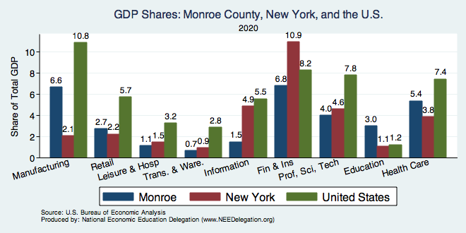
Monroe County GSP: Manuf, Finance, Health
Note: Does not add to 100% because of omitted sectors.

Slide 26
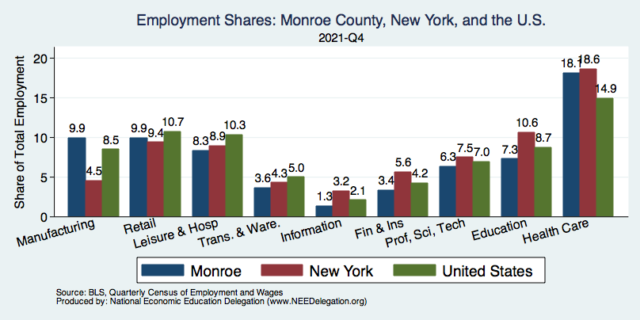
Monroe County Employment: Health
Note: Does not add to 100% because of omitted sectors.

Slide 27
Evidence of Impact

Slide 28
GDP: Quarterly Growth
Notes:
Graph: gdp_pot_grow.png
The Point: From 1990 – 2007, average annual US GDP growth pre-crisis is 2.94%. However, post-crisis US GDP growth is 2.19% (0.75 percentage points lower). Why is has the recovery been sluggish?
Note: At the recession’s height, the gap between quarterly GDP growth and potential growth was 2.5 percentage points.

Slide 29
GDP Relative to Long-Term Trends

Slide 30
GDP Relative to Long-Term Trends
Gap: 11% or $5,000 per person
11%

Slide 31
GDP Trajectory: Pandemic Plunge!
Q1 - Down
Q3 - Flat
GDP is:
$0.5 Trillion Below 2019 forecast.
$0.6 Trillion ABOVE 2019-Q4 level.

Slide 32
Spending Patterns Since First US Case
Q1 - Wobbly
Q3 - Flat
Source: https://tracktherecovery.org/

Slide 33
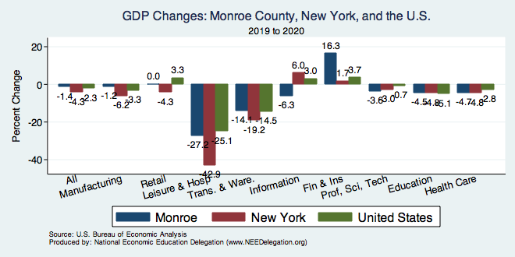
But Not All Industries Were Equally Harmed

Slide 34
Spending Patterns – Hardest Hit Sectors
+0.2%
Transportation
Source: https://tracktherecovery.org/

Slide 35
Monthly Changes in Nonfarm Employment
Notes:
PAYEMS.png

Slide 36
Monthly Changes in Nonfarm Employment
June: 372,000
Notes:
PAYEMS.png

Slide 37
V-Shaped Recovery Labor Market
Months since the start of the recession
Source: Bureau of Labor Statistics (BLS)

Slide 38
Employment Gap
0.5 Million below February, 2020.
6.7 Million below where we should be.
Notes:
payroll_recent.png

Slide 39
Employment Gap – In Historical Perspective
28.1 Million below where we should be.
Notes:
payroll_recent.png

Slide 40
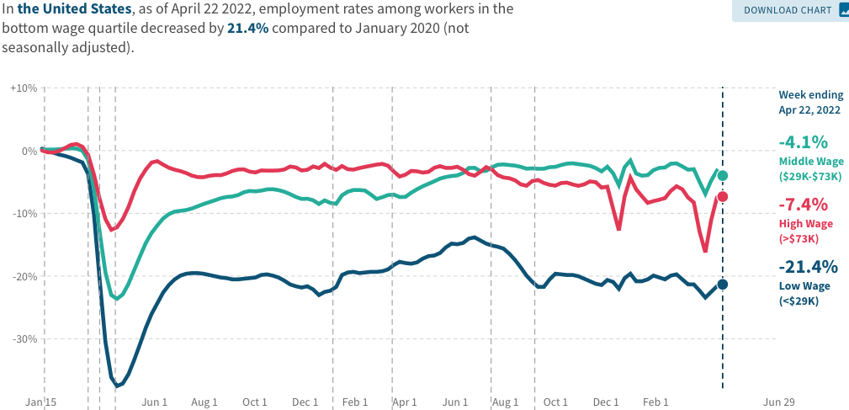
Low Wage Employment is Lagging

Slide 41
Stimulus Payments Saved Low Wage Workers

Slide 42
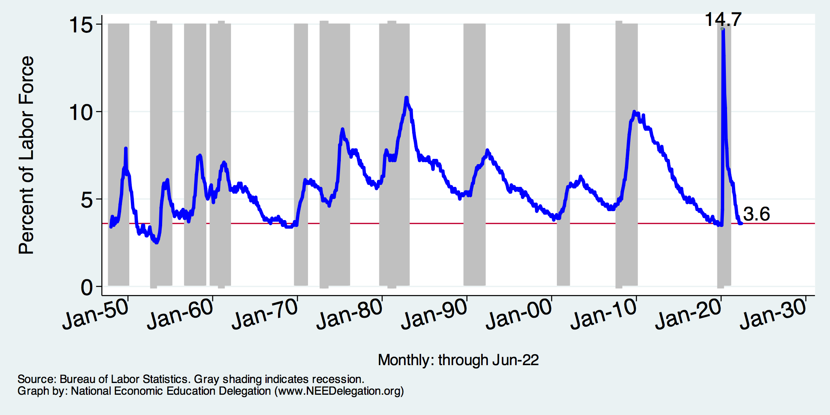
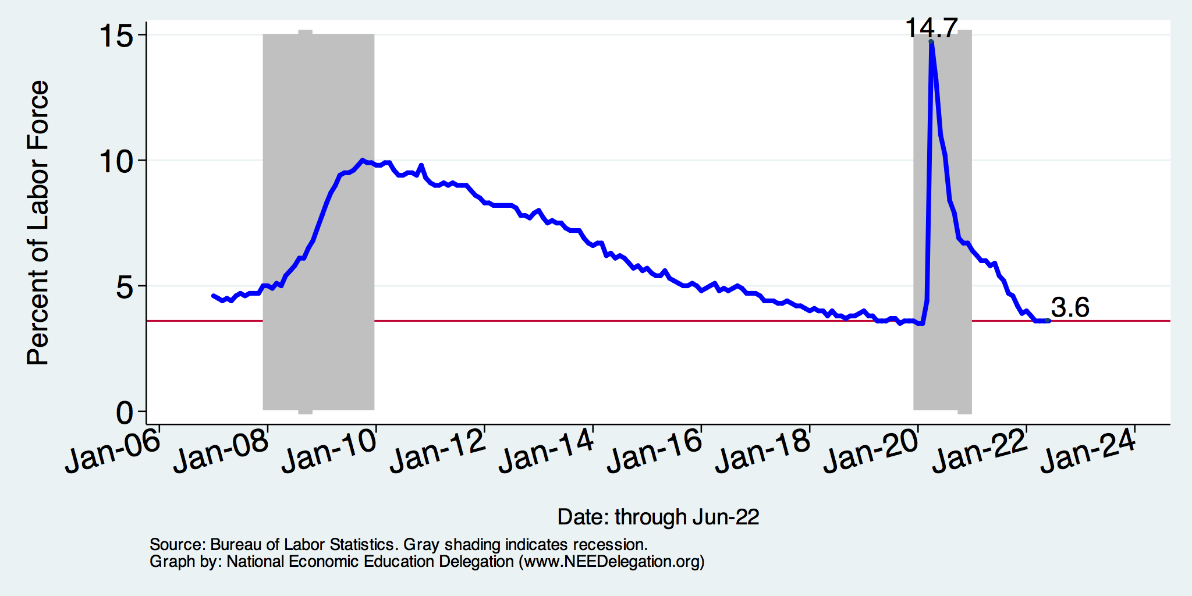
Unemployment Rate
Notes:
Unemployment rises during recessions and falls during economic expansions.
Unemployment peaked at the end of the 2009 recession.
The Fed worked to reduce the effects of the recession. Near the end of 2008, the FOMC reduced the federal funds rate to nearly zero and worked to reduce longer-term interest rates via large-scale asset purchase programs (late 2008 – 10/2014).
Unemployment is currently below the natural rate of unemployment. This is traditionally accompanied by economic growth and rising price levels. It’s also a major reason for FOMC’s decision to increase the federal funds rate.

Slide 43
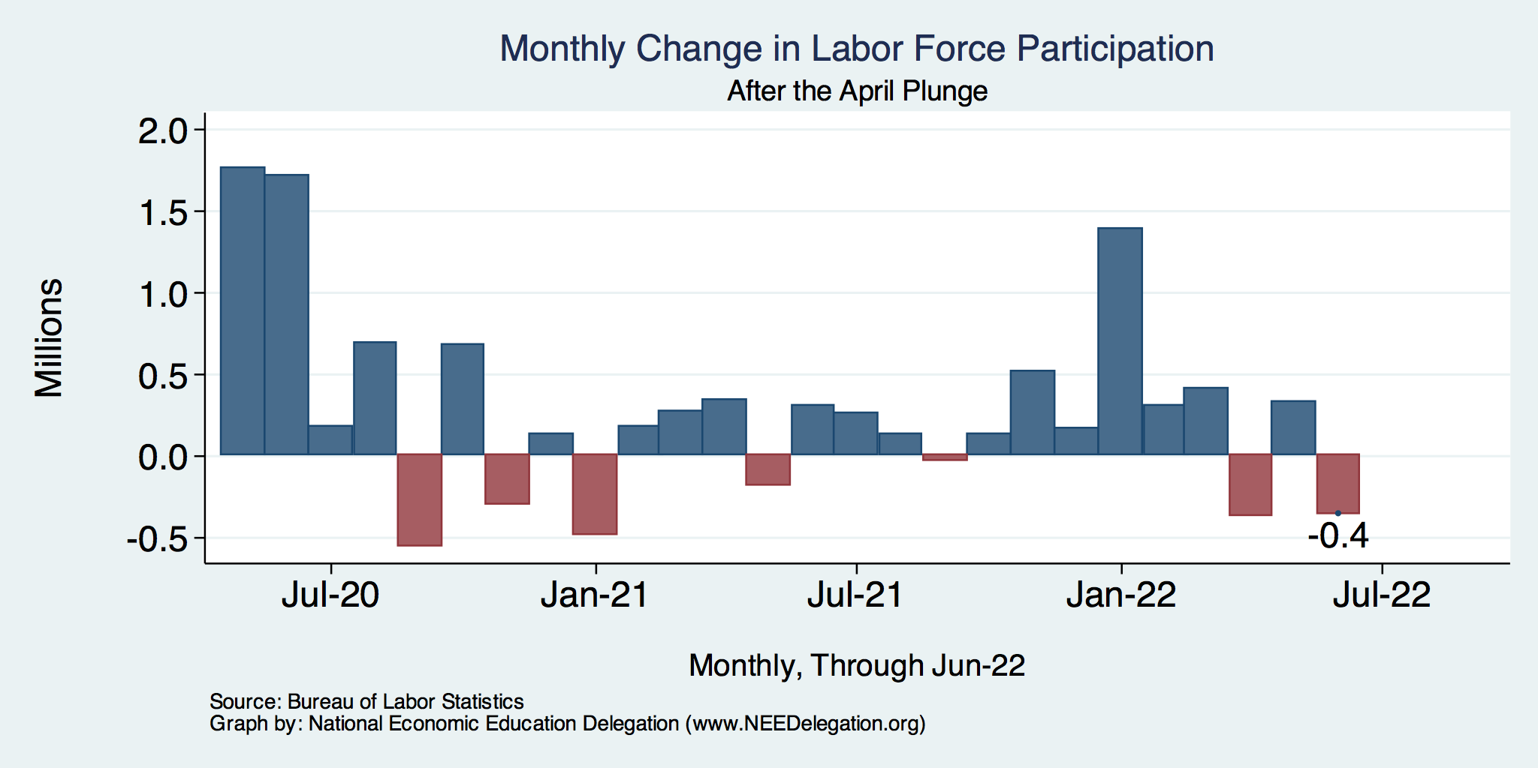
UR Driven by Labor Force Participation?

Slide 44
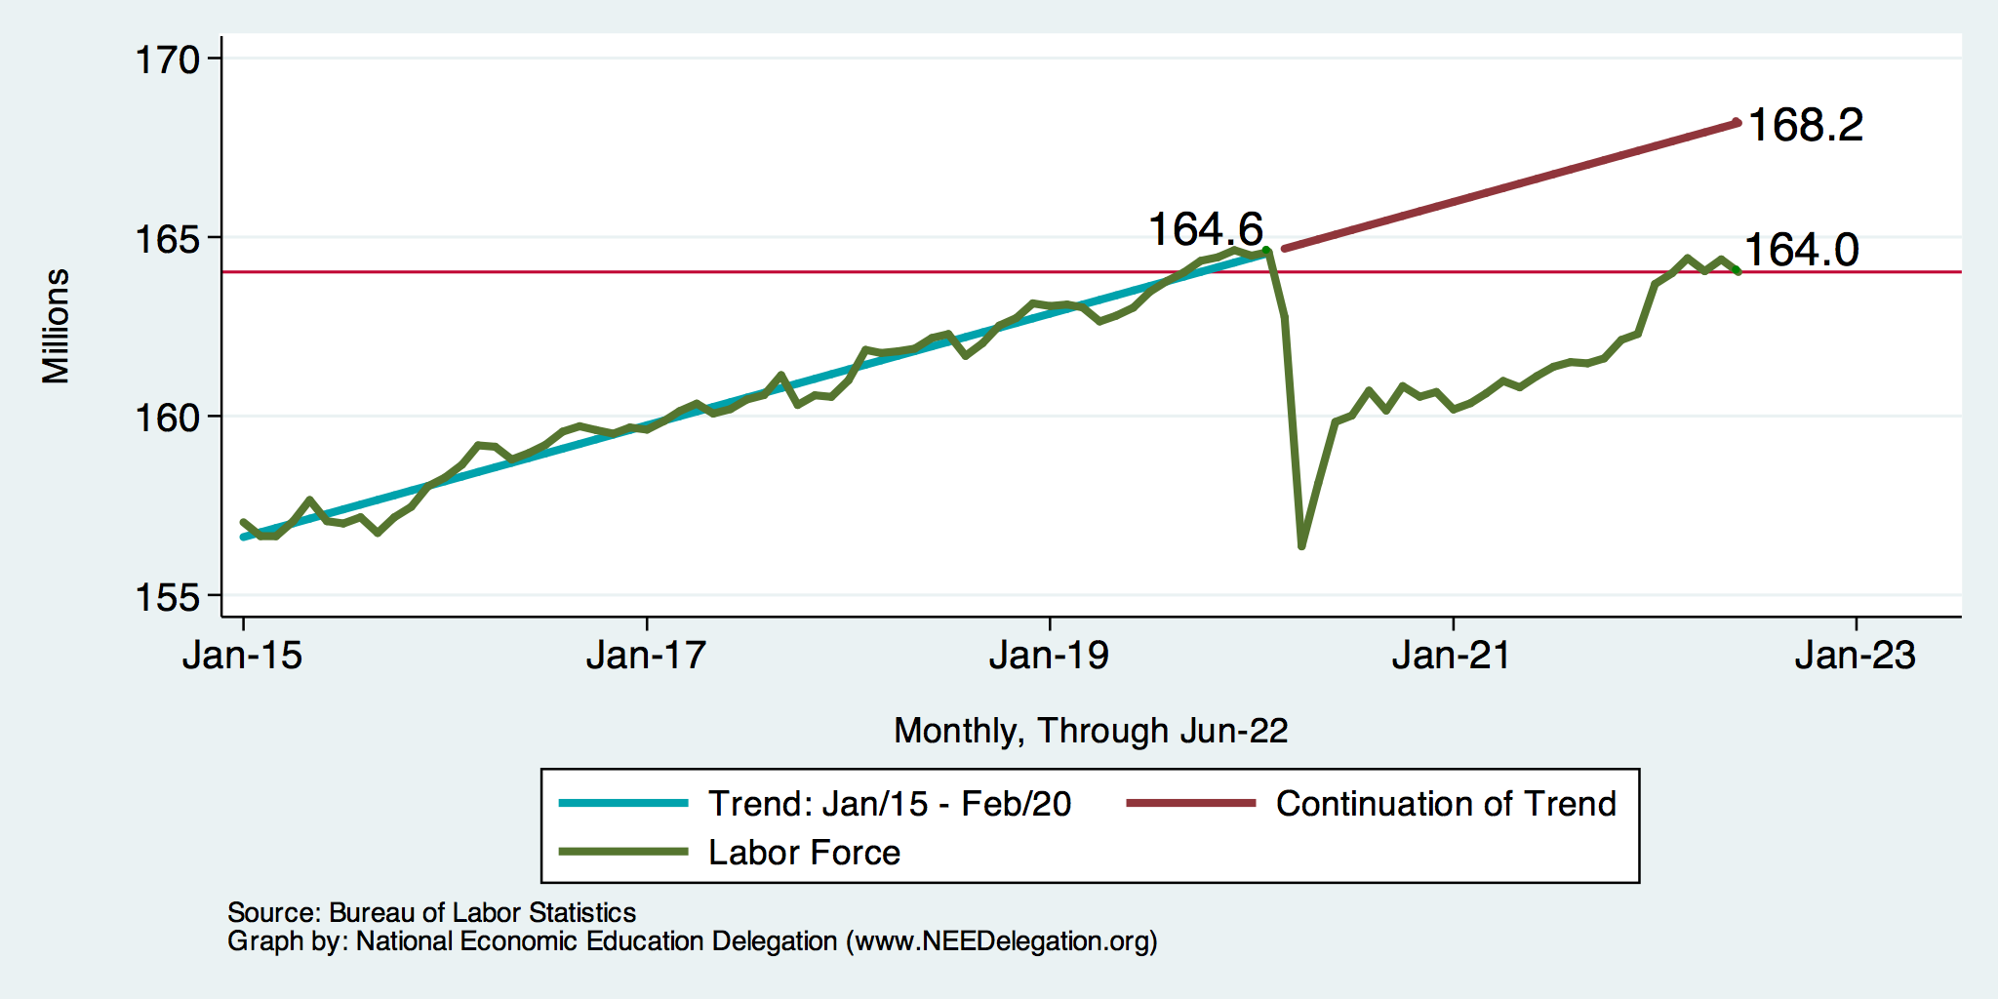
Trends in Labor Force Participation
Down 4.2 million
Notes:
CLF16OV.png

Slide 45
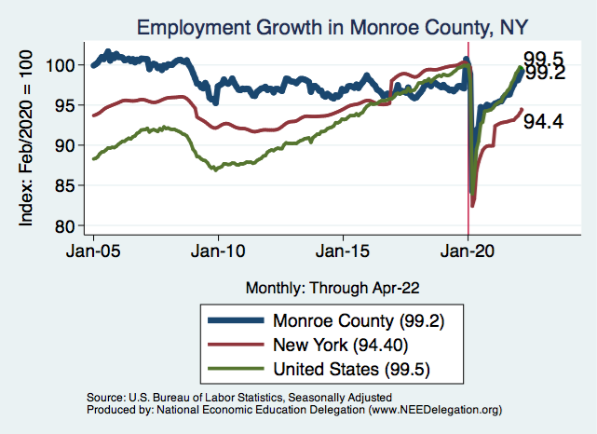
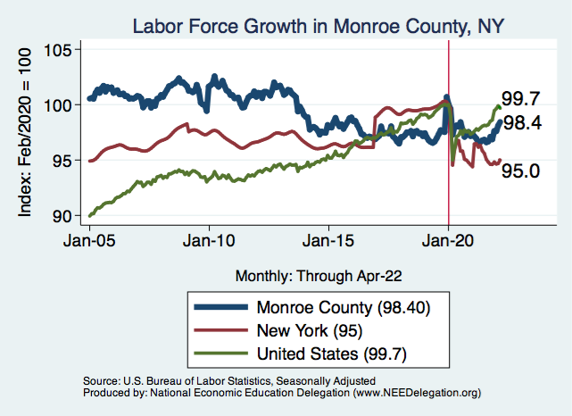
Employment in Monroe County

Slide 46
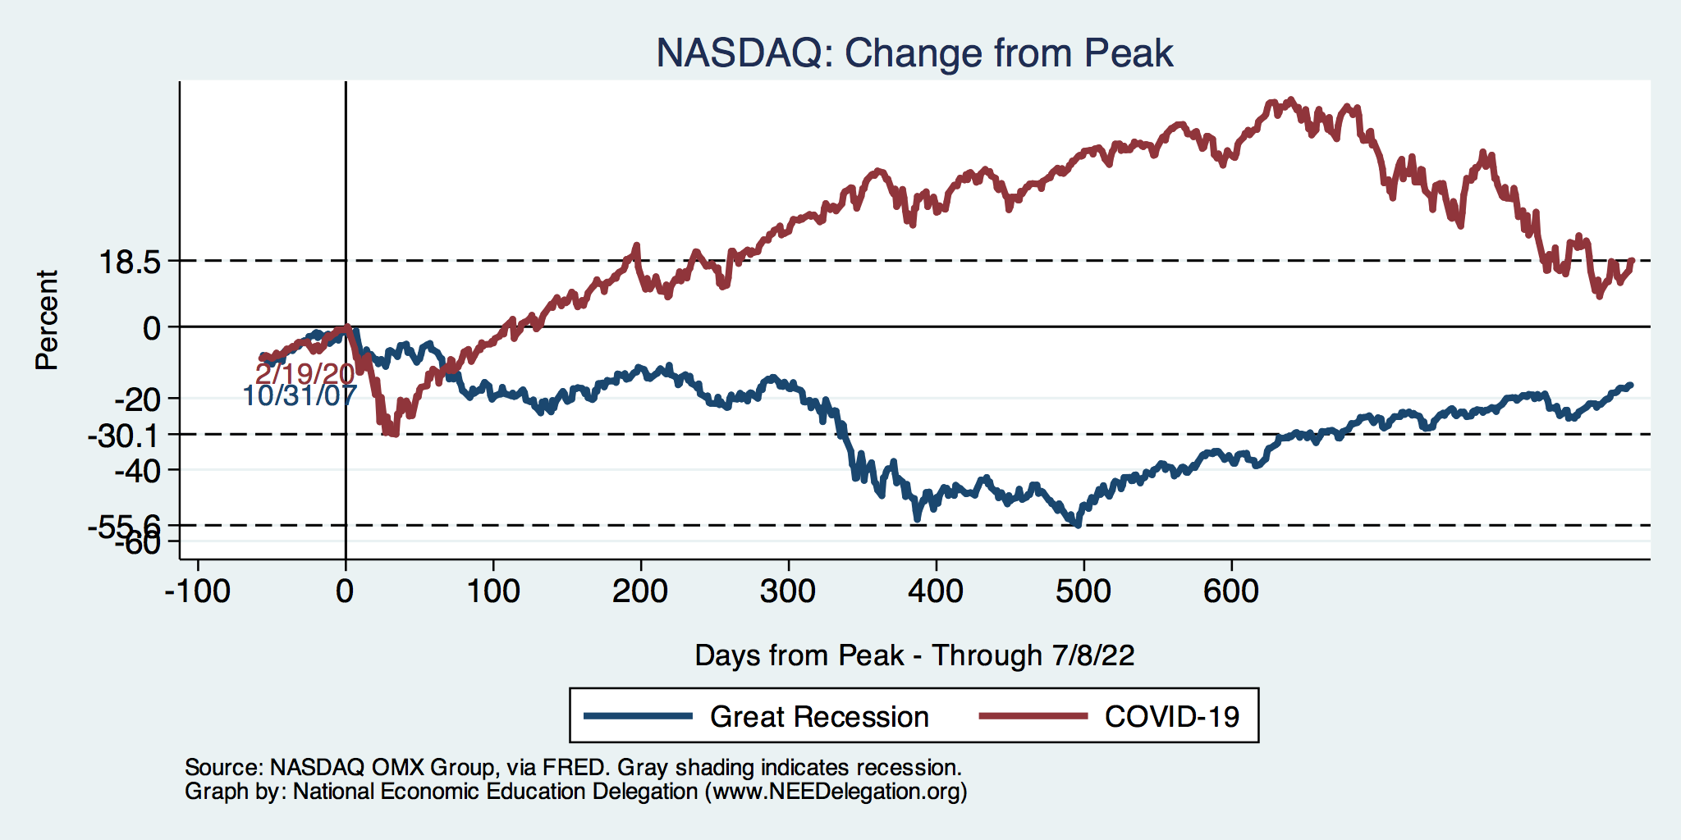
Stocks: Bounced Back Faster This Time

Slide 47
Hot Topics
Government policy
Inflation

Slide 48
What Have Been Policy Effects?
MONETARY POLICY (Fed) acted quickly and effectively to prevent a financial market meltdown and to keep credit flowing. But the Fed lends and does not spend.
FISCAL POLICY (Congress) acted quickly, but inevitably made some mistakes.
Stimulus Checks, A ($268b)
Expanded Unemployment, B ($268b)
Paycheck Protection Program, C- ($525b)

Slide 49
Abnormally High Savings
Biden Boost
Trump Bump
CARES

Slide 50
Monetary Policy: Federal Reserve
Primary goal is to keep interest rates low, to facilitate continued borrowing.
Federal Funds Rate – rate at which banks lend to each other, usually overnight.
Purchases of U.S. Treasury securities – keep money flowing to the government at low rates of interest.

Slide 51
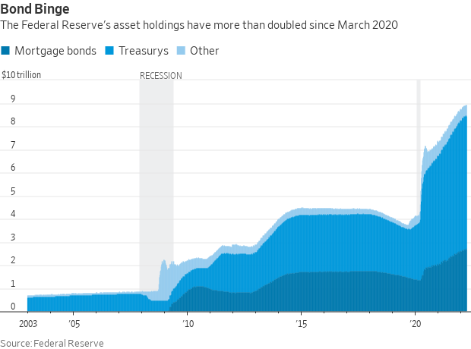
Fed Policy during the Recovery
Zero interest rates until March and a Big QE program
Largely Treasury Securities
Pandemic
Financial Crisis
Notes:
25% of marketable Federal Debt; 15 percent of mortgages

Slide 52
Federal Funds Rate – Last 5 Years
Notes:
The FOMC waited for labor market conditions to improve before raising the fed funds rate in late 2015.
FOMC currently working to normalize monetary policy by raising interest rates and reducing assets on its balance sheet
FedFunds_recent.png

Slide 53
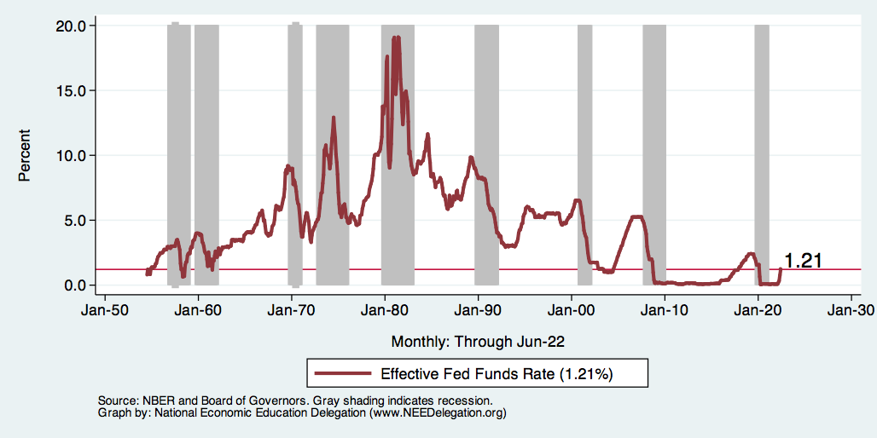
Federal Funds Rate
Notes:
The fed funds rate is the interest rate on overnight loans between banks. Think of it as the baseline interest rate on which banks base all other interest rates (e.g. mortgage rates)
FOMC lowers the fed funds rate during recessions and raises the fed funds rate during expansions
Fed funds rate peaked in the 1980s as then Chairman Paul Volcker sought to reign in “run away” inflation of the 1970s; doing so resulted in a recession in the early 1980s.
Since the 2008-09 recession, the fed funds rate has been kept near zero.
During the 2008-09 recession, Federal Reserve turned to unconventional tools to influence longer term interest rates to further stimulate the economy - QE
FedFunds.png

Slide 54
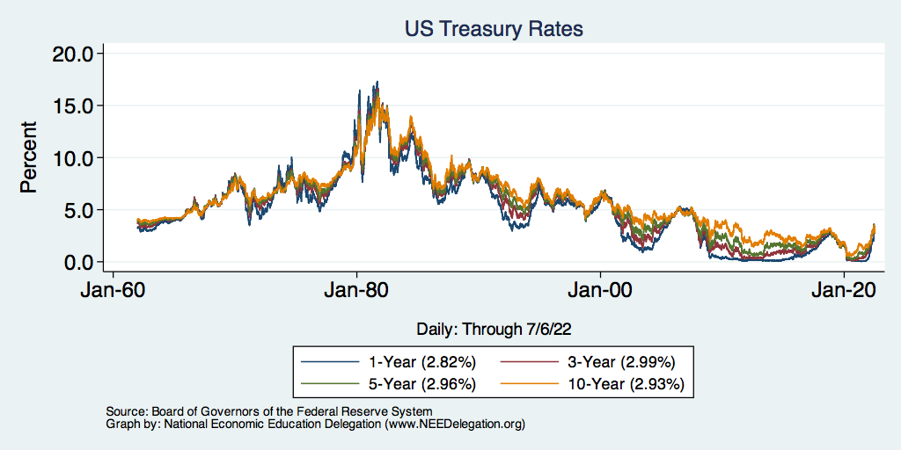
Treasuries – Low Interest Rates
Notes:
treas_recent.png

Slide 55
Inflation

Slide 56
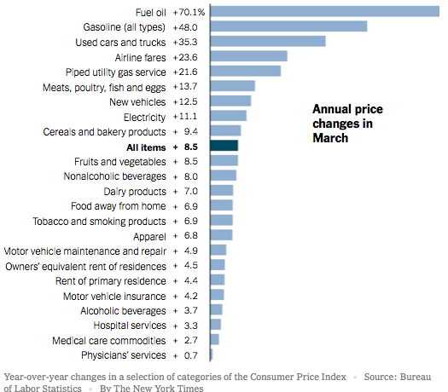
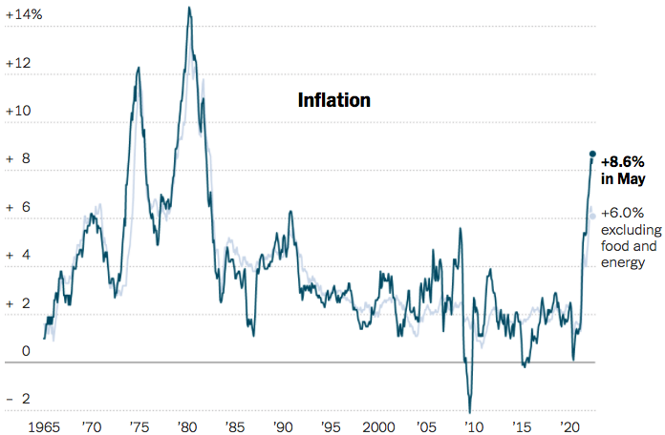
Inflation News
January 2022
Source: New York Times, Wall Street Journal
Notes:
Why CPI overestimates or underestimates inflation – COVID CPI should reflect a change in purchases. Covid CPI 6.54%

Slide 57
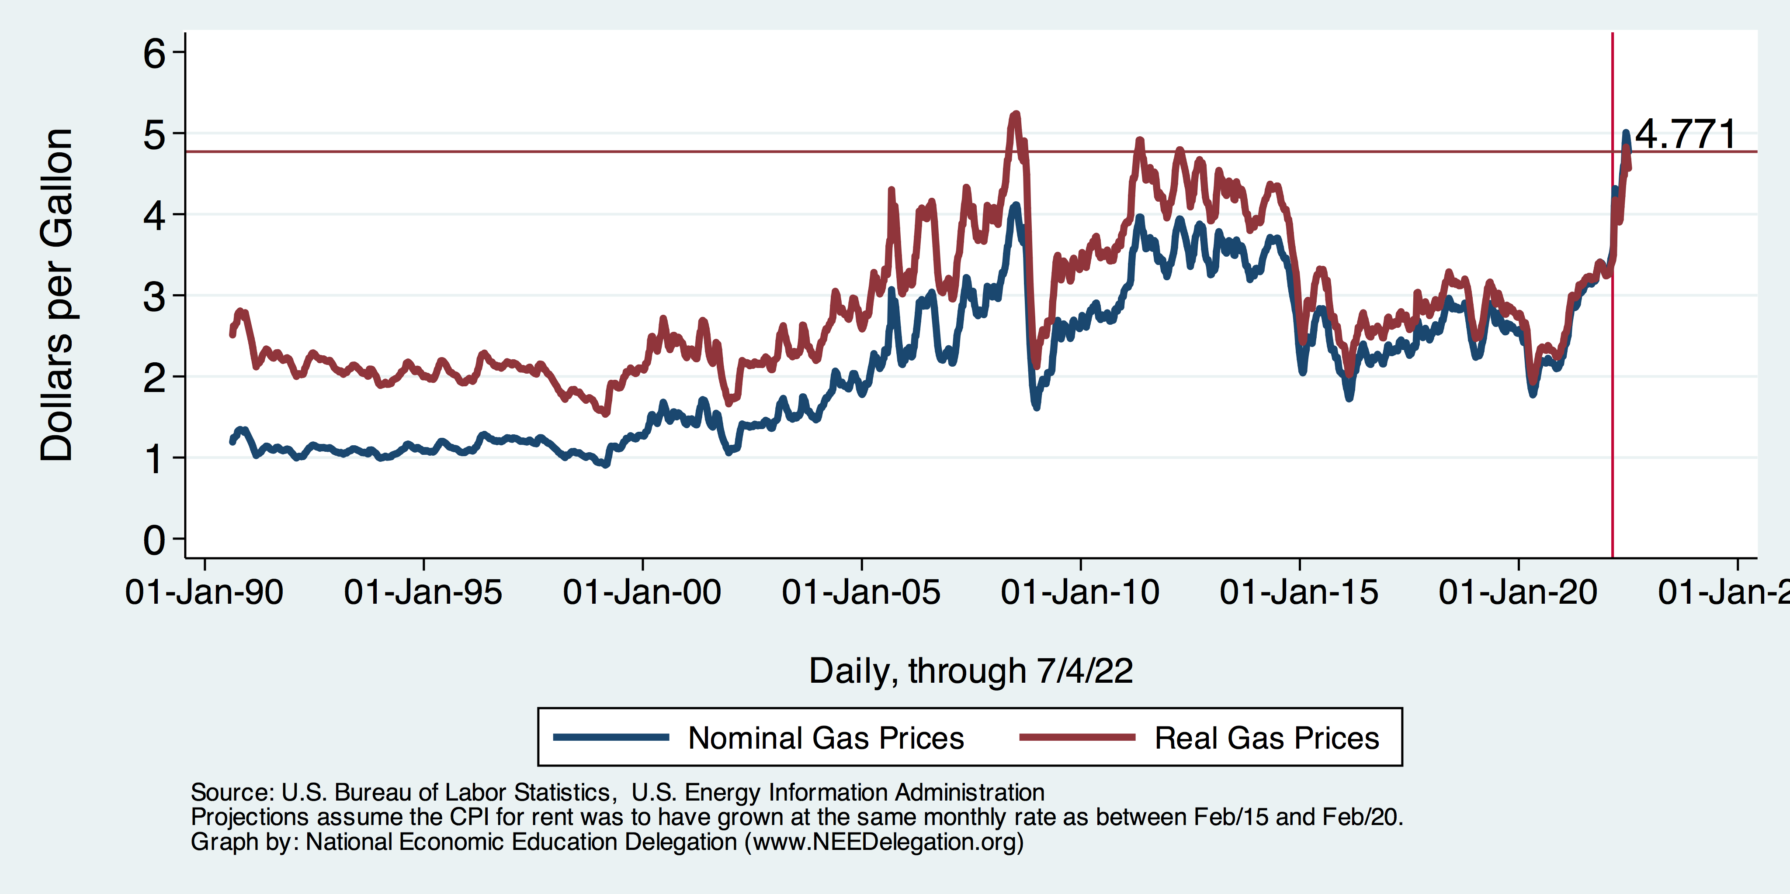
Gas Prices: National Average at the Pump

Slide 58
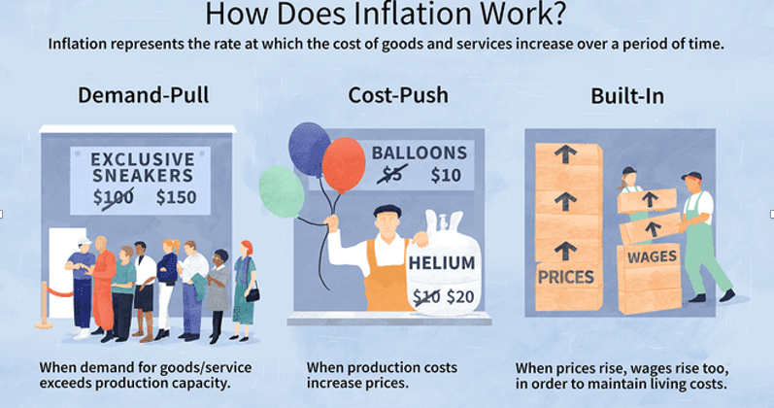
Source: Investopedia

Slide 59
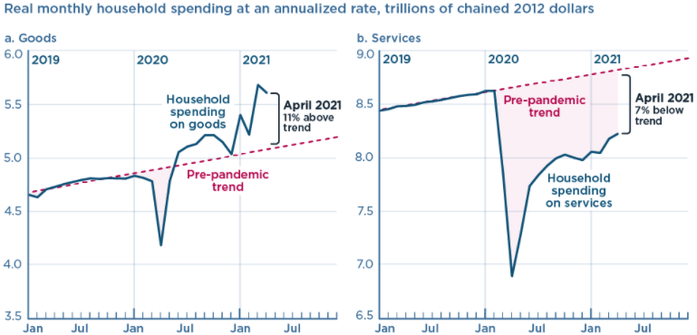
We’re Buying Mostly … Stuff
Demand-Pull
Source: Jason Furman, PIIE

Slide 60
Inflation: Concentrated
Cost-Push

Slide 61
Supply Chains
Cost-Push

Slide 62
Corporate Profits…Adding to Inflation?

Slide 63
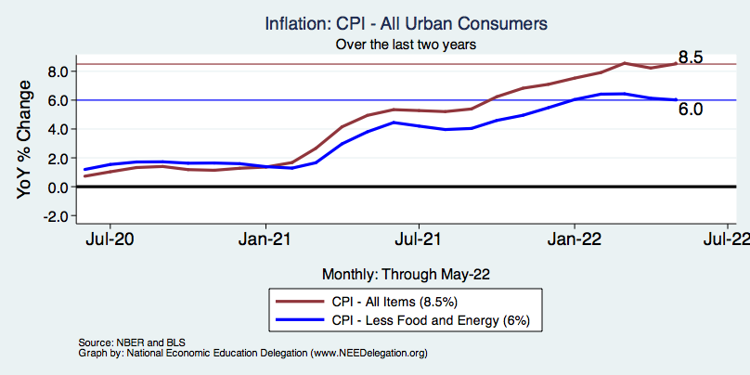
Inflation – Climbing! Should we worry?
Notes:
Cpi_recent.png

Slide 64
Inflation in Historical Perspective

Slide 65
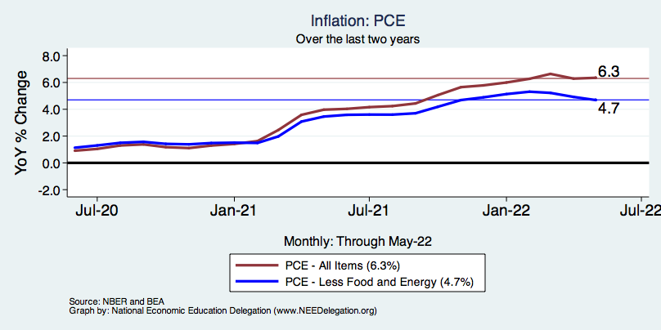
Inflation – The Fed’s Metric! Should we worry?
Growth over low base prices
High base
Notes:
Cpi_recent.png

Slide 66
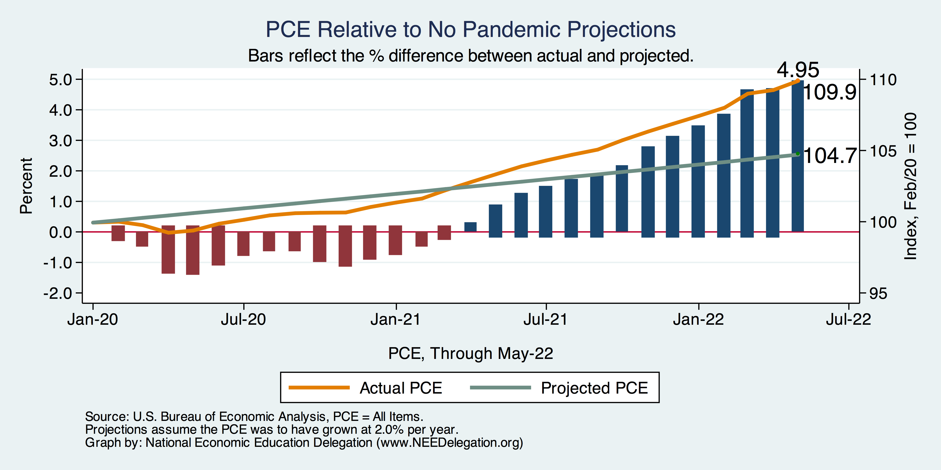
Inflation – PCE and Fed Suggest: Probably
Notes:
Cpi_recent.png

Slide 67
My Diagnosis for the Uptick in Inflation
Yes, there were supply chain issues that affected some areas in particular (e.g., computer chips).
But there is too much total spending and in the absence of bold Fed actions is likely to continue.
Fiscal stimulus led households to increase saving over 2021 by more than $2 trillion. Strong retail sales numbers suggest they are prepared to spend it.
Whose to Blame: ARP probably too big, but the Fed could have acted sooner.

Slide 68
Measure of Inflation Expectations
Breakeven Inflation Rate = Difference between
nominal and real 5-year and 10-year Treasury
constant maturity securities.
Market participants expect around 2.4%
of inflation annually over the next 10 years and
2.6% over the next 5 years.
Inflation expectations are calming down.

Slide 69
Russia and Ukraine
Gas prices – Russia is a major world supplier
Food prices – region’s breadbasket
Fertilizer – prices are 3-4x their 2020 levels
Palladium – catalytic convertors, Russia supplies 40%
Neon – semiconductors, Ukraine supplies 70%
Therefore: more supply chain issues, more inflation, food insecurity.

Slide 70
Primary Topics Covered
GDP
Recovered the decline, but not where it should be.
Won’t recover previous forecast until late 2022…at the earliest.
Employment
Still down 6.7 million jobs relative to forecast.
Labor force is 4.2million smaller than forecast.
Rising wages are not enticing low-wage workers back to work.
Inflation
Going to be high for a while, but transitory – maybe?

Slide 71
Takeaways
Economic Growth: The recovery has been V-shaped.
The economic recovery should continue through 2022.
IMF expects US growth to be 3.78% -- downward revision from 5.2%.
Economic growth in 2022:Q1 was muted for the reasons discussed below.
Tailwinds: Strong consumer demand (but maybe stalled a little).
Headwinds: Inflation, supply chain disruptions, rising commodity prices, labor market challenges.
The labor market still faces some challenges
The unemployment rate is low.
In many sectors, we have not reached pre-pandemic employment levels.
Inflation: What is fueling inflation?
Supply chain disruptions
Changes in the composition of demand

Slide 72
Takeaways
Is a recession on the horizon?
Larry Summers, Jamie Dimon, and Elon Musk are worried about a recession.
While the chances of slipping into a recession have increased, I think on many dimensions the economy is doing quite well.
Consumer’s have been driving the recovery, and consumer’s account for two-thirds of GDP.
Job creation remains robust – 390k in May.
What about first-quarter GDP?
2022:Q1 was -1.6%
Some of this lower growth was driven by Omicron variant.
Much of this lower growth was driven by lower inventory.
Inventories led GDP growth in 2021:Q4, didn’t sell, so production in Q1 fell.

Slide 73
Income Inequality: Christopher Herrington
Stock Market Crash
WWII
Housing Bubble
Dot-com Bubble

Slide 74
Thank you!
Any Questions?
www.NEEDelegation.org
Jon D. Haveman
Jon@NEEDelegation.org
Contact NEED: info@NEEDelegation.org
Submit a testimonial: www.NEEDelegation.org/testimonials.php
Become a Friend of NEED: www.NEEDelegation.org/friend.php

Slide 75
Structural Changes?
Pandemic has been an accelerant.
Not a change agent.
Retail
Telecommuting
Telehealth
Business travel?
Wealth concentration
Industry concentration
Automation

Slide 76
Consumption: Quarterly Growth
Notes:
Graph: gdp_pot_grow.png
The Point: From 1990 – 2007, average annual US GDP growth pre-crisis is 2.94%. However, post-crisis US GDP growth is 2.19% (0.75 percentage points lower). Why is has the recovery been sluggish?
Note: At the recession’s height, the gap between quarterly GDP growth and potential growth was 2.5 percentage points.

Slide 77
Affected Women More Than Men?

Slide 78
Another Measure: Unemployment
Peak: 22.9% (April, 2019)

Slide 79
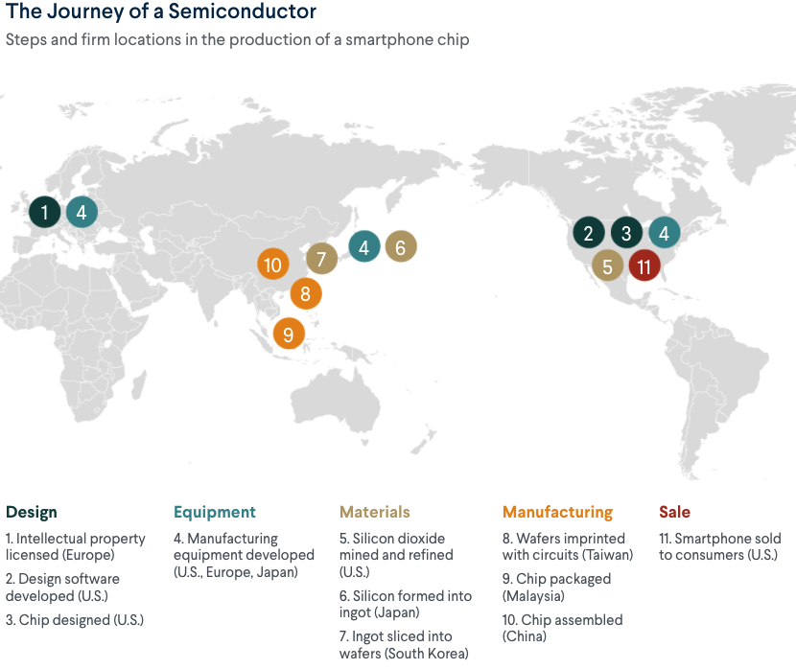
What Are Supply Chains?
https://www.cfr.org/article/what-happened-supply-chains-2021

Slide 80
Why does spending matter?
Spending:
Goods 20%
Services 44%
Total 64%
Notes:
Components sum to GDP
Average % of GDP for each component from 1960-Present: C = 64%, I=15%, G=24%, NX = 2% (X = 7%, M=9%)
Net Exports as a % of GDP has increased over the sample period, but it’s contribution to GDP is relatively small

Slide 81
Affected Women More Than Men
Men
Women
Long term implications for women?

Slide 82
Why Women More Than Men?
Women are disproportionately represented in low-wage and face-to-face jobs.
Our childcare and school systems don’t meet the needs of working mothers.
COVID-19 has upended the labor market, with disastrous consequences for working women and their families.
Many women continued working in high risk jobs.
The difference in impact is waning.

Slide 83
Affecting Black Workers More than White
White
Black

Slide 84
What Index to Follow: CPI or PCE?
CPI is the headline statistic, followed by most newspapers.
Allows more granularity – ability to look at specific products.
PCE is the one followed by the Fed.
Why?
Accounts for short term fluctuations in consumer purchases.
Based on more reliable data.
Fed generally pays attention to the core inflation #s.
Excluding food and energy.

Slide 85
Inflation: Critical Issues
Inequities
Price changes vary wildly across goods.
How inflation hits you depends on what you buy and your level of income.
Some evidence that lower income individuals face higher inflation.
Online inflation is much lower than the CPI
Estimates suggest about 2% lower.
Both have implications for the policy response.
Safety net? Antitrust action?

Slide 86
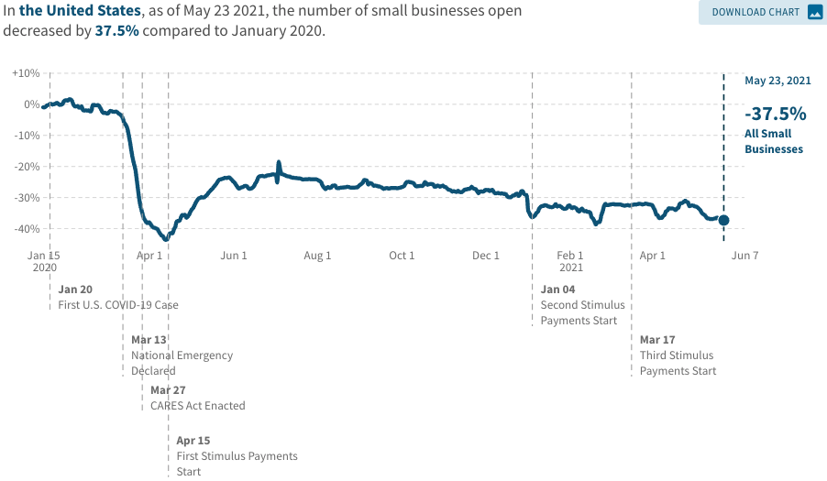
A Hard-Hit Sector: Small Business
Small Biz Closures in the United States

Slide 87
Small Businesses: They Didn’t Get Enough PPP

Slide 88
A “K-shaped” recovery?
Executive Summary
Those with financial wealth/residential real estate have seen its value grow in excess of inflation.
High income earners (>60k/yr) have largely kept their jobs;
middle and low income earners have depressed employment rates
Women are disproportionately exiting labor force.
Food insecurity has been very high.

Slide 89
Coronavirus and Inequality
Resources to weather the storm.
Racial inequities.
Educational inequities
Telecommuting
Low wage jobs are at risk.

Slide 90
Retail Sales Are Slowing – Q4-21? Q1-22?
Could be X-mas shopping
all happened in November.
(Supply chain awareness?)

Slide 91
The Great Resignation

Slide 92
Quits Are High! The Great Resignation

Slide 93
Quits – Rising, but More in Some Industries
Accom. & Food Services
Leisure & Hospitality
Retail

Slide 94
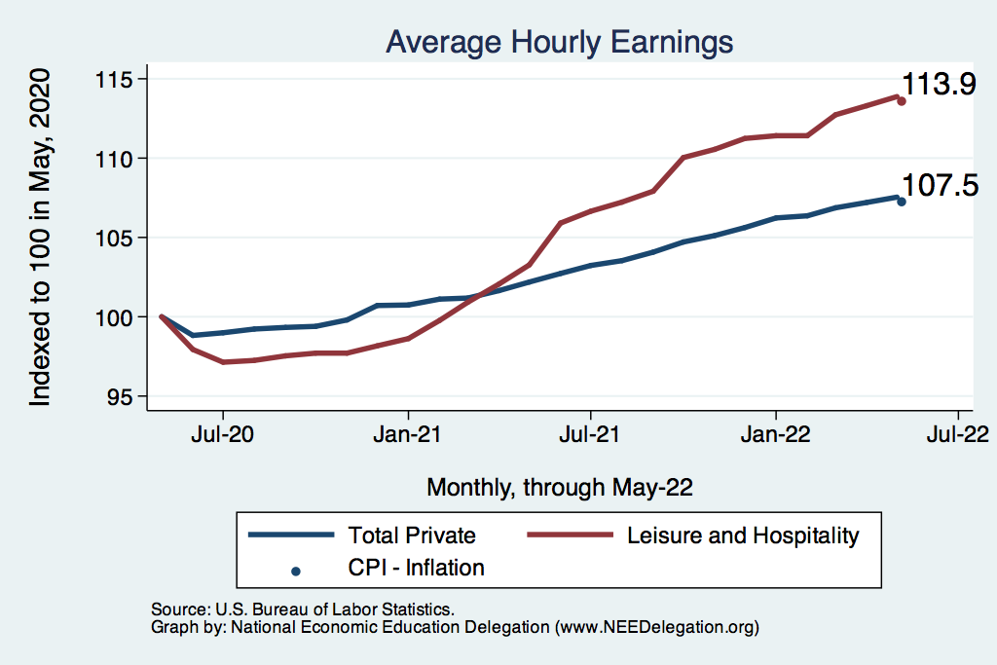
This is Happening Despite Rising Wages
Leisure & Hospitality
Total Nonfarm

Slide 95
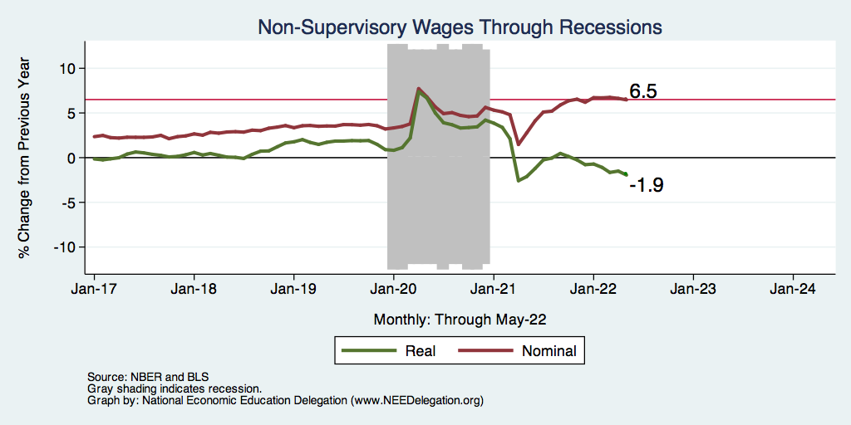
Inflation Adjusted Wages Are Falling

Slide 96
Declining Resources May Change Things
Source: NYTimes.com

Slide 97
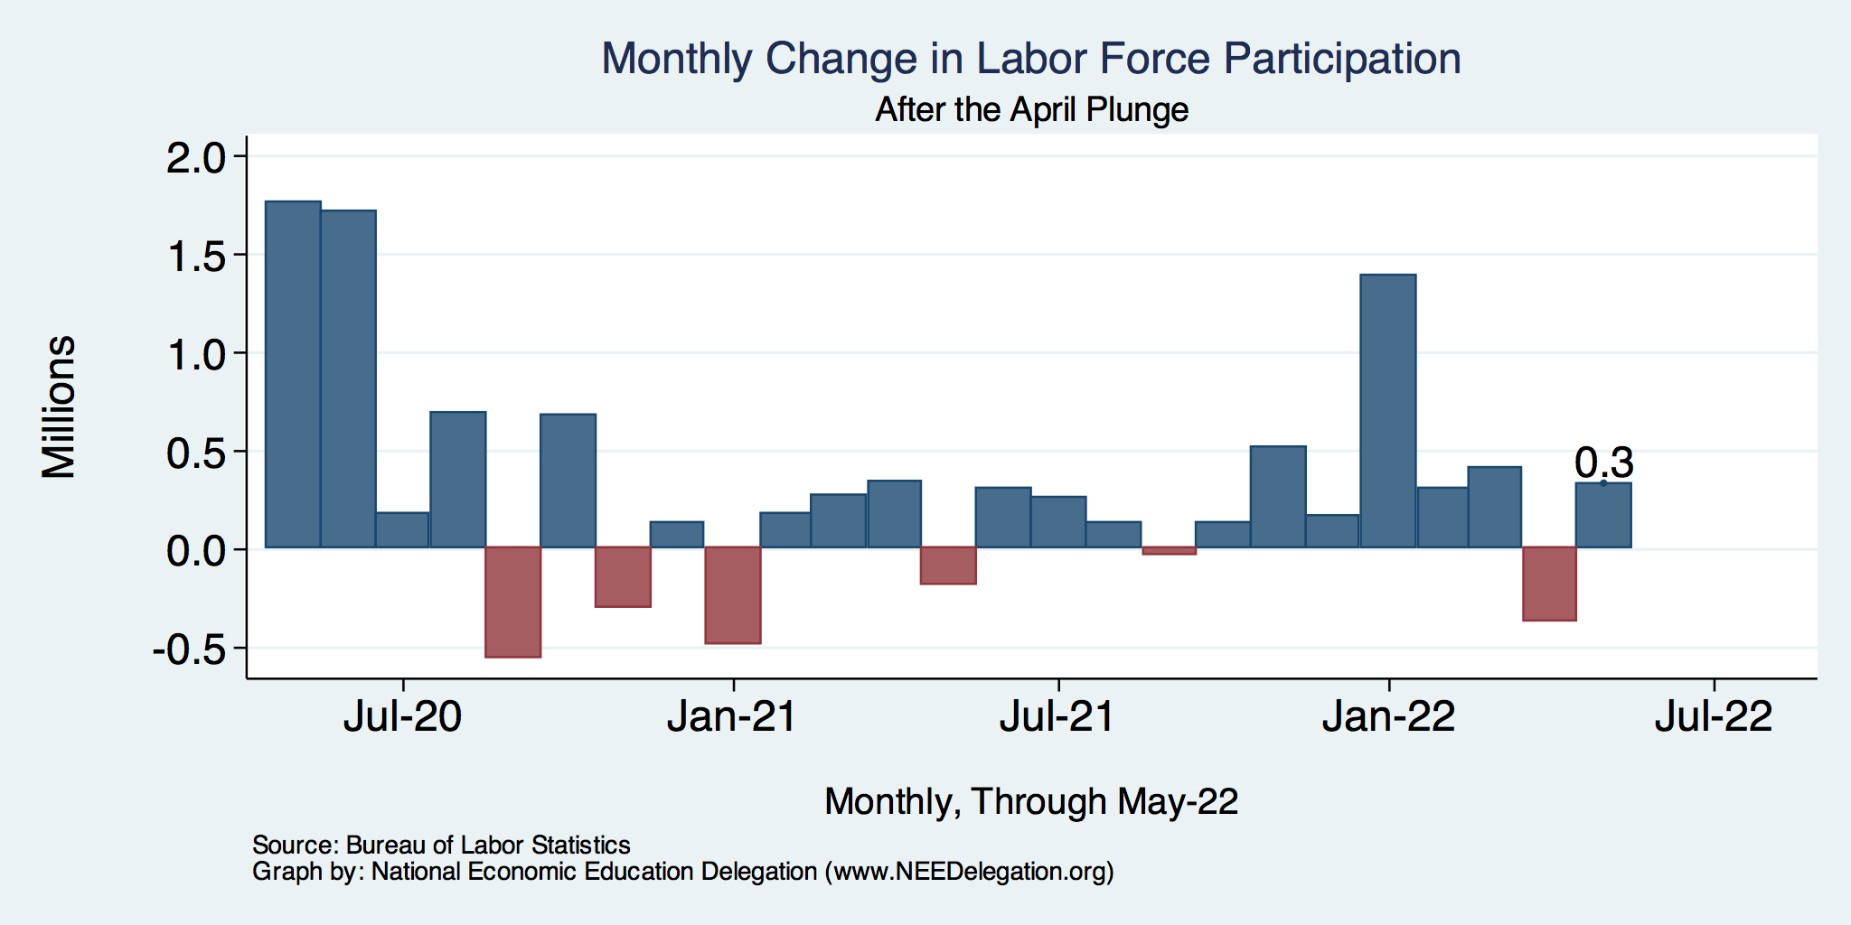
CTC Expiration Spurs Labor Force Growth

Slide 98
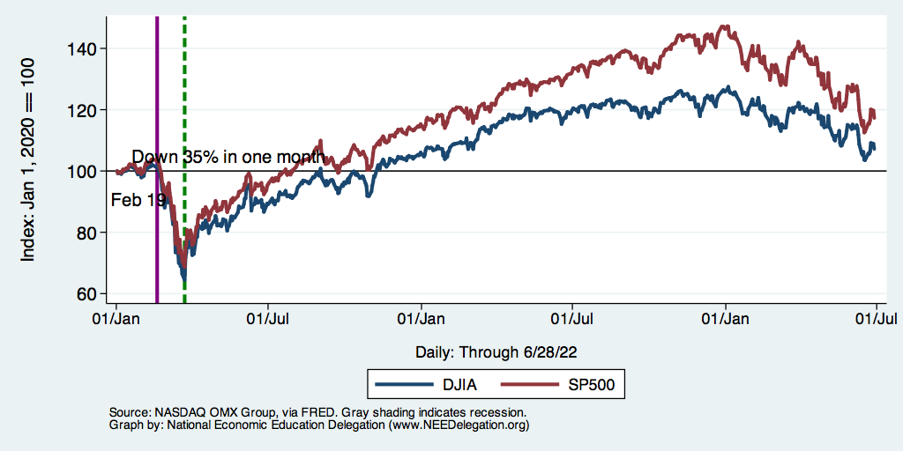
Stocks: Bounced Back Quickly, But..

Slide 99
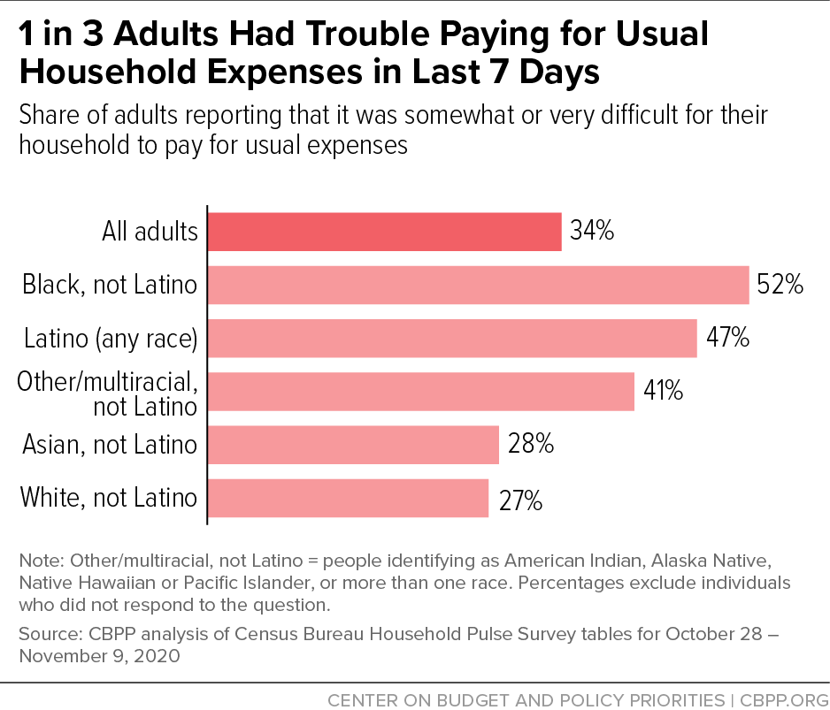
Low Income Troubles

Slide 100
Labor Force is Shrinking – Drives Down UR

Slide 101
Russia/Ukraine(/Belarus)

Slide 102
Consequences for the Global Economy
Primarily:
Oil
Wheat
Why?
Major suppliers of each
29% of world wheat production
20-40% of Europe’s oil and gas
Russia part of OPEC+
Russian and Ukranian combined economies are small.
Don’t forget Belarus.

Slide 103
The Conflict in Ukraine and the US Economy
Short run
Uncertainty
Recession?
Increase in cost of food and fuel
Long run
Decrease in globalization

Slide 104
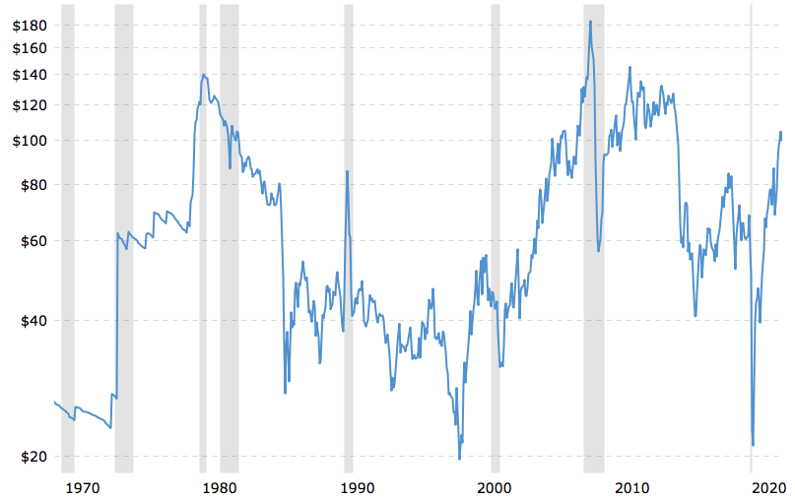
Supply Shocks: Then and Now
Historical Oil Price adjusted for Inflation.
$99.76 on May 10/22
Source: macrotrends.net

Slide 105
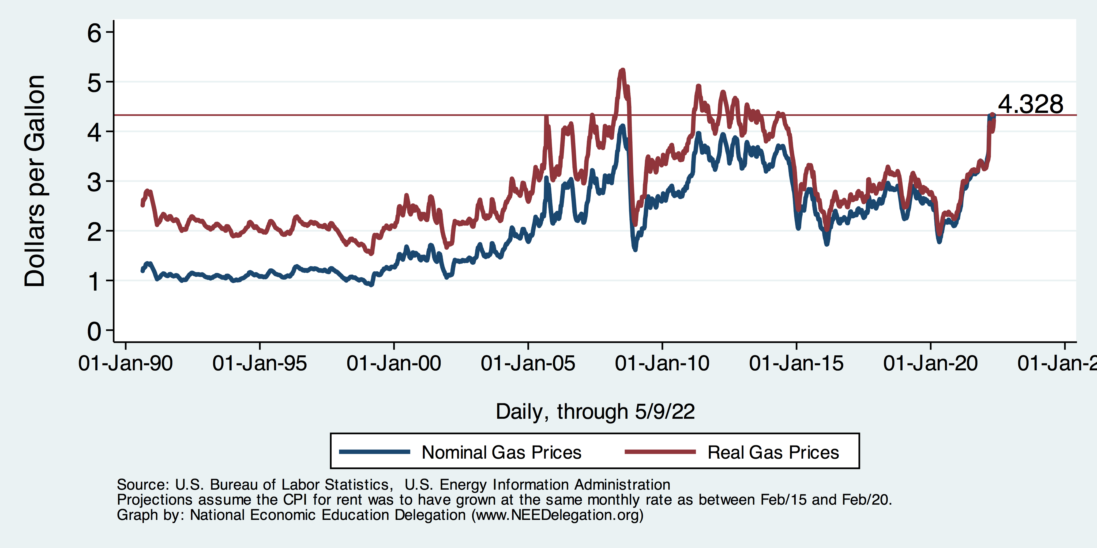
Gas Prices at the Pump

Slide 106
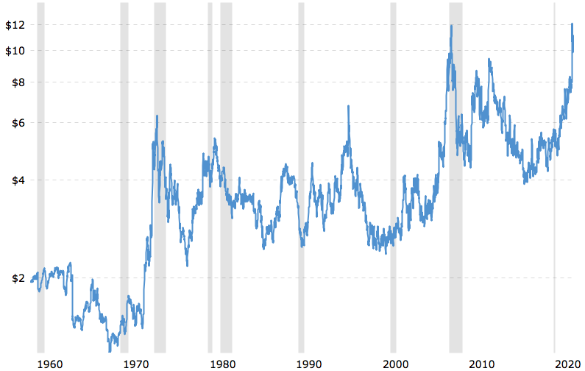
Wheat Prices Also Look Scary
Wheat Futures Prices
NOT Adjusted for inflation.
$10.93 on May 10/22.
Source: macrotrends.net

Slide 107
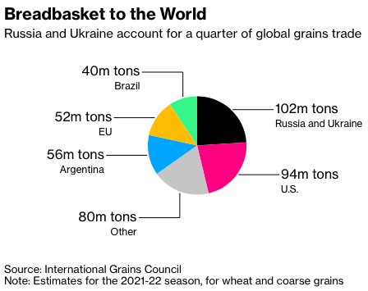
Grains
Notes:
https://www.bloomberg.com/news/articles/2022-03-02/wheat-soars-above-10-as-russia-invasion-stifles-black-sea-trade

Slide 108
Oh, and…
40% of the world’s PALLADIUM comes from Russia.
Used in catalytic convertors.
70% of the world’s NEON comes from Ukraine.
Used in production of semiconductors.
Fertilizer: Russia is the world’s largest supplier.
Prices are 3-4x their 2020 levels.
Therefore: more supply chain issues, more inflation, food insecurity.

Slide 109
www.NEEDelegation.org/LocalGraphs
For every state and county in the United States.
Detailed graphs on employment, housing, moves, and other statistics.

