Slide 1
Osher Lifelong Learning Institute, Winter 2022
Contemporary Economic Policy
University of Pittsburgh, PA
March-April, 2023
Jon Haveman, Ph.D.
National Economic Education Delegation

Slide 2
National Economic Education Delegation
Vision
One day, the public discussion of policy issues will be grounded in an accurate perception of the underlying economic principles and data.
Mission
NEED unites the skills and knowledge of a vast network of professional economists to promote understanding of the economics of policy issues in the United States.
NEED Presentations
Are nonpartisan and intended to reflect the consensus of the economics profession.

Slide 3
Who Are We?
Honorary Board: 54 members
2 Fed Chairs: Janet Yellen, Ben Bernanke
6 Chairs Council of Economic Advisers
Furman (D), Rosen (R), Bernanke (R), Yellen (D), Tyson (D), Goolsbee (D)
3 Nobel Prize Winners
Akerlof, Smith, Maskin
Delegates: 652+ members
At all levels of academia and some in government service
All have a Ph.D. in economics
Crowdsource slide decks
Give presentations
Global Partners: 48 Ph.D. Economists
Aid in slide deck development

Slide 4
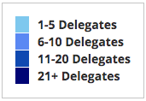
Where Are We?

Slide 5
Available NEED Topics Include:
US Economy
Healthcare Economics
Climate Change
Economic Inequality
Economic Mobility
Trade and Globalization
Minimum Wages
Immigration Economics
Housing Policy
Federal Budgets
Federal Debt
Black-White Wealth Gap
Autonomous Vehicles
Healthcare Economics

Slide 6
Course Outline
Contemporary Economic Policy
Week 1 (3/15): US Economic Update (Geoffrey Woglom, Amherst College)
Week 2 (3/22): Trade and Globalization (Alan Deardorff, University of Michigan)
Week 3 (3/29): Cryptocurrencies (Geoffrey Woglom)
Week 4 (4/5): Climate Change Economics (Sarah Jacobson)
Week 5 (4/12): Autonomous Vehicles (Jon Haveman, NEED)

Slide 7
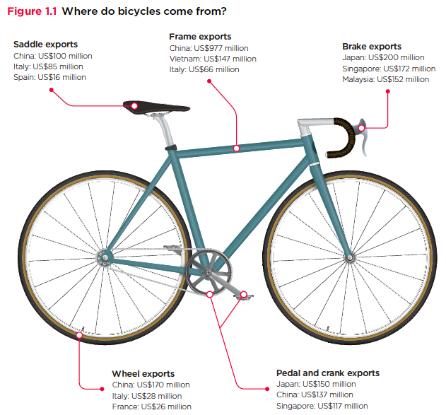
Trade: Bicycle Supply Chain
Source: World Development Report 2020

Slide 8
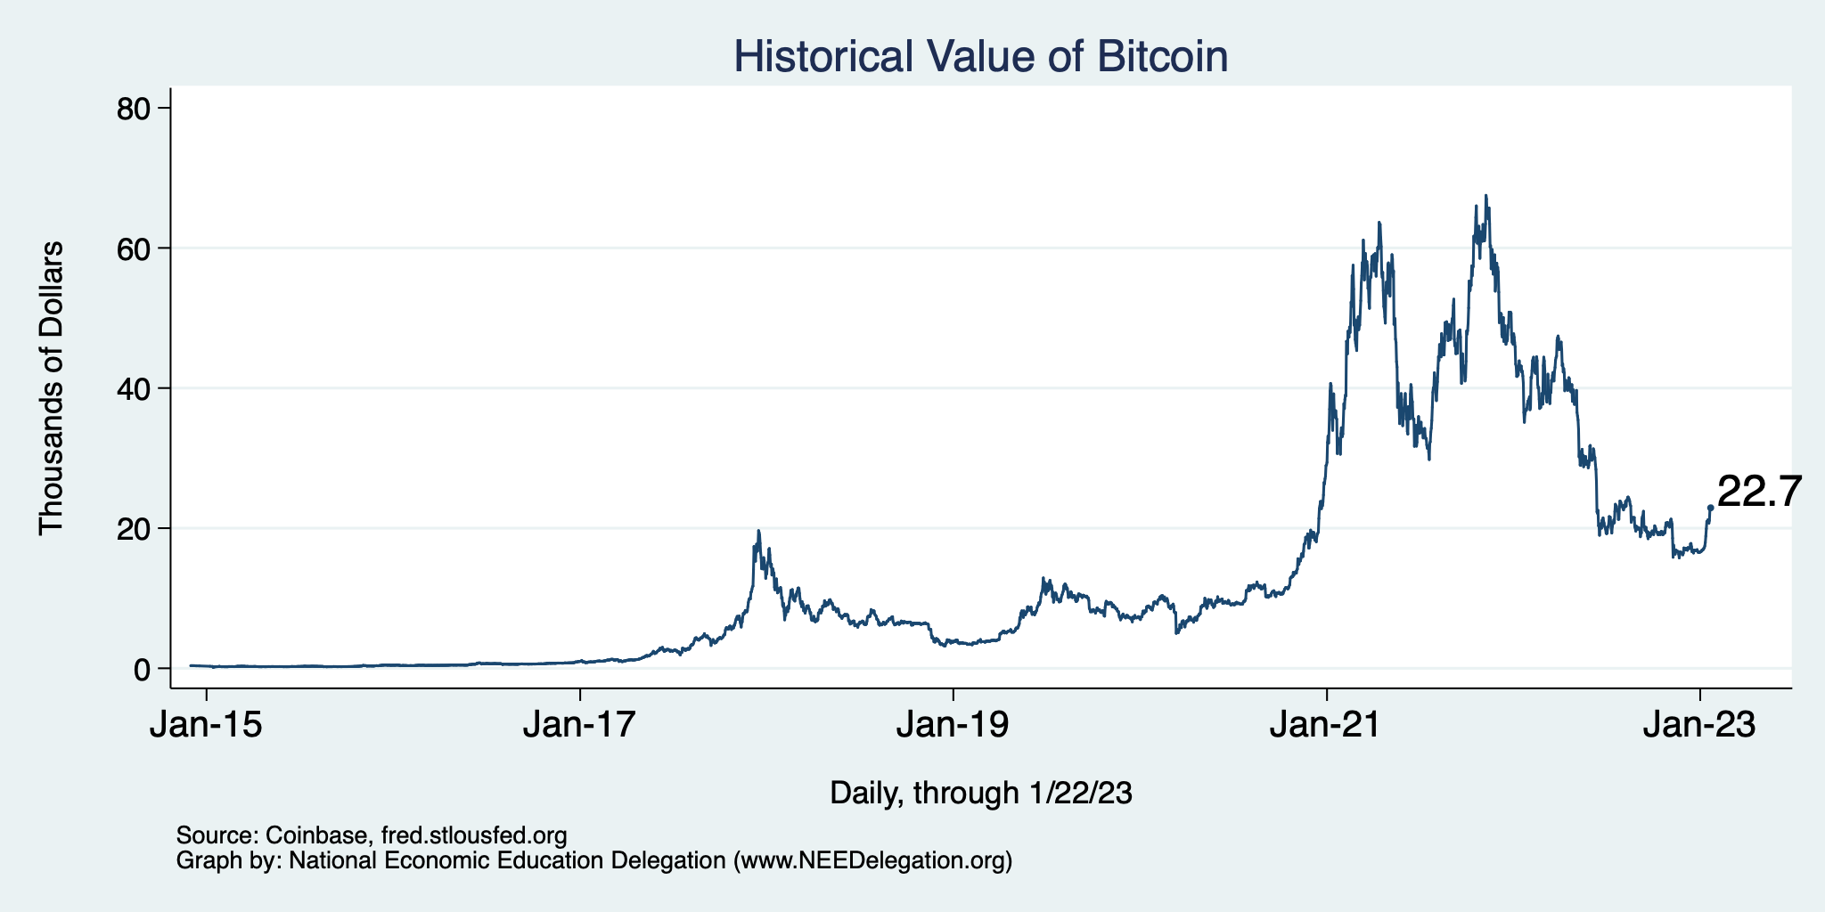
Bitcoins: What Is All the Excitement About?
Was

Slide 9
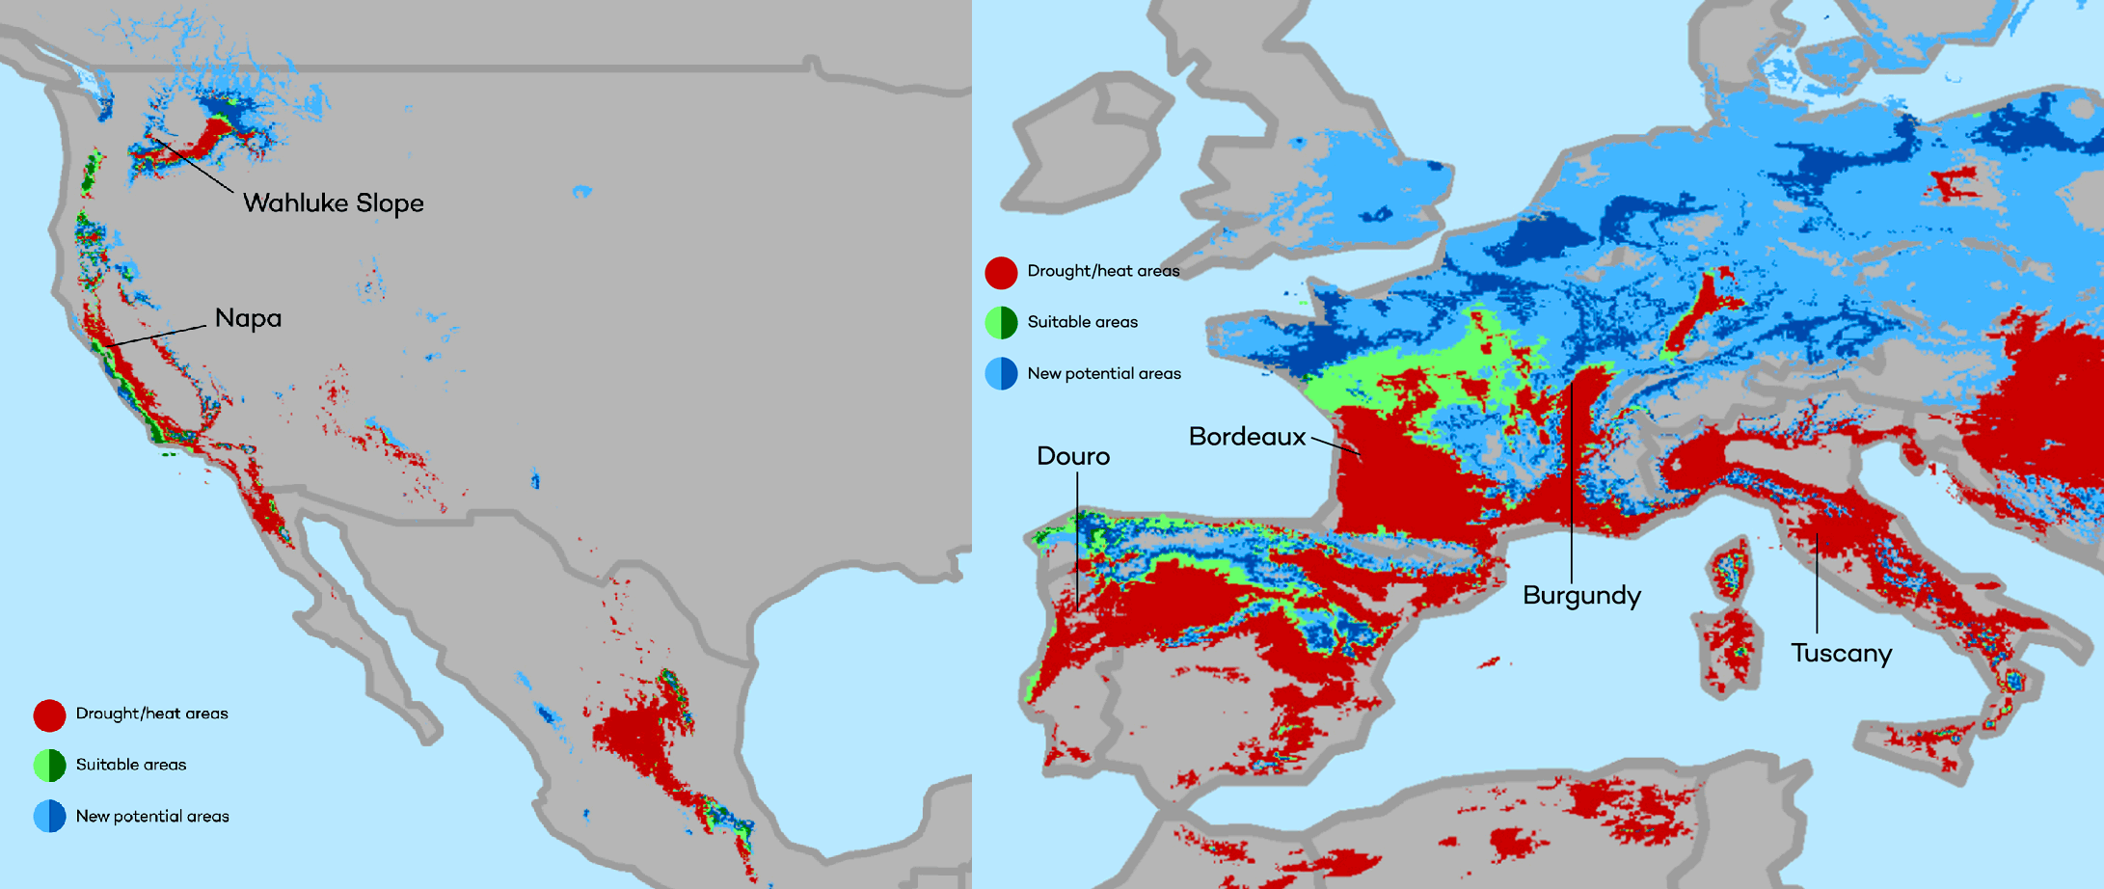
Climate Change Economics
The changing map of the world’s wine-growing regions.

Slide 10
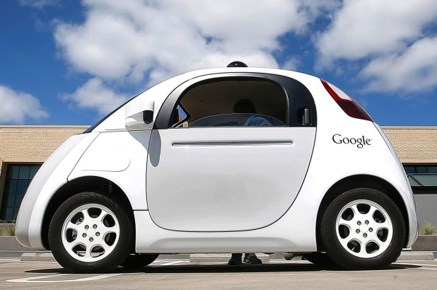
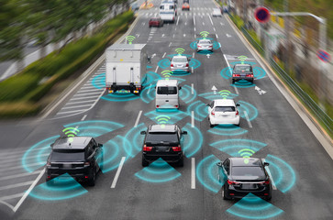
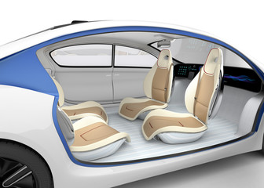
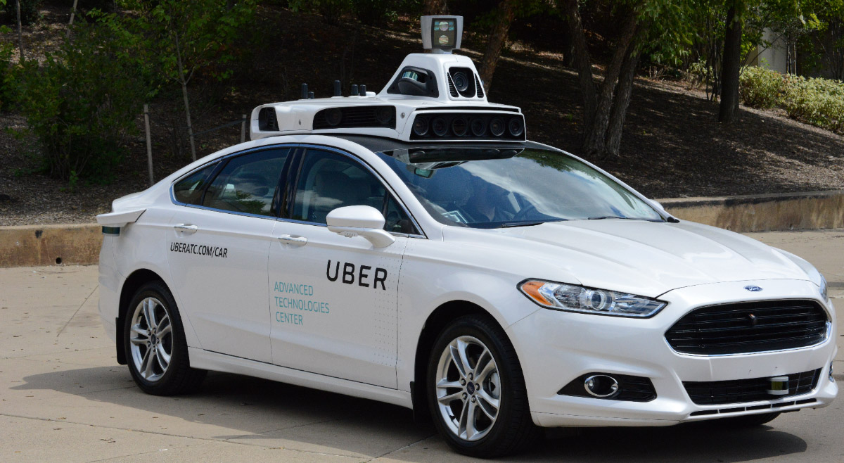
Autonomous Vehicles

Slide 11
Submitting Questions
Please submit questions of clarification in the chat.
I will try to handle them as they come up.
We will do a verbal Q&A once the material has been presented.
Slides will be available from the NEED website tomorrow (https://needelegation.org/delivered_presentations.php)

Slide 12
Credits and Disclaimer
This slide deck was authored by:
Jon D. Haveman, NEED
Scott Baier, Clemson University
Geoffrey Woglom, Amherst College (Emeritus)
Brian Dombeck, Lewis & Clark College
Doris Geide-Stevenson, Weber State
Disclaimer
NEED presentations are designed to be nonpartisan.
It is, however, inevitable that the presenter will be asked for and will provide their own views.
Such views are those of the presenter and not necessarily those of the National Economic Education Delegation (NEED).

Slide 13
Credits and Disclaimer
This slide deck was authored by:
Jon D. Haveman, NEED
Scott Baier, Clemson University
Geoffrey Woglom, Amherst College (Emeritus)
Brian Dombeck, Lewis & Clark College
Doris Geide-Stevenson, Weber State
Disclaimer
NEED presentations are designed to be nonpartisan.
It is, however, inevitable that the presenter will be asked for and will provide their own views.
Such views are those of the presenter and not necessarily those of the National Economic Education Delegation (NEED).

Slide 14
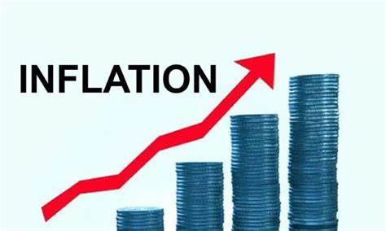
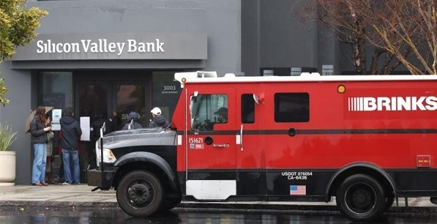
US Economy: Update
Geoffrey Woglom,
Professor of Economics
Amherst College, emeritus
March 15, 2023

Slide 15
Outline for the Talk
Summary of the state of the economy.
The Effect of M&F policies.
What lies ahead for the economy.
The implications of recent bank failures

Slide 16
Gross Domestic Product
Consumption | 68.2%
Investment | 17.8%
Exports | 11.5%
Imports | -14.7%
Government | 17.5%
GDP | 100.0%

Slide 17
Real GDP and ‘Potential’ during the Recovery
The “output gap” is about $100b
Source: Fred, St Louis Fed
Notes:
GDP is about $27 trillion. GDPNOw 3.9 1/5 Blue Chip 1.2

Slide 18
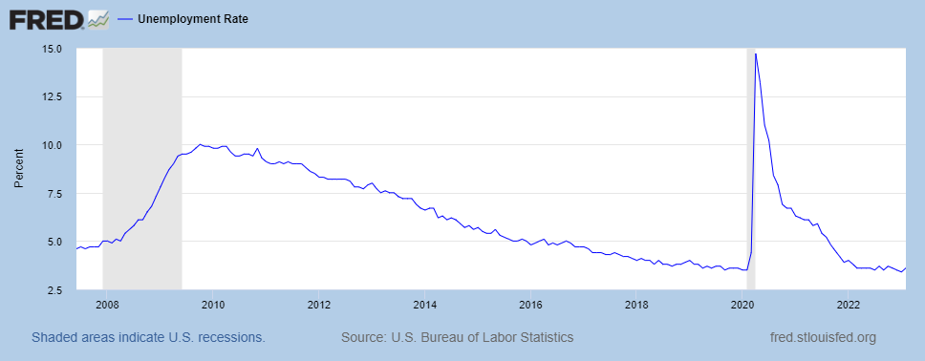
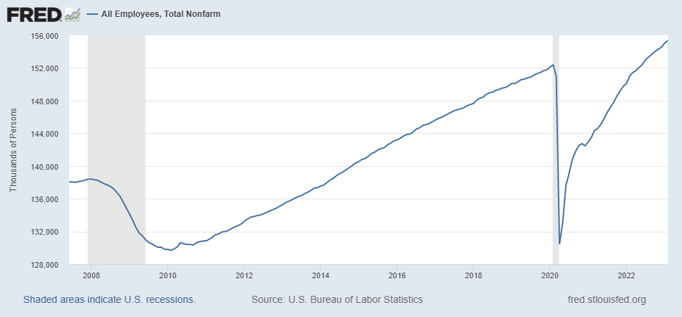
Labor Market: Fully Recovered?
Slight uptick in February to 3.6%
Notes:
One big difference with GDP graph. Total jobs have barely recovered, although 517 thousand jobs added in January

Slide 19
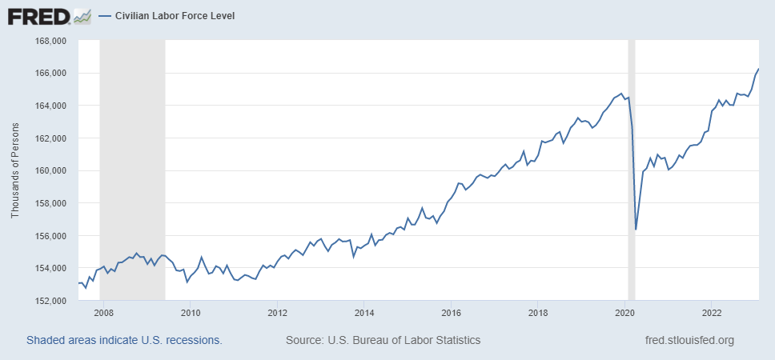
Where Have All the Workers Gone?
Notes:
Big increase in February helps to explain rise in unemployment 419 increase 177 more employed

Slide 20
Labor Market in Pennsylvania

Slide 21
Overall Good News on the Real Side
GDP is very close to its potential.
The labor market as measured by the unemployment rate is fully recovered.
Fly in the ointment: labor force has lost over 1.5 million workers.
But there is also a nominal side: interest rates, asset prices, inflation and wages.
News isn’t so good!

Slide 22
Interest Rates: Era of Falling Rates Over?
Notes:
Fed policy rate 4.5 to 4.25. Concerns with inflation

Slide 23
National Housing Market and Closer to Home
https://www.zillow.com/research/data/

Slide 24
The Fall in Prices is Having an Effect

Slide 25
Stock Prices: Rates and Recession?
Notes:
Since the end of 2021, lost almost 20%

Slide 26
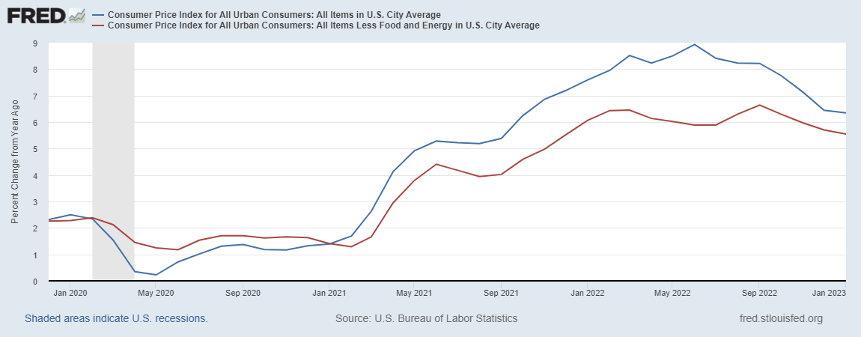
Inflation during the Recovery
Looks Promising?
Notes:
August CPI yoy 8.3% down from 8.5 and Core 6.3 up from 6.3 in JUly

Slide 27
Inflation: A Closer Look
Source: BLS accessed from Fred

Slide 28
Rents Paid and Rents Asked For

Slide 29
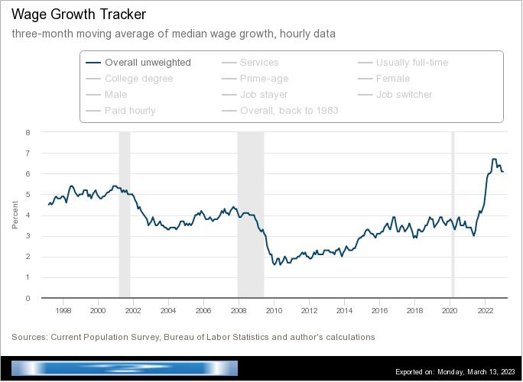
Wages Haven’t Kept Pace with Inflation
Notes:
But, note that low wage workers are doing relatively the best

Slide 30
The “Nominal” Side
Inflation: There is a lot of work still to be done.

Slide 31
Policy Effects
Fiscal:
2020-2021: massive stimulus. Cares Act, 3 rounds of stimulus checks, expanded unemployment benefits, Payroll Protection Loans.
Monetary:
2020-2/2022: policy interest rate at zero, new round of quantitative easing.
3/2022-present: most rapid increase in interest rates since Paul Volcker

Slide 32
Accommodative Monetary Policy until 3/2022

Slide 33
Where we Stand
The ARP was probably too big, but helped many poor families, and the Fed was aware of the size of the stimulus.
Monetary policy was too easy for too long, but since March of last years has been much more restrictive.
Yes, there were supply chain issues that temporarily raised inflation, but there was (is?) too much total spending.
So, where are we headed?
What will the Fed do?

Slide 34
Latest Numbers on Consumption

Slide 35
Forecasters Are in fact Seeing the “R” Word

Slide 36
What is a Recession?
Defined by the National Bureau of Economic Research (NBER)
“The NBER's definition emphasizes that a recession involves a significant decline in economic activity that is spread across the economy and lasts more than a few months.”
Popular Rule of Thumb: Two or more, consecutive quarters where Real GDP falls.
Recessions are caused by decreases in total spending.

Slide 37
Real GDP Growth and Recessions
Notes:
Shaded Bars are recessions. 2022Q1, -1.6; Q2, -0.6 at annual rates.

Slide 38
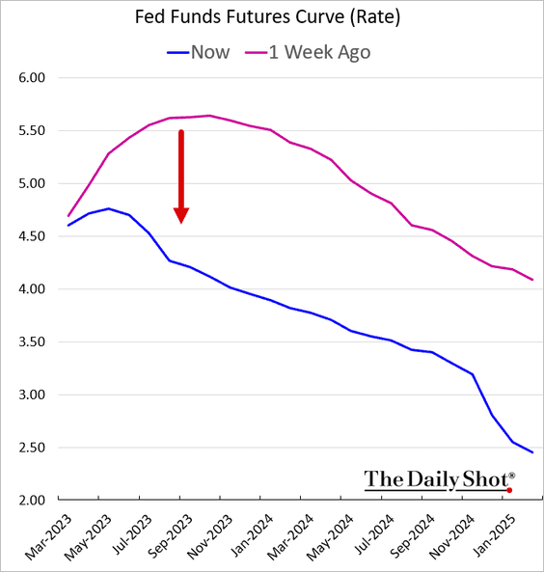
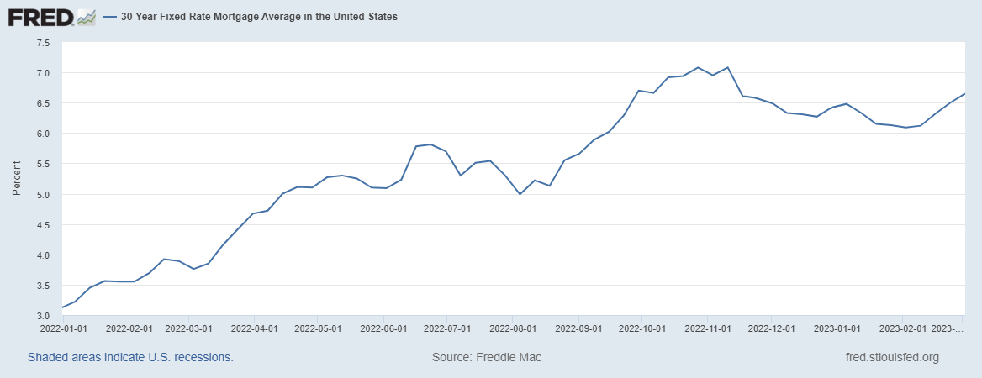
On March 3rd Powell Emphasized Rate Hikes
Blue last week
Red two weeks ago
Terminal rate

Slide 39
Something Happened Over the Weekend

Slide 40
Silicon Valley Bank
Regional mid-sized bank with $212b in assets; $6billion in capitalization (15th largest).
Focused on loans to venture capital and managing the desposit accounts of startups.
Very rapid growth in deposits and assets between 2021 and 2022, which led to big investments in “safe” long term Treasury bond.
The market value of these bonds fell drastically due to the Fed’s rise in interest rates.
No problem! The bank does not incur “losses” unless it sells the bonds before maturity.
Notes:
JP morgan chase 3.7 trillion

Slide 41
Whoops!
Concentrated and sophisticated depositors see the problem and want to get their money out (FDIC insurance guarantees deposits up to $250 thousand, and 90% above this amount!).
Deposit withdrawals force SVB to sell those bonds.
Precipitating a classic bank run and leading to the FDIC seizing the bank on Friday.

Slide 42
Silicon Valley’s Not So Wonderful Life

Slide 43
FDIC Bank Closures, in General
“Auction” off the failed bank; all depositors paid in full.
Payoff insured deposits and liquidate bank assets
Under Dodd-Frank, the FDIC is supposed to use the cheaper procedure.
In either case, funding comes from banks payments of deposit insurance premium.

Slide 44
But, in This Case:
Janet Yellen announced that all depositors would be paid in full, and there would be complete insurance of all bank deposits for a year.
Senior Executives all fired.
Fed created a new lending program, so that banks can borrow against Treasury bonds without realizing losses.
The rationale was to prevent bank run spreading to other midsize banks.
Two other banks recently closed
Stock prices of a number of similar sized banks have plummeted.

Slide 45
Problems with the Bailout
Political:
Did political favoritism play a role in bailing out well connected, sophisticated silicon valley depositors.
Why didn’t bank regulators see this coming?
Economic: has the moral hazard of “too big to fail” been increased.
For the Fed: Will the Fed have to scale back its interest rate increases to prevent wide scale financial crisis?

Slide 46
Sadly, It Looks as if Things Could Get Worse
Credit Suisse a large Bank (45th largest in the world) with a significant US presence is in trouble
WSJ, 3/15: “Credit Suisse has been the problem child of European banking for several years. Repeated scandals and financial losses have hammered the 166-year-old bank, which combines a wealth-management business catering to the world’s elite rich with a Wall Street investment bank.”
But, the danger is contagion and European bank shares were down.

Slide 47
Credit Suisse Takes a Beating

Slide 48
Turbulence in the Treasury Market

Slide 49
Trade: Bicycle Supply Chain
Next Week: Alan Deardorff
Source: World Development Report 2020

Slide 50
Let’s Hear from You!
Geoffrey Woglom
grwoglom@amherst.edu
Contact NEED: Info@NEEDelegation.org
Submit a testimonial: www.NEEDelegation.org/testimonials.php
Support NEED: www.NEEDelegation.org/donate.php

