Slide 1
Osher Lifelong Learning Institute, Fall 2023
Contemporary Economic Policy
Eckerd College
Fall, 2023
Jon Haveman, Ph.D.
National Economic Education Delegation

Slide 2
National Economic Education Delegation
Vision
  One day, the public discussion of policy issues will be grounded in an accurate perception of the underlying economic principles and data.
Mission
  NEED unites the skills and knowledge of a vast network of professional economists to promote understanding of the economics of policy issues in the United States.
NEED Presentations
  Are nonpartisan and intended to reflect the consensus of the economics profession.

Slide 3
Who Are We?
Honorary Board: 54 members
  2 Fed Chairs: Janet Yellen, Ben Bernanke
  6 Chairs Council of Economic Advisers
    Furman (D), Rosen (R), Bernanke (R), Yellen (D), Tyson (D), Goolsbee (D)
  3 Nobel Prize Winners
    Akerlof, Smith, Maskin
Delegates: 652+ members
  At all levels of academia and some in government service
  All have a Ph.D. in economics
  Crowdsource slide decks
  Give presentations
Global Partners: 48 Ph.D. Economists
  Aid in slide deck development

Slide 4


Where Are We?

Slide 5
Available NEED Topics Include:
US Economy
Healthcare Economics
Climate Change
Economic Inequality
Economic Mobility
Trade and Globalization
Minimum Wages
Immigration Economics
Housing Policy
Federal Budgets
Federal Debt
Black-White Wealth Gap
Autonomous Vehicles
US Social Policy

Slide 6
Course Outline
Contemporary Economic Policy
  Week 1 (10/10): Economic Update (Geoffrey Woglom Amherst College)
  Week 2 (10/17): International Institutions (Alan Deardorff U of Michigan)
  Week 3 (10/24): Economics of Immigration (Roger White Whitier College)
  Week 4 (10/31): Trade and Globalization (Avik Chakrabarti U Wisconsin Milwaukee))
  Week 5 (11/07): Economic Inequality (Roger White Whittier College)
  Week 6 (11/10): Federal Debt (Brian Peterson Lagrange College)

Slide 7
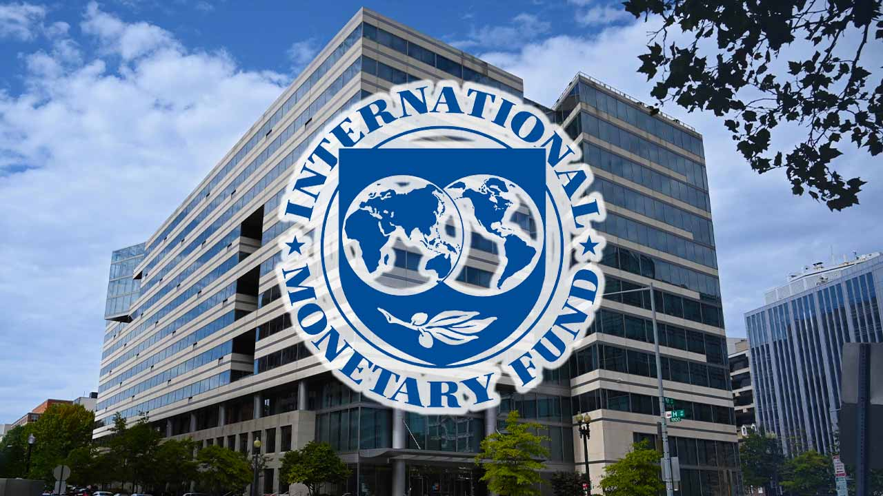
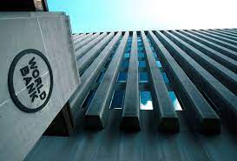
International Institutions: Alan Deardorff

Slide 8
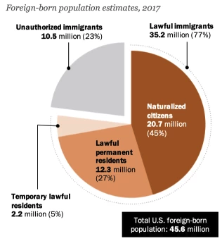
Immigrant Population in 2017
Categories of the total number
of immigrants in the United States.
https://www.pewresearch.org/fact-tank/2019/07/12/how-pew-research-center-counts-unauthorized-immigrants-in-us/

Slide 9

Trade: Bicycle Supply Chain
Source: World Development Report 2020

Slide 10

Income Inequality: Share of Top 10%
Stock Market Crash
WWII
Housing Bubble
Dot-com Bubble

Slide 11
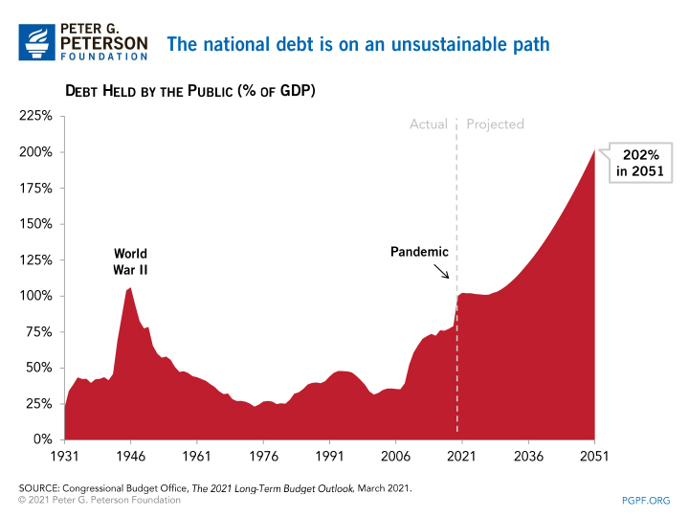
The Federal Debt is Becoming A Problem

Slide 12
Submitting Questions
Please submit questions in the chat.
  I will try to handle them as they come up, but may take them in a bunch as time permits.
We will do a verbal Q&A once the material has been presented.
  And the questions in the chat have been addressed.
After talk, I hope there will be time for more extended questions.

Slide 13
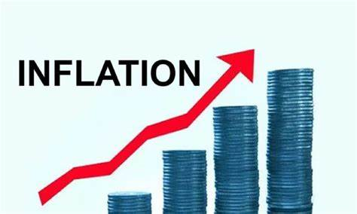
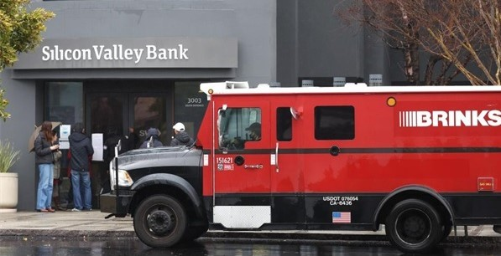
US Economy: Update
Geoffrey Woglom,
Professor of Economics
Amherst College, emeritus
October 10, 2023

Slide 14
Credits and Disclaimer
This slide deck was authored by:
  Jon D. Haveman, NEED
  Scott Baier, Clemson University
  Geoffrey Woglom, Amherst College (Emeritus)
  Brian Dombeck, Lewis & Clark College
  Doris Geide-Stevenson, Weber State
Disclaimer
  NEED presentations are designed to be nonpartisan.
  It is, however, inevitable that the presenter will be asked for and will provide their own views.
  Such views are those of the presenter and not necessarily those of the National Economic Education Delegation (NEED).

Slide 15
Outline for the Talk
Summary of the state of the macroeconomy.
The Effect of M&F policies.
What lies ahead for the economy.
What will the Fed do at its next policy meeting 10/31-11/1
Important things that will NOT be covered today
Income inequality.
Climate change.
And many other important economic issues. Why NOT?

Slide 16
Gross Domestic Product
Consumption | 68.1%
Investment | 17.7%
Exports | 10.9%
Imports | -13.9%
Government | 17.3%
GDP | 100.0%

Slide 17
The Size of the World Economies
https://www.visualcapitalist.com/visualizing-the-105-trillion-world-economy-in-one-chart/

Slide 18
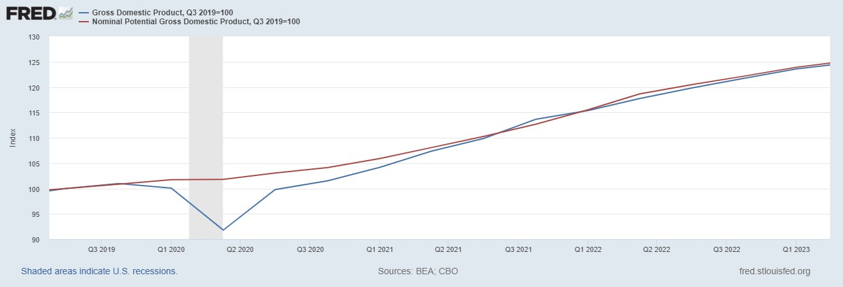
GDP and ‘Potential’ during the Recovery
Grey bars are recessions
The “output gap” is about $85b
Source: Fred, St Louis Fed

Slide 19
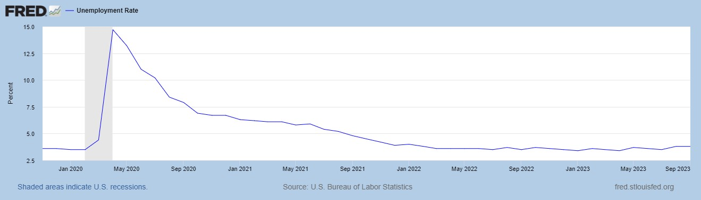
Unemployment is Near Record Lows

Slide 20
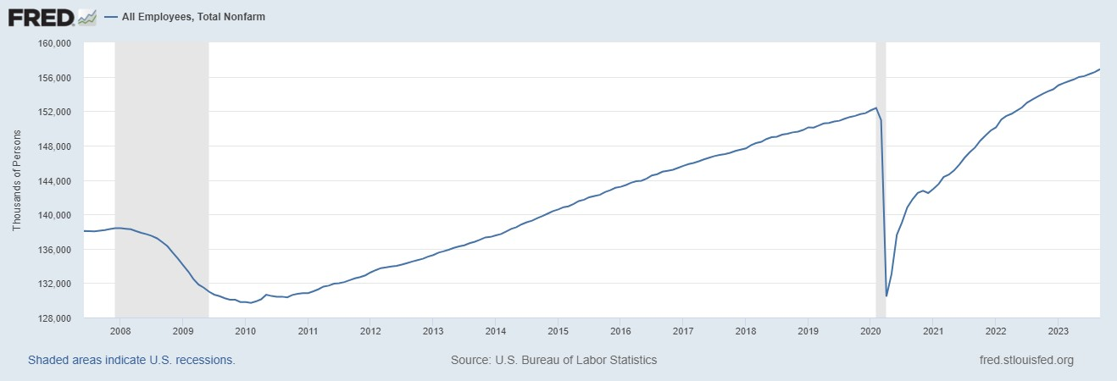
Where Have All the Workers Gone?
Notes:
Largely explained by baby boomer retirements and a little excess retirements due to COVID

Slide 21
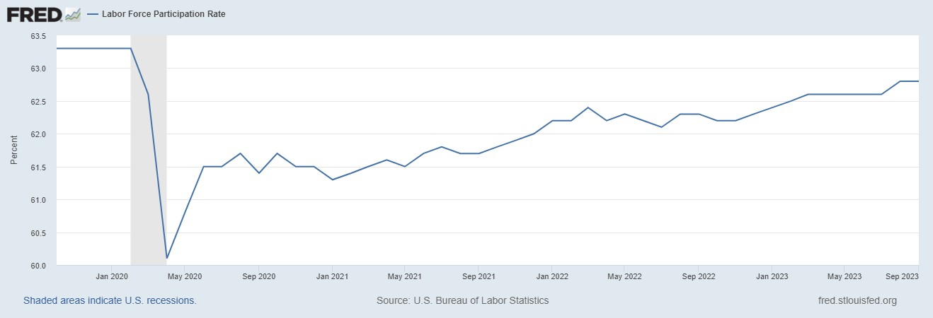
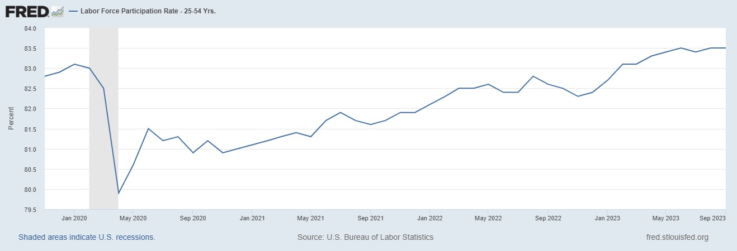
The Great Resignation?
Notes:
CBO Jan 2020 projections: LF, 62.5, vs 62.6; Total employment; 154.8 million vs actual 155.6. Civilian Labor Force; 160 vs 166.7

Slide 22
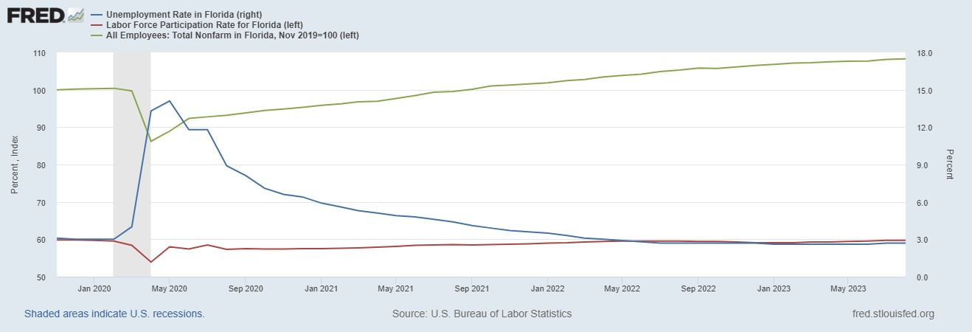
Labor Market in Florida

Slide 23
Overall Good News on the Real Side
GDP is very close to its potential.
The labor market as measured by the unemployment rate is fully recovered.
There was no apparent Great Resignation
But there is also a nominal side: interest rates, asset prices, inflation and wages.
News isn’t so good!

Slide 24
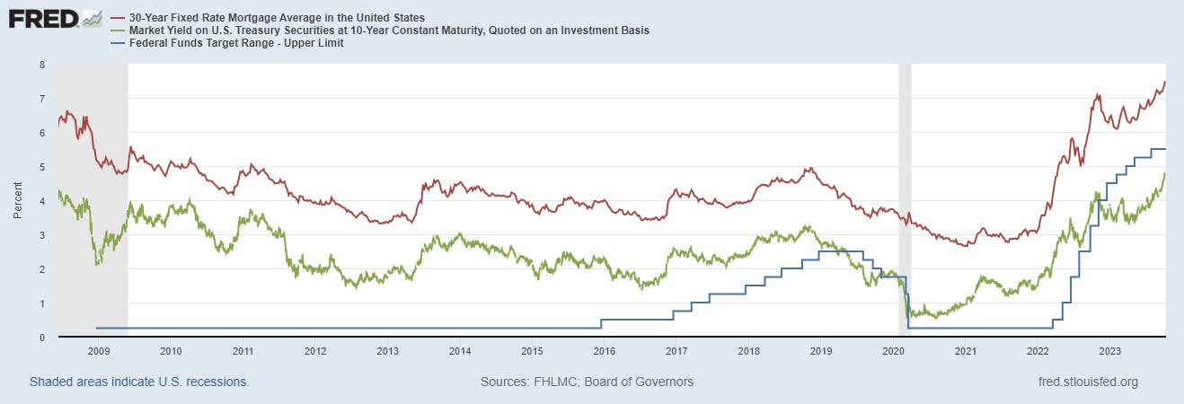
Interest Rates: Era of Falling Rates Over?
Notes:
Fed policy rate 4.5 to 4.25. Concerns with inflation

Slide 25
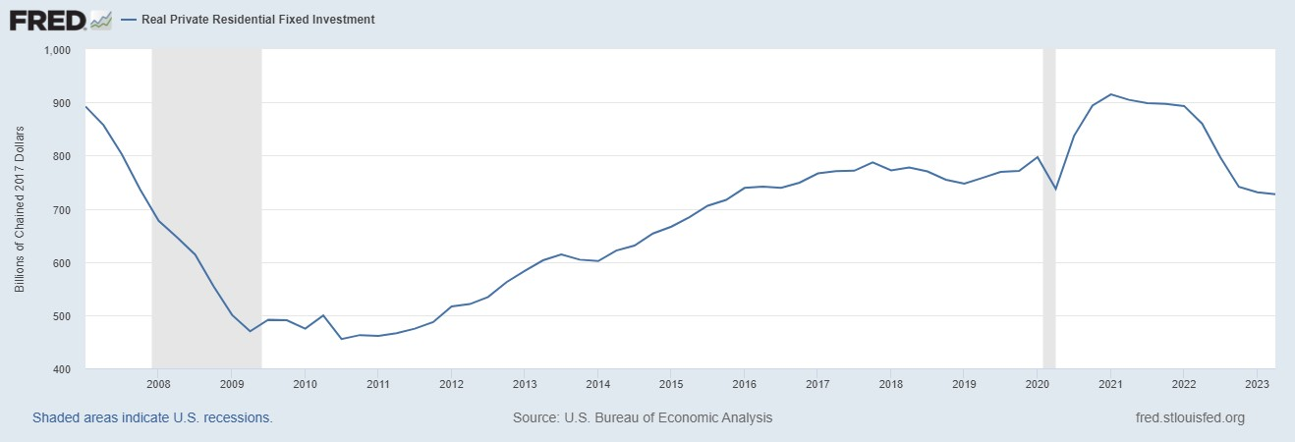
Mortgage Rates are Having an Effect

Slide 26
National Housing Market and Closer to Home
https://www.zillow.com/research/data/

Slide 27
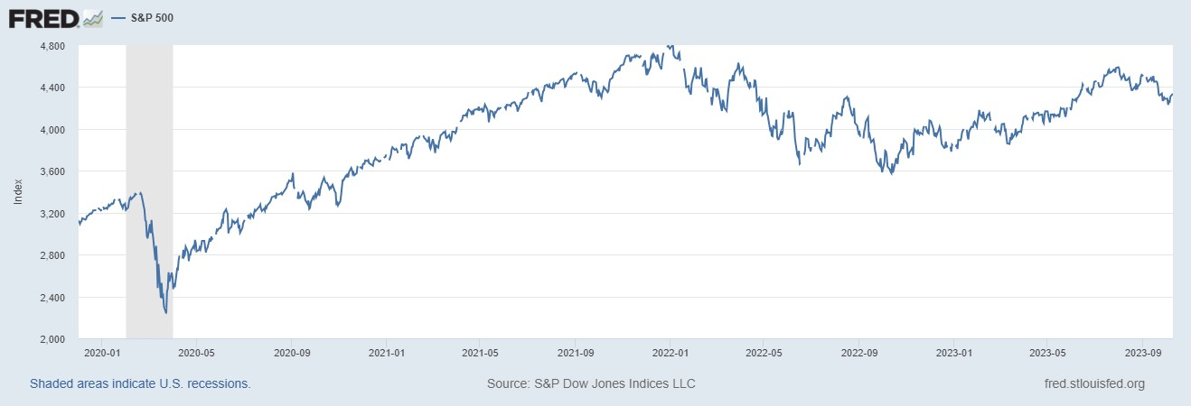
Stock Prices: Greed Giving Way to Fear?
Notes:
Since the end of 2021, lost almost 15%

Slide 28
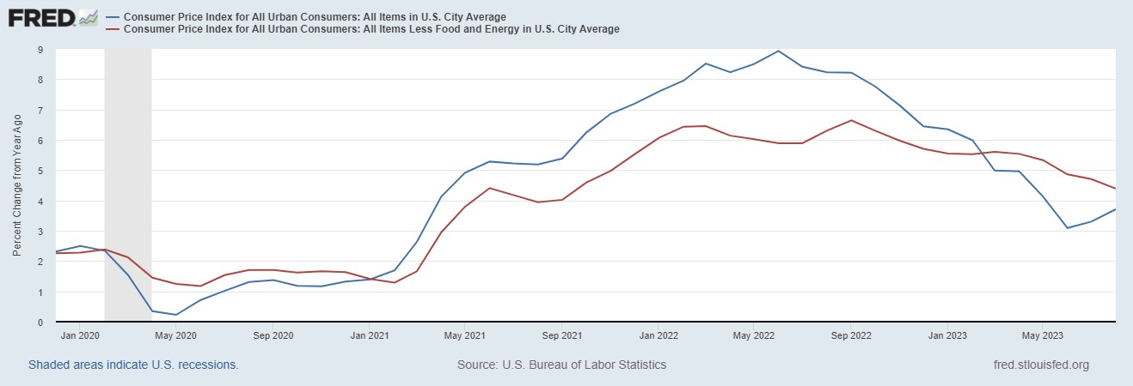
Inflation during the Recovery (CPI)
Notes:
August CPI yoy 8.3% down from 8.5 and Core 6.3 up from 6.3 in JUly

Slide 29
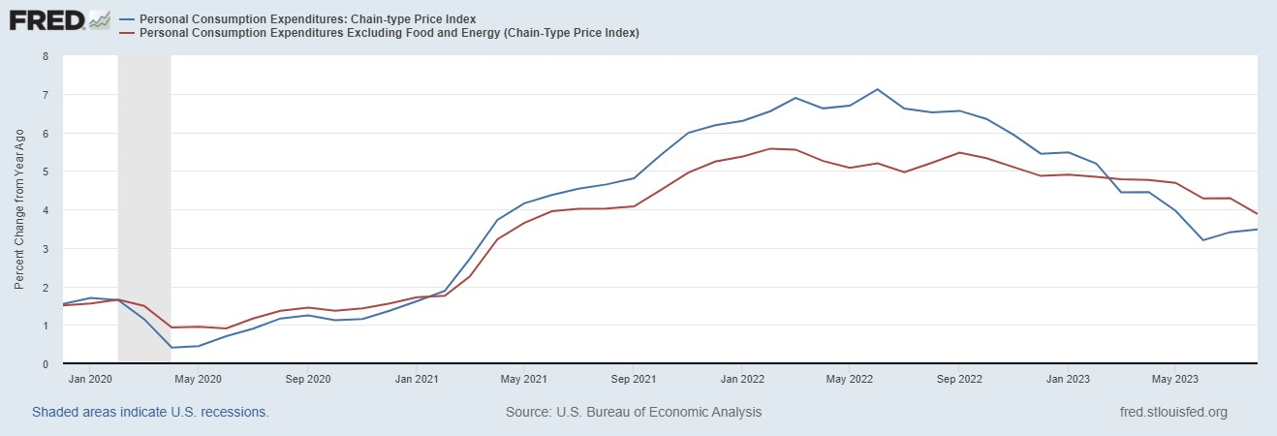
Fed’s Measure (PCE)
Fed Doesn’t React until 3/2022
Looks Promising?

Slide 30
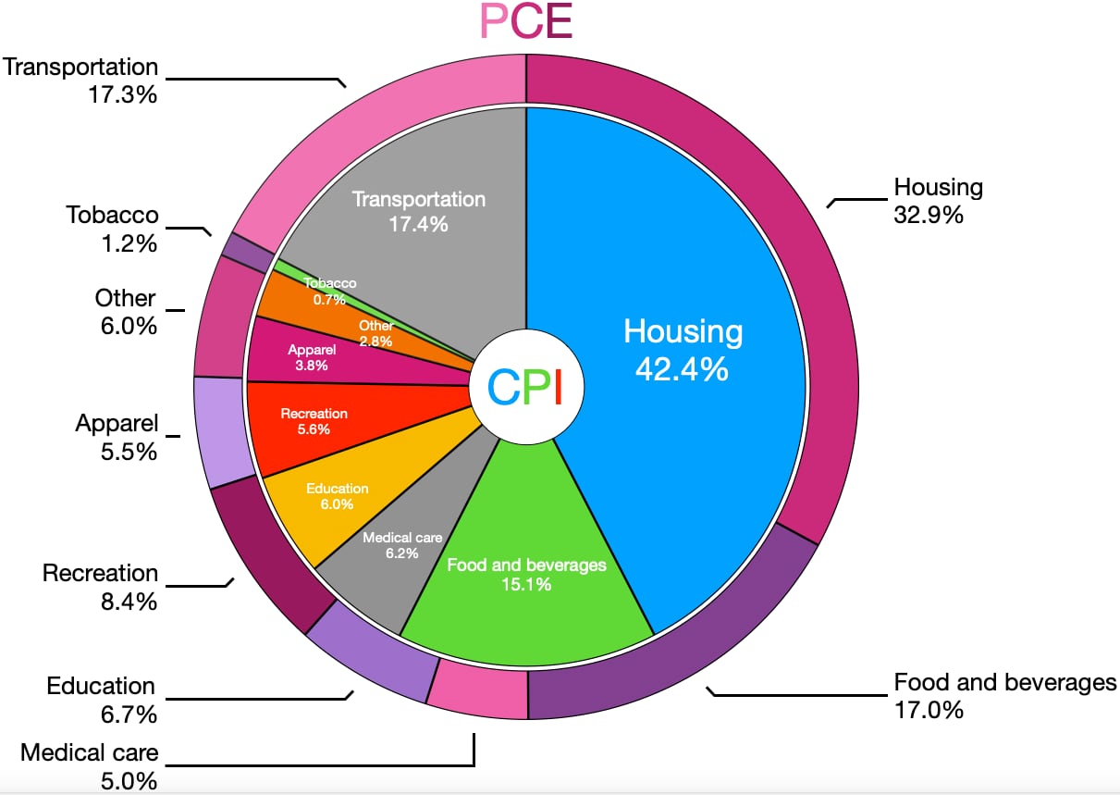
CPI vs. PCE: Differences
CPI tends to be higher (Aug):
CPI, 4.3%
PCE, 3.5%
Core CPI, 3.7%
Core PCE, 3.9%.
Typically more like 0.5 % pts.
https://en.wikipedia.org/wiki/Personal_consumption_expenditures_price_index#

Slide 31
Measuring “Underlying” Inflation
Two Reasons for Measuring Recent Inflation:
What has happened to the Cost of Living?
What is likely to happen to inflation over the next 12-18 months?

Slide 32
Rents Paid versus Asking Rents

Slide 33
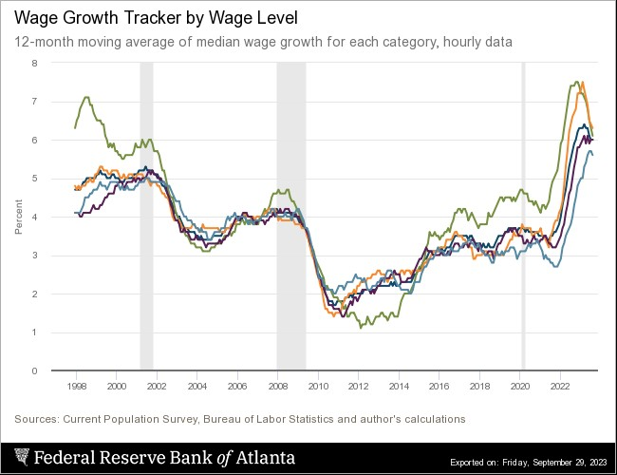
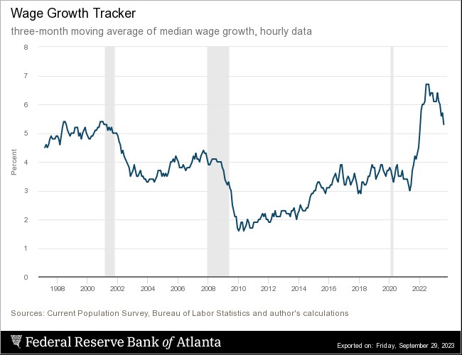
Wages Haven’t Kept Pace with Inflation
Notes:
But, note that low wage workers are doing relatively the best

Slide 34
The “Nominal” Side
Inflation: There is a lot of work still to be done.

Slide 35
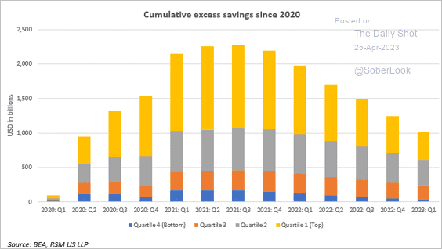
Policy Effects: Fiscal
2020-2021: massive stimulus. Cares Act, 3 rounds of stimulus checks, expanded unemployment benefits, Payroll Protection Loans.

Slide 36
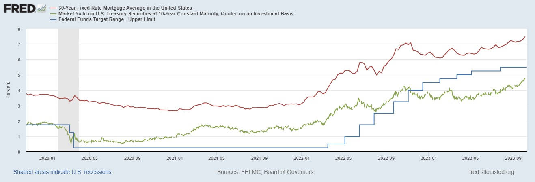
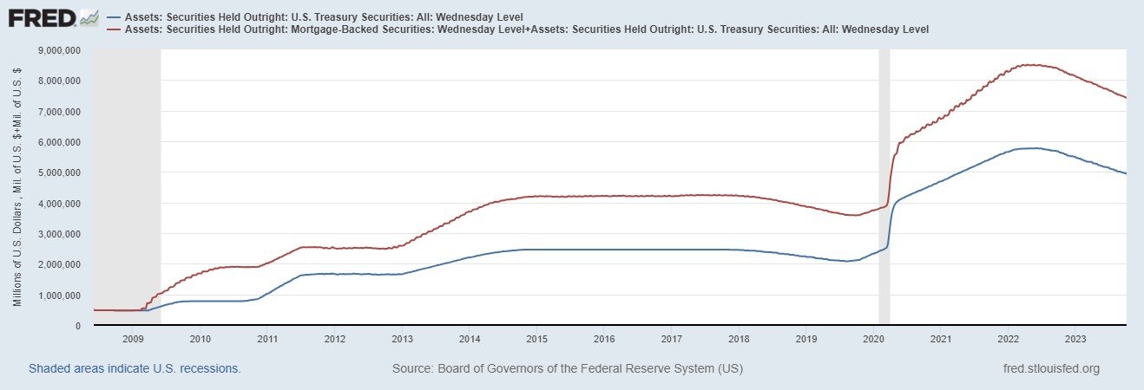
Policy Effects: Monetary
2020-2/2022: policy interest rate at zero, new round of quantitative easing.
3/2022-present: most rapid increase in interest rates since Paul Volcker

Slide 37
Where we Stand
Bidenomics?
  The ARP was probably too big, but helped many poor families, and the Fed was aware of the size of the stimulus.
  Chips Act
  Inflation Reduction Act.
More importantly, Presidents don’t have much effect on the economy in the short run.
Monetary policy was too easy for too long, but since March of last year has been much more restrictive.
Yes, there were supply chain issues that temporarily raised inflation, but there was (is?) too much total spending.
So, where are we headed?
What will the Fed do?

Slide 38
Fed’s View in September
Austin Goolsbee, President of the Chicago Fed. The economy is on a “golden path”and will achieve the “mother of all soft landings.”
Notes:
Survey of Professional Forecasters from early August: GDP and unemployment much like the June Fed forecast. Inflation much like the Fed’s September forecast.

Slide 39
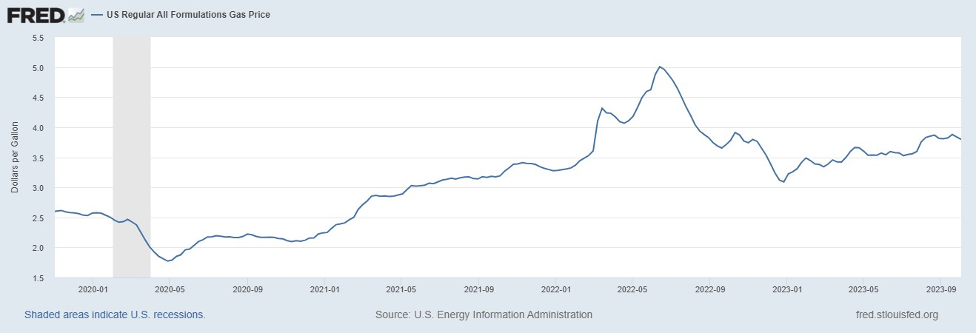
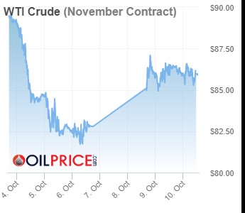
More Bad News for Biden: Gas Prices!
Last Data Point, 10/2

Slide 40
Key Players’ Views on the Risk of a Recession
https://advisor.visualcapitalist.com/

Slide 41
What is a Recession?
Defined by the National Bureau of Economic Research (NBER)
“The NBER's definition emphasizes that a recession involves a significant decline in economic activity that is spread across the economy and lasts more than a few months.”
Popular Rule of Thumb: Two or more, consecutive quarters where Real GDP falls.
Recessions are caused by decreases in total spending.

Slide 42
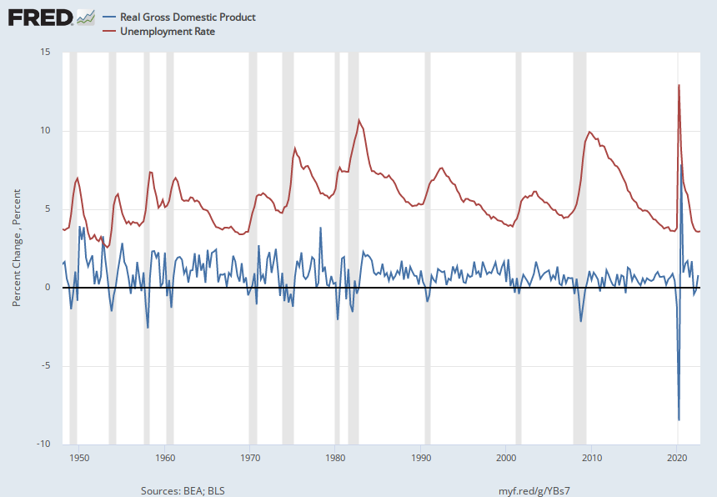
Real GDP Growth and Recessions
Notes:
Shaded Bars are recessions. 2022Q1, -1.6; Q2, -0.6 at annual rates.

Slide 43
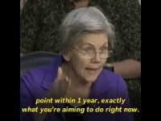
Monetary Policy is Tough

Slide 44
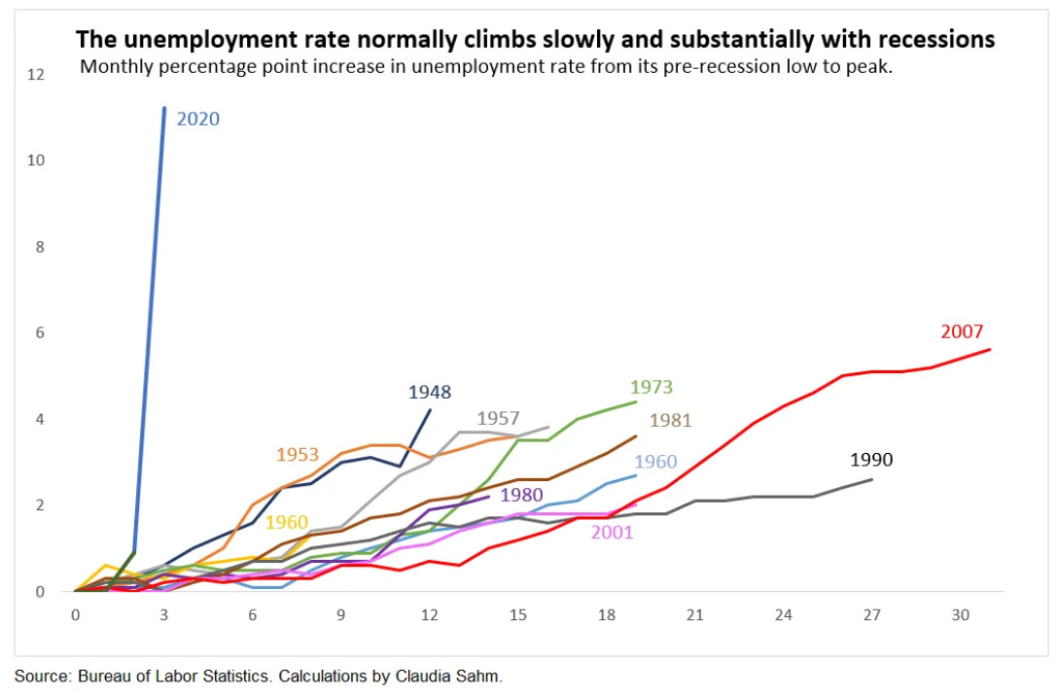
They are Both Right!
Warren:
Powell:
“We are taking the only measures we have to bring inflation down….Will working people be better off if we just walk away from our job and inflation remains at 5 or 6 percent?”

Slide 45
And, It Will Only Get Harder
Biden has tied his campaign to the performance of the economy, but it is the Fed that can affect the economy between now and 11/24
Known Unknowns
  Congressional paralysis and possible government shutdown, 11/17.
  Wars in Ukraine and Israel.

Slide 46
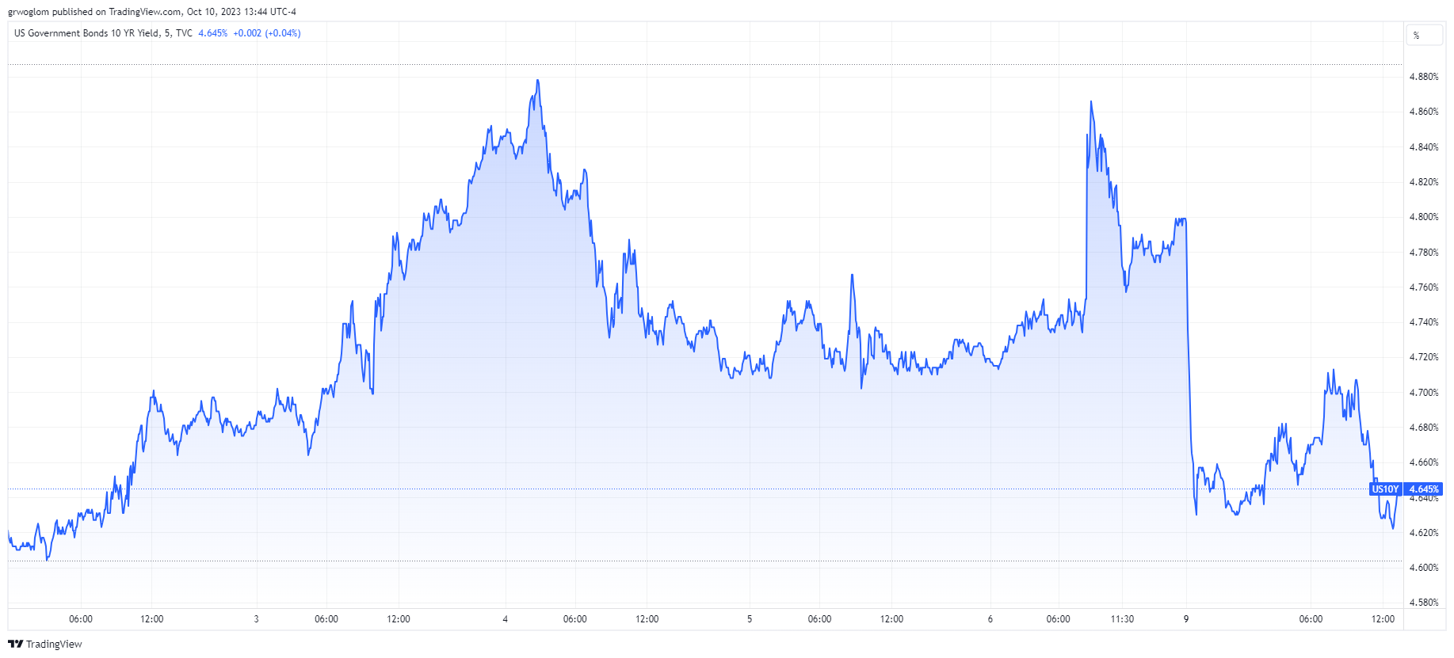
Unknown Unknowns!
Treasury, 10-yr rate

Slide 47
Stay Tuned!
This month’s economic reports (8:30AM)
12th, September CPI.
26th, Third Quarter GDP estimates.
27th, PCE inflation.
31st, Employment Cost Index
31st, Start of a Two-Day Fed Policy Meeting.

Slide 48
International Institutions: Alan Deardorff

Slide 49
Let’s Hear from You!
Geoffrey Woglom grwoglom@amherst.edu
Contact NEED: Info@NEEDEcon.org
Submit a testimonial: www.NEEDEcon.org/testimonials.php
Support NEED: www.NEEDEcon.org/donate.php

