Slide 1
Osher Lifelong Learning Institute, Spring 2023
Contemporary Economic Policy Issues
Duke University
May-June 2023
Host: Jon Haveman, Ph.D.
National Economic Education Delegation

Slide 2
National Economic Education Delegation
Vision
One day, the public discussion of policy issues will be grounded in an accurate perception of the underlying economic principles and data.
Mission
NEED unites the skills and knowledge of a vast network of professional economists to promote understanding of the economics of policy issues in the United States.
NEED Presentations
Are nonpartisan and intended to reflect the consensus of the economics profession.

Slide 3
Who Are We?
Honorary Board: 54 members
2 Fed Chairs: Janet Yellen, Ben Bernanke
6 Chairs Council of Economic Advisers
Furman (D), Rosen (R), Bernanke (R), Yellen (D), Tyson (D), Goolsbee (D)
3 Nobel Prize Winners
Akerlof, Smith, Maskin
Delegates: 652+ members
At all levels of academia and some in government service
All have a Ph.D. in economics
Crowdsource slide decks
Give presentations
Global Partners: 48 Ph.D. Economists
Aid in slide deck development

Slide 4
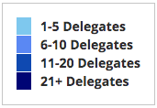
Where Are We?

Slide 5
Available NEED Topics Include:
US Economy
Healthcare Economics
Climate Change
Economic Inequality
Economic Mobility
Trade and Globalization
Minimum Wages
Immigration Economics
Housing Policy
Federal Budgets
Federal Debt
Black-White Wealth Gap
Autonomous Vehicles
Healthcare Economics

Slide 6
Course Outline
Contemporary Economic Policy
Week 1 (5/2): US Economic Update (Geoffrey Woglom, Amherst College)
Week 2 (5/9): Monetary Policy (Geoffrey Woglom)
Week 3 (5/16): Healthcare Economics (Kelley Cullen, E. Washington University)
Week 4 (5/23): Climate Change Economics (Sarah Jacobson, Williams College)
Week 5 (5/30): The Black-White Wealth Gap (Mike Shor, Univ. of Connecticut)
Week 6 (6/6): Federal Debt (Jon Haveman, NEED)

Slide 7
The Fed and Short-term Interest Rates
Blue is the fed funds rate.
Red is the rate on 3 month Treasuries.
Green is the prime bank lending rate
Notes:
Take note over the redline peeking above the others

Slide 8
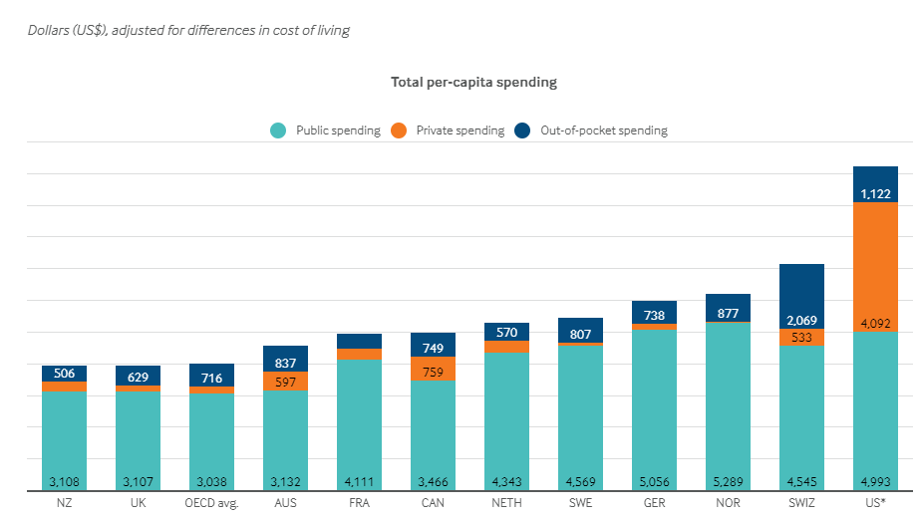
International Comparison: Health Spending
Notes:
Some good resources:
https://www.commonwealthfund.org/publications/issue-briefs/2020/jan/us-health-care-global-perspective-2019
A bit older report: https://www.commonwealthfund.org/publications/issue-briefs/2015/oct/us-health-care-global-perspective
https://www.healthsystemtracker.org/chart-collection/quality-u-s-healthcare-system-compare-countries/#item-overall-age-specific-potential-years-of-life-lost-per-100000-population-1990-2017
https://axenehp.com/international-healthcare-systems-us-versus-world/

Slide 9
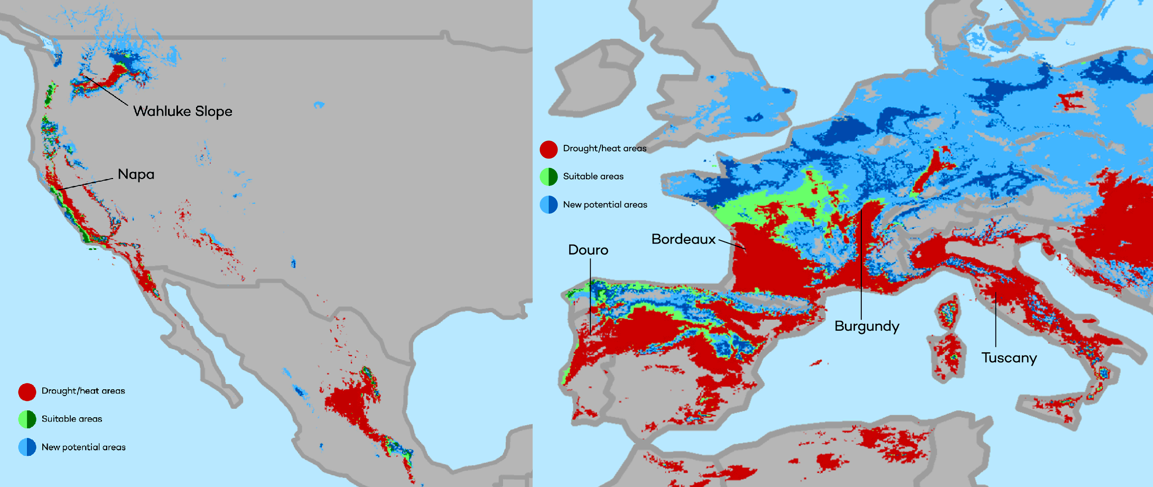
Climate Change Economics
The changing map of the world’s wine-growing regions.

Slide 10
Evidence of the B-W Wealth Gap
Mean is
7x Greater
Median is 8x Greater

Slide 11
The Federal Debt is Becoming A Problem

Slide 12
Submitting Questions
Please submit questions of clarification in the chat or raise your “digital” hand.
I will try to handle them as they come up.
We will do a verbal Q&A once the material has been presented.
Slides will be available from the at the course web site later today.
https://sites.google.com/view/macro-current-issues/home

Slide 13
Credits and Disclaimer
This slide deck was authored by:
Jon D. Haveman, NEED
Scott Baier, Clemson University
Geoffrey Woglom, Amherst College (Emeritus)
Brian Dombeck, Lewis & Clark College
Doris Geide-Stevenson, Weber State
Disclaimer
NEED presentations are designed to be nonpartisan.
It is, however, inevitable that the presenter will be asked for and will provide their own views.
Such views are those of the presenter and not necessarily those of the National Economic Education Delegation (NEED).

Slide 14
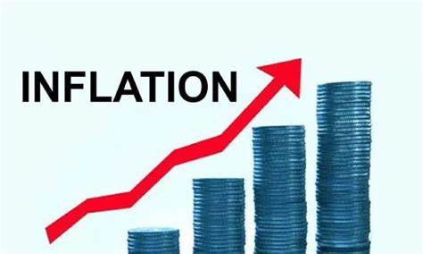
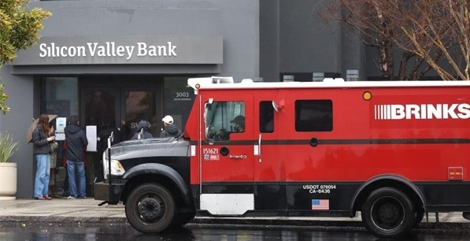
US Economy: Update
Geoffrey Woglom,
Professor of Economics
Amherst College, emeritus
May 2, 2023

Slide 15
Outline for the Talk
Summary of the state of the economy.
The Effect of M&F policies.
What lies ahead for the economy.
The implications of recent bank failures

Slide 16
Gross Domestic Product
Consumption | 68.4%
Investment | 17.2%
Exports | 11.4%
Imports | -14.5%
Government | 17.5%
GDP | 100.0%

Slide 17
Real GDP and ‘Potential’ during the Recovery
The “output gap” is about $250b
Source: Fred, St Louis Fed

Slide 18
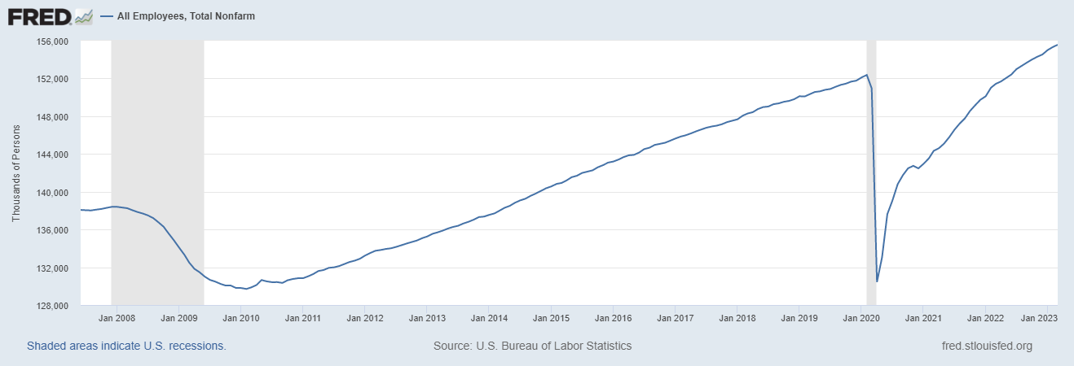
Where Have All the Workers Gone?
Notes:
Largely explained by baby boomer retirements and a little excess retirements due to COVID

Slide 19
The Great Resignation?
Notes:
CBO Jan 2020 projections: LF, 62.5, vs 62.6; Total employment; 154.8 million vs actual 155.6. Civilian Labor Force; 160 vs 166.7

Slide 20
Labor Market in North Carolina

Slide 21
Overall Good News on the Real Side
GDP is very close to its potential.
The labor market as measured by the unemployment rate is fully recovered.
There was no apparent Great Resignation
But there is also a nominal side: interest rates, asset prices, inflation and wages.
News isn’t so good!

Slide 22
Interest Rates: Era of Falling Rates Over?
Notes:
Fed policy rate 4.5 to 4.25. Concerns with inflation

Slide 23
National Housing Market and Closer to Home
https://www.zillow.com/research/data/

Slide 24
The Fall in House Prices is Having an Effect

Slide 25
Stock Prices: Fear about Rates and Recession
Notes:
Since the end of 2021, lost almost 15%

Slide 26
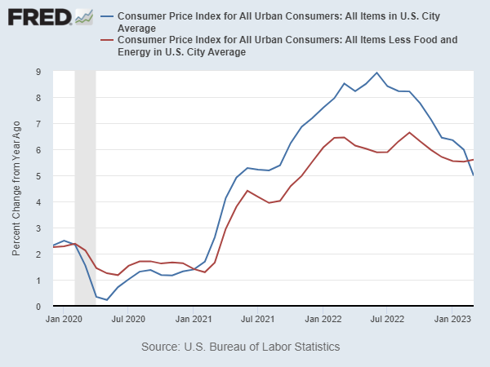
Inflation during the Recovery (CPI)
Notes:
August CPI yoy 8.3% down from 8.5 and Core 6.3 up from 6.3 in JUly

Slide 27
Fed’s Measure (PCE)
Looks Promising?

Slide 28
CPI vs. PCE: Differences
CPI tends to be higher (Mar):
CPI, 4.9%
Core CPI, 5.6%
PCE, 4.2%
Core PCE, 4.6%.
Typically more like 0.5 % pts.
https://en.wikipedia.org/wiki/Personal_consumption_expenditures_price_index#

Slide 29
Rents Paid versus Asking Rents

Slide 30
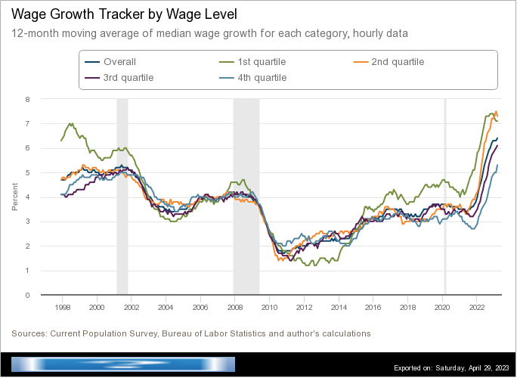
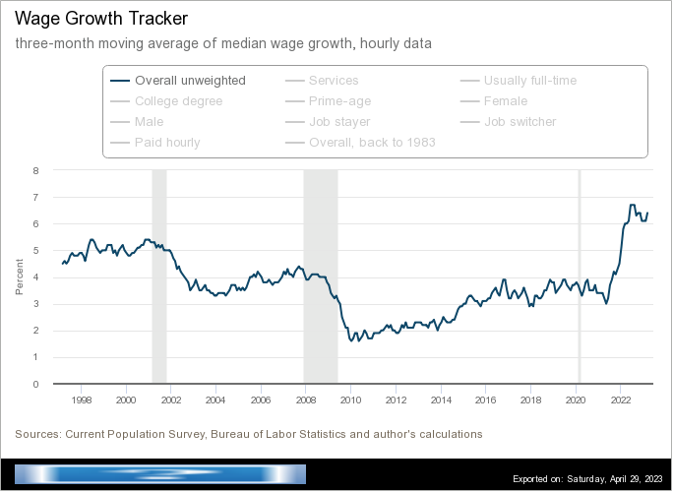
Wages Haven’t Kept Pace with Inflation
Notes:
But, note that low wage workers are doing relatively the best

Slide 31
The “Nominal” Side
Inflation: There is a lot of work still to be done.

Slide 32
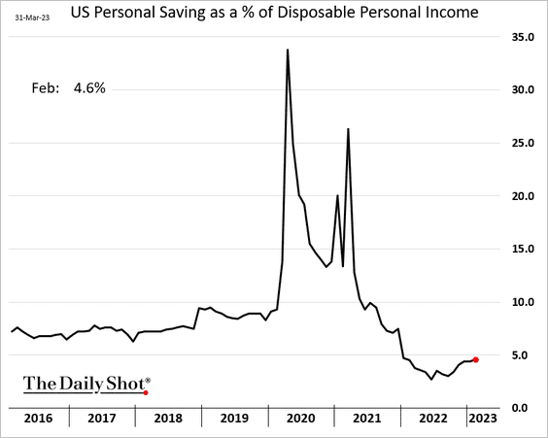
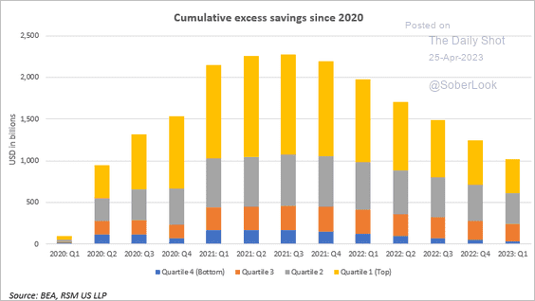
Policy Effects: Fiscal
2020-2021: massive stimulus. Cares Act, 3 rounds of stimulus checks, expanded unemployment benefits, Payroll Protection Loans.

Slide 33
Policy Effects: Monetary
2020-2/2022: policy interest rate at zero, new round of quantitative easing.
3/2022-present: most rapid increase in interest rates since Paul Volcker

Slide 34
Where we Stand
The ARP was probably too big, but helped many poor families, and the Fed was aware of the size of the stimulus.
Monetary policy was too easy for too long, but since March of last years has been much more restrictive.
Yes, there were supply chain issues that temporarily raised inflation, but there was (is?) too much total spending.
So, where are we headed?
What will the Fed do?

Slide 35
Latest Numbers on Consumption

Slide 36
Forecasters Are in fact Seeing the “R” Word

Slide 37
What is a Recession?
Defined by the National Bureau of Economic Research (NBER)
“The NBER's definition emphasizes that a recession involves a significant decline in economic activity that is spread across the economy and lasts more than a few months.”
Popular Rule of Thumb: Two or more, consecutive quarters where Real GDP falls.
Recessions are caused by decreases in total spending.

Slide 38
Real GDP Growth and Recessions
Notes:
Shaded Bars are recessions. 2022Q1, -1.6; Q2, -0.6 at annual rates.

Slide 39
On March 7th Powell Emphasized Rate Hikes?
Red Pre March 7; Post March 7
Terminal rate

Slide 40
Something Happened the Next Weekend!

Slide 41
Silicon Valley Bank
Regional mid-sized bank with $212b in assets; $6billion in capitalization (15th largest).
Focused on loans to venture capital and managing the desposit accounts of startups.
Very rapid growth in deposits and assets between 2021 and 2022, which led to big investments in “safe” long term Treasury bond.
The market value of these bonds fell drastically due to the Fed’s rise in interest rates.
No problem! The bank does not incur “losses” unless it sells the bonds before maturity.
Notes:
JP morgan chase 3.7 trillion

Slide 42
Whoops!
Concentrated and sophisticated depositors see the problem and want to get their money out (FDIC insurance guarantees deposits up to $250 thousand, and 90% above this amount!).
Deposit withdrawals force SVB to sell those bonds.
Precipitating a classic bank run and leading to the FDIC seizing the bank on Friday.

Slide 43
Silicon Valley’s Not So Wonderful Life

Slide 44
FDIC Bank Closures, in General
“Auction” off the failed bank; all depositors paid in full.
Payoff insured deposits and liquidate bank assets
Under Dodd-Frank, the FDIC is supposed to use the cheaper procedure.
In either case, funding comes from banks’ payments of deposit insurance premium.

Slide 45
But, in This Case:
Janet Yellen announced that all depositors would be paid in full, and there would be complete insurance of all bank deposits for a year.
Senior Executives all fired.
Fed created a new lending program, so that banks can borrow against Treasury bonds without realizing losses.
The rationale was to prevent bank run spreading to other midsize banks.
Two other banks recently closed
Stock prices of a number of similar sized banks have plummeted.

Slide 46
Problems with the Bailout
Political:
Did political favoritism play a role in bailing out well connected, sophisticated silicon valley depositors.
Why didn’t bank regulators see this coming?
Economic: has the moral hazard of “too big to fail” been increased.
For the Fed: Will the Fed have to scale back its interest rate increases to prevent wide scale financial crisis?

Slide 47
Another Shoe Drops?
Front Page of the NYTimes, May 1,2023

Slide 48
But, Markets are Anticipating Higher Rates!

Slide 49
Is This a Problem?
Credit Crunch?

Slide 50
Next Week: Why is Sen Warren so Angry?

Slide 51
Let’s Hear from You!
Geoffrey Woglom
grwoglom@amherst.edu
Contact NEED: Info@NEEDEcon.org
Submit a testimonial: www.NEEDEcon.org/testimonials.php
Support NEED: www.NEEDEcon.org/donate.php

