Slide 1
Osher Lifelong Learning Institute, Fall 2022
Contemporary Economic Policy
Berkshire Community College
September-October, 2022
Geoffrey Woglom,
Professor of Economics Emeritus, Amherst College
National Economic Education Delegation

Slide 2
National Economic Education Delegation
Vision
  One day, the public discussion of policy issues will be grounded in an accurate perception of the underlying economic principles and data.
Mission
  NEED unites the skills and knowledge of a vast network of professional economists to promote understanding of the economics of policy issues in the United States.
NEED Presentations
  Are nonpartisan and intended to reflect the consensus of the economics profession.

Slide 3
Who Are We?
Honorary Board: 54 members
  2 Fed Chairs: Janet Yellen, Ben Bernanke
  6 Chairs Council of Economic Advisers
    Furman (D), Rosen (R), Bernanke (R), Yellen (D), Tyson (D), Goolsbee (D)
  3 Nobel Prize Winners
    Akerlof, Smith, Maskin
Delegates: 652+ members
  At all levels of academia and some in government service
  All have a Ph.D. in economics
  Crowdsource slide decks
  Give presentations
Global Partners: 49 Ph.D. Economists
  Aid in slide deck development

Slide 4


Where Are We?

Slide 5
Available NEED Topics Include:
Healthcare Economics
US Economy
Climate Change
Economic Inequality
Economic Mobility
Trade and Globalization
Minimum Wages
Immigration Economics
Housing Policy
Federal Budgets
Federal Debt
Black-White Wealth Gap
Autonomous Vehicles
US Social Policy

Slide 6
Advisory about Recording
Each week, our class sessions will be recorded to the cloud and distributed to those that request it or to all class members (depending on your preference) within 24 hours. It will only be distributed to enrolled class members and for the sole purpose of enhancing our learning. I ask that you do not forward or share it with members outside of our classroom community. If any of you ever feel uncomfortable with my recording or distributing a recording of a class session, please notify me.

Slide 7
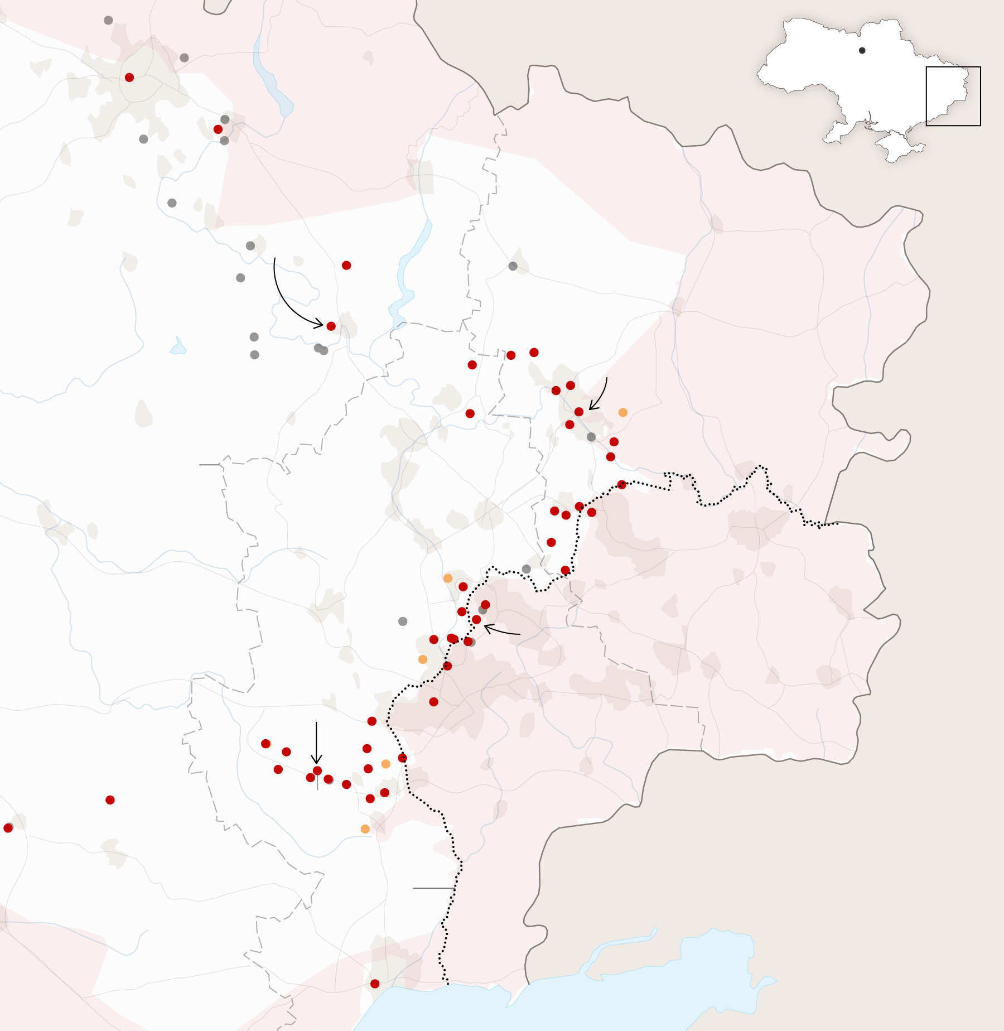
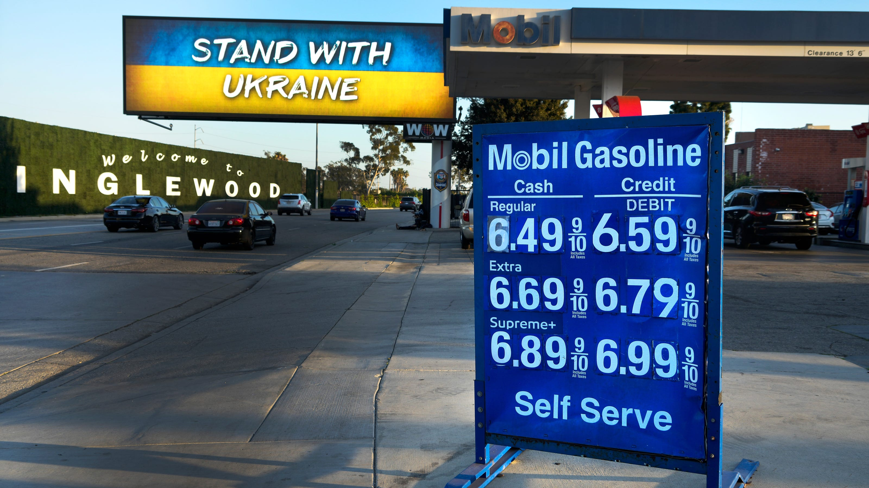
US Economy: Update
Geoffrey Woglom,
Professor of Economics
Amherst College, emeritus
September 20, 2022

Slide 8
Outline for the Talk
Quick summary of the state of the economy.
Current confusion on the state of the economy.
What’s at stake in controlling inflation.
What lies ahead for the economy.

Slide 9
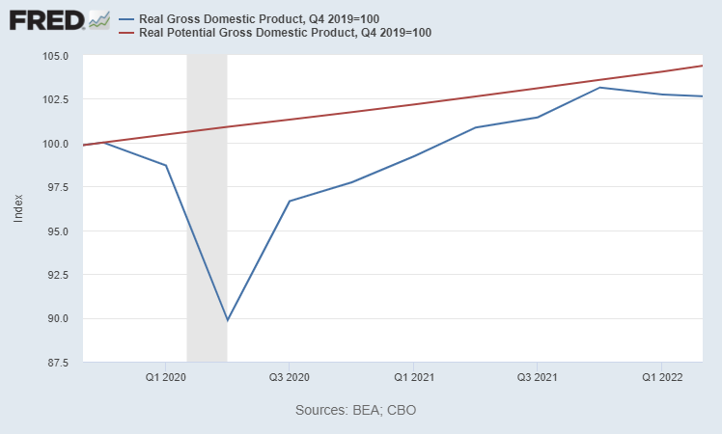
Real GDP and ‘Potential’ during the Recovery
The “output gap” is about $400b
89.9
Source: Fred, St Louis Fed
Notes:
Point Out that the recover is slowing

Slide 10
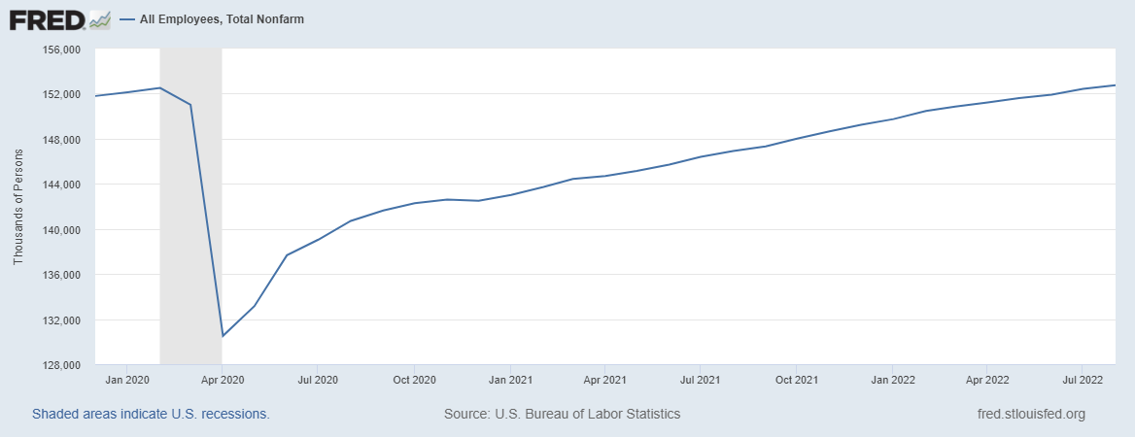
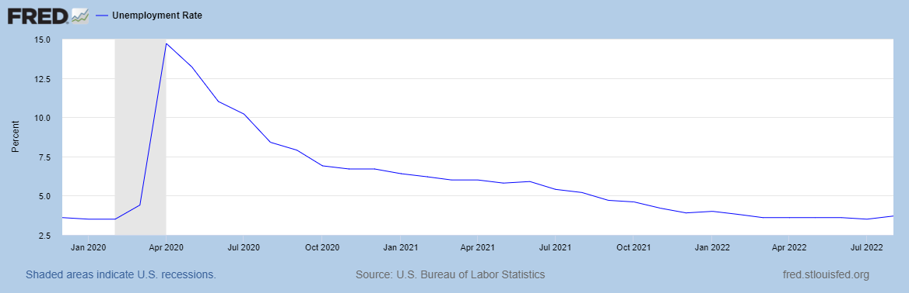
Labor Market is Almost Fully Recovered
Up 0.3 pct points
Notes:
One big difference with GDP graph. Total jobs have barely recovered

Slide 11
Three (Apparent) Mysteries
Does 2 consecutive quarters of negative real GDP growth mean we are in a recession?
Does the uptick in the unemployment rate mean a weak economy headed for recession?
Where have all the workers gone?

Slide 12
First, What is a Recession?
Defined by the National Bureau of Economic Research (NBER)
“The NBER's definition emphasizes that a recession involves a significant decline in economic activity that is spread across the economy and lasts more than a few months.”
Popular Rule of Thumb: Two or more, consecutive quarters where Real GDP falls.
Recessions are caused by decreases in total spending.

Slide 13
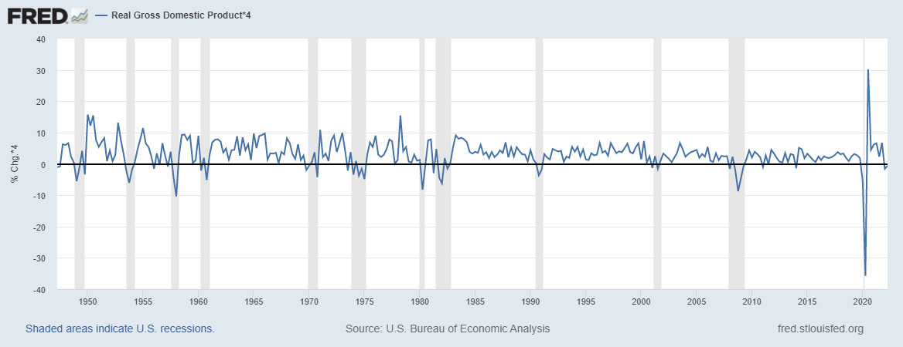
Real GDP Growth and Recessions
Notes:
Shaded Bars are recessions. 2022Q1, -1.6; Q2, -0.6 at annual rates.

Slide 14
Recession or No Recession: What do you think?
Employment has grown continually.
But the unemployment rate is up and GDP growth is negative
Poll1
Why does it matter?
It may be a measurement issue. An alternate measure of GDP (GDI) was up 1.7% in Q1 and 1.3% in Q2.
Very unlikely, the NBER will call a recession starting in the first half of this year.
But is the uptick in the unemployment rate a sign of a weak economy and a looming recession?

Slide 15
Some Definitions
CNPopulation=Labor Force+ Not in the Labor Force
Not in the Labor Force are people without jobs and who are not looking for jobs
Labor Force(LF) =Employed (E) + Unemployed(U).
Unemployed are people without a job who are actively seeking to find a job.
Unemployment rate(UR) is U/LF

Slide 16
Some Arithmetic
July: LF = 164.0; E=158.3; U=5.7, so UR=5.7/164=3.5
August LF =164.7; E=158.7; U=6.0, so UR = 6/164.7=3.65, rounded to 3.7
How did both the number of unemployed increase 300K and the number of employed increase by 400K?
Is the increase in LF a sign of a weakening economy?
Poll2.

Slide 17
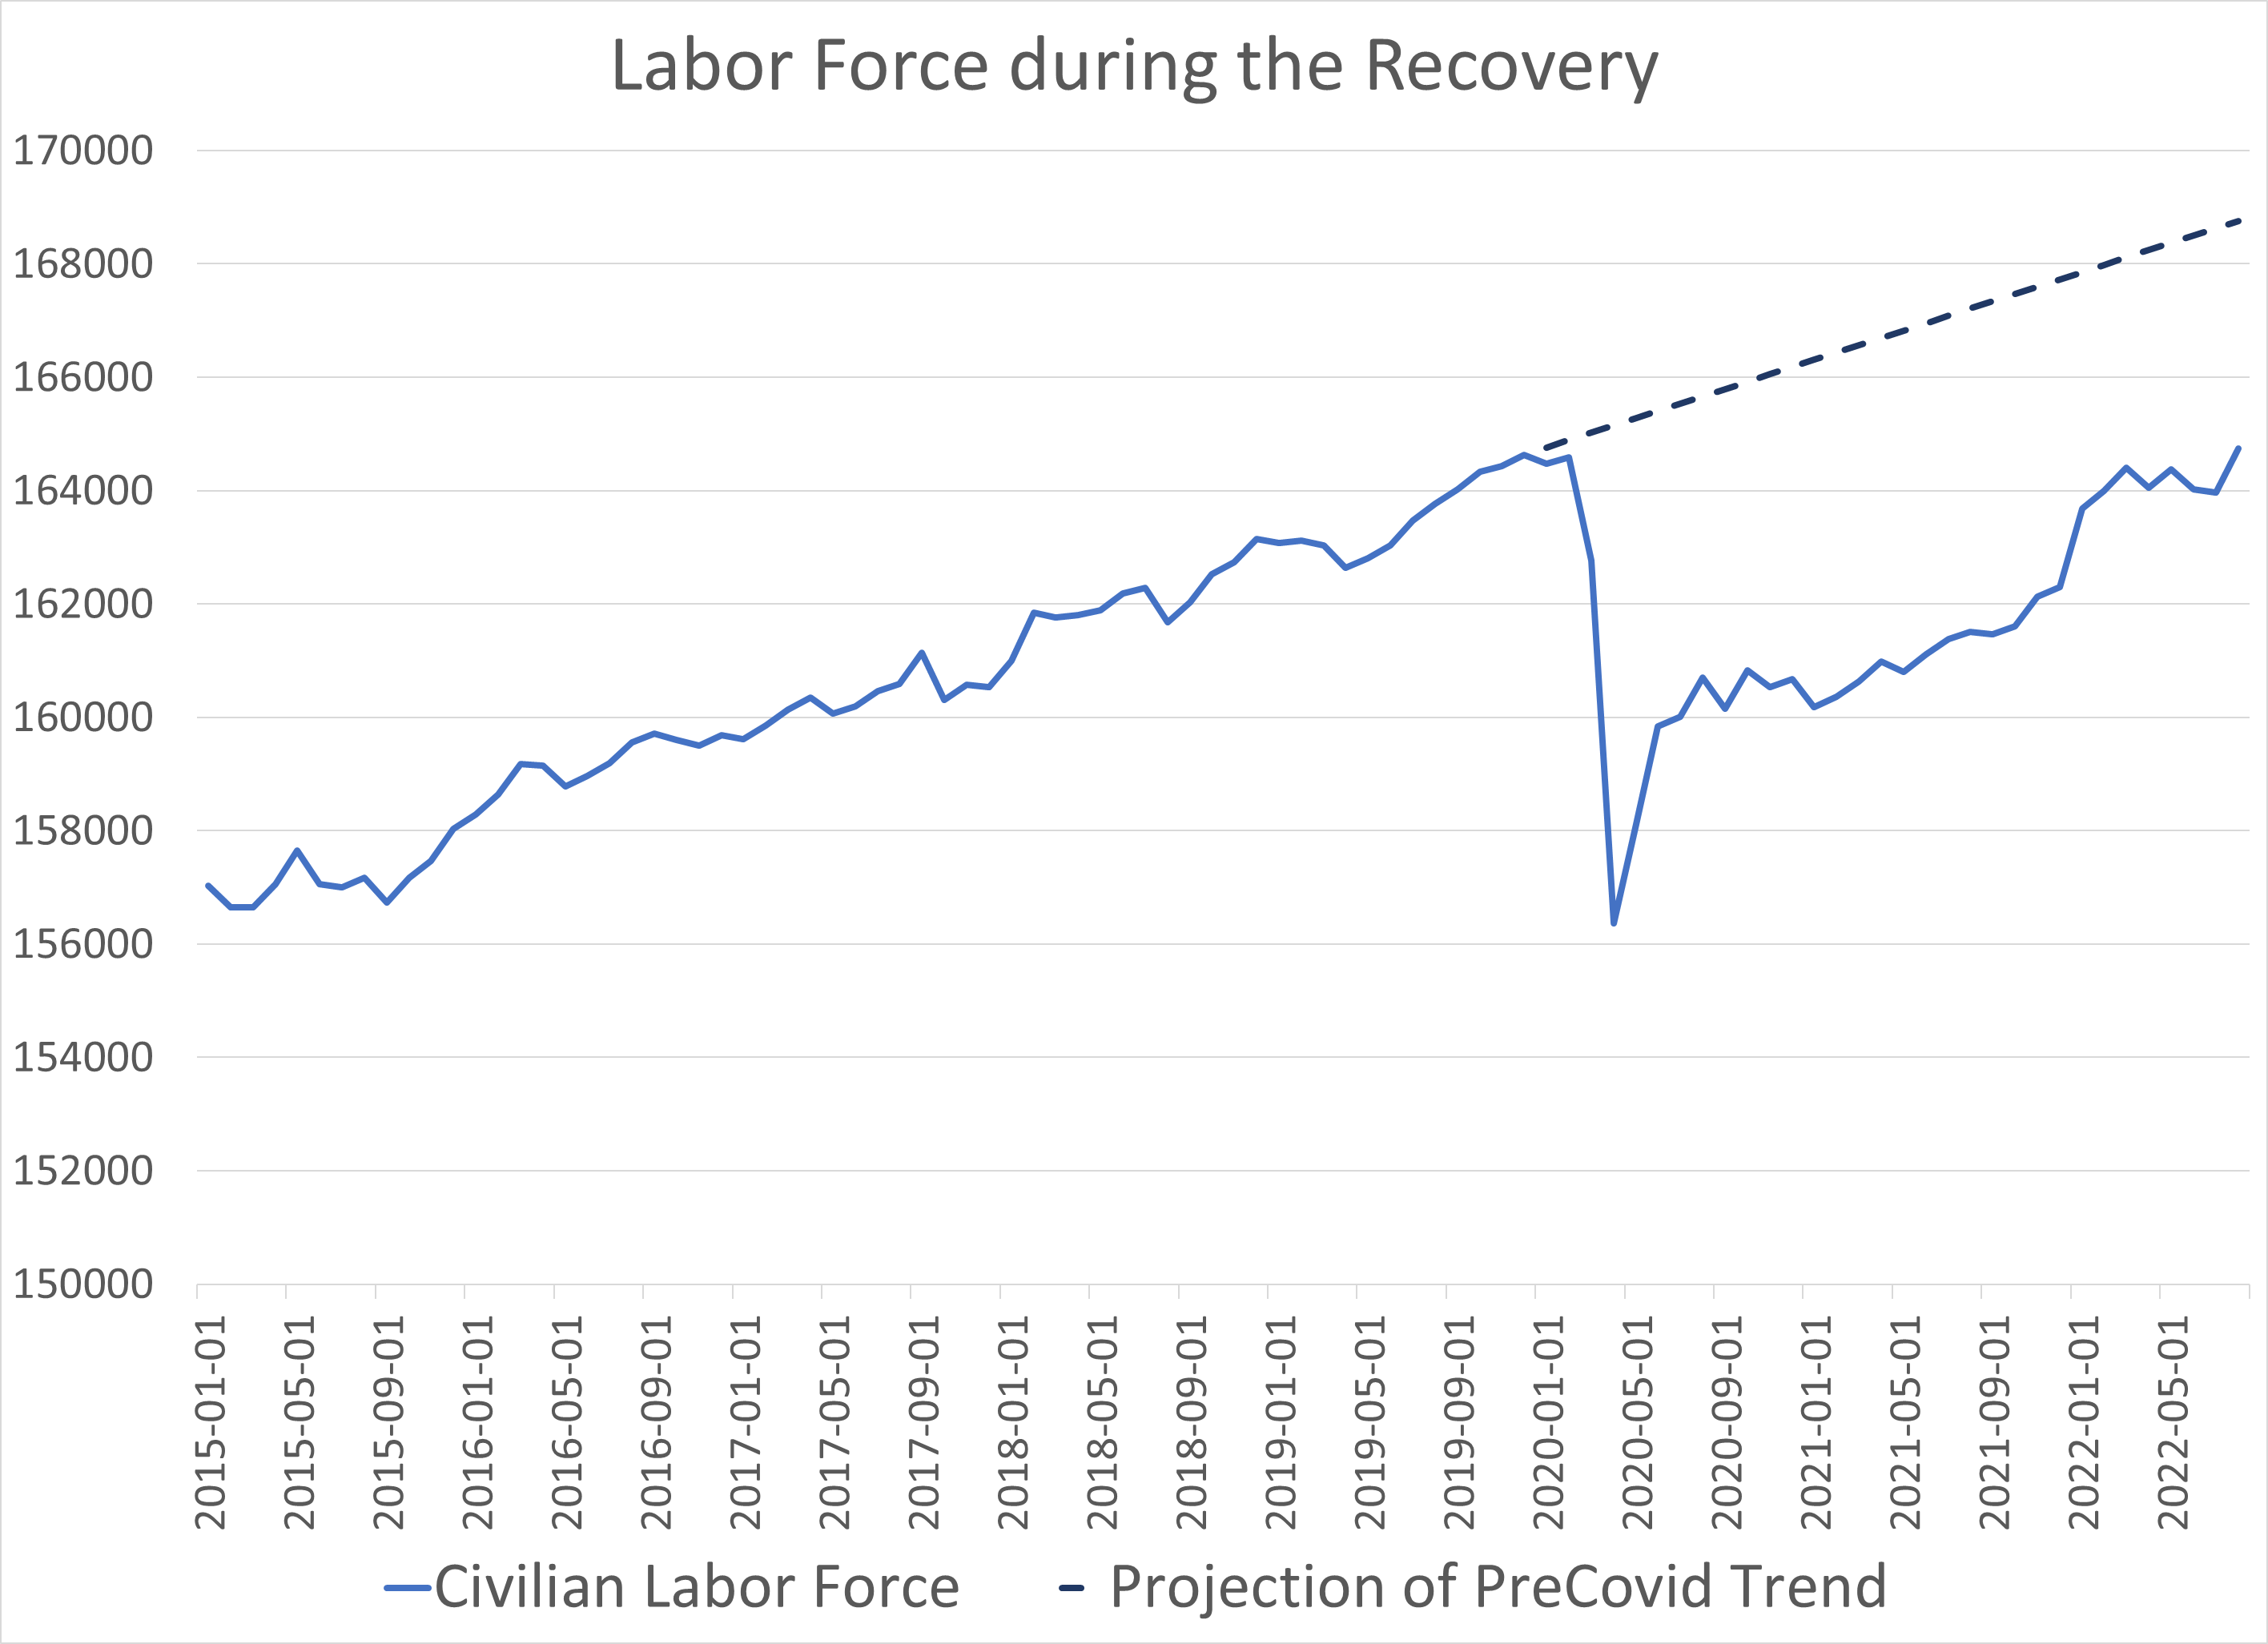
Where Have All the Workers Gone?

Slide 18
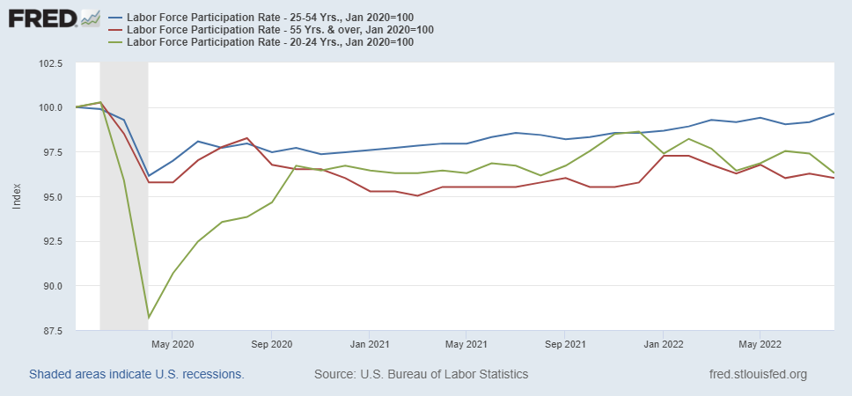
Age Seems to Matter

Slide 19
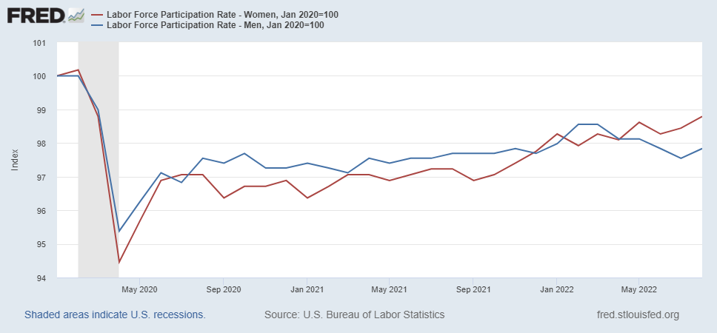
Gender Also Matters

Slide 20
Fiscally Driven Recovery

Slide 21
Households Lead the Way
Saving
Consumption Higher than Pre-pandemic, but Savings up, about $2.2 trillion

Slide 22
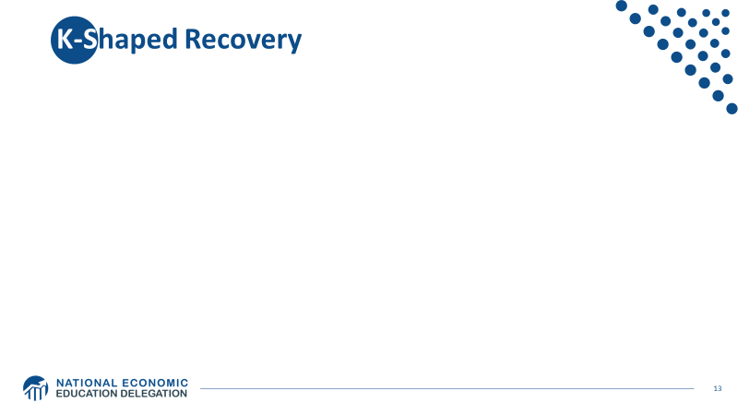
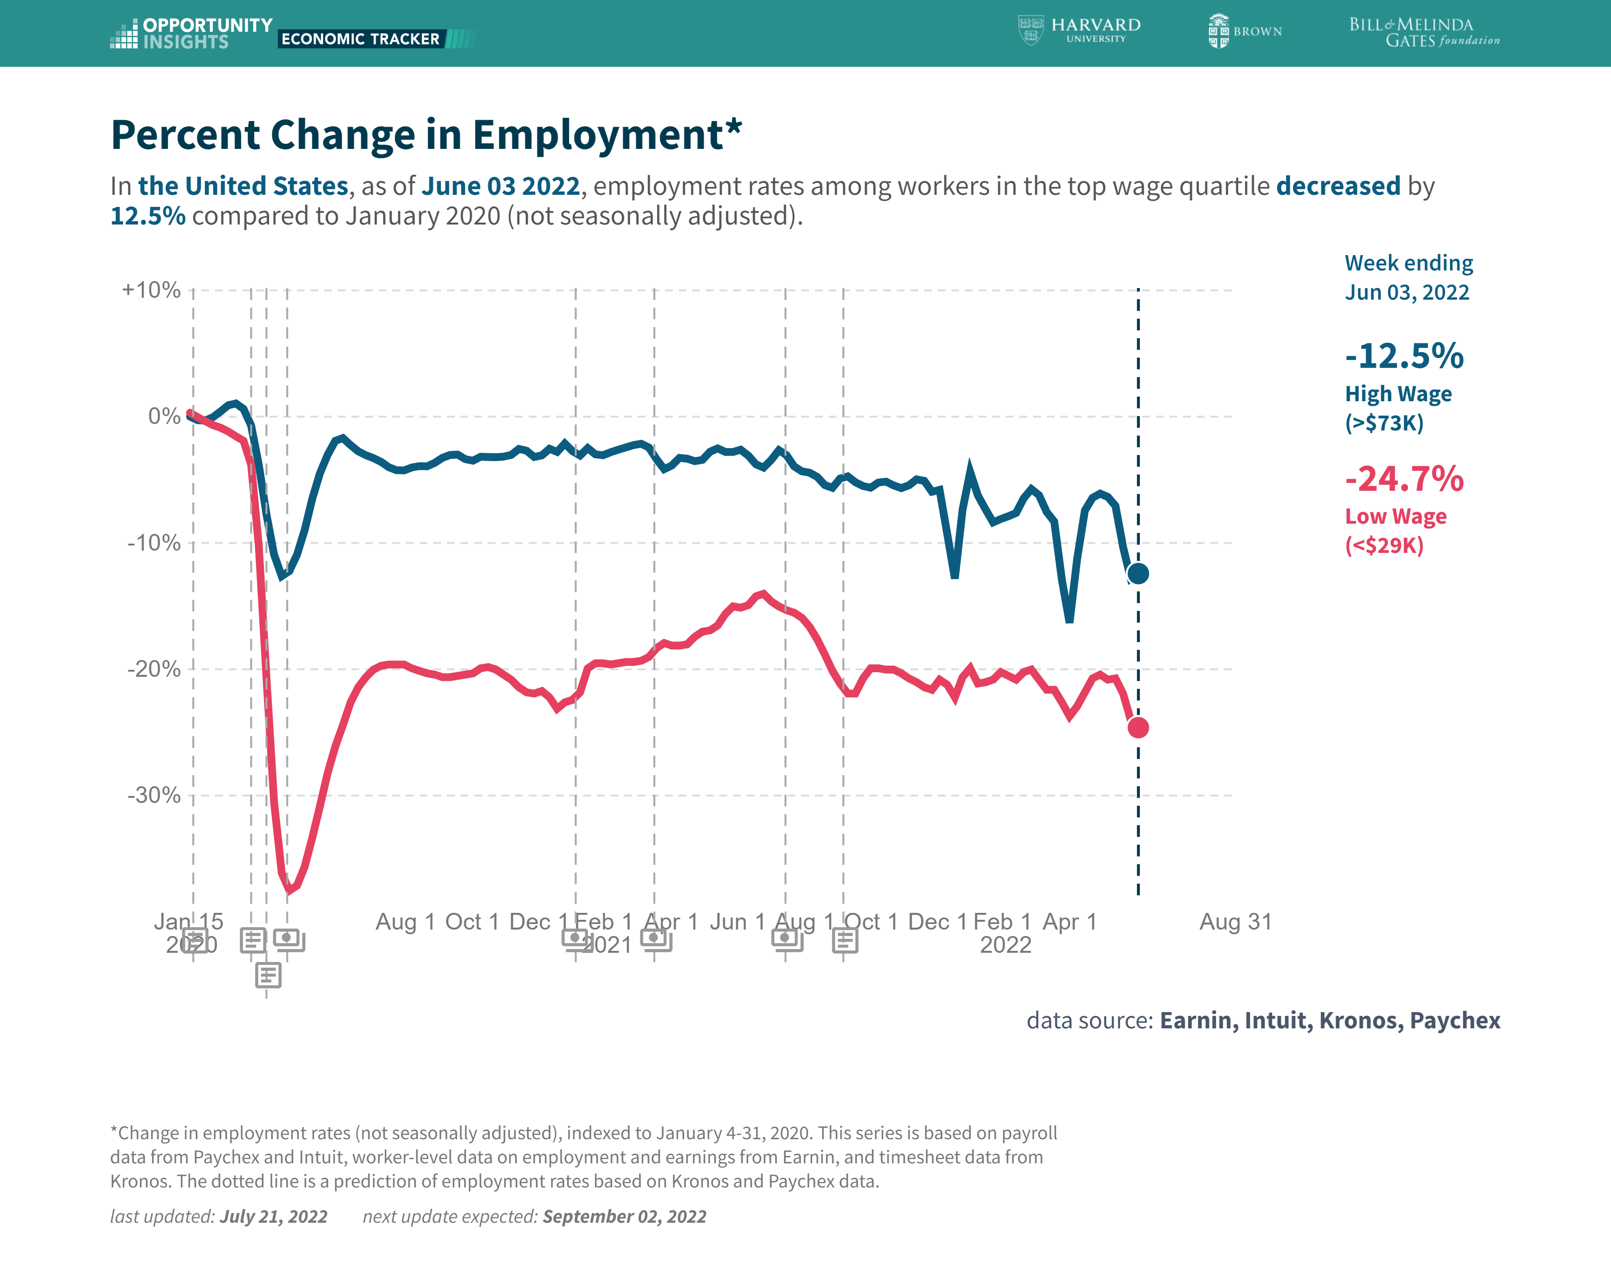

Slide 23
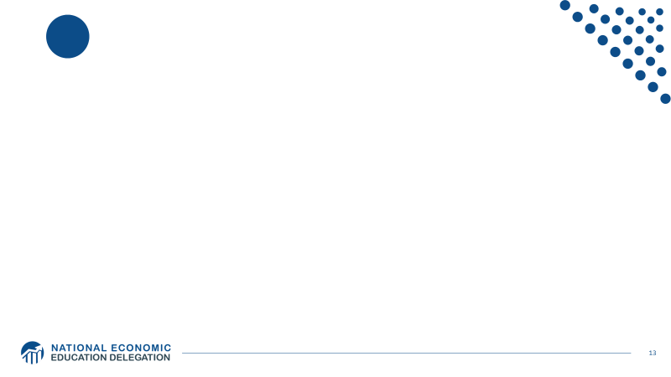
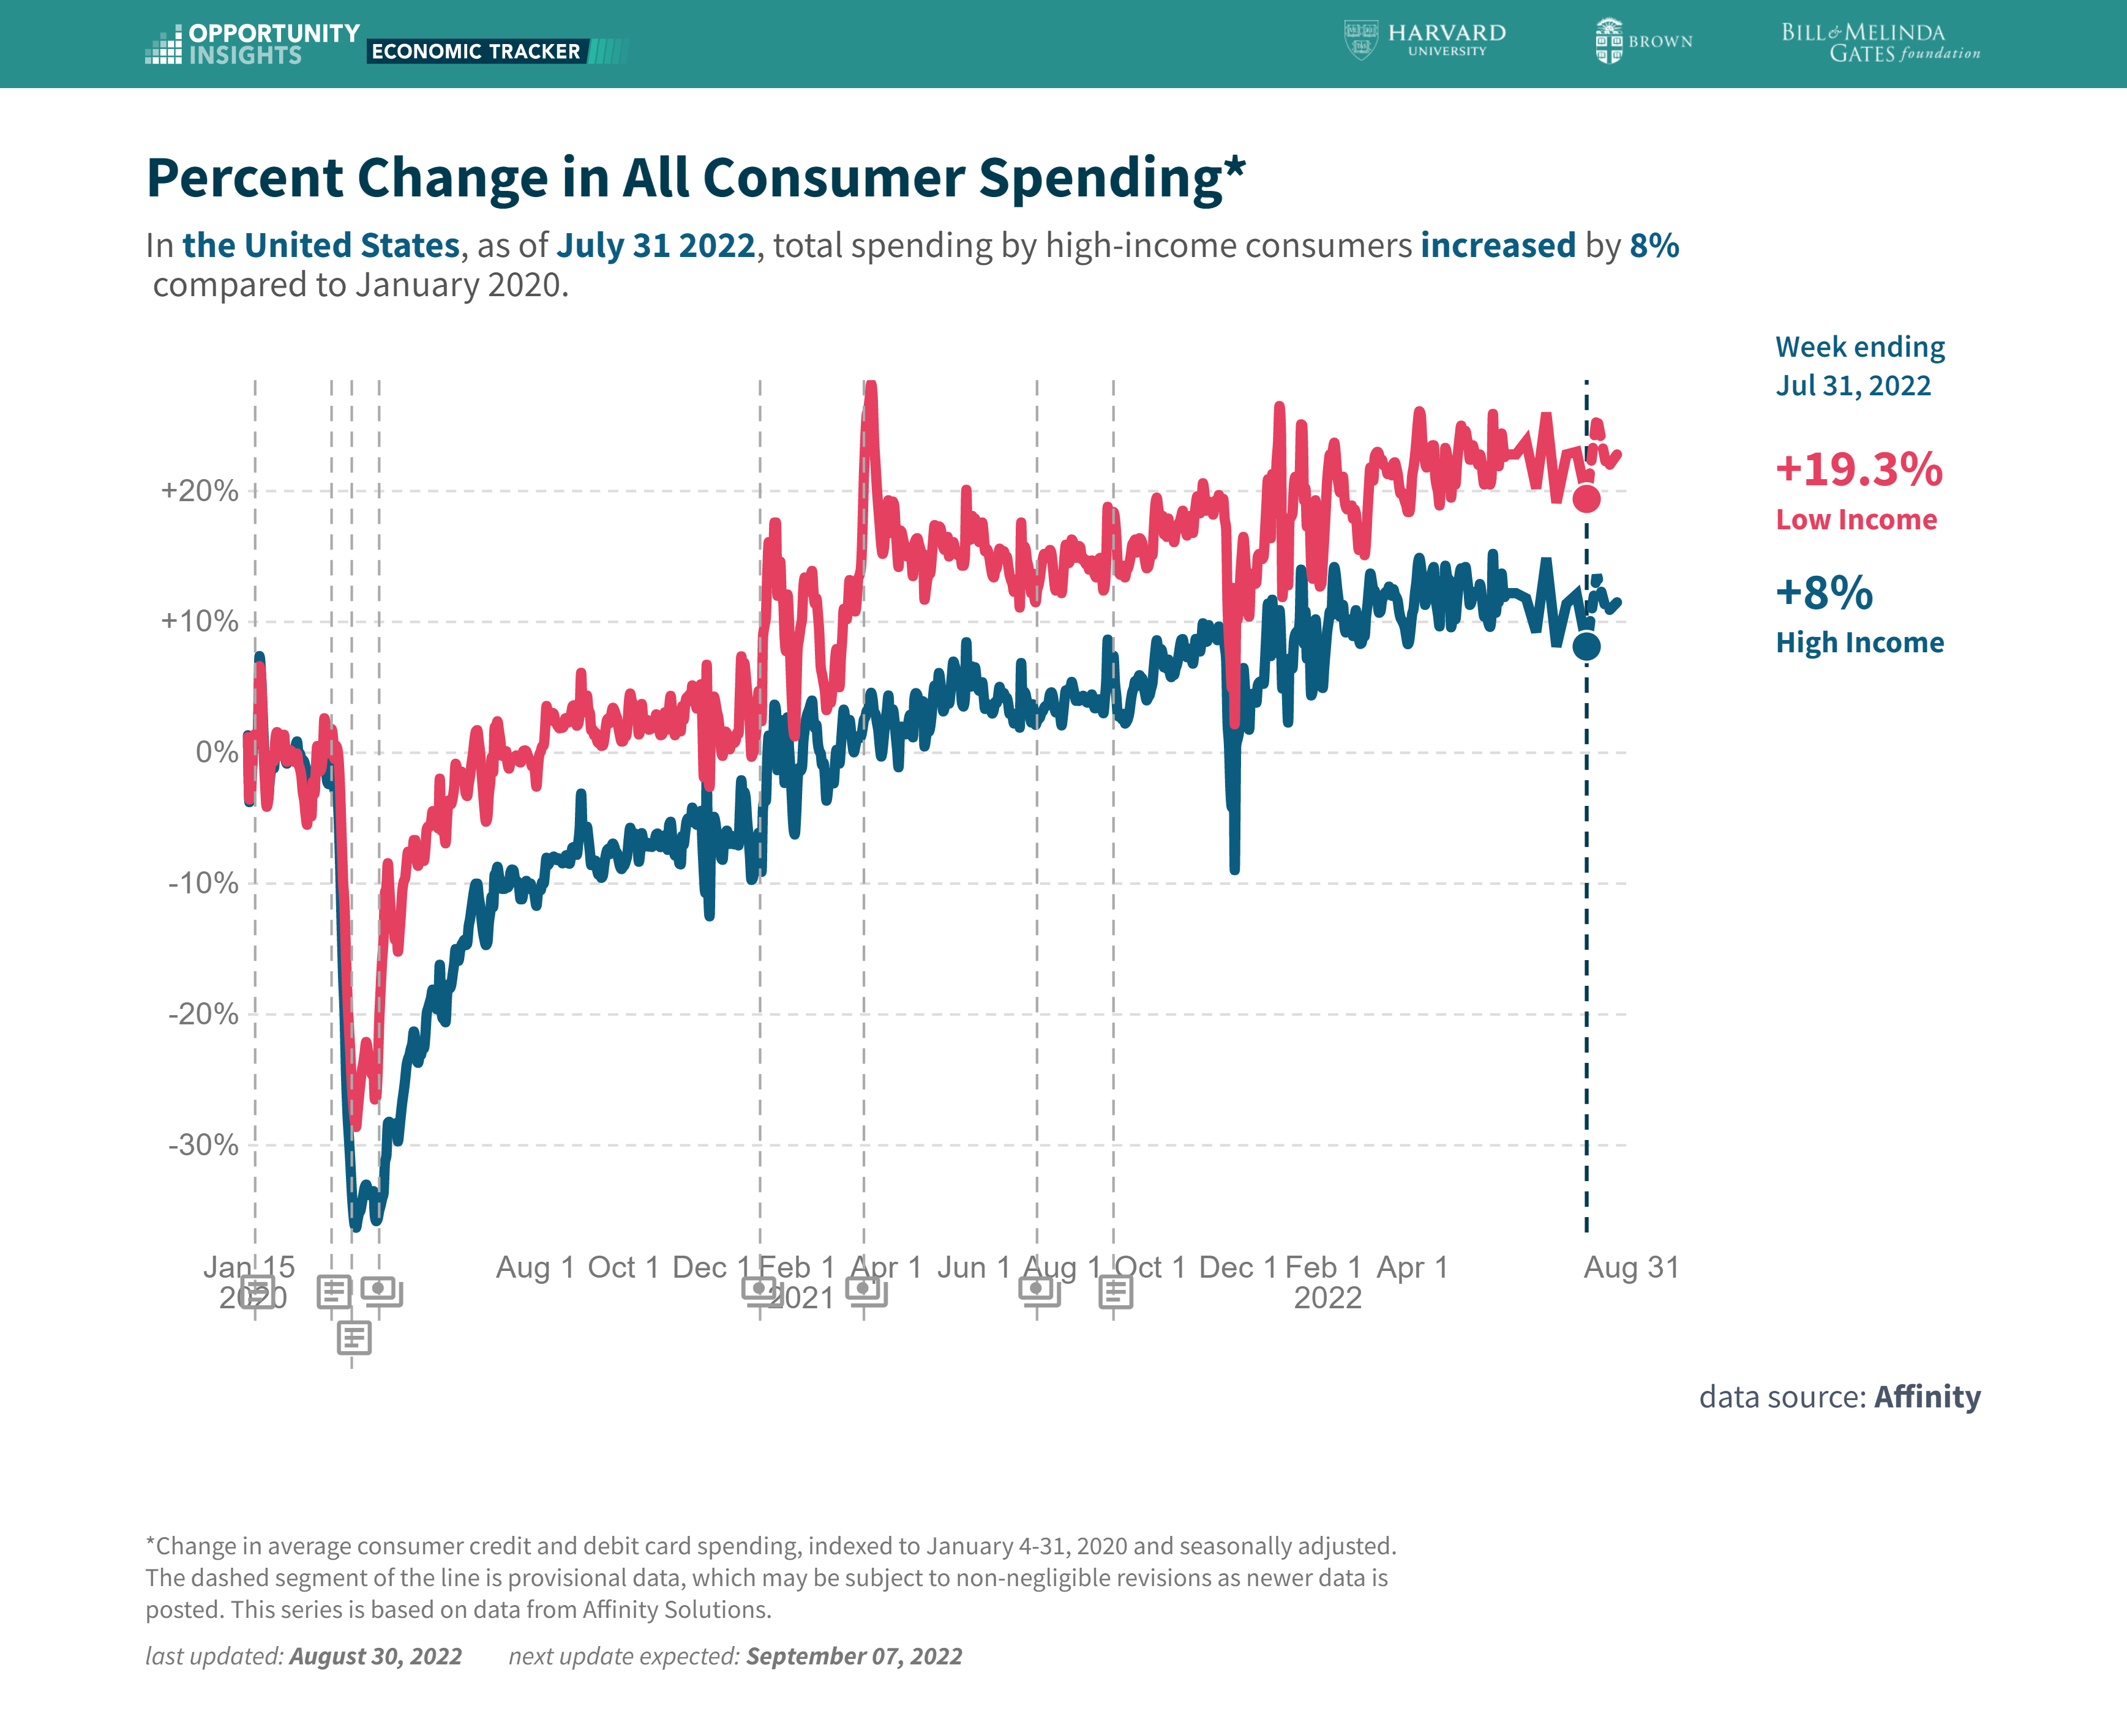
Stimulus Payments Saved Low Wage Workers

Slide 24
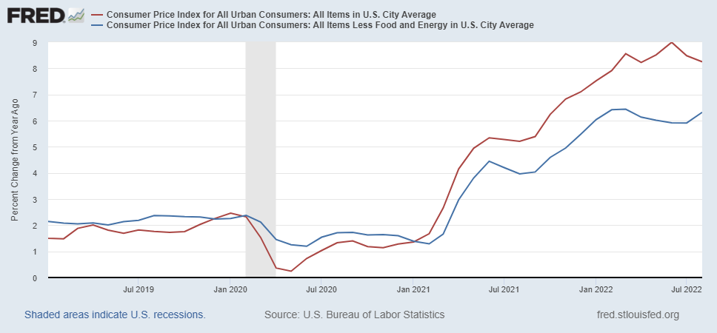
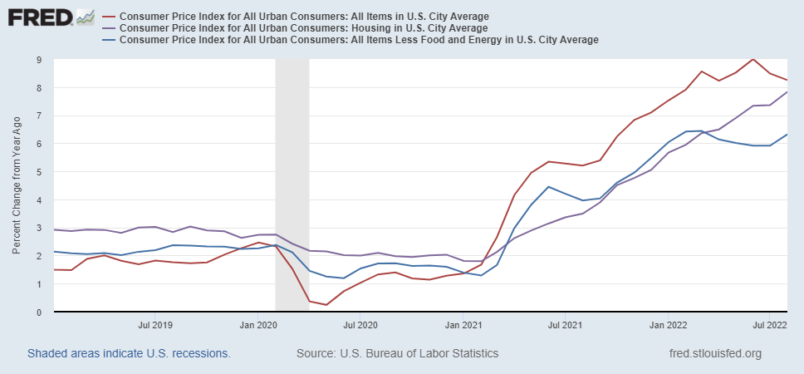
Inflation during the Recovery
Notes:
August CPI yoy 8.3% down from 8.5 and Core 6.3 up from 6.3 in JUly

Slide 25
The Stock Market Wasn’t Happy
Notes:
S&P fell by more than 4% during the day.

Slide 26
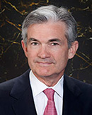
Stabilizer in Chief: the Fed
The Fed’s Dual Mandate:
  “Stable prices” which means 2% rate of inflation in the Personal Consumption Price Index (which corresponds to about 2.5% inflation in the more well-known CPI).
  “Maximum employment” which means the highest level of employment (lowest unemployment rate) consistent with mandate 1.
The Fed affects the economy via interest rates, raising them when they are more worried about inflation and lowering them when they are more worried about unemployment.
Fiscal Policy (taxes and spending, President and the Congress) can affect inflation and unemployment, but it is the Fed’s job to achieve the dual mandate
Jerome Powell
February 2018
Notes:
Define inflation as the rate of increase in the average level of prices not gasoline price inflation. Exceptions Deep Recesssions. ARP we will talk about later.

Slide 27
The Fed on November 4, 2021
The Committee seeks to achieve maximum employment and inflation at the rate of 2 percent over the longer run. With inflation having run persistently below this longer-run goal, the Committee will aim to achieve inflation moderately above 2 percent for some time so that inflation averages 2 percent over time and longer‑term inflation expectations remain well anchored at 2 percent. The Committee expects to maintain an accommodative stance of monetary policy until these outcomes are achieved.
Notes:
Go back to 24

Slide 28
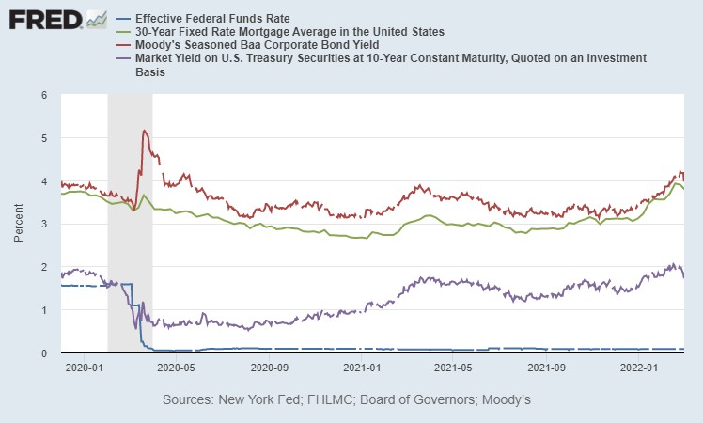
Accommodative Monetary Policy!

Slide 29
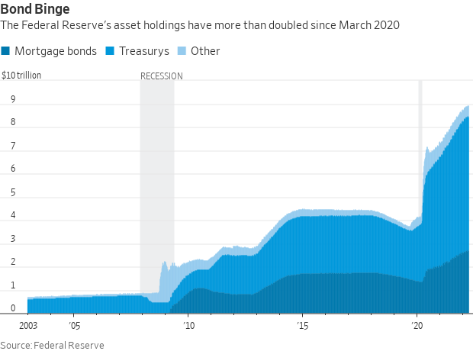
Fed QE during the Recovery
Zero interest rates until March and a Big QE program
Notes:
25% of marketable Federal Debt; 15 percent of mortgages

Slide 30
Why?
“Supply Chain Disruptions” can have a temporary effect to raise the rate of inflation.
The Fed had had a recent history of raising interest rates before the economy achieved full employment
  Average inflation during the 2010s was only 1.6 percent.
  The unemployment rate in Nov of 2021 was 4.2 percent, whereas pre-pandemic it was 3.5 percent.
(More on this in 2 weeks)

Slide 31
What’s at Stake?
If people expect inflation, that can lead to high actual inflation.
Paul Volcker in 1981 realized this point and wrung inflation out of the system with a massive recession.
Unemployment peaked at 11%.
Europe’s lost decade.
Latin America Debt Crisis.
But, (for the US) it worked!

Slide 32
“Anchoring” Inflation Expectations
Forecasts: Philadelphia Fed, “Survey of Professional Forecasters”
Notes:
Livingston Survey. 75-78. Unemployment 7% and 6% inflation. Look at the stability in the post 2001 period and the 2003-2005 period

Slide 33
But, Boy Have Things Changed since November!
May
Powell’s Wakeup Moment
"Surveys of Consumers,” University of Michigan, ©

Slide 34
Chair Powel at Jackson Hole Conference (8/26)
Restoring price stability will take some time and requires using our tools forcefully to bring demand and supply into better balance. Reducing inflation is likely to require a sustained period of below-trend growth. Moreover, there will very likely be some softening of labor market conditions. While higher interest rates, slower growth, and softer labor market conditions will bring down inflation, they will also bring some pain to households and businesses. These are the unfortunate costs of reducing inflation. But a failure to restore price stability would mean far greater pain.

Slide 35
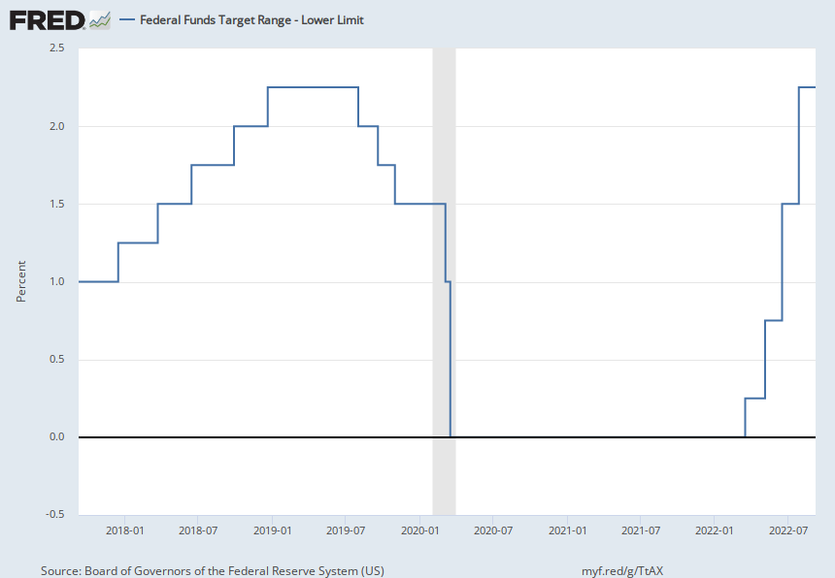
Four Increases in 4 Meetings
Notes:
25, 50, 75, 75 with more to come

Slide 36
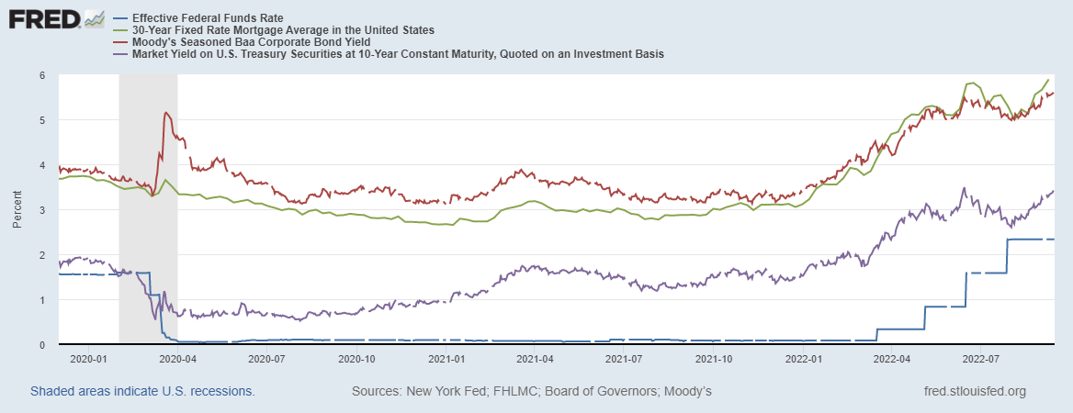
Interest Rates are Headed Higher

Slide 37
My Diagnosis for the Uptick in Inflation
Yes, there were supply chain issues that affected some areas in particular (e.g., computer chips).
But there was and is (?) too much total spending.
Fiscal stimulus led households to increase saving over 2021 by more than $2 trillion.

Slide 38
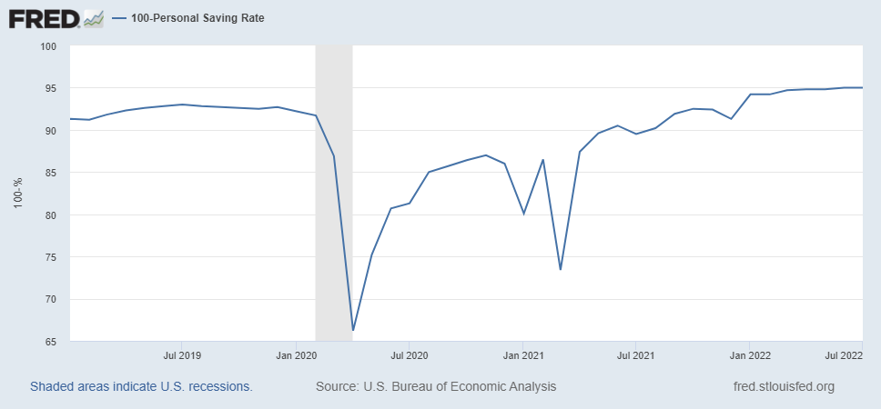
Consumers Are Spending Some of It!
Fraction of After-Tax Income Spent
Notes:
Consumption is 70 percent of GDP. Reatil sales was up 0.3 % in august after falling in July. Initial claims for unemploy,ment fell.

Slide 39
Where we Stand
The ARP was probably too big, but the Fed was aware of this.
The growth in real GDP is slowing but there is still a great deal of momentum.
The Fed’s Choice
  Slam on the brakes by raising interest rates by 75 (100?) basis points at their meeting. (The following meeting is a week before the election)
  Go for a smaller increase to show resolve, but try to avoid a recession.
Poll3.

Slide 40
So, What Lies Ahead?
Darned if I know!
What will happen to the War in Ukraine; gas prices, food prices the EU economies?
Michigan Survey of Consumer Sentiment and Expectations of Inflation released next week?
The Goal: a “Soft Landing”?
Working in the Fed’s favor
  Supply pressure easing.
  Gasoline Prices Falling.
  Financial Market Expectations of Inflation are pretty stable.

Slide 41
Global Supply Chain Pressures

Slide 42
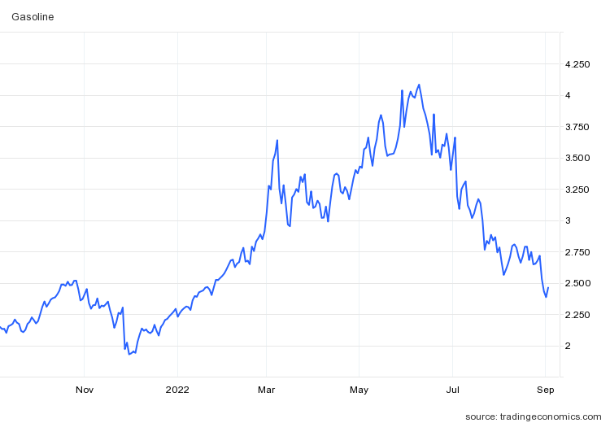
Gas Prices

Slide 43
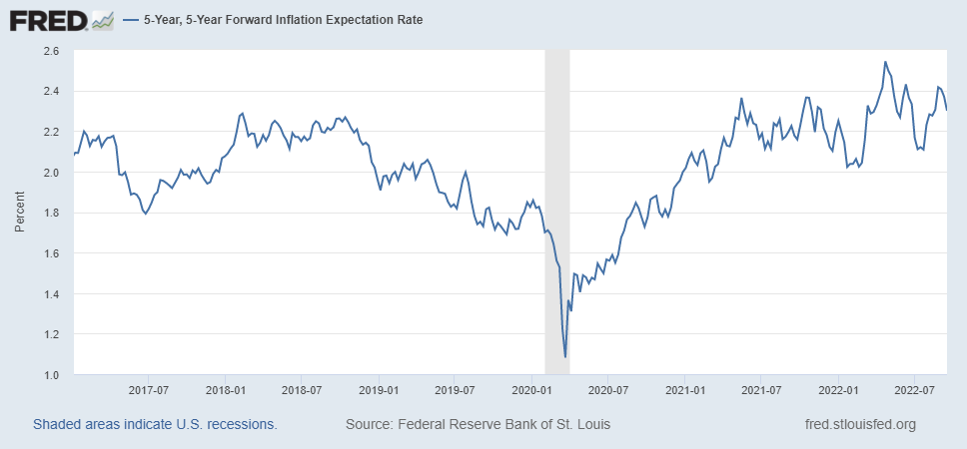
Financial Market Expectations of Inflation

Slide 44
Stay Tuned (Next Fed Meeting this PM)!
But now Let’s Hear what you think?
  Are we headed for a recession?
  Will the Fed be successful in taming?
  Should (will?) the state of the economy affect the midterms?

