Slide 1
Osher Lifelong Learning Institute, Spring 2022
Contemporary Economic Policy
Auburn University
March-April, 2022
Host: Jon Haveman, Ph.D.
National Economic Education Delegation

Slide 2
National Economic Education Delegation
Vision
  One day, the public discussion of policy issues will be grounded in an accurate perception of the underlying economic principles and data.
Mission
  NEED unites the skills and knowledge of a vast network of professional economists to promote understanding of the economics of policy issues in the United States.
NEED Presentations
  Are nonpartisan and intended to reflect the consensus of the economics profession.

Slide 3
Who Are We?
Honorary Board: 54 members
  2 Fed Chairs: Janet Yellen, Ben Bernanke
  6 Chairs Council of Economic Advisers
    Furman (D), Rosen (R), Bernanke (R), Yellen (D), Tyson (D), Goolsbee (D)
  3 Nobel Prize Winners
    Akerlof, Smith, Maskin
Delegates: 640+ members
  At all levels of academia and some in government service
  All have a Ph.D. in economics
  Crowdsource slide decks
  Give presentations
Global Partners: 48 Ph.D. Economists
  Aid in slide deck development

Slide 4


Where Are We?

Slide 5
Available NEED Topics Include:
Coronavirus Economics
US Economy
Climate Change
Economic Inequality
Economic Mobility
Trade and Globalization
Minimum Wages
Immigration Economics
Housing Policy
Federal Budgets
Federal Debt
Black-White Wealth Gap
Autonomous Vehicles
US Social Policy

Slide 6
Course Outline
Contemporary Economic Policy
  Week 1 (3/31): US Economy & Russia/Ukraine Conflict
  Week 2 (4/7): Minimum Wages (Veronika Dolar, SUNY-Old Westbury)
  Week 3 (4/14): Climate Change Economics (Sarah Jacobson, Williams College)
  Week 4 (4/21): Economics of Immigration (Roger White, Whittier College)
  Week 5 (4/28): The Black-White Wealth Gap (Mike Shor, University of Connecticut)
  Week 6 (5/5): Healthcare Economics (Veronika Dolar, SUNY-Old Westbury)

Slide 7
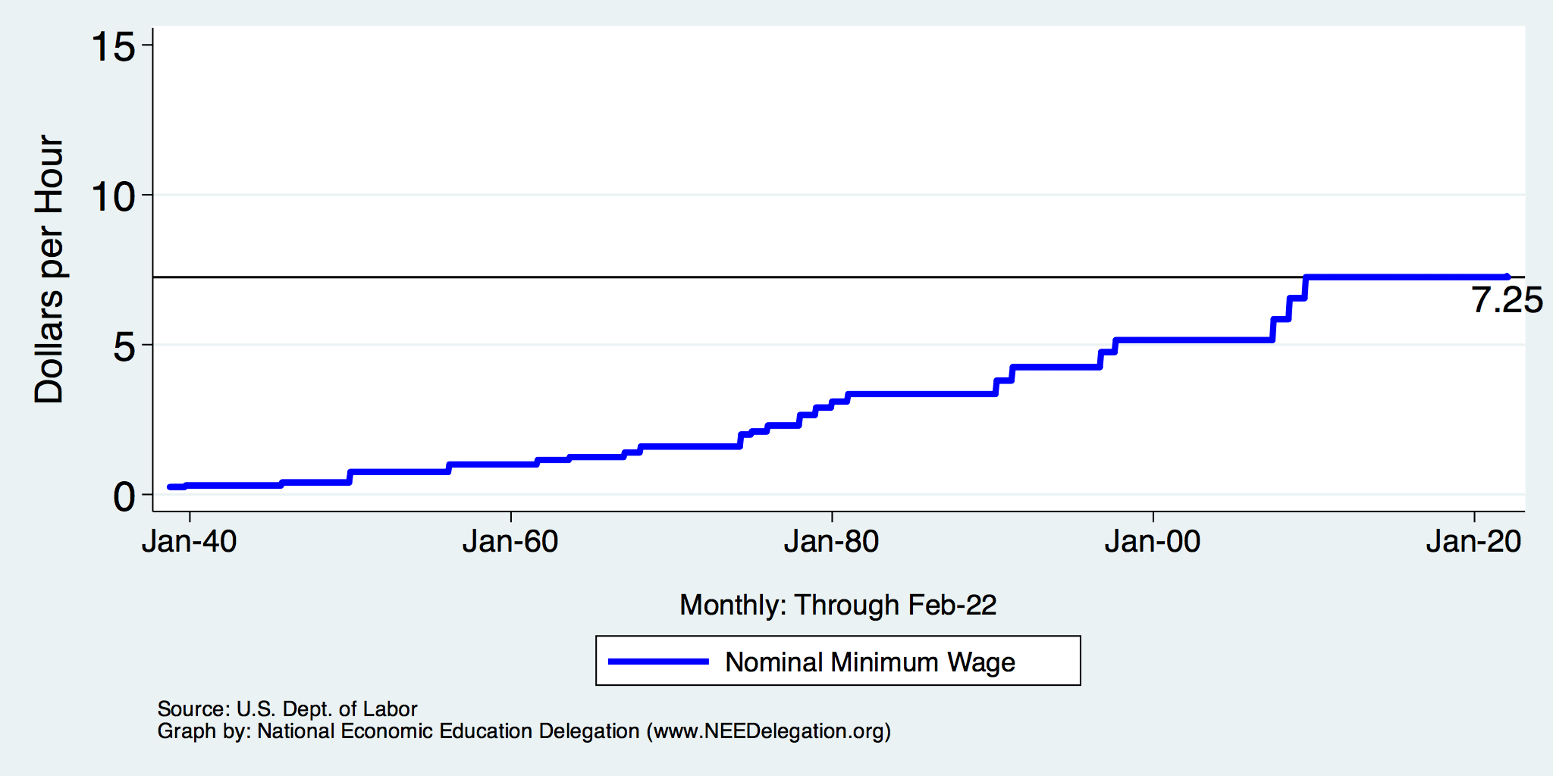
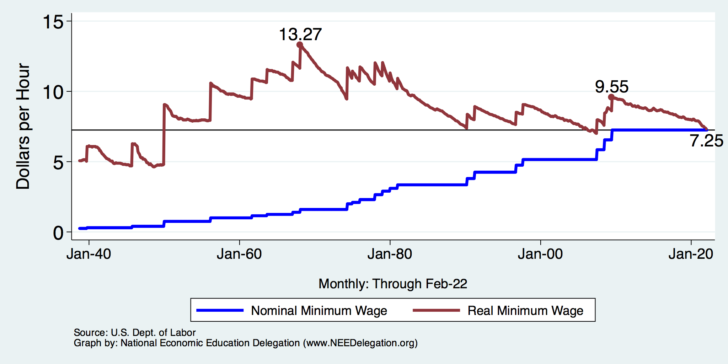
History of the Federal Minimum Wage

Slide 8
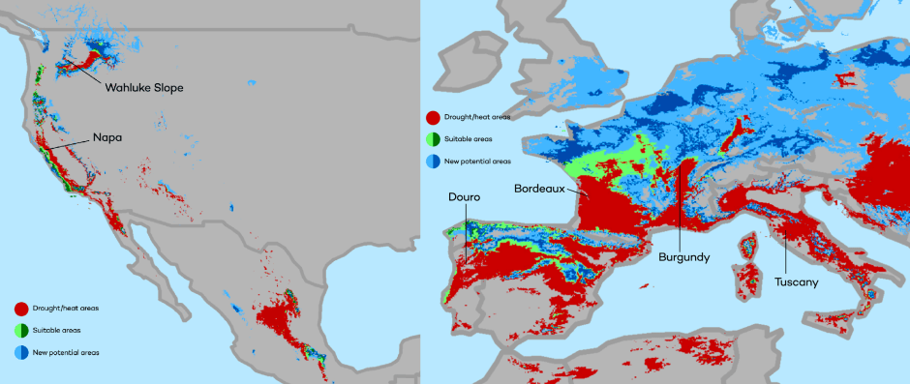
Climate Change Economics
The changing map of the world’s wine-growing regions.

Slide 9
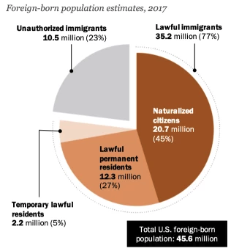
Immigrant Population in 2017
Categories of the total number
of immigrants in the United States.
https://www.pewresearch.org/fact-tank/2019/07/12/how-pew-research-center-counts-unauthorized-immigrants-in-us/

Slide 10

Evidence of the B-W Wealth Gap
Mean is
7x Greater
Median is 8x Greater

Slide 11
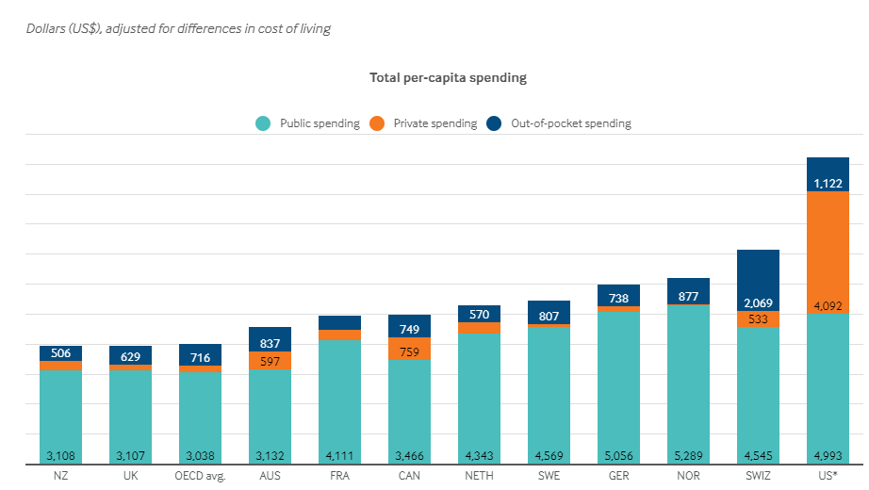
International Comparison: Health Spending
Notes:
Some good resources:
https://www.commonwealthfund.org/publications/issue-briefs/2020/jan/us-health-care-global-perspective-2019
A bit older report: https://www.commonwealthfund.org/publications/issue-briefs/2015/oct/us-health-care-global-perspective
https://www.healthsystemtracker.org/chart-collection/quality-u-s-healthcare-system-compare-countries/#item-overall-age-specific-potential-years-of-life-lost-per-100000-population-1990-2017
https://axenehp.com/international-healthcare-systems-us-versus-world/

Slide 12
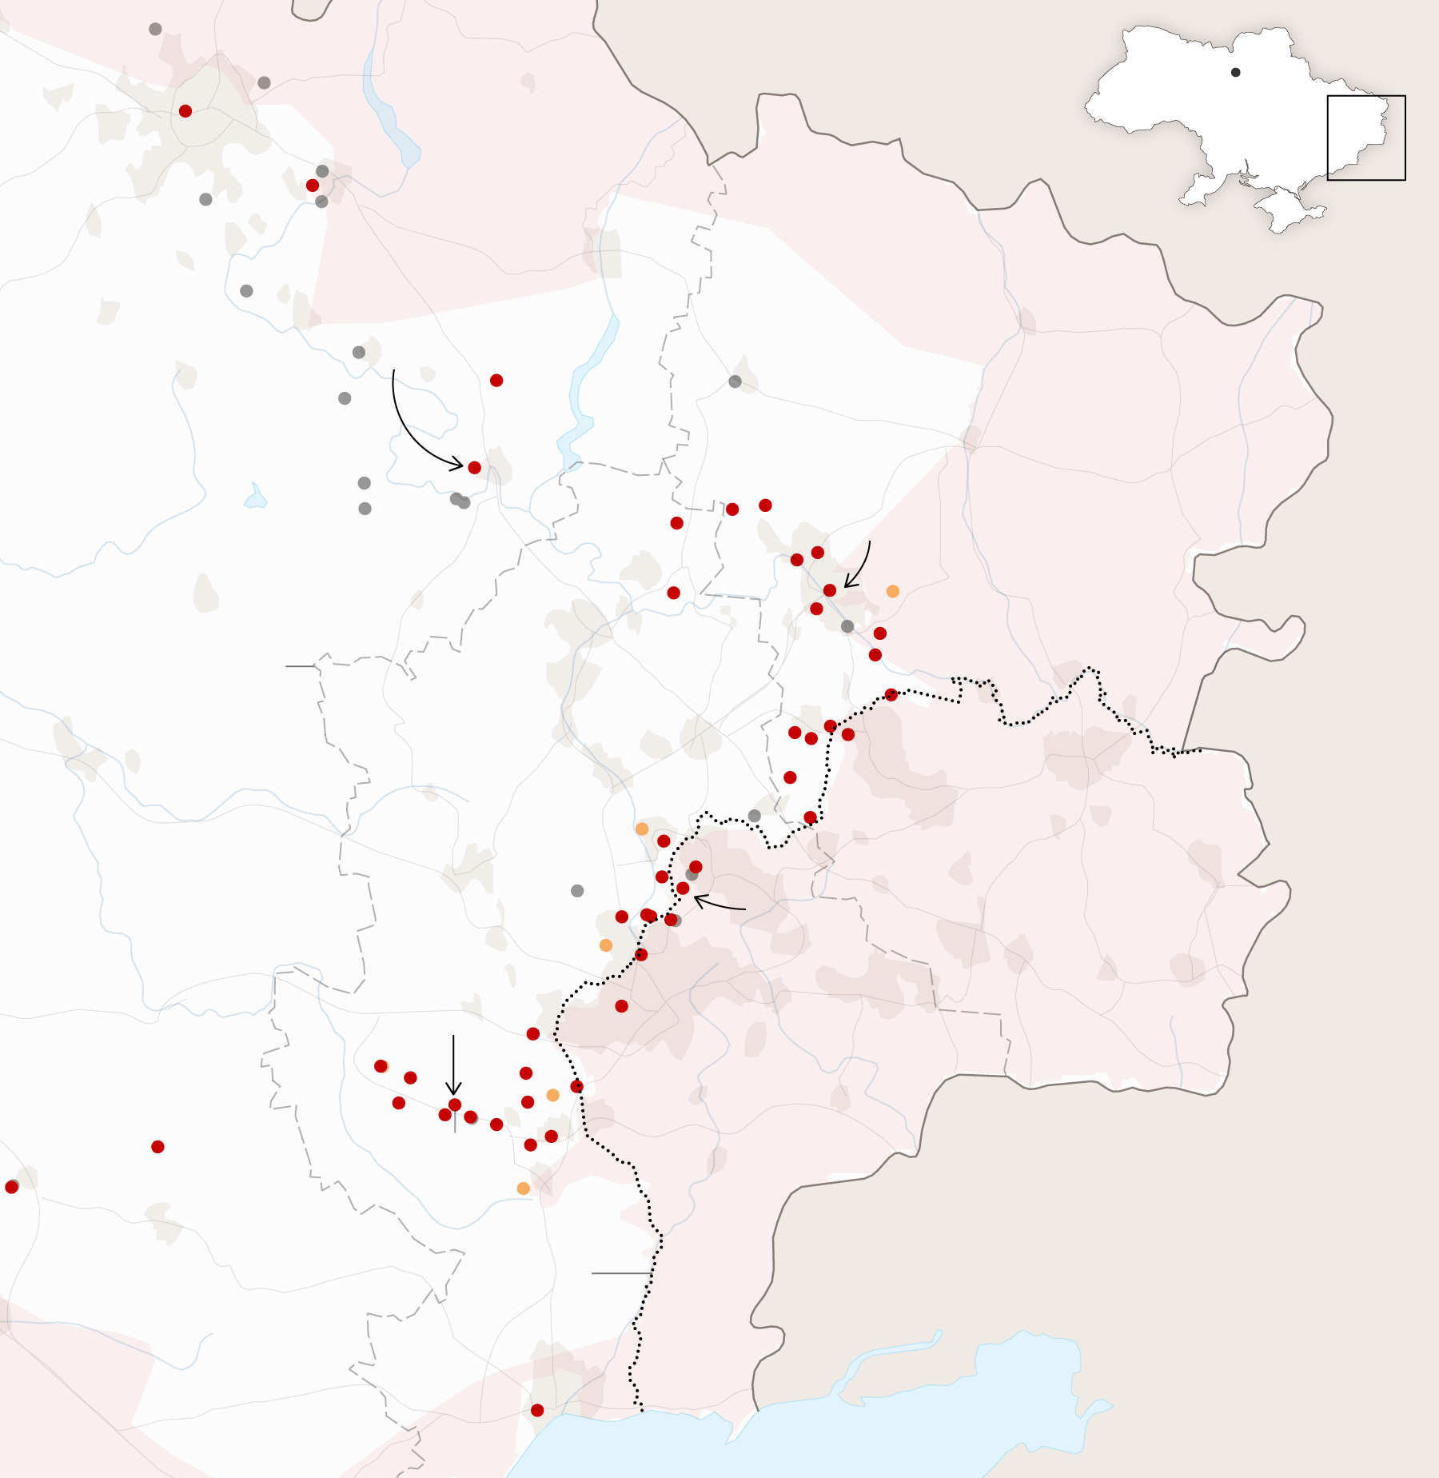
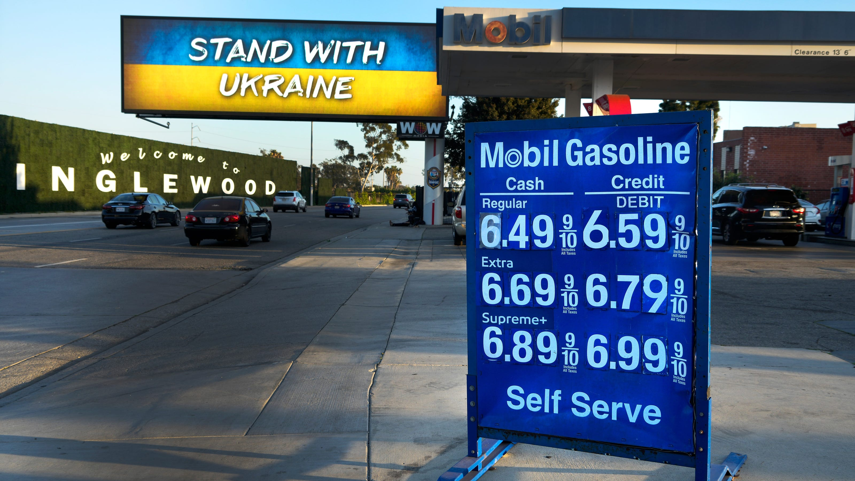
US Economy and
Russia/Ukraine Conflict
Geoffrey Woglom, Ph.D.
Amherst College

Slide 13
Submitting Questions
Please submit questions of clarification in the chat.
  I will try to handle them as they come up.
We will do a verbal Q&A once the material has been presented.
OLLI allowing, we can stay beyond the end of class to have further discussion.
Slides will be available from the NEED website tomorrow (https://needelegation.org/delivered_presentations.php)

Slide 14
Outline for the Talk
Quick summary of the state of the economy.
Closer look at inflation and whose to blame (in my opinion).
What’s at stake at controlling inflation.
Brief thoughts on the effects of the Ukraine crisis.

Slide 15
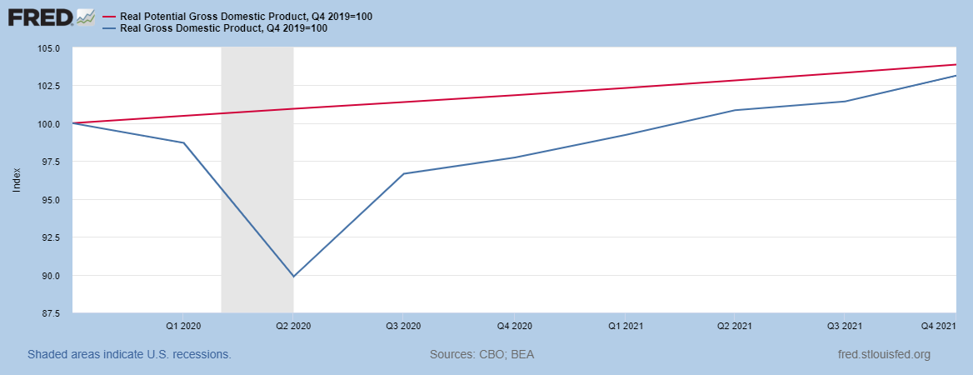
Real GDP and ‘Potential’ during the Recovery
The “output gap” is less than $100b
89.9
Source: Fred, St Louis Fed
Notes:
Point Out that the recover is slowing

Slide 16
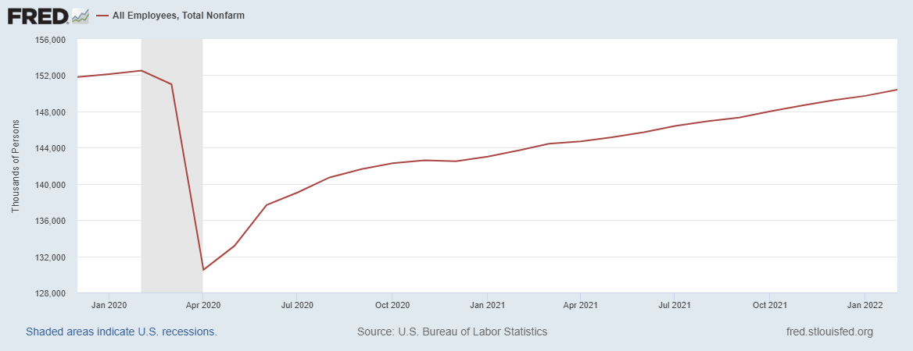
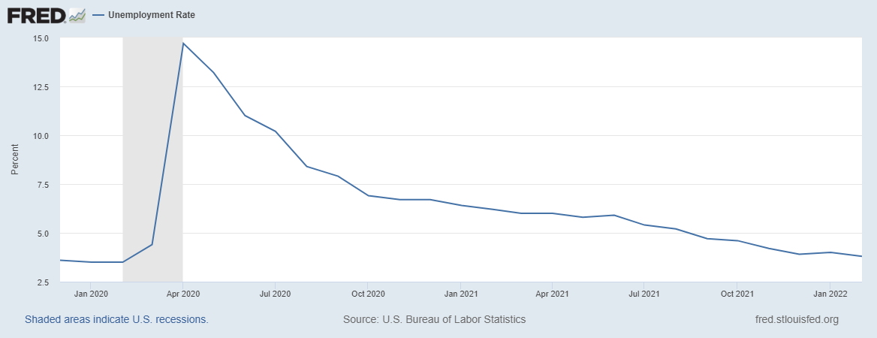
Labor Market is Almost Fully Recovered
Down 2 mil
Notes:
Down 2 million, but some of that do to reductions 0.5 mil in the labor force

Slide 17
Fiscally Driven Recovery

Slide 18
Households Lead the Way
Saving
Consumption Higher than Pre-pandemic, but Savings up, about $2.2 trillion

Slide 19
Overall Households Are Doing Well

Slide 20
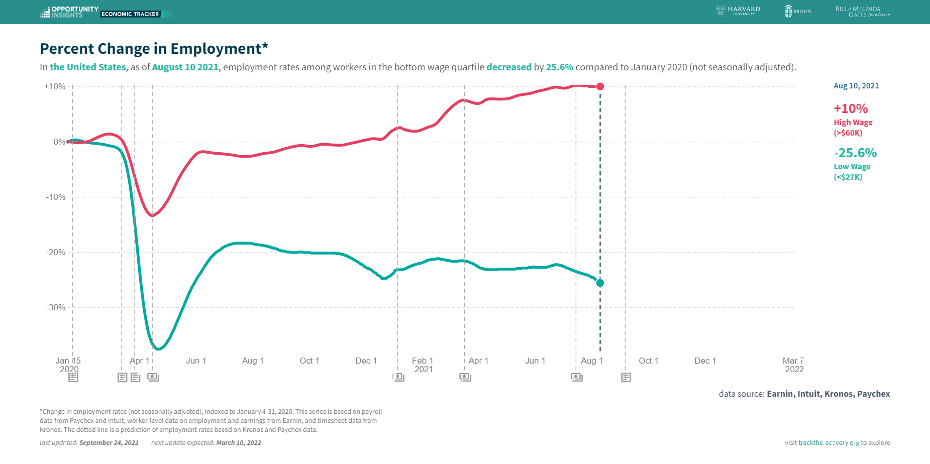
K-Shaped Recovery

Slide 21
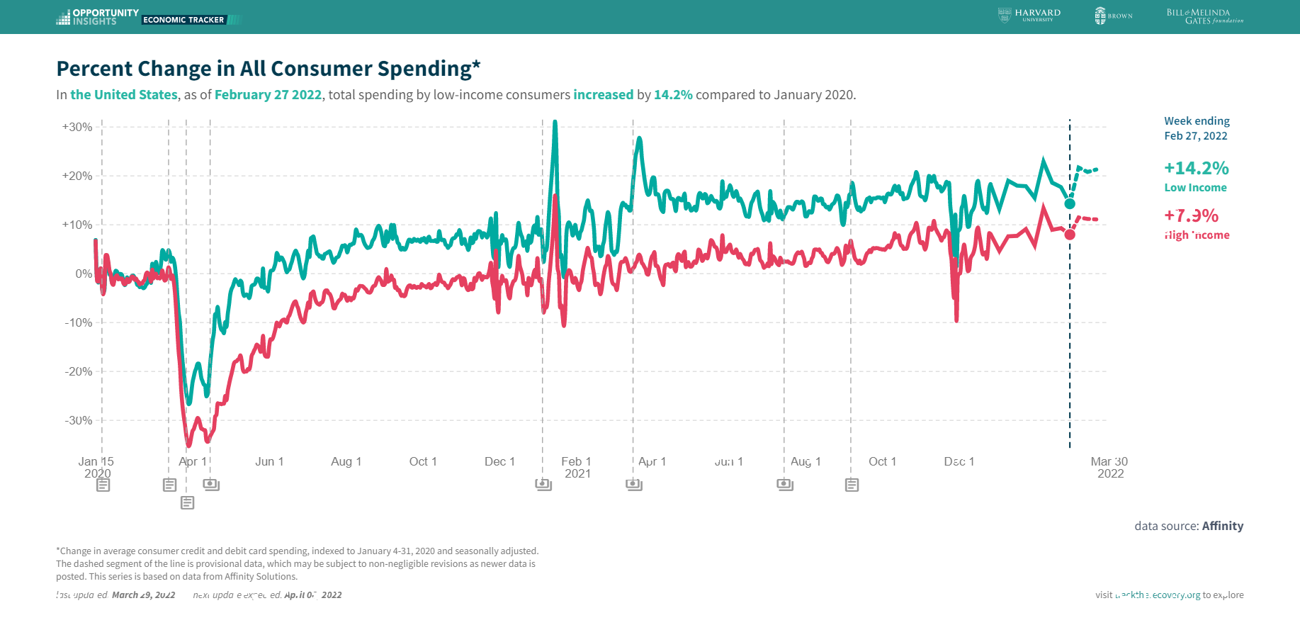
Stimulus Payments Saved Low Income Families

Slide 22
Inflation during the Recovery
Notes:
January to january 5.2%

Slide 23
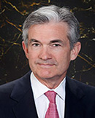
Stabilizer in Chief: the Fed
The Fed’s Dual Mandate:
  “Stable prices” which means 2% rate of inflation in the Personal Consumption Price Index (which corresponds to about 2.5% inflation in the more well-known CPI).
  “Maximum employment” which means the highest level of employment (lowest unemployment rate) consistent with mandate 1.
Fiscal Policy (taxes and spending, President and the Congress) can affect inflation and unemployment, but it is the Fed’s job to achieve the dual mandate
Jerome Powell
February 2018
Notes:
Define inflation as the rate of increase in the average level of prices not gasoline price inflation. Exceptions Deep Recesssions. ARP we will talk about later.

Slide 24
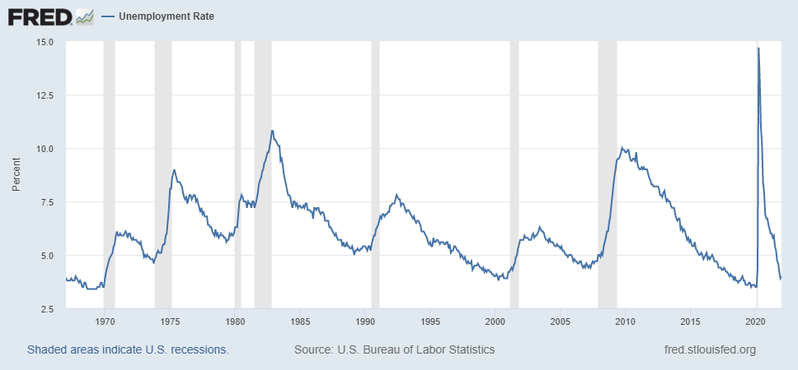
Track Record on Unemployment
Shaded Bars are Recessions
Notes:
Define natural 3 episodes. Great Moderation

Slide 25
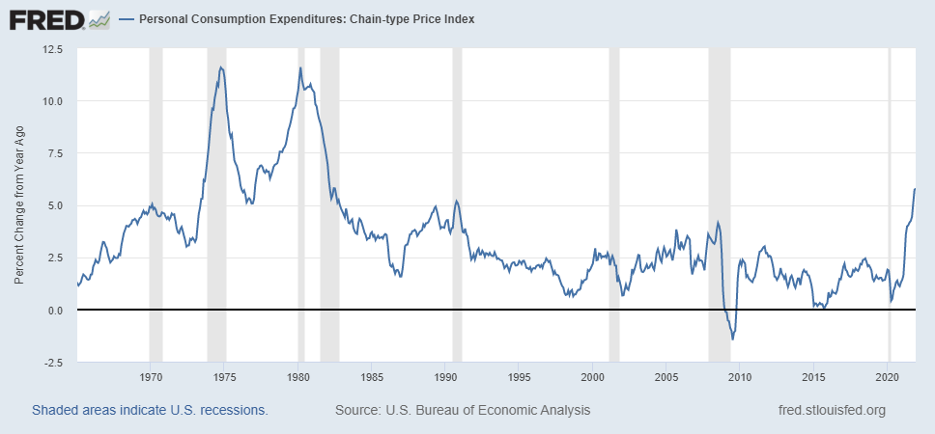
Track Record on “Price Stability”
Notes:
Shaded lines are recessions . 1970S THE Great Moderation

Slide 26
Determinants of Unemployment & Inflation
Unemployment: The higher the level of total spending, the lower the unemployment rate.
Inflation:
  Too much spending and inflation rises (Vietnam).
  Increase in production costs (e.g., “supply chain bottlenecks.”)
  Expectations of high inflation can cause inflation to be high.
Notes:
Slides 24 and 25, then back to 27

Slide 27
The Fed’s Affects the Economy via Interest Rates
Higher Interest rates discourage firms from buying new plant and equipment, households from buying new homes and tend to lower stock and house prices (!).
Reduced spending tends to lower production and employment and eventually lowers inflation.

Slide 28
Become a Central Banker in One Slide!
If you are more concerned that inflation is too high, raise interest rates.
If you are more concerned that unemployment is too high, lower interest rates.
Inflation and unemployment just right: keep rates the same.

Slide 29
One Big Complication: Lags
Milton Friedman: Monetary Policy affects GDP and Inflation with Long and Variable (Unpredictable) Lags.
Raising interest rates today does nothing to spending today nor to inflation.
But over time spending slows and eventually inflation falls.
Friedman believed that lags led to the Fed to “oversteering” the economy consistently.

Slide 30
The Great Moderation
From 1990 until 2008, the performance of the US economy was extraordinary and even Milton Friedman gave kudos to the Alan Greenspan.
We (economist) thought we knew why: Central Bankers finally listened to us on the importance of stabilizing inflationary expectations, starting with Paul Volcker.
Volcker was determined to reduce inflationary expectations.
Notes:
Back to slide 24 and then on to 30

Slide 31
“Anchoring” Inflation Expectations
Forecasts: Philadelphia Fed, “Survey of Professional Forecasters”
Notes:
Livingston Survey. 75-78. Unemployment 7% and 6% inflation. Look at the stability in the post 2001 period and the 2003-2005 period

Slide 32
My Diagnosis for the Uptick in Inflation
Yes, there were supply chain issues that affected some areas in particular (e.g., computer chips).
But there is too much total spending and in the absence of bold Fed actions is likely to continue.
Fiscal stimulus led households to increase saving over 2021 by more than $2 trillion and today’s strong retail sales numbers suggest they are prepared to spend it.
Whose to Blame: ARP probably too big, but the Fed could have acted sooner.

Slide 33
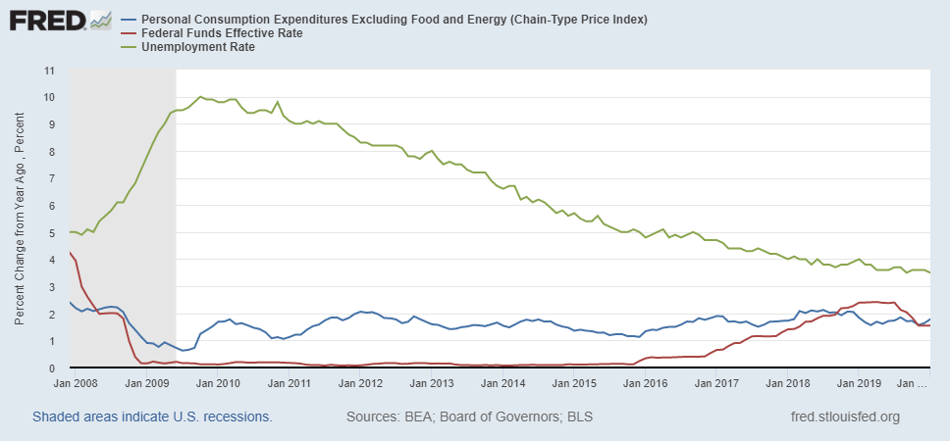
Why Did Powell Do It?
Powell Replaces
Yellen as Chair
Notes:
On average inflation is less than 2% And Fred raises rates before inflation exceeds 2.%. But, very credible. Latest tightening was begun before Powell became Chair. Tightening is very gradual 1.5 pct pts in 2 years.

Slide 34
Policy Changes under Powell
In the Fed’s dual mandate put more emphasis on the employment goal relative to the inflation goal.
Inflation goal switched from targeting forecasted future inflation to trying to achieve average realized inflation of 2%
Have they forgotten about Lags!
Note: At the moment, the price level is 3 percent higher than the target level. Will Powell shoot for deflation?
Notes:
Description of Policy goals reversed the order of the inflation and employment objectivesw

Slide 35
Fed Policy Statement, 3/16/2022
The Committee seeks to achieve maximum employment and inflation at the rate of 2 percent over the longer run. With appropriate firming in the stance of monetary policy, the Committee expects inflation to return to its 2 percent objective and the labor market to remain strong. In support of these goals, the Committee decided to raise the target range for the federal funds rate to 1/4 to 1/2 percent and anticipates that ongoing increases in the target range will be appropriate. In addition, the Committee expects to begin reducing its holdings of Treasury securities and agency debt and agency mortgage-backed securities at a coming meeting.

Slide 36
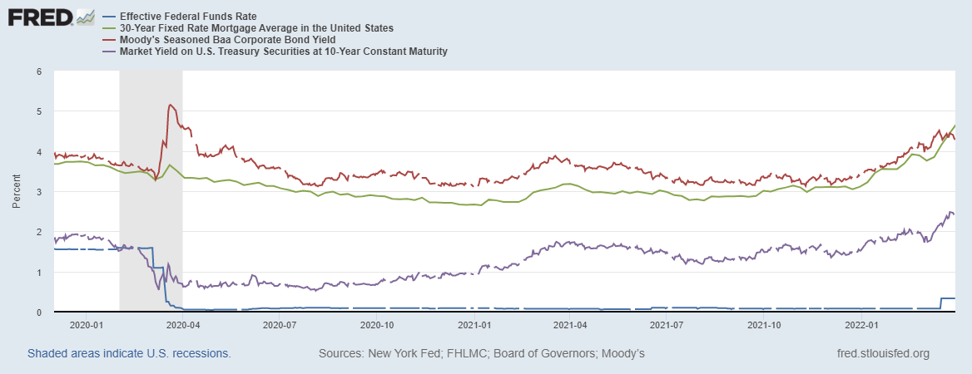
Pandemic Interest Rates

Slide 37
So Far Inflationary Expectations Look Stable
Professional forecasters, financial markets and the Fed itself think that inflation in 2023 will be in the 2.5-3.3%, range
Good Luck with these Forecasts!

Slide 38
If Expectations Start to Increase
The Fed will have a very difficult choice
Raise interest rates a lot (in an election year) to slow inflation
  stalling the recovery.
  disrupting financial markets.
Raise interest rates slowly and moderately to cushion the effect on employment
  avoids a recession (maybe).
  inflationary expectations become unanchored

Slide 39
The Conflict in Ukraine and the US Economy
Short run
  Uncertainty
  Increase in Cost of Food and Fuel
Long run
  Decrease in Globalization
  The Role of the Dollar as a International Reserve Currency.

Slide 40
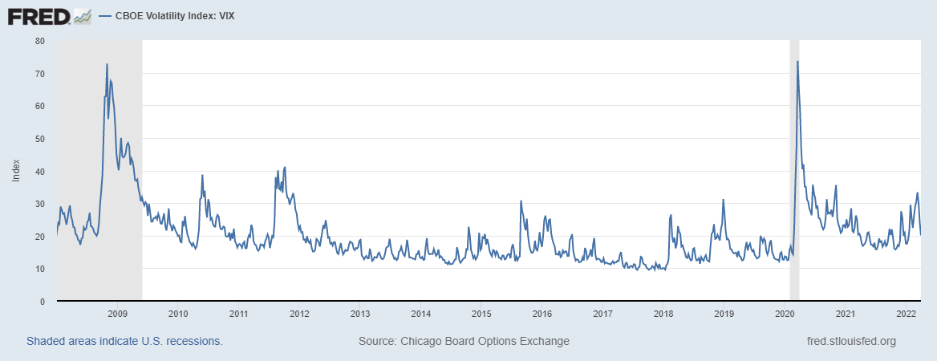
The Fear Index

Slide 41
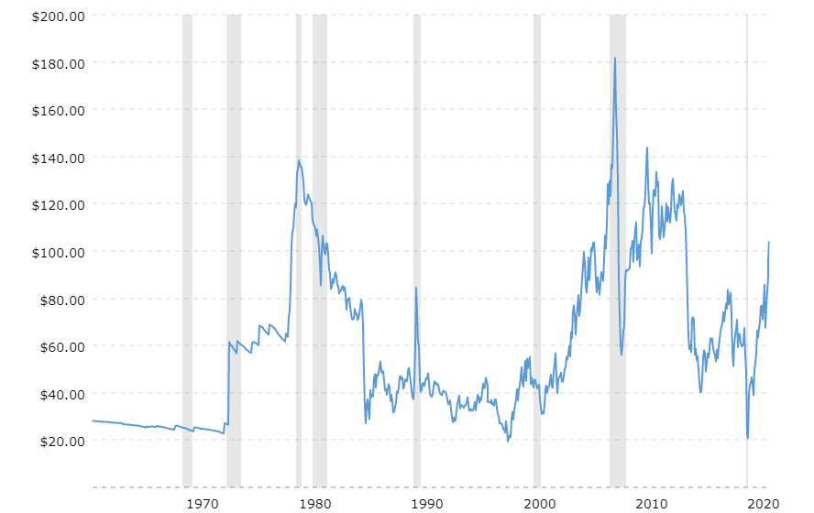
Supply Shocks: Then and Now
Historical Oil Price adjusted for Inflation
Source: macrotrends.net

Slide 42
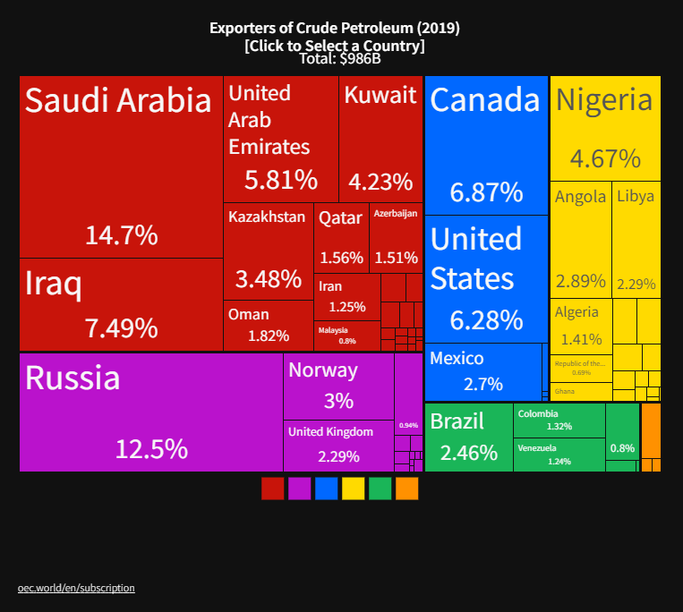
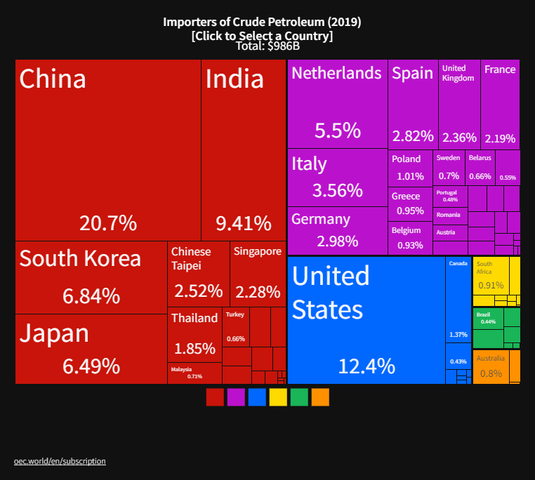
The Price of Oil is Likely to Rise (further)
Winners
Losers
Notes:
Since 2019 US has become a net exporter of oil

Slide 43
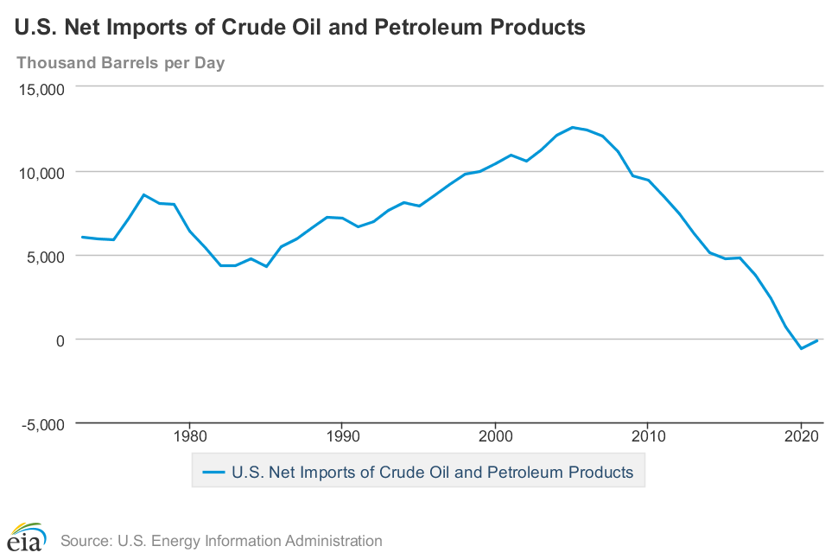
How Much Will the US be Hurt?
In the 1970s, the US as a whole was less wealthy when oil price went up.
Not now (fracking)
But, unless you own an oil well, you are likely to feel the pinch!

Slide 44
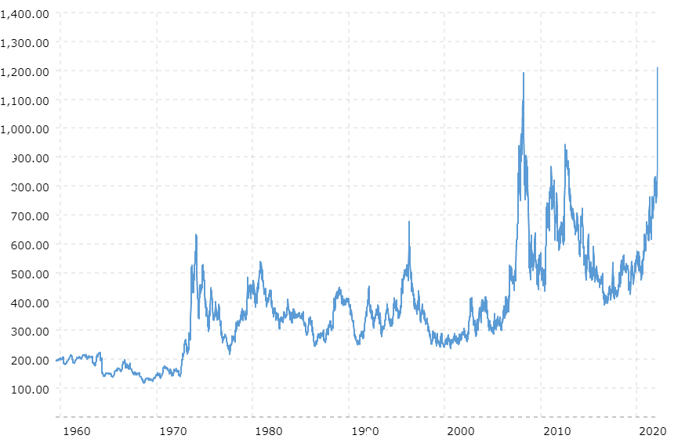
Wheat Prices Also Look Scary
Wheat Futures Prices
NOT Adjusted for inflation
Source: Macrotrends.net

Slide 45
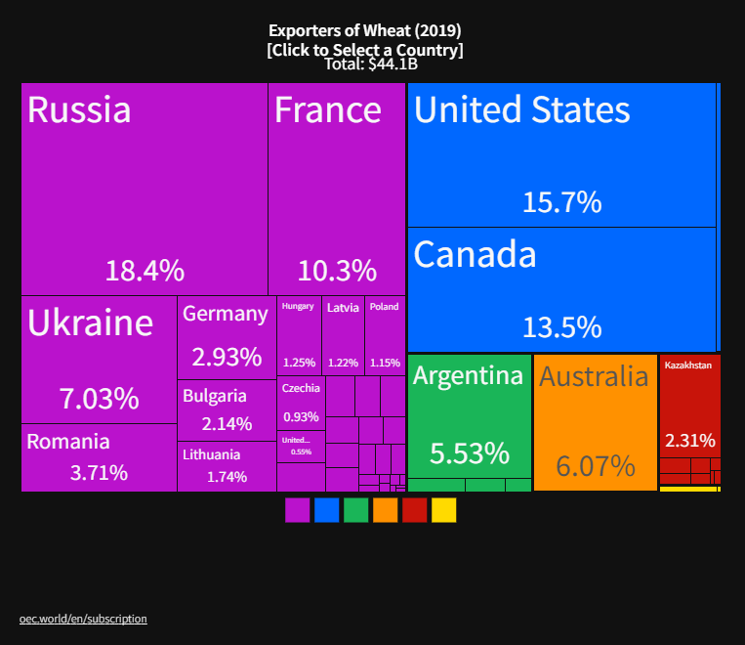
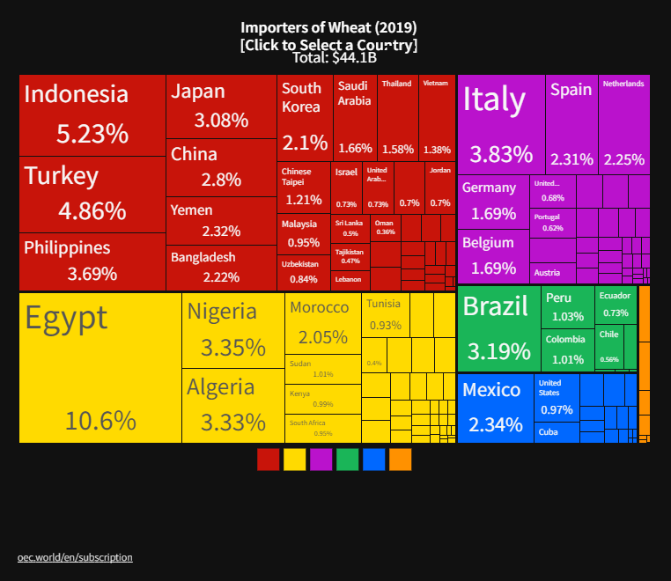
The Price of Wheat: Winners and Losers
Winners
Losers

Slide 46
Long-run Effects
Deglobalization to Protect Supply Chains.
New Developments to avoid-US imposed financial wars.
  China’s alternative to SWIFT
  Rise of crypto currencies
  The Dollar’s Role as a reserve Currency

Slide 47
Demand for Dollars by Central Banks
Source IMF Currency Composition of Official Exchange Reserves
Notes:
Talk about the fall of the Euro Brexit etc.

Slide 48
The Federal Minimum Wage: Veronika Dolar

Slide 49
Questions?
www.NEEDelegation.org
Geoffrey Woglom
grwoglom@amherst.edu
Contact NEED: Info@NEEDelegation.org
Submit a testimonial: www.NEEDelegation.org/testimonials.php
Support NEED: www.NEEDelegation.org/donate.php

Slide 50
www.NEEDelegation.org/LocalGraphs
For every state and county in the United States.
Detailed graphs on employment, housing, moves, and other statistics.

