Slide 1
Osher Lifelong Learning Institute, Fall 2023
Contemporary Economic Policy
American University
Fall, 2023
Jon Haveman, Ph.D.
National Economic Education Delegation

Slide 2
Course Outline
Contemporary Economic Policy
  Week 1 (9/28): US Federal Budget (Jon Haveman, NEED)
  Week 2 (10/5): Trade and Globalization (Arkadiusz Mironko, Indiana Univ. East)
  Week 3 (10/12): International Institutions (Alan Deardorff U of Michigan)
  Week 4 (10/19): Economic Update (Geoffrey Woglom Amherst College)
  Week 5 (10/26): Monetary Policy (Geoffrey Woglom)
  Week 6 (11/02): Intro to Financial Economics(Geoffrey Woglom)

Slide 3
Submitting Questions
Please submit questions in the chat.
  I will try to handle them as they come up, but may take them in a bunch as time permits.
We will do a verbal Q&A once the material has been presented.
  And the questions in the chat have been addressed.
After talk, I hope there will be time for more extended questions.

Slide 4
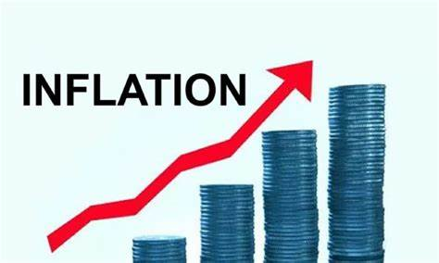
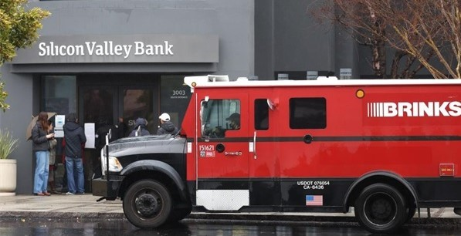
US Economy: Update
Geoffrey Woglom,
Professor of Economics
Amherst College, emeritus
October 10, 2023

Slide 5
Credits and Disclaimer
This slide deck was authored by:
  Jon D. Haveman, NEED
  Scott Baier, Clemson University
  Geoffrey Woglom, Amherst College (Emeritus)
  Brian Dombeck, Lewis & Clark College
  Doris Geide-Stevenson, Weber State
Disclaimer
  NEED presentations are designed to be nonpartisan.
  It is, however, inevitable that the presenter will be asked for and will provide their own views.
  Such views are those of the presenter and not necessarily those of the National Economic Education Delegation (NEED).

Slide 6
Outline for the Talk
Summary of the state of the macroeconomy.
The Effect of M&F policies.
What lies ahead for the economy.
What will the Fed do at its next policy meeting 10/31-11/1

Slide 7
Gross Domestic Product
Consumption | 68.1%
Investment | 17.7%
Exports | 10.9%
Imports | -13.9%
Government | 17.3%
GDP | 100.0%

Slide 8
The Size of the World Economies
https://www.visualcapitalist.com/visualizing-the-105-trillion-world-economy-in-one-chart/

Slide 9
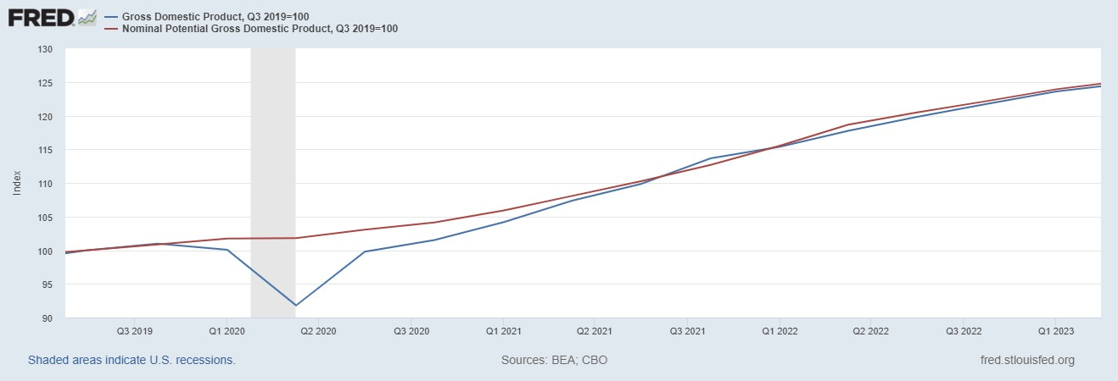
GDP and ‘Potential’ during the Recovery
Grey bars are recessions
The “output gap” is about $85b
Source: Fred, St Louis Fed

Slide 10
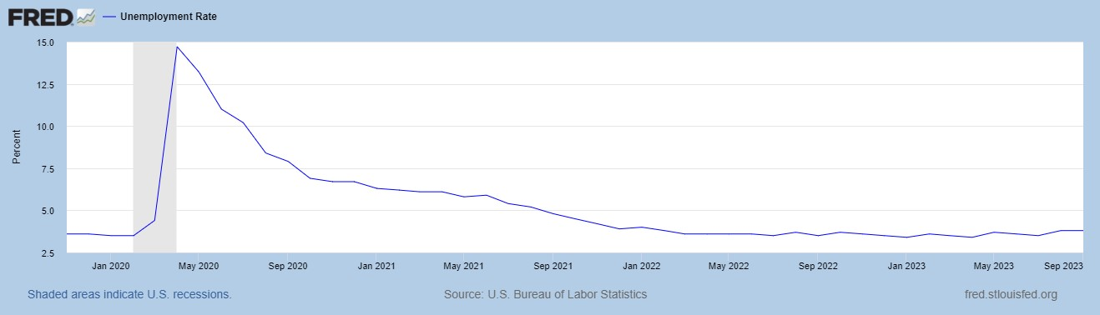
Unemployment is Near Record Lows

Slide 11
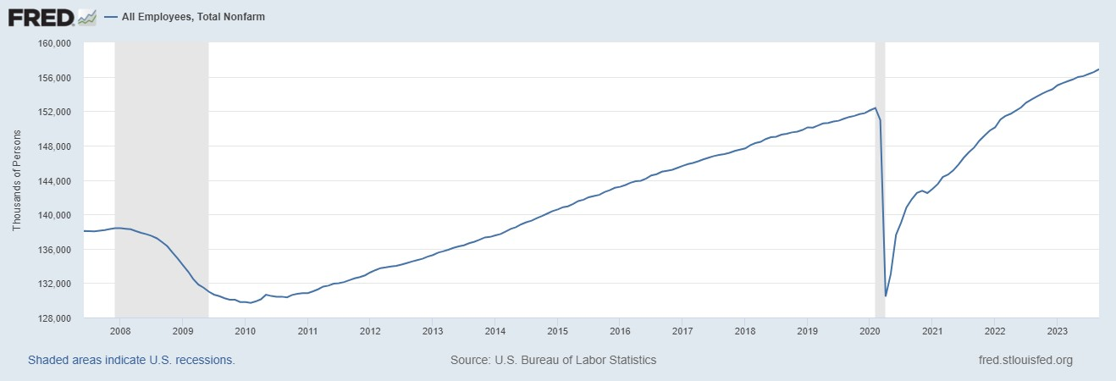
Where Have All the Workers Gone?
Notes:
Largely explained by baby boomer retirements and a little excess retirements due to COVID

Slide 12
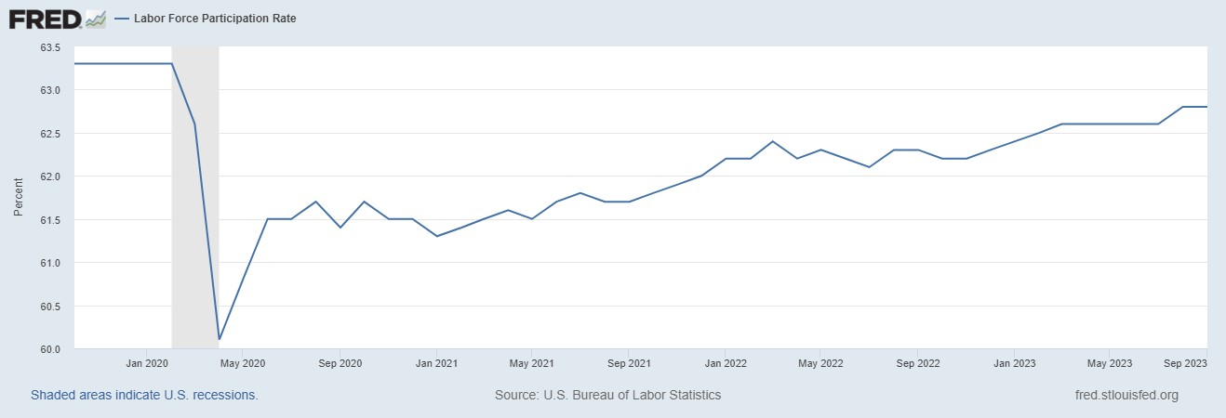
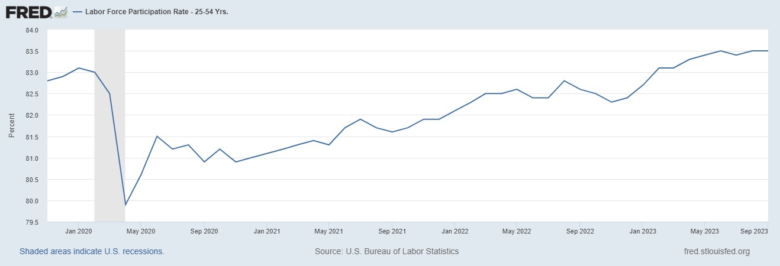
The Great Resignation?
Notes:
CBO Jan 2020 projections: LF, 62.5, vs 62.6; Total employment; 154.8 million vs actual 155.6. Civilian Labor Force; 160 vs 166.7

Slide 13
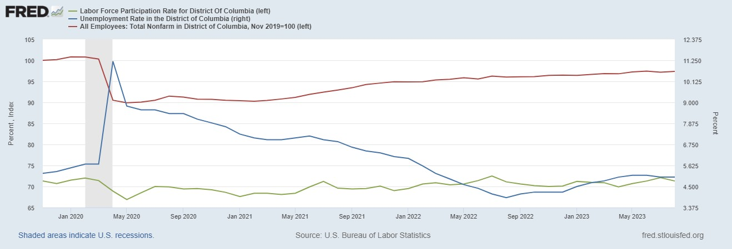
Labor Market in the District

Slide 14
Overall Good News on the Real Side
GDP is very close to its potential.
The labor market as measured by the unemployment rate is fully recovered.
There was no apparent Great Resignation
But there is also a nominal side: interest rates, asset prices, inflation and wages.
News isn’t so good!

Slide 15
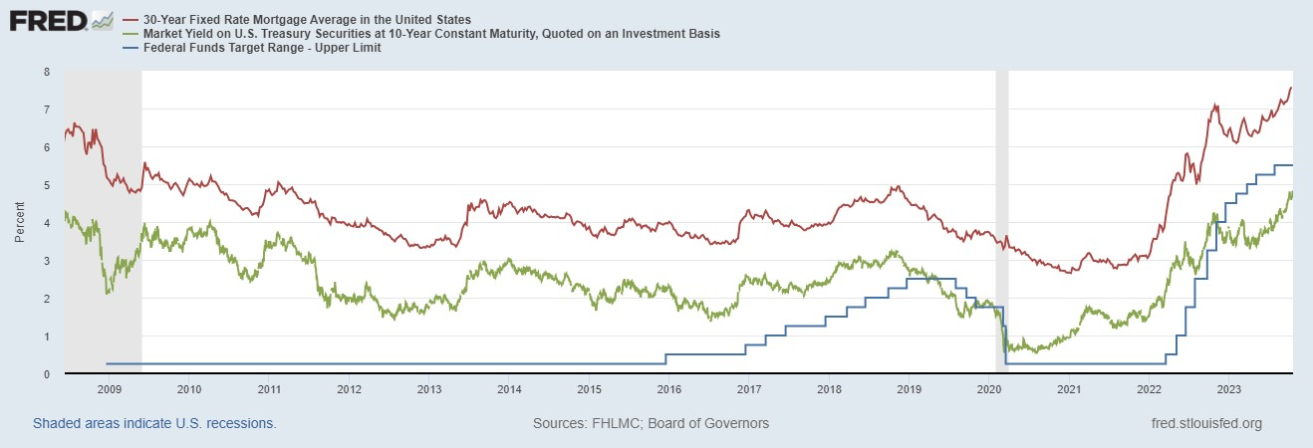
Interest Rates: Era of Falling Rates Over?
Notes:
Fed policy rate 4.5 to 4.25. Concerns with inflation

Slide 16
National Housing Market and Closer to Home
https://www.zillow.com/research/data/

Slide 17
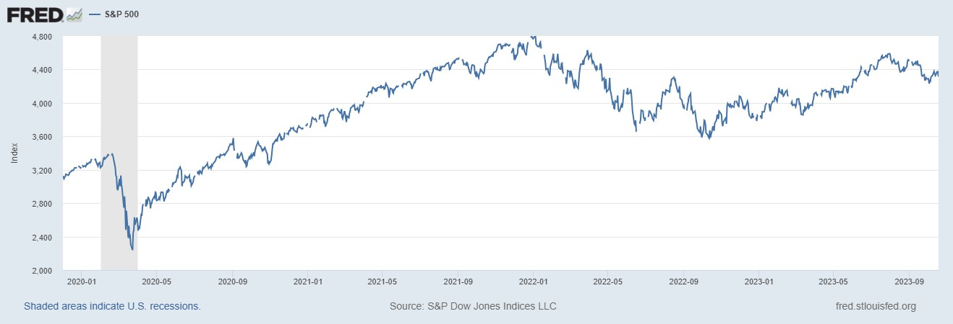
Stock Prices: Greed Giving Way to Fear?
Notes:
Since the end of 2021, lost almost 15%

Slide 18
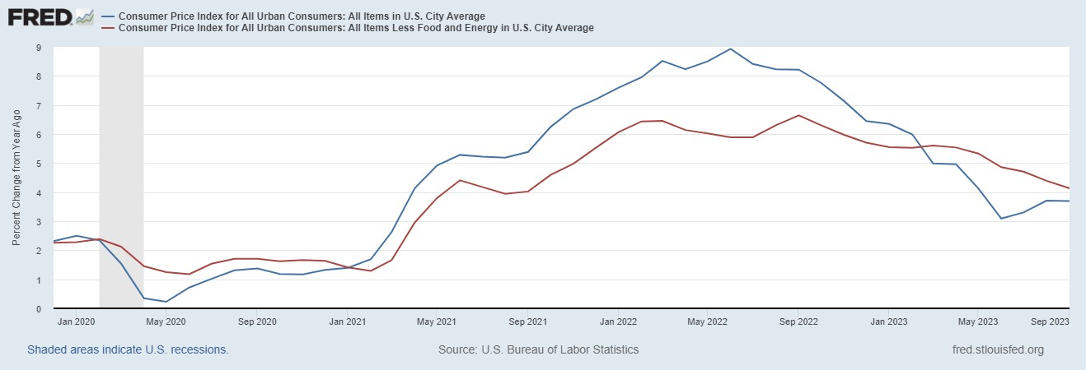
Inflation during the Recovery (CPI)
Notes:
August CPI yoy 8.3% down from 8.5 and Core 6.3 up from 6.3 in JUly

Slide 19
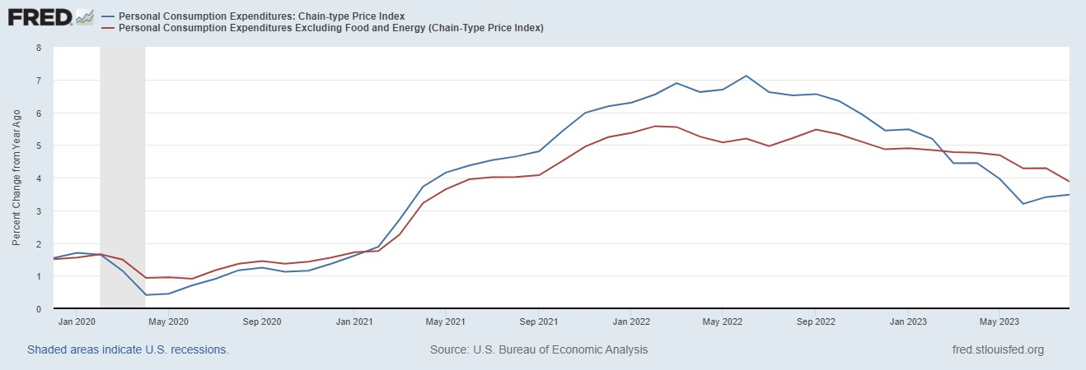
Fed’s Measure (PCE)
Fed Doesn’t React until 3/2022
Looks Promising?

Slide 20
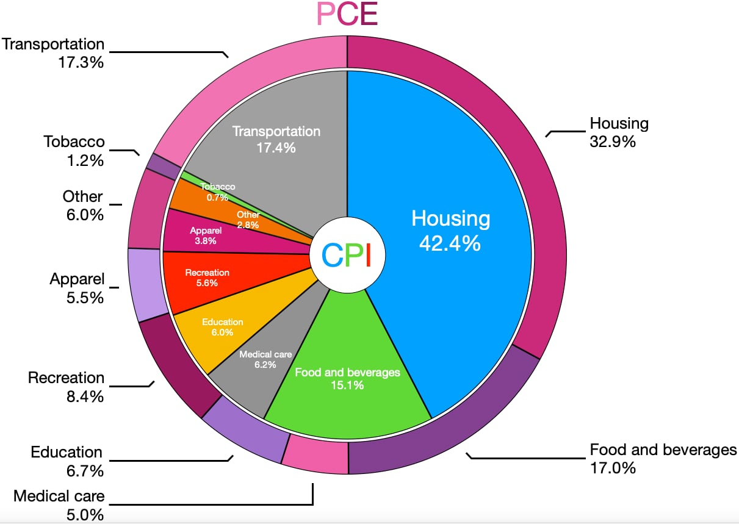
CPI vs. PCE: Differences
CPI tends to be higher (Aug):
CPI, 4.3%
PCE, 3.5%
Core CPI, 3.7%
Core PCE, 3.9%.
Typically more like 0.5 % pts.
https://en.wikipedia.org/wiki/Personal_consumption_expenditures_price_index#

Slide 21
Measuring “Underlying” Inflation
Two Reasons for Measuring Recent Inflation:
What has happened to the Cost of Living?
What is likely to happen to inflation over the next 12-18 months?

Slide 22
Rents Paid versus Asking Rents

Slide 23
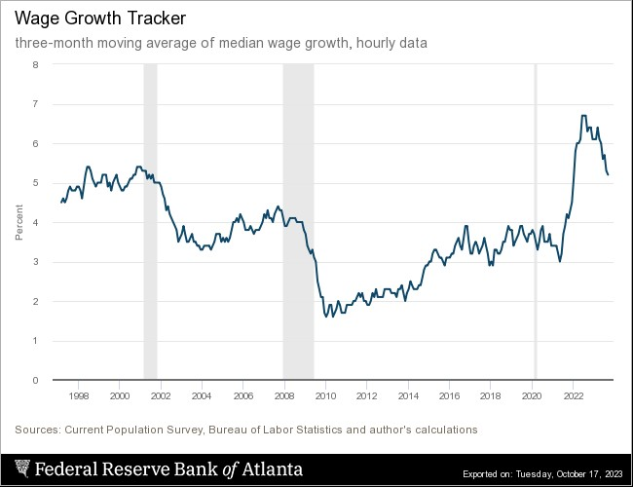
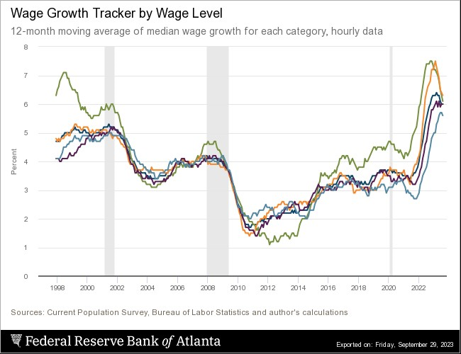
Wages Haven’t Kept Pace with Inflation
At Least, Not Yet
Notes:
But, note that low wage workers are doing relatively the best

Slide 24
The “Nominal” Side
Inflation: There is a lot of work still to be done.

Slide 25
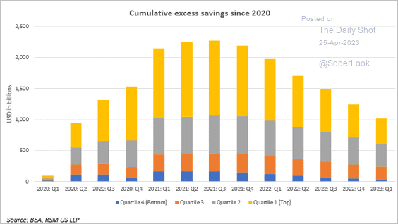
Policy Effects: Fiscal
2020-2021: massive stimulus. Cares Act, 3 rounds of stimulus checks, expanded unemployment benefits, Payroll Protection Loans.

Slide 26
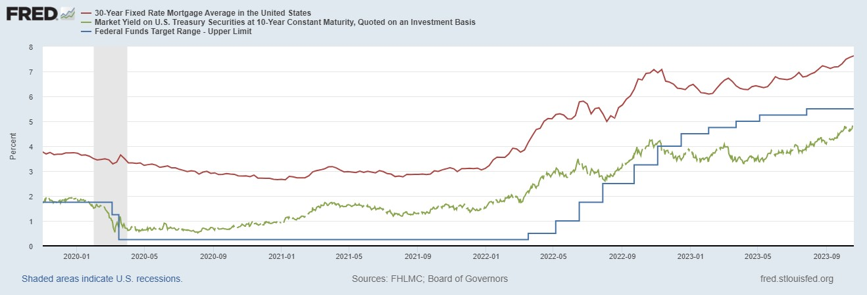
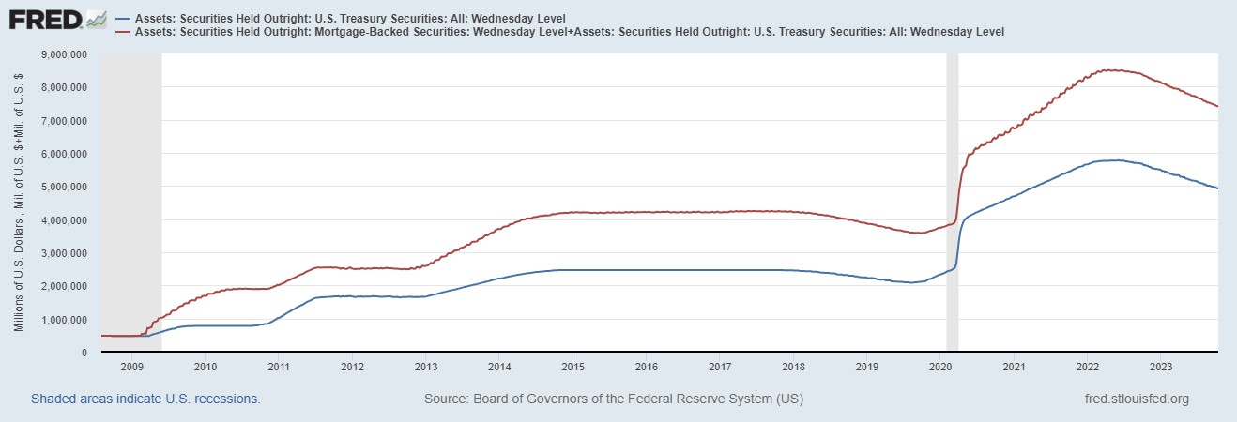
Policy Effects: Monetary
2020-2/2022: policy interest rate at zero, new round of quantitative easing.
3/2022-present: most rapid increase in interest rates since Paul Volcker

Slide 27
Where we Stand
Bidenomics?
  The ARP was probably too big, but helped many poor families, and the Fed was aware of the size of the stimulus.
  Chips Act
  Inflation Reduction Act.
More importantly, Presidents don’t have much effect on the economy in the short run.
Monetary policy was too easy for too long, but since March of last year has been much more restrictive.
Yes, there were supply chain issues that temporarily raised inflation, but there was (is?) too much total spending.
So, where are we headed?
What will the Fed do?

Slide 28
Fed’s View in September
Austin Goolsbee, President of the Chicago Fed. The economy is on a “golden path”and will achieve the “mother of all soft landings.”
Notes:
Survey of Professional Forecasters from early August: GDP and unemployment much like the June Fed forecast. Inflation much like the Fed’s September forecast.

Slide 29
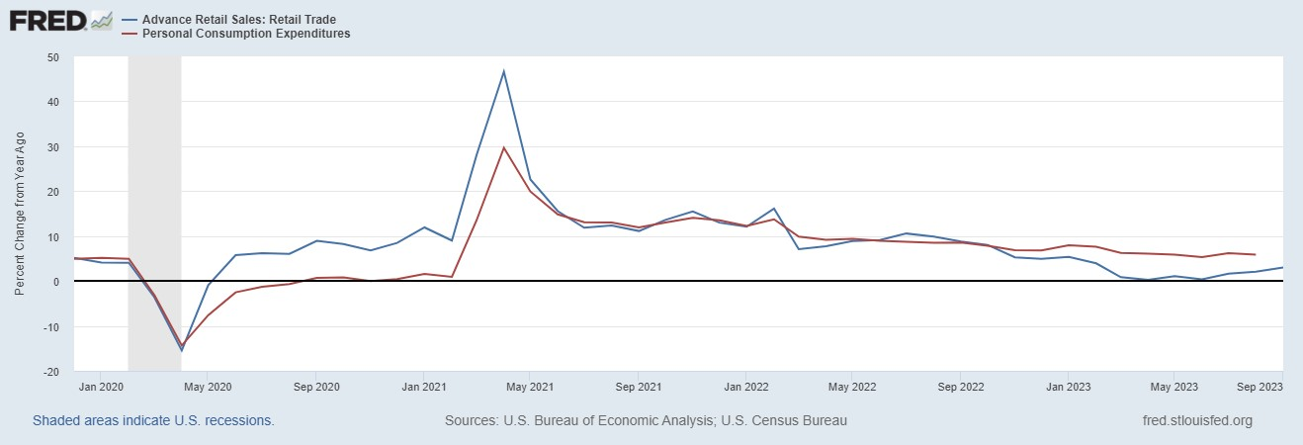
Latest Readings on Consumers
NY Fed estimates that commencement of student loan payments will lower consumption growth by 0.1%

Slide 30
Mortgage Rates are Having an Effect

Slide 31
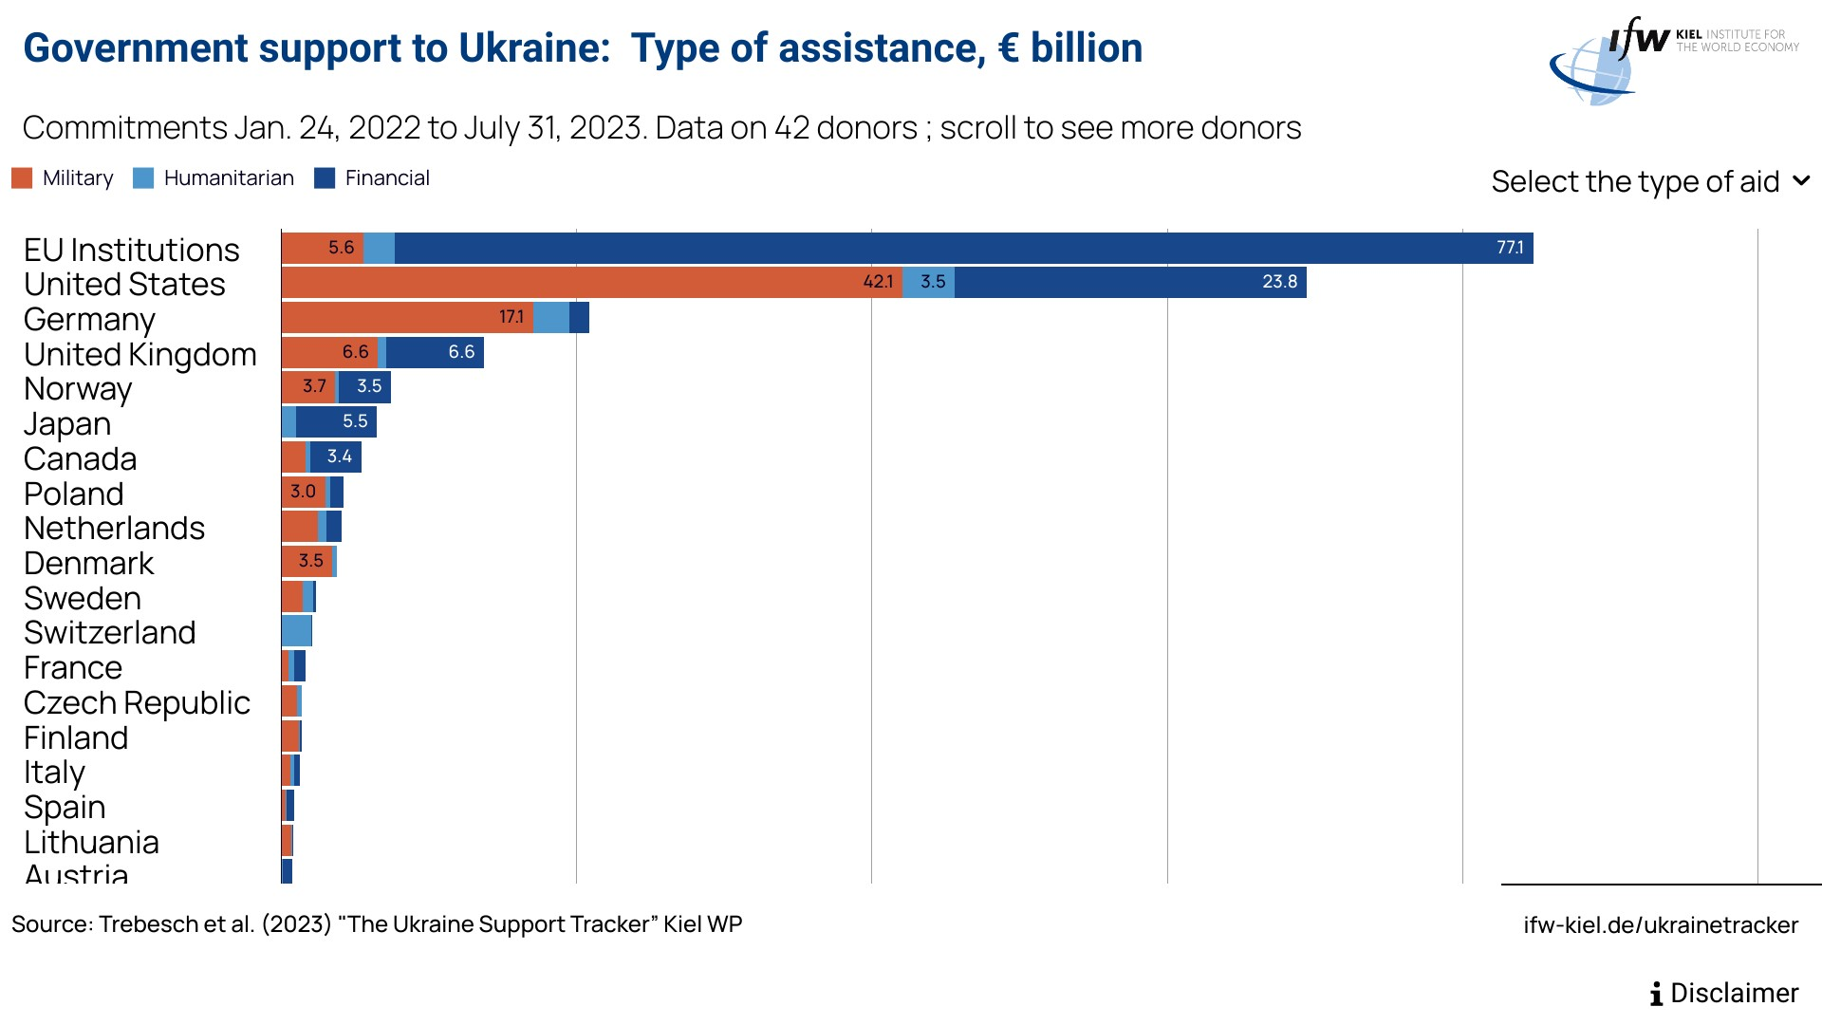
Aid to Ukraine: How Big?
10 % of FY 2023 Defense Budget
1.3 % of FY 2023 Total Outlays;
0.3% of GDP

Slide 32
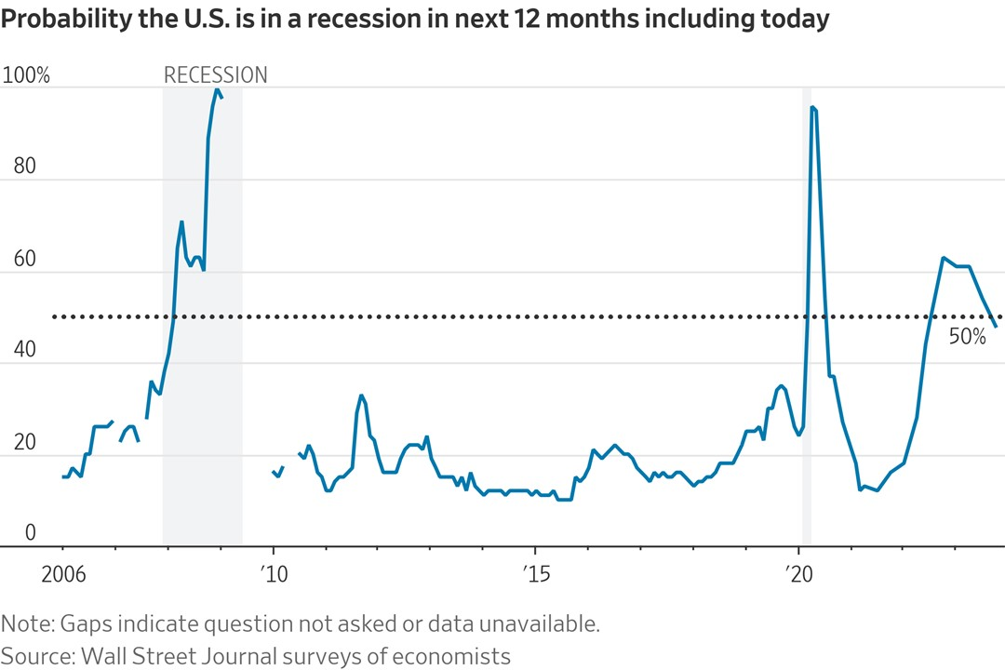
Wall Street Consensus: No Recession

Slide 33
Key Players’ Views on the Risk of a Recession
https://advisor.visualcapitalist.com/

Slide 34
What is a Recession?
Defined by the National Bureau of Economic Research (NBER)
“The NBER's definition emphasizes that a recession involves a significant decline in economic activity that is spread across the economy and lasts more than a few months.”
Popular Rule of Thumb: Two or more, consecutive quarters where Real GDP falls.
Recessions are caused by decreases in total spending.

Slide 35
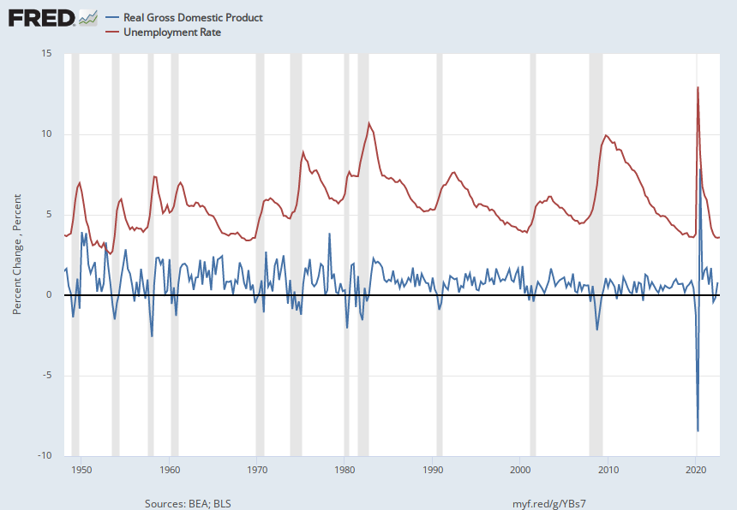
Real GDP Growth and Recessions
Notes:
Shaded Bars are recessions. 2022Q1, -1.6; Q2, -0.6 at annual rates.

Slide 36
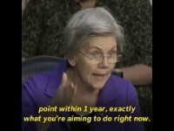
Monetary Policy is Tough

Slide 37
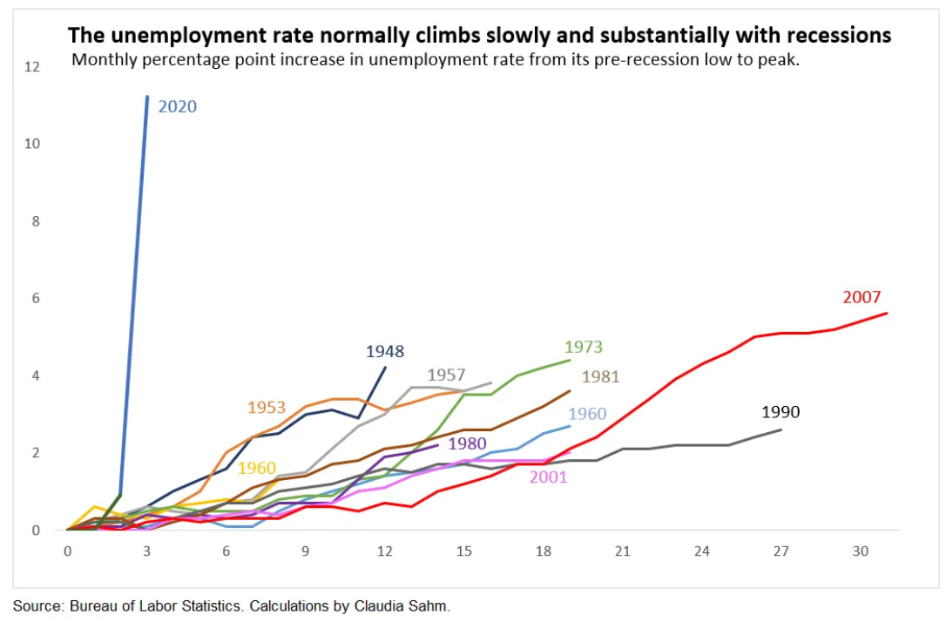
They are Both Right!
Warren:
Powell:
“We are taking the only measures we have to bring inflation down….Will working people be better off if we just walk away from our job and inflation remains at 5 or 6 percent?”

Slide 38
And, It Will Only Get Harder
Biden has tied his campaign to the performance of the economy, but it is the Fed that can affect the economy between now and 11/24
Known, Unknowns
  Congressional paralysis and possible government shutdown, 11/17.
  Wars in Ukraine and Israel.

Slide 39
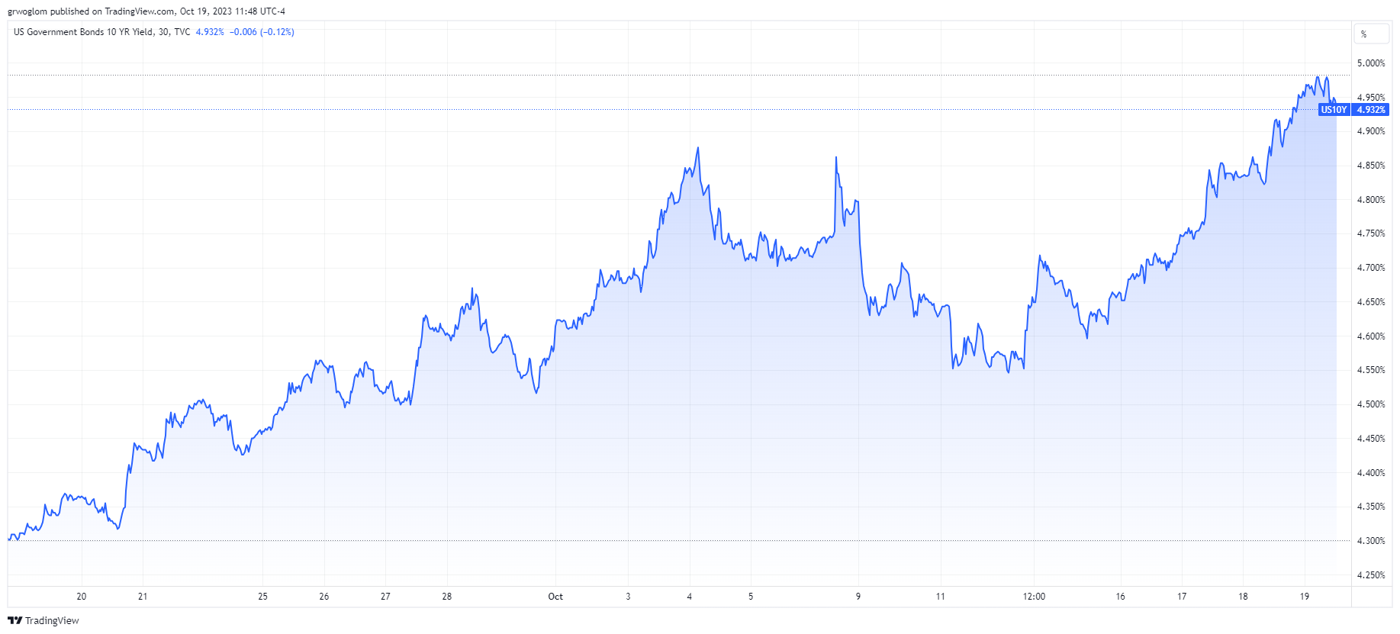
Unknown Unknowns!

Slide 40
Stay Tuned!
This month’s economic reports (8:30AM)
26th, Third Quarter GDP estimates.
27th, PCE inflation.
31st, Employment Cost Index
31st, Start of a Two-Day Fed Policy Meeting.

Slide 41
Google Site
https://sites.google.com/view/macro-current-issues/home

Slide 42
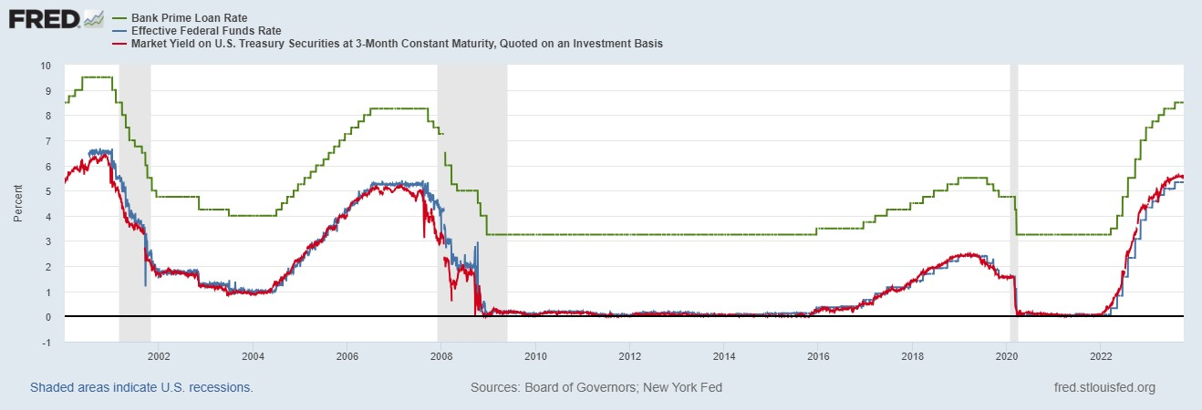
The Fed and Short-term Interest Rates
Blue is the fed funds rate.
Red is the rate on 3 month Treasuries.
Green is the prime bank lending rate
Notes:
Take note over the redline peeking above the others

Slide 43
Let’s Hear from You!
Geoffrey Woglom grwoglom@amherst.edu
Contact NEED: Info@NEEDEcon.org
Submit a testimonial: www.NEEDEcon.org/testimonials.php
Support NEED: www.NEEDEcon.org/donate.php

