Slide 1
Osher Lifelong Learning Institute, Winter 2022
Contemporary Economic Policy
American University
March-May, 2022
Host: Jon Haveman, Ph.D.
National Economic Education Delegation

Slide 2
National Economic Education Delegation
Vision
One day, the public discussion of policy issues will be grounded in an accurate perception of the underlying economic principles and data.
Mission
NEED unites the skills and knowledge of a vast network of professional economists to promote understanding of the economics of policy issues in the United States.
NEED Presentations
Are nonpartisan and intended to reflect the consensus of the economics profession.

Slide 3
Who Are We?
Honorary Board: 54 members
2 Fed Chairs: Janet Yellen, Ben Bernanke
6 Chairs Council of Economic Advisers
Furman (D), Rosen (R), Bernanke (R), Yellen (D), Tyson (D), Goolsbee (D)
3 Nobel Prize Winners
Akerlof, Smith, Maskin
Delegates: 651+ members
At all levels of academia and some in government service
All have a Ph.D. in economics
Crowdsource slide decks
Give presentations
Global Partners: 49 Ph.D. Economists
Aid in slide deck development

Slide 4
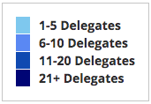
Where Are We?

Slide 5
Available NEED Topics Include:
Coronavirus Economics
US Economy
Climate Change
Economic Inequality
Economic Mobility
Trade and Globalization
Minimum Wages
Immigration Economics
Housing Policy
Federal Budgets
Federal Debt
Black-White Wealth Gap
Autonomous Vehicles
US Social Policy

Slide 6
Course Outline
Contemporary Economic Policy
Week 1 (3/11): US Economy & Coronavirus Economics
Week 2 (3/18): Federal Debt (Brian Peterson, Central College)
Week 3 (3/25): Trade and Globalization (Alan Deardorff, Univ. of Michigan)
Week 4 (4/1): Healthcare Economics (Veronika Dolar, SUNY-Old Westbury)
Week 5 (4/8): Economics of Immigration (Jennifer Alix-Garcia, Oregon St. Univ.)
Week 6 (4/15): Economic Inequality (Kyle Montanio, Colorado University - Denver)
Week 7 (4/22): Economic Mobility (Kathryn Wilson, Kent State University)
Week 8 (4/29): Discrimination in US Policy History (Jon Haveman, NEED)
Week 9 (5/6): The Black-White Wealth Gap (Mike Shor, Univ. of Connecticut)
Week 10 (5/13): The Gender Wage Gap (Mallika Pung, Univ. of New Mexico)

Slide 7
The Federal Debt is Becoming A Problem

Slide 8
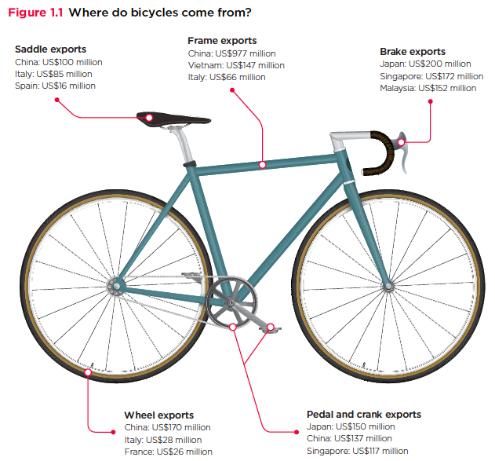
Trade: Bicycle Supply Chain
Source: World Development Report 2020

Slide 9
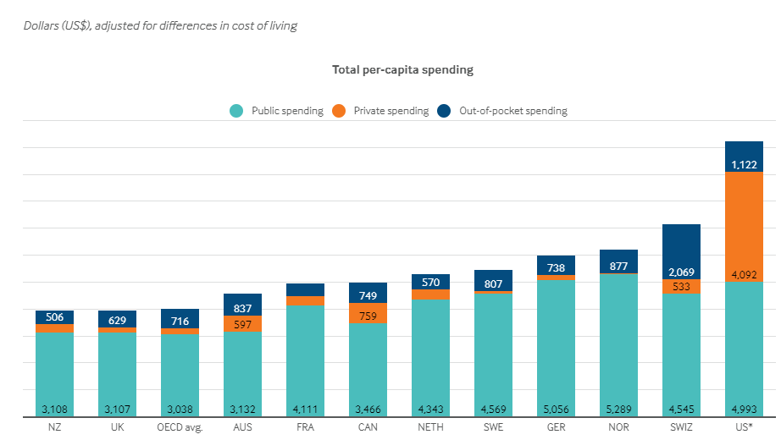
International Comparison: Health Spending
Notes:
Some good resources:
https://www.commonwealthfund.org/publications/issue-briefs/2020/jan/us-health-care-global-perspective-2019
A bit older report: https://www.commonwealthfund.org/publications/issue-briefs/2015/oct/us-health-care-global-perspective
https://www.healthsystemtracker.org/chart-collection/quality-u-s-healthcare-system-compare-countries/#item-overall-age-specific-potential-years-of-life-lost-per-100000-population-1990-2017
https://axenehp.com/international-healthcare-systems-us-versus-world/

Slide 10
Immigrant Population in 2017
Categories of the total number
of immigrants in the United States.
https://www.pewresearch.org/fact-tank/2019/07/12/how-pew-research-center-counts-unauthorized-immigrants-in-us/

Slide 11
National Income Inequality: Share of Top 10%
Stock Market Crash
WWII
Housing Bubble
Dot-com Bubble

Slide 12
Reflections on the American Dream
https://www.brookings.edu/blog/social-mobility-memos/2018/01/11/raj-chetty-in-14-charts-big-findings-on-opportunity-and-mobility-we-should-know/

Slide 13
Events/Policies with Direct Wealth Implications
Slave trade
The first deprivation.
Slavery
40 acres (and a mule)
The second deprivation.
Discriminatory distribution of land.
Freedmen’s Bank
Lax oversite and dissolution.
Jim Crow Laws & Economic Policy
Convict leasing, debt peonage, chain-gang, sharecropping, and lynching.
Homestead Act
Discriminatory distribution of land.
Land theft and destruction
E.g., Black Wall Street – Tulsa, 1921.
GI Bill
Discriminatory access – Levittown
Federal Housing Authority
Redlining
And many more.

Slide 14
Evidence of the B-W Wealth Gap
Mean is
7x Greater
Median is 8x Greater

Slide 15
Gender Wage Gap Over the Years
Gap between men and women’s median earnings has narrowed considerably
since the late 1970s.

Slide 16
US Economy and Coronavirus Economics
Doris Geide-Stevenson, Ph.D.
Weber State University
March 11, 2022

Slide 17
Outline
State of the pandemic
The U.S. Economy
Total Output
Policy Support
Labor Market
Inflation
Equity Markets
Housing Markets
Great Resignation

Slide 18
State of the Pandemic

Slide 19
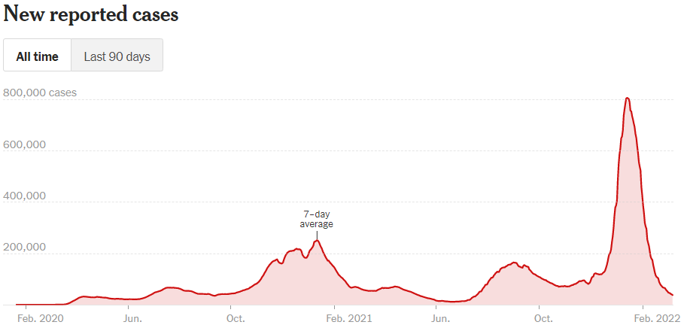
Making Real Progress .. Then Omicron
Source: NYTimes

Slide 20
Hospitalizations and Deaths
Total Covid deaths in the US: 964,674 (Johns Hopkins Coronavirus Resource Center, March 10, 2022)
Source: New York Times, March 10, 2022

Slide 21
and now – the Russian invasion of Ukraine

Slide 22
Credits and Disclaimer
This slide deck was authored by:
Jon D. Haveman, NEED
Scott Baier, Clemson University
Geoffrey Woglom, Amherst College (Emeritus)
Brian Dombeck, Lewis & Clark College
Doris Geide-Stevenson, Weber State
Disclaimer
NEED presentations are designed to be nonpartisan.
It is, however, inevitable that the presenter will be asked for and will provide their own views.
Such views are those of the presenter and not necessarily those of the National Economic Education Delegation (NEED).

Slide 23
The U.S. Economy
The Role of the Pandemic versus Policy Adjustments? And what now?

Slide 24
GDP Trajectory: Pandemic Plunge and Recovery
GDP is:
$0.5 Trillion below 2019 forecast.
$0.2 Trillion ABOVE 2019-Q4 level.
Real GDP = Total value of production = Consumption + Investment + Government Purchases + Net Exports
Almost no Output Gap compared to the start of the pandemic, but a quick recovery.
Notes:
Above pre-pandemic levels, but not back to potential output.

Slide 25
Spending Patterns Since First US Case
Q3 - Flat
Source: https://tracktherecovery.org/

Slide 26
But Not All Industries Were Equally Harmed

Slide 27
Unprecedented Policy Support
Source: Vanguard Economic and Market Outlook for 2022:Striking a better balance

Slide 28
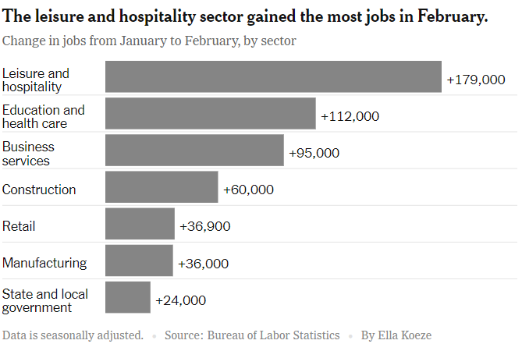
Employment Changes - US
Source: New York Times, March 4, 2022

Slide 29
Employment Gap
3.9 Million below February, 2020.
8.6 Million below where we should be.
Notes:
payroll_recent.png

Slide 30
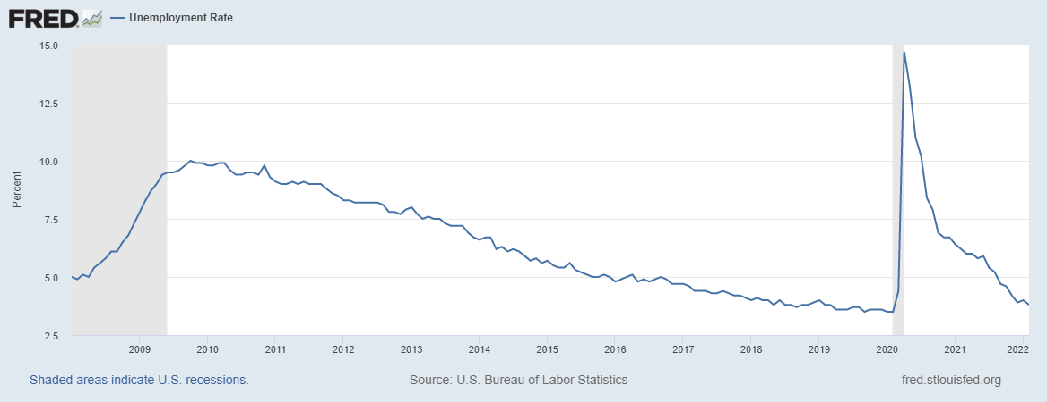
Labor Force Participation and Unemployment
Unemployment rate is still somewhat misleading.

Slide 31
Inflation and Asset Markets
Inflation, Equity Markets, Housing Markets

Slide 32
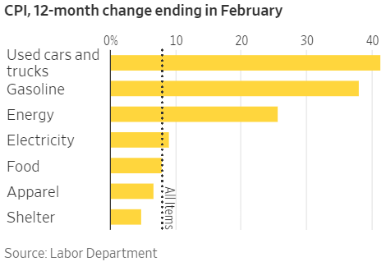
Inflation News
January 2022
All items: 7.9% - new four decade high
Source: Wall Street Journal
Notes:
Why CPI overestimates or underestimates inflation – COVID CPI should reflect a change in purchases. Covid CPI 6.54%

Slide 33
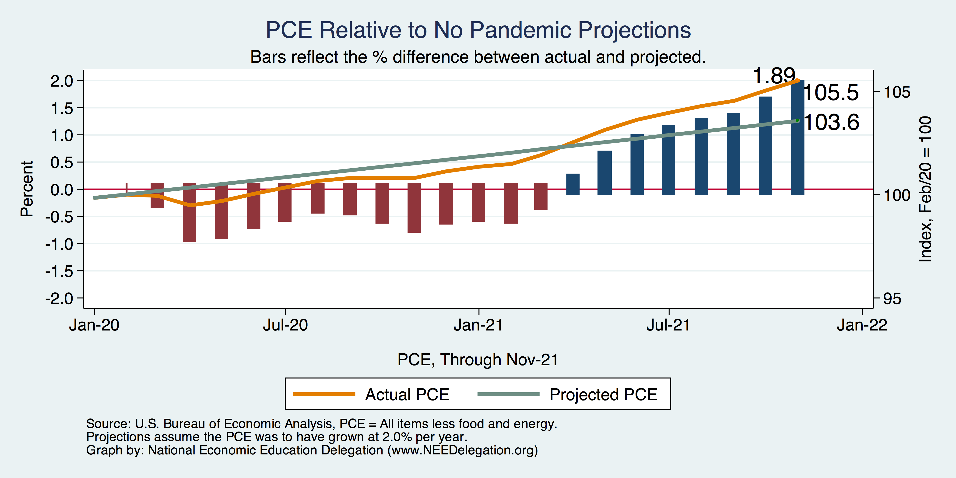
Inflation Targeting over the longer term?
Notes:
Cpi_recent.png

Slide 34
Measure of Inflation Expectations
Breakeven Inflation Rate = Difference between
nominal and real 5-year and 10-year Treasury
constant maturity securities.
Market participants expect around 2.9%
of inflation annually over the next 10 years and
3.4% over the next 5 years.
Inflation expectations are increasing – especially after the Russian invasion.

Slide 35
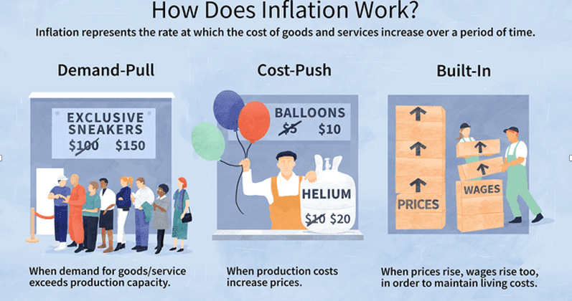
Source: Investopedia

Slide 36
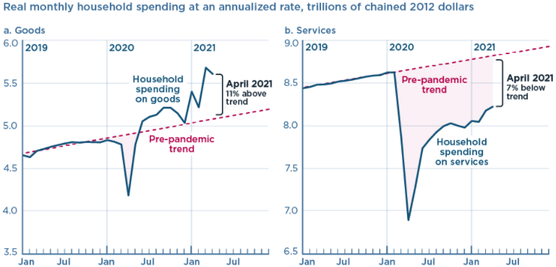
We’re Buying Mostly … Stuff
Demand-Pull
Source: Jason Furman, PIIE

Slide 37
Inflation: Concentrated
Cost-Push
Notes:
Cost push will continue through 22: China Covid measures, staffing issues US

Slide 38
Corporate Profits…Adding to Inflation?

Slide 39
Will Inflation continue to be elevated?
Very likely yes, at least through 2022.
Continued supply chain issues (China, US staff shortages, Russia-Ukraine conflict)
Mitigated by decrease in demand (policy support decreased), but consumers are back to substituting toward in-home consumption which can create bottlenecks
Sanctions on Russia will impact energy markets.

Slide 40
Projected Policy Changes - Fed
Notes:
From Dec. 15, 2021

Slide 41
Fed Reaction
Very likely to raise interest rates faster than expected – especially if the labor market keeps recovering (fewer demand/supply imbalances, continued recovery of the labor force participation rate and low unemployment rate).

Slide 42
Equity Markets – Is there still Overvaluation?
Maybe yes – based on negative real earnings yields (inflation adjusted earnings per share) which indicates
that profits are not keeping up with share price increases (even though corporate profits are increasing).

Slide 43
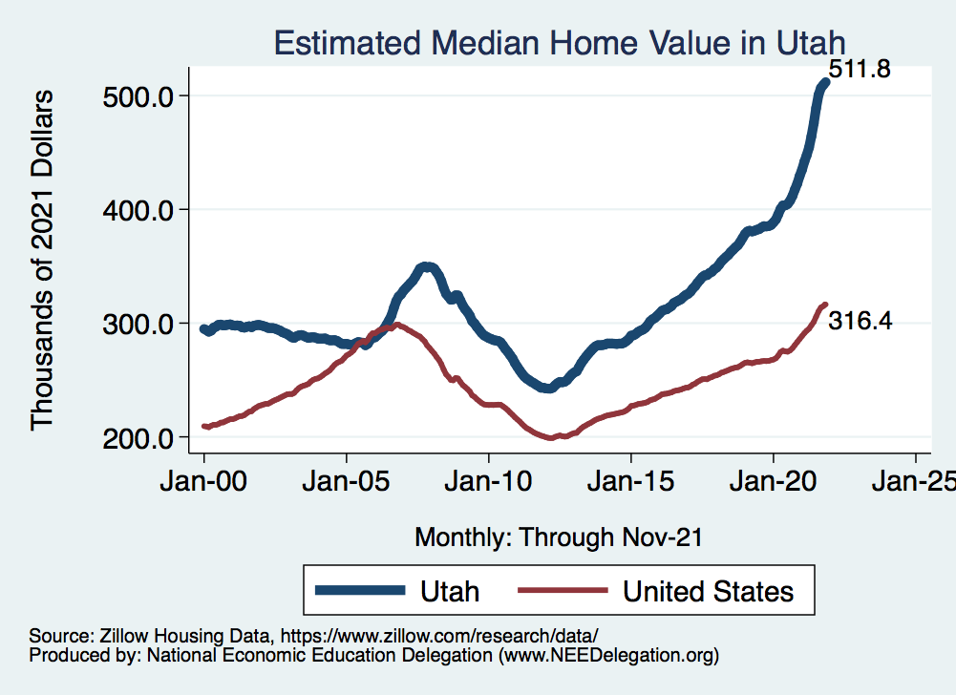
Real Estate Prices

Slide 44
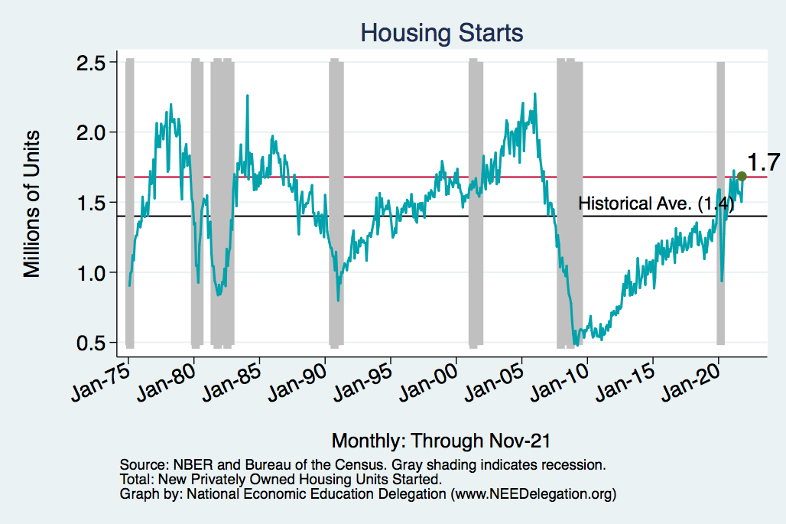
Home Prices and Housing Starts
Notes:
Charts:
homeprices_recession.png
housing.png

Slide 45
The Great Resignation

Slide 46
Quits Are High! The Great Resignation

Slide 47
Quits – Rising, but More in Some Industries
Accom. & Food Services
Leisure & Hospitality
Retail

Slide 48
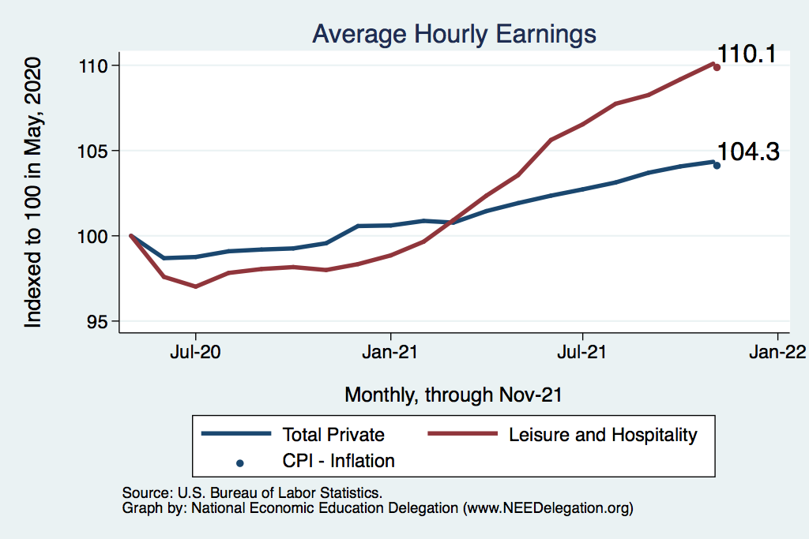
This is Happening as Nominal Wages Rise
Leisure & Hospitality
Total Nonfarm

Slide 49
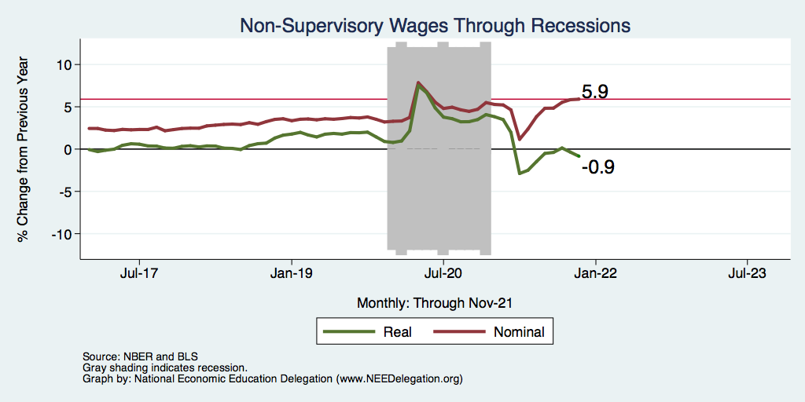
Inflation Adjusted Wages Are Falling

Slide 50
Declining Resources May Change Things
Source: NYTimes.com

Slide 51
Primary Topics Covered
GDP
Recovered the decline, but not where it should be.
Won’t recover previous forecast until late 2022. Growth: 4.0%
Employment
Still down 8.6 million jobs relative to forecast. (3.9 million relative to Feb/20).
Labor force is 2.5 million smaller than at the beginning of the pandemic.
Rising wages are just now starting to entice low-wage workers back to work.
Inflation
Going to be high for a while – definitely not transitory.
Notes:
IMF: 6% Fed: 5.5%

Slide 52
Conclusion
Recovery was V-shaped!
GDP will likely have expanded 5.5% percent in 2021, about 4% in 2022.
Physical health determines economic health for the economy.
Variants may well slow our progress: Omicron.
Gov’t missteps may also hinder progress.
Biggest problems:
Supply chain bottlenecks.
Labor force participation.
Russian invasion of Ukraine.

Slide 53
Best Measures of Progress – Conclusion
Inflation – getting it under control.
Real wages – need to see progress.
Workforce participation – need growth here to get GDP growth.
Pay less attention to the unemployment rate.

Slide 54
The Federal Debt: Brian Stevenson

Slide 55
Thank you!
Any Questions?
www.NEEDelegation.org
Doris Geide-Stevenson, Ph.D.
dgsteven@weber.edu
Contact NEED: info@NEEDelegation.org
Submit a testimonial: www.NEEDelegation.org/testimonials.php
Become a Friend of NEED: www.NEEDelegation.org/friend.php

Slide 56
www.NEEDelegation.org/LocalGraphs
For every state and county in the United States.
Detailed graphs on employment, housing, moves, and other statistics.

